Slide 1
sPhenix Quench Detector Review
March 15, 2017

Slide 2
Overall Description
Superconducting Magnet with 25 Voltage Taps
Additional 4 Redundant Taps
Energy Dump Resistor
Quench Detector
Strain Gage and Temperature Sensors System

Slide 3
Requirements
The system will be powered by a UPS.
The system will have a watch dog timer.
The PXIe quench signal out will be a square wave that will be toggled every time the software completes a loop.
The signal will also be used to time the duration of a loop.
When a quench is detected the signal will go low, and stay low.
This signal will go to a board that will implement the watch dog timer and output the interlock quench signal.
The interlock quench signal will normally be high.
This board will look for transitions; if the transitions stop the board will lower the interlock quench signal.
Capability of real-time display of raw and processed data, on demand.
The system will have test points to monitor the measured parameters in real time.
The system will provide the ability to time-correlate the samples.
The Quench Detector will record the time of each event.
The fast and slow loggers will include the quench event signal to help time-correlate the samples.

Slide 4
Requirements Continued
The Quench detector will have 24 channels (3 PXIe-4300 Boards).
Channels are listed in the Excel file.
Gains are listed in the Excel file. Assumptions are:
The maximum ramp rate is 3.125 A/sec.
The A/D will have 16 bits resolution for +/- 10 V input.
The system will sample at 720 Hz.
The system should have simultaneous sampling on all channels.
The sample clock will be from a PLL locked to the power line.
This same PLL will supply the clock for the fast logger.
It will have a hardware anti-aliasing filter.
8th order.
corner frequency of 85 Hz.
It will have a software integrator.
Integrate 12 samples, this puts notches at integer multiples of 60 Hz.
No decimation.
The system will implement three algorithms.
Vmeas – (L * di/dt.)
Vhalf coil comparison.
Half coils are not identical, may need a scaling factor between them.
For the gas-cooled leads and flex leads a fixed threshold.
The system will trigger if any algorithm detects a quench.
The internal signals will be sent to circular buffers that stores 20 seconds of data (14400 samples/channel; 576 kBytes total storage).
The circular buffer will have 10,800 pre-trigger data points (3/4 buffer pre-trigger).
Graphs of the buffers should be available after a quench.
The system will have an adjustable time delay for each algorithm.

Slide 5
Requirements Contimued
The fast logger will implement a circular buffer on 32 channels.
Sample Rate of 2880 Hz (4*720 Hz).
The sample clock will be from a PLL locked to the power line.
Gain of the analog section will be
Separate anti-aliasing filters from the Quench Detector.
8th order
Corner frequency of 340 Hz.
It will store 10 seconds of data per channel (28,800 samples/channel; 1.152 Mbytes total storage).
The circular buffer will have 21,600 pre-trigger data points (3/4 buffer pre-trigger)
The circular buffers will stop on a quench signal.
Graphs of the buffers should be available after a quench.
The slow logger will store all 32 channels continuously.
Sample Rate of 1 Hz.
It will decimate the data from the fast logger.
? stage CIC anti-aliasing filter.
Graphs of the buffers should always be available.

Slide 6
Quench Detection Algorithms
The system will implement three algorithms.
Vmeas – (L * di/dt.)
Vhalf coil comparison.
Half coils are not identical, may need a scaling factor between them.
For the gas-cooled leads and flex leads a fixed threshold.
After Rotator failure in 2009 the half coil comparison was done on different Rotator magnets with the same current.

Slide 7
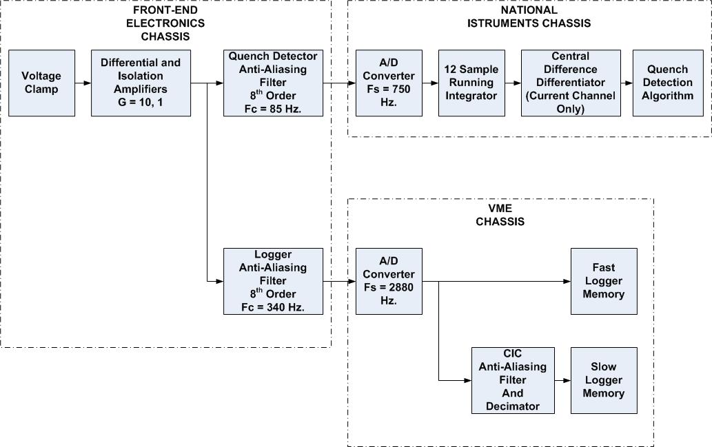
Signal Processing Block Diagram

Slide 8
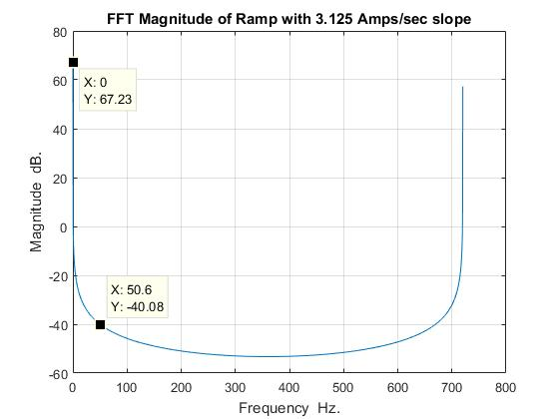
Ramp Frequency Content

Slide 9
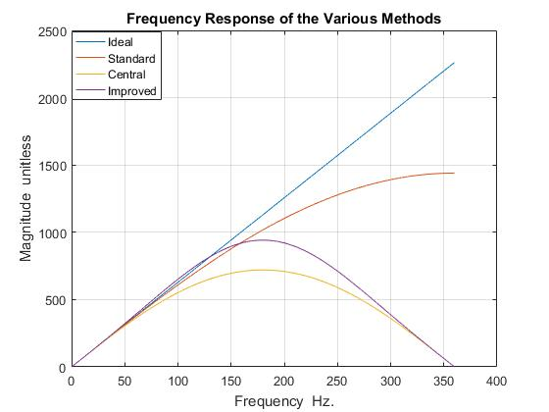
Differentiator Frequency Response

Slide 10
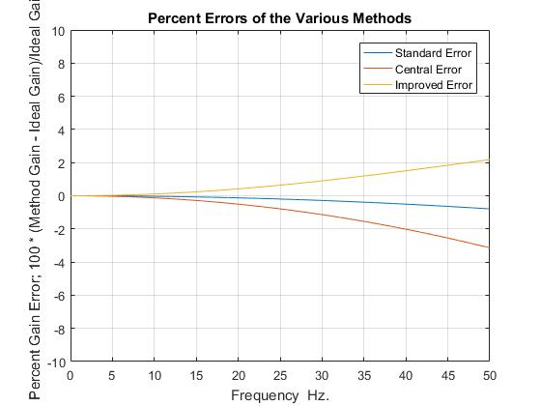
Percent Errors of Different Differentiator Methods

Slide 11
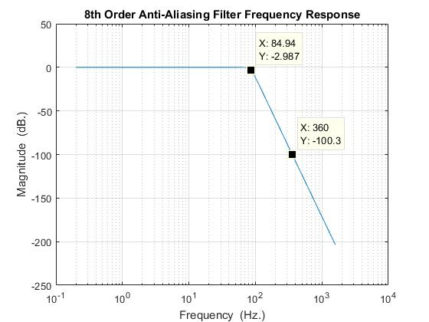
Anti-Aliasing Filter Frequency Response

Slide 12
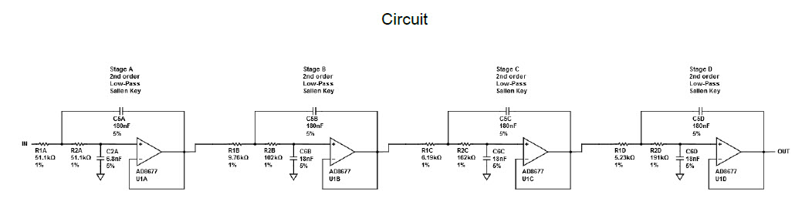
Anti-Aliasing Filter Circuit

Slide 13
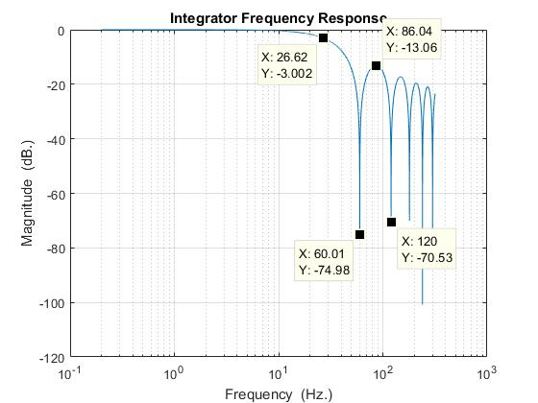
Integrator Frequency Response

Slide 14
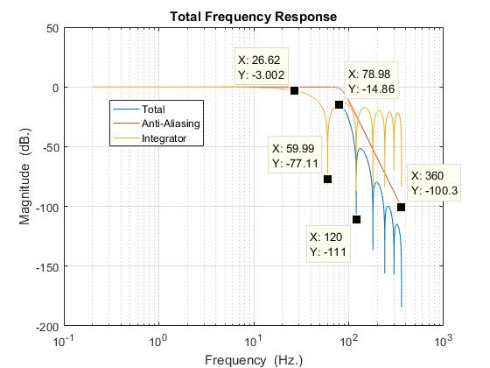
Total Frequency Response

Slide 15
Front-End Electronics
Copy RHIC Quench Detector Front End
Use RHIC Quench Detector Front End up to AD210BN
Anti-Aliasing Filter will be new design
Voltage Clamp
Designed for 300 V, exponential decay with a time constant of 39.5 seconds. (L/R = 2.57 H / 65 mOhm)
Use current limiting resistors in magnet as part of circuit
Open Lead Detection
REF200 Current Source and balancing resistors
Isolation
Provided by AD210BN
DC continuous 3500 Vpeak
Gains
Gain of 10 for superconducting busses
Gain of 1 for magnet coils, gas-cooled leads, flex bus

Slide 16
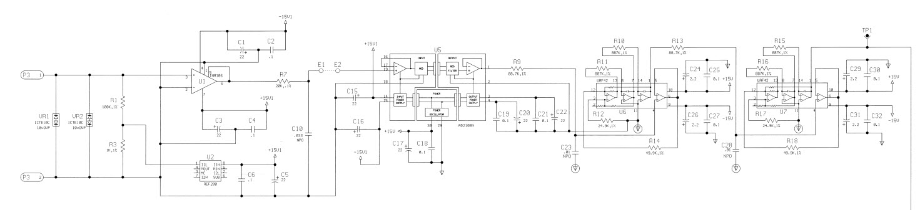
RHIC Front-End Electronics

Slide 17
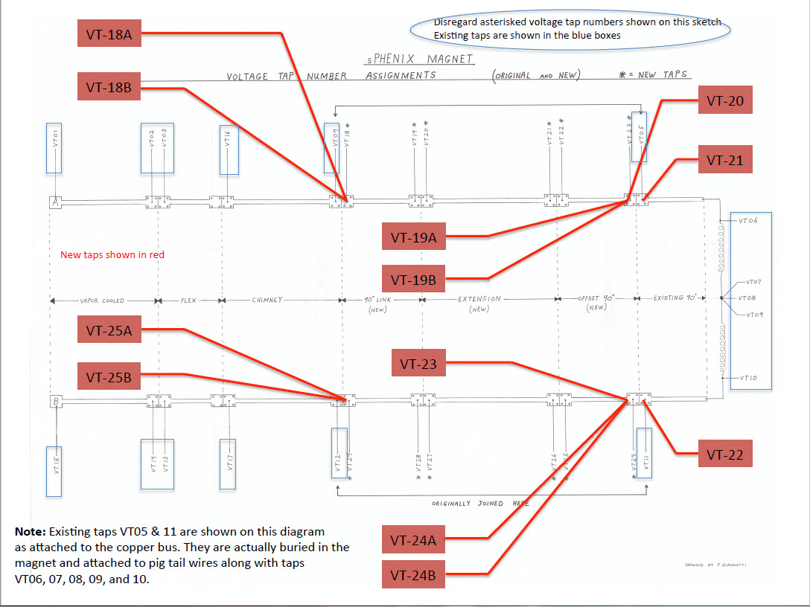
Voltage Taps

Slide 18
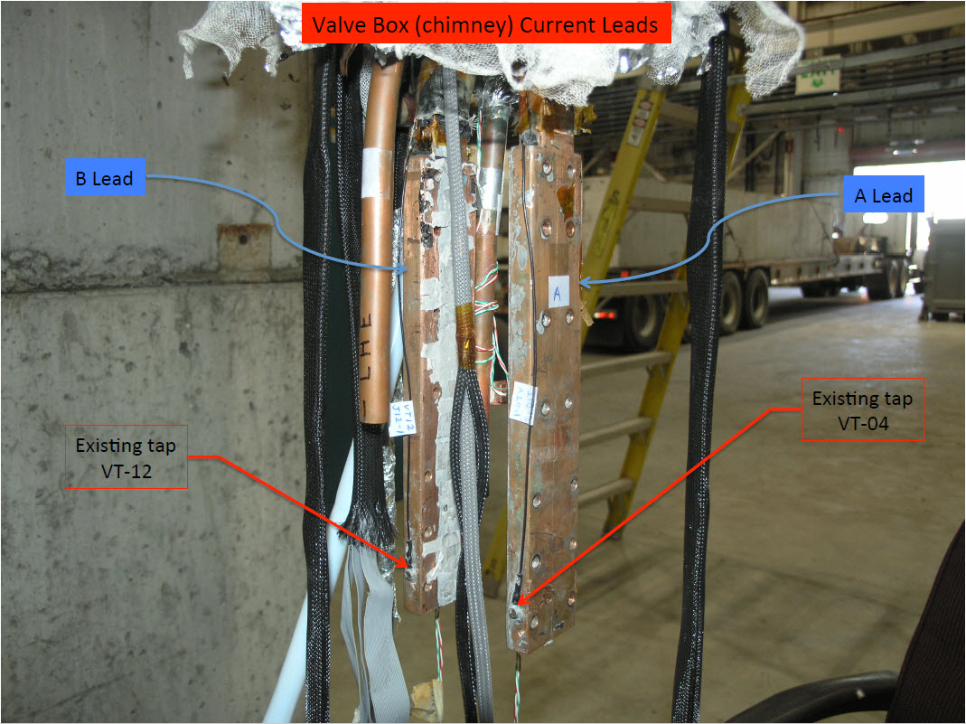
Voltage Taps continued

Slide 19
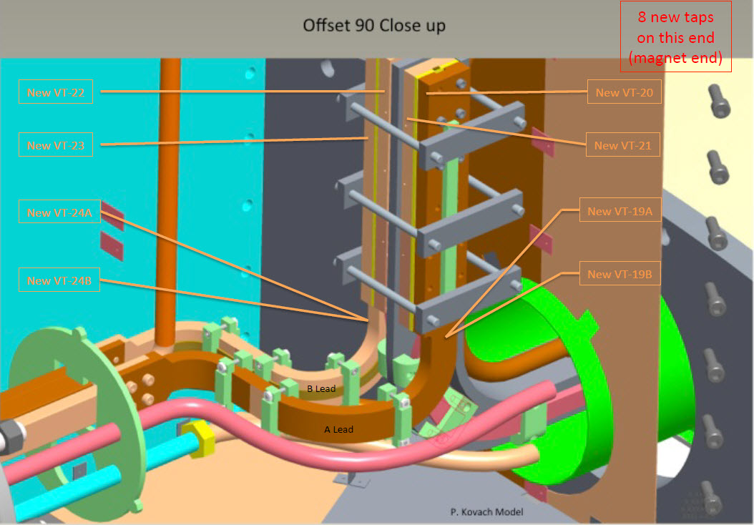
Voltage Taps continued

Slide 20
Quench Detector Channel Assignments

Slide 21
Interlocks
Cryo interlock
Cryo system is ready and at temperature
Gas-Cooled Lead Flow interlock
Gas-Cooled Lead Flow is appropriate for the Current
Quench System Interlock
Quench System is running and not in a quench state
Quench Contactor Interlock
Quench Switch is closed

Slide 22
Interlocks continued
POWER SUPPLY INTERLOCKS AND SIGNALS
Water Flow Interlock
ADDED FLOW SWITCH INTLK
SCR Fuse Interlock
NO SCR FUSE INTERLOCK – ALL BUSS UNIT
SCR Over-Temperature Interlock
ADDED KLIXON TO EACH SCR 12 EACH PLUS CROWBAR SCR
Transformer Temperature Interlock
Rectifier 1
Rectifier 2
Interphase
ADDED KLIXONS TO MAIN TXFM – NOT INTERPHASE TFMR

Slide 23
Interlocks continued
Cabinet Temperature Interlock
ADDED CUBICLE OT DEVICE
Control Power Interlock
CONTROL POWER HAS 10A BREAKERS IN FRONT OF PS
AC Input Under-Voltage
AC PHASE LOSS ONLY
AC Input Over-Current
AC CURRENT IMBALANCE RELAY
AC Sequence Interlock
AC SEQUENSE INTERLOCK BUILT IN TO REGULATOR BUCKET
DC Output Over-Voltage
NO PROTECTION
DC Output Over-Current
DC OVER CURRENT INTERLOCK BY FRONT PANEL METER TO PLC
Output Ripple Interlock
NO PROTECTION
Output Filter Fuse Interlock
OUTPUT FILTER FUSE AND TRIGGER INT TO PLC

Slide 24
Interlocks continued
Enclosure Door Interlock
FRONT AND REAR DOOR INT TO PLC
ADDED WATER LEAK DETECTION
INT TO PLC
GROUND FAULT
INT TO PLC
DCCT FAULT
INT TO PLC
ADDED WATER SOLENOID
CONTROL BY PLC
ADDED REAR DOOR FANS AND AIR VAINS
AIR VAINS ARE WARNING NOT INT
DUMP RESISTOR AND CONTACTOR
CONTACTOR LOCAL / REMOTE CONTROLS
CONTACTOR AUXILIARY CONTACTS
PS DCCT SIGNAL
RESISTOR GROUND OPTION

