Slide 1
SVT OB simulation geometry updates
28 August 2025 Aditya Yalavatti, Sam Henry University of Oxford
Current ePIC outer Barrel simulation geometries
Full CAD-file version: https://github.com/eic/epic/tree/SVTOB_UK
Previously reported bugs fixed
Used for hit maps and material thickness scans to aid design
Currently not working with eicrecon
Likely too complex and slow for routine simulations
Simplified flat component model (Aditya Yalavatti): https://github.com/eic/epic/tree/flat_OB
Fully working, we will push to github very soon
Simplified model with curved silicon surfaces (Sam Henry): https://github.com/eic/epic/tree/curved_OB
Not yet working with eicrecon
Final goal: hybrid model with simplified curved surface for active silicon, and support structure from CAD files

Slide 2
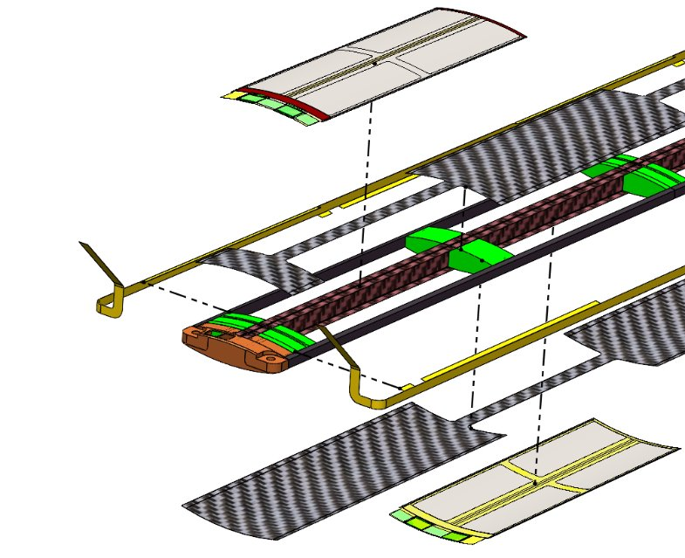
Outer barrels
L3: 46 staves at 271mm radius
L4: 70 staves at 430mm radius
Staves – curved silicon on carbon fiber support

Slide 3
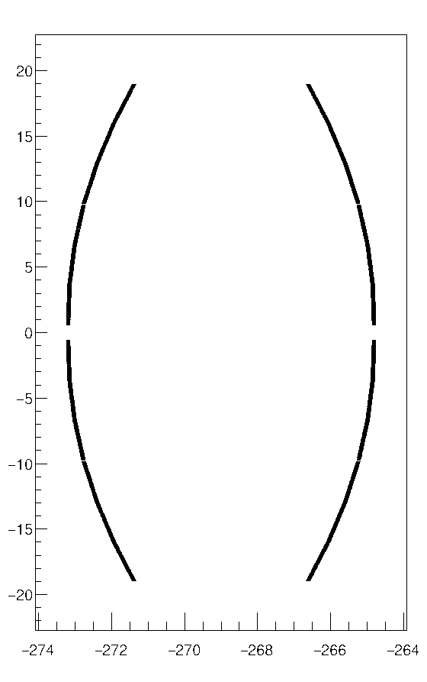
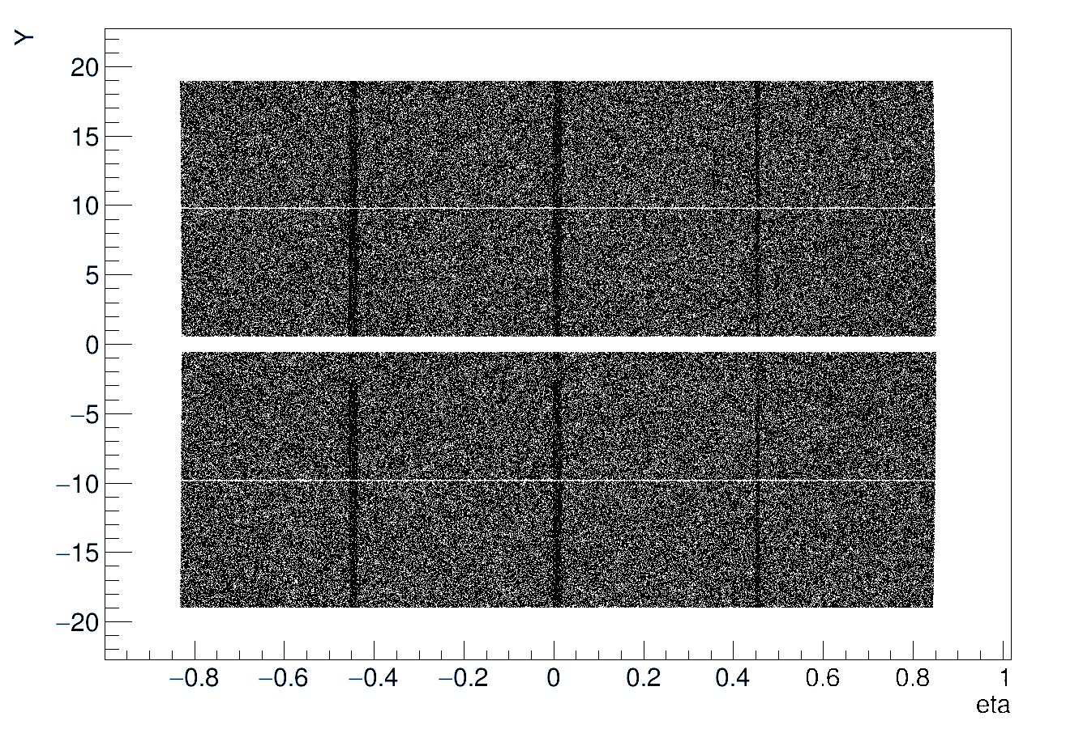
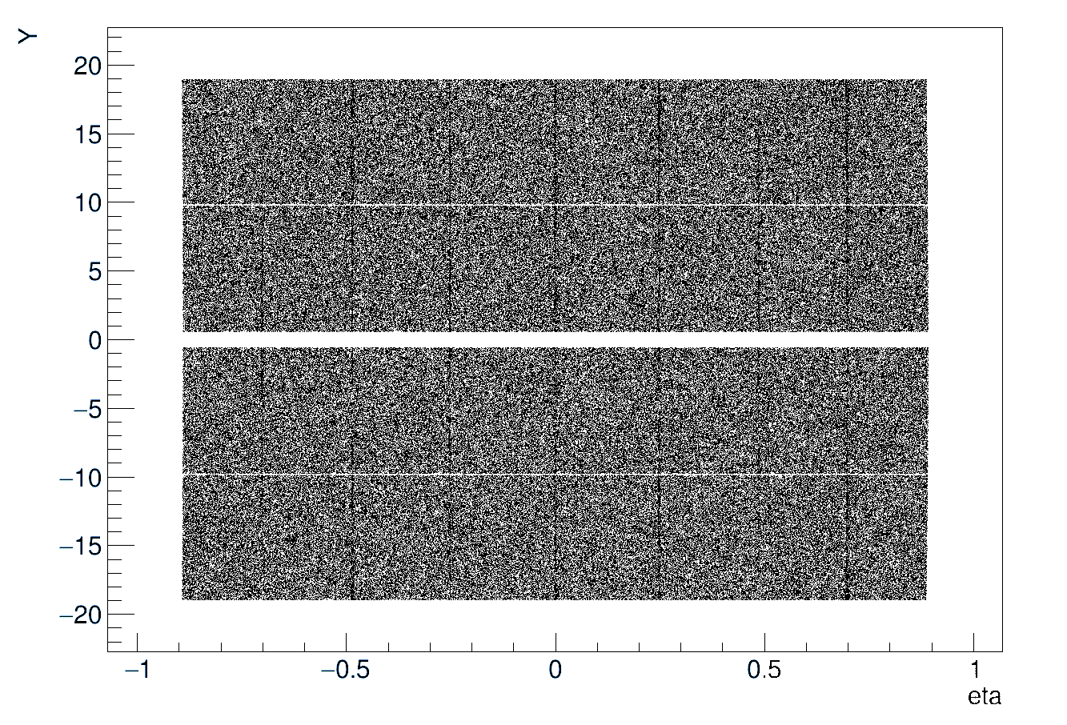
OB full CAD file model hit maps
Single stave
L4
L3

Slide 4
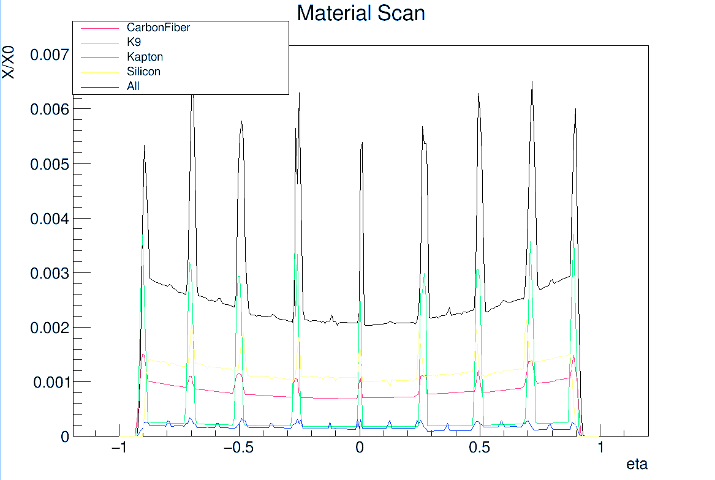
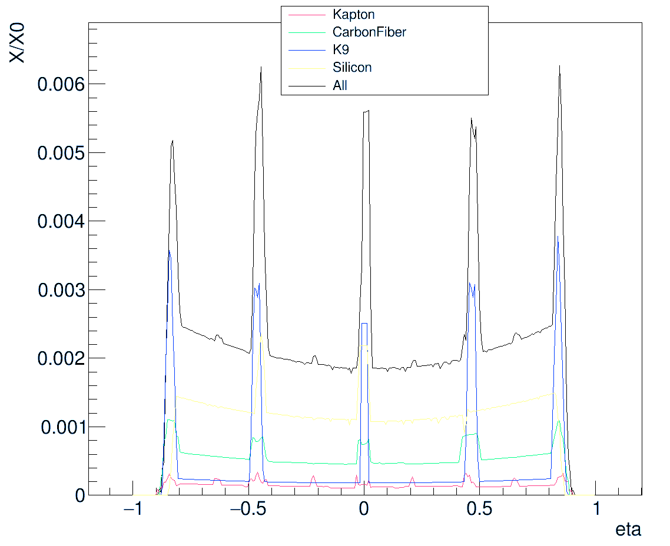
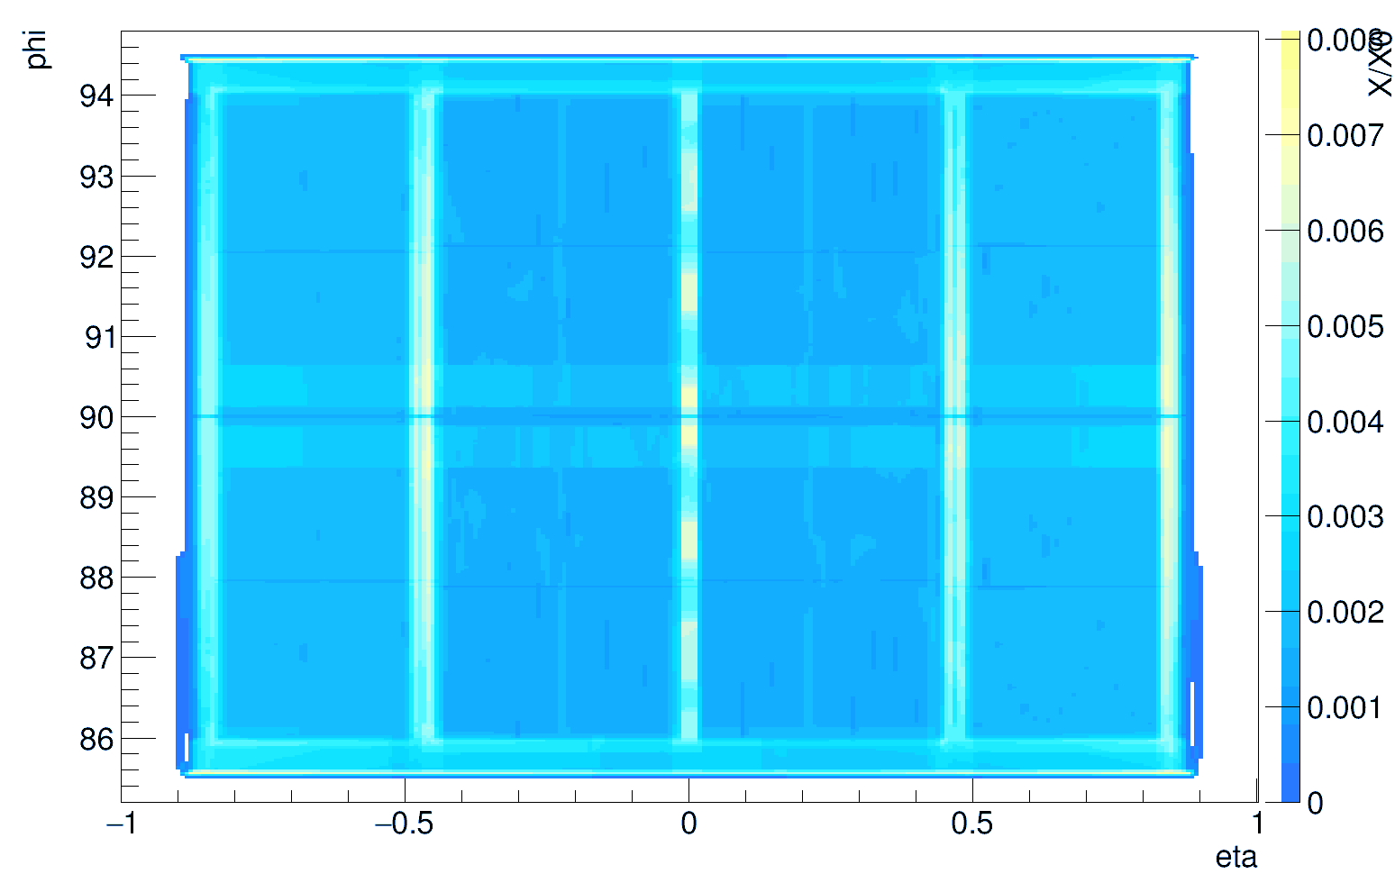
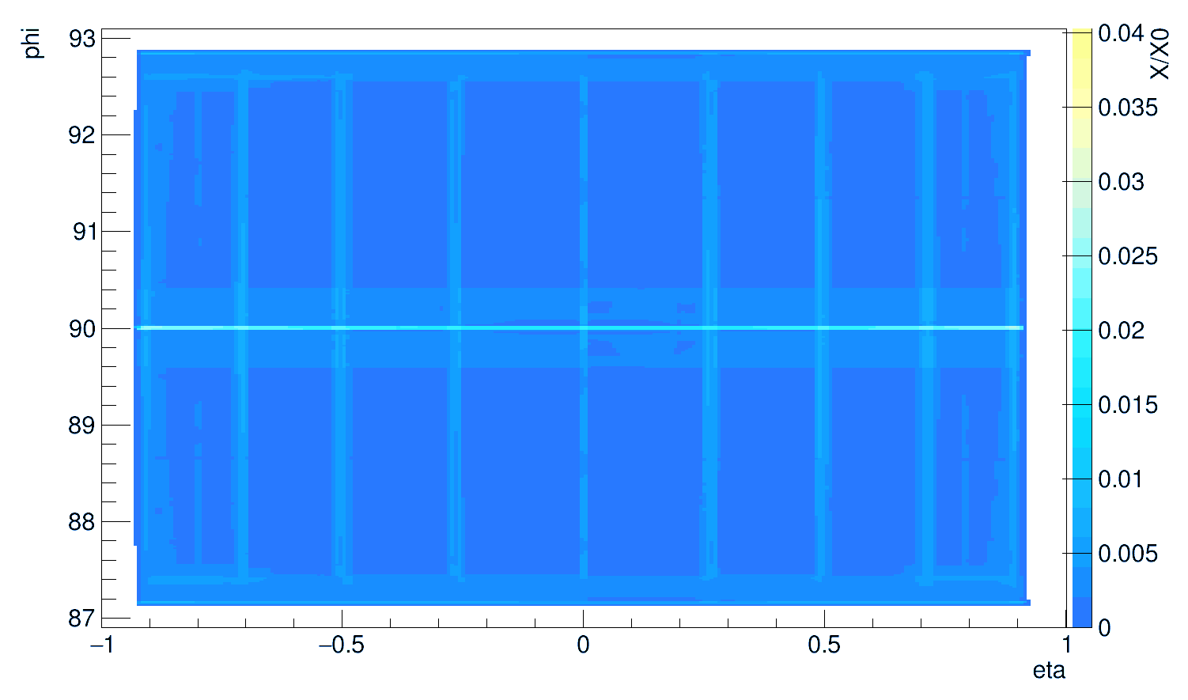
Material thickness scans
L3
L4
Single stave

Slide 5
A Simplified Model of Braces on the Standard ePIC Geometry
Aditya Yalavatti

Slide 6
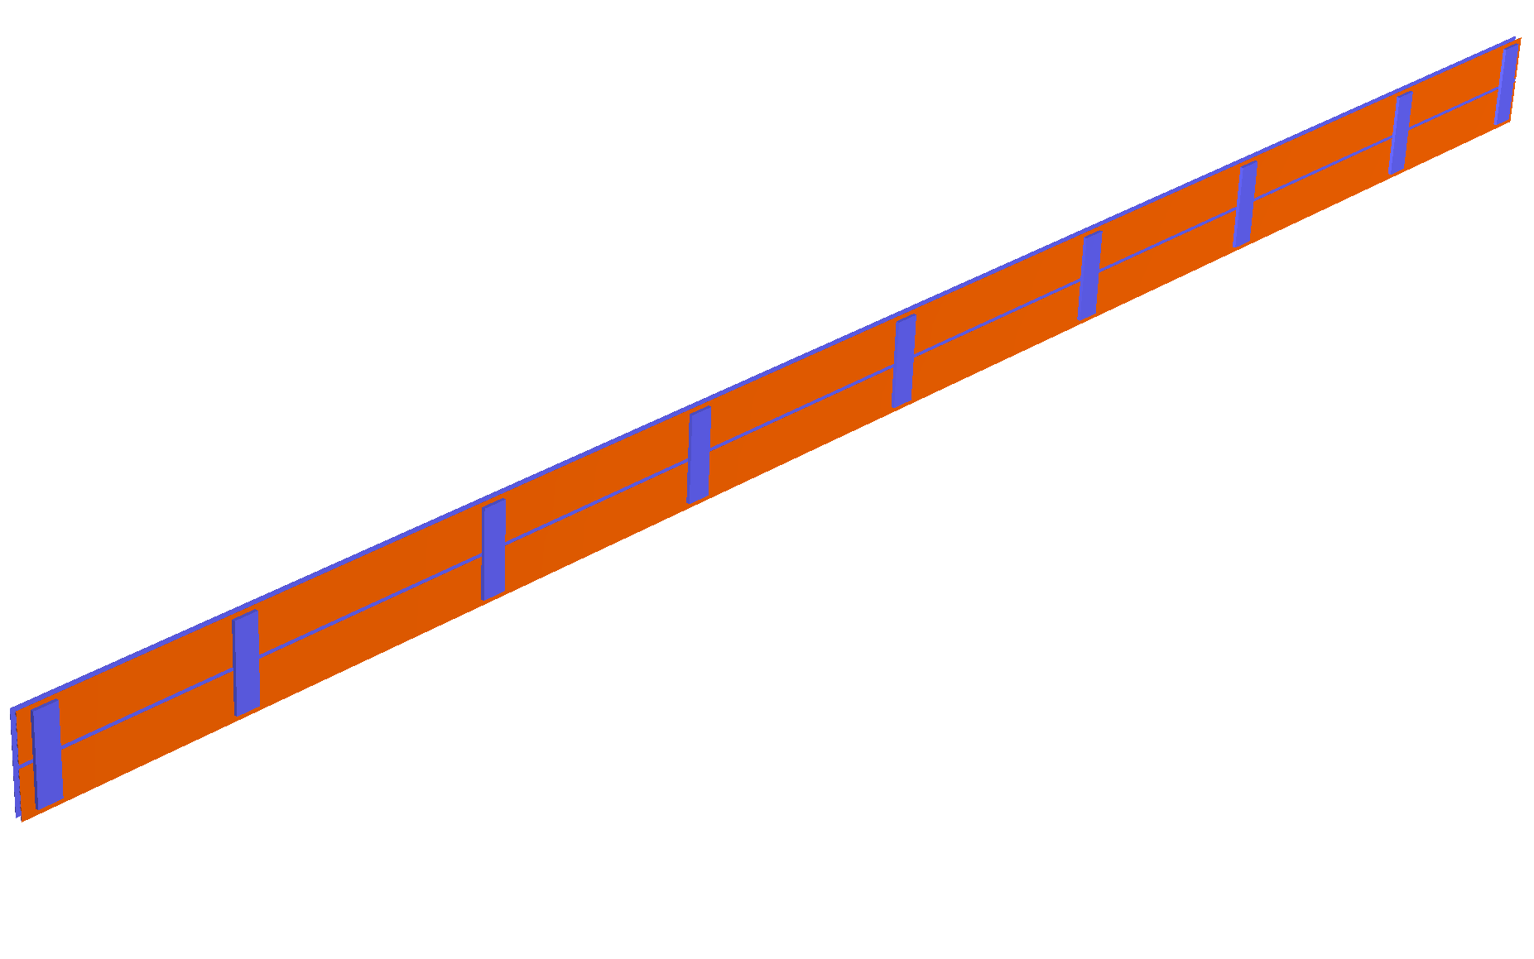
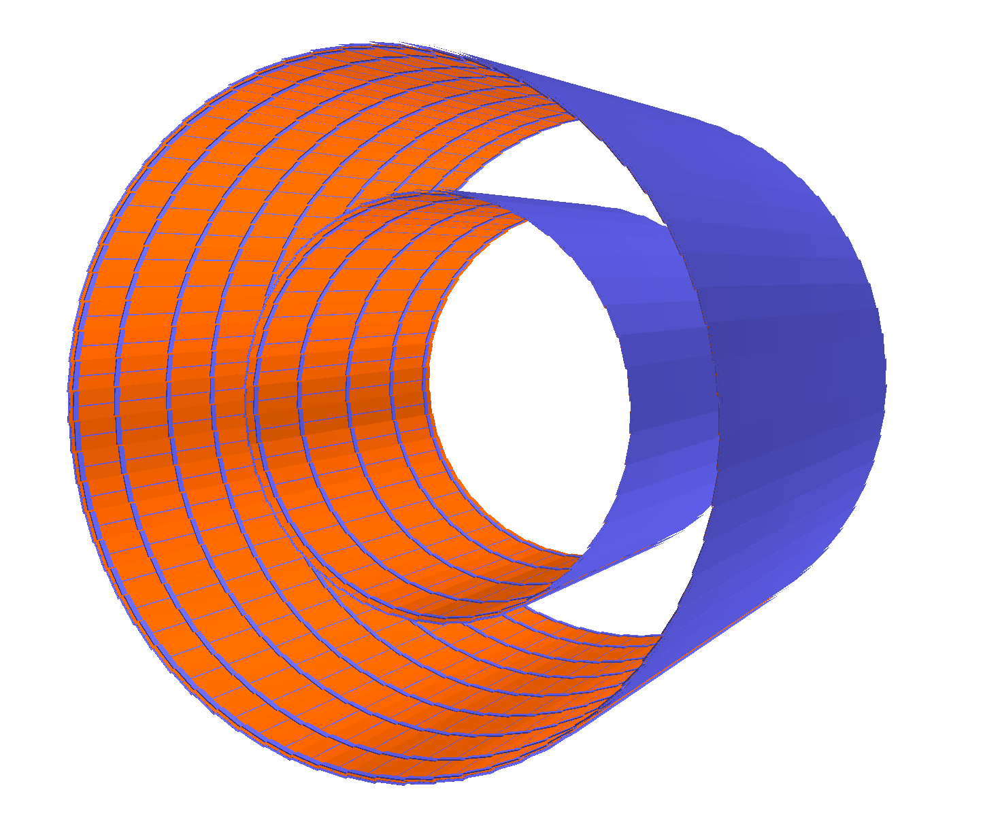
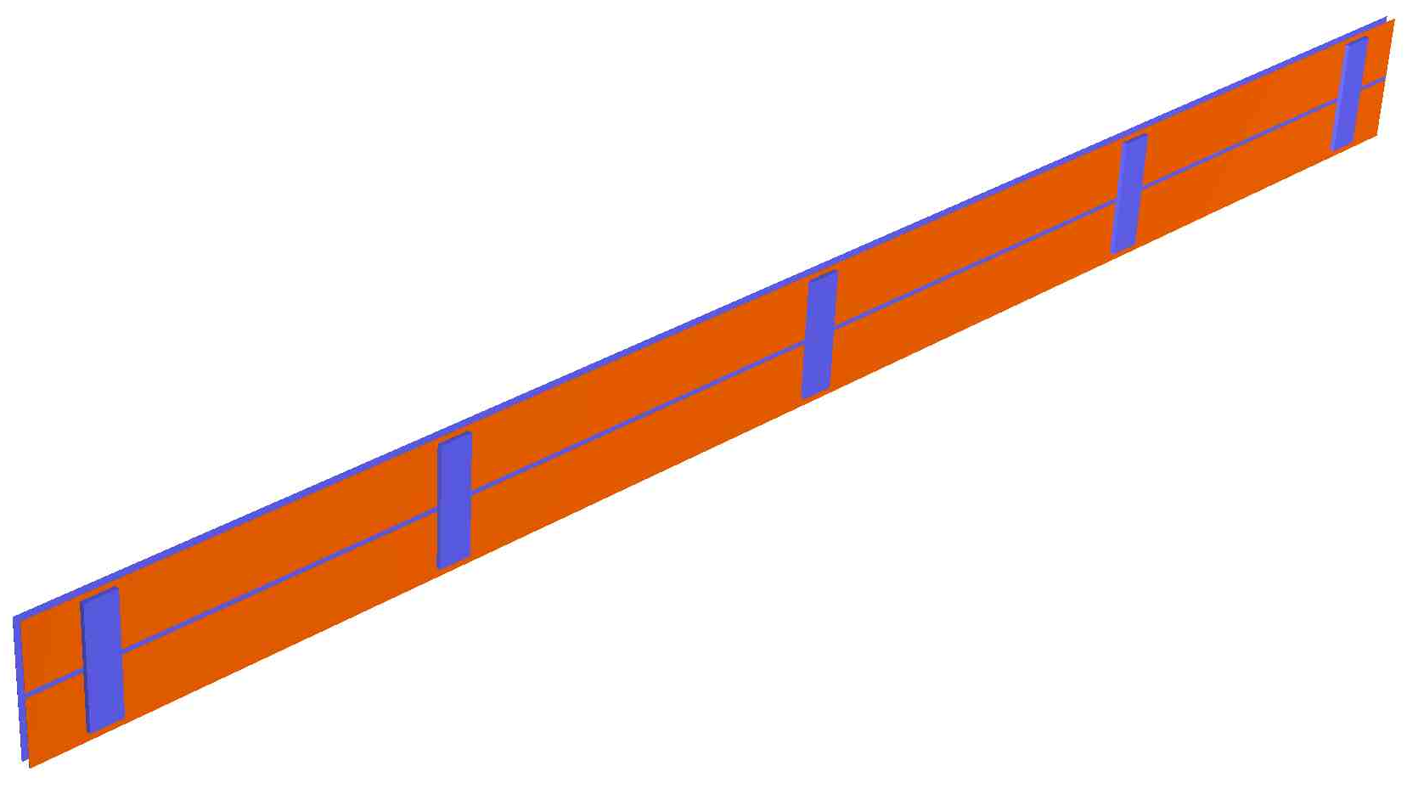
Geometry Visualisation
L4
L3
Silicon Barrel

Slide 7
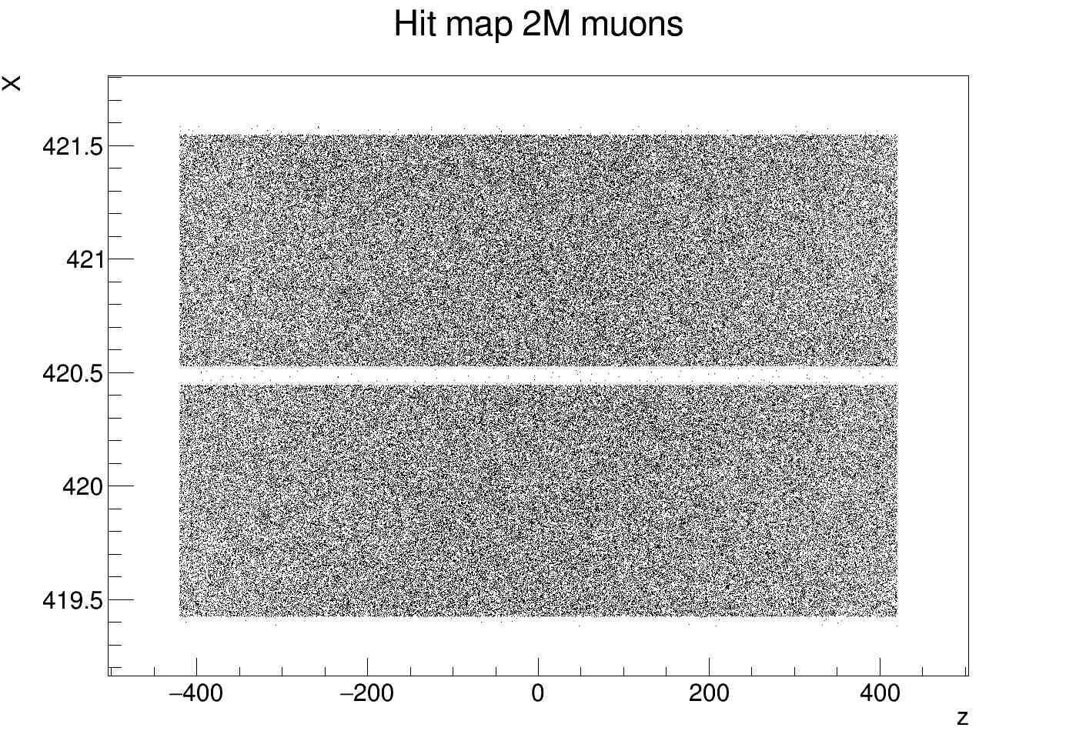
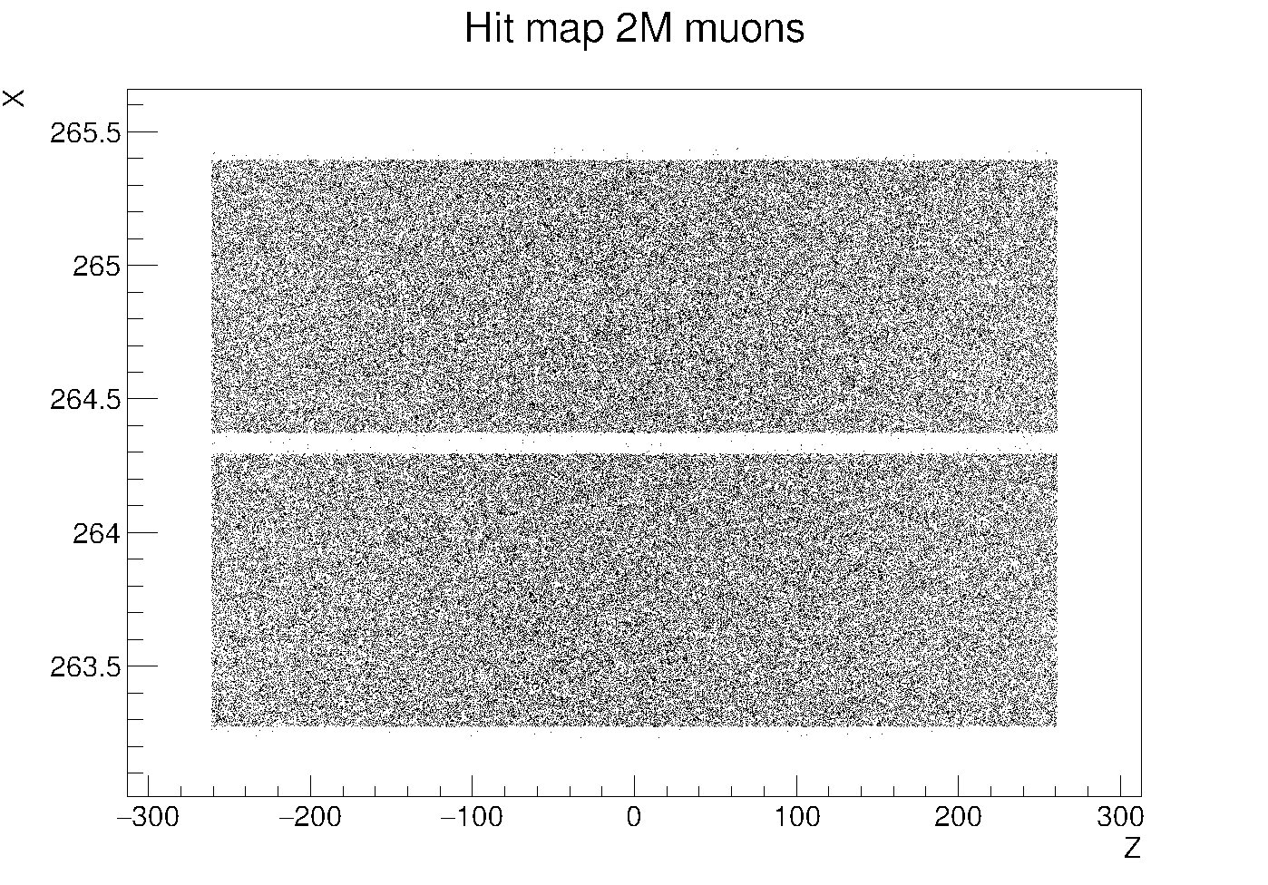
Hit Maps
3
L4 Barrel
L3 Barrel

Slide 8
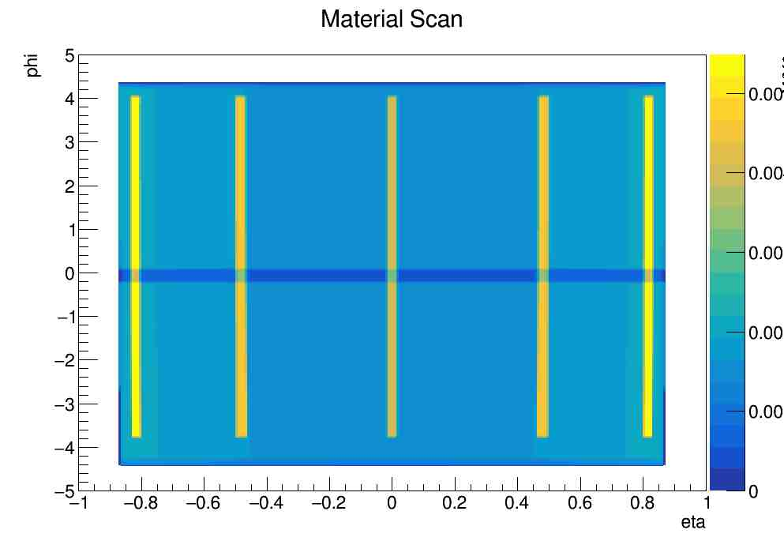
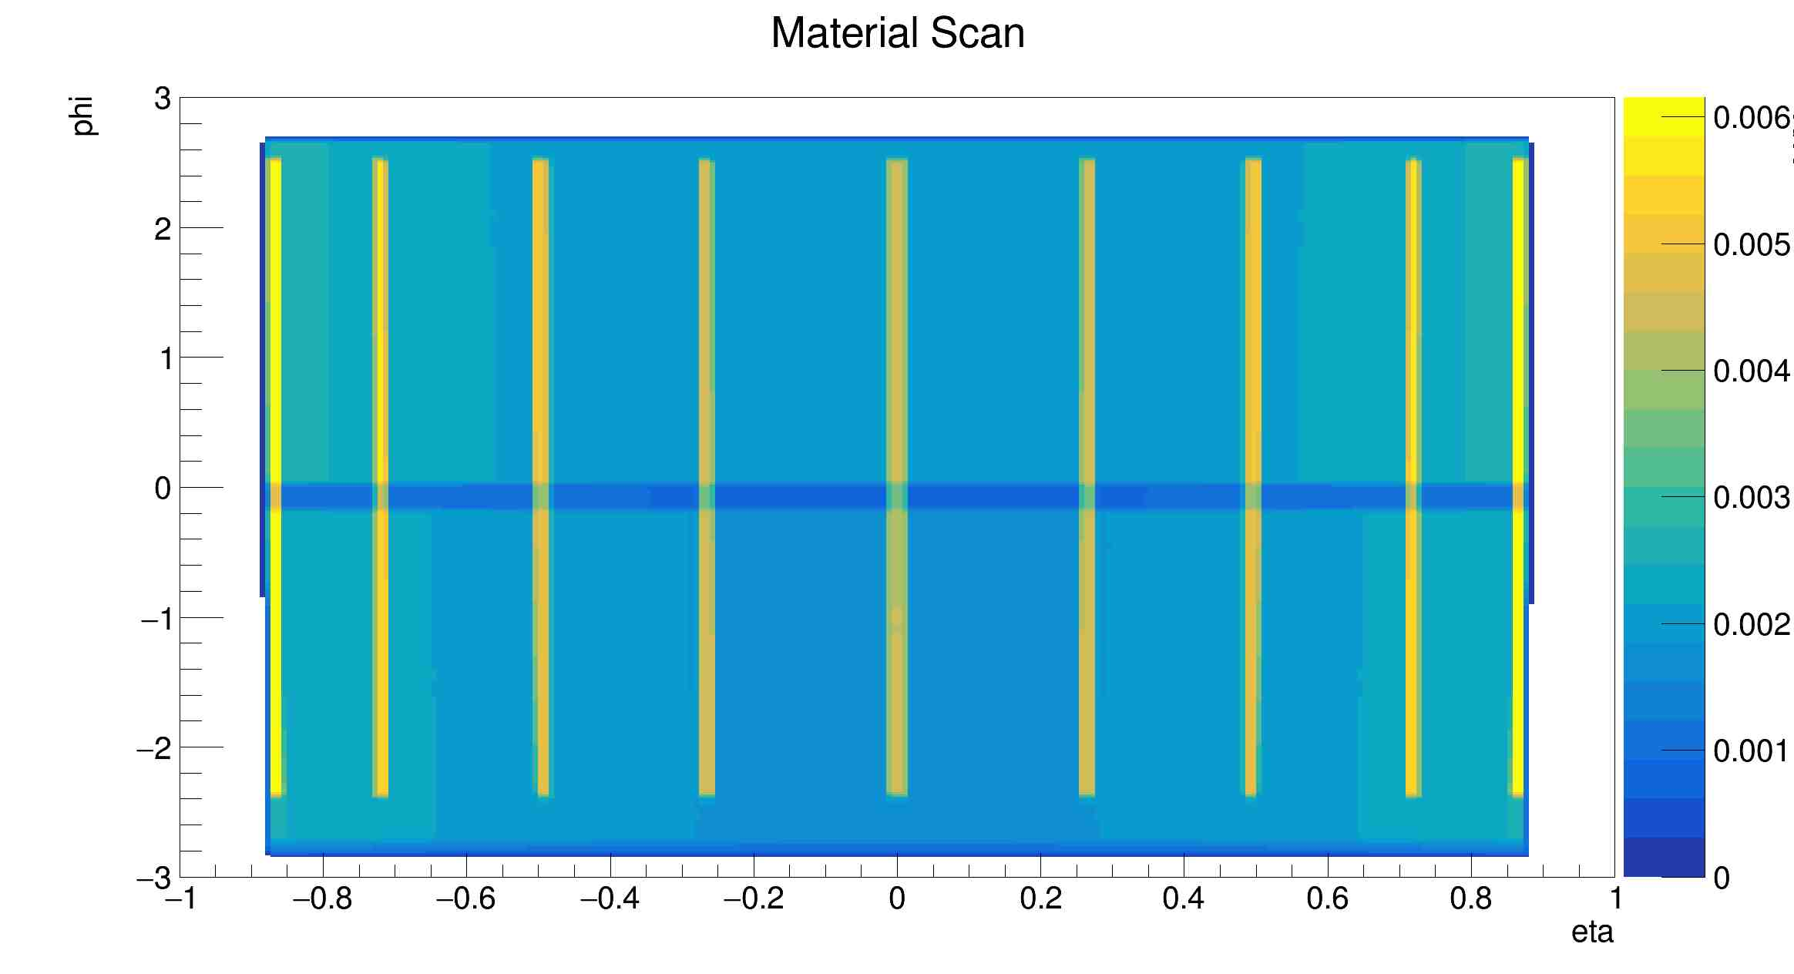
2D Thickness Map
L3
L4

Slide 9
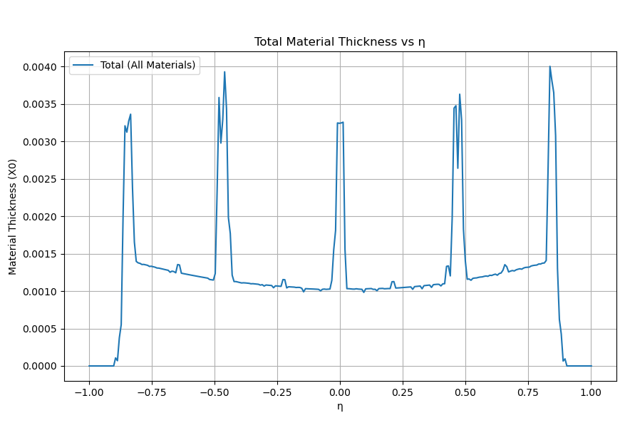
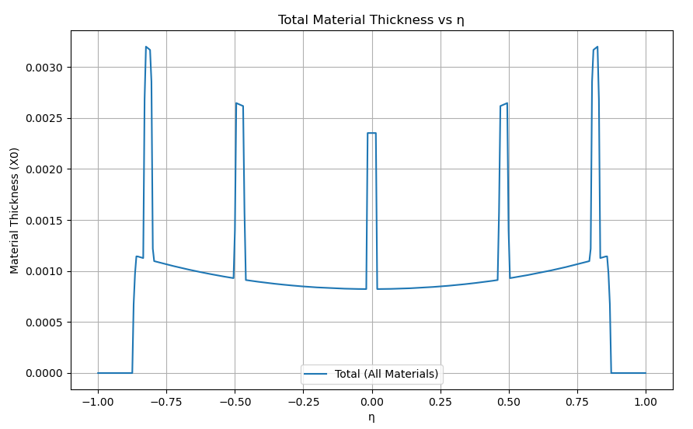
Material Scan – L3
Simplified Model
SVTOB

Slide 10
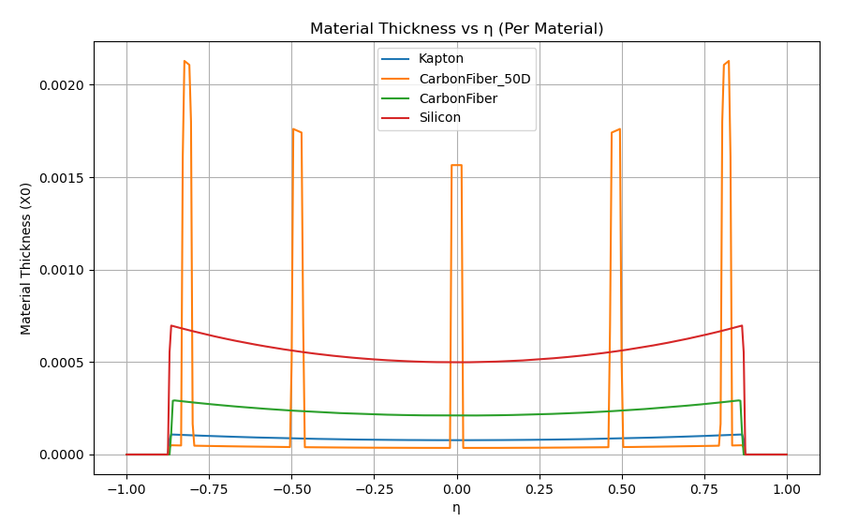
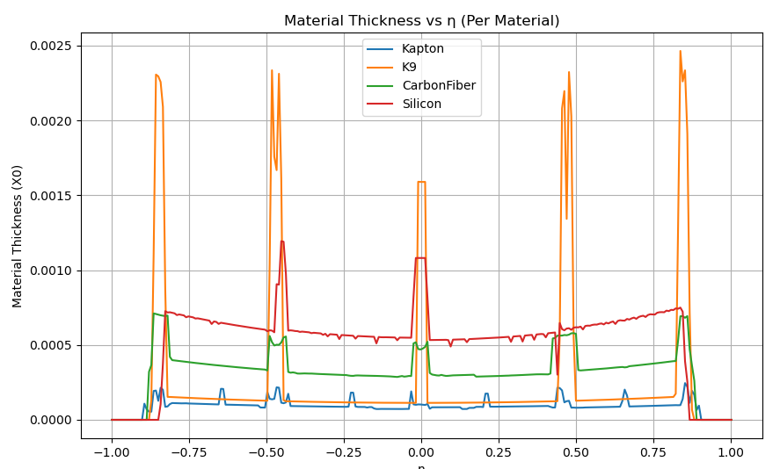
Material Scan – L3
Simplified Model
SVTOB

Slide 11
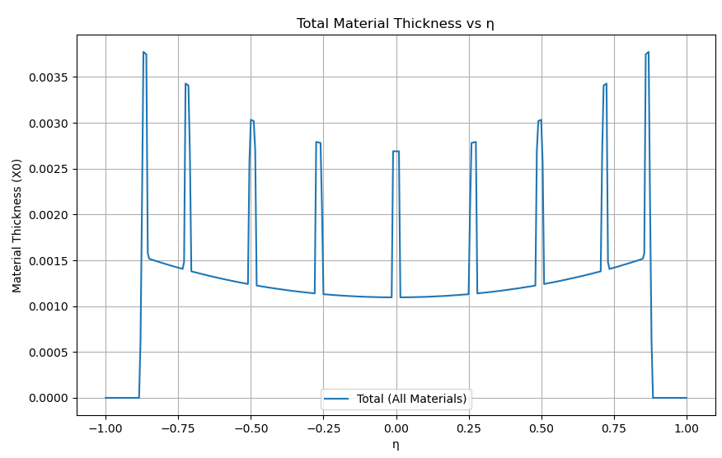
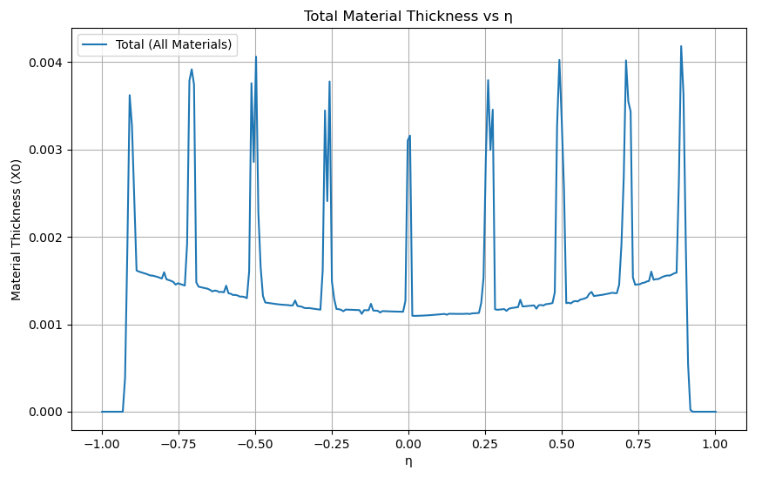
Material Scan – L4
Simplified Model
SVTOB

Slide 12
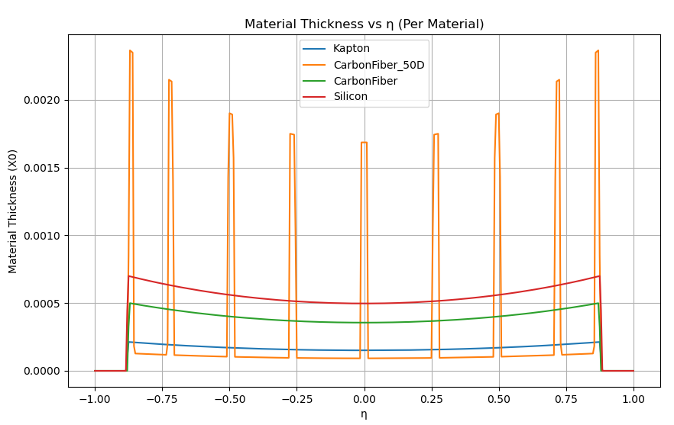
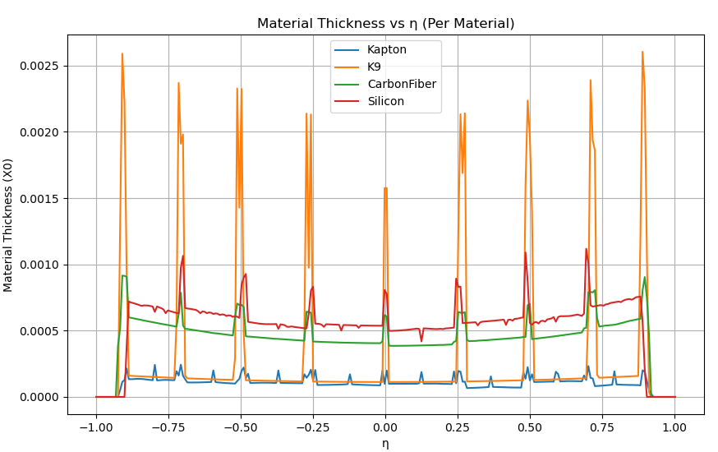
Material Scan Comparison – L4
Simplified Model
SVTOB

Slide 13
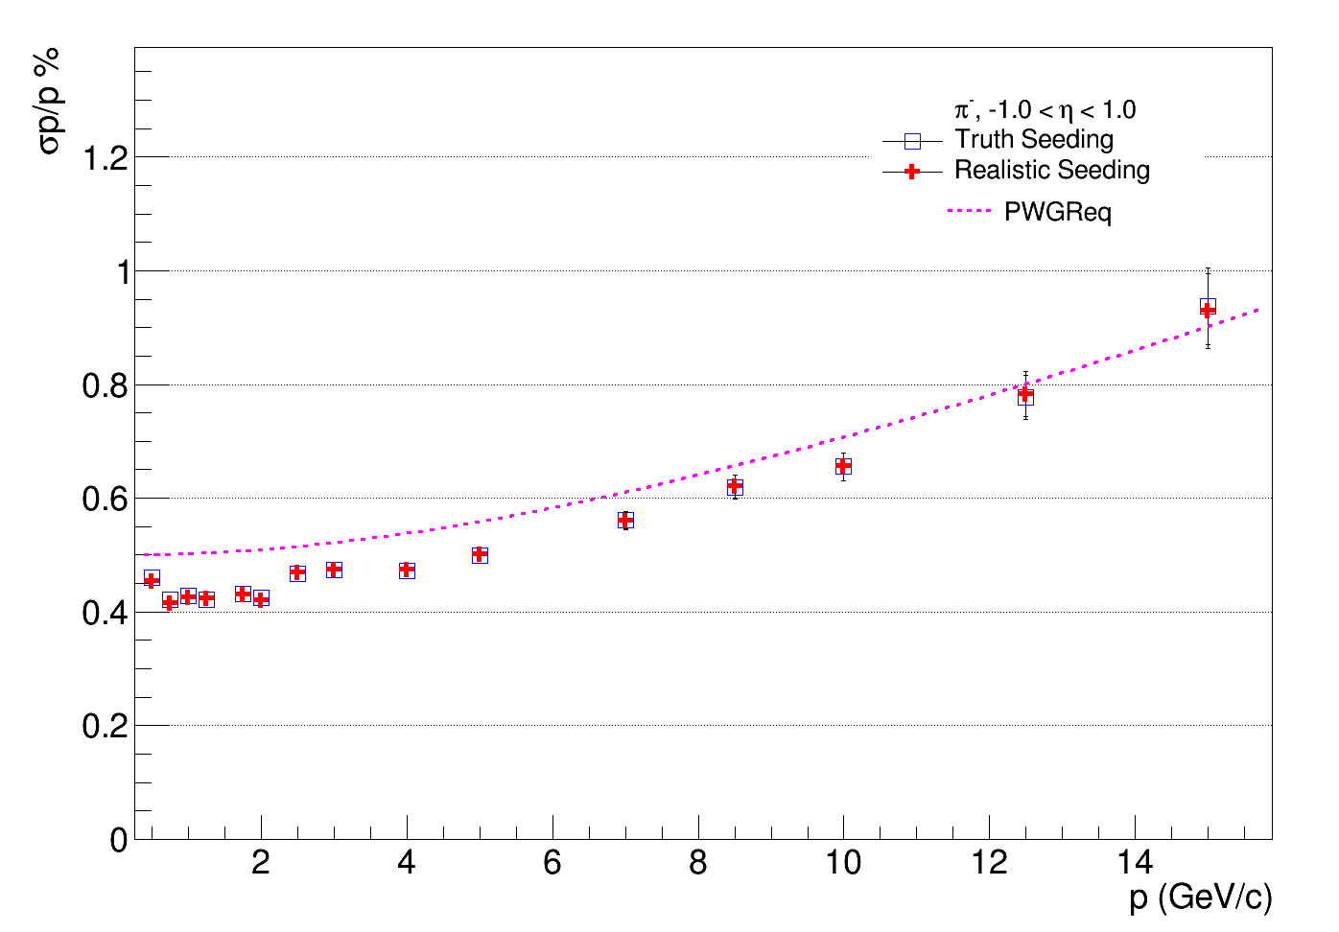
Momentum Resolution

Slide 14
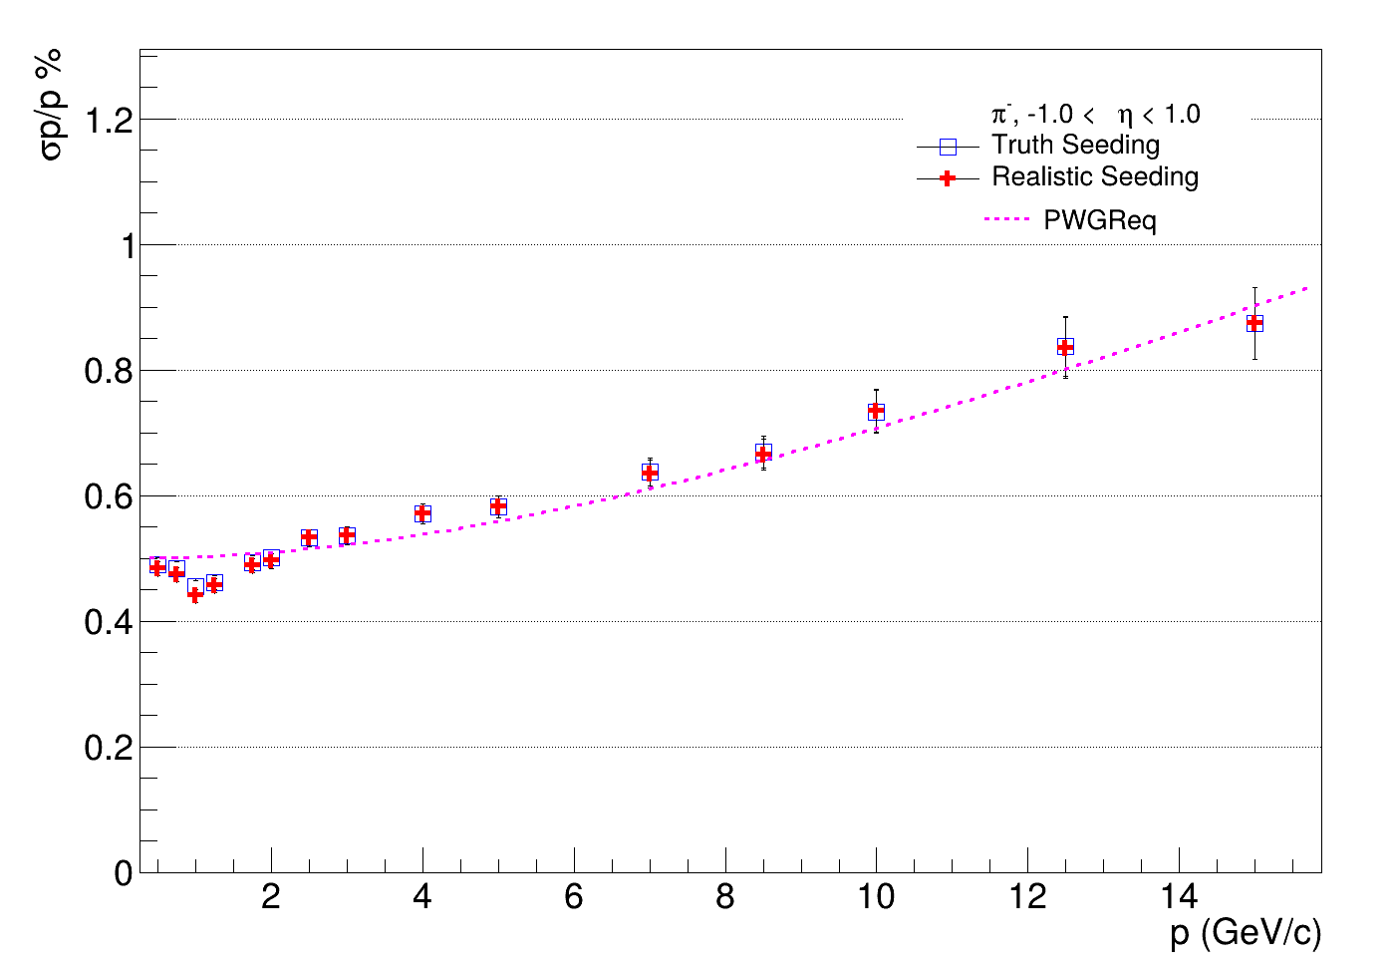
Momentum Resolution – Comparison
Standard Geometry
Braced Geometry

Slide 15
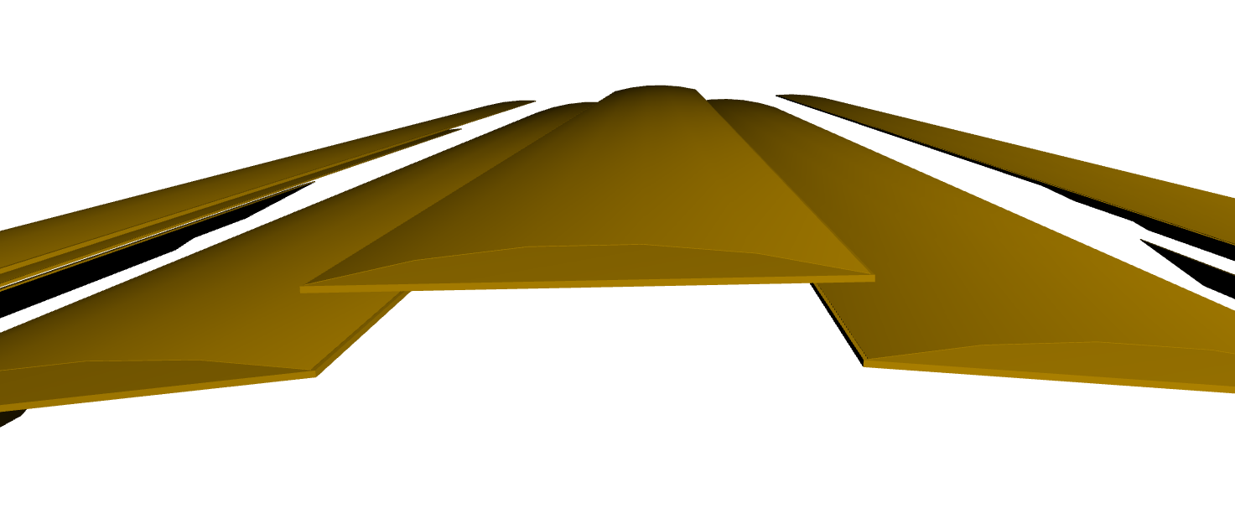
Simplified curved silicon model
First attempt: single curved surface above flat support for each stave
Radius of curvature << barrel radius
Problem: eicrecon does not see hits
Likely issue with DD4HEP readout segmentation – may not be possible with CylindricalGridPhiZ
See: https://github.com/eic/epic/tree/curved_OB https://github.com/eic/epic/pull/924

