Slide 1
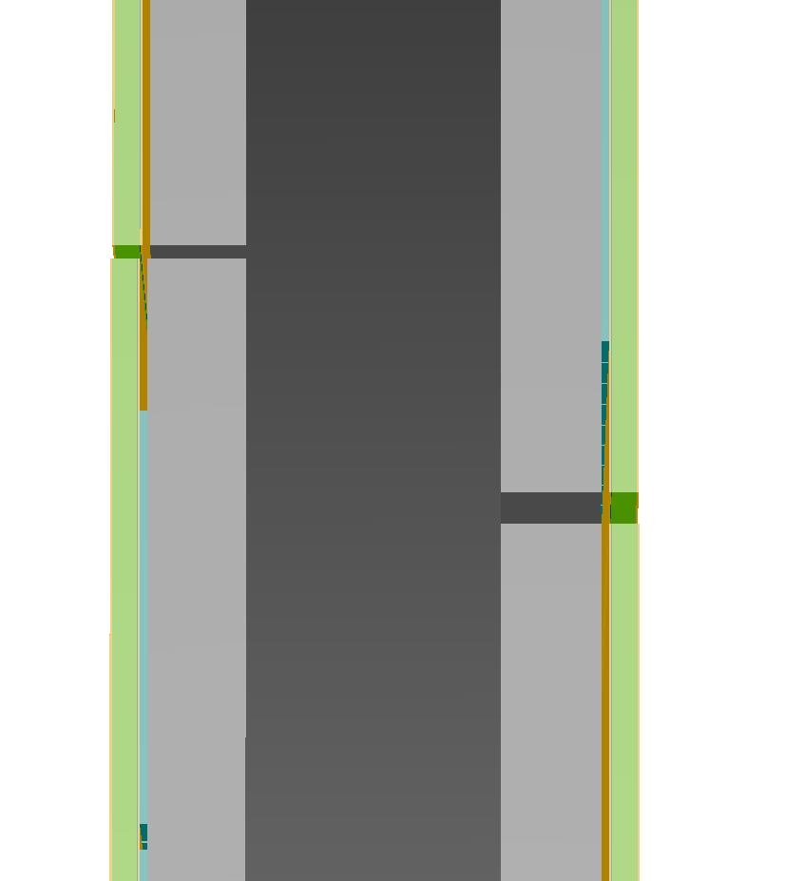
1 cm C Foam
Density = 0.09 g cm-3
Support
0.3 mm Si
Sensor
0.1 cm Fr4
PCB
0.4 cm Fr4
Module board
0.008125 cm Kapton
0.008125 cm Copper
0.008125 cm Kapton

Slide 2
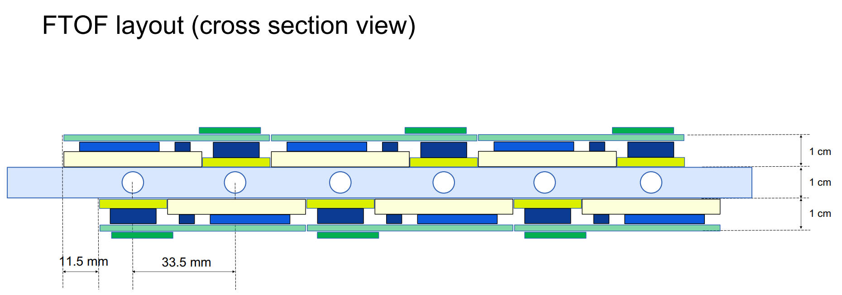
Reference https://indico.bnl.gov/event/24949/attachments/57520/98759/ePICTOF_WP2_FTOFLayout_09272024v2.pdf

