Slide 1


Update on DIRC Photon Sensor Tests at UoG
2025
Andrew Cheyne
Rachel Montgomery
Kathleen Ramage
Updated 8th December 2025

Slide 2

Cherenkov Detectors
Particle identification for ePIC

Slide 3
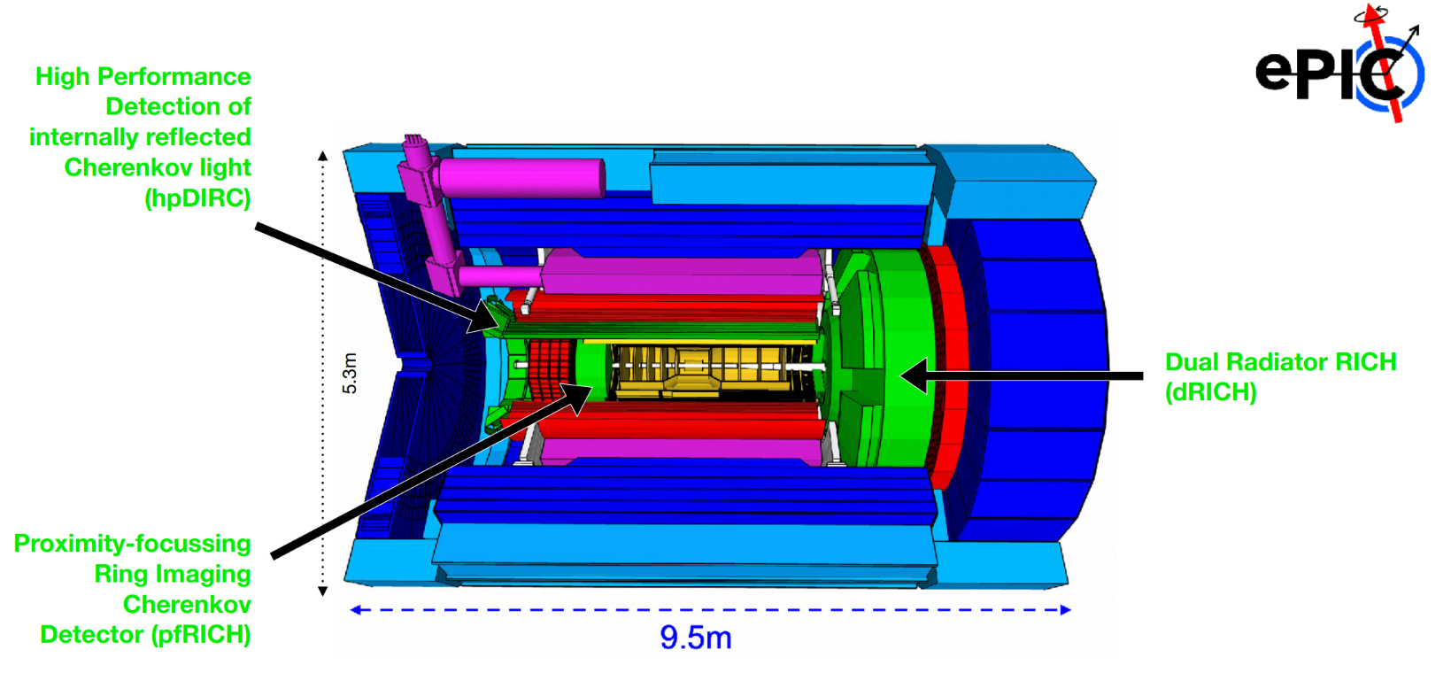
Particle identification system

Slide 4
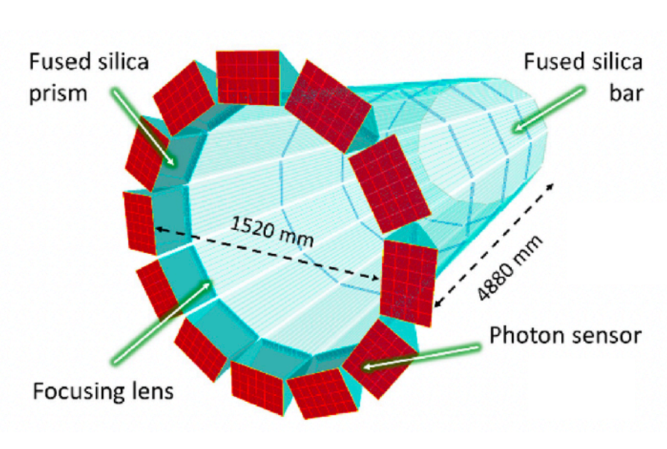
hpDIRC photon sensors
hpDIRC
12 optically isolated sectors.
Photon sensors:
Cherenkov angle reconstructed for each track from hit positions and arrival times
SPE and TOF capability (<75ps)
<1mm spatial resolution
Low dark count rate (few kHz/cm2 acceptable)
→ Pixelated MCP-PMT (MicroChannel Plate PhotoMultiplier Tube) photo sensors or HRPPDs (High Resolution Picosecond Photodetectors)

Slide 5
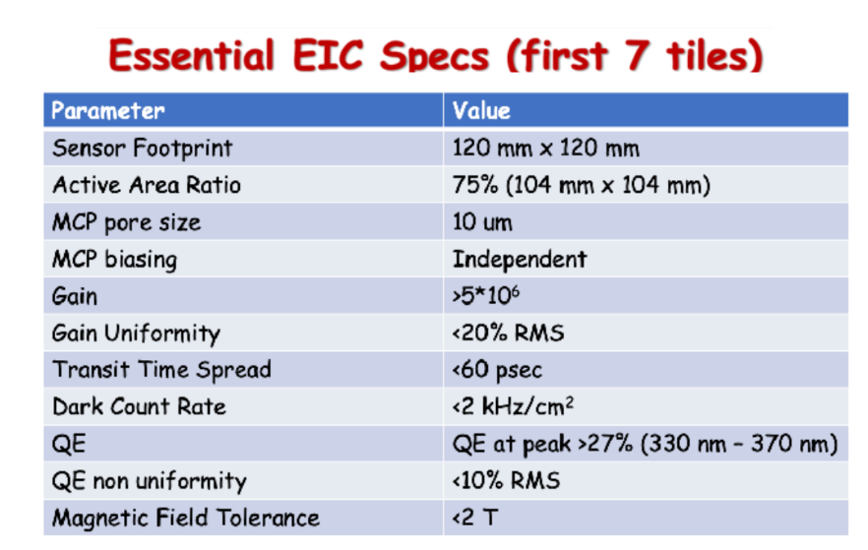
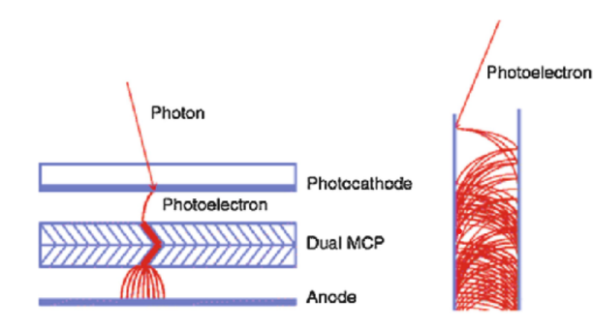
MCP-PMT
MCP-PMTs are an established technology.
Photoelectron multiplication occurs in µm channels with mm amplification path.
Fast timing resolution and TTS.
Operation under high magnetic fields.
Aim: Compare Photek MCP-PMT with Incom HRPPD for hpDIRC

Slide 6
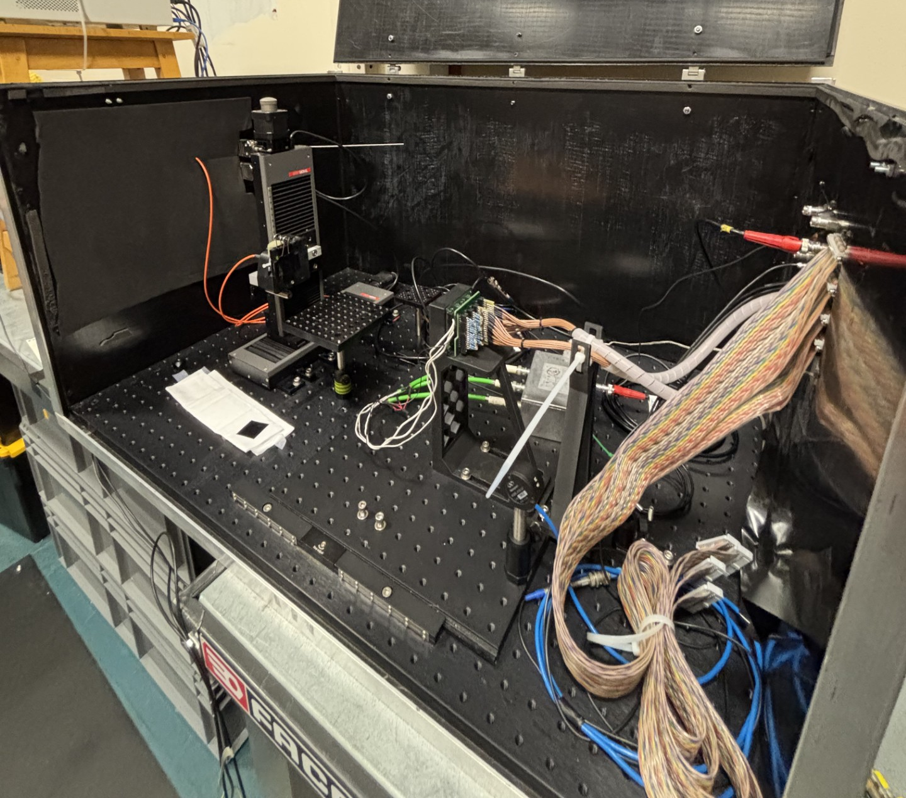
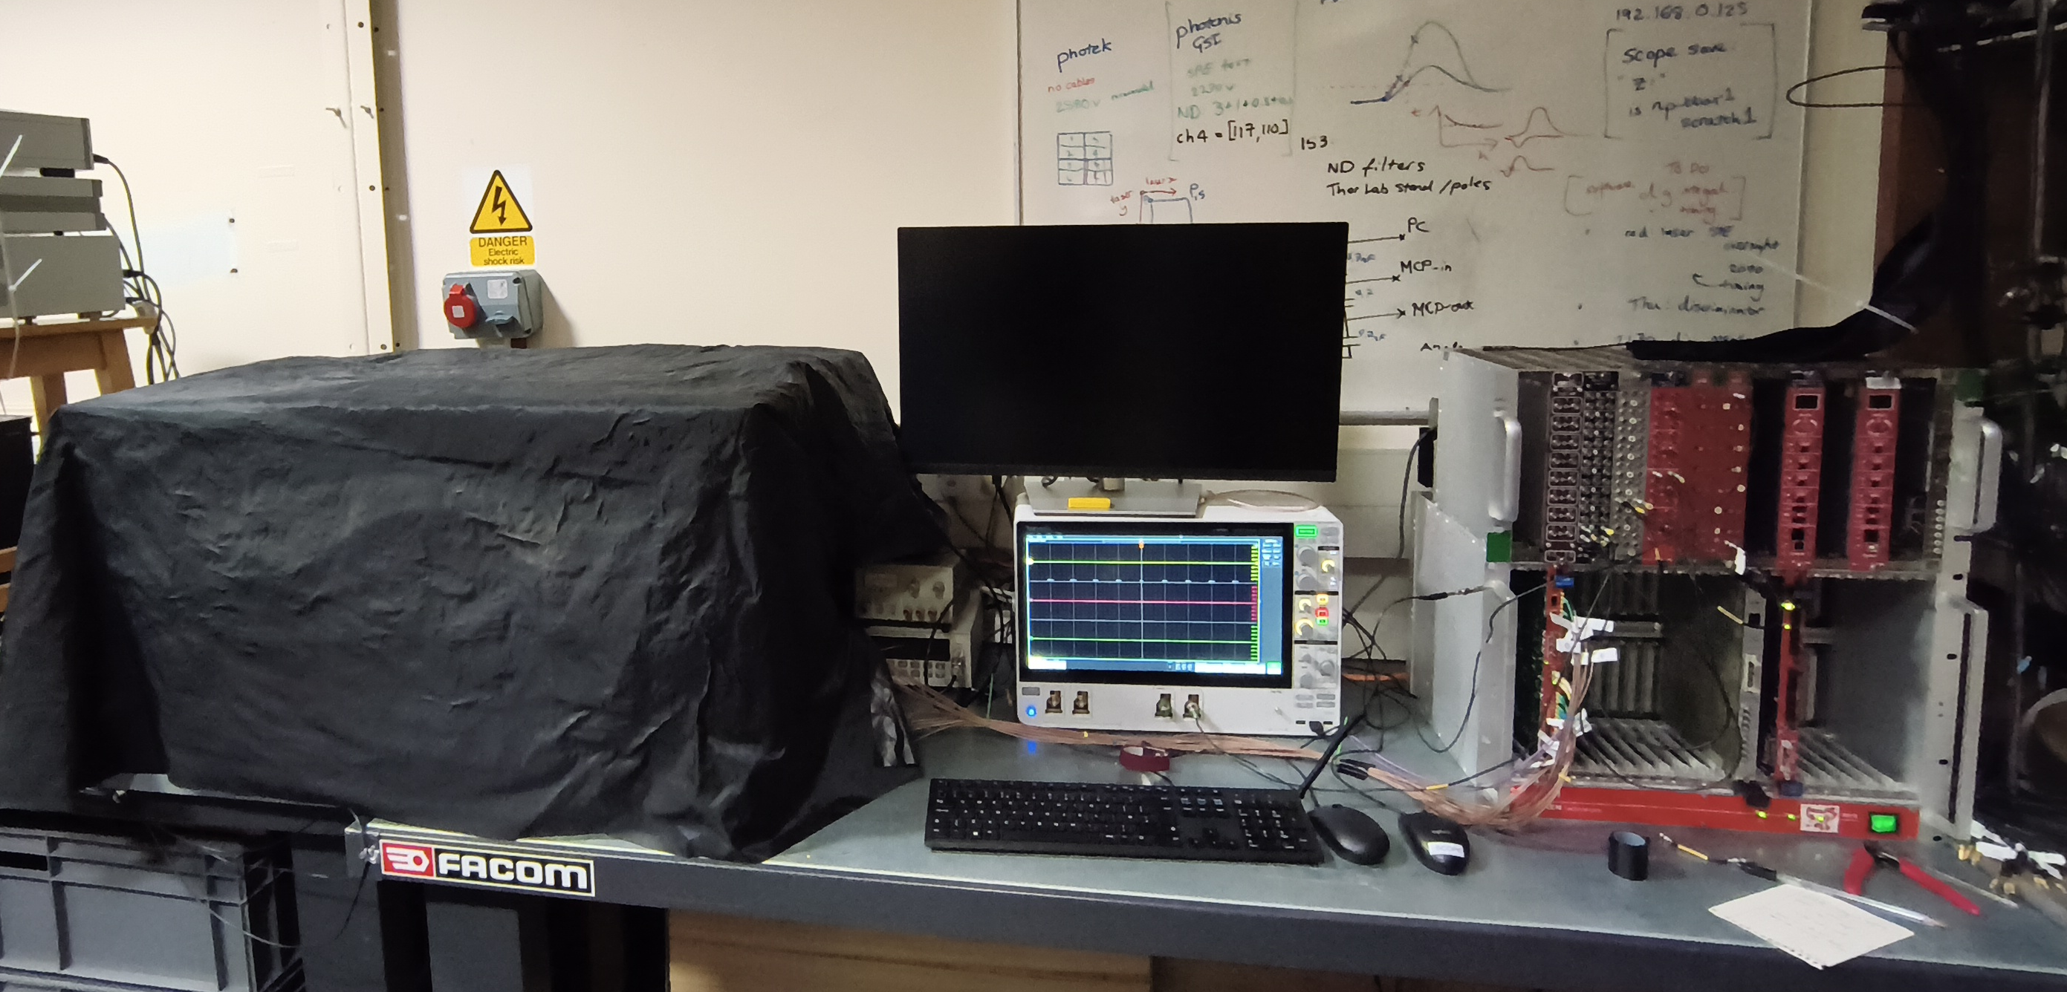
Testing setup
Thorlabs XY stepper motors
CAEN digitiser
PiLAS laser
ND filters
Oscilloscope
MCP-PMT
Initial Photonis set up:
8 x 8 pixel device
Used to cross-check with results published by A. Lehman et al [1].
[1] https://arxiv.org/abs/2403.13938

Slide 7
Photonis MCP
Benchmarking and timing results

Slide 8
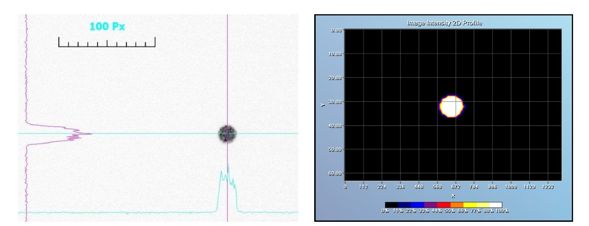
PiLAS picosecond pulsed laser
Blue (407.2nm) and Red (634.7nm) laser with 2ps jitter and 36ps FWHM.
Laser spot diameter at detector focal plane measured with CCD to be 0.890mm.
ND filters to control photon level, flood field available via diffuser.
Position shifted with Thorlabs XY stepper motor.
CCD image of laser spot

Slide 9
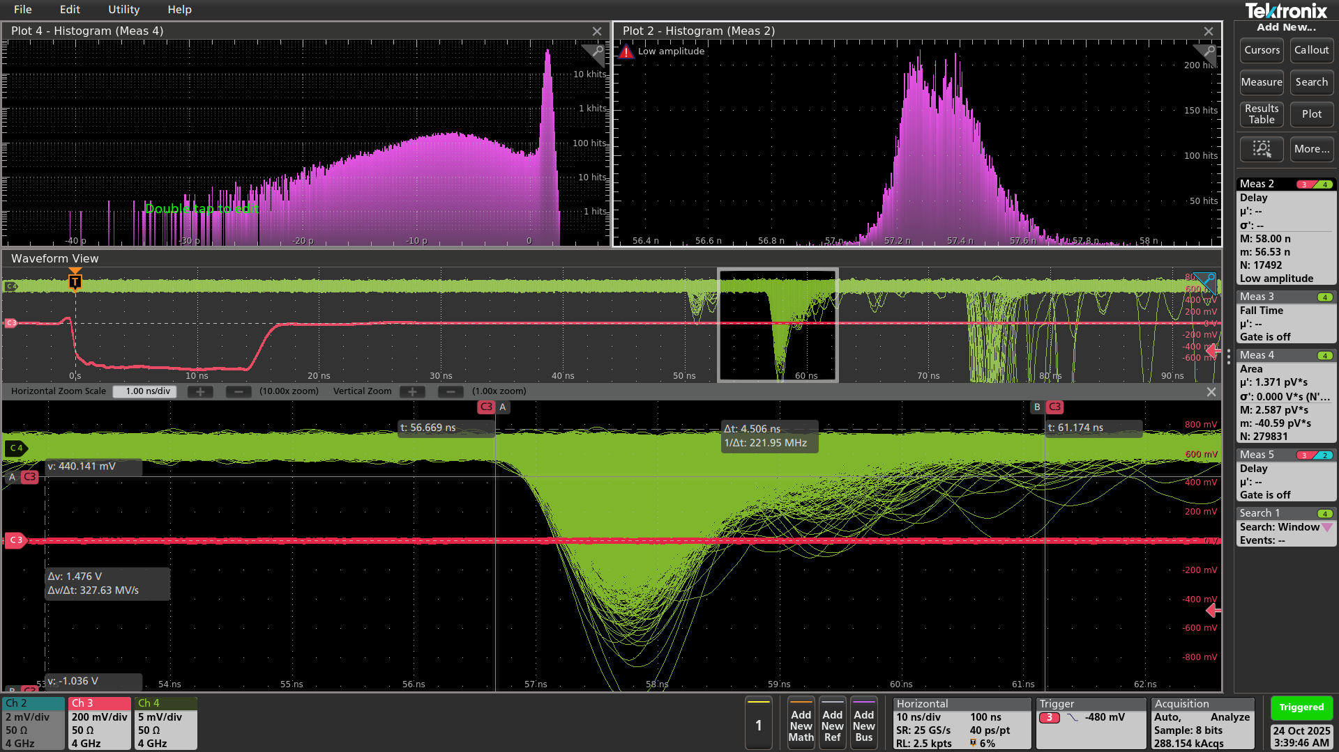
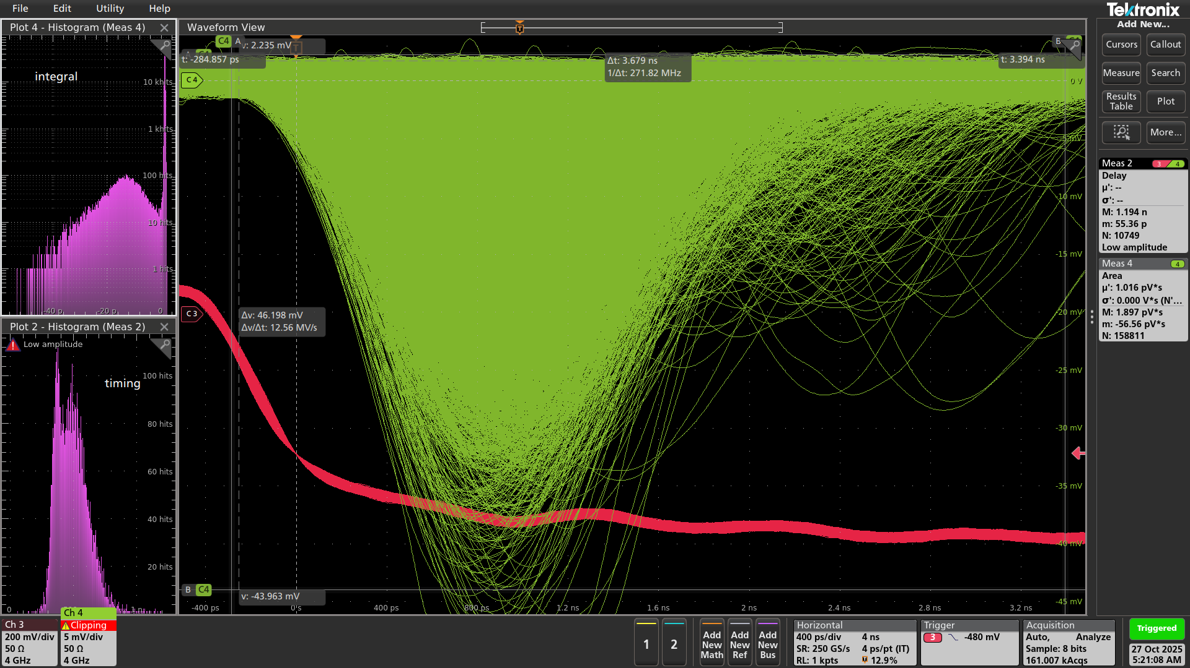
Scope measurements with MCP
Oscilloscope was used to:
Measure integral of a signal within a fixed window for gain
Measure time difference between laser (red) and signal (green) for TTS (transit time spread)

Slide 10
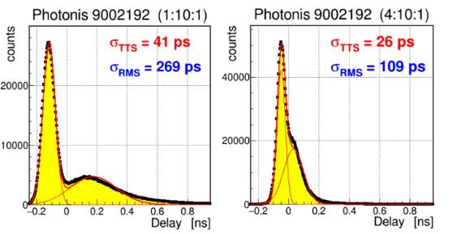
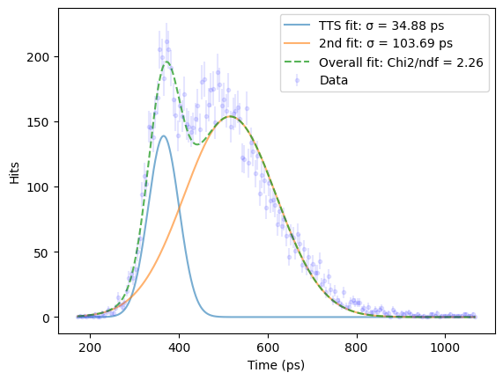
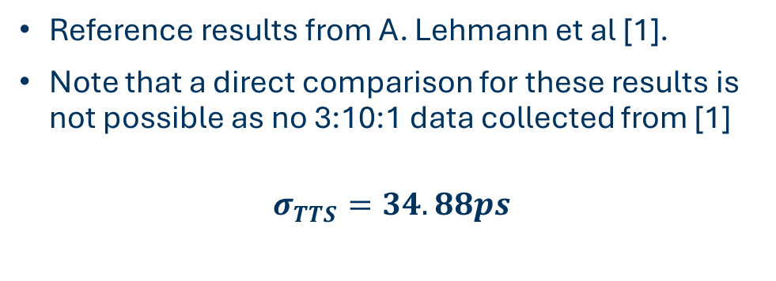
TTS measurement with scope
Reference results from A. Lehmann et al [1].
Note that a direct comparison for these results is not possible as no 3:10:1 data collected from [1]
$$σ_{TTS}=34.88ps$$
Results obtained for 3:10:1 tube (?)

Slide 11
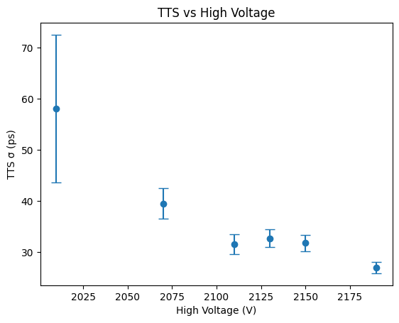
TTS vs HV
Saw an improvement of TTS with increasing voltage applied, as expected.

Slide 12
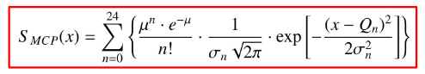
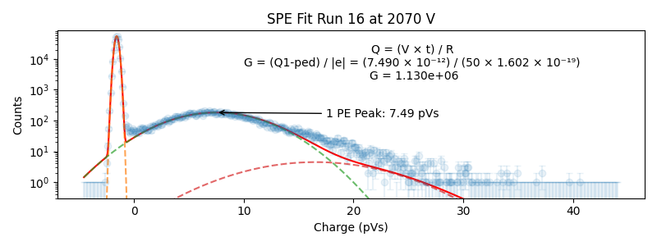
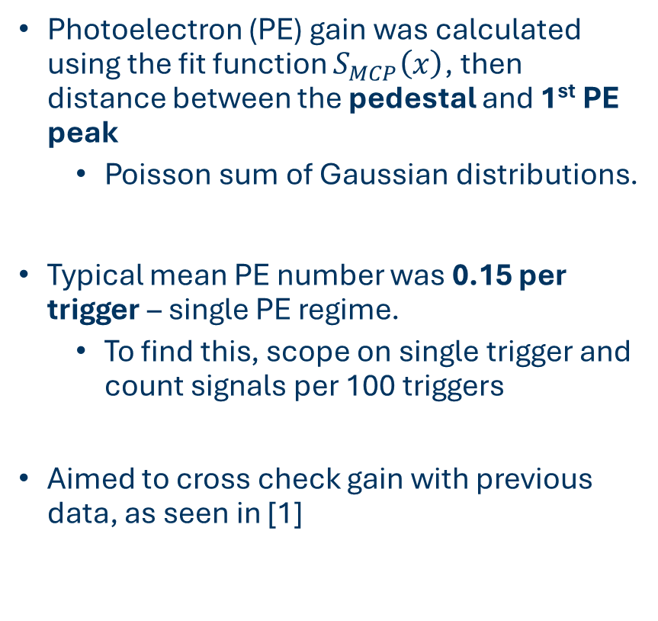
Gain from SPE integral fit
Photoelectron (PE) gain was calculated using the fit function $S_{MCP}\left(x\right)$, then distance between the pedestal and 1st PE peak
Poisson sum of Gaussian distributions.
Typical mean PE number was 0.15 per trigger – single PE regime.
To find this, scope on single trigger and count signals per 100 triggers
Aimed to cross check gain with previous data, as seen in [1]

Slide 13
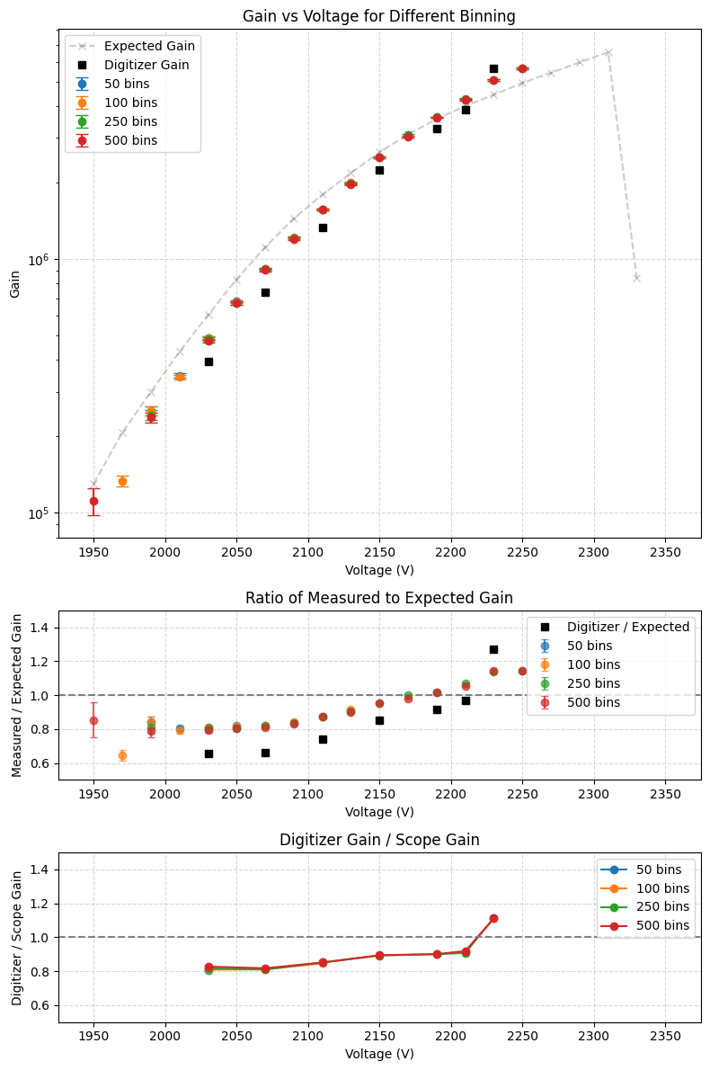
Gain curve comparison
The ratio of recorded/expected can see gain is similar to GSI results.
Digitiser/scope is mostly flat – suggesting consistency between methods.
Comparison of digitiser and scope results versus previous data (grey).

Slide 14
Photek MCP
Mapping and initial results

Slide 15
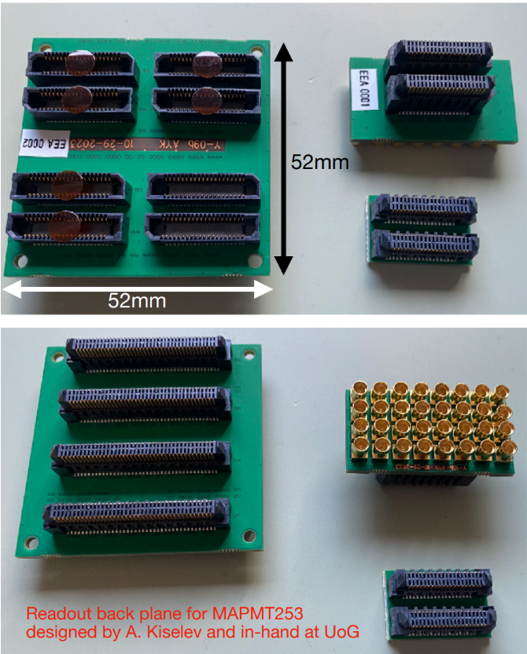
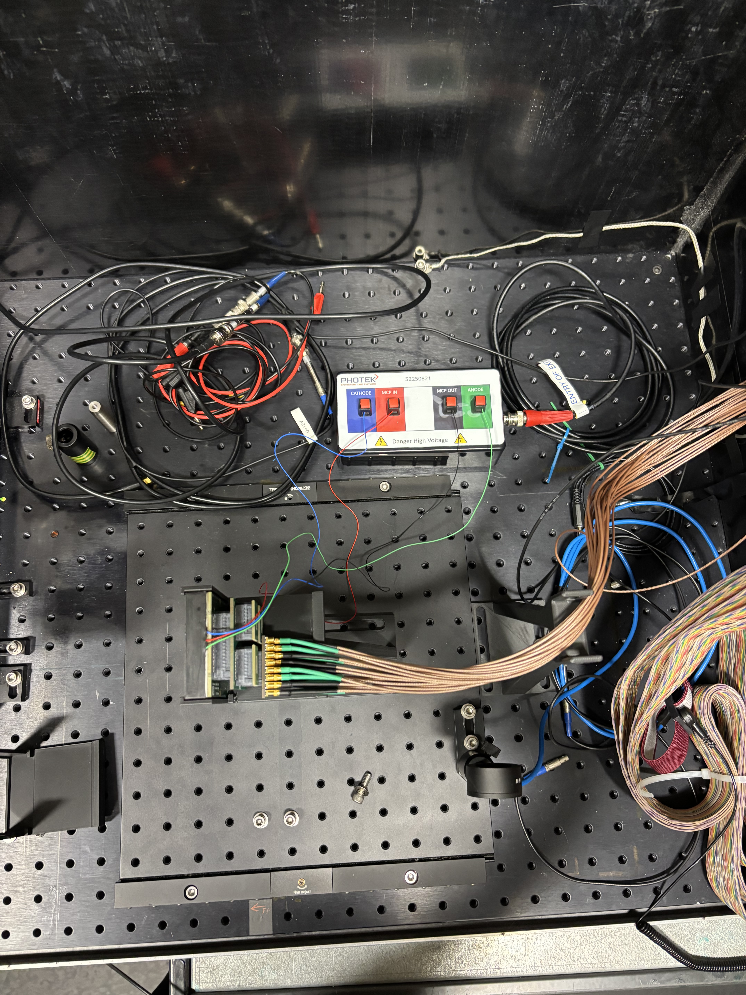
Setup
Photek device mounted like Photonis.
16 x 16 pixels
Read out back plane breakout board. Only possible in 8 distinct sections.

Slide 16
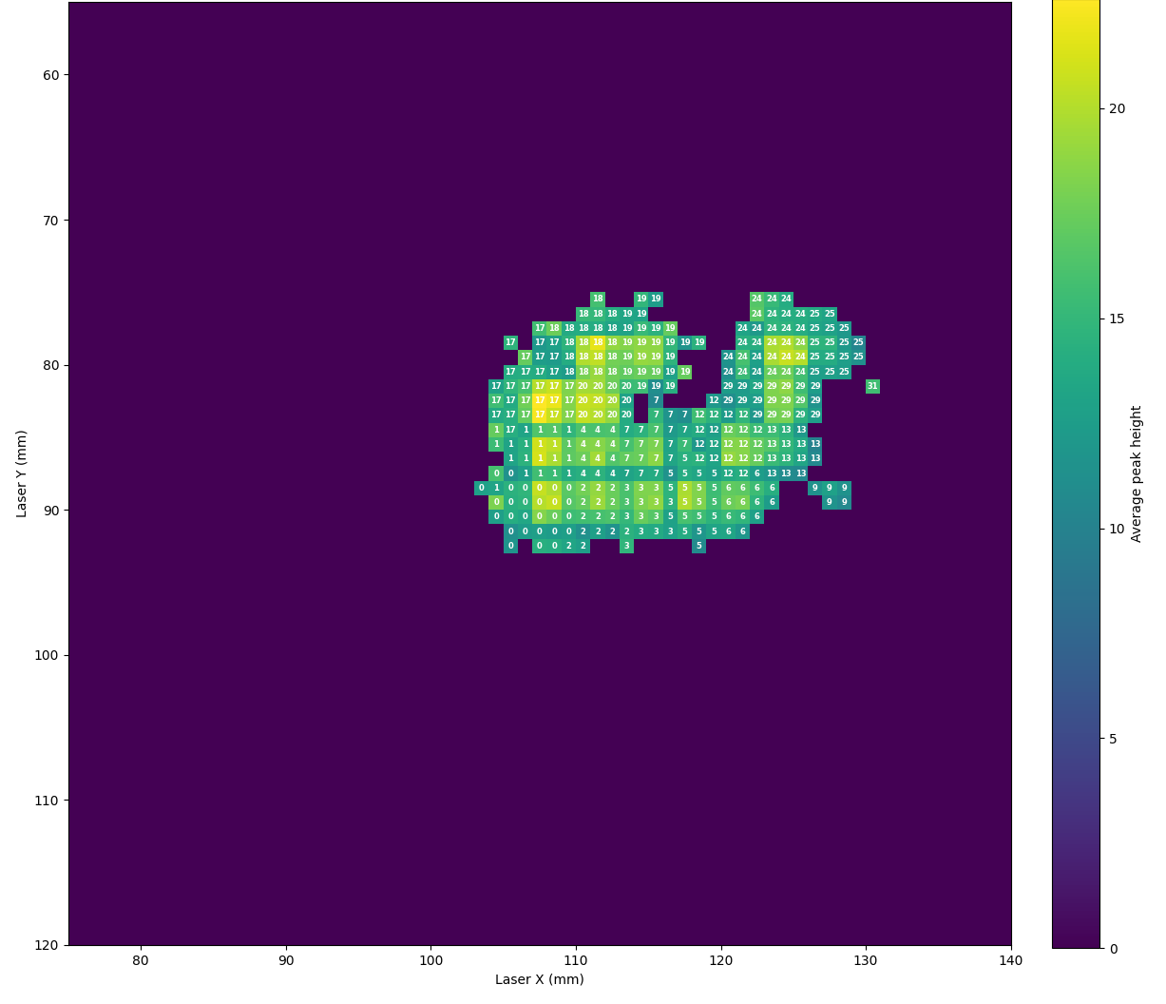
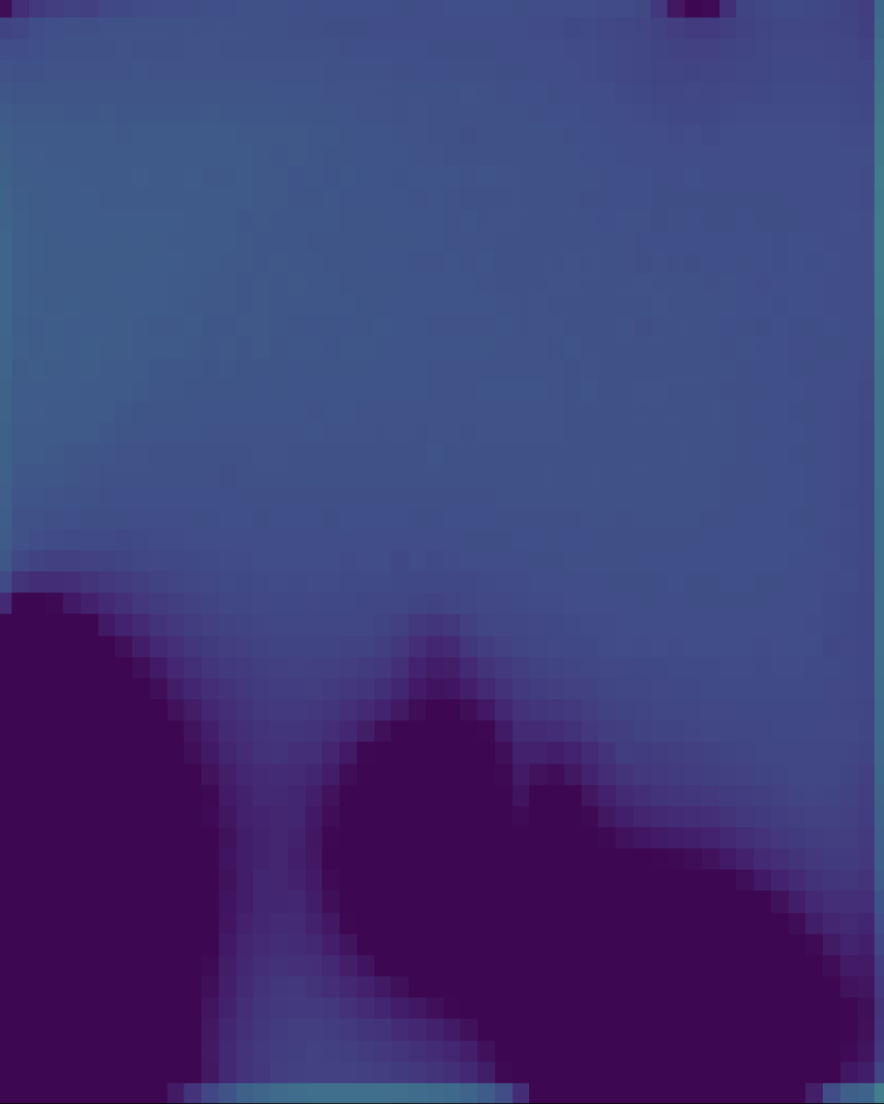
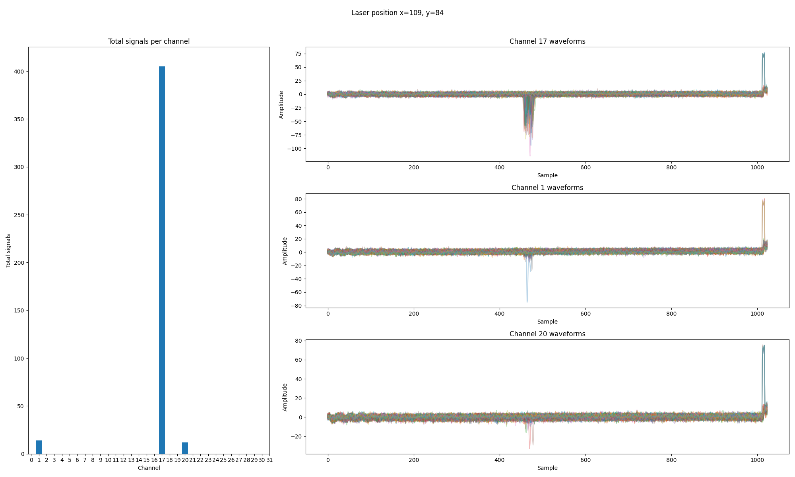
Channel mapping
Channel with most signals below -10mV identified.
Channel 17 chosen as reference.
Some channels missing from breakout board – not rectangular area.

Slide 17
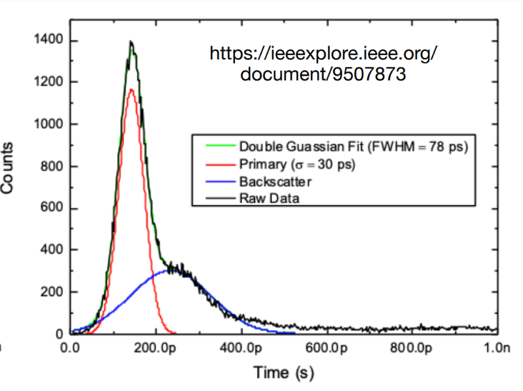
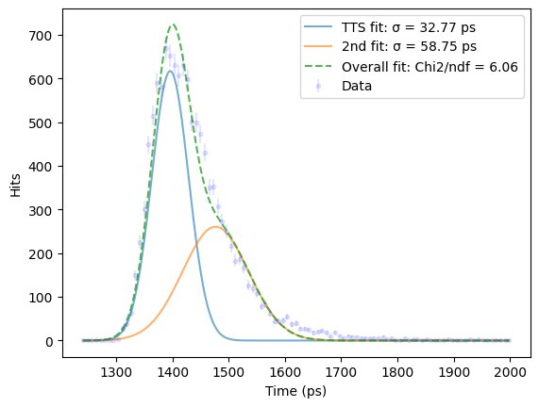
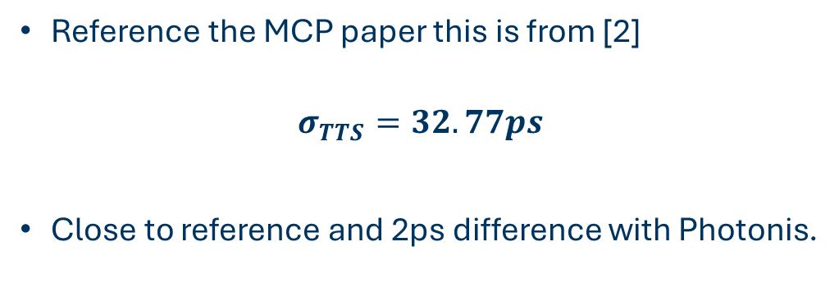
TTS comparison with scope
Reference the MCP paper this is from [2]
$$σ_{TTS}=32.77ps$$
Close to reference and 2ps difference with Photonis.

Slide 18
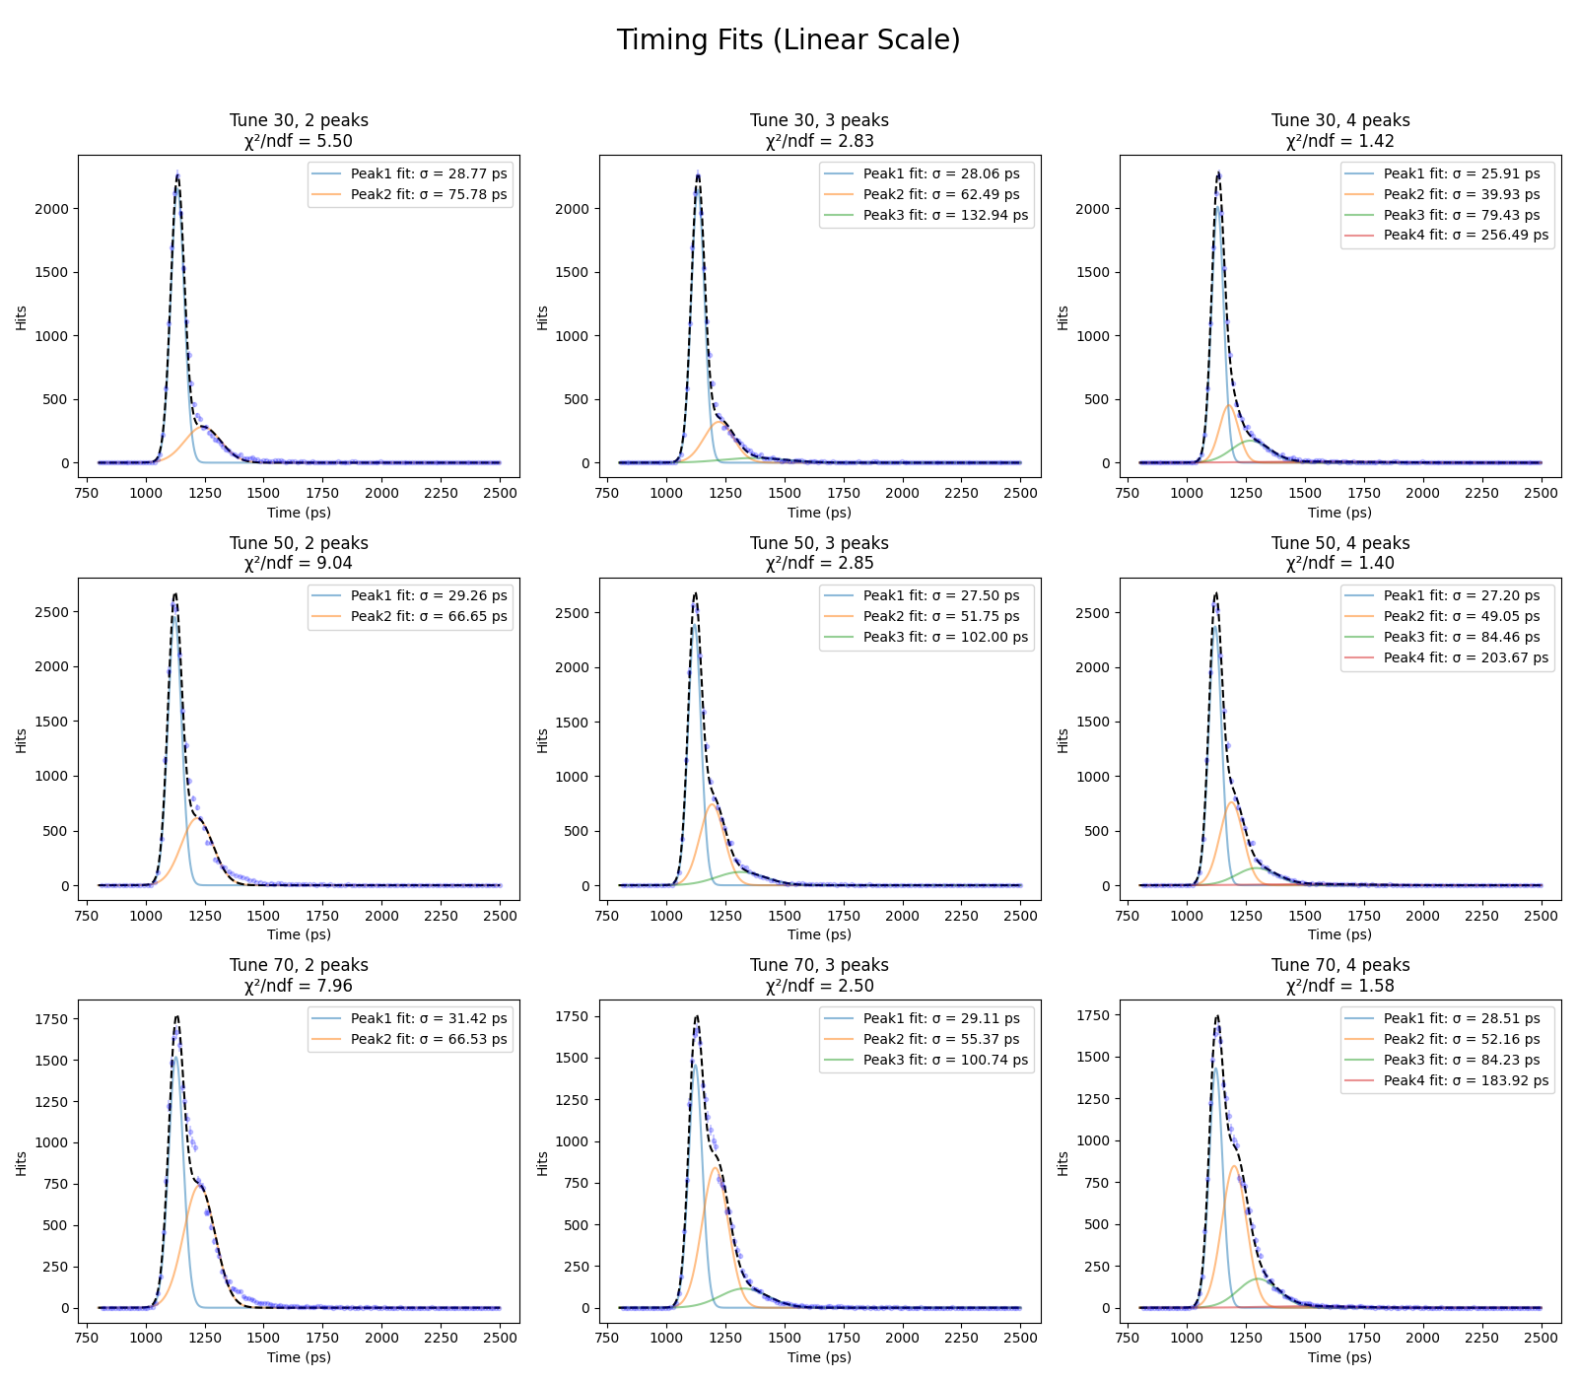
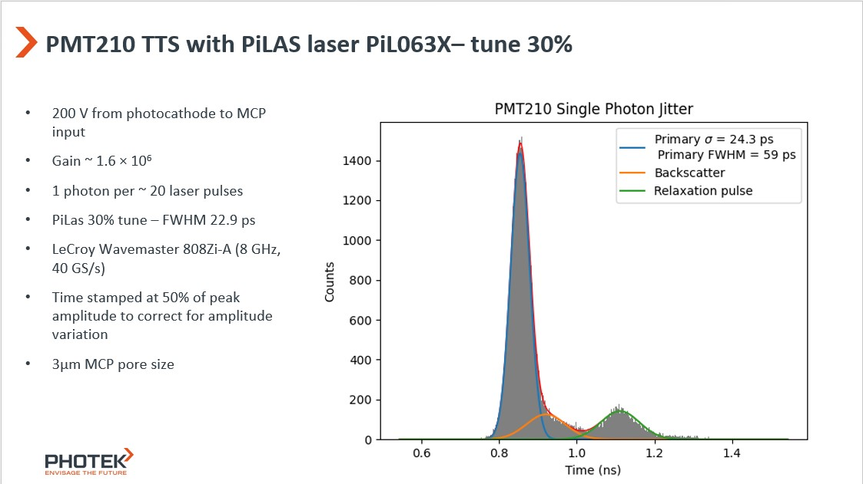
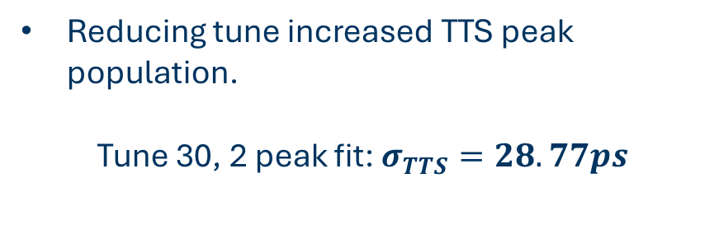
TTS reducing laser tune
Reducing tune increased TTS peak population.
Tune 30, 2 peak fit: $σ_{TTS}=28.77ps$

Slide 19
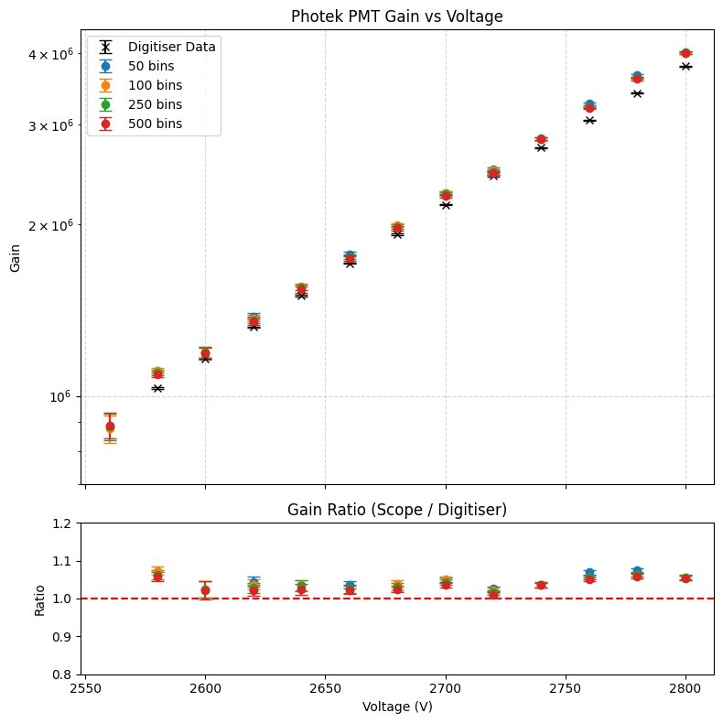
Gain
Ratio is consistent with Photonis.

Slide 20

Future plans
Photek:​
Gain scan underway of Photek tube at all 8 readout locations​
8 orientations * 32 ​(some missing channels)​
Timing measurements between pixels​ with mask and diffuser.
QE using:​ Calibrated photodiode and LED and/or​ monochromator​
​
Photonis​:
Gain scan of Photonis​
Timing measurements like above.​
QE like above​
​
HRPPD

Slide 21
Backup Slides

Slide 22
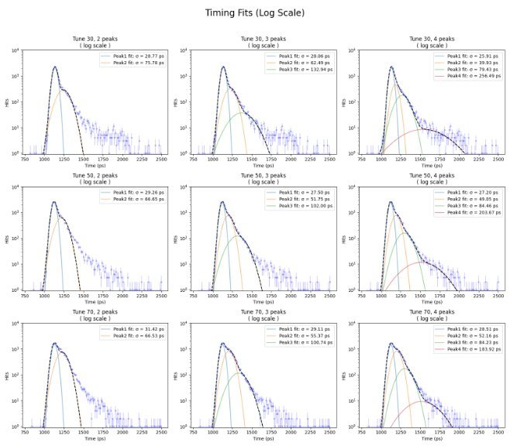
Log timing fits

Slide 23
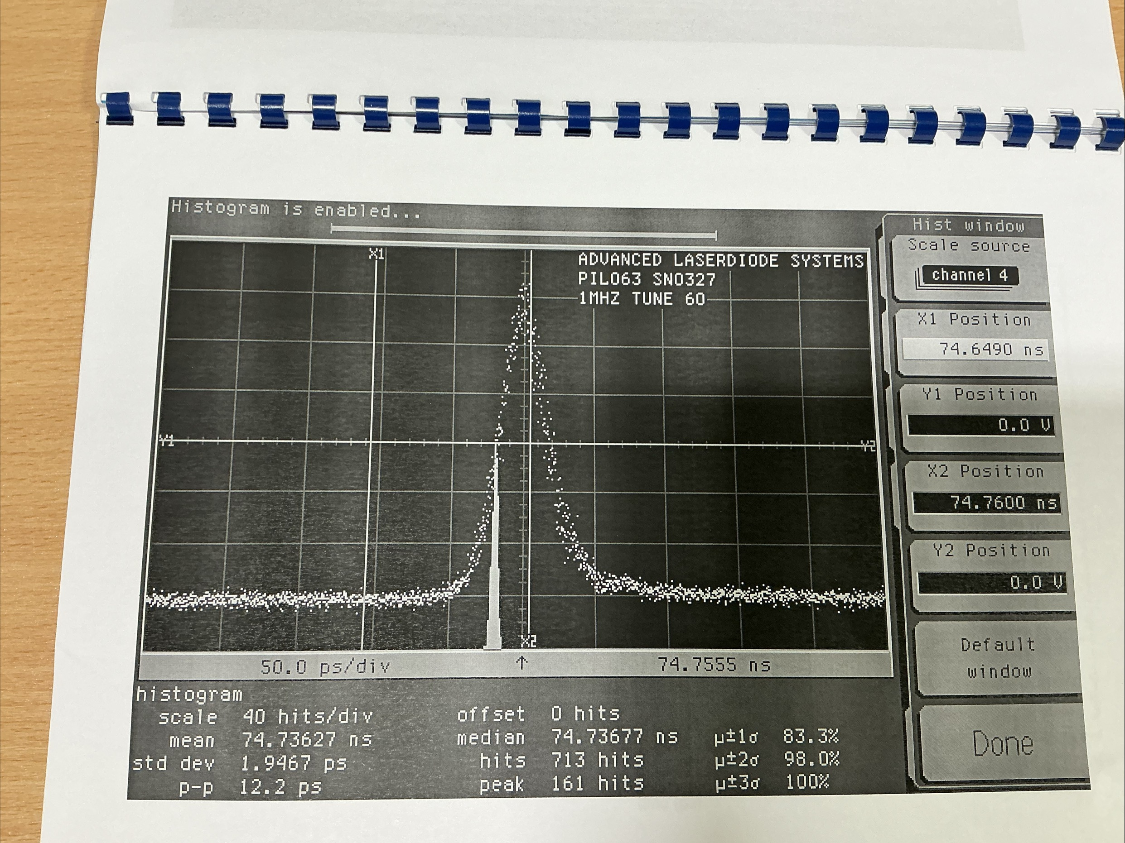
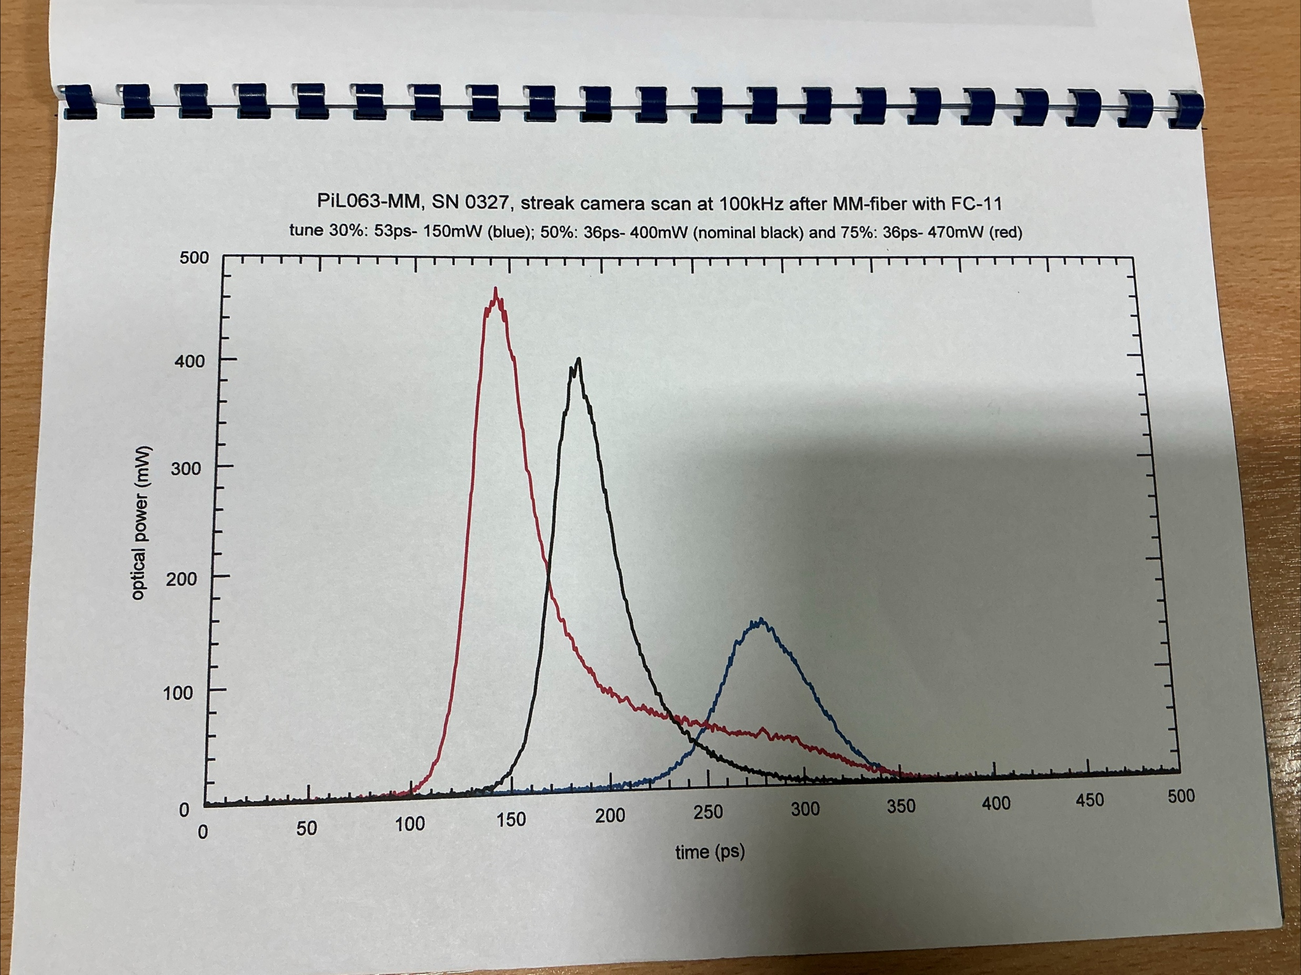
Laser profiles

