Slide 1
Stephen JD Kay
08/12/25
EIC UK 2025
UNIVERSITY OF YORK
KINGS MANOR K/122 – 08/12/25
Heslington West MRC/113 – 09/12/25

Slide 2
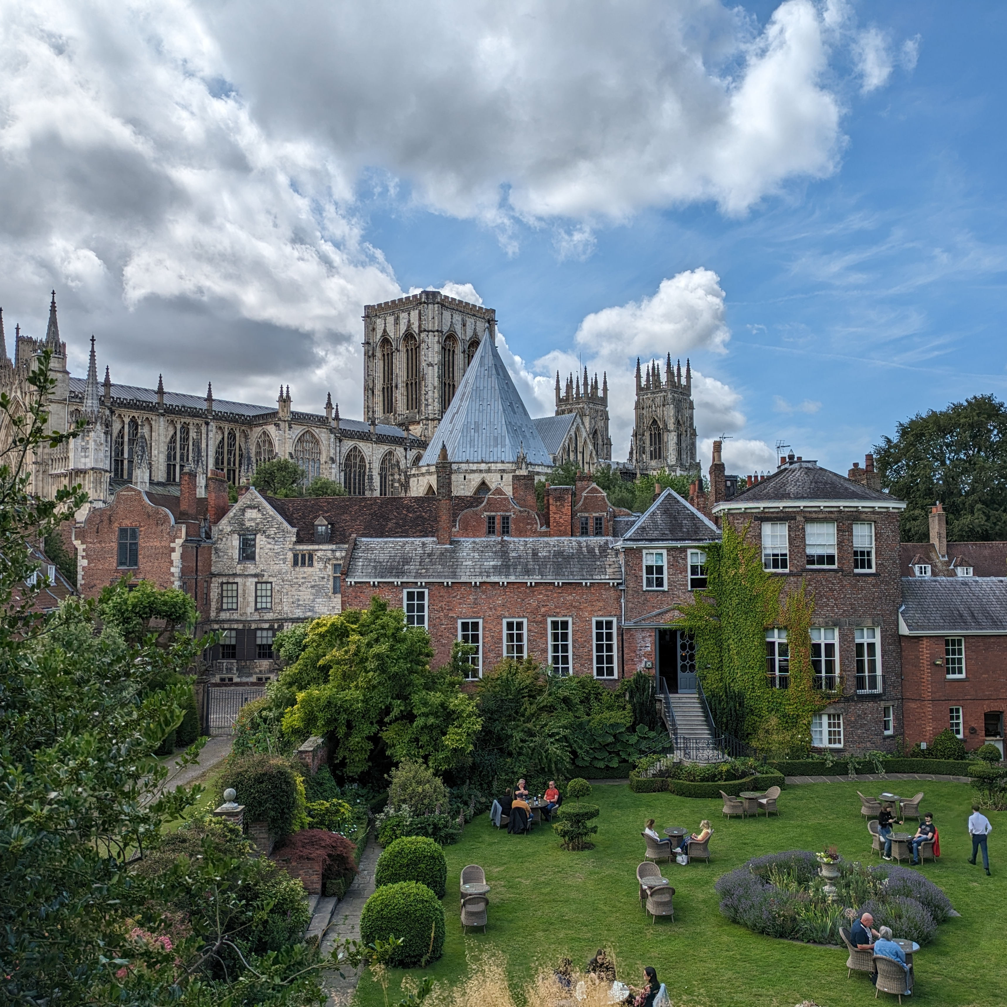
WELCOME
Welcome to York!
Practical info
Brief overview of schedule
Group Meal
Acknowledgements

Slide 3
Practical Info
Welcome to King’s Manor!
Venue tomorrow is on campus - See the travel info
No fire alarm tests planned today or tomorrow!
Please evacuate if there is an alarm!
Follow instructions from porters/fire wardens

Slide 4
Schedule
Please upload your slides or email them to Stephen.kay@york.ac.uk
08/12/25 Afternoon Session 1 - ePIC Focused
08/12/25 - Afternoon Session 2 - EIC Focused
08/12/25 - 19:00 Group Meal
09/12/25 - Morning Session 1 - ePIC Focused
09/12/25 - Morning Session 2 - EIC Focused

Slide 5
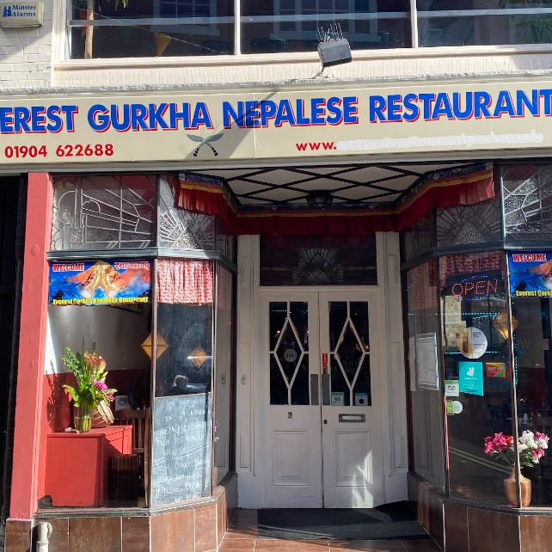
Meal this evening @ 19:00
Everest Gurkha Nepalese Restaurant
Short ~10 minute walk from here
Christmas Market on Parliament street - Might be crowded!
A-la-carte menu
York locals will be happy to help with suggestions on venues/sights to occupy you in the interim!

Slide 6

Acknowledgements
The organisers would like to acknowledge the support of the IOP for this event.
Support has enabled the free nature of the event and the catering.

Slide 7
STEPHEN.KAY@YORK.AC.UK
STUART.FEGAN@YORK.AC.UK
KAYLEIGH.GATES@YORK.AC.UK

