Slide 1
Benchmarking IAEA CIELO evaluations of n + ^{235,238}U
Roberto Capote
Deputy Section Head, Nuclear Data Section
International Atomic Energy Agency
Department for Nuclear Sciences and Applications
mini-CSWEG 2017, LANL, USA, 4-5 May 2017

Slide 2
IAEA CIELO evaluations: n + ^{235,238}U
²³⁵U
ENDF/B-VIII.β3 = ENDF/B-VIII.β2 (IAEA u238-b18)
ENDF/B-VIII.β4 = IAEA u235-b36 … (prelim. STD)
ENDF/B-VIII.postβ4 = IAEA u235-b46… (STD 2017)
²³⁸U
ENDF/B-VIII.β3 = ENDF/B-VIII.β2 (IAEA u238-b46)
ENDF/B-VIII.β4 = IAEA u238-b51 … (prelim. STD)
ENDF/B-VIII.postβ4 = IAEA u238-b58 … (STD 2017)

Slide 3
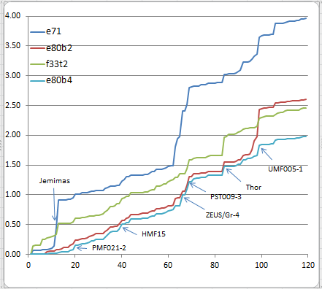
ENDF/B evals, LANL Mosteller suite
N=119

Slide 4
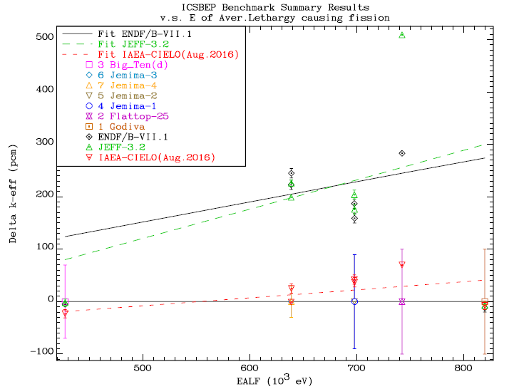

Slide 5
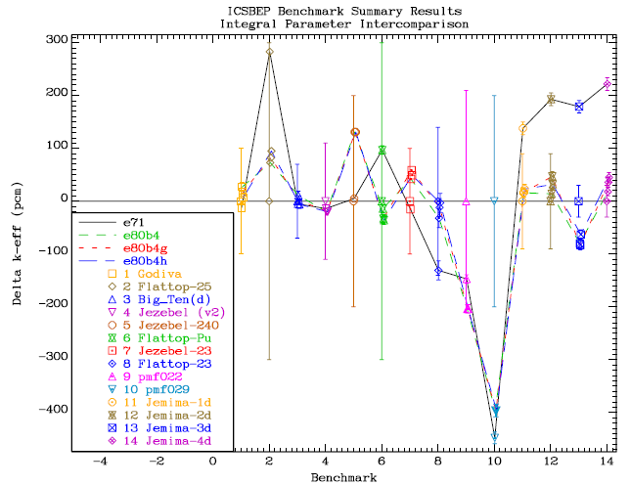

Slide 6
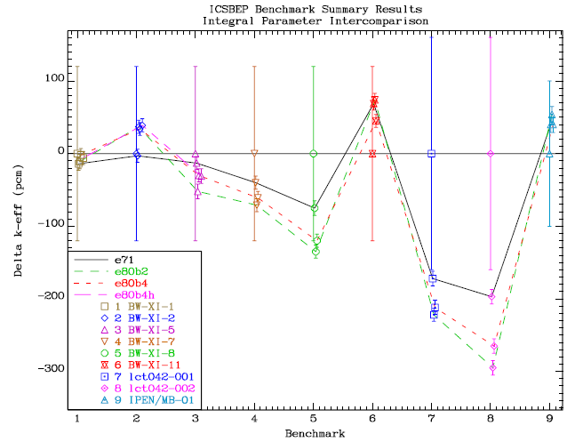

Slide 7
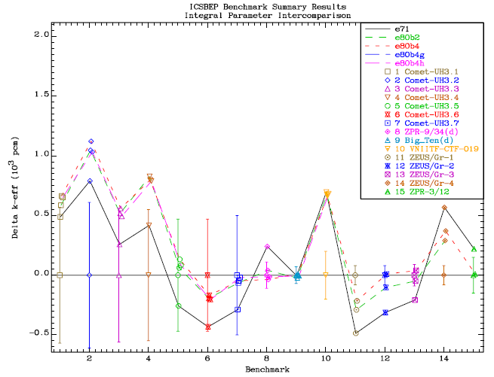

Slide 8
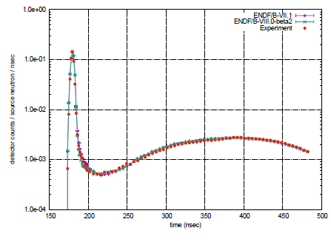
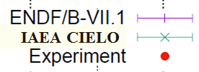
LLNL Pulsed Sphere (14MeV n + ²³⁵U)
LLNL Pulsed Spheres calculations by B. Kiedrowski using MCNP

Slide 9
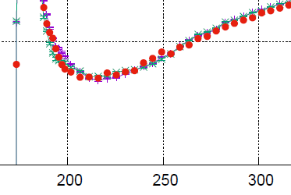

LLNL Pulsed Sphere (14MeV n + ²³⁵U)
IAEA CIELO
LLNL Pulsed Spheres calculations by B. Kiedrowski using MCNP

Slide 10
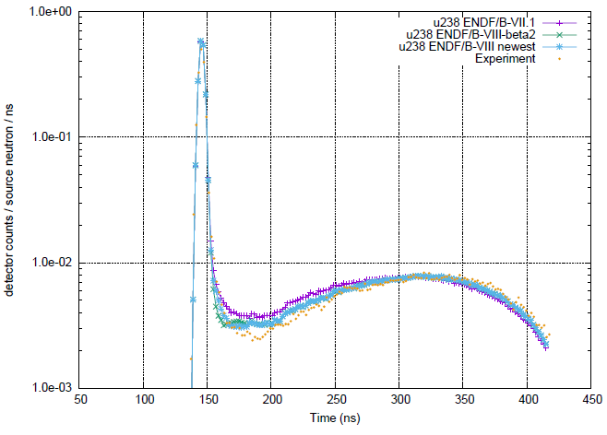
EXPERIMENT
RENORMALIZED

Slide 11
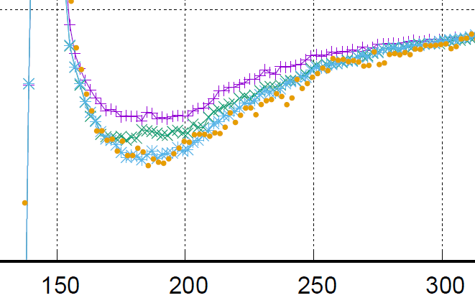
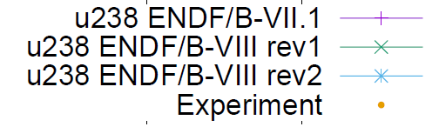
LLNL Pulsed Sphere (14MeV n + ²³⁸U)
IAEA CIELO ib46 (β2)
IAEA CIELO ib51 (β4)
β2
β4
LLNL Pulsed Sphere calculations by B. Kiedrowski using MCNP

Slide 12
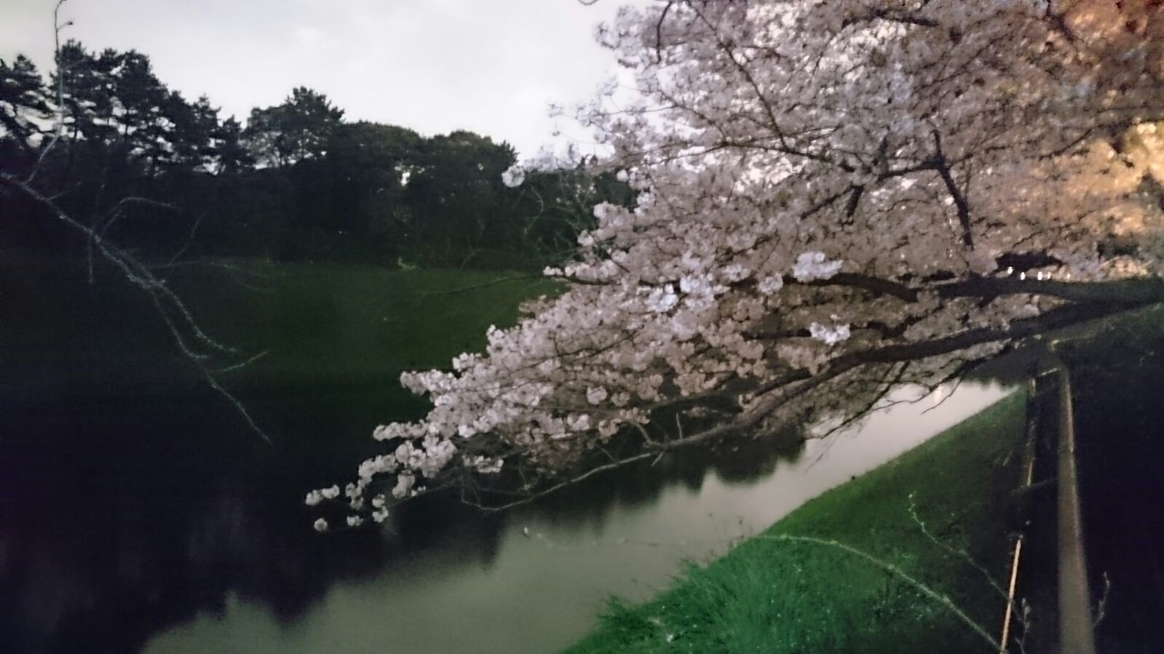
Thanks !

