Slide 1
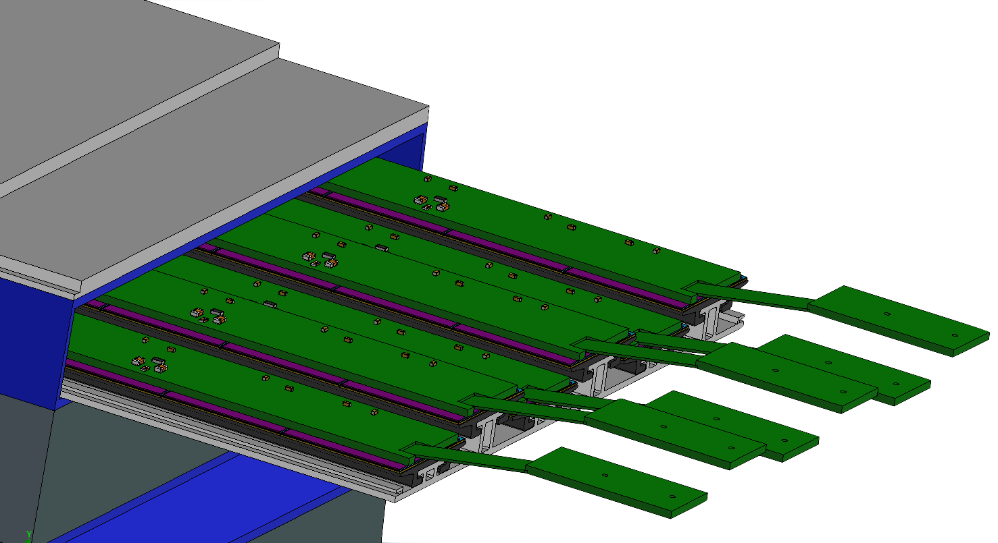
AstroLinx
Barrel Imaging Calorimeter Preliminary Design Review
Greg Shildt
BIC PDR
Oklahoma State University
on behalf of the BIC DSC
September 17-18, 2025

Slide 2
Outline
Overview
Design
Test articles
Final design plans
QA/QC plan
Safety
Plans for preproduction, production

Slide 3
Charge Questions
Charge:
1. Is the progress and design maturity of the barrel electromagnetic calorimeter systems
aligned with being baselined in June 2026 (>60% maturity is required)?
2. Are the technical performance requirements appropriately defined and complete for this
stage of the project?
3. Are the plans for achieving detector performance and construction sufficiently developed
and documented for the present phase of the project?
4. Are the current designs and plans for detector and electronics readout likely to achieve
the performance requirements with a low risk of cost increases, schedule delays, and
technical problems?
5. Are the calorimeter fabrication and assembly plans consistent with the overall project
and detector schedule?
6. Are the plans for detector integration in the EIC detector appropriately developed for the
present phase of the project?
7. Have ES&H and QA considerations been adequately incorporated into the designs at
their present stage?
8. Have the recommendations from previous reviews been adequately addressed?

Slide 4
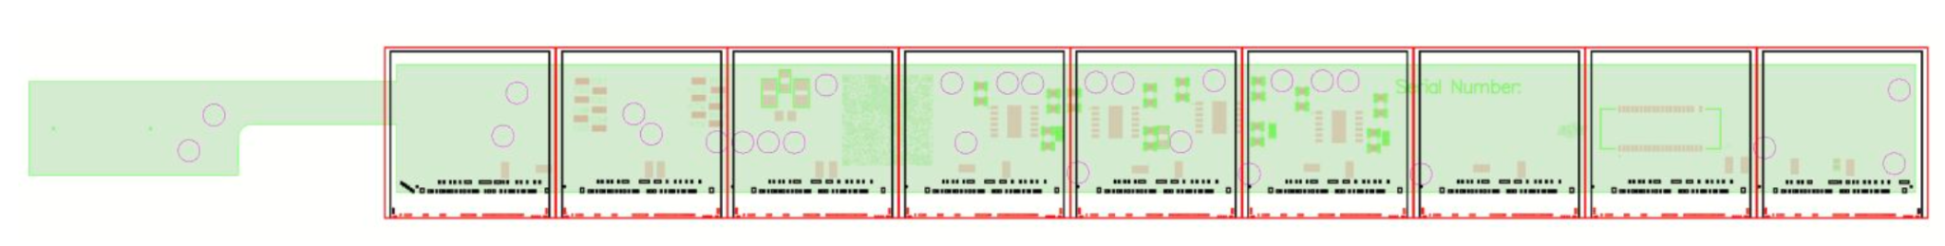
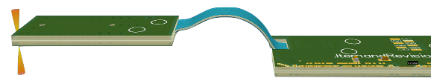
Overview
Supply power and data transmission to AstroPix chips
Each AstroLinx supplies 9 AstroPix and adheres atop to form a module
Wire-bonds connect AstroLinx to AstroPix
Test article design is a rigid-flex PCB
Connects 12 modules in daisy-chain to form 1 full stave
  Each module reads out on the data bus to End of Tray Card Directly
Connects to the End of Tray card with same connector
Notes:
Astrolinx is a medium to get power to chips and data from the chips. There is one Astrolinx per module (9 chips) and 12 Astrolinx per stave. The board sits directly on top of the chips and gets wirebonded to the chips pads. The board is a rigid-flex that connects to the next Astrolinx in the stave and transfers power and data on buses.

Slide 5
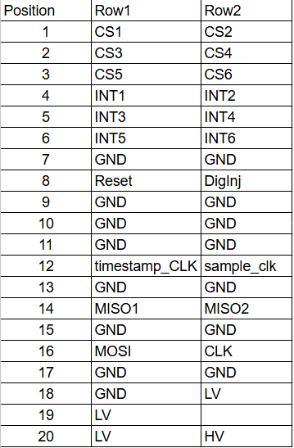
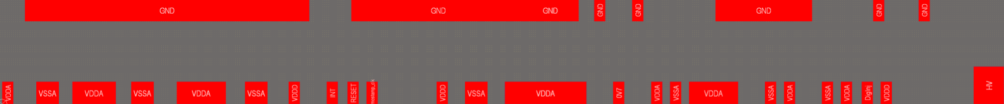
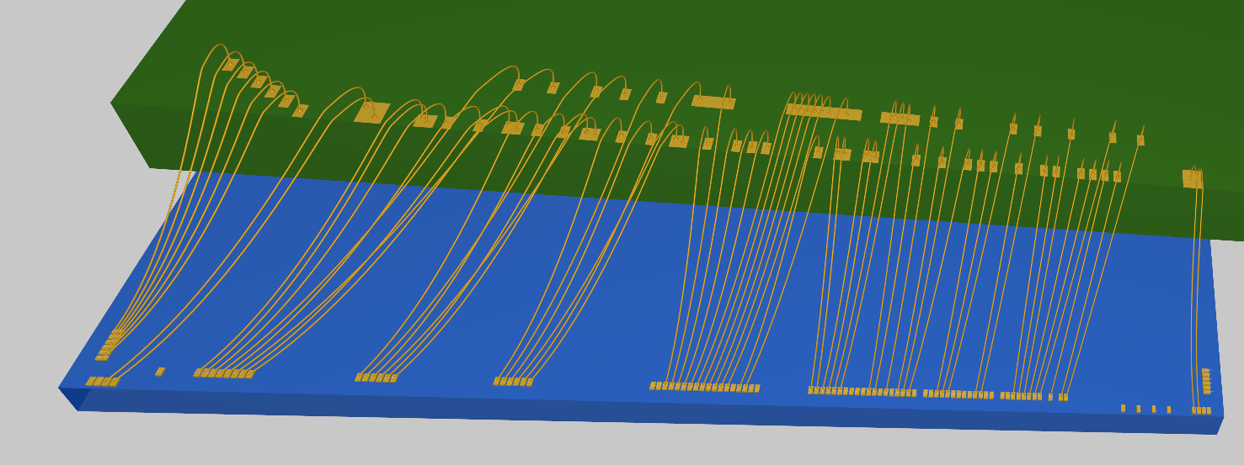
Design
Charge 4
Used wire-bond simulation in Altium Designer to verify the wire-bonds can be placed with the pad placement on the AstroLinx. Prevents collision and creepage.
Pinout for test articles
Wire-bond pad footprints - SPI, first, last
Wire-bond pad mapping - first footprint simulation
Notes:
Charge 4: Are the current designs and plans for detector and electronics readout likely to achieve
the performance requirements with a low risk of cost increases, schedule delays, and
technical problems?

Slide 6
Design
Impedance Structures - keeps signal lines cleaner
Fewer reflections → lower loss and less noise
Target: 50 Ohms +/- 2.5Ohms
  Manufacturing capabilities
  Useability
  Dependant on stackup
Structure | Layers | Track Width | Gap | T1 | Impedance (Ohms)
Co-planar Single Ended Stripline | 1, 8 Ref 2 | 350um | 100um | 1 oz (35um) | 51.07
Co-planar Single Ended Mictrostrip | 3 Ref 3,4 | 110um | 100um | ½ oz (17.5um) | 49.53
Coplanar Single Ended Stripline (Flex) | 3 Ref 4 | 110um | 100um | ½ oz (17.5um) | 51.07

Slide 7
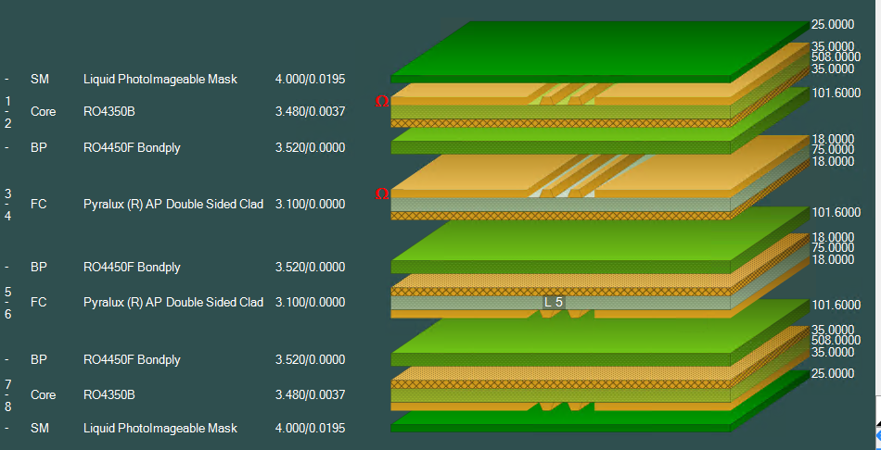
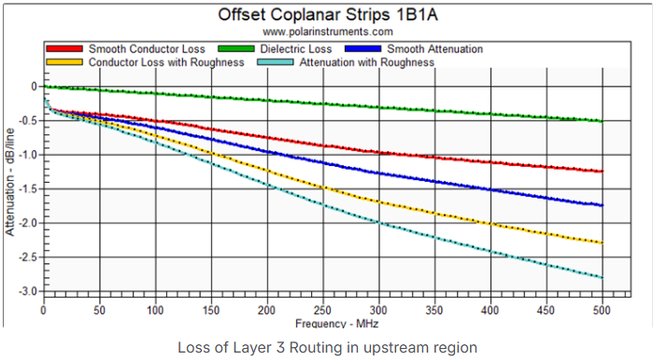
Design
Physical stack-up
Data signal integrity
Limit reflections → less noise
Limit power loss → better transmission lines and less power and signal loss
Speedstack for stackup
SI9000 for data simulation
Data Power Loss Plot
Recommendation: Stave Concept: Simulate power and data transmission along the full chain to the EOS board
Response: This is done all on the module PCB, AstroLinx

Slide 8
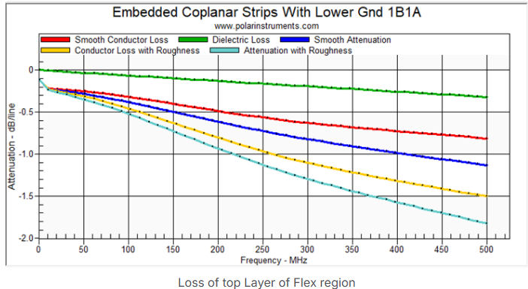
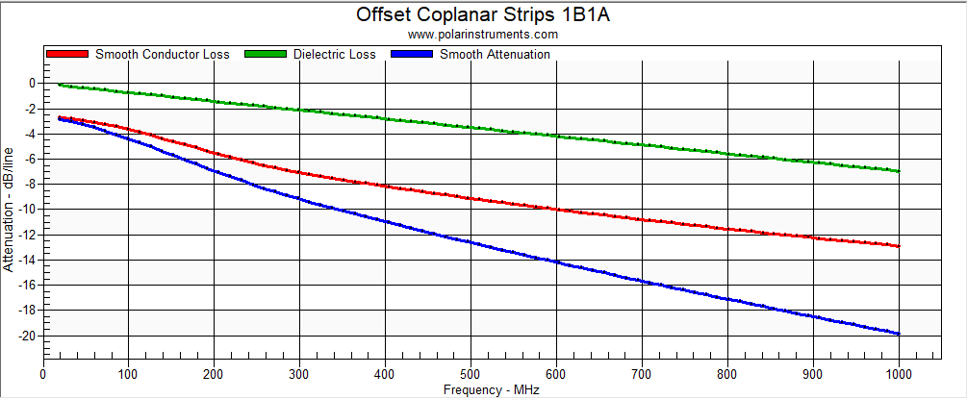
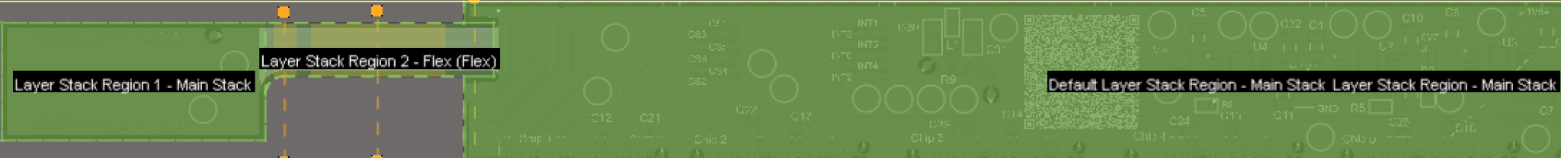
Design
Data signal integrity
3.5 dB loss over full stave – good loss
Data Power Loss Plot
Data Power Loss Plot
Board Region View

Slide 9
Design
Power
LV provides power to the board
  Need 3V minimum at the last board for regulators to maintain voltage
  9V input
    Allows for input voltage fluctuation
    Reduces current (via Ohm’s law)
    Vastly reduces power drop over each board
  Voltage drop per board 5mV – actual LV voltage at last regulator ~8.25V
  Total power consumption per board: 0.544mW, per stave: 6.52mW
Supply | Voltage(V) | Current(mA) | Power per Module (mW) | Power per stave (mW)
VDDA | 1.8 | 1.47 | 23.85 | 286.2
VSSA | 1.2 | 1.33 | 14.4 | 172.8
VDDD | 1.8 | 6.88 | 110.16 | 1321.92
Given power consumption

Slide 10
Design
Charge 4 and 8
Additional Items:
HV filter
  Remove noise for a cleaner HV transmission
Chip select and interrupt chevrons
  Allows selection of which board in order of stave
  Data is sent to specific chips
Power circuits
  Low voltage is converted to 0V7, 1V2, 1V8D, 1V8A voltages at the board level
  Lower power loss
  Power nets to chips are closer to necessary voltage
Power stability
  Each chip layout has a 100nF capacitor for 1V8A and 1V8D circuits
  Improves voltage stability and removes any noise in voltage conversion
SPI Ground
  The final wirebond layout has a large GND pad to allow for ending the communication buses
Notes:
Charge 8 for slides 10-17: 8. Have the recommendations from previous reviews been adequately addressed? Charge 4 for HV: Are the current designs and plans for detector and electronics readout likely to achieve
the performance requirements with a low risk of cost increases, schedule delays, and
technical problems?

Slide 11
Plans for Test Articles - Charge 1
Fabrication and QC testing of 6 AstroLinx for module assembly and testing - Q1/Q2 FY26
Impedance coupon
  Test board to verify our signal lines have correct structure at all layers
Peel coupon
  Verifies board fabrication for adhesion between layers
Readout board
  Allows FPGA board to communicate with the chips on the module for demonstration/initial verification

Slide 12
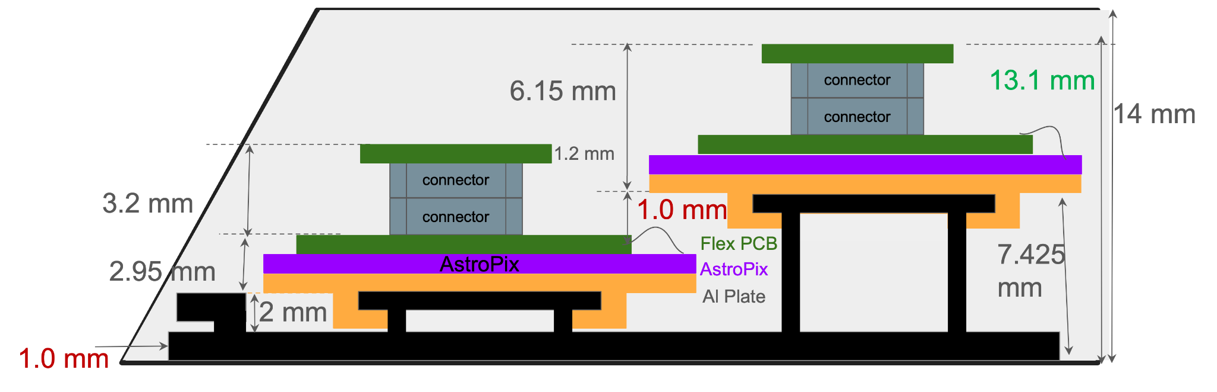
Future Design Changes
Limitations in mechanical envelope
Current design PCB Thickness ~1.7mm
Redesign to 1.2mm
Investigate move to a rigid design with jumper
  Helps with change in impedance with new stackup
Value Engineering for production quantities
Sector cross-section

Slide 13
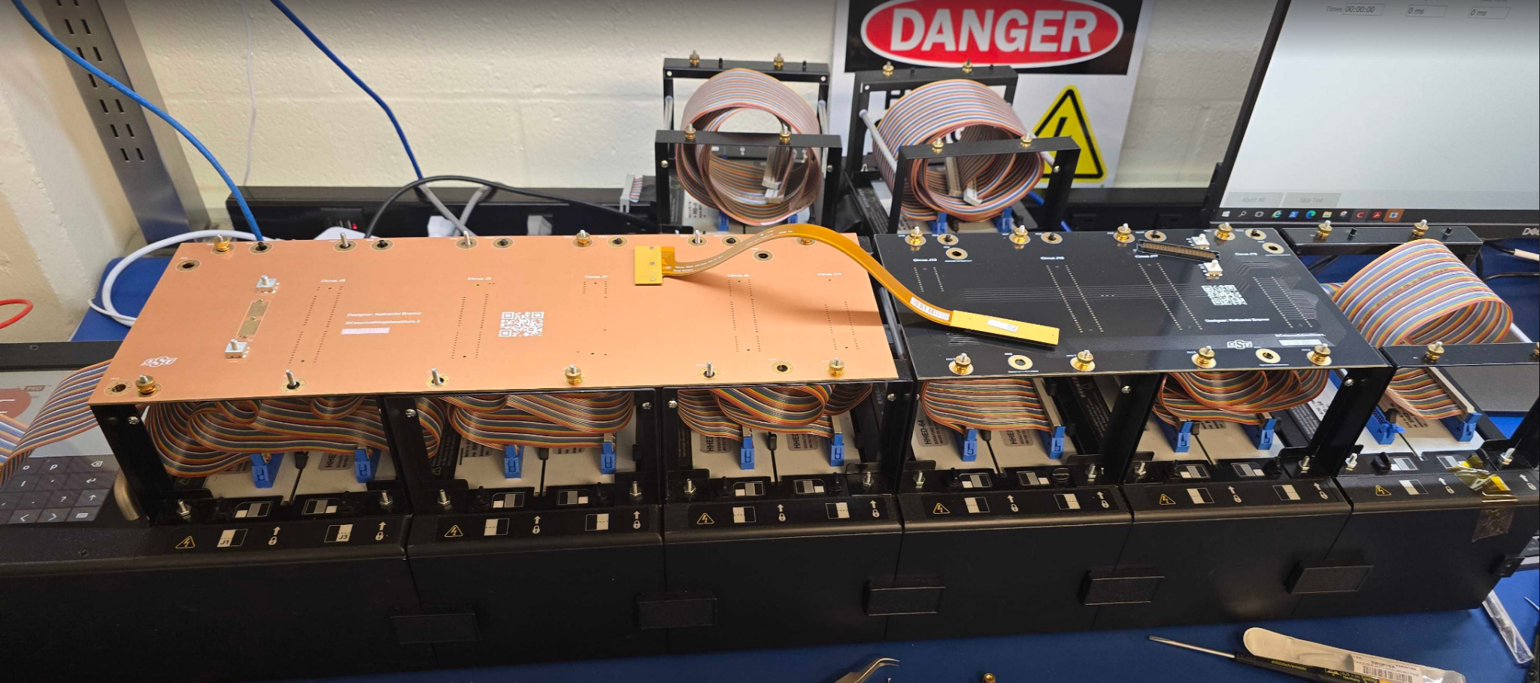
QA/QC Plans
Procedures
The Astrolinx will be fabricated and assembled by a vendor, so testing is vital. We plan to test every PCB in Preproduction.
QA Procedures:
Time Domain Reflectometry - Verifies that all traces are uninterrupted
QC Procedures:
Visual Inspection
Connectivity and High Voltage with Cirris Tester
  Outputs connection table and line resistance
Verify signal loss with Vector Network Analyzer
Reduce testing in Production based on yield from Preproduction due to quantities.
Cirris Tester

Slide 14
Safety - Charge 7
Points of concern:
Chemicals while cleaning the board
High voltage while testing
Soldering
All items have been planned and accounted in our training and testing procedures. No safety concerns after our QC testing.
Safety design considerations:
HV moved away from board edges
HV given clearance from other copper to avoid arcing

Slide 15
Plans for Preproduction/Production
Test Articles
  30 AstroLinx
  OSU testing
  Optimize testing procedures for this board
Preproduction (FY26-FY27)
  450 AstroLinx
  Test all
  Deliver 24 boards/week
Production
  35,000 AstroLinx
  Sample testing

