Slide 1
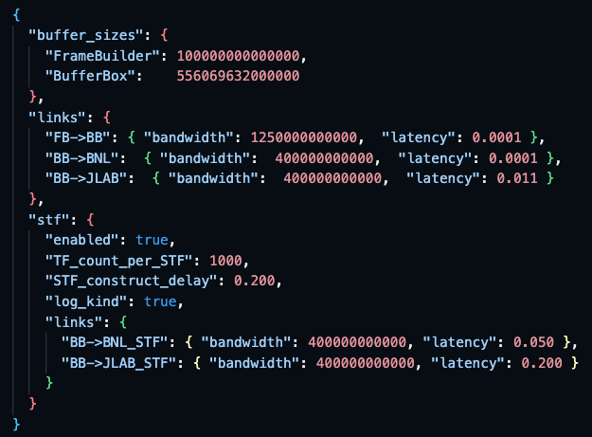
Network configuration
BW: byte/s
Latency: second

Slide 2
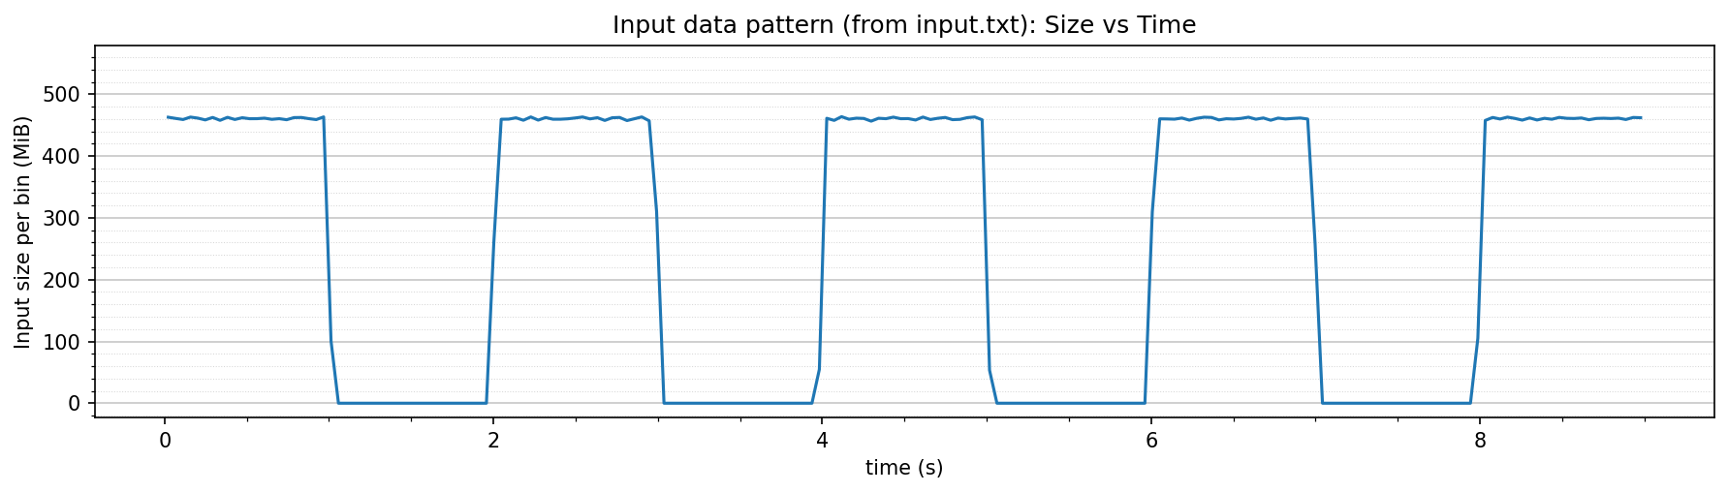
Input data

Slide 3
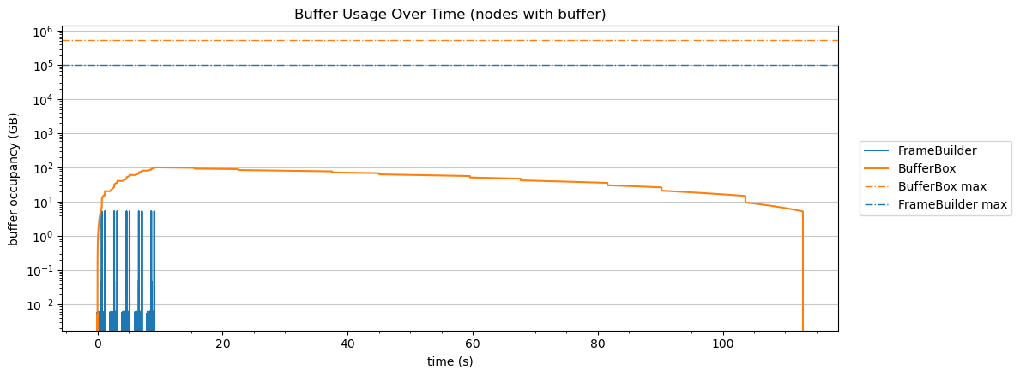
Buffer usage

Slide 4
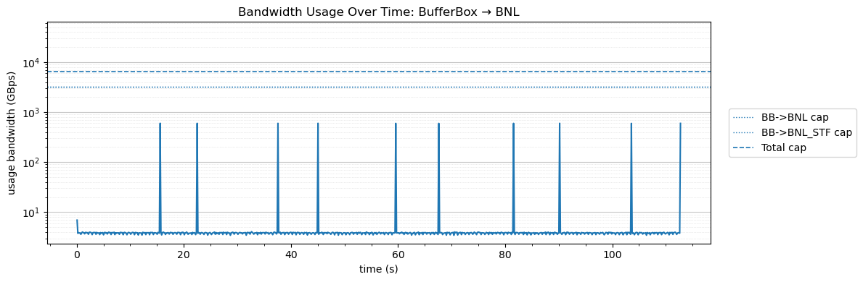
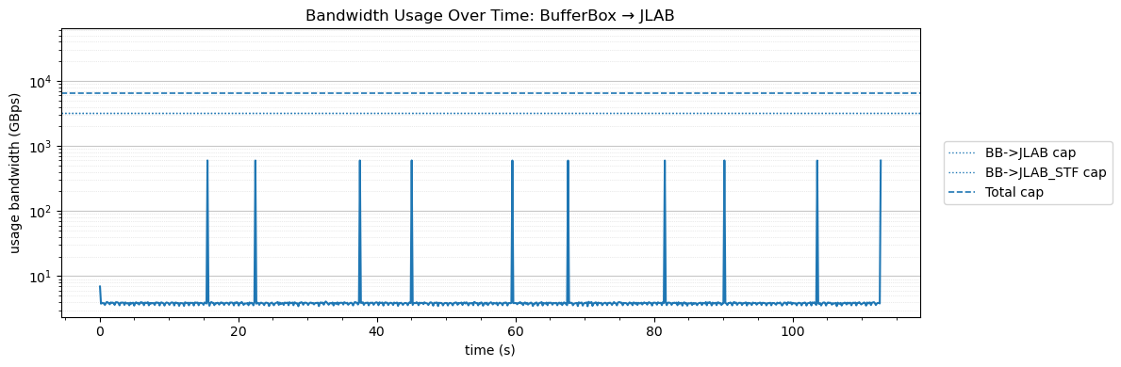
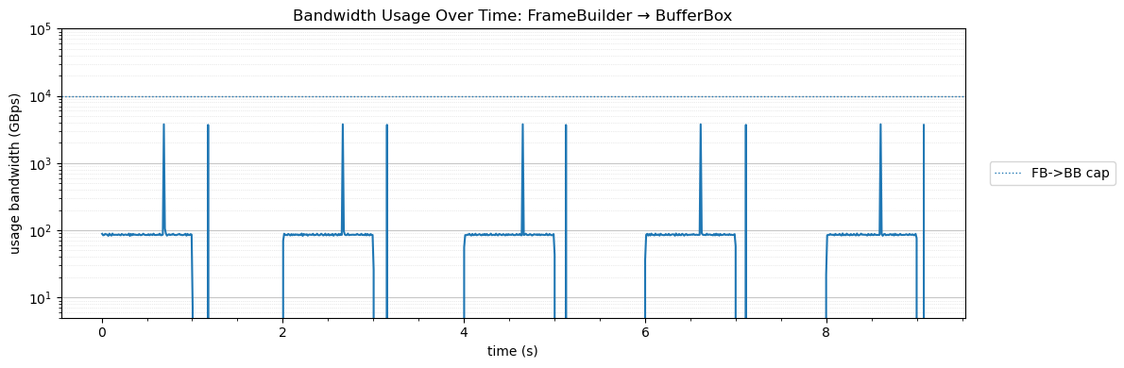
Bandwidth usage

Slide 5
stats
data_type | destination | count | Average e2e latency (sec) | P50 (sec) | P90 (sec) | P99 (sec)
STF | BNL | 10 | 58.78 | 58.79 | 95.94 | 103.00
STF | JLAB | 10 | 58.93 | 58.94 | 96.09 | 103.15
TF | BNL | 10244 | 51.90 | 51.90 | 93.03 | 102.73
TF | JLAB | 10244 | 51.91 | 51.91 | 93.04 | 102.74
STF | ALL | 20 | 58.85 | 58.86 | 96.08 | 103.91
TF | ALL | 20488 | 51.91 | 51.91 | 93.03 | 102.74

Slide 6
Appendix: model
DAM
FBDC
4Tbps total BW, ~ 2KM
(400Gbps x 10, network switch 100/400b)
400 Gbps
<latency>
E1
BNL
E1 buffer size: hold 3 weeks of data
<throughput>
<latency>
DAM
FBDC
Frame
Builder
Buffer Box
TF stream
…
STF stream (Rucio)
buffer size
buffer size
Buffer depth: several days (72 hours, link)
E1
JLAB
Desired transfer time: O(sec)
DAM buffer: 16GB
(link)
400 Gbps
11ms (60 ms back up route)
Echelon 0 data reduction
From O(10TB/s) to O(100GB/s)
Echelon 0 DAQ room
Echelon 0 computing (SDCC enclave)
Echelon 1

