Slide 1
Closeout Summary of E&DAQ PDR3 (60% Design Review)
Jeff Landgraf (for Electronics and DAQ WG)
September 3-4, 2025

Slide 2
Charges
Are the technical performance requirements appropriately defined and complete for this stage of the project?
Are the plans for the various detector electronics and data acquisition systems appropriately documented and complete for this stage of the project?
Are the current plans from front-end electronics to data acquisition for the detector likely to achieve the technical performance requirements, with a low risk for cost increases, schedule delays, and technical problems?
Are the schedule assumptions for the fabrication of the various electronics and data acquisition systems and assembly plans reasonable and consistent with the overall detector schedule?
Have ESH&Q and QA considerations been adequately incorporated into the plans at their present stage?
Have the recommendations from previous reviews been adequately addressed?

Slide 3
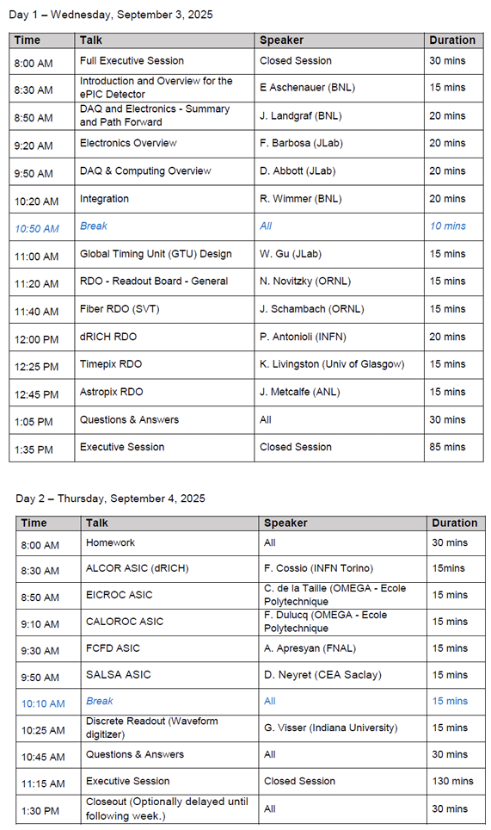
Committee and Agenda
Committee:
  Matt Noy (CERN)
  Mitch Newcomer (UPenn)
  Prashansa Mukim (BNL)
  Filippo Costa (CERN)
Introduction /
Requirements /
Integration
GTU / RDOs /
Readout Chains including ITS3, Timepix, & Astropix
ASICS
Front End Elecrtronics

Slide 4
Readout Chains
Charge 2, 3, 4
Detector System | Sensor | ASIC / Digitization | Digitization Clock | FEB | FEB-RDO Protocol | RDO Type | RDO Location | Notes
Si Tracking --- (ITS3 / LAS): (IB, OB, EE, HE) | ITS3/LAS | Integrated /w sensor | 39.4 MHz (2-8 us time) | Integrated (Schambach) | GBT | Fiber Aggregator GenericRDO | South Platform | J. Schambach Presentation
MPGD tracking: (SAMPA): (IB, OB, EE, HE) | urWELL / uMegas | SALSA | 39.4 MHz | lpGBT / VTRX+ | GBT | 4 → 1 GenericRDO | South Platform | RDO – N. Novitzki Presentation FEB – F. Barbosa Presentation
Calorimeters (CALOROC): BarrelHCAL, Backward HCAL, Barrel ECAL, Backward ECAL, Backward HCAL | SiPM | CALOROC | 39.4 MHz | lpGBT / SFP+ | GBT | 4 → 1 GenericRDO | South Platform | N. Novitzki Presentation
Calorimeters (CALOROC): LFHCAL, HCAL Insert | SiPM | CALOROC | 39.4 MHz | lpGBT / SFP+ | GPT | 4 → 1 GenericRDO | East HCAL Platform | N. Novitzki Presentation
Calorimeters (Discrete): FwdEcal | SiPM | Discrete | 98.5 MHz | FPGA / SFP+ / Cu | Internal | 16 → 1 GenericRDO | South Platform | G. Visser Presentation Planned RDO similar to existing designs
Far Forward (AC-LGAD / EICROC): B0 tracking, Roman Pots, Off Momentum | AC-LGAD | EICROC | 39.4 MHz | lpGBT / VTRX+ | GBT | Direct to FELIX | N/A | Same as per Endcap TOF
Far Backward: (AC-LGAD / FCFD): Lumi photon spectrometer tracker | AC-LGAD | FCFD | 39.4 MHz | lpGBT / VTRX+ | GBT | Direct to FELIX | N/A | Same as per Barrel TOF
Central Detector (AC-LGAD / EICROC): Endcap TOF | AC-LGAD | EICROC | 39.4 MHz | lpGBT / VTRX+ | GBT | Direct to FELIX | N/A | F. Barbosa Presentation
Central Detector (FCFD): Barrel TOF, pfRICH, DIRC | HRPPD / MCPMT | FCFD | 39.4 MHz | lpGBT / VTRX+ | GBT | Direct to FELIX | N/A | F. Barbosa Presentation
Far Forward/Backward (CALOROC / Discrete): B0 Crystal Calorimeter, ZDC Crystal Calorimeter, ZDC HCAL, Lumi Photon Spectrometer Calorimeter | SiPM | Discrete | 39.4 MHz (or) 98.5 MHz | FPGA / SFP+ / Cu (or) lpGBT / SFP+ | Internal GBT | 16 → gRDO (or) 4 → 1 gRDO | East/West Tunnel Near Detectors | Small channel count detectors Expect to copy either CALOROC or Discrete
Far Backward: (Discrete): Direct Photon Lumi Calorimeter* | SiPM | Flash-250 | 197 MHz | FADC 250 | Streaming ADCs | (N/A) | West Tunnel | Special FELIX processing to histogram / Sum bunch by bunch luminosity data
Far Backward: (TimePix): Low Q Tagger | TimePix | Integrated / w sensor | 98.5 MHz | Integrated / w sensor | Internal | SPIDR4 Variant (NIKEF) | West Tunnel Under Detector | K. Livingston Presentation Planned RDO similar to existing designs
Imaging Calorimeter (Astropix): | AstroPix | Integrated / w sensor | 98.5 MHz | Integrated / w Sensor | Astropix Internal | End of Stave Card (NASA) | On Detector | J. Metcalfe Presentation Planned RDO similar to existing designs
Central Detector (ALCOR): dRICH | SiPM | ALCOR | 39.4 MHz | FPGA / Cu | Internal | FPGA / VTRX+ | On Detector in PDU | Pietro Antonioli Presentation
Electronics design pending
Planned variants of GenericRDO
Scope of outside Electronics/DAQ

Slide 5
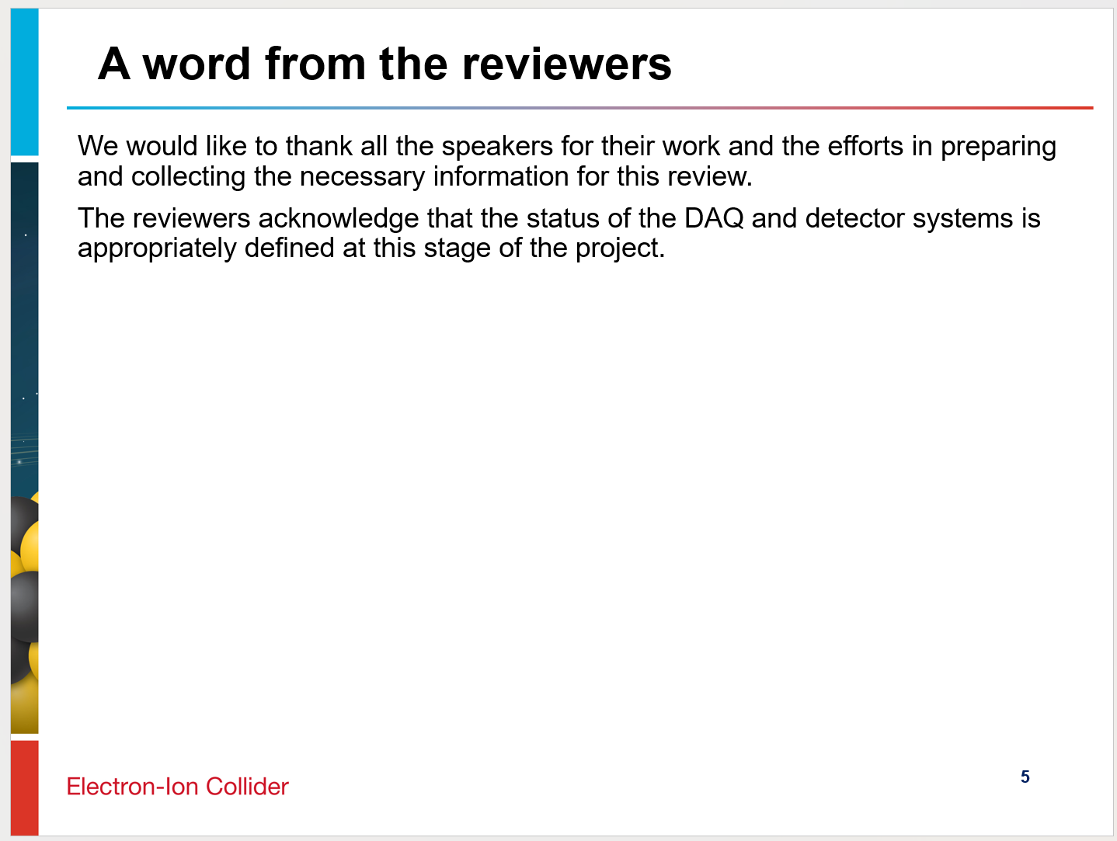
Overall Summary

Slide 6
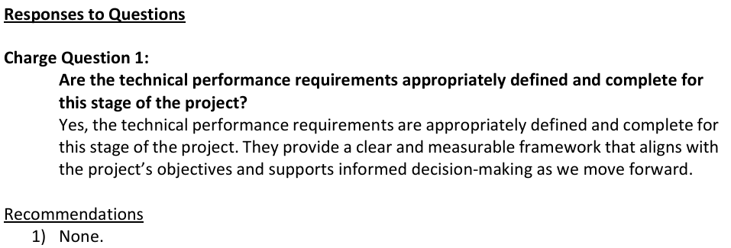
Charge Question 1.

Slide 7
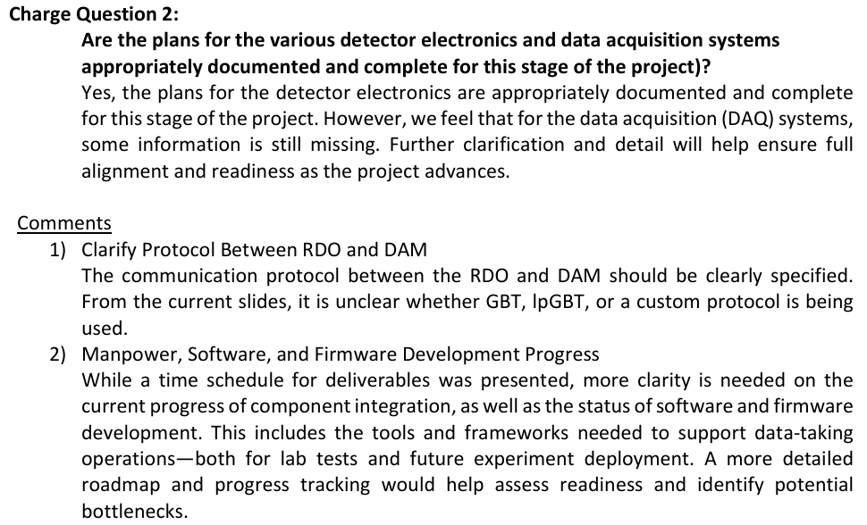
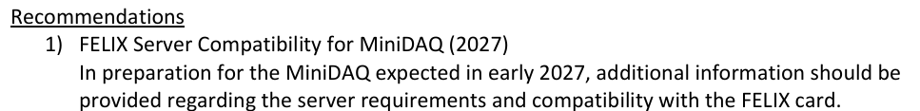
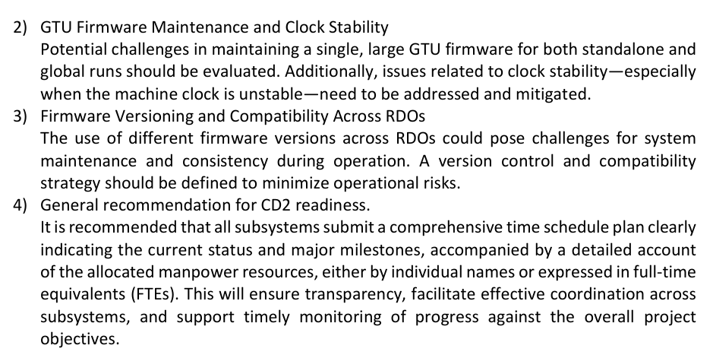
Charge Question 2

Slide 8
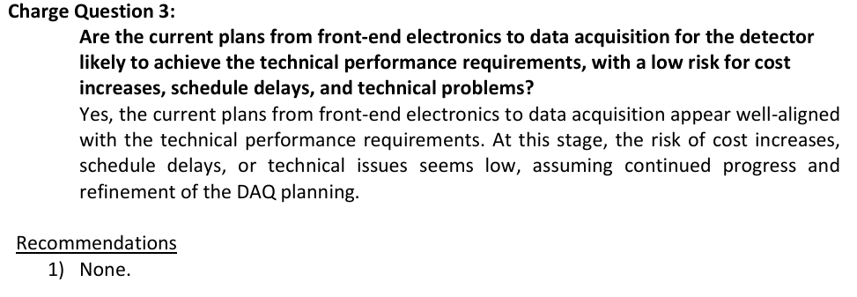
Charge Question 3

Slide 9
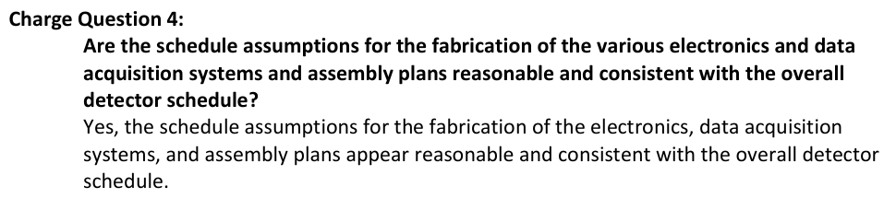
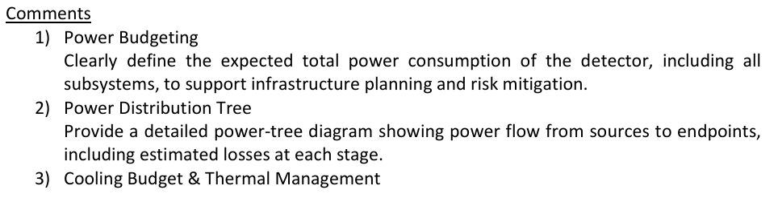
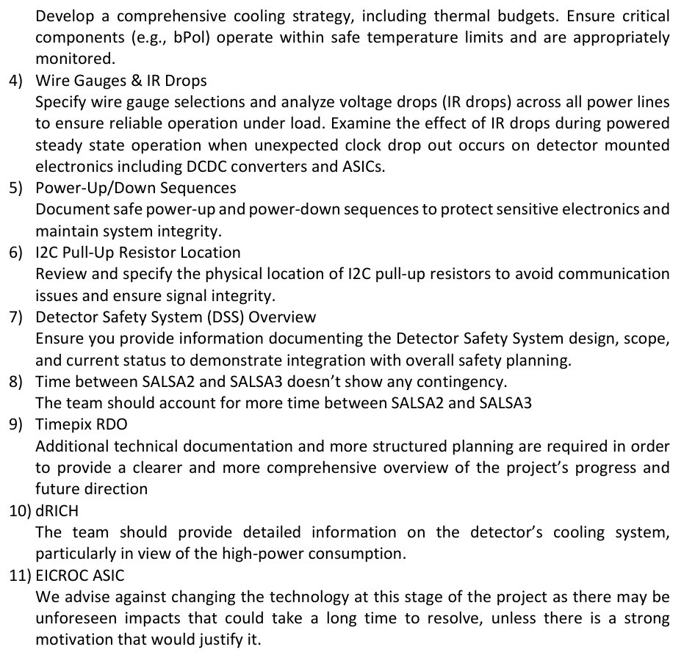
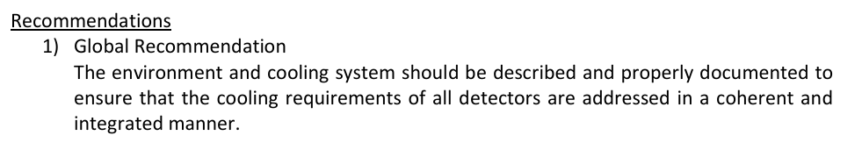
Charge Question 4

Slide 10
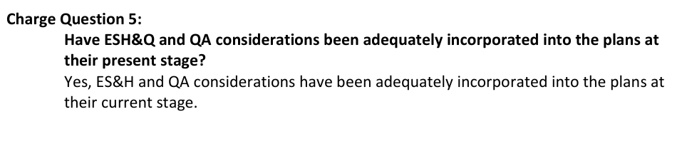

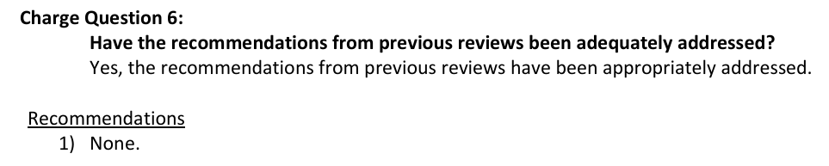
Charge Question 5 & 6

