Slide 1
Electronics & DAQ WG
Fernando Barbosa (JLab)
11 September 2025

Slide 2
Welcome & News
Today’s Topics:
Summary of the E&DAQ IPDR3 Review - Jeff
Further notes on VTRX+ and Power Diagrams from IPDR3 - Fernando
RDO form factor (continuation from 14 August 2025 E&DAQ WG meeting) - William
AOB
Upcoming meetings:
25 September 2025 – E&DAQ WG: DC-DC converters
Recent measurements on bPOL48
Review of quantities needed – bPOL48 controller ASICs and modules
29 September 2025 – TIC: concurrence on the 32/36 ch CALOROC choice

Slide 3
Further notes on Power Diagrams from IPDR3
Comments from reviewers related to power:
1) Power Budgeting - Clearly define the expected total power consumption of the detector, including all subsystems, to support infrastructure planning and risk mitigation.
2) Power Distribution Tree - Provide a detailed power-tree diagram showing power flow from sources to endpoints, including estimated losses at each stage.
4) Wire Gauges & IR Drops - Specify wire gauge selections and analyze voltage drops (IR drops) across all power lines to ensure reliable operation under load. Examine the effect of IR drops during powered steady state operation when unexpected clock drop out occurs on detector mounted electronics including DCDC converters and ASICs.
5) Power-Up/Down Sequences - Document safe power-up and power-down sequences to protect sensitive electronics and maintain system integrity.
Develop power distribution system diagrams from main supply to point-of-use, with wire gauges, fusing, IR drops, power budgeting – per sub-system/sub-detector.
Refine cooling requirements for input to infrastructure and integration.
Develop document on power sequencing and behavior analysis from possible failure modes.

Slide 4
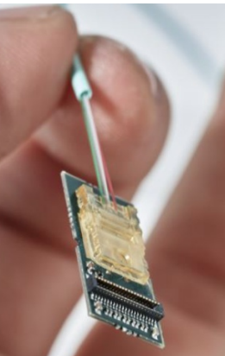
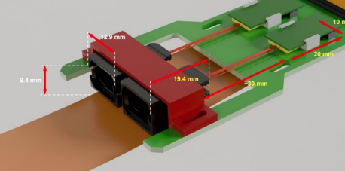
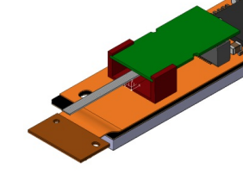
Further notes on VTRX+
From discussions with Filippo Costa (CERN ITS3):
Documented experience from ITS3 group (file uploaded with permission from Filippo)
VTRX+ is very, very fragile (as we have heard previously)
Sheath – bundles and protects 5 fibers: free to slide
Sliding may damage fibers at PCB
Apply glue before use, as shown
Keep fibers on plane with PCB and secured
Parts being prototyped at CERN
Requested samples
Available soon

Slide 5
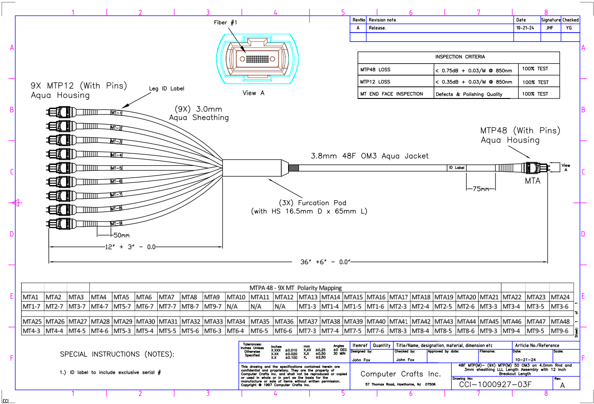
Further notes on VTRX+ and Aggregation
Custom fiber bundles – routed and secured inside detector
At detector patch disconnect (multiple)
To RDOs/DAQ
From
9 VTRX+ (45 Fibers)

