Slide 1
pfRICH Laser Calibration
Light Paths
Bob Azmoun, Dan Cacace, Bill Li

Slide 2
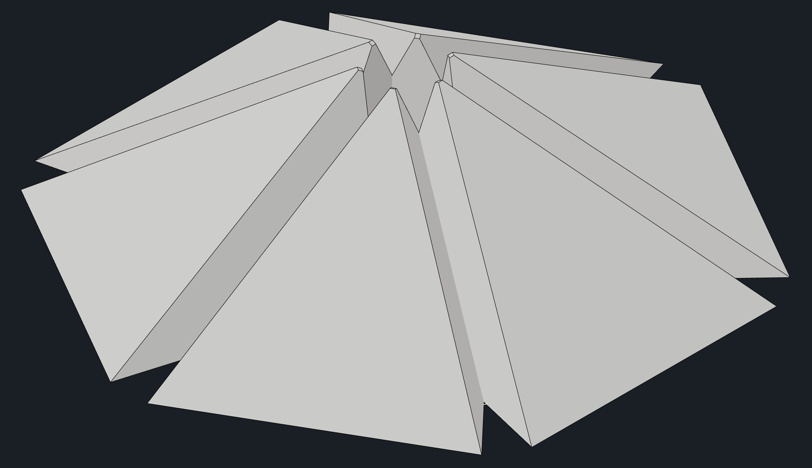
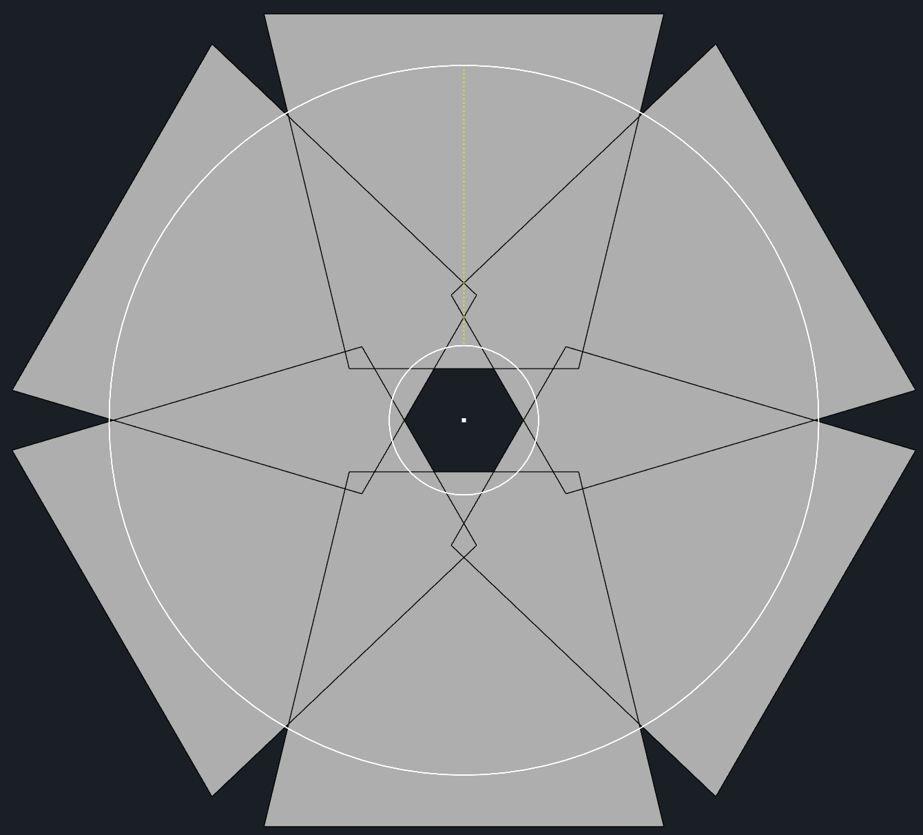
“Direct” Light Path
Measure HRPPD pixel single photon response
  Pulse height
  Timing
Goal is to avoid any reflections and maximize pixel coverage
50deg diffuser, not masked
  Need to mask to minimize reflections
  Covers all HRPPDs
6 Fibers, minimized footprint
  Direction of light expansion is in direction of sensor plane expansion

Slide 3
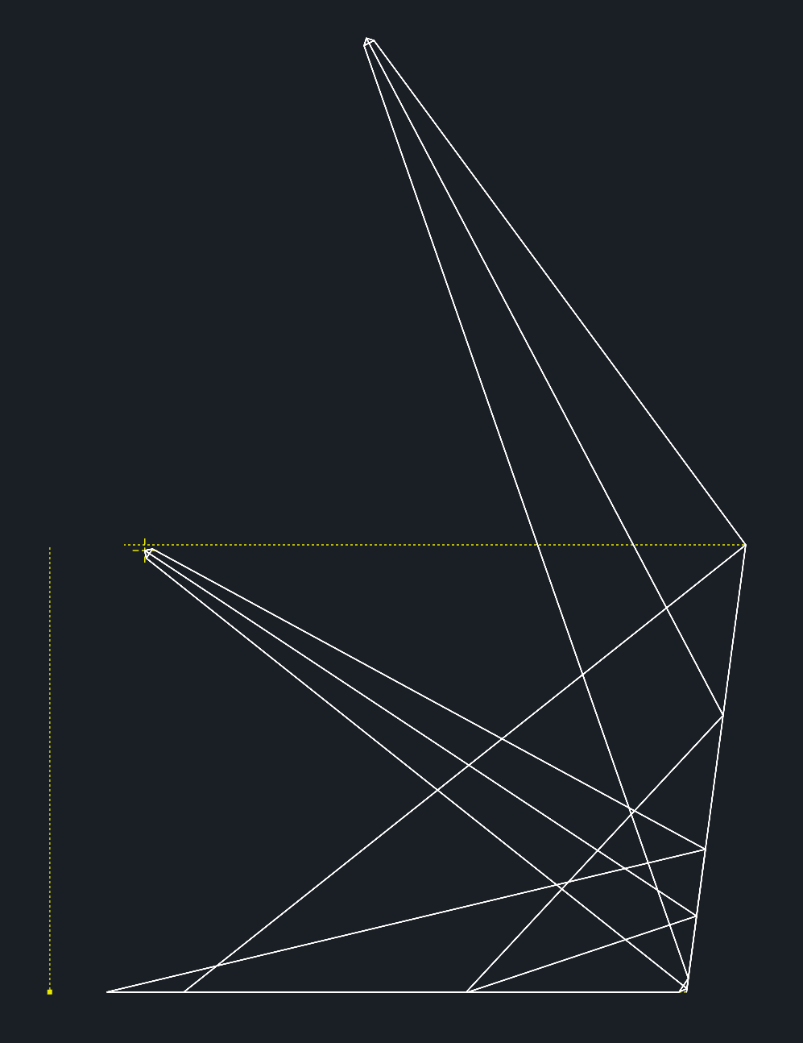
“Indirect/Reflected” Light Path
Measure mirror reflectivity
  Relative WRT history and different mirror regions
  Goal is to measure single photons after a single mirror reflection
  6 fibers (in addition to 6 “direct” fibers)
Where are the optimal fiber positions?
The optimal fiber position is well outside the pfRICH volume.
  A more optimal position within the pfRICH would likely be near the center of the aerogel, which is unacceptable.
  Two options would be to have a fiber in the “corner” near the inner mirror or near the outer mirror.
At the inner mirror, the nominal fiber position is only able to hit the lower third of the exterior mirror.
  Is this acceptable? → what mirror area is a good representative sample?
  Can we do better?
Optimal Fiber
Position is Outside Vol.
Nominal Fiber
Position @ Inner Corner
Aerogel
Central
Axis
Exterior
Mirror
Sensor plane

Slide 4
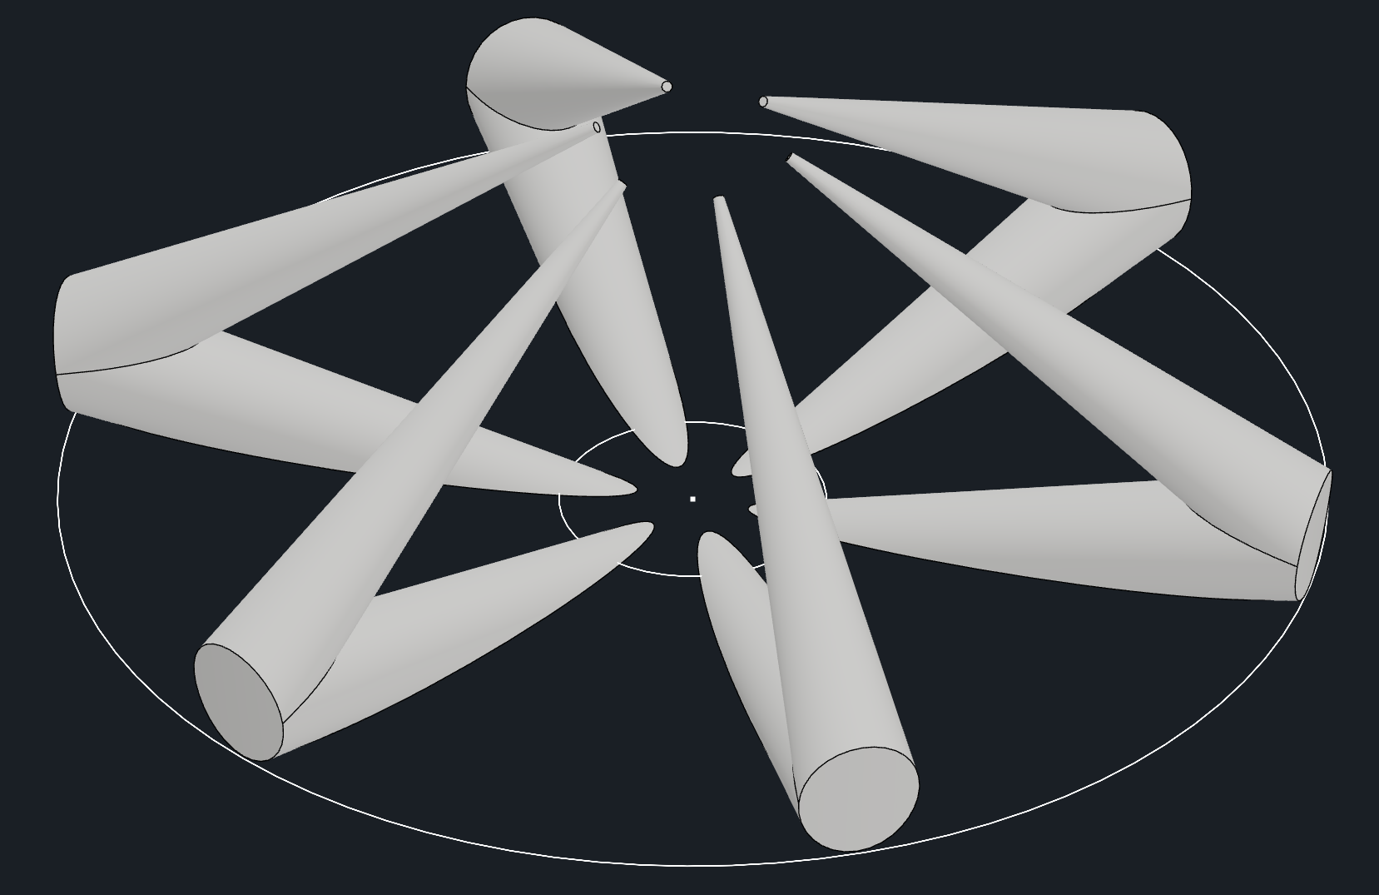
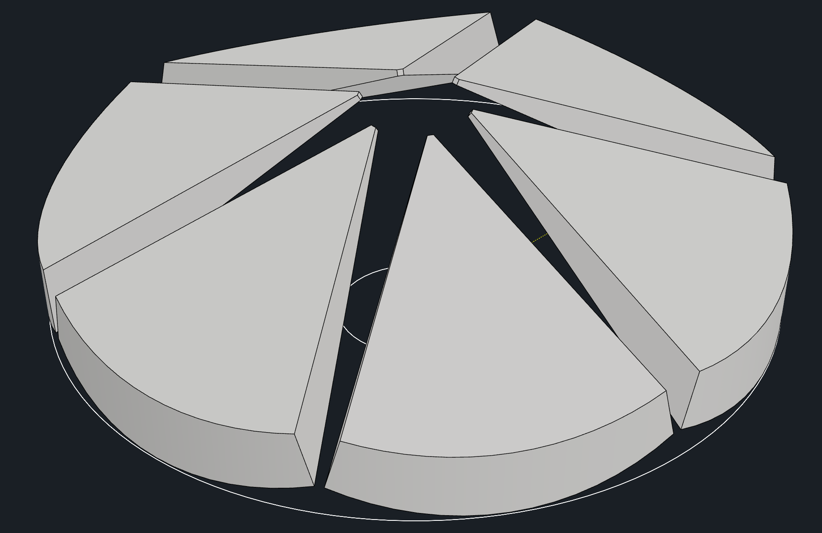
Fibers placed at Inner “corner”
10 deg total NA (approximated reflection)
50deg diffuser, masked (no reflection)
Mechanical drawing estimates reflected light profile on sense plane
Reflected light profile is not shown, but it is clear there will be a focusing effect due to outer mirror curvature (will study in TracePro)

Slide 5
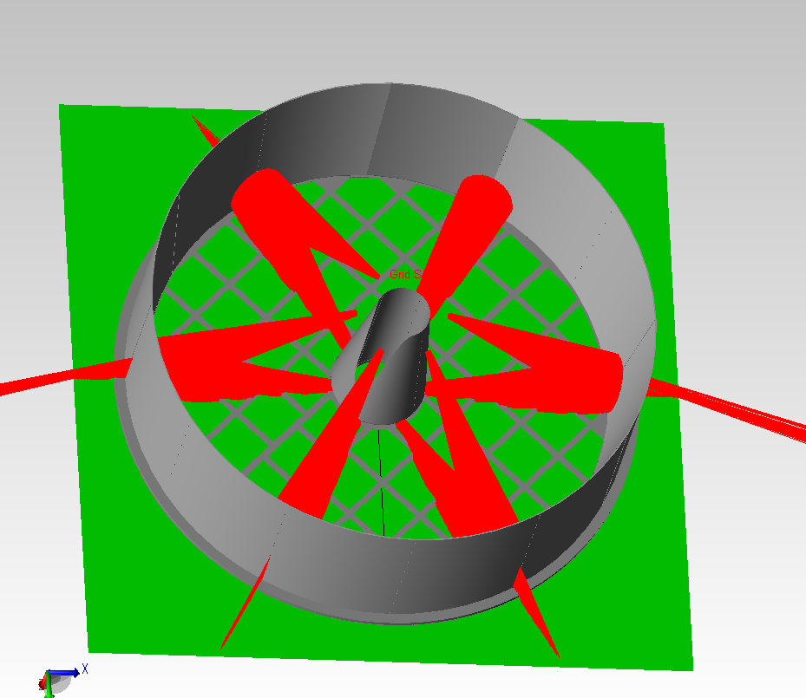
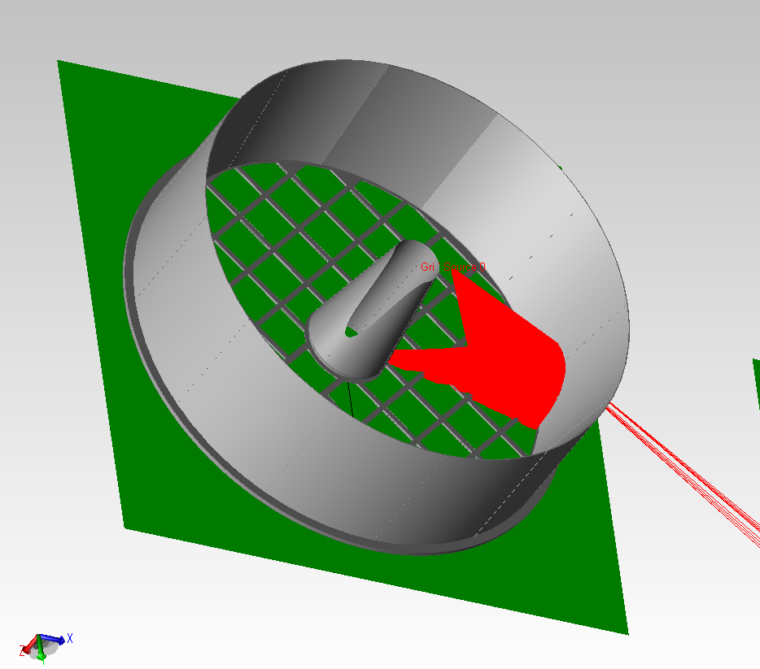
Inner “corner” (verification using TracePro)
12.7 deg total NA
25.4 deg total NA
Fiber tilt angle set to generate >95% single reflections → only a small portion of the outer mirror is sampled
By increasing the div. angle, more of the mirror can be sampled (use diffuser with mask as in prev. slide)

Slide 6
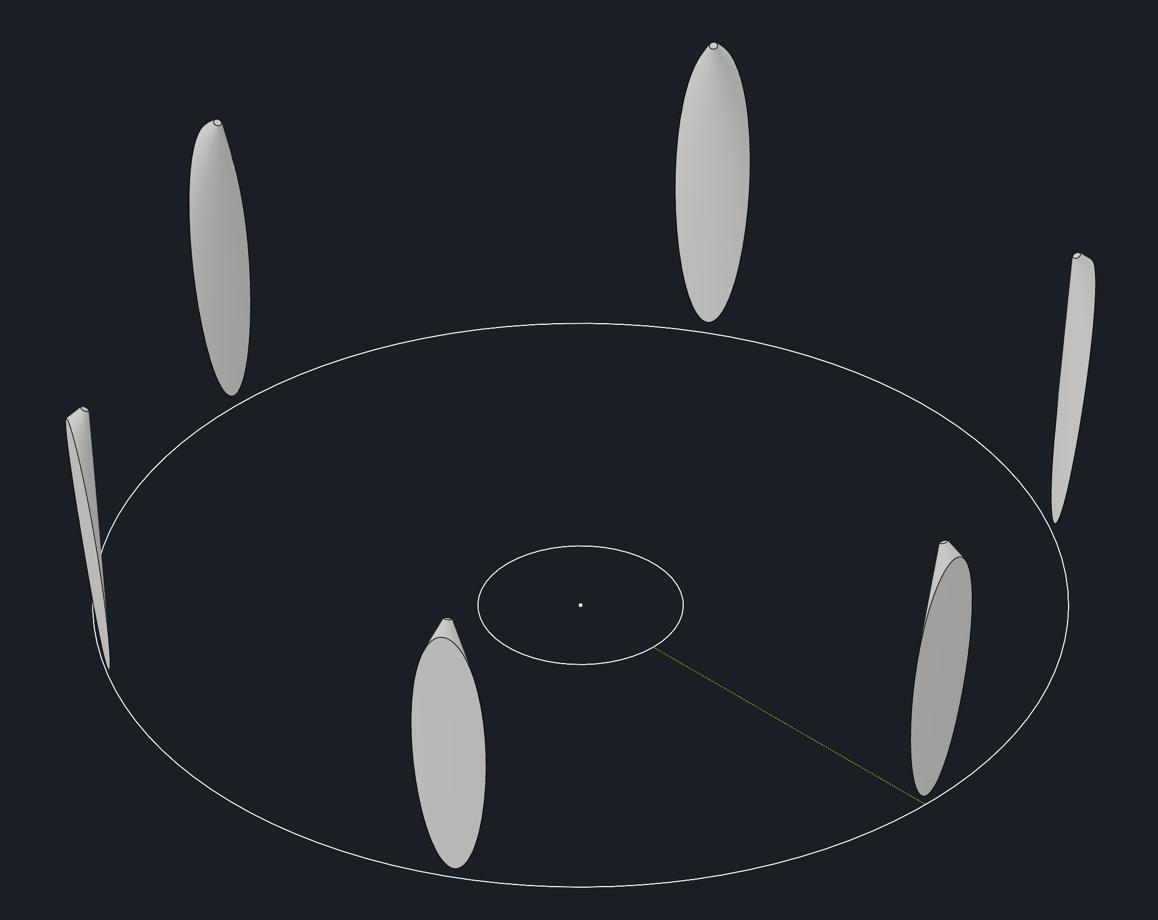
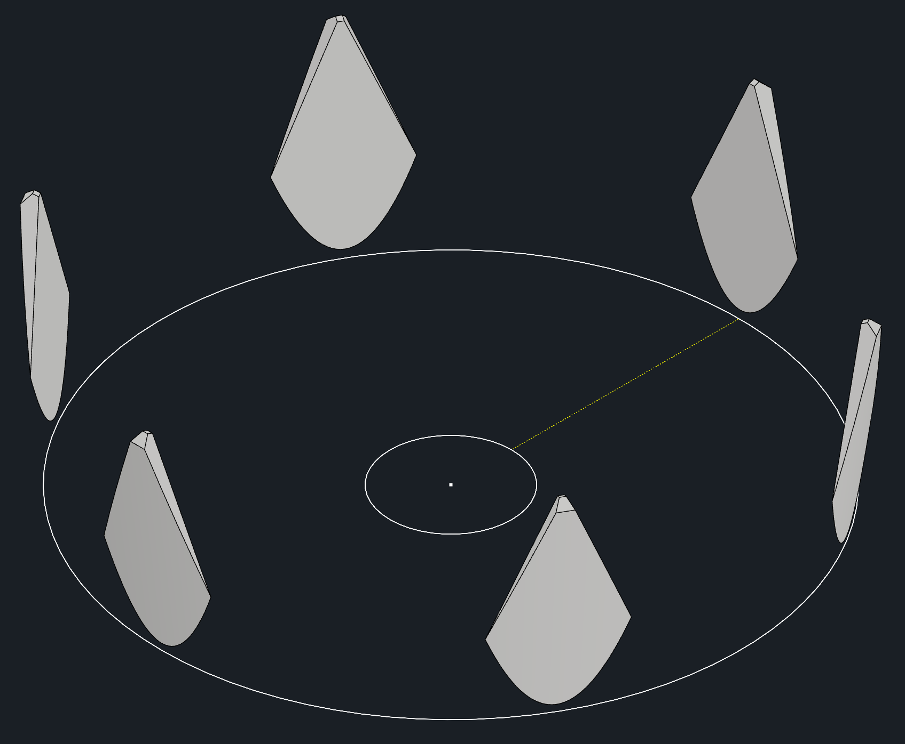
Fibers Placed at Outer “corner”
10 deg total NA (no reflection)
50deg diffuser (no reflection)
Though coverage of the mirrors is large, only a small number of HRPPD pixels are illuminated
The mirror coverage can also be increased with a broader div. angle
Since the quality of the measurement would be significantly improved with broader HRPPD coverage, (eg, improved averaging out of responsivity/gain fluctuations) we elect to place the fibers at the “inner corner”
The mirror %-coverage will be measured and optimized using TracePro
In this geometry only a portion of the outer mirror will be sampled and will also represent the inner mirror reflectivity

Slide 7
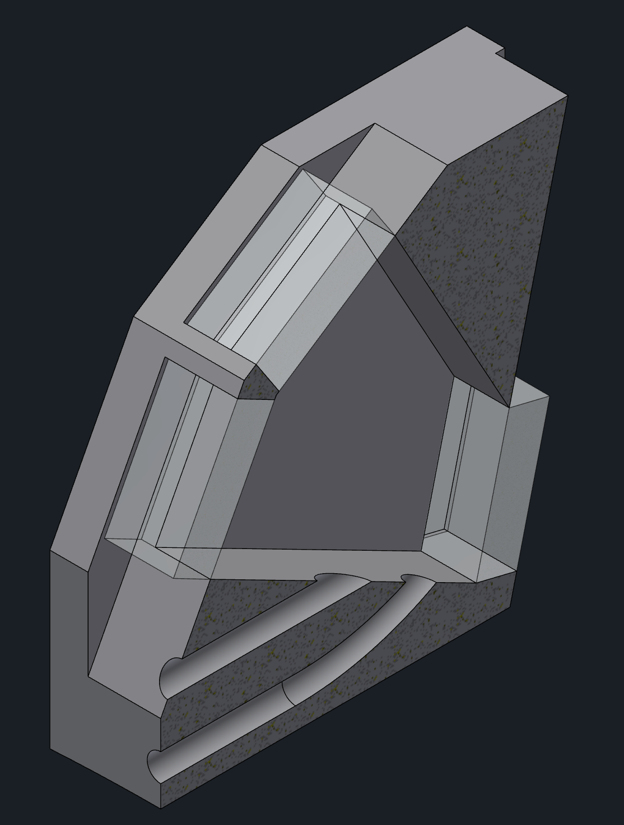
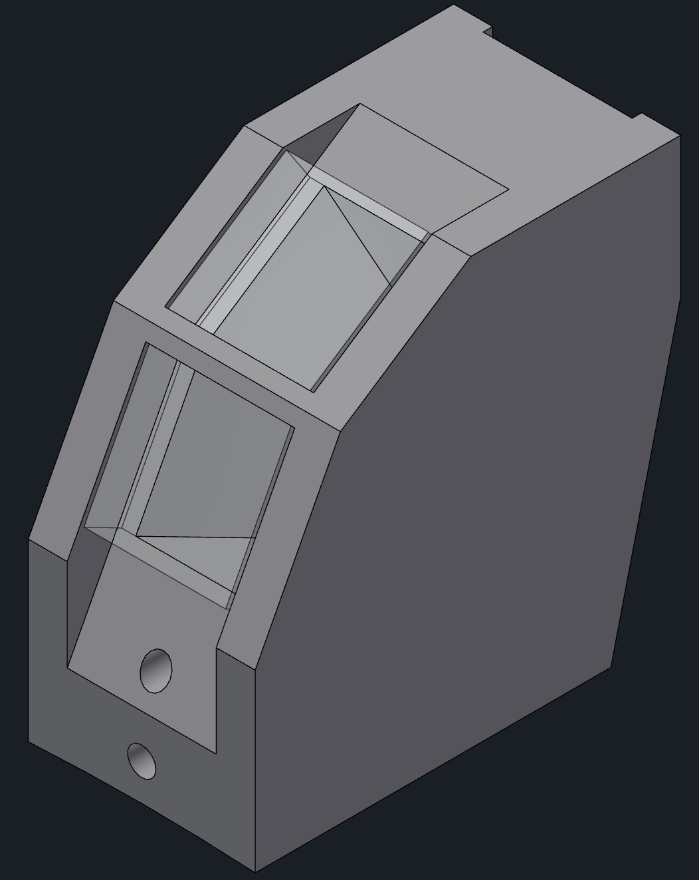
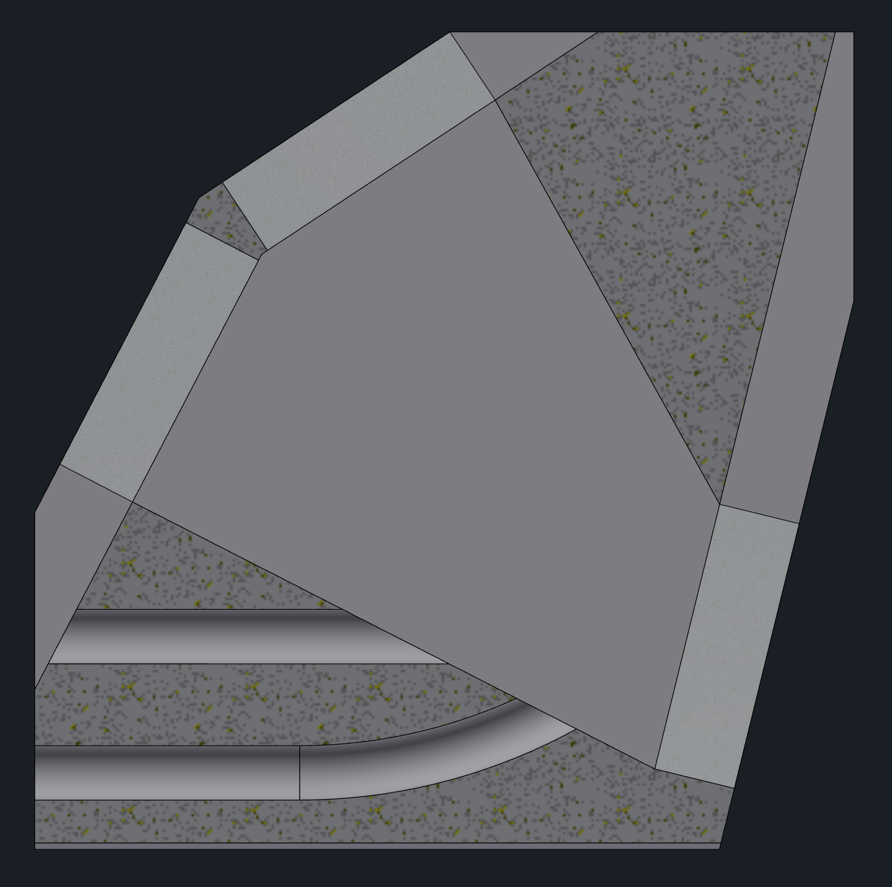
Diffuser and Fiber Holder
Single Holder for 1“direct” and 1 “indirect” fiber
6 Holders needed for 12 fibers (3D printed)→ fewer mounting points
Apply Masks, as needed
8 mm
Reflected
Diffuser
Direct
Diffuser
15 mm
15 mm
Direct Fiber
Reflected Fiber
Mirror
  Minimal footprint → minimal signal shadowing (should be tested in simulation)
  Half the number of mirrors; no severe fiber bending needed (less light loss, mechanical strain)
  Design can be further optimized

