Slide 1
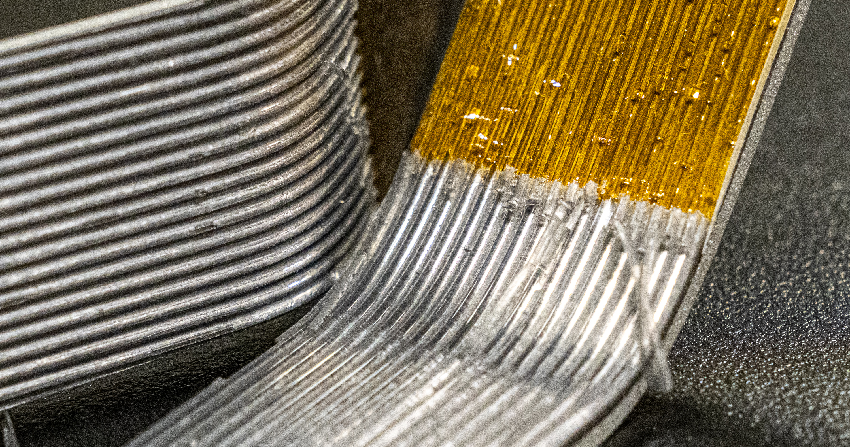
BIC SECTOR DEVELOPMENT Update
September 12, 2025
Kevin G. Bailey & Tom O’Connor

Slide 2
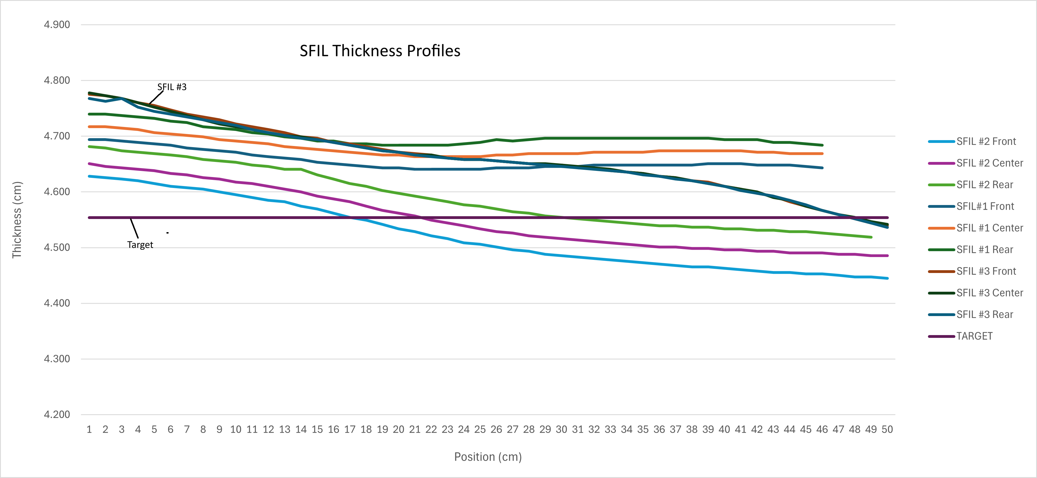
Test SFIL #3 w/ GlueX fiber
Slice for comparator created
Small section for density created
Density 4.76g/cc (314g, 66cc
Profile slope L-R

Slide 3
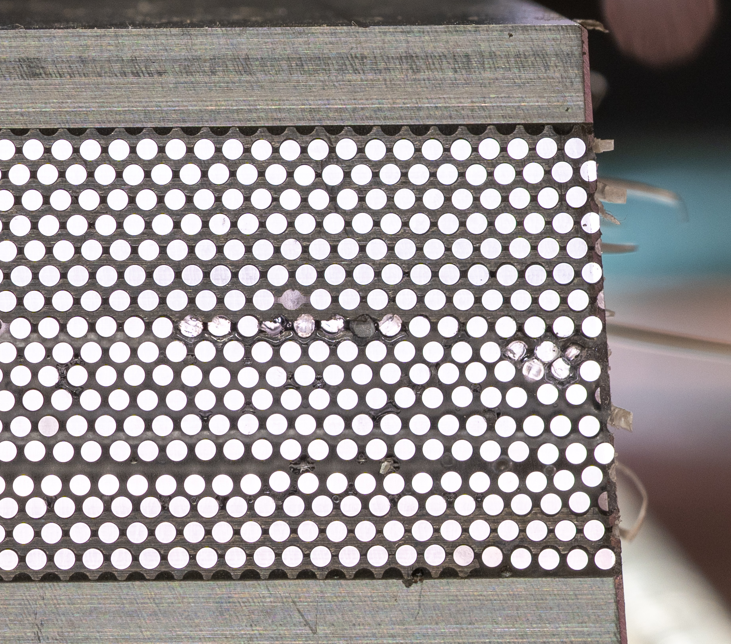
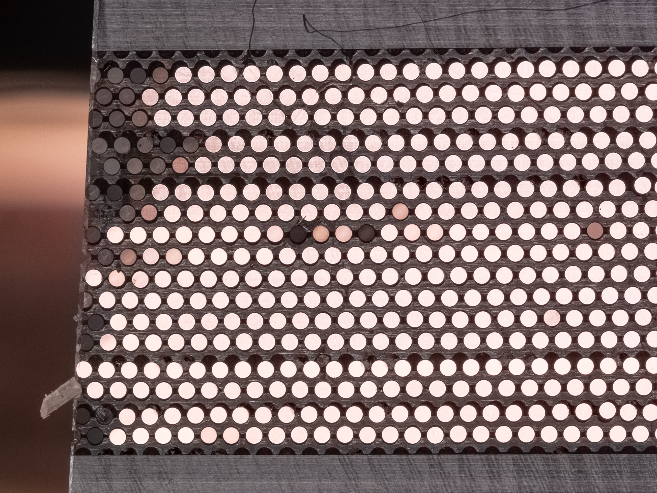
comparing ends
Left Side = 2mm Higher
Right Side = Start

Slide 4
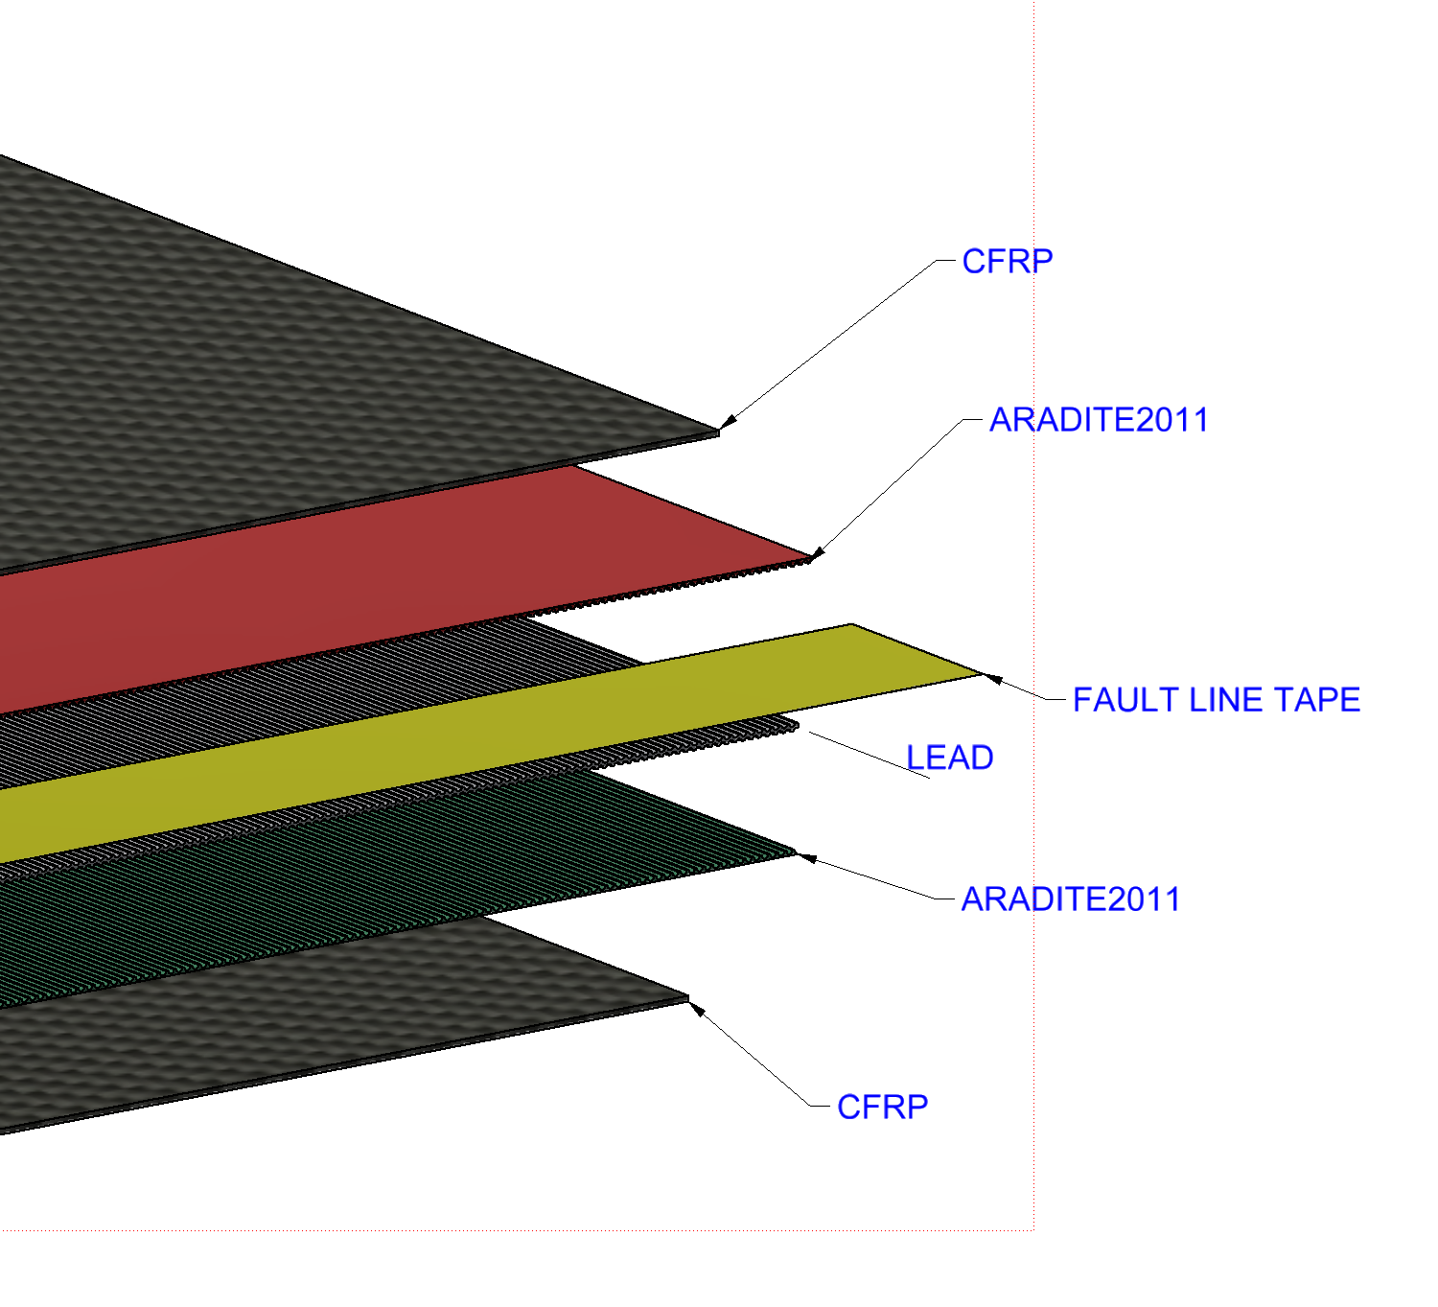
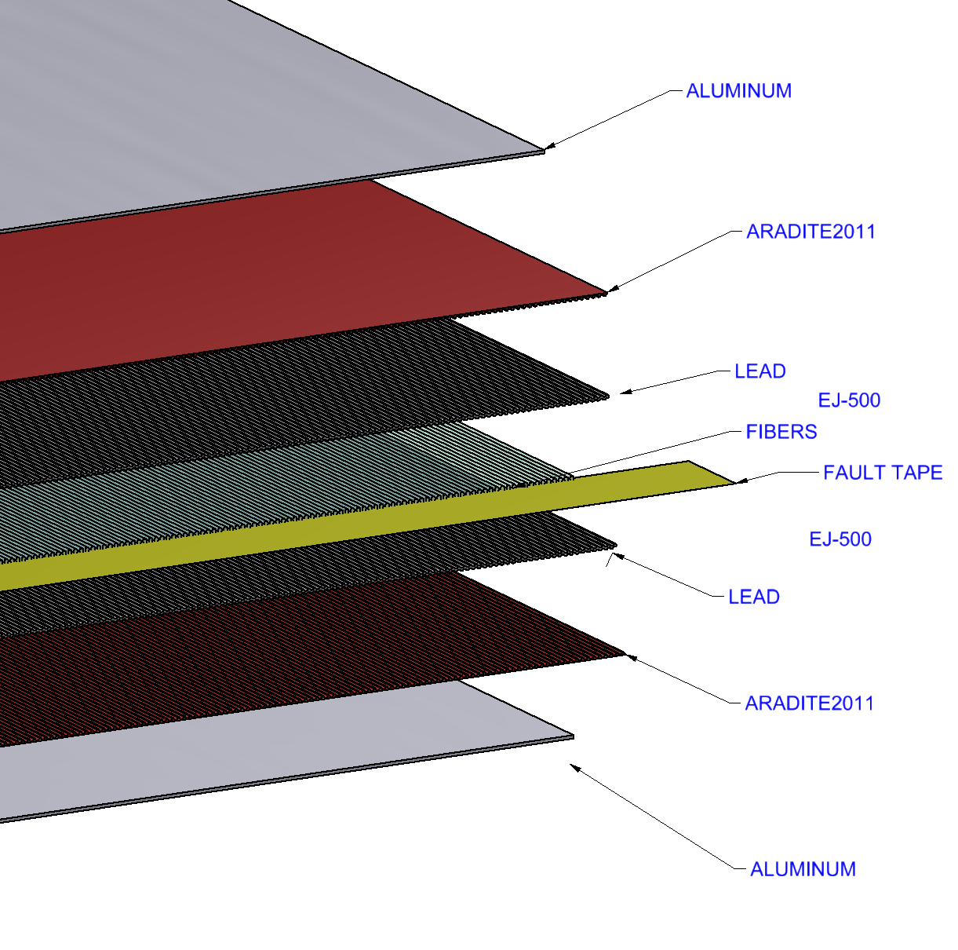
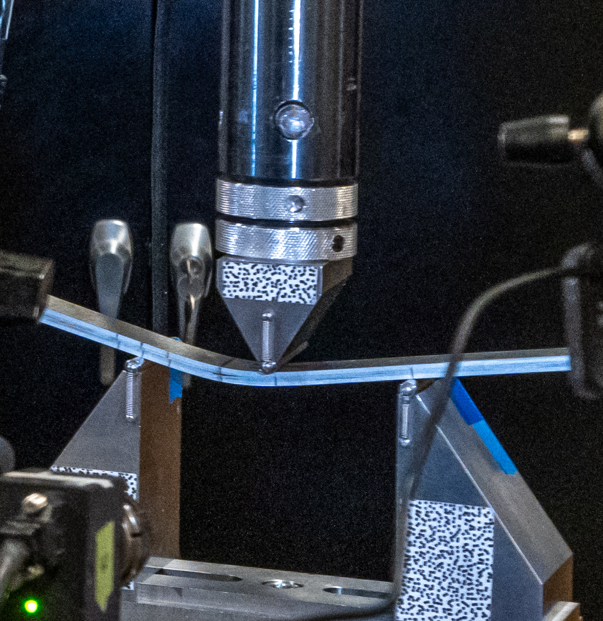
Destructive Test@ CMSC
Two cases
Mode 1
Interlaminar Fracture Toughness DCB
(Double Cantilevered Beam)
- normal to plane of crack
Testing started 9/5/2025
Awaiting results

Slide 5
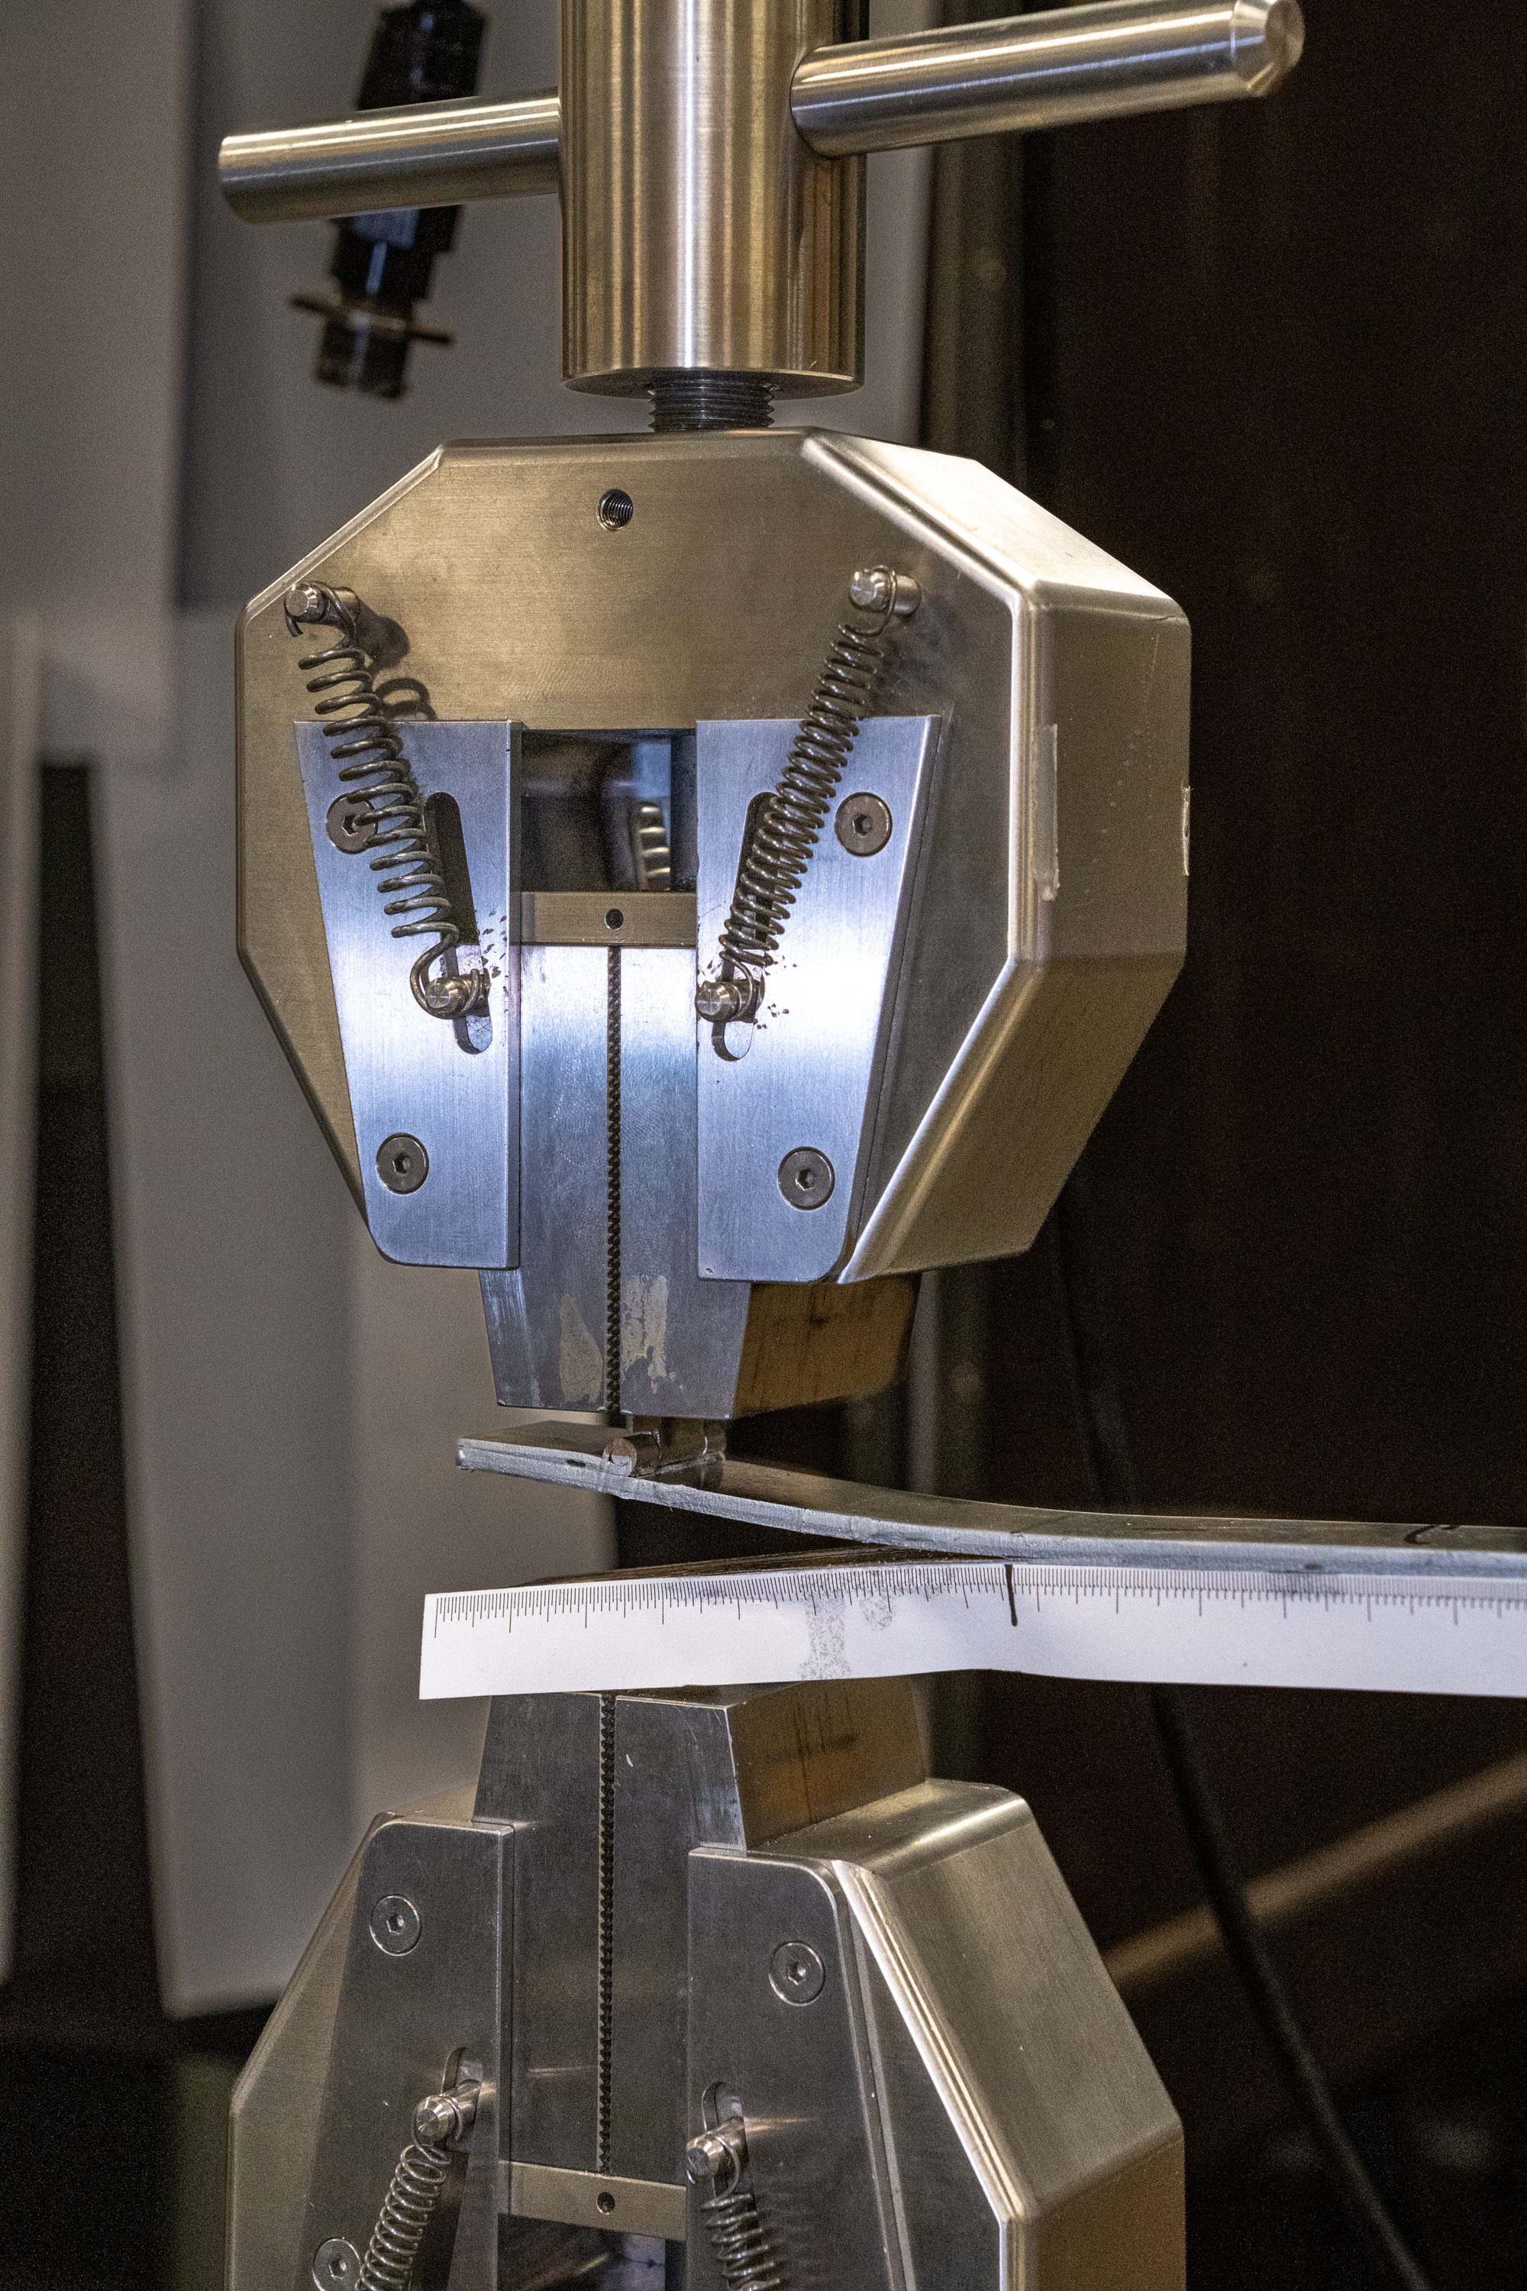
Destructive tests
Mode 2
Interlaminar Fracture Toughness ENF
(End Notched Flexure)
- Parallel to crack plane – shear

Slide 6
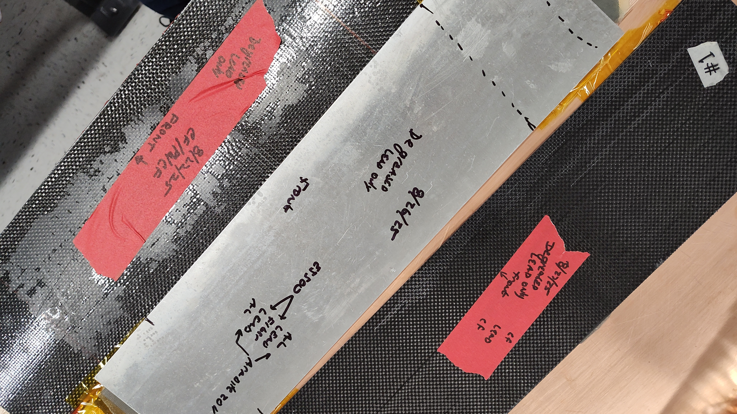
Degreased only samples to be tested

Slide 7
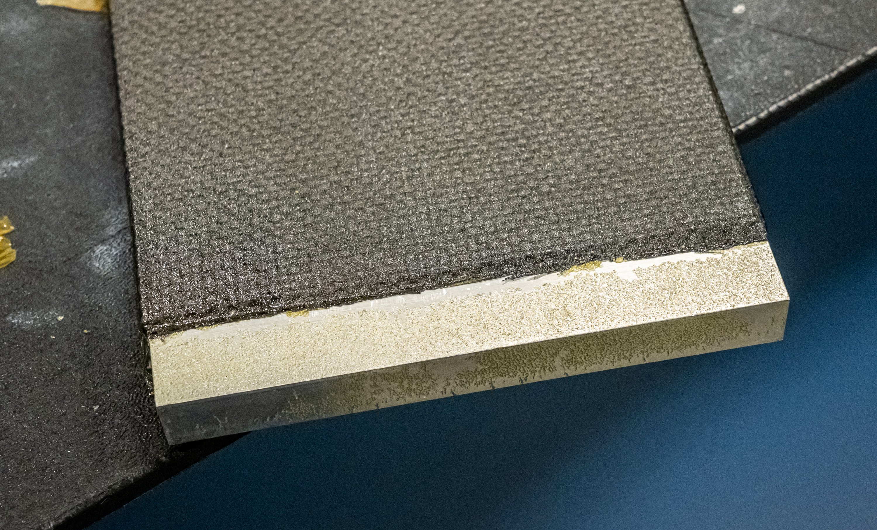
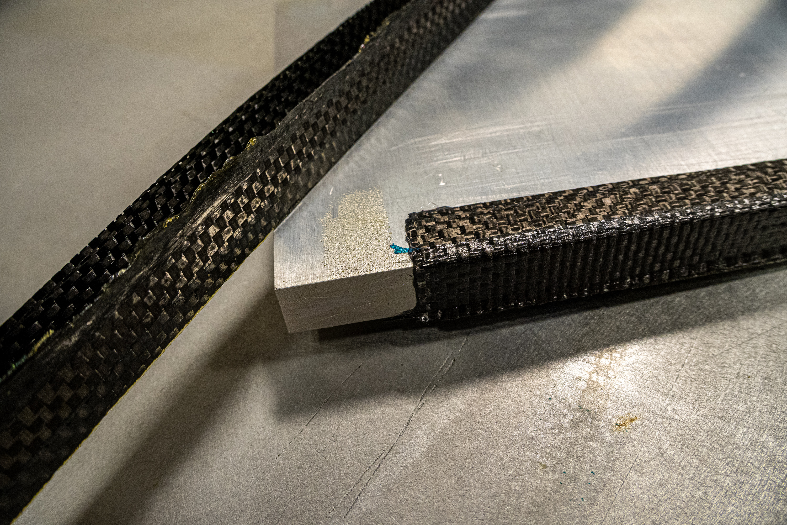
DRAWER MOLD ARRIVES FIRST LAYUPS JUST FINISHED
ONE PIECE TRIAL
PROVES STUBORN TO REMOVE
SIDE C SHAPED FOR FOUR PIECE DRAWER

Slide 8
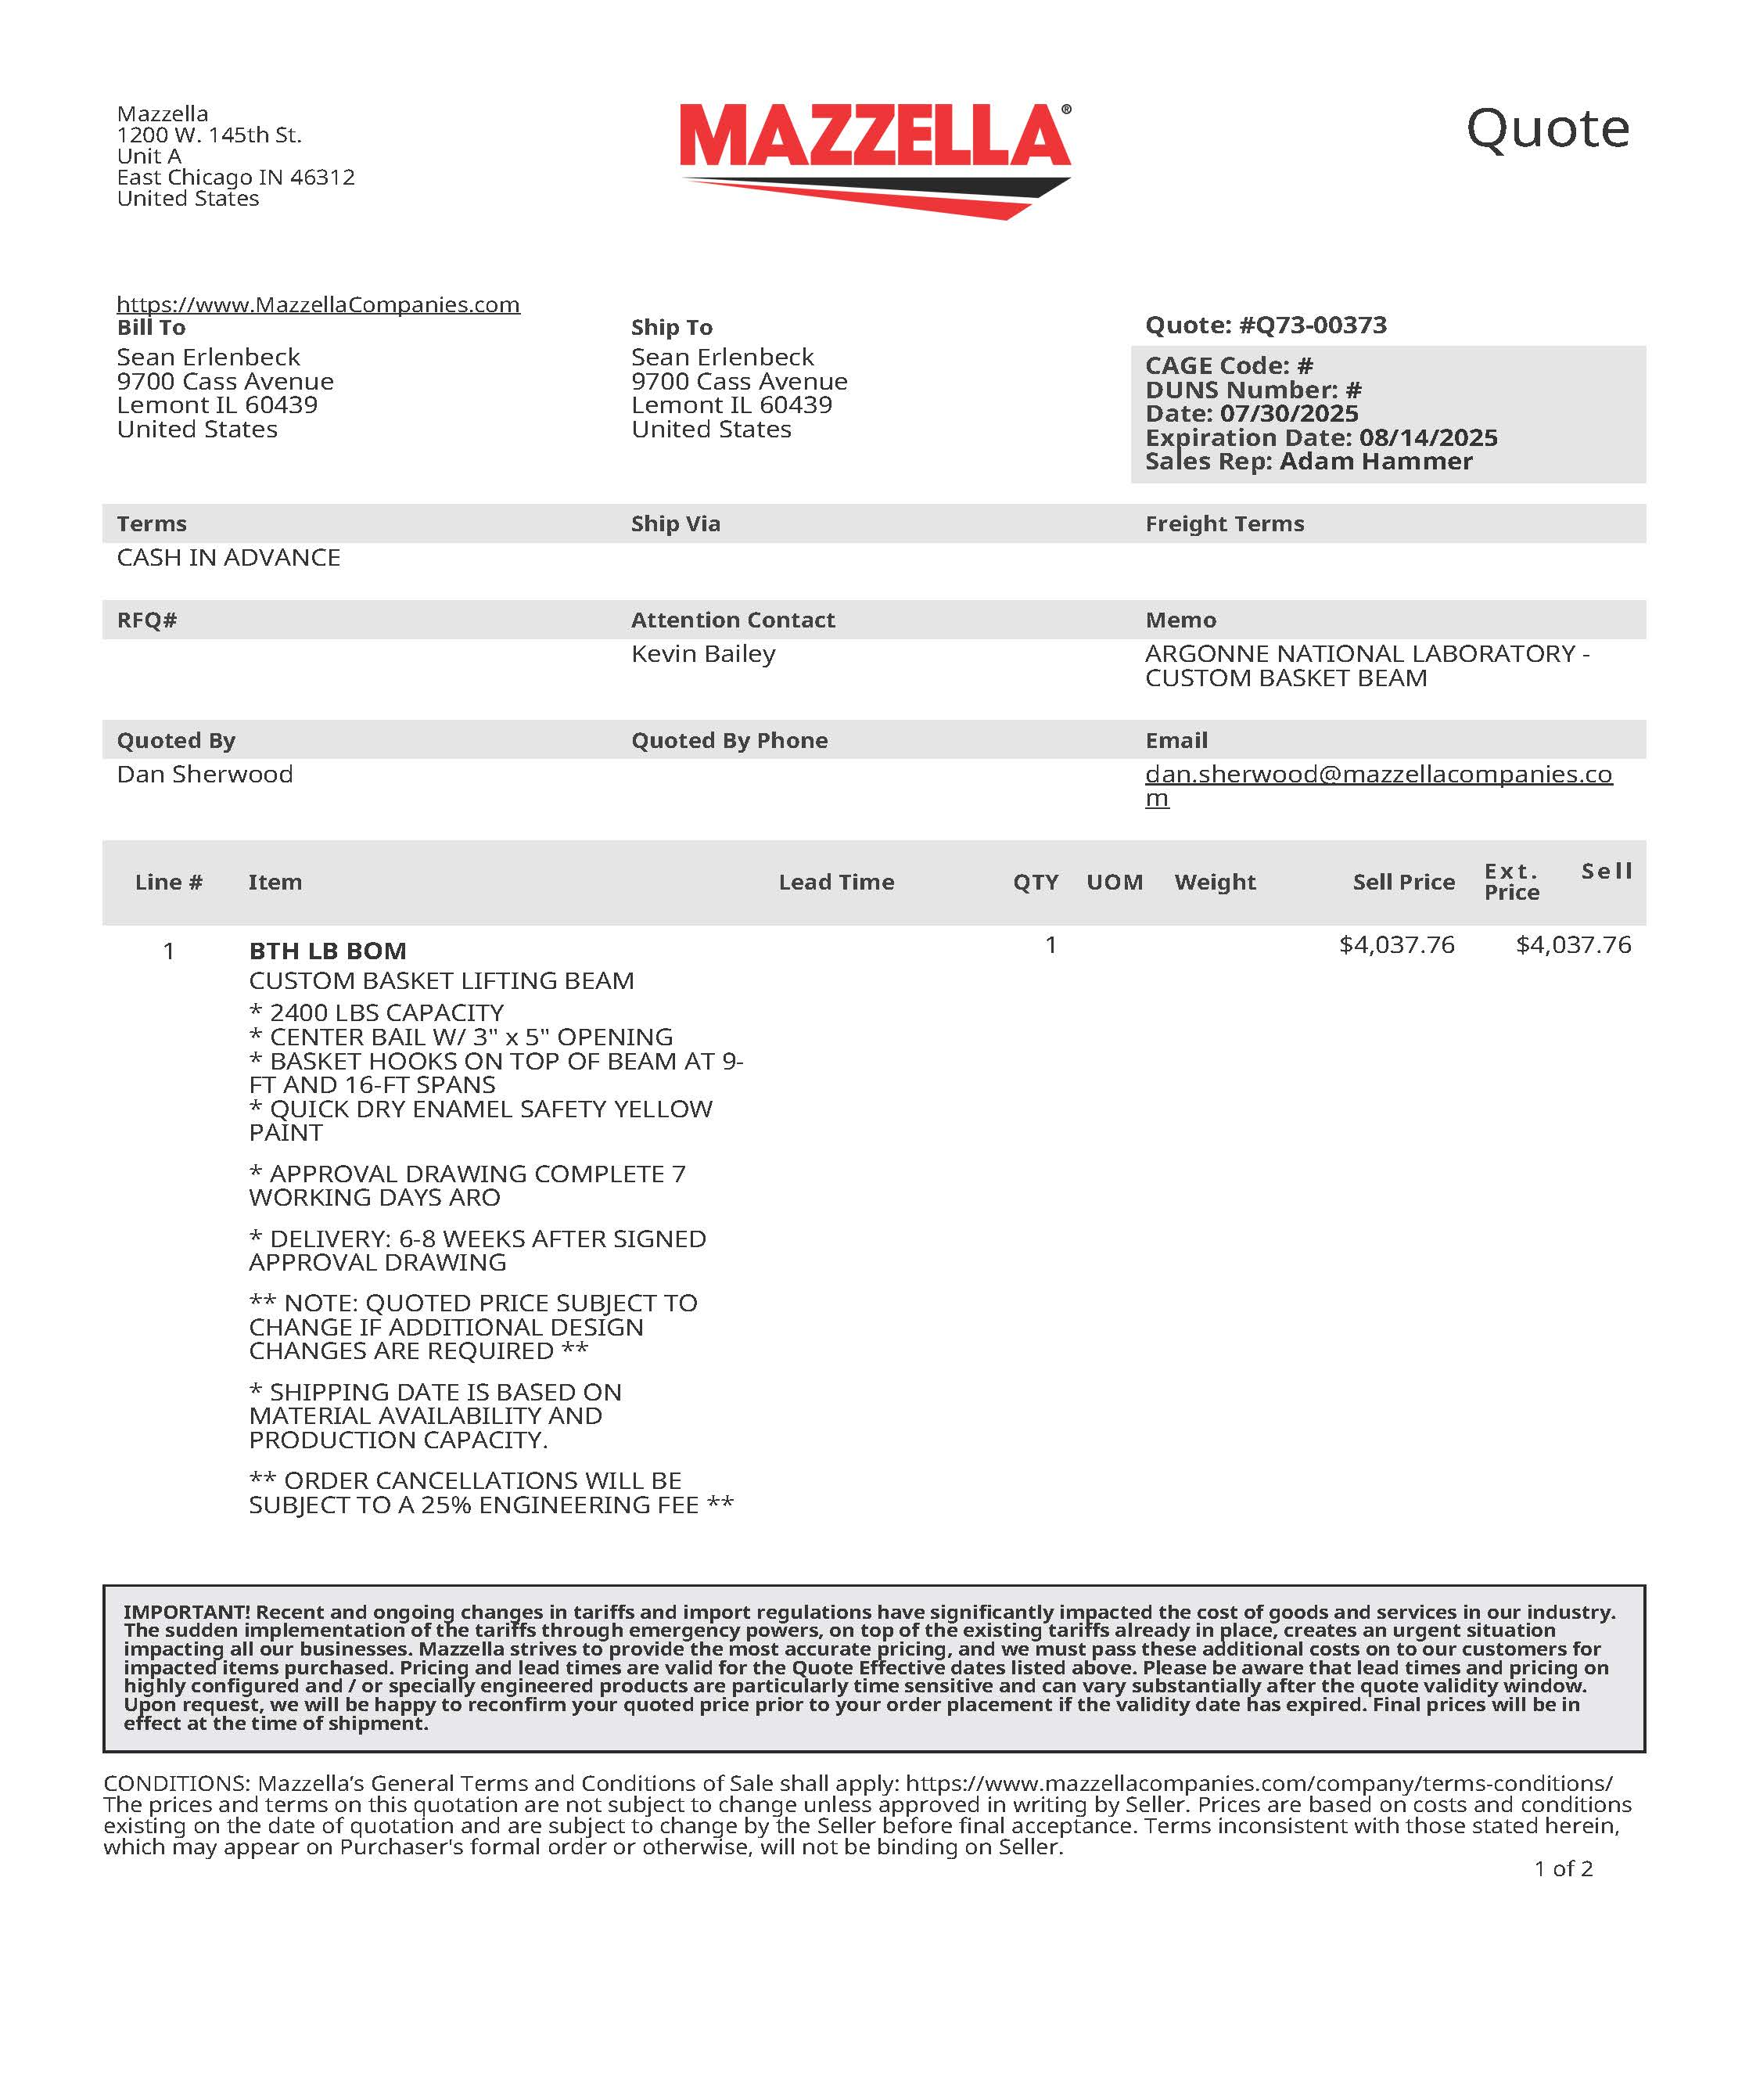
Mazzella quote
Lifting beam design quote
- designed as our needs
- engineered solution design
- sign off necessary
Extra ($)
- shackles
- straps
- other hardware

Slide 9
Forward
Agjust procedeure to reduce L-R slope in SFIL
Build a small stack to verify changes
Once corrected build a bulk layer of (2 SFIL) layers ??

Slide 10
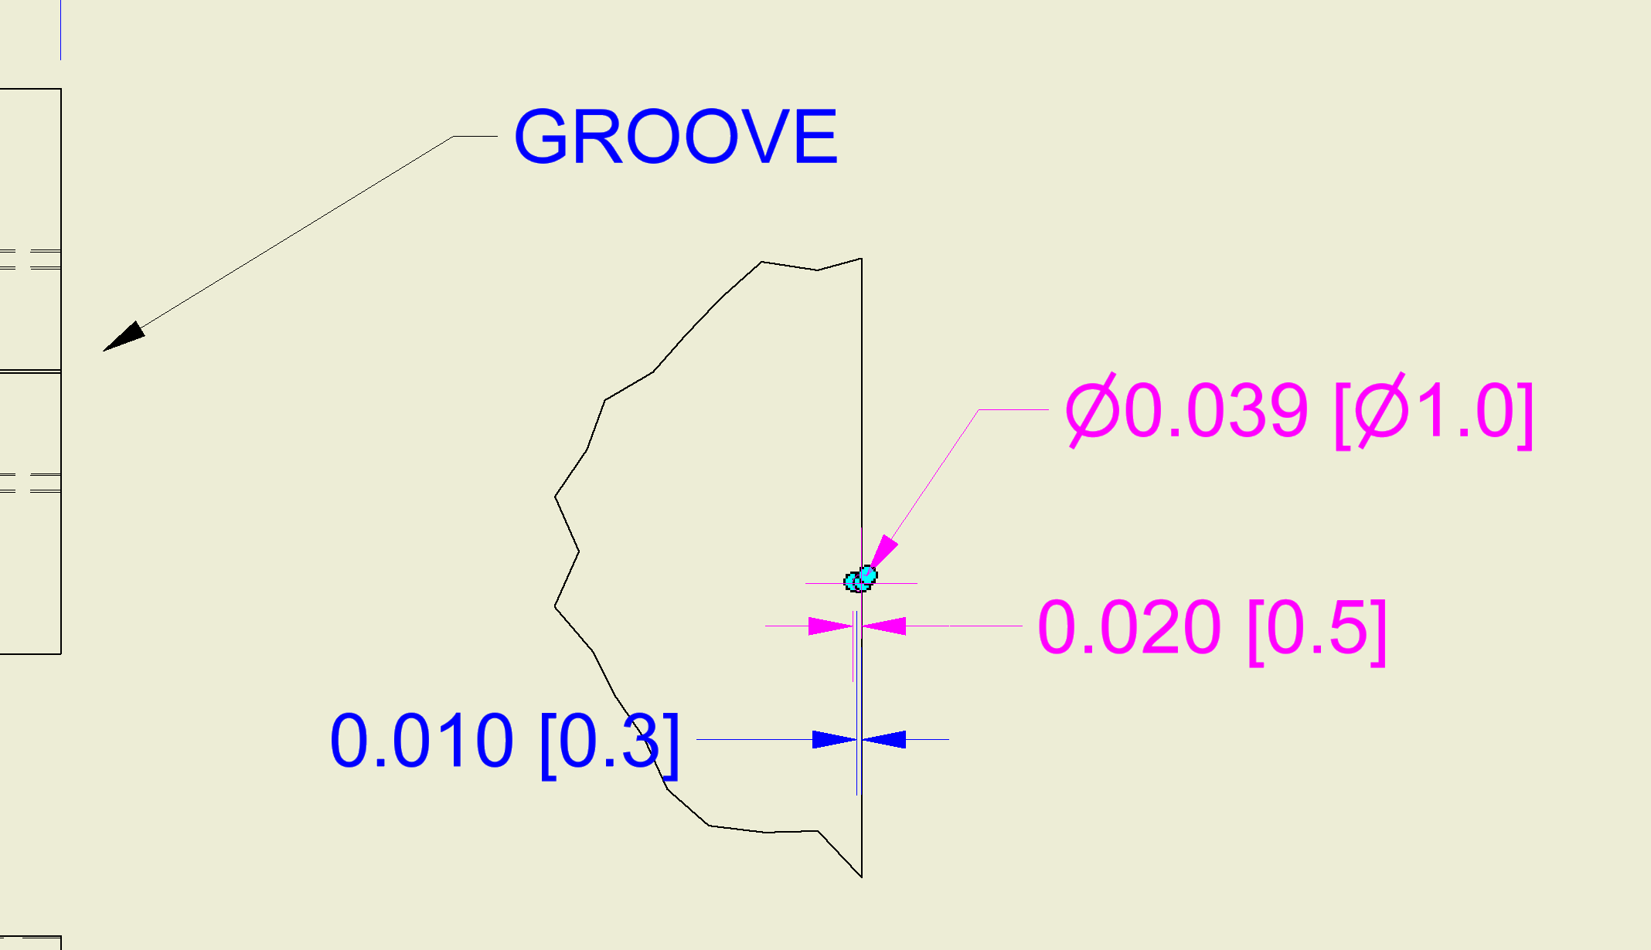
Build plates regrooved
Four available

