Slide 1
SPHENIX CRYO CONNECTORS/CABLES FOR EXTENSION CABLES

Slide 2
SPHENIX CRYO CONNECTORS/CABLES FOR EXTENSION CABLES

Slide 3
SPHENIX CRYO CONNECTORS/CABLES FOR EXTENSION CABLES

Slide 4
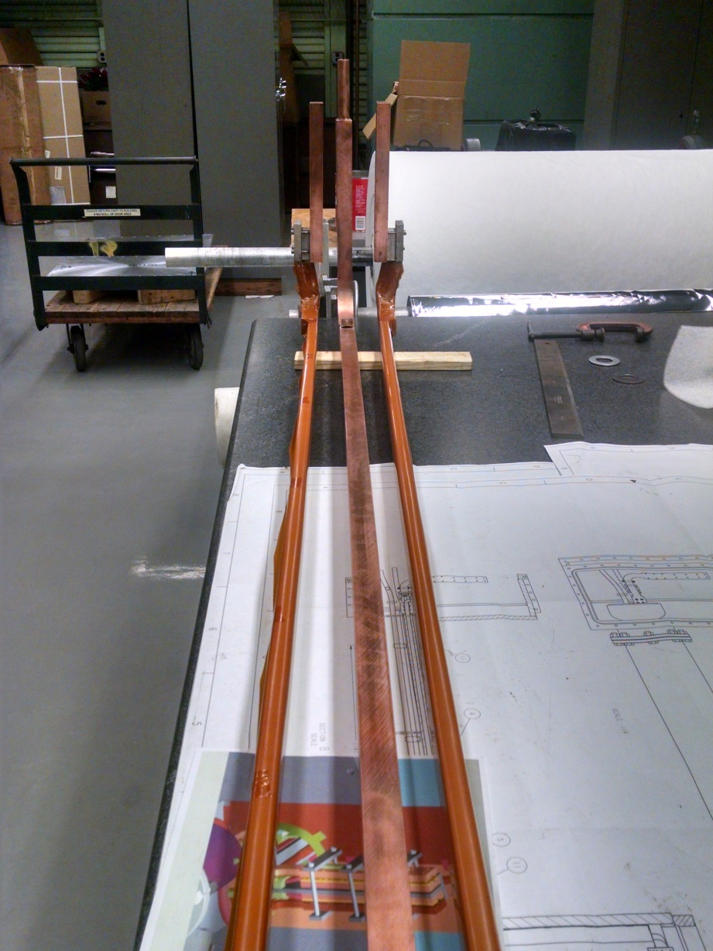
SPHENIX CRYO CONNECTORS/CABLES FOR EXTENSION CABLES

Slide 5
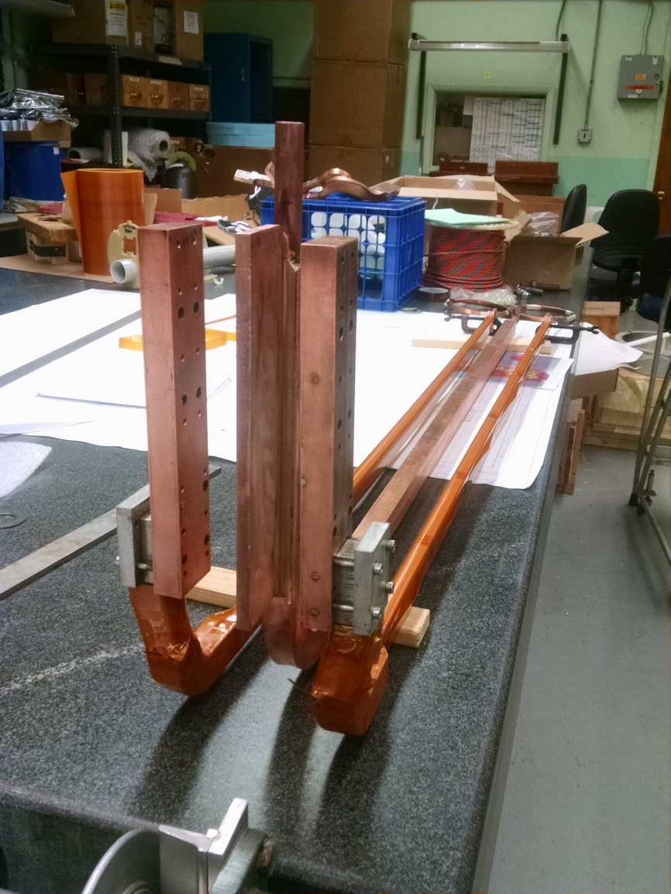
SPHENIX CRYO CONNECTORS/CABLES FOR EXTENSION CABLES

Slide 6
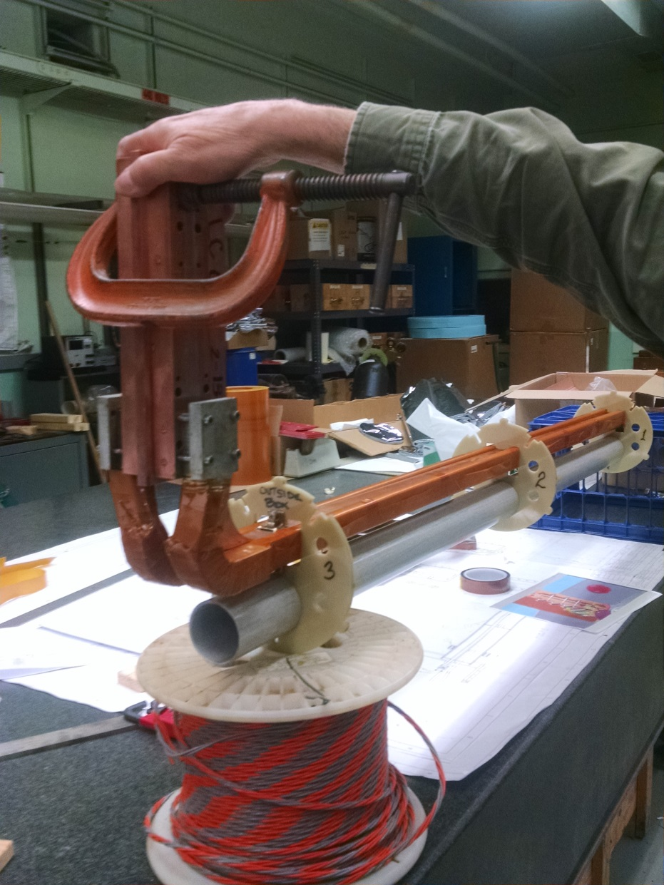
SPHENIX CRYO CONNECTORS/CABLES FOR EXTENSION CABLES

Slide 7
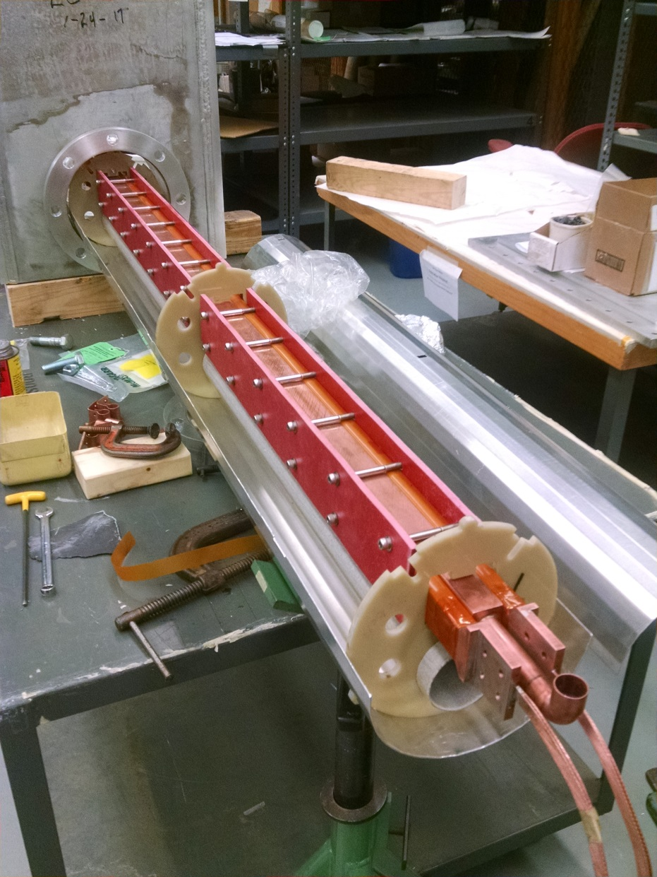
SPHENIX CRYO CONNECTORS/CABLES FOR EXTENSION CABLES

Slide 8
TEFZEL/KAPTON I ORDERED see attached data sheet for 20con 28awg Kapton cable

