Slide 1
Agenda
(https://indico.bnl.gov/conferenceDisplay.py?confId=2982)
D. Phillips: Discussed with the technicians that they’d implement a way to prevent the cab of the crane from driving into the ValveBox
R. Ceruti and his team have nearly finished (98%) the Extension assembly (by this week/today)
In addition, Al heat shield screwed together and 30 layer MLI blanket is in place
They need to purchase a flex connector for the plumbing (a couple weeks’ wait)
⇒ J. Hock’s steel-making progress … and Streck’s delivery
Cable/connectors (T. Tallerico)
AOB (Dealing with Project file, writing CDR for CD1 …)

Slide 2
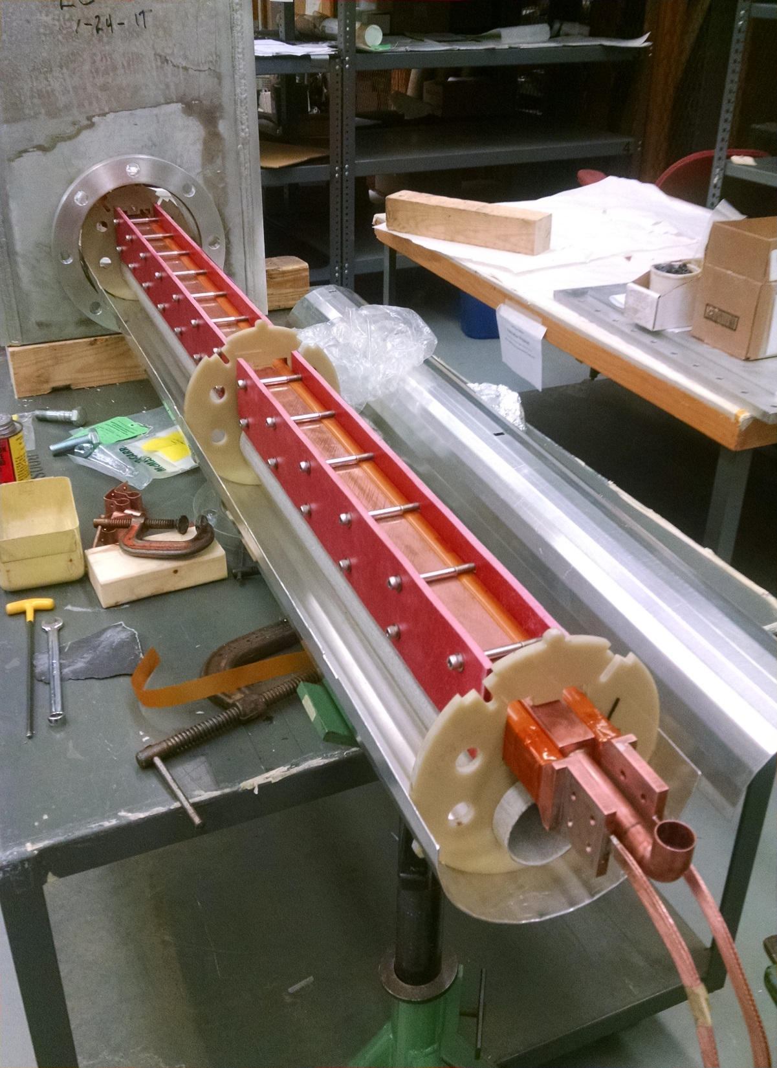
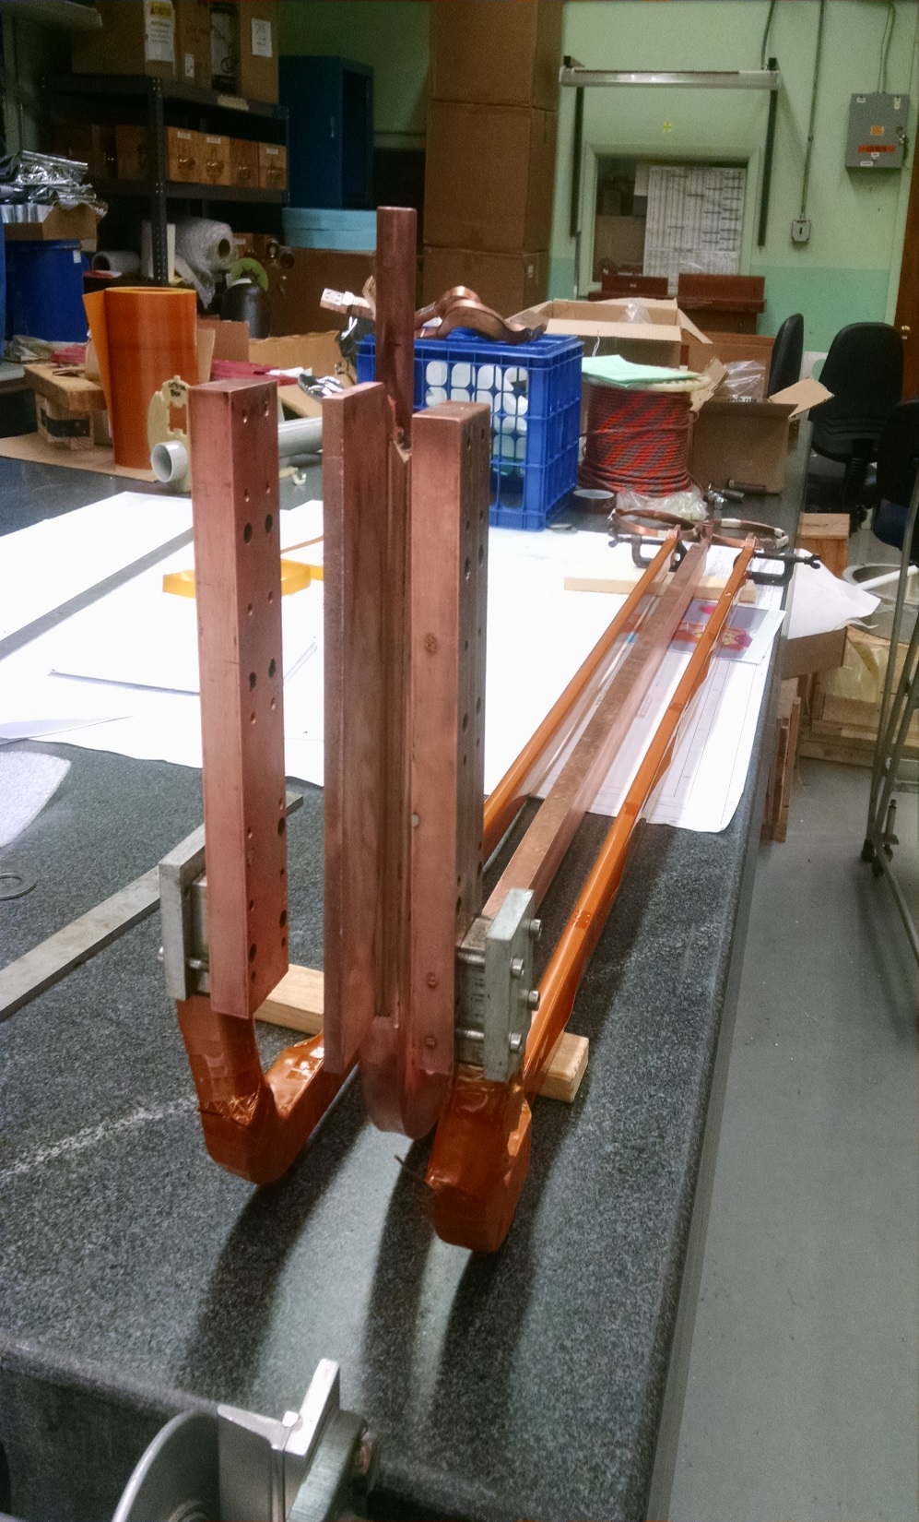
Fiber glass

Slide 3
Status (continued)
Steel making progress (J. Hock) :
Streck delivered the 3 pieces Monday & Tuesday that they have machined for us (see next page).

Slide 4
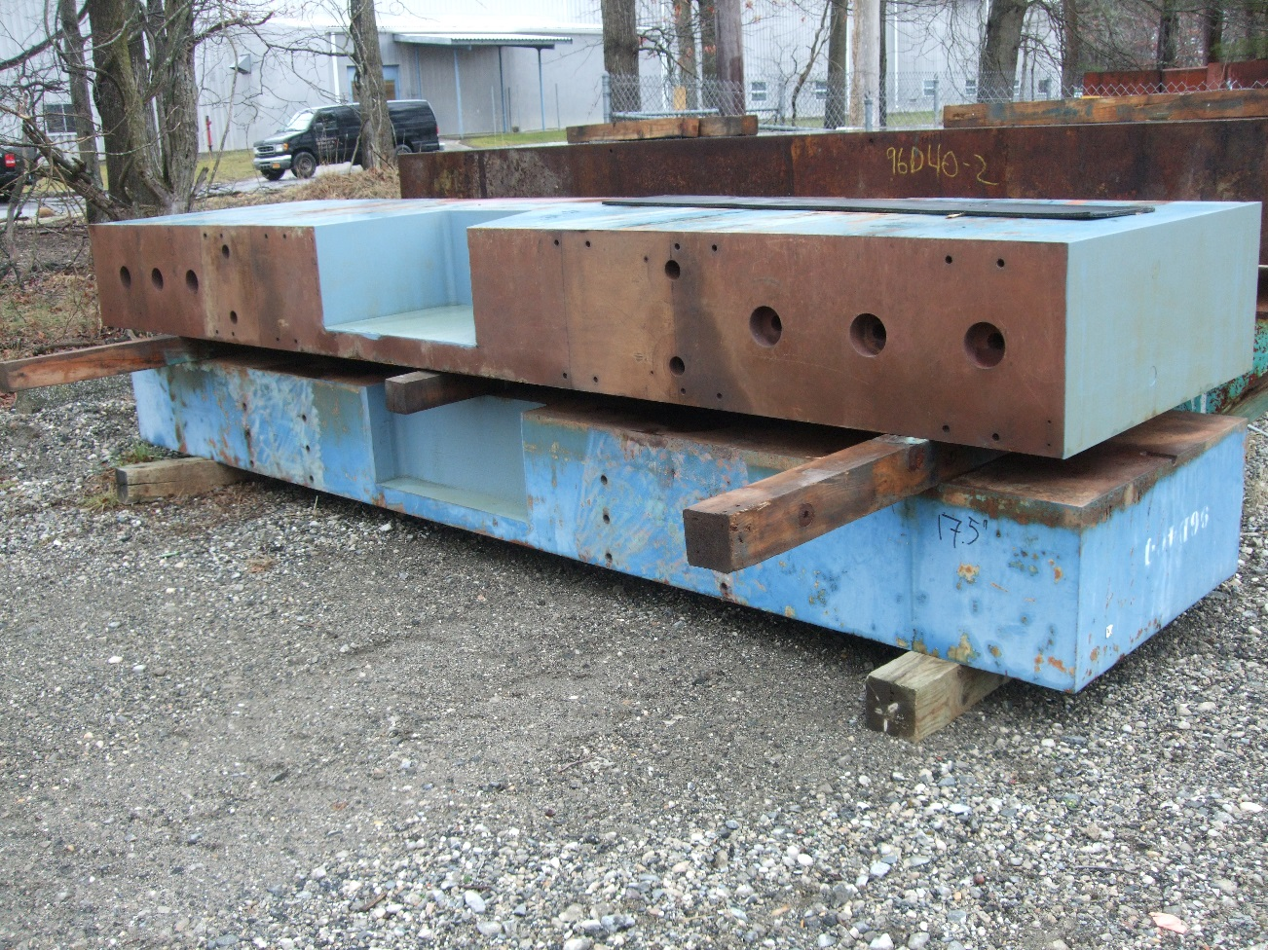
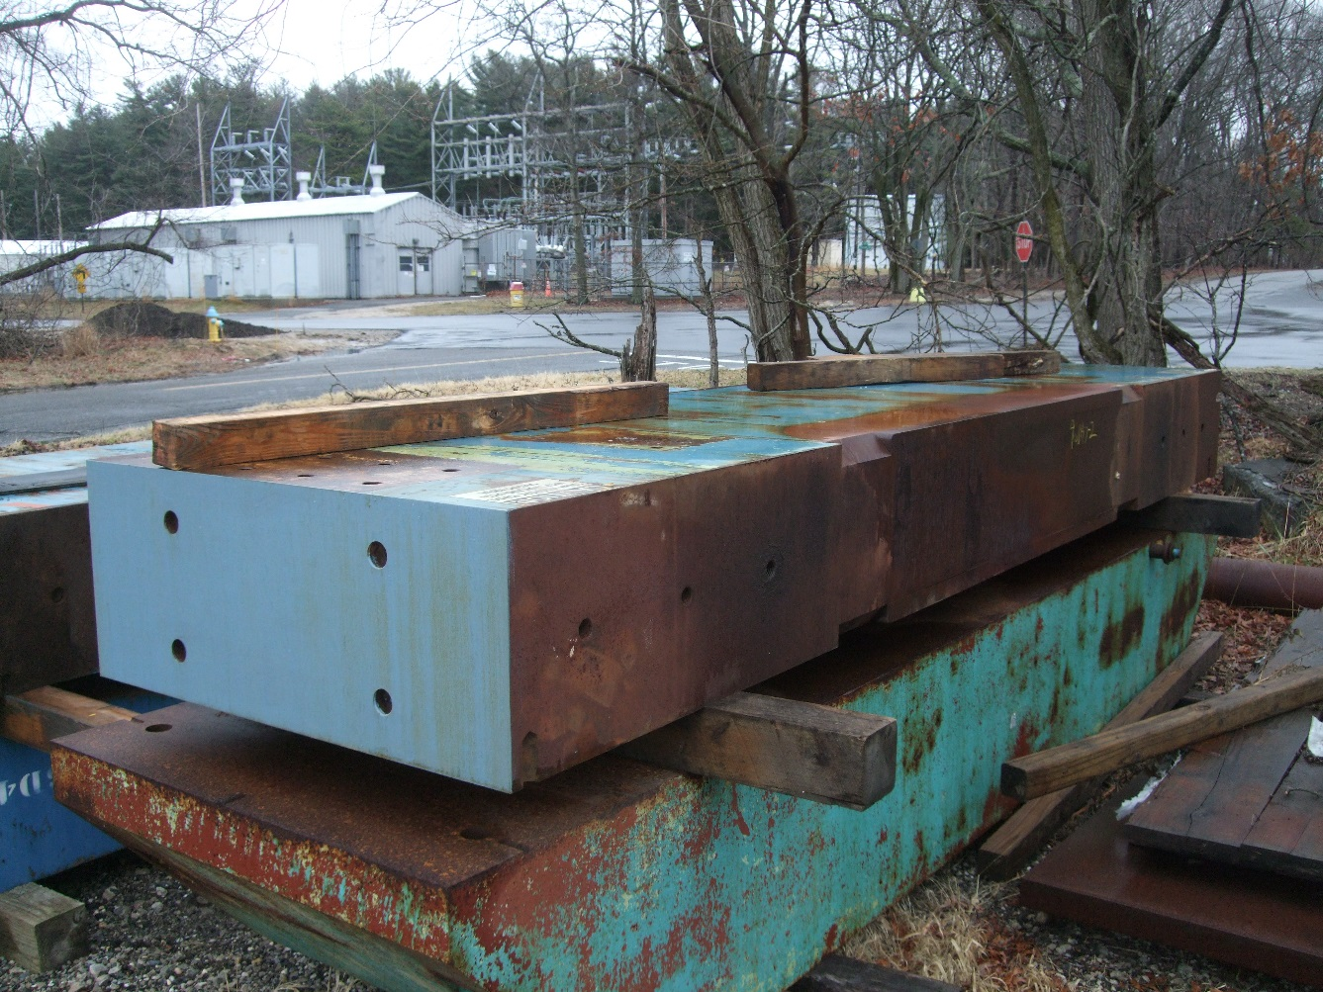
All 3 pieces of roof steel delivered by Streck

