Slide 1
CALOROC ASIC Channels
Fernando Barbosa (Jlab)
TIC Meeting
29 September 2025

Slide 2
Agenda
  Recommendation for a 36 ch CALOROC ASIC Implementation – Fernando
    Today, we seek concurrence from the collaboration to adopt the CALOROC ASIC in a 36 ch implementation.
  Logic and Rational for the Recommendation - Norbert
    Technical details in support of the recommendation to adopt the CALOROC ASIC in a 36 ch implementation.
Record
  Electronics & DAQ WG – 10 July 2025
    Consensus recommendation to adopt the 36 ch implementation.
  EICUG & ePIC Joint Collaboration Meeting – 14-18 July 2025
    Recommendation was presented and leading to today’s presentation at the TIC meeting.
  IPDR3 DAQ & Electronics – 3-4 September 2025
    Recommendation was presented to the review committee.

Slide 3
CALOROC Development
Readout of SiPM-based calorimeters not requiring the higher precision readout from the Discrete implementation (14-bit) and with higher channel density (ASIC)
Streaming readout ASIC development based on the H2GCROC (72 ch)
  Similar frontend, modified backend/interface section
    Two frontend versions now (1A, 1B), to be selected based on upcoming tests
  Benefitting from OMEGA/IN2P3’s previous projects and re-use of IP cores
Our nominal choice has been a 64 ch CALOROC ASIC based on
  Keeping the power dissipation at <1 W per ASIC
  Demonstrated performance of the 72 ch H2GCROC.
N.B. – 64/72 ch or 32/36 ch, where the 72 ch and 36 ch refer to the actual ASIC layout with full channel utilization.

Slide 4
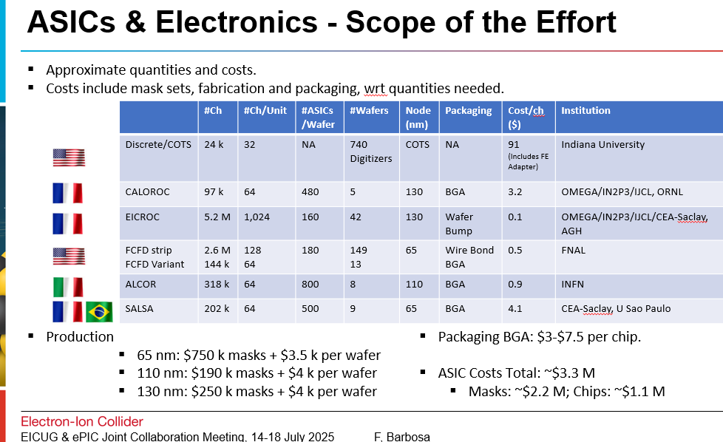
Recommendation
The current version is a complete 36 ch CALOROC in a MPW (shared with the EICROC) and at TSMC
  Saves one step in development (from 36 ch to 72 ch) [labor and non-labor costs, schedule], lower risk.
Direct costs due to additional packaging are not significant:
Conservative estimate with 30% overage:
  < $25k
Plus Tests and PCB Assembly costs.
Total cost is dominated by mask fabrication

Slide 5
Summary
Today, we seek concurrence from the collaboration to adopt the CALOROC ASIC in a 36 ch implementation.
Reasons:
  Technical merits
  Flexibility in PCB layout for different sub-detectors employing the CALOROC ASIC
  Additional direct costs are not significant
  One less step in the development cycle, leading to savings, shorter schedule, lower risk.

