Slide 1
CyMBal Cooling first impressions
| VETTER Seraphin
30.07.2025

Slide 2
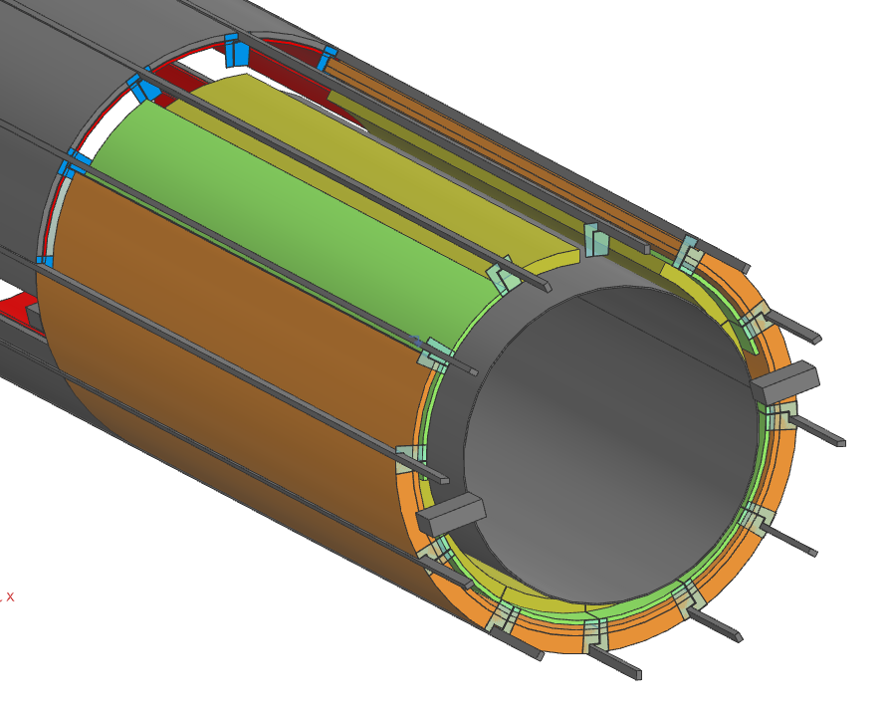
envelope

Slide 3
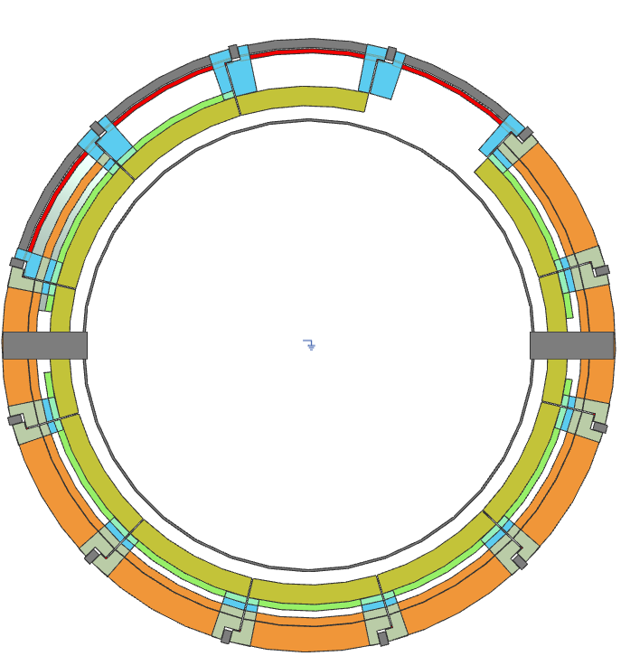
envelope

Slide 4
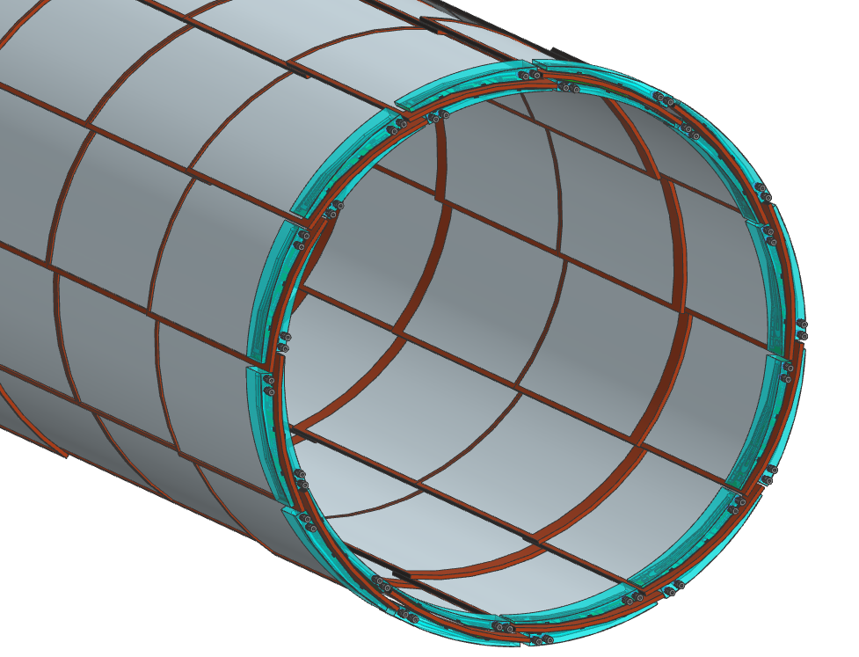
Fish scale tiles
All inside Envelope 560/615

Slide 5
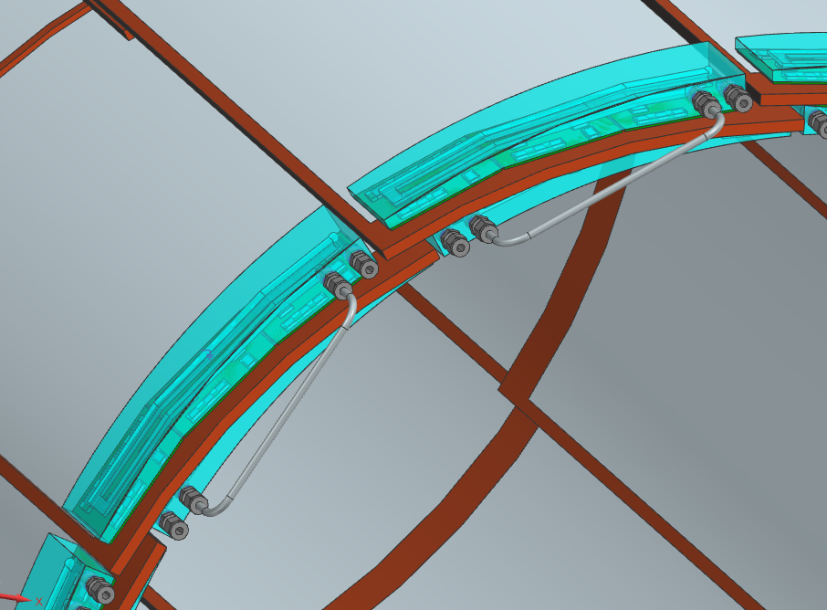
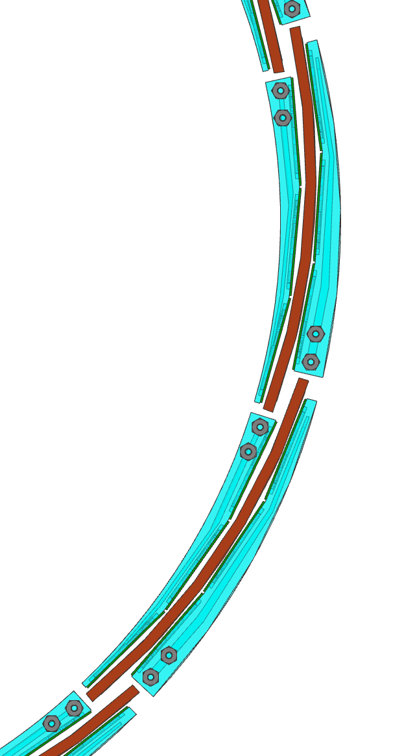
Fish scale tiles
Top & Bottom Cooling are connected
Multiple sectors could also be connected

Slide 6
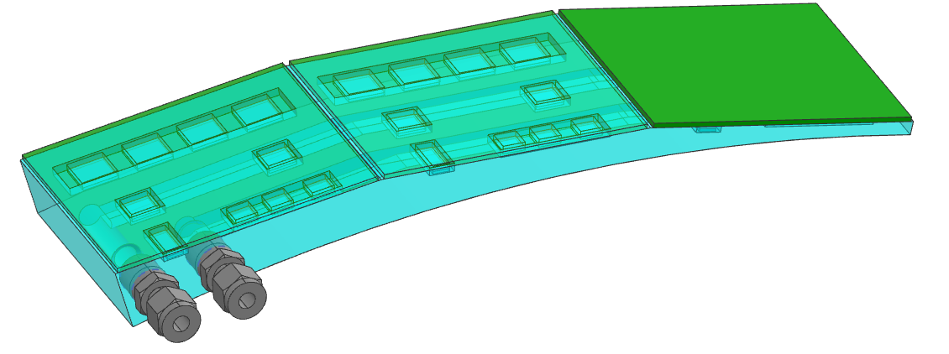
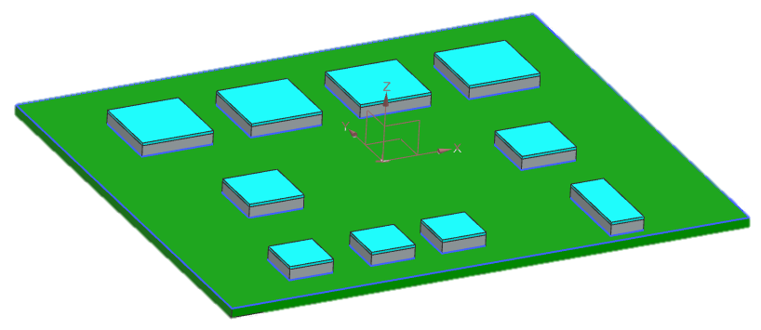
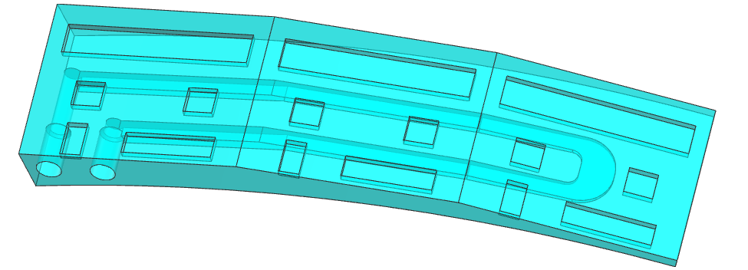
Fish scale tiles
80
95

Slide 7
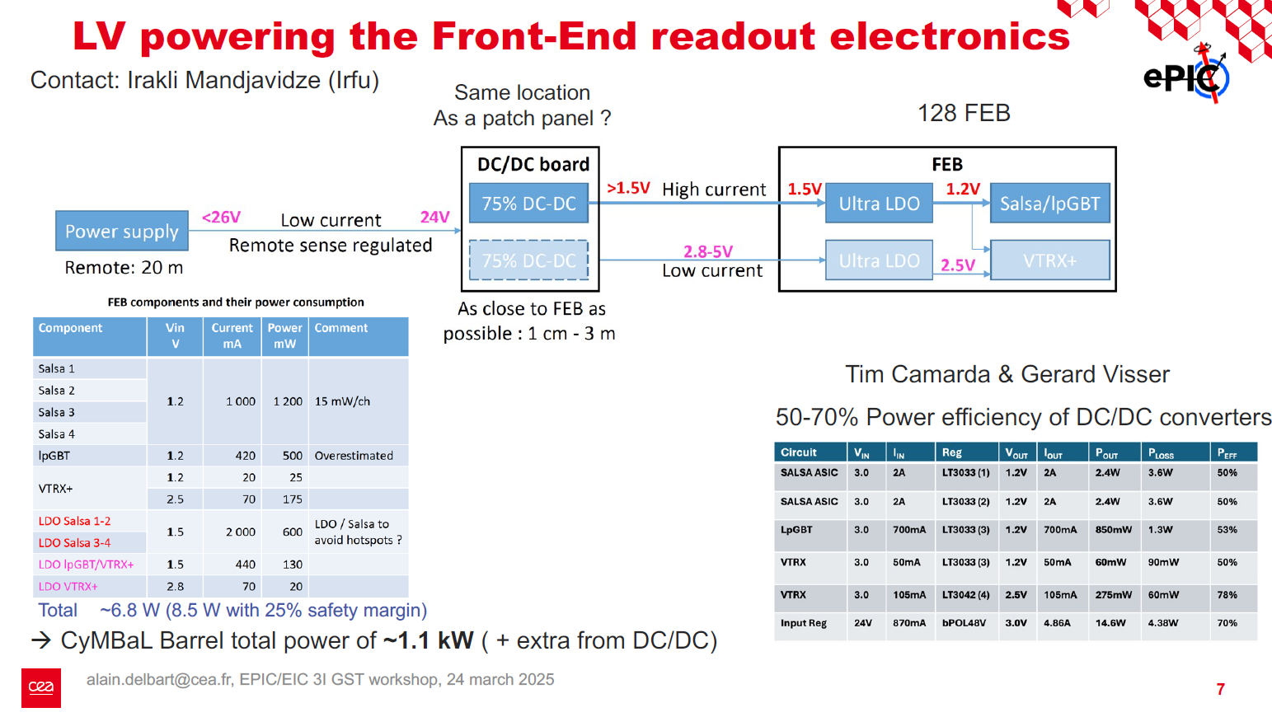
Power consumption

Slide 8
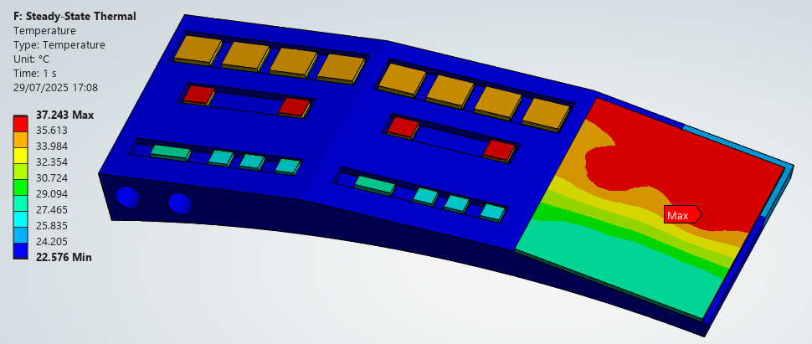
Fish scale tiles simulations
3l/min, Tin 22 degC, Tout 22.366 degC
Pressure Drop 0.006 bar

Slide 9
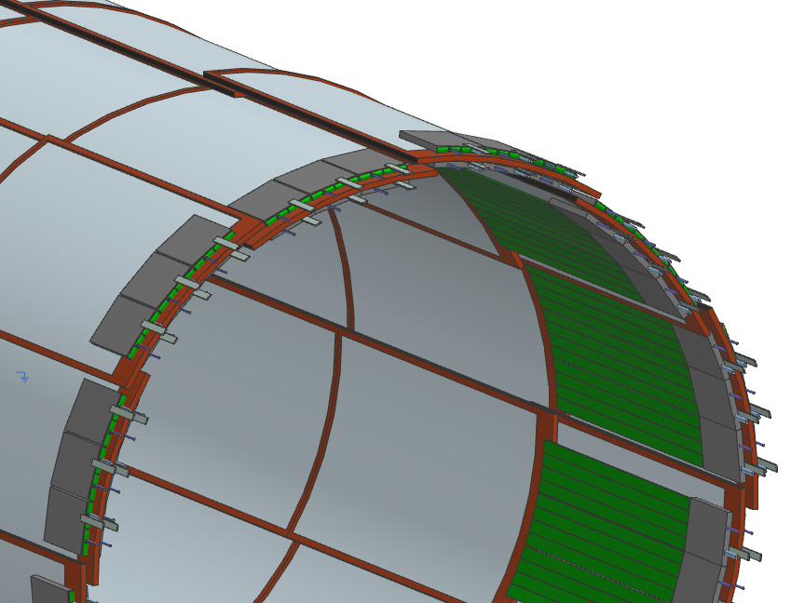
Alternate tiles

Slide 10
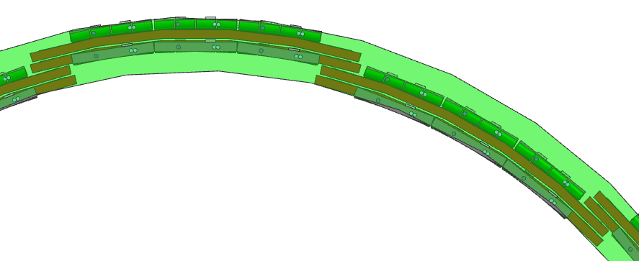
Alternate tiles
All inside Envelope 560/615
Space for Boards is distributed unevenly
Envelope is also not symmetrical in phi
11mm

Slide 11
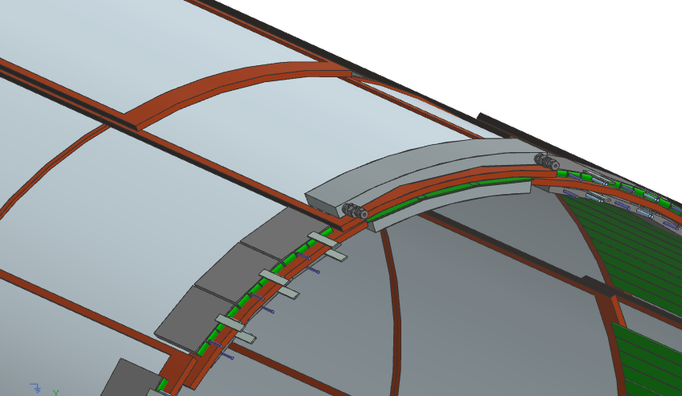
Alternate tiles swapped
Tiles swapped, all inside Envelope 560/615
The two im the middle
the two with the boards are inside

Slide 12
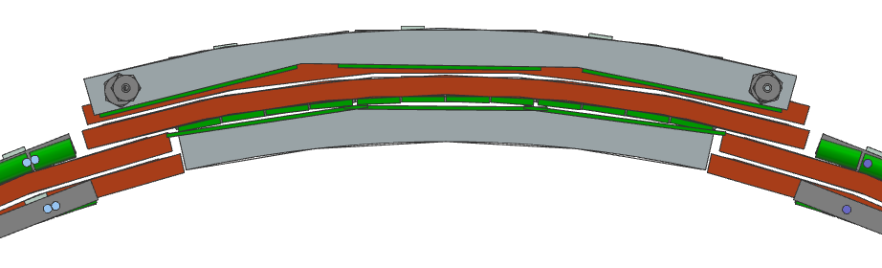
Alternate tiles swapped
Tiles swapped
inner two are outside
the two with the boards are inside
Botton Boards do not fit, max Board width 80mm

