Slide 1
ePIC Electronics and DAQ WG – 9/18/2025
News / Announcements
  Directors Review for CD-2 Readiness:
    Nov 12-14
    Pageturns / Practice Oct 20-21
      Project review: includes cost drilldowns, QA plans, Schedule,
  preTDR – early October
    Do not edit official preTDR
    There is a DAQ private version to edit (email me for edit permission if you need it – or we may ask you)
  TIC Meeting – CALOROC decision (we recommend to stay at 36 channels…) (Sept 29th)
  Other Business?
Agenda
  Grab bag of recent issues – to keep people informed and discuss further
    Synchrotron Radiation
    Readout chain details
      MPGD
      TOF (labeling of FEB / RDO / Service Hybrids)
      Separated DAQ systems
        Lumi Detectors
        Polarimetry
    RDO protocols

Slide 2
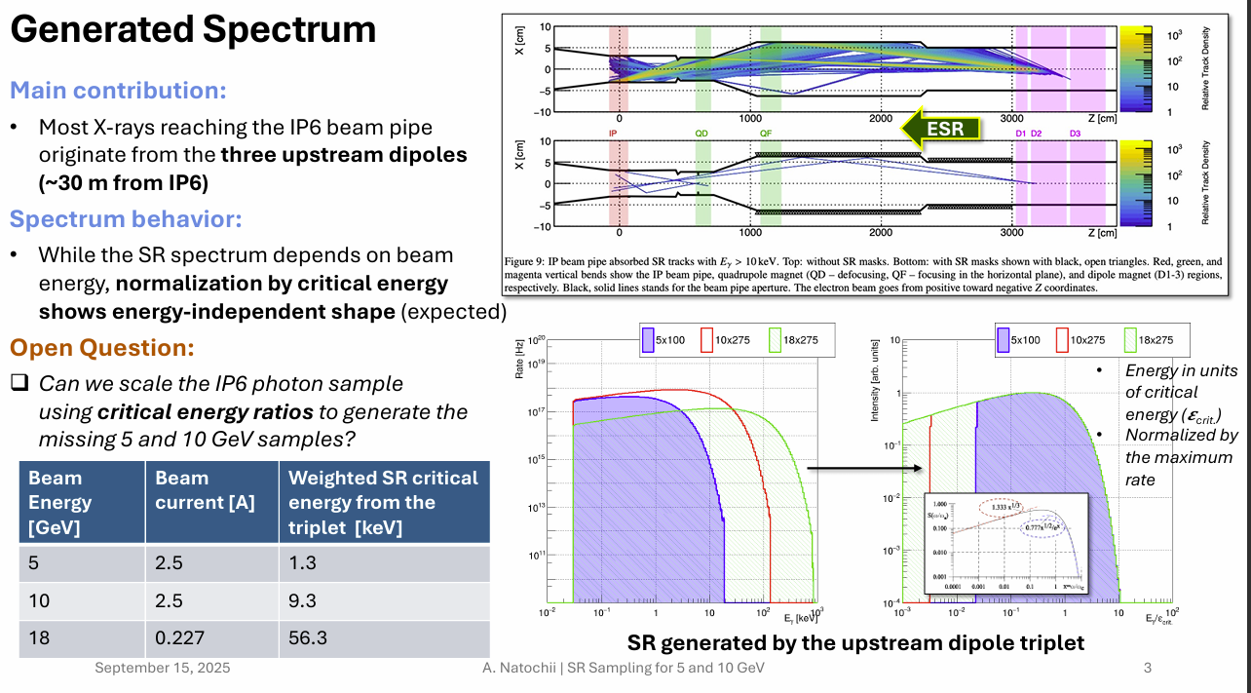

Synchrotron Radiation
Still not ready – but need strategy for preTDR
“Old” understanding (presented in Aug Review)
  Weigh SR energy/Beam Current
  Result 18 GeV worst by factor of 5

Slide 3
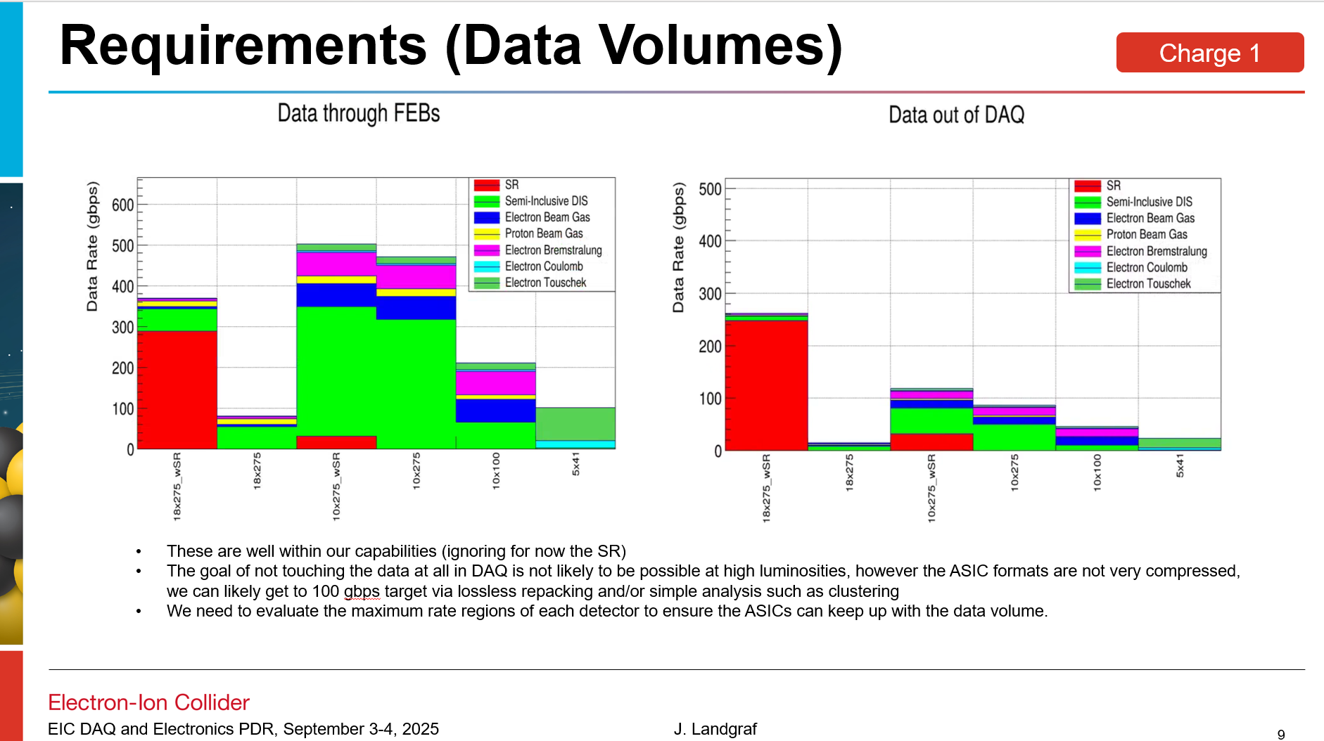
Synchrotron Radiation
Still not ready – but need strategy for preTDR
“Old” understanding (presented in Aug Review)
  Weigh
  Result 18 GeV worst by factor of 5
Distribution of Synchrotron Radiation:
~All in SVT
Upper Limits in other detectors
  18 GeV ~ 14 MHz
  10 GeV ~ 140 MHz

Slide 4
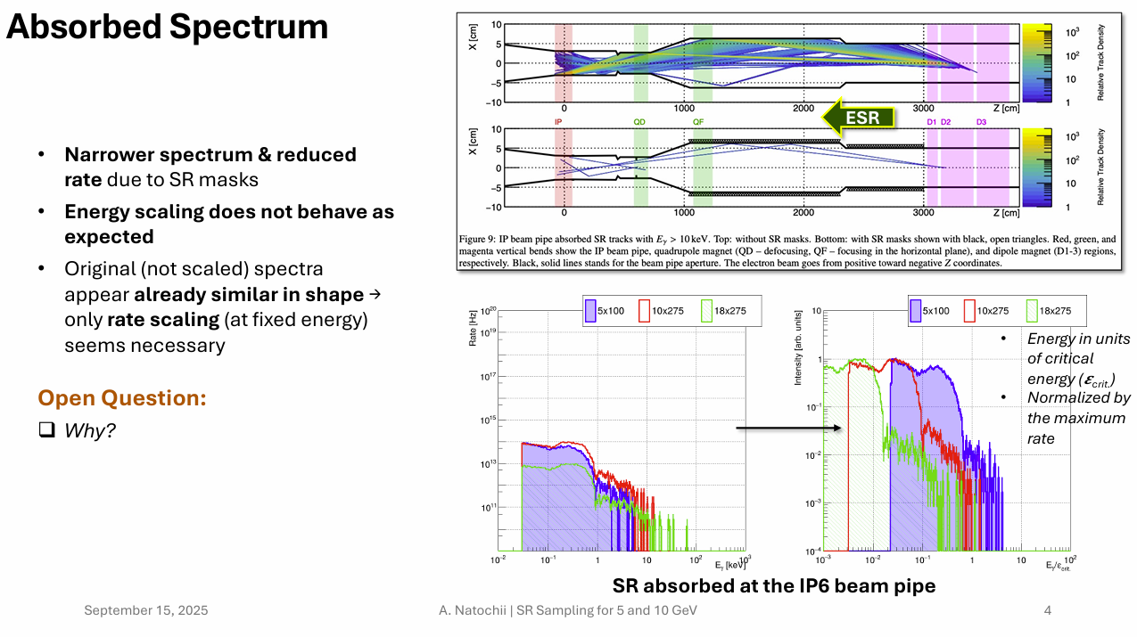

Synchrotron Radiation
Still not ready – but need strategy for preTDR
“Old” understanding (presented in Aug Review)
  Weigh
  Result 18 GeV > 10 GeV by factor of 5
“New” simulations (Discussion with Andrii Natochii this week)
  Absorption matters a lot
  Result at 10 GeV 10x Result at 18 GeV

Slide 5

Synchrotron Radiation
Still not ready – but need strategy for preTDR
“Old” understanding (presented in Aug Review)
  Weigh
  Result 18 GeV > 10 GeV by factor of 5
“New” simulations (Discussion with Andrii Natochii this week)
  Absorption matters a lot
  Result at 10 GeV 10x Result at 18 GeV
preTDR?
  Quote 18 GeV Numbers
  “Depend upon beamline development expected x10-x100 improvement in SR

Slide 6


Readout Chains
Charge 2, 3, 4
Detector System | Sensor | ASIC / Digitization | Digitization Clock | FEB | FEB-RDO Protocol | RDO Type | RDO Location | Notes
Si Tracking --- (ITS3 / LAS): (IB, OB, EE, HE) | ITS3/LAS | Integrated /w sensor | 39.4 MHz (2-8 us time) | Integrated (Schambach) | GBT | Fiber Aggregator GenericRDO | South Platform | J. Schambach Presentation
MPGD tracking: (SALSA): (IB, OB, EE, HE) | urWELL / uMegas | SALSA | 39.4 MHz | lpGBT / VTRX+ | GBT | 4 → 1 GenericRDO | South Platform | RDO – N. Novitzki Presentation FEB – F. Barbosa Presentation
Calorimeters (CALOROC): BarrelHCAL, Backward HCAL, Barrel ECAL, Backward ECAL, Backward HCAL | SiPM | CALOROC | 39.4 MHz | lpGBT / SFP+ | GBT | 4 → 1 GenericRDO | South Platform | N. Novitzki Presentation
Calorimeters (CALOROC): LFHCAL, HCAL Insert | SiPM | CALOROC | 39.4 MHz | lpGBT / SFP+ | GPT | 4 → 1 GenericRDO | East HCAL Platform | N. Novitzki Presentation
Calorimeters (Discrete): FwdEcal | SiPM | Discrete | 98.5 MHz | FPGA / SFP+ / Cu | Internal | 16 → 1 GenericRDO | South Platform | G. Visser Presentation Planned RDO similar to existing designs
Far Forward (AC-LGAD / EICROC): B0 tracking, Roman Pots, Off Momentum | AC-LGAD | EICROC | 39.4 MHz | lpGBT / VTRX+ | GBT | Direct to FELIX | N/A | Same as per Endcap TOF
Far Backward: (AC-LGAD / FCFD): Lumi photon spectrometer tracker | AC-LGAD | FCFD | 39.4 MHz | lpGBT / VTRX+ | GBT | Direct to FELIX | N/A | Same as per Barrel TOF
Central Detector (AC-LGAD / EICROC): Endcap TOF | AC-LGAD | EICROC | 39.4 MHz | lpGBT / VTRX+ | GBT | Direct to FELIX | N/A | F. Barbosa Presentation
Central Detector (FCFD): Barrel TOF, pfRICH, DIRC | HRPPD / MCPMT | FCFD | 39.4 MHz | lpGBT / VTRX+ | GBT | Direct to FELIX | N/A | F. Barbosa Presentation
Far Forward/Backward (CALOROC / Discrete): B0 Crystal Calorimeter, ZDC Crystal Calorimeter, ZDC HCAL, Lumi Photon Spectrometer Calorimeter | SiPM | Discrete | 39.4 MHz (or) 98.5 MHz | FPGA / SFP+ / Cu (or) lpGBT / SFP+ | Internal GBT | 16 → gRDO (or) 4 → 1 gRDO | East/West Tunnel Near Detectors | Small channel count detectors Expect to copy either CALOROC or Discrete
Far Backward: (Discrete): Direct Photon Lumi Calorimeter* | SiPM | Flash-250 | 197 MHz | FADC 250 | Streaming ADCs | (N/A) | West Tunnel | Special FELIX processing to histogram / Sum bunch by bunch luminosity data
Far Backward: (TimePix): Low Q Tagger | TimePix | Integrated / w sensor | 98.5 MHz | Integrated / w sensor | Internal | SPIDR4 Variant (NIKEF) | West Tunnel Under Detector | K. Livingston Presentation Planned RDO similar to existing designs
Imaging Calorimeter (Astropix): | AstroPix | Integrated / w sensor | 98.5 MHz | Integrated / w Sensor | Astropix Internal | End of Stave Card (NASA) | On Detector | J. Metcalfe Presentation Planned RDO similar to existing designs
Central Detector (ALCOR): dRICH | SiPM | ALCOR | 39.4 MHz | FPGA / Cu | Internal | FPGA / VTRX+ | On Detector in PDU | Pietro Antonioli Presentation
Polarimeters: Separate Systems, Separate Scope, Our Readout Scheme!!!
Electronics design pending
Planned variants of GenericRDO
Scope of outside Electronics/DAQ

Slide 7
Readout Chain Details
MPGD
  Irakli has been presenting direct to FELIX scheme for about a year. I missed/ignored this, considering the calorimeter RDO a near perfect fit… Need a baseline decision.
TOF (labeling of FEB / RDO / Service Hybrids)
  Question here is really just semantic. Do we call the Service Hybrids FEBs or RDOs?
  Difference is:
    EICROC: ASIC bump bonded to sensor, Service Hybrid on detector but is it FEB or RDO? It aggregates, but with no FPGA, just lpGBT & VTRX+.
    Others: FEB contains ASIC/lpGBT, RDO defined by using FPGA rather than just lpGBT.
Lumi Direct Photon Detector:
  Plan is now CALOROC (which can not handle highest luminosity)
  High luminosity running turns into upgrade (using flash250 / streaming ADCs to FELIX an option but not baseline)
  Far back now contains 5 identical 1680 SiPM / CALOROC calorimeters: 2 x Low Q Tagger Cal, 2 x Lumi PS Cal, 1 x Lumi Direct Photon
  Lumi Direct Photon to have separated readout (it’s own FELIX / mini-GTU / RDOs “Mini-DAQ” system)
Polarimetry
  Use our scheme (mini-GTU, RDOs, FELIX if needed “Mini-DAQ” system)
  Costing, Procurement stays in polarimetry CAM
  Digitization / scale not yet discussed…

Slide 8
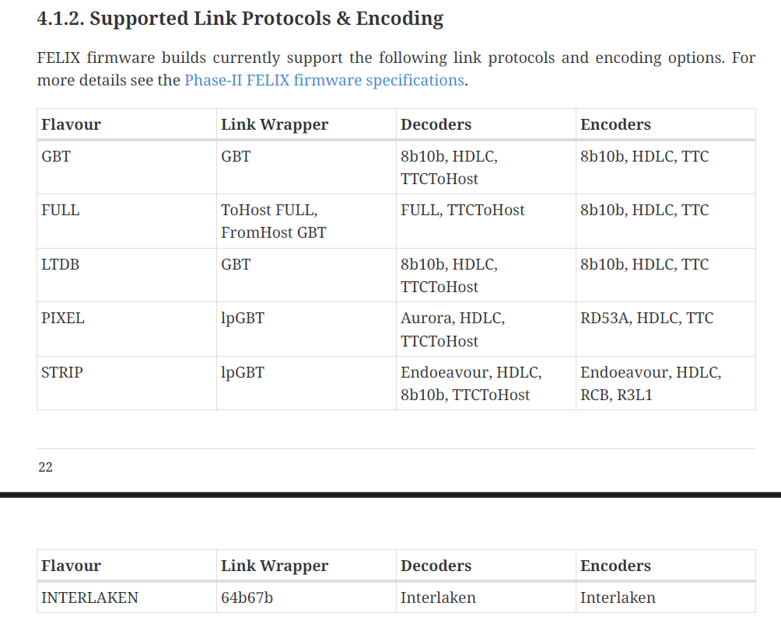
RDO protocols
Need zero-suppression scheme. lpGBT dedicates a fraction of bits to each ASIC, and the ASICs fill them with No-ops when not busy. The RDO needs to aggregate – replacing No-ops with valid data from other links. (Same for EIC-ROC service hybrid, which aggregates many lpGBT)
Need to decide / build low level protocol, making best use of existing FELIX features:
  Several Exist
  Speed Differs
  Reconstructed clock support differs
  Slow controls link differs
  FPGA utilization differs
Ideas?

