Slide 1




Bayesian Optimization for AGS Injection
Eiad Hamwi
PhD Candidate, Cornell ERL/EIC Group
PI: Georg Hoffstaetter de Torquat

Slide 2
AGS Injection
3-bunch train kicked out of AGS Booster in 1 turn
Fast kicker at F3
0.14 µs rise time
2.25 µs flat-top
0.73–1.0 µs/rev @ 2.5GeV
Bunch train injected via septum inflector
Closed-orbit injection bump via BLW
Fast kicker at A5
0.12 µs rise time
0.60 µs flat-top
2.9 µs/rev @ 2.5GeV
4 Booster cycles (per Booster supercycle) fill 1 AGS cycle

Slide 3
Booster to AGS (BtA) transfer line
AGS
Bends 4
H Correctors 2
V Correctors 4
F Quadrupoles 7
D Quadrupoles 8
Booster

Slide 4
Injection parameters
Timing
Booster fast-kicker timing (no flat-top)
Fast-kicker amplitudes (Booster & AGS)
Steering
4 horizontal + 4 vertical + septum
Over-parametrized with plenty of controls
Shaping
7 focusing + 8 defocusing
Phase advances are close to π
4 multi-wire screen diagnostics

Slide 5
Injection optimization
Steering
4 horizontal + 4 vertical + septum
Over-parametrized with plenty of controls
Shaping
7 focusing + 8 defocusing
Phase advances are close to π
4 multi-wire screen diagnostics
Transfer efficiency
DC Current transformer (DCCT)
Beam loss monitor
Emittance growth
DC Current transformer (DCCT)
Beam loss monitor
Ionization Profile Monitor (IPM)

Slide 6
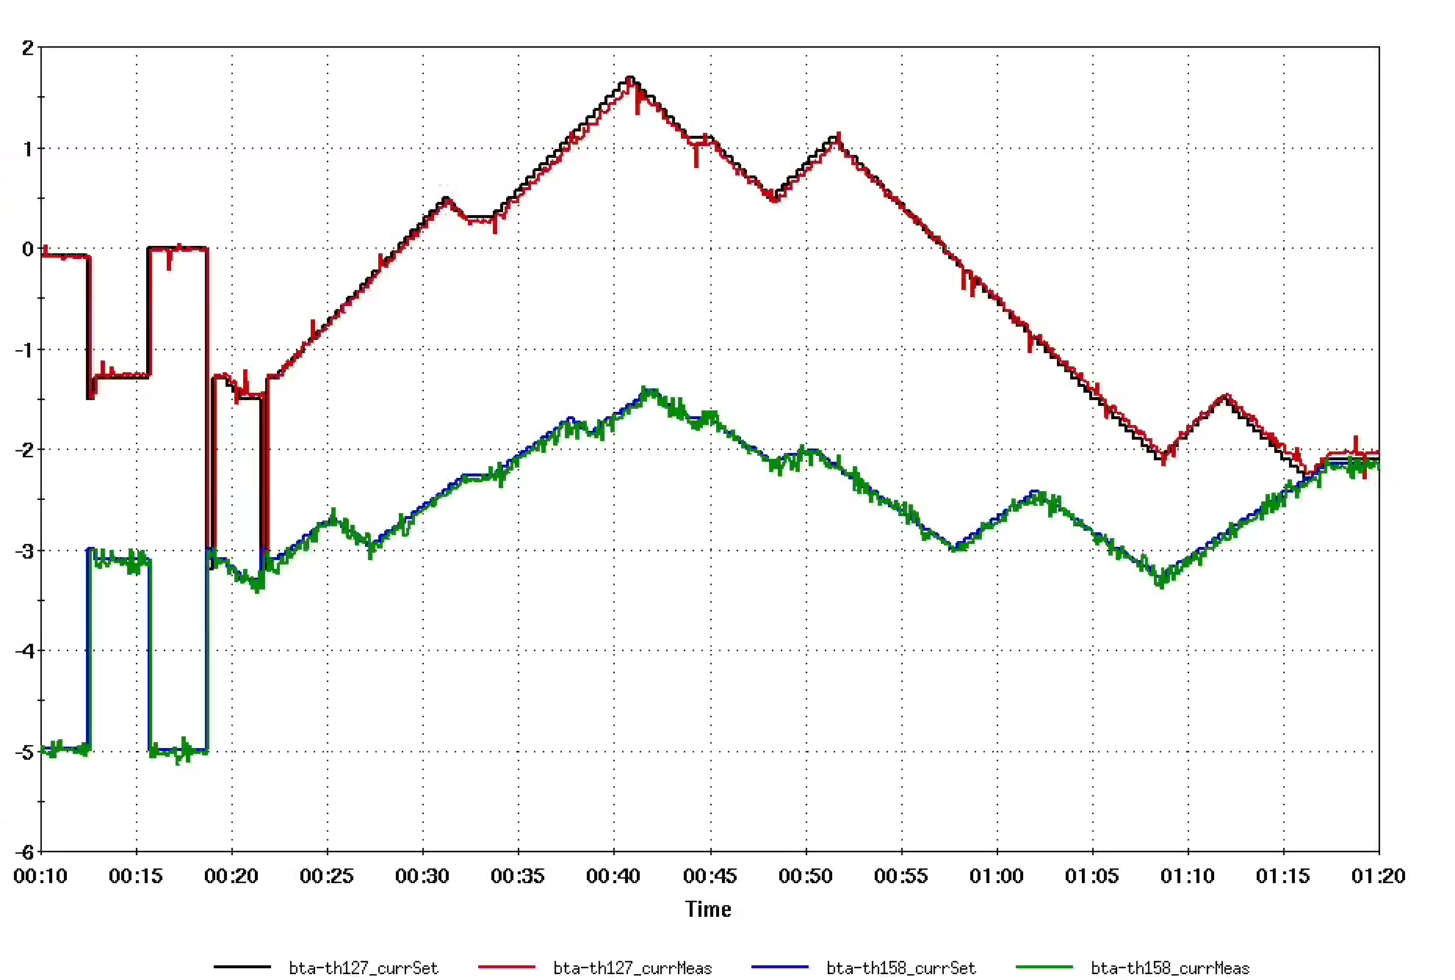
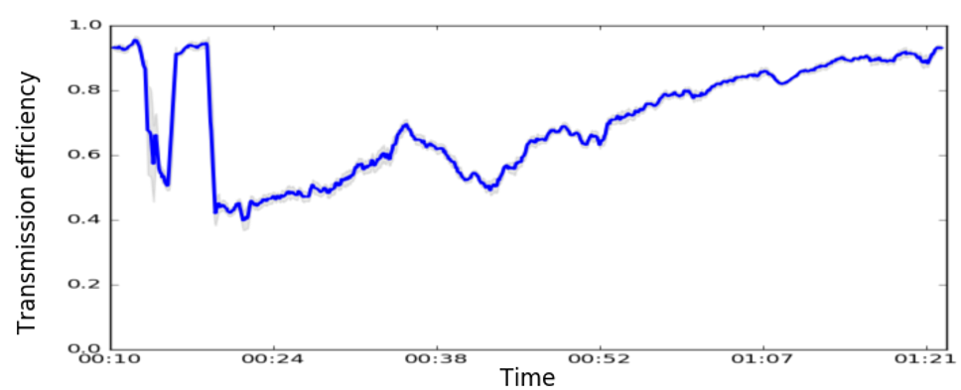
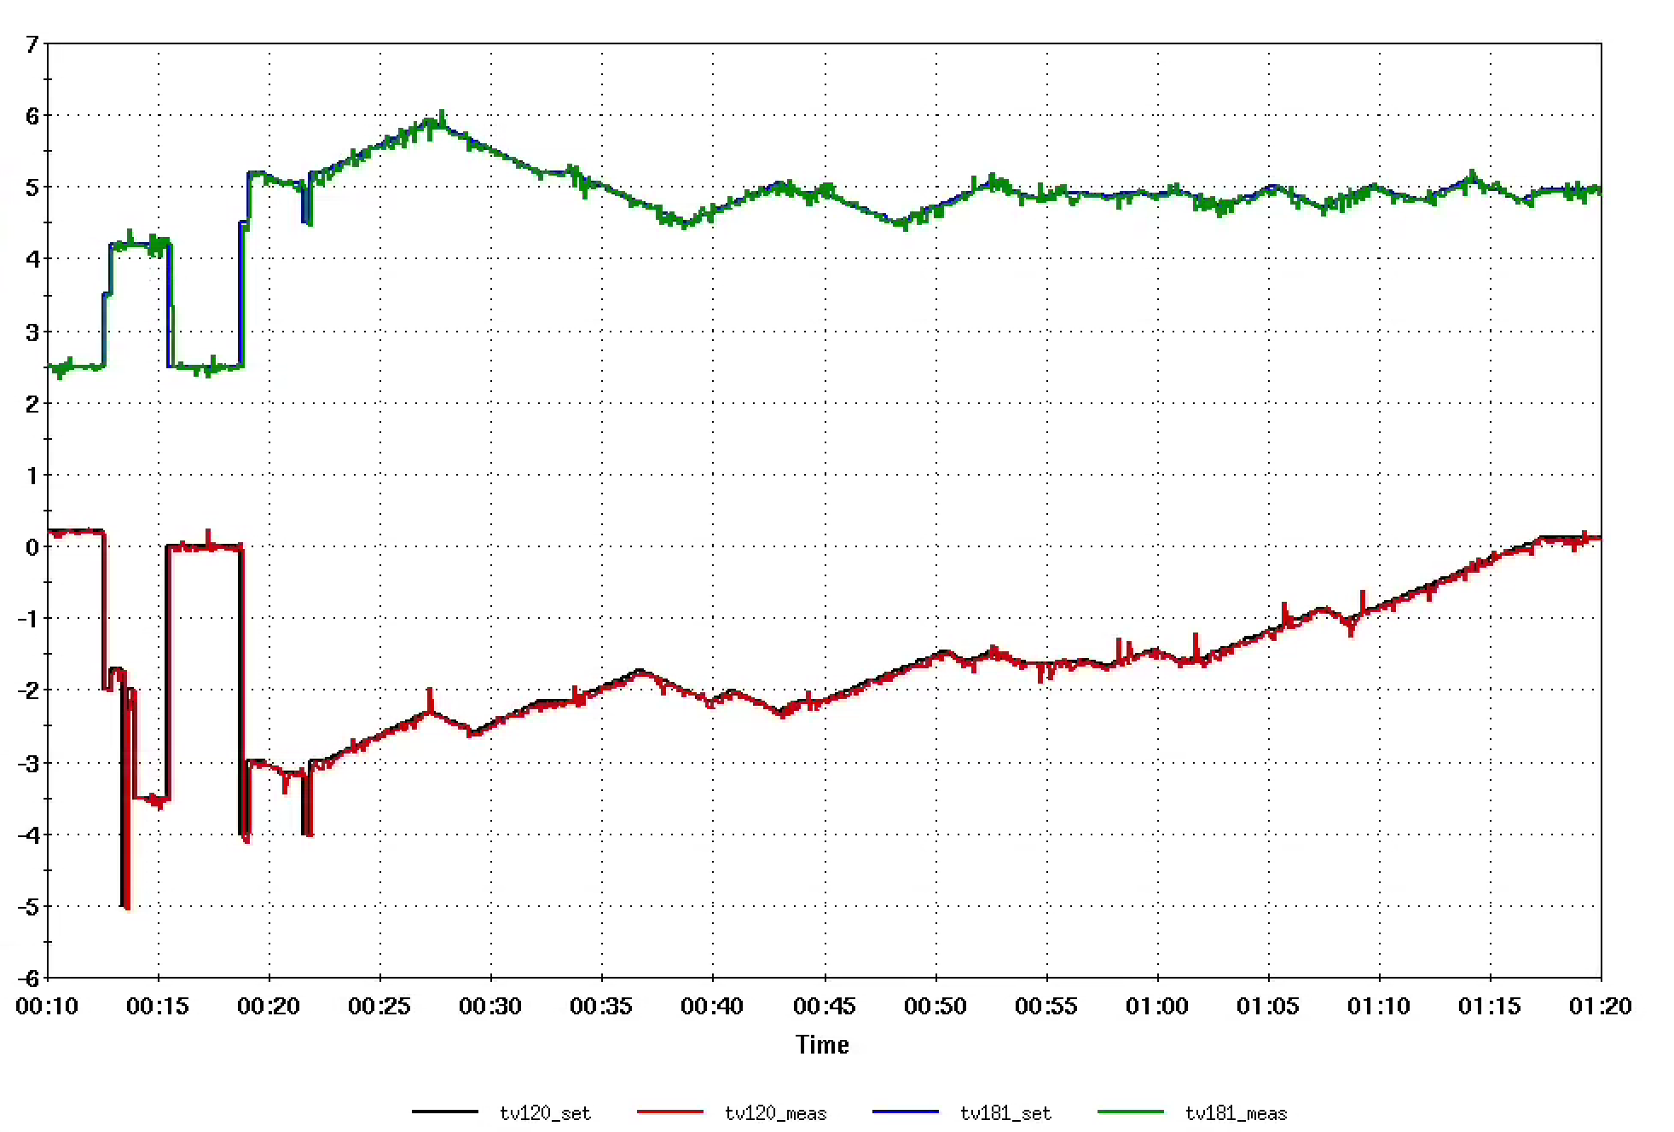
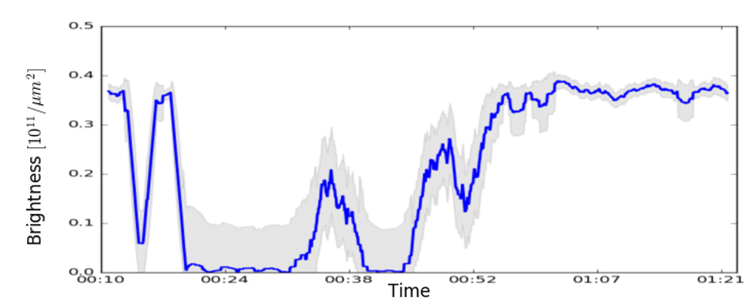
Injection optimization – 2024 Test Results
Steering (2H + 2V)
IPM signal possible
Averaged 3 cycles
1+ hrs

Slide 7
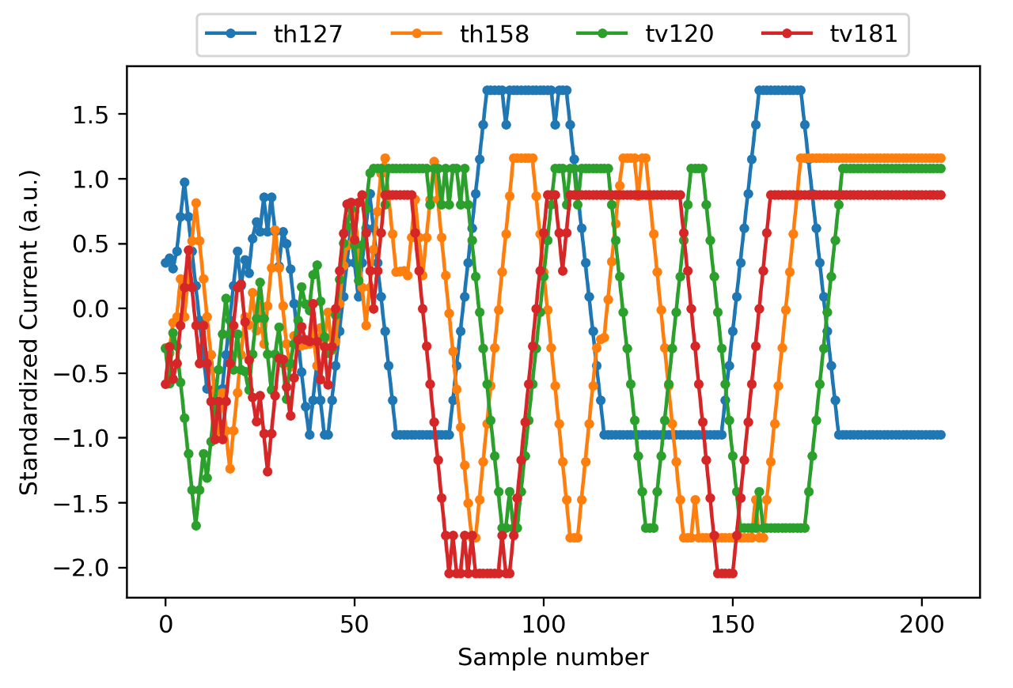
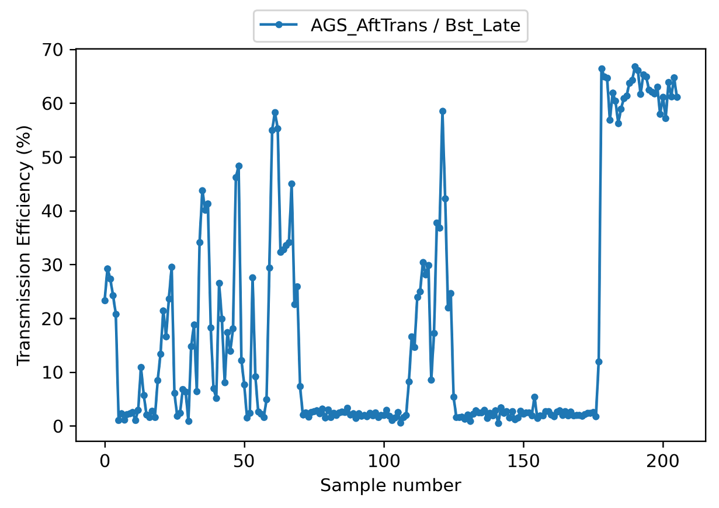
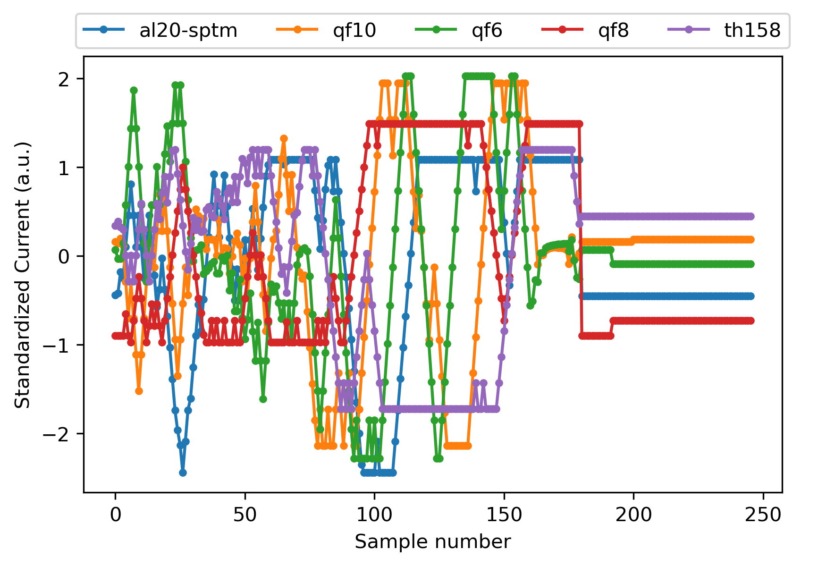
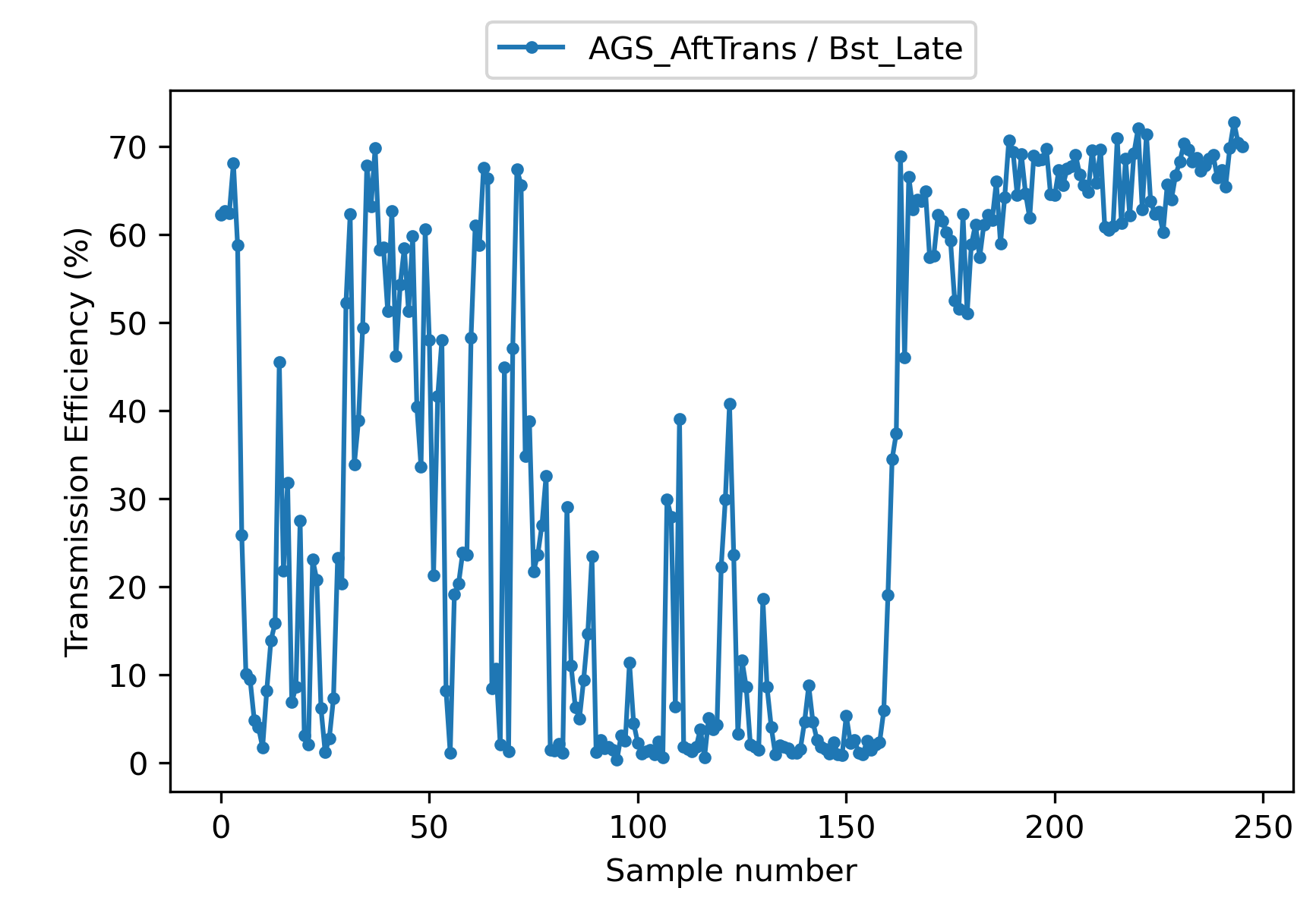
Injection optimization – 2025 Test Results
Steering (2HC + 2VC)
No IPM signal
No averaging
~20 mins
Shaping (3QF + 2HC)
No IPM signal
No averaging
~25 mins

Slide 8
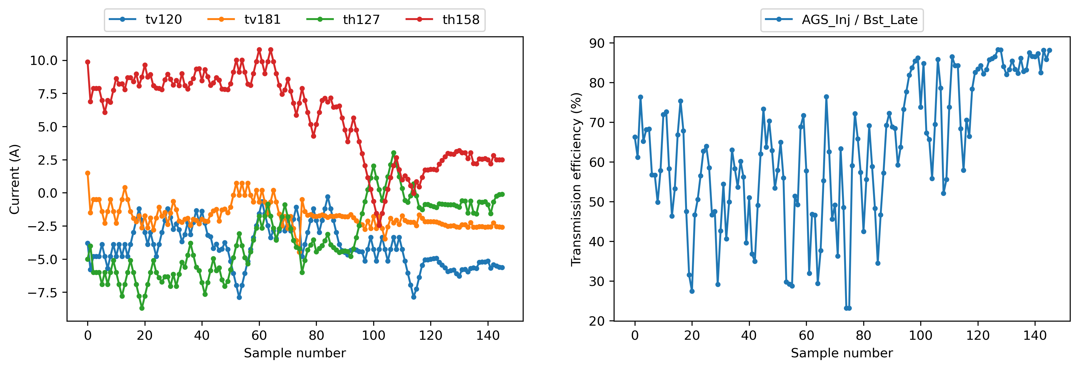
Injection optimization – 2025 Validation
Real-world test – 20% improvement
Steering (2HC + 2VC)
No IPM signal
No averaging
~15 mins

Slide 9
Discussion

Slide 10
Thanks for Listening!
Questions?

