Slide 1

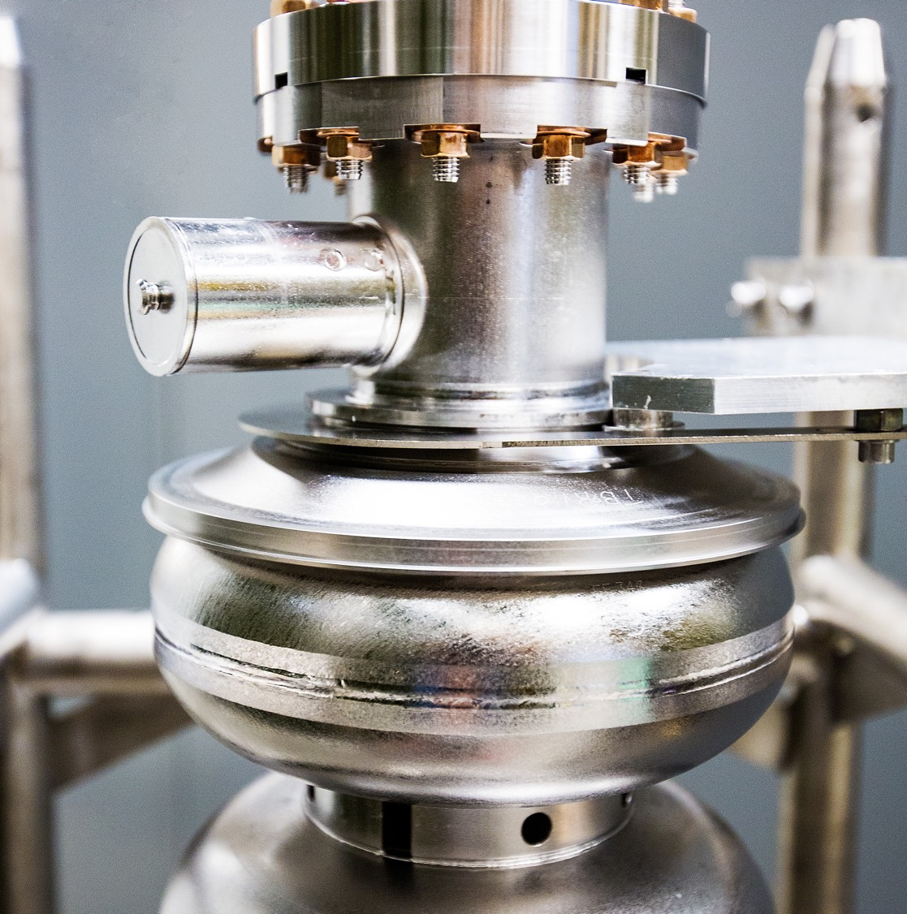
RL for AGS Injection
Discussion Topic
10/20/2025
Armen Kasparian

Slide 2
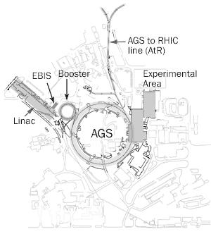
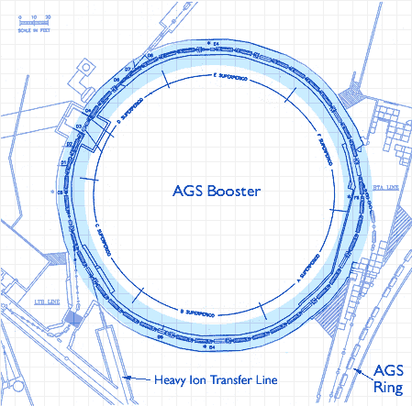
Problem Definition
Variance in the beam input from the AGS Booster into the Booster to AGS transfer line (BtA) causes loss of beam intensity through the transfer line
Correctors and quads exist in the BtA to adjust and shift the beam and raise the efficiency of the transfer line
Multi wires exist in the BtA although some are too destructive and cannot be utilized for optimization
Has to be manually tuned on a weekly basis to bring expected output closer to input intensity
BtA
https://www.bnl.gov/rhic/booster.php

Slide 3
Staged Development Process
Stage 1:
Develop SciBMad simulation to be utilized for environment
Develop environment interfacing between python Scientific Optimization Control Toolkit (SOCT) and Julia based SciBMad simulation
Algorithm study for optimization on this SciBMad surrogate environment
Stage 2:
Develop proxy with safeguards
Calibration and fine tuning of trained model utilizing real accelerator
Retrain agent on real accelerator
Apply algorithm on accelerator

Slide 4
Stage 1 Breakdown
Develop simulation to be utilized for environment
Developed as close to real accelerator as possible
Build in SciBMad and written in Julia
Develop environment interfacing between python Scientific Optimization Control Toolkit (SOCT) and Julia based SciBMad simulation
Build a wrapper around Julia simulation
Interface between the simulation code and the control optimization code should allow for gradient passing
Augment wrapper to include differentiability
SciBMad built in Julia allows for potential differentiability (in respect to actions) in the simulation
Algorithm study for optimization on this SciBMad surrogate model
With environment built, test multitudes of different control and optimization algorithms
Applying Deep Differential Reinforcement Learning (DDRL), Deep Reinforcement Learning (DRL), RED-Q, Bayesian Optimization (BO) etc.
Integrate UQ, exploration techniques, and new algorithms to accelerate the RL learning process, improve the sample-efficiency, and improve solution robustness.

Slide 5
Stage 2 Timeline
Develop interface/proxy between control algorithm and accelerator with appropriate safeguards
Calibration and fine tuning of trained model utilizing real accelerator
Run model without sending actions to accelerator to insure simulation matches real system
Run model and retrain agent on real accelerator
Retrain the model allowing actions to be performed in real time
Apply model on accelerator
Utilize trained model on real accelerator when needed
T1
T2
T3
BtA Transfer Line
BtA Transfer Line
BtA Transfer Line
Calibration
Retraining
Application
Pretrained model on Simulation
Calibrated Pretrained model
Finalized model

Slide 6
Scientific Optimization and Control Toolkit (SOCT)
https://github.com/JeffersonLab/SciOptControlToolkit
Composable
Easy to add new agents and environments
Registration mechanism
Allows for easy development and use of new components
Standard OpenAI Gymnasium API
Utilize industry standard Gymnasium environment specification
Visualizations
Tensorboard integration allows for live monitoring of training
Reproducible
Models and configurations are saved and stored for inference/retraining
Easily pull in previous runs for continued research

Slide 7




SOCT and SciBMad Simulation Interoperability
SOCT built and developed in Python
Utilizes either Tensorflow/Pytorch for differentiation and interfaces with environments built with Gymnasium
Environments are standalone and exist without SOCT
SciBMad build and developed in Julia
Buffer
Buffer
Agent
SOCT
(Python)
Environment
PyJulia
Action
Next State
SciBMad
(Julia)
Simulation

Slide 8
Current Environment Setup
Built and currently running!
Single step optimization (absolute action)
State (8): 4 Steering Magnets / Horizontal/Vertical Beam Positions / Horizontal/Vertical Beam Size
Action (4): 4 Steering Magnets
Reward: Transfer efficiency
Julia simulation (SciBMad) interfaced with via PyJulia
Gradients cannot be passed between Python and Julia through PyJulia
Need some sort of manually implemented gradient interface between the two programs
Working out some bugs with the variables being calculated (potentially requiring an updated version of SciBMad)

Slide 9
End Goal Environment Setup
Multi step optimization (time dynamics)
State (~24): 4 Quads / 4 Steering Magnets / 4 multi wires (each x/y reading with mean/std)
Action (~8): 4 Quads / 4 Steering Magnets
Reward: Transfer efficiency
Julia simulation (SciBMad)
Fully differentiable simulation with gradients propagating between Julia simulation and Python optimization code
Time dependence dynamics found in real machine

Slide 10
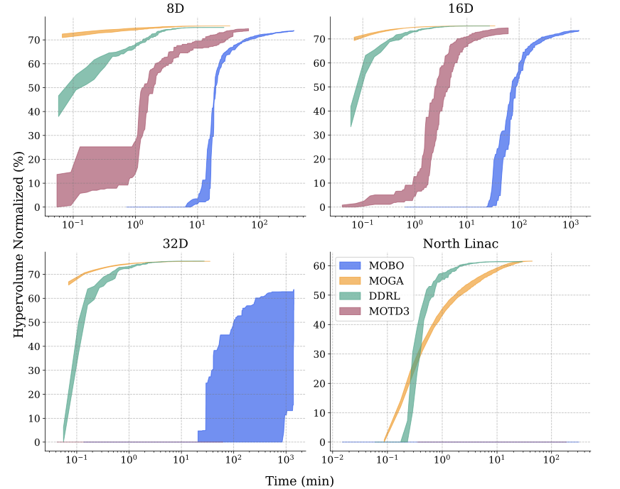
Differentiability and why it matters to us
Harnessing the Power of Gradient-Based Simulations for Multi-Objective Optimization in Particle Accelerators
Deep Differential RL outperforms BO, GA on higher dimensional problems
Utilize gradients instead of the critic model in the RL actor critic setup allows for better performance!
Paper focuses on multi objective environments but is extensible to single objective environments as well
Notes:
Figure 6: Pareto Coverage on different environments with the four algorithms. Note - the x-axis is shown in log scale and does not include iteration 0, as such the Hypervolume at that step (zero due to random initialization) is not shown in the figures.

Slide 11
Practical Approach to Gradient Passing
PyJulia provides the following:
Function calls: Python → Julia → Python (values only)
Data conversion: NumPy arrays ↔ Julia arrays
No automatic differentiation bridge
Manual gradient implementation
Compute the gradients in Julia, then pass them back to Python
Tensorflow Custom Gradient function with Julia call internally
NOT TESTED BUT COULD BE A SOLUTION
Next State, Reward, Gradients
Environment
SciBMad
Action

Slide 12
Appendix

Slide 13
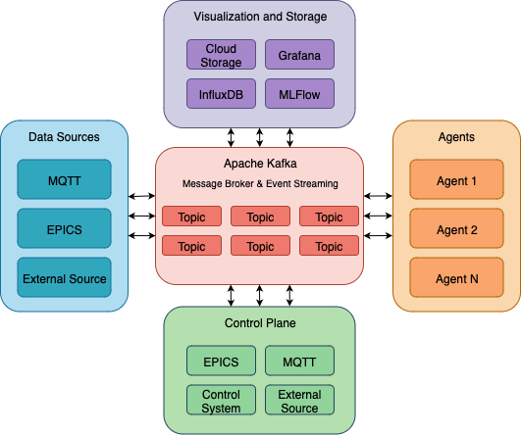
Streaming Monitoring Optimization Control System (SMOCS)
Kafka based distributed data streaming platform
Designed for real time data streaming, processing, ML model training/inference, and controls

Slide 14
Reinforcement Learning vs Bayesian Optimization*
Reinforcement Learning
Generalization Across Operating Conditions: RL trains a single policy network that can handle diverse scenarios (different beam energies, magnet configurations, initial conditions) without reoptimization. Once trained, the policy provides instant predictions (<1ms inference) for any new condition, making it ideal for real-time accelerator operations where conditions change frequently.
Sequential Nature of RL: While currently single-step, particle accelerators often require dynamic correction along the beamline or adaptive responses to time-varying disturbances. RL's framework naturally extends to multi-step trajectory optimization and online learning, allowing the same infrastructure to scale when you add temporal dynamics or feedback control.
Exploration of Complex Reward Landscapes: RL algorithms use sophisticated exploration strategies that can discover non-obvious solutions in reward functions with many local optima, discontinuities, or complex constraints.
Bayesian Optimization
Extreme Sample Efficiency: BO typically finds potential solutions in low dimensional and low statistical samples quickly by intelligently balancing exploration and exploitation using probabilistic models.
Uncertainty Quantification: BO provides confidence intervals on predictions and naturally handles noisy objectives, giving you not just "best currents = [2.3, -1.5, 0.8, -2.1]" but also "±0.3A confidence" on each value.
Simplicity: BO is built for single step optimization and can be applied in the manner that the current process is currently done. Instead of manually tuning the BtA every week you can run a BO script to optimize the parameters and leave it until retuning is required.
Computational Cost: Scaling performance drops when the state space and action space grows
*for this problem

Slide 15
Discussion notes that came up
Domain randomization in the environment required to learn the underlying unknown variables of the BtA SciBMad simulation
Potential for using PyTorch gradient passing effort from SciBMad (Julia to Python) instead of manual gradient passing via Tensorflow custom gradient functions
Potential of using the NSRL beam line to create an environment that allows more testing and beam time than the BtA for algorithm development

