Slide 1
Coupling Analysis in LtB
Lucy Lin
3rd AI/ML for EIC Hadron Pre-injectors Collaboration Meeting
Oct 20-22, 2025

Slide 2
Optically Pumped Polarized Proton Source
OPPIS (Optically Pumped Polarized Ion Source) Since 2000, H⁻ ion source has been upgraded several times to higher intensity and polarization.
Prior to Run-13(2013), the ECR-type source was used to generate the primary proton beam. The ECR-source was originally developed to operate on DC current and placed inside a super conductive solenoid (SCS).
In 2013, the ECR-source was replaced with a high-brightness source “Fast Atomic Beam Source” (FABS) operating in a pulsed mode. The FABS-source improved source parameters such as beam current density, angular divergence and stability.
In 2022, We reduced the LEBT portion of the beam line by about 5feet, modify polarization part of OPPIS (He-cell, Rb-cell and Na-cell) and the extractor-transformer system.
D. Raparia 25/06/18

Slide 3
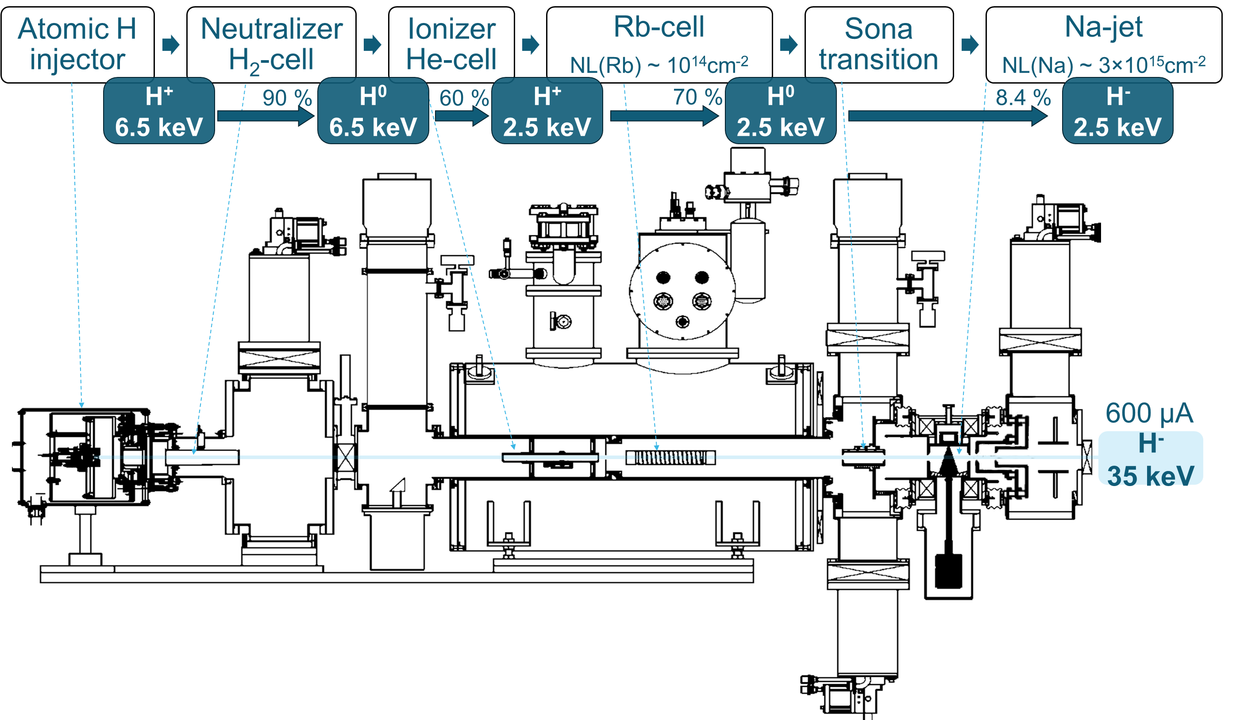
Optically Pumped Polarized Ion Source
OPPIS produces 3-5 mA Polarized H⁻ ion pulse current
81-84% polarization @200 MeV , 0.5 mA
to LEBT
D. Raparia 25/06/18
Notes:
General Introduction of the OPPIS source.
All three main blocks of the OPPIS were developed with either minor or major upgrades

Slide 4
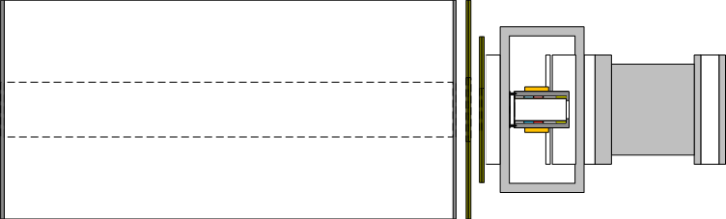
Polarization Transfer Technique
Polarized light
Polarized electron
Polarized proton
Production of circular polarized tunable wavelength (~795nm) laser beam
Polarization of the outer electron of Rb-atom by laser
Ionization of hydrogen atom at He-cell
Production of electron spin polarized hydrogen atoms by capture electron from Rb
Polarization transfer from electron to proton by “Sona-transition” technique
Ionization of hydrogen atoms by capture of second electron in Na-jet for acceleration
Solenoid scan
H⁰
Na-jet
&
Solenoid
H⁻
He-cell
Rb-cell
SC-solenoid
Sona-transition with 3 corr. coils in it
D. Raparia 25/06/18

Slide 5
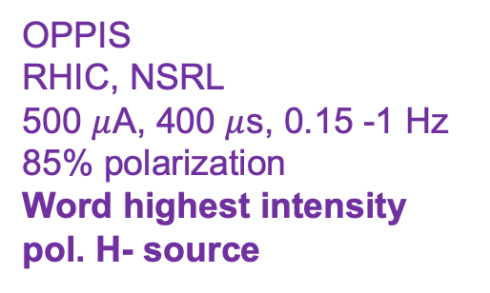
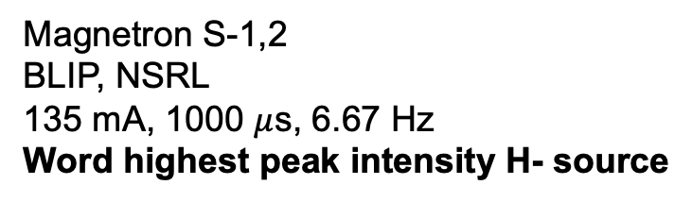
Polarization Direction Manipulation
The Low Energy Beam Transport (LEBT) lines combine three beams. The first line is the polarized OPPIS beam-line and the second and third are the high-intensity unpolarized beam-line.
Switching Magnet
Slits for energy discrimination
Magnetron S-2
OPPIS
RHIC, NSRL
500 $μ$A, 400 $μ$s, 0.15 -1 Hz
85% polarization
Word highest intensity pol. H- source
23.7 deg. dc dipole magnet
To RFG
OPPIS
RFQ
LEBT
Magnetron S-1
Chopper
Spin Rotator
Magnetron S-1,2
BLIP, NSRL
135 mA, 1000 $μ$s, 6.67 Hz
Word highest peak intensity H- source
D. Raparia 25/06/18

Slide 6
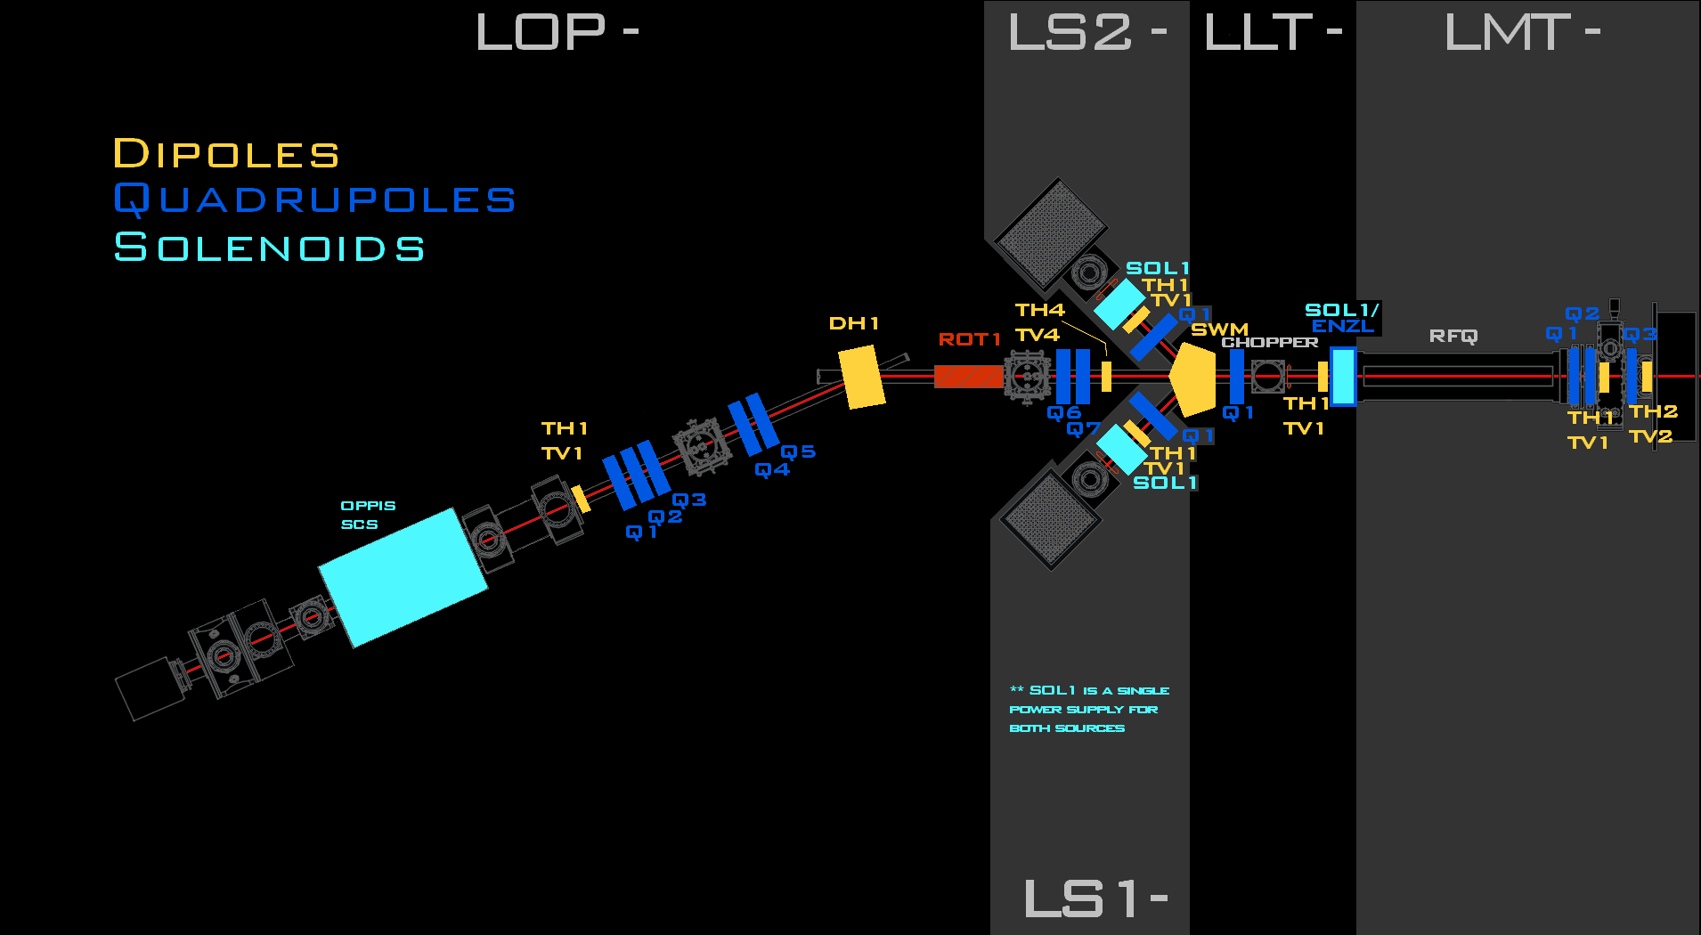
OPPIS / LEBT / MEBT
Corrector scan

Slide 7
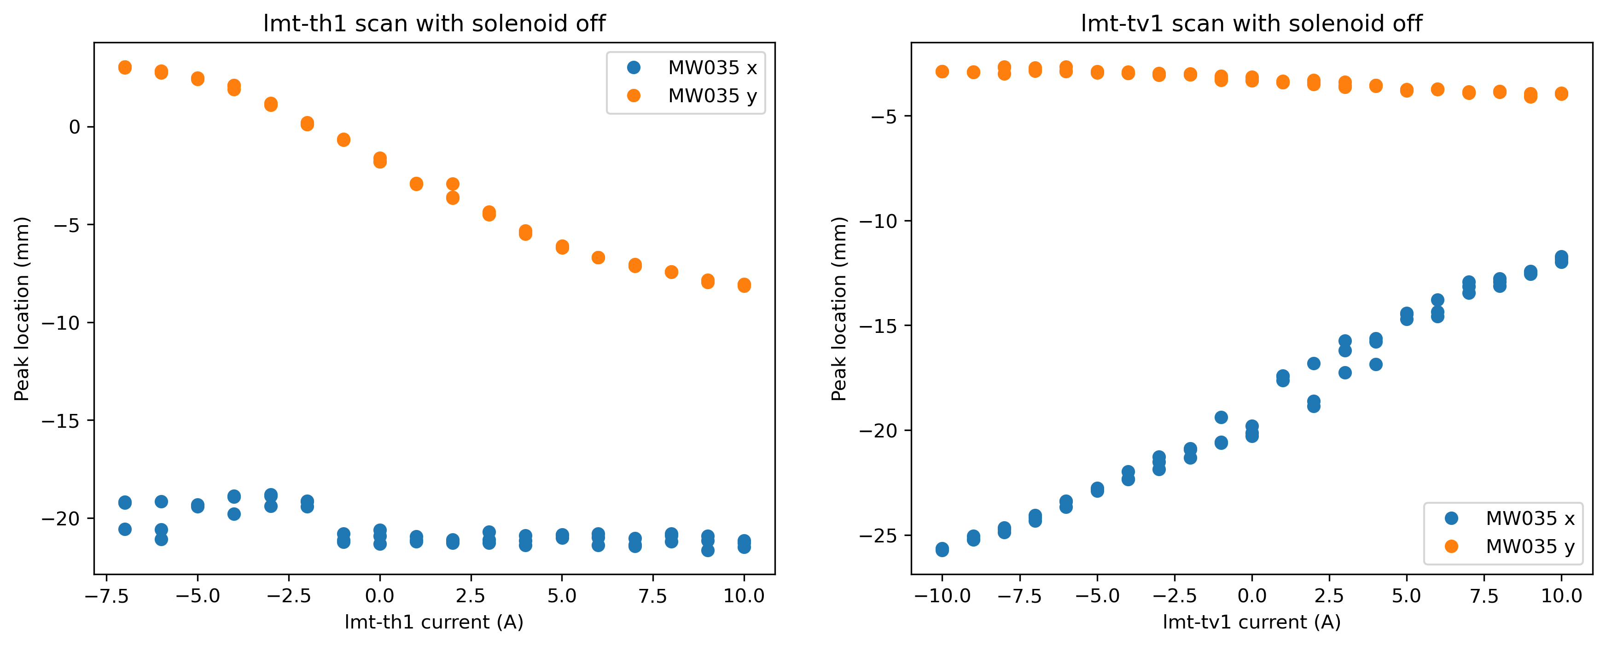
MEBT corrector scan
Found that polarities of lmt-th1 and lmt-tv1 were reversed in MEBT

Slide 8
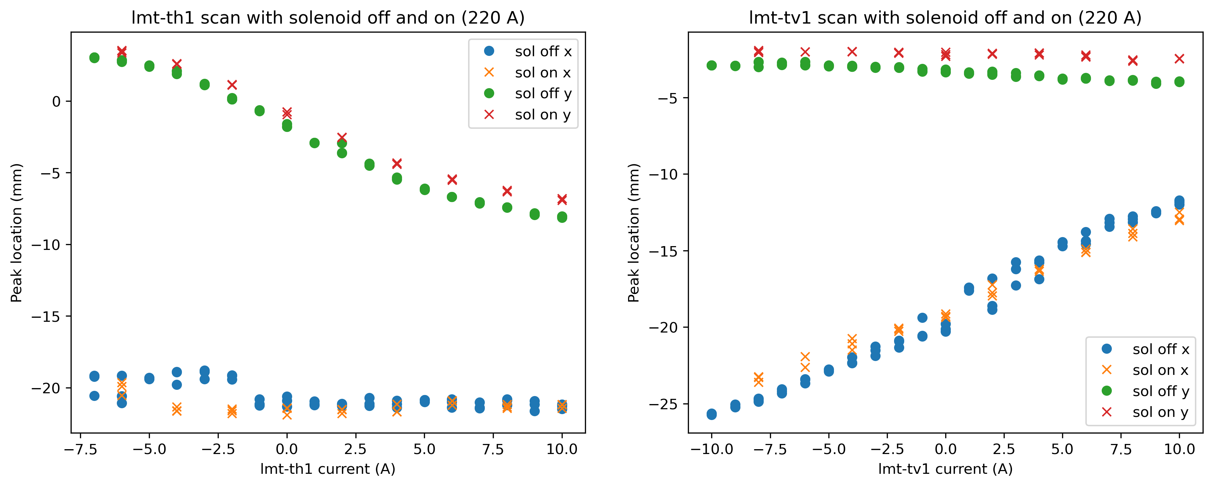
MEBT corrector scan
Turn solenoid in Na-cell off and on, not significant change in behavior

Slide 9
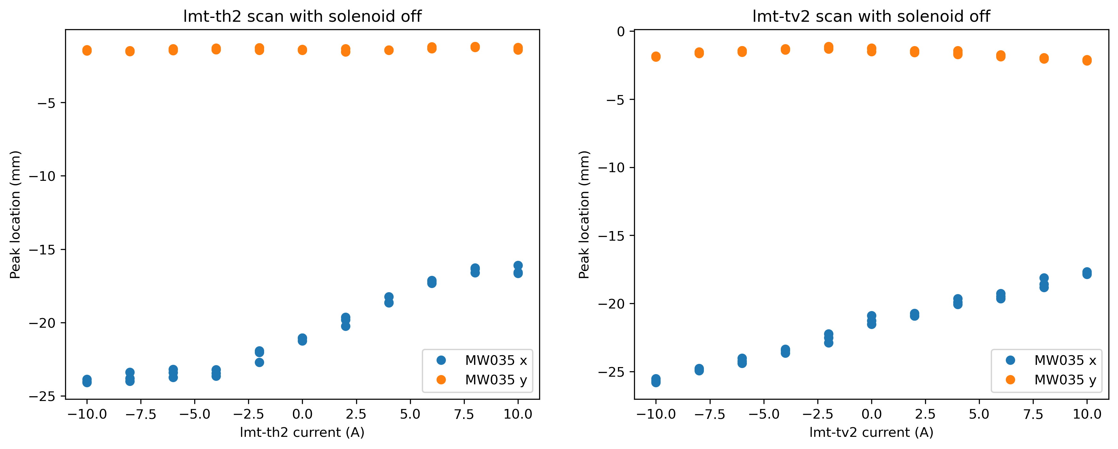
MEBT corrector scan
Weird behavior of lmt-th2 and lmt-tv2? No real explanation as of now

Slide 10
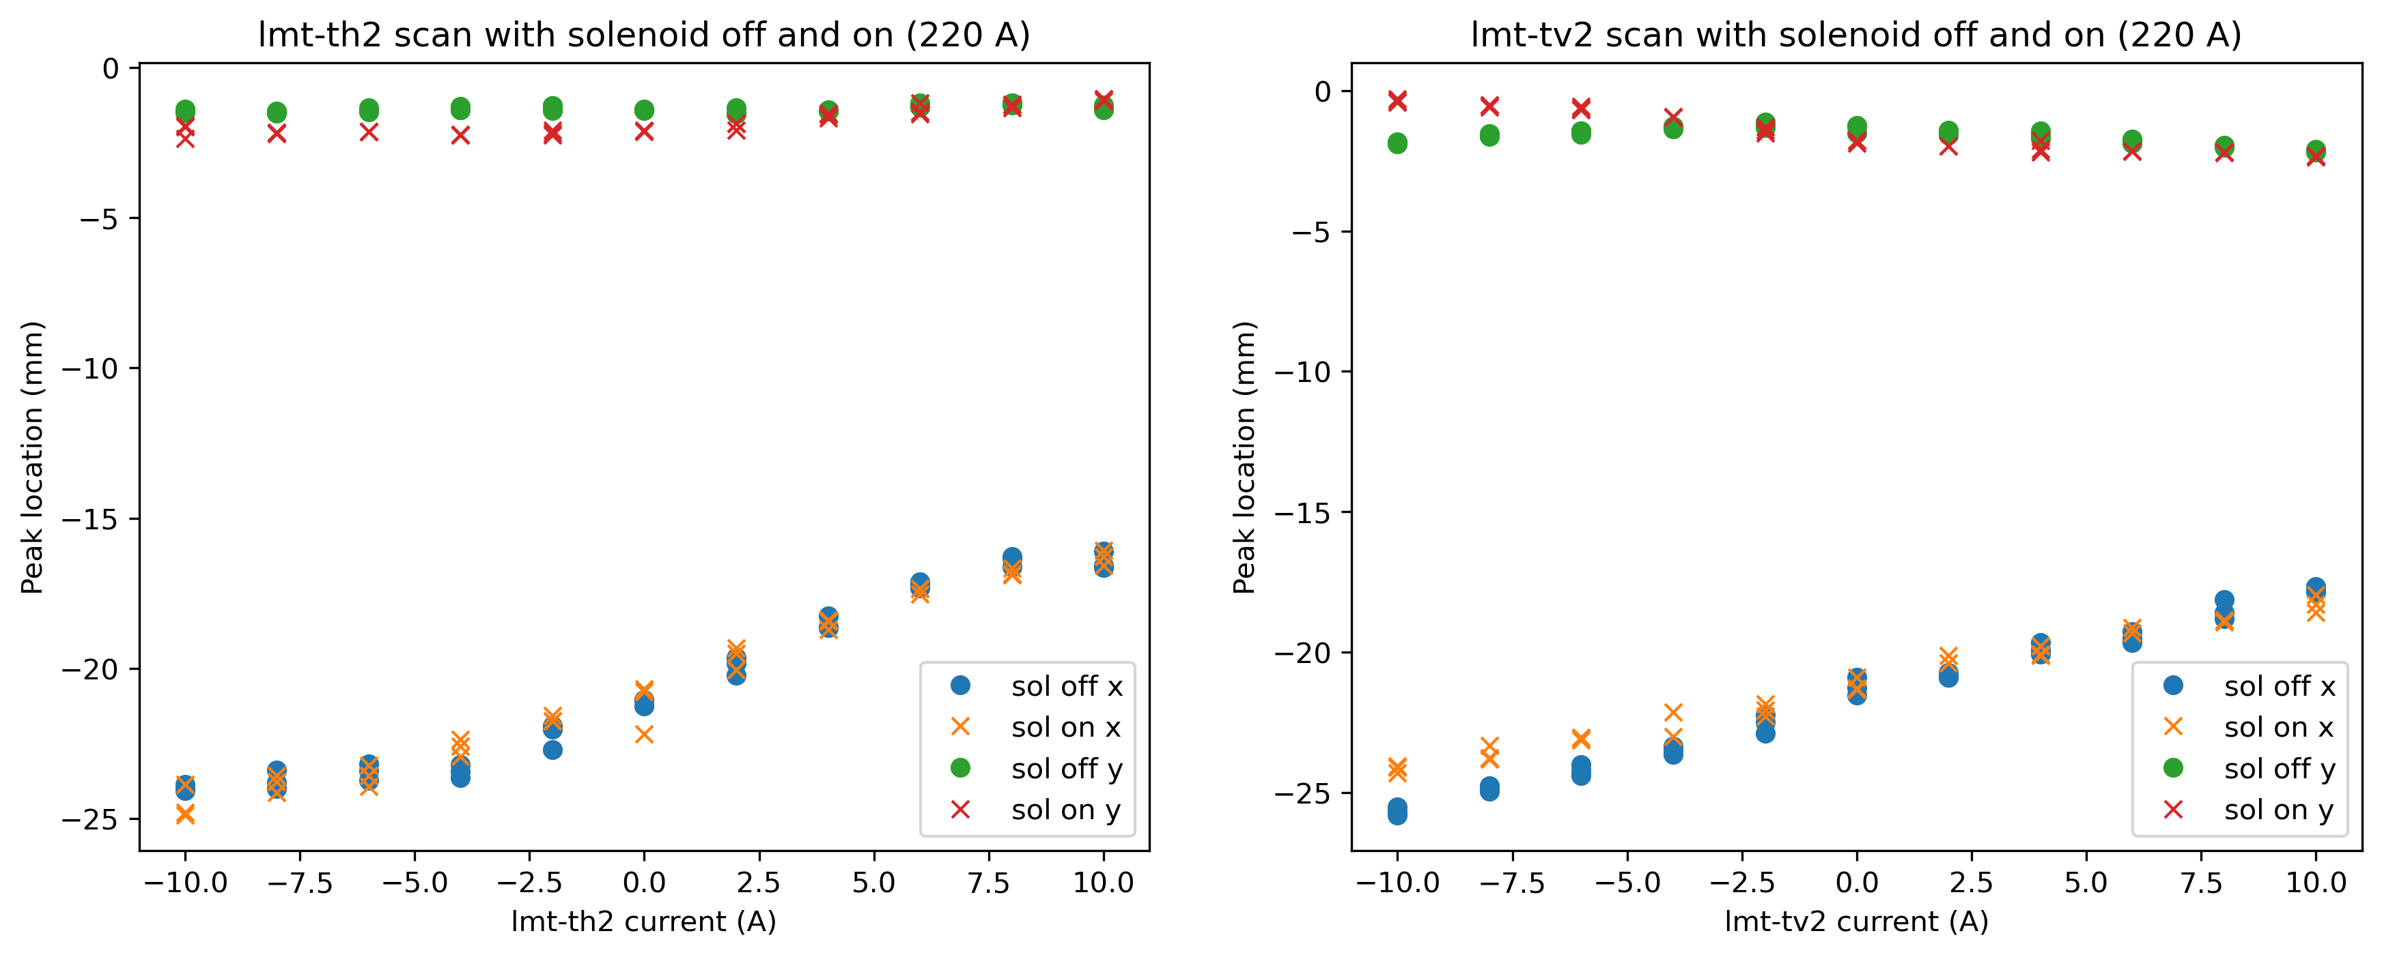
MEBT corrector scan
Turn solenoid in Na-cell off and on, not significant change in behavior

Slide 11
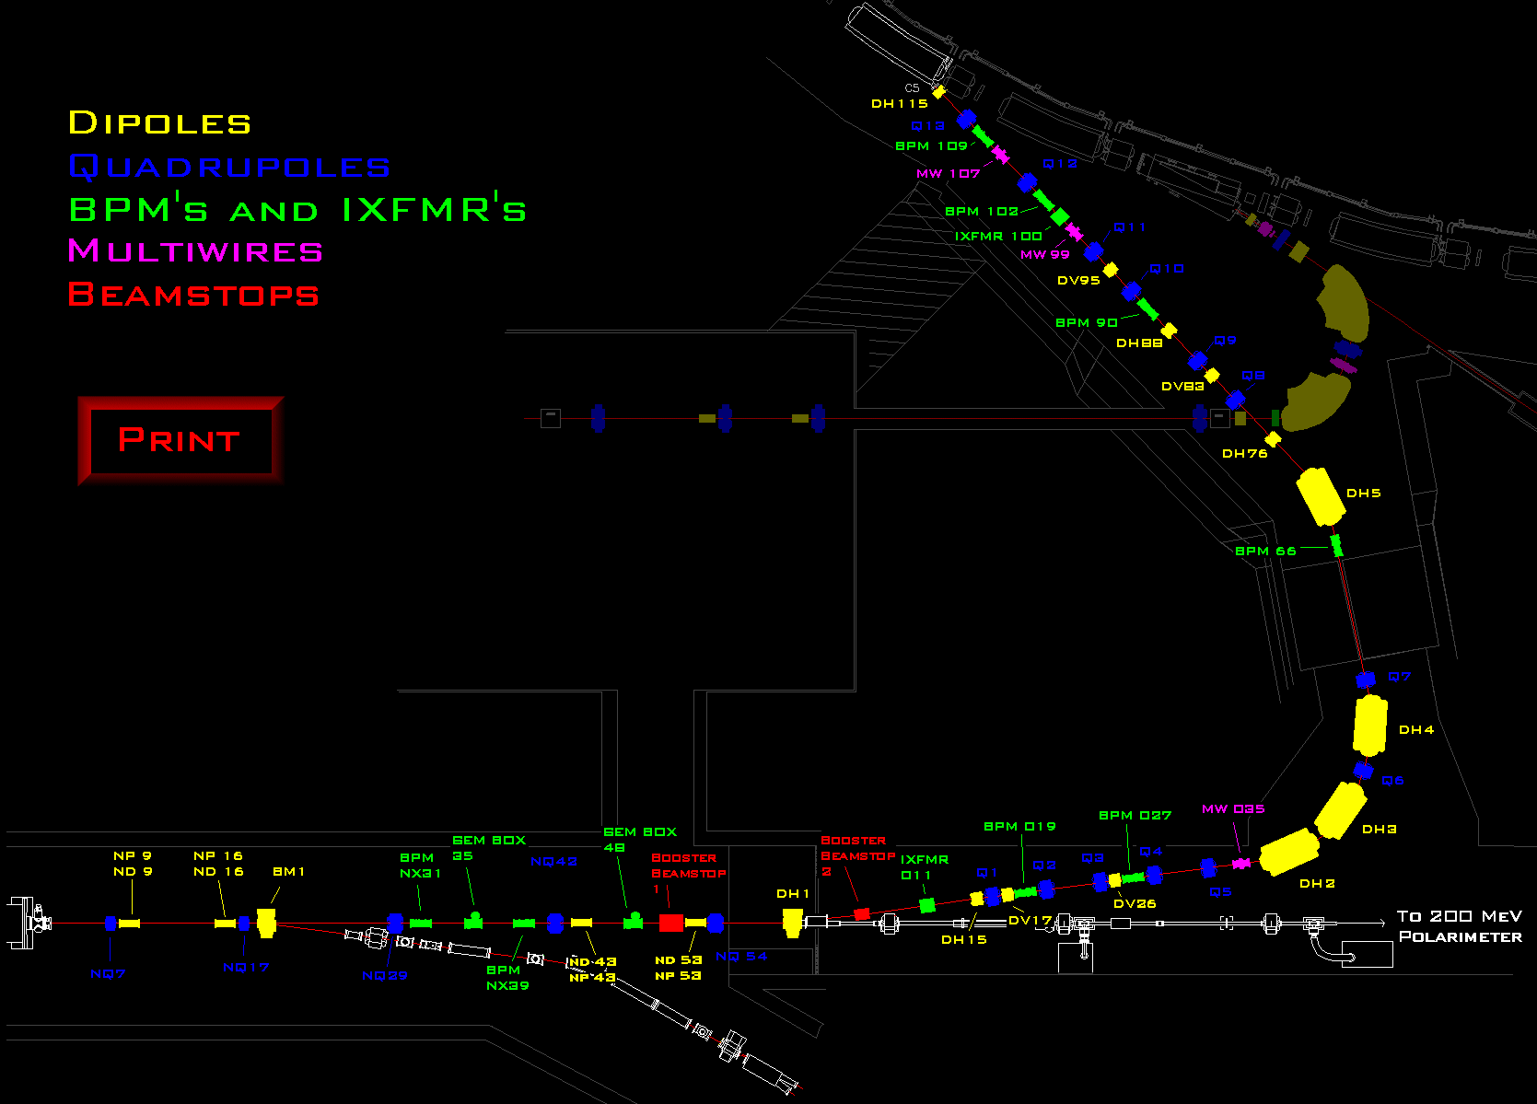
HEBT / LtB
profile observed
Q7 + Q17 scan

Slide 12
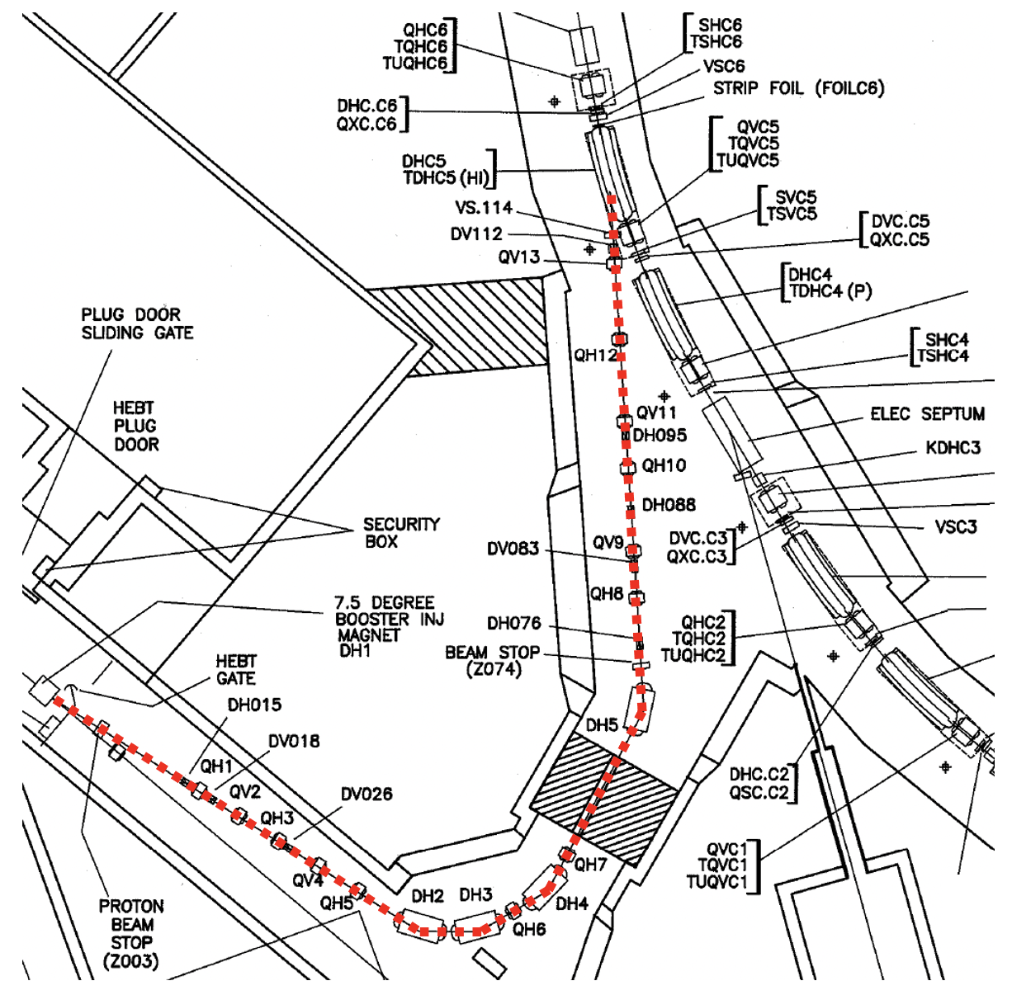
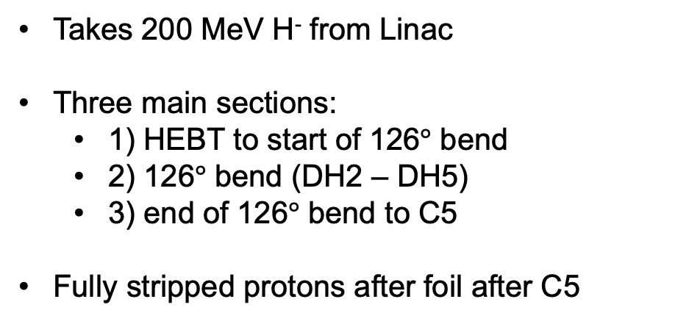
Linac to Booster (LtB)
Takes 200 MeV H⁻ from Linac
Three main sections:
1) HEBT to start of 126$°$ bend
2) 126$°$ bend (DH2 – DH5)
3) end of 126$°$ bend to C5
Fully stripped protons after foil after C5

Slide 13
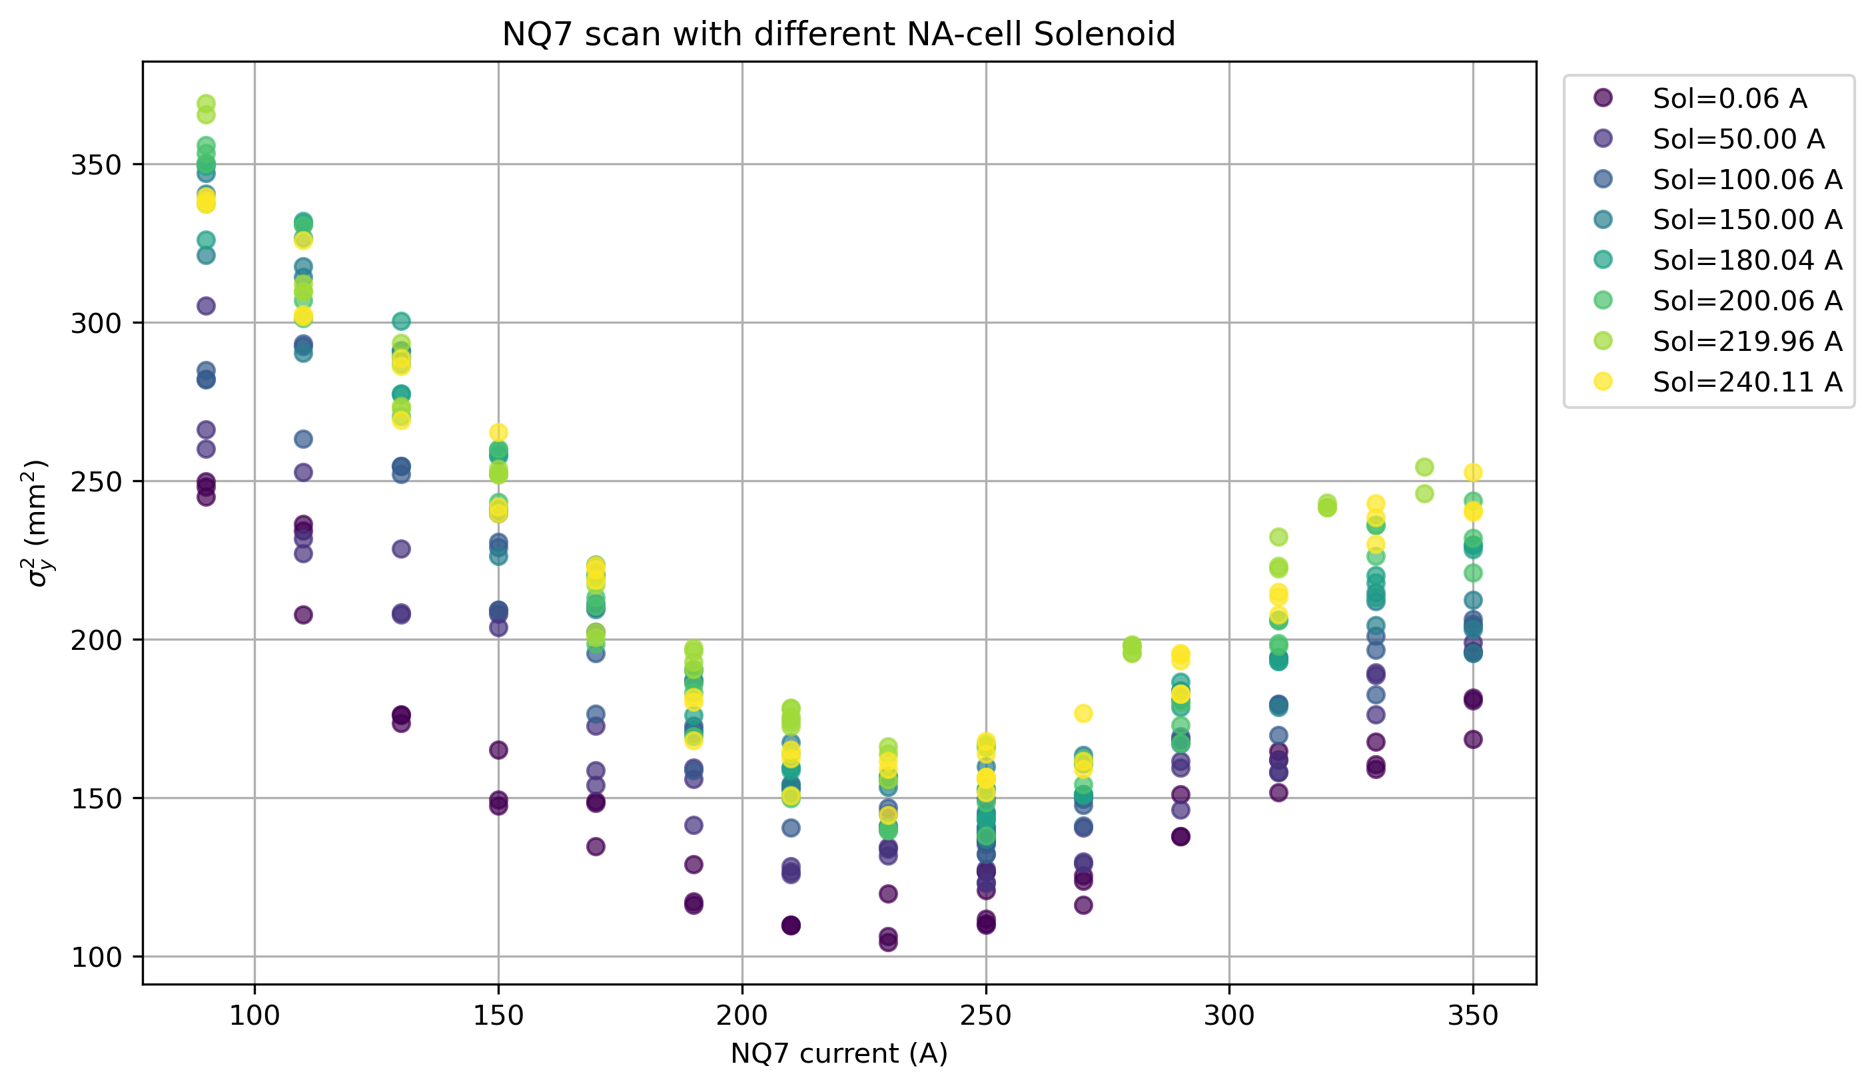
HEBT quad scan

Slide 14
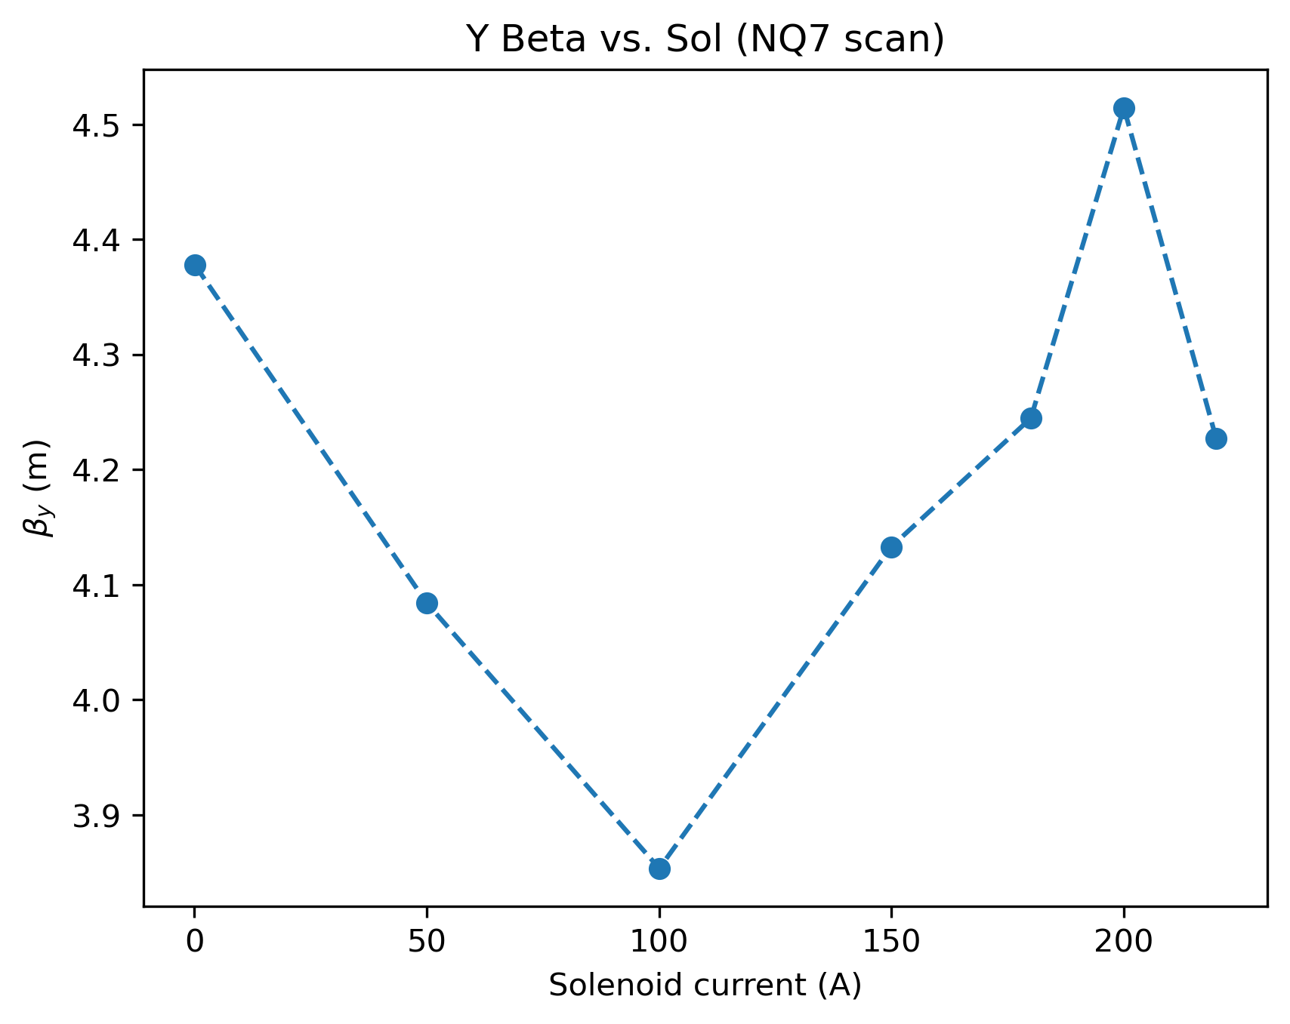
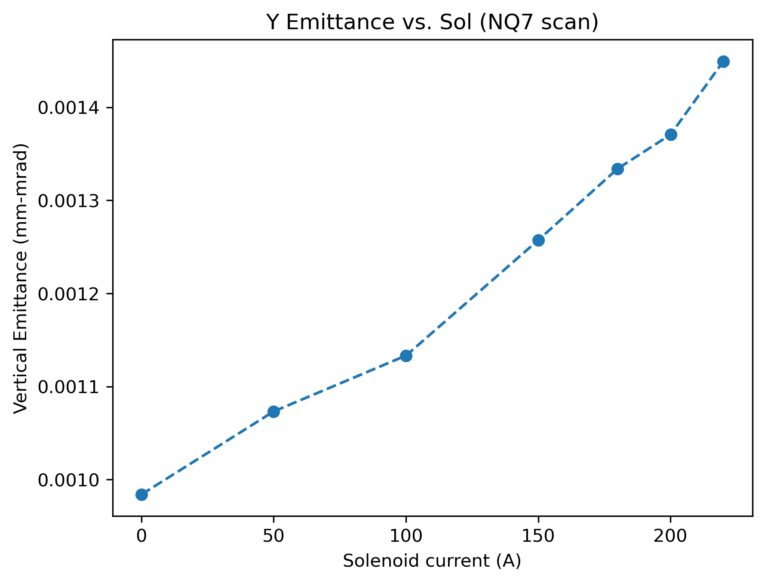
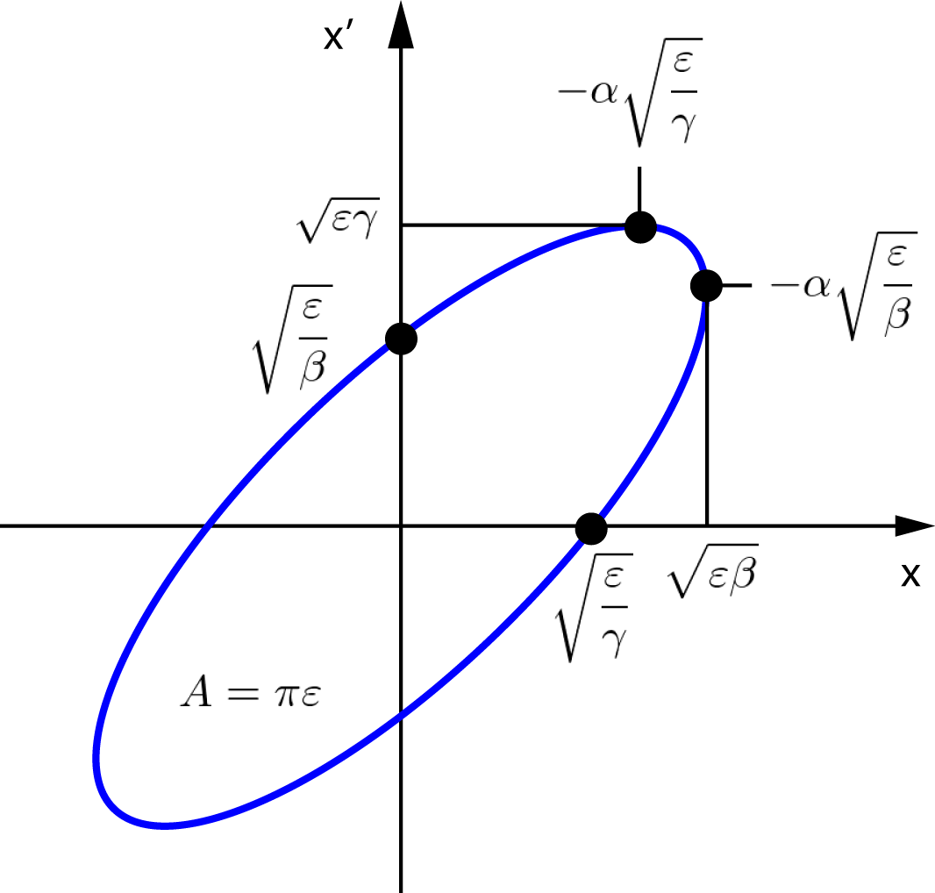
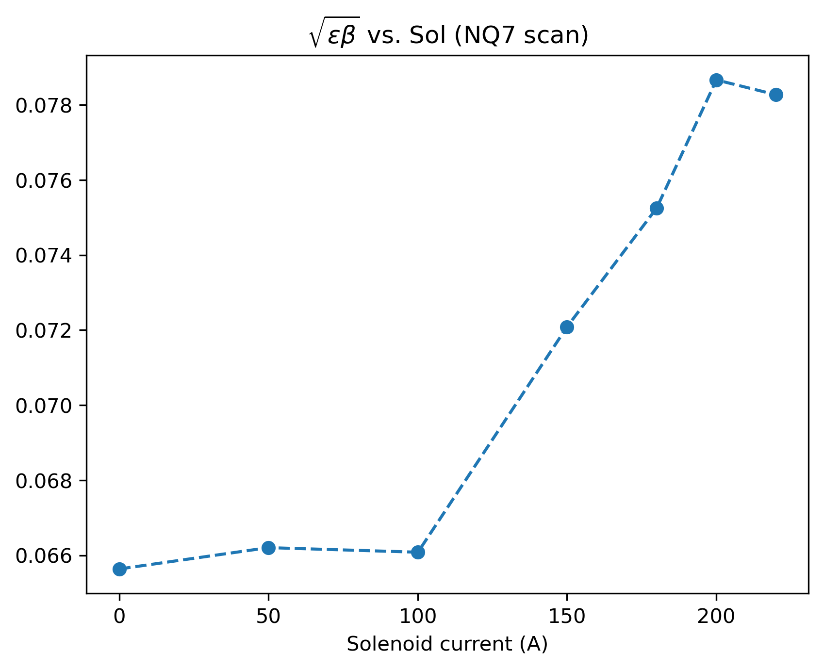
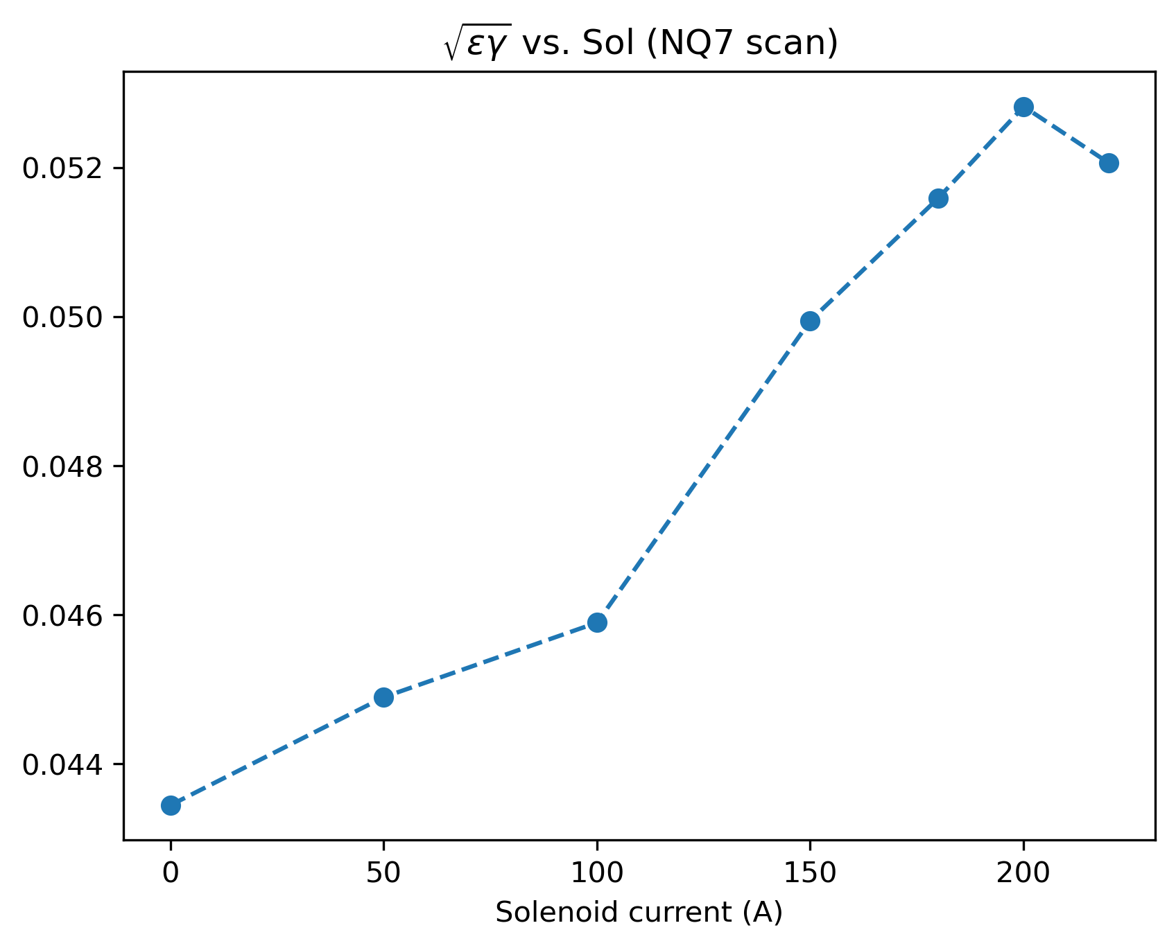
HEBT quad scan

Slide 15
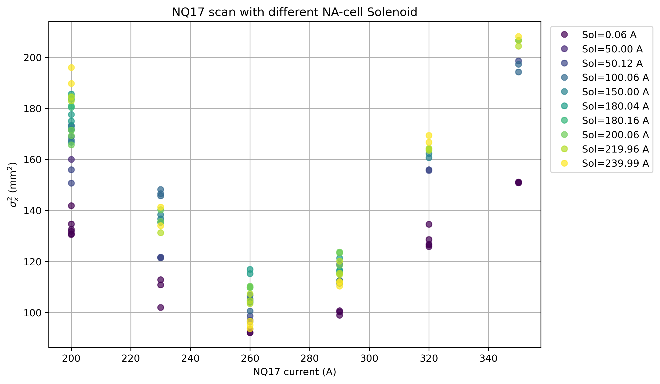
HEBT quad scan

Slide 16
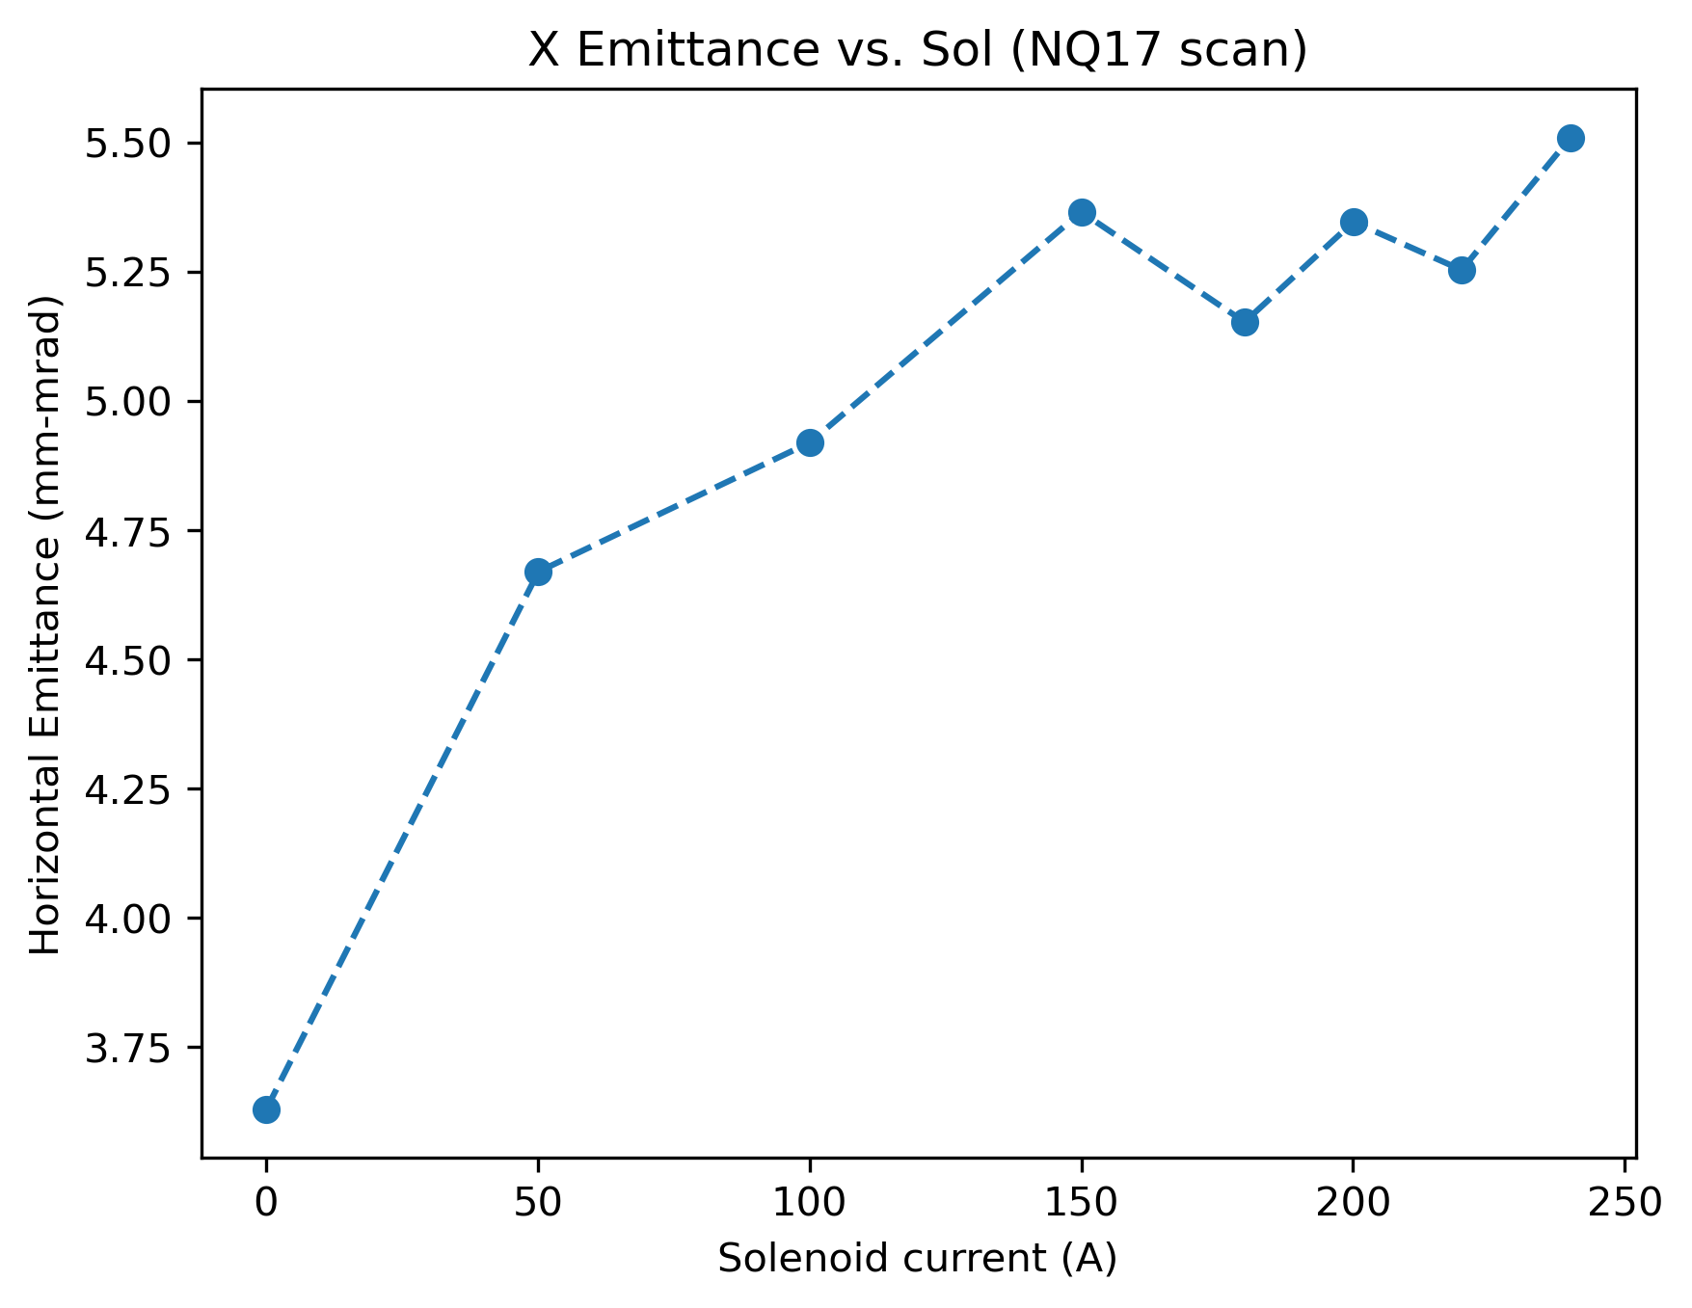
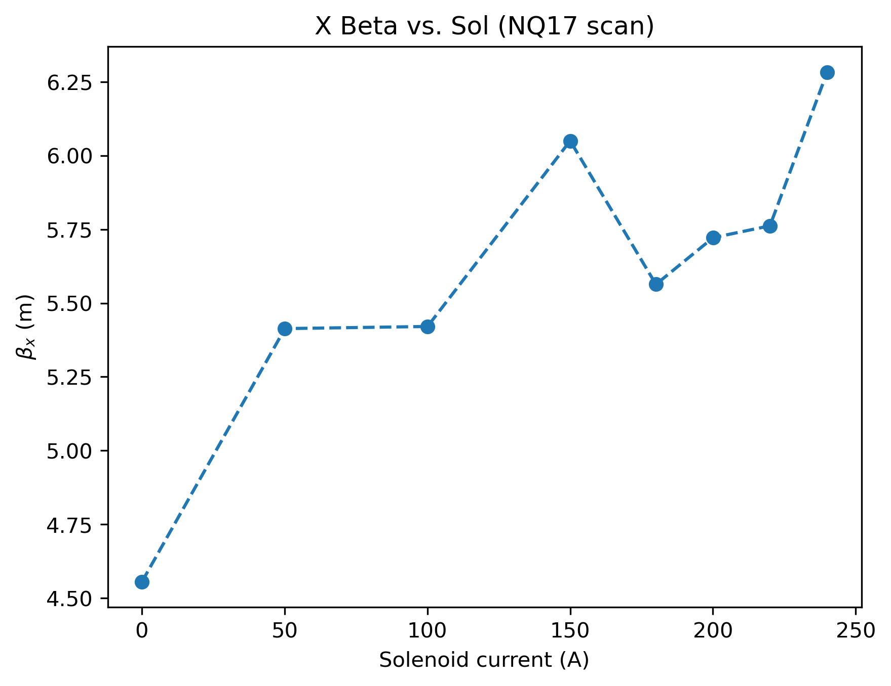
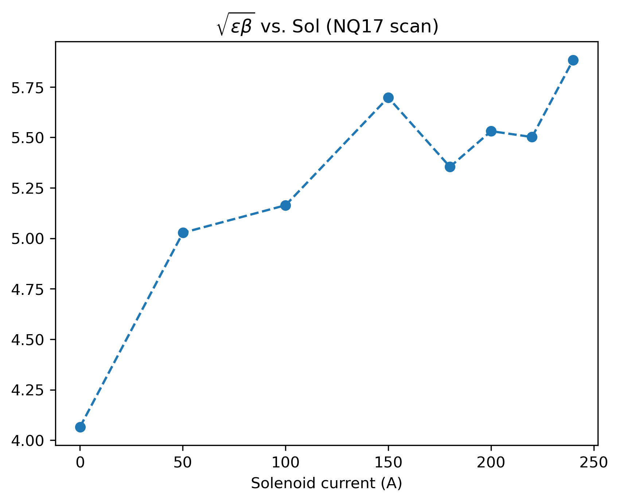
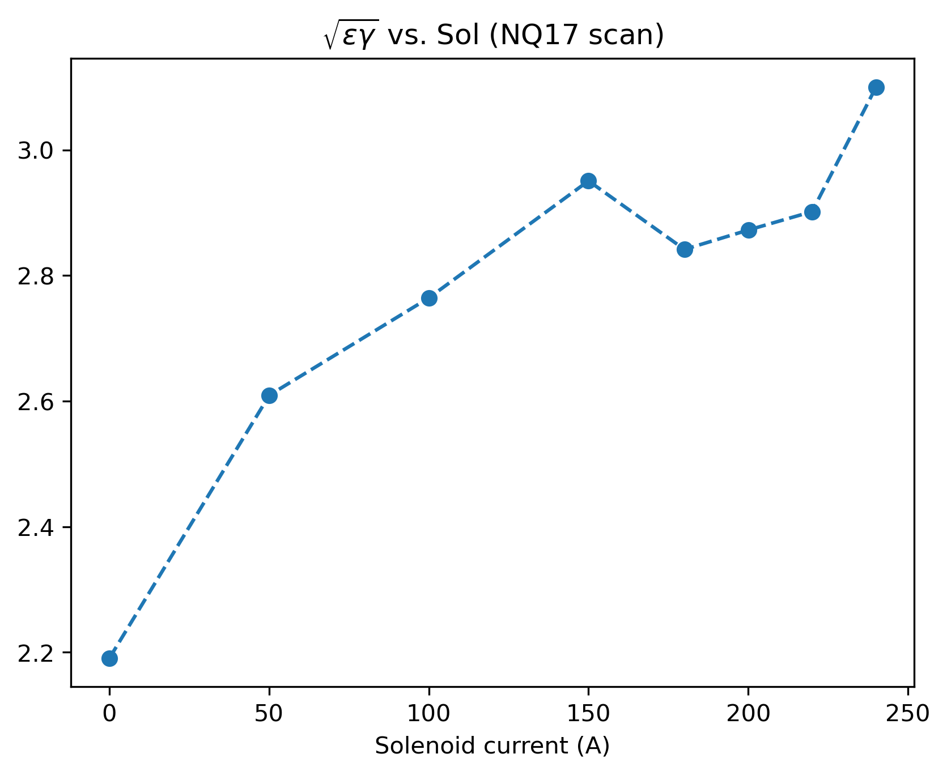
HEBT quad scan

Slide 17
HEBT / LtB
profile observed
Q9 + Q8 scan

Slide 18
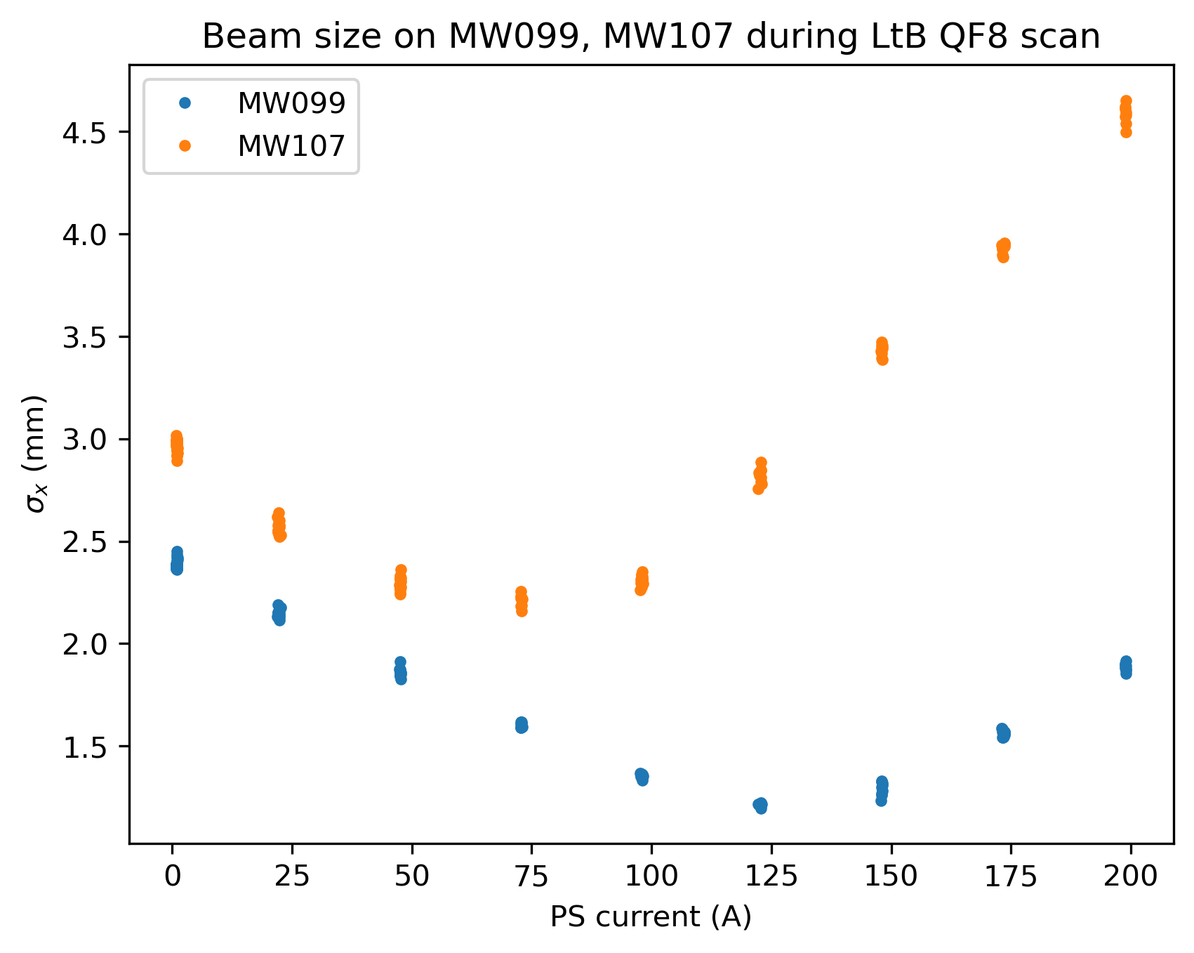
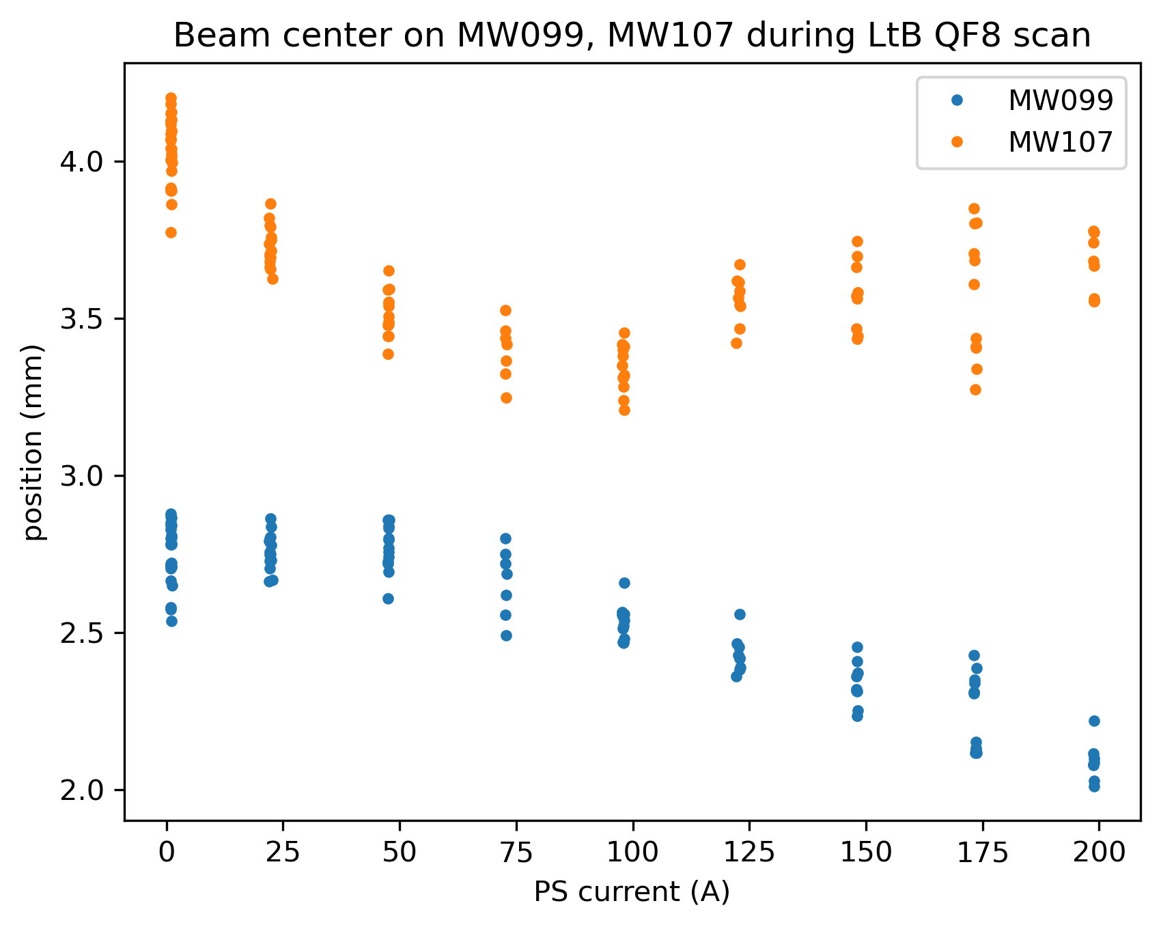
LtB quad scan

Slide 19
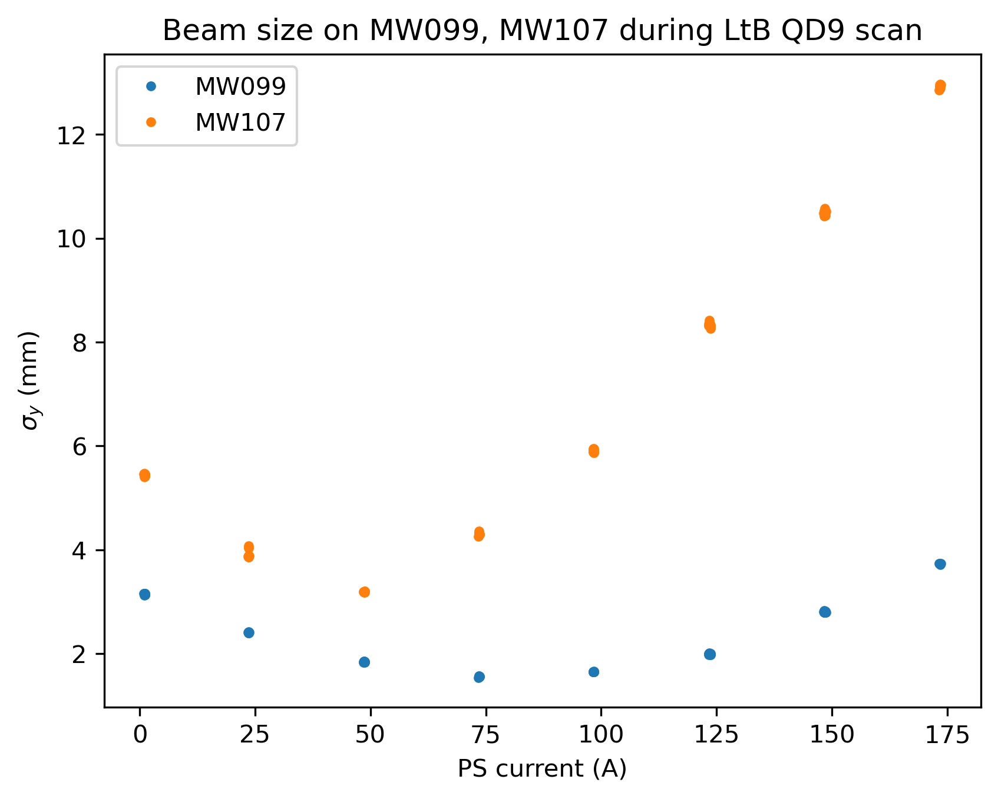
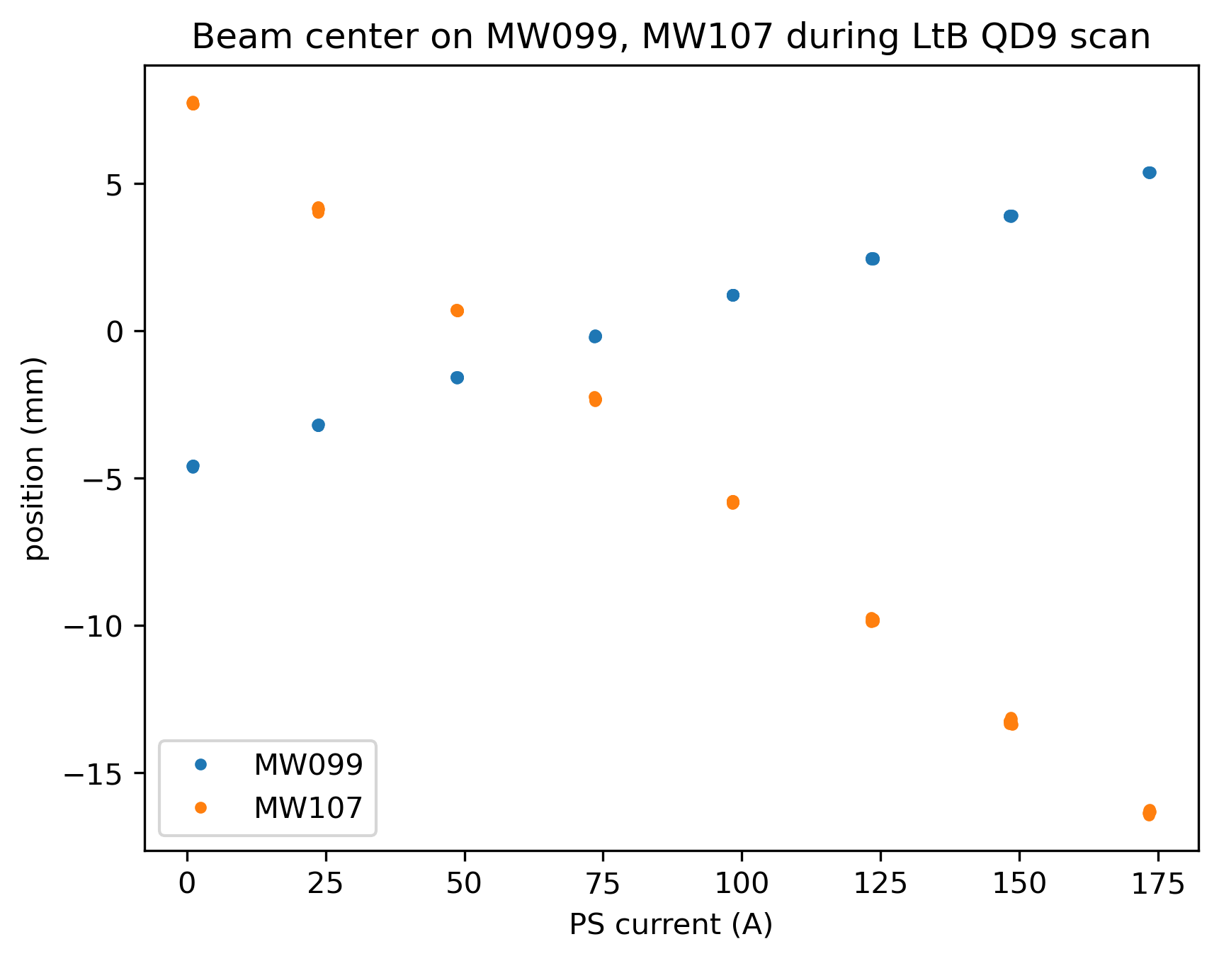
LtB quad scan

Slide 20
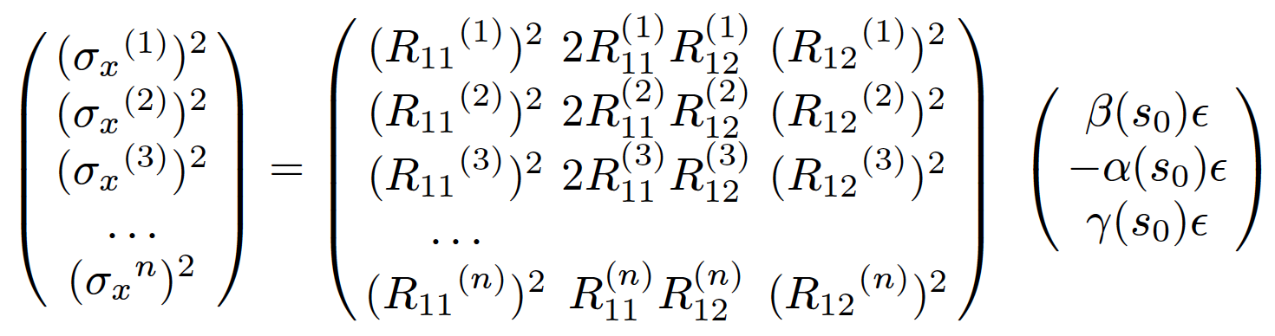
LtB quad scan
Traditional emittance calculation gives very different answers at MW99 and MW107 for horizontal
Dispersion? Coupling? Experiment to measure?
Skip parabola fitting which uses thin lens approximation, use full transfer matrix from currents (accuracy of transfer function? Distances in model? Etc.)
Dispersion here

Slide 21
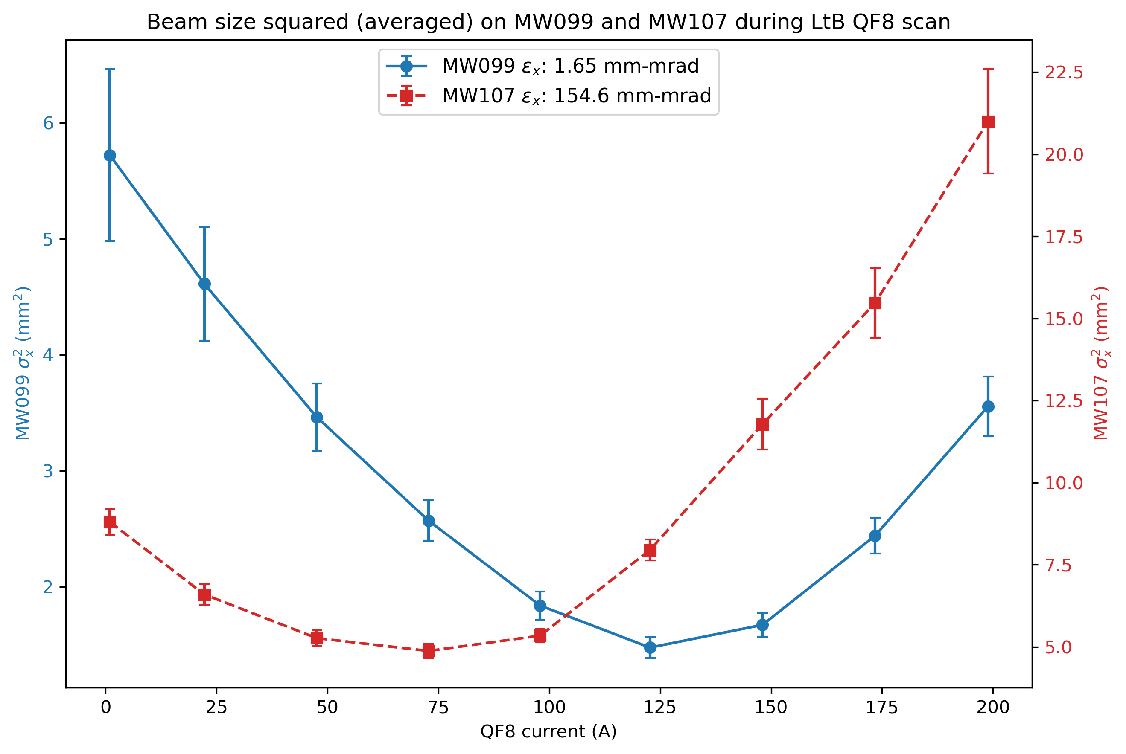
LtB quad scan
MW | alpha | beta | gamma | emittance
99 | -1.20 | 5.80 | 0.42 | 1.65
107 | 12.98 | 9.25 | 18.33 | 154.6

Slide 22
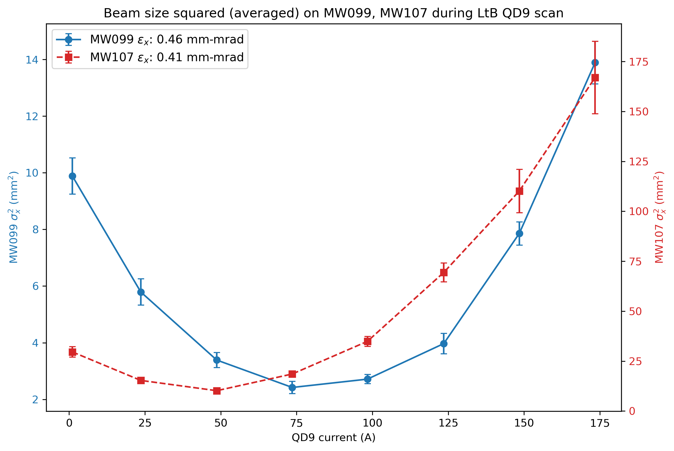
LtB quad scan
MW | alpha | beta | gamma | emittance
99 | 5.57 | 12.66 | 2.53 | 0.46
107 | 4.96 | 14.18 | 1.81 | 0.41

