Slide 1
ORM measurement and evaluation
Lucy Lin
3rd AI/ML for EIC Hadron Pre-injectors Collaboration Meeting
Oct 20-22, 2025

Slide 2
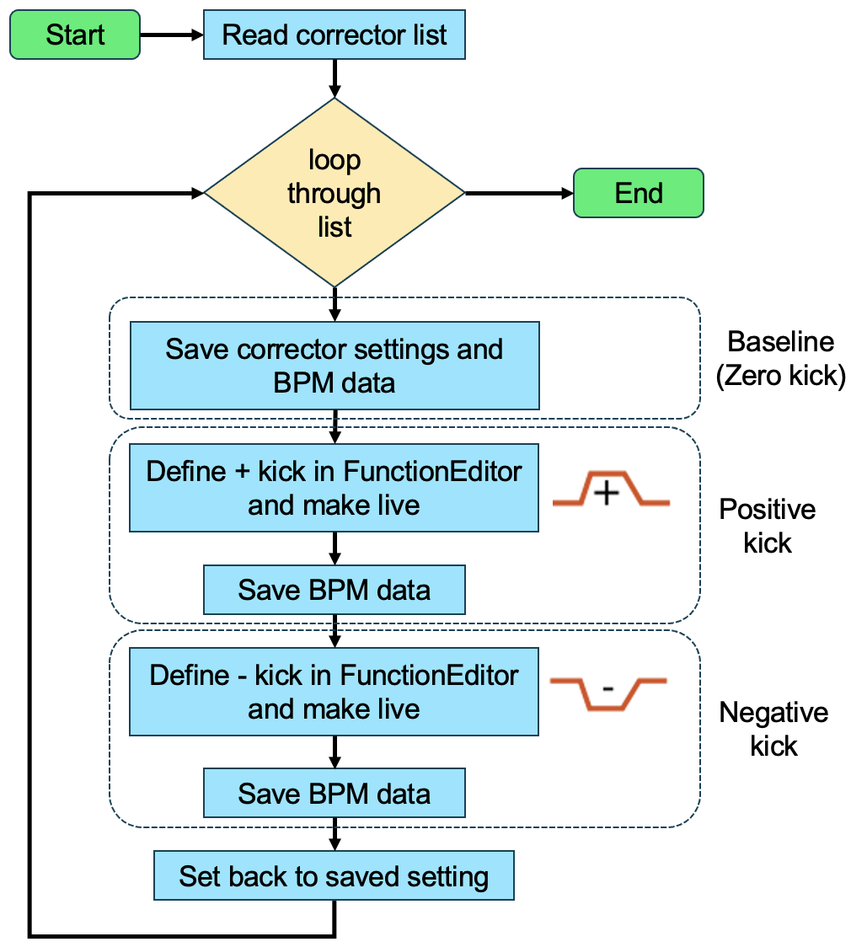
CAD script to get real orbit responses
Script development with Collider Accelerator Department (CAD) Controls Group
Can be easily adapted to any accelerator at BNL
Script sets three corrector settings: positive, zero, negative; and save corresponding orbits
All magnet settings (including dipoles and quadrupoles etc.) are saved for model construction and calibration

Slide 3
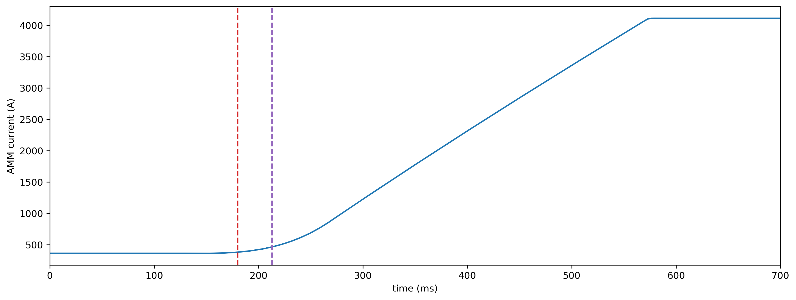
AGS ORM: April 29, 2025
Polarized proton with snakes
Low energy p = 2.2 GeV/n at 180 ms, p = 2.7 GeV/n at 213 ms
180 ms
213 ms

Slide 4
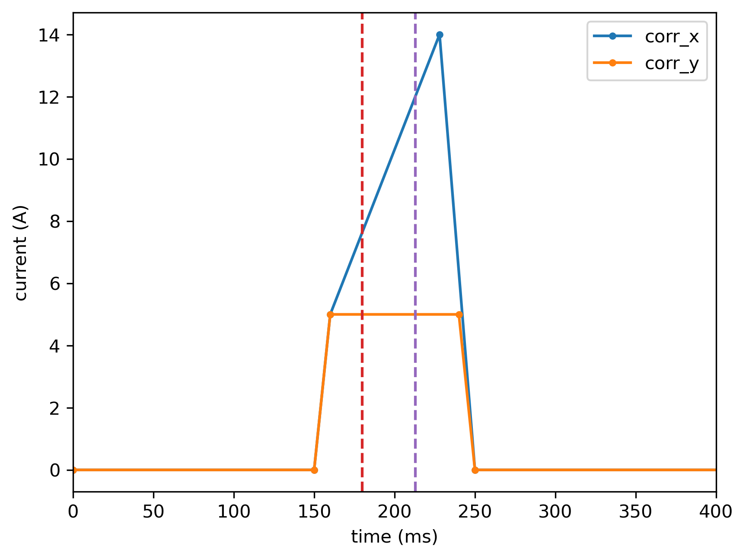
AGS ORM: April 29, 2025
180 ms
213 ms

Slide 5
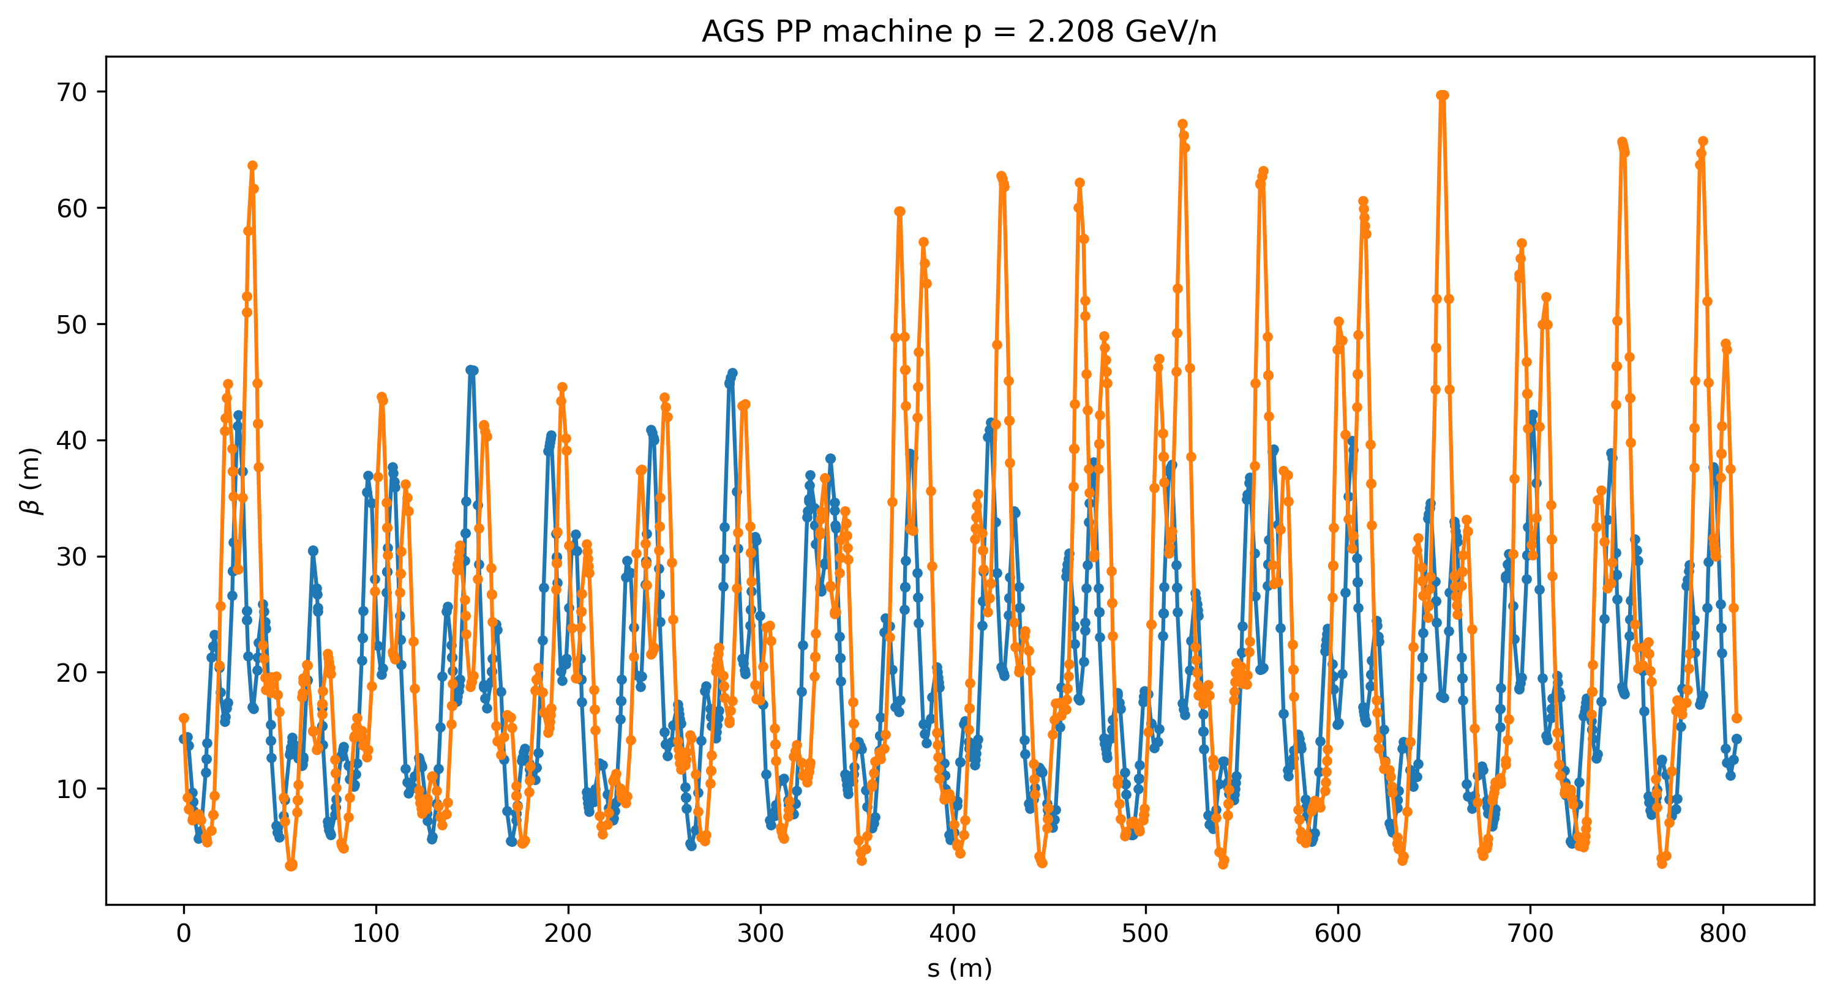
AGS ORM: April 29, 2025
Snake as matrices (CSNK_B2.1+0.75Sol, WSNK_B1.53)

Slide 6
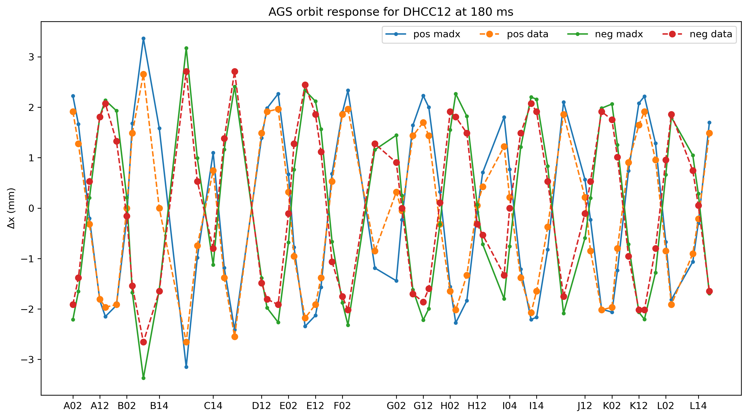
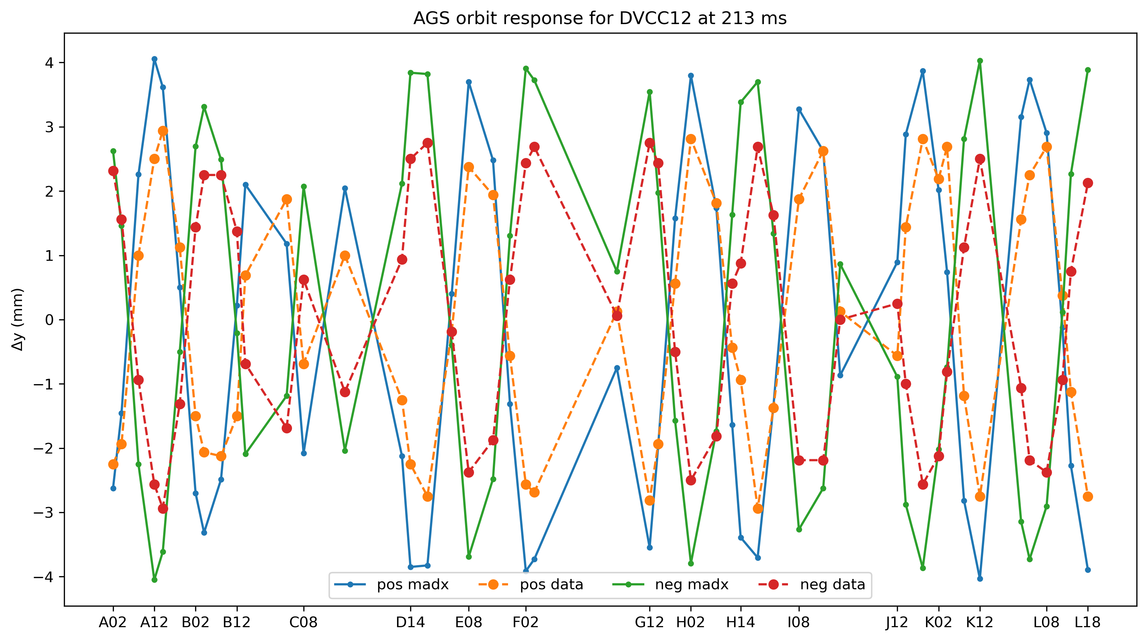
AGS ORM: April 29, 2025

Slide 7
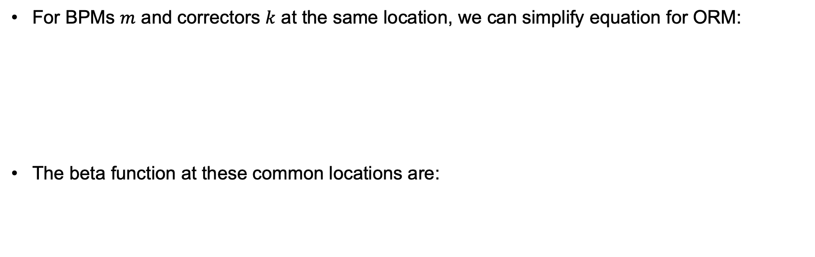
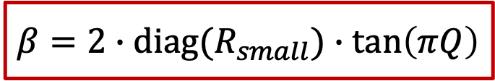
Beta function from ORM: diagonal terms
For BPMs $m$ and correctors $k$ at the same location, we can simplify equation for ORM:
The beta function at these common locations are:
$$R_{small}=\frac{\sqrt{β_{m}β_{k}}}{2\sin{(πQ)}}\cos{(\left|ψ_{m}−ψ_{k}\right|−πQ)}=\frac{β}{2\sin{(πQ)}}\cos\left(πQ\right)=\frac{1}{2}β\cot\left(πQ\right)$$
$$β=2∙diag(R_{small})∙\tan\left(πQ\right)$$

Slide 8
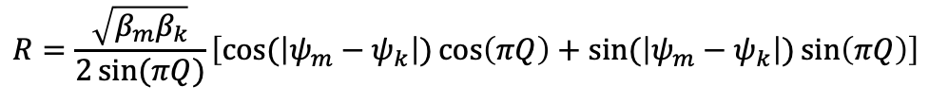
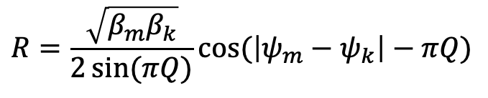
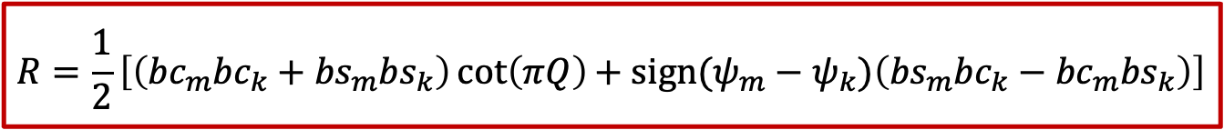

Beta function from ORM: full matrix
Full equation for ORM:
$$R=\frac{\sqrt{β_{m}β_{k}}}{2\sin{(πQ)}}\cos{(\left|ψ_{m}−ψ_{k}\right|−πQ)}$$
$$R=\frac{\sqrt{β_{m}β_{k}}}{2\sin{(πQ)}}\left[\cos{(\left|ψ_{m}−ψ_{k}\right|)\cos\left(πQ\right)+\sin{(\left|ψ_{m}−ψ_{k}\right|)\sin\left(πQ\right)}}\right]$$
$$R=\frac{\sqrt{β_{m}β_{k}}}{2}\left[\cos{(\left|ψ_{m}−ψ_{k}\right|)\cot\left(πQ\right){+\sin{(\left|ψ_{m}−ψ_{k}\right|) }}}\right]$$
$$R=\frac{\sqrt{β_{m}β_{k}}}{2}\left[\left(\cos{ψ_{m}\cos{ψ_{k}+\sin{ψ_{m}\sin{ψ_{k}}}}}\right){\cot\left(πQ\right){+ sign(ψ_{m}−ψ_{k})\left(\sin{ψ_{m}\cos{ψ_{k}}−\cos{ψ_{m}\sin{ψ_{k}}}}\right)}}\right]$$
$$R=\frac{1}{2}\left[\left({bc}_{m}{bc}_{k}+{bs}_{m}{bs}_{k}\right){\cot\left(πQ\right){+ sign(ψ_{m}−ψ_{k})\left({bs}_{m}{bc}_{k}−{bc}_{m}{bs}_{k}\right)}}\right]$$
$${bc}_{m}=\sqrt{β_{m}}\cos{ψ_{m}}, {bc}_{k}=\sqrt{β_{k}}\cos{ψ_{k}}, {bs}_{m}=\sqrt{β_{m}}\sin{ψ_{m}},{bs}_{k}=\sqrt{β_{k}}\sin{ψ_{k}}$$

Slide 9
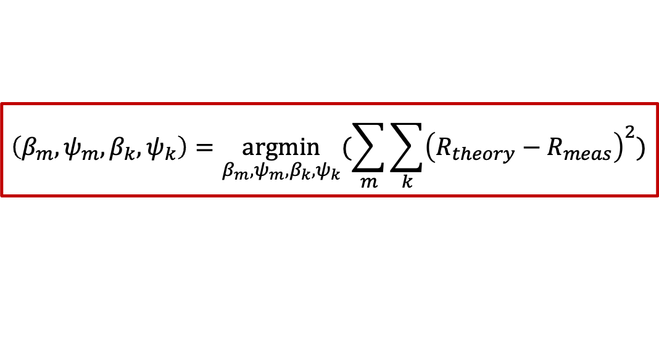
Beta function from ORM: full matrix
Use full equation for ORM and initial guesses of beta and phase values, perform non-linear optimization to find beta and phase values that minimize sum of squares of residuals between calculated and measured R.
$$R_{theory}=\frac{1}{2}\left[\left({bc}_{m}{bc}_{k}+{bs}_{m}{bs}_{k}\right){\cot\left(πQ\right){+ sign(ψ_{m}−ψ_{k})\left({bs}_{m}{bc}_{k}−{bc}_{m}{bs}_{k}\right)}}\right]$$
$${bc}_{m}=\sqrt{β_{m}}\cos{ψ_{m}}, {bc}_{k}=\sqrt{β_{k}}\cos{ψ_{k}}, {bs}_{m}=\sqrt{β_{m}}\sin{ψ_{m}},{bs}_{k}=\sqrt{β_{k}}\sin{ψ_{k}}$$
$$\left(β_{m},ψ_{m},β_{k},ψ_{k}\right)=\underset{β_{m},ψ_{m},β_{k},ψ_{k}}{argmin}{(\sum_{m}{\sum_{k}{{\left(R_{theory}−R_{meas}\right)}^{2}}})}$$

Slide 10
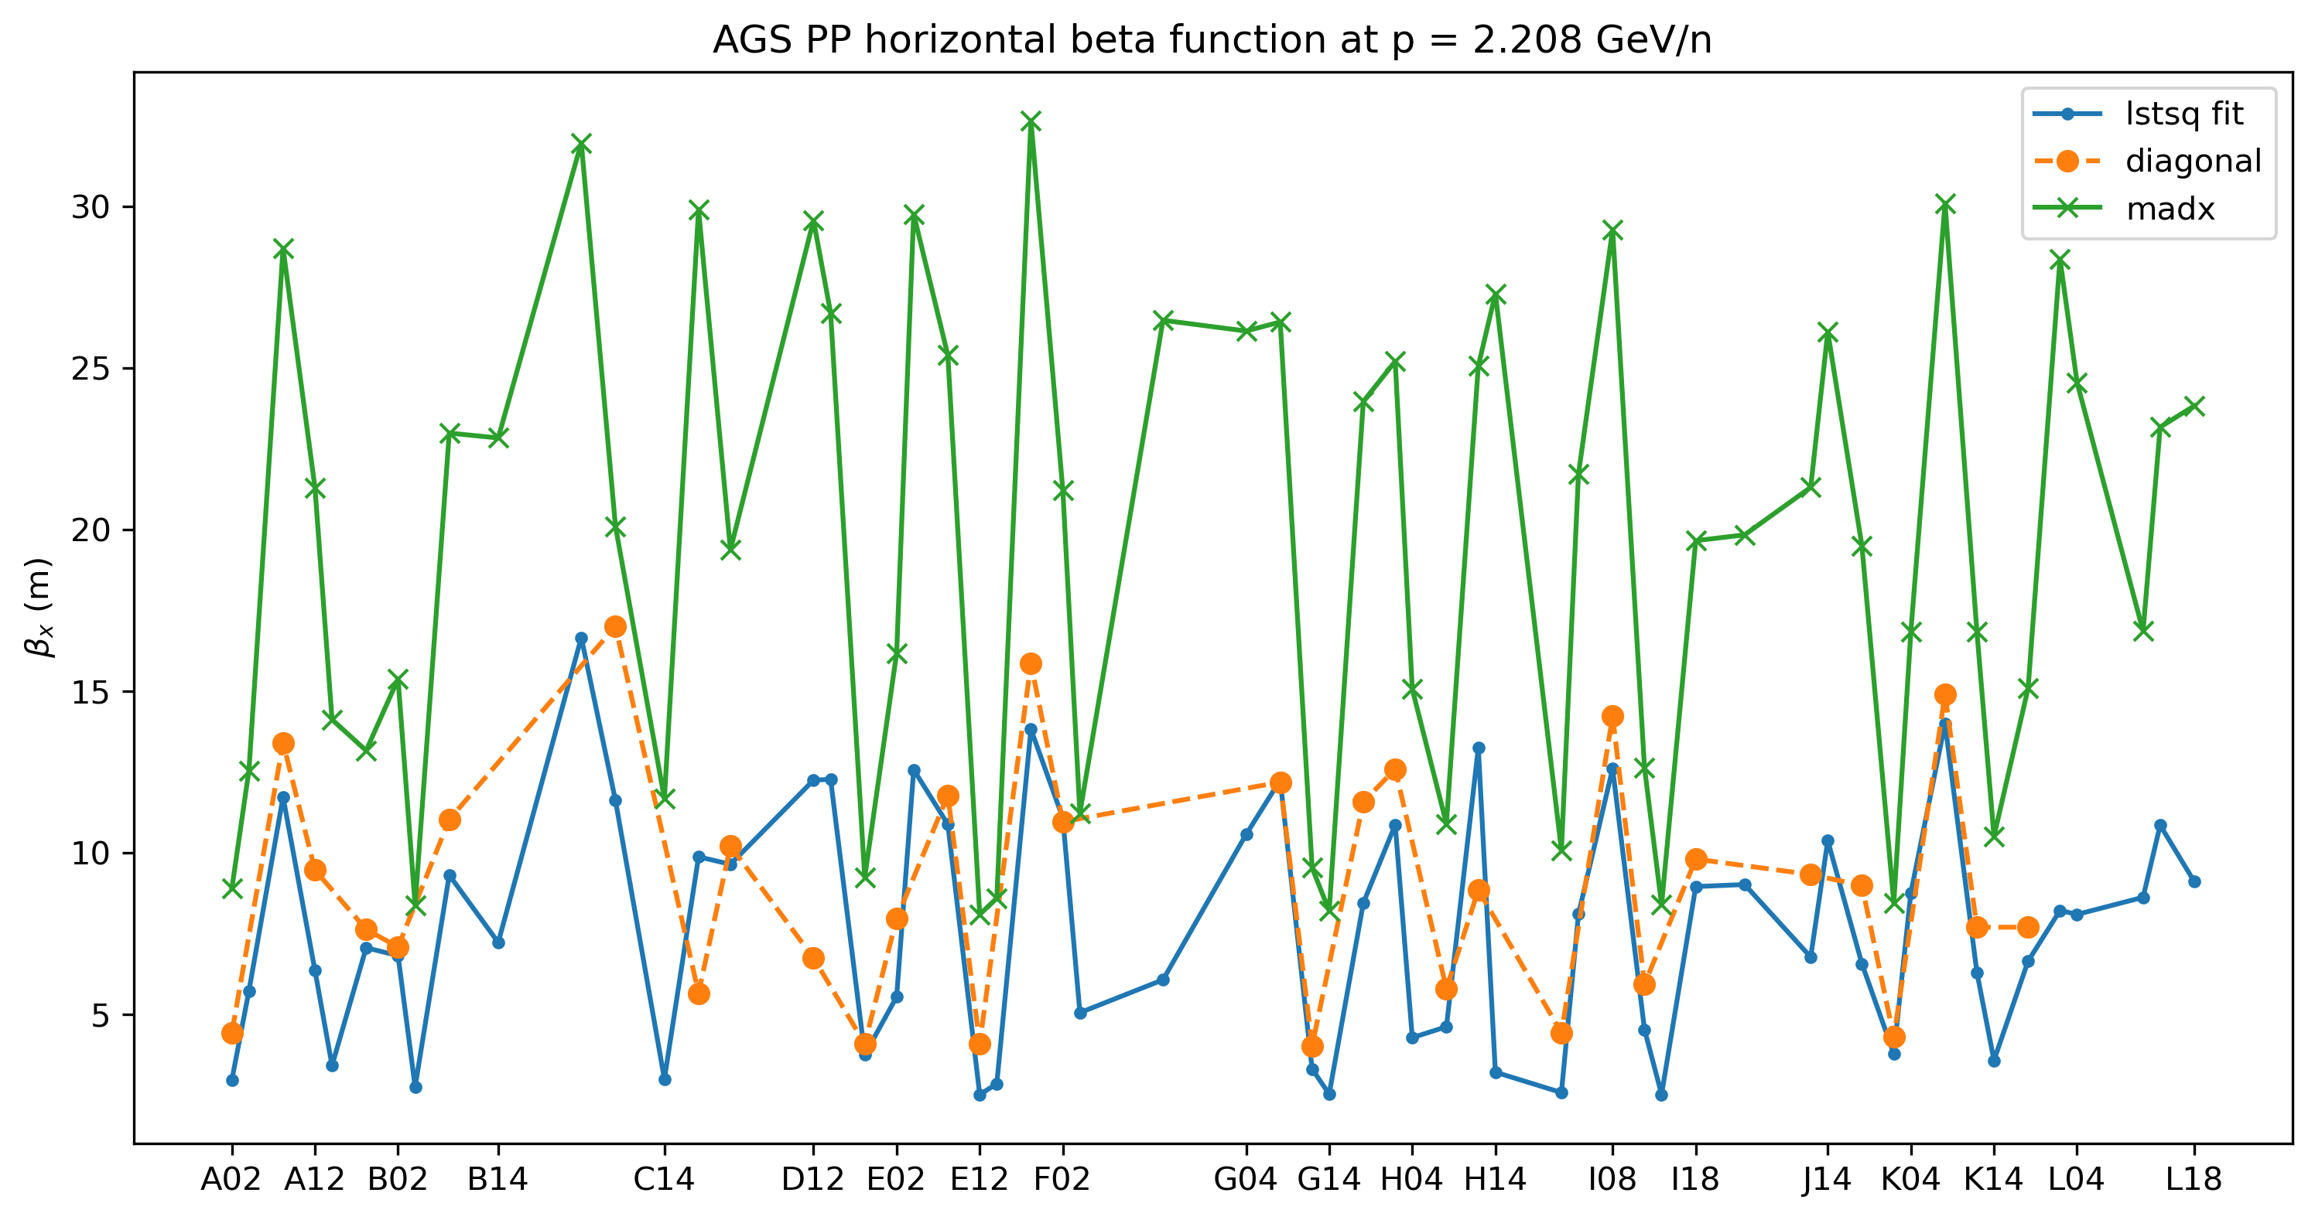

AGS ORM beta: April 29, 2025
180 ms
$$χ_{red}^{2}=36.14$$

Slide 11
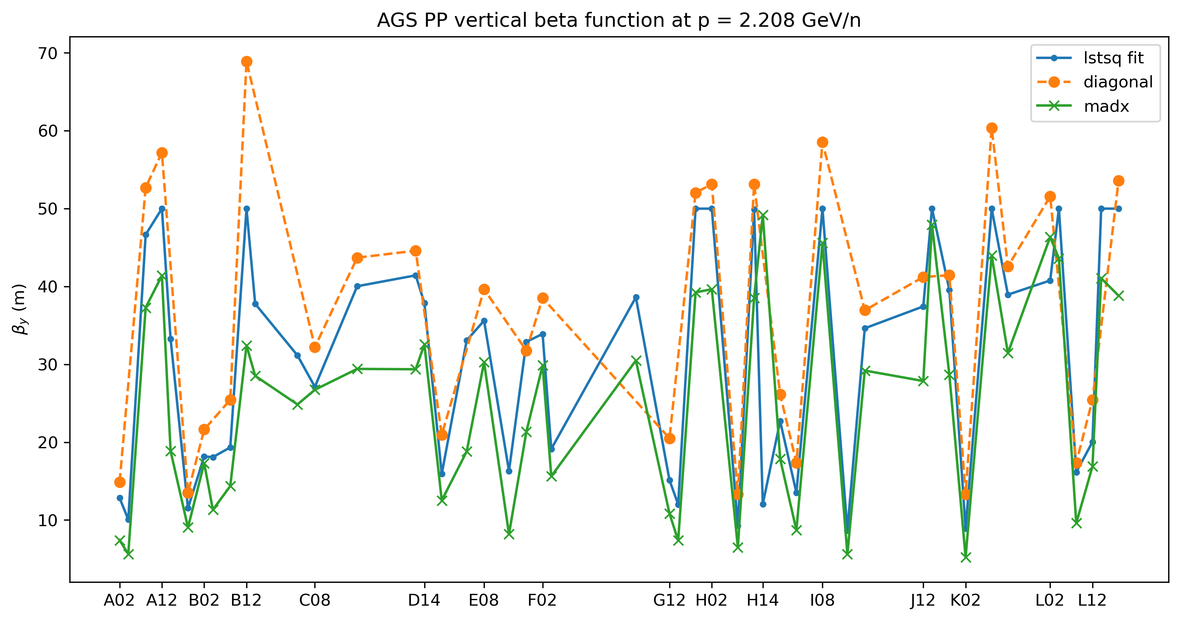

AGS ORM beta: April 29, 2025
180 ms
$$χ_{red}^{2}=26.25$$

Slide 12
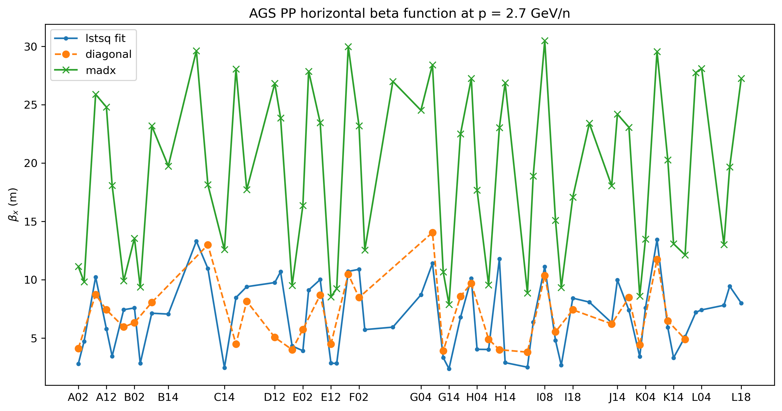

AGS ORM beta: April 29, 2025
213 ms
$$χ_{red}^{2}=14.13$$

Slide 13
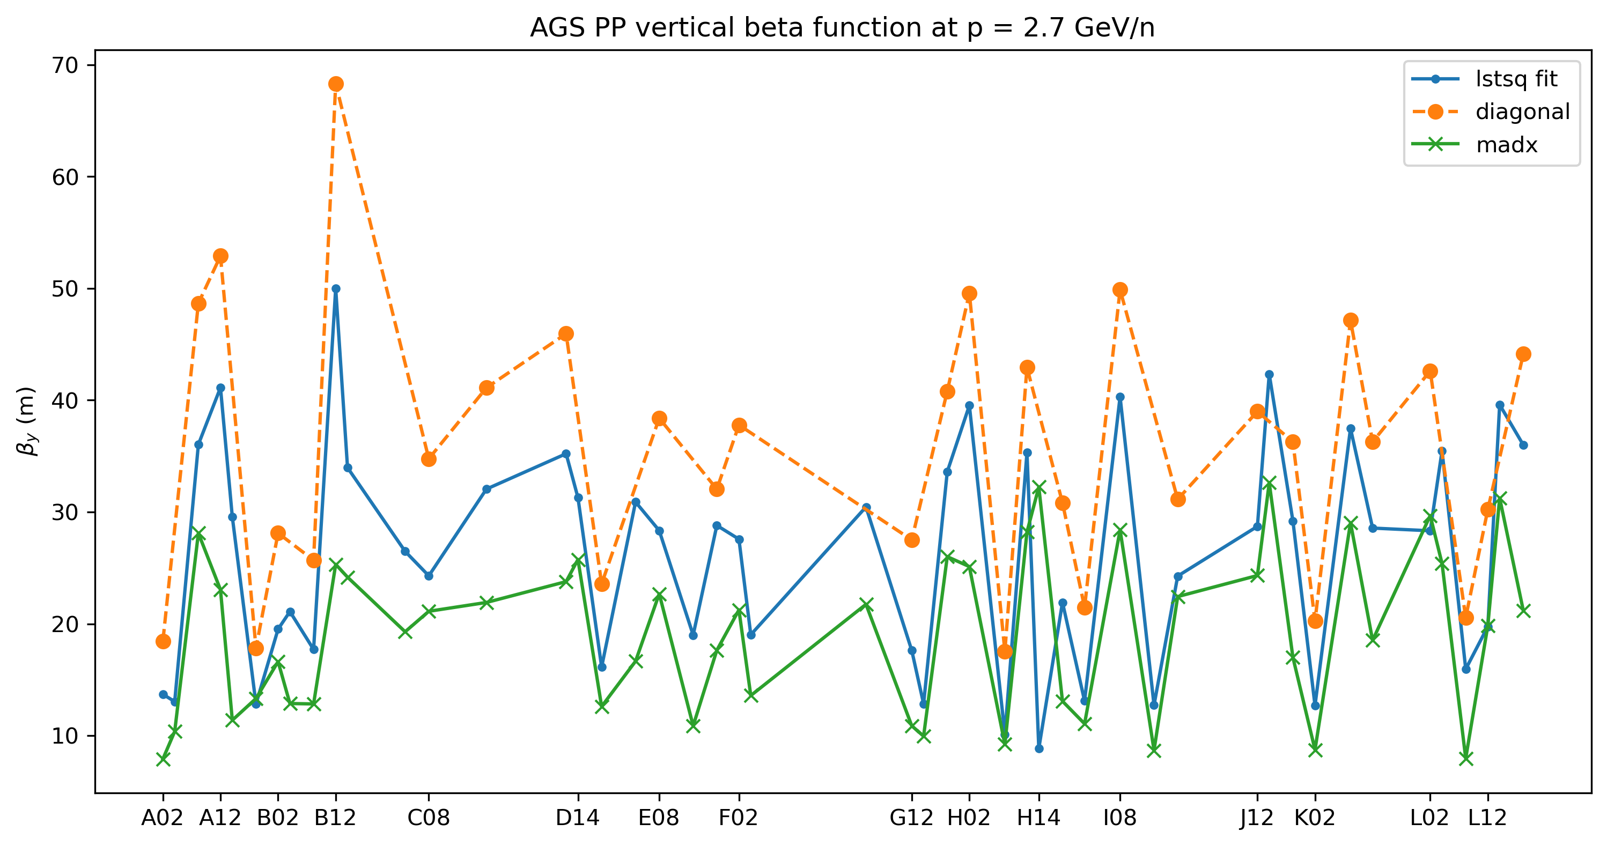

AGS ORM beta: April 29, 2025
213 ms
$$χ_{red}^{2}=19.93$$

Slide 14
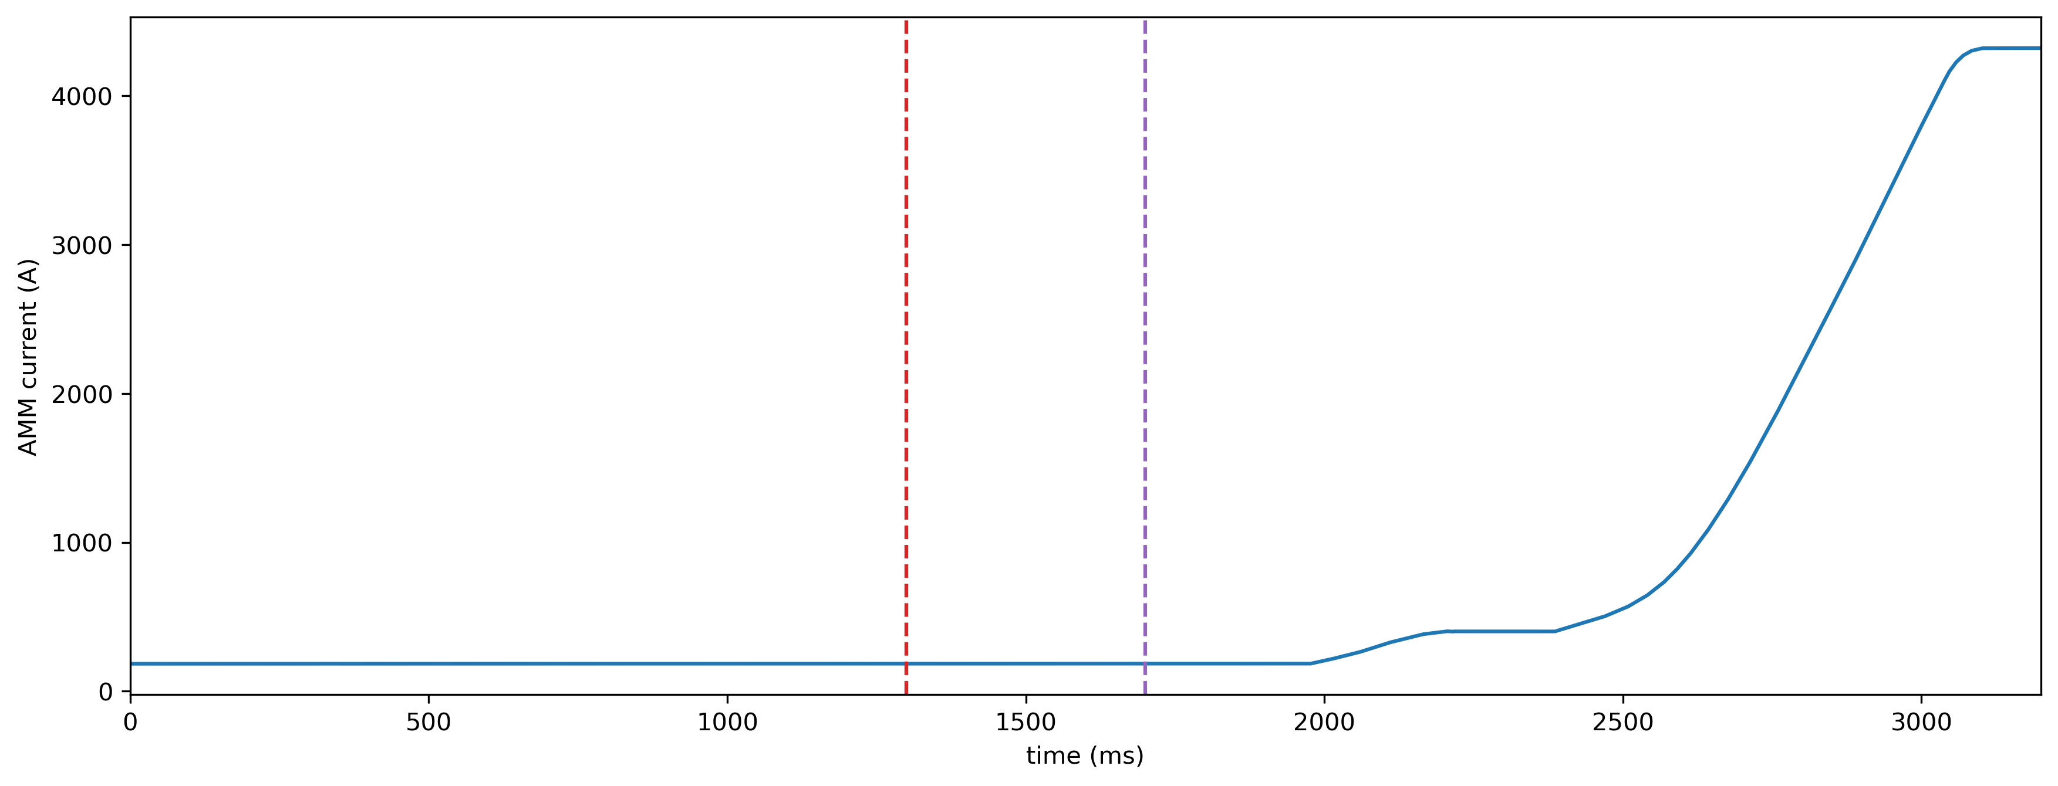
AGS ORM: August 18, 2025
Bare machine with gold
Low energy p = 0.4228 GeV/n at 1300 ms, p = 0.4231 GeV/n at 1700 ms
1300 ms
1700 ms

Slide 15
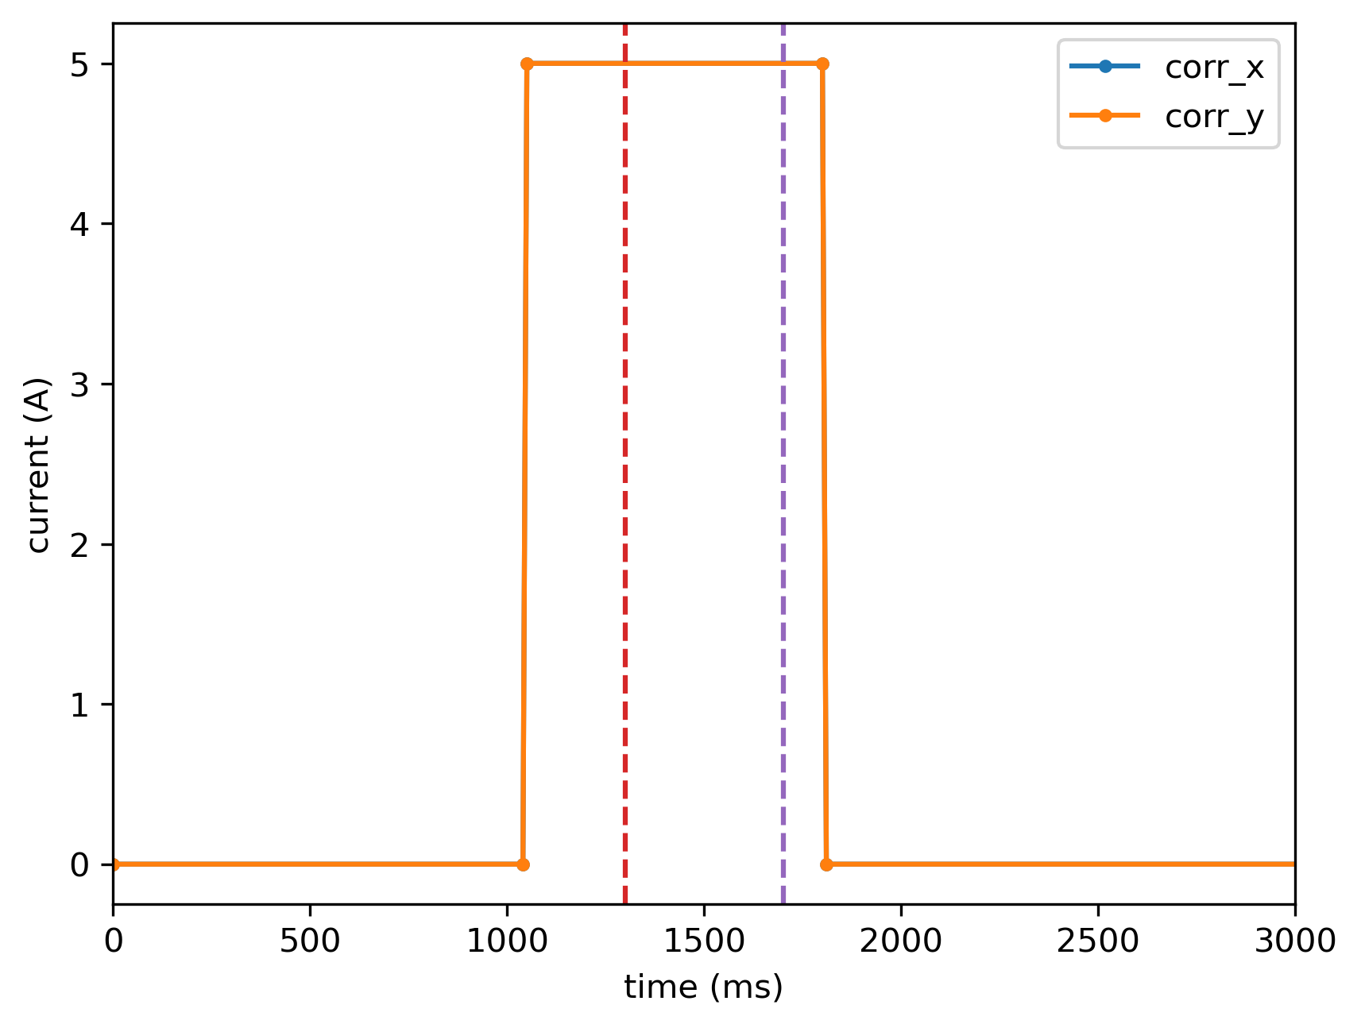
AGS ORM: August 18, 2025
1300 ms
1700 ms

Slide 16
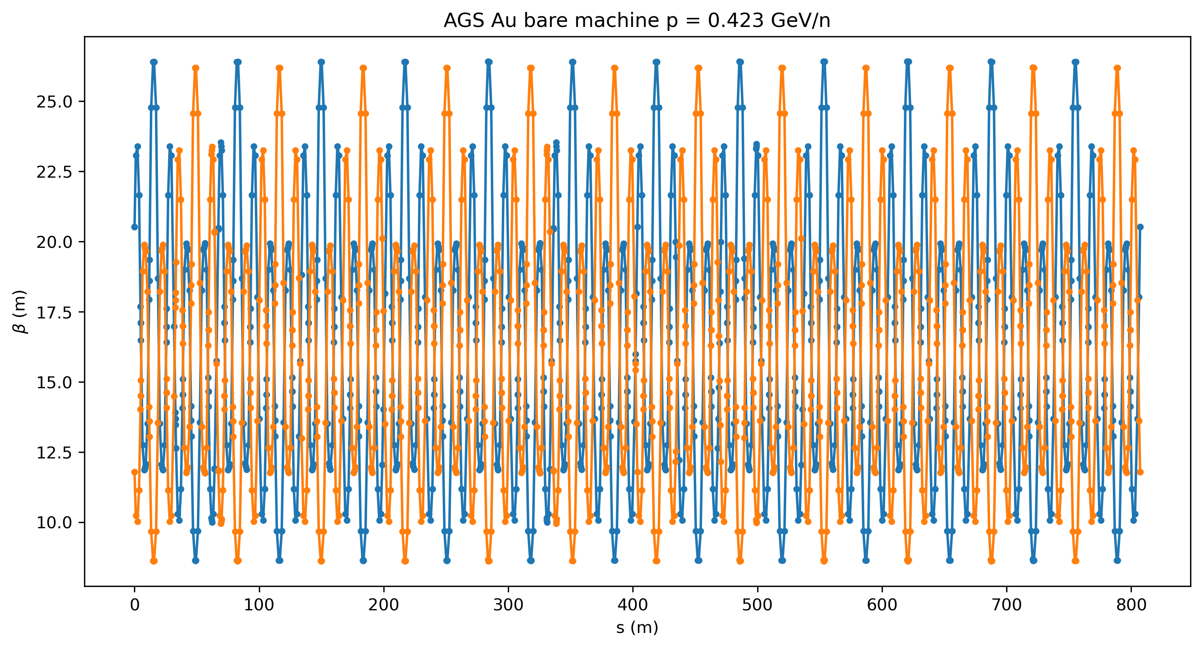
AGS ORM: August 18, 2025
Huge simulated beta beat at low energy

Slide 17
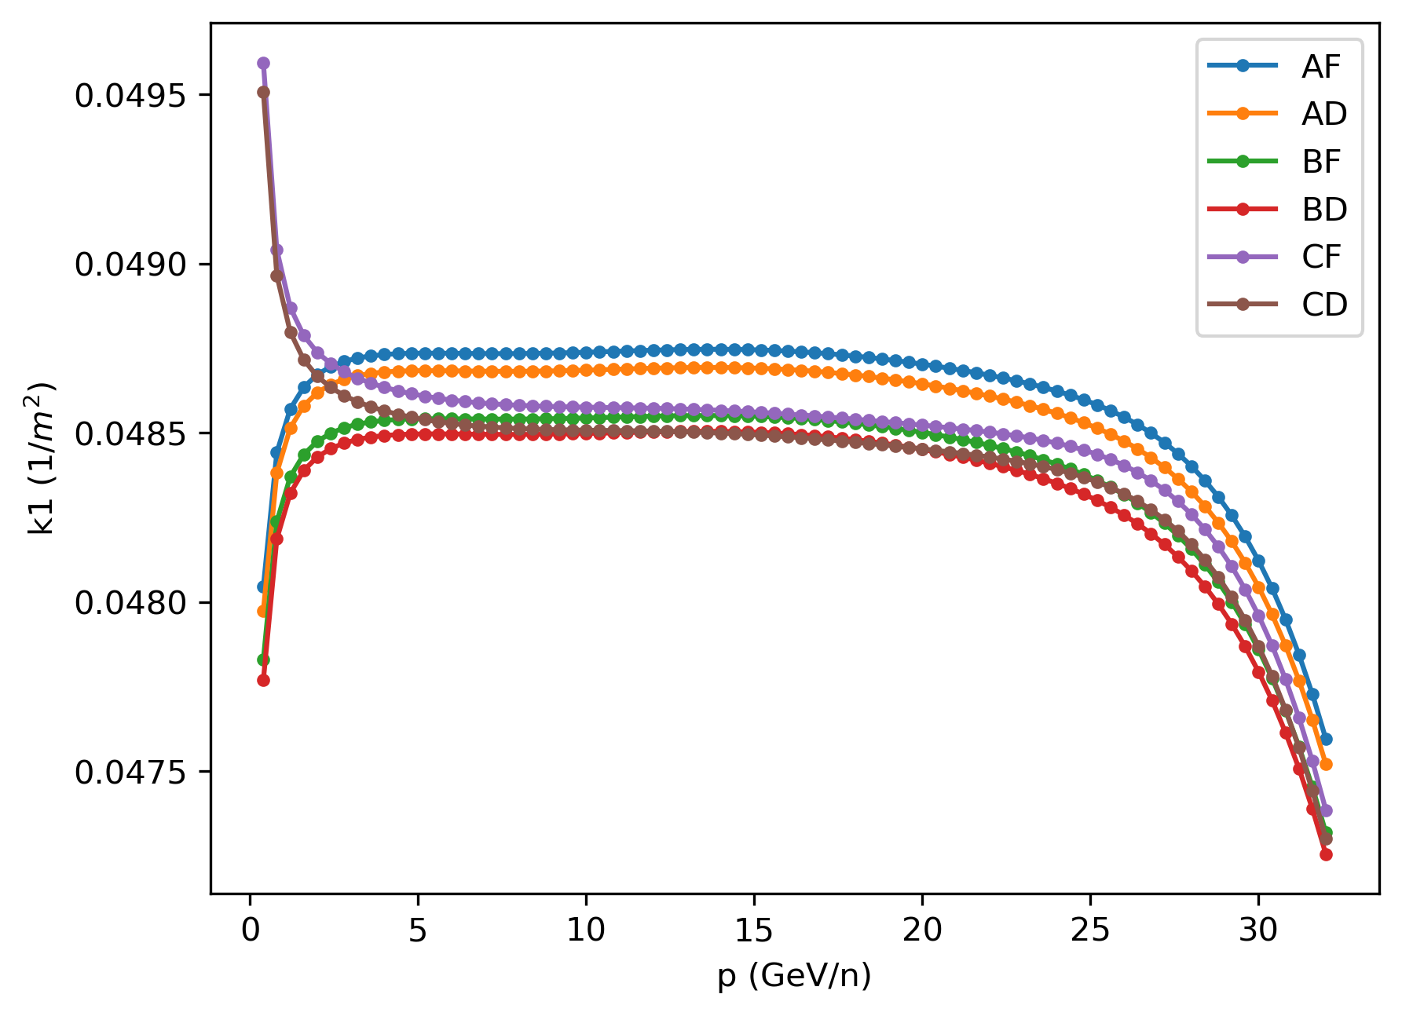
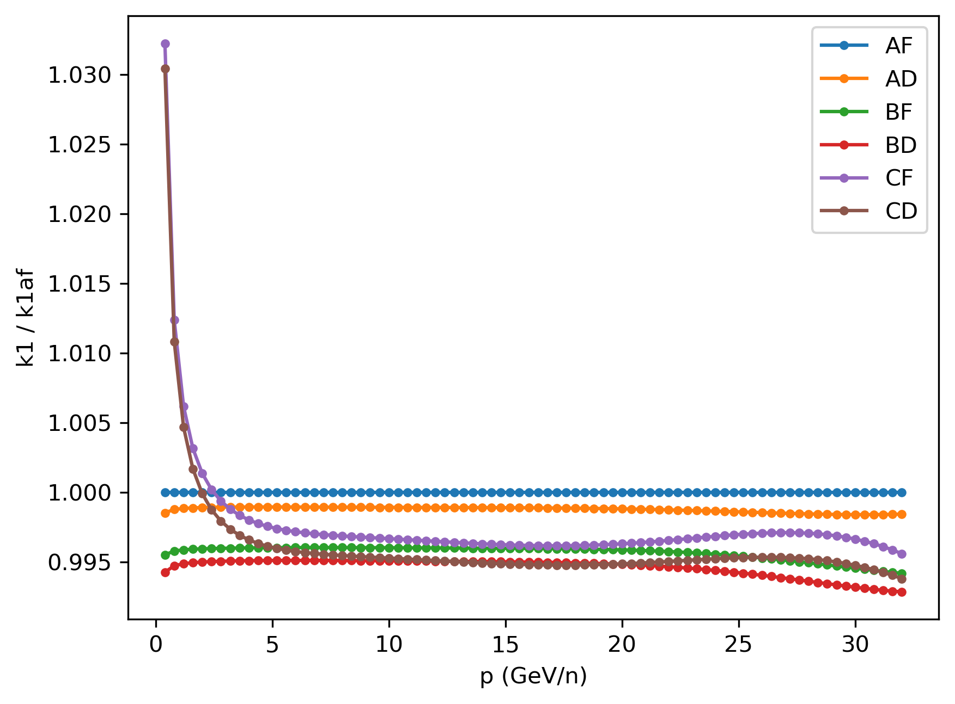
AGS ORM: August 18, 2025
Beta beat caused by different k1 for main magnet family C at low energy (p < 5 GeV/u)

Slide 18
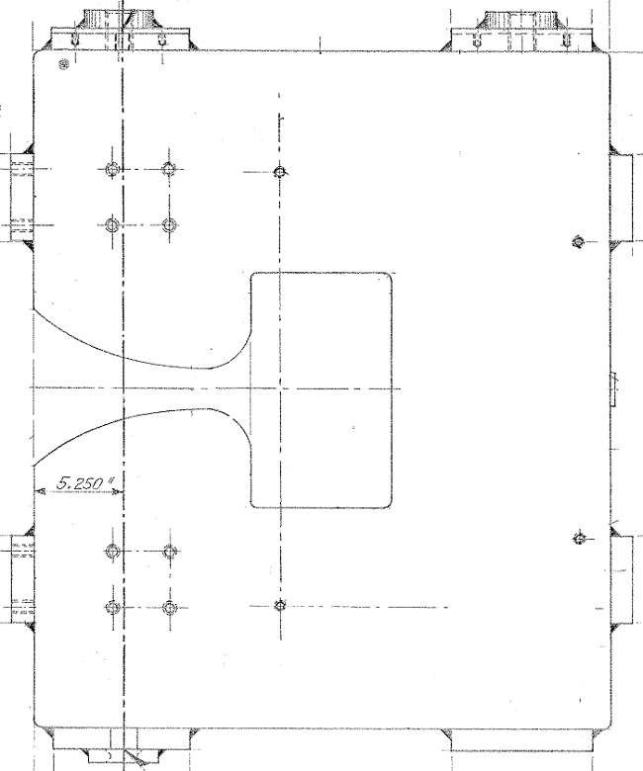
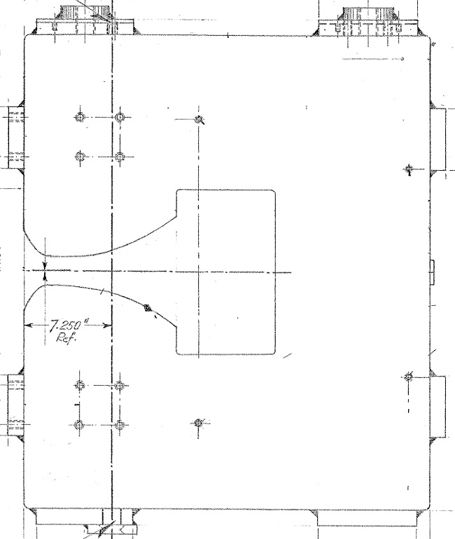
AGS Main Magnet
Open Magnet (A,B)
Closed Magnet (C)
Notes:
https://www.cadops.bnl.gov/Operations/documentation/SPeriods2014/Devices/MainMagnets/mainmagnet.html

Slide 19
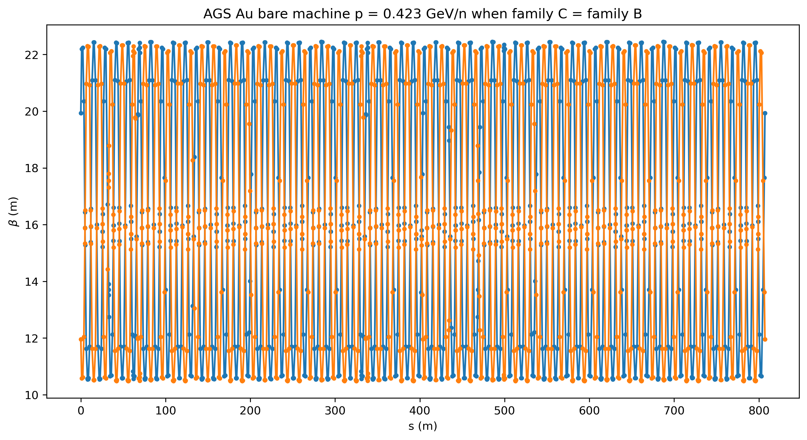
AGS ORM: August 18, 2025
Beta beat goes away when set family C to be the same as family B

Slide 20
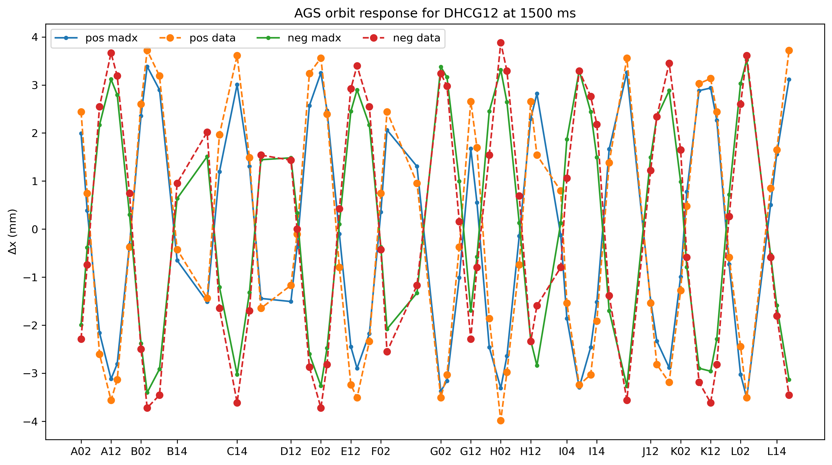
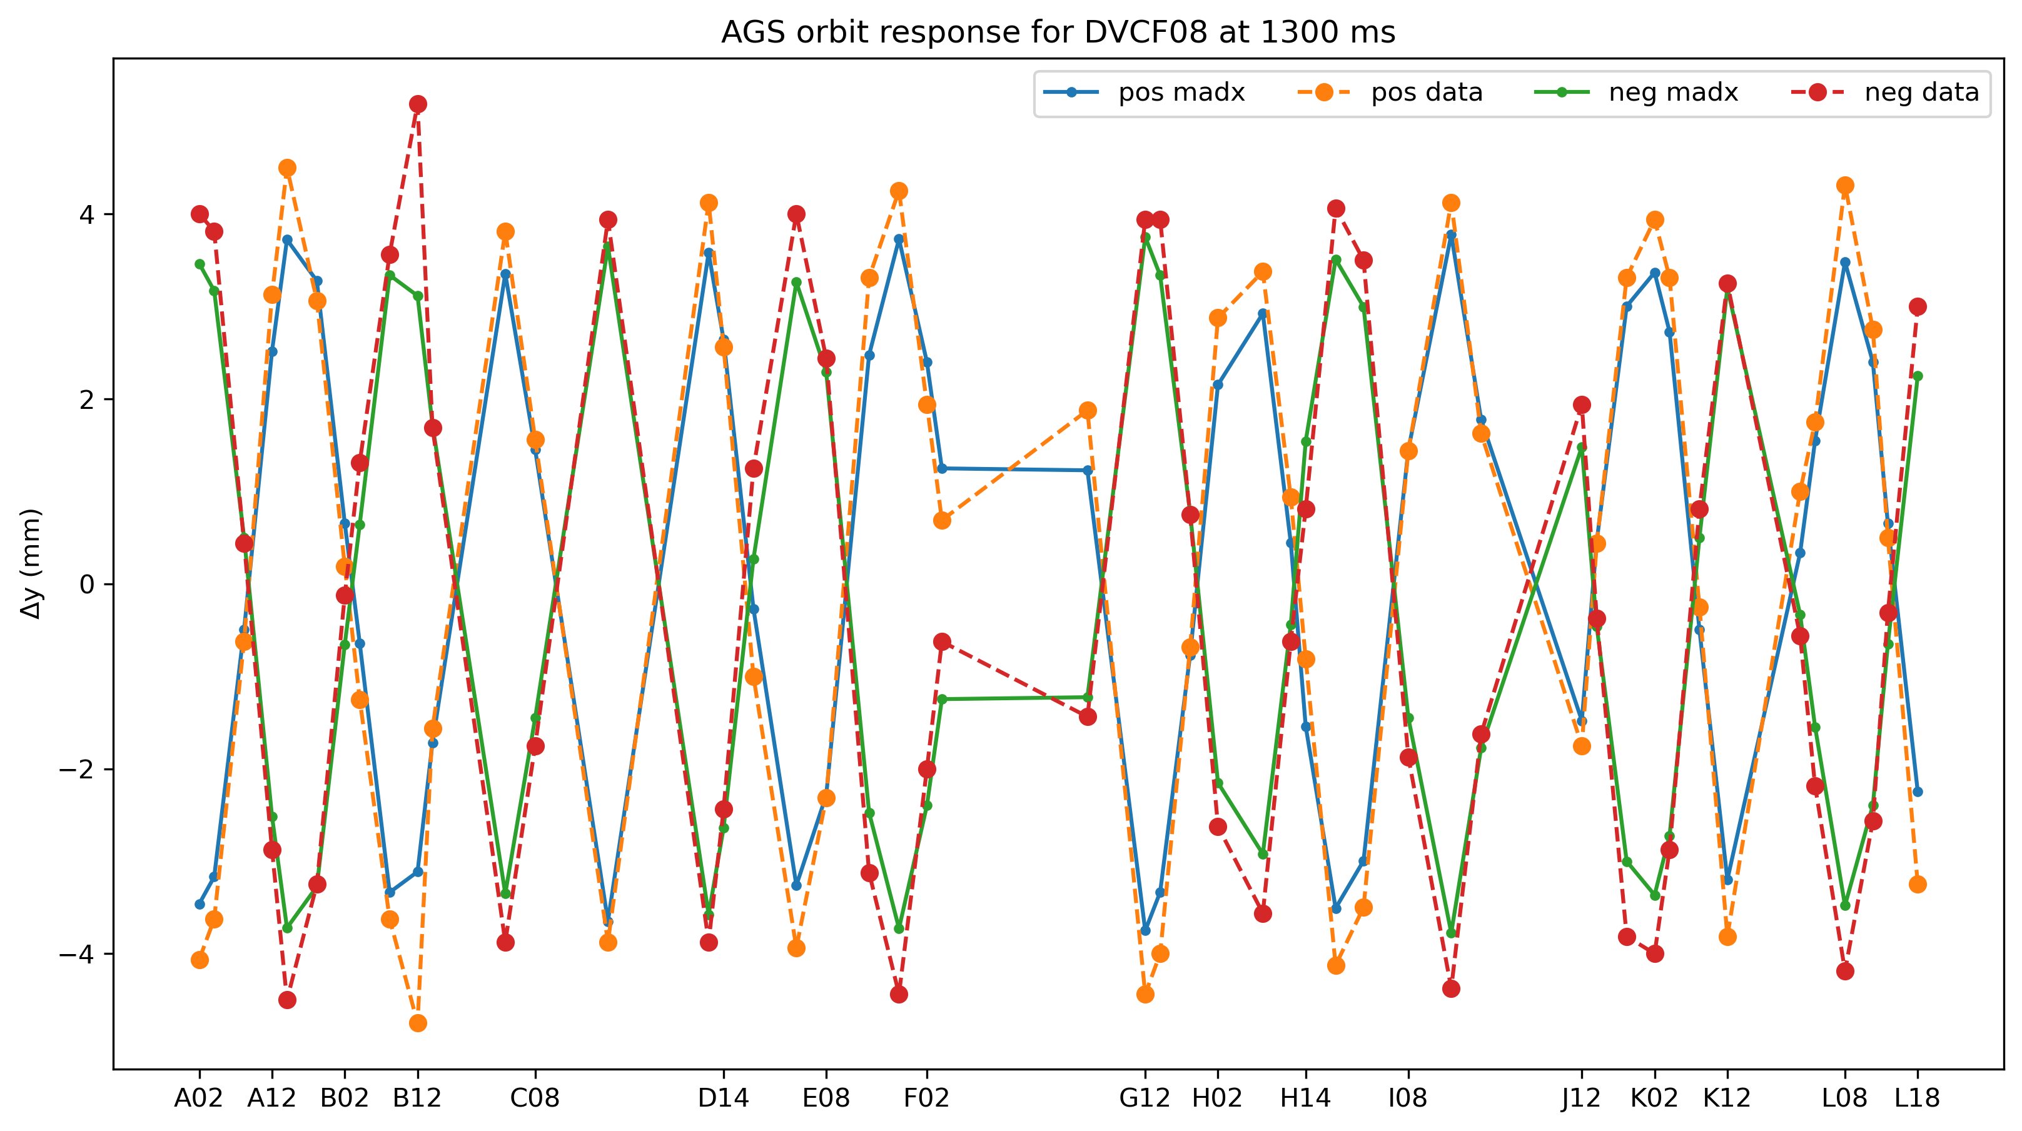
AGS ORM: August 18, 2025

Slide 21
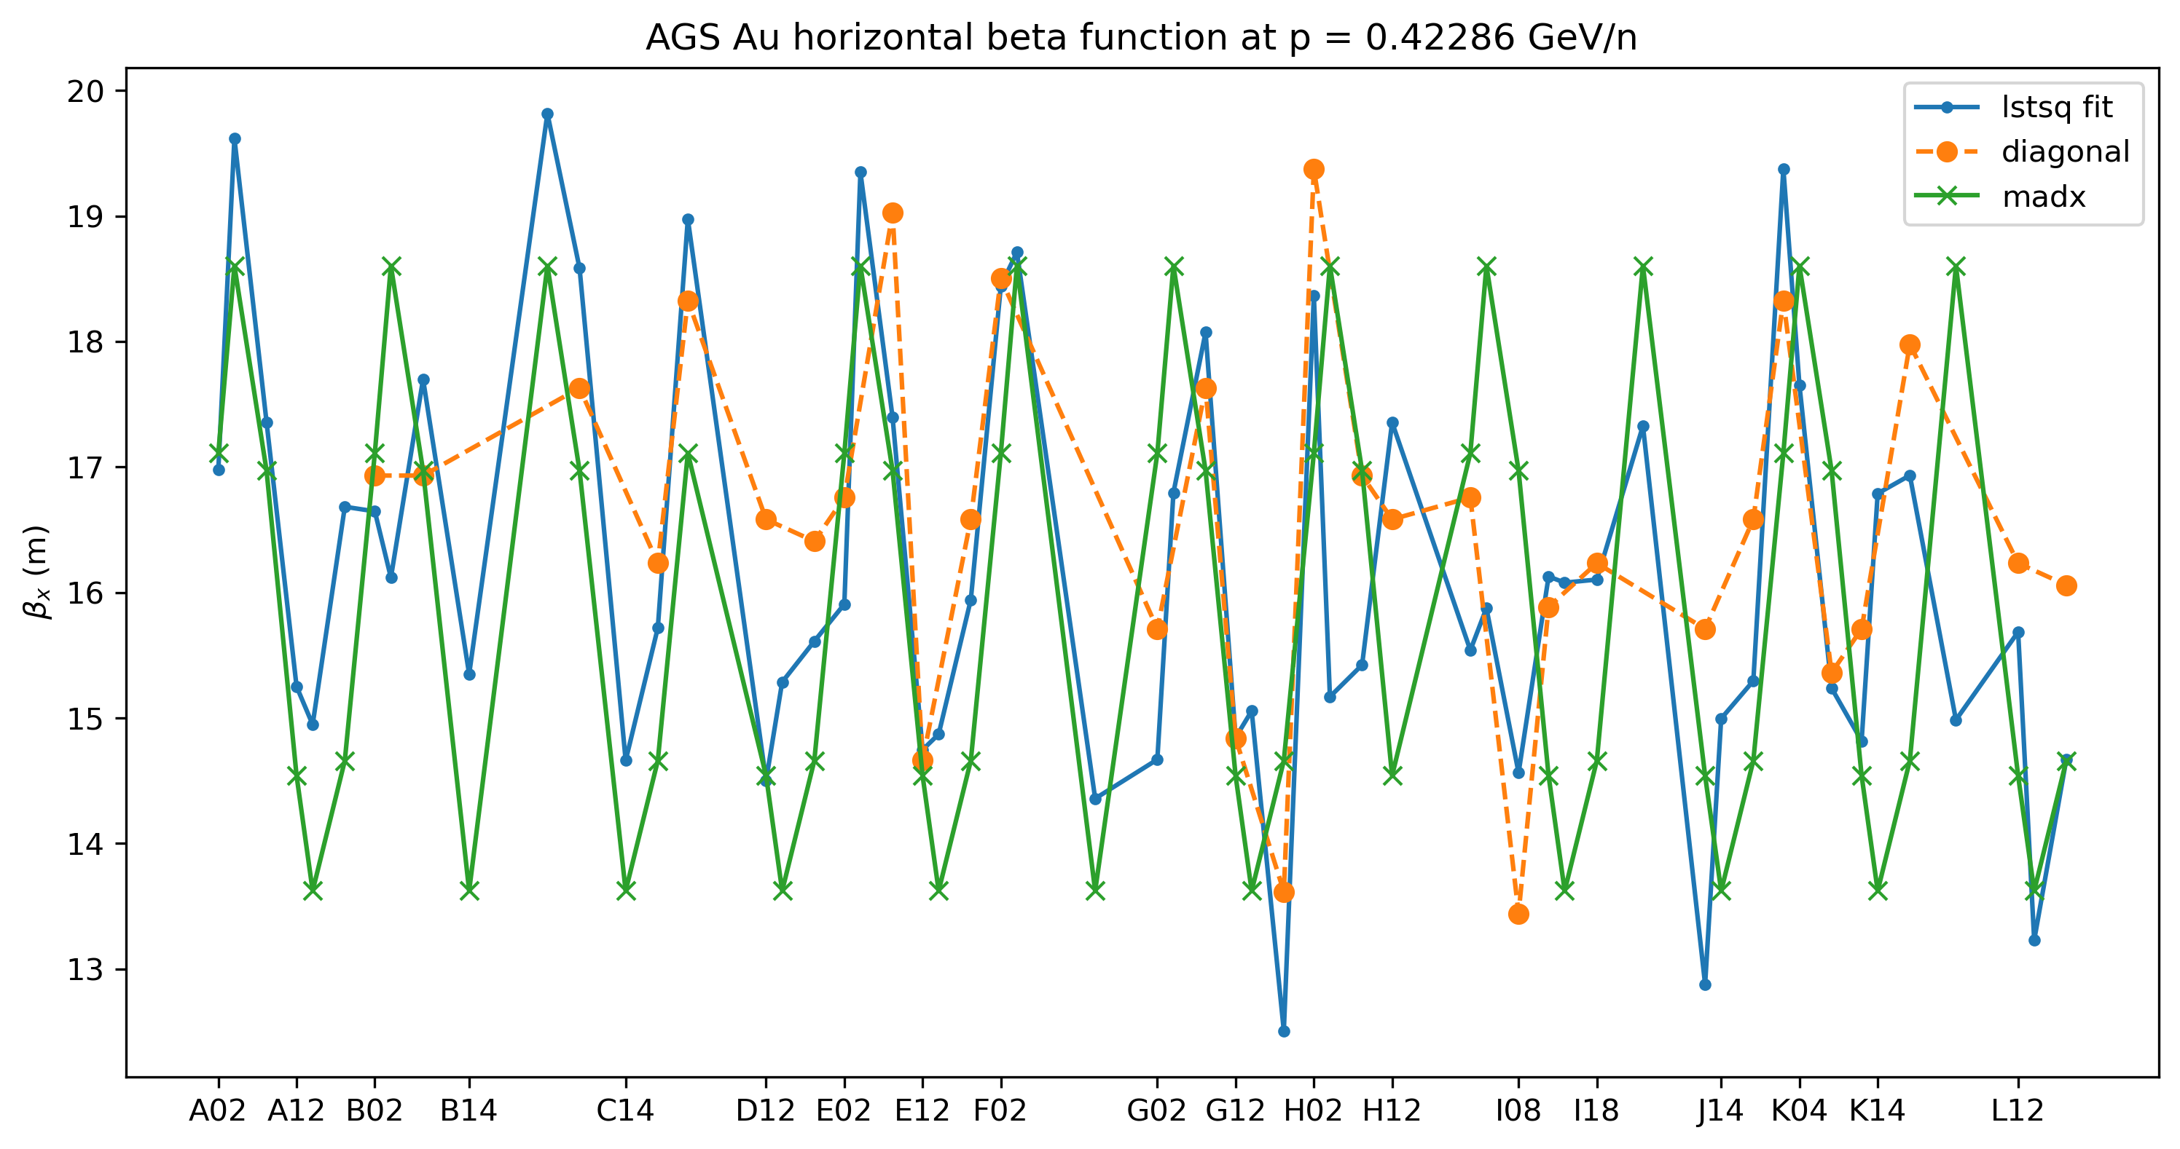

AGS ORM beta: August 18, 2025
1300 ms
$$χ_{red}^{2}=0.79$$

Slide 22
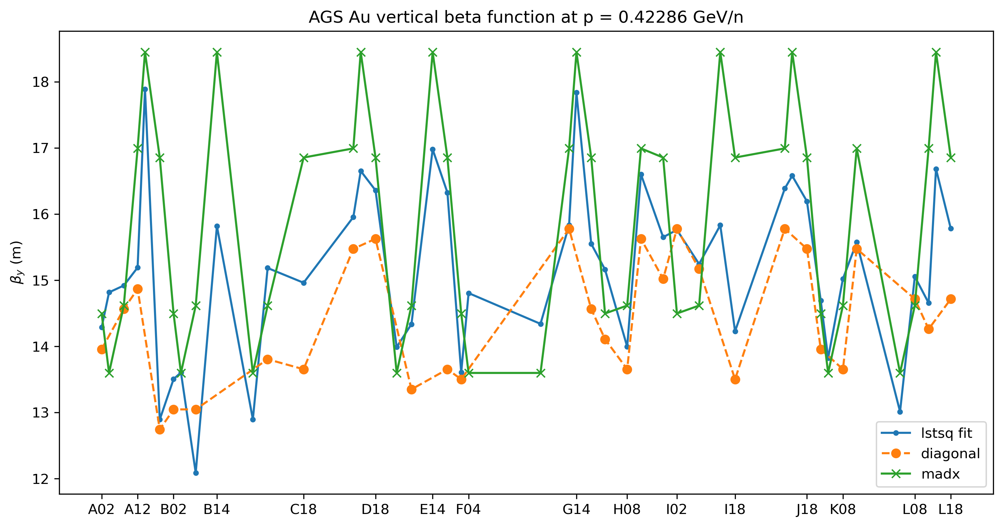

AGS ORM beta: August 18, 2025
1300 ms
$$χ_{red}^{2}=0.78$$

Slide 23
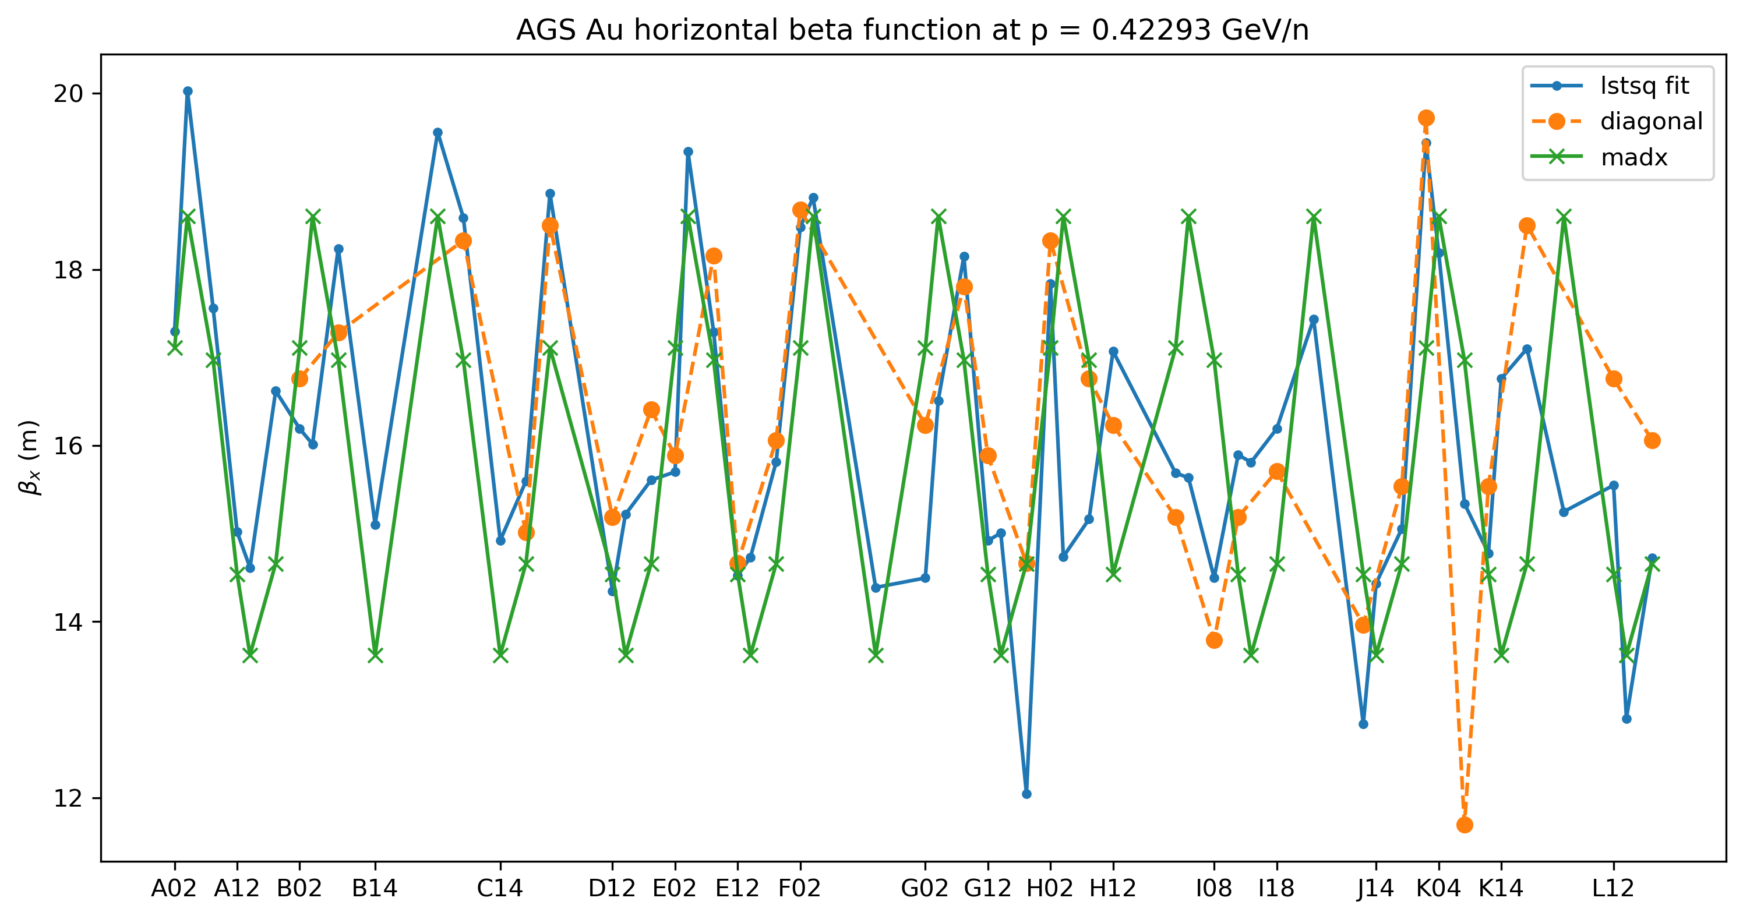

AGS ORM beta: August 18, 2025
1400 ms
$$χ_{red}^{2}=0.71$$

Slide 24
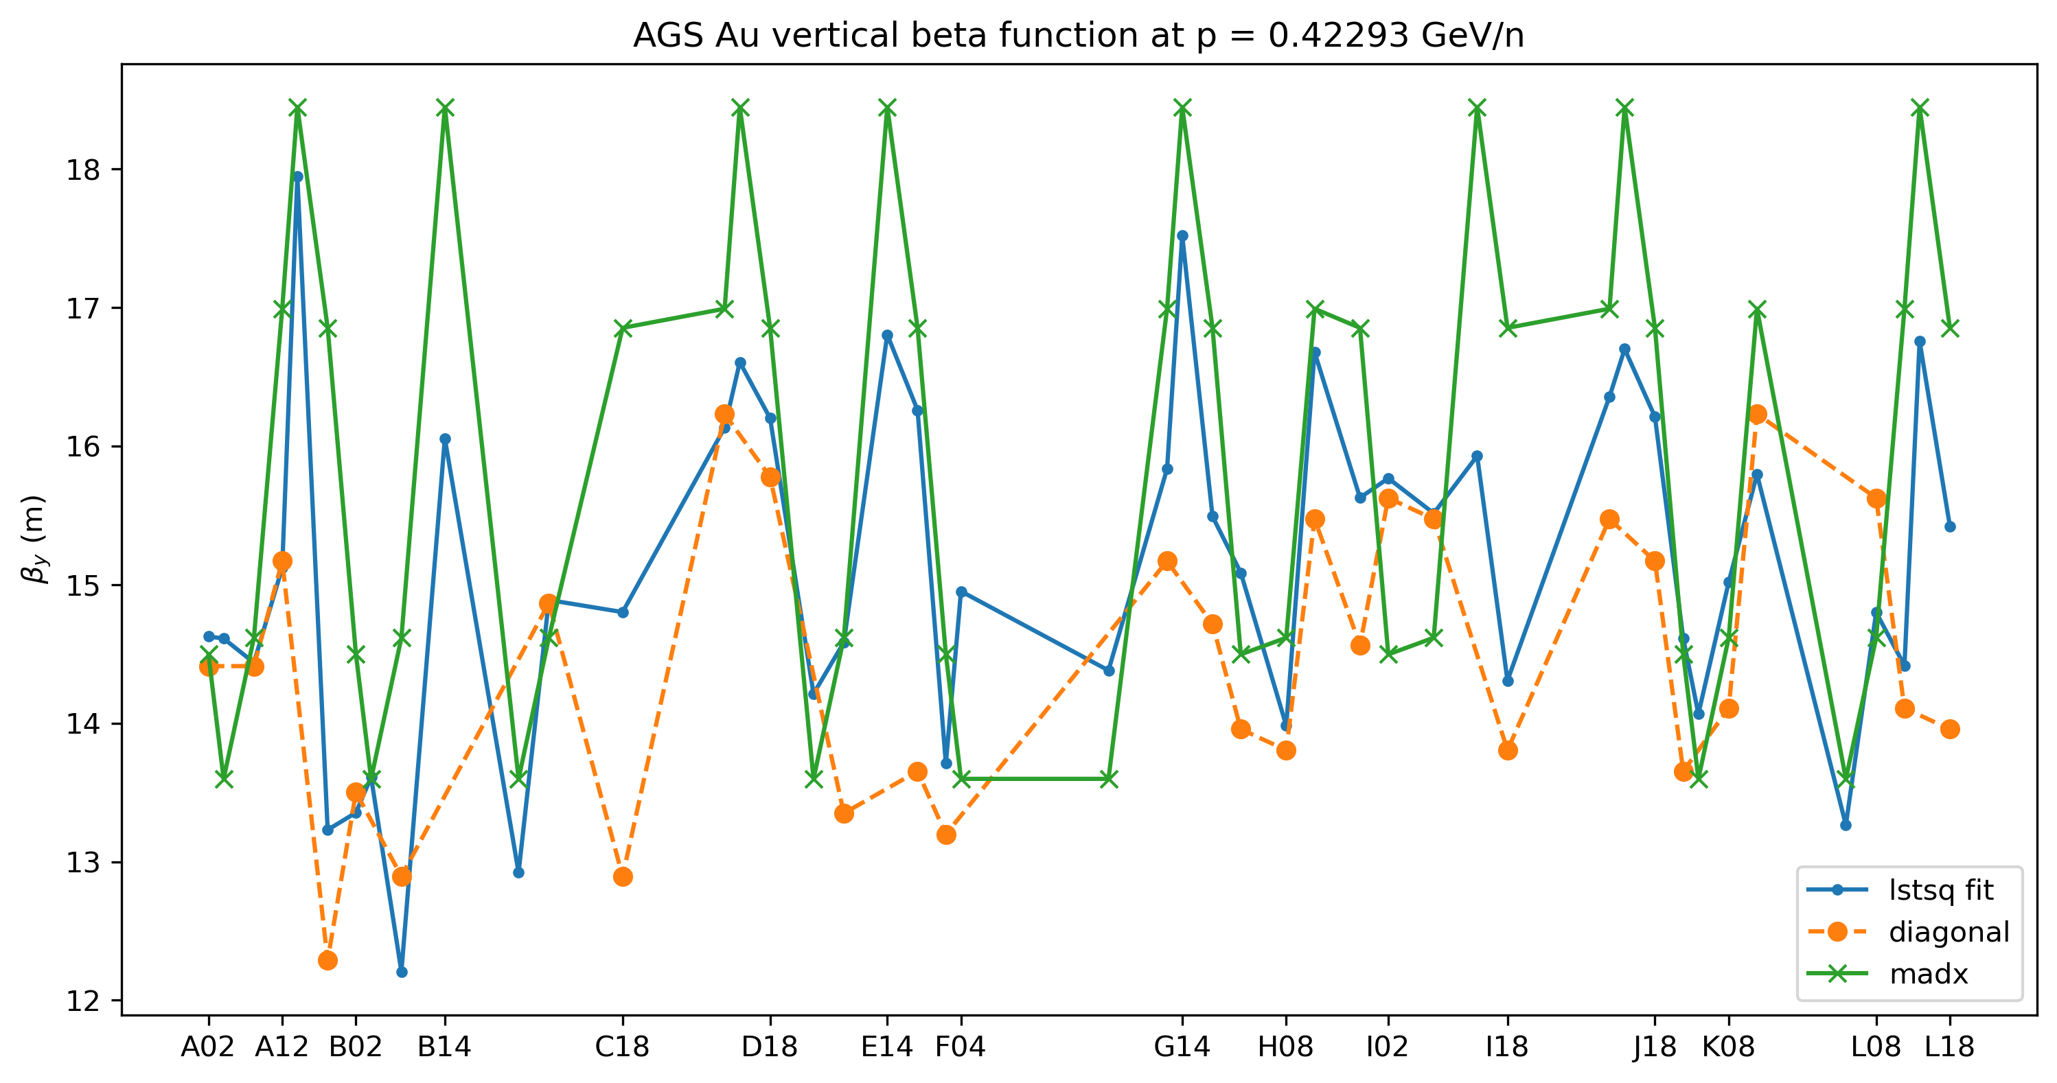
AGS ORM beta: August 18, 2025
1400 ms
$$χ_{red}^{2}=0.79$$

Slide 25
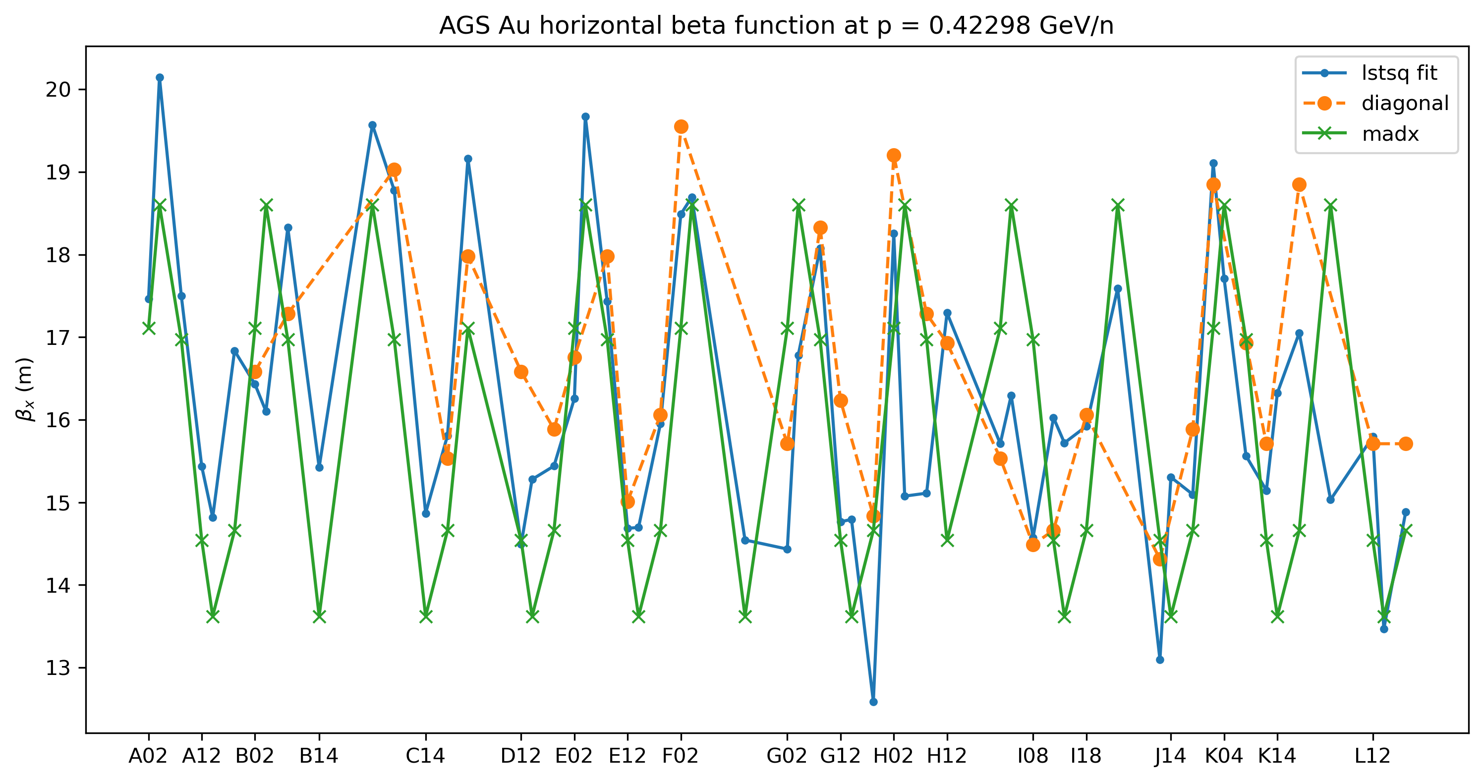

AGS ORM beta: August 18, 2025
1500 ms
$$χ_{red}^{2}=0.77$$

Slide 26
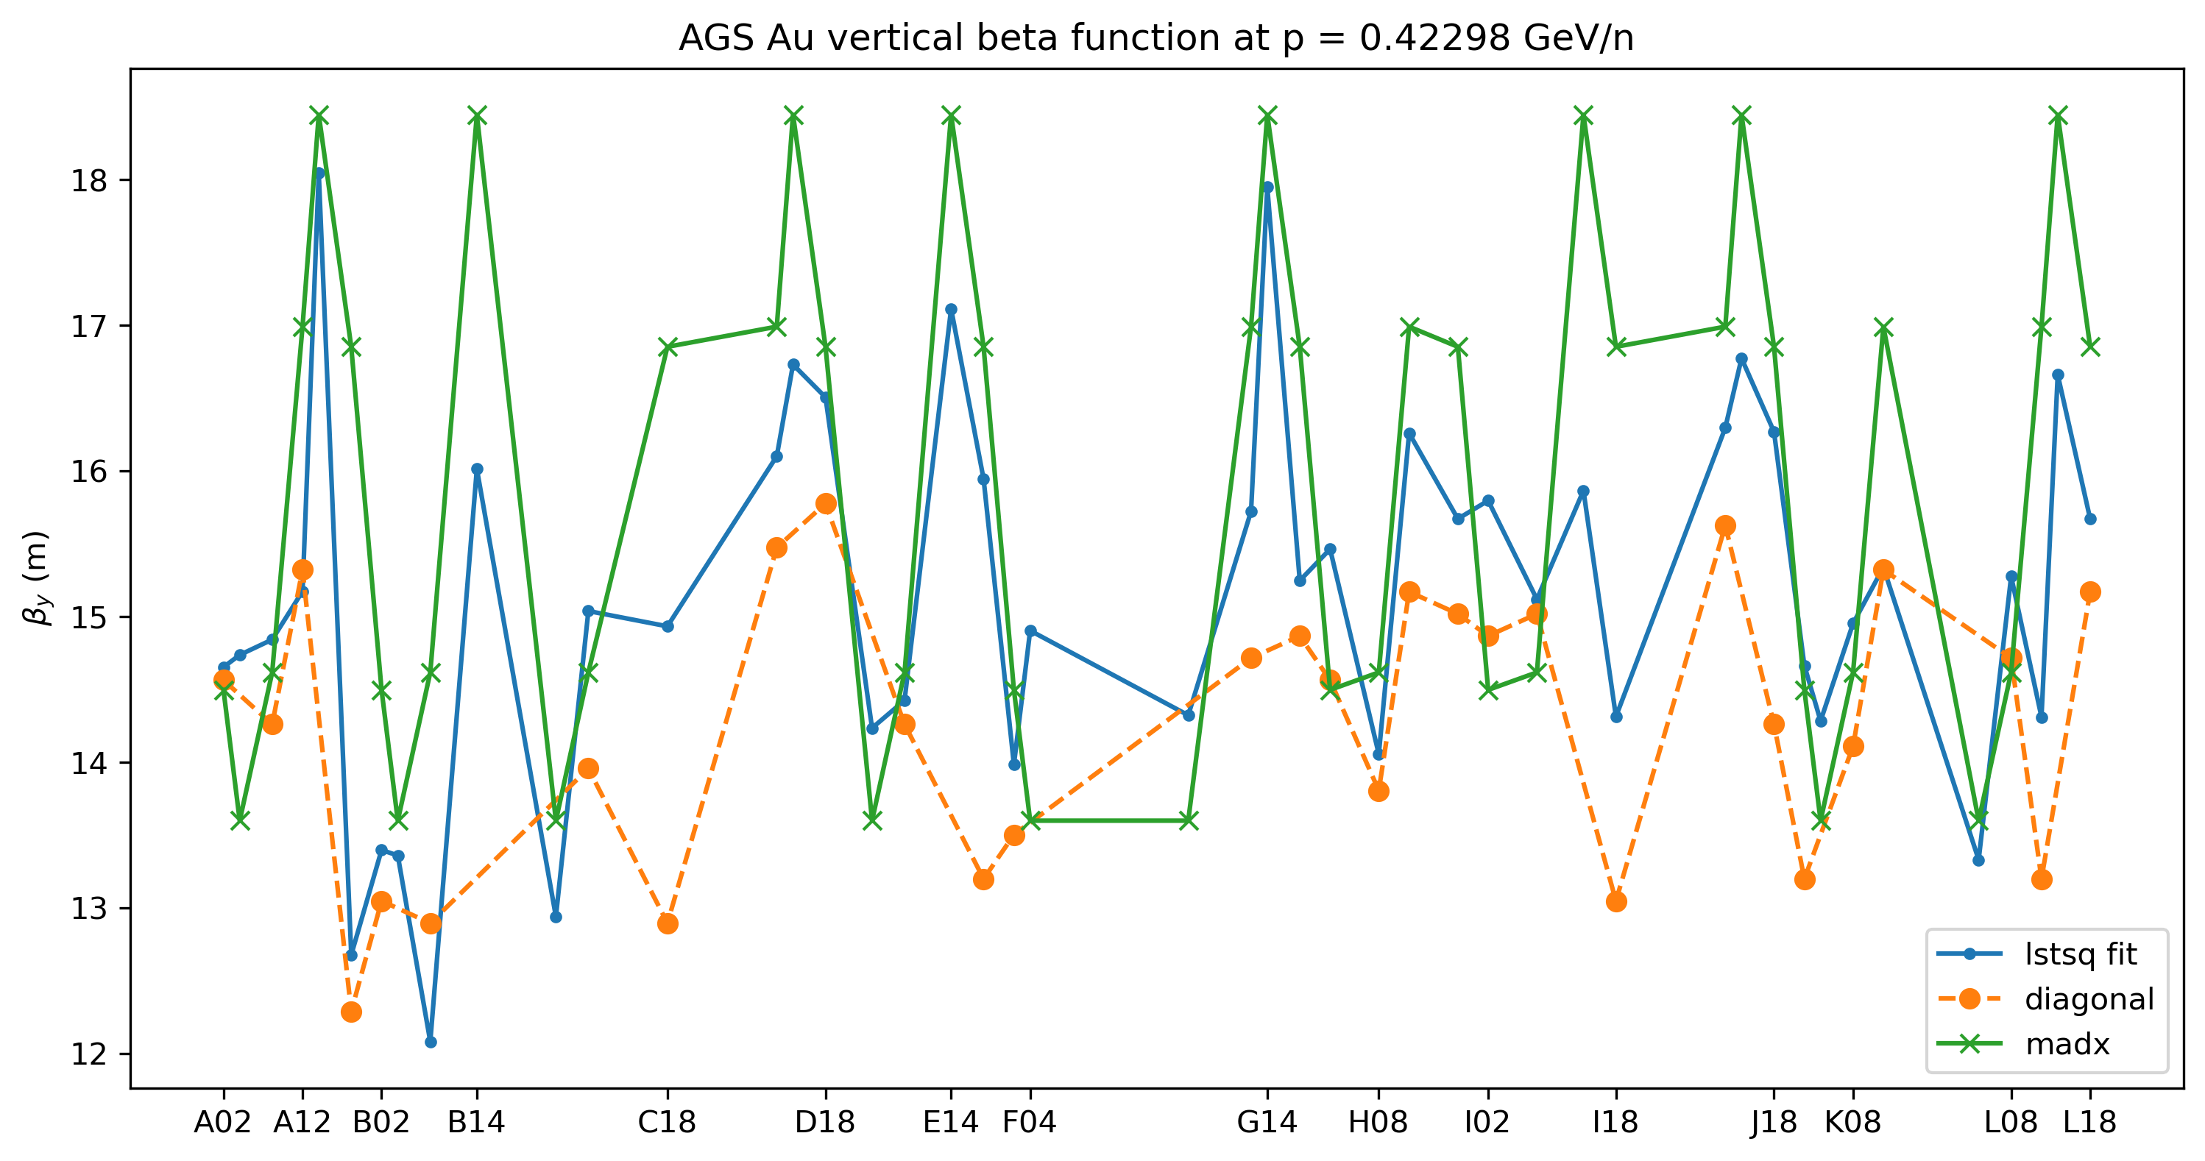

AGS ORM beta: August 18, 2025
1500 ms
$$χ_{red}^{2}=0.74$$

Slide 27
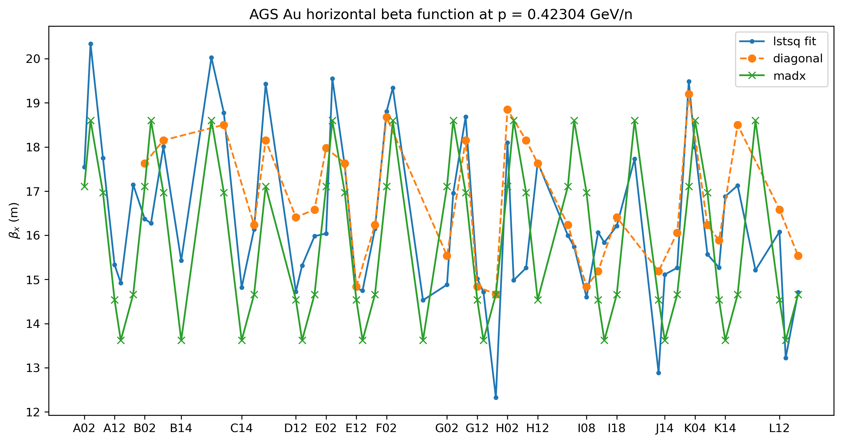

AGS ORM beta: August 18, 2025
1600 ms
$$χ_{red}^{2}=0.85$$

Slide 28
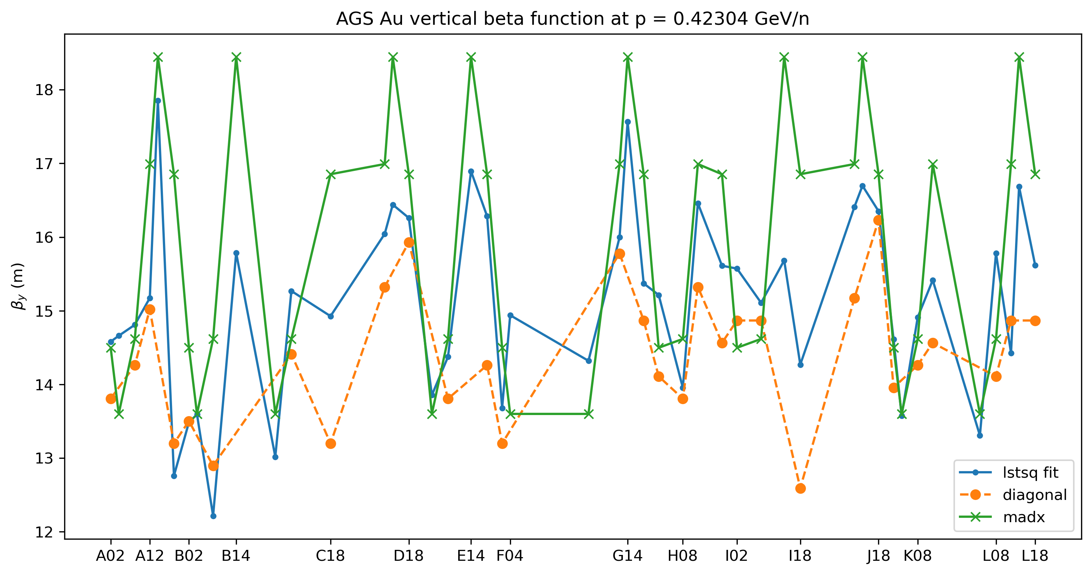

AGS ORM beta: August 18, 2025
1600 ms
$$χ_{red}^{2}=0.73$$

Slide 29
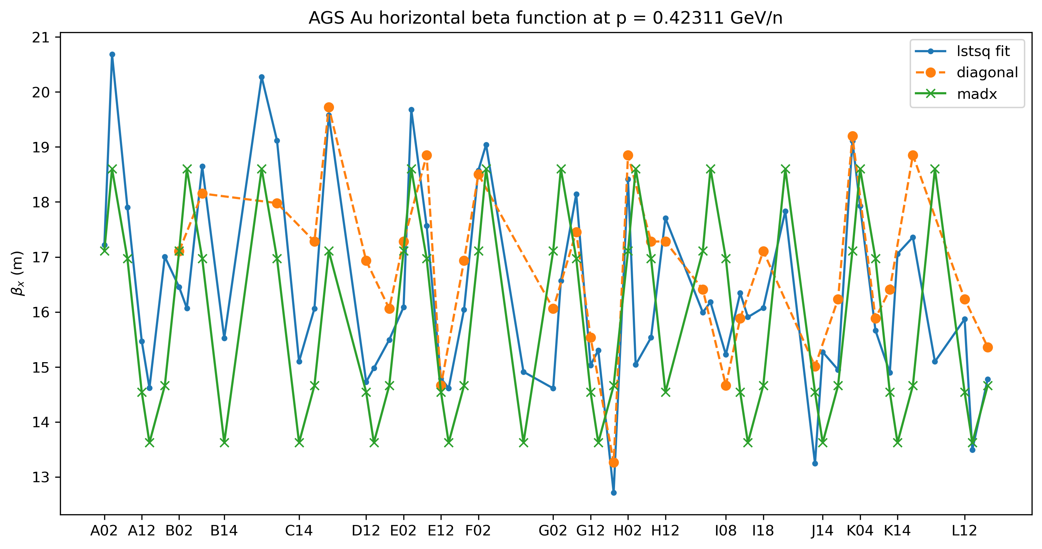

AGS ORM beta: August 18, 2025
1700 ms
$$χ_{red}^{2}=0.88$$

Slide 30
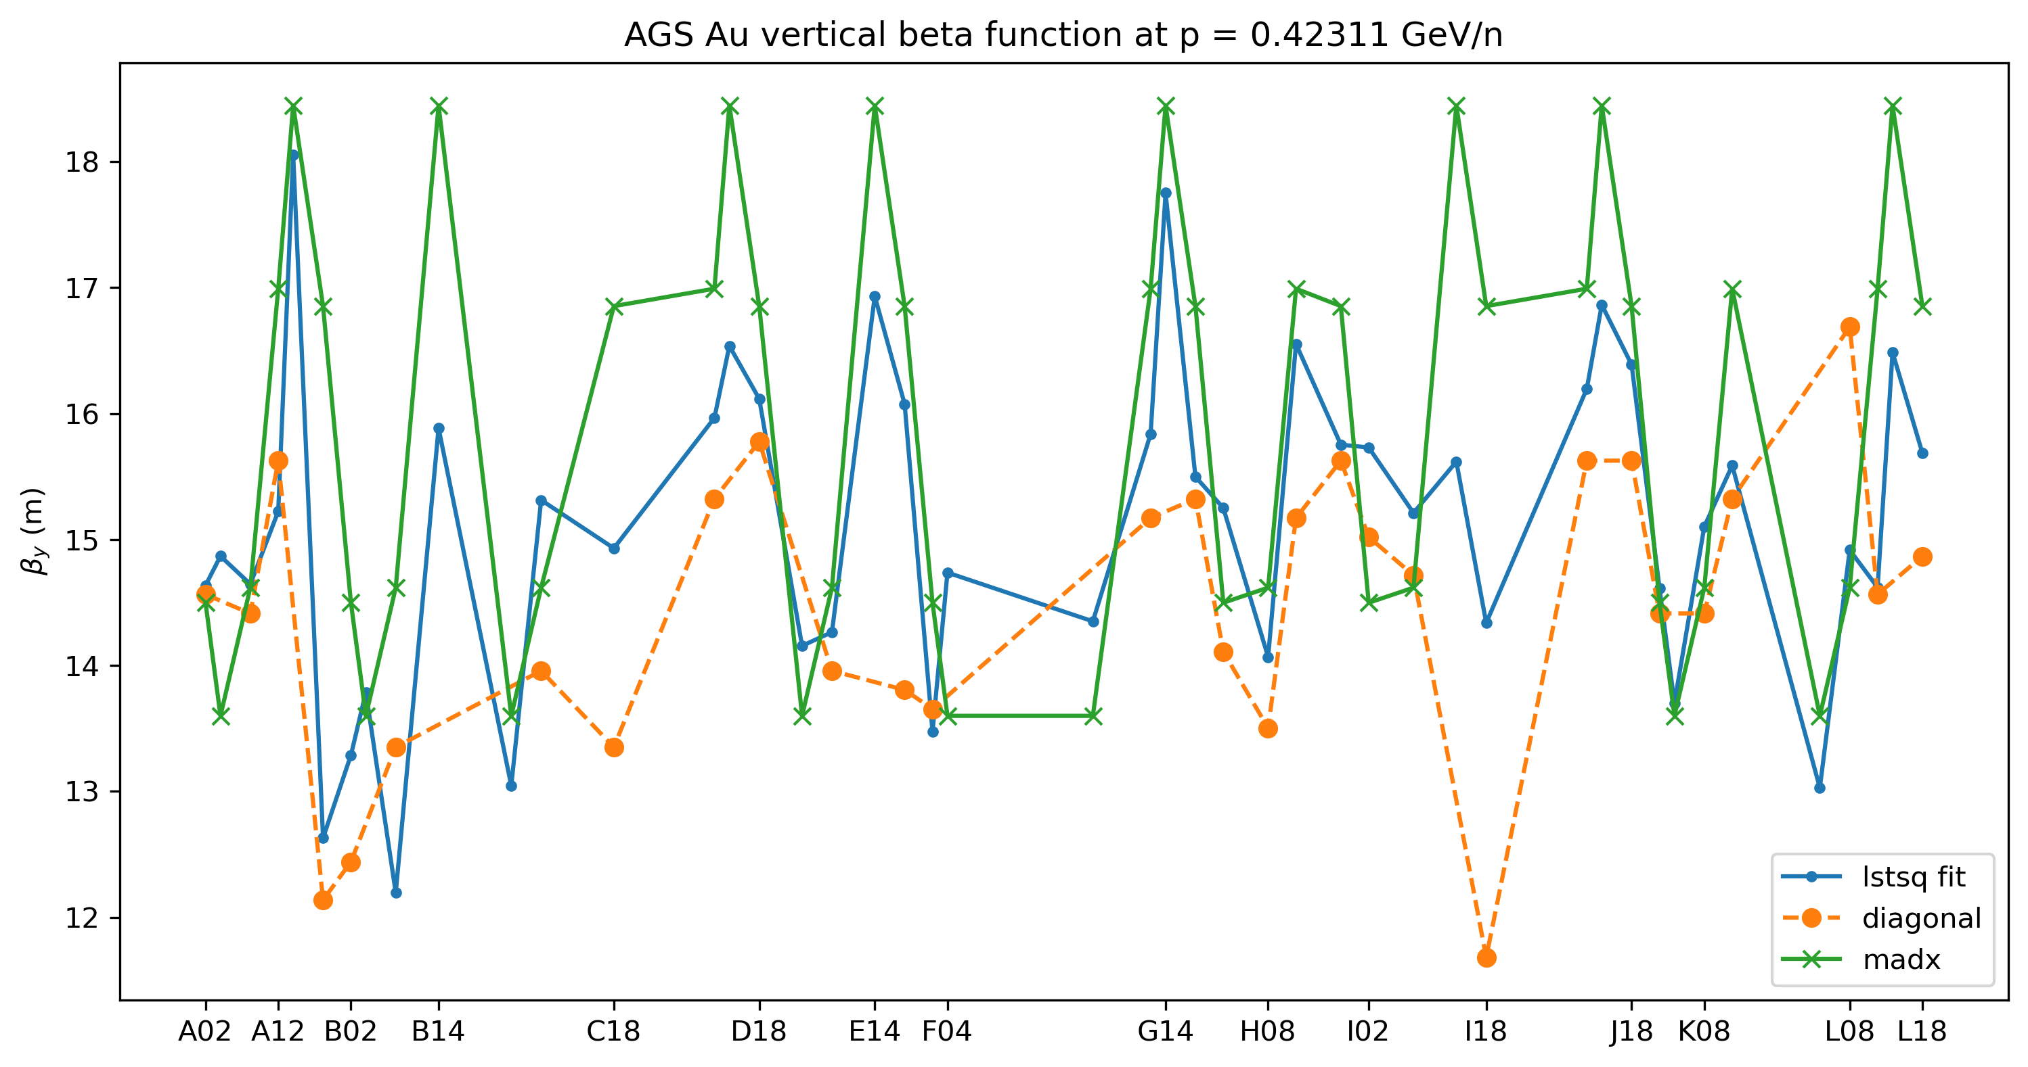

AGS ORM beta: August 18, 2025
1700 ms
$$χ_{red}^{2}=0.65$$

