Slide 1




AGS modeling at low energy & beam-based verification
Eiad Hamwi
PhD Candidate, Cornell ERL/EIC Group
PI: Georg Hoffstaetter de Torquat

Slide 2
Outline
Beamline description
Orbit, optics, and chromaticity
Nonlinear Normal Form
Separatrix & Extraction
Ramping
CESR Resonant Island Studies
Summary and Conclusion

Slide 3
Uniqueness of the AGS
Most modern synchrotrons are flat rings that utilize “separate-function” magnets, isolating individual planar multipole fields for beam manipulation.
The AGS, however, leverages “combined-function” magnets which simultaneously generate dipole, quadrupole, and some sextupole fields.
Furthermore, polarized proton operations benefit remarkably from the use of “partial snakes” which are helical dipole magnets that generate an energy-dependent spin precession.

Slide 4
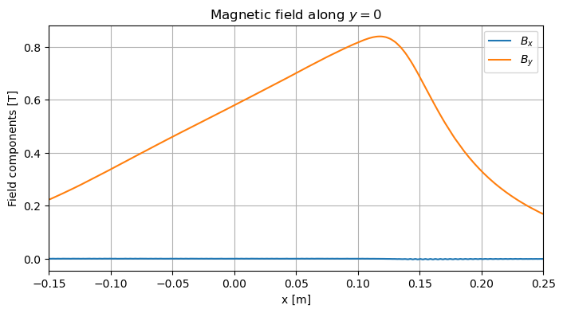
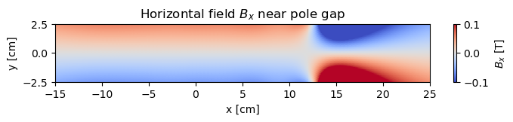
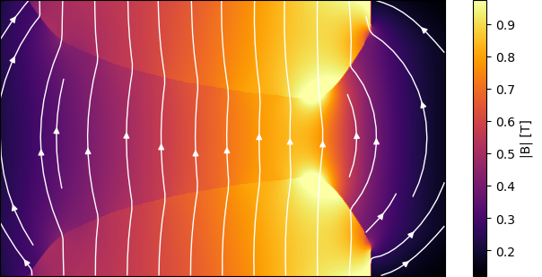
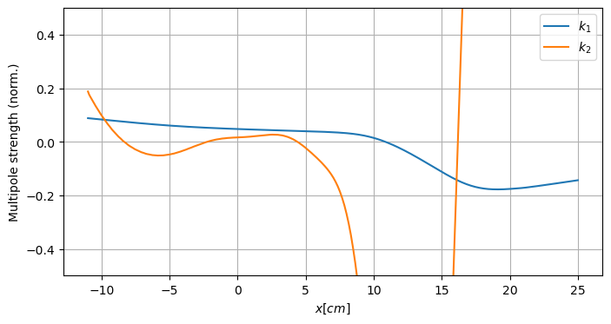

Main Magnets
The 240 combined-function, main magnets of the AGS are effectively offset-quadrupole magnets. The roughly hyperbolic pole-tips produce a quadrupole field whose center is shifted relative to the reference orbit.
$\left|k_{1}\right|=0.0485±0.002 m^{−2}$
$\left|k_{2}\right|=0.01±0.02 m^{−3}$

Slide 5
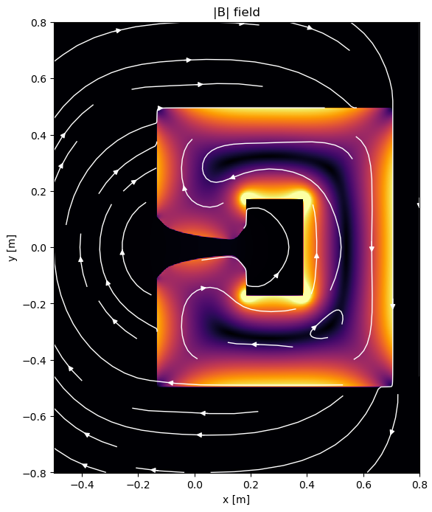
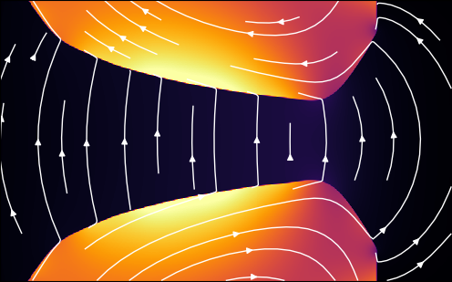
Main Magnets – Hysteresis
“Before the current is turned on for a pulse, the remanent field at the aperture centerline is about 15 gauss due to the remaining magnetization in the steel core from the previous pulse. The value of this remanent field depends mainly on the coercive force of the steel which averages around 0.77 oersted. As the pulse current rises, the injection field value of 120 gauss should be reached simultaneously in all magnets.”
“Two related problems are involved:
coercive force and low field permeability show standard deviations of 10% to 15% from the mean, and
both properties show an "aging" deterioration of 60% or more as determined by accelerated aging tests in which samples are subjected to 150°C for five days.
It is assumed that it will take at least 20 years for the same aging to take place at room temperature. Fortunately, the high field properties show no appreciable aging.”
AGS Design Report, December 1966
Magnetic field
Possible
Magnetization

Slide 6
Main Magnets – Modelling
The AGS main magnets are rectangular bends, rather than arc bends. The nonzero gradients generate an s-dependent field along the closed orbit.
Therefore, natural coordinate system for such a magnet is the Cartesian system, rather than the typical choice of cylindrical, curvilinear coordinates.
This means that the closed orbit will not be zero throughout the main magnets, complicating simulations.
Fortunately, this avoids the confusion surrounding multipole fields in curvilinear coordinates.

Slide 7
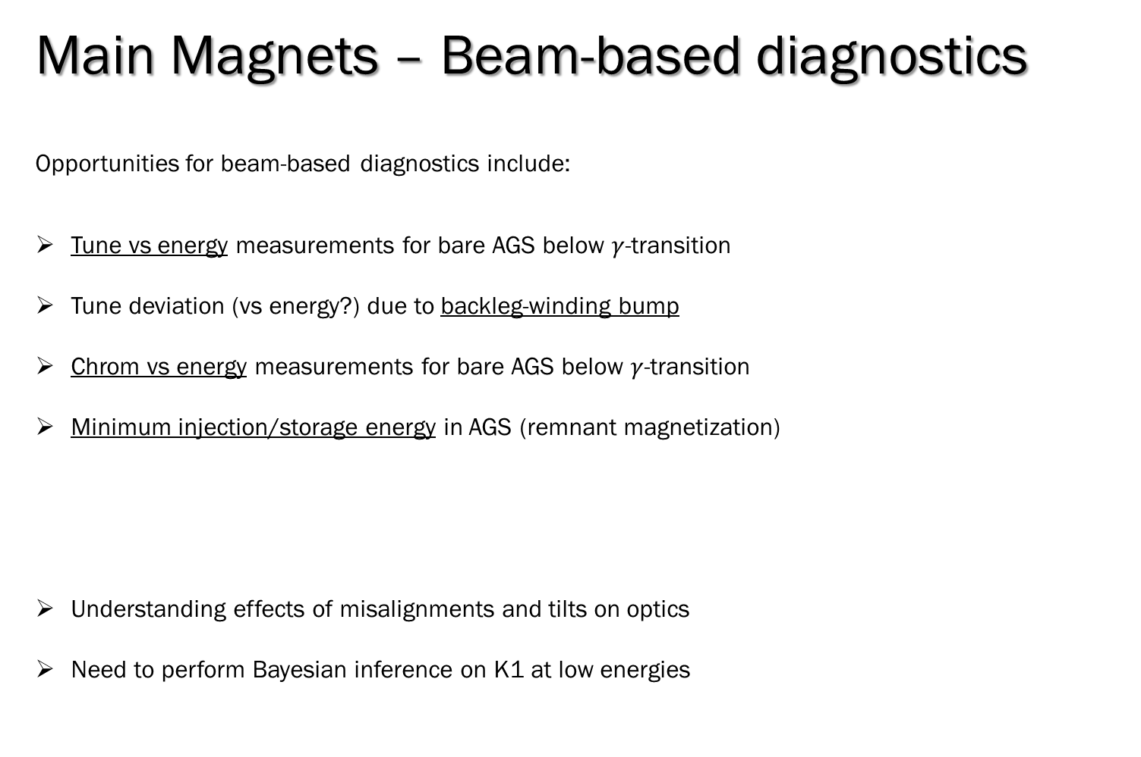
Main Magnets – Beam-based diagnostics
Opportunities for beam-based diagnostics include:
Tune vs energy measurements for bare AGS below $γ$-transition
Tune deviation (vs energy?) due to backleg-winding bump
Chrom vs energy measurements for bare AGS below $γ$-transition
Minimum injection/storage energy in AGS (remnant magnetization)
Understanding effects of misalignments and tilts on optics
Need to perform Bayesian inference on K1 at low energies

Slide 8
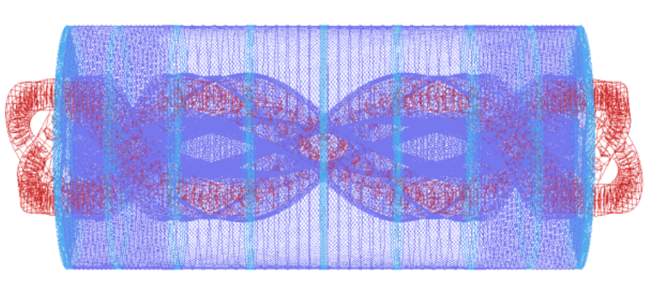
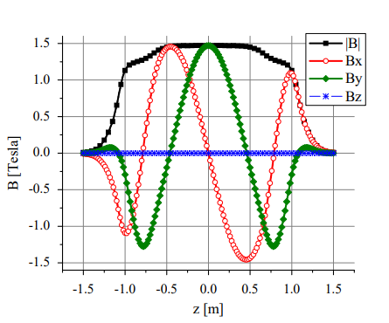
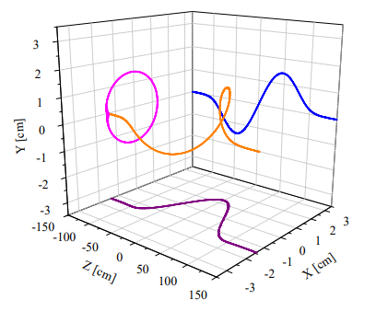
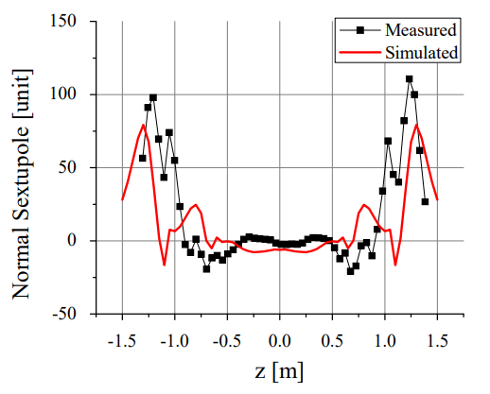
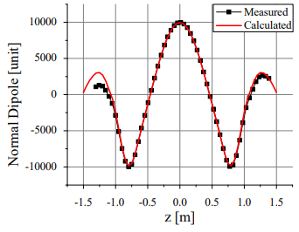
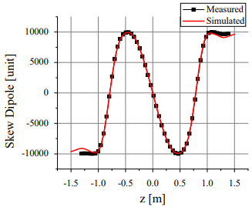


Partial snakes - Warm
The two partial, helical dipole snakes each produce an approximately constant field and generate a helical orbit distortion.
$${10}^{−4} \left|B_{0}\right|$$
$$R=31 mm$$

Slide 9
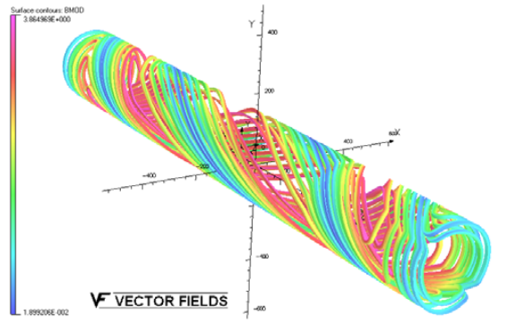
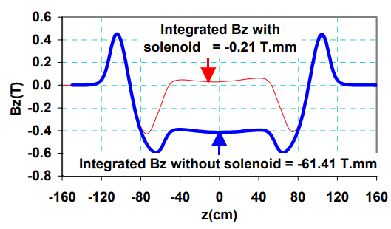
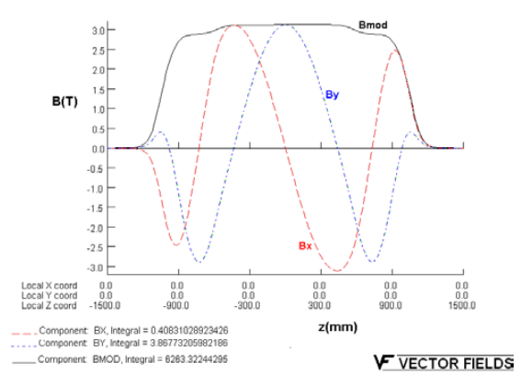
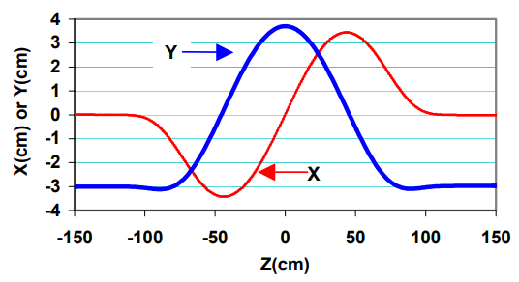
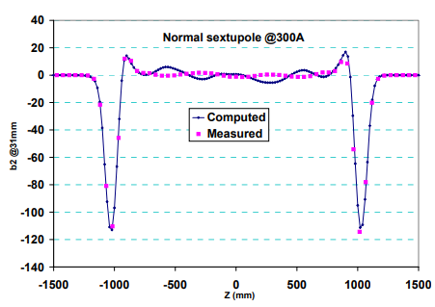
Partial snakes - Cold
The two partial, helical dipole snakes each produce an approximately constant field and generate a helical orbit distortion.

Slide 10
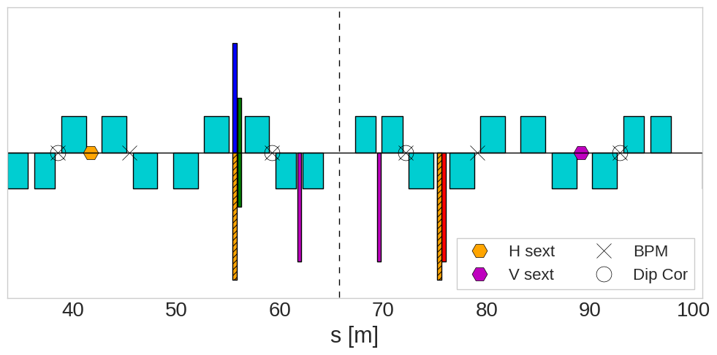
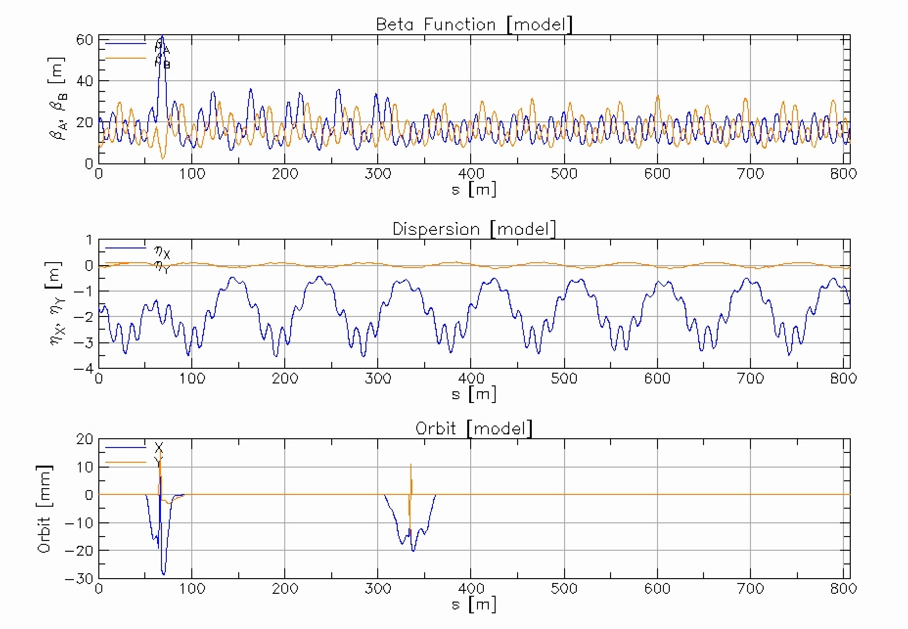
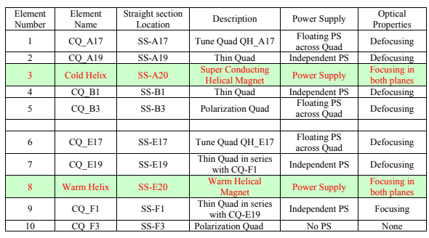
Partial snakes - compensation
Under-determined system for optics, but over-determined if conditions are relaxed.
Cold snake
4 independent quads
3 sets of main magnet BLW (steering + focusing)
Several weak correctors
Warm snake
3 independent quads
Several weak correctors
■ Backleg Windings (BLW)
A20 snake

Slide 11
Partial snakes– Beam-based diagnostics
Opportunities for beam-based diagnostics include:
Chrom without sextupoles vs bare AGS (subtract effects of compensation quads)
Find orthogonal pairs of skew quads vs energy via coupling measurements (possibly against bare AGS)
Wave analysis of beta & phase functions between snakes using turn-by-turn BPMs and fast-kickers/shakers

Slide 12
References
[1] J. Takano et al., “Helical dipole partial Siberian snake for the AGS”, 2006 JINST 1 P11002
[2] J. Takano et al., “Field Measurements in the AGS Warm Snake”, in Proc. EPAC'04, Lucerne, Switzerland, Jul. 2004, paper WEPLT114, pp. 2116-2118.
[3] R. Gupta et al., “Magnetic Design of a Superconducting AGS Snake”, in Proc. PAC'03, Portland, OR, USA, May 2003, paper WPAE002, pp. 1936-1938.
[4] E. Willen et al., “Superconducting Helical Snake Magnet for the AGS”, in Proc. PAC'05, Knoxville, TN, USA, May 2005, paper MPPT046, pp. 2935-2937.
[5] N. Tsoupas et al., “Acceleration of Polarized Protons in the AGS”, BNL Tech Note C-A/AP/#391, Feb. 2010.

