Slide 1
Slow Extraction Stuff
Kevin Brown, C-AD
October 21, 2025 Cornell University

Slide 2
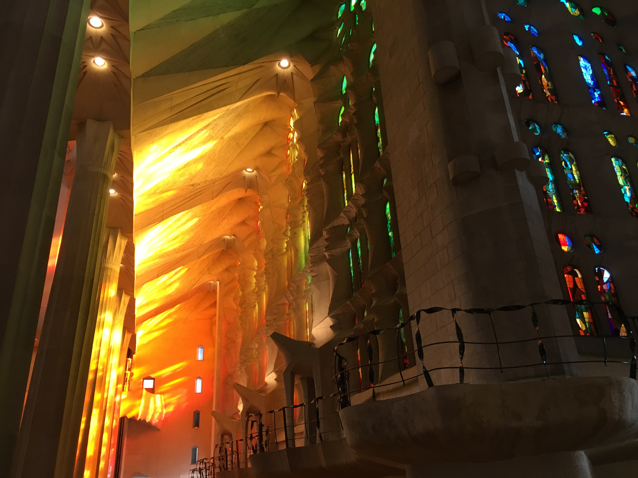
Separatrices, Folding, and Shaping

Slide 3
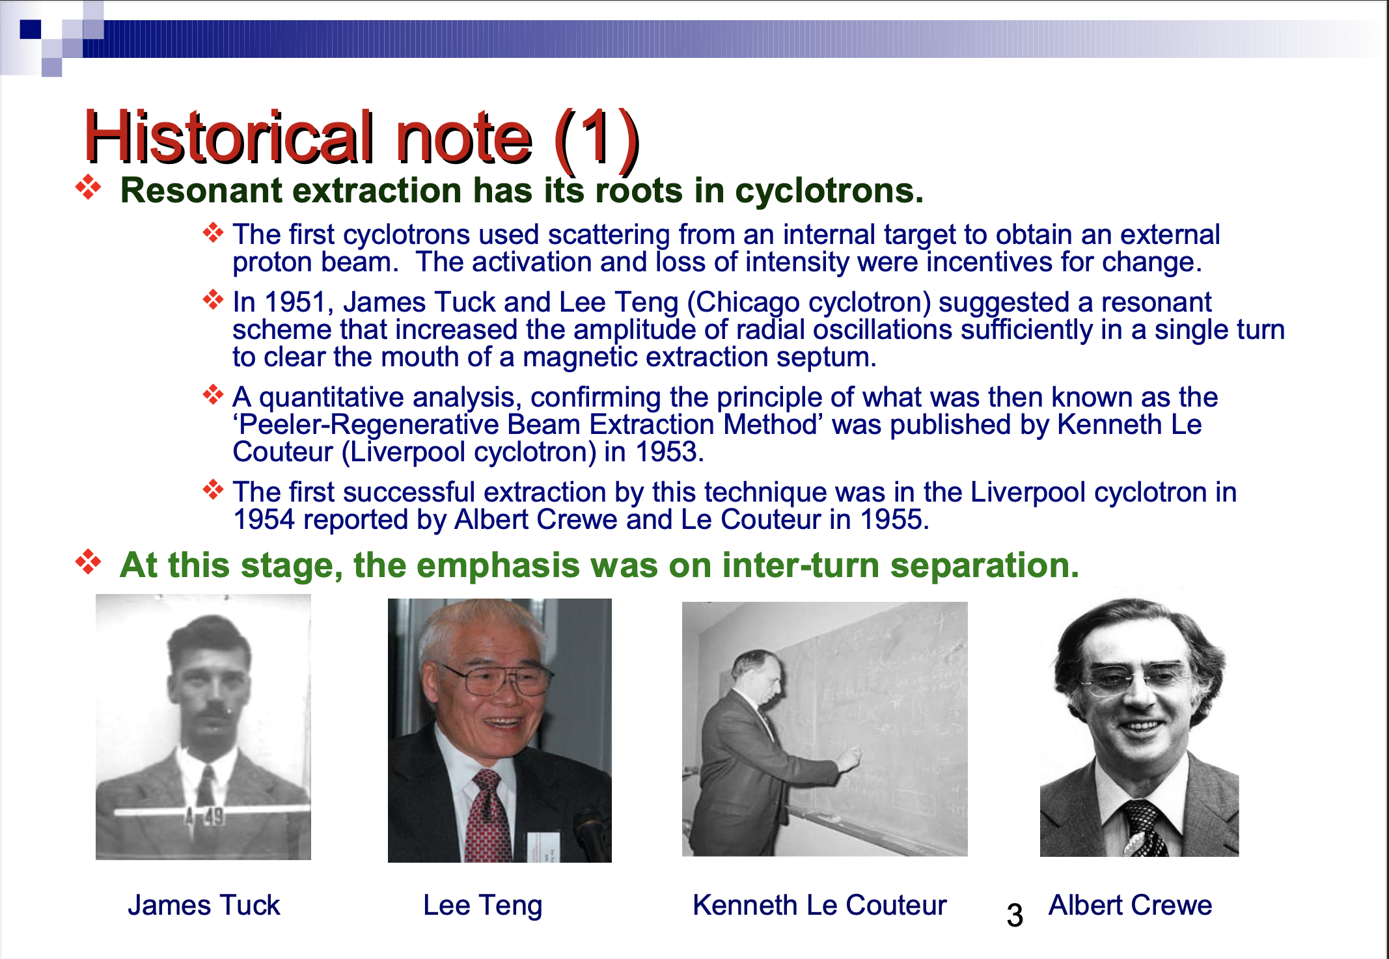
From 2017 CAS, P. J. Bryant

Slide 4
Historical Perspective
Let’s talk, for a moment, about this:
Y. Kobayashi and H. Takahashi,
“Improvement of the Emittance in the Resonant Beam Ejection”, Proc. VIth Int. Conf. on High Energy Accel., Massachusetts, pp.347-351 (1967)
Notes:
Operators try to be proactive, but mostly are reactive

Slide 5
ε is a small phase shift in one period.

Slide 6
Note: ‘g’ is their notation for multipole strength.
Notes:
A lot of the time we want to learn how to keep some signal at zero.

Slide 8
Slow Extraction and Higher Order Multipoles
A perturbation from a sextupole
From a ‘thin’ duodecapole

Slide 9
Kobayashi Hamiltonian (normal 3rd integer)
And, when we add a duodecapole (simple 3rd integer)
And to make life a little easier,

Slide 10
What does it look like?

Slide 11
Tracking Simulations: J-PARC SE
BNL-99420-2013-TECH C-A/AP/270;BNL-99420-2013-IR

Slide 12
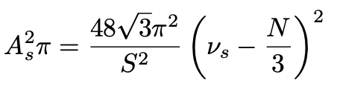

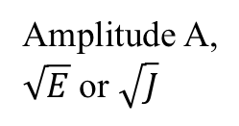


Tune - Amplitude Diagram
resonance line
Amplitude A,
$\sqrt{E}$ or $\sqrt{J}$
Unstable
Region
Separatrix for particles
encountering the resonance
from below.
A₀
stopband for
particle with
amplitude A₀
Separatrix for particles
encountering the resonance
from above.
Stable
Region
Stable
Region
$$ν_{res}−|δ (A_{0})|$$
$$ν_{res}$$
$$ν_{res}+|δ (A_{0})|$$
Tune, ν
The size of the stable area is a function of the tune and amplitude of the particles going into resonance.

Slide 13
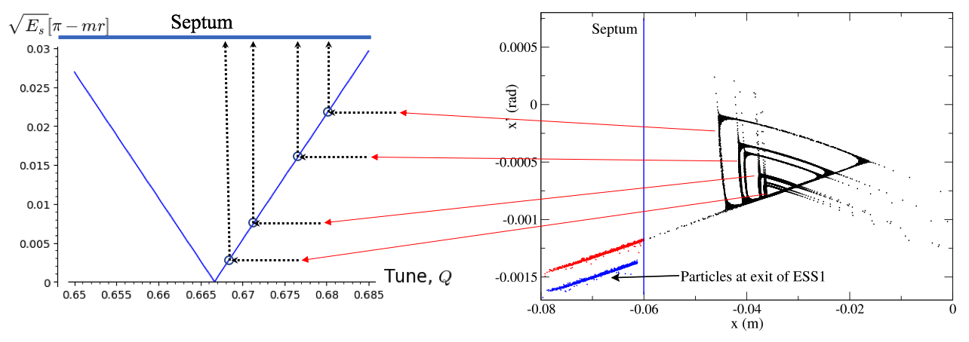
Tune - Amplitude Diagram
Unstable
Region

Slide 14
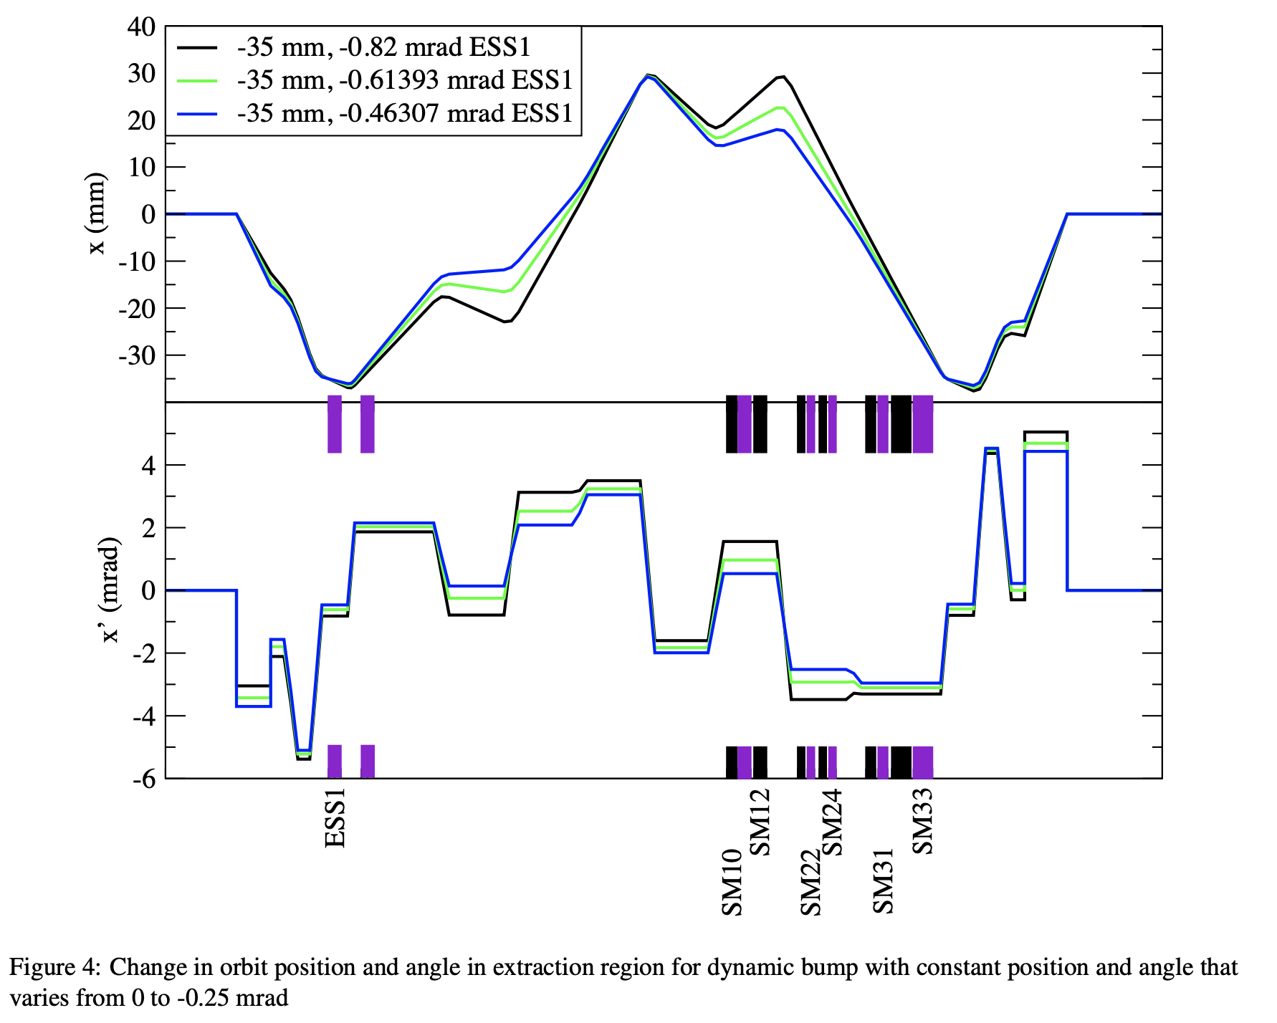
BNL-99420-2013-TECH C-A/AP/270;BNL-99420-2013-IR

Slide 15
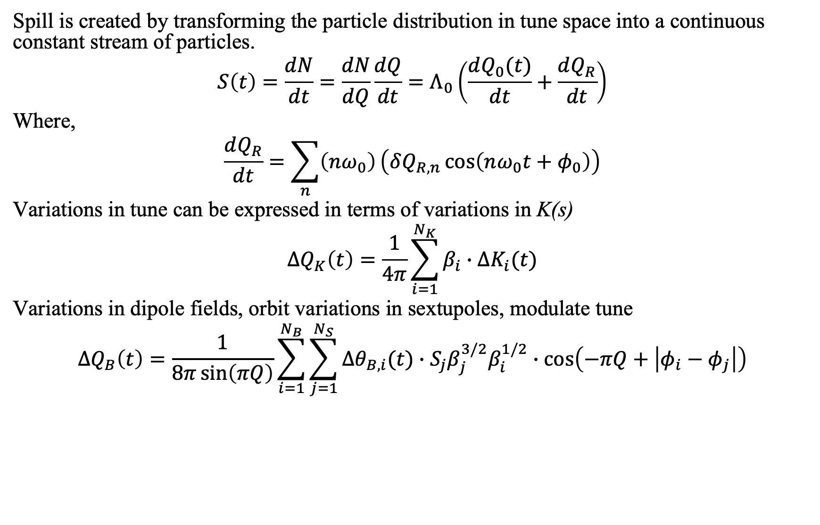
Spill Structure Theory 1: Harmonics analysis
Spill is created by transforming the particle distribution in tune space into a continuous constant stream of particles.
$$S\left(t\right)=\frac{dN}{dt}=\frac{dN}{dQ}\frac{dQ}{dt}=Λ_{0}\left(\frac{dQ_{0}(t)}{dt}+\frac{dQ_{R}}{dt}\right)$$
Where,
$$\frac{dQ_{R}}{dt}=\sum_{n}{\left(nω_{0}\right)}\left(δQ_{R,n}\cos\left(nω_{0}t+φ_{0}\right)\right)$$
Variations in tune can be expressed in terms of variations in K(s)
$$ΔQ_{K}\left(t\right)=\frac{1}{4π}\sum_{i=1}^{N_{K}}{β_{i}∙ΔK_{i}(t)}$$
Variations in dipole fields, orbit variations in sextupoles, modulate tune
$$ΔQ_{B}\left(t\right)=\frac{1}{8π\sin\left(πQ\right)}\sum_{i=1}^{N_{B}}{\sum_{j=1}^{N_{S}}{Δθ_{B,i}(t)∙S_{j}β_{j}^{3/2}β_{i}^{1/2}∙\cos\left(−πQ+\left|φ_{i}−φ_{j}\right|\right)}}$$

Slide 16
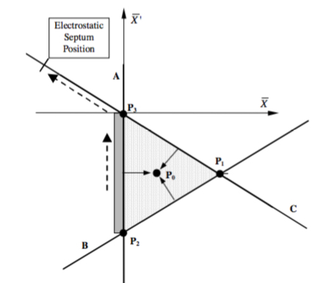
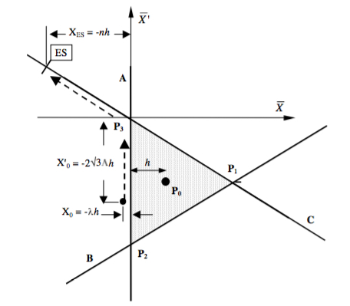
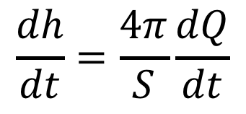
Spill Structure Theory 2: Transit Time Theory
$$\frac{dh}{dt}=\frac{4π}{S}\frac{dQ}{dt}$$

Slide 17
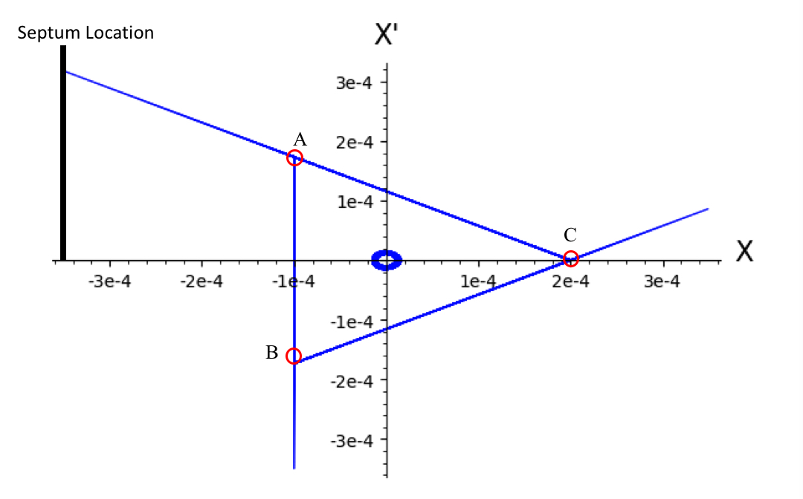
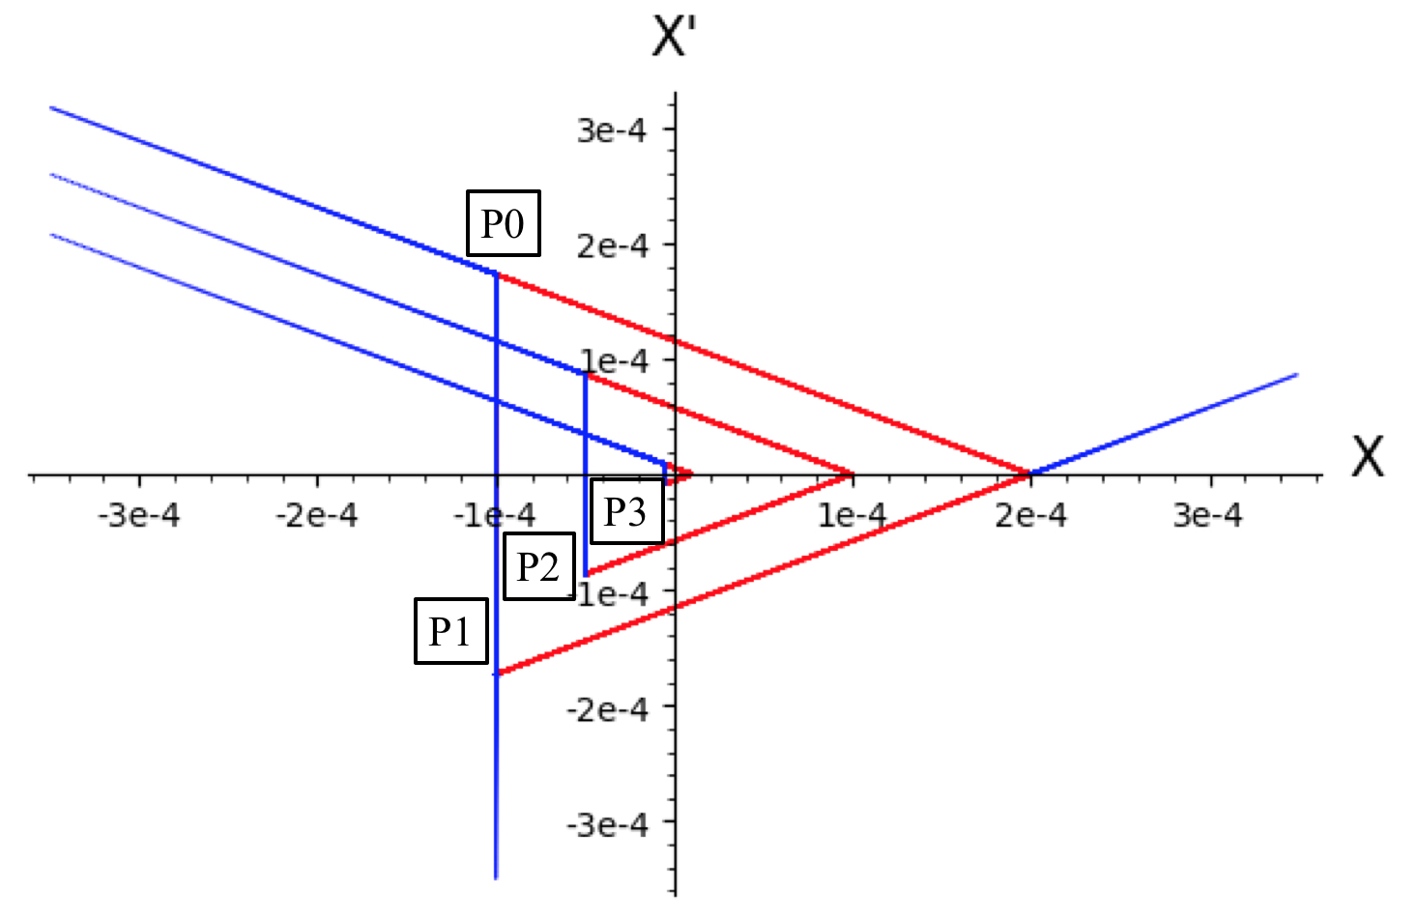
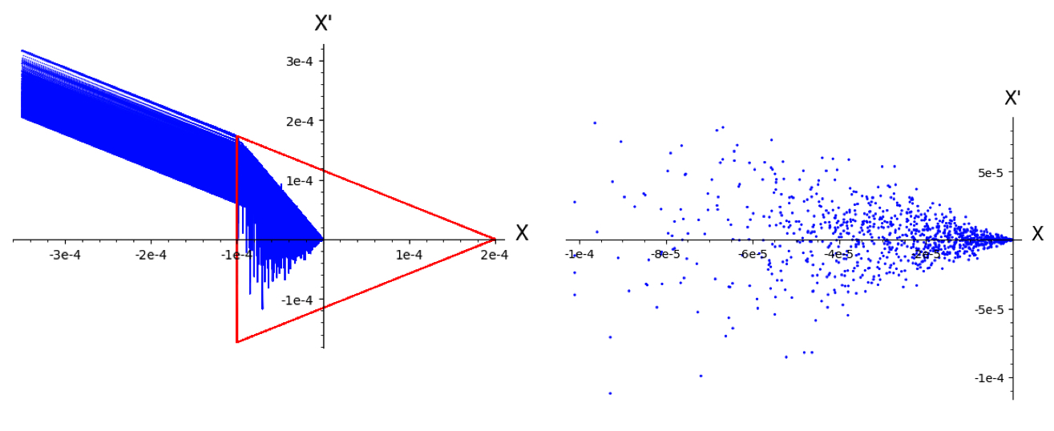
Transit Time Theory

Slide 18
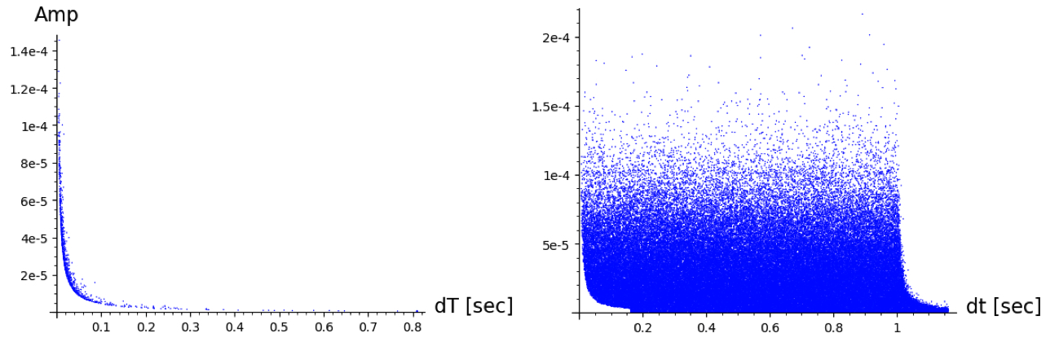
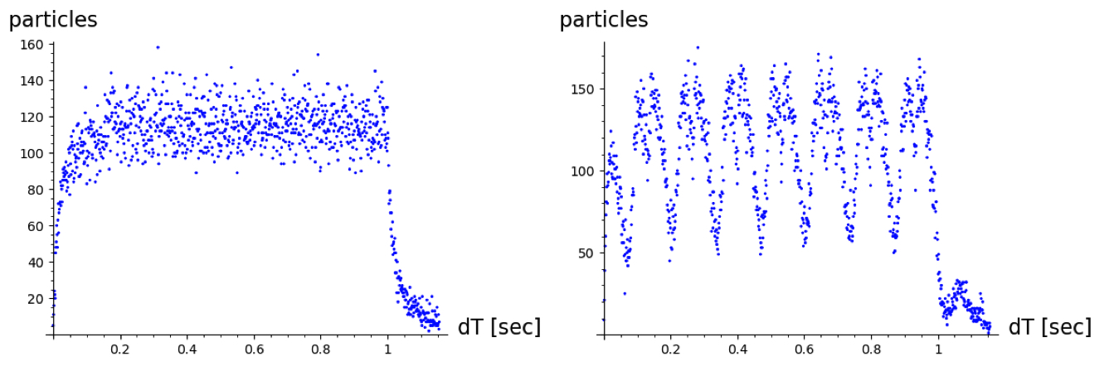
Spill Simulations Using Transit Time Monte- Carlo Model
Transit time distribution for all particles entering resonance at the same time.
No PS Ripple
With 7.5 Hz Tune Ripple
#
#

Slide 19
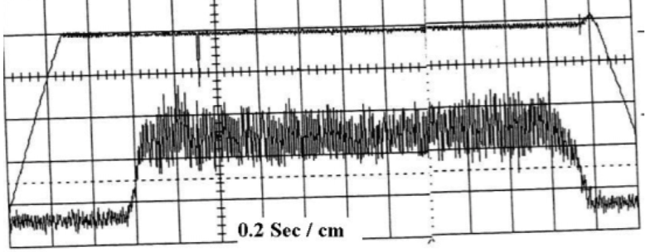
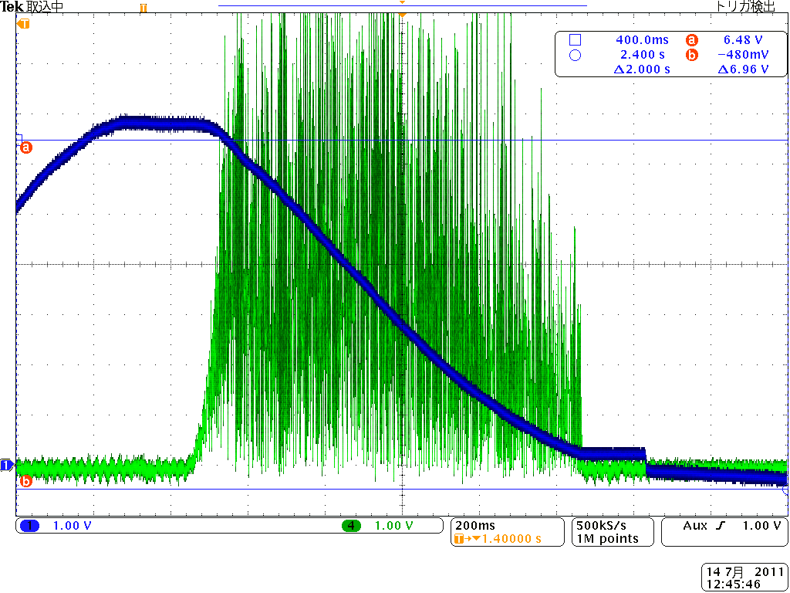
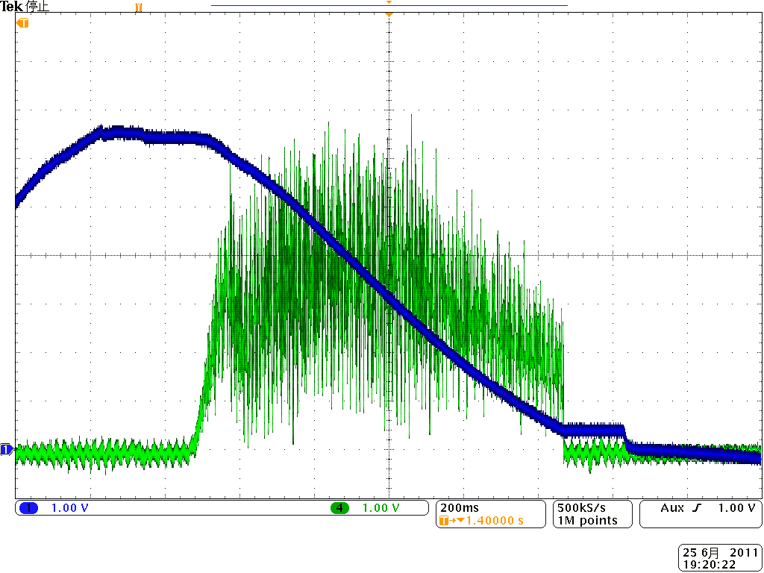
Samples of Spills
National Institute of Radiological Sciences, QST, Japan
2.2 Seconds
1.4 sec
Example of AGS Spill from 1990s
After improvement at 380 MeV/u
Suppressing spill ripple
by reducing synchrotron frequency
then
3D scanning was possible
in lateral direction
CNAO, MedAustron, Italy
Original spill at 380 MeV/u
Huge ripple due to dipole field ripple
was observed, because f_{Dipole} closing to f_{synchro} ,
but
Wobbling method: OK
Respiratory-gating: OK
Air core quad feed forward

Slide 20
Samples of Spills
CERN SPS
Marburg Ion-Beam Therapy Centre, Germany
JPARC has some unique problems, due to operation with zero chromaticity.

Slide 21
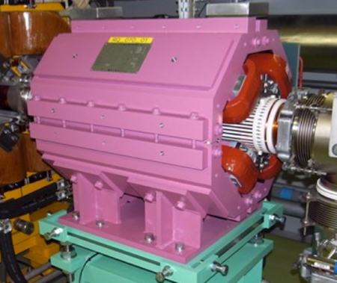
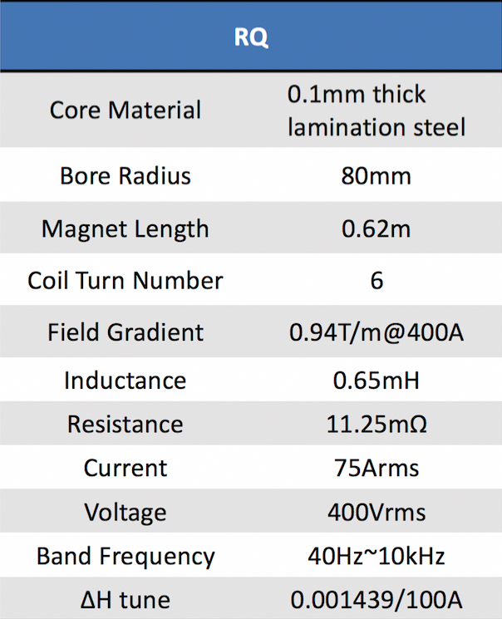
Spill Ripple Compensation (JPARC RQ Quad)

Slide 22
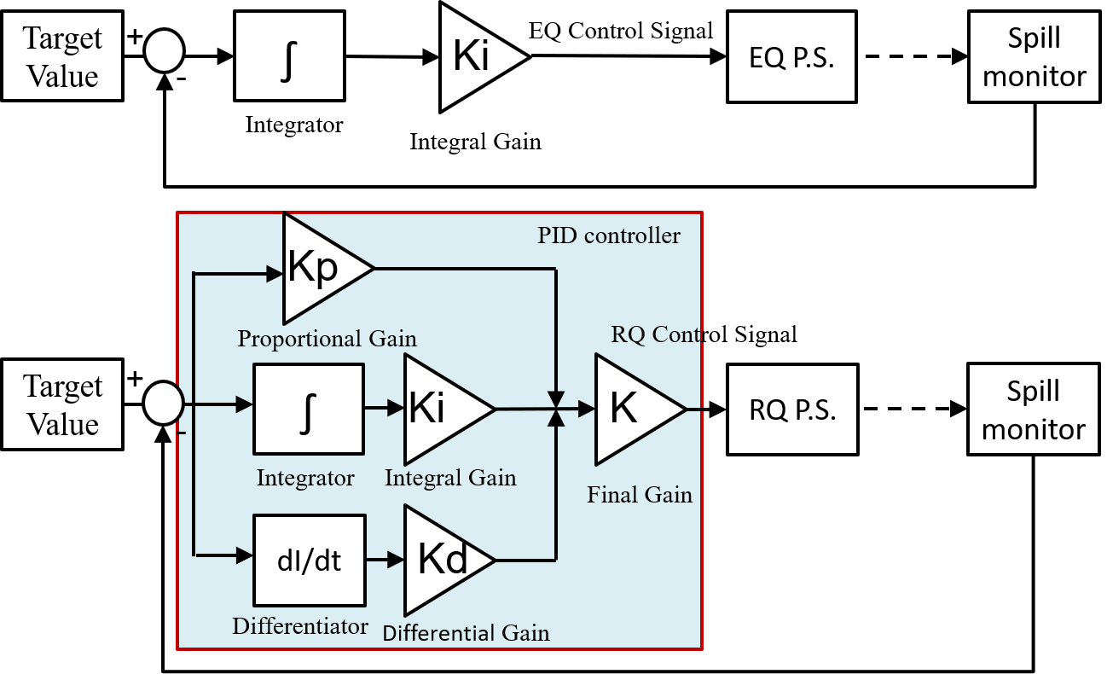
JPARC Spill feedback block diagram
Feedback Gain (Feb. 2018)
EQ: Ki= 62.89
RQ: Kp=1.0, Ki= 20000, Kd=0.00002, K=0.75
by T. Kimura

Slide 23
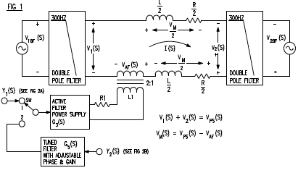
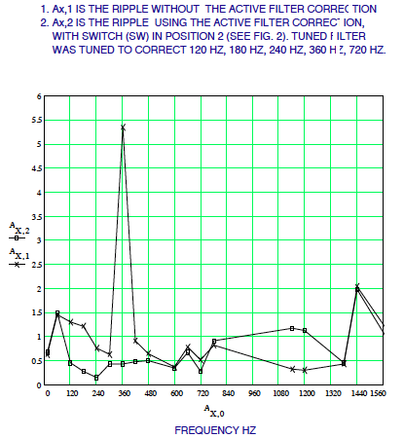
Active Ripple Filter
Fundamental
24 phase = 1440
The tuned filter is basically performing an analog FFT, via bandpass (Butterworth) filters.
Each filter stage passes a narrow band around a 60 Hz harmonic. A gain and phase are applied to the output of the filter.
All filter outputs are added together to form a single reference to the Power Supply.

Slide 24
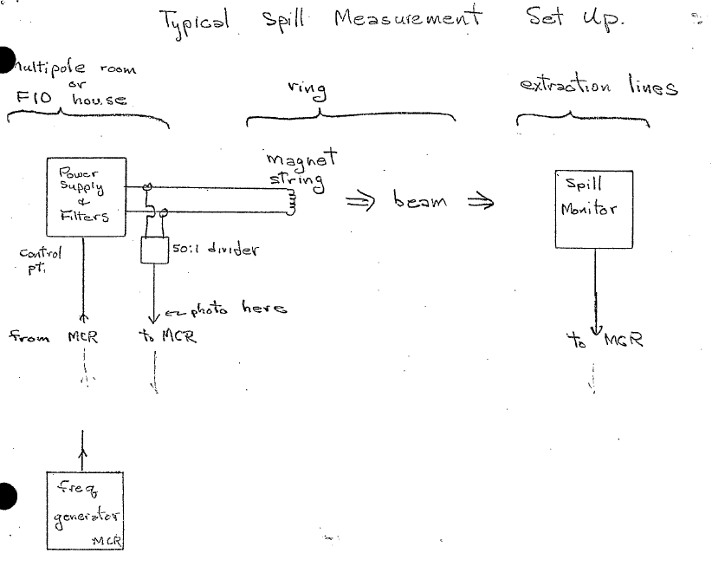


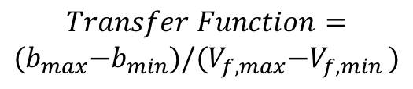

Transfer Function Measurements
Adjust phase to maximize b for given A.

Slide 25
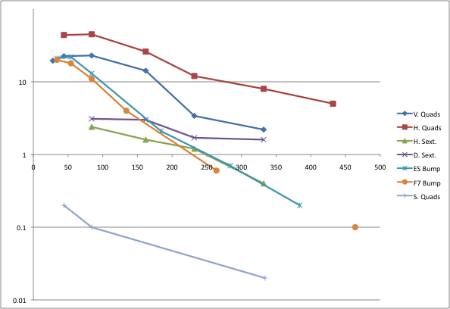
Transfer Function Measurements
Freq. [Hz]
Transfer function [% spill modulation/ ps volts]

Slide 26
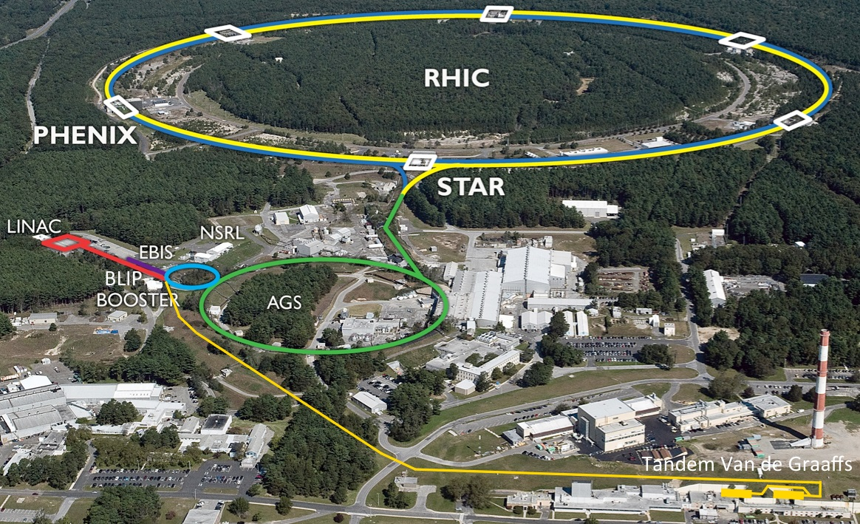
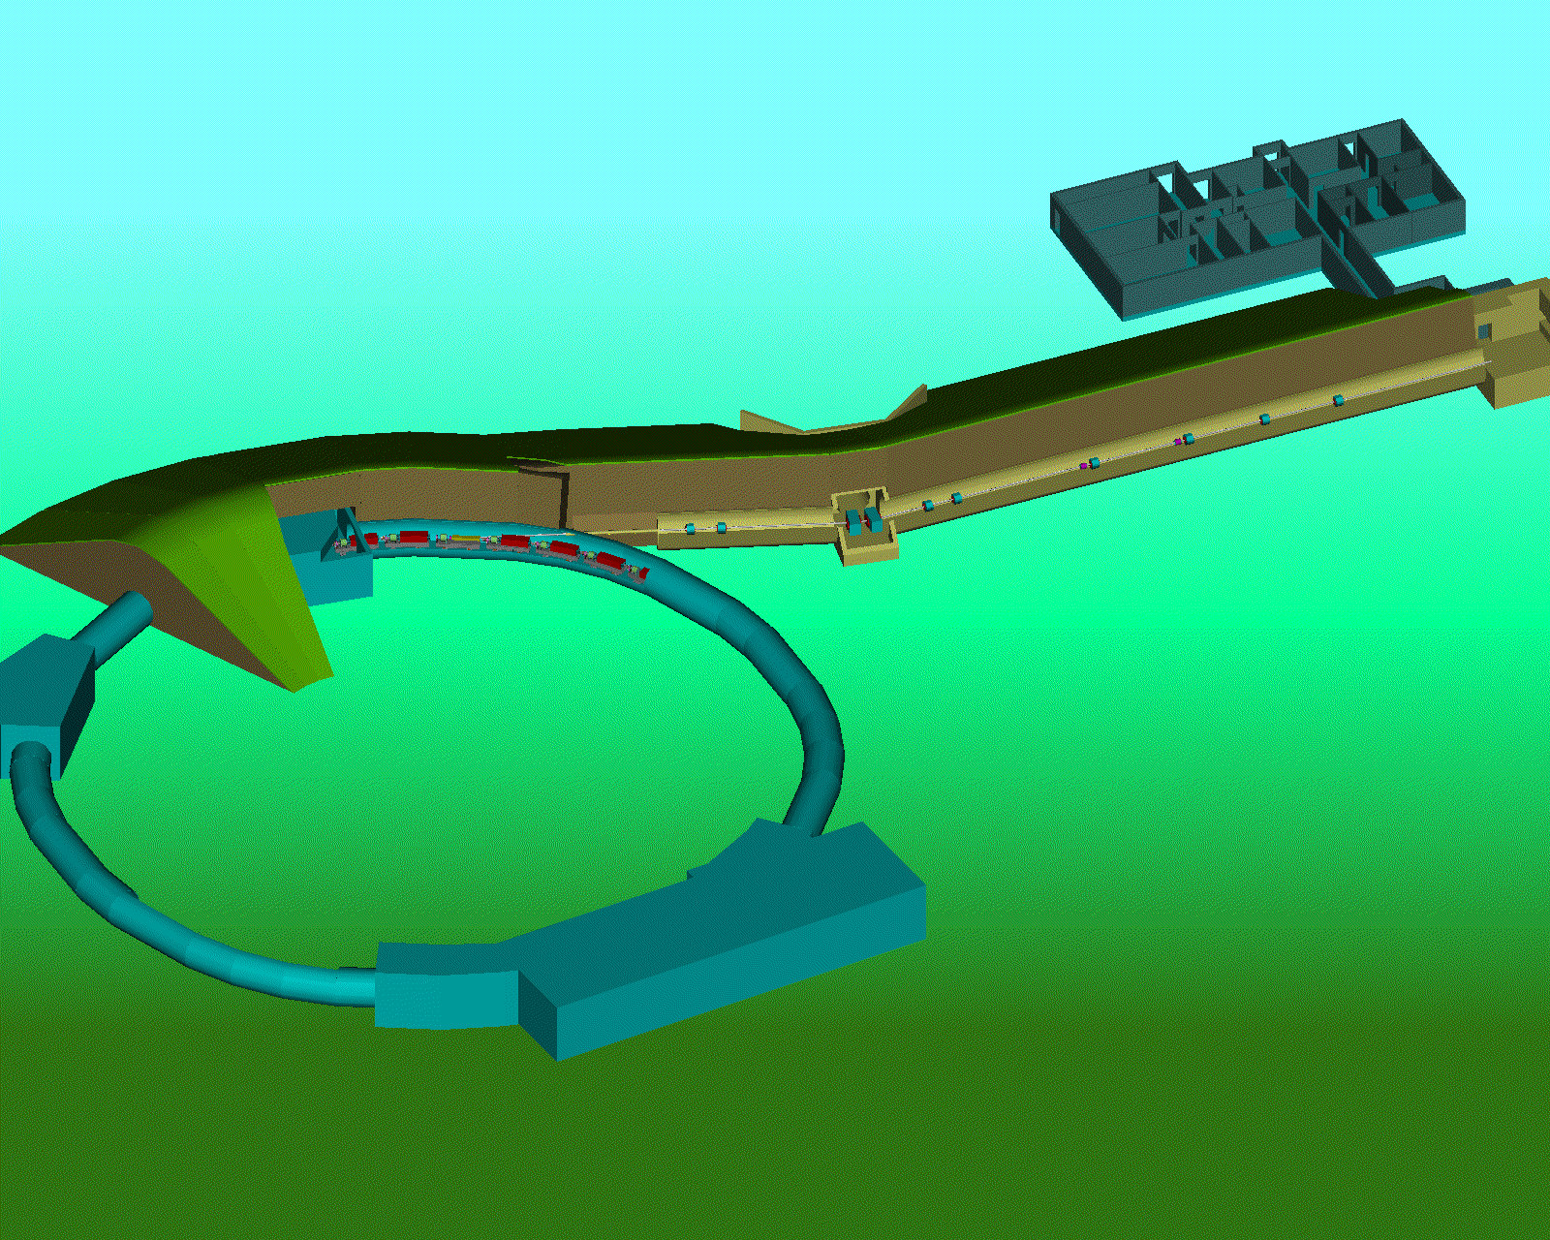

Slide 27
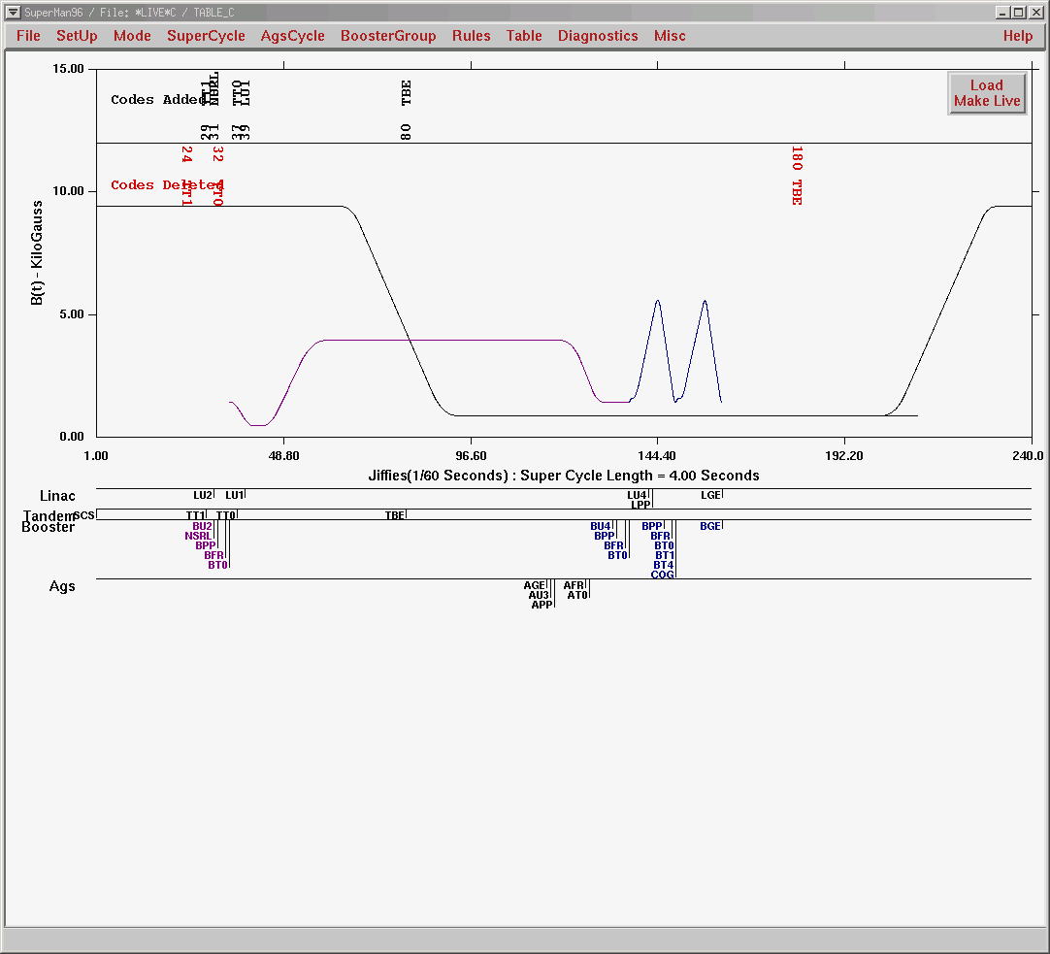
AGS Main Magnet
Booster Main Magnet
NSRL Event

Slide 28
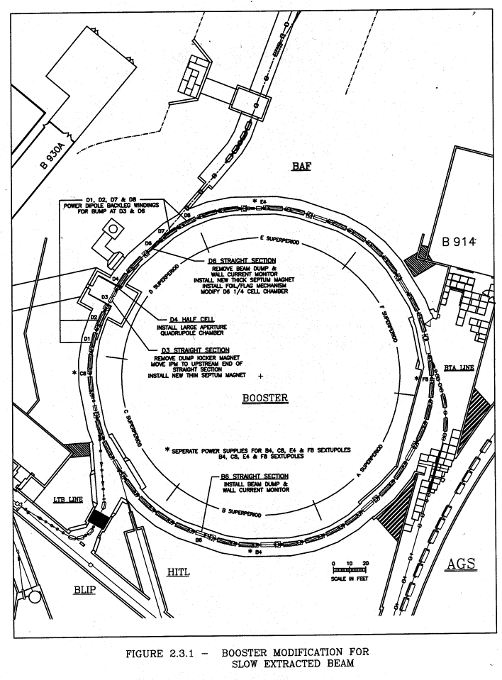
Booster Parameters
Parameter | Value
Circumference | 201.78 (1/4 AGS) m
Ave. Radius | 32.114 m
Magnetic Bend R | 13.8656 m
Lattice Type | Separated Function, FODO
No. Superperiods | 6
No. of Cells | 24
Betatron Tunes,X,Y | 4.82, 4.83
Vacuum Chamber | 70 x 152 mm Dipoles 152 mm (circular) Quads
Max. Rigidity | 17 Tm
Injection Rigidity | 2.2 Tm (200 MeV protons)
Acceleration Rate | 8.9 T/s (7.5 Hz)
E1
D7
D6: Thick
Septum
D4
D1
D3: Thin
Septum
C7
EBIS

Slide 29
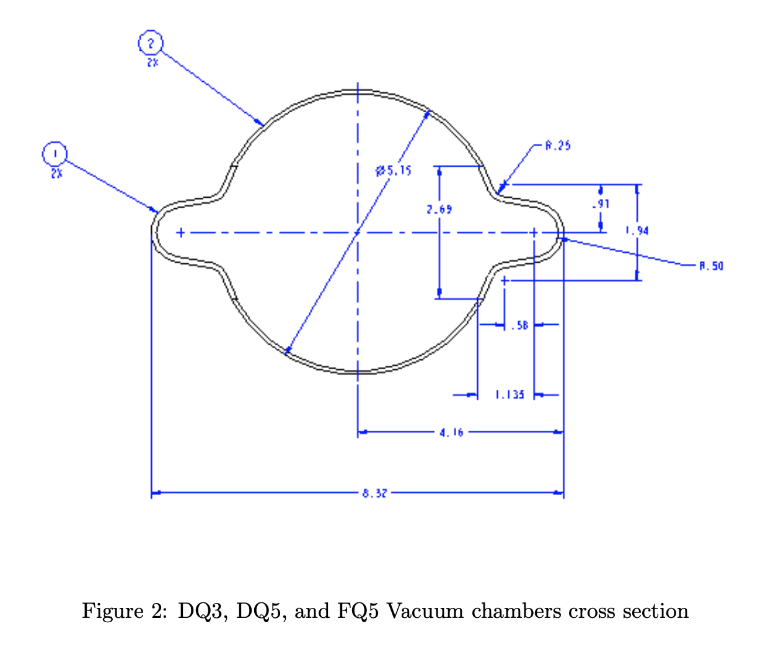
C-A/AP/69 February 2002

Slide 30
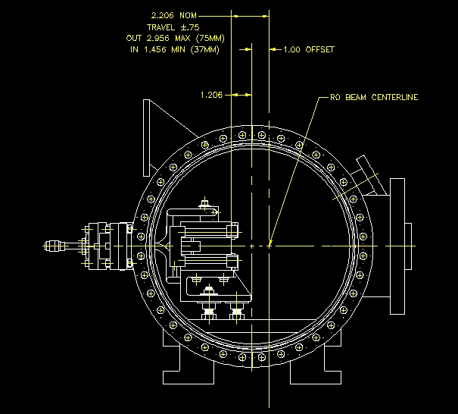
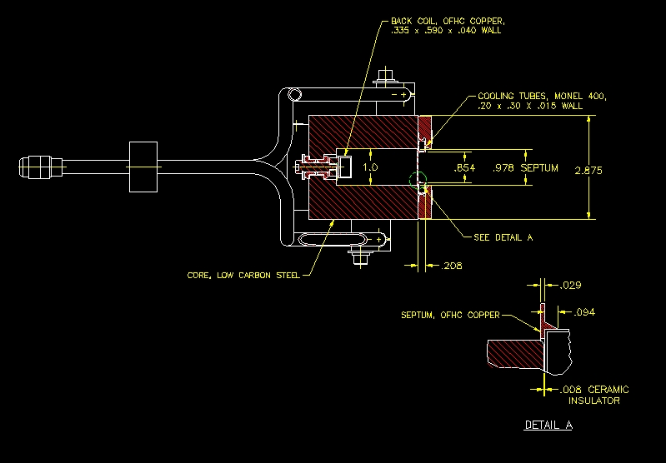
D3: Thin Septum
Thickness = 0.74mm

Slide 31
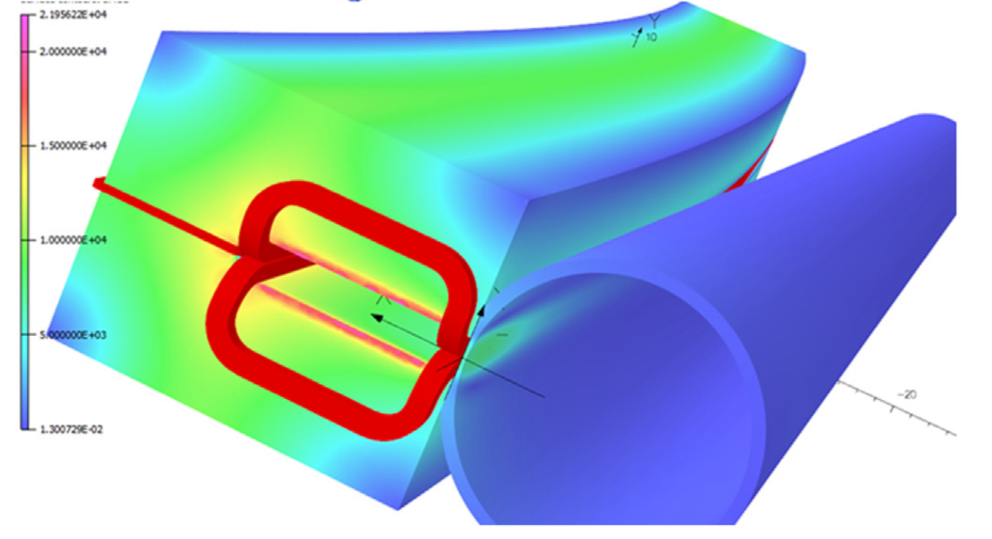
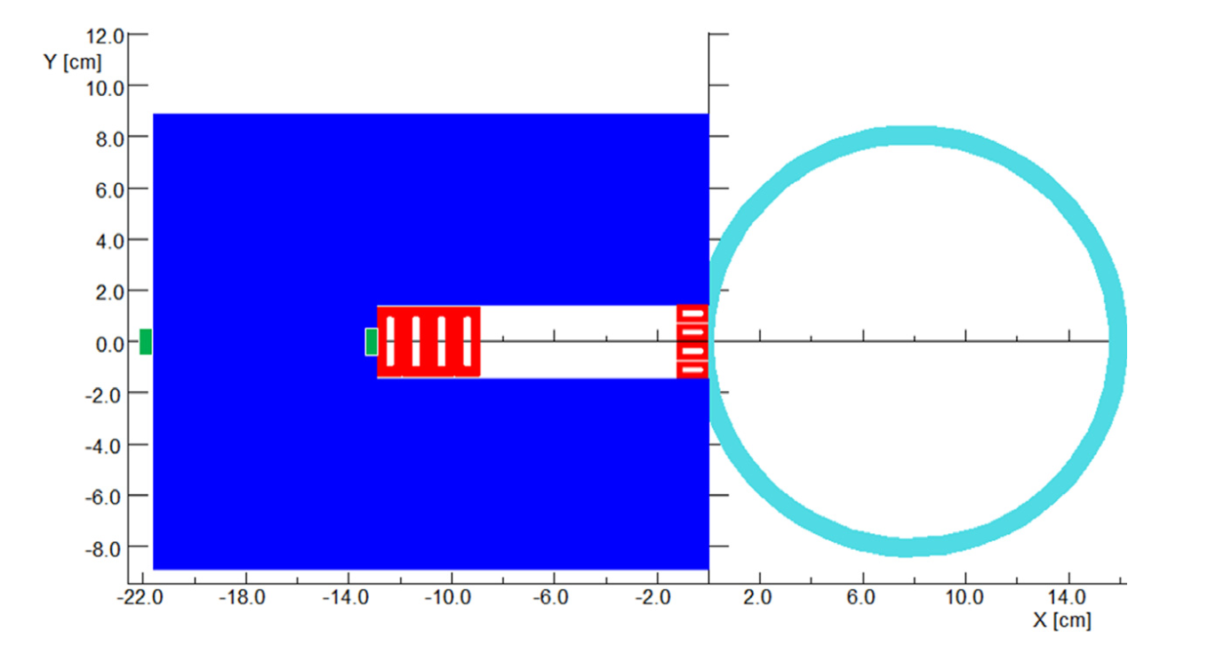
Thick Septum Magnet
Overall septum thickness is 17.5mm
Nuclear Inst. and Methods in Physics Research, A 923 (2019) 8–18

Slide 32
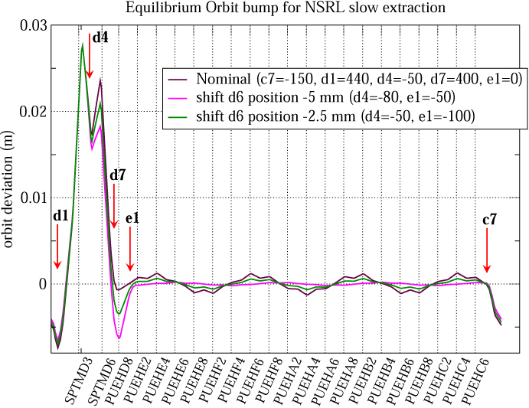
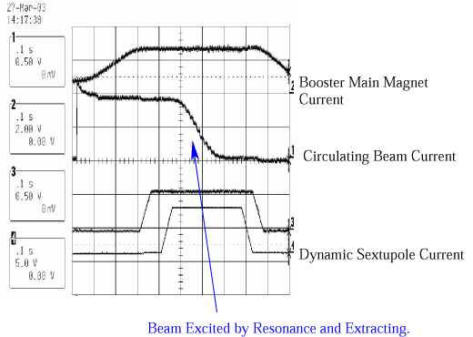
Extraction Point

Slide 33
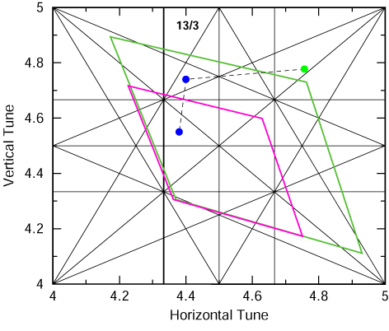
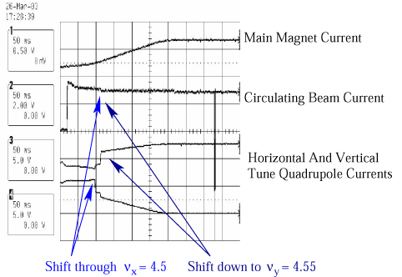
Injection, Acceleration, and Tune Space Manipulations

Slide 34
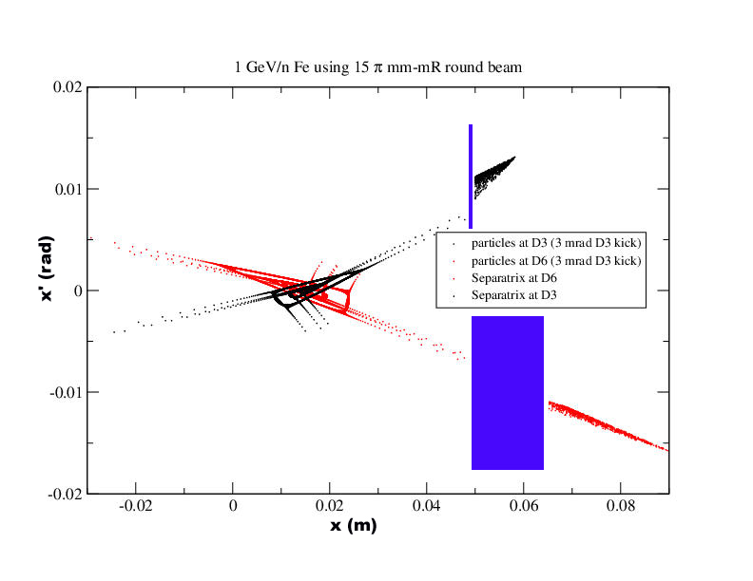
Booster Resonant/Slow Extraction

Slide 35
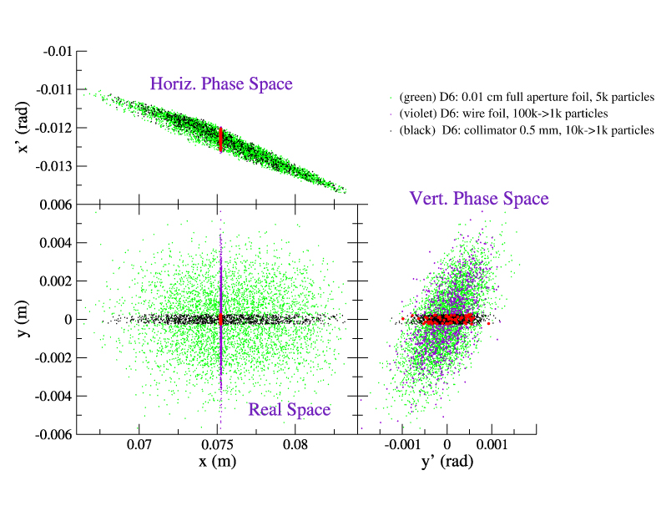

Slide 36
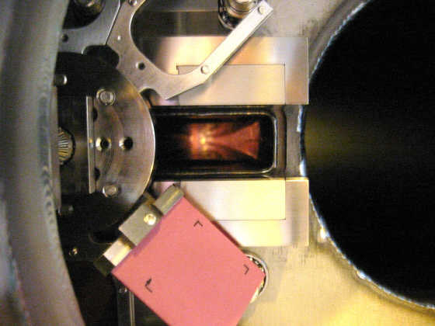
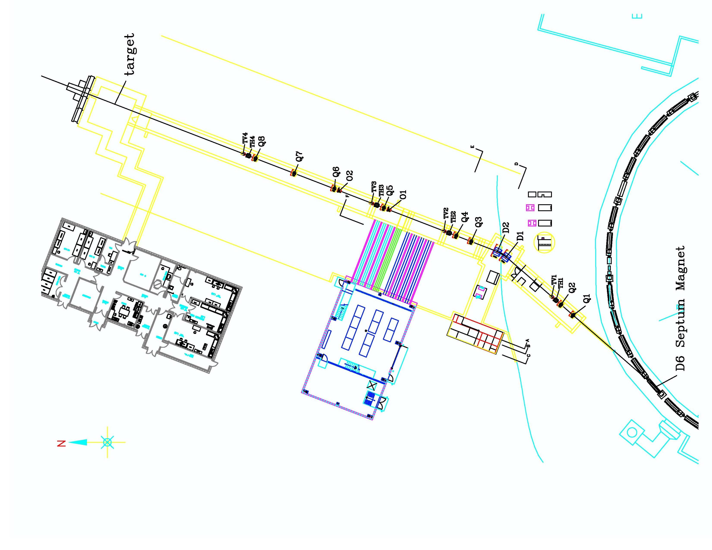
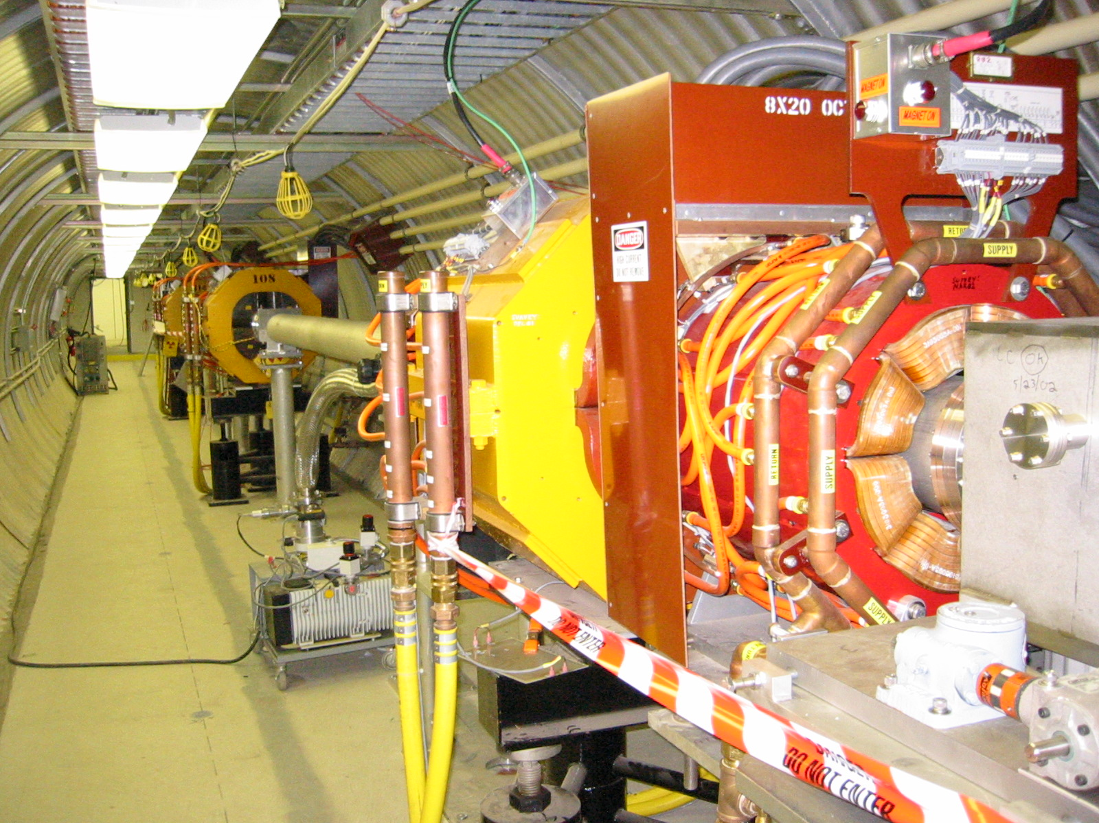
NSRL

Slide 37
Questions?
More later on ways to make transverse uniform beams

