Slide 1
Reinforcement Learning in AGS Bunch Merge
Yuan Gao
Cornell Collaboration Meeting
10/20/2025

Slide 2
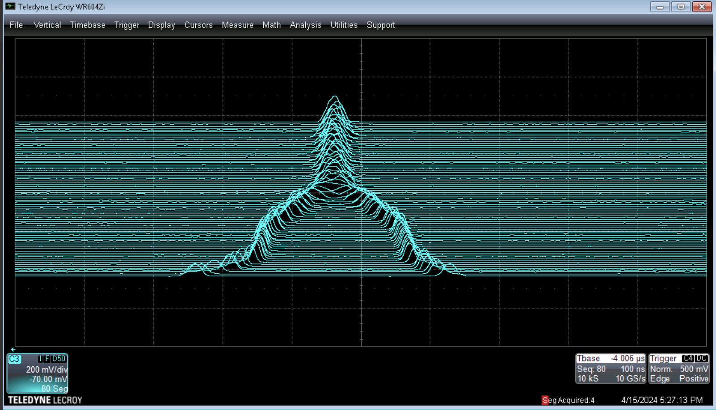
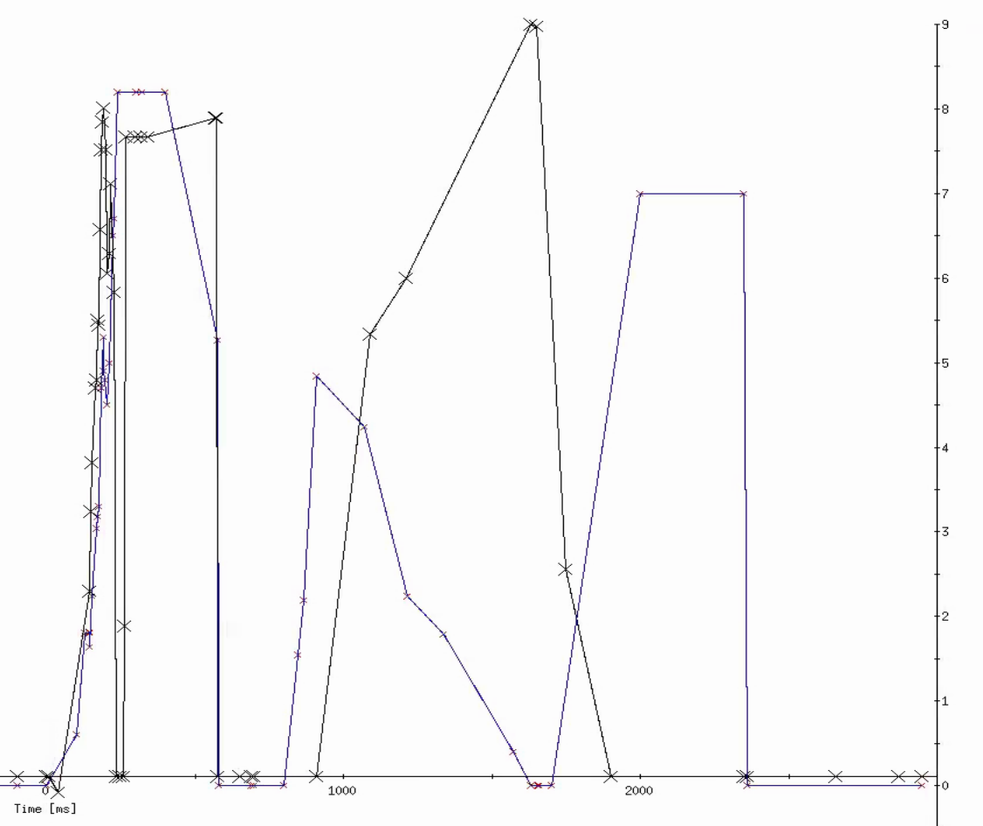
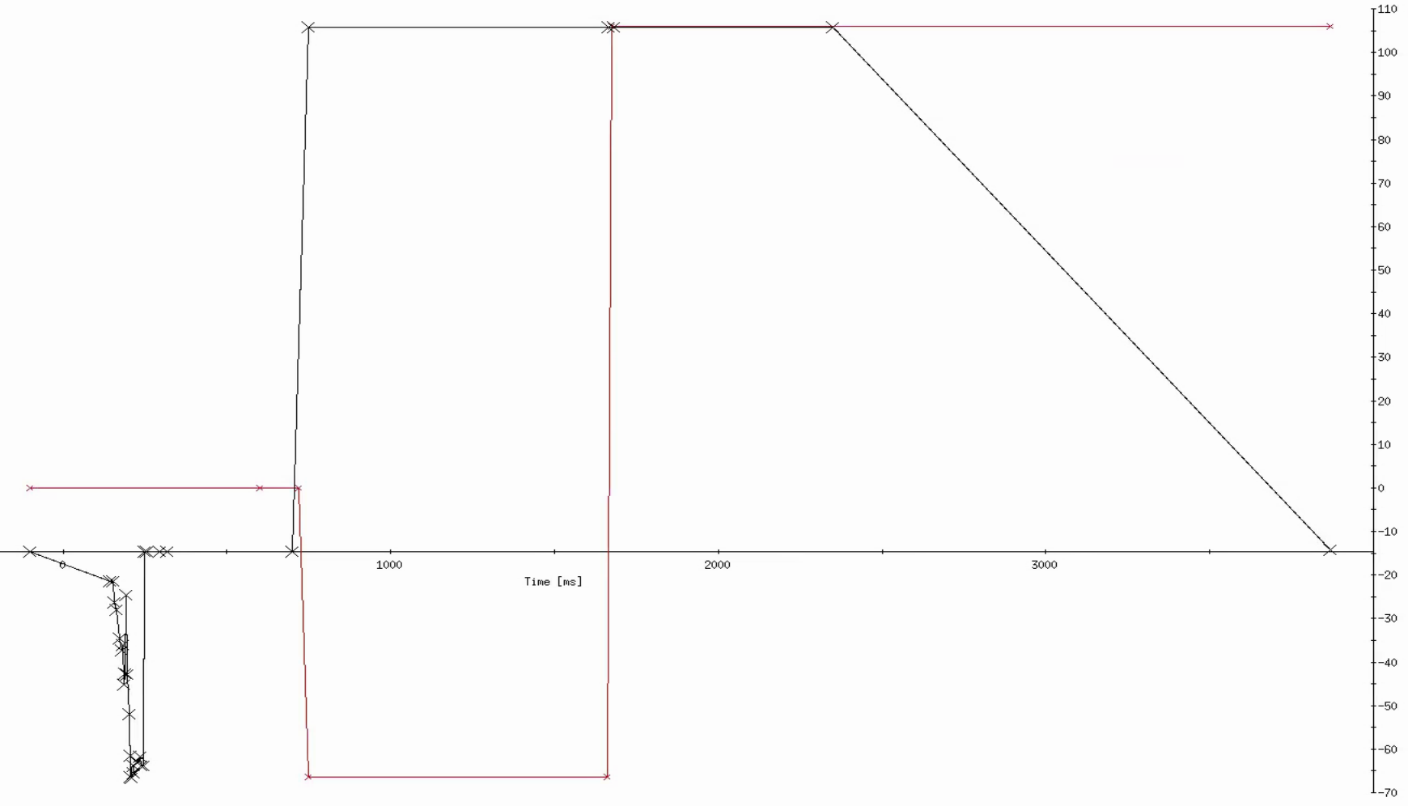
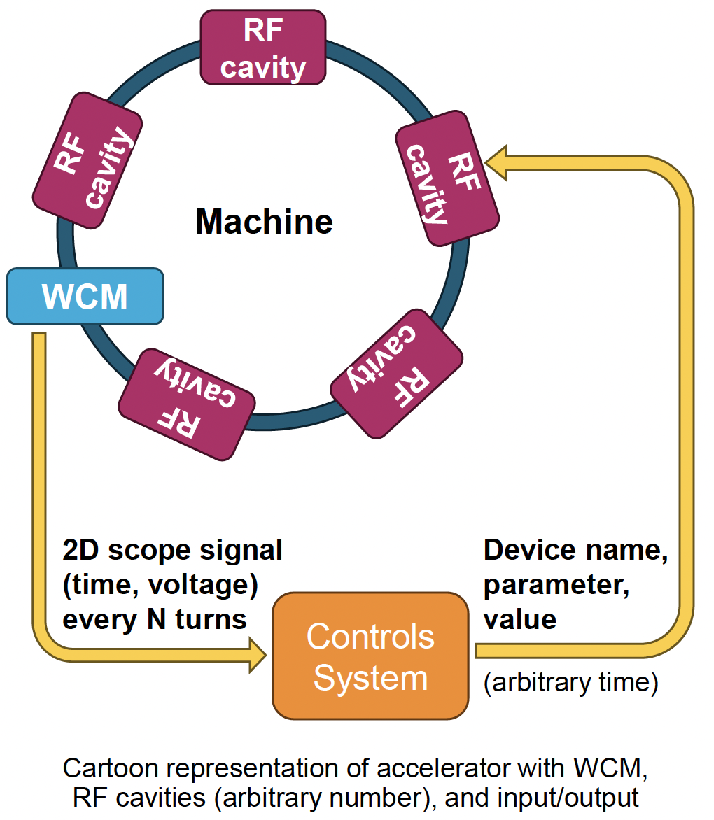
AGS Bunch Merging
RF voltage and phase during merge
end of merge
end of squeeze & start of merge
Before transferring to AGS, beam bunch is split longitudinally to reduce the space charge effect: -> reduce emittance -> improve polarization
Bunches are later merged before AGS extraction;
Requires expert tuning of many parameters:
Prone to drift over time;
Time consuming;
Method: Reinforcement Learning (RL)
Soft Actor-Critic (SAC)
Controls: RF voltages, phases
Goal: Obtain a “good” merged bunch profile:
Emittance preservation:
No particle lost; Gaussian shape;
No “baby” bunches;
Stable final bunch profile:
Not shifting left to right; Not bouncing up and down;
Merged in the center;
start of squeeze
Merge signals are captured by the Wall Current Monitor (WCM) which generates voltage vs time signal and displayed in a scope.
Each of the mountain range data traces is separated in time by N cycles vertically.

Slide 3
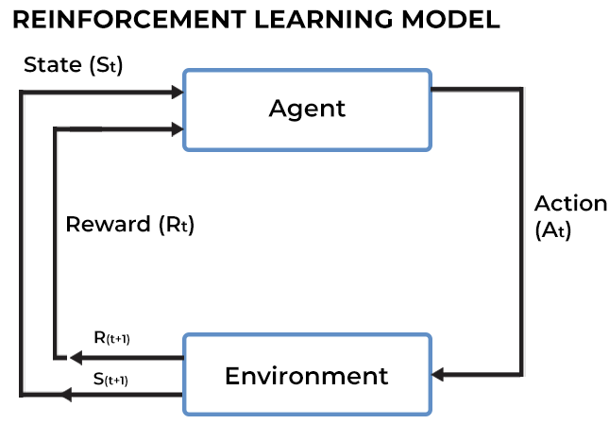
Reinforcement Learning in Bunch Merge
Reinforcement learning is a machine learning paradigm where an agent learns to make decisions by interacting with an environment and receiving rewards for its actions, aiming to maximize cumulative reward over time.
For this bunch merge experiment:
State:
Final bunch’s center position;
Final bunch length;
Bunch center variation;
Bunch length variation;
Action: RF voltages to set
Reward: Weighted sum of bunch length, center variation and bunch length variation. The smaller the sum, the higher the reward.
Require many training data at the beginning
Quick inference time, good for online continuous control

Slide 4
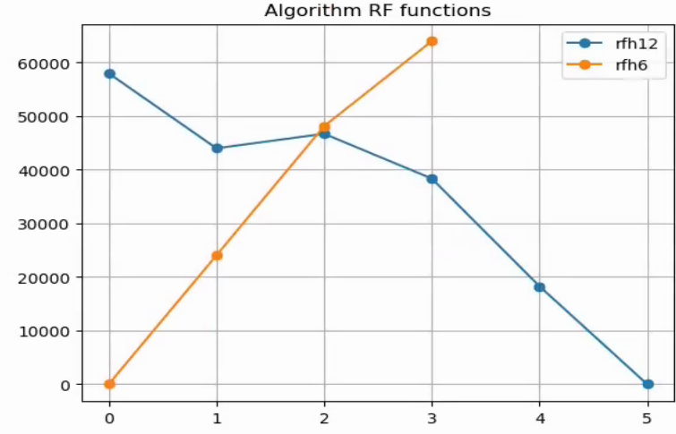
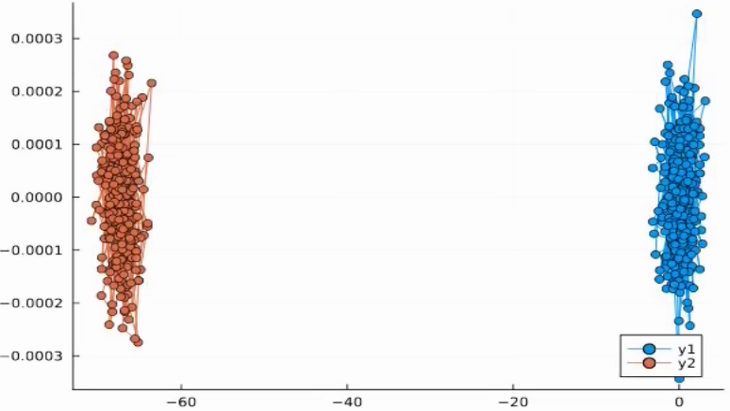
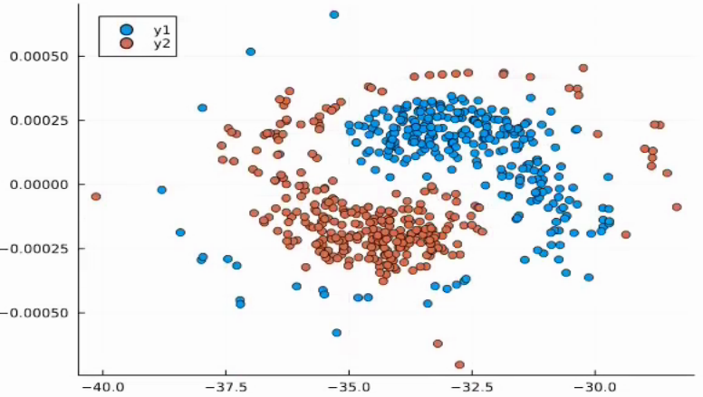
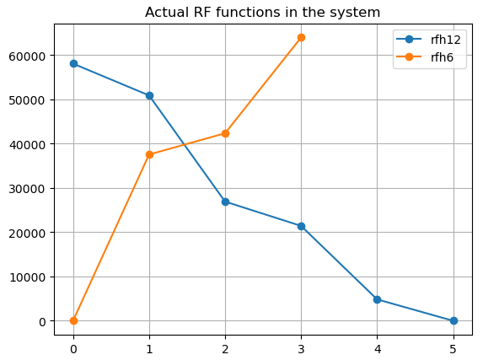
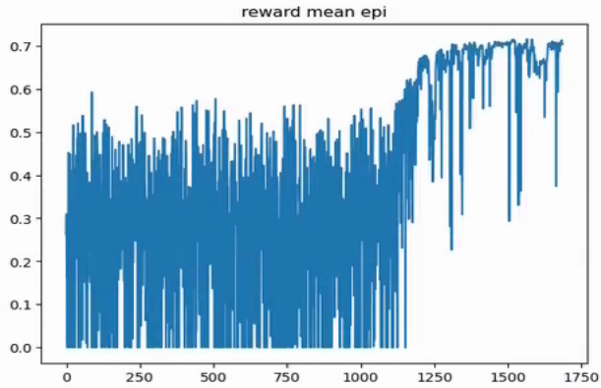
Simulation Results
Agent learned RF functions similar to the ones used in the actual system
A Julia simulator was build using the Run 22 data
Action: Two RF functions with 6 control points.
2000 initial random samples, trained 40 k steps.
After training, the average reward is around 0.7
Voltage
Time after AT0

Slide 5
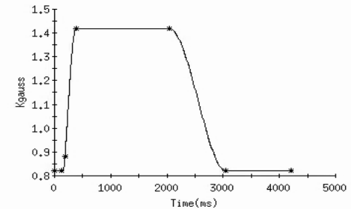
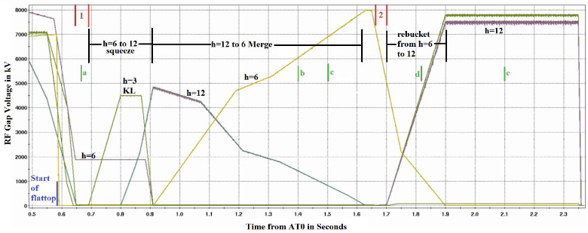
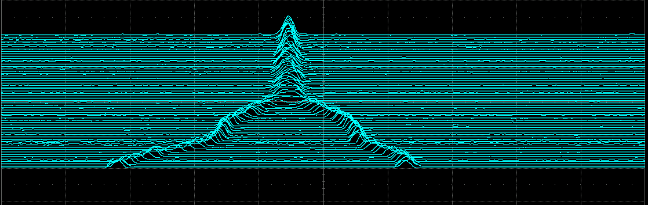
Bunch Merge Operations
Merge in the AGS “flattop”
Merge operations happens from 910 ms – 1630 ms after AT0, on the AGS “flattop”.
Cavities used for 2 to 1merge: B, BC, and C are used for h=12 and JK and K for h=6.
Each group of cavities takes the same phase and voltage functions.
WCM signal monitor range is 650 ms – 2050 ms, covers the entire process (squeeze, merge and rebucket):
Contains 80 traces, each trace is a bunch profile;
Trace interval is 17.5 ms, shows how the bunch shape evolves with time.
Need a way to handle the merge traces data.
80 traces, 17.5 ms interval
AGS Scope Data

Slide 6
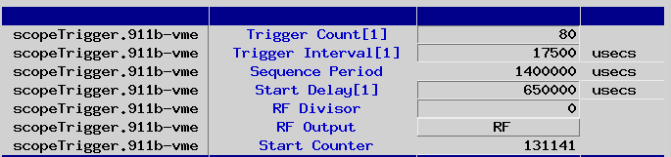
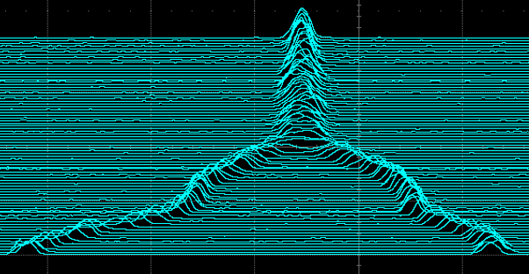


Saving the WCM Signals
Signals shown in WCM are configured by the scope settings: where to start, how long the sequence, etc.
Those settings are copied to a local scope to ensure the same sequence will be focused.
scopelecroy6100Man will get triggers to save the local scope data to files, also log some statistics.
pet: /AGS/Instrumentation/wcm/Scope
AGS scope
Triggers
Copy settings
scopelecroy6100Man
Local scope

Slide 7
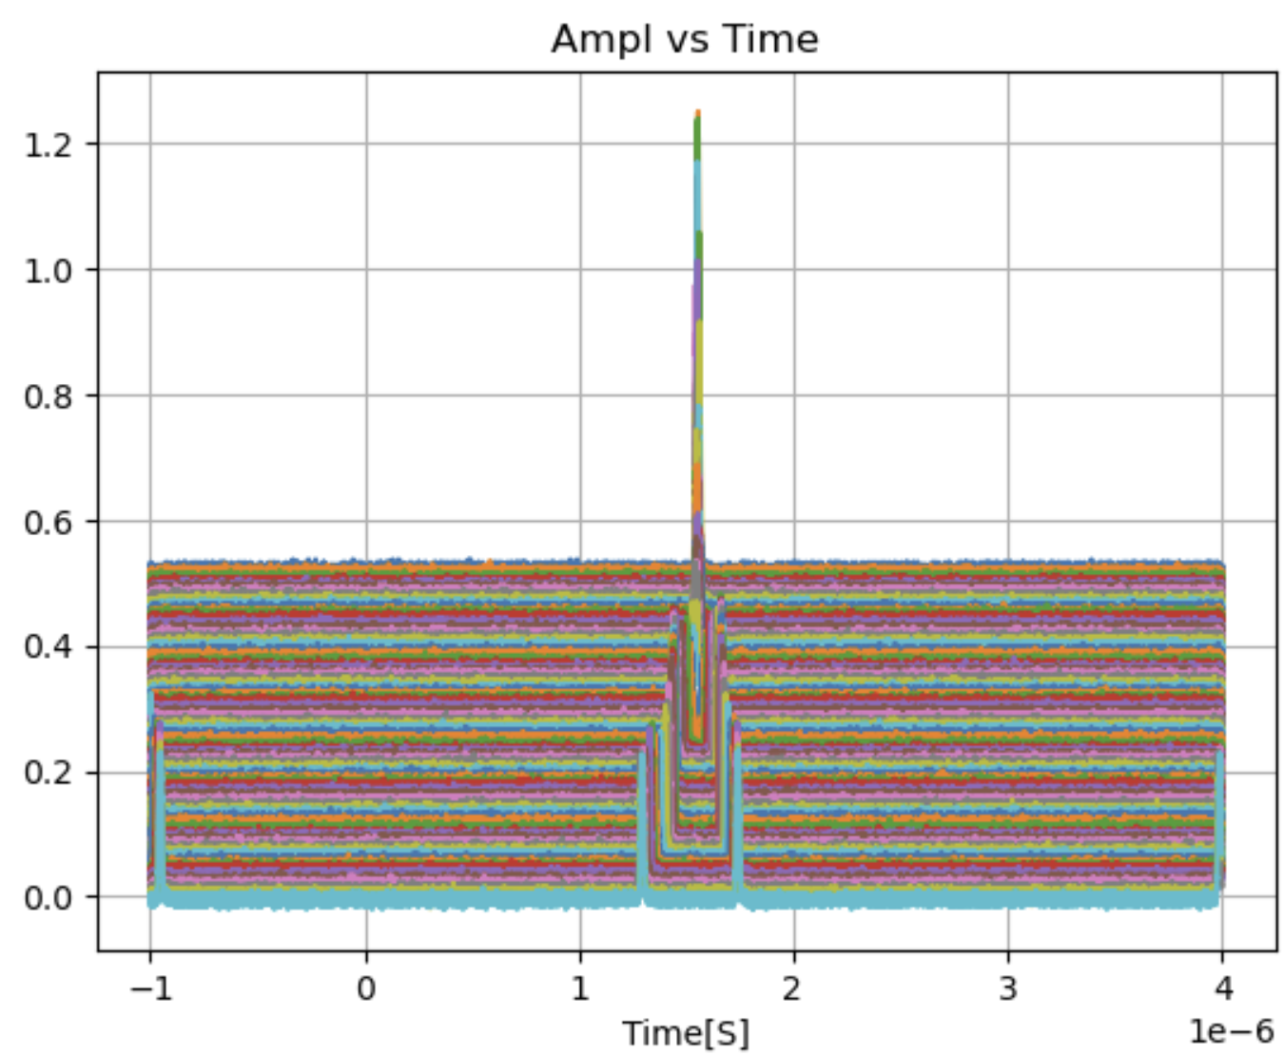
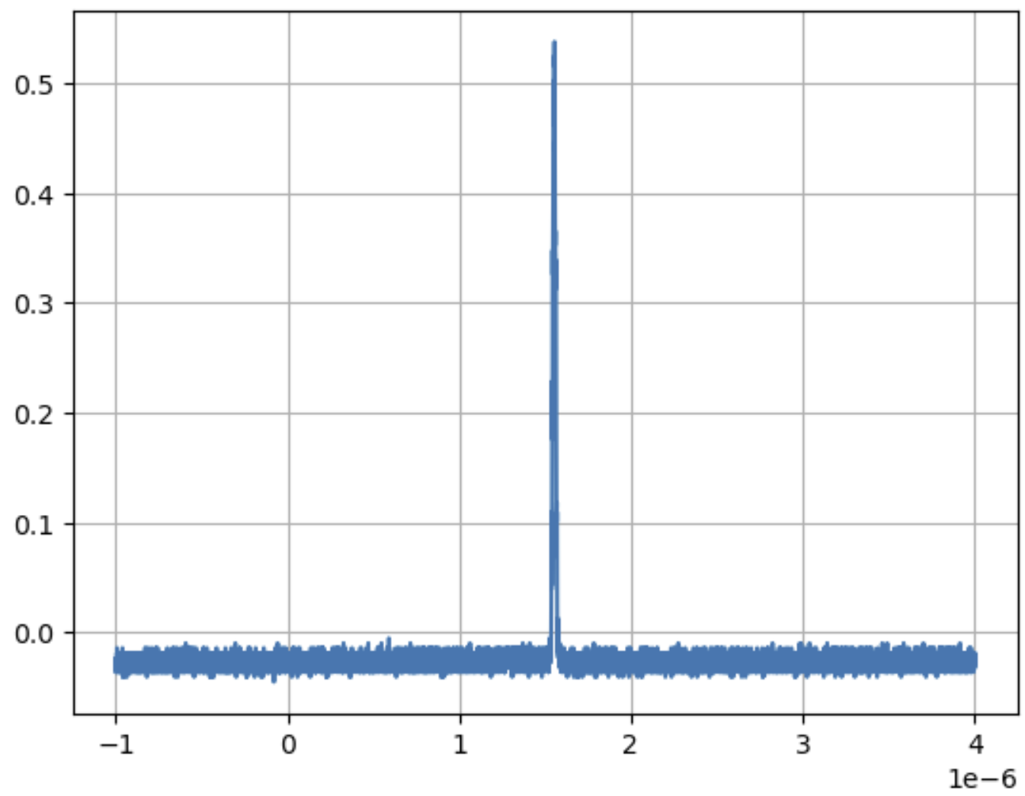
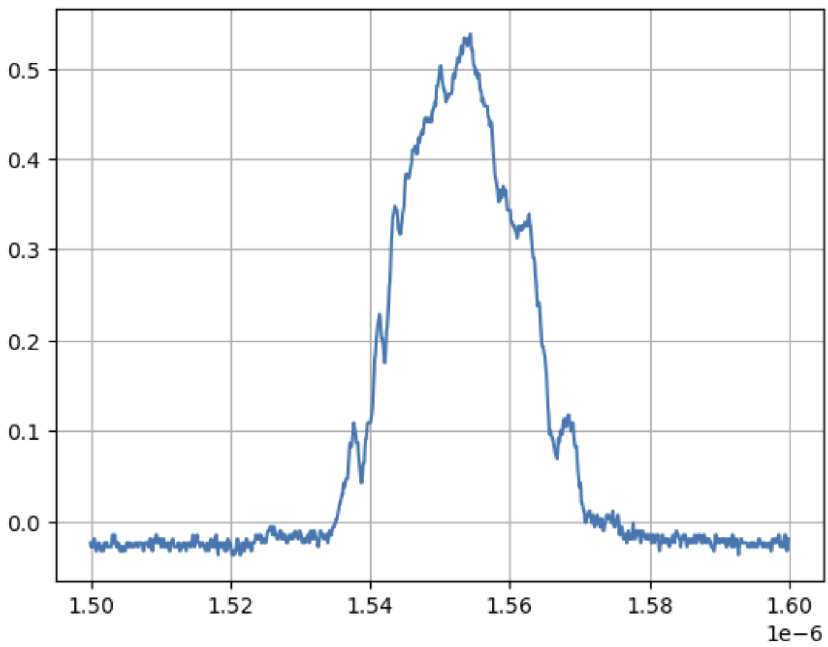
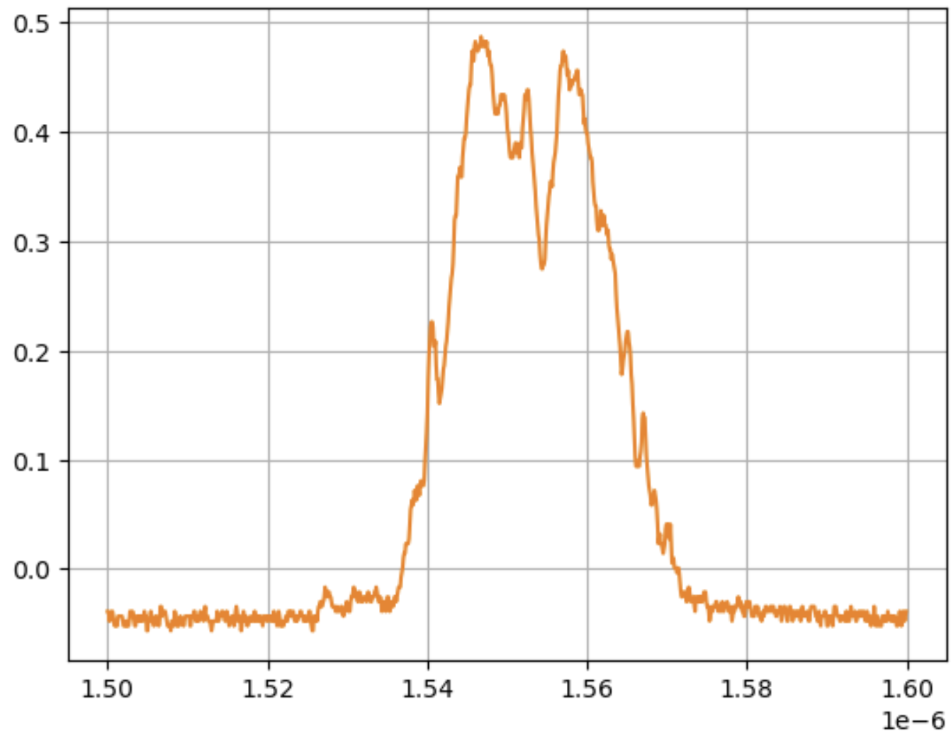
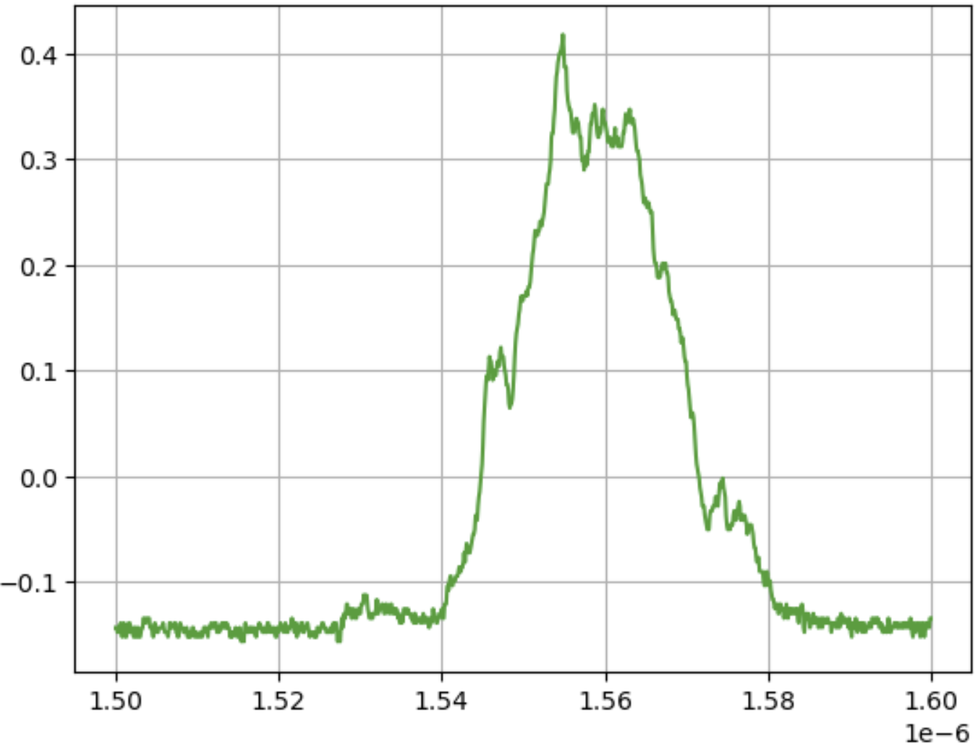
Processing Bunch Data
80 arrays, each contains around 50k points.
The useful data is ~ 1%.
Some useful preprocessing steps: smoothing and down sampling.
Extract: center pos, bunch len, center variation, bunch len variation
……
Last trace

Slide 8
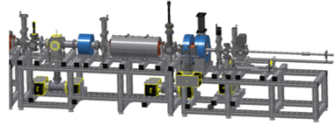
Experiment Workflow
The observable is the WCM signals, which is saved to files on every AGS cycle.
Each file contains 80 traces (arrays) with 50k points each. The last ten traces are used to extract the merge information.
Based on the information, the agent send a set of RF voltages to the machine and then collect information from the WCM signals for the next action.
RF settings:
5 cavities with 6 voltages
Accelerator system
RL Agent
RMS bunch length,
Center variation,
Bunch length variation
Generate
Saved to files on every cycle
WCM signals

Slide 9
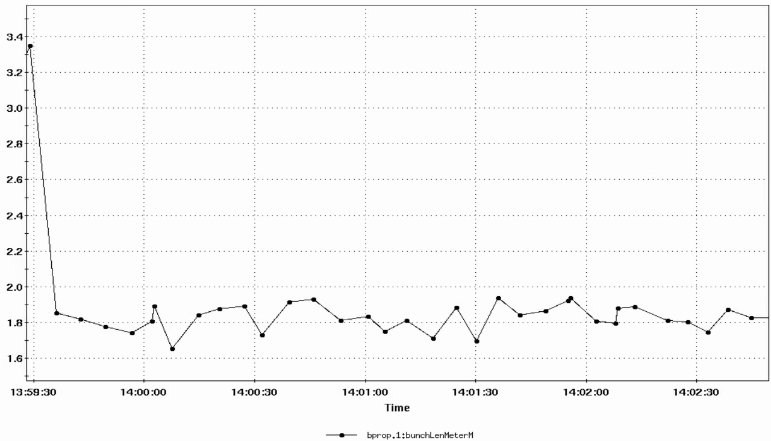
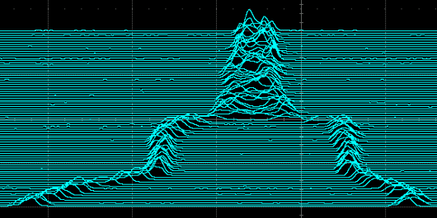
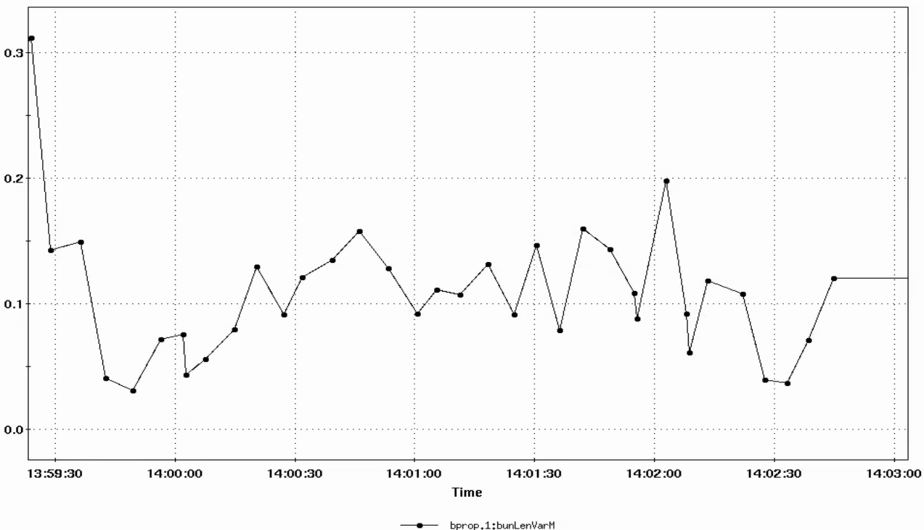
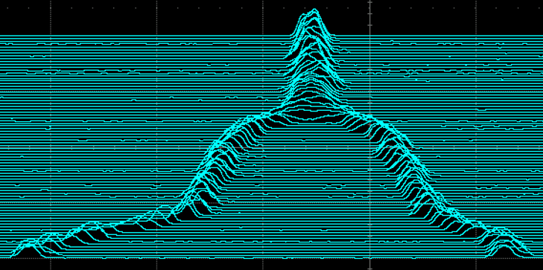
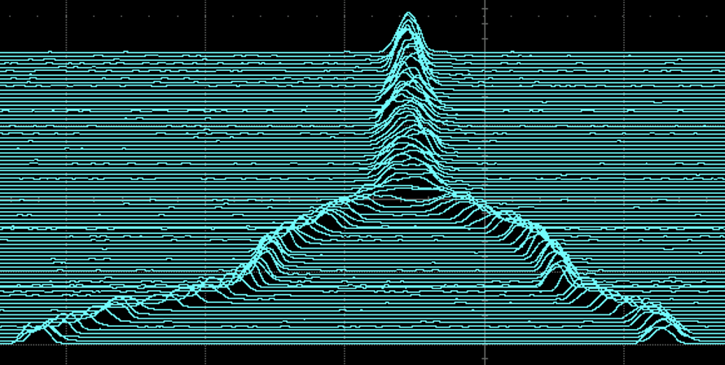
Experimental Results
System logging bunch data during the RL optimization
We first intentionally break the merging process to test
Initial
Final bunch length
The RL agent was able to quickly correct the merge and maintain it
Comparable to operational merges
Bunch length variation
RL settings
Operation settings

Slide 10
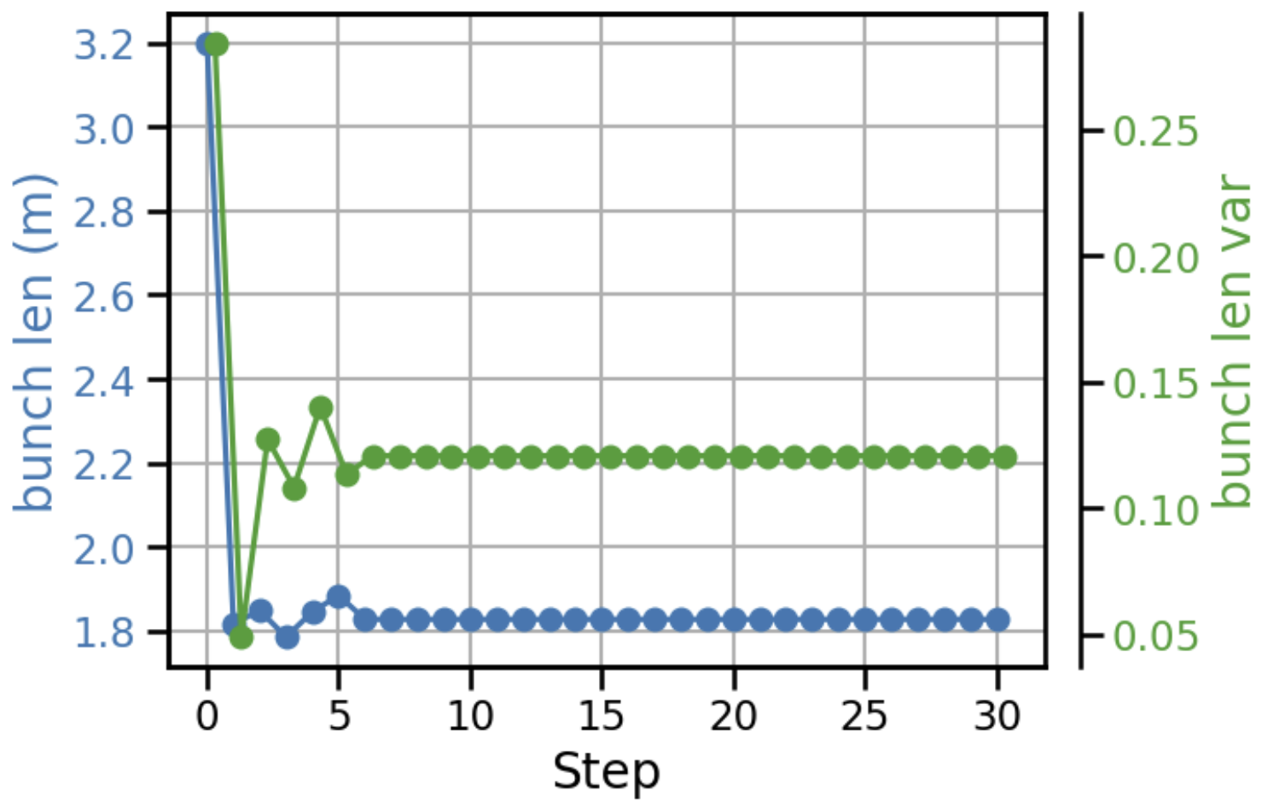
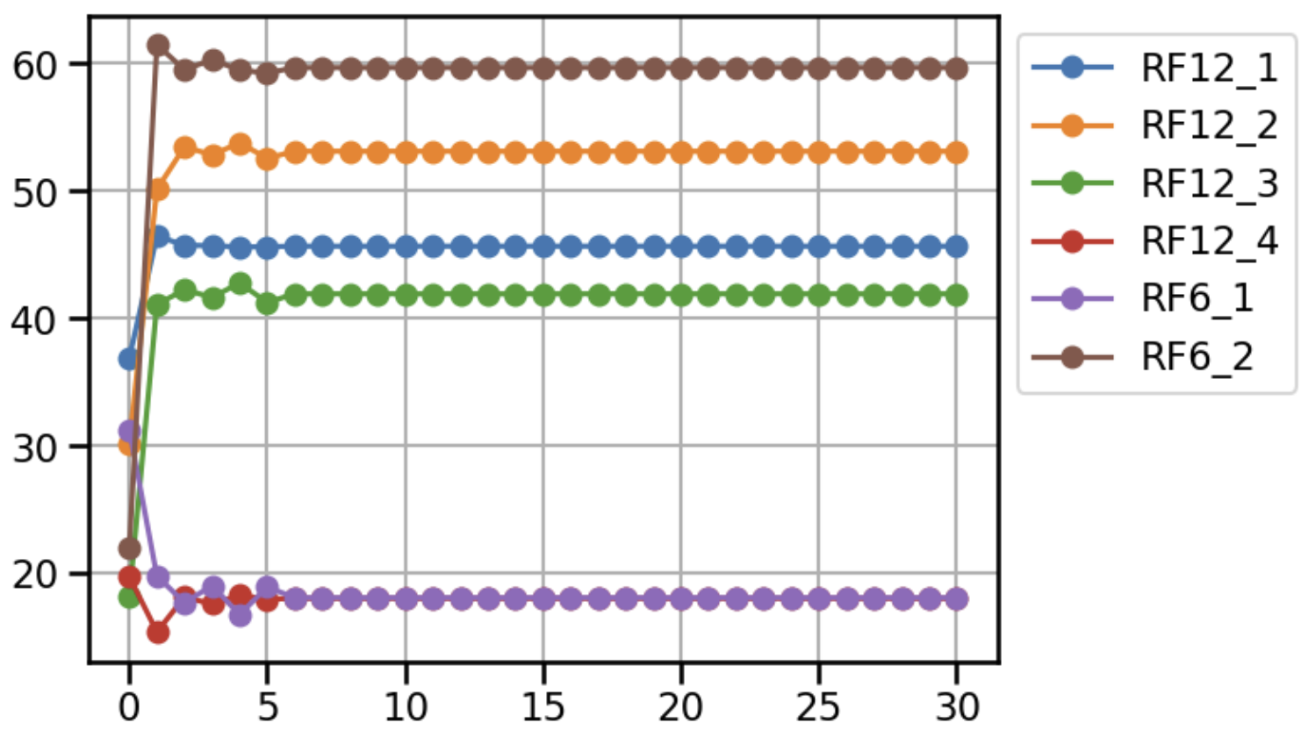

RL Agent Action and Optimization
The RL agent was able to locate the optimal solution in one step and maintain it.
Both the bunch length and bunch variations were optimized effectively.
All actions converge in one step

Slide 11
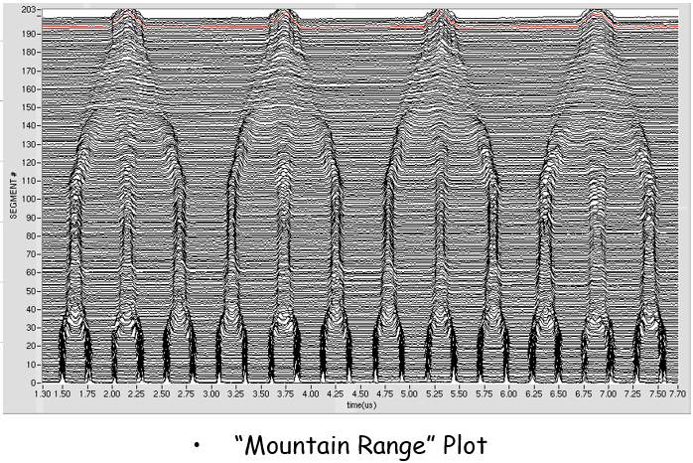
Incentives for a Beam Property Manager
The goal is to publish beam parameters, such as bunch length, dpp, emittance, etc., in real time, for any beam.
Those parameters will also be logged, so they can be accessed later for further analysis.
Also give some options to explore the “what if” scenarios.

Slide 12
Incentives for a Beam Property Manager
Can see the evolution of the bunches
It’s also useful have those parameters available to check, especially when there is beam experiments.
For ML applications
The goal is to publish beam parameters, such as bunch length, dpp, emittance, etc., in real time, for any beam.
Those parameters will also be logged, so they can be accessed later for further analysis.
Also give some options to explore the “what if” scenarios.
Settings
Accelerator system
ML Agent
Get data
Manager

Slide 13
Two Calculation Methods
Read from systems:
Particle species, charge, energy, RF volt, Rev freq, B dot, etc.
Measure Synch Freq
Explore different setups:
Input different RF volt
Calculate & Publish:
Corrected RF volt, Emittance, dpp, etc.
Calculate & Publish:
Synch Freq, Emittance, dpp, etc.

Slide 14
Two Calculation Methods
Read from systems:
Particle species, charge, energy, RF volt, Rev freq, B dot, etc.
Measure Synch Freq
Explore different setups:
Input different RF volt
Calculate & Publish:
Corrected RF volt, Emittance, dpp, etc.
Calculate & Publish:
Synch Freq, Emittance, dpp, etc.

Slide 15
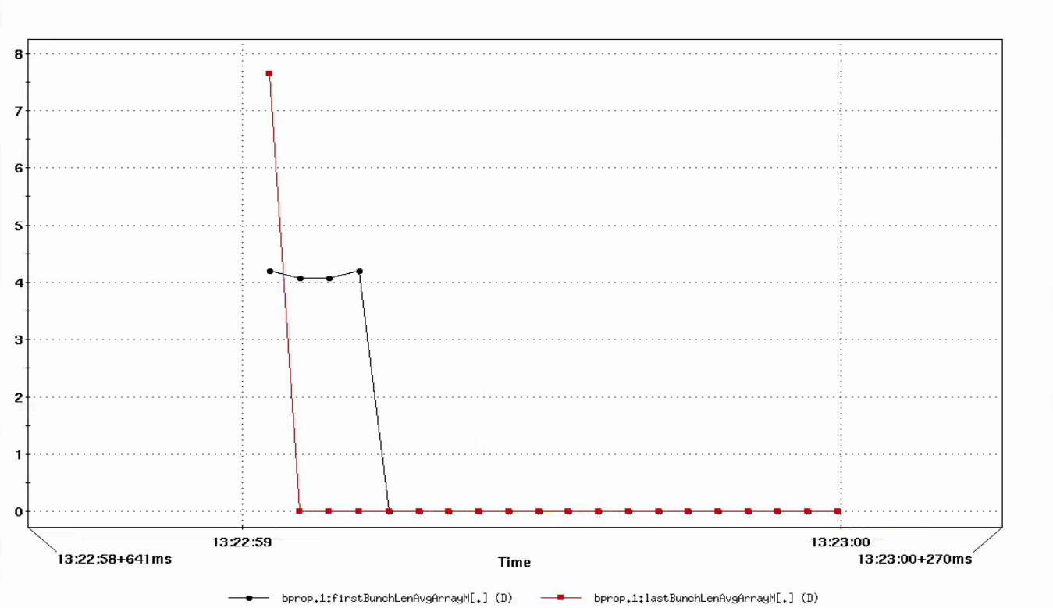
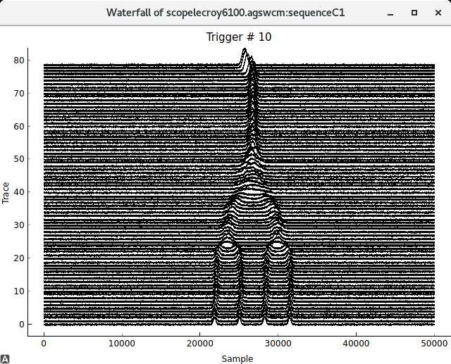
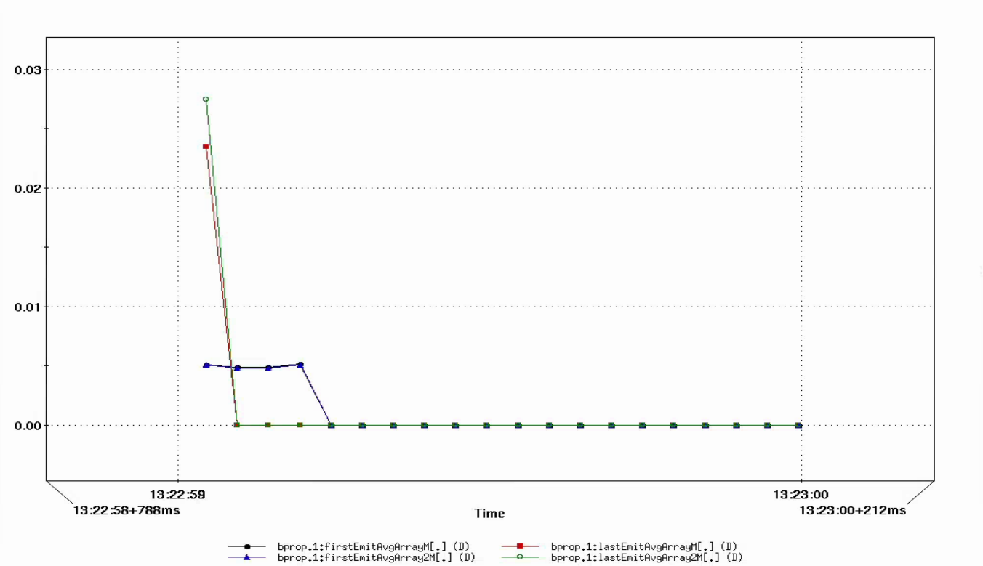
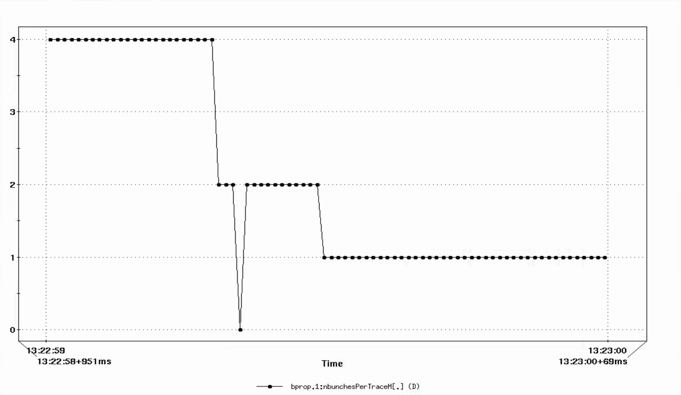
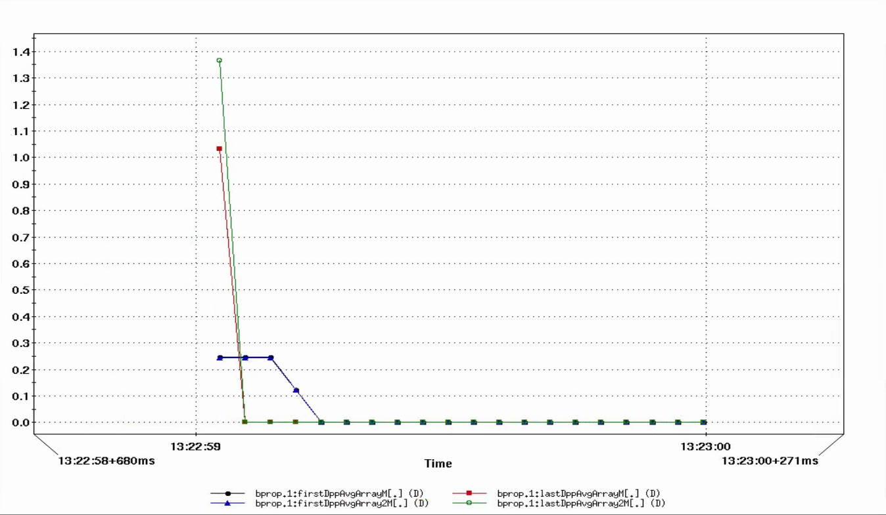
Examples: 4 – 2 – 1 Merge
Bunch length
Emittance
Number of bunches
Momentum spread
Two methods agree with each other

Slide 16
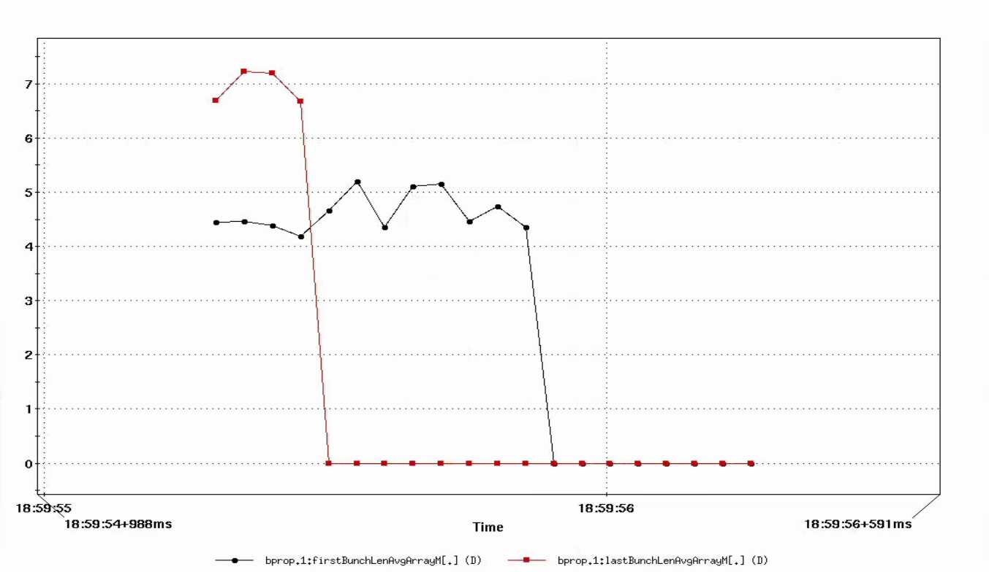
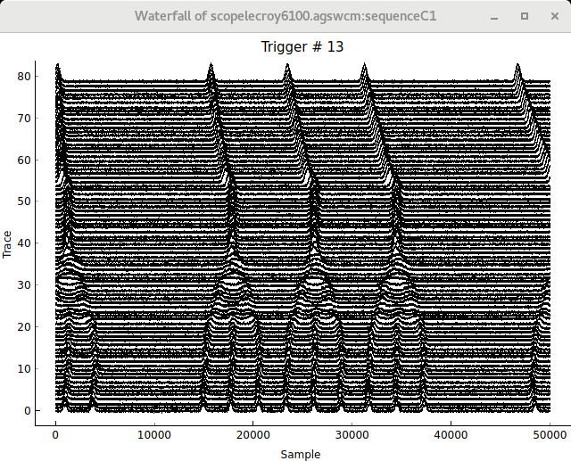
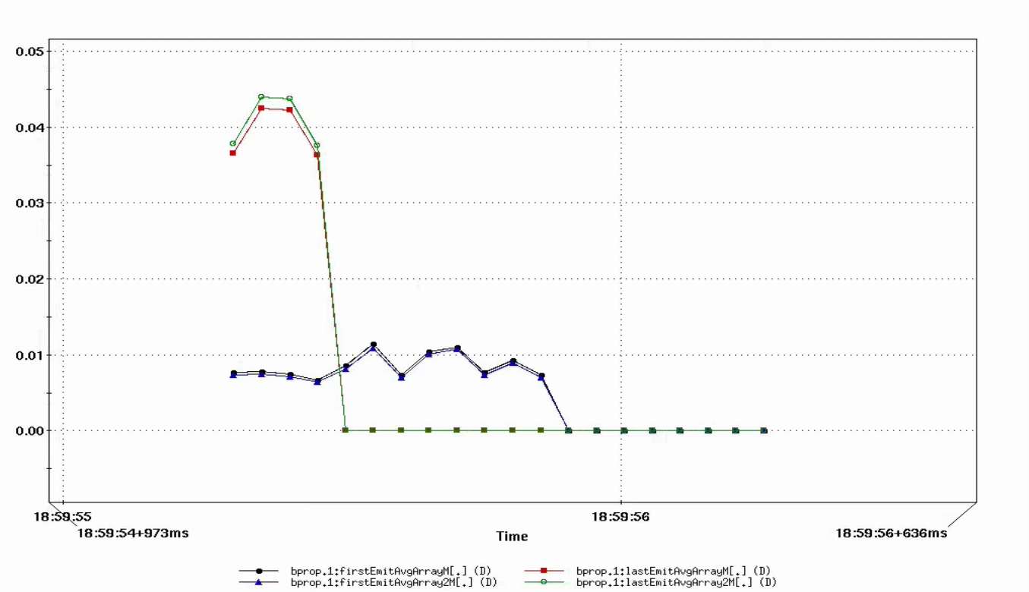
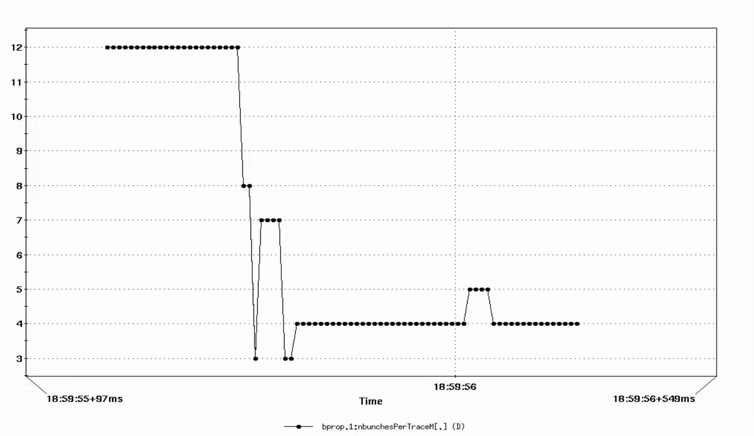
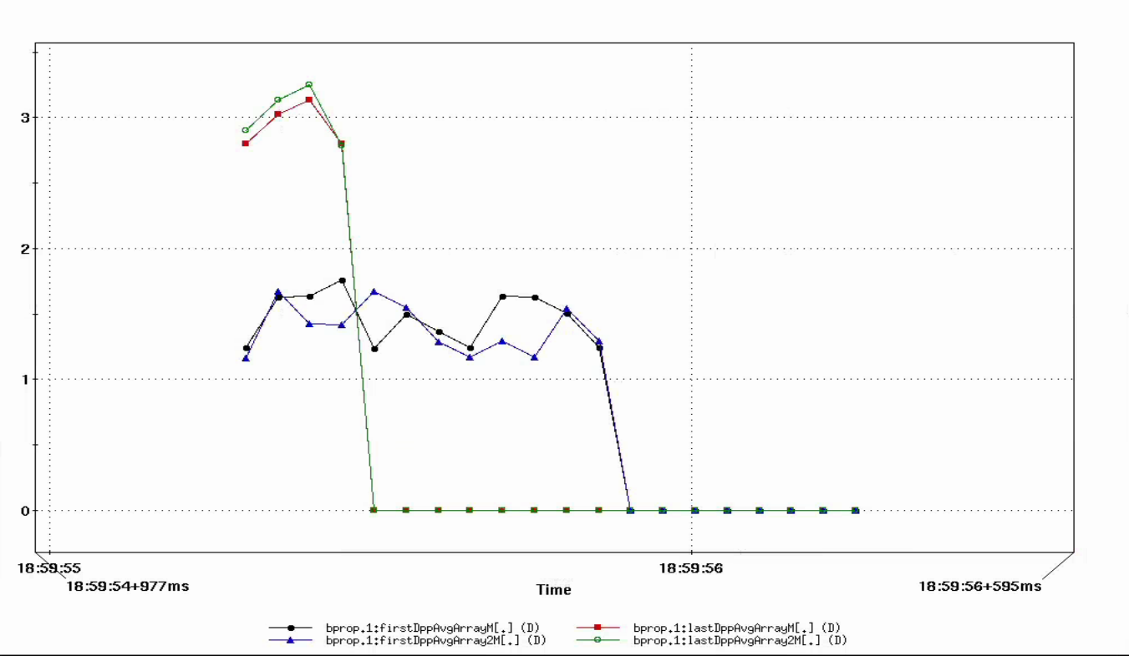
Examples: 3 – 1 Merge
Bunch length
Emittance
Number of bunches
Momentum spread
Two methods agree with each other

Slide 17
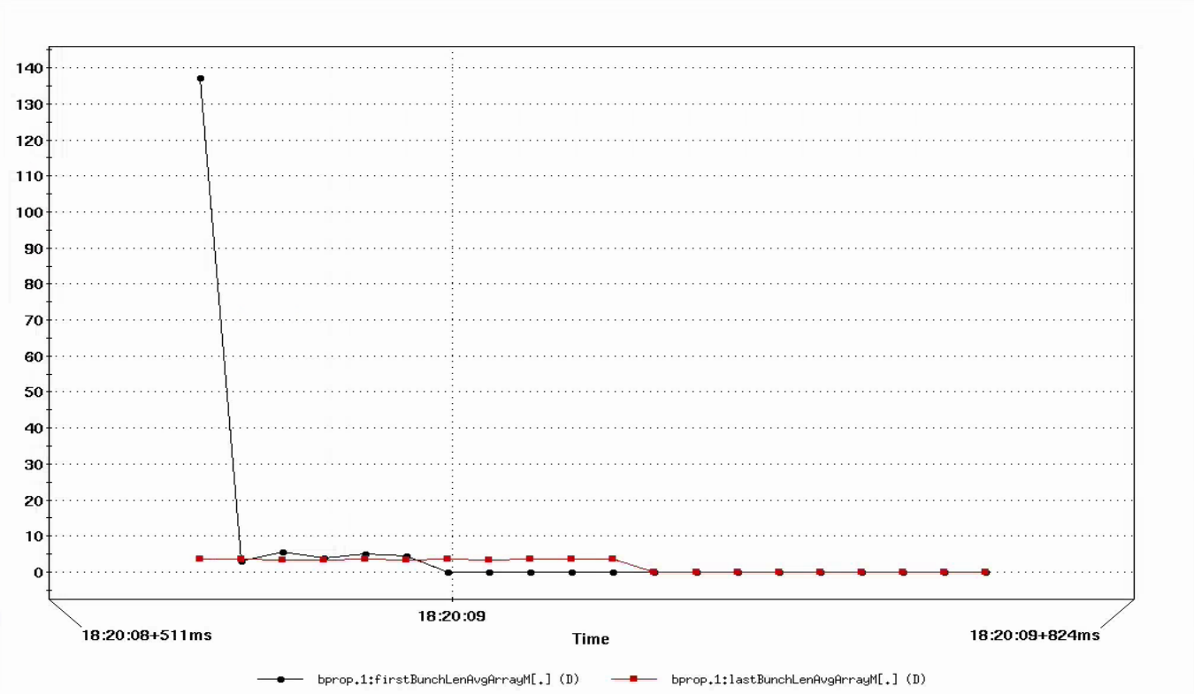
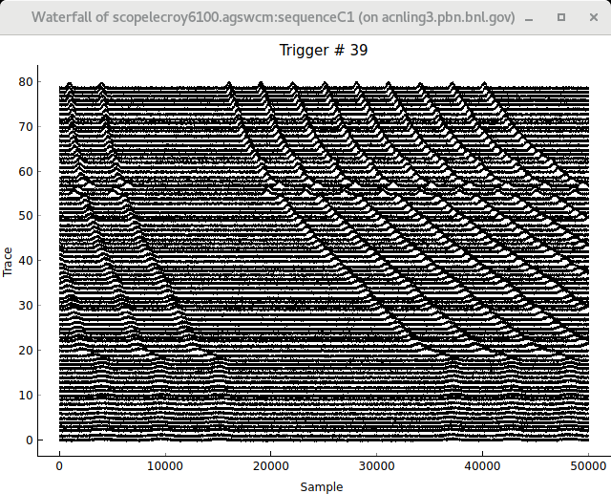
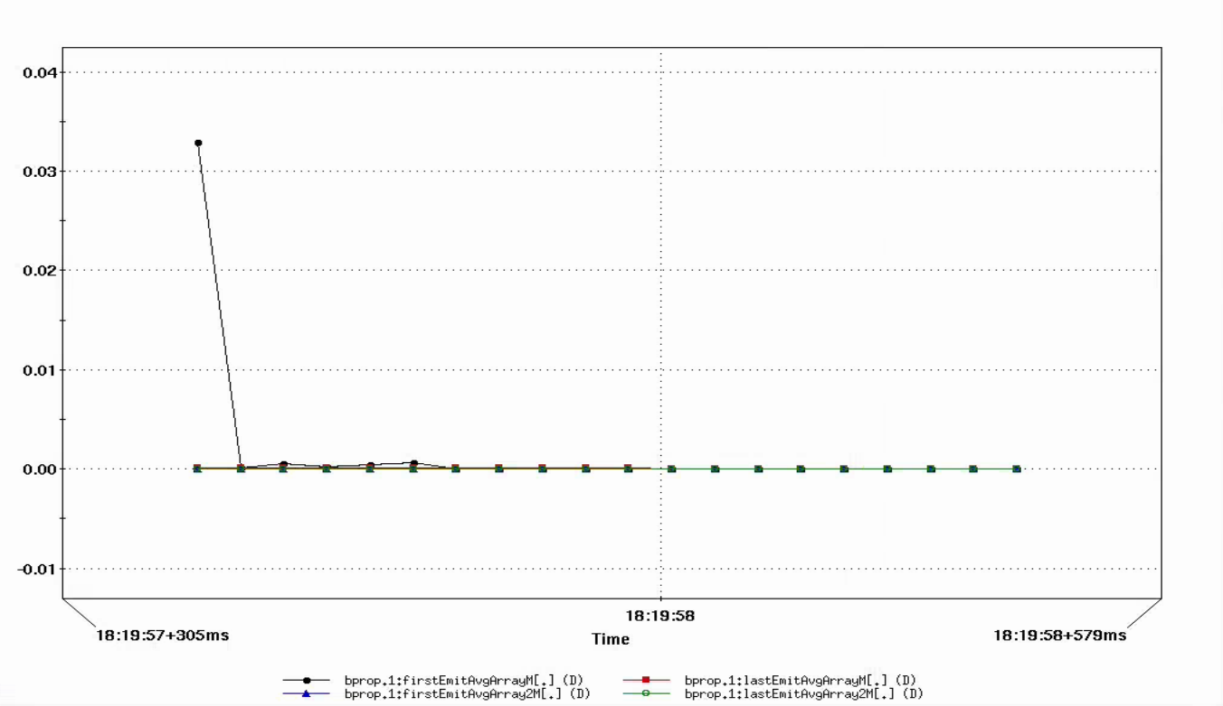
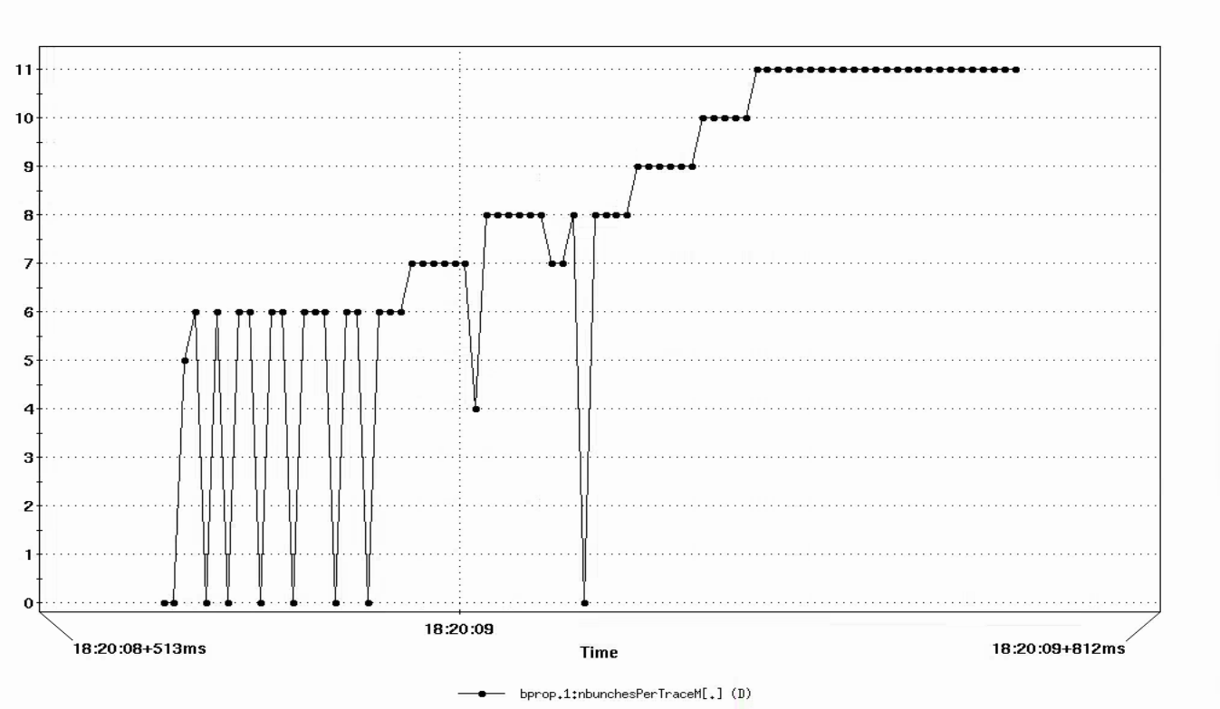
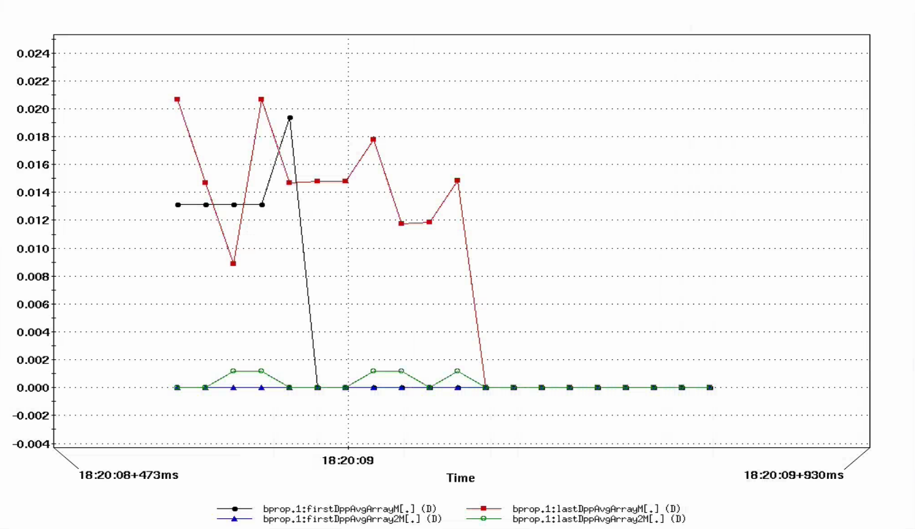
Examples: General Beam
Bunch length
Emittance
Momentum spread
Number of bunches

Slide 18





Acknowledgement
Kevin Brown, Vincent Schoefer, Keith Zeno, John Morris, Andrei Sukhanov, Michael Costanzo, Shruti Tajne, Md Latiful Kabir, Weijian Lin
Georg Hoffstaetter de Torquat, Jonathan Unger, Eiad Hamwi, Matthew Signorelli, David Sagan
Yinan Wang
Auralee Edelen, Ryan Roussel
Malachi Schram, Armen Kasparian, Kishan Rajput

Slide 19
Backup Slides

Slide 20
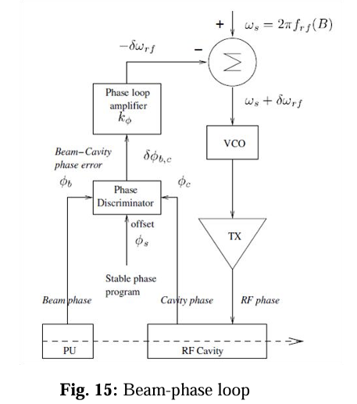
RF Phase Control
The RF system regulates the phases in such a way that the geographic phases differences among cavities are handled.

Slide 21
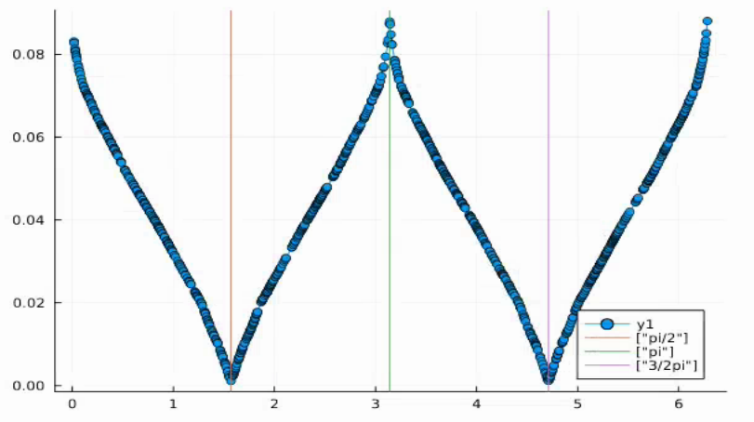
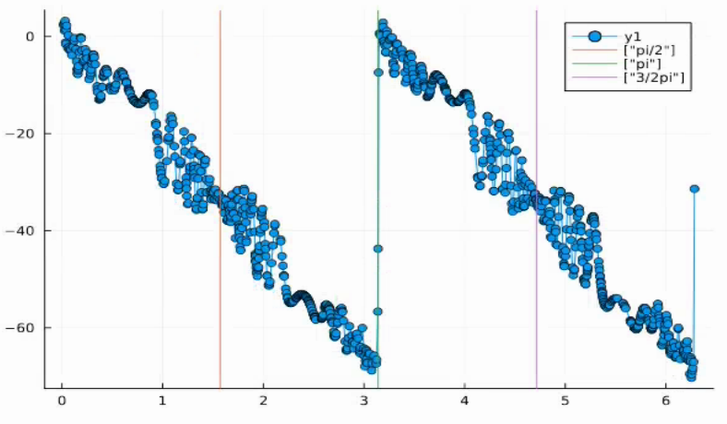
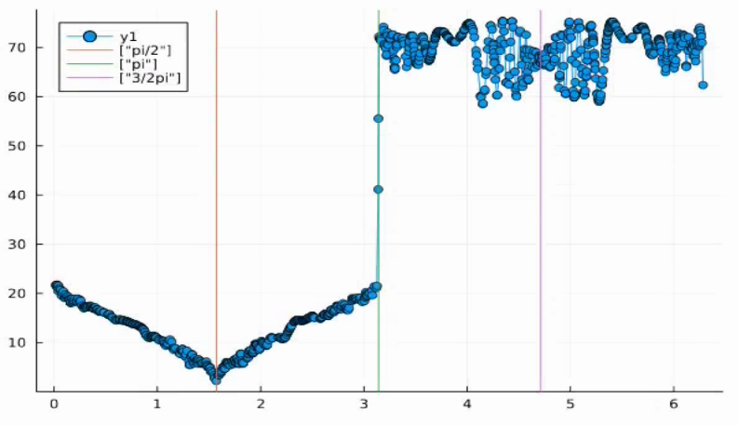
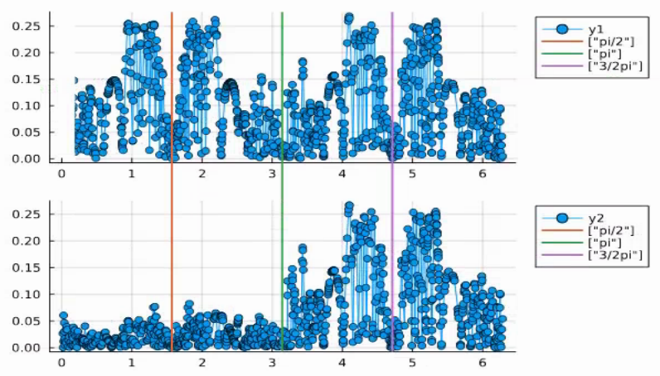
Proton Merge Phase Scan
Emittance
Center position
Bunch length
Bunch variations

