Slide 1
Simulation of Ionization Monitors
Chris Hall - RadiaSoft

Slide 2
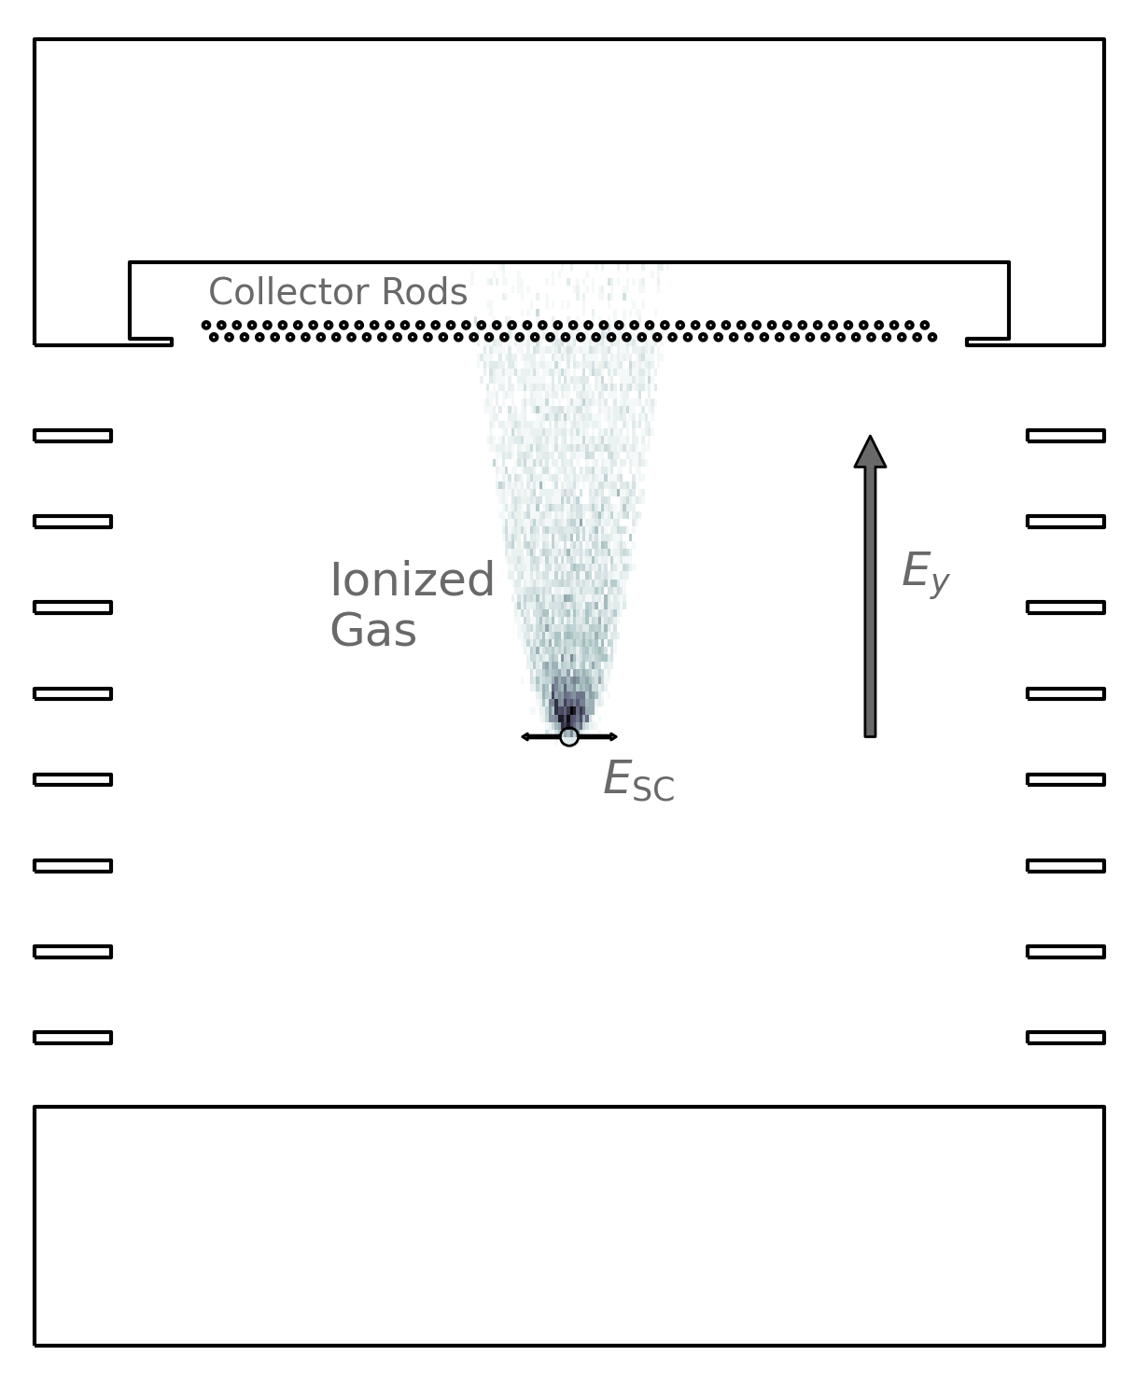
Ion Profile Monitors
Passing beam ionizes background gas
Ions are collected, their profile provides information on the beam distribution
Ion distribution does not exactly match the beam distribution. Must account for:
Beam space charge
Guiding fields
Ionization energy
Beam position

Slide 3
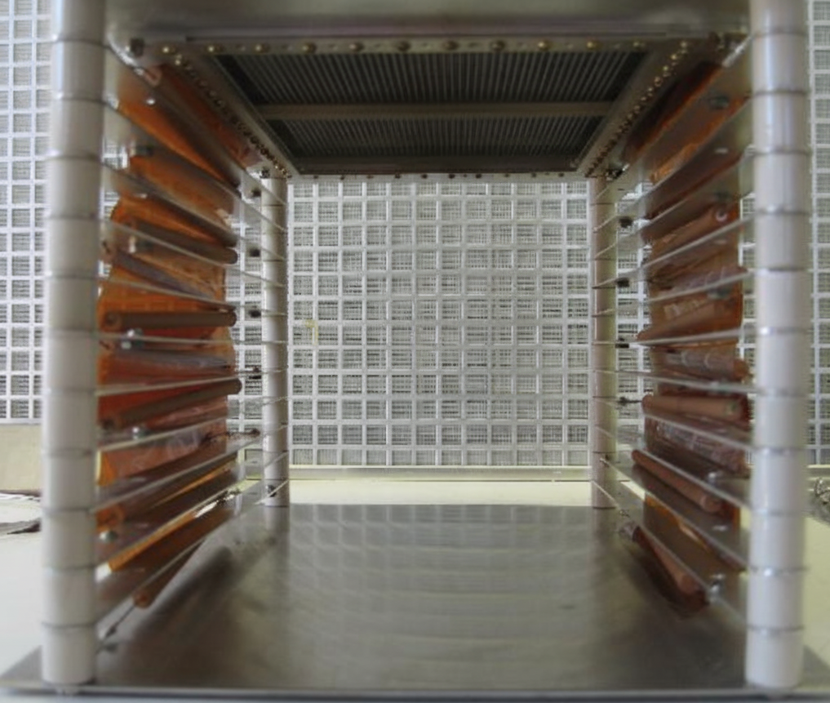
AGS Ion IPM Studies
Main emittance measurement tool
AGS also has electron gathering IPMs
Measurements less sensitive to intensity
Faster collection
Not run constantly
Previous correction approaches rely on narrow, empirical correction and simplified calculations
Ultimately want to apply an ML approach to correct emittance measurements
First build a simulation of the IPM to better understand measurements

Slide 4
Warp
Warp is a multi-species, three-dimensional particle-in-cell (PIC) application specializing in the simulation of intense beams of charged particles
Main routines in Fortran with a Python wrapper
Provides a framework for building plasma simulations
Field solvers
Particle push algorithms
Embedded boundaries from STL
Produce field maps
Particle scraping
Ionization with support for SDCS and DDCS from tabular data or functional forms
https://bitbucket.org/berkeleylab/warp/

Slide 5
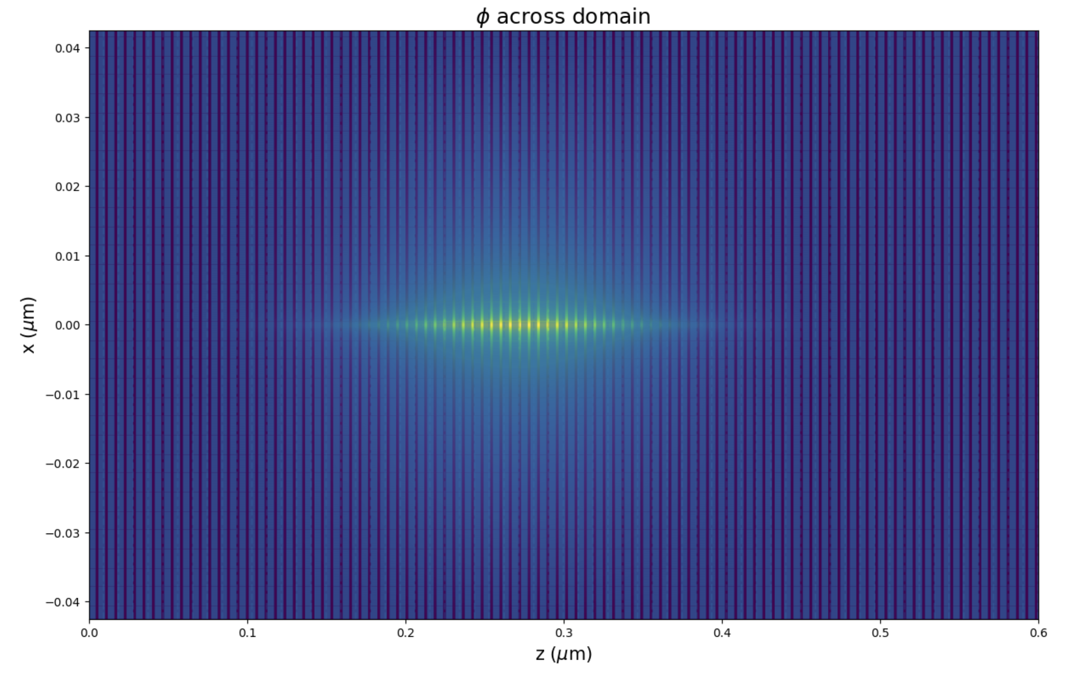
Beam Definition
Transverse Gaussian distributions
Current distribution
Gaussian
Uniform (bunched or DC)
Parabolic
Field solve – 3D Poisson using Multigrid method
Can consider multiple bunch passes – only really significant at lower collection voltages
Time Structure*
~200 ns
30 - 75 ns
*typical values I’ve tested with

Slide 6
Tracking – Time step considerations
Particles should not cross multiple cells per time step
For ion collection (assuming nitrogen) need to ensure ion lands inside a wire (1.27 mm diameter)
Collection time of a nitrogen ion

Slide 7
Simulation Cycle
~ ps timesteps
Structure simulation with multiple segments depending on whether beam is being tracked
Significantly reduces run time for simulations
Only first bunch induces ionization – simplifies simulation stopping conditions
~ ns timesteps
~ ps timesteps

Slide 8
Varying Collection Voltage
Measured bunch size is heavily dependent on collection voltage
Hard to discern significant impact from trailing bunches. SC clears core ~100 – 200 ns on its own.

Slide 9
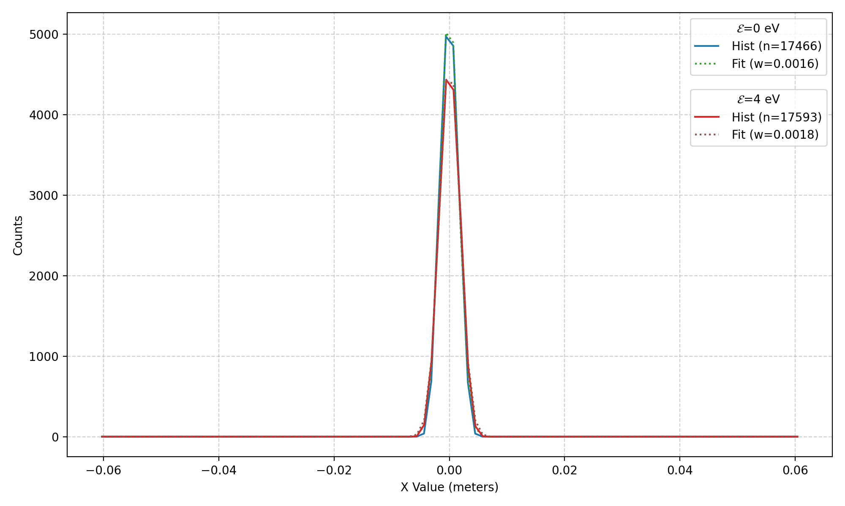
Ionization Process
Available models:
Fixed initial energy (random angle)
Single differential cross section*
Bethe
Voitkiv
Double differential cross section*
Voitkiv
Cross sections not available for all ion species we might be interested in (like N2)
Very significant for electrons, less so for ions
*Cross sections implemented from: https://pypi.org/project/ionics/
Sampling handled by Warp routines

Slide 10
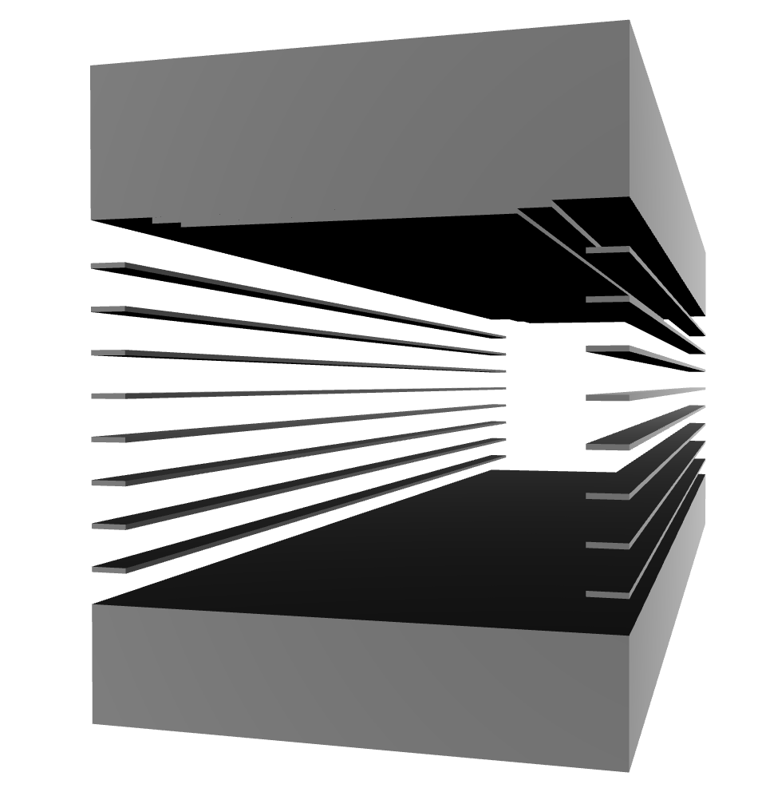
IPM STL Model
STL model built from dimensions copied off of original device drawings
SLT model provides embedded boundaries
Physical (particle scraping)
Electrical (collecting field)

Slide 11
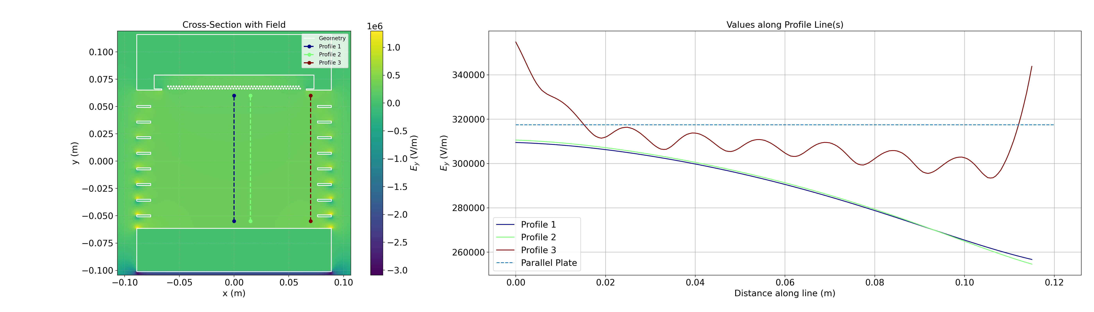
IPM Boundaries – Field Solve
Field solve is run as a separate simulation, prior to particle tracking
Imported as a field map into the particle tracking simulation
Collection wires are not included in field solve
Field is reduced compared to parallel plate approximation but is probably not significant for measured beam size

Slide 12
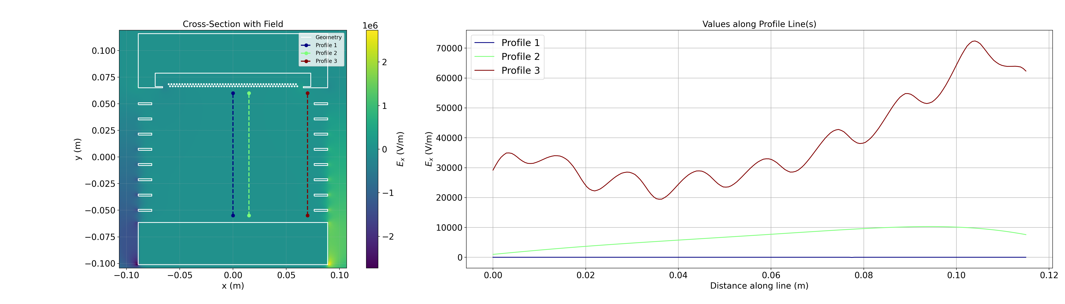
IPM Boundaries – Field Solve
E_{x} is negligible near the center of the IPM

Slide 13
IPM Boundaries – Particle Scraping
Scraping routine for STL objects uses winding number (calculated through PyMesh library) to check if inside a closed surface
Trajectory intersection checks are available for Warp primitive geometries but not STL
Could be more significant for electron tracking

Slide 14
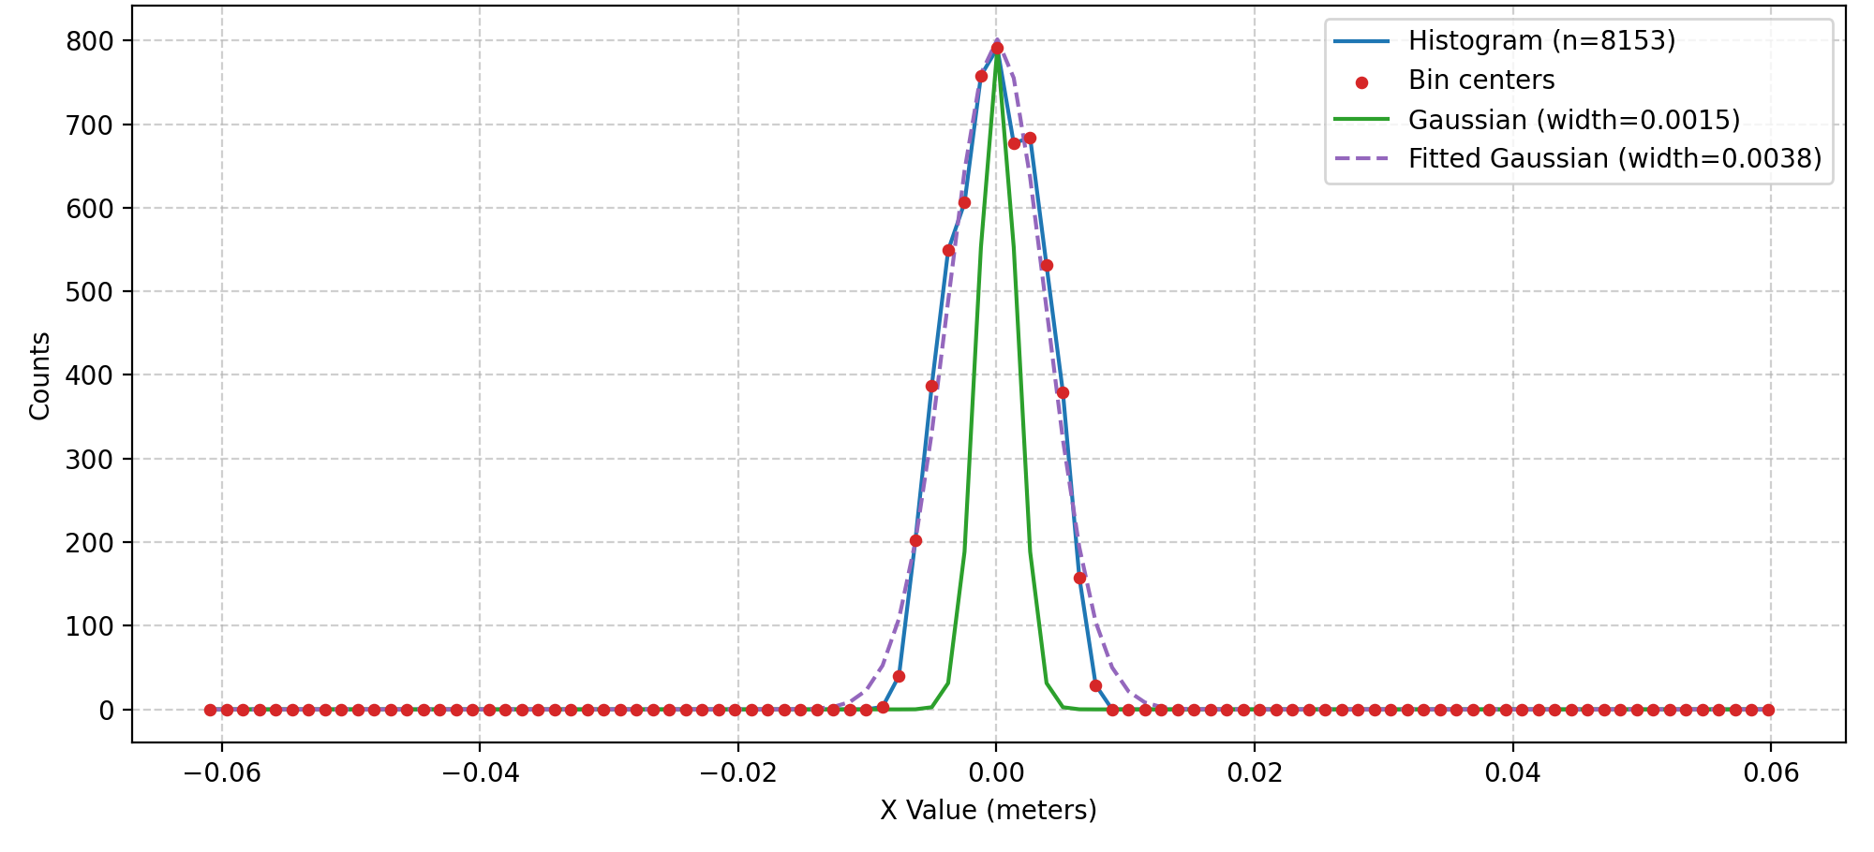
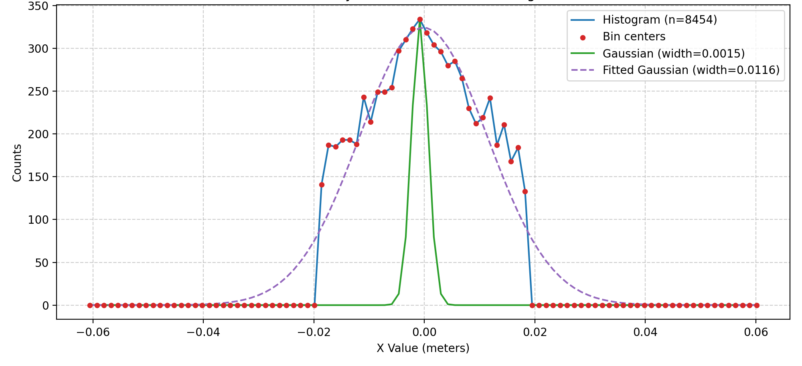
Measured Beam Size
Lost ions are tallied on each wire
Gaussian is fit to this distribution to find RMS size
In some cases, the measured distribution is very non-Gaussian – calculating RMS from the lost particle coordinates gives a very different answer

Slide 15
Comparison to Theory
Assumes:
Characteristic times to extract from the bunch core due to:
Space charge:
External field:
V. Shiltsev. "Space-charge effects in ionization beam profile monitors." Nuclear Instruments and Methods in Physics Research Section A: Accelerators, Spectrometers, Detectors and Associated Equipment 986 (2021): 164744.

Slide 16
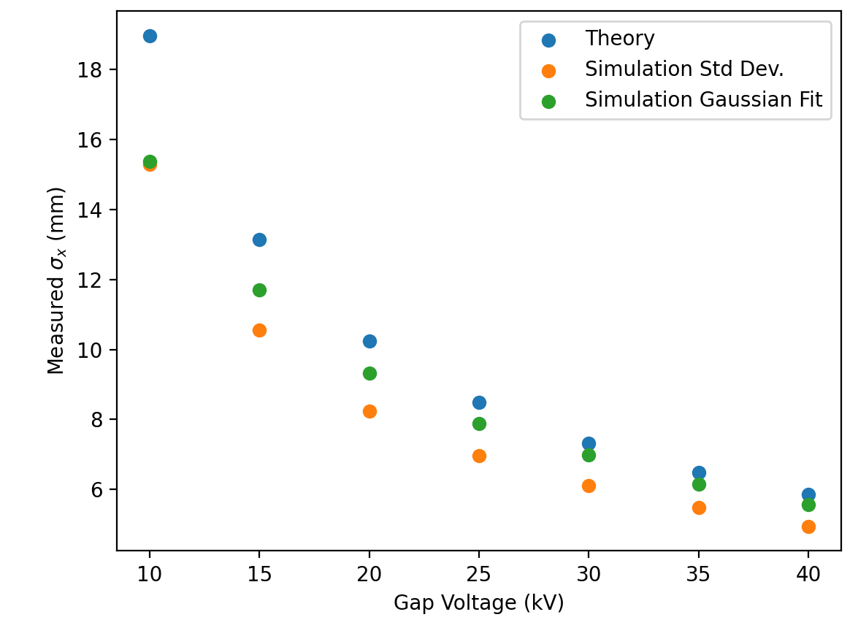
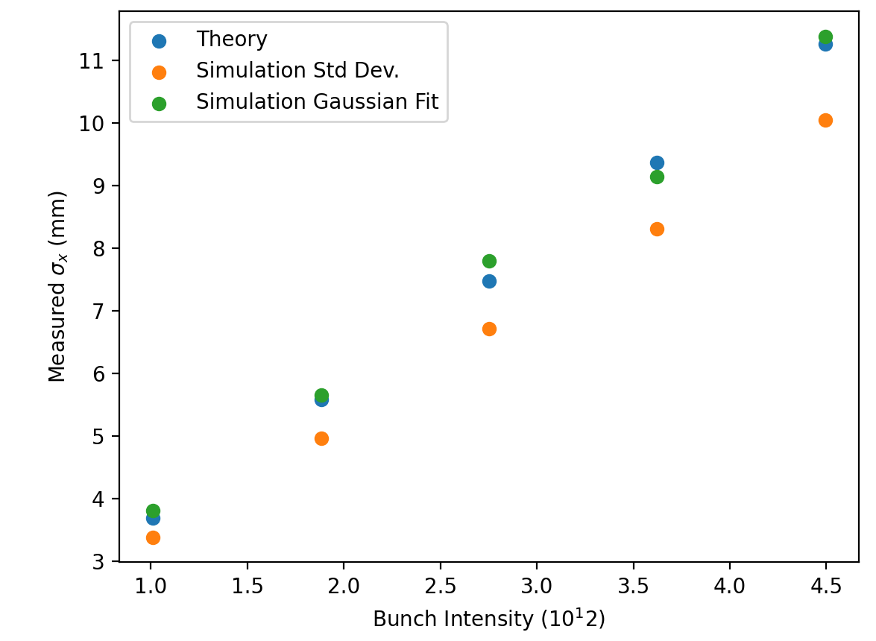
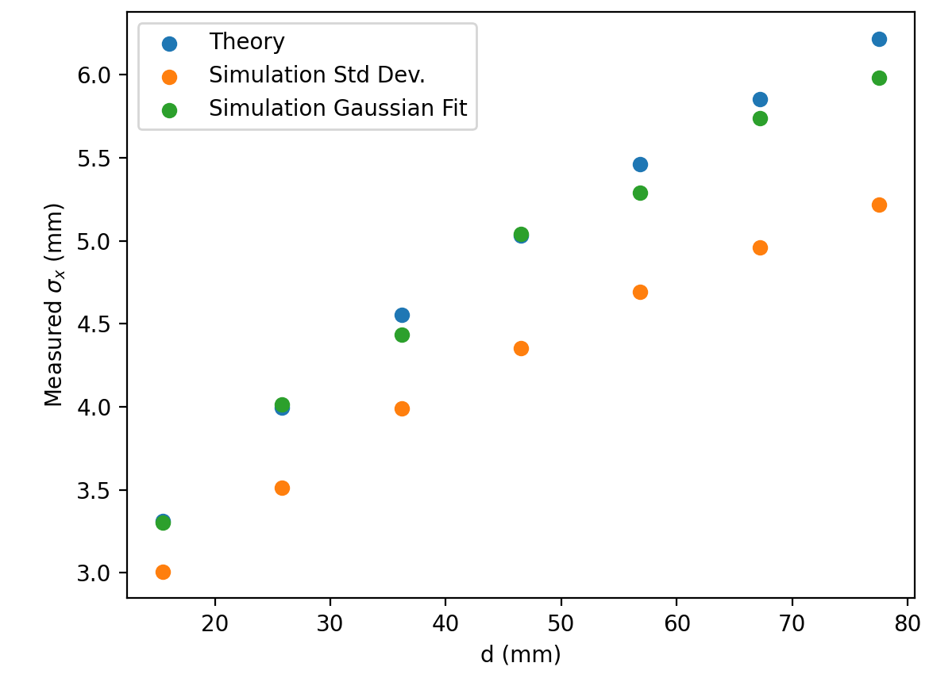
Comparison to Theory
Condition is violated for small gap voltages
Simulation Std Dev calculated directly from exact coordinates of lost ions
Simulation Gaussian fit use a fit to counts of ions assigned to wire positions

Slide 17
Training a Model from Simulations
Simulation dataset with random
Beam size
Intensity
For each parameterization of the beam run scan over
Collector voltage
Vertical offset of bunch centroid from collector
Train models to predict true beam size from scan

Slide 18
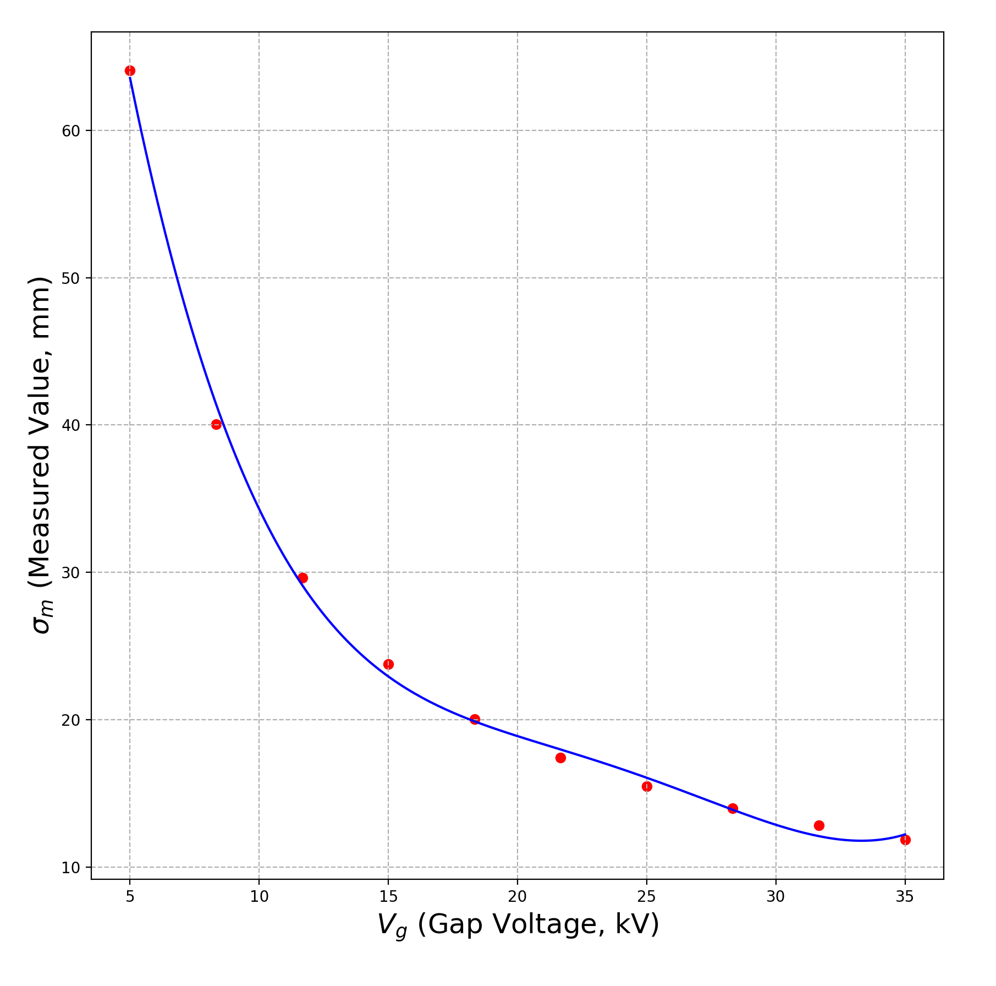
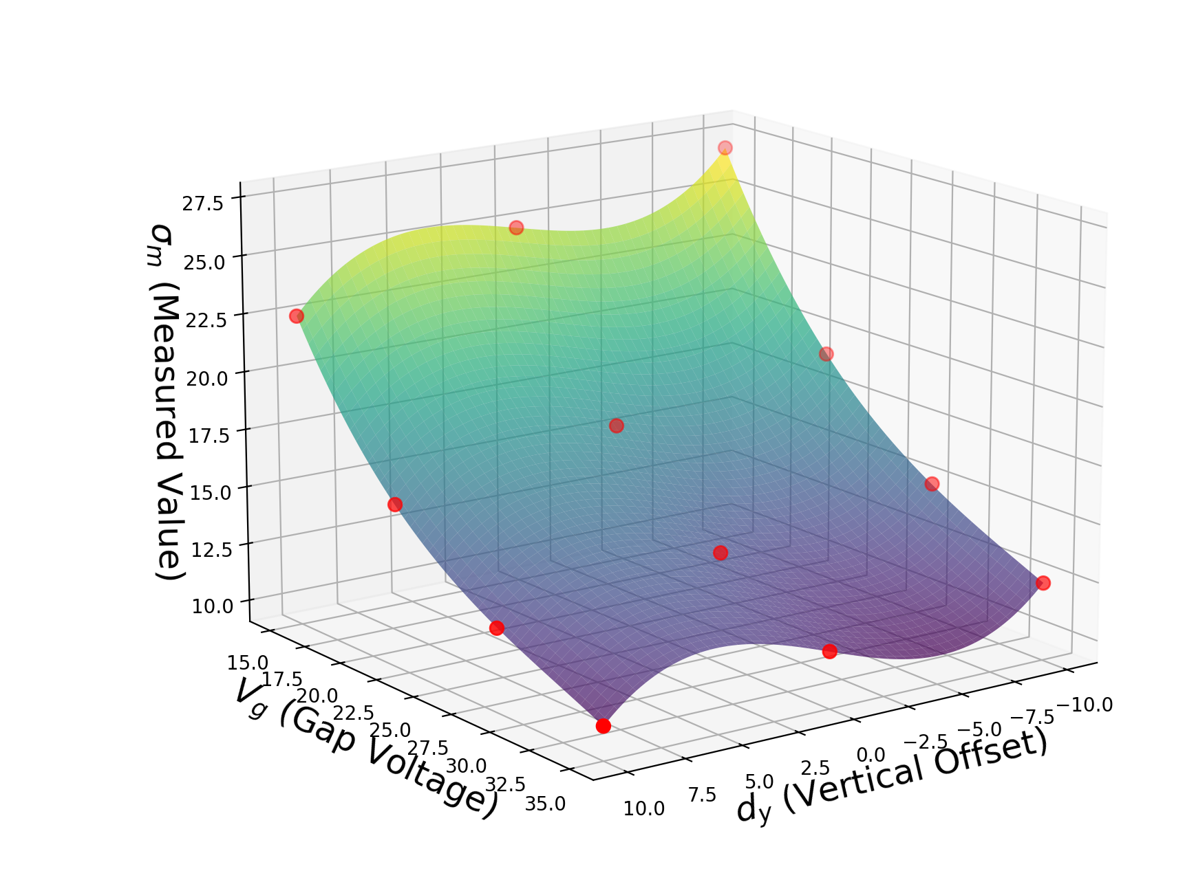
Measurement Cases
Voltage-fit Scan
Voltage-fit: A 4th order polynomial line is fit a voltage scan of 12 points. The polynomial coefficients are used as inputs to the regressor.
Surface-fit: A 4th order polynomial surface is fit to the scan data. The polynomial coefficients are used as inputs to the regressor.
Point-by-point: The regressor models are trained using the individual data points from the scan. Intended as a reference case.
Surface-fit Scan

Slide 19
Model Evaluation
Compares 3 models for each approach
“Gaussian noise” case add in errors to the measured beam size sampled from a Gaussian
GP is always the clear best performer
Using the surface-fit offers some benefit for noisy measurements
Maybe not as easy to carry out though?

Slide 20
Field Solve Comparison
Multigrid vs Bassetti-Erskine calculation

Slide 21
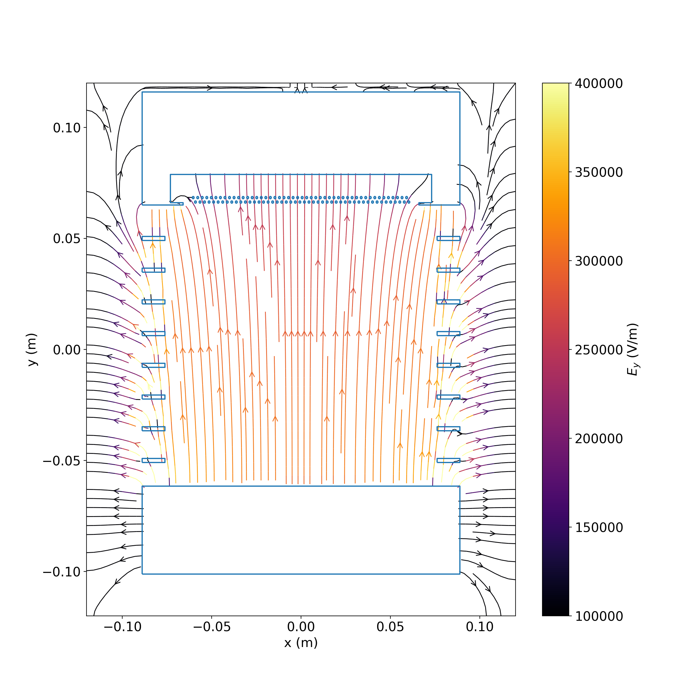
IPM Field Lines

Slide 22
Asymmetric Beam Scan

Slide 23
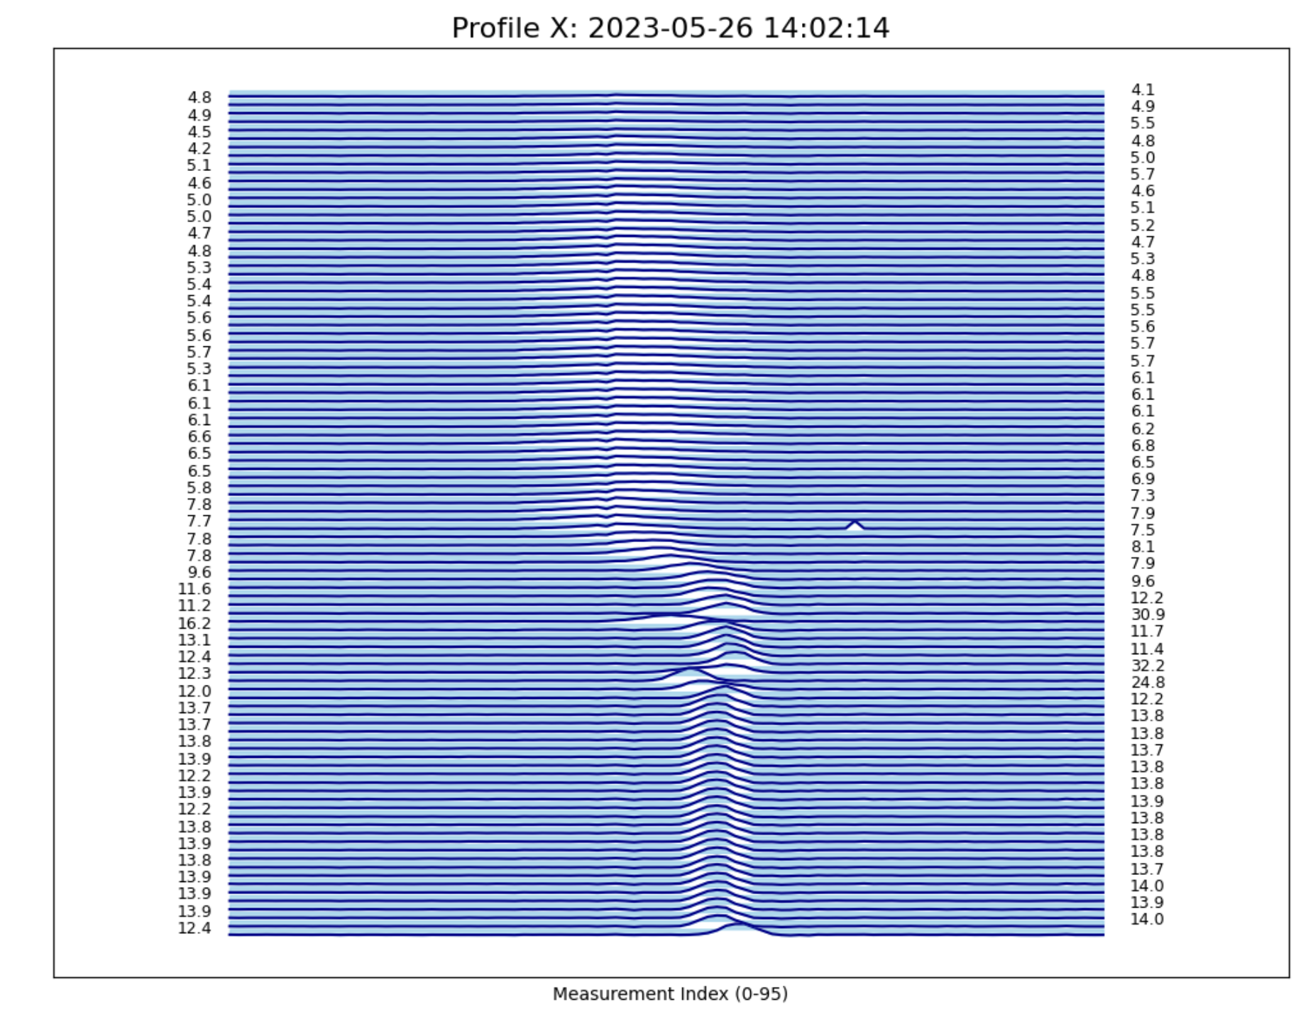
Measured Profile Prediction
Predict next measured profile from prior measurements
Initial attempt with VAE yielded mixed results
Using a transformer architecture looks more promising

Slide 24
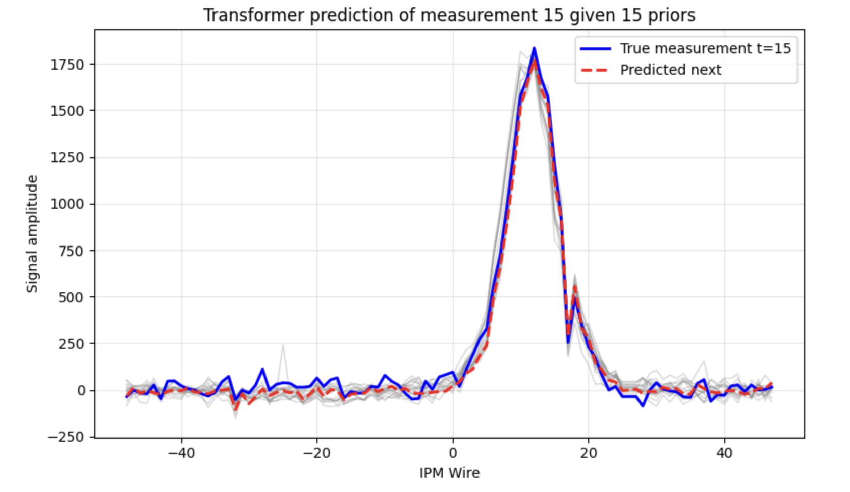
Initial Transformer Results
Works extremely well for test data taken within same month as training data

Slide 25
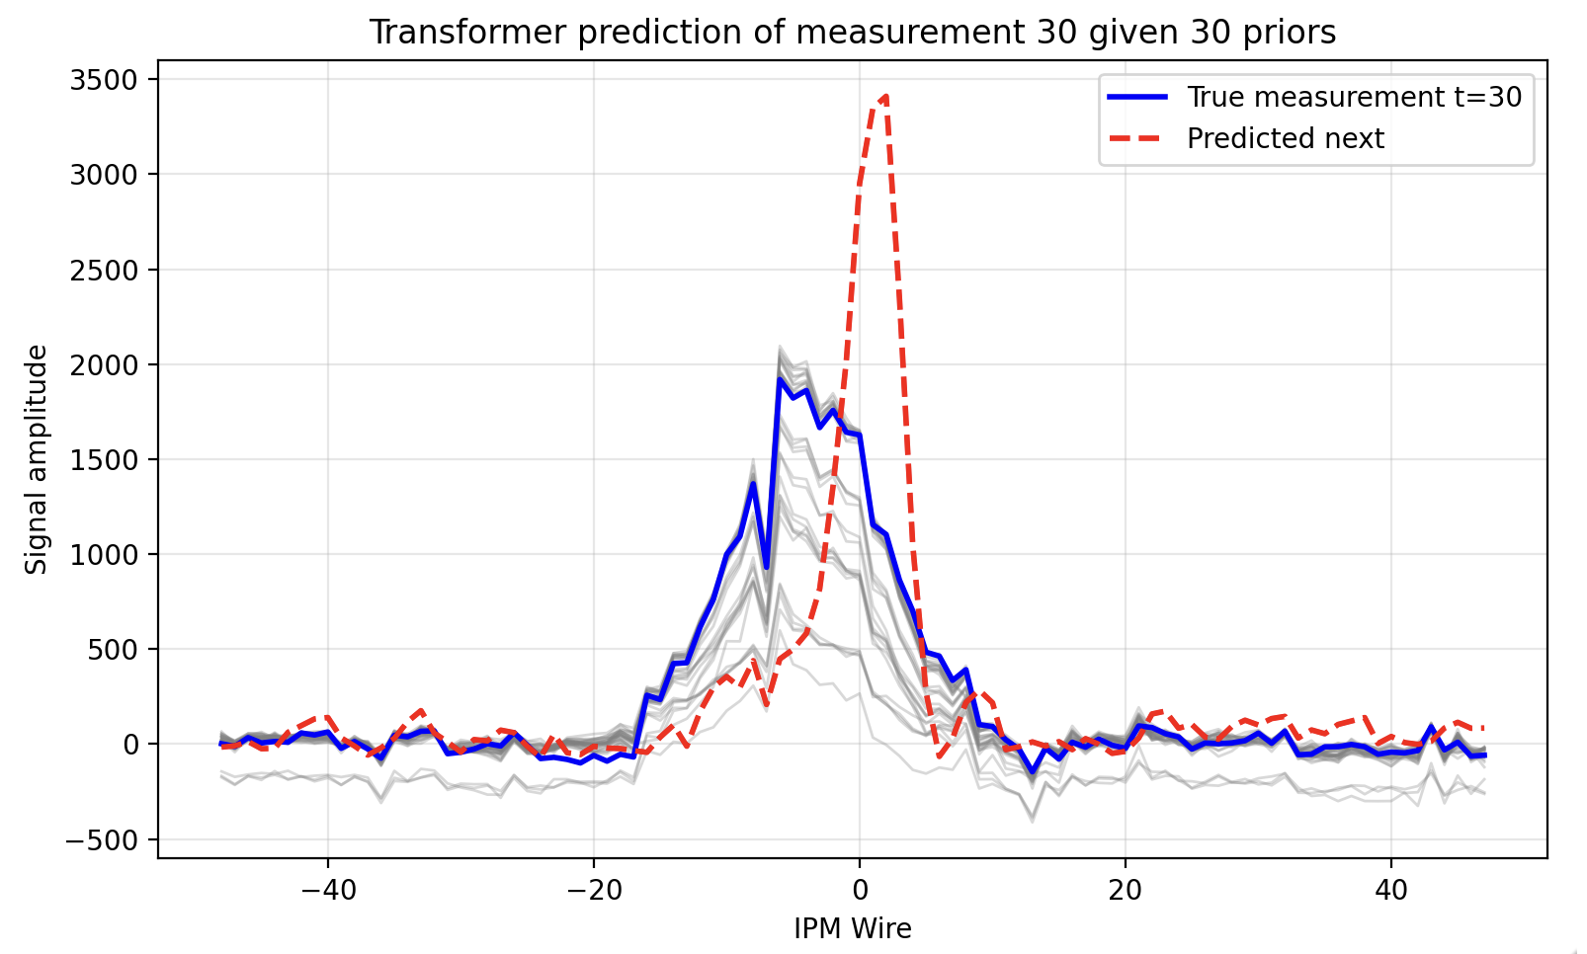
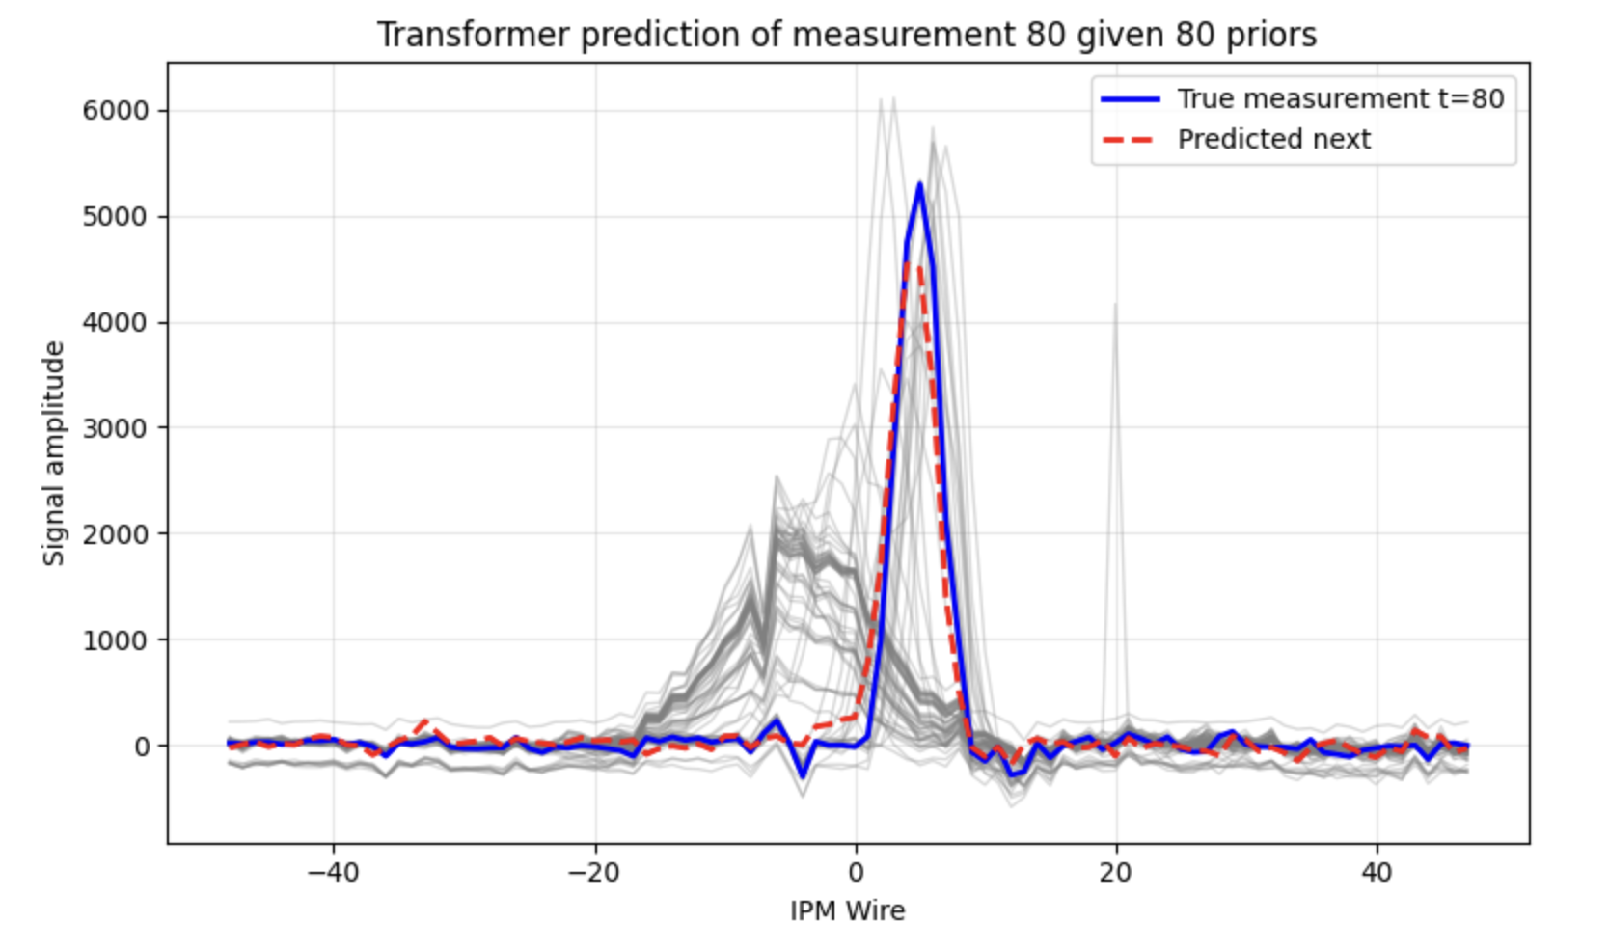
Initial Transformer Results
Tested on data taken 1 year before training set
Struggles with measurements early in the cycle
Performs better later, as profile improves

