Slide 1




David L. Bruhwiler,*$ Joanne Beebe-Wang,% Kevin A. Brown,%# Georg Hoffstaetter& and Jonathan Edelen$ $RadiaSoft LLC – %Brookhaven National Laboratory – #Stony Brook University – &Cornell University speaker: Kevin Brown
RadiaSoft evaluation of beam homogenization
21 October 2025
3rd AI/ML for EIC Hadron Pre-injectors Collaboration Meeting
Work supported Under Contract No. DE-Sc0012704 with the Auspices of the U.S. Department of Energy

Slide 2
Overview
an effort has recently begun to support the High Energy Effects Test Facility (HEET) Project
https://www.bnl.gov/heet/
nonlinear focusing approach (octupoles & higher-order multipoles)
The linear optics must create a tight horizontal waist and (in a different location) a tight vertical waist.
Place an octupole (or a combined-function multipole) at each of these waists:
give the y-motion a strong 3rd-order kick where the x-motion is only weakly perturbed (i.e. at the horizontal waist)
likewise , give the x-motion a strong kick at the location of the vertical waist
Particle tracking will set limits on the Twiss beta values at the waist locations, for various ion species
machine learning can be used to develop a real-time control algorithm
dynamic steering approach (generalized rastering)
roughly Gaussian transverse ion beam profile & a reasonable rep rate of ion bunches
two steering magnets, placed near the end of the beamline
simulations will assess deviation of the integrated irradiation intensity from the desired properties
machine learning can be used to develop a real-time control algorithm
other considerations
Use the Aline within the AGS switchyard as our initial working point
Minimize chromatic effects
Assess failure scenarios for octupole(s) and steering magnet(s)
Assess the impact of control errors and/or field errors on the target distribution

Slide 3
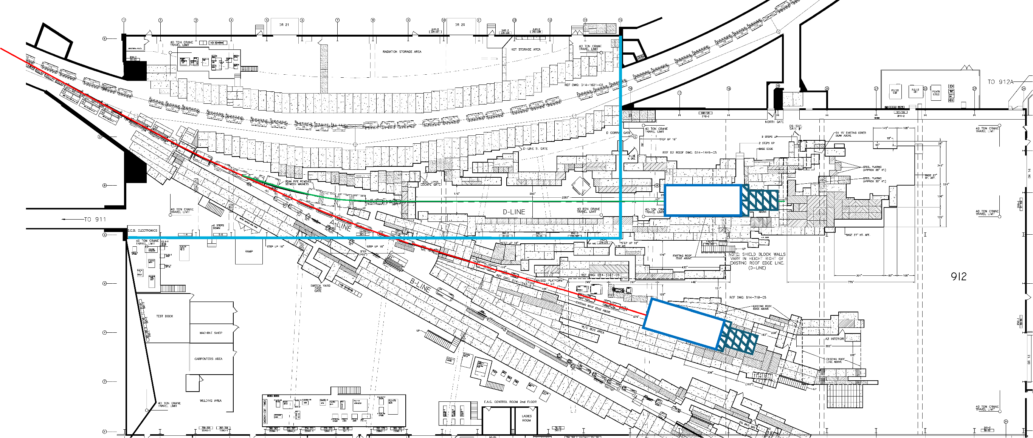
Work will begin with the A-line in the AGS switchyard
Schematic of the Alternating Gradient Synchrotron (AGS) switchyard at BNL. The Aline is shown in red.

Slide 4
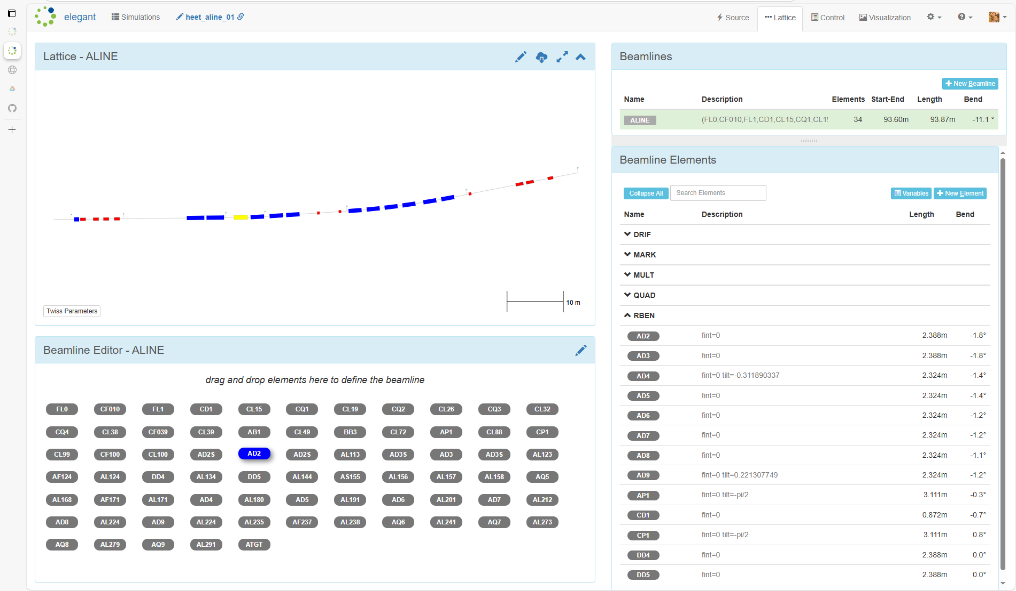
Sirepo – elegant is being used to modify the AGS A-line
The design capabilities of elegant are being used for near-term goals:
assess & minimize chromatic effects in the A-line
create horizontal & vertical waists for octupole placement
determine optimal placement of rastering dipoles
Screenshot of the Sirepo–elegant model for the Aline (part of AGS switchyard at BNL).

Slide 5
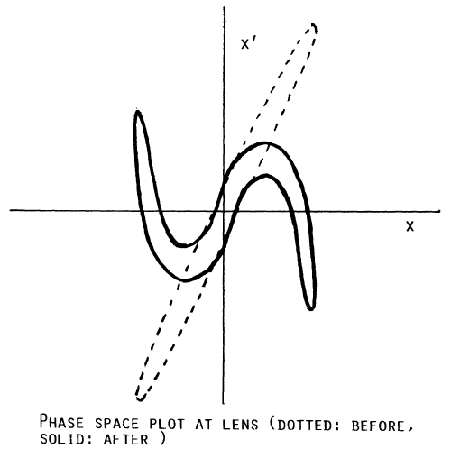
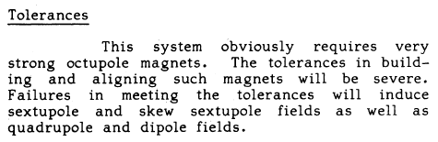
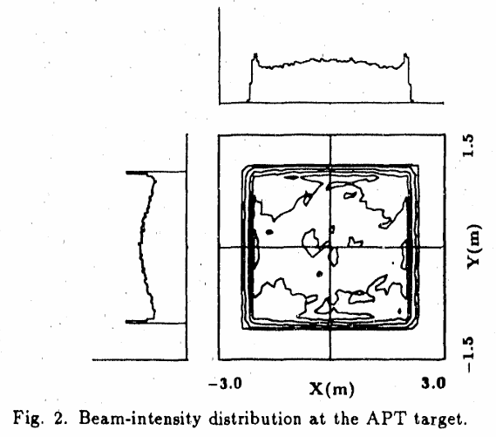
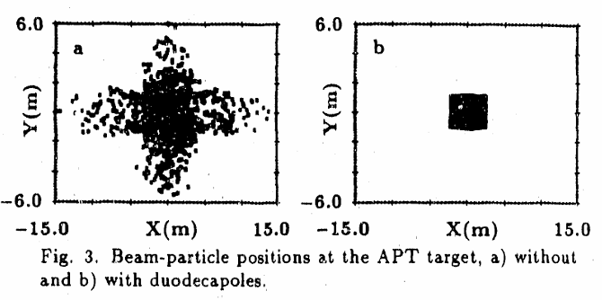
Use of octupoles & duodecapoles for uniform irradiation: 1963 – 1990
neutron spallation has been a motivating application
tritium production
nuclear waste transmutation
fusion materials testing
limitations of the approach
duodecapoles may be required
high-flux ‘ears’ must be scraped
lack of flexibility
requires strong, high-quality magnets & the failure modes are complex
a patent was filed
P.F. Meads, Jr., “A nonlinear lens system to smooth the intensity distribution of a Gaussian beam,” IEEE Trans. Nucl. Sci. 30, p. 2838 (1983).
P.F. Meads, Jr., “Ion Optical Design of High Quality Extracted Synchrotron Beams with Application to the Bevatron,” Lawrence Radiation Laboratory Report UCRL-10807 (1963).
A. Jason and B. Blind, “Confined Energy Distribution for Charged Particle Beams,” U.S. Patent Number 4962317 (1990).
B. Blind, “Production of uniform and well-confined beams by nonlinear optics,” 11th Conf. on Application of Accelerators in Research & Industry, (1990).

Slide 6
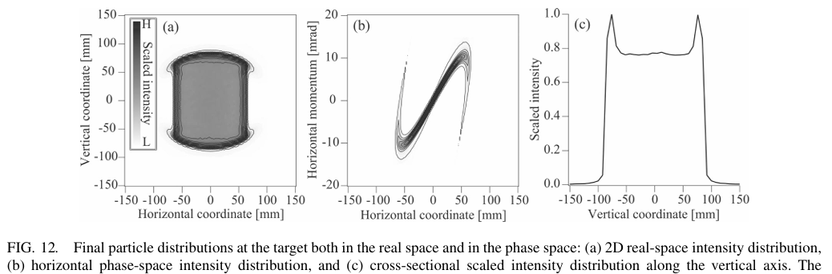
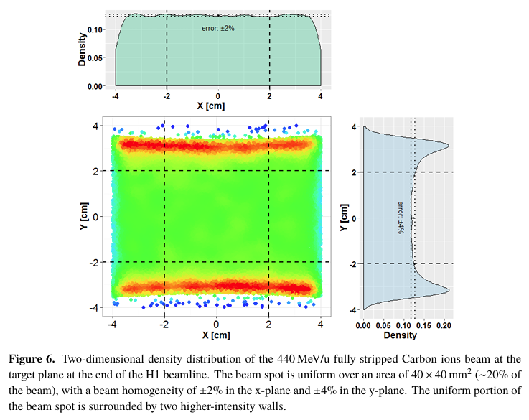
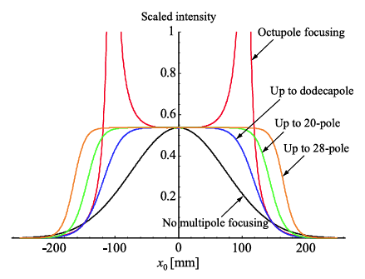
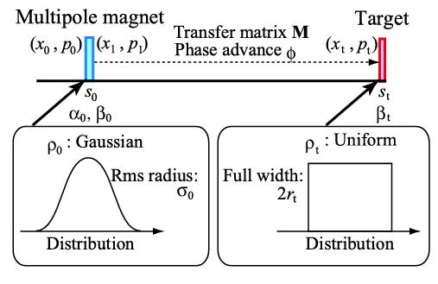
Use of octupoles & duodecapoles for uniform irradiation: 1997 – present
first experimental realization
other selected papers (from 2007)
Tsoupas et al., “Uniform Particle Beam Distributions Produced by Octupole Focusing,” Nucl. Sci. Eng. 126, p. 71 (1997).
Y. Yuri et al., “Uniformization of the transverse beam profile by means of nonlinear focusing method,” Phys. Rev. ST-AB 10, 104001 (2007).
Y. Yuri et al., “Uniform beam distribution by nonlinear focusing forces,” Proc. Int. Part. Accel. Conf., THPEC041 (2010).
T. Amin et al., “ Formation of a uniform ion beam using octupole magnets for BioLEIR facility at CERN,” J. Instrumentation 13, P04016 (2018).
S. Meigo, M. Ooi and H. Fujimori, “Two-parameter model for optimizing target beam distribution with an octupole magnet,”
Phys. Rev. Accel. & Beams 23, 062802 (2020).

Slide 7
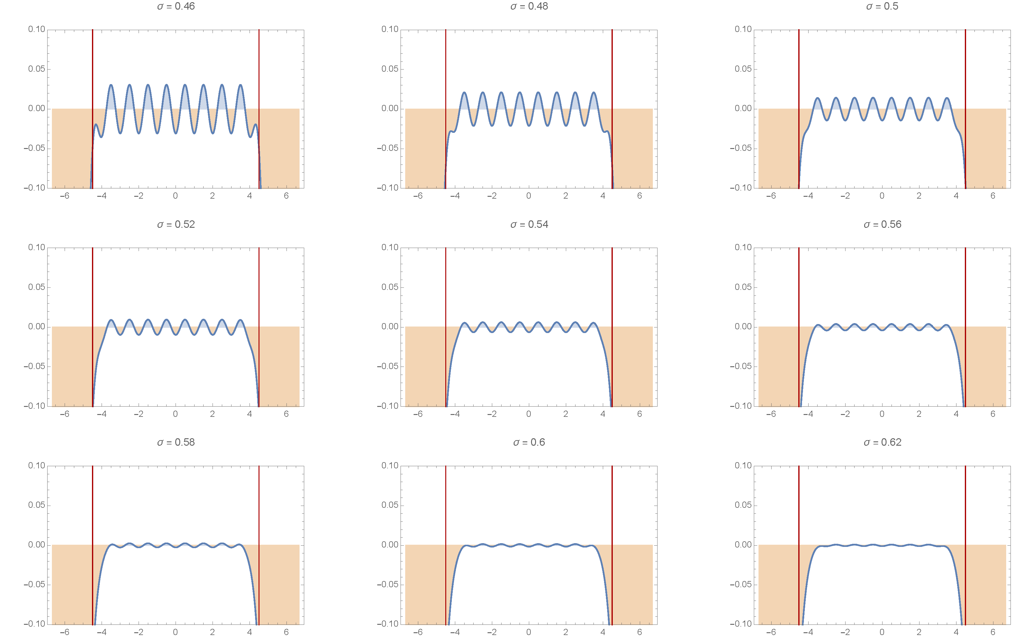
1st-order assessment of uniformity that can be achieved via rastering
σ is the ratio of RMS width to distance between spot centers
σ = 0.62 (lower-right figure)
high degree of uniformity
significant rollover on edges
σ = 0.48 (upper-middle)
lower degree of uniformity
other considerations
sweep rate of dipole fields must be suitable for separation between ion bunches
dipoles likely must be placed after the final focusing quads
otherwise, quad apertures might have to be too large
1D schematic overlay of beam spots on target, assuming ion bunches with ideal Gaussian profiles.

Slide 8
NSRL Octupole Approach
Beamline uses slow extracted beam from Booster
Horizontal phase space is very non-Gaussian
To transform the non-Gaussian to a ‘Normal’ distribution foils are used to scatter & blow up the emittance & take advantage of randomization of scattering to create more Gaussian profile
Optics are fairly simple – first two quads + 20 degree bend used to create achromatic tune
Quads upstream of 1st octupole creates large beam in one plane, tiny beam in other plane
Quad upstream of 2nd octupole creates same condition in opposite planes
Quads after 2nd octupole control the beam size and rotation of phase space to create uniform beam on target.

Slide 9
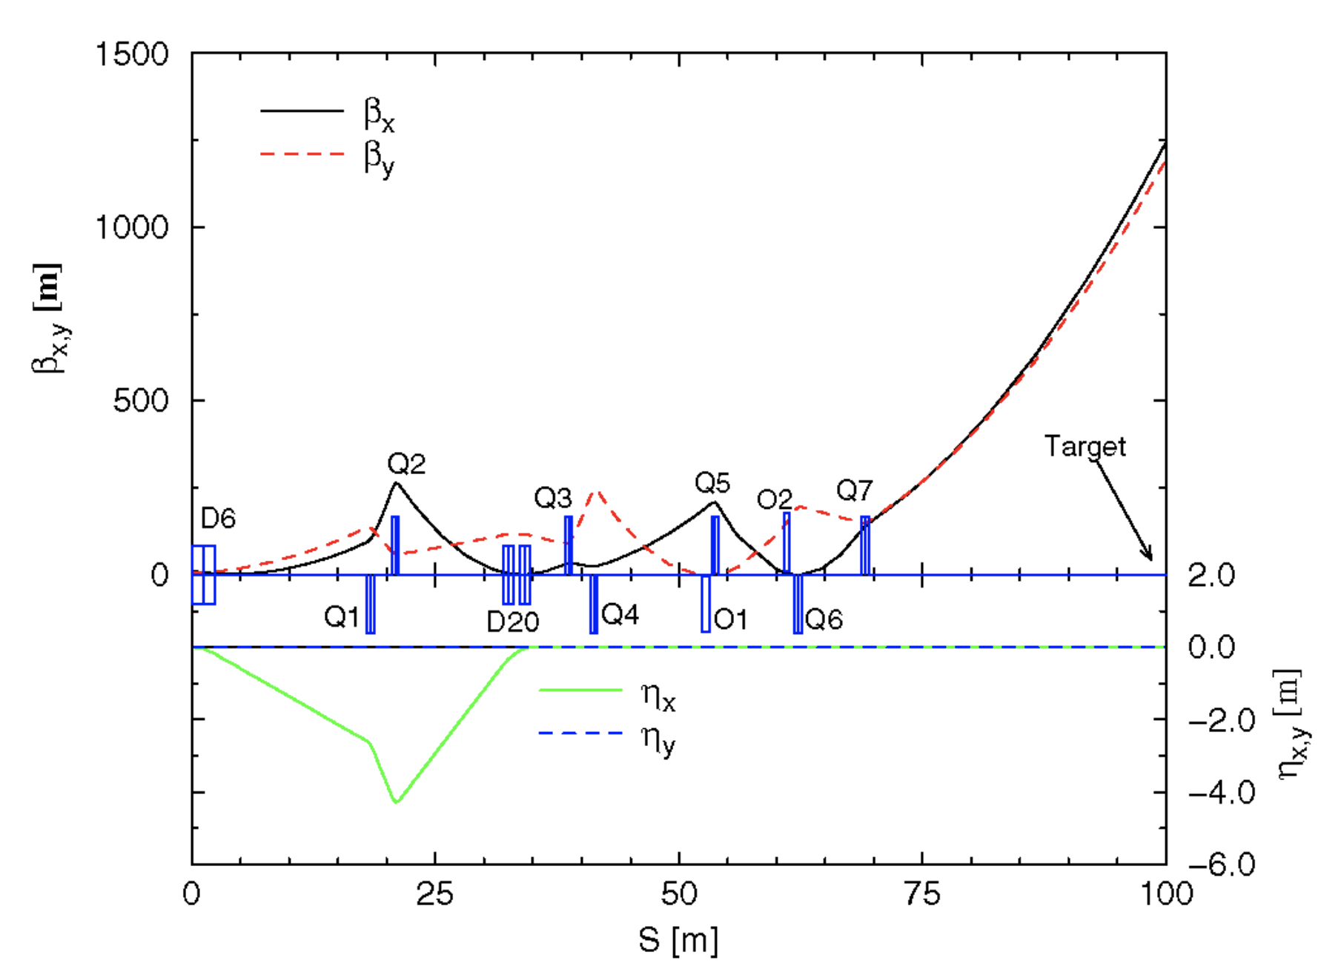
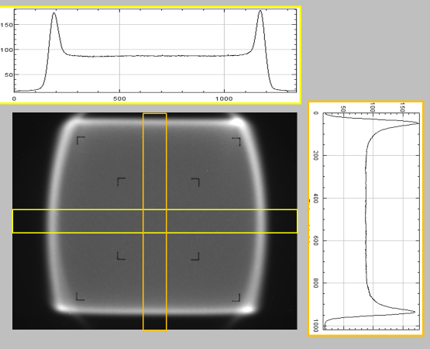
PHYSICAL REVIEW SPECIAL TOPICS - ACCELERATORS AND BEAMS 10, 024701 (2007)
20 cm

Slide 10
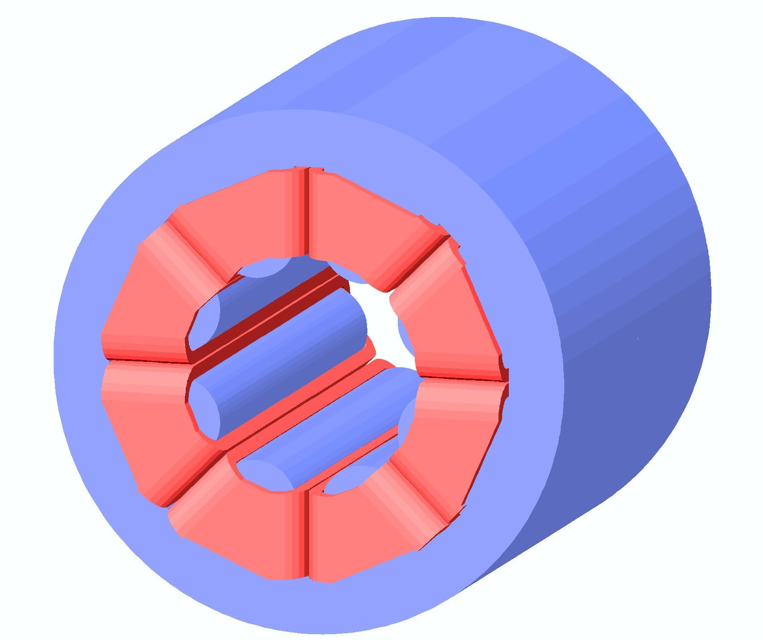
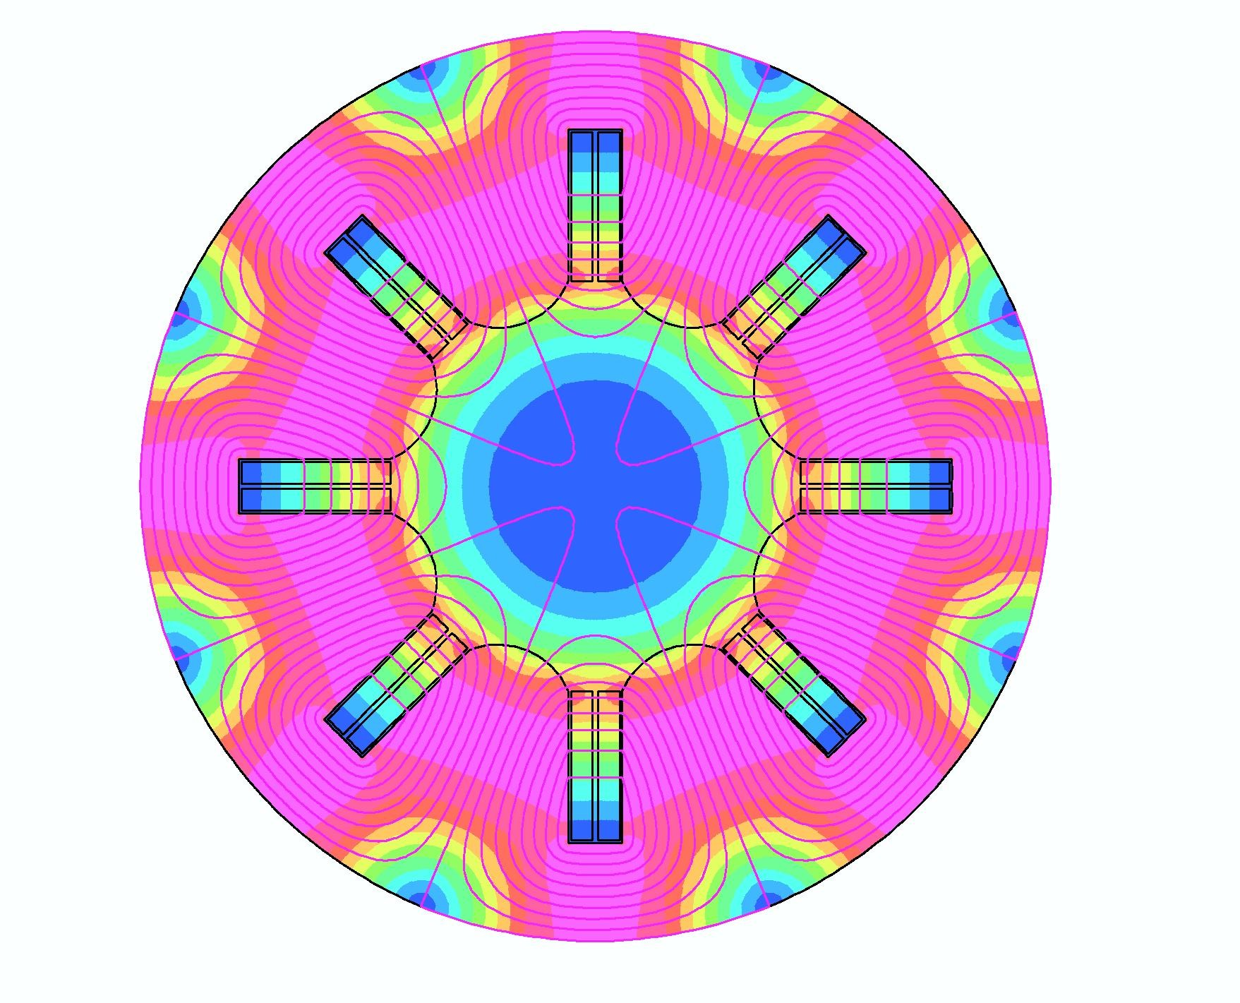
Uniform Beams
Octupole:
x’=x’+O(x³+3xy²)

Slide 11
Concluding considerations
HEET must support many charge-to-mass ratios at a variety of beam energies
the linear optics must be flexible and robust to accommodate these variations
it’s straightforward for sweeping dipoles to accommodate these variations
the design effort for nonlinear focusing will be more challenging
note: it has been successfully achieved at NSRL, using octupoles
higher energies for HEET → higher octupole fields, or longer magnets (as compared to NSRL)
basis for selecting one approach over the other
properties of failure modes
failure modes for nonlinear focusing will be more complicated to mitigate
ease & flexibility of operations
dynamic focusing (aka rastering) will be more flexible and conceptually simpler to manage
cost
specific to the use of octupoles
this approach produces higher-irradiation “ears” along the edges of the rectangular beam distribution
these ears must be scraped
may be possible to combine an octupole approach (e.g. horizontal) with vertical scanning
J.-H. Jang, “Uniform Irradiation with a Combination of an Octupole Magnet and a Scanning Magnet in the KOMAC Beam Lines,” J. Korean Phys. Soc. 63, p. 1351 (2012).

