Slide 1
AGS Horizontal Resonance Strength Correction (With special attention to low energy)
V. Schoefer, with help from E. Hamwi
3rd AI/ML for EIC Hadron Injectors Collaboration Meeting
10/21/2025

Slide 2
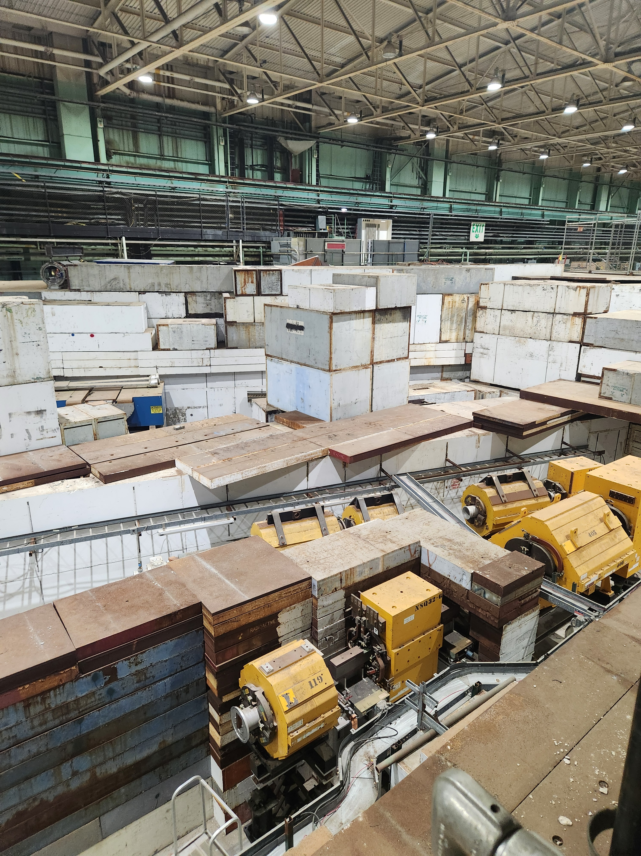

Slide 3
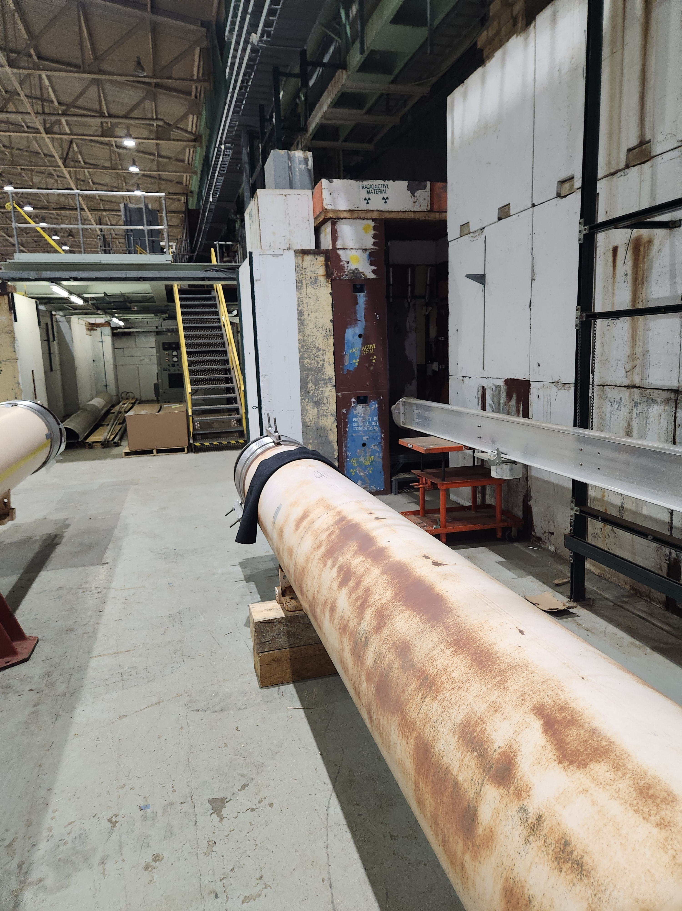

Slide 4
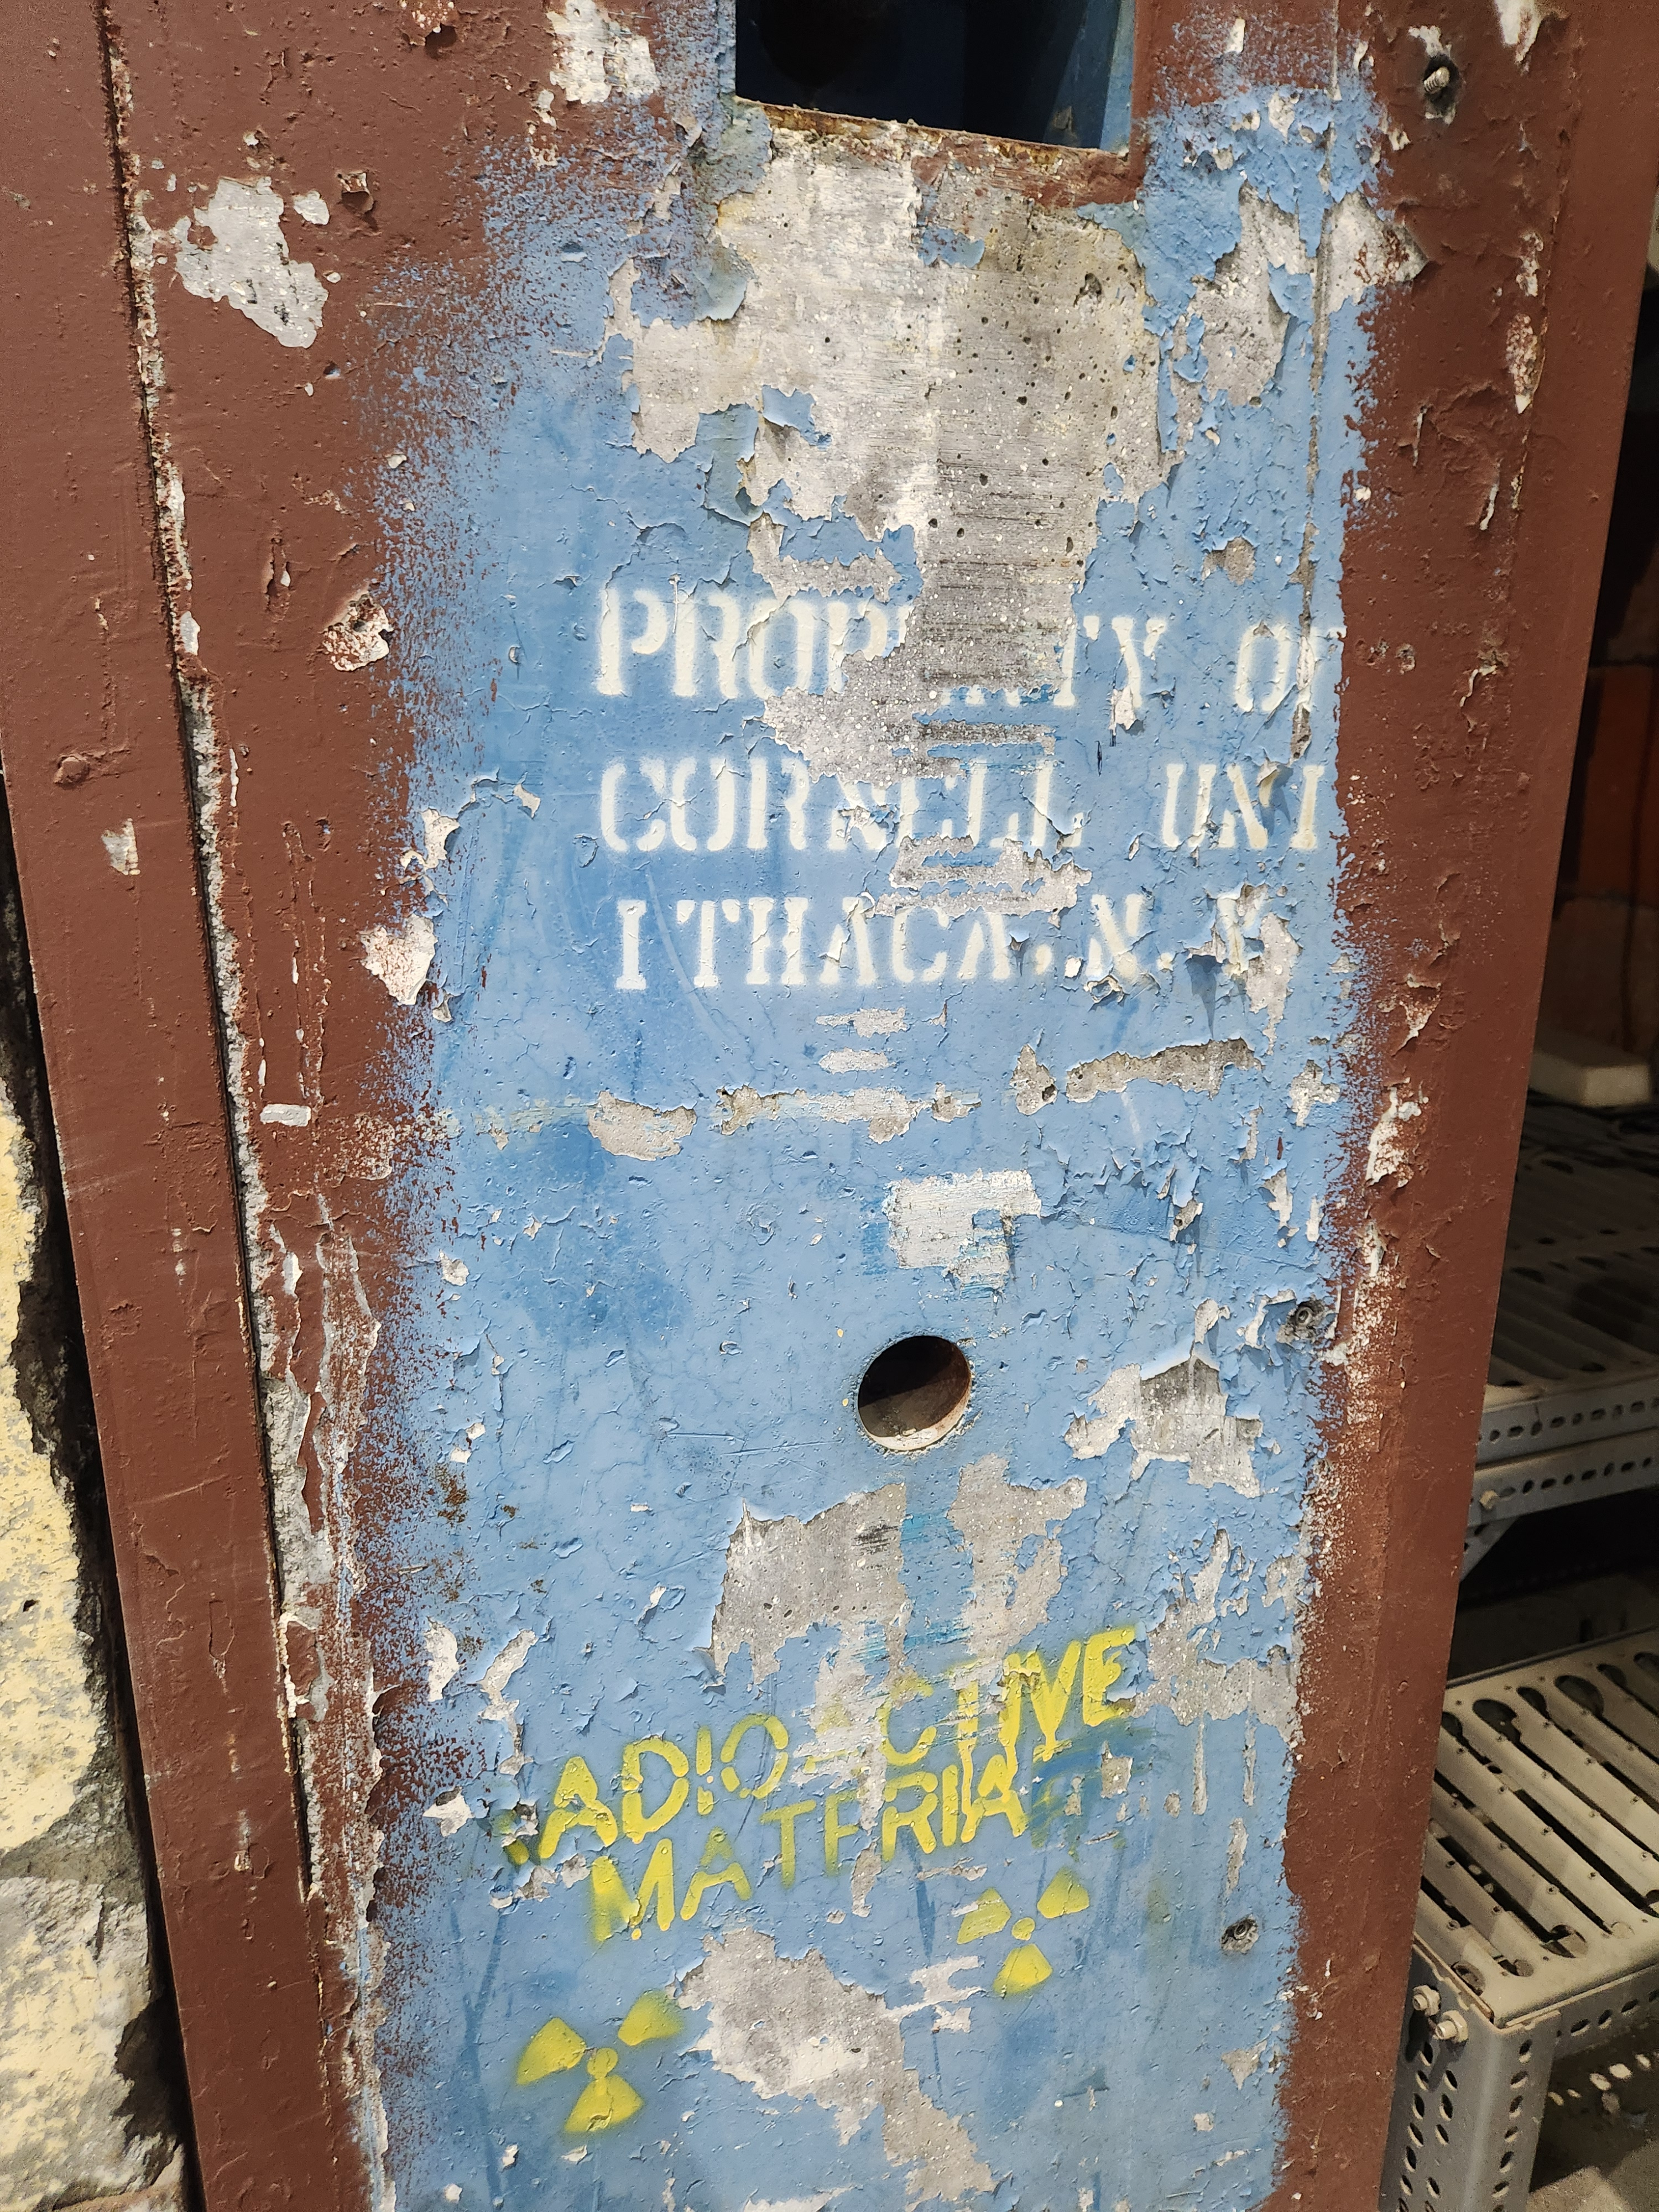
Archaeological evidence of an ancient BNL-Cornell
collaboration

Slide 5
Outline
Polarization and resonances in the AGS
Polarization measurements and the difficulty of optimization
Indirect lines of improvement
Optics and improvement of corrections
Locating unknown sources of depolarization
Improved timing of corrections (later talk)
Measurements at low energy
Single, slow resonance crossing

Slide 6
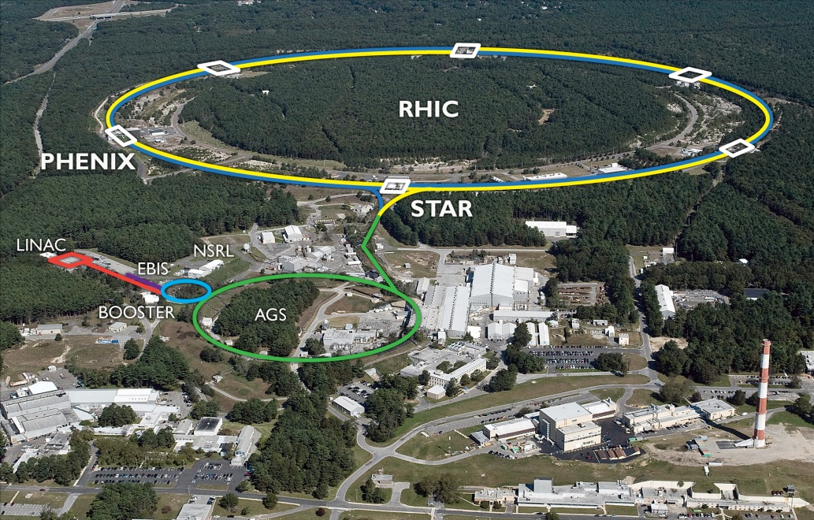
RHIC Accelerator Complex
Accelerator Rings
 | Circumference [m]
Booster | 201
AGS | 807
RHIC | 3833
~1.2 km
Typical Top Energies [Total, GeV/N]
 | Au | Pol. Protons
Linac (H⁻) | -- | 1.1*
Booster | 1 | 2.3
AGS | 10 | 23.8
RHIC | 100 | 255
Tandem van de Graaff
* The “200 MeV” Linac give 200 MeV kinetic energy
Heavy Ions | Protons
E-beam Ion Source (EBIS) | OPPIS (polarized)
Tandem van de Graaf | High-intensity H⁻ (unpolarized)
6

Slide 7
RHIC Polarized Beam Complex
 | Max Energy [GeV] | Pol. At Max Energy [%]
Source +Linac | 0.2 | 82-84
Booster | 2.5 | ~80-84
AGS | 23.8 | 67-70 | p-Carbon
RHIC | 255 | 55-60 | Jet, full store avg*
2 Siberian Snakes/ring
Spin flipper
Absolute Polarimeter (H jet)
RHIC pC Polarimeters
PHENIX
STAR
Spin Rotators
(longitudinal polarization)
Spin Rotators
(longitudinal polarization)
LINAC
BOOSTER
* Includes both ramp loss and store decay
Pol. H⁻ Source
Helical Partial
Siberian Snake
200 MeV Polarimeter
AGS
 | Relative Ramp Polarization Loss (Run 17, full run avg)
AGS | 17 %
RHIC | 8 %
AGS Polarimeter
Strong AGS Snake

Slide 8
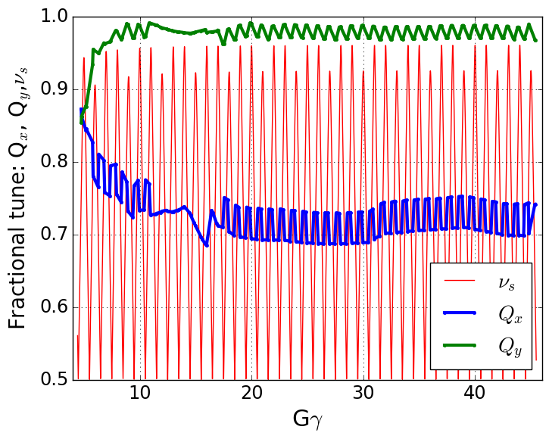
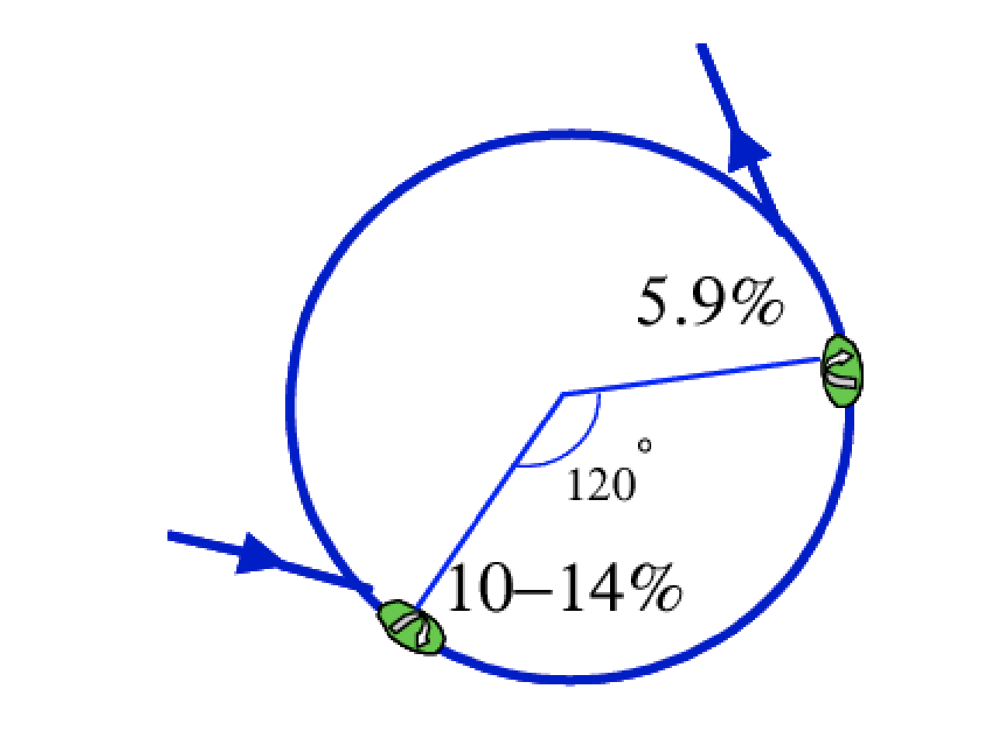
Depolarizing resonances in AGS
Frequency of particle motion in the focusing magnets is (mostly) ENERGY INDEPENDENT
Precession frequency of spin motion is in general ENERGY DEPENDENT
If particle sample fields with a frequency equal to the spin precession frequency: spin motion
“Snakes”, helical dipoles, help manipulate the spin motion with local rotations to avoid that condition (at the cost of complicated fields/optics distortion)
Spin tune gap
Hor resonance crossings
Tune
jump
(pause tune jump near transition)
Extraction
Injection

Slide 9
Depolarizing resonances in AGS
VERTICAL resonances are stronger and are completely avoided by the snakes + high vertical tune (or are they?....)
Spin tune gap
Hor resonance crossings
HORIZONTAL resonances are still active, most recent efforts focus on improving these weak but numerous resonances
Tune
jump

Slide 10
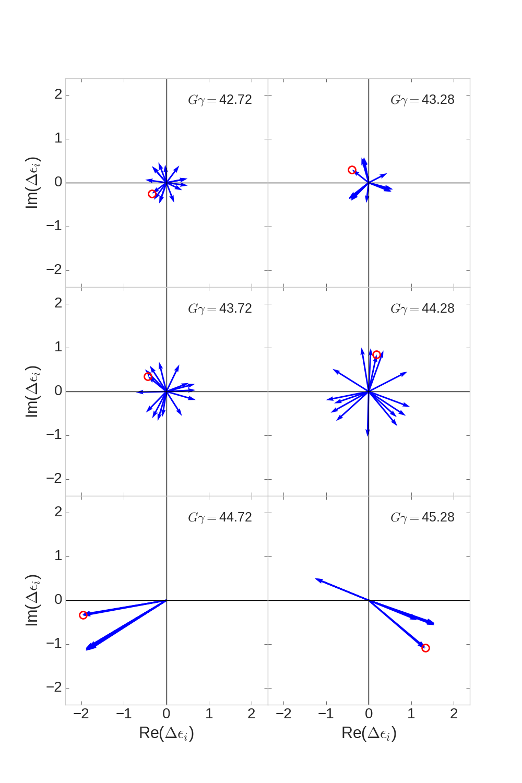
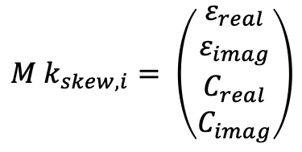
Partial snake resonance suppression with betatron coupling
Skew quad correction vectors (last six hor resonances)
In principle minimizing resonance strength (calculated with SPRINT) and coupling (two complex numbers) takes 4 skew quads
$$M k_{skew,i}= \left(\begin{matrix}ε_{real} \\ ε_{imag} \\ C_{real} \\ C_{imag}\end{matrix}\right)$$
BUT:
There are 82 such linear algebra problems to solve
AND:
Phasing between skew quadrupole terms and snake terms varies wildly resonance to resonance
AND:
Correction vectors are frequently parallel, especially near strong vertical intrinsic resonances
We have 15 skew quad ‘knobs’ to form independent corrections at each energy
Phase offset chosen so that snake drive term is purely real
Red circle marks the same skew quad in each frame, phase changes rapidly from resonance to resonance

Slide 11
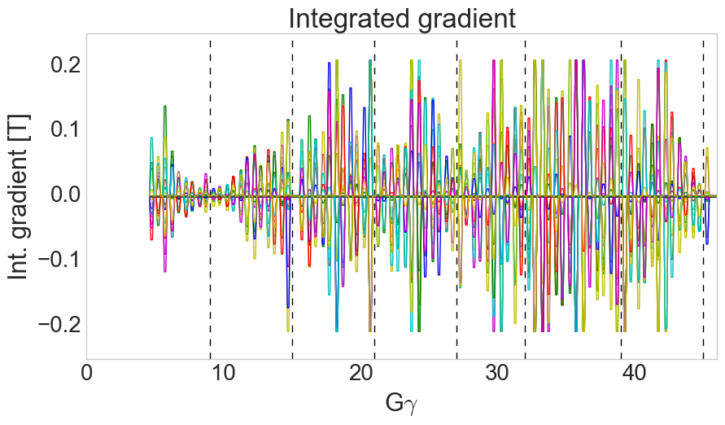
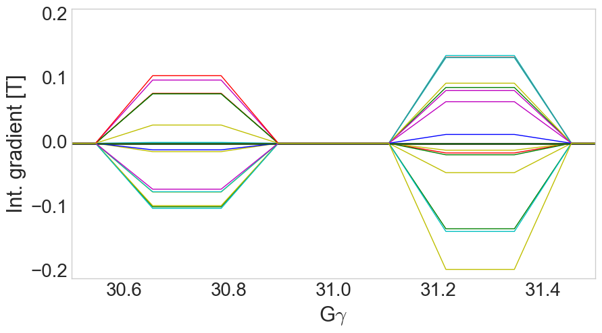
Calculated correction waveforms
Pulsing the skew quads with 1 ms rise, 1.3 ms flattop and 1 ms fall allows changing currents quickly to accommodate new correction vectors every resonance
Also avoids having skew fields during strong vertical intrinsics (tracking showed small polarization losses at these with skew quads powered)
Calculated resonance strength reducible to zero at almost every resonance
Tune shift from coupling < 0.005
Each trace= 1 skew quad
1.0 ms
1.3 ms
1.0 ms
11

Slide 12
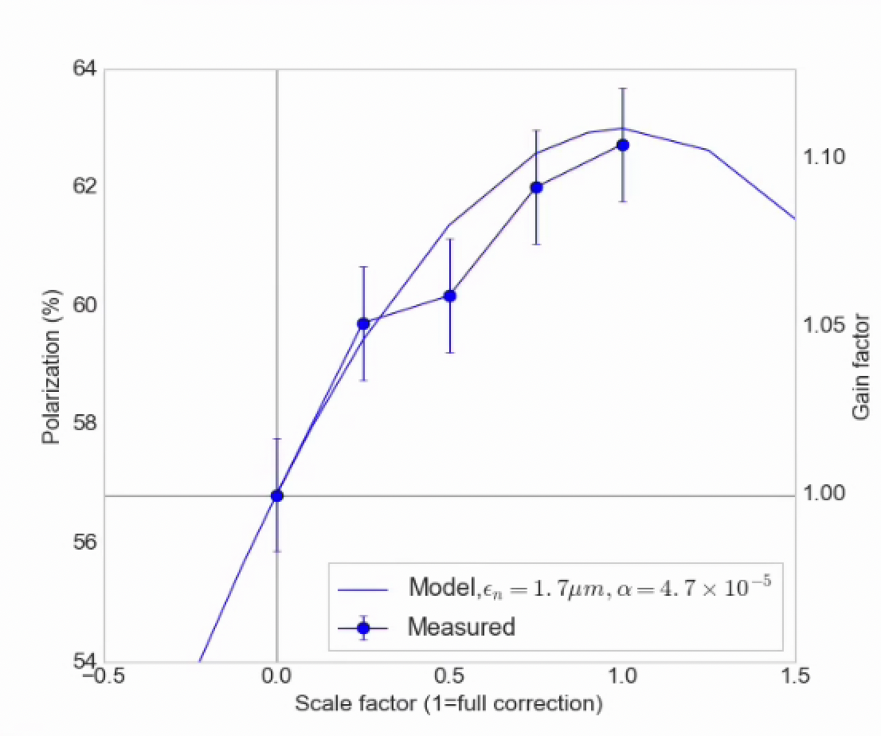
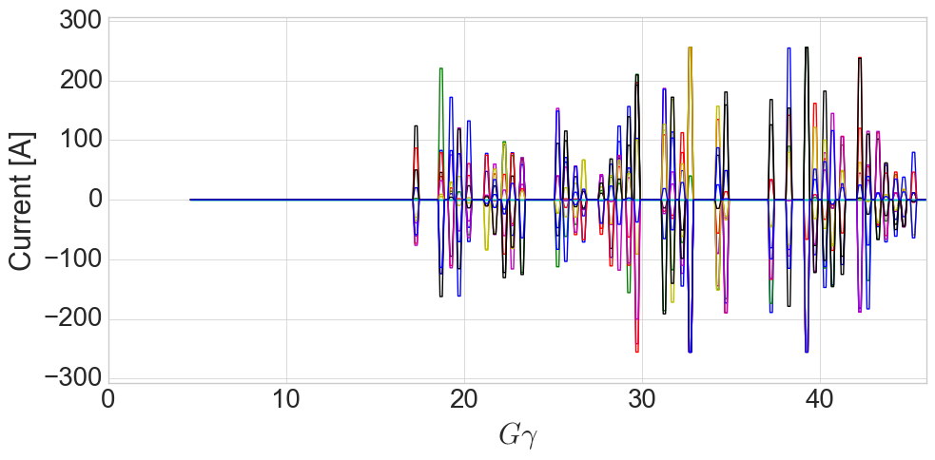
Ramp implementation and Polarization
Early attempts:
High energy pulses only (avoids difficult low energy optics)
Omitting several pulses with too large orbit excursions
Within statistical error of model in terms of gain factor over uncorrected polarization
Correcting only resonance above transition
Skew quad current
Each trace= 1 skew quad

Slide 13
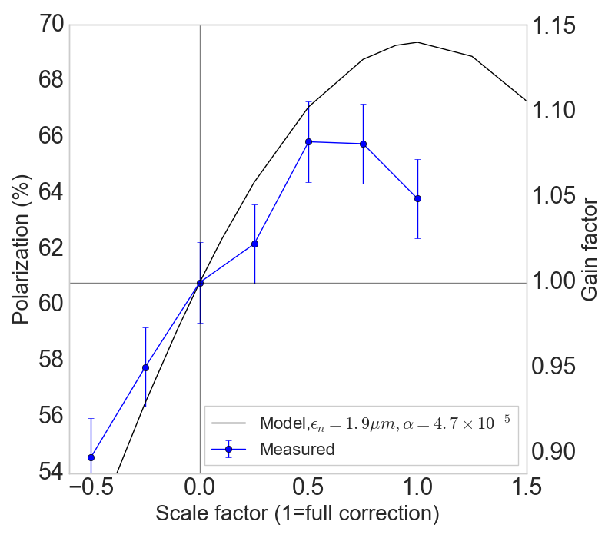
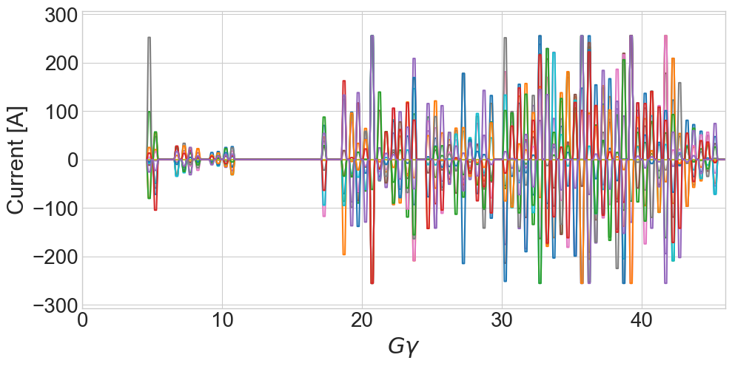
Low energy resonance correction
Correcting scaling, full cycle
Benefit from low energy pulses (GƔ < 15) expected to be ~3-4%
Measured benefit ~1%
In some cases negative, less reliable correction
Orb correction also enables broader scans
Skew quad currents
Intentionally omit
Near transition
Each trace= 1 skew quad

Slide 14
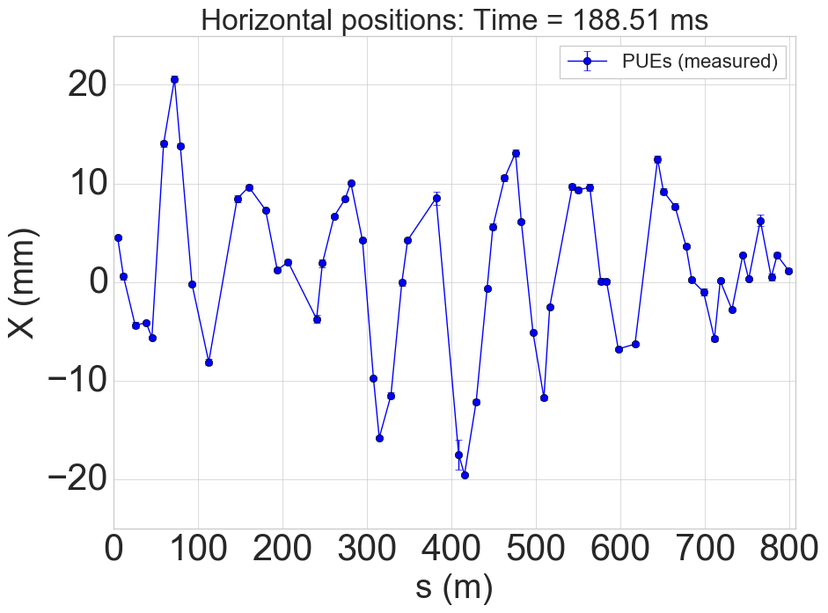
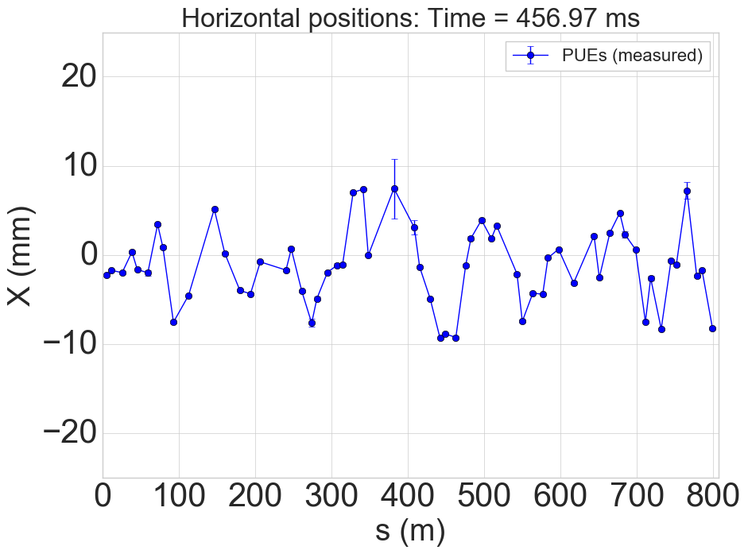
What’s wrong with low energy?
Sample horizontal orbits (at BPMs)
Model error is highest at low energy
Snakes
Orbit feed-down effects
Huge orbit excursions (+/- 2 cm, non-negligible sextupoles)
Not that great at higher energy (+/- 1 cm)
Q_{x} closer to Q_{y}: residual coupling from errors will change the drive term addressed by the skew quads
Near GƔ = 9 =0+Q_{y}, very small correction strengths required
Implies structurally easy to provoke a strong resonance
Low energy (ɣ=5)
High energy (ɣ=25)
Tunes
Correction currents

Slide 15
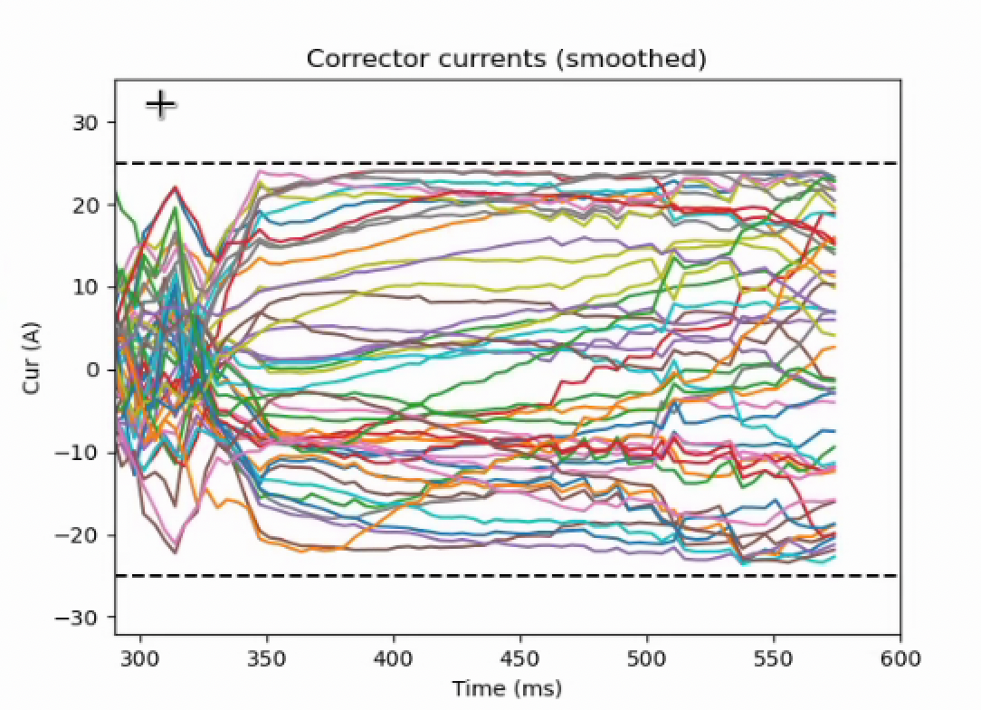
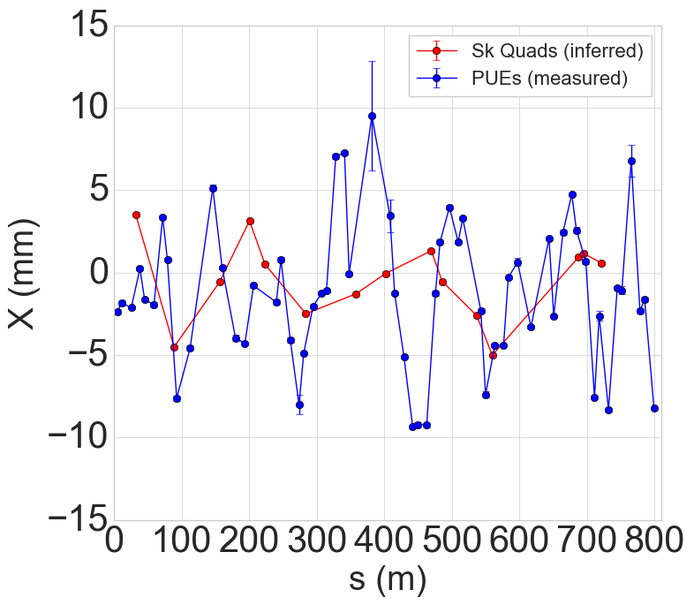
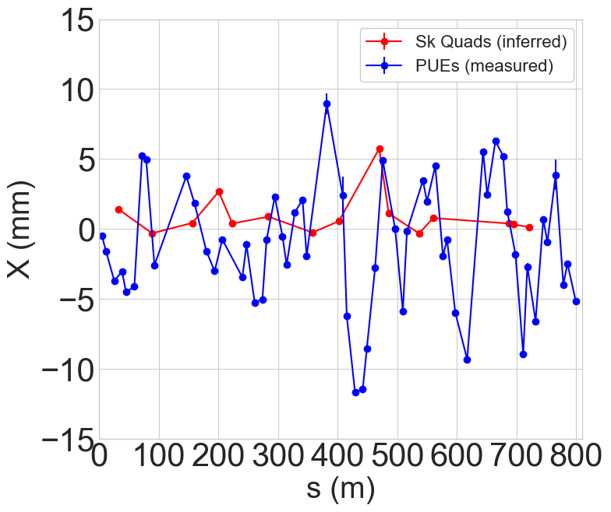
Orbit effects
AGS Hor Orbit Corrector Currents
NO ROUTINE GENERALIZED ORBIT CORRECTION IN AGS OR BOOSTER
Centering using orbit steerers accomplished to <2 mm at 13 of 15 locations
Correction objective only at skew quad locations
Outliers at C20 and G20: too demanding on orbit correctors (omitted from most corrections)
Global orbit (at BPMs) not significantly better
Before correction
After correction
Correction in the model above 99% still possible without C,G20
Survey measurement completed last year Magnet realignment planned for long shutdown after end of RHIC run
Discussing adding correctors, upgrading existing correctors
G20
C20

Slide 16
Orbit effects
Targeted correction implemented in Run 24
ONLY horizontal
ONLY to center in skew quads (insufficient strength for global correction
ONLY at mid-to-high energies
Avoided model complications at low energy
Operational difficulty defining and moving to a ‘design’ orbit
Horizontal orbit offsets cause
beam loss during skew quad pulses
beta-beat from sextupoles
VERTICAL excursions in sextupoles lead to additional unknown horizontal resonance terms from coupling
Not at all accounted for in the correction
Spin esonance drive from feed-down is energy dependent
(i.e. some resonances might be untouched, others could be highly reinforced

Slide 17
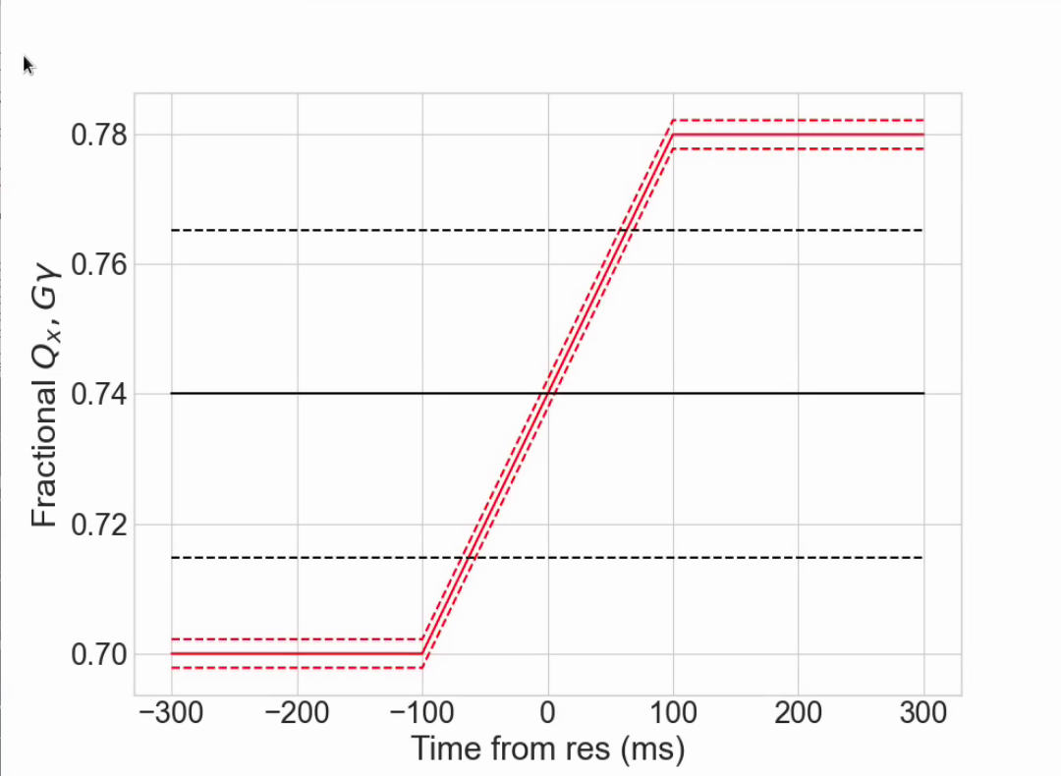
Single resonance crossing, high energy
At nominal acceleration rate (dGɣ/dθ =4.7 x 10⁻⁵), max polarization loss from a single resonance is 0.1-0.5%
too small to to measure individually
Configure a crossing at fixed energy: just above nominal extraction, with ramped horizontal tune and very slow ramp rate (>100x longer)
Resonance crossing
Parameter | Value
Gɣ | 45.74
dp/p (full base) | 1x10⁻³
Chrom ξ_{x} | 4
ΔQx | 0.08
Tune ramp length [ms] | 200
Crossing rate (⍺) | 1.7 x 10⁻⁷
Slow crossing gives measurable 20-25% relative polarization loss

Slide 18
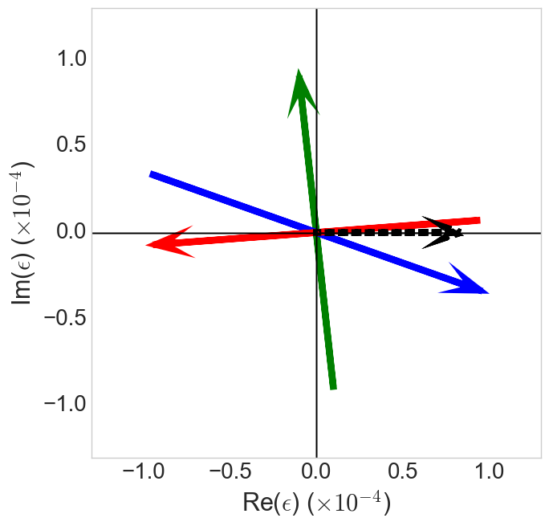
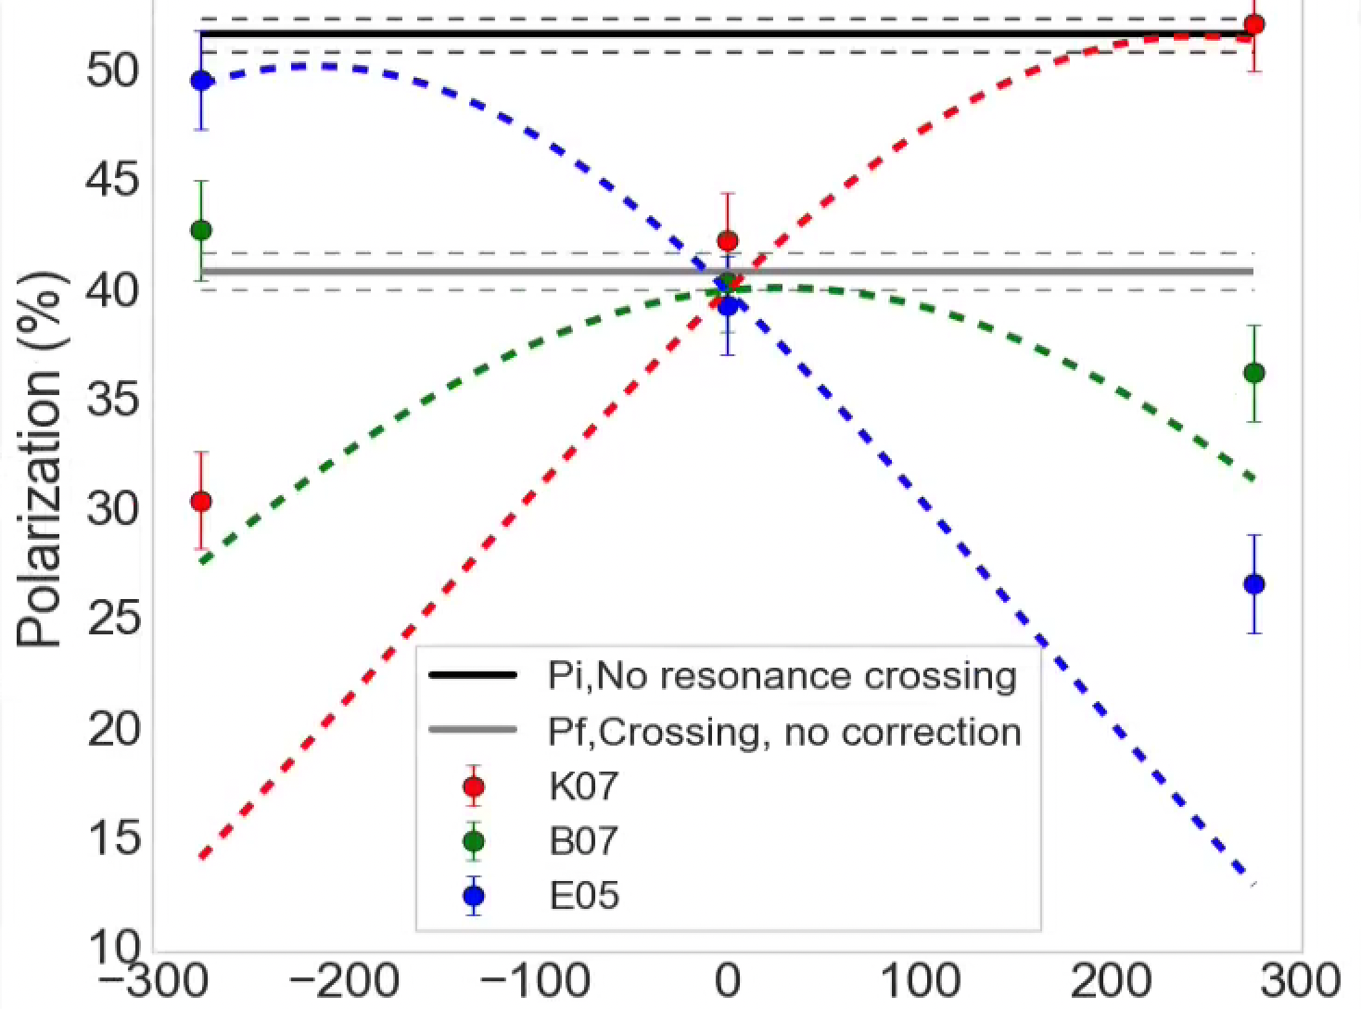
Single resonance crossing, high energy (Gɣ = 45.74)
Resonance ‘portrait’ at Gɣ = 45.74
Polarization response to skew strength
B07
P_{f}/P_{i} (uncorrected)
0.79 +/- 0.02
|ε|_{meas} = (7.9+/-0.4)x10⁻⁵
|ε|_{mod} = (7.6+/-0.5)x10⁻⁵
|ε| = Res strength
Measured uncertainty is statistical
Model uncertainty is systematic from uncertainty in emittance
Snake drive
K07
E05
Select three skew quads with good relative phasing
K07 in phase with snakes
E05 180º from K07
B07 orthogonal to snake drives
Skew quad arrow length is full current range of supply (arrow head is positive)
Skew quad current (A)
At high energy, single crossing shows GOOD AGREEMENT WITH SPRINT MODEL for small resonance strengths, worse with increasing strength
Phasing of skew quads is as expected
Correcting current is accurate
Demonstration of total correction

Slide 19
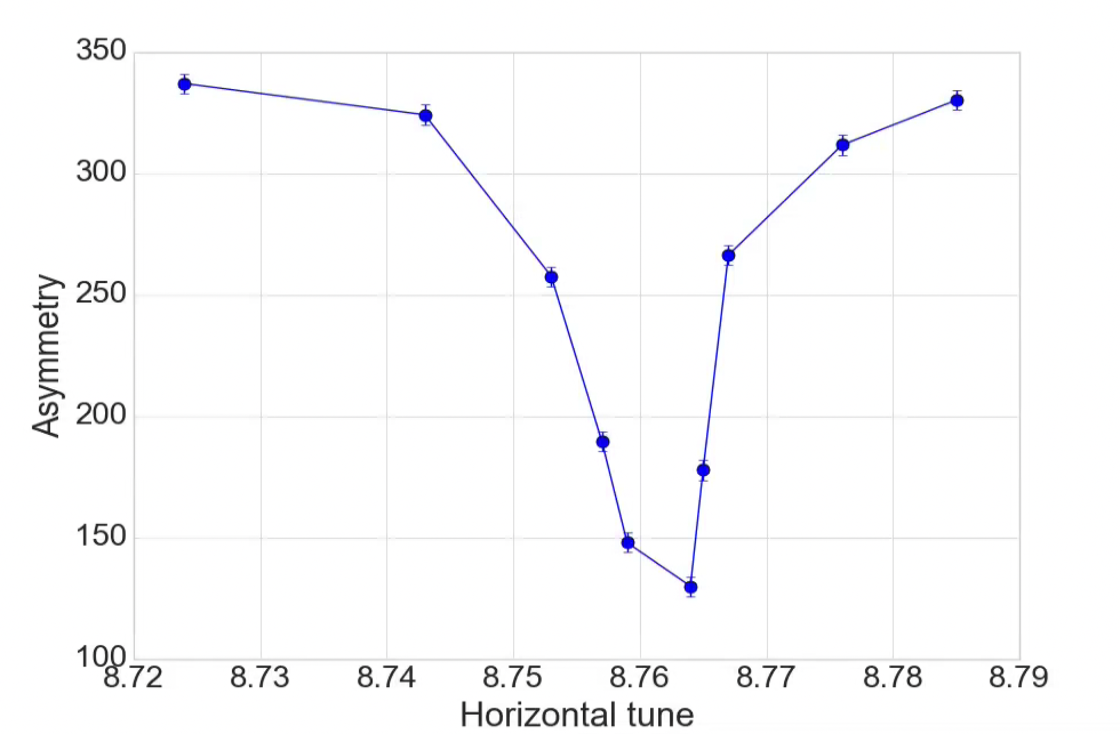
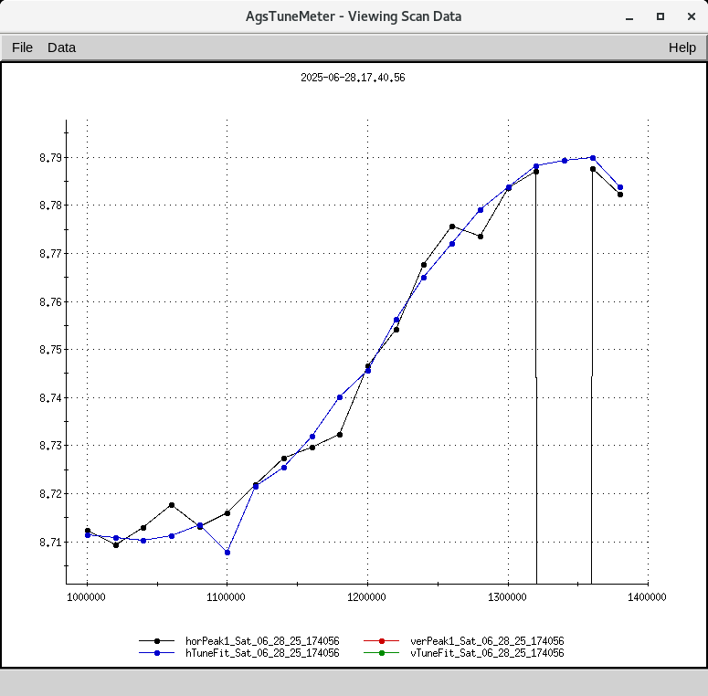
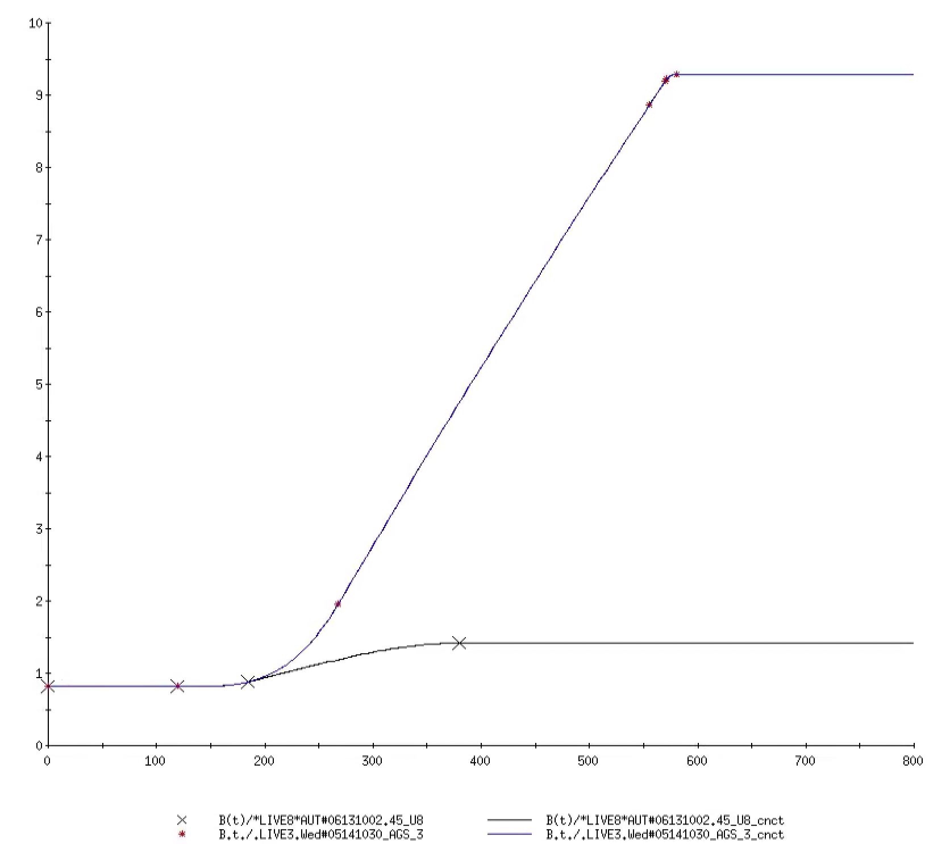
Single resonance crossing, Low energy, (Gɣ = 7.24)
Energy here chosen to be Ggamma = 7.24
BELOW first major depolarizing resonance (Ggamma = 9)
Advantage is that polarization is maintained even without snakes, so snake on/off comparisons can be made
Analyzing power of polarimeter is unknown
Results reported in terms of raw asymmetry (proportional to polarization, good for relative measurements)
Tune sweep of 0.08 units in 200 ms
GƔ=45.5
AGS MM B-field (kG)
Qx
GƔ=7.24
Time

Slide 20
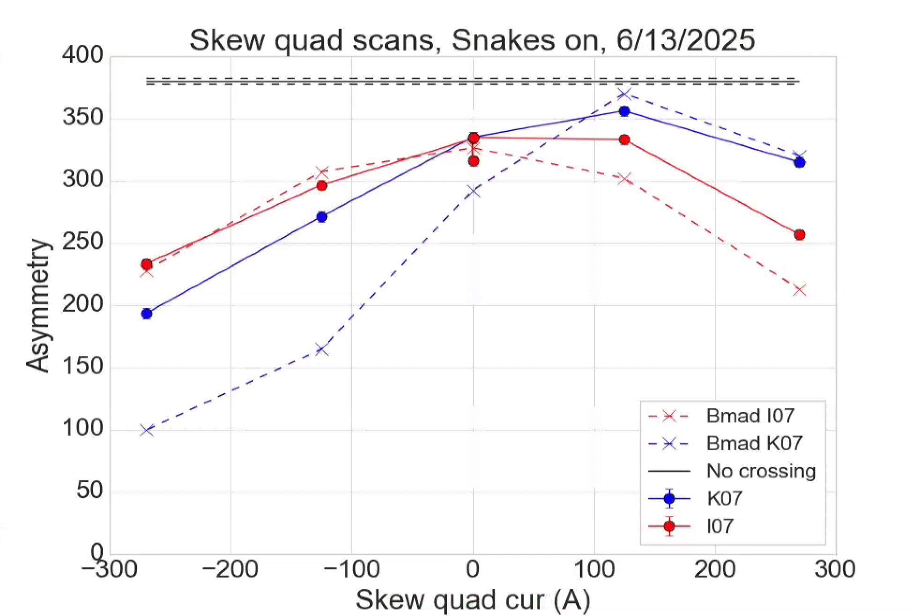
Skew quad scans, low energy, SNAKES ON
Scan two skew quad strengths expected to be:
K07 -> In phase with snake term
I07 -> out of phase with snake term
Comparison with full Bmad tracking (with idealized “flat” orbit)
Reasonably good:
Accurately predicts maxima (so the phases are well predicted)
Disagrees (for K07) when resonance drive is large
More depolarization predicted by model
Might be driven by orbit effects via feed-down
Parameter | Value
Gɣ | 7.24
ΔQx | 0.08
Tune ramp length [ms] | 200
Crossing rate (⍺) | 1.7 x 10⁻⁷
Hor emit | 2 um (rms, norm)
Long. emit | 0.5 eVs
COMPARISON WITH Bmad
Bmad = Full 6D tracking simulation of res crossing

Slide 21
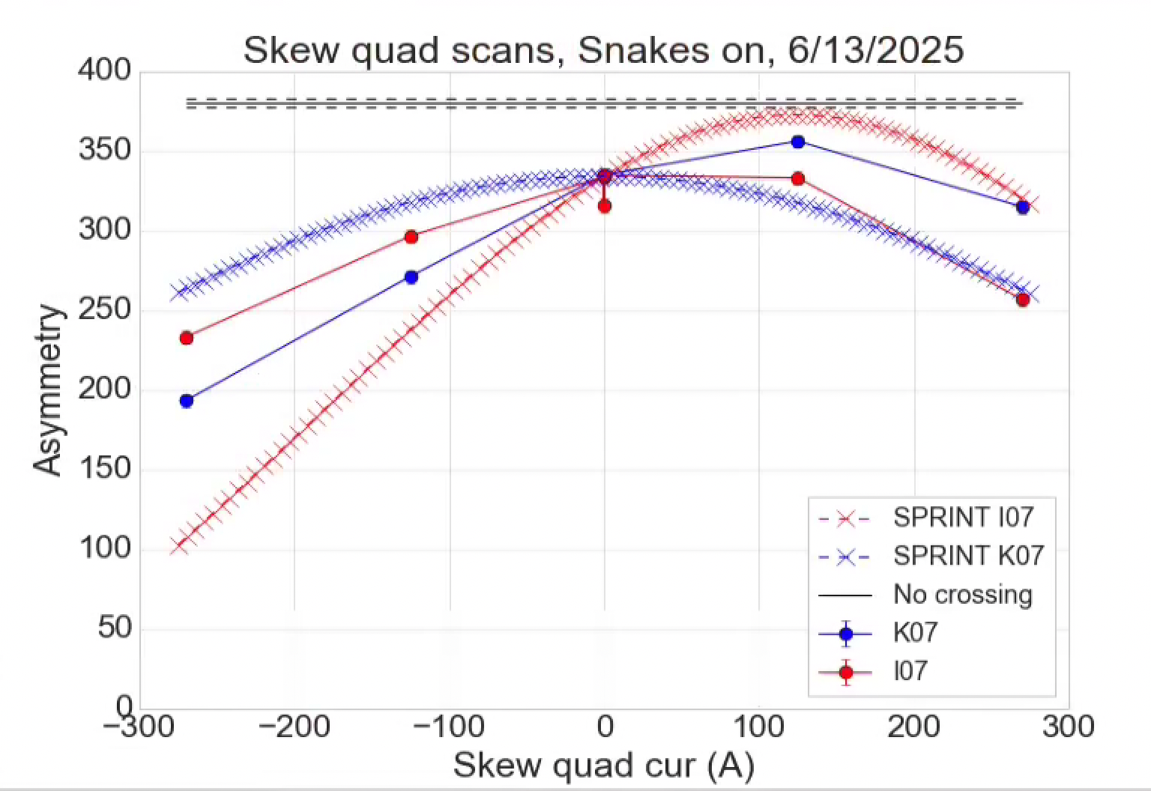
Skew quad scans, low energy, SNAKES ON
Comparison with SPRINT predictions shows basically 90° phase error
Effects of K07 and I07 look swapped
It’s the MODELs that don’t agree with each other
Bmad agrees with data
SPRINT calculation doesn’t
In SPRINT code
Absolute phase is not defined
Response matrix determined by numerical differences from small changes in each skew quad (forms the response matrix), possible this is buggy
Resonance calculation itself is probably OK
Model of snake optics implemented in SPRINT is very crude, worst at low E
COMPARISON WITH SPRINT
Heads up SPRINT-to-Bmad comparisons need to be made over full energy range (simple, single skew quad only over full energy, then snakes e.g.)
Previously only done near top energy (Bmad AGS was not mature)
SPRINT = resonance strength calculation → Froissart-Stora estimate of depolarization
21

Slide 22
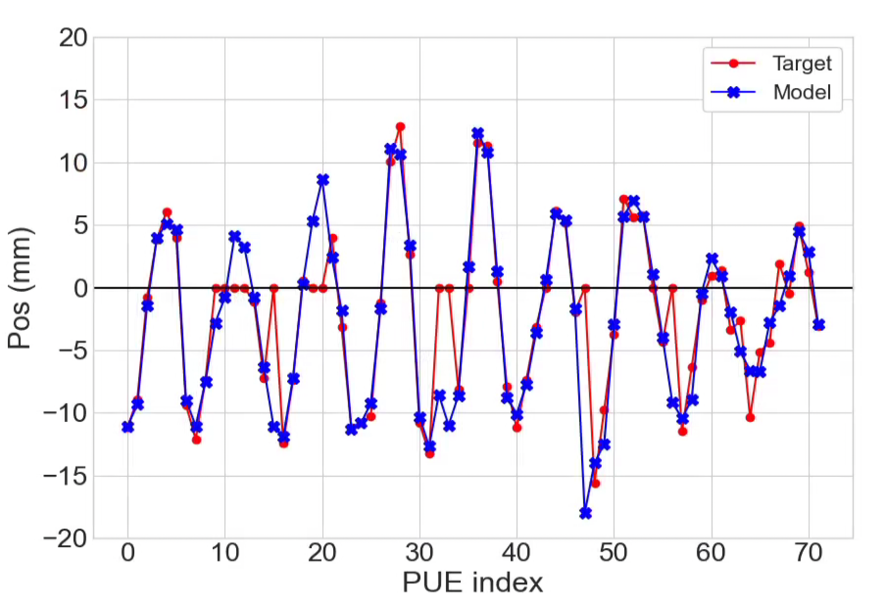
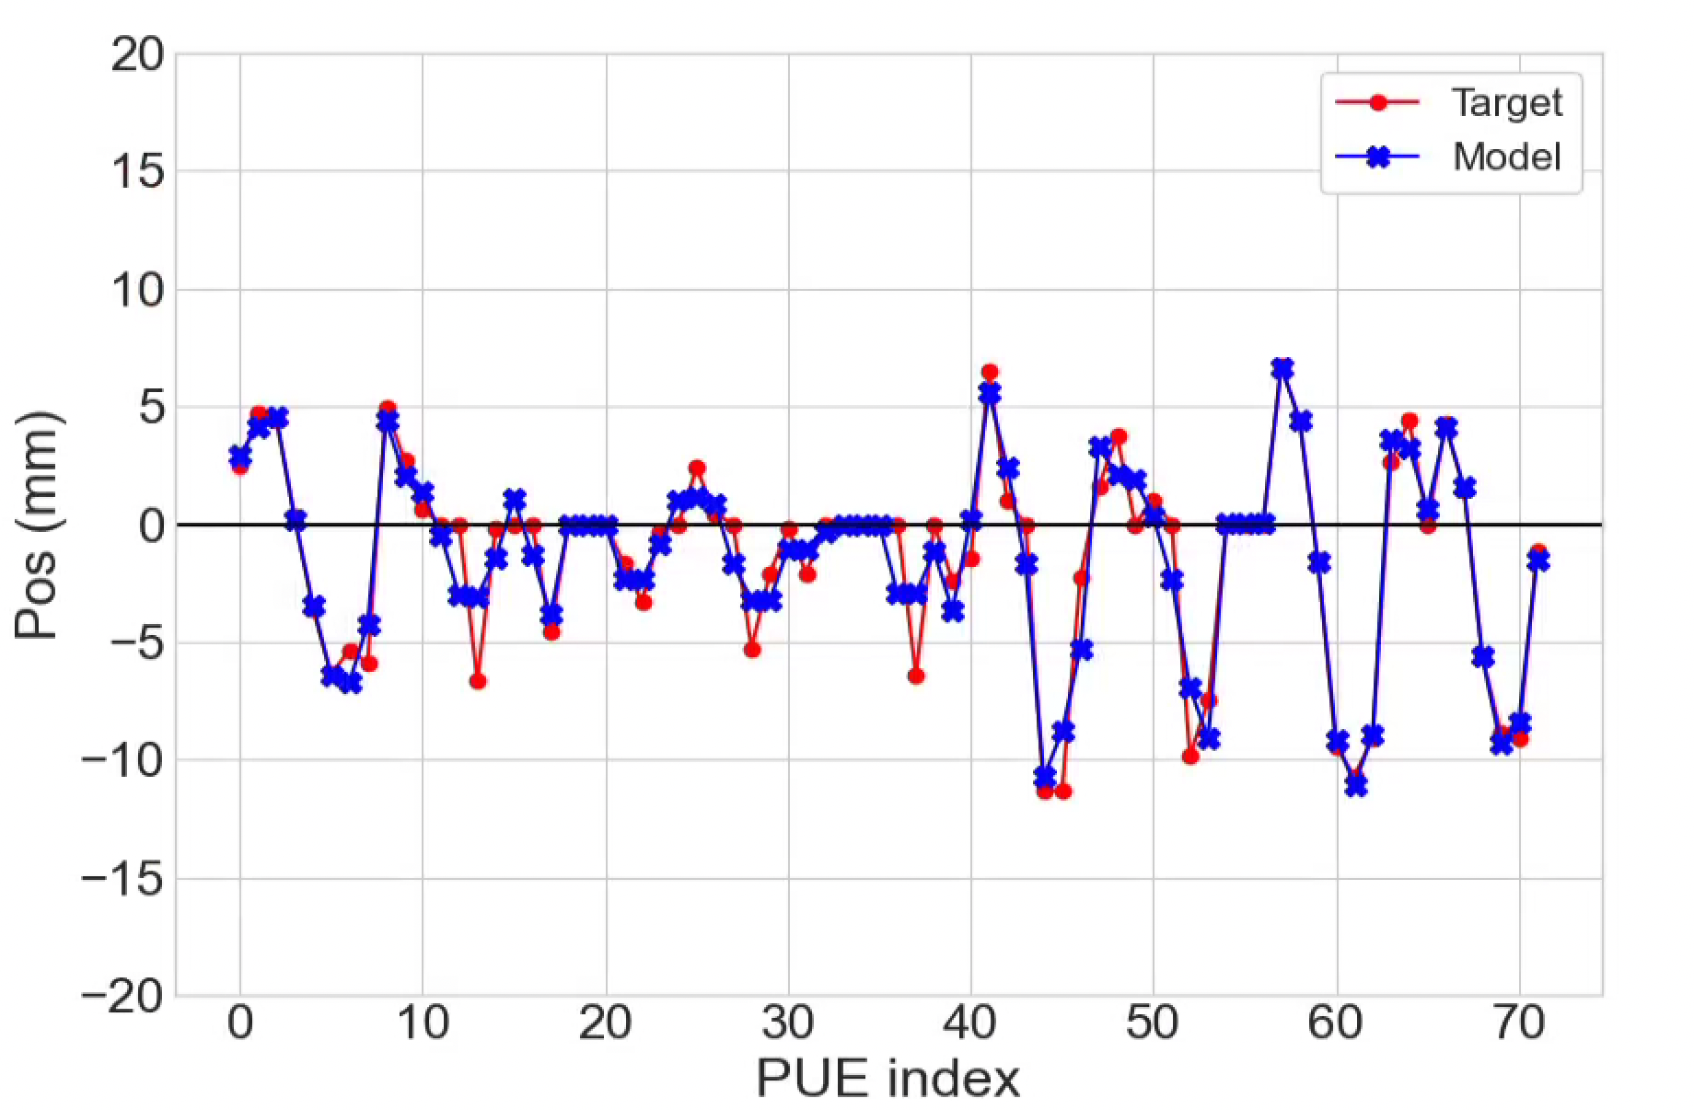
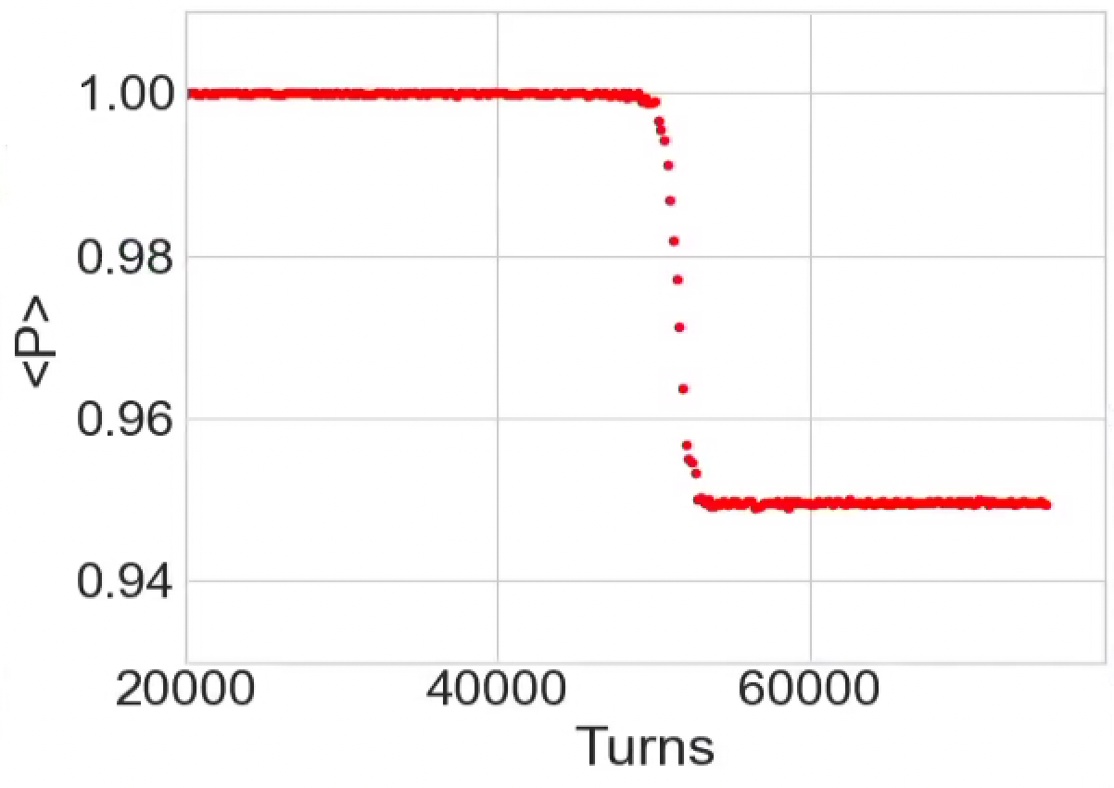
Resonance crossing without snakes
Horizontal
Vertical
Snakes off in both Bmad and AGS
Residual drive principally from sextupole feed-down of vertical orbit
Bmad closed orbit fit to realistic measured orbit using only the orbit steerers (not survey misalignments)
Operational chrom currents
H,V = (38 A, 31 A)
Model appears to accurate predict closed orbit effects (at least in the absence of snakes)
Bmad spin tracking
Measured depolarization is 4% +/- 1%
Good agreement with orbit fit model

Slide 23
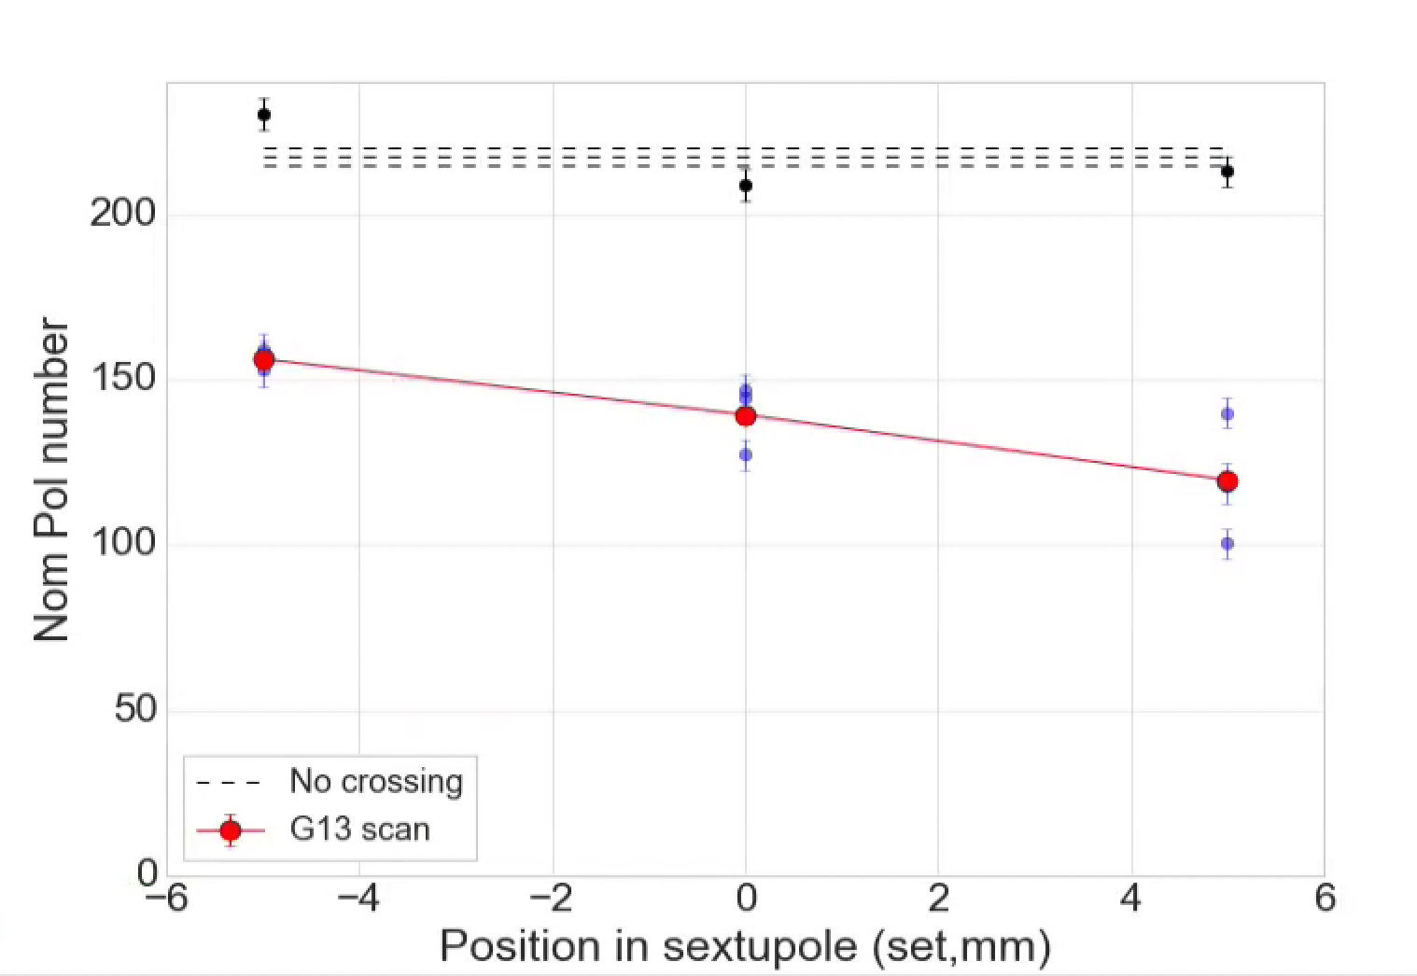
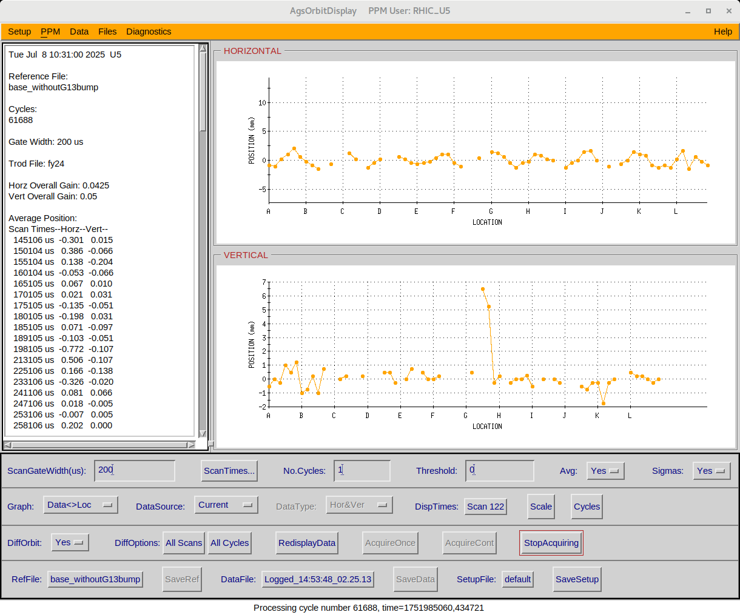
Individual sextupole offsets
Local vertical bump at location of individual sextupole shows measurable effect on the crossing efficiency
Polarization transmission gets both worse and more erratic when the drive term is made larger
Local bump at G13 sextupole, snakes are on, so change is relative to the snake drive term: +/- 5 mm range limited by p.s.
Difference orbit (local G13 bump)

Slide 24
AI, ML, Polarization and their difficulties
One polarization measurement takes ~5 minutes for a 2% precision (precision is proportional to sqrt(time of measurement)
In general polarization measured at end of ramp, after all resonances crossed
Setup of individual resonance crossings one by one is time consuming
If errors are time dependent (over days,weeks), repeated optimizations are prohibitively expensive
Direct AI/ML based attack on polarization seems unlikely
Effort could be put on attacking the elements of the problem
Orbit and optics effects (Lucy’s talk re: orbit response)
Refinement of model inputs: snake and main magnet models (Eiad’s talk)
AGS orbit, tune and chrom controls is archaic in implementation and (in the case of the orbit) insufficient to efficiently maintain a full developed polarized beam program
Ripe for digital twin effort
What to do?

Slide 25
AGS Model/Digital Twin: necessary elements
Most efforts so far have been to refine model inputs
Not a lot of effort on model infrastructure and control capability
we shouldn’t wait for a perfect model to implement control
Current model is sufficiently precise to implement orbit control: will improve model agreement just to eliminate feedown
What do we have to consider:
Implement design/trim functionality in control software of orbit/optics elements: orbit correctors, BLWs, tune and chrom supplies, snake compensation quadrupoles
Define a design orbit as a function of time in cycle: design orbit defined by BLWs (injection, snake compensation, extraction), “design” component of correctors, radial steering function
Radial steering either needs to be calibrated and included, or subtracted out (subtracted out is RHIC approach).
Complicated by diversity of controls: sometimes (x,y) pair functions, sometimes, trigger+amplitude. Gamma-jump is gauss time, not real time
Will require considerable re-tuning and re-optimization for polarized protons: present setup is accumulation of 20 years of unconstrained individual tweaks
ANY effort to improve overall control or modeling will be significantly hampered by present state of orbit control in the AGS (as evidence I offer every effort so far)

Slide 26
Parameters of an AGS Model
Red are scalar
Black are functions
“Function” = linearly interpolated (x,y) pairs except Ɣ which is combo of cubic and linear
Particle | Design Optics | Design orbit
Z | Tune quads (2) | Inj BLW (2)
A | Chrom sext (2) | Csnk BLW (3)
Ɣ | Snake quads (7) | Xtrcn BLW (2)
E₀ | Ɣ-jump quads (6) | Rad steering (1)
 | Ɣ-jump time | Correctors [design component] (up to 96=48x2 planes)
 | Helical dipoles (2)
6 scalar values
17 design optical functions
8 design orbit function + 96 correctors
Trim elements
Stop-band corrector (N-poles) ~5-10
Coupling skew quads (1)
Spin res skew quads (15)
Correctors [trim component] (up to 96=48x2 planes)
RF elements
RF voltages (12)
Harmonic table: governs changes of h in each cavity
~20 functions + 96 correctors
+ Slow extraction elements for HEET

Slide 27
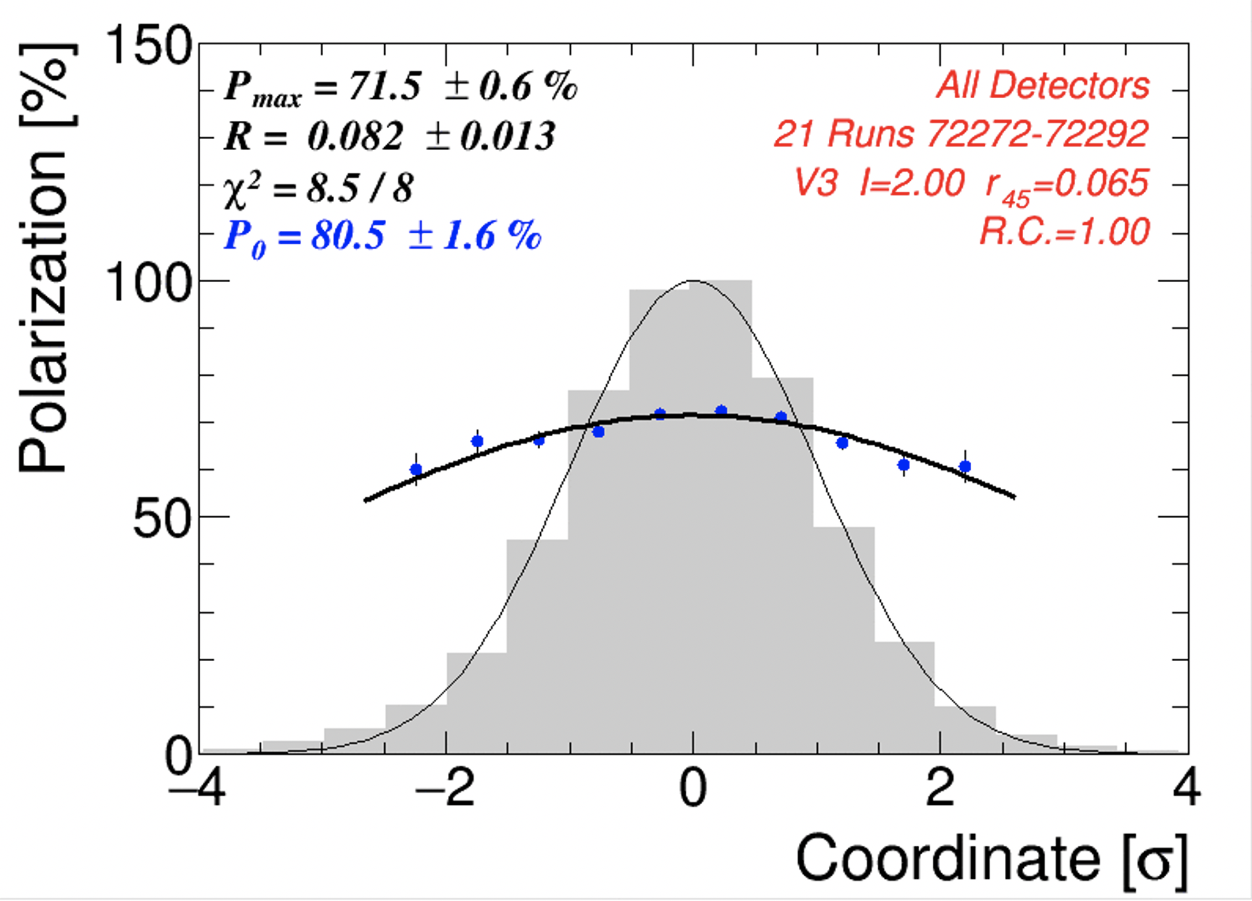
Are horizontal resonance all that’s left? (Hint: probably not)
Nominally, every vertical resonance is avoided*
These kinds of resonances produce a polarization “profile”, less polarization on the transverse outside of the beam
If they were GONE, the profile would be flat
--- it isn’t
Polarization profile
Polarization
Transverse position
Intensity profile
*the few early crossings *can* be avoided, polarization benefit too small to measure, intensity suffers

Slide 28
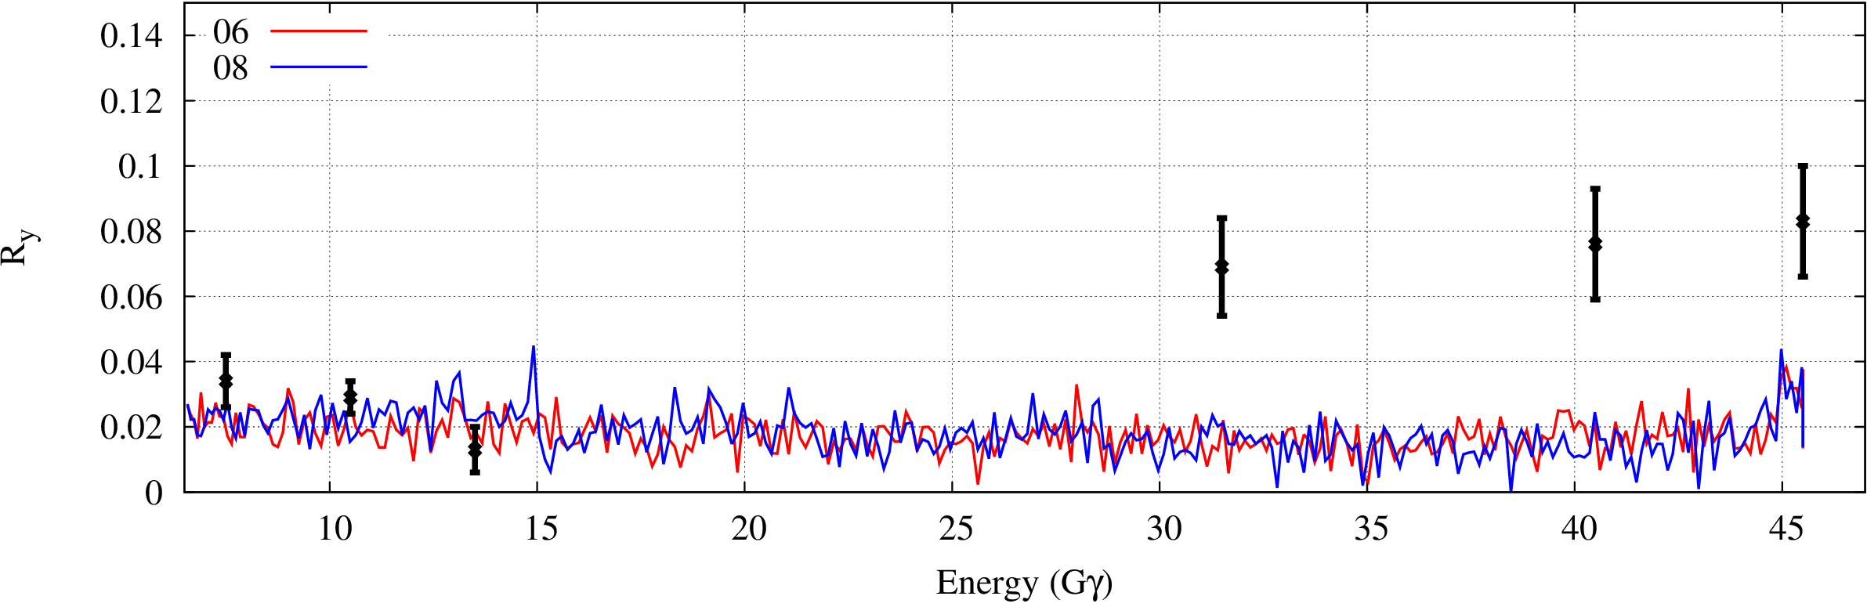
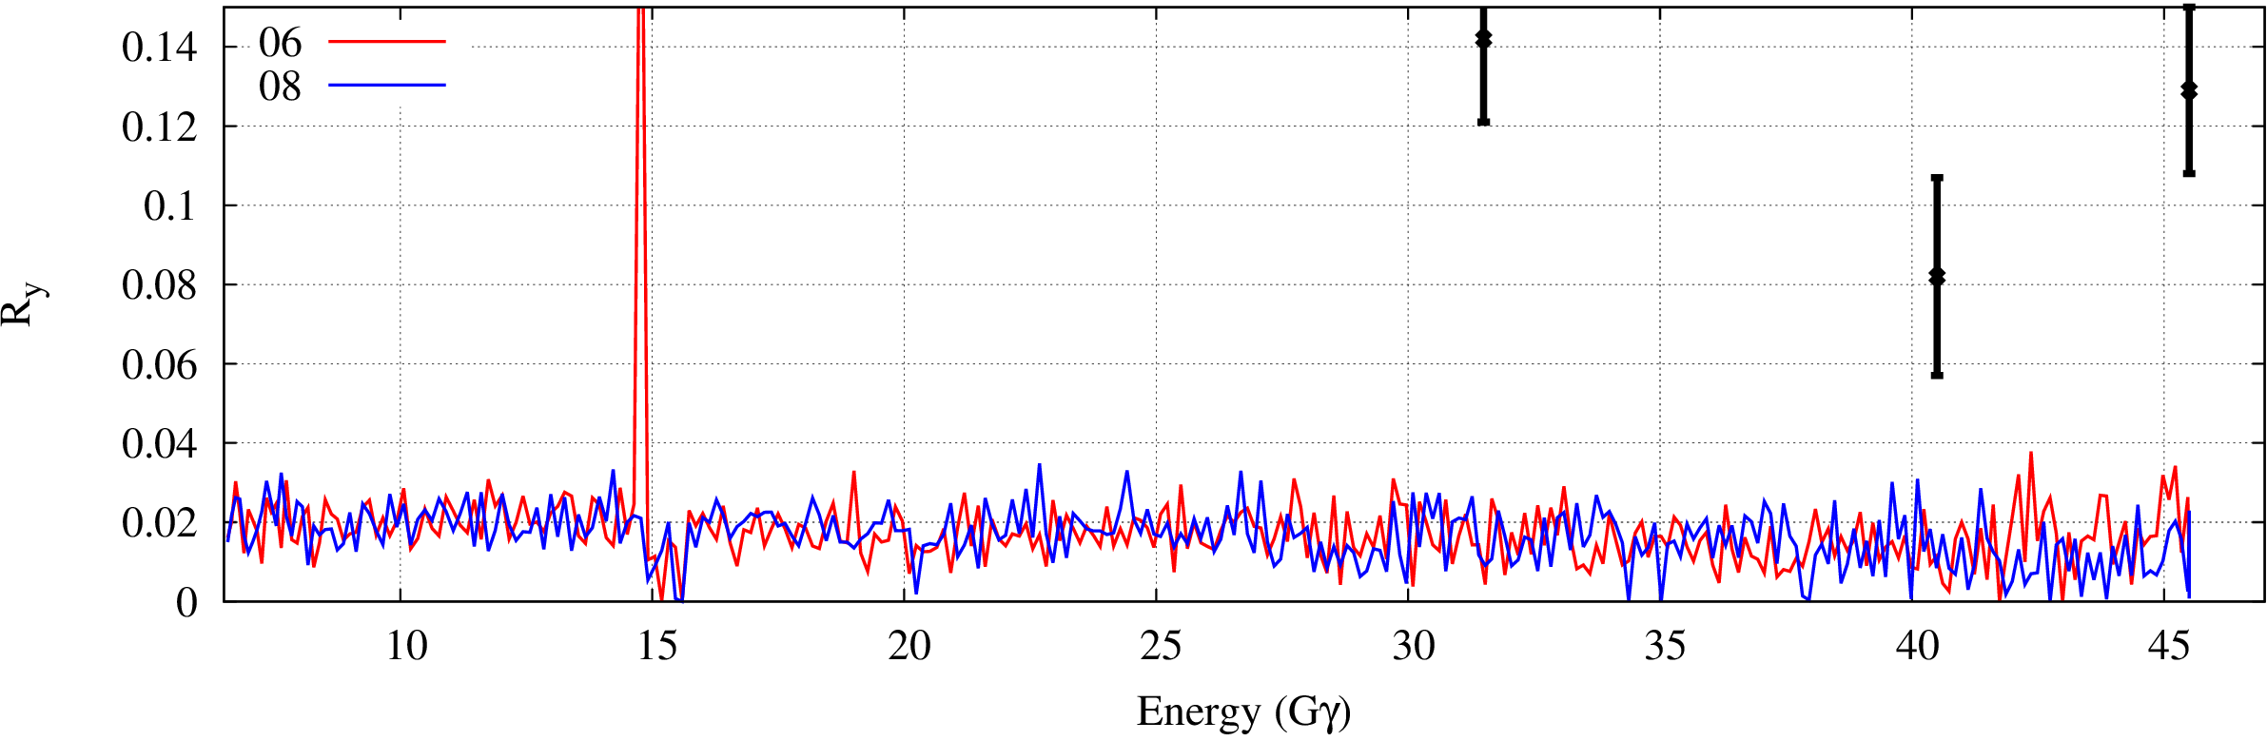
AGS Vertical Polarization Profile Comparisons
The vertical polarization profile is developed between Gγ=13.5 and 31.5, across 12+, 36- and transition.
(Simulation by Yann)
JQ on
Acceleration with purely horizontal resonances and no betatron coupling would develop ONLY a horizontal profile
Vertical profile could develop from
Uncorrected vertical resonances
Horizontal resonances + mixing of hor profile into vertical via coupling
But we don’t observe significant emittance swapping
Development of vertical profile is a totally open question
“Ry” is a measure of profile steepness: 0 = flat, no resonances
JQ off

Slide 29
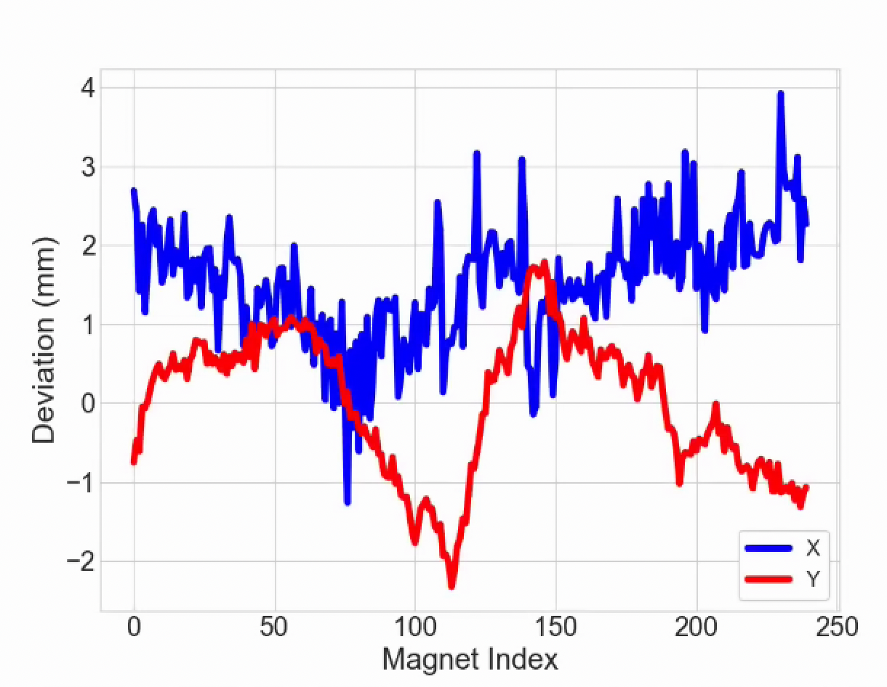
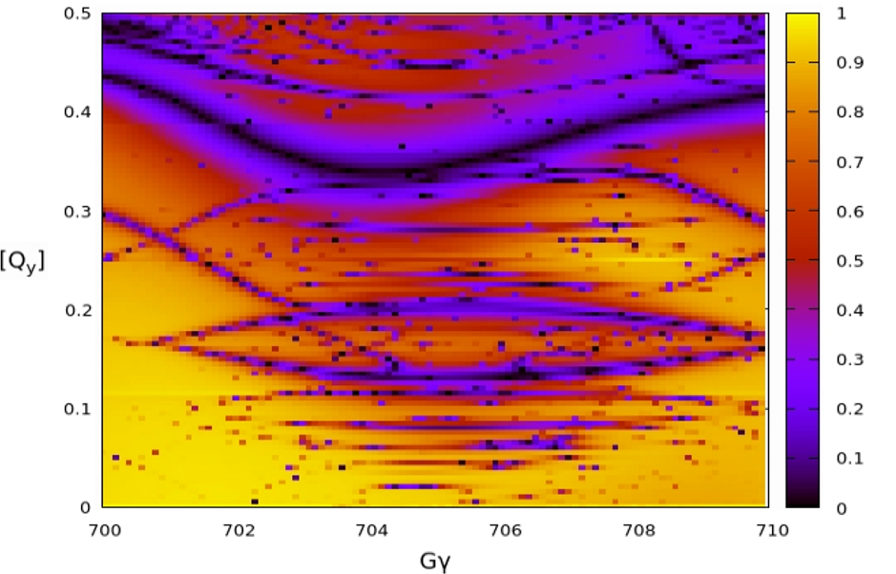
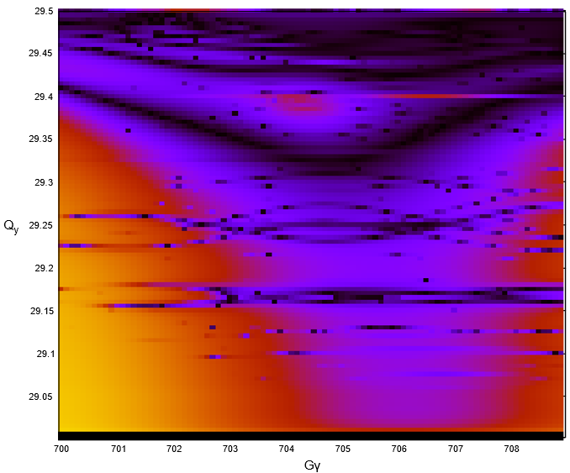
Remaining depolarization: where does it go? Misalignments?
AGS Main magnet misalignments
Resonance associated with vertical motion probably still important
AGS Magnet survey/realignment effort
all 240 AGS main magnets are combined function (dipole + quadrupole)
No global realignment since the 90’s (smaller targeted effort in 2012)
Needs simulation assessment of impact on depolarizing resonances (ongoing)
Also puts orbit closer to reach of existing (or moderately upgraded) correction magnets
Realignment planned for post Run 25
EIC HSR Lattice optimized to reduce resonance lines (³He)
Could use tools from EIC/HSR efforts
Resonance “portraits” have been useful in optimizing lattice design for HSR
Could be used to study impact of machine error on resonance structure
Q_{y}
(HSR modeling by Eiad Hamwi)

Slide 30
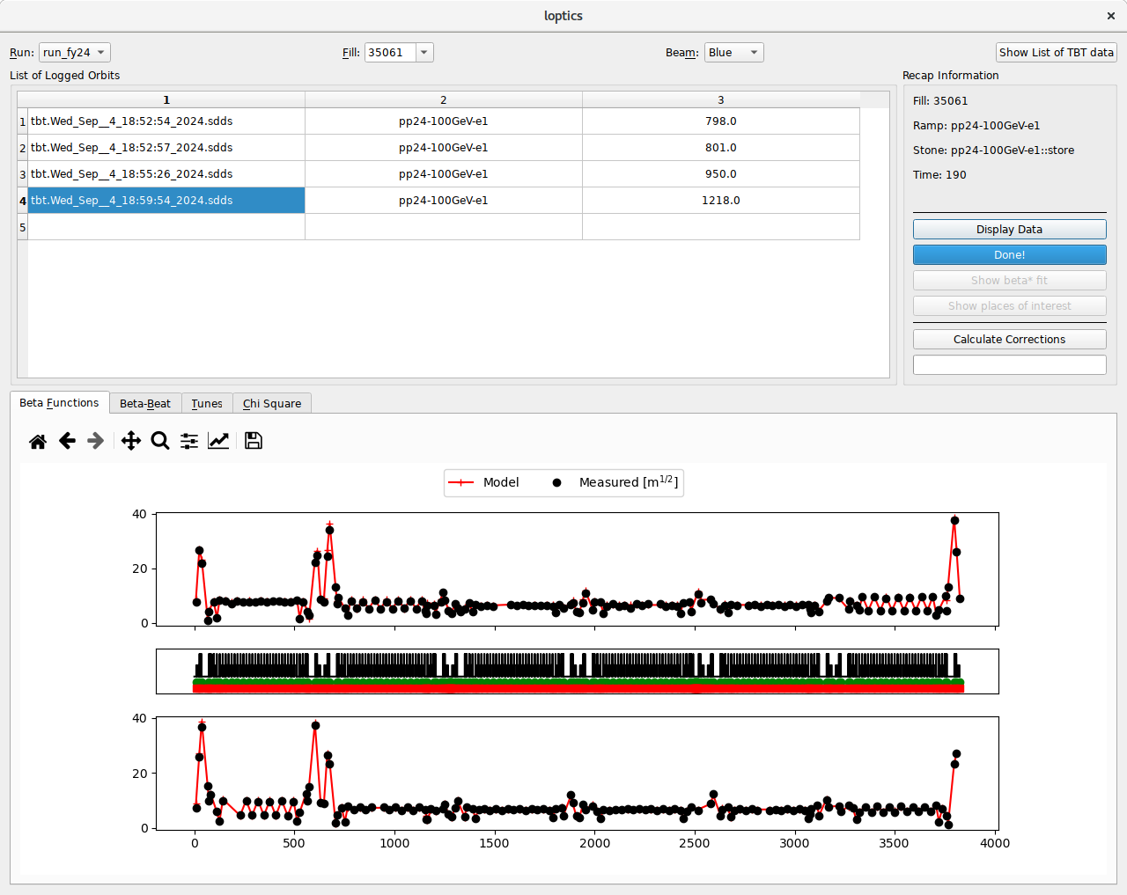
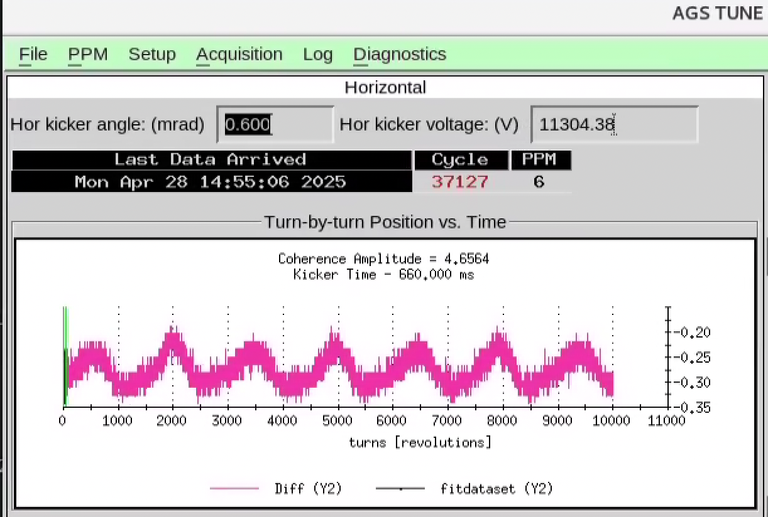
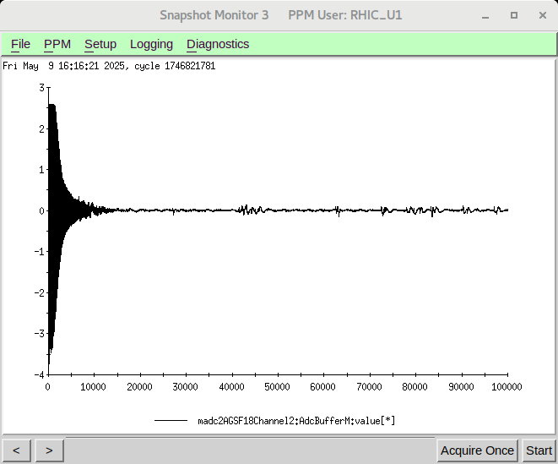
Instrumentation and Beam control upgrades
Turn-by-turn BPMs
Fast turnaround optics measurements
Driving term localization (e.g. linear coupling)
Complementary to ORM
Tune meter Baseband tune (BBQ) pickup
Much higher signal to noise
Important for horizontal precision (high chrom, low signal)
Possibility of feedback/feedforward stabilization
Used to great effect at RHIC
RHIC TBT Beta Function Measurement
Standard TBT BPM
BBQ signal

Slide 31
Brookhaven Accelerator Complex Scheduling
End of RHIC physics program nominally: Dec 2025
Possible extension of (up to) order 6-8 weeks (very ambiguous)
Extended operation all involved polarized protons in the AGS
Linac (polarized protons) become available for studies early-mid Nov (independent of RHIC run extension)
Last extended running for a while
Likely to be very tightly packed schedule (”no snake” studies are much easier to work in)
The Middle Ages (the period between RHIC shutdown and start of EIC)
NSRL operations in Booster continue as normal (study time negotiable)
AGS planned to operate (on average) two months a year
Longer operations with longer shutdowns probably preferable (4 months every 2 years, e.g).
EIC related priorities are demonstrating
polarized He-3
general polarized beam developments
Other programs proposed but not yet planned: HEET, AtR test beams

Slide 32
Summary
Remaining sources of depolarization in AGS are likely:
Incomplete correction of low energy horizontal resonances
Disagreement between Bmad and SPRINT needs followup
Not-well-understood development of vertical polarization profile
Closed orbit feed-down effects are low-hanging fruit for correction efforts
Direct removal of depolarizing drive terms (sextupole feed-down)
Simplifies every modeling effort going forward
AGS seems for implementation of Digital Twin infrastructure (at least up to the point of orbit control)

