Slide 1
NSRL Digital Twin
Lucy Lin
3rd AI/ML for EIC Hadron Pre-injectors Collaboration Meeting
Oct 20-22, 2025

Slide 2
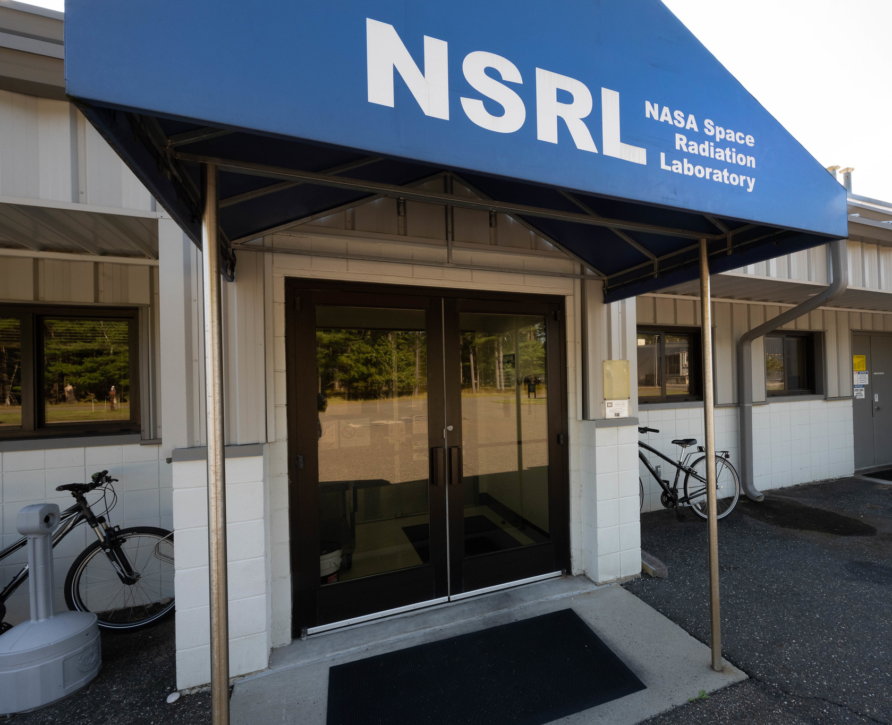
NASA Space Radiation Laboratory (NSRL)
Understanding the risks and uncertainties from the space radiation environment is crucial for NASA missions:
“In space, astronauts are exposed to ionizing radiation that is quantitatively and qualitatively different from terrestrial radiation. This environment includes protons and high-Z, high-energy (HZE) ions together with secondary radiation, including neutrons and recoil nuclei that are produced by nuclear reactions in spacecraft materials or tissue.”
- Risk of Radiation Carcinogenesis (2016)
NASA HRP Space Radiation Element

Slide 3
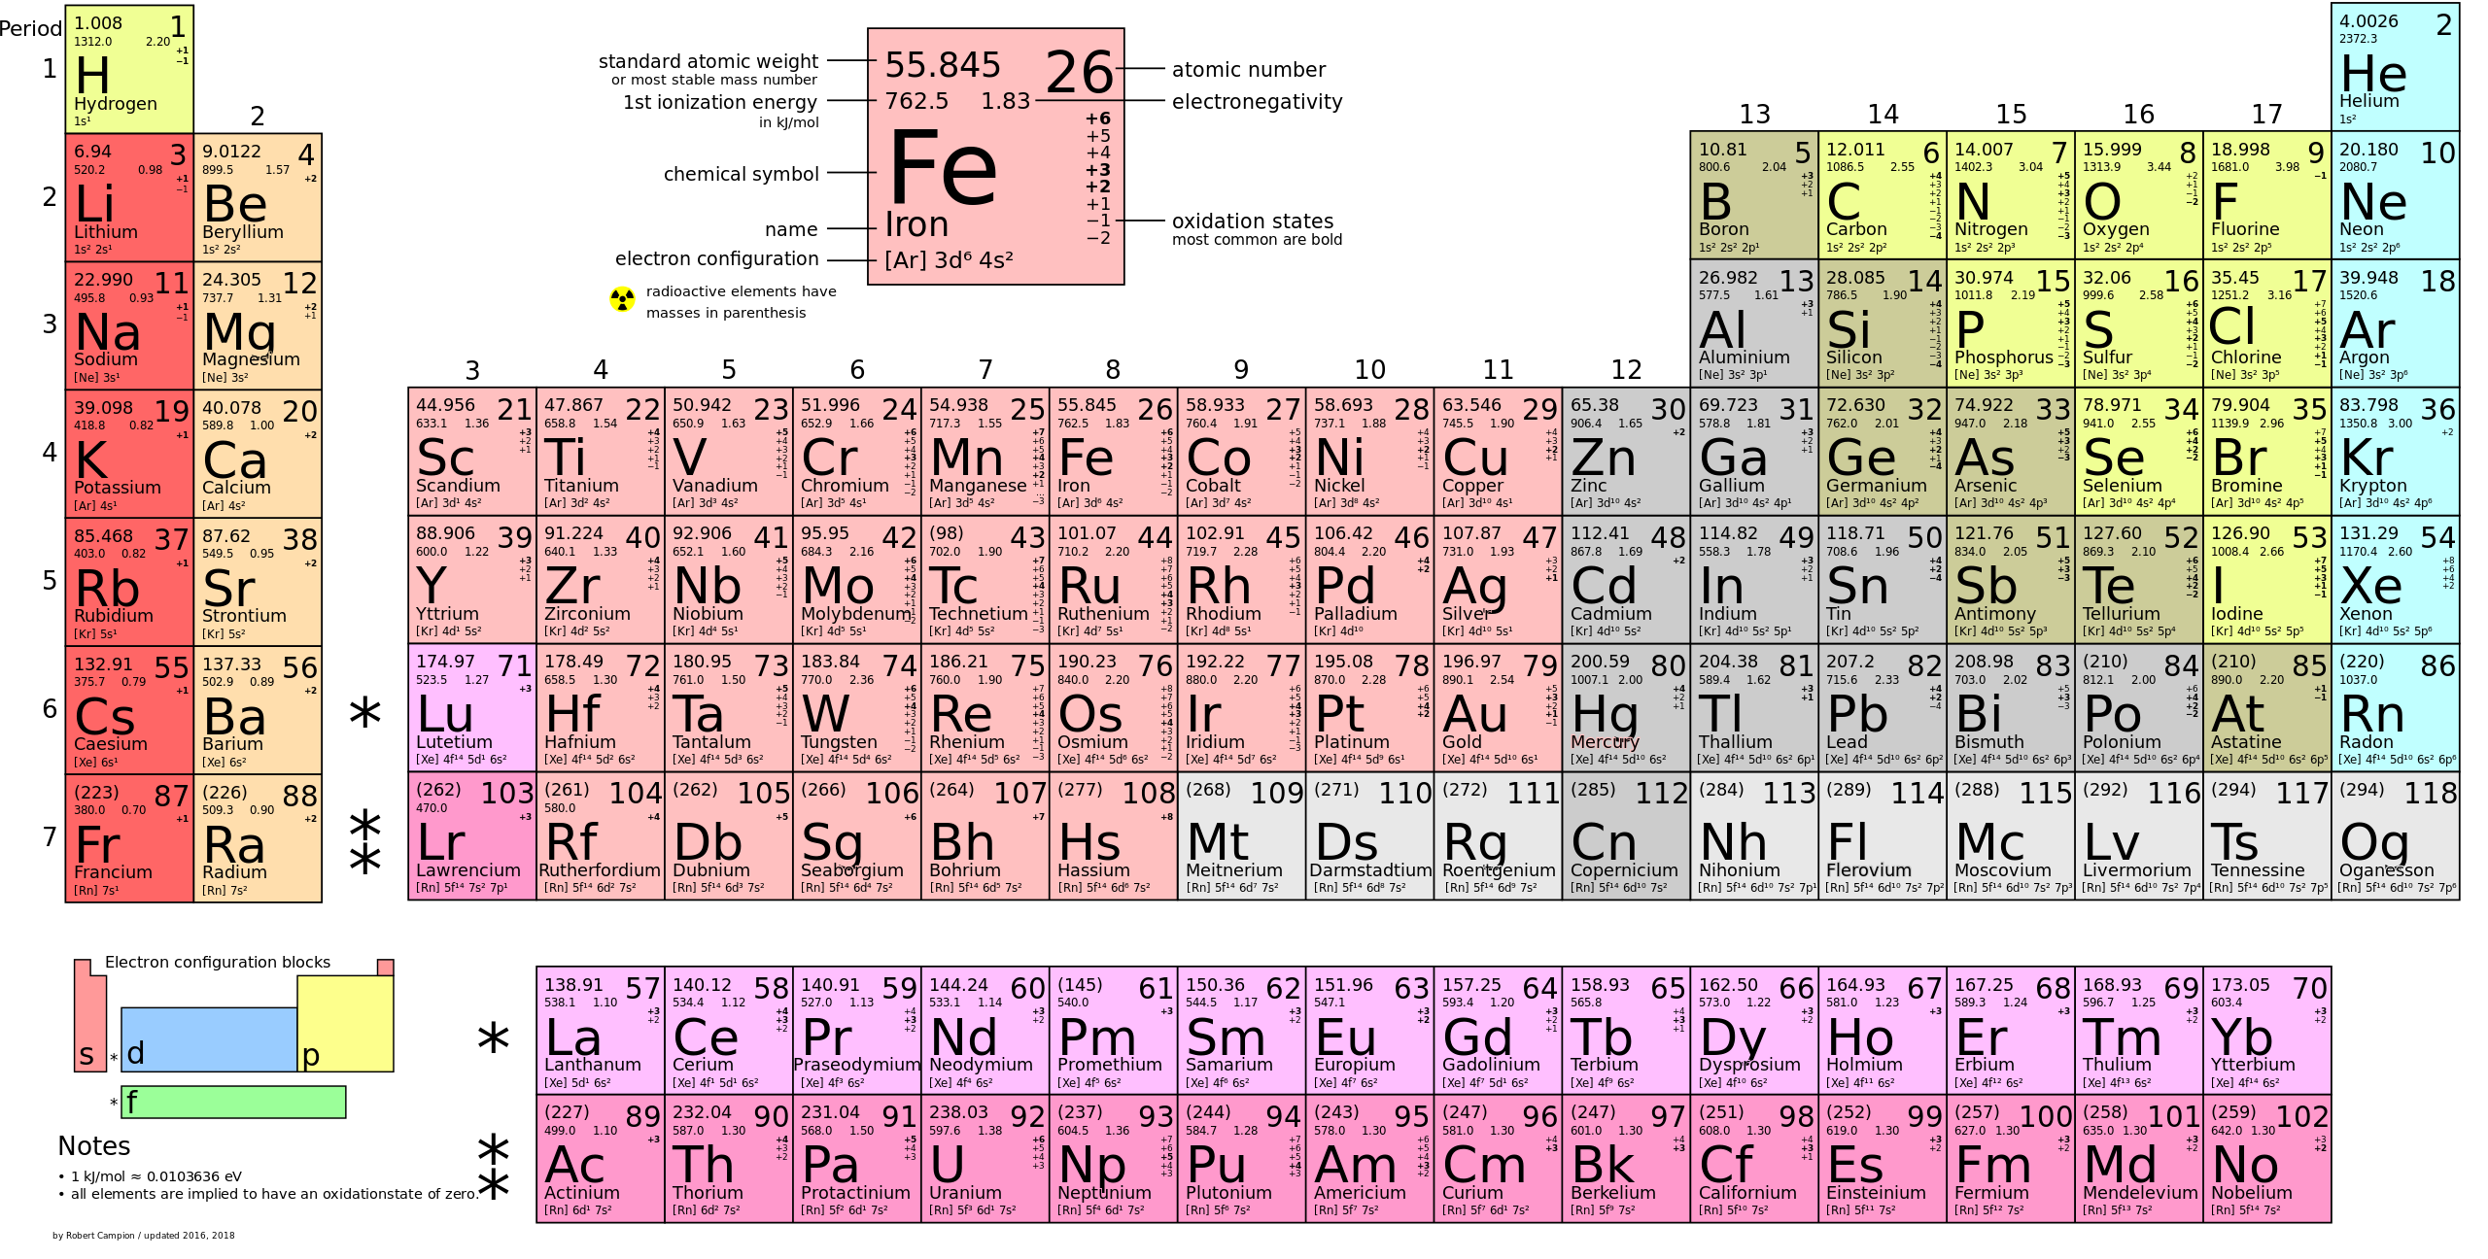
& ²H
Ions Delivered to NSRL
past & present

Slide 4
Sources & Synchrotron Complex
Target
Source machines:
Linac (proton)
EBIS (ion)
Tandem Van de Graaffs (ion)
Slow Extraction
NSRL
Booster
LtB
Linac
TtB
AGS Booster synchrotron:
Accelerate beam to KE between 50 and 2500 MeV/n
EtB
Tandem
Ebis

Slide 5
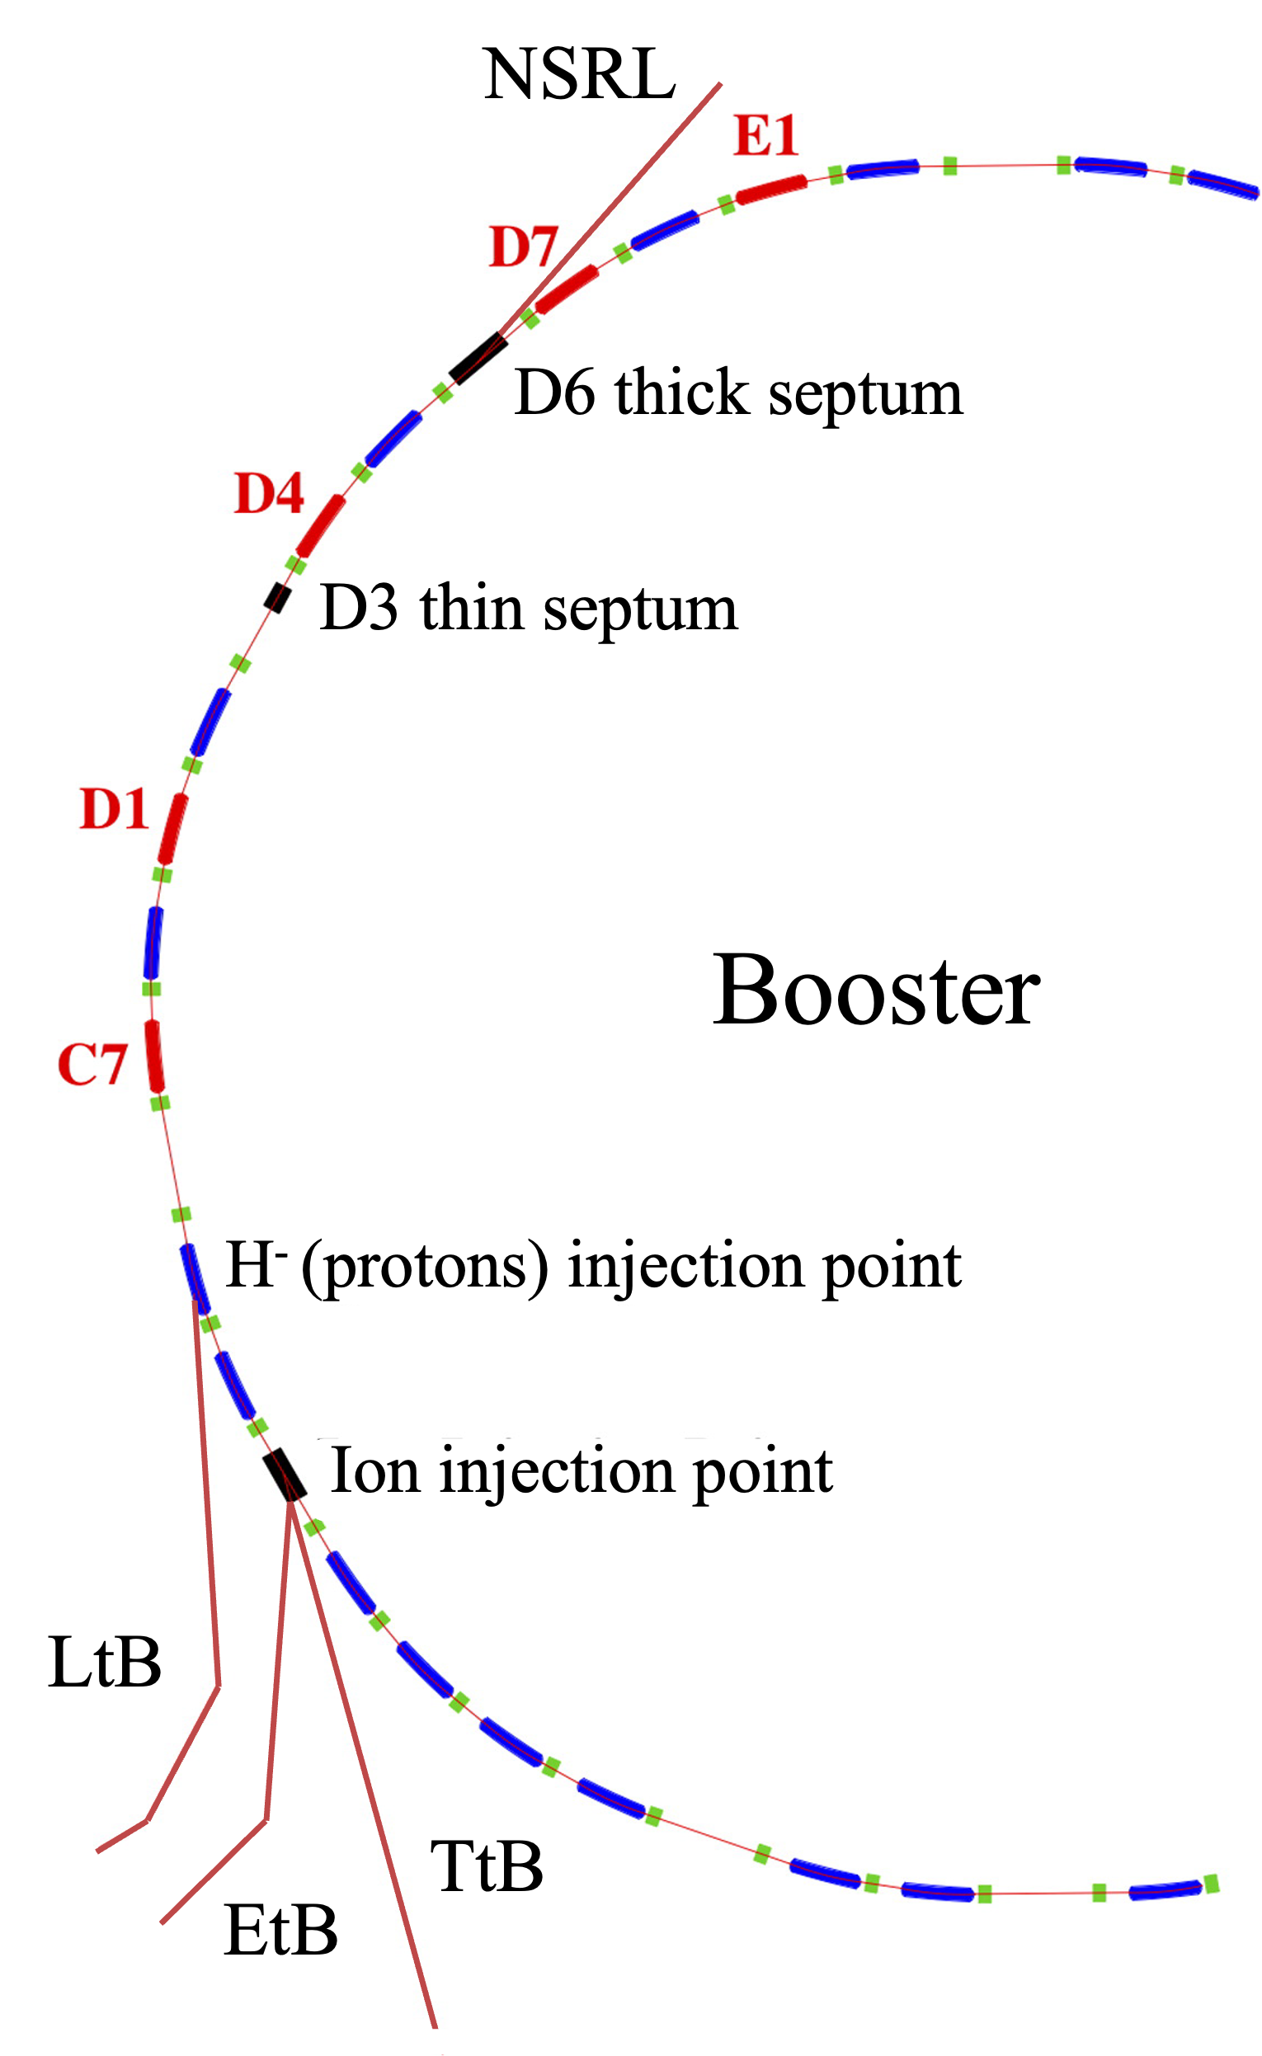
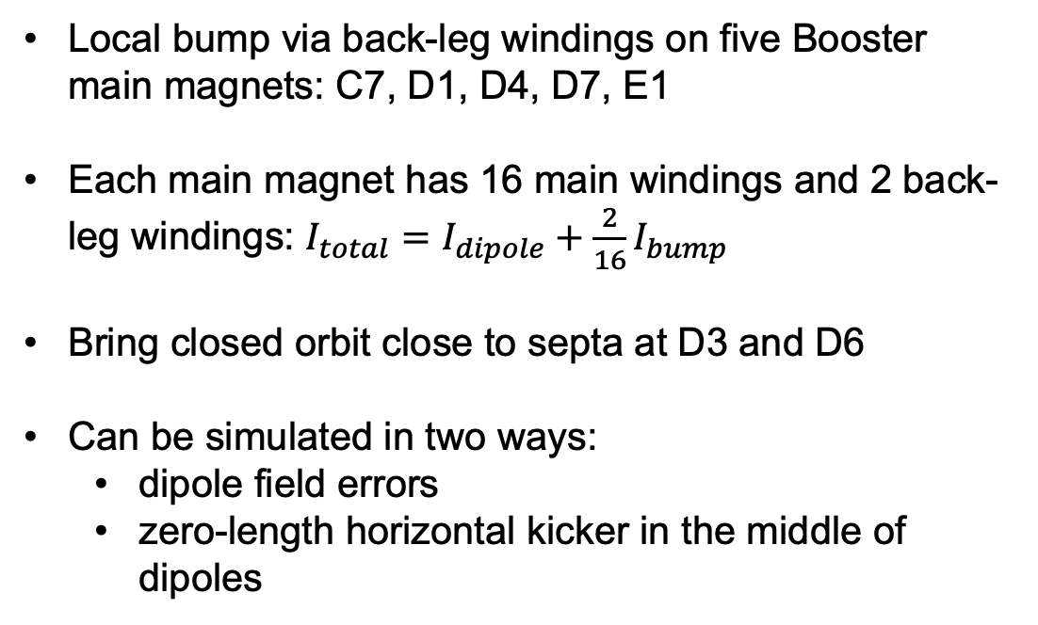
Booster extraction bump
Local bump via back-leg windings on five Booster main magnets: C7, D1, D4, D7, E1
Each main magnet has 16 main windings and 2 back-leg windings: $I_{total}=I_{dipole}+\frac{2}{16}I_{bump}$
Bring closed orbit close to septa at D3 and D6
Can be simulated in two ways:
dipole field errors
zero-length horizontal kicker in the middle of dipoles

Slide 6
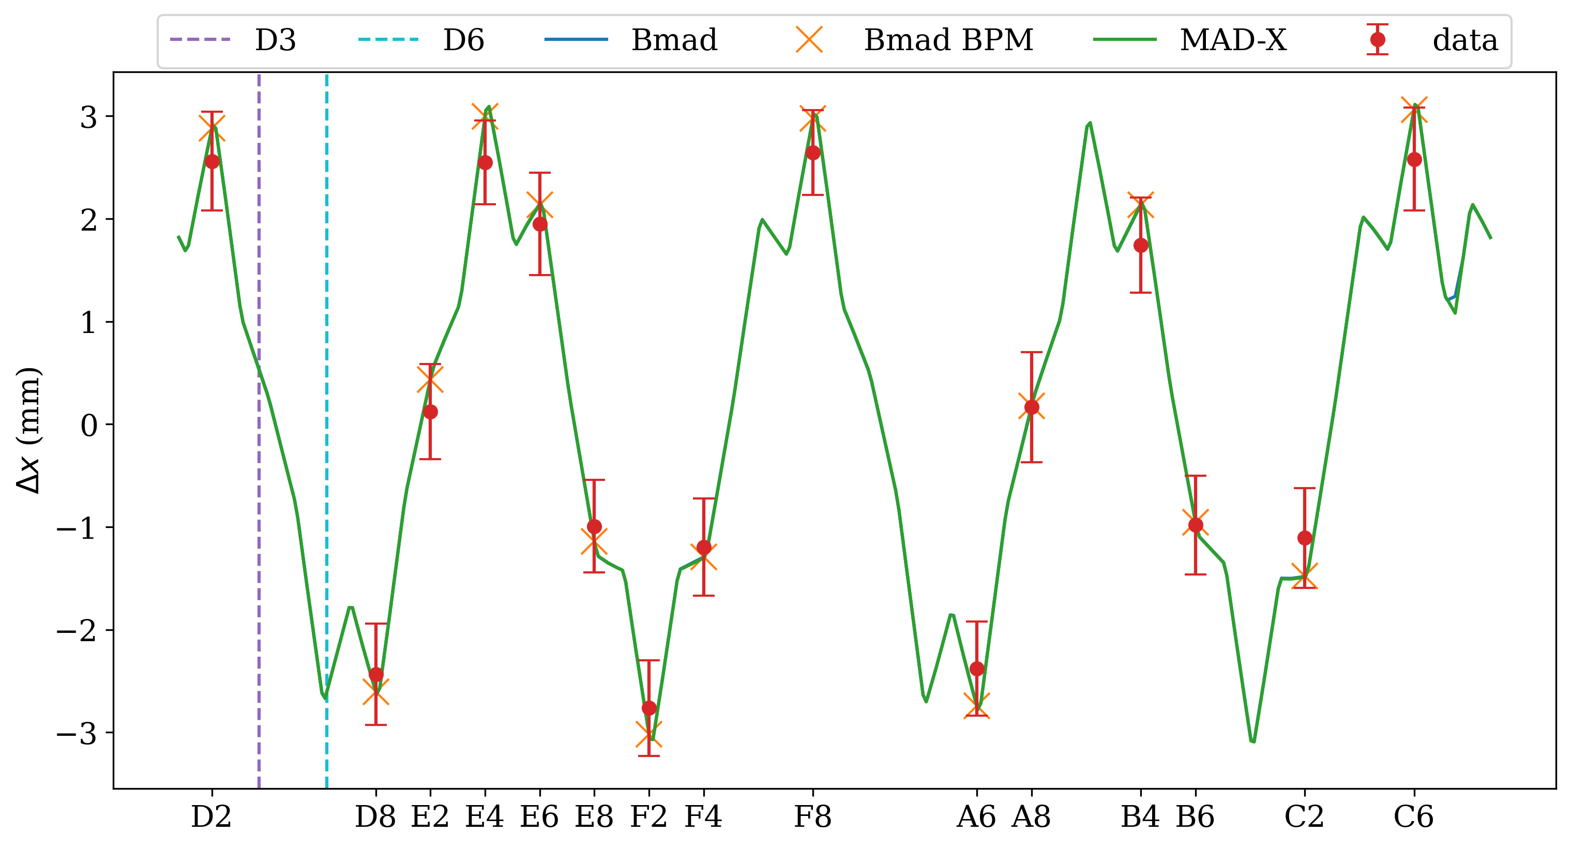
Bump simulation vs. measurement
618 MeV/n Silicon
Single bump measurement (C7 bump = 80 Amp shown) show good agreement with simulation
Bump defined as horizontal kicker in MAD-X, dipole field error in Bmad

Slide 7
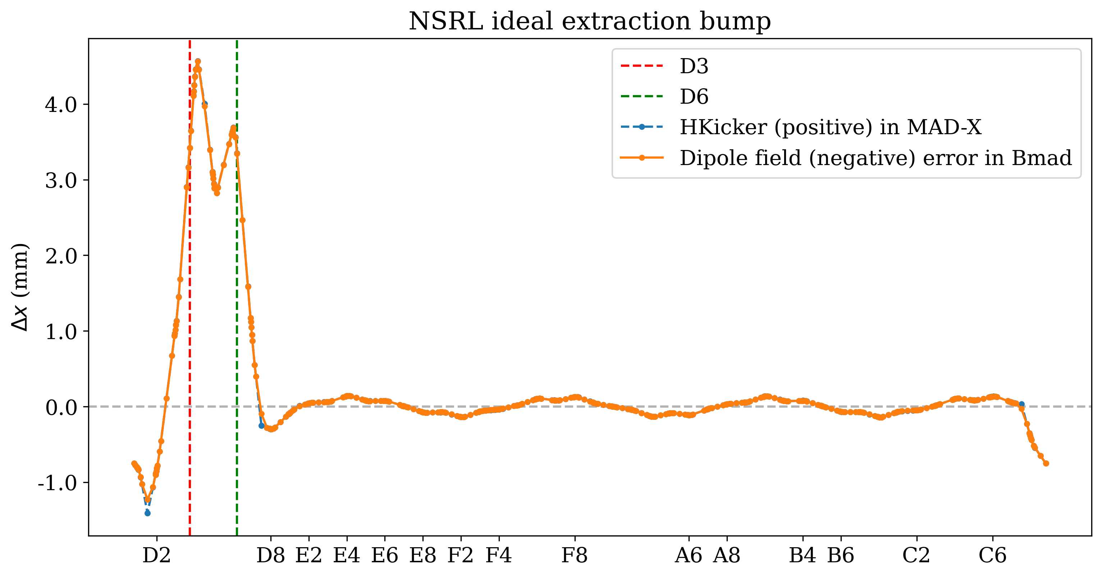
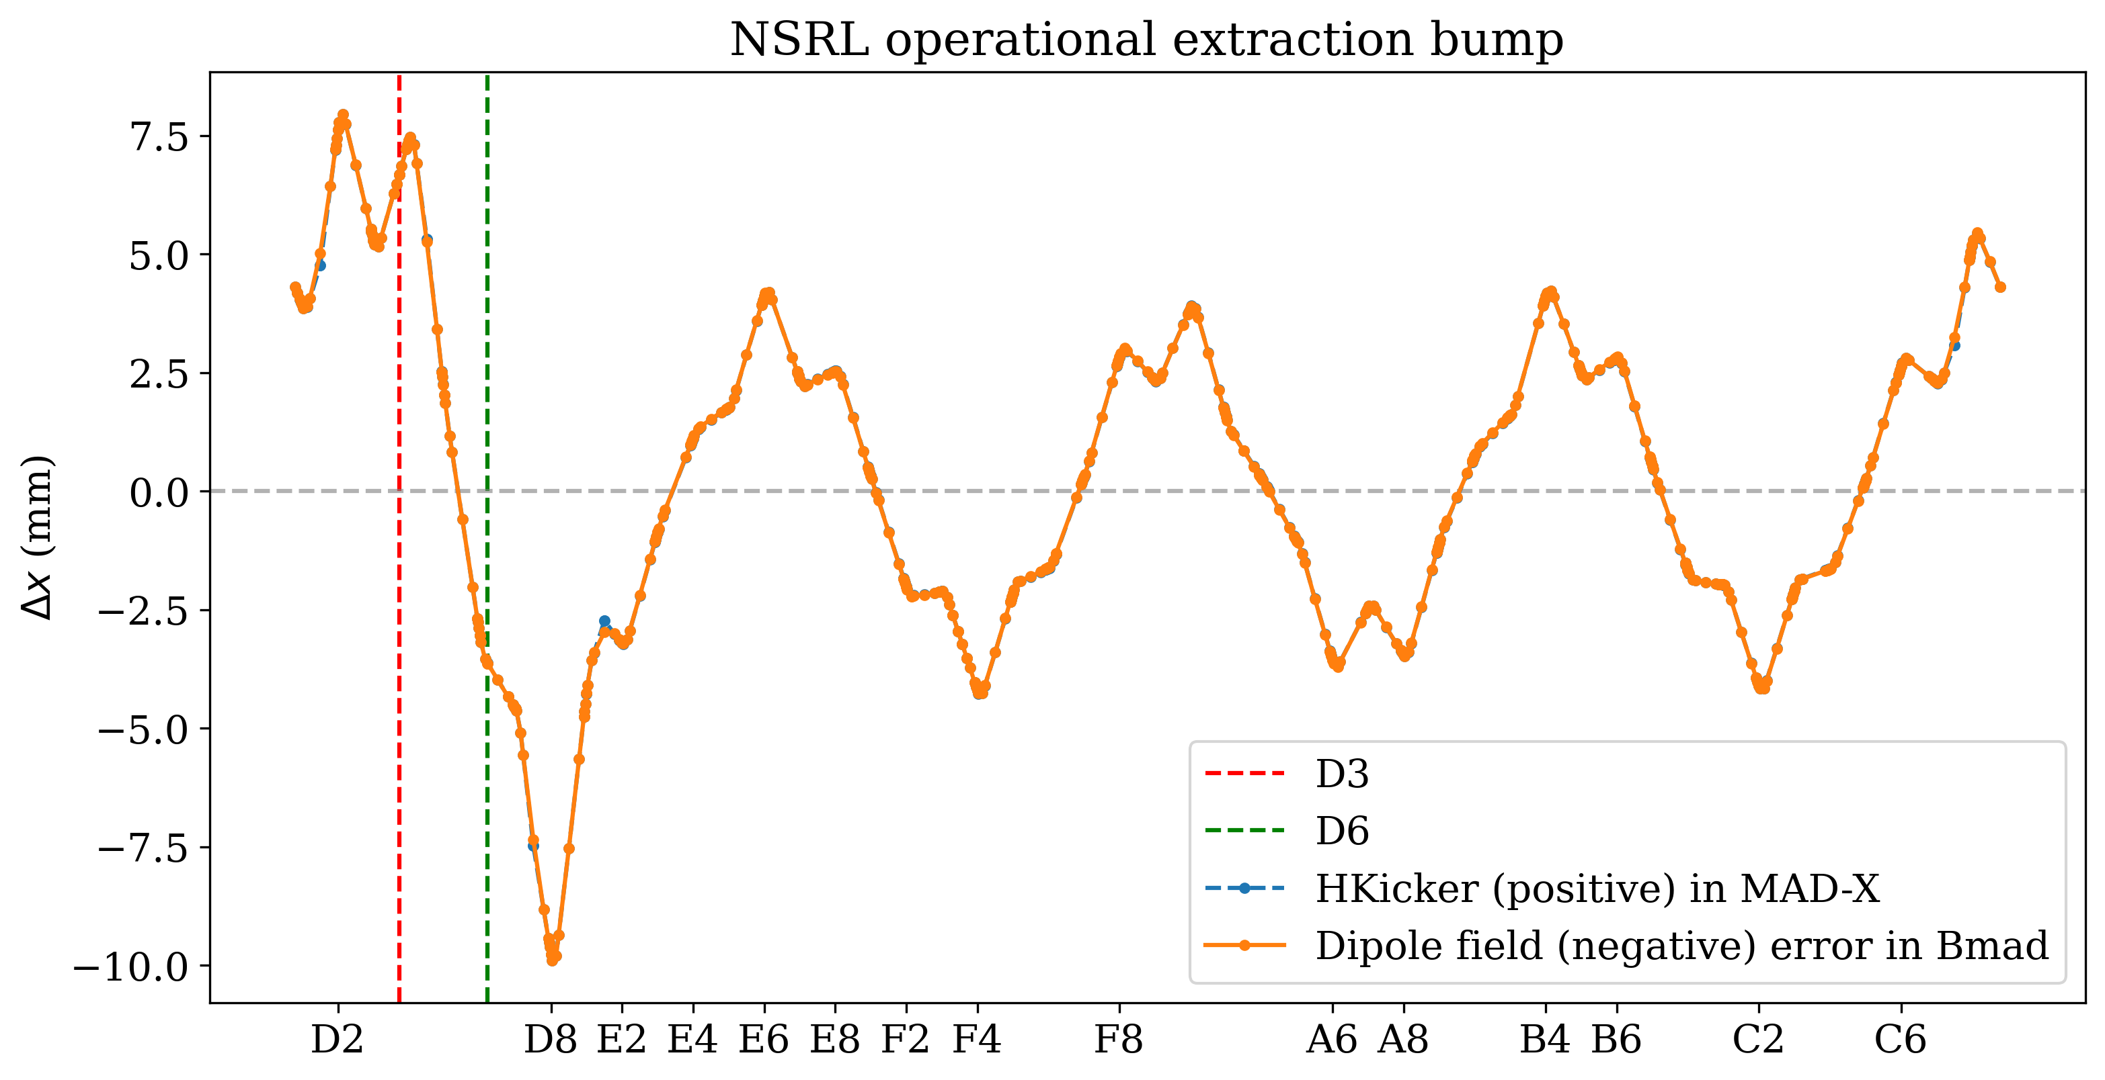
Bump design vs. Reality
618 MeV/n Silicon
Surprise discovery: operational bump is miles away from design bump due to years of blind tuning

Slide 8
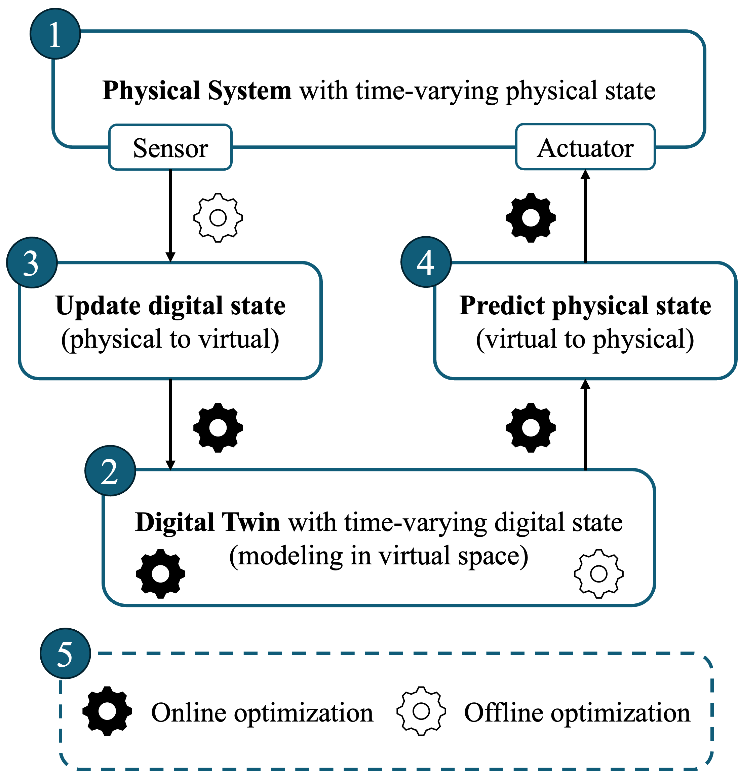
What is digital twin (DT)?
"A digital twin is a set of virtual information constructs that mimics the structure, context, and behavior of a natural, engineered, or social system (or system-of-systems), is dynamically updated with data from its physical twin, has a predictive capability, and informs decisions that realize value. The bidirectional interaction between the virtual and the physical is central to the digital twin.”
- Foundational Research Gaps and Future Directions for Digital Twins (2024)
National Academies of Sciences, Engineering, and Medicine report

Slide 9
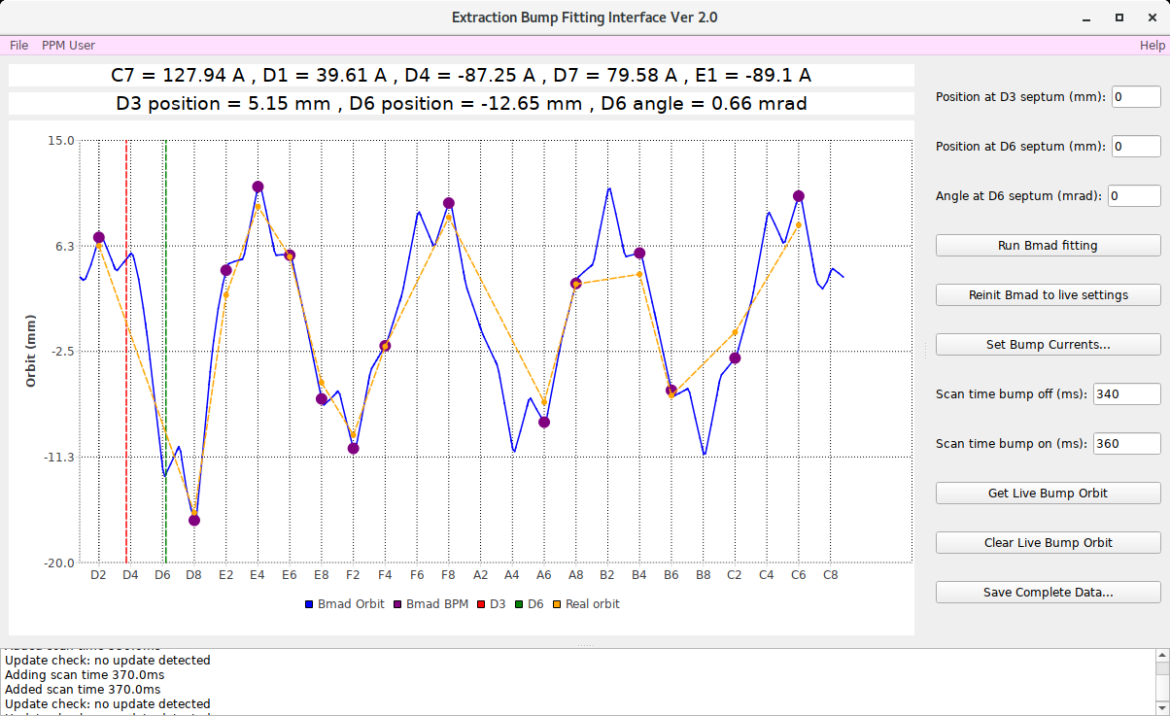
Digital Twin for extraction bump
1 GeV/n Proton
Load live bump currents from real machine
Simulated D3 + D6 orbit info using live bumps
Simulated bump orbit using live bumps
Real bump orbit measured by beam position monitors

Slide 10
Digital Twin for extraction bump
1 GeV/n Proton
Use Bmad to fit any design bump shape
Send calculated bump currents to real machine
Time stamps in Booster cycle used to measure bump orbit
Save simulated and measured data

Slide 11
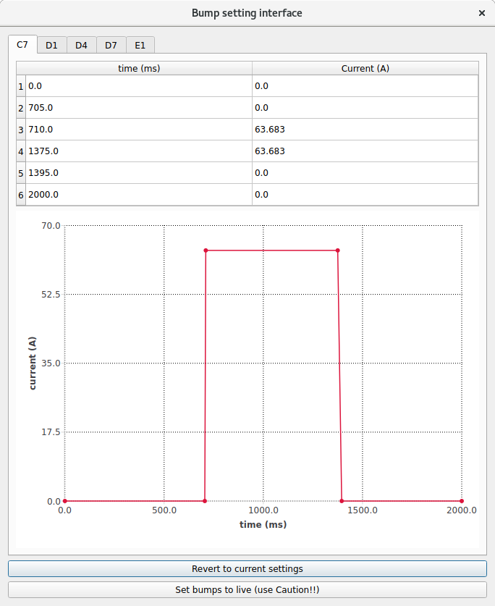
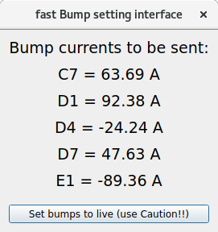
Digital Twin for extraction bump
370 MeV/n Silicon
Booster magnet currents are time-dependent
Bump currents are only turned on during NSRL extraction
Full bump setting interface allows changes to both timing and current
For normal operation, timing stays the same, fast setting interface allows changes to only current

Slide 12
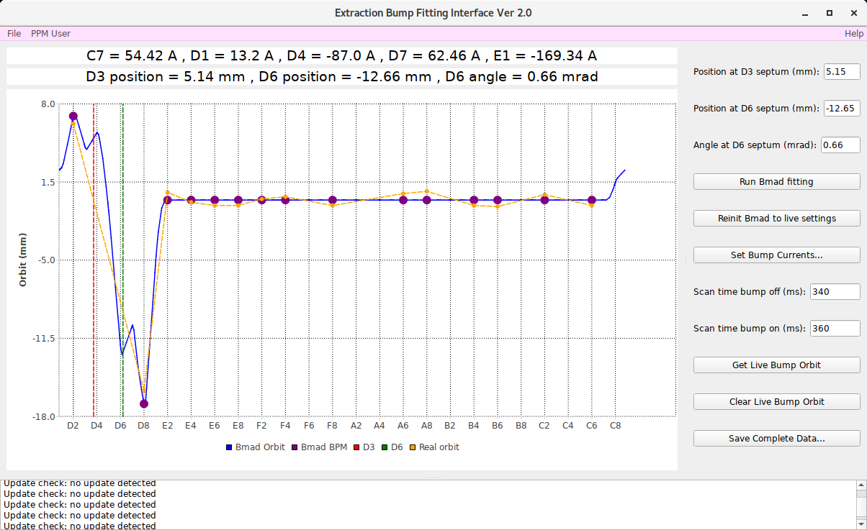
DT-assisted bump tuning
1 GeV/n Proton
Optimize operational bump by minimizing the residual orbit across the Booster ring

Slide 13
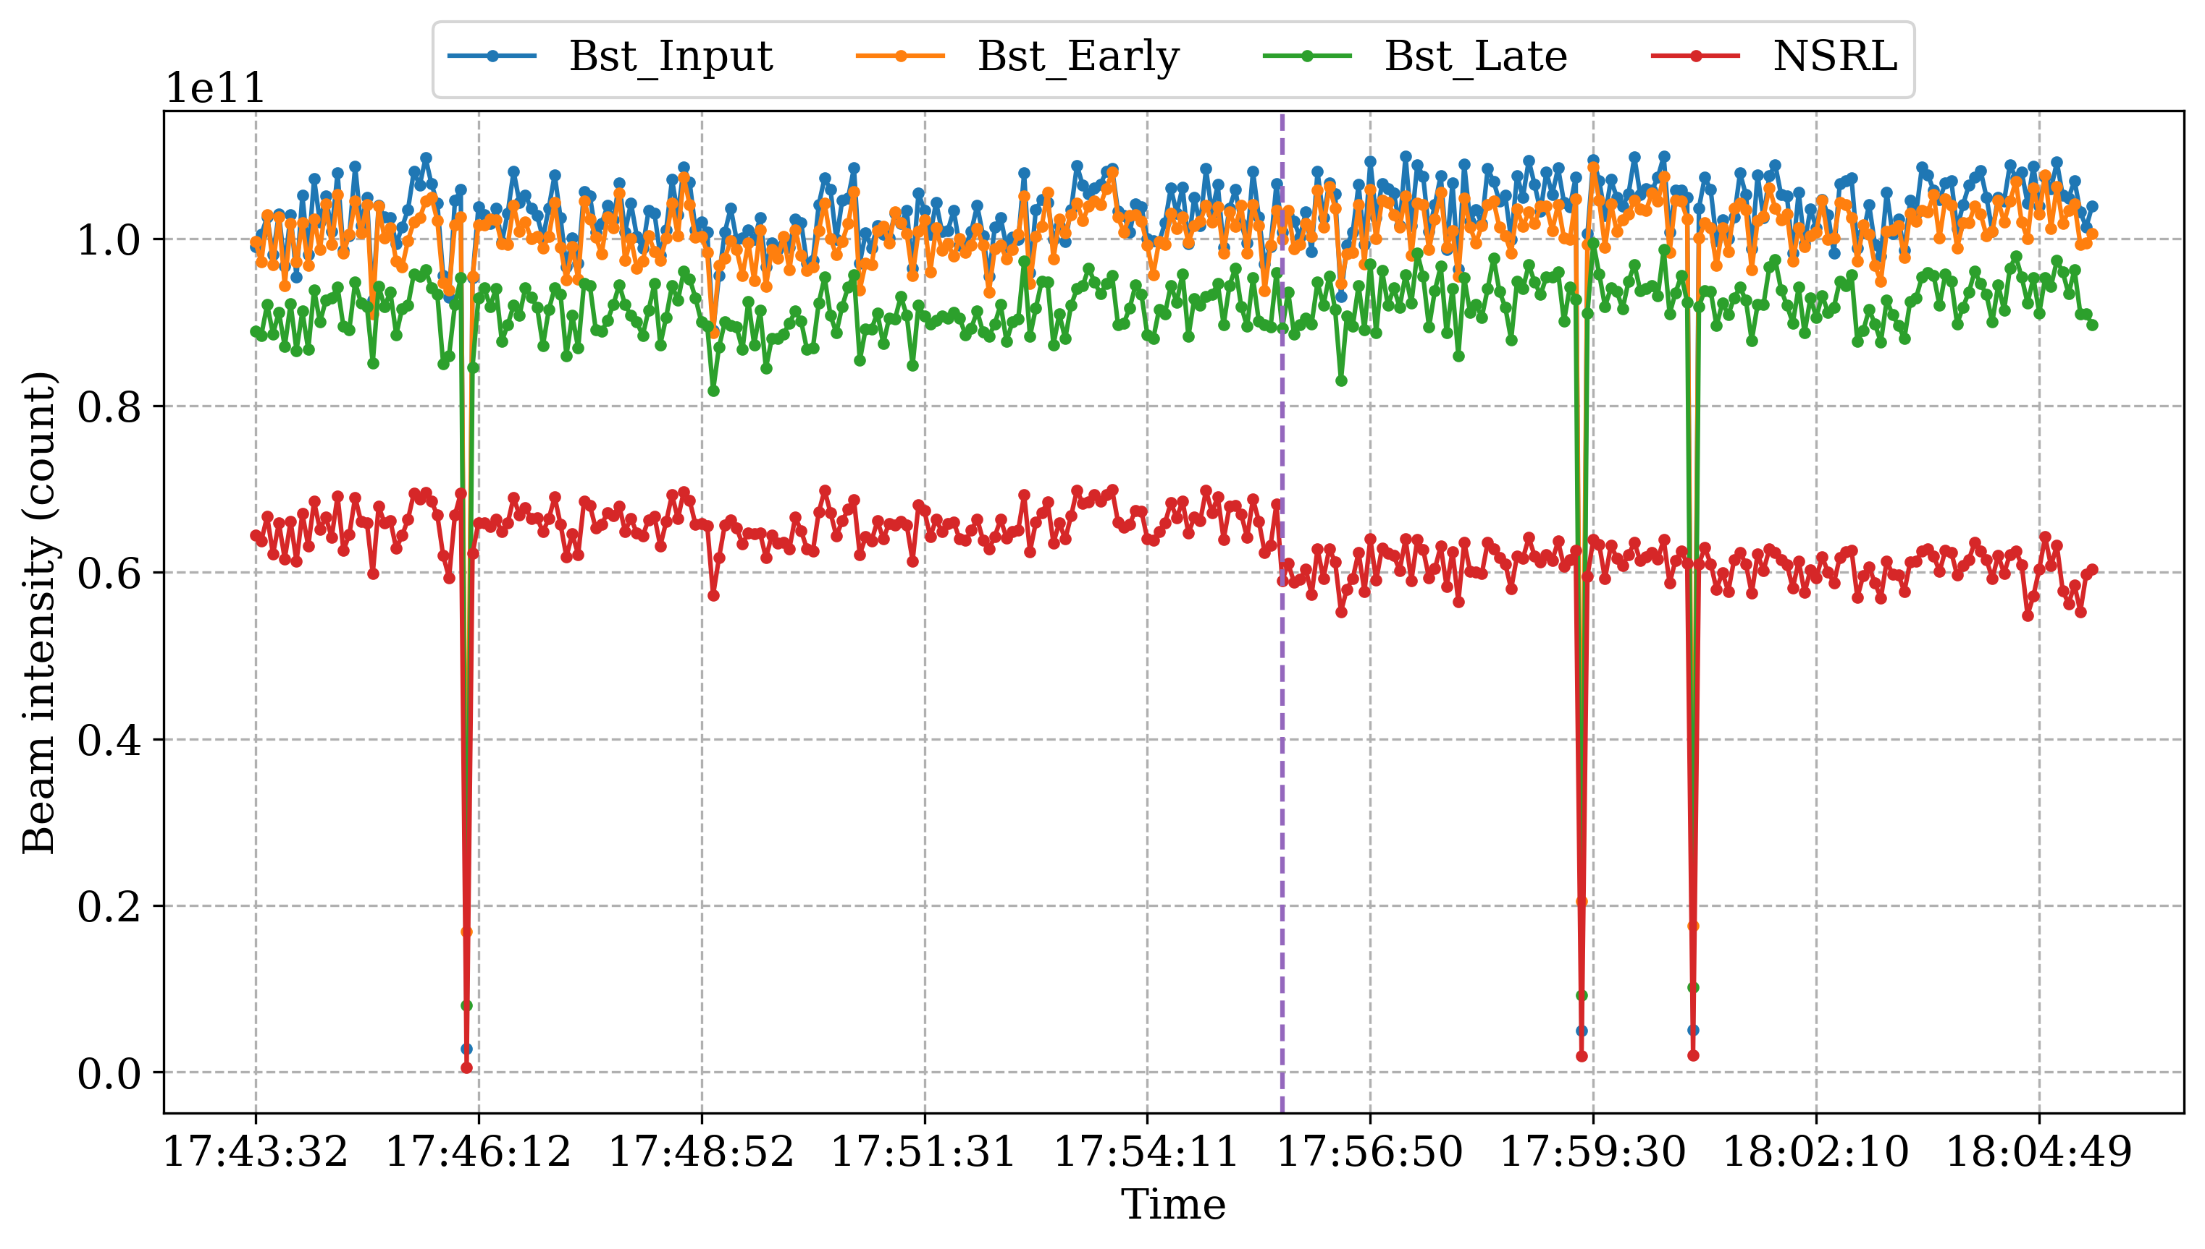
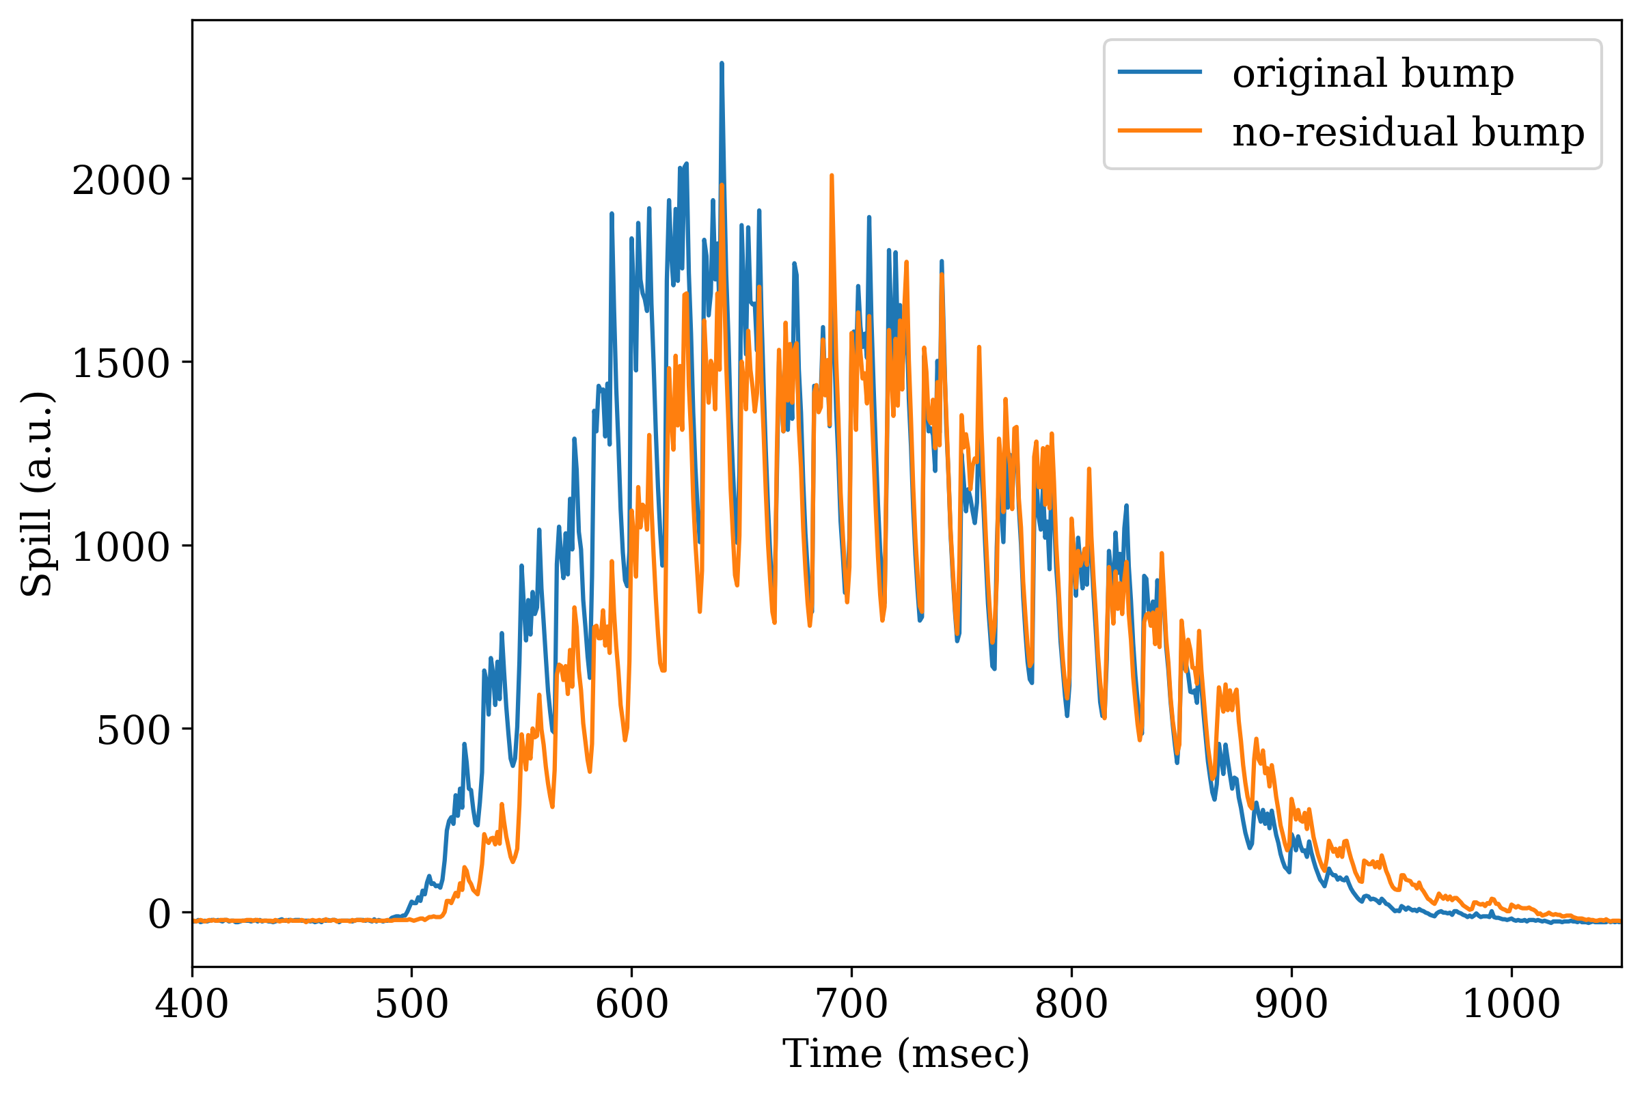
DT-assisted bump tuning
1 GeV/n Proton
Minimal change in intensity and spill for bump with minimal residual orbit

Slide 14
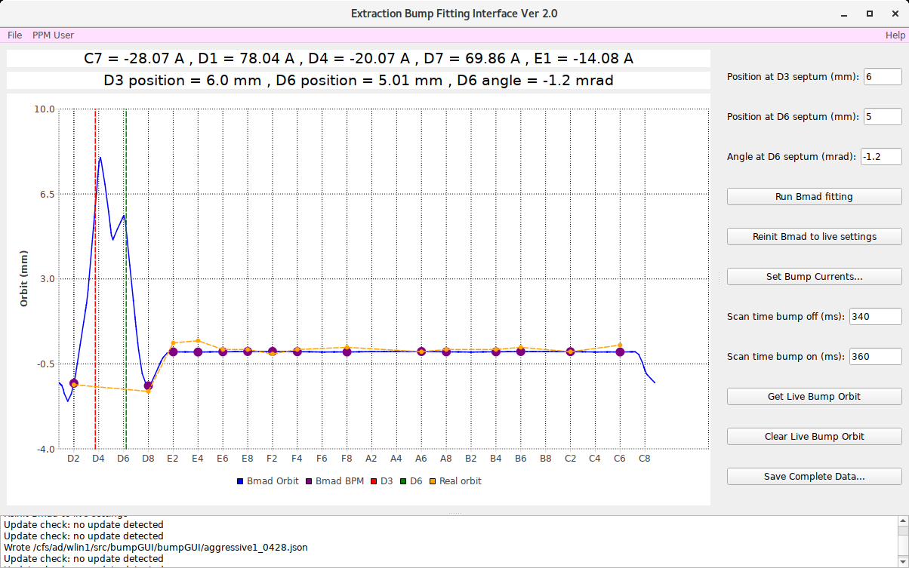
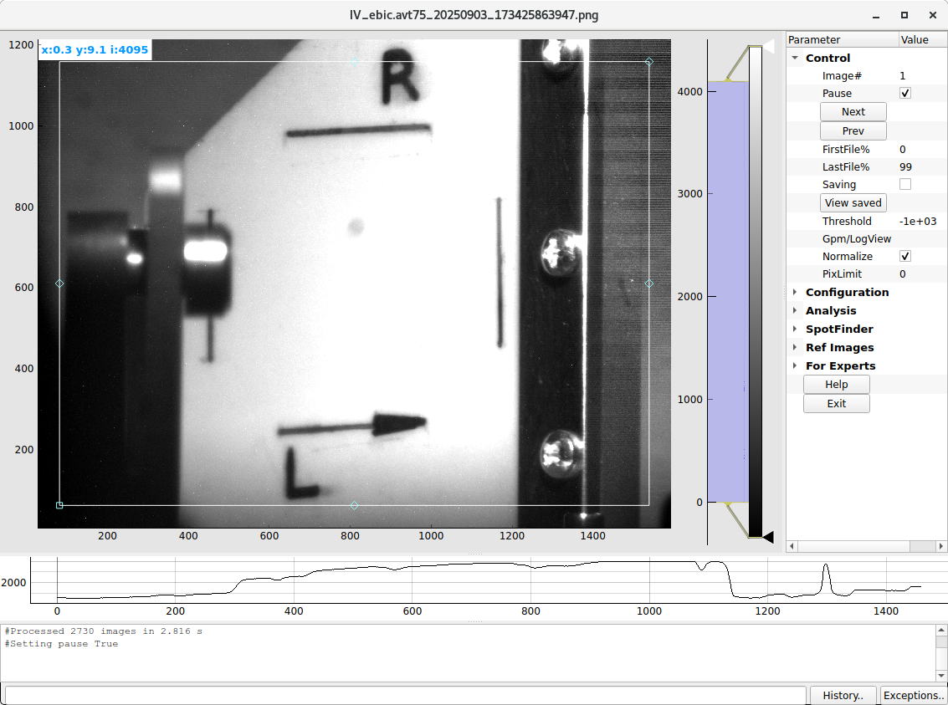
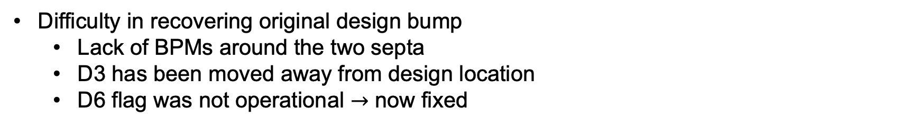
DT-assisted bump tuning
Difficulty in recovering original design bump
Lack of BPMs around the two septa
D3 has been moved away from design location
D6 flag was not operational $→$ now fixed

Slide 15
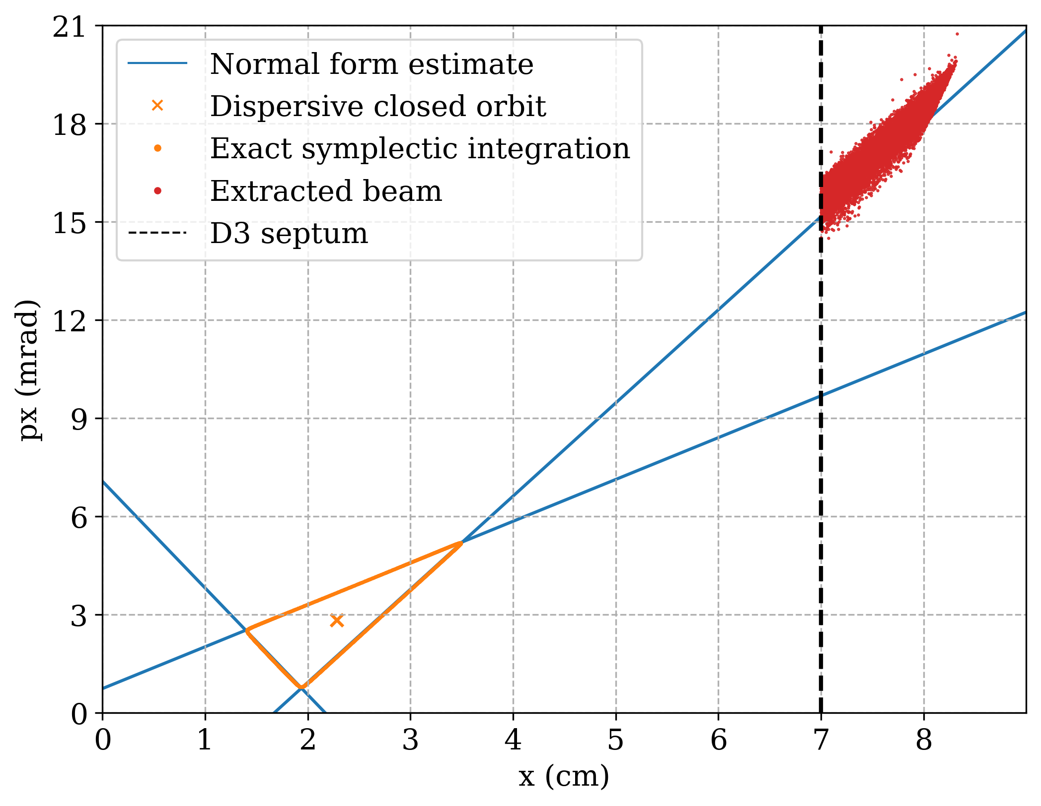
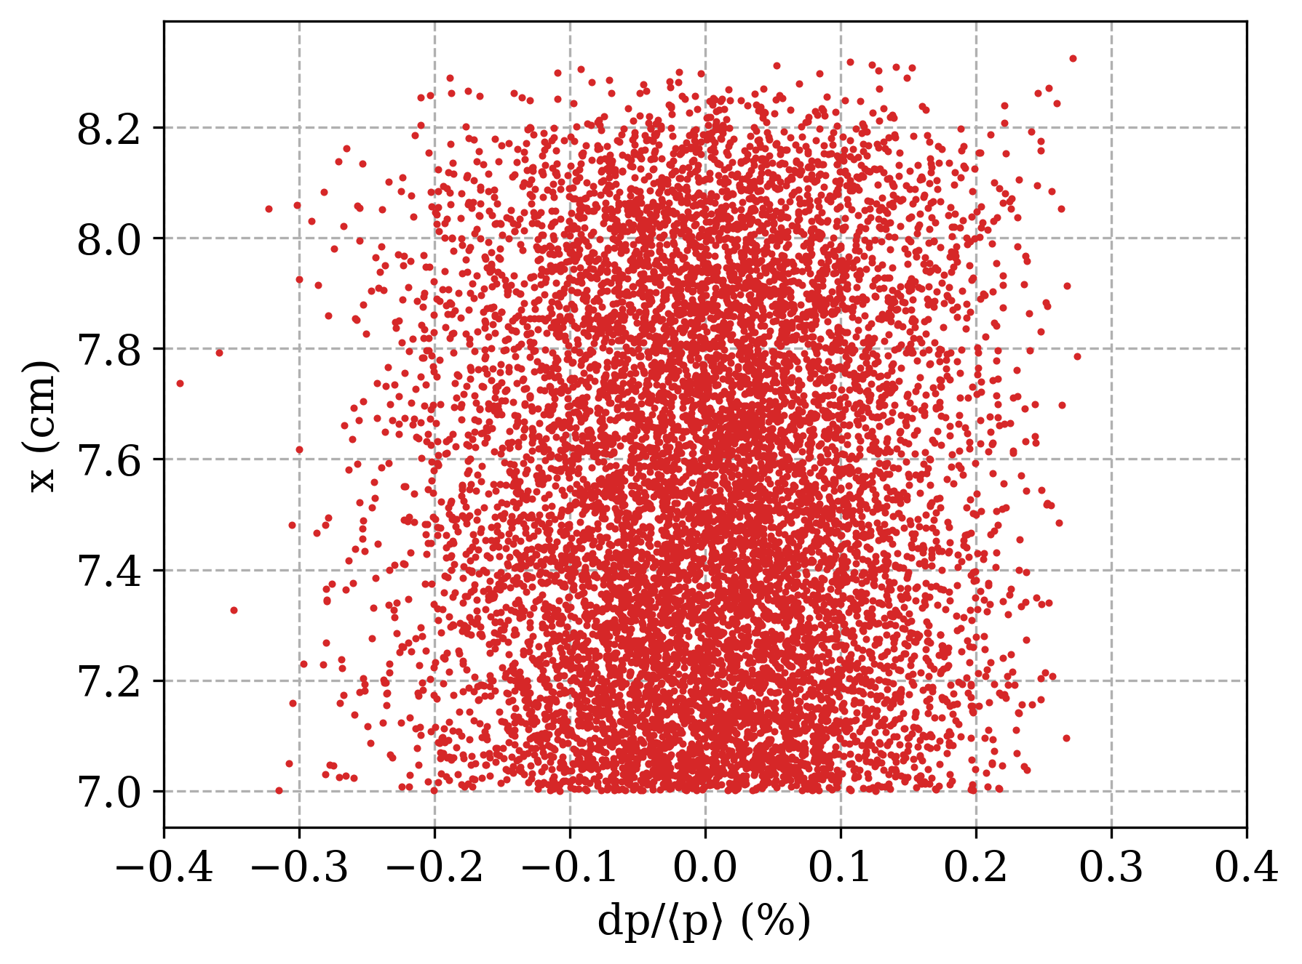
Resonant Slow Extraction
Thin septum (0.76 mm) at D3 + thick septum (15.2 mm) at D6 in the Booster
Third-integer (13/3) resonance created by four sextupoles: C8, F8, B4, E4
Triangular stable region in horizontal phase space, brought closer to the septa via local extraction bump
Slow extracted beam at the beginning of NSRL line would have minimal dispersion

Slide 16
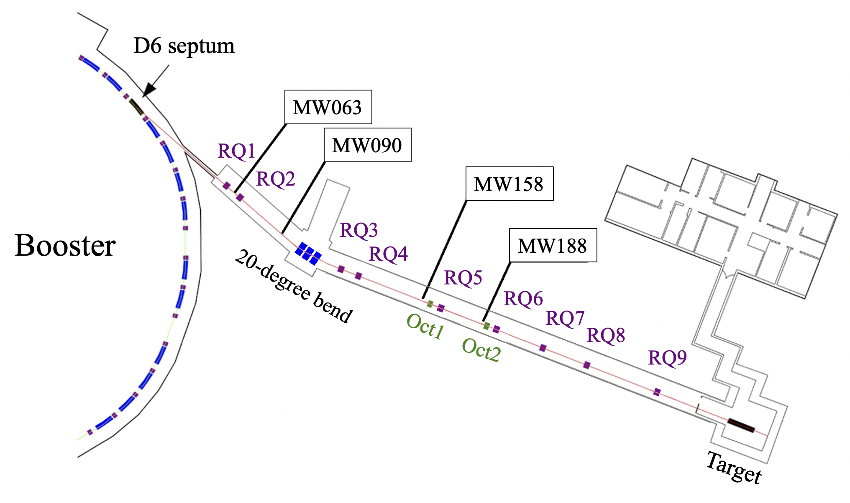
NSRL beam line
Nine quadrupoles, three dipoles (20 degree), two octupoles, four multi-wires
Designed to be achromatic after the 20-degree bend
Two octupoles create uniform square beam at the target

Slide 17
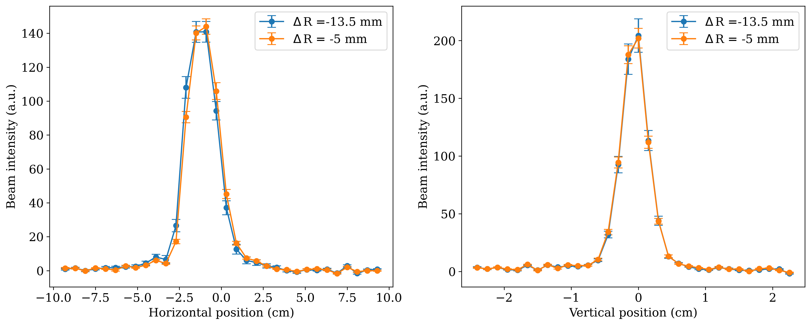
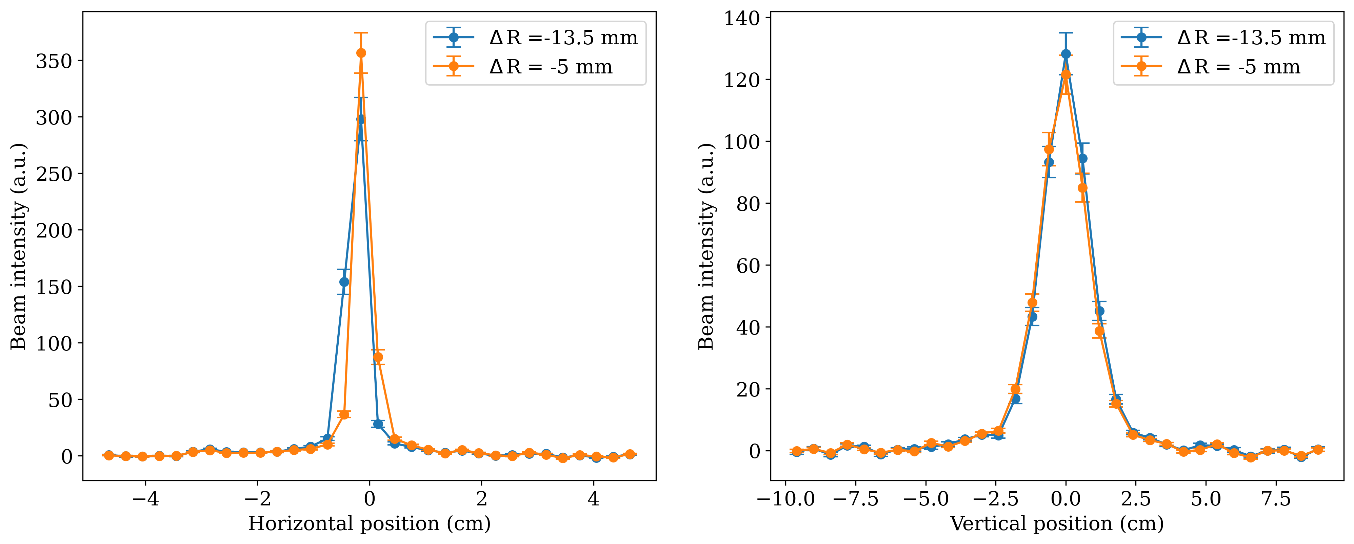
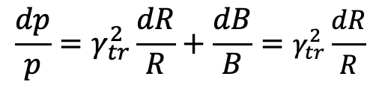
Achromatic condition
250 MeV/n Helium
Momentum is changed via radial steering function that changes the beam radius
Booster main magnet is kept constant
Beam profiles measured at MW158 and MW188 after the 20-degree bend show the line is achromatic
$$\frac{dp}{p}=γ_{tr}^{2}\frac{dR}{R}+\frac{dB}{B}=γ_{tr}^{2}\frac{dR}{R}$$

Slide 18
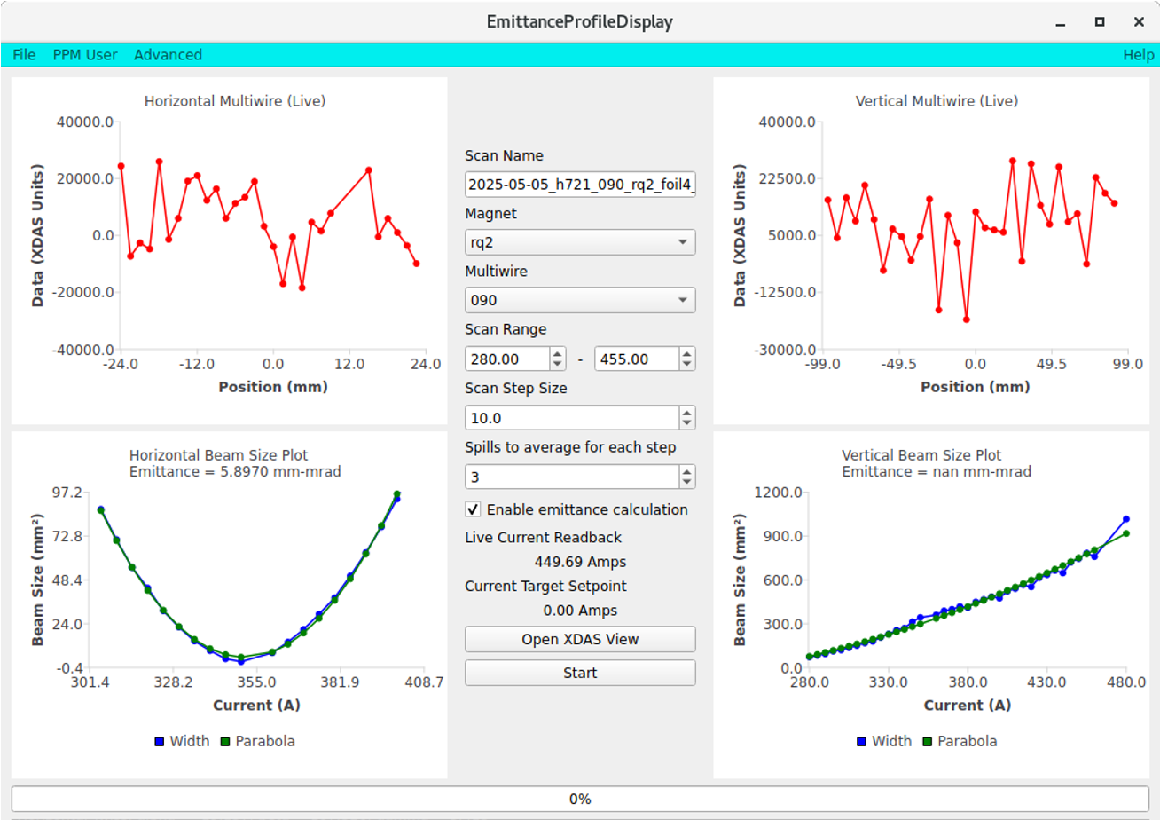
Initial Twiss parameter via quad scan
Quadrupole scan application to automate quad scans and emittance calculations

Slide 19
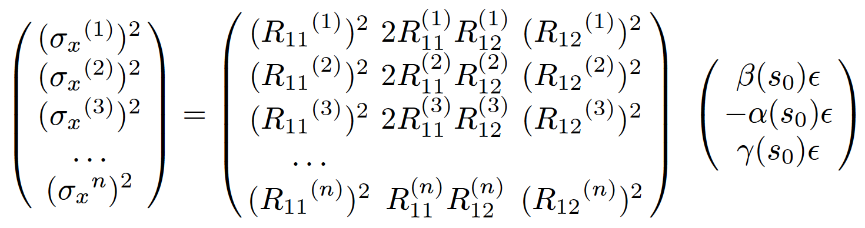
Back propagate Twiss parameters
720 MeV/n Proton
Skip parabola fitting which uses thin lens approximation, use full transfer matrix from currents to calculate Twiss parameters at the upstream of the quadrupole
Back propagate to the beginning of R-line (upstream of D6)
Foil thickness | alpha | beta | gamma | emittance
4 mil | 0.21 | 9.14 | 0.11 | 7.52
6 mil | -0.059 | 7.49 | 0.13 | 9.06
8 mil | -0.28 | 6.91 | 0.15 | 9.94

Slide 20
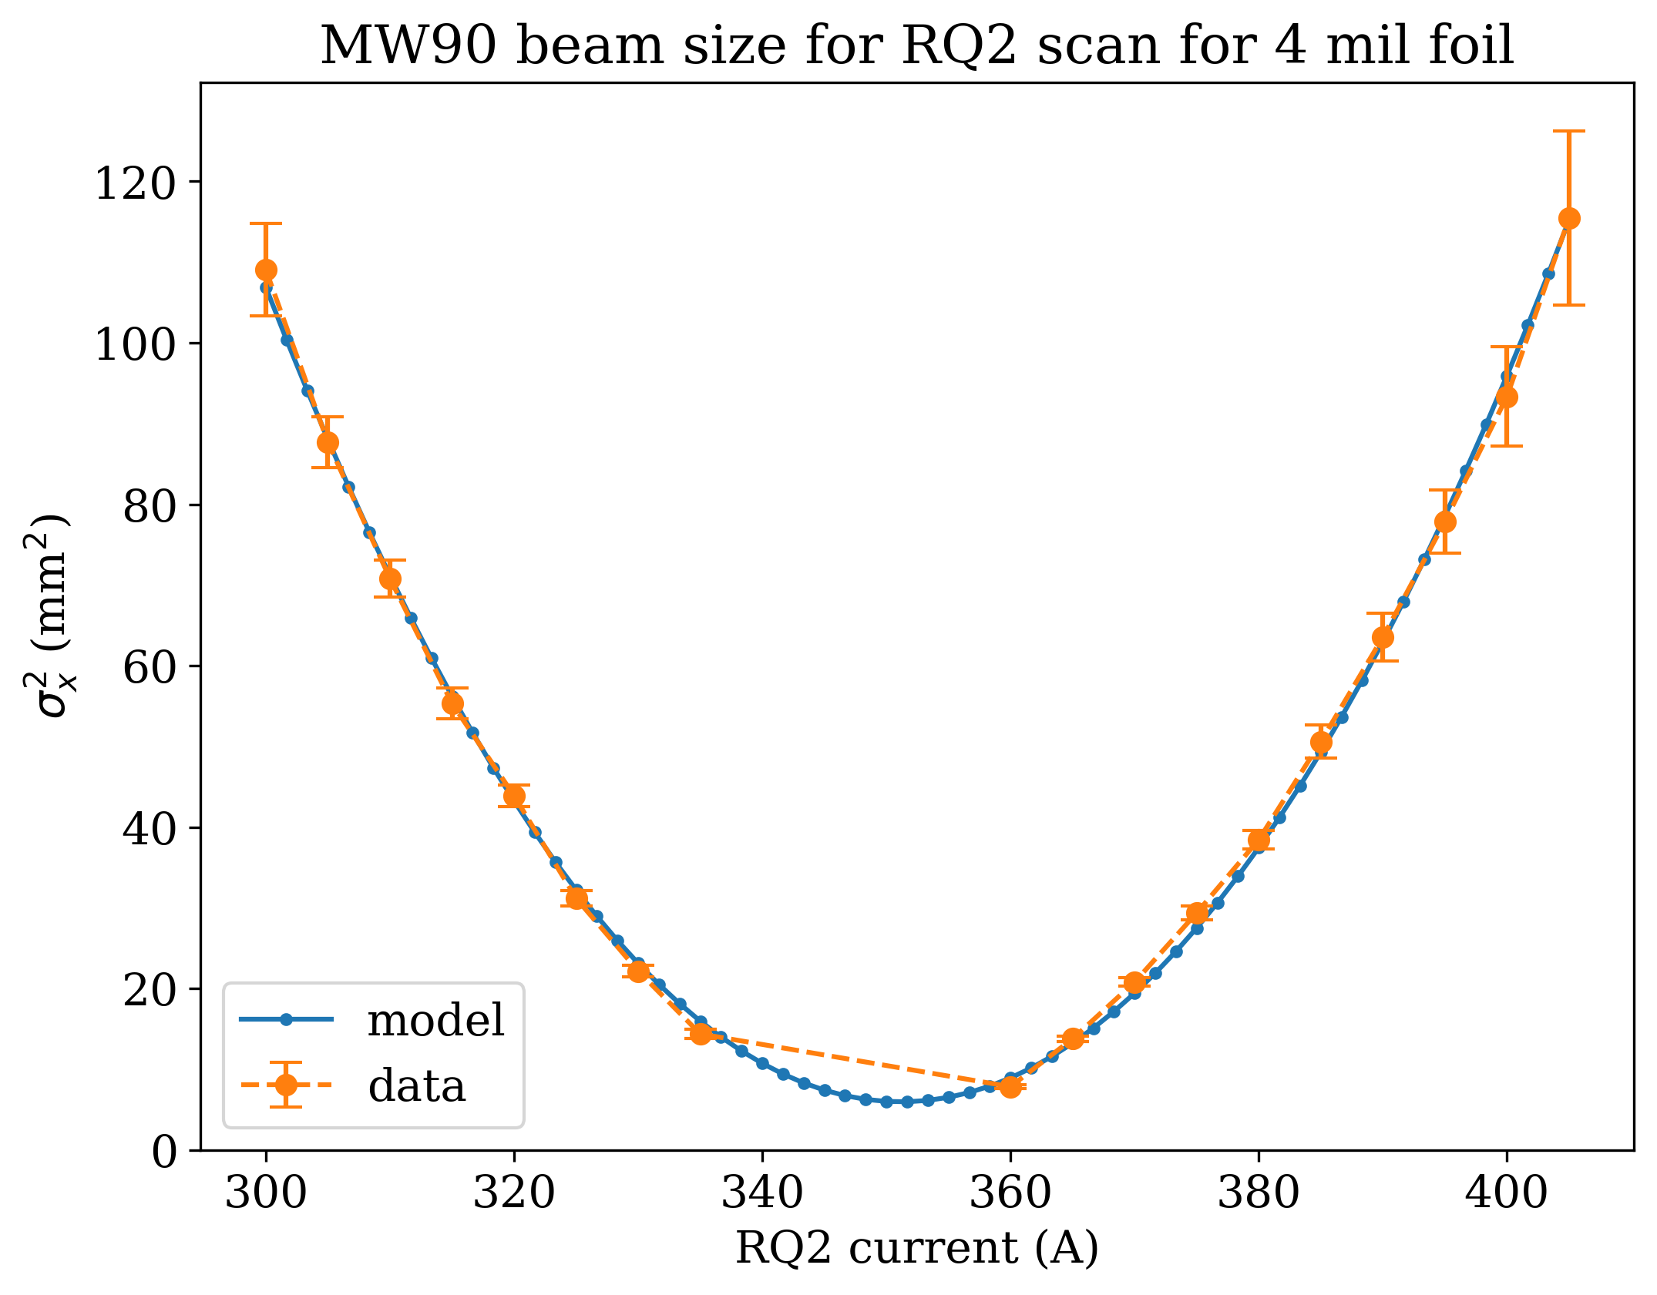
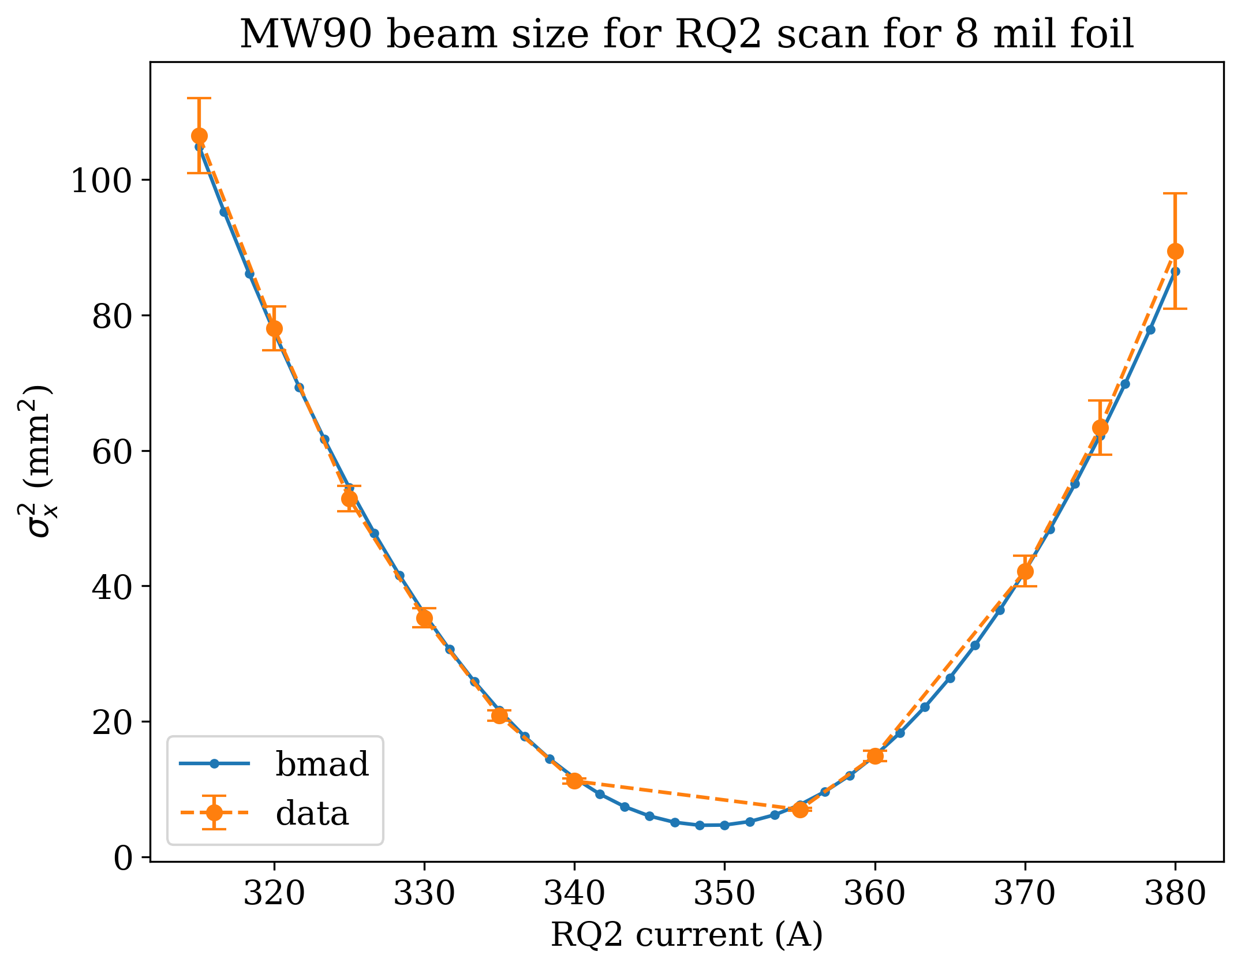
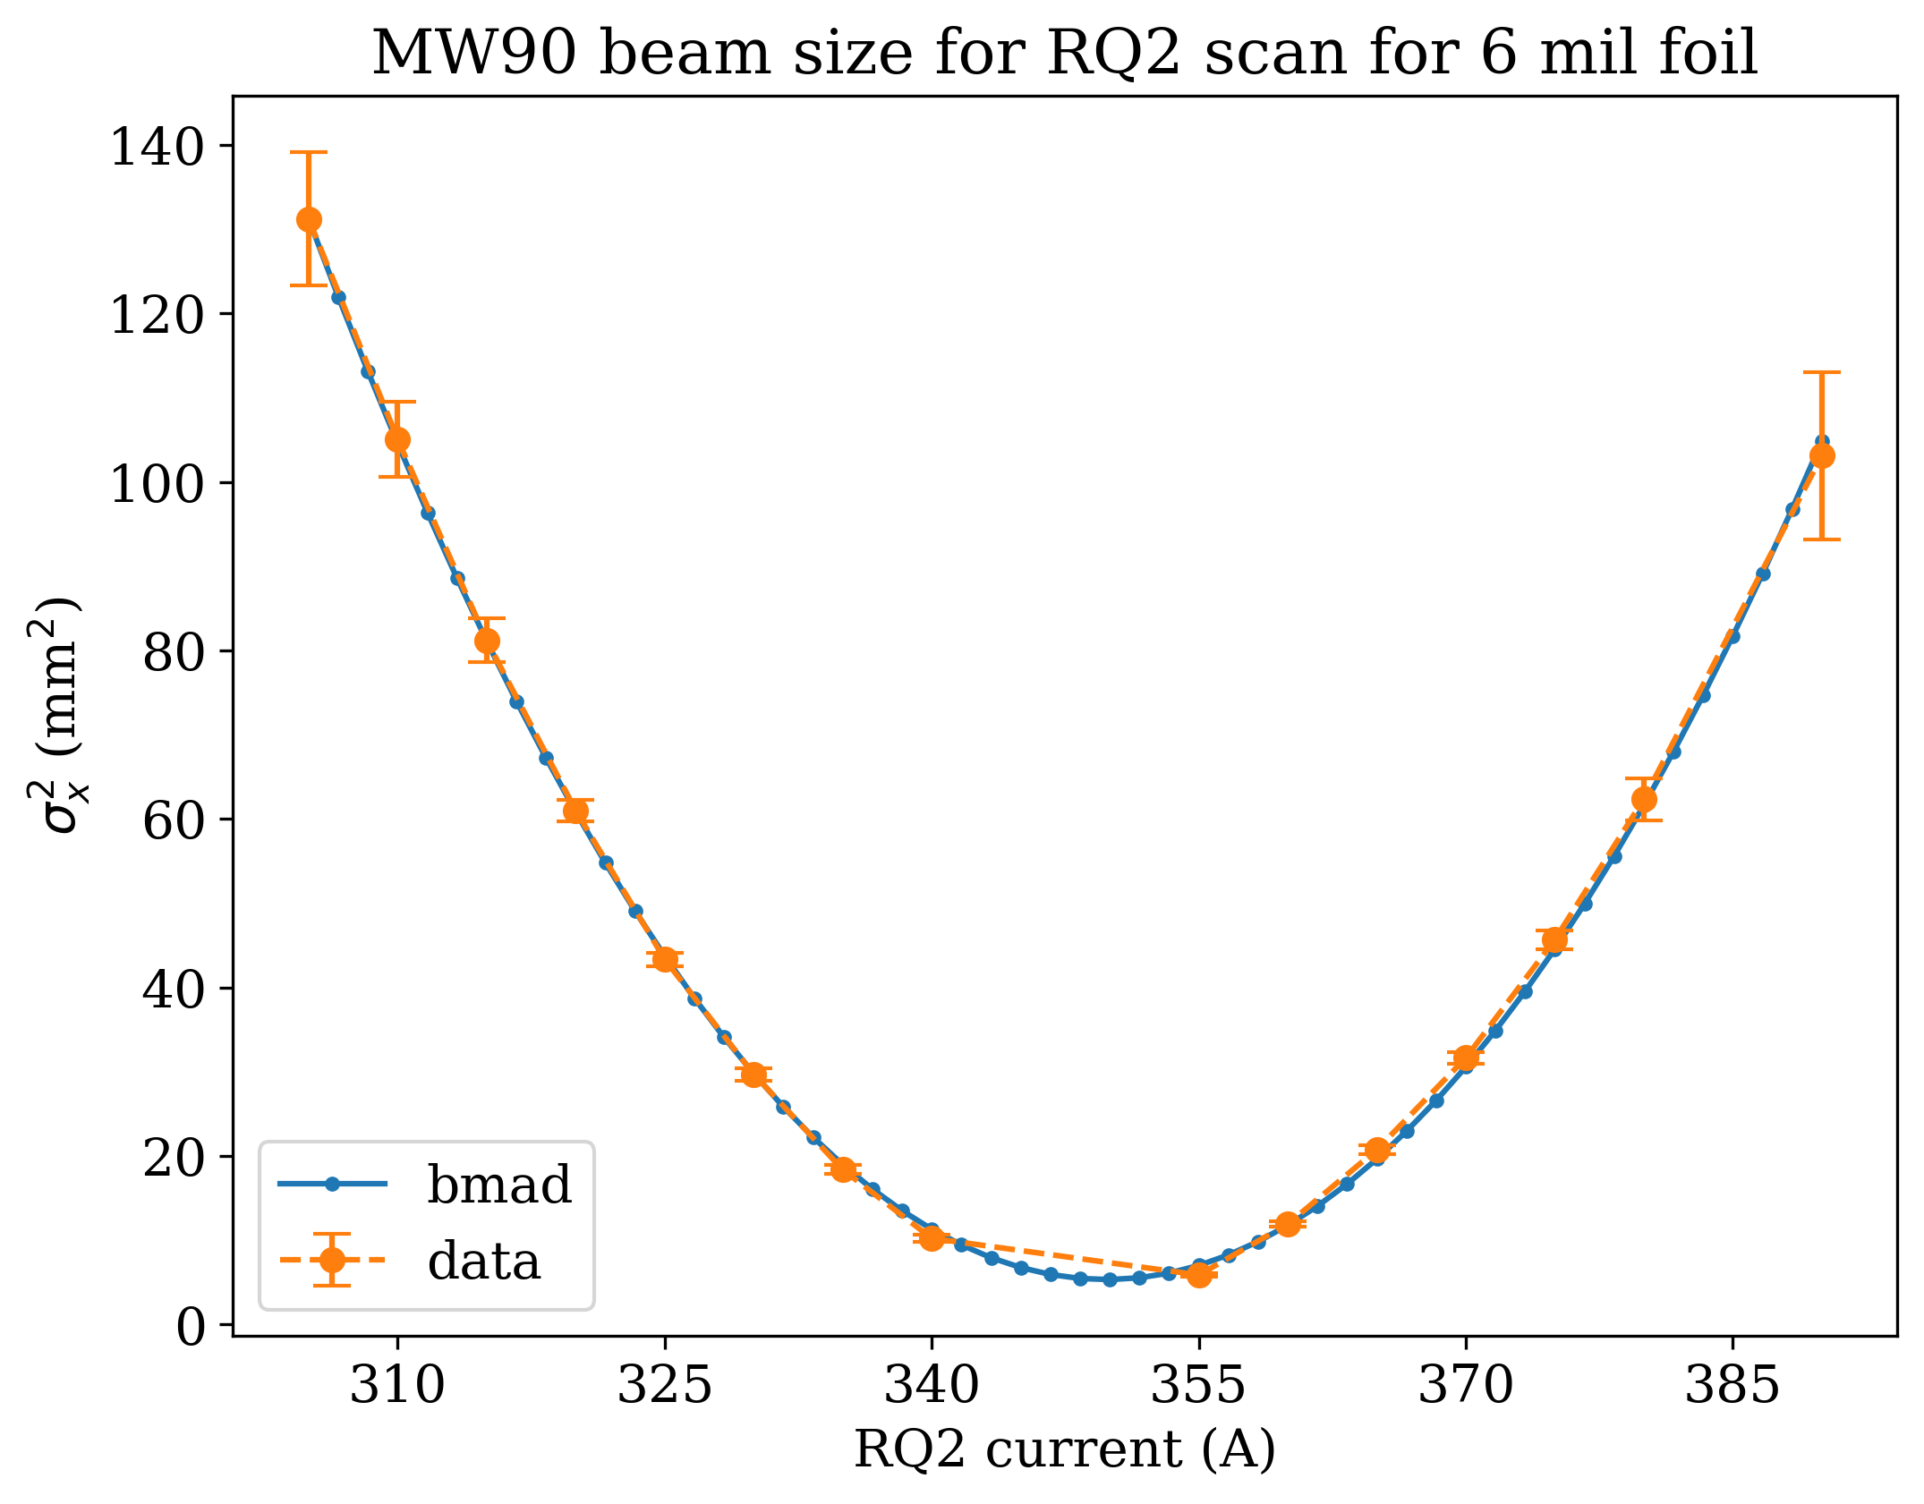
Use back-propagated Twiss in Bmad
720 MeV/n Proton

Slide 21
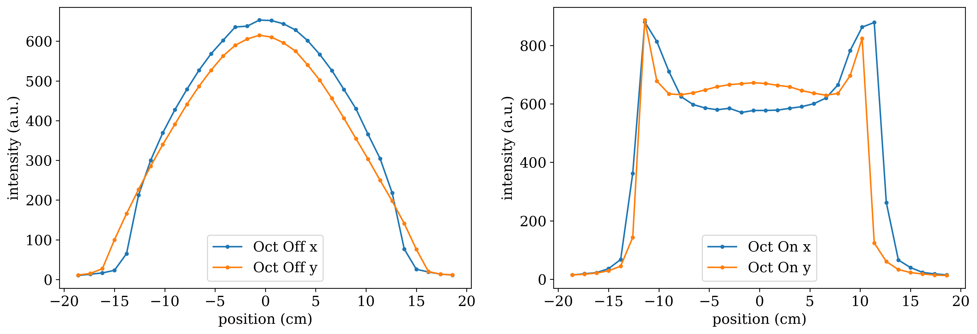
Uniform beam with octupoles
500 MeV/n Silicon
Two octupoles (Oct 1, Oct 2) transform Gaussian-like beam distribution to Batman-like shapes with uniform center region

Slide 22
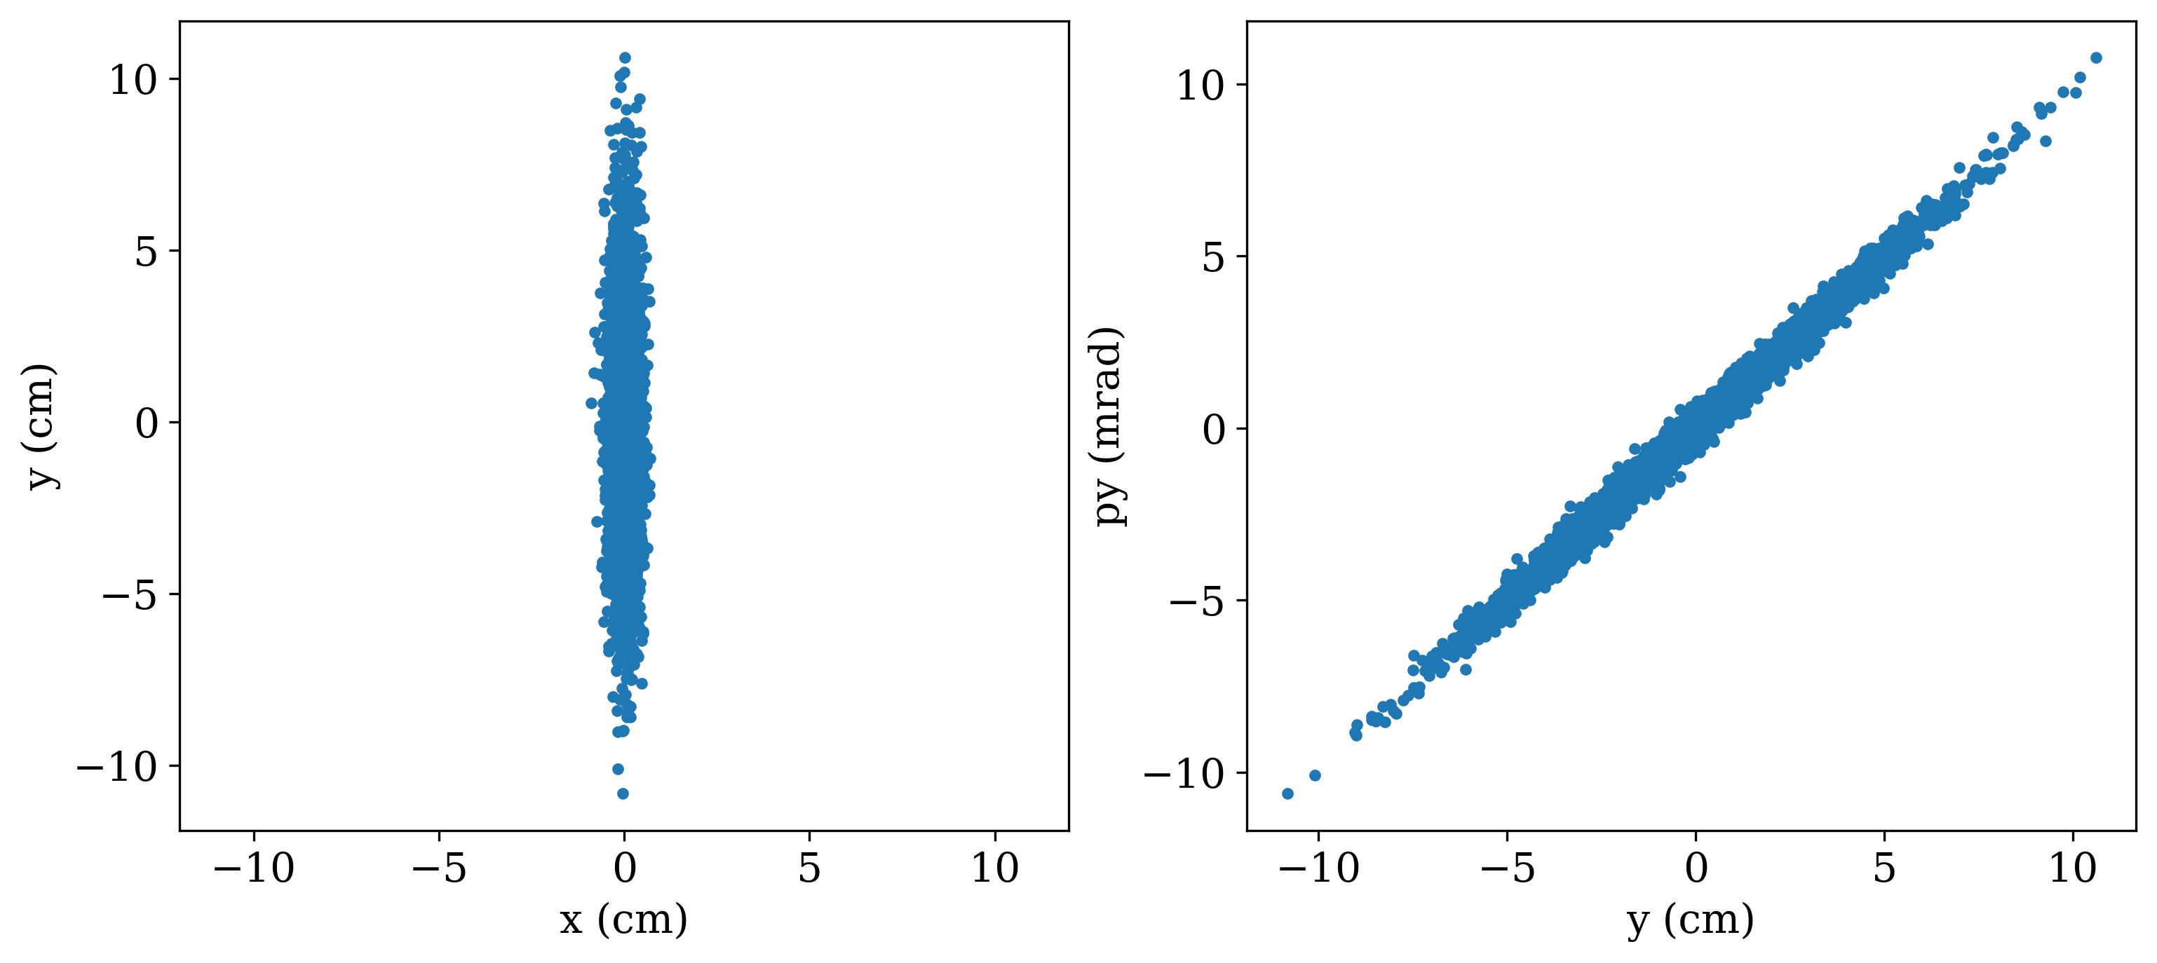
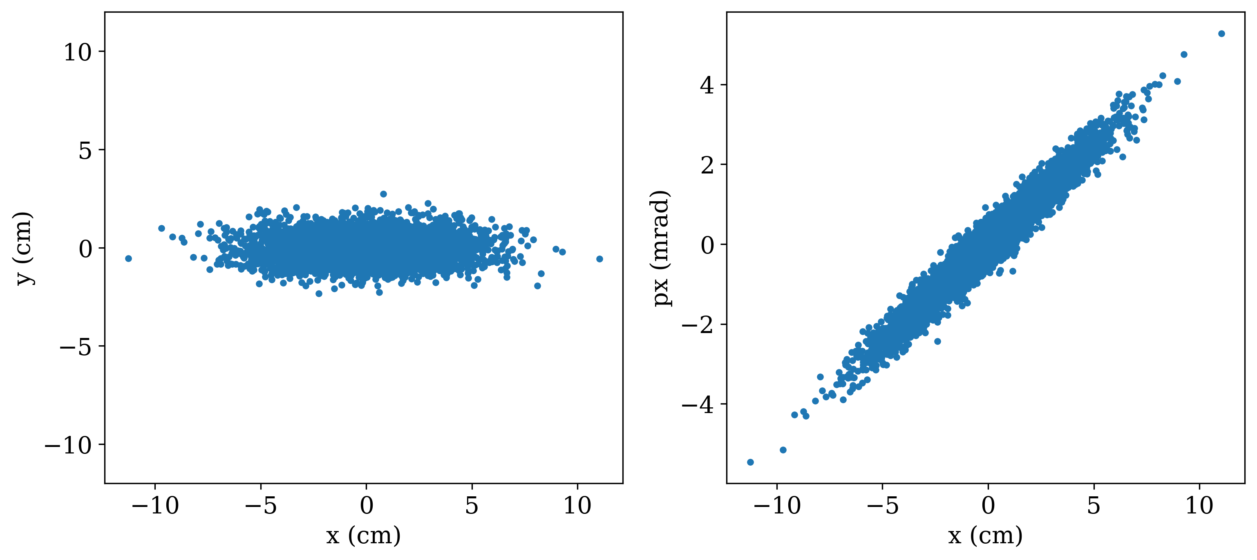
Uniform beam with octupoles
720 MeV/n Proton
Beam needs to be flat in transverse plane and highly correlated in phase space before each octupoles
Top plot before Oct 1 (vertical), bottom plot before Oct 2 (horizontal), simulated using operational values for 720 MeV/u proton

Slide 23
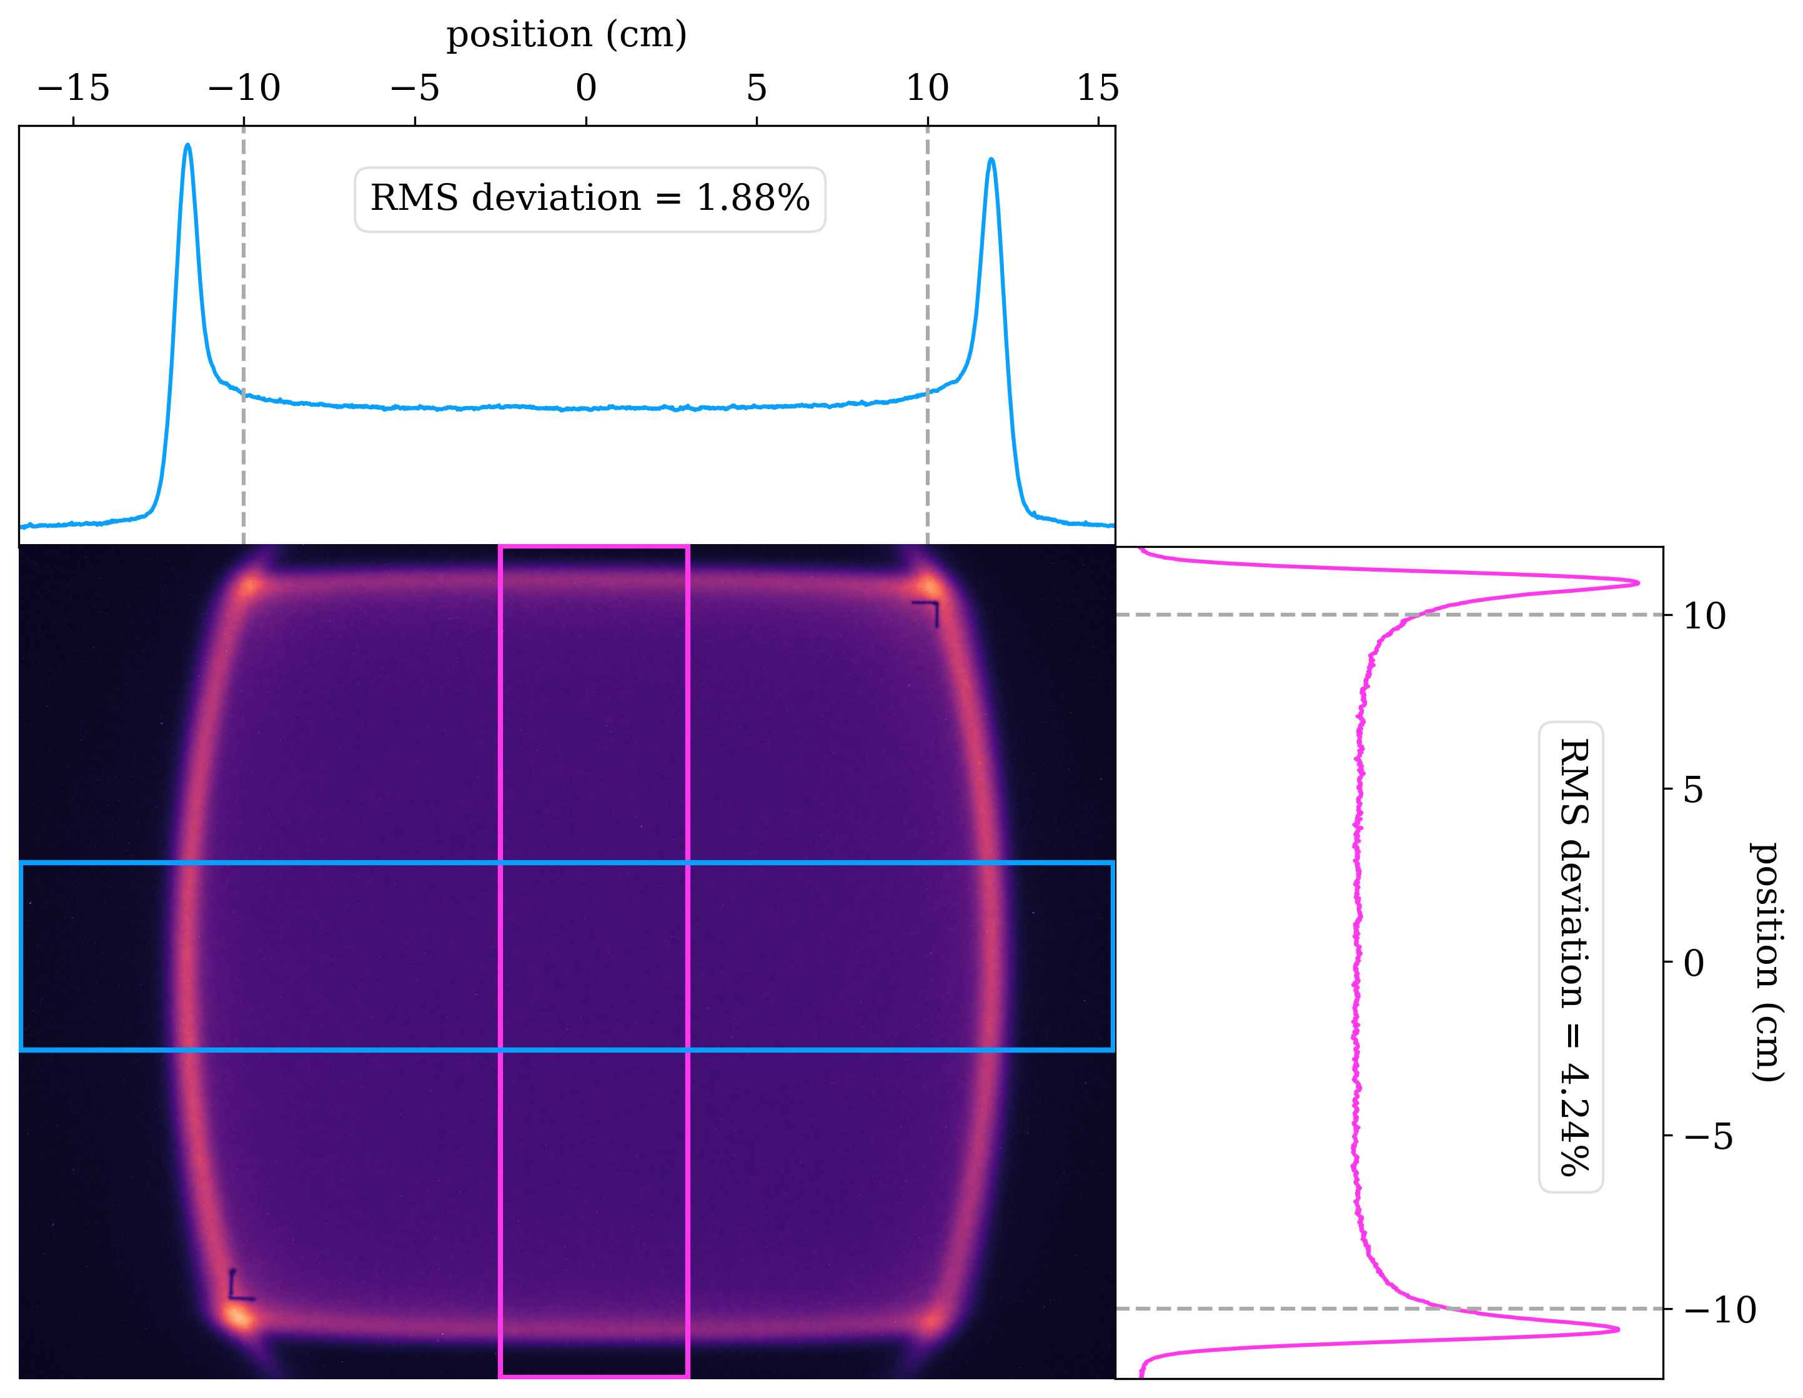
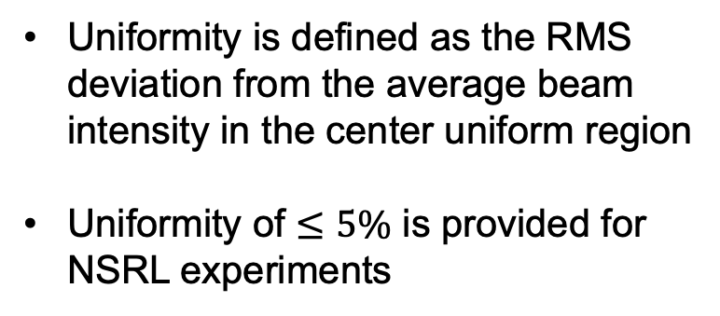
Uniform beam with octupoles
480 MeV/n Iron
Uniformity is defined as the RMS deviation from the average beam intensity in the center uniform region
Uniformity of $≤5\%$ is provided for NSRL experiments

Slide 24
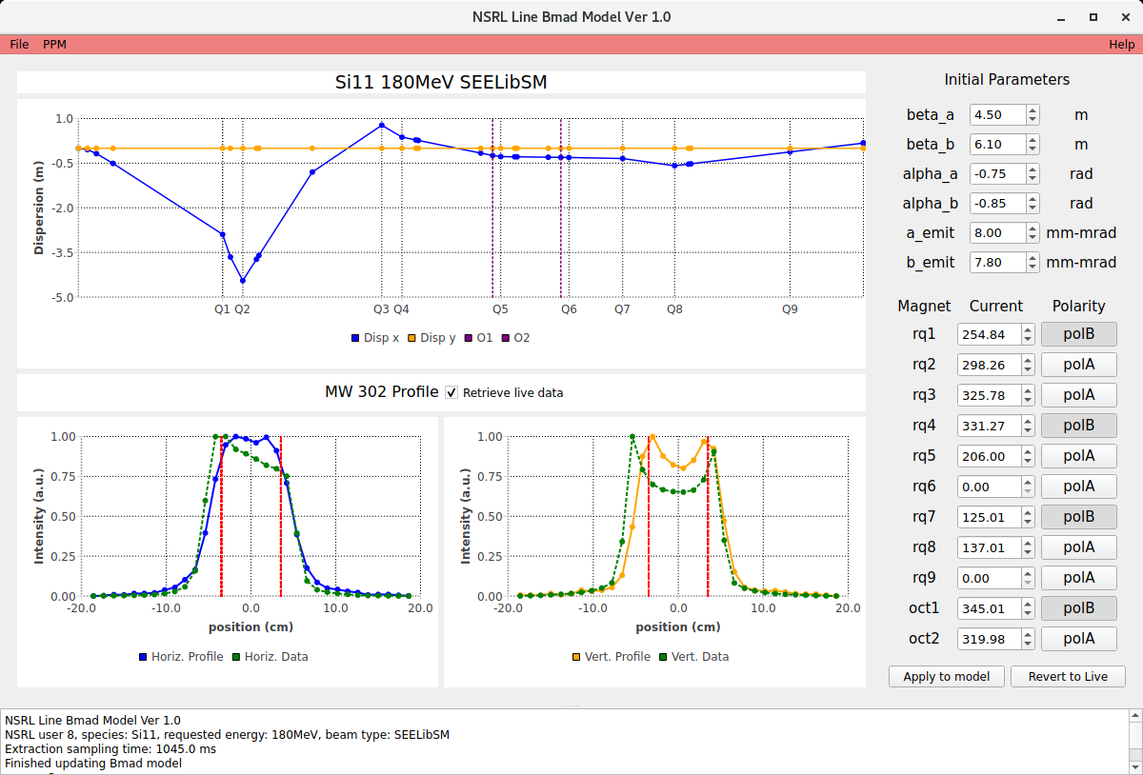
Digital Twin for NSRL line
180 MeV/n Silicon
Initial beam parameters used by model
Currents and polarities of quadrupoles from live machine
Simulated dispersion of NSRL line using live machine info
Simulated vs. real transverse beam profile at MW302

Slide 25
Future work
Attempt to better tune extraction bump shape with the help of DT and D6 flag
Find location of D3 septum using SciBmad slow extraction simulation
Develop more streamlined procedure to find accurate initial condition
Ongoing study about NSRL orbit, need to include correctors as DT variables
Continue previous effort to optimize uniformity with the help of DT

