Slide 1
NSRL BO and Transitioning to A Digital Twin Implementation with Badger
Levente Hajdu*, R. Roussel
October 2025

Slide 2
Topics:
ADO’s / Multinet (the CAD control system)
Xopt and Badger
Badger interface with Multinet
Pitfalls of the prior BO \ Image processing approach

Slide 3
Accelerator Device Objects (ADO’s) and Multinet The Basics
Multinet was selected in the 1990’s as the CAD home grown control system over EPICS for its implementation of multiplexing (PPM – Pulse to Pulse Modulated User)
Example: We can run NSRL, BLIP and fill RHIC in a multiplexed mode.
Packages for C\C++, Java, Python
Time based functions limited to C\C++ (we can bind to Python)
EIC will use EPICS for it’s control system, but the injector chain will remain with ADO for some time until upgrade resource (funds / people / hardware) can he found

Slide 4
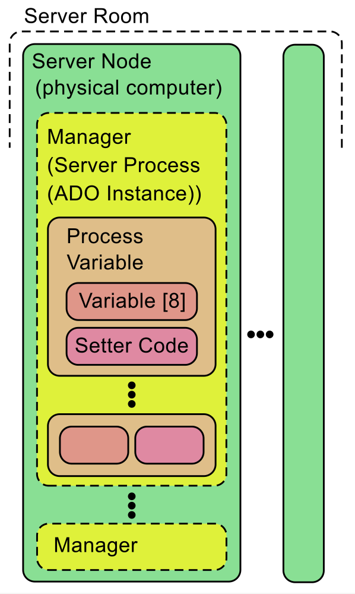
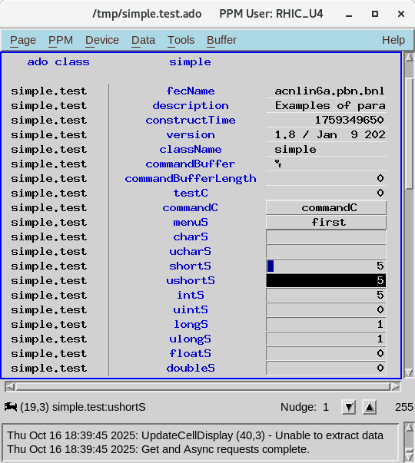
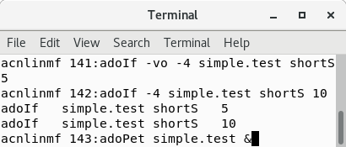
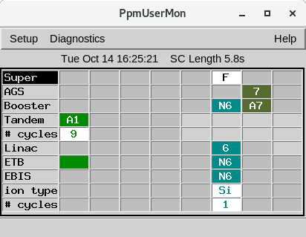
Accelerator Device Objects (ADO’s) and Multinet The Basics

Slide 5
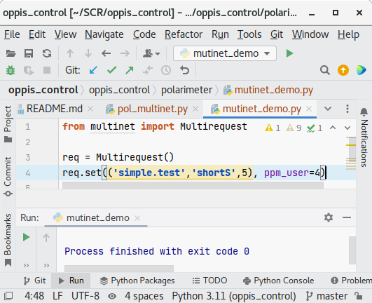

Accelerator Device Objects (ADO’s) and Multinet The Basics
Multinet is the Python package for talking to ADO’s
from multinet import Multirequest
req = Multirequest()
req.set(('simple.test', 'shortS', 5), ppm_user=4)
Yes, this could easily be replaced with an epics function call!
This assumes the developer has access to the CAD package repository
This assumes you’re on the internal controls network
Error checking is omitted

Slide 6
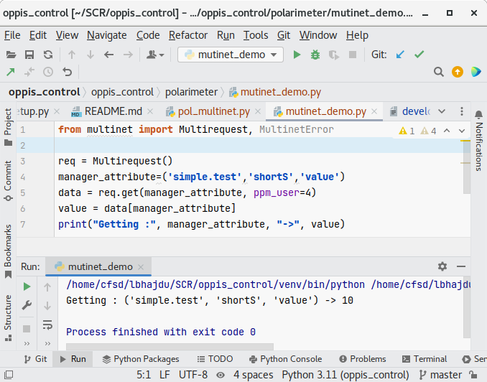
Accelerator Device Objects (ADO’s) and Multinet The Basics
Multinet is the Python package for talking to ADO’s
from multinet import Multirequest
req = Multirequest()
manager_attribute=('simple.test', 'shortS', 'value')
data = req.get(manager_attribute, ppm_user=4)
value = data[manager_attribute]
print("Getting :", manager_attribute, "->", value)
We generally encapsulate these lines into a function
Output
This assumes the developer has access to the CAD package repository
This assumes you’re on the internal controls network
Error checking is omitted

Slide 7
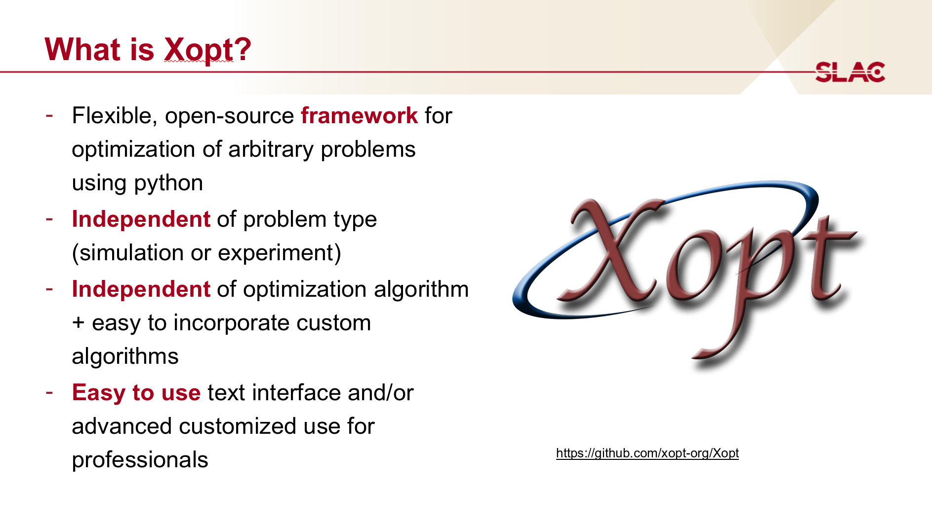

Slide 8
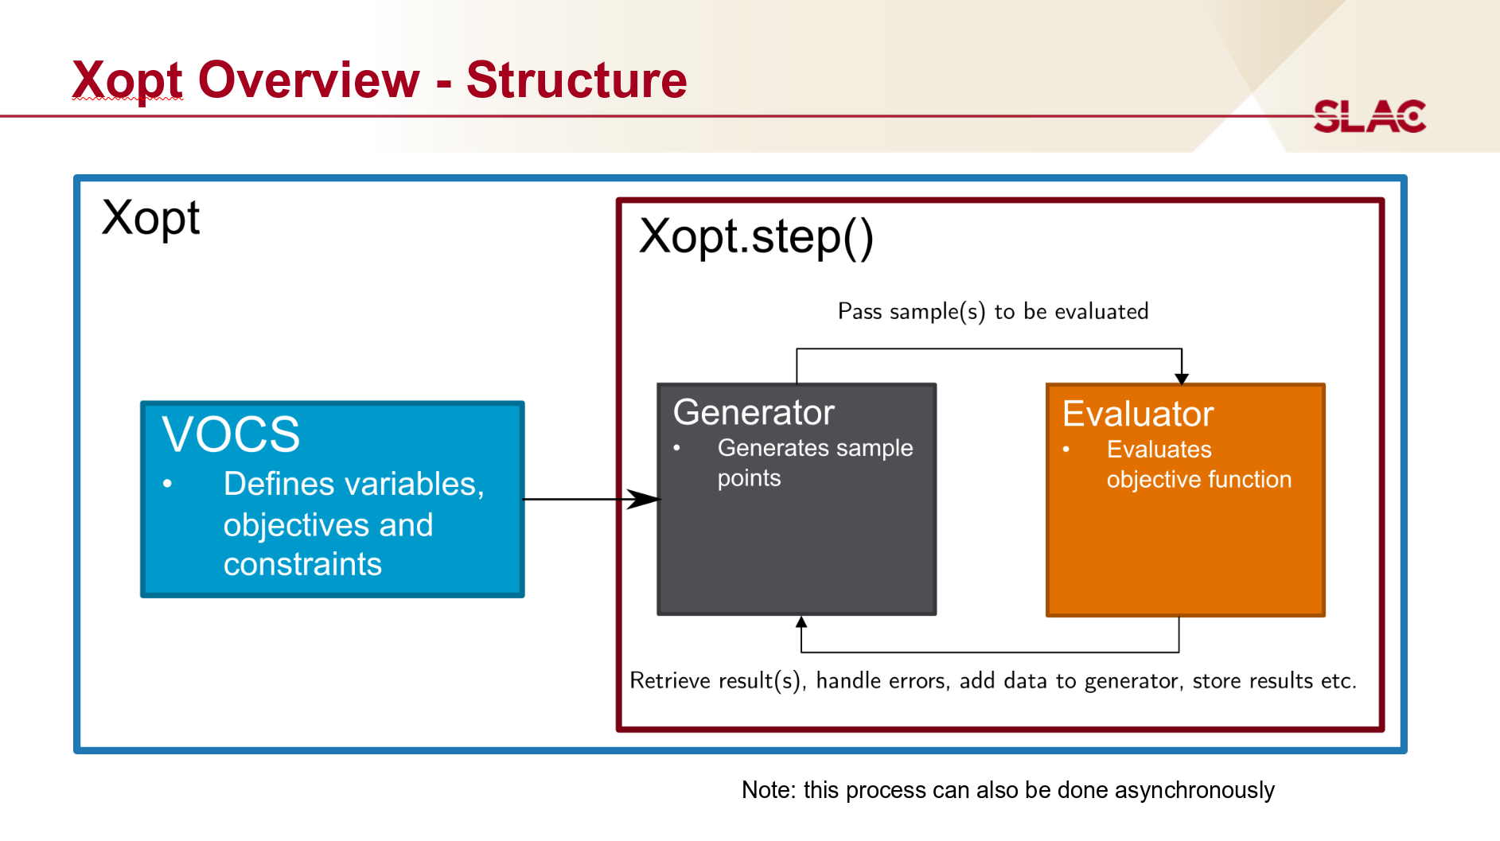

Slide 9
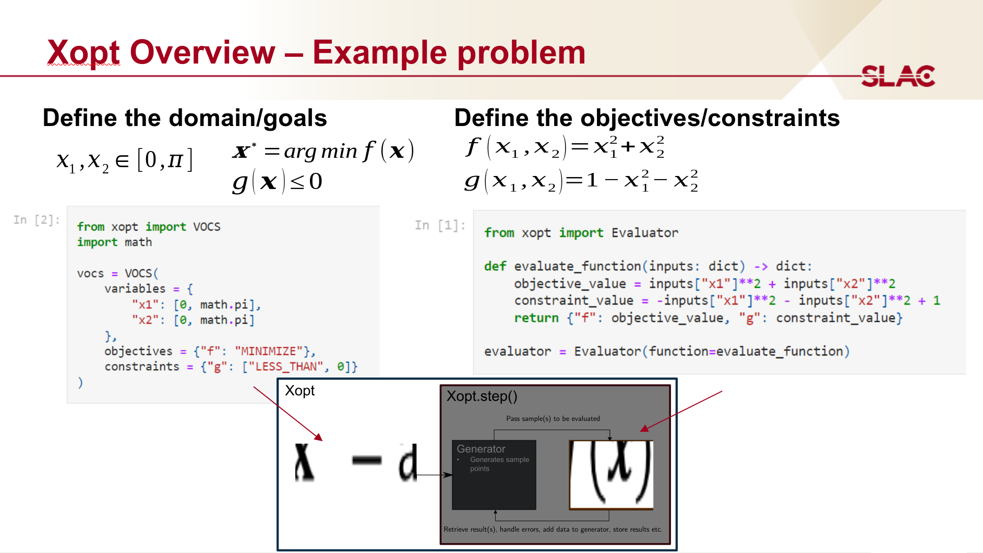

Slide 10
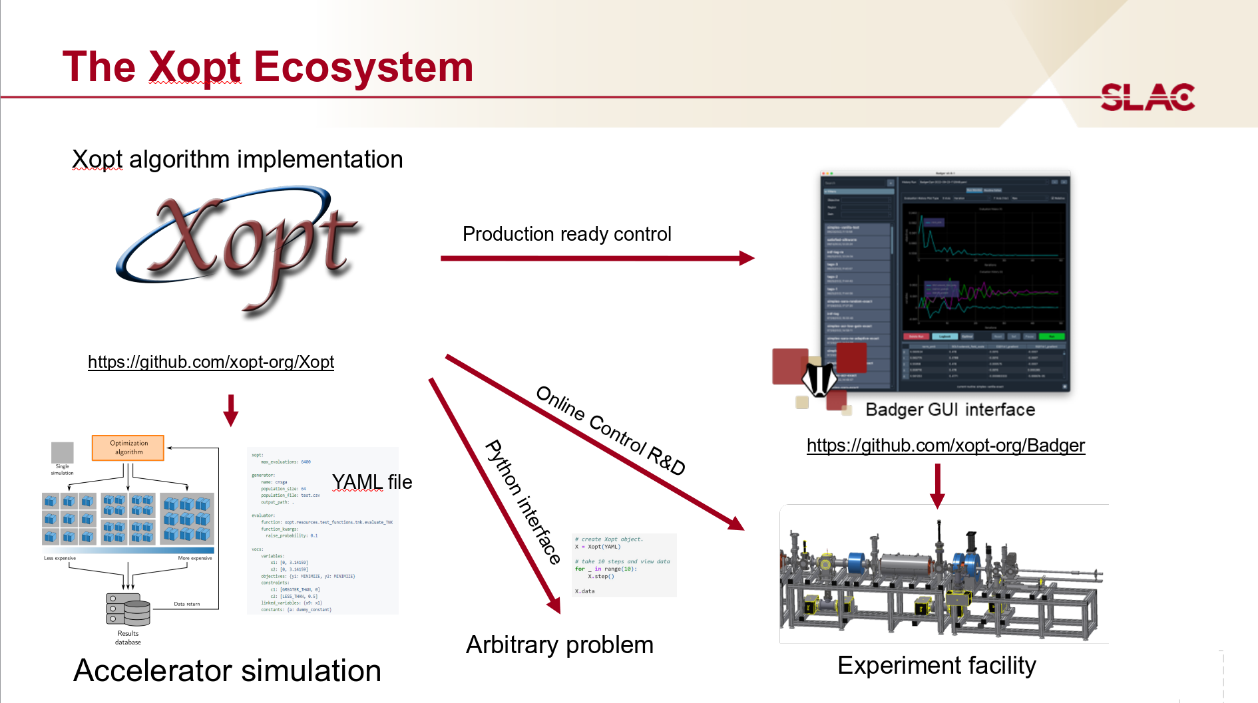

Slide 11
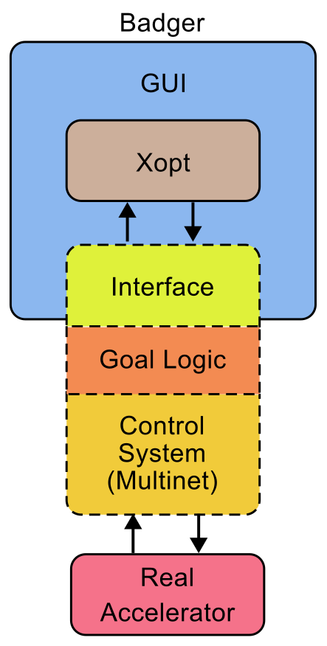
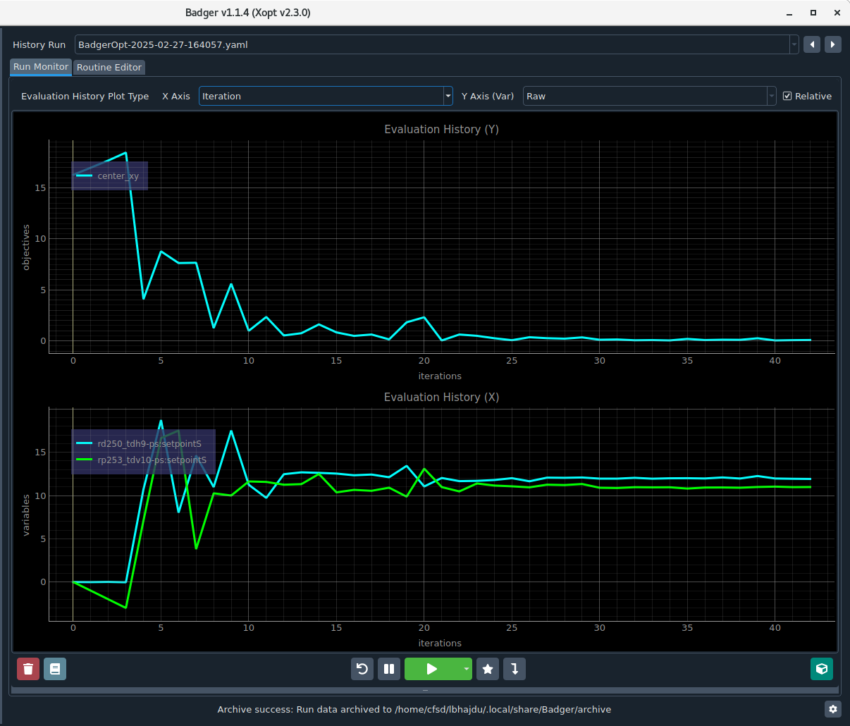
The Badger - Multinet Interface
We write this part

Slide 12
Interfacing Badger to Multinet
Base class to implement Badger interface
[min, max] we overwrite these
Badger passes us values to set as a dictionary:
class Environment(environment.Environment):
ppmUser: int = 3
agsCycleReadBackDelay: int = 2
variables = {
"rq6-ps:setpointS": [0, 2000], # size
"rq7-ps:setpointS": [0, 2000], # size
"rq8-ps:setpointS": [0, 2000], # size
"rd250_tdh9-ps:sgnCurrentS": [-1000, 1000], # x
"rp253_tdv10-ps:sgnCurrentS": [-1000, 1000], # y
}
observables = ["center_X", "center_y", "center_xy", "box_corner_dist"]
def set_variables(self, variable_inputs: dict[str, float]):
req = Multirequest()
for var, x in variable_inputs.items():
manager, value = nameToManagerAndValue(var)
req.set((manager, value, x), ppm_user=self.ppmUser)
agsDelay(nCycles=self.agsCycleReadBackDelay)
def get_observables(self, observable_names):
dict = {}
…
return dict
"rd250_tdh9-ps:sgnCurrentS": 15,
"rp253_tdv10-ps:sgnCurrentS": 17
Sets multinet values
We pass back a dictionary of observables:
Delay
"center_X": 15,
"center_y": 17,
"center_XY": 25,
"box_corner_dist": 30
This is more complex,
But it could just be return a bpm value

Slide 13
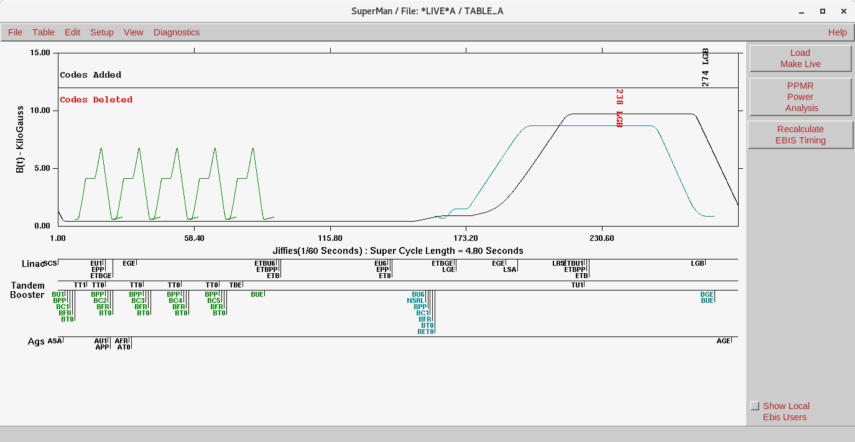
About the delay … it’s a synchrotron injector
Super Cycle Manager
Because we don’t want waveforms jumping suddenly updates are only applied on the very next cycle if they are set before the “group-end” event and then one cycle needs to happen before readback of the new data (ie 2 cycles min.)
Main Magnet Functions
Color Coded by PPM
Group End Event

Slide 14
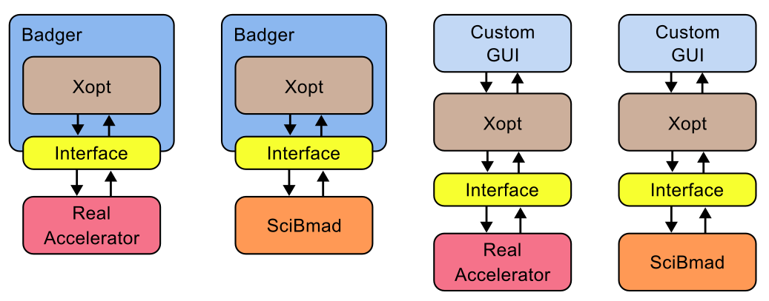
Permutations
Writing the interface to “glue” parts together is not hard so many permutations are possible:
*Assuming knowledge of your control system

Slide 15
The Pitfalls of BO with Complex Image Processing
Typically all problems arise from reporting the wrong number back to Badger
If we had it to do all over again we could get closer
but in some cases it would fail to converge
A digital twin we can adjust offline will save beam time
We may still need image processing with BO for the final step where there is tolerance drift over time
SciBmad will not model the drift over time, unless the model is adjusted

Slide 16
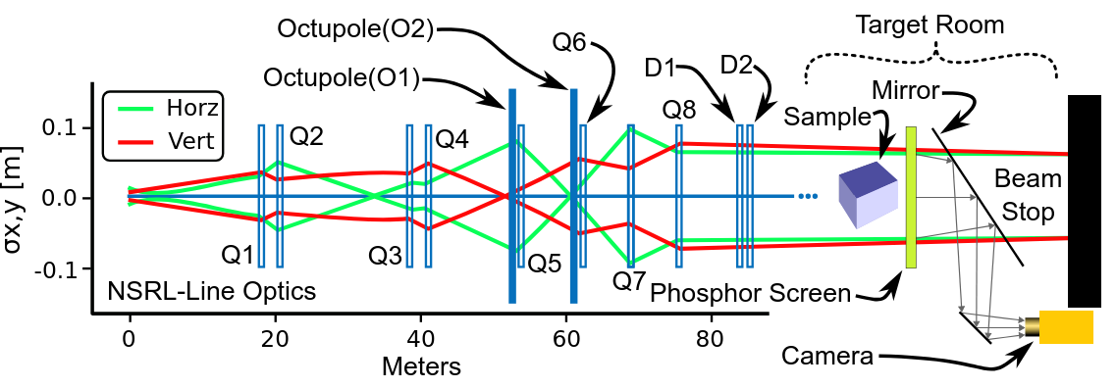
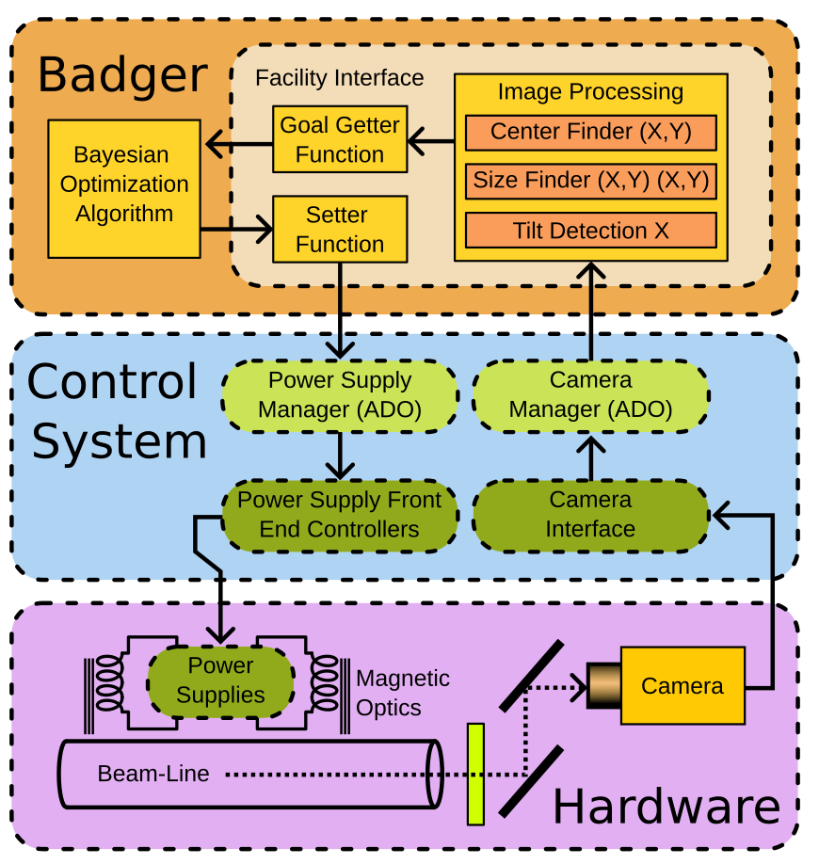
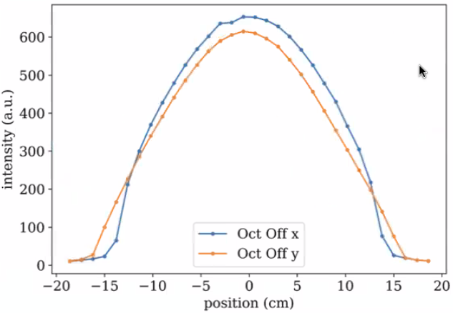
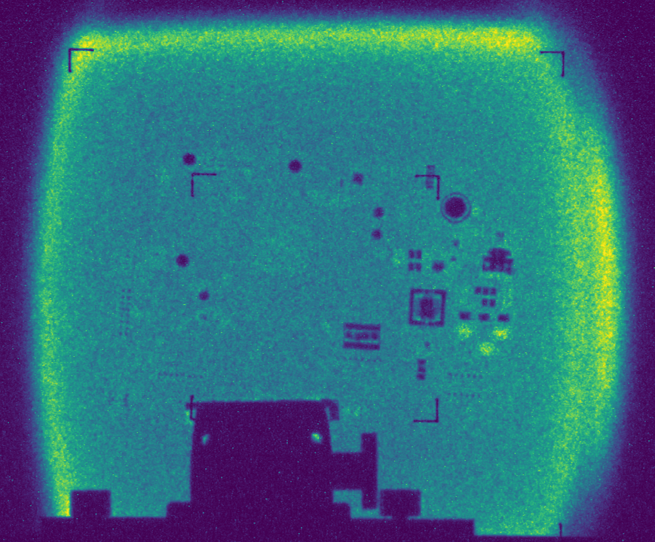

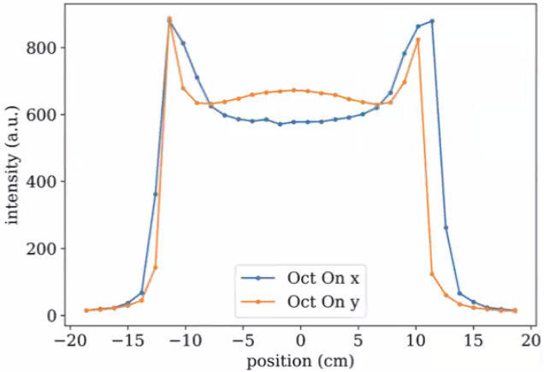
NSRL - Beamline Optics
Data flow between Badger, Control System, and Hardware
Image taken with NSRL beam imager showing PCB board being tested while being bombarded with 385MeV/u bismuth ions.
Beam species, ranging in atomic number (Z) from 1, hydrogen/protons, to 83 bismuth beams up to 20cm by 20cm uniform-area
Bmad simulation of beam profile for 211 MeV/u bismuth with octupoles on and off.
‹#›

Slide 17
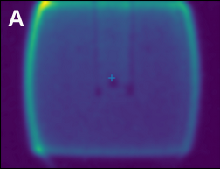
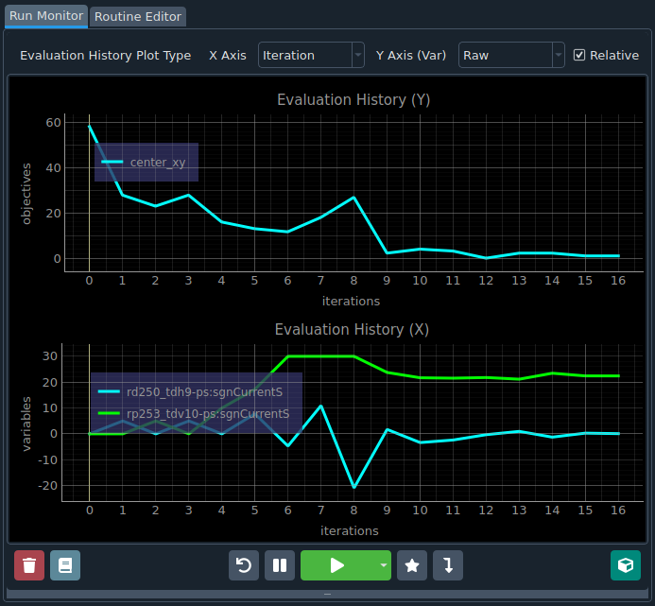
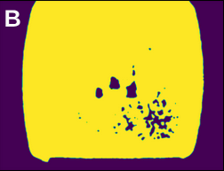
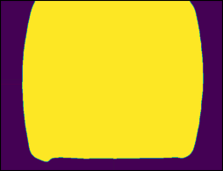
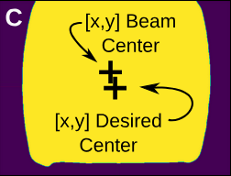
Beam Centering Goal Algorithm
Badger interface showing a beam centering study: the top plot displays the beam’s distance from the center, while the bottom plot shows dipole settings.
Gaussian Blurring
Distance to Desired Center f((x,y),(x,y))
Binary Thresholding (Otsu's method)
Contour Detection and Shape Fill
Distance to Desired Center f((x,y),(x,y))
Centroid Calculation of X and Y Moments
‹#›

Slide 18
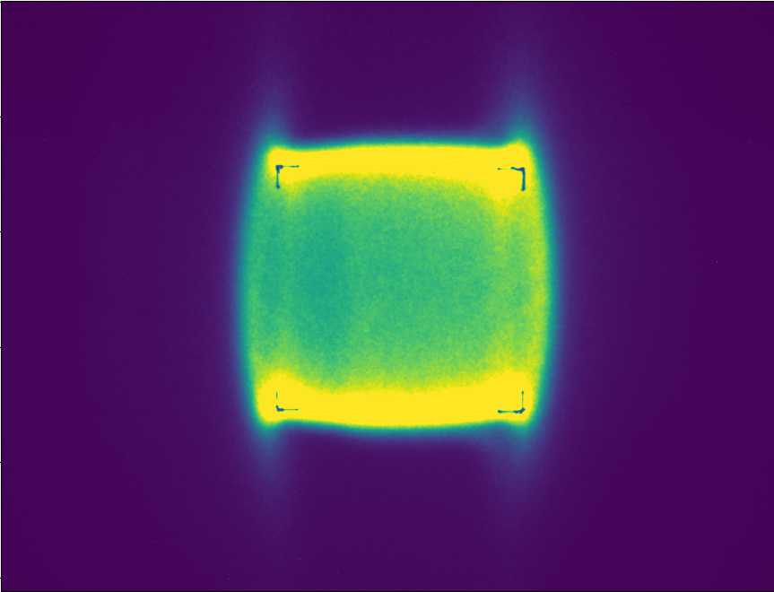
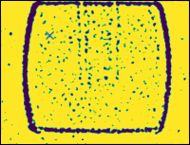
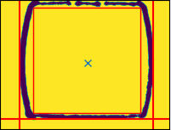
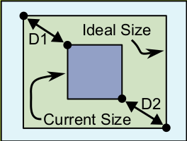
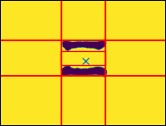
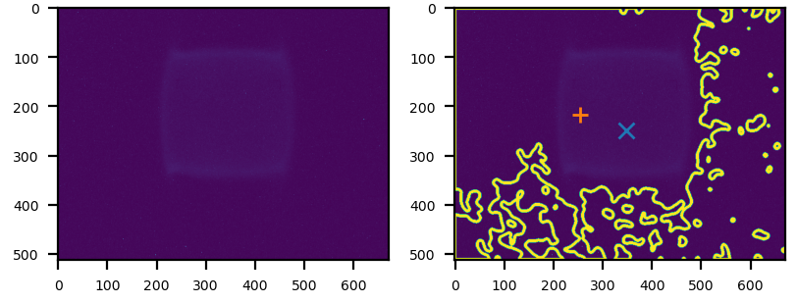
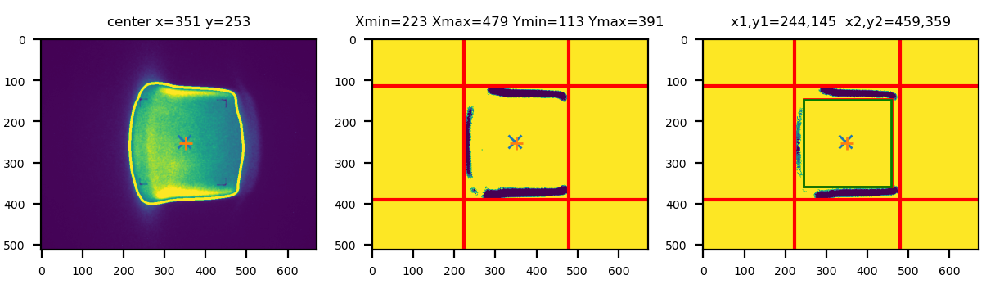
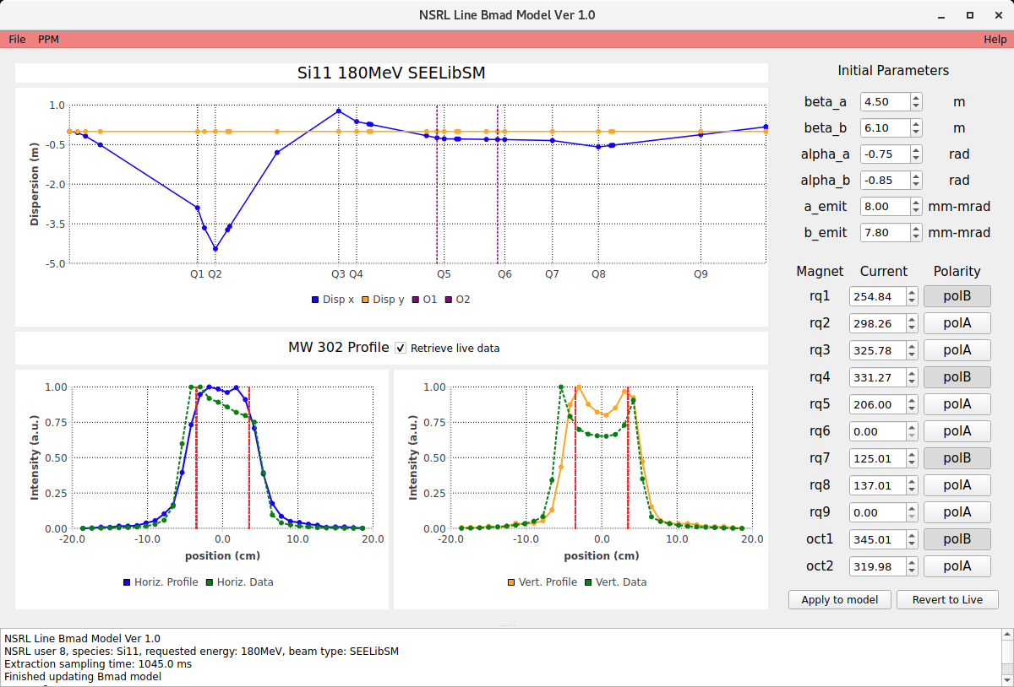
Usable Area Goal Quantification Algorithm
5cm × 5cm Beam
Adjust Sizing Quadrupole Magnets
Heavy Gaussian Blur
Adaptive Threshold (Gaussian-Weighted Neighbours)
1)Remove Pixel Islands
2) Scanning Four Outer Sides
3) Grow Out Box from Center
(Found in Prior Center Finder Step)
Calculate Distance to Corners of Ideal Size
It still works with only 2 sides found
Future Work: A True Digital Twin
Made By W. Lin
Typical debugging strip printed out with each spill
Signal Too Small (Will Not Converge)
‹#›

Slide 19
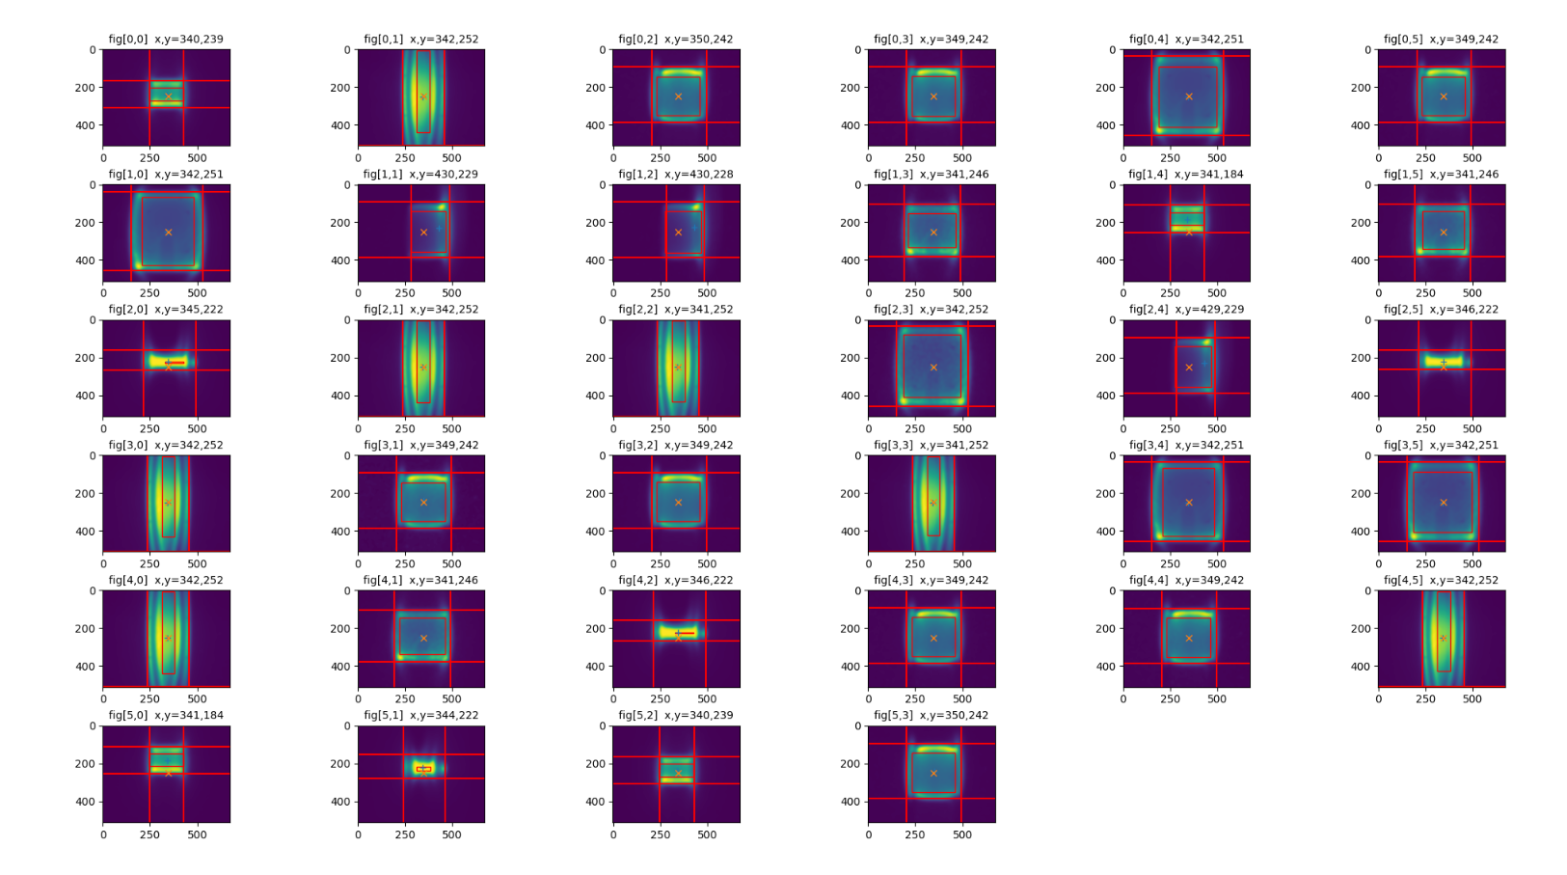
We thought we had good offline test until we tied it live (species, aperture,energy)

Slide 20
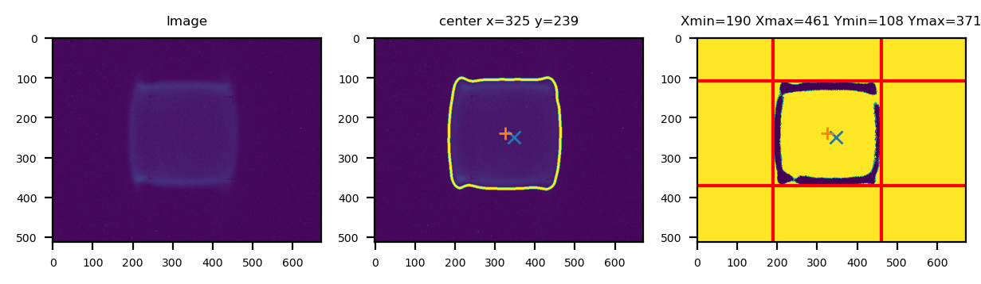
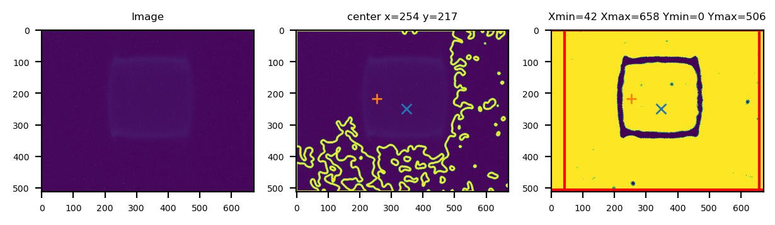
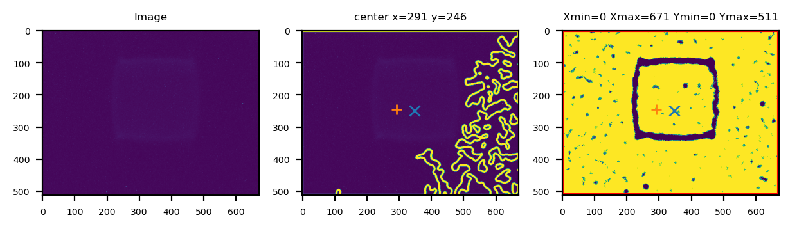
Camera Aperture Stop-Down Test
This is when we released just finding the right threshold was not going to cut it and we need to remove small islands of pixels.
The human eye can still see the shape
If we had it to do over we would have used the Gaussian-Weighted neighbours threshold over Otsu's method for thresholding

Slide 21
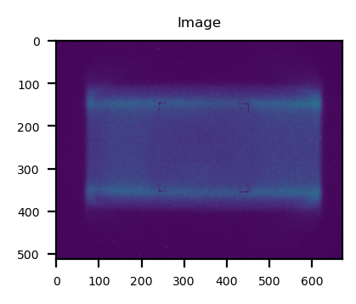
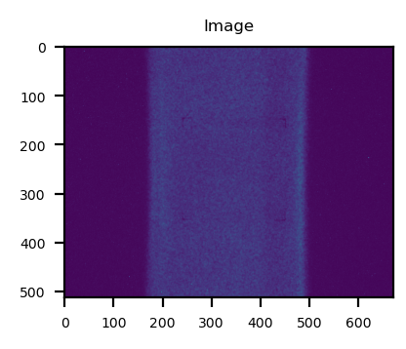
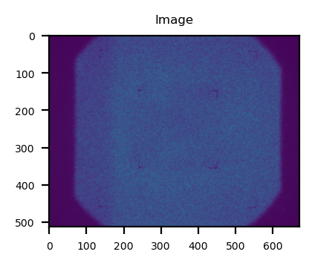
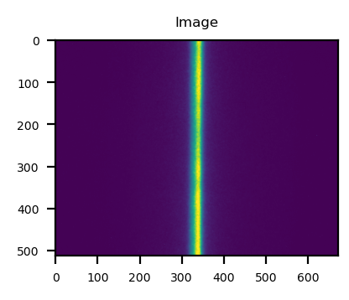
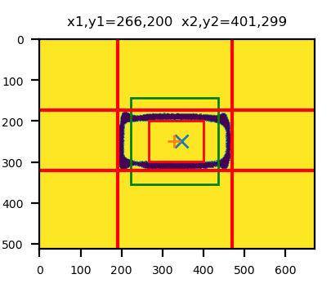
Too Much Travel
The whole beam pipe
Object it the way, we could have moved this
Wrong box expansion

Slide 22
The Next Step … A True Digital Twin … By Lucy

