Slide 1
G-gamma meter evaluation, inc. Booster and AGS
V. Schoefer
10/18/2025

Slide 2


What is the “G-gamma meter”?
Just an energy meausurement
Gamma is the Lorentz energy factor
G is a quantity related to spin: puts the energy in units convenient for interpreting spin motion (GƔ)
The Thomas-BMT equation for spin motion
$$E_{tot}=γE_{0}$$
$$\frac{dS}{dt}=\frac{e}{γm}S×\left[\left(1+Gγ\right)B_{⊥}+\left(1+G\right)B_{∥}+\left(Gγ+\frac{γ}{γ+1}\right)\frac{E×β}{c}\right]$$
Initially created for the AGS to help time in energy sensitive spin-related corrections
Necessary to know the energy as a function of time through acceleration
Somewhat more difficult than a static situation
Machine learning involvement proposed early in the collaboration
Languished after we lost some collaboration members…

Slide 3
Motivations for precision energy measurements
Corrections that require fast ‘jumps’ | Facilities
Tune jumps/skew quad pulses for polarization | AGS
Closed orbit distortions for spin imperfection resonances | AGS, EIC(RCS) ← explicit interest from V. Ranjbar
Ɣtr-jumps for transition crossing | AGS, EIC(HSR)
Reproducibility of setups | Facilities
Fast switching of species | NSRL(Booster), HEET(Booster,AGS)
Maintaining high precision beam transfers | EIC (RCS→ESR transfer directly into collision with ions
Feedback for unstable low energy transfers | NSRL(Booster): could extend the plausible range of species to include some at very low rigidity
Supplement precision steady state energy measurements | Facilities
Storage energy determinations | EIC(ESR), FCC-ee
Plan is to use resonant depolarization (destructive)
Can we help supplement precision monitoring between dedicated measurments?

Slide 4
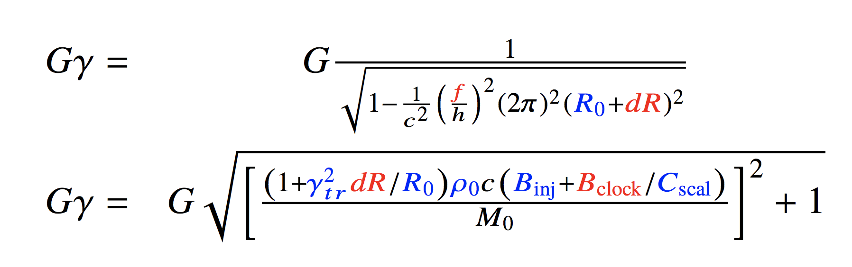
How energy measurement works at AGS
Calibration of the Ggamma meter consists of calculating Gg two ways:
Gg(B) and Gg(f) at the same times in the cycle and
fitting the BLUE parameters until they agree to sufficient precision
From RF frequency
From field
In RED:
Measured quantities
f = RF frequency
dR = radial shift from ’zero’
B_{clock} = Field reported by Gauss clock
In BLUE:
Machine parameters (not known to sufficient precision)
Ɣ_{tr} = transition gamma
R0 = true central radius of AGS
ρ₀ = avg bend radius of AGS main magnet
C_{scal} = Gauss clock calibration (gauss/tick)
B_{inj} = Dipole field at injection
Bddfactor = [NOT IN FORMULA] Gauss measurement sensitive to (B-double dot), not well understood

Slide 5
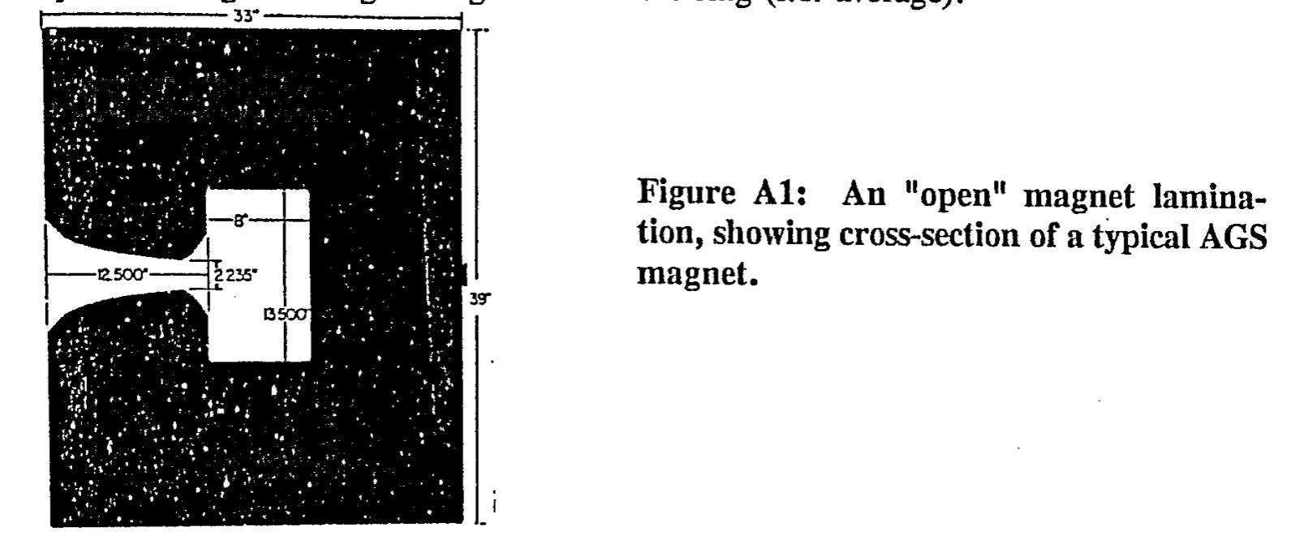
Main Magnet Field Measurement
Measurement via Hall Probe + “Gauss clock”
Hall probe measures field at injection (low bandwidth)
Changes from that field measured by coil in a reference magnet
Located outside the AGS tunnel
Powered in series with ring
Ref magnet is a type A: Long and open
Coil length is chosen to reflect average of long/short magnets
Note: if saturation/hysteresis is different in ‘closed’ magnets, this is a systematic error
Induced voltage is fed to voltage-to-freq converter, produces a ‘tick’ every ~20 gauss (both up and down, can measure how flat a flattop is
THE DESIGN OF THE DIPOLE PICK-UP COILS FOR USE WITH THE AGS GAUSS CLOCK, AGS TECH Note 363, Warner Van Zwienen

Slide 6
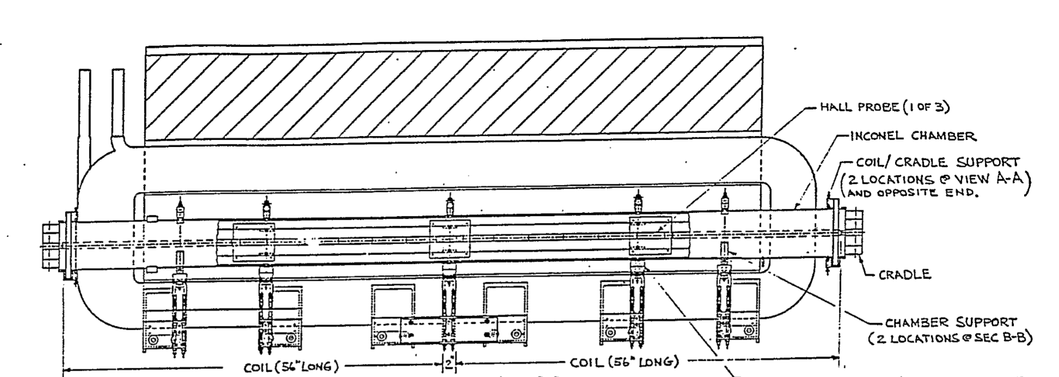
Gauss clock coil setup
Top down view of AGS main magnet
Magnet backleg (steel)
Coil 1
Coil 2
Beam -->
Coils are wound in two sections with a 2” gap in the center of the magnet body
Gap reflects the difference between a ‘long’ AGS magnet and the average AGS magnetic length

Slide 7
Measurement inputs
f = RF frequency → Frequency
dR = radial shift from ’zero’
B_{clock} = Field reported by Gauss clock
Value |  | Device | Notes
RF frequency | f | Frequency meter with RF sweep input signal | Measured over ~2 ms (trade between precision and f’’) | Loses sensitivity at high energy (relativistic beam has very small df/f for energy changes
Radial shift | dR | Average of horizontal PUEs | Can be distorted by local bumps, missing PUEs
B-field | B_{clock} | Reference AGS magnet with coil produces ‘up’ and ‘down’ ticks every ~20 gauss. Integrate to get *change* in field | Calibration uncertain, B-dot effects | Needs to be told about the injection field to get absolute field measurement

Slide 8
Machine/Fit Parameters
Quantity |  |  | Typically included in fit?
Radius of AGS | R0 | Unknown to sufficient precison, definition is subtle for combined function magnets. | Yes
Gauss clock calibration (gauss/tick) | Cscal | Nominally 20 Gauss/tick, usually a little under. Up not necessarily equal to down tick, but down not relevant for this | Yes
Ramp rate error in Gauss clock | Bddfactor | Unknown origin of this systematic error, crucial to include it (if not included, the difference between Gg(B) and Gg(f) has the shape of B-dot | Yes
Injection B-field | Binj | Provides initial field for gauss clock | No, manually set to make Gg(B)=Gg(f) at injection where Gg(f) is still very precise
Transition gamma | Ɣtr | Nominally ~8.5, weak knob, jumps near transition usually excluded for other reasons | No
AGS avg Bend radius | ρ₀ | Causes some numerical trouble, near non-orthogonality with B,R parameters | No

Slide 9
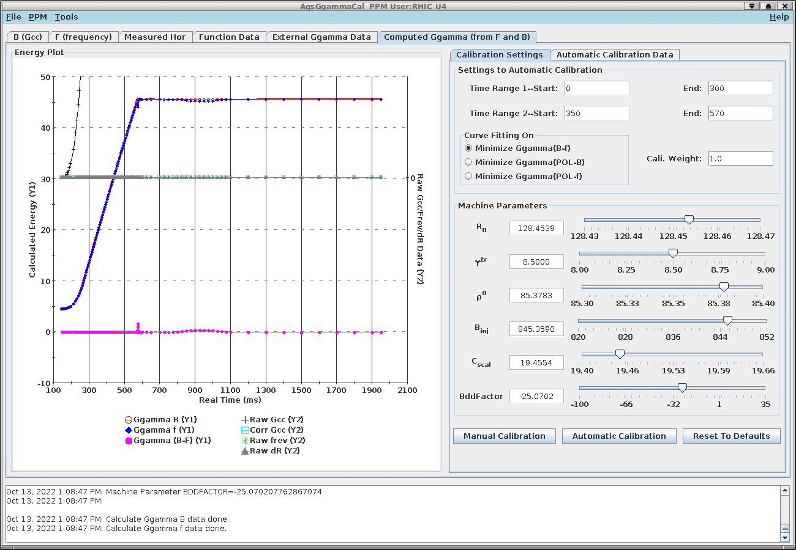
AgsGgammaCal application
Imports B,f data (acquired at the orbit acquisition times) and calculates the energies
Averages over an arbitrary number of cycles (necessary for precision frequency data at higher energy)
Allows manual changing of parameters and automatic fitting
Typically achieve <0.01 difference in Ggamma between methods
Calculated energy from quantities measured at ~100 times in cycle
Minimize difference Gg(f)-Gg(B)

Slide 10
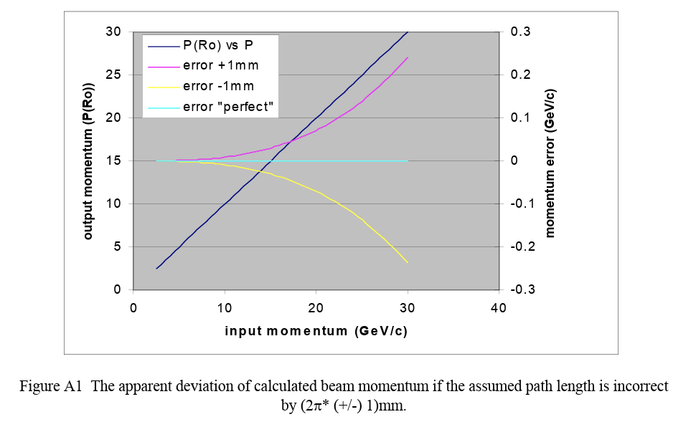
Systematic difficulties
Magnetic field:
Gauss clock measures changes in magnetic field: calibration only known to a few percent
Drifts over time (long standing problem, see vertical tune jump from 1980’s)
Injection field needed as starting field: Measured with Hall probe, usually fit to make initial Gg(B)-Gg(f) minimal
Frequency:
Measurable to high precision but
Relativity: as beam speed approaches, same changes in energy produce smaller changes in frequency
Error in gamma due to path length error grows quadratically with energy
From C-A/AP/#79
Determining the. Momentum of a Beam Accelerating in the AGS
L. Ahrens and M .Harvey

Slide 11
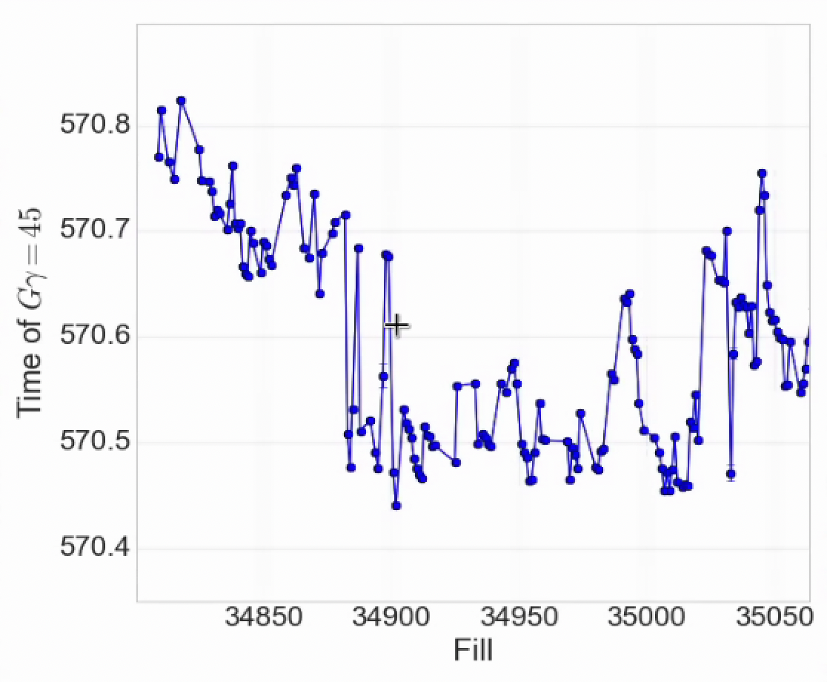
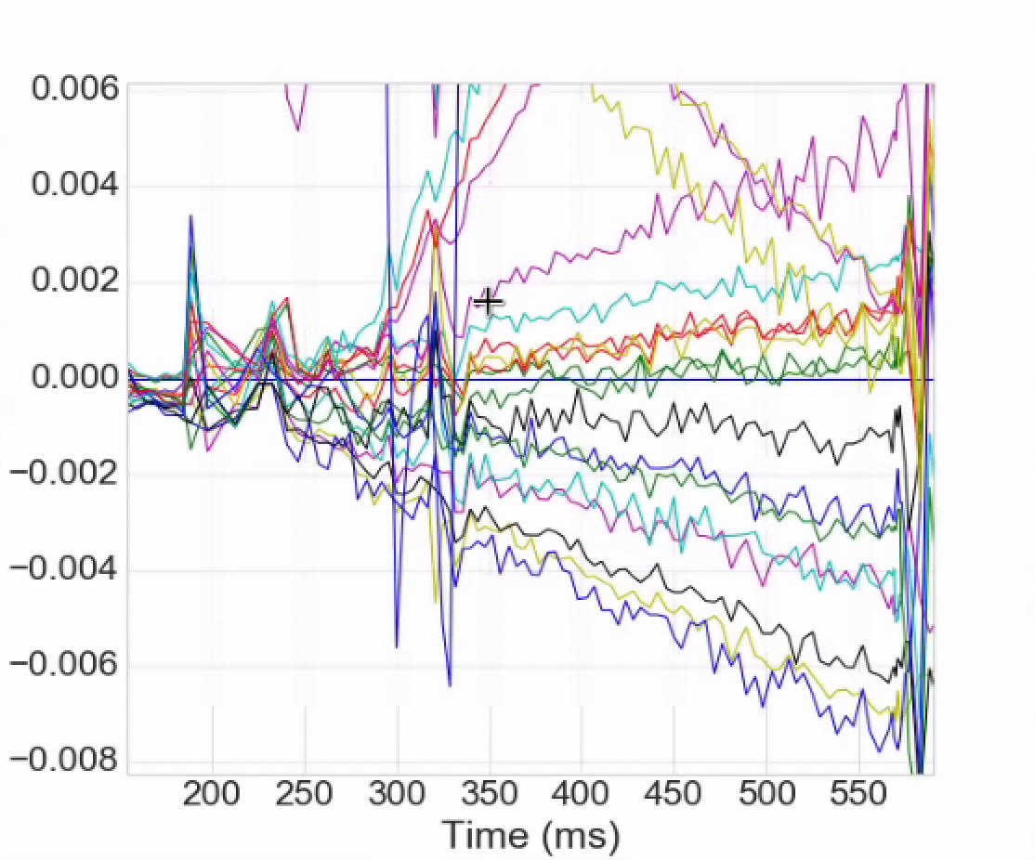
Energy stability in AGS
Arrival time at GƔ = 45
Slow drift of the energy as a function of time during the ramp
For tune jump 100 us is significant, 200 us is bad
Tolerance is better with skew quads, but would still prefer stability
Injection matching
Change during a fill is small (drift is ~hours)
Deviation is often linearly increasing during ramp
ML project to improve calibration precision, make online continuous calibration and quantify uncertainty
Conventional analysis of the MM field contribution to this drift
We have a slow software feedback for RHIC energy matching
Consider developing a system for the whole cycle
~ 6 wks
Change in GƔ during acceleration, fill by fill
ΔGƔ

Slide 12
AI/ML opportunities
Software manager collects all the input data for the calculation every cycle
Calibration (parameter determination) usually requires averaging over 30-50 cycles
Occurs manually on a roughly weekly basis
Extension to Booster is straightforward: all necessary parts exist, needs a manager, maybe a dedicated frequency meter
Can incoming data be continually assimilated to make parameter estimates?
Requires data quality checks (cycles without beam, occasional comm errors etc.)
Requires context sensitivity: AGS is always switching configurations during the run, important to maintain parameters appropriately
Uncertainty quantification
Can this help determine where we should put efforts into increased precision?
Radial measurement is based on average of BPMs: very crude
Model could use global BPM data to infer real path length
Model knows path length impact of the helical dipoles
What other data can we be bringing in? The Gg(B)-Gg(f) calibration is especially challenging in electron machines where the Gg(f) is basically always very sensitive.

Slide 13
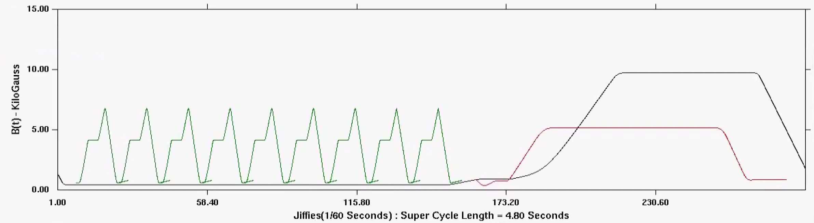
Booster Field/Energy
Booster also has a gauss clock
Absolute energy less crucial to. polarization in current operation (than AGS)
Fast extraction to AGS triggered by gauss clock (during acceleration)
Relative field changes over an interval (Gauss clock Up-Down counts)
Used to measure flatness of porches (merges, slow extraction)
AI/ML opportunities
Fast information about field
Stability of BtA transfers (combine with injection TBT)
Input for ML approaches to slow extraction spill stabilization

Slide 14
Brookhaven Accelerator Complex Scheduling
End of RHIC physics program nominally: Dec 2025
Possible extension of (up to) order 6-8 weeks (very ambiguous)
Extended operation all involved polarized protons in the AGS
Linac (polarized protons) become available for studies early-mid Nov (independent of RHIC run extension)
Last extended running for a while
Likely to be very tightly packed schedule (”no snake” studies are much easier to work in)
The Middle Ages (the period between RHIC shutdown and start of EIC)
NSRL operations in Booster continue as normal (study time negotiable)
AGS planned to operate (on average) two months a year
Longer operations with longer shutdowns probably preferable (4 months every 2 years, e.g).
EIC related priorities are demonstrating
polarized He-3
general polarized beam developments
Other programs proposed but not yet planned: HEET, AtR test beams

Slide 15
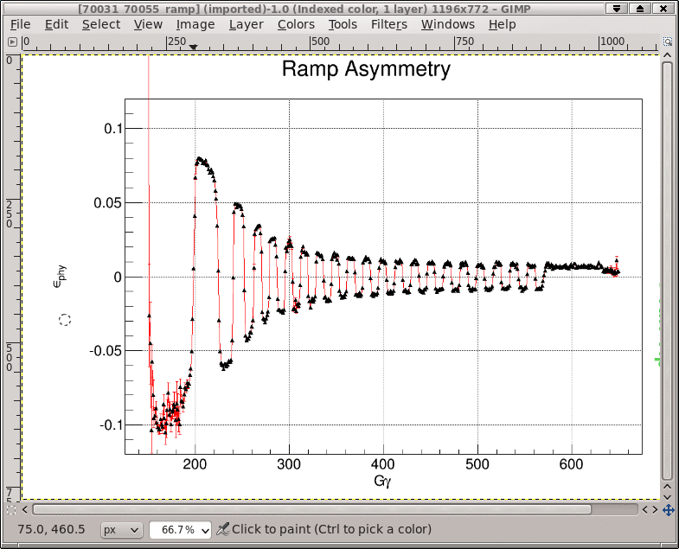
Alternate energy measurement: spin flip
Partial snake causes spin flips at particular energies:
Gɣ = integers
Measured with carbon polarimeter
Fit asymmetry to spin flip formula: read off the energies
Benefits: simple, very few systematics to worry about, sufficient precision
Drawbacks: Takes a full shift to measure (Ggamma meter is continuous), takes some post-processing, measurement energies and resonance energies are different-- have to interpolate to resonance times.
Tune jump times are typically derived from spin flip and Ggamma meter and both tried. Typically times/polarization are similar in both cases. Ggamma meters allow continuous monitoring

