Slide 1

SciBmad: A modern, high performance, and differentiable accelerator physics ecosystem
Matt Signorelli
3rd AI/ML for EIC Hadron Pre-injectors Collaboration Meeting
Ithaca, NY, October 20-22, 2025

Slide 2
Accelerator Software Wish-List
Fully usable in high-level programming languages (Python and Julia)
Modular and easy to integrate with other programs/machine learning tools/optimizers
Fully nonlinear, non-paraxial, symplectic integration including spin
Super fast by SIMD/SIMT-parallelization on both the CPU and GPU
Nonlinear parametric normal form analysis including spin and radiation
Arbitrary interdependent and time-dependent lattice parameters
Advanced lattice definition and design tools
Forwards-, backwards-, and Taylor-differentiable
Can we have all of this? Enter: SciBmad
Notes:
Modularity
In Julia we get JIT-ted functions to use with other itnegrators and optimizers without having to abide by any rules/use tensors
Easy to use; Julia is easy to use, but we will have a full-featured python interface (like wrapping C code in python)
GPU and CPU parallelization we automatically get for free by using Julia
Programs/tools: all of Julia’s plotters at your service lattice “parsing” in Julia language itself

Slide 3
SciBmad
A new…
Modular
High performance
CPU/GPU compatible
Differentiable/polymorphic
Fully-featured
…accelerator physics simulation ecosystem usable from Python or Julia
SciBmad
Beamlines.jl
Fast, differentiable, advanced accelerator lattice definitions
GTPSA.jl
Fast high-order differentiation using the GTPSA library
NonlinearNormalForm.jl
Parametric map-based perturbation theory including spin and radiation
BeamTracking.jl
CPU/GPU compatible, polymorphic integrators
AtomicAndPhysicalConstants.jl
Physical and particle constants library.
Implemented as a modular toolkit for rapid development of higher-level programs
Notes:
Modularity
In Julia we get JIT-ted functions to use with other itnegrators and optimizers without having to abide by any rules/use tensors
Easy to use; Julia is easy to use, but we will have a full-featured python interface (like wrapping C code in python)
GPU and CPU parallelization we automatically get for free by using Julia
Programs/tools: all of Julia’s plotters at your service lattice “parsing” in Julia language itself

Slide 4
Composability with other packages
In a high-level programming language, we can use any optimizer, plotting package, and/or AI/ML tool written by other people
SciBmad offloads the work from the accelerator physicists to other experts
E.g. suppose you have a tracking function, and you want the closed orbit:
We can use any optimizer, written by other people, immediately. E.g. Optim.jl:
Or NLSolve.jl, etc.
function track(ring, z0) ...
return z_out
end
using Optim
optimize(z->norm(z-track(ring, z)), zeros(6))
using NLsolve
nlsolve(z->norm(z-track(ring, z)), zeros(6))
In this workshop, you’ll do an example with Xopt
Work is currently in progress to add PyTorch bindings for SciBmad (Chanpisey Ung)
Notes:
Because this is ICAP, we can get into more technical details. Composability of packages and optimizers!

Slide 5
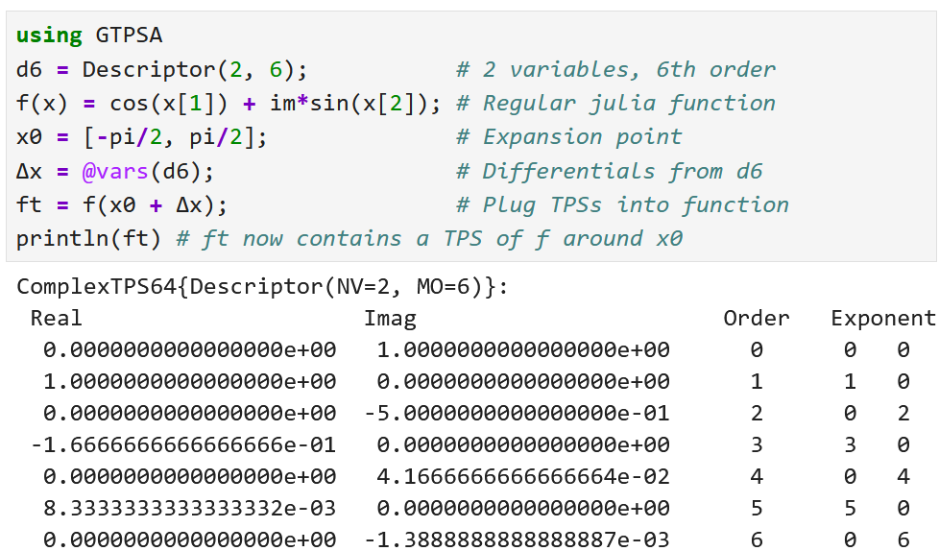
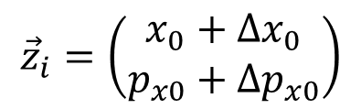
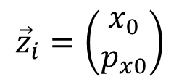
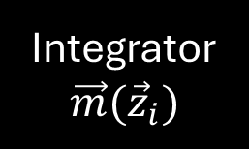
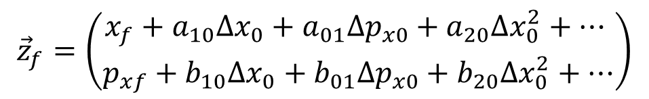
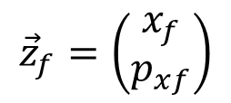

GTPSA
Regular code: Phase space coordinates are regular 64-bit floating point numbers
$${\vec{z}}_{i}=\left(\begin{matrix}x_{0} \\ p_{x0}\end{matrix}\right)$$
Integrator
$$\vec{m}({\vec{z}}_{i})$$
$${\vec{z}}_{f}=\left(\begin{matrix}x_{f} \\ p_{xf}\end{matrix}\right)$$
Polymorphic, differentiable code: Coordinates are Truncated Power Series
$${\vec{z}}_{i}=\left(\begin{matrix}x_{0}+Δx_{0} \\ p_{x0}+Δp_{x0}\end{matrix}\right)$$
Integrator
$$\vec{m}({\vec{z}}_{i})$$
Identity map as TPSs
$${\vec{z}}_{f}=\left(\begin{matrix}x_{f}+a_{10}Δx_{0}+a_{01}Δp_{x0}+a_{20}Δx_{0}^{2}+… \\ p_{xf}+b_{10}Δx_{0}+b_{01}Δp_{x0}+b_{20}Δx_{0}^{2}+…\end{matrix}\right)$$
Integrate the map in the same integrator as for regular particles, get the Taylor map for free!
Notes:
Because this is ICAP, we can get into more technical details. Composability of packages and optimizers!

Slide 6
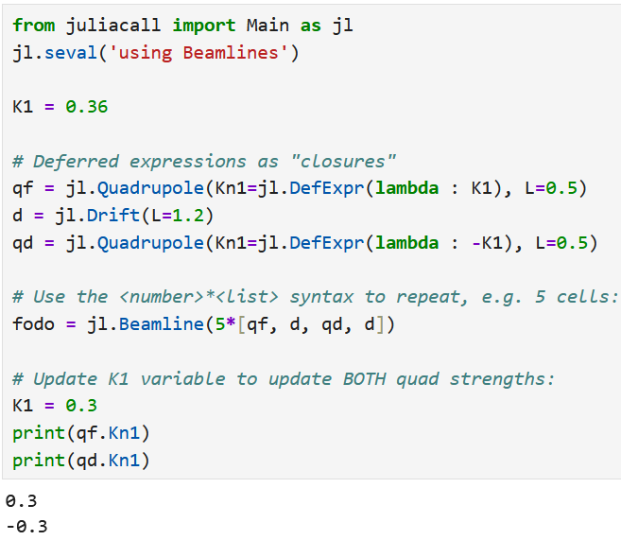
Beamlines
Fast, powerful, differentiable, and polymorphic lattice definitions
Closely follows the increasingly-popular Particle Accelerator Lattice Standard (PALS)
Lattice definition in the language itself (Python or Julia)
Everything is a lazily-evaluated deferred expression – no bookkeeper, faster, and less bugs!
Dependent variables computed only when you need them and on-the-fly
Python example:
Notes:
Because this is ICAP, we can get into more technical details. Composability of packages and optimizers!

Slide 7
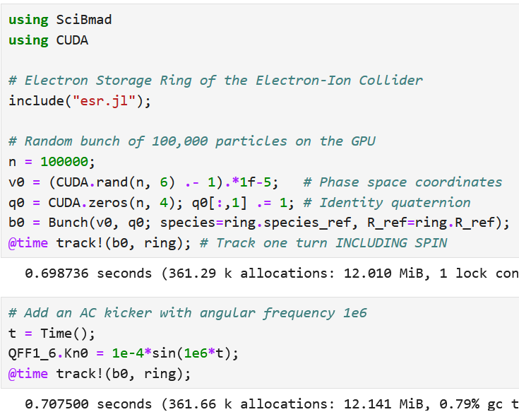
BeamTracking
Yoshida’s 2nd, 4th, 6th, and 8th order symplectic integrators for drift-kick, quadrupole-kick, solenoid-kick, and bend-kick splits including spin (Joe Devlin)
All tested against PTC
All universally polymorphic and differentiable
All CPU SIMD enabled via SIMD.jl
All GPU enabled via KernelAbstractions.jl
NVIDIA CUDA, Apple Metal, Intel oneAPI, and AMD ROCm
Arbitrary time-dependent parameters
Notes:
Because this is ICAP, we can get into more technical details. Composability of packages and optimizers!

Slide 8
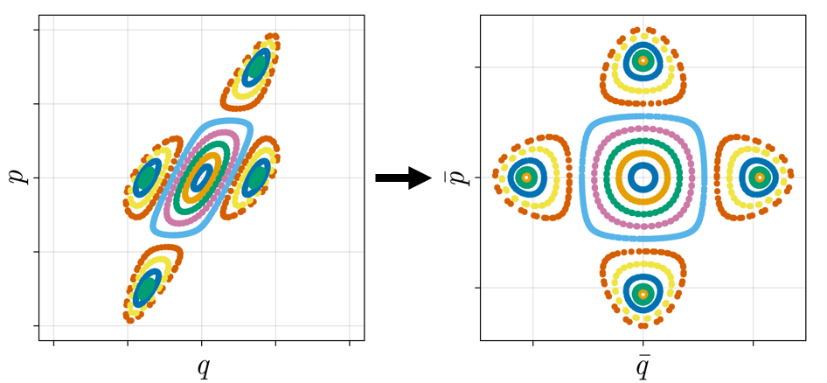
NonlinearNormalForm
Map-based perturbation theory with nonlinear, parametric Hamiltonian maps using Lie algebraic methods
Lie algebra extended to include a quaternion operator in the vector field
Spin normal form analysis same as orbital
Invariant spin field, spin resonances
Radiation, coasting beam all handled
6D de Moivre and Teng-Edwards lattice functions
Extensive tests against the Fully Polymorphic Package (FPP)
Lie operators, logs, exponents, equilibrium moments, etc.
Notes:
Because this is ICAP, we can get into more technical details. Composability of packages and optimizers!

Slide 9
Conclusions
SciBmad is/has…
Fully usable in high-level programming languages (Python and Julia)
Modular and easy to integrate with other programs/machine learning tools/optimizers
Fully nonlinear, non-paraxial, symplectic integration including spin
Super fast on both the CPU and GPU
Nonlinear parametric normal form analysis including spin and radiation
Arbitrary interdependent and time-dependent lattice parameters
Advanced lattice definition and design tools
Forwards-, backwards-, and Taylor-differentiable
✔
✔
✔
✔
✔
✔
✔
✔
Notes:
Modularity
In Julia we get JIT-ted functions to use with other itnegrators and optimizers without having to abide by any rules/use tensors
Easy to use; Julia is easy to use, but we will have a full-featured python interface (like wrapping C code in python)
GPU and CPU parallelization we automatically get for free by using Julia
Programs/tools: all of Julia’s plotters at your service lattice “parsing” in Julia language itself

Slide 10
Contributors and Thank You!
SciBmad would not have been possible without the help of many:
Dan Abell
J. Scott Berg
Oleksii Beznozov
Alex Coxe
Laurent Deniau
Joseph Devlin
Auralee Edelen
Etienne Forest
Saja Gherri
Eiad Hamwi
Alexander He
Georg Hoffstaetter de Torquat
Jack Kelley
Lixing Li
Lucy Lin
Chris Mayes
Evan Root
Ryan Roussel
David Sagan
Chanpisey Ung
Jonathan Unger
Ningdong Wang
Sophia Yang
Always open to more collaborators!

Slide 11
Our Program Today
Attendees of the workshop have put together some examples for you!
Introduction, normal form, and exact chromaticity using AD (Matt Signorelli)
Exact orbit response matrices using AD (Lucy Lin)
NRSL octupole optimization using Xopt (Eiad Hamwi)
Spin resonance crossing in the AGS (Joe Devlin)
Example Jupyter notebooks are provided in both Python and Julia

Slide 12
Installation and Demo
SciBmad is compatible with Windows, Linux, or Mac.
Installation instructions can be found here:
Introduction Jupyter notebooks in Julia and Python are here:
https://github.com/bmad-sim/SciBmad.jl
https://github.com/bmad-sim/SciBmad.jl/tree/main/examples

