Slide 1
MPGD-DSC - μRWELL-BOT bi-weekly Update on PED Test Article design
Kondo Gnanvo – Sept. 18, 2025

Slide 2
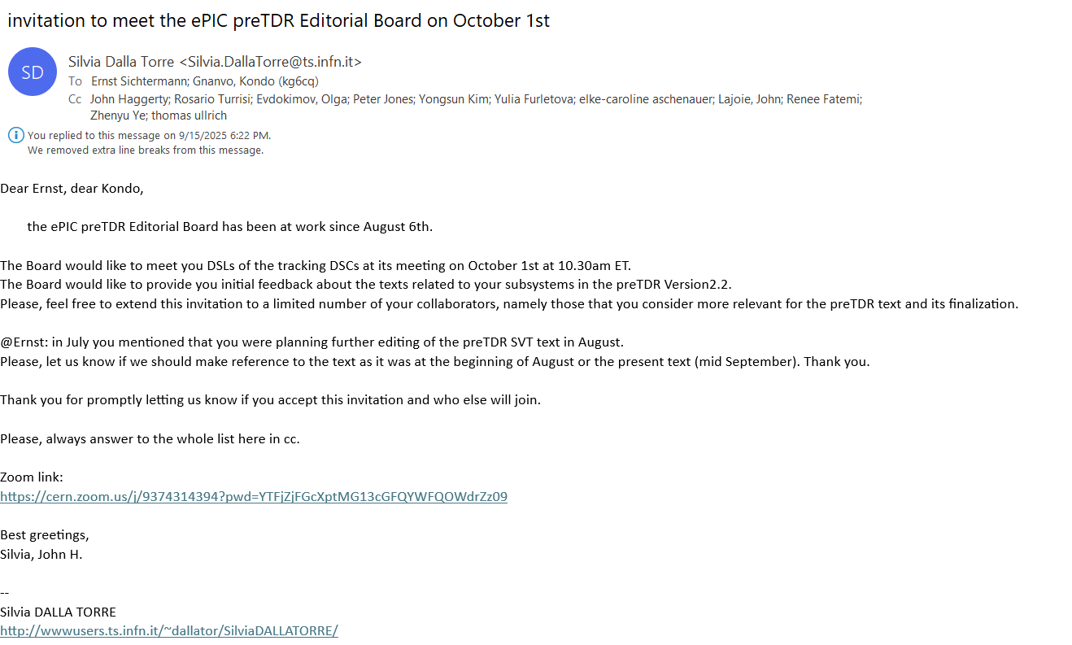
ePIC preTRD discussion meeting with Editorial board

Slide 3
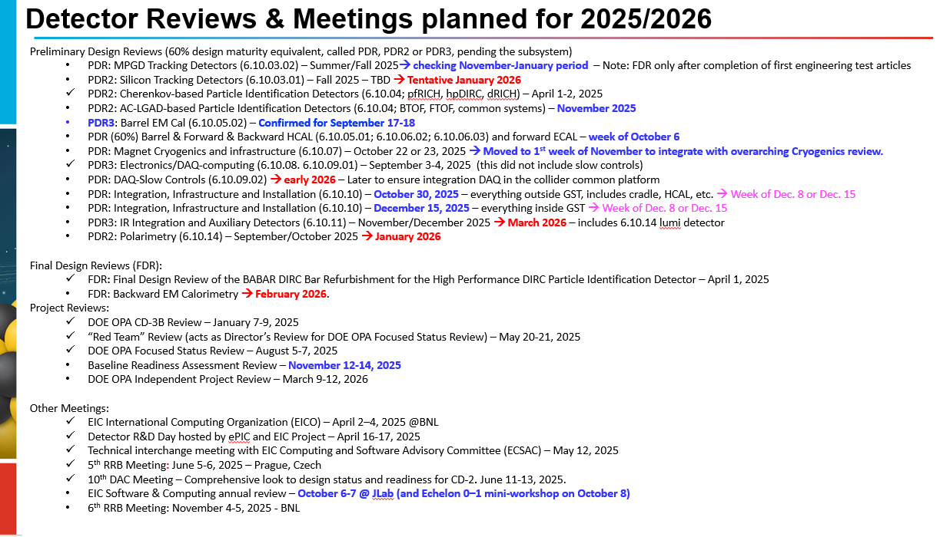
MPGD PDR review dates

Slide 4
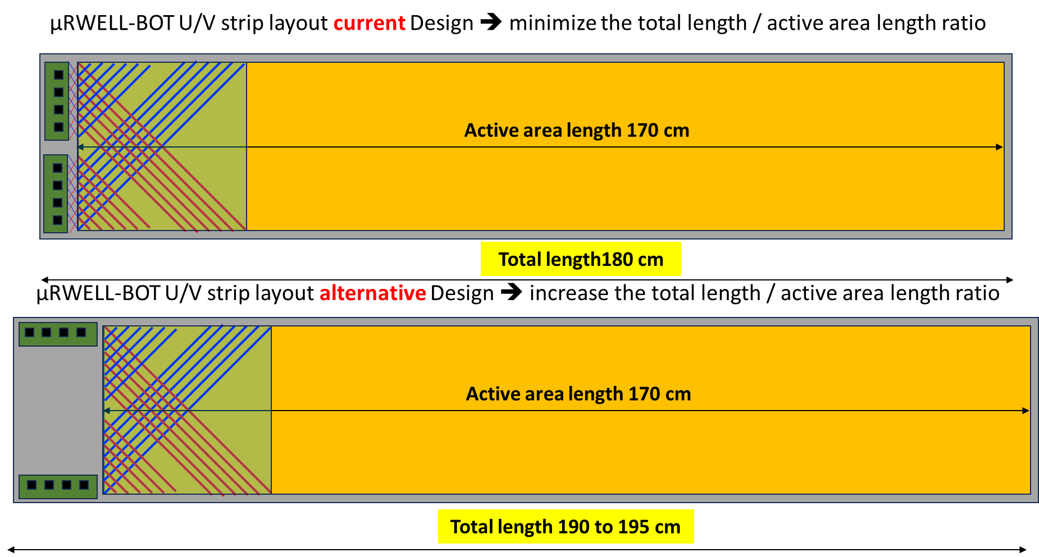
μRWELL-BOT module: Discussion on readout design modifications
GEM foil

Slide 5
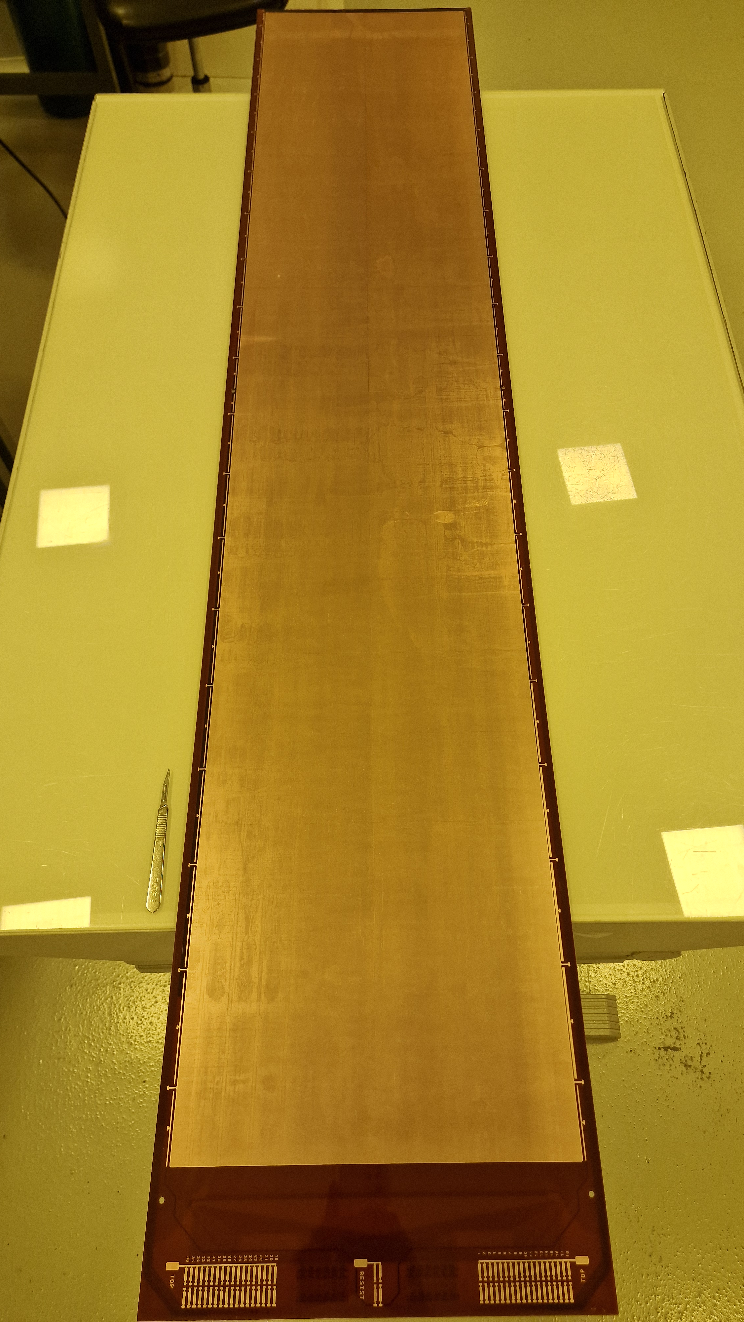
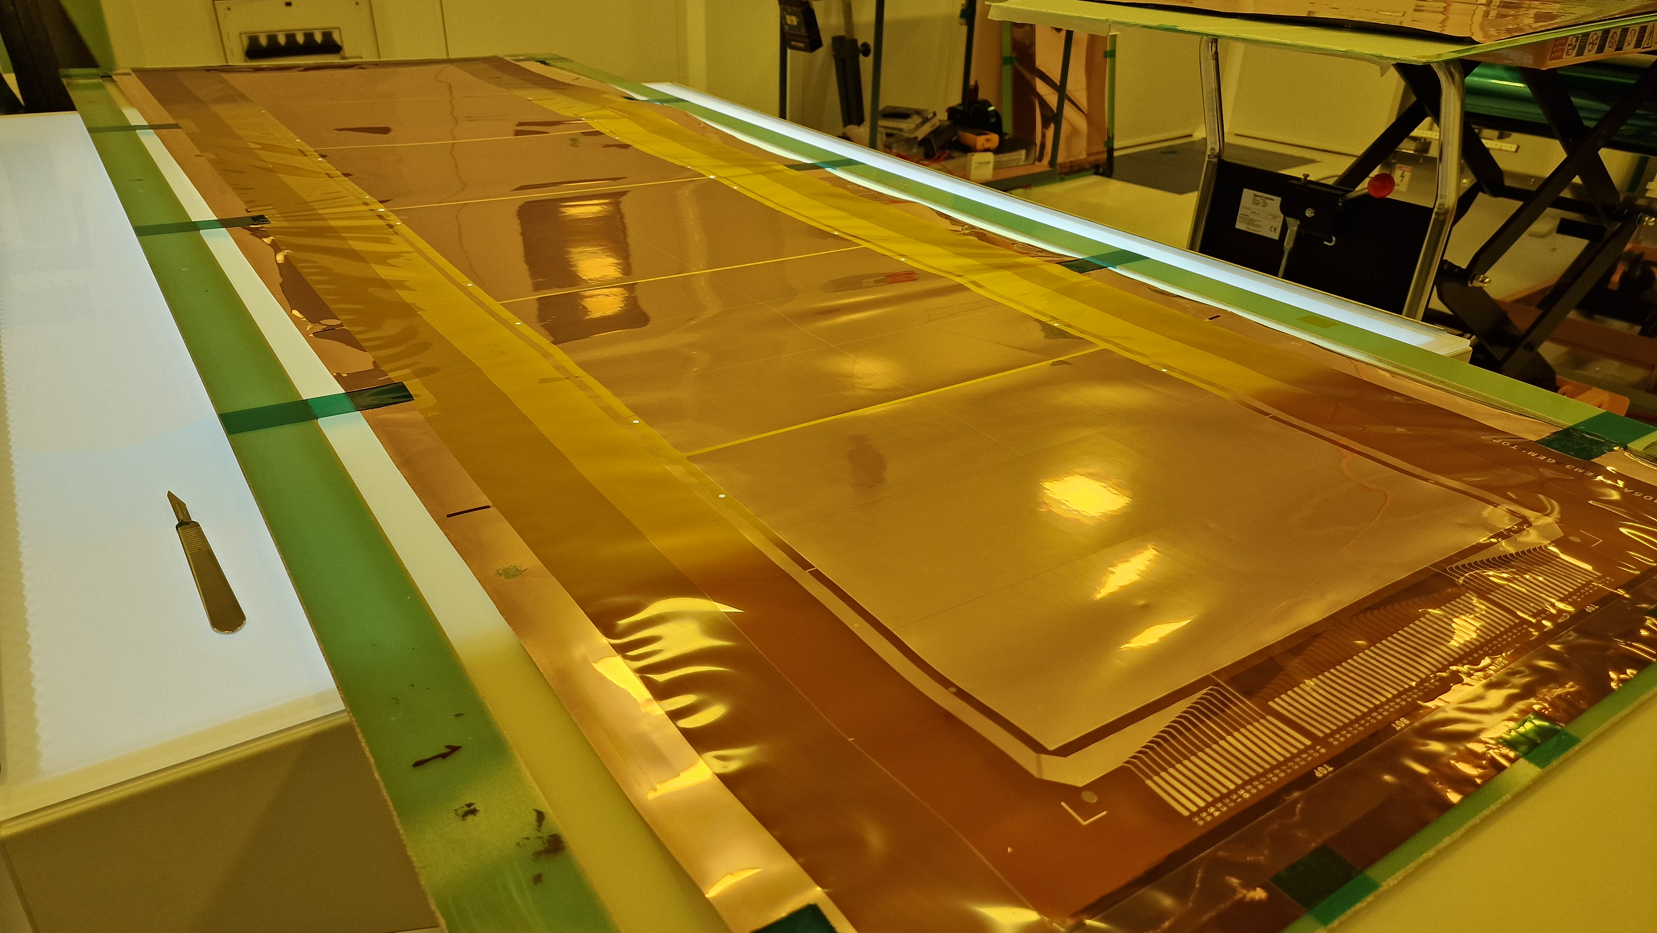
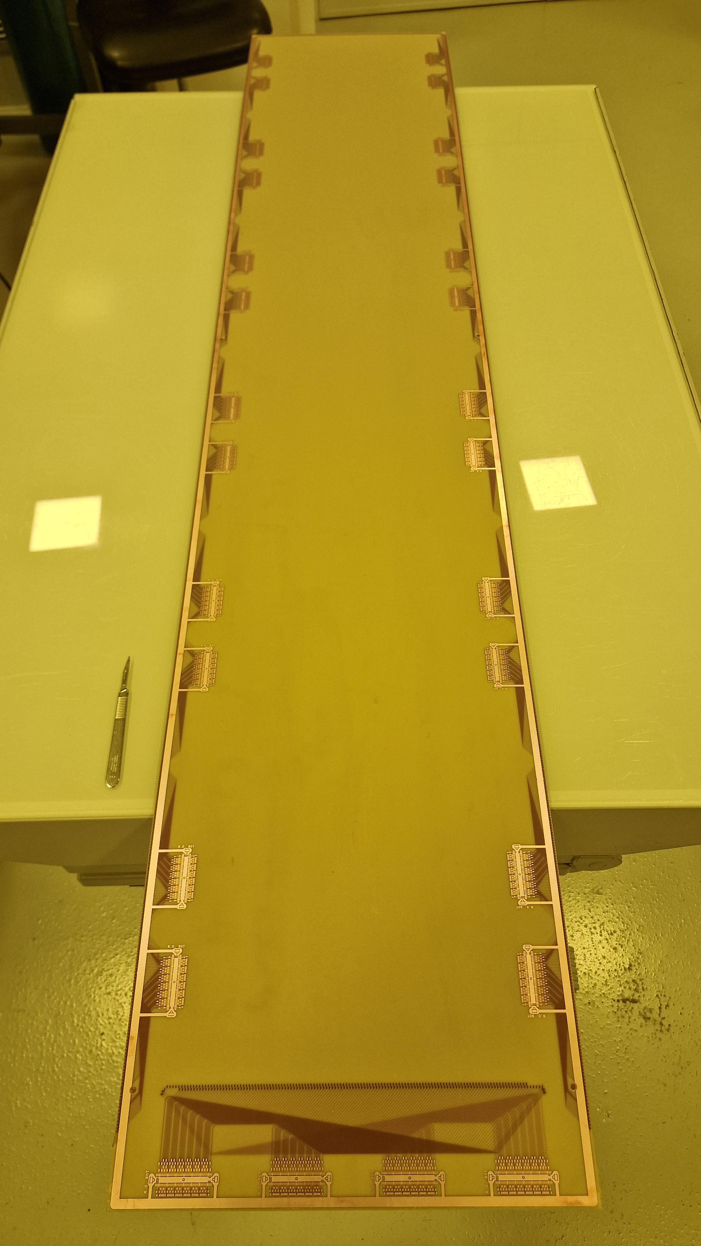
μRWELL-BOT module: CERN items all delivered
GEM foil & μRWELL / X-Y strip readout (in hand)
Delivered at JLab yesterday (September 3rd)
Cathode foil is already competed (in hand)
Frames from RESARM (in hand)
30 Hirose-to-Panasonic adapter (in hand)
We could then test the test article with APV25 electronics while waiting for SALSA
We have all detector parts in hand (almost) for the assembly in Sept.
μRWELL / CapaSh readout PCB: Front view
GEM foil
μRWELL / CapaSh readout PCB: back view

