Slide 1
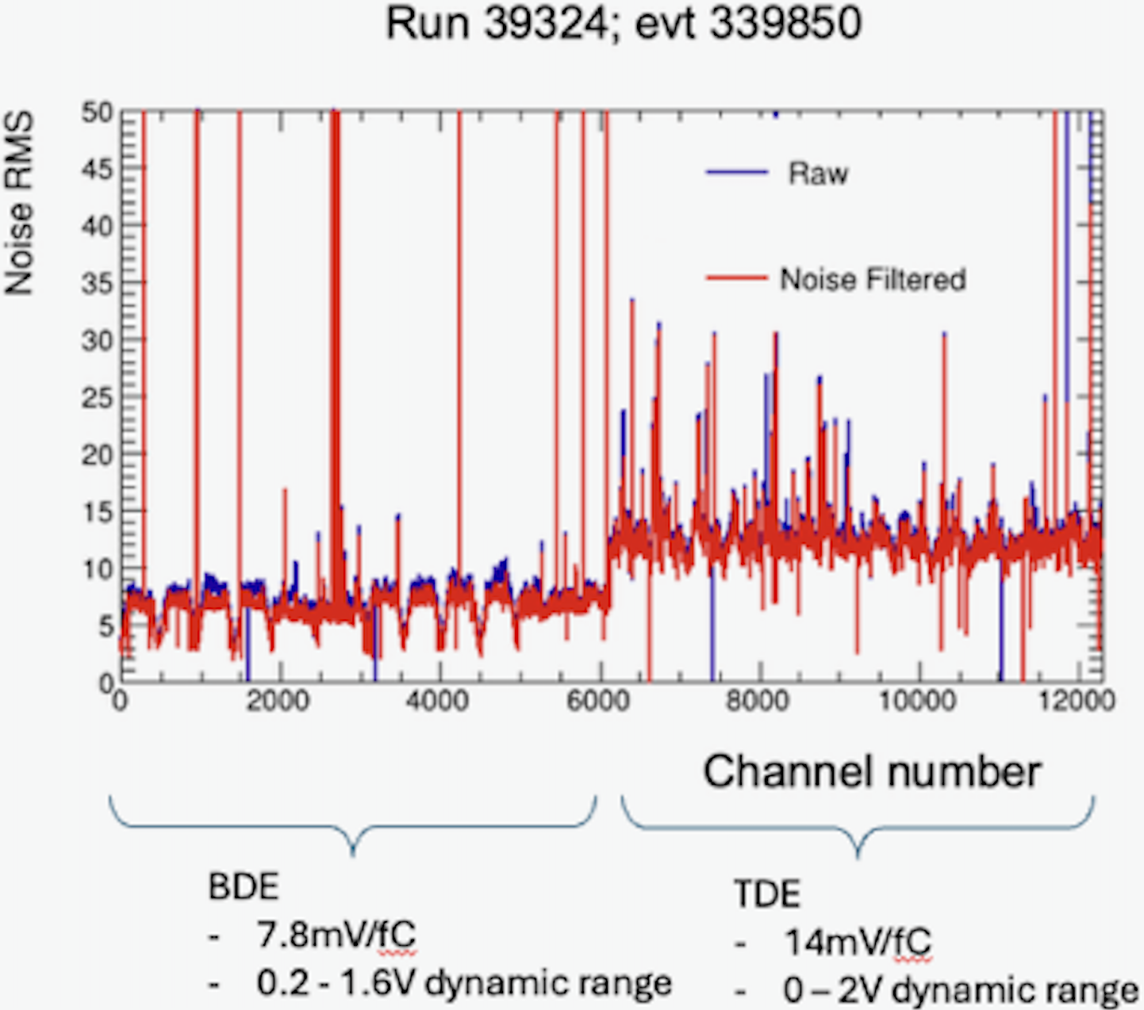
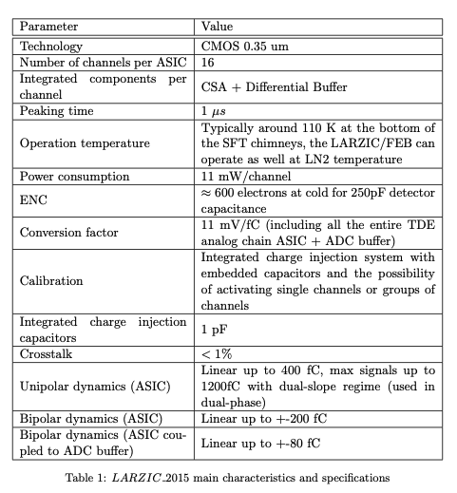
ProtoDUNE VD Noise
11mV/fC
7 ADC RMS
~ 480e ENC
12 ADC RMS
~ 830e ENC
Is TDE running at 11mV/fC?

Slide 2
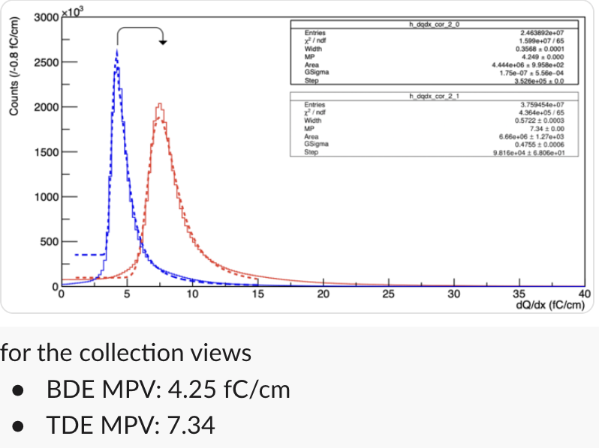
Yoann’s dQ/dx reco from LArSoft
current config: 14mV/fC for BDE, 11mV/fC for TDE
Now we know BDE runs at 7.8mV/fC
BDE MPV: 4.25 fC/cm * 14/7.8 = 7.63 fC/cm
Consistent with TDE MPV: 7.34
=> Another indication that TDE runs at 11mV/fC

