Slide 1
BIC Update
Triple I Engineering Meeting Update
Kevin Bailey & Tom O’Connor
September 22, 2025

Slide 2
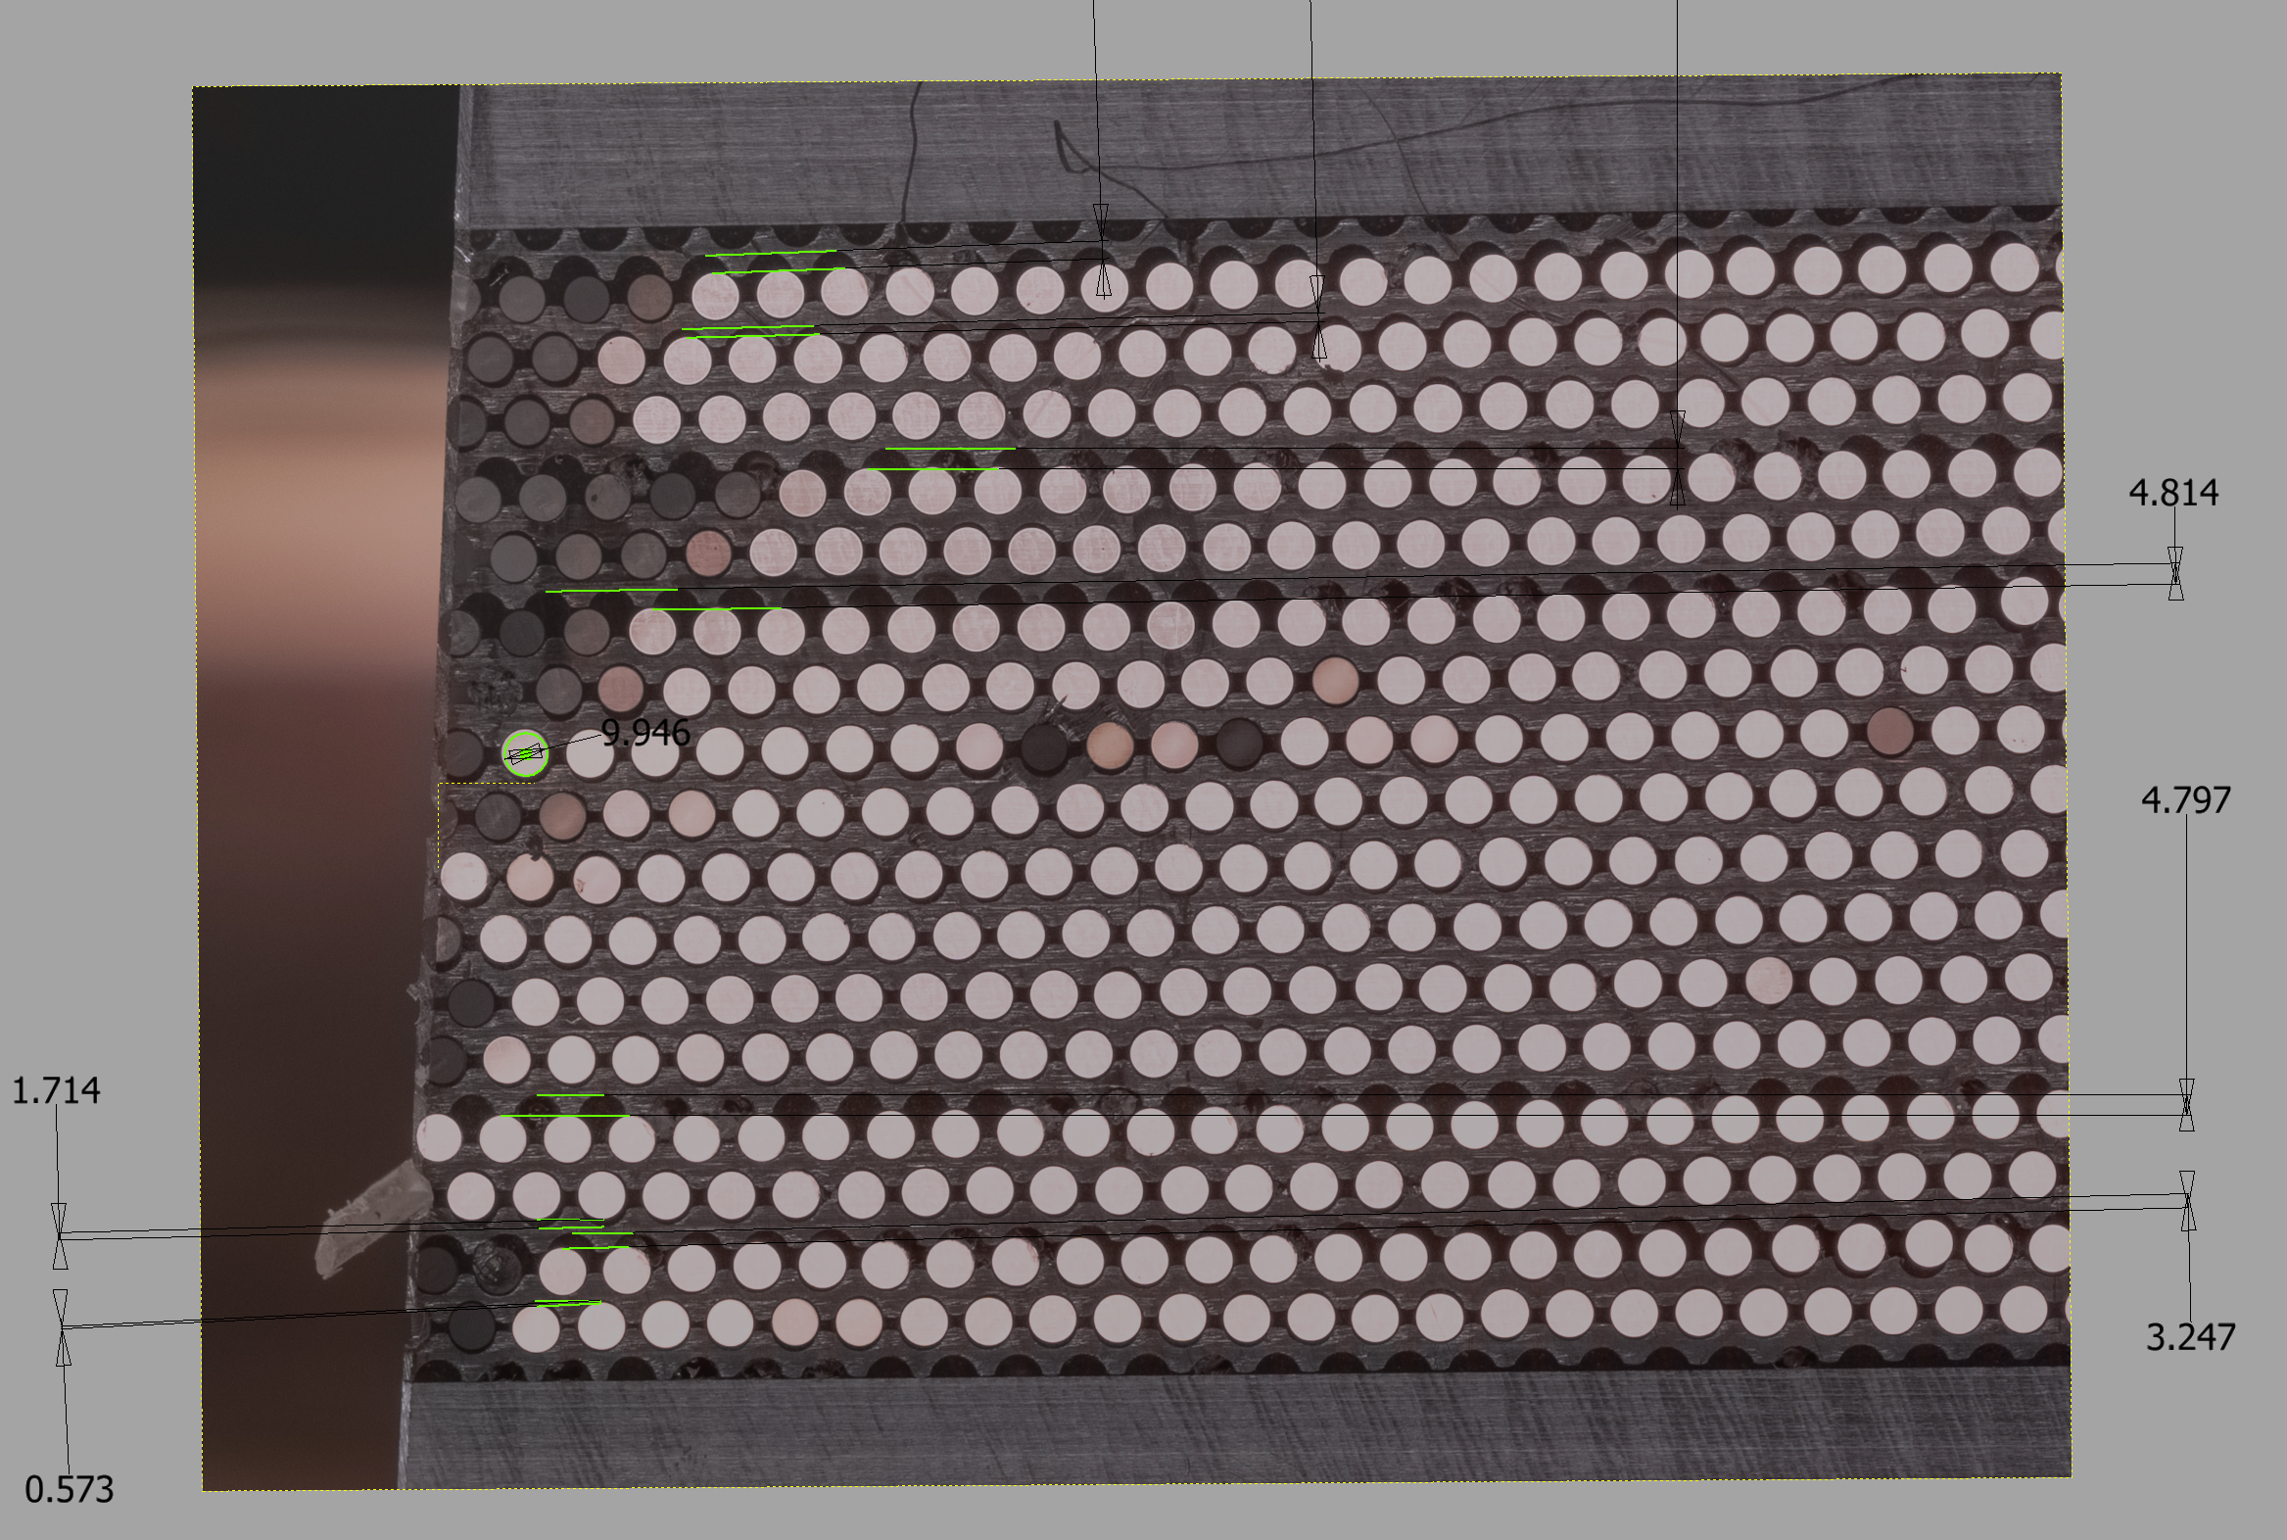
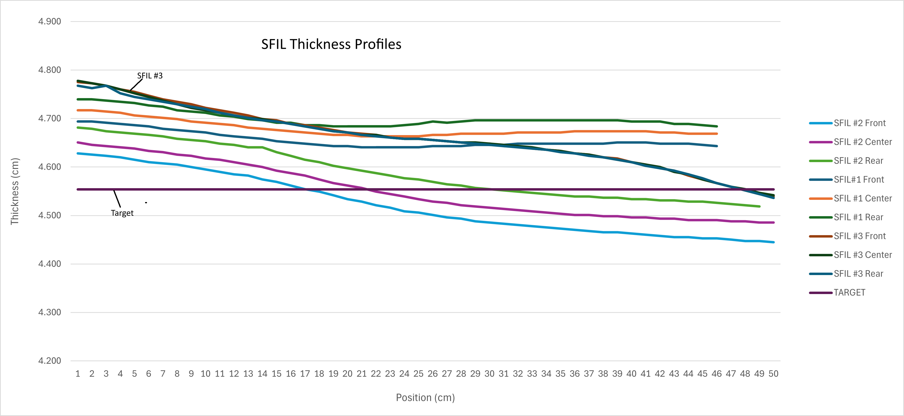
Test SFIL #3 w/ GlueX fiber
Slice for comparator created (measurements tbd)
Small section for density created
  Density 4.76g/cc (314g, 66cc)
Profile slope L-R ~2mm+
Profile slope Front to Back corrected
Fiber / lead missalignment appears to match slope error

Slide 3
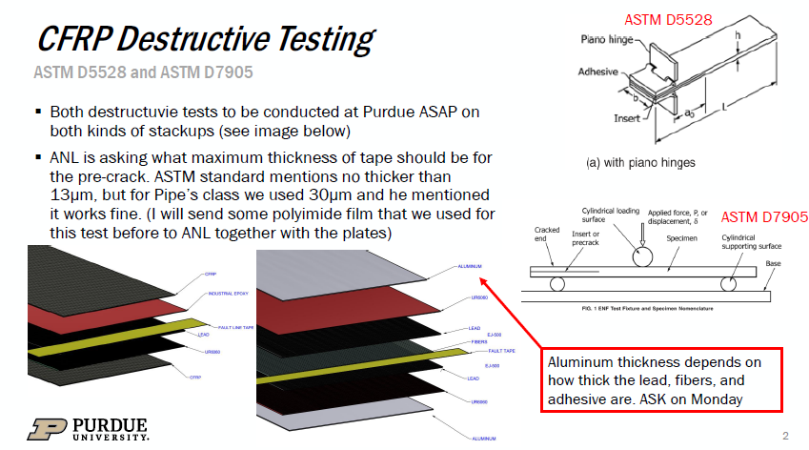

Slide 4
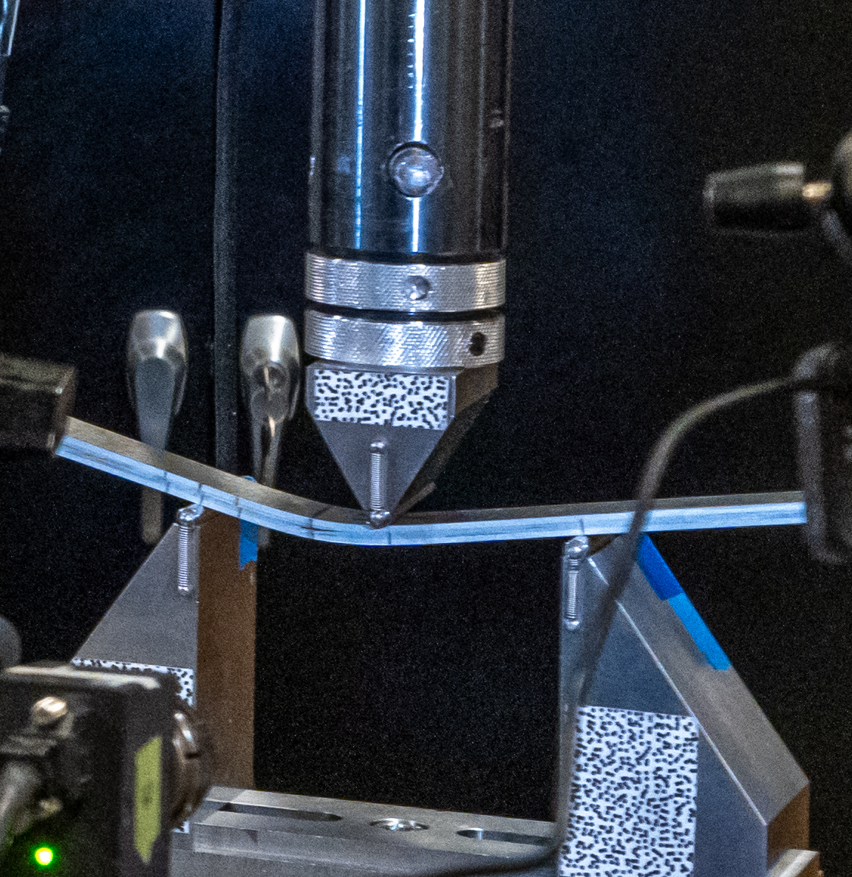
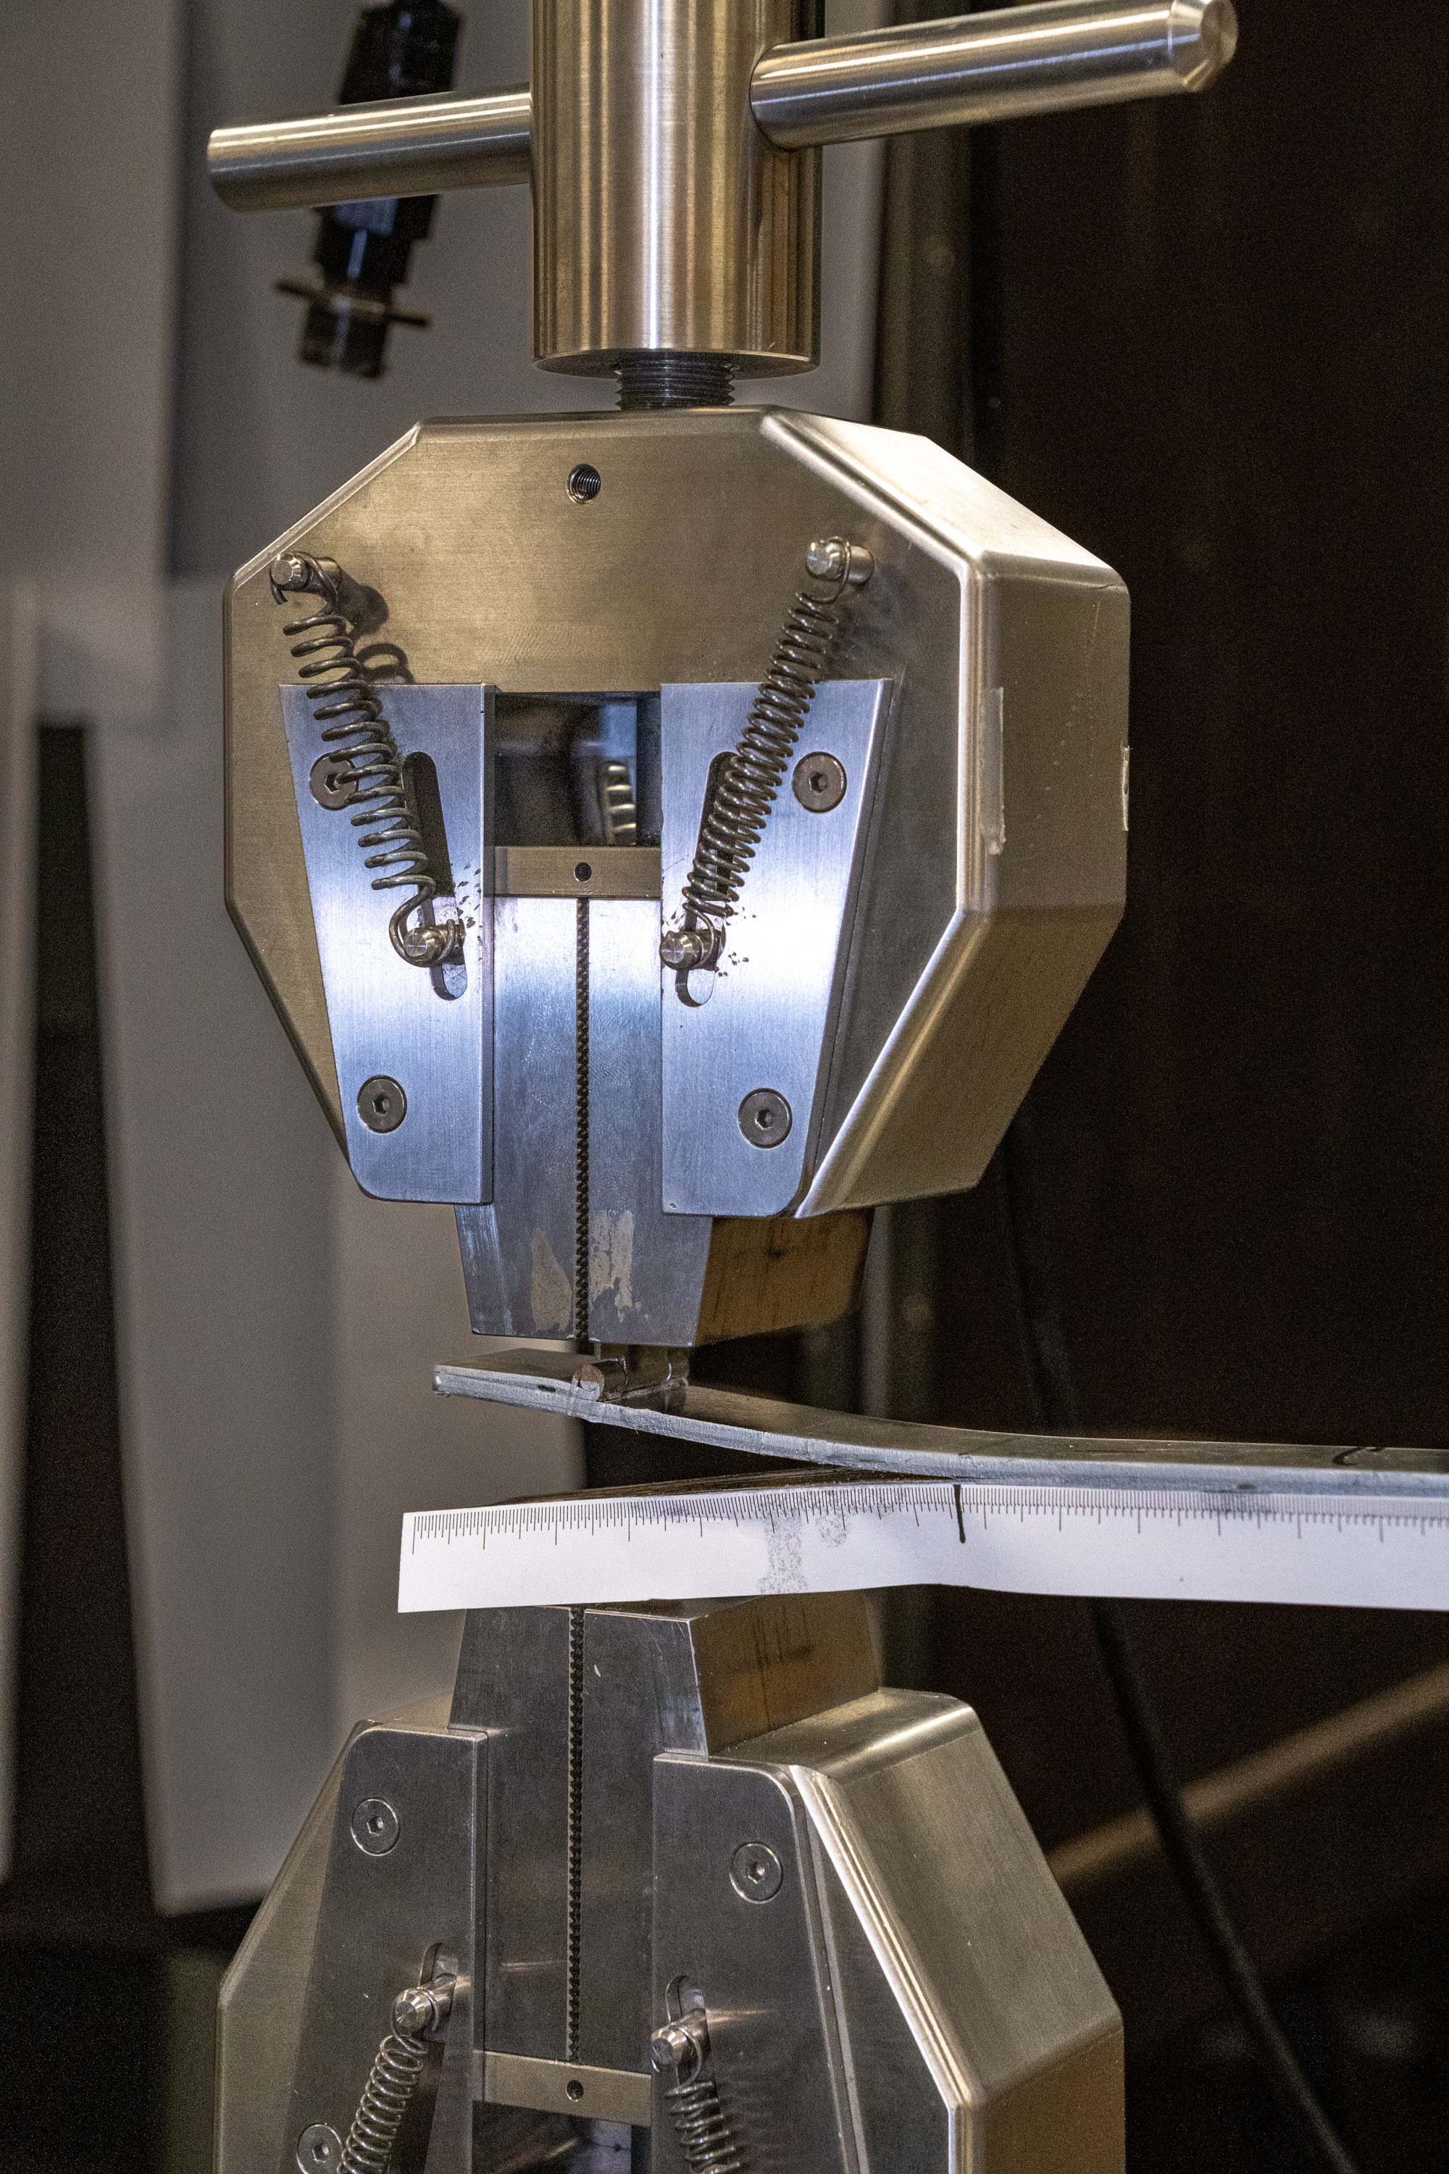

Slide 5
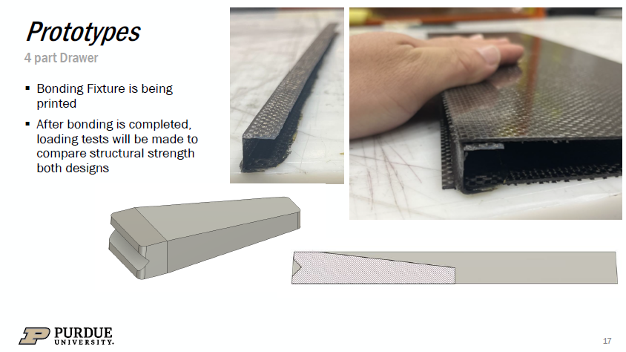
FIRST LAYUPS JUST FINISHED

Slide 6
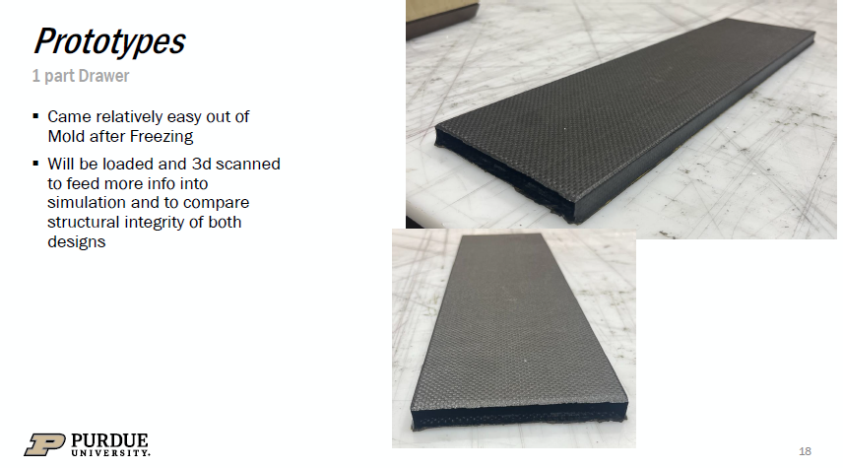

Slide 7
