Slide 1
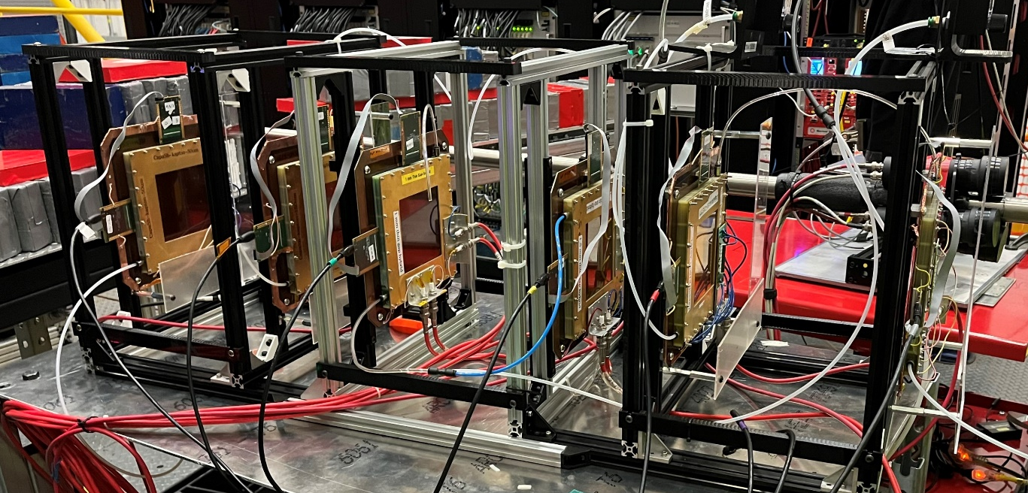
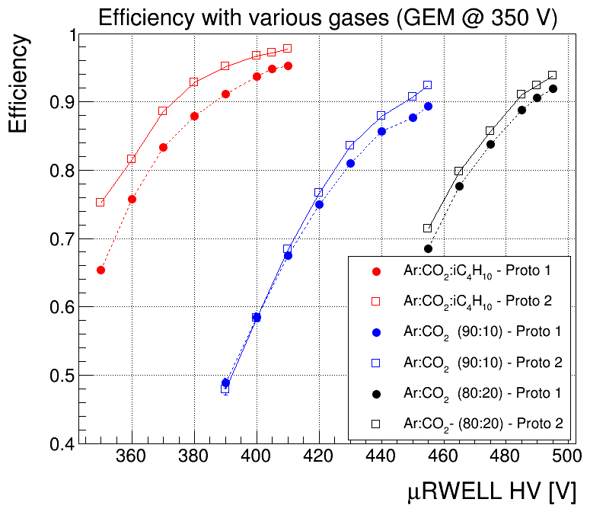
Preliminary JLab 2025 beam test results:
Thin-gap prototypes in beam test at JLab (June 2025)
Efficiency studies with 3 different ar-based gas mixture
2 prototypes: 1 mm gap (proto 1) & 1.5 mm gap (proto 2)
3 Gases: Ar:CO2:iC₄H₁₀ (90:7:3), Ar:CO₂ (90:10) & Ar:CO₂ (80:20)
HV scans: GEM HV, μRWELL HV, drift field & transfer field
Analysis still ongoing some very appealing preliminary results
98% reached for 1.5 mm gap thin-gap prototype with Ar-CO2-iso
96% for 1 mm thin gap reaches 96%

Slide 2
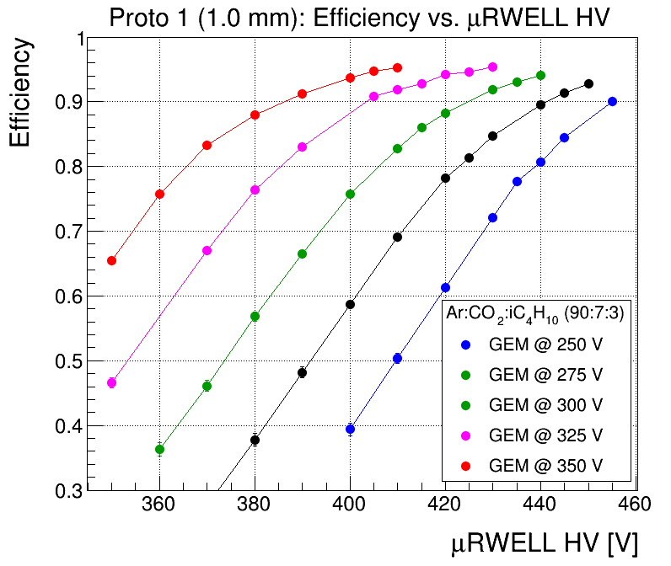
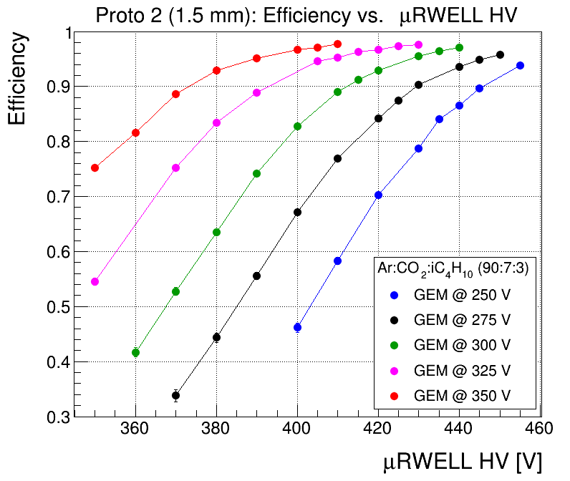
Preliminary JLab 2025 beam test results: μRWELL HV scans
Ar:CO₂:iC₄H₁₀ (90:7:3)
96%
98%

Slide 3
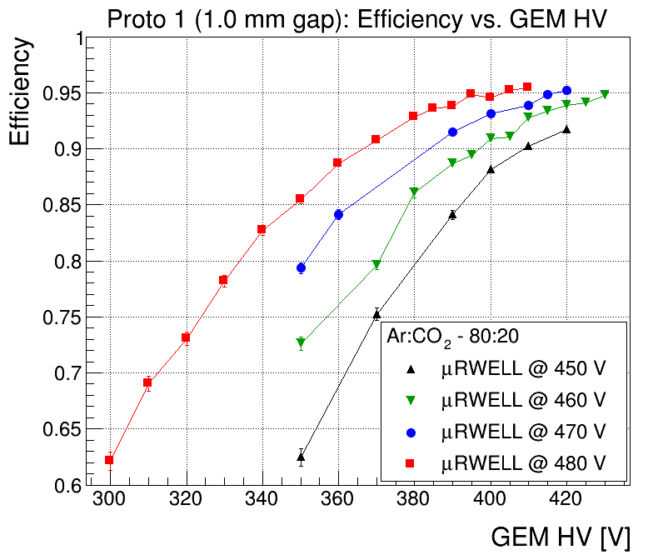
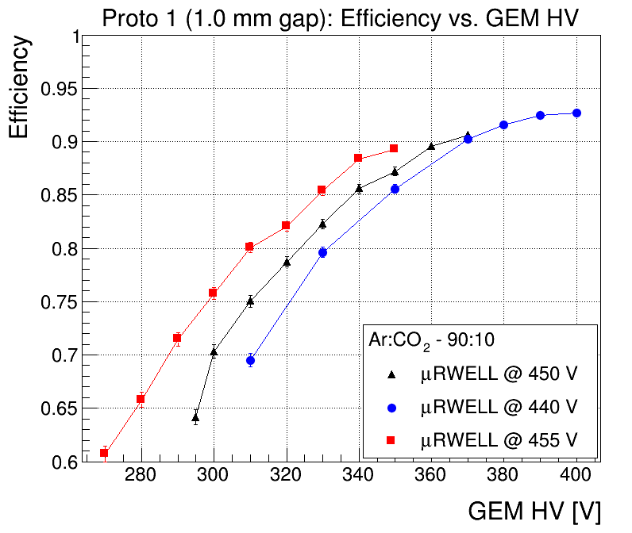
Preliminary JLab 2025 beam test results: GEM HV scans – Proto 1
Ar:CO₂ (80:20)
Ar:CO₂ (90:10)

Slide 4
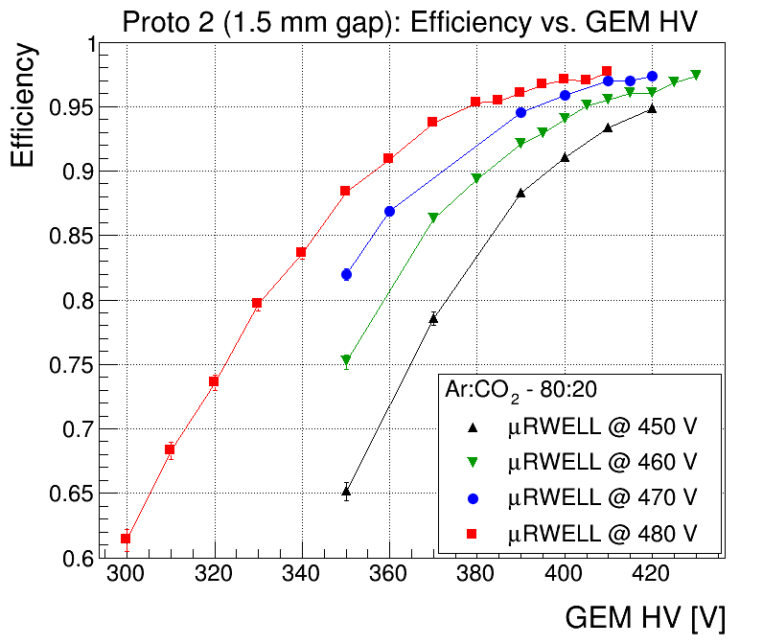
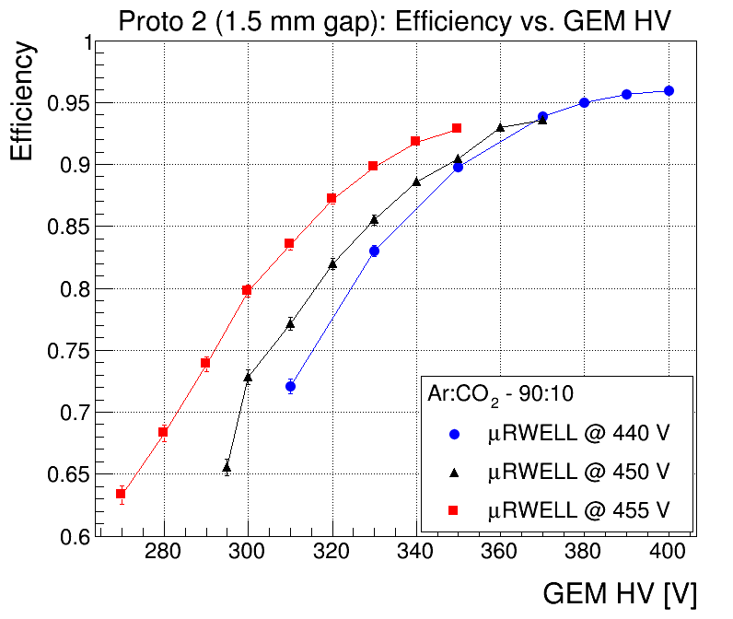
Preliminary JLab 2025 beam test results: GEM HV scans – Proto 2
Ar:CO₂ (80:20)
Ar:CO₂ (90:10)

Slide 5
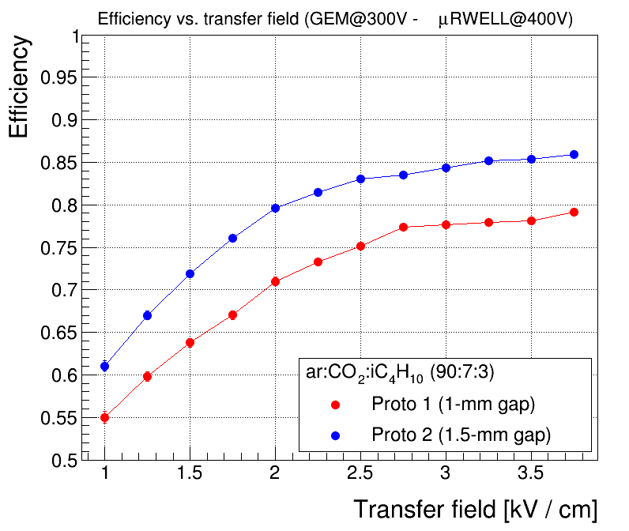
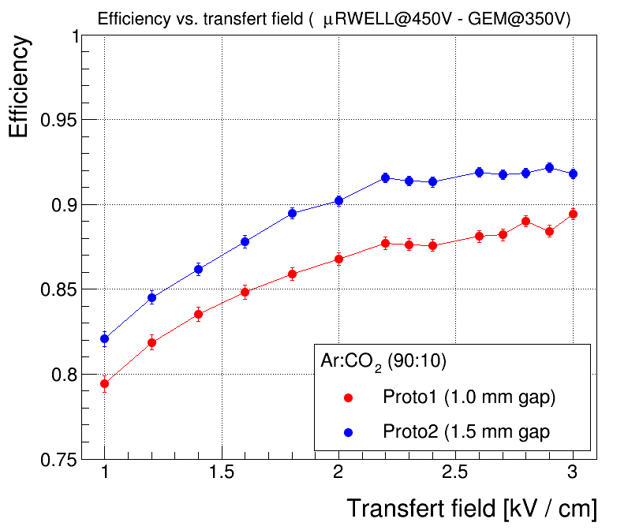
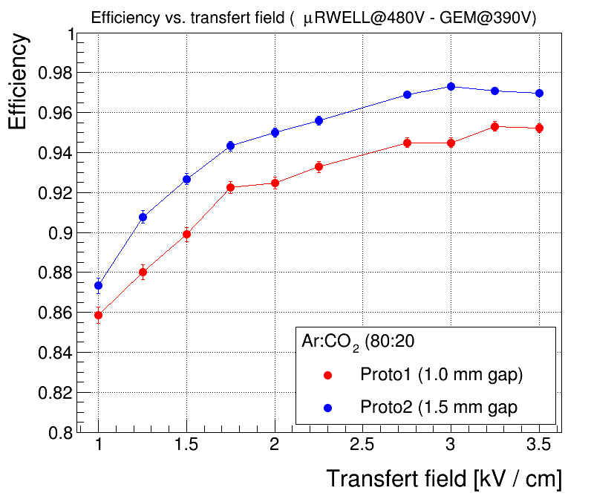
Preliminary JLab 2025 beam test results: Transfer field scans
Ar:CO₂:iC₄H₁₀ (90:7:3)
Ar:CO₂ (90:10)
Ar:CO₂ (80:20)

Slide 6
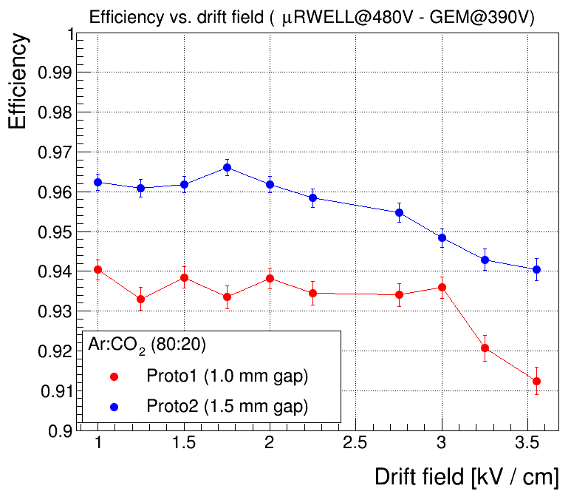
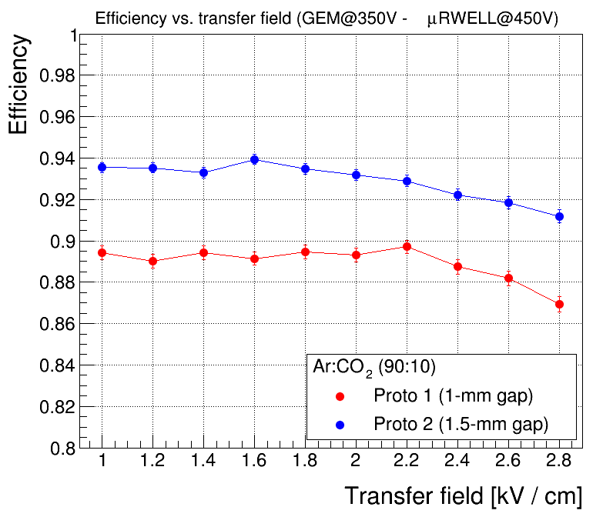
Preliminary JLab 2025 beam test results: Drift field scans
Ar:CO₂ (80:20)
Ar:CO₂ (90:10)

