Slide 1
CyMBal Update
Seraphin Vetter, Alain Delbart, for the CEA/Saclay IRFU team
29.09.2025

Slide 2
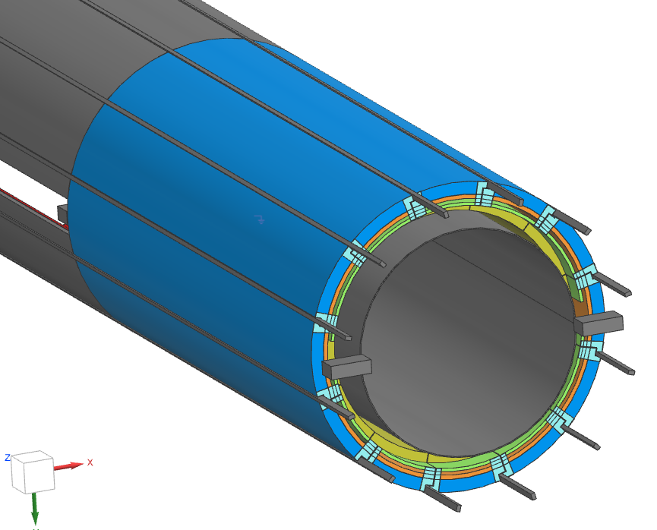
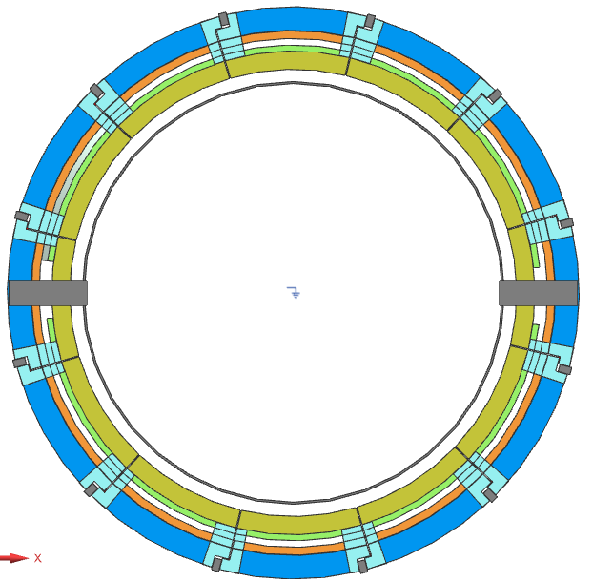
Envelope from July 2025
This is the only data that I work with
Is there a newer updated version?
CyMBal Envelope 560-615??

Slide 3
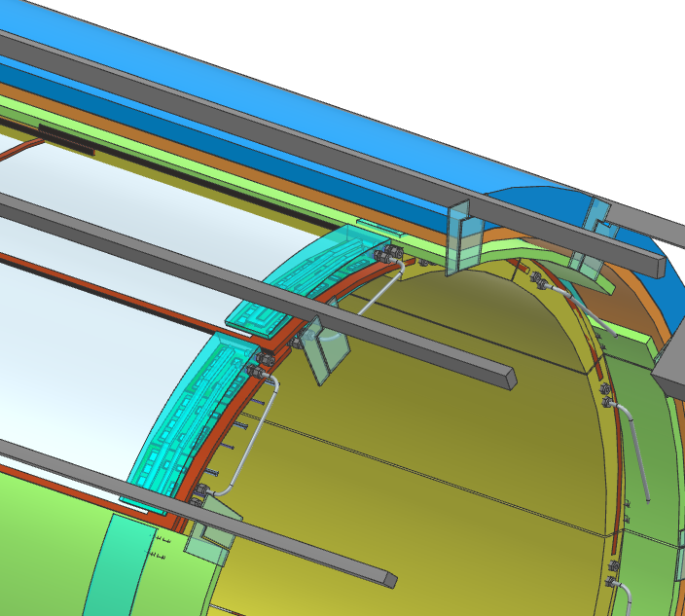
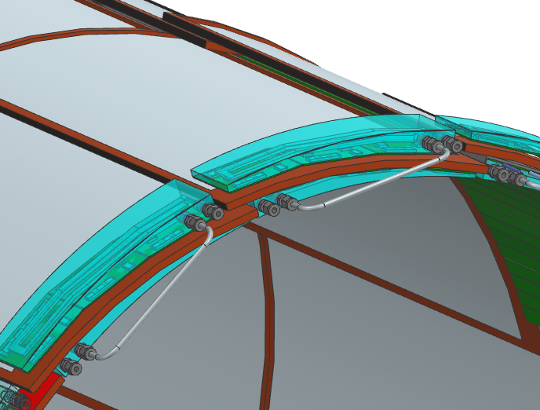
CyMBal tiles cooling
We know roughly where to put the boards and cooling
Design is just a first sketch

Slide 4
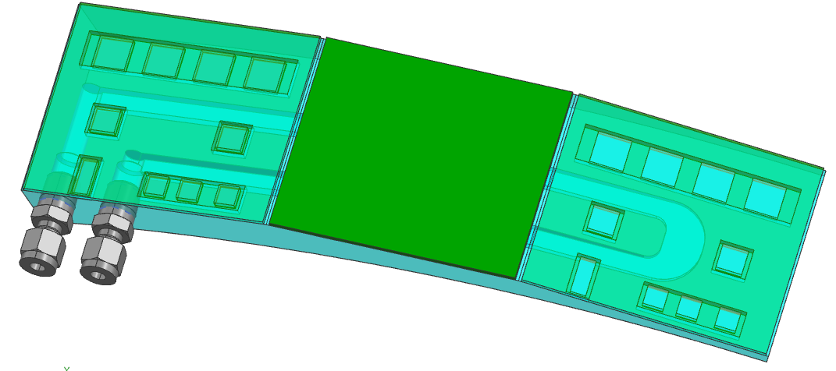
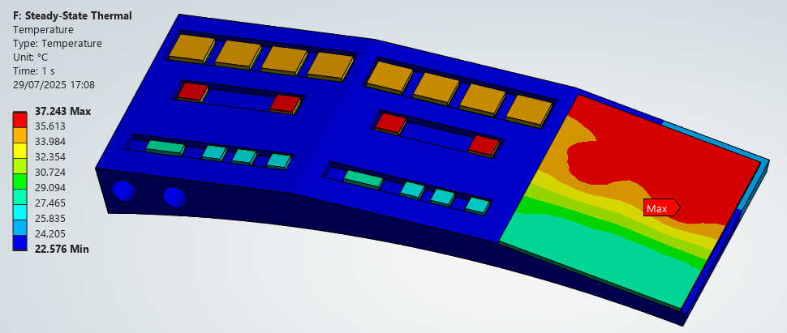
CyMBal tiles cooling
3l/min, Tin 22 degC, Tout 22.13 degC
Pressure Drop 0.044 bar
Aluminum

Slide 5
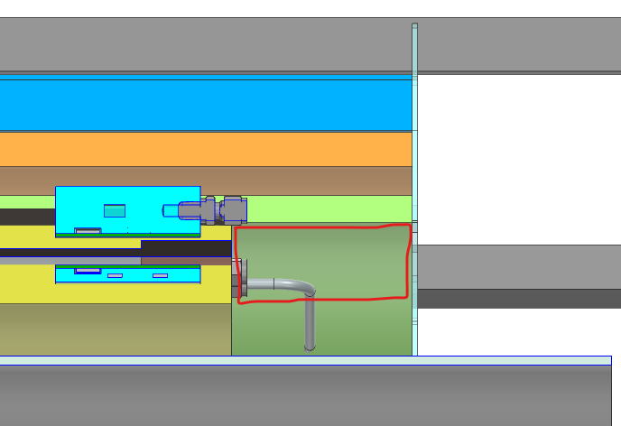
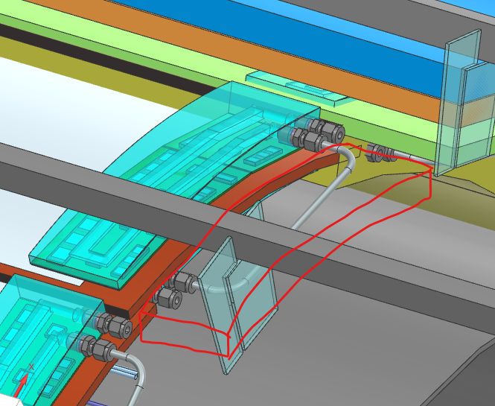
CyMBal Evelope questions
Is there a newer version?
Envelope diameters?
Can we use the space in red?
        Cables and Tubes will connect there
I have to find some space for a DC-DC board
        Maybe in the red area or the Service tray?

Slide 6
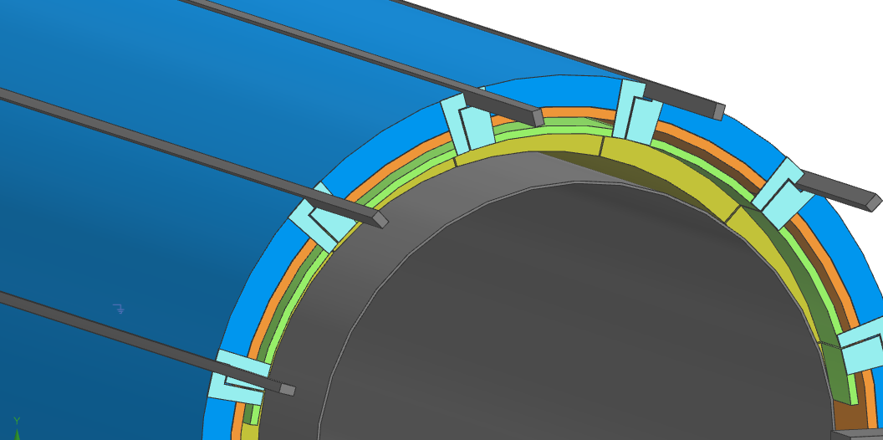
Where does cymbal attach to?
I started thinking about how to mount CyMBal .
Where does CyMBal attach to?
        Directly to the rails?
        TOF?
        The service tray?
Who is in charge of the rail design?
Is there any more information on the rails?

