Slide 1
Integration, Installation and Infrastructure (Triple I Group)
TIC Update
Roland Wimmer

Slide 2
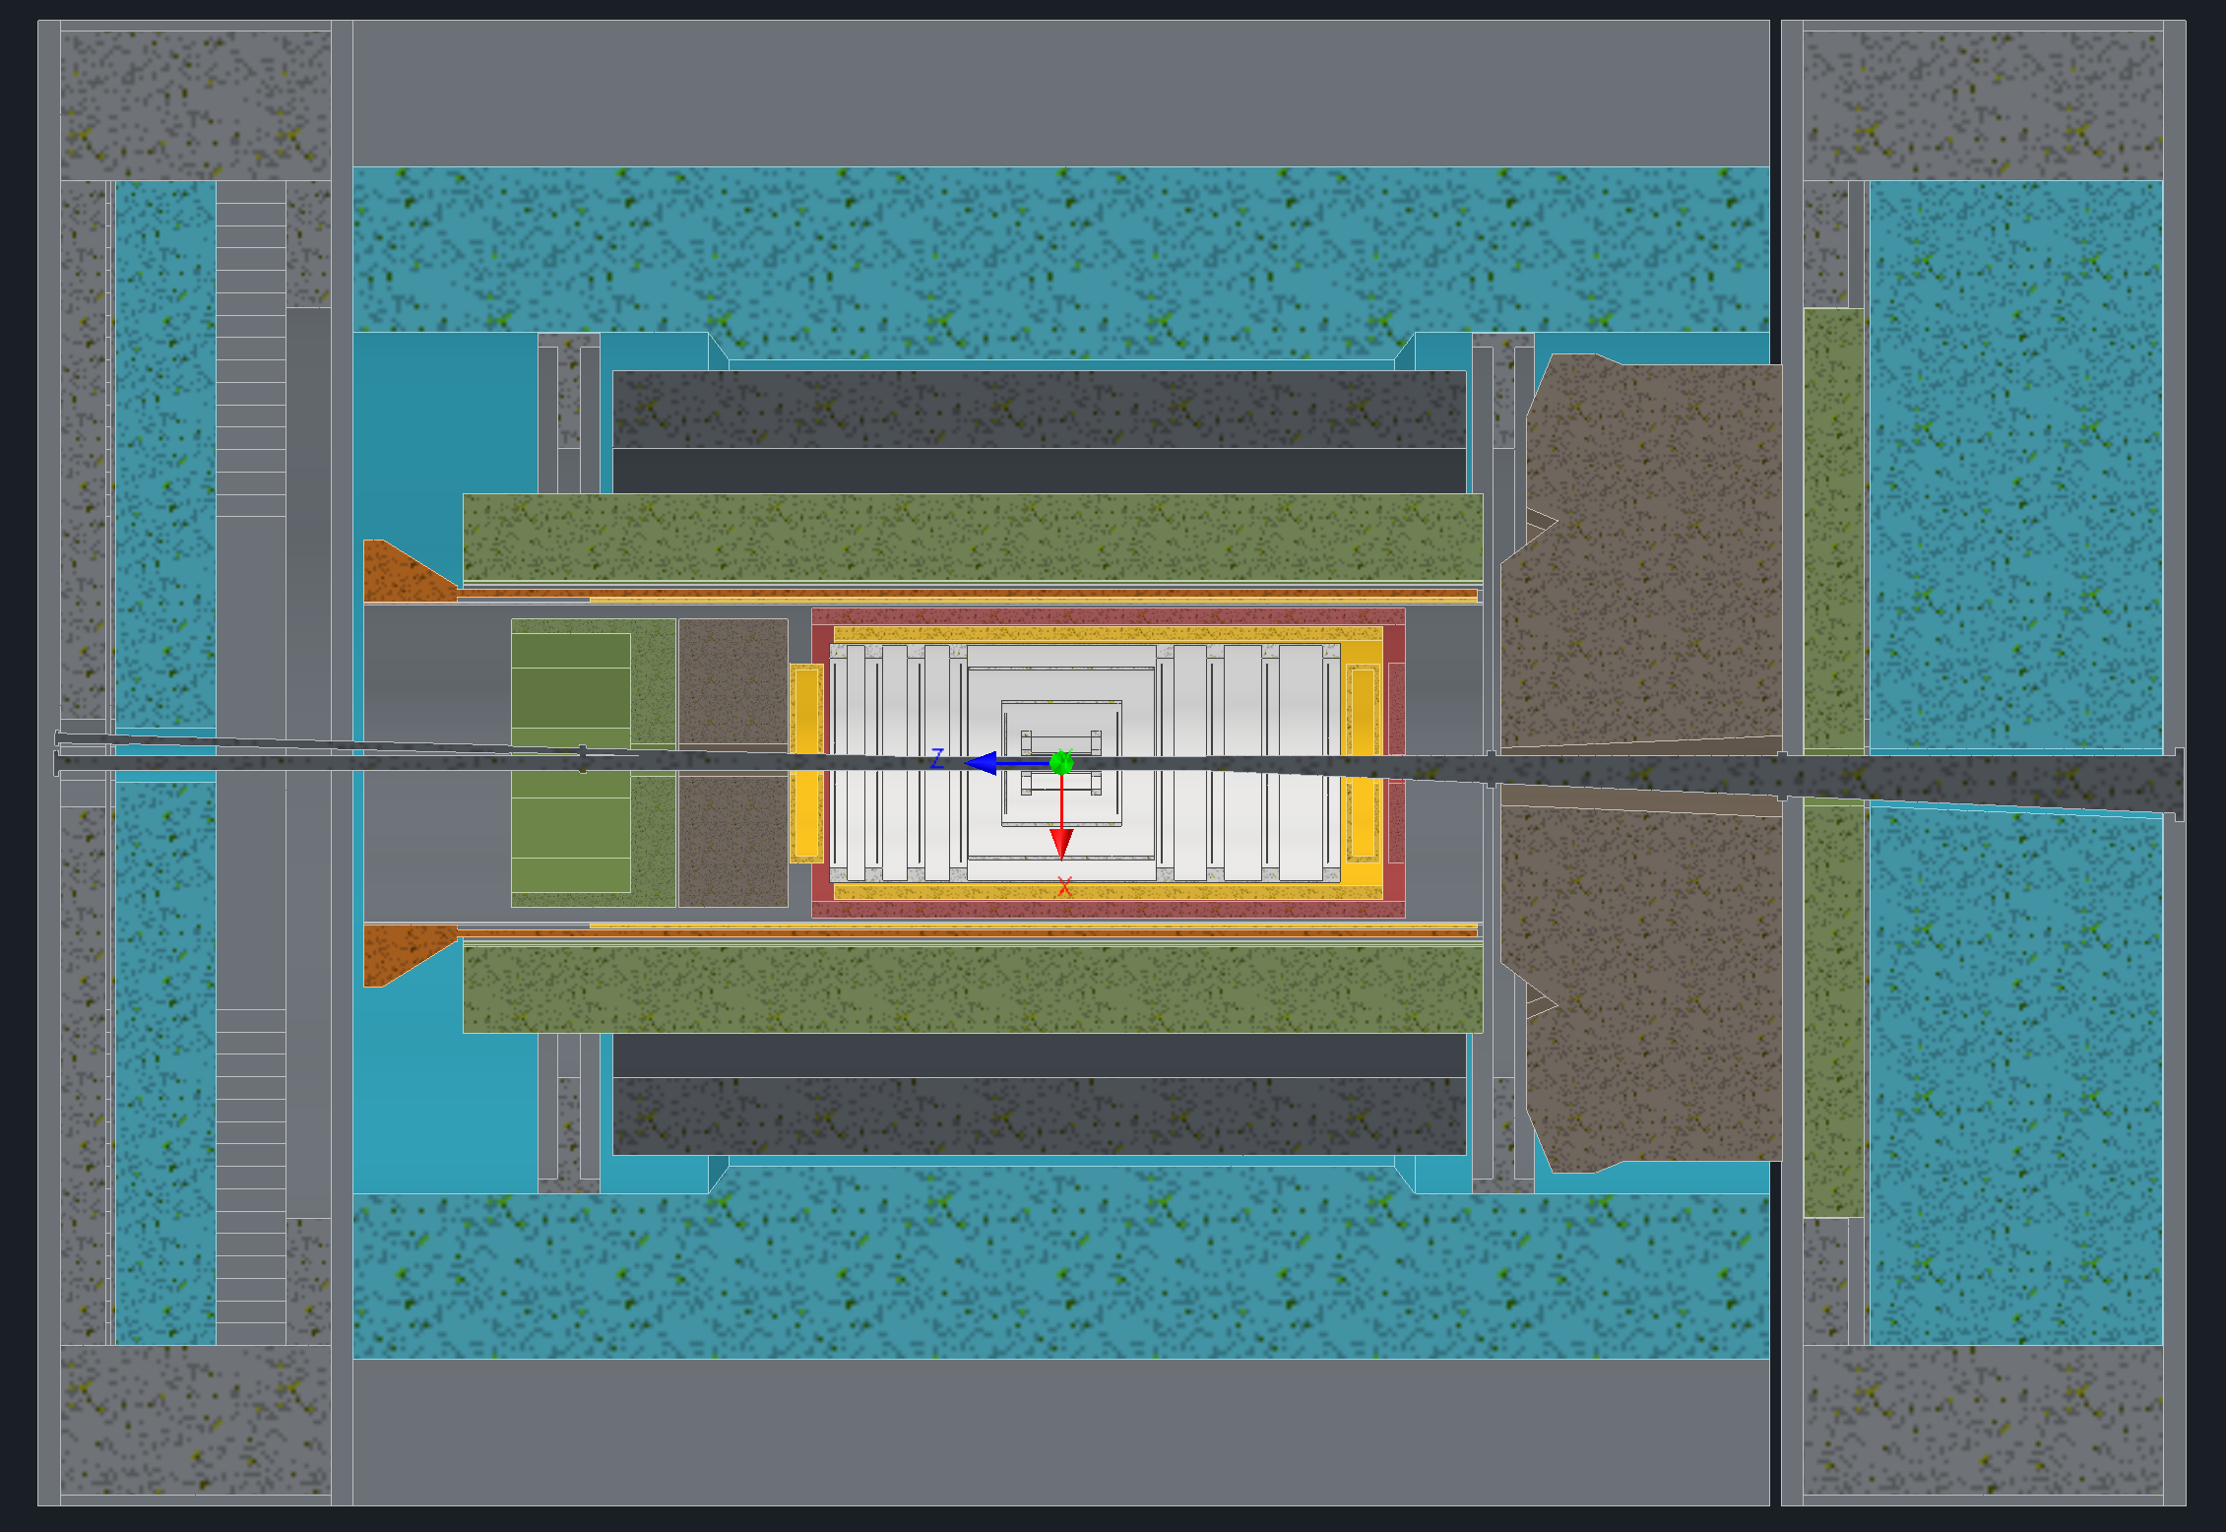
Detector Model Updates
Envelope Updates
Barrel EMCal Installation & Support
Services Updates

Slide 3
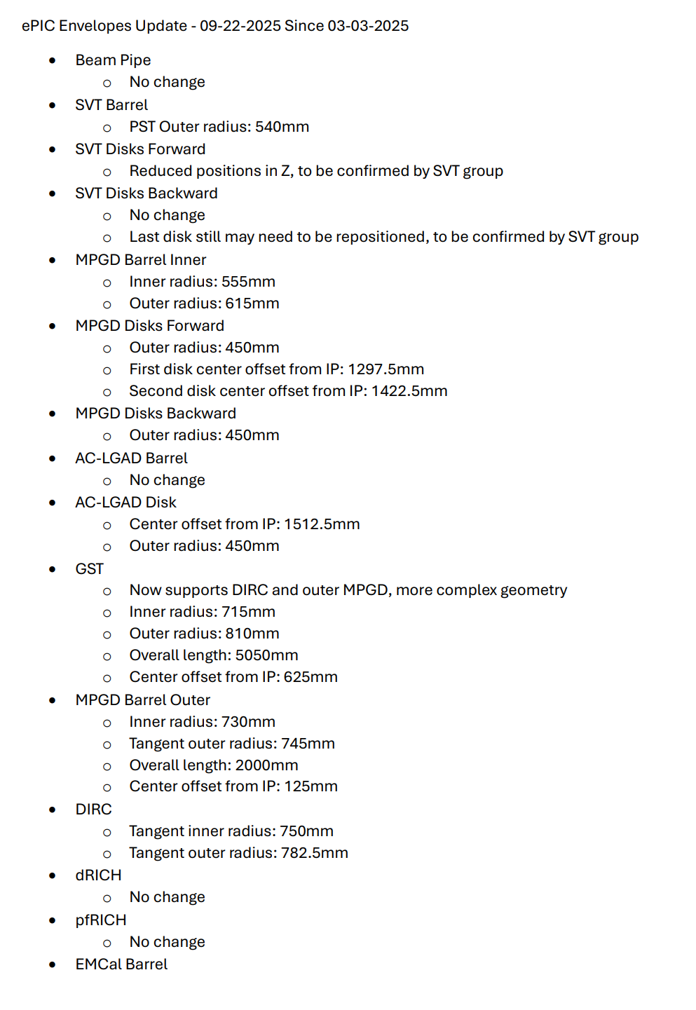
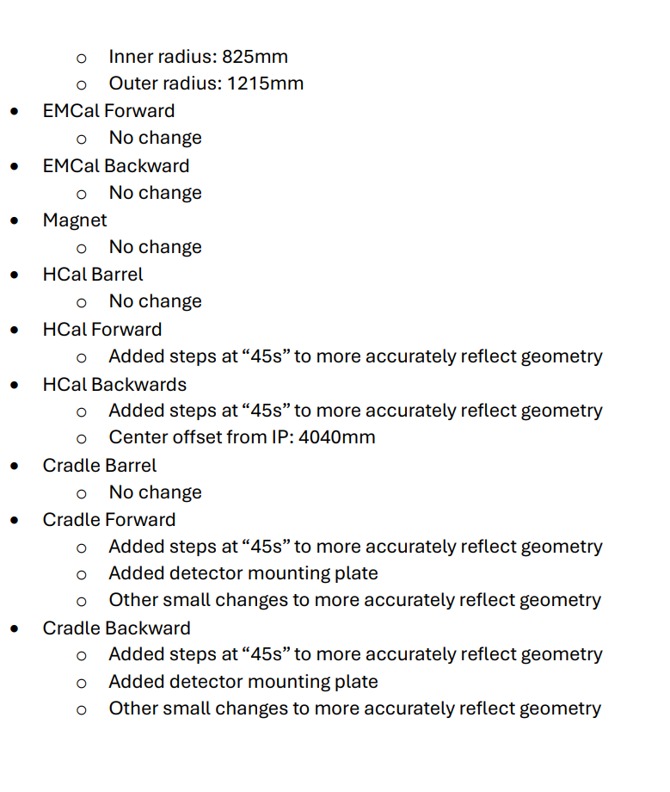
Envelope Updates
The updated envelopes pdf went out, everyone has access
Current changes were recorded in the change log as well as records of previous changes

Slide 4
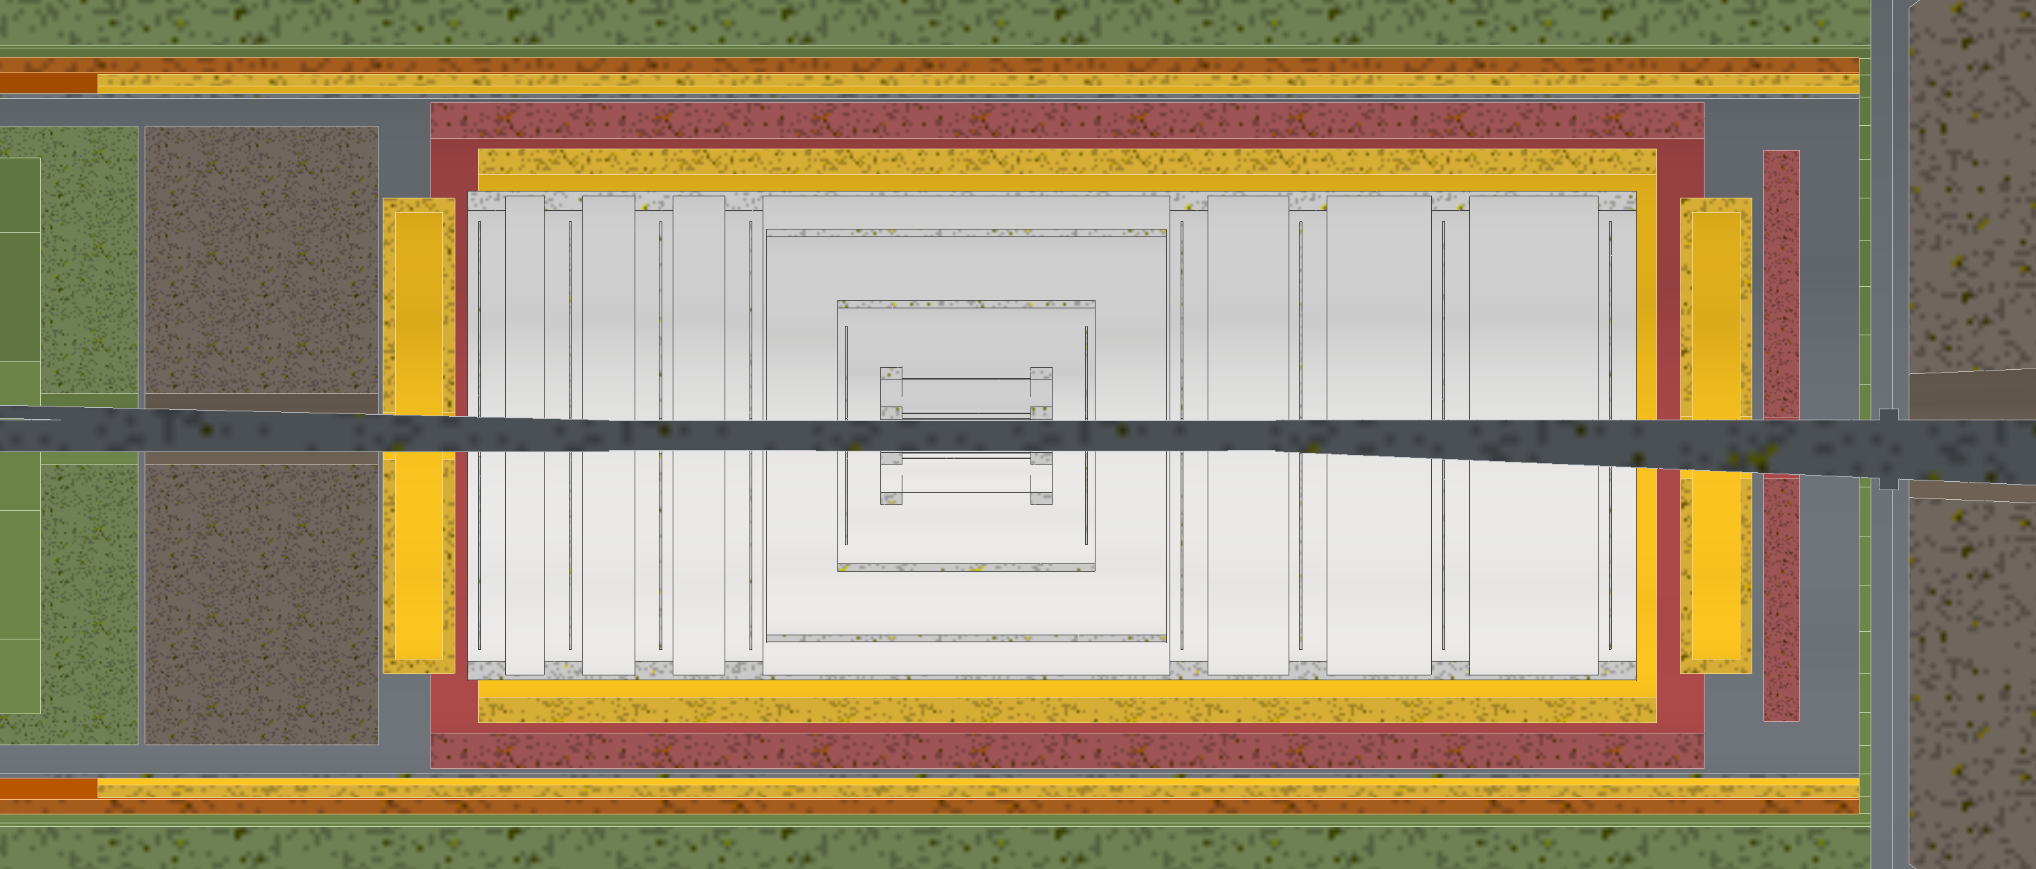
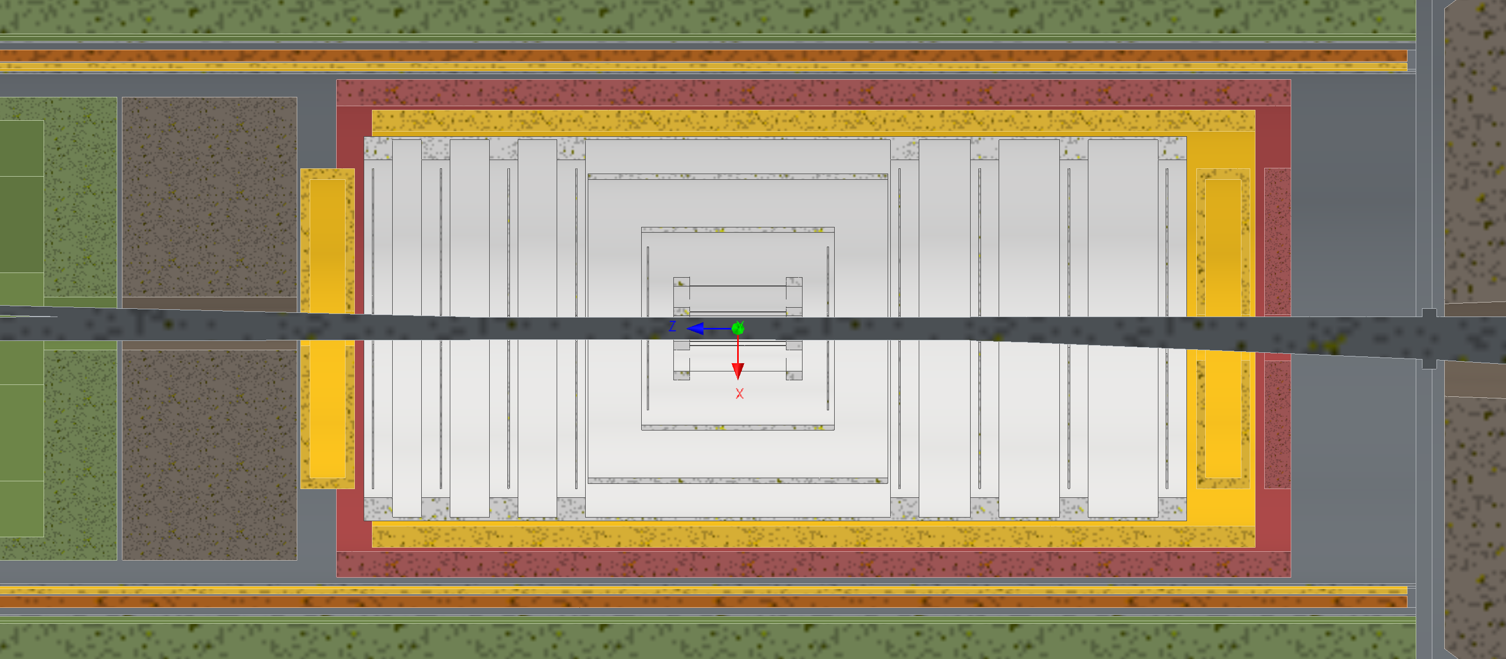
Envelope Updates
Finalized MPGD Disk movement and radius
Shifted forward SVT disks towards IP
Shifted ToF disk towards IP and made radius smaller
Before
After

Slide 5
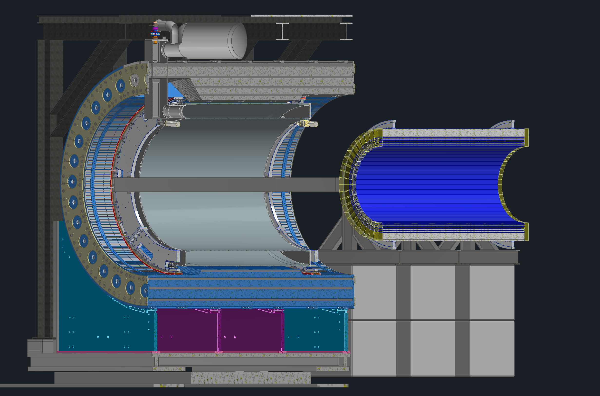
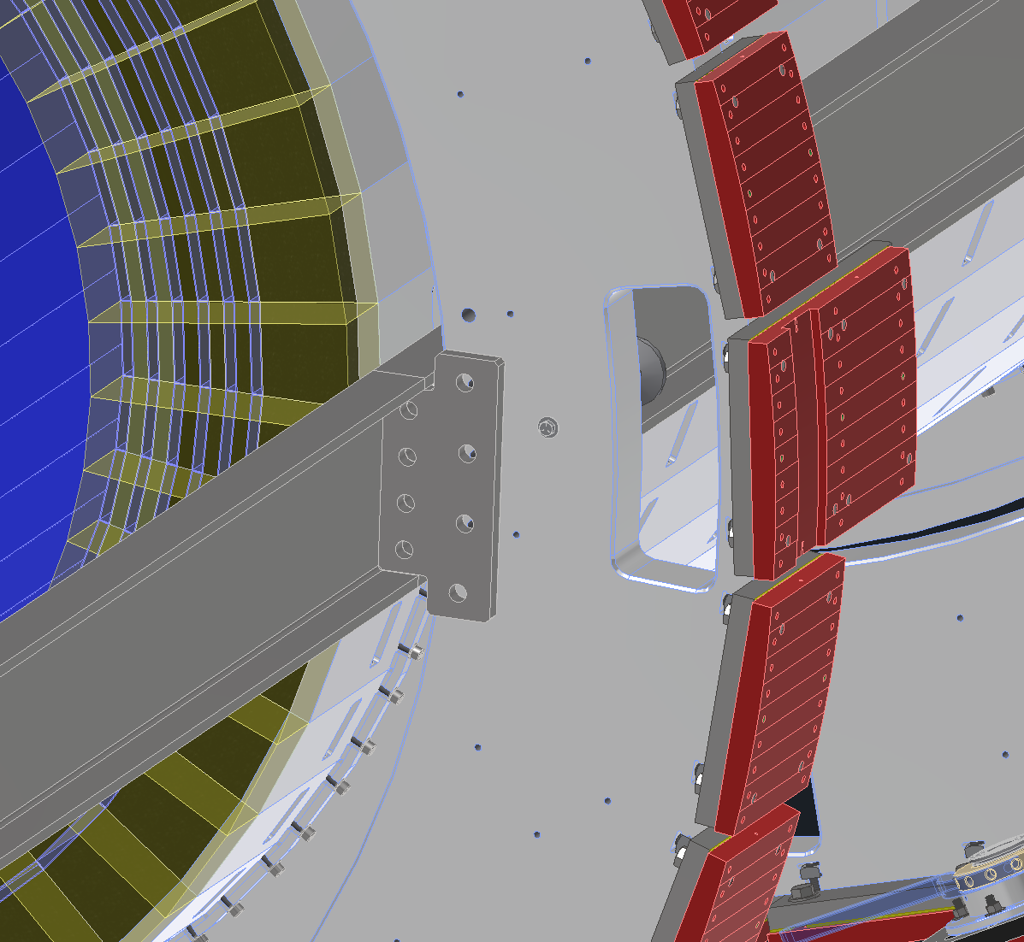
Barrel EMCal Installation & Support
Inner Support Rings
The support is comprised of two rings, each made up of a splice plate and an upper and lower cradle. The splice plates attach to both cradles at 3 and 9 O’clock.
These splice plates have rollers which rest on large C channels which will be used for installation and support.
The c-channels used to install and support the barrel EMCal will be mounted to both rings via steel plates at 3 and 9 o’clock.

Slide 6
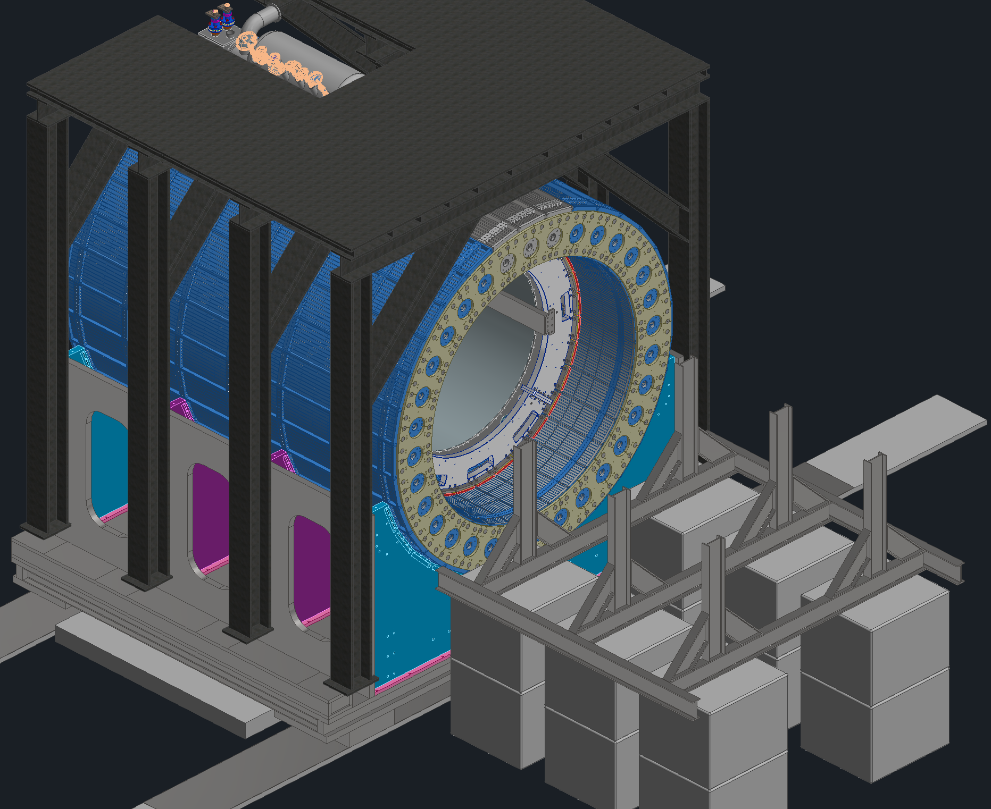
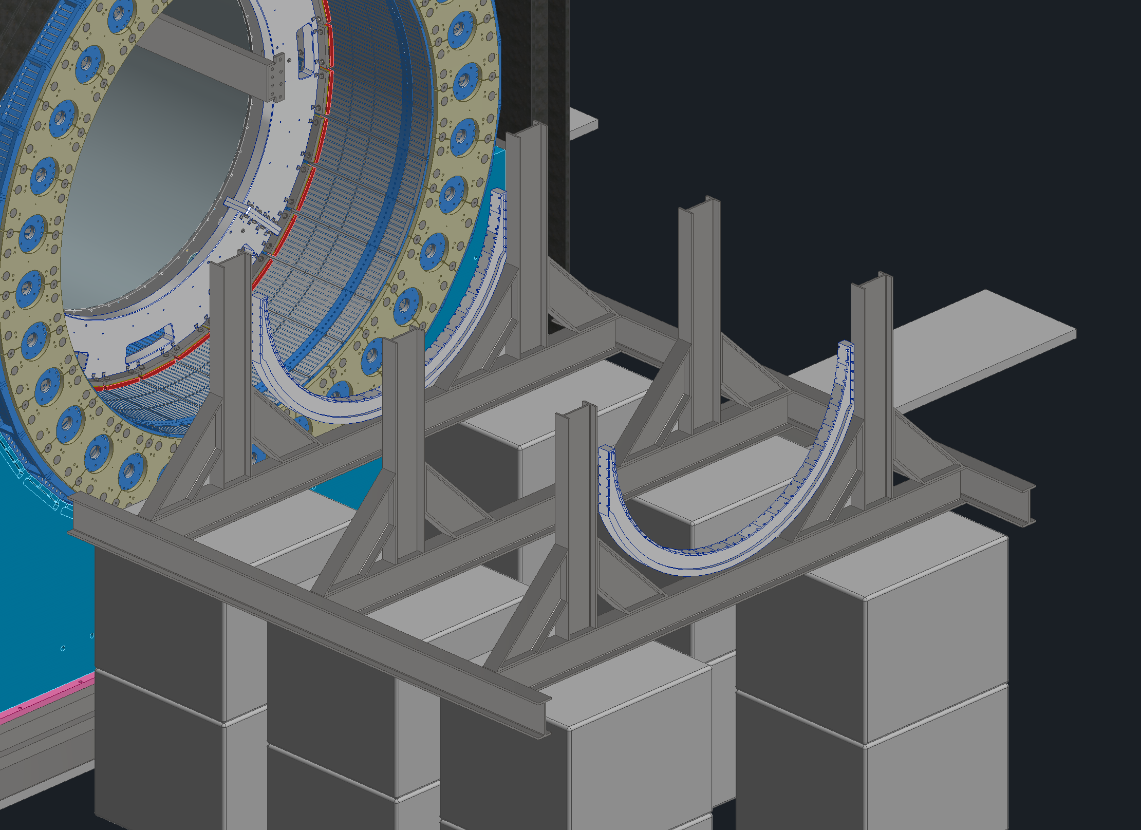
Assembly & Installation
Step 0: Setup the installation tooling
Step 1: Lower the bottom support cradles onto the steel frame and attach
Support Cradles

Slide 7
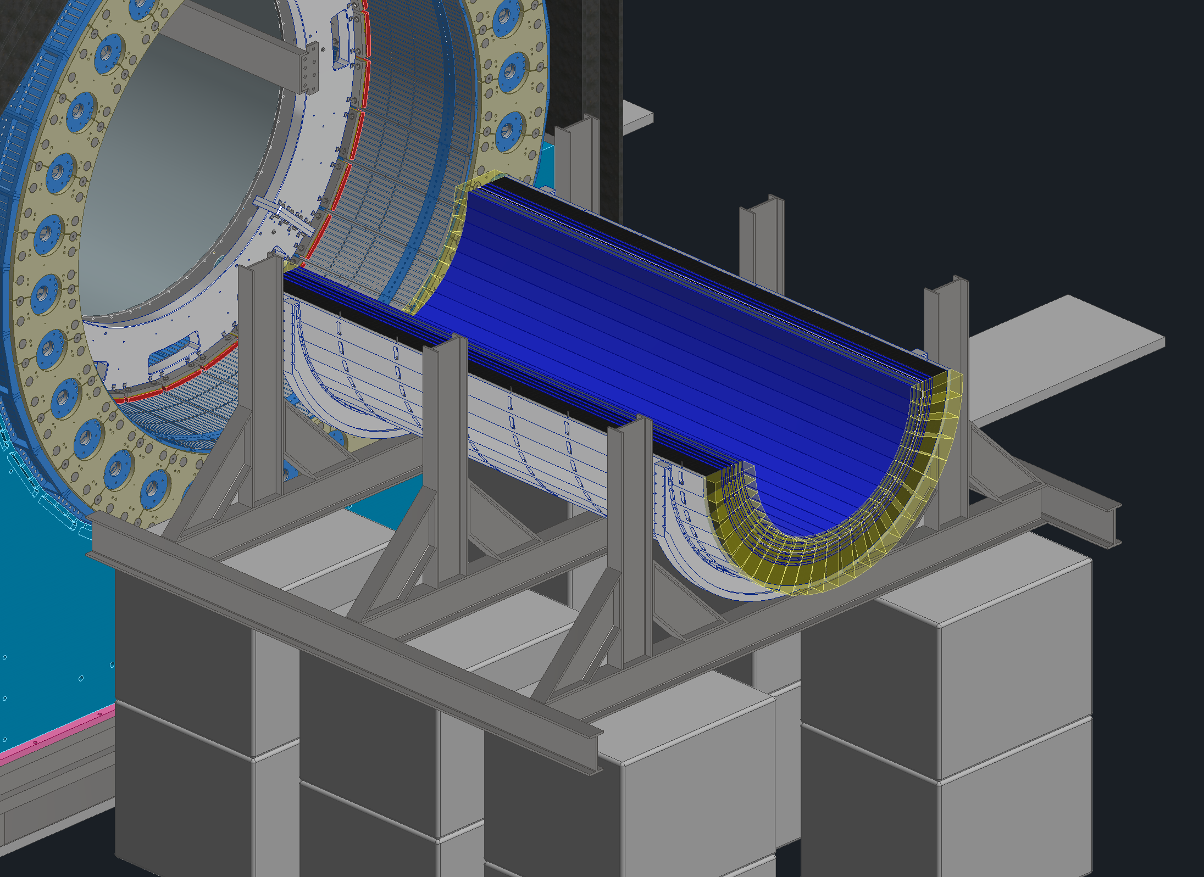
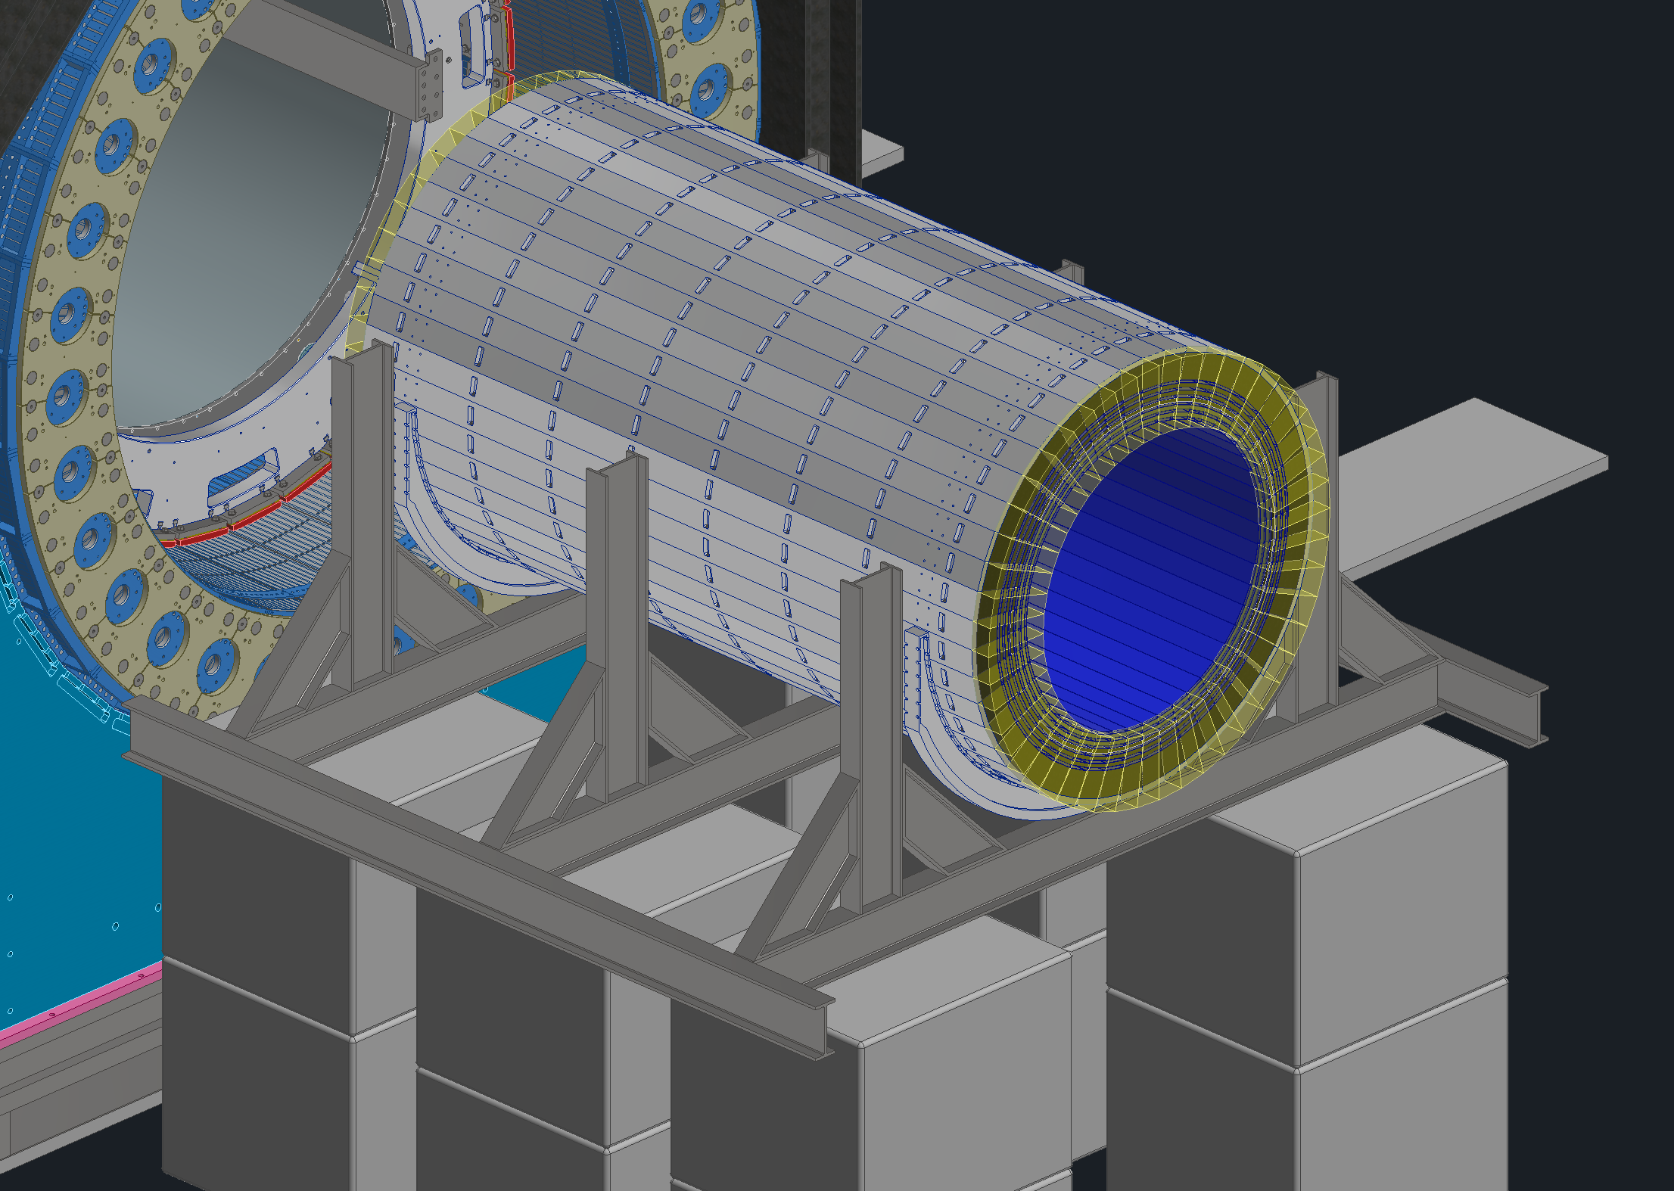
Assembly & Installation
Step 2: Lower the bottom 24 barrel EMCal sectors into place one by one
Step 3: Place the remaining, top 24, barrel EMCal sectors into place

Slide 8
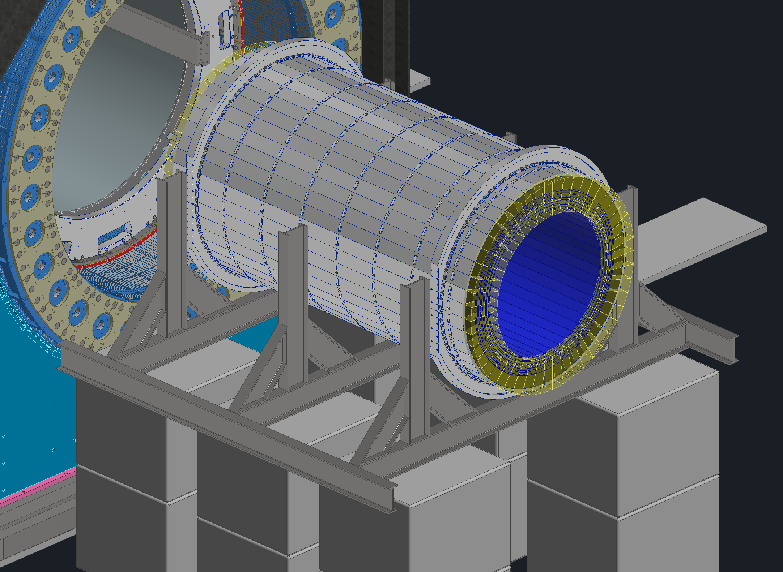
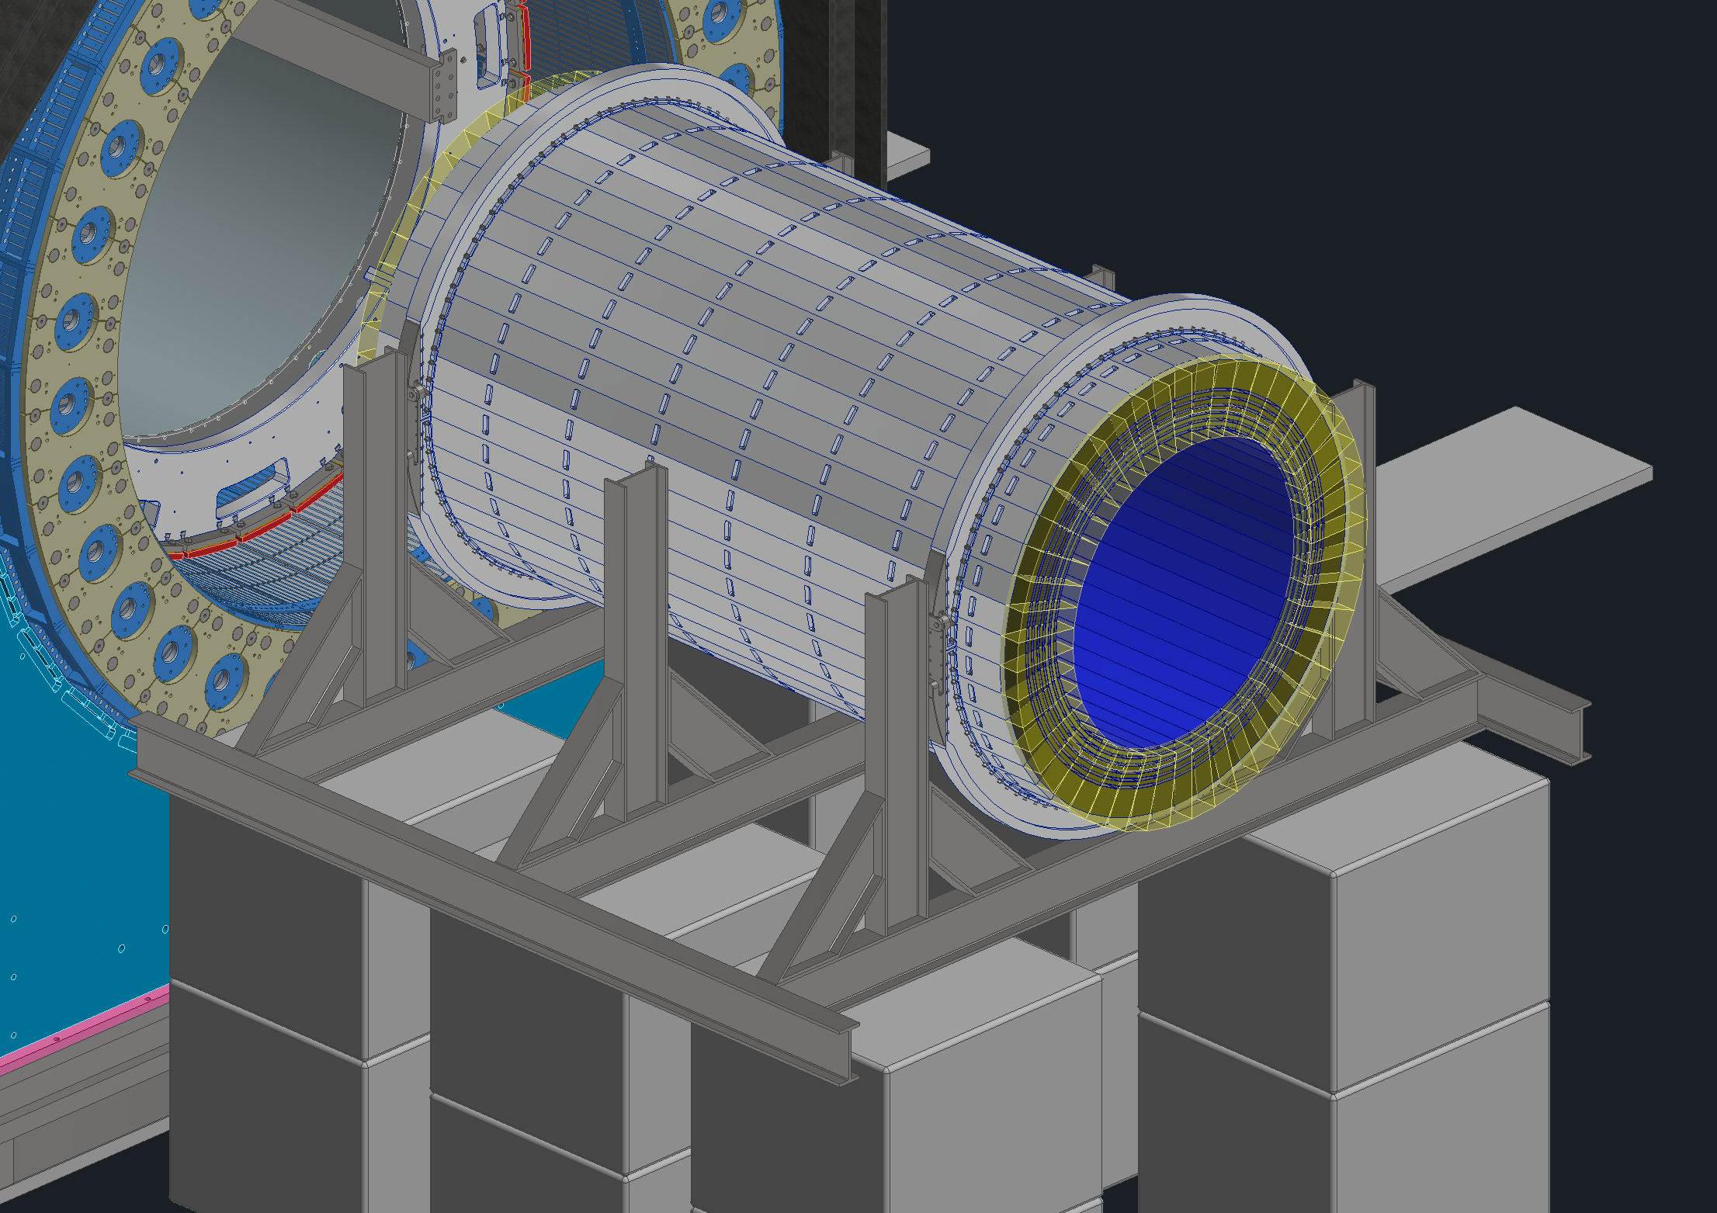
Assembly & Installation
Step 4: Install the top cradles
Step 5: Jack up the whole assembly and install the splice plates at 3 and 9 o’clock
Splice Plates

Slide 9
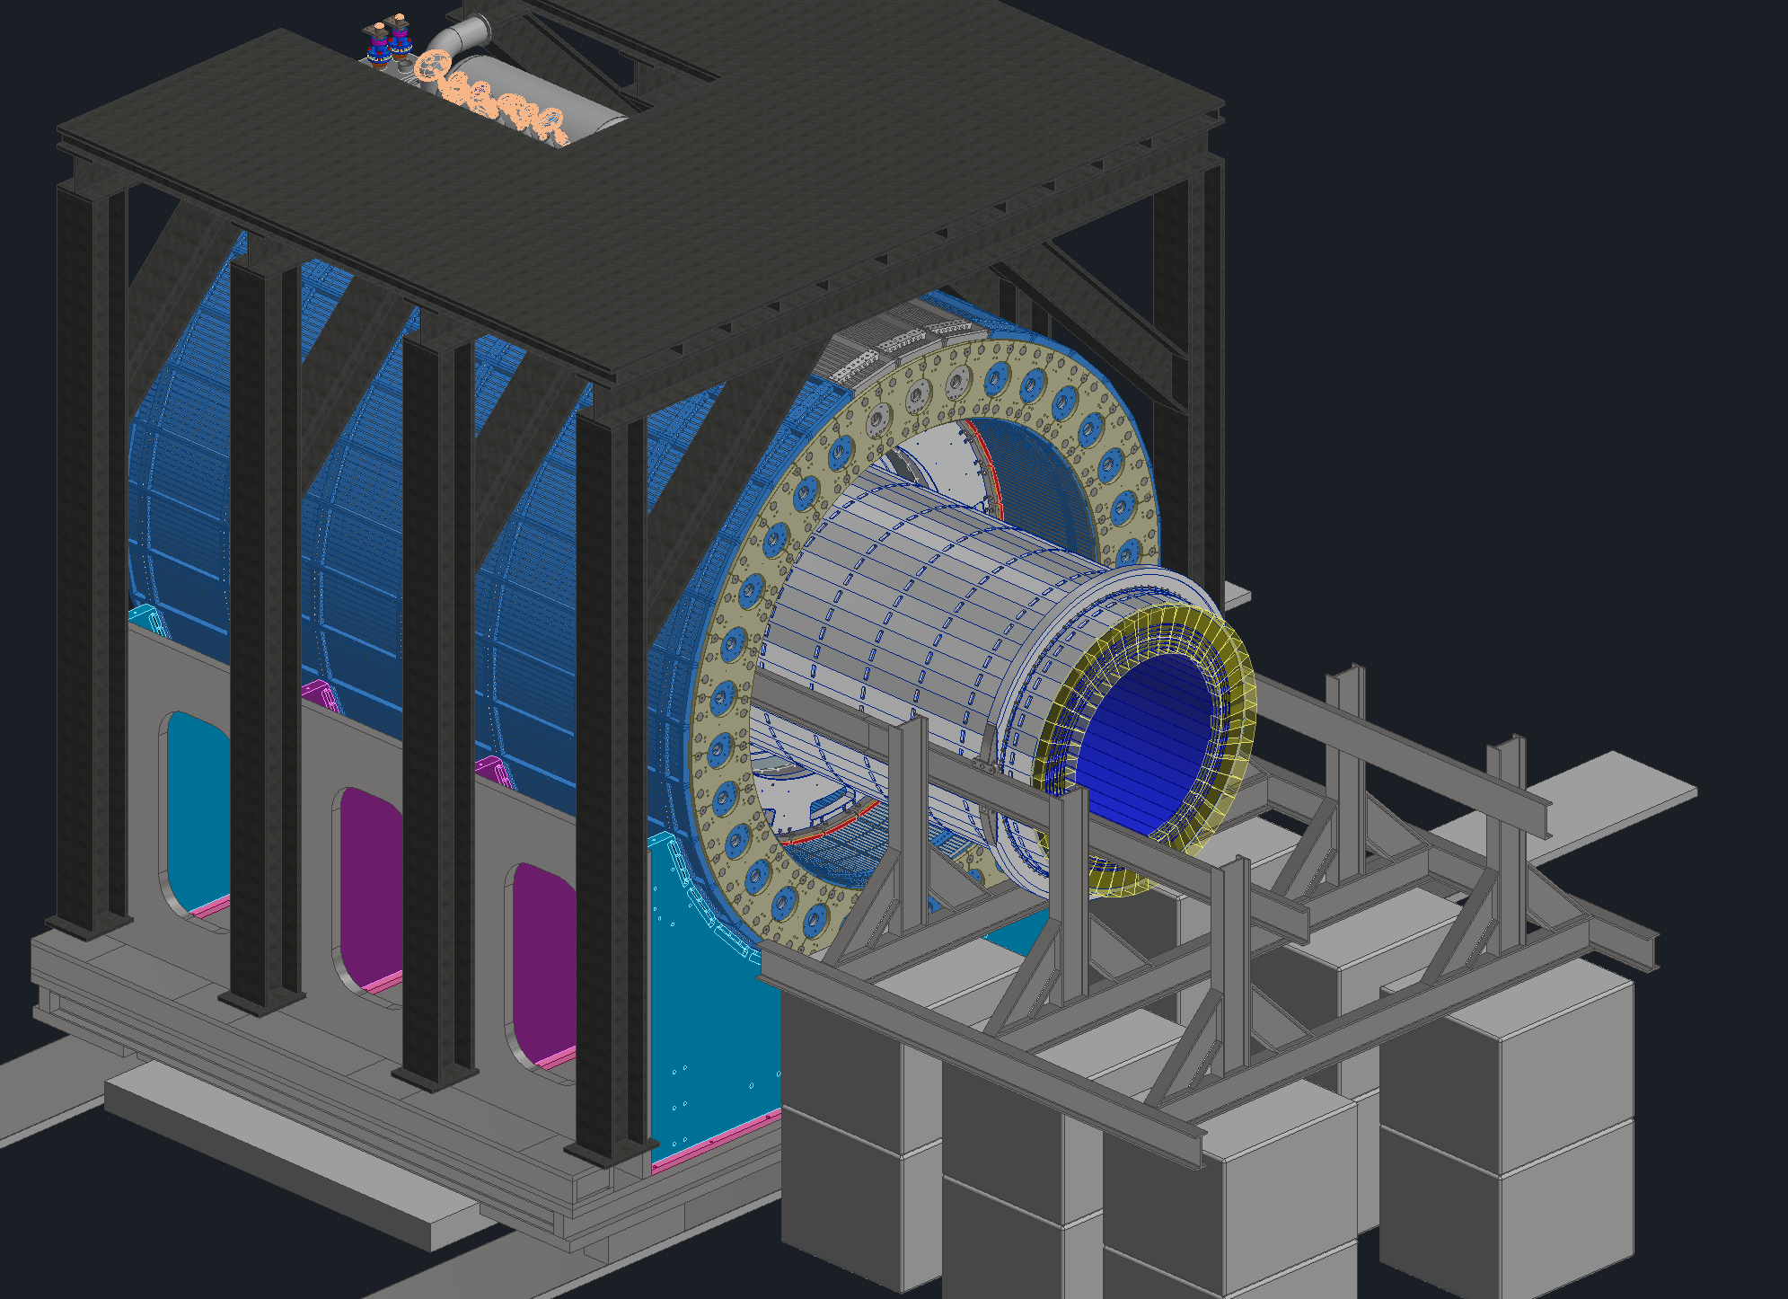
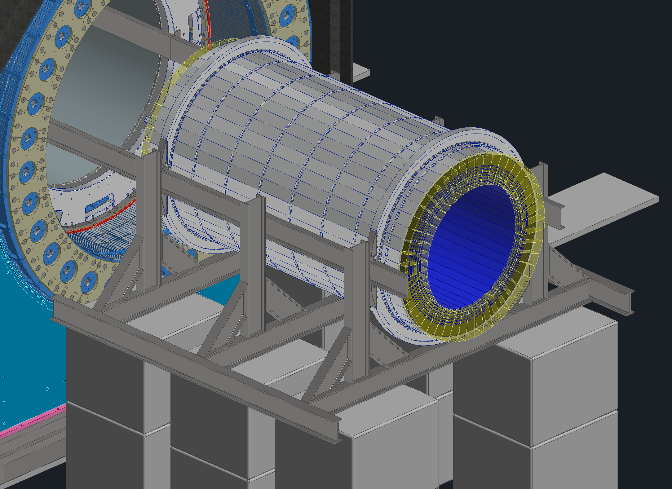
Assembly & Installation
Step 6: Add the supporting side channels and lower the assembly onto them to be slid into the main detector
Step 7: Slide the assembly into the detector

Slide 10
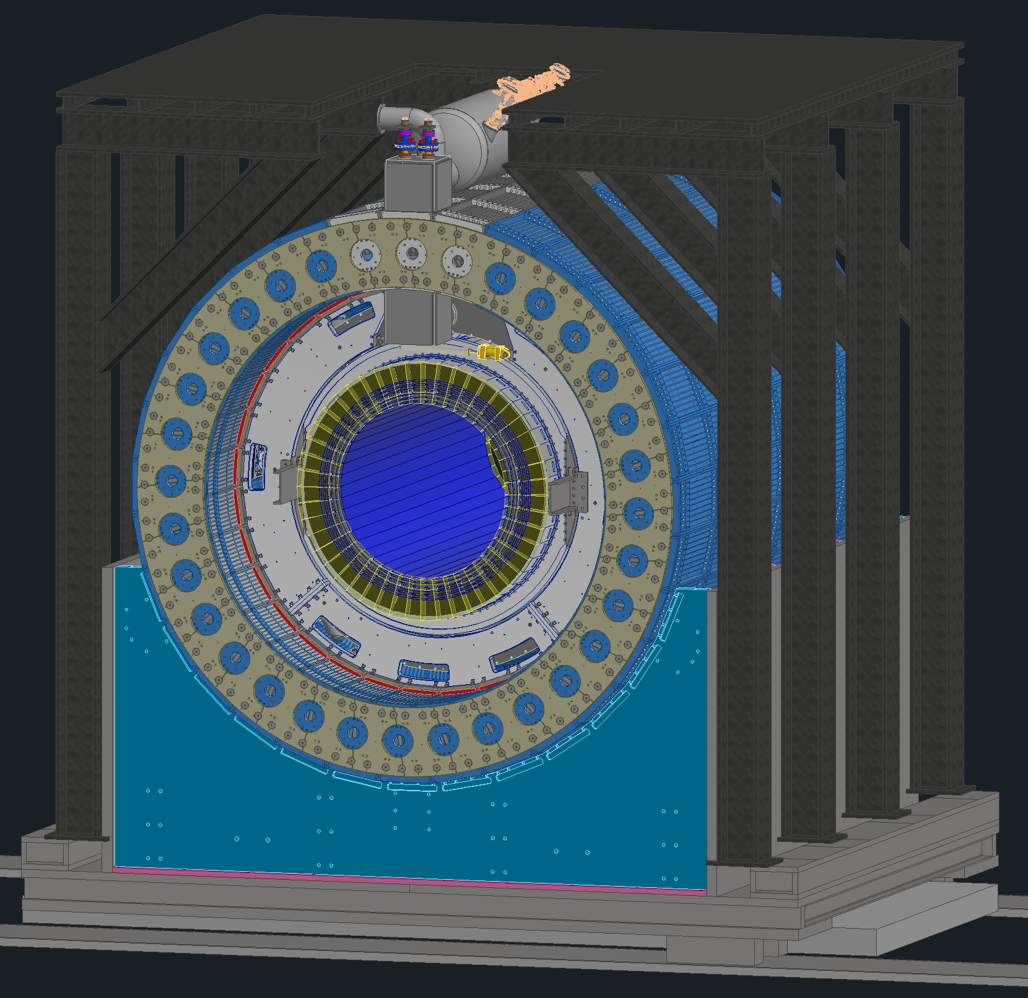
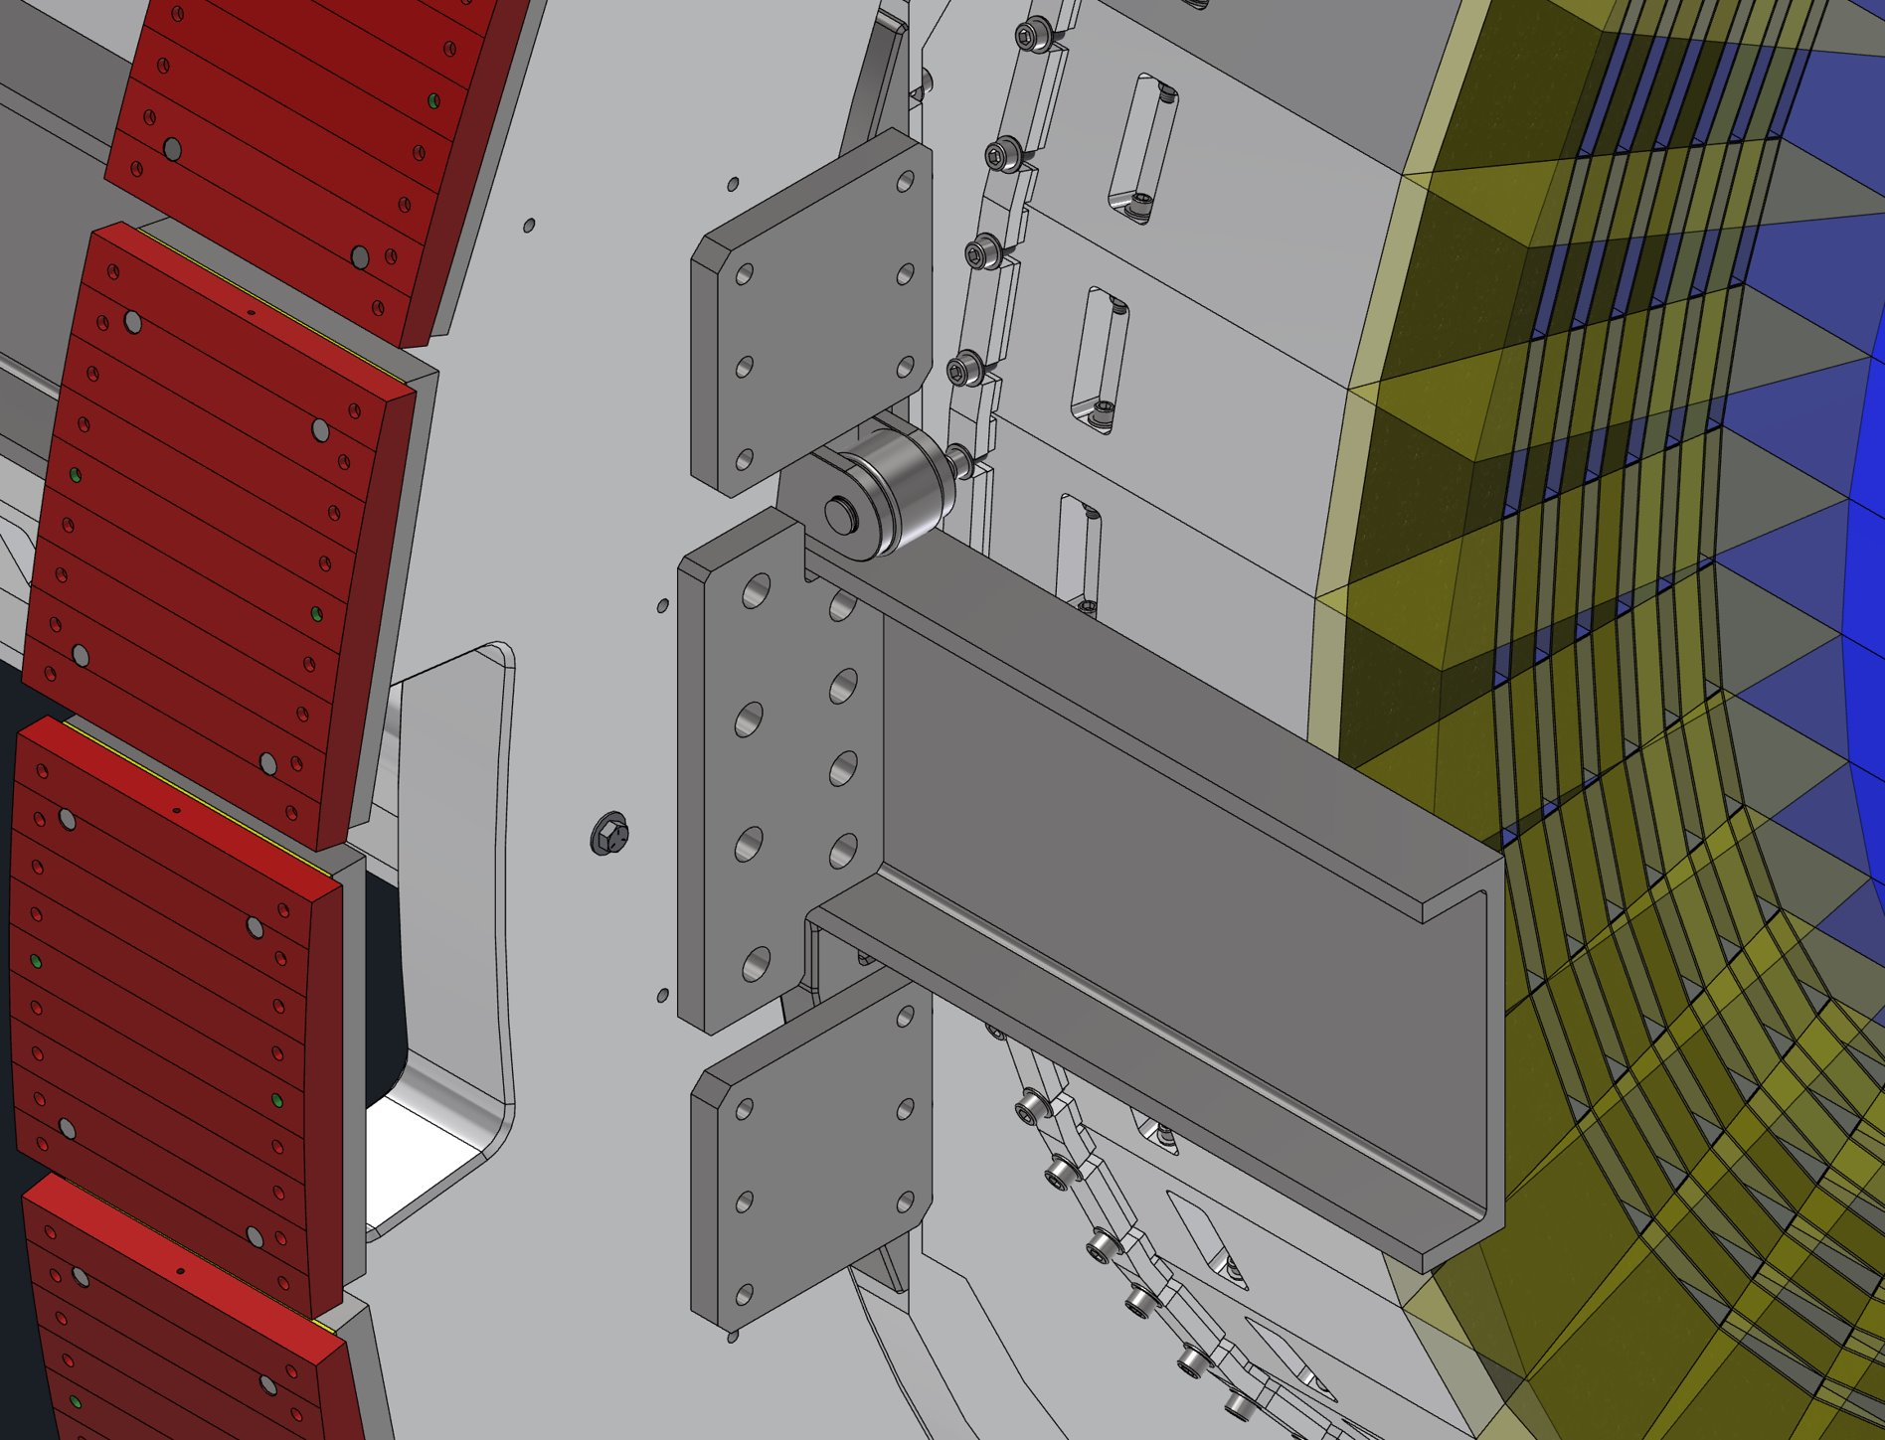
Assembly & Installation
Step 8: Install plates from the cradles to the Inner Support Rings to lock the barrel EMCal in place and remove the installation tooling
Step 9: Assembly and installation is complete

Slide 11
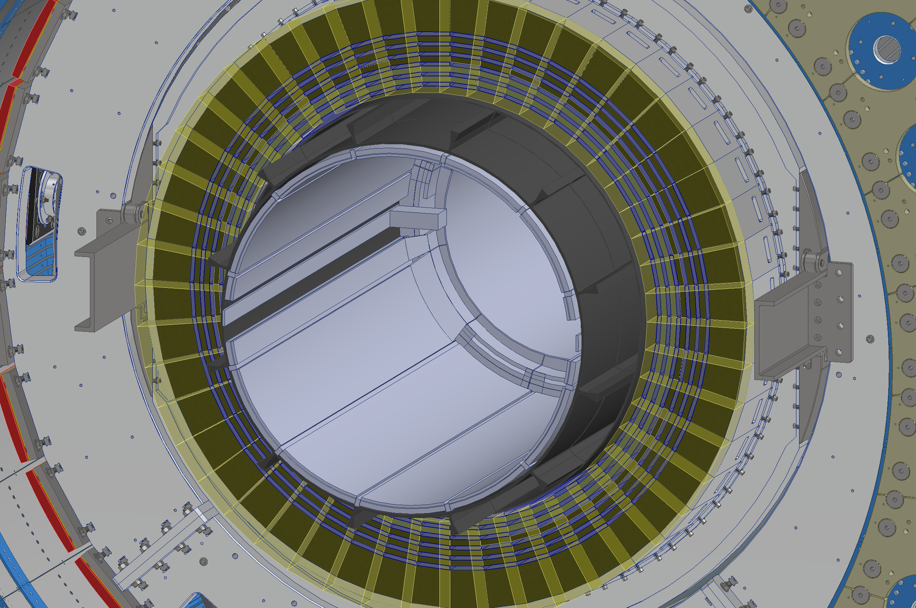
Integration – GST Support
The GST support will feature 2 brackets on each end that extend outward to the barrel EMCal’s supporting channel
These brackets will allow for the finer adjustment needed for the GST and inner trackers

Slide 12
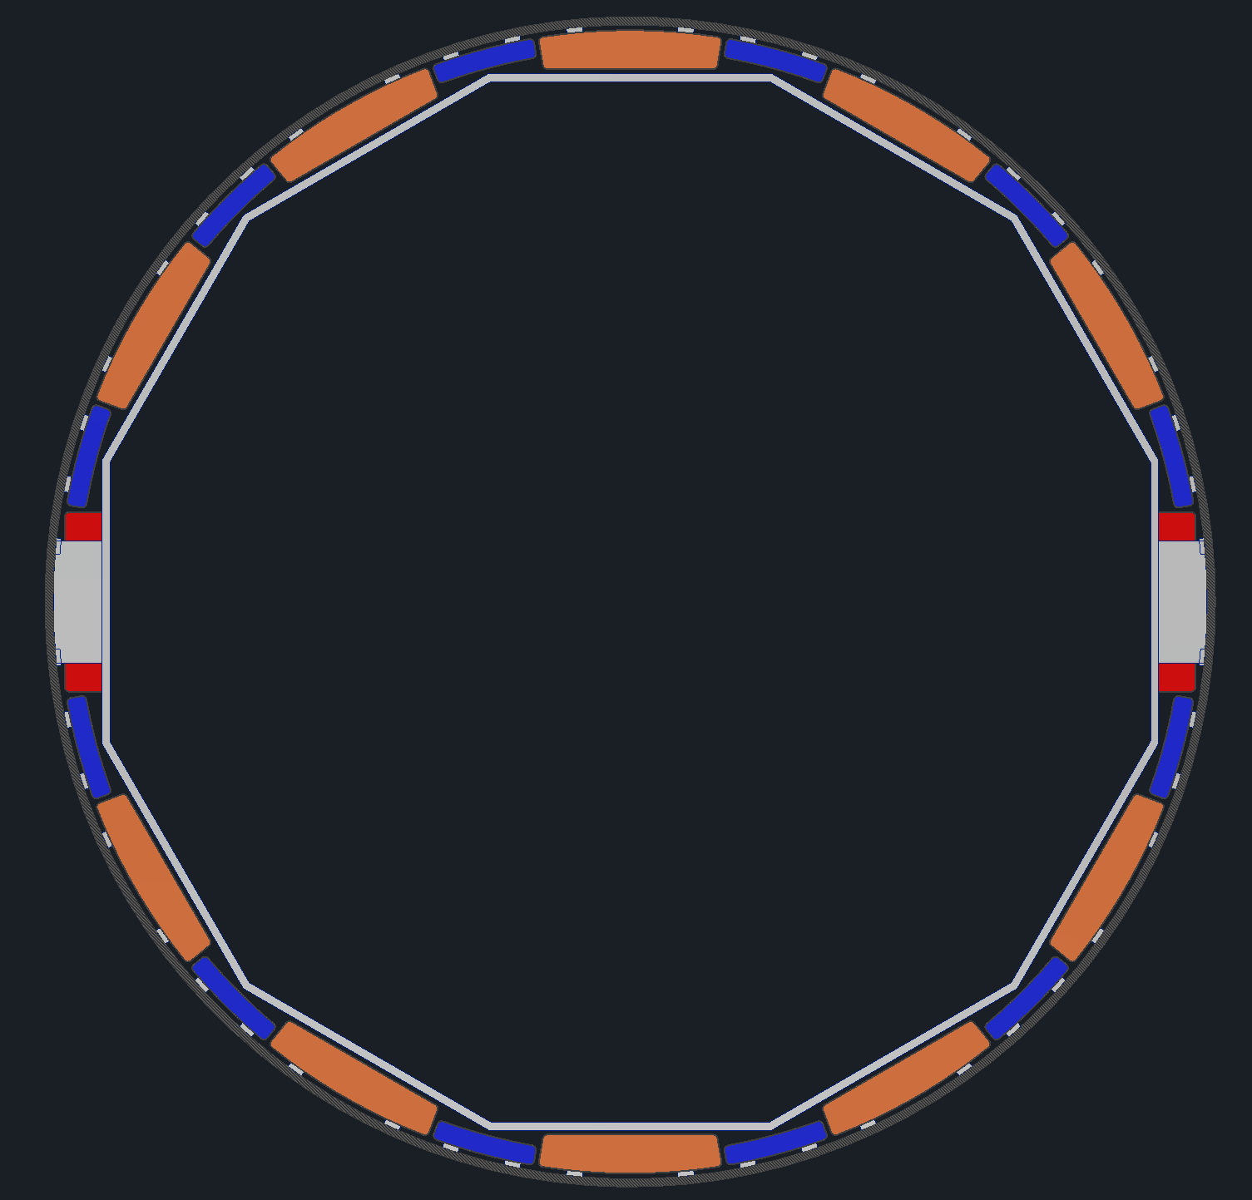
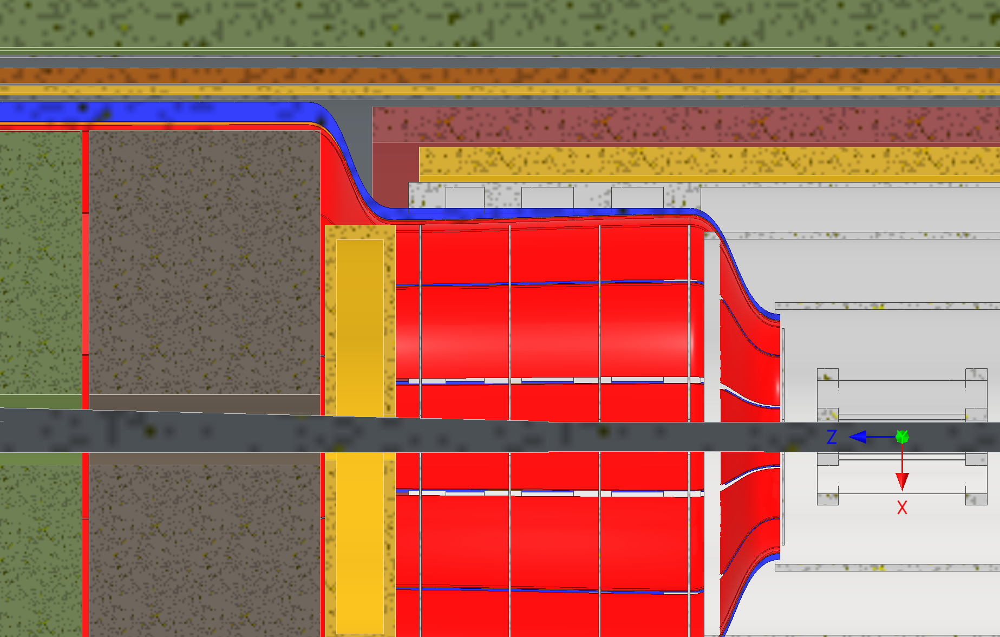
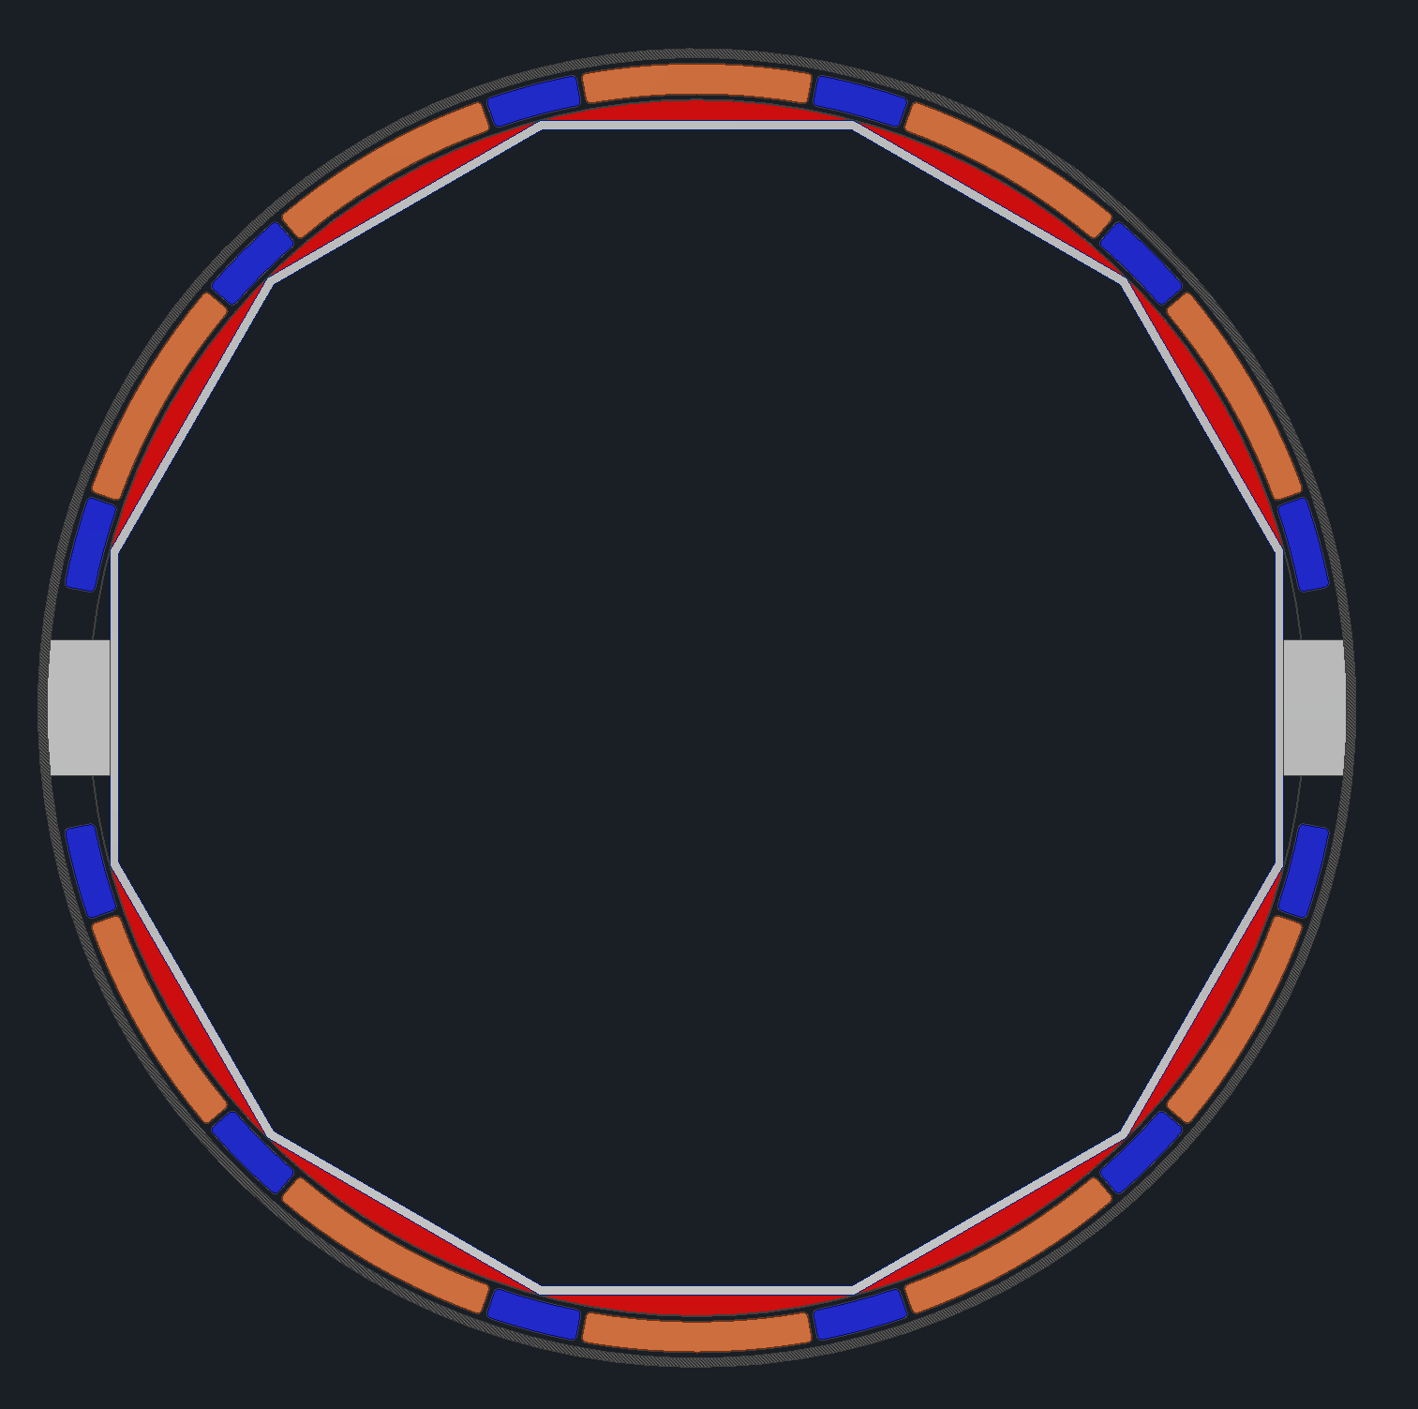
Services Updates
Currently looking into how best to route services around pfRICH and EEEMCal
Two phi split ideas are shown to the right, these give more space around the EEEMCal, however routing the services from the detectors to these trays seems impossible. We will make some mockups to test

Slide 13
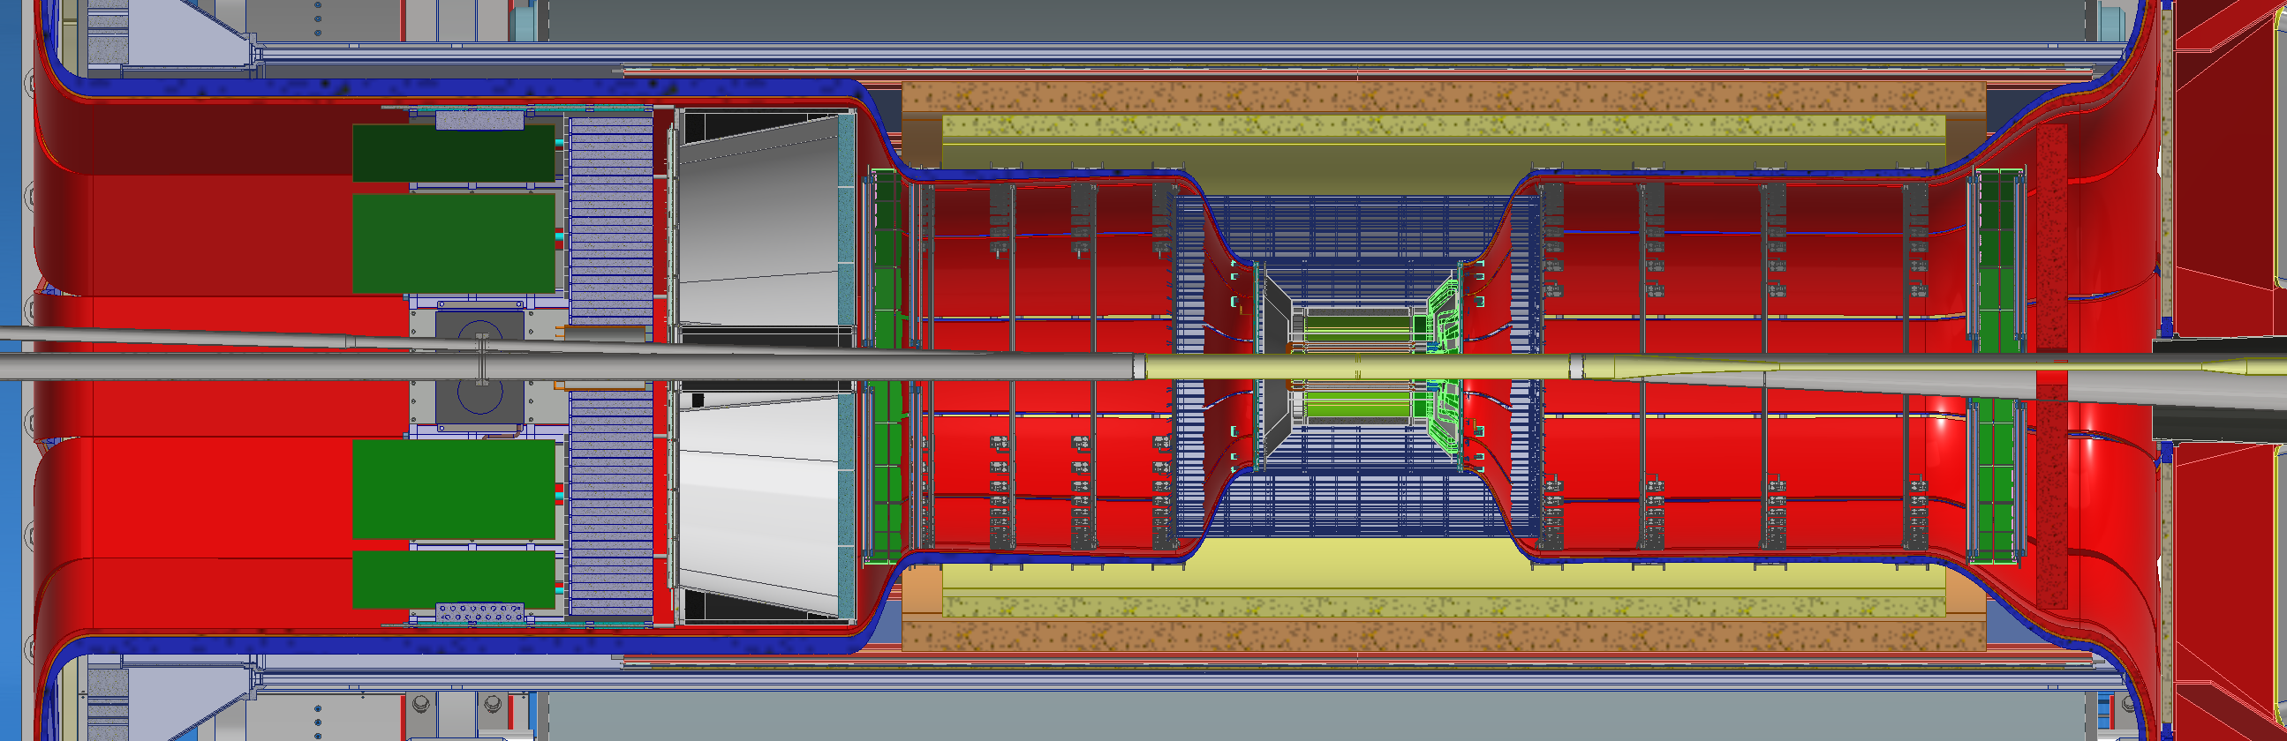
Services
Updating the services model according to the mentioned changes
Making an updated services model with densities for simulations again

Slide 14
Backup Slides

