Slide 1
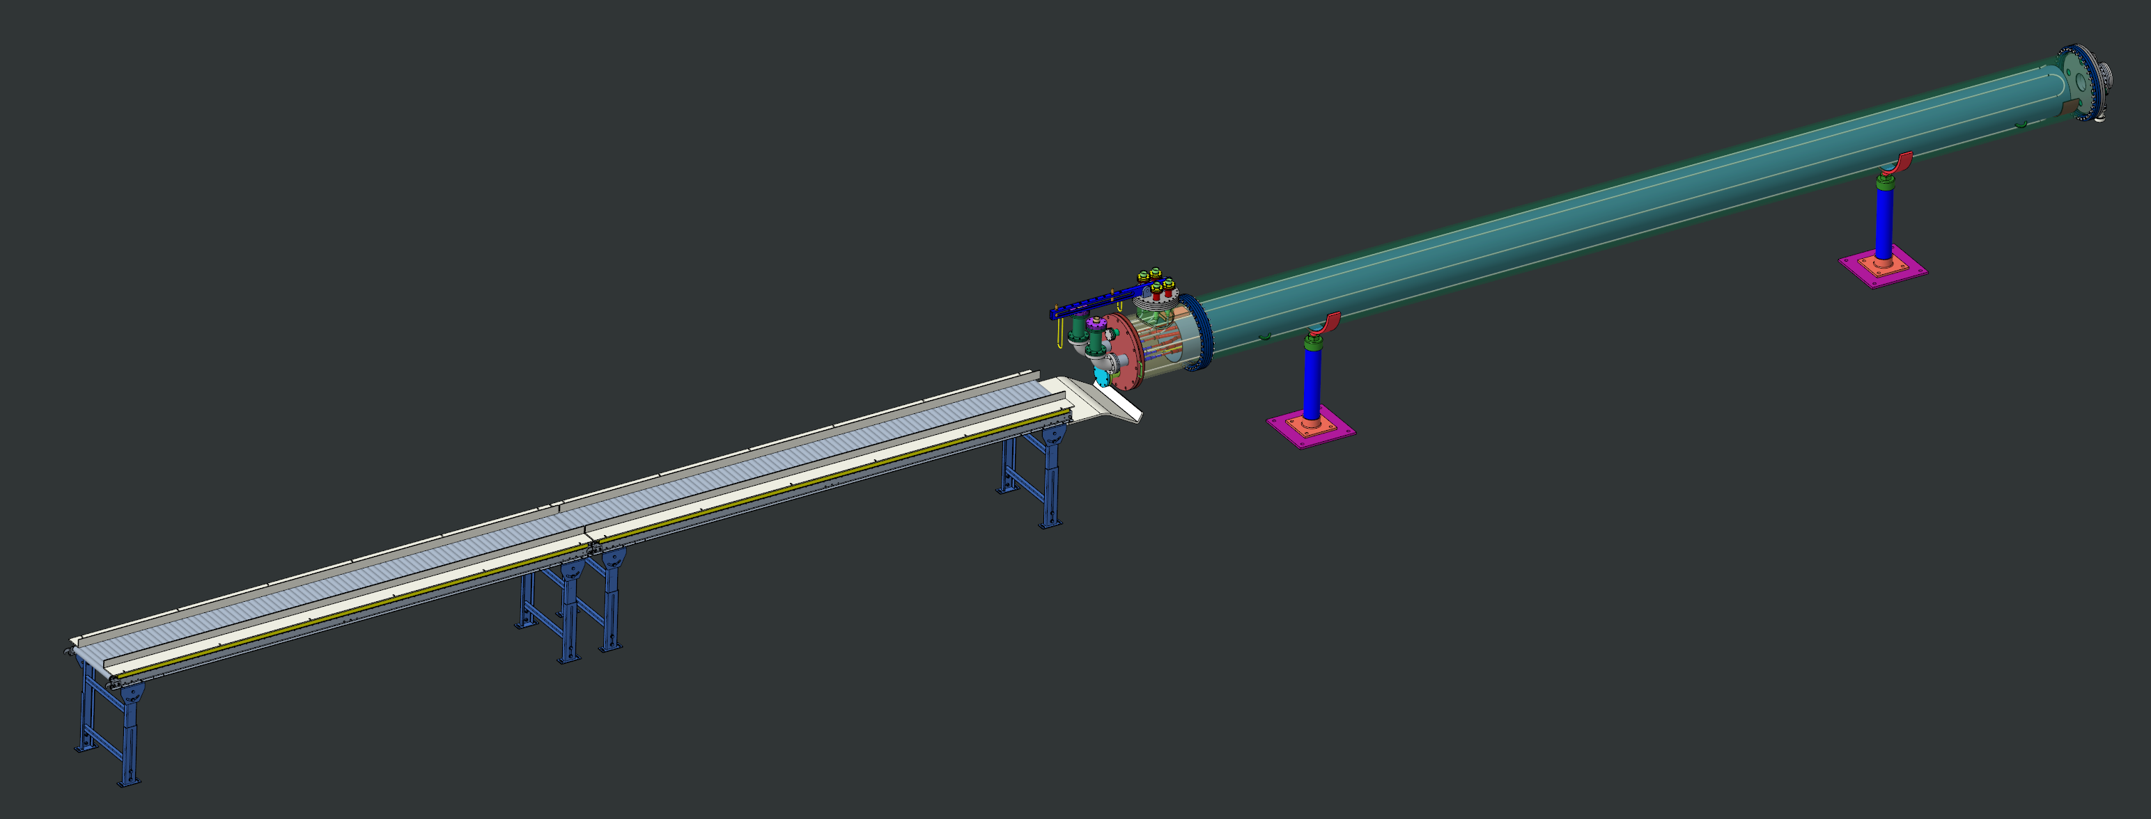
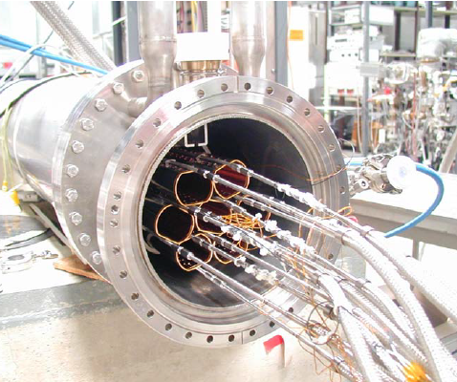
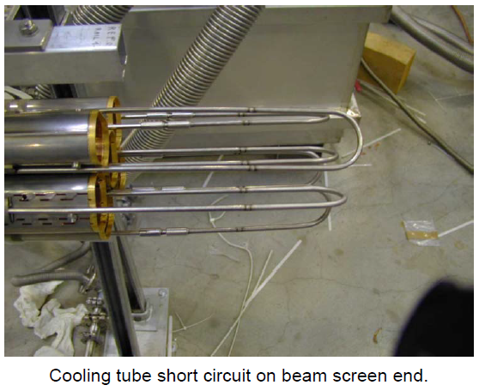
Design of Cold Beam Screen Test Equipment
October 6, 2025
Chang Jun
EIC Vacuum Group

Slide 2
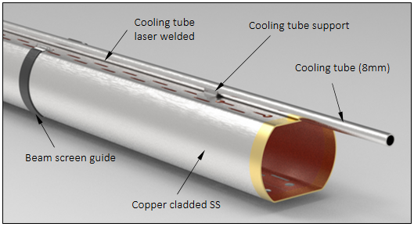
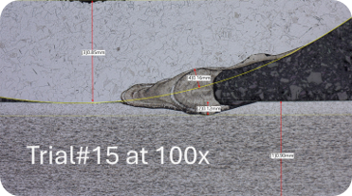
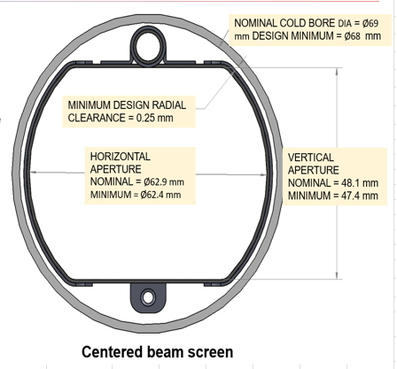
Beam Screens & Cold-Leak Test
The Beam Screens (OD=65mm) are inserted inside
the Beam Pipes passing along the super-conducting magnets.
This test is to confirm that all intermittent laser welding spots are leak proof between the cooling tube & beam screen body.
The welded areas shall not permit any Helium leaks during operation.
Inspection of all welds for cracks at room temperature shall be performed by the beam screen supplier.
This test is to check for cracks in the weld at low temperatures,
which could be caused by thermal contraction.
This Helium leak test shall be performed under vacuum
(~10E-3 torr) & ~100K cooled by LN2.
1.5kg/m

Slide 3
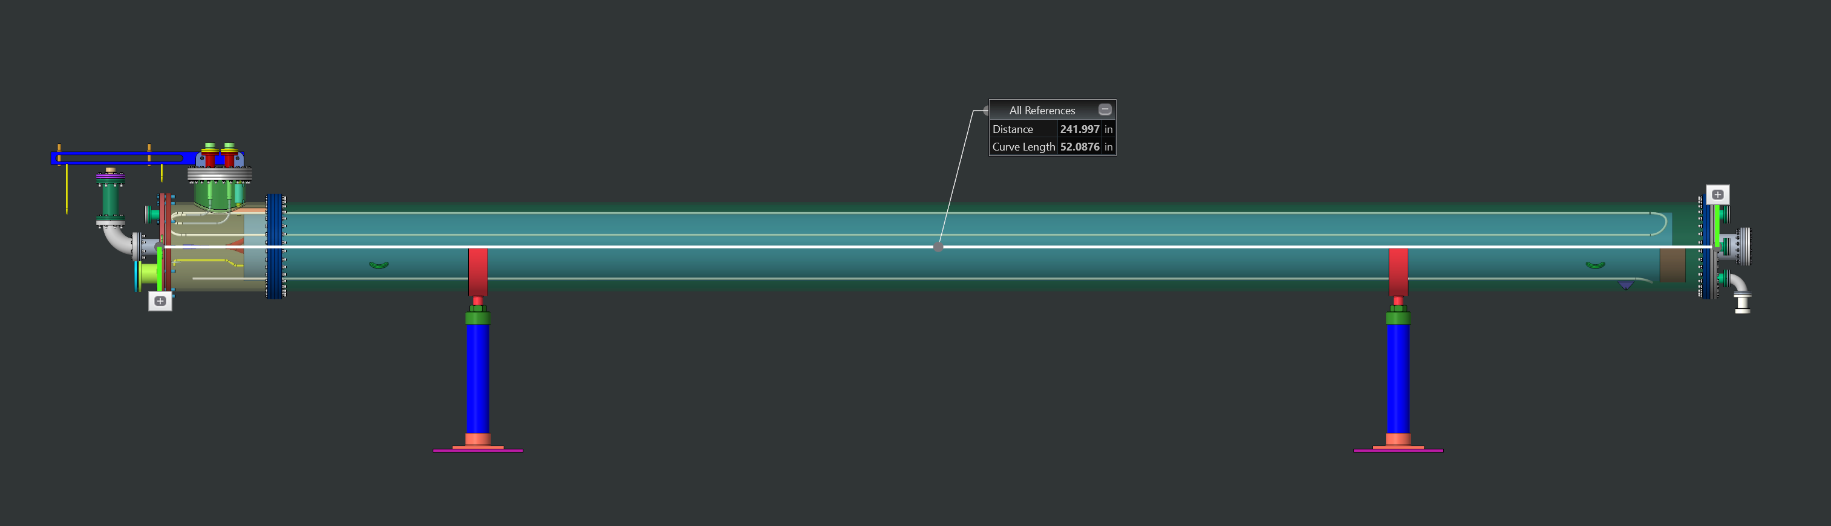
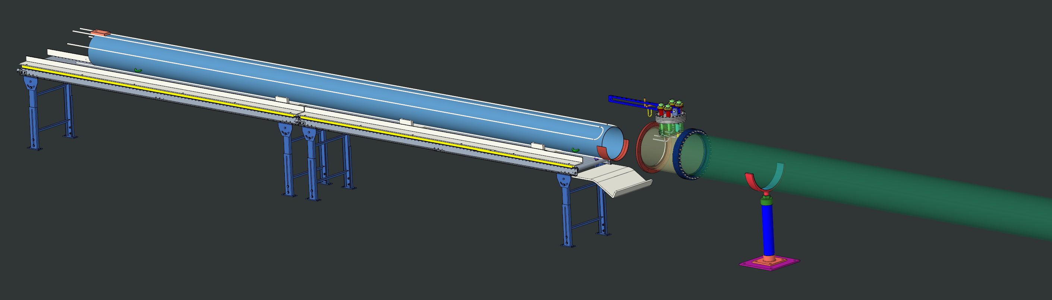
Cryostat with T Joint (~850kg) & Thermal Shield (~150kg)
All Parts:
304 SS
Cryostat: Total L=242” (6147mm) OD=14” (356mm) → t=11.5mm (Sch-40S)
→ t=4.78mm (Sch-10S) (35MPa under 0.1MPa)
Thermal Shield: OD=10.75” (273mm) → t = 0.135” (3.4mm) & L=226” (5740mm)
LN2 Cooling Pipes OD=3/8” (9.5mm) & t=0.9mm

Slide 4
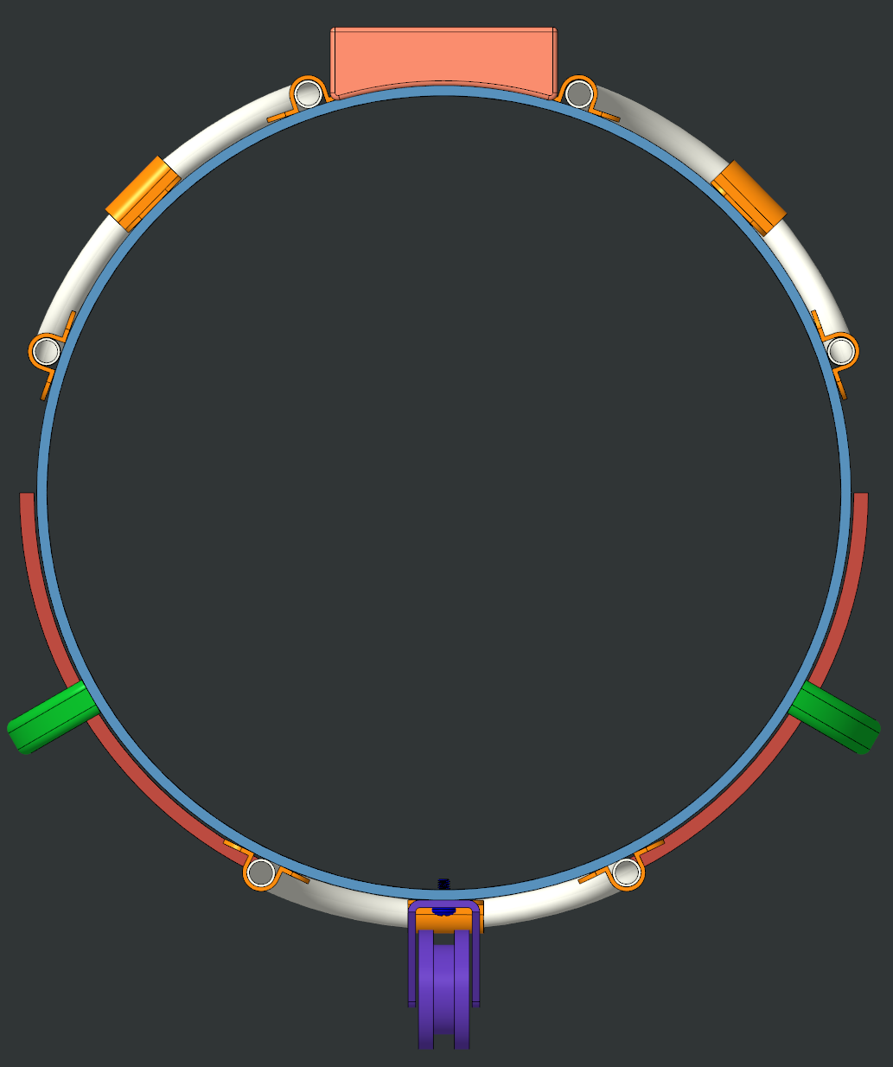
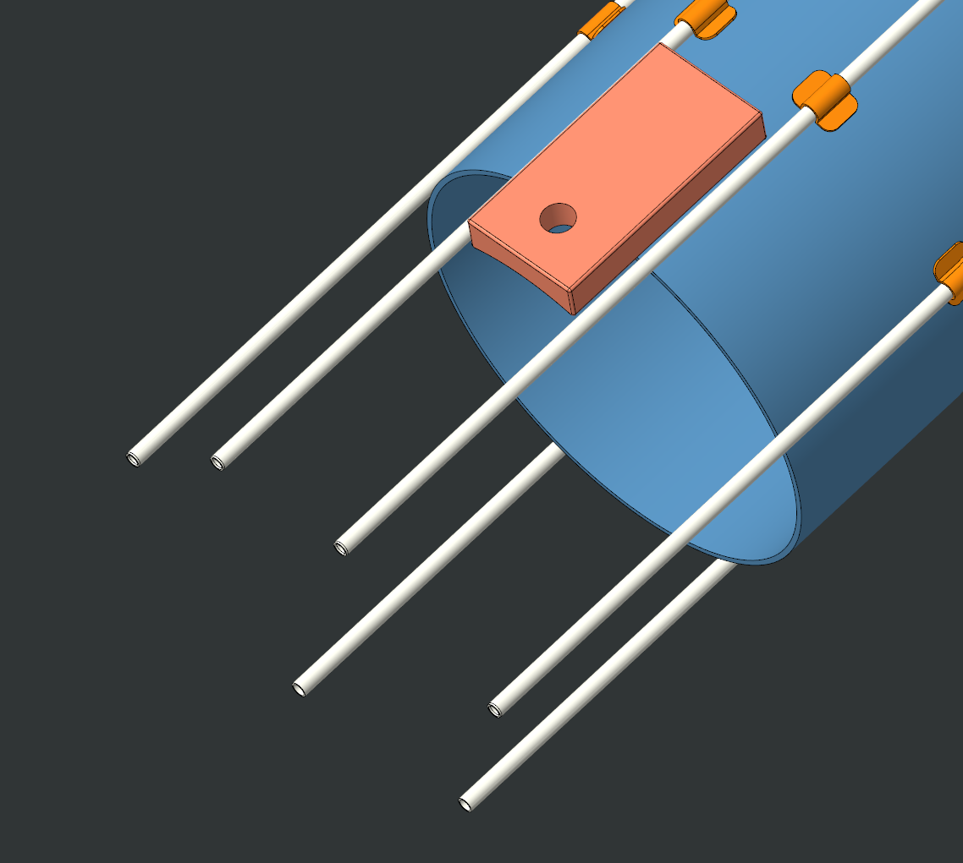
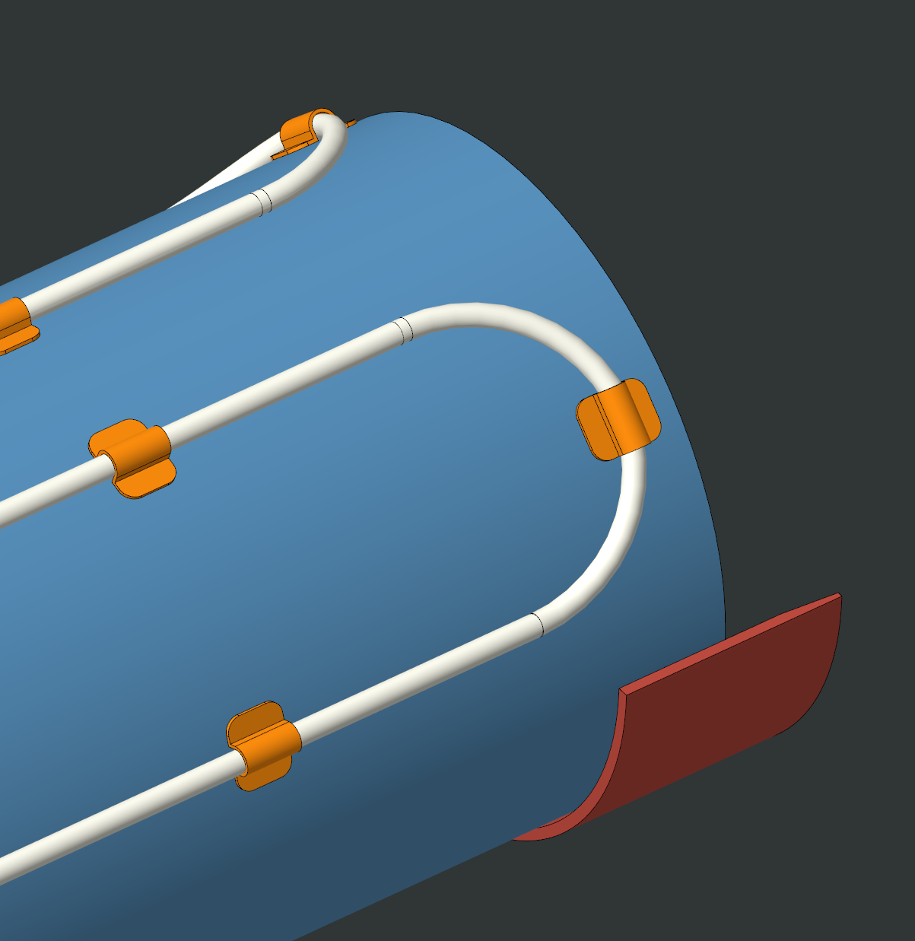
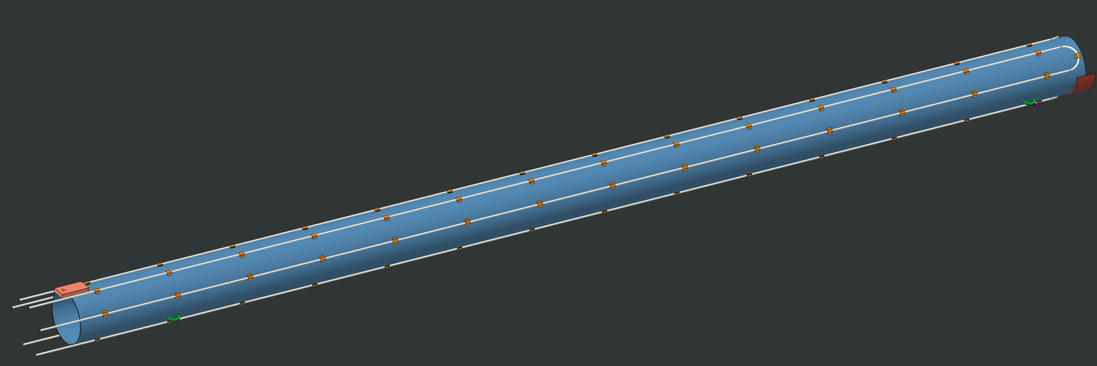
Thermal Shield with 3 sets of LN2 Supply/Return Lines
Stainless Steel Tube, 316L, .375 OD X .035 Wall
Brackets to be welded & LN2 tubes soldered to thermal shield to improve thermal contact.

Slide 5
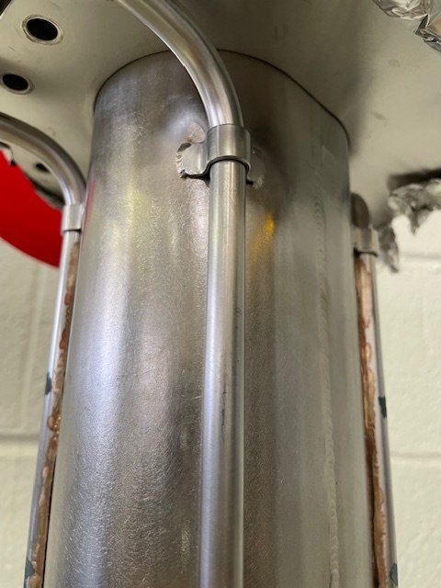
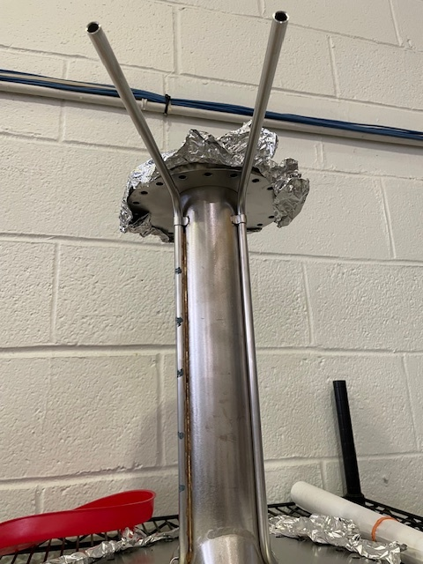
Cooling Pipe Connected: Example @ BNL Workshop

Slide 6
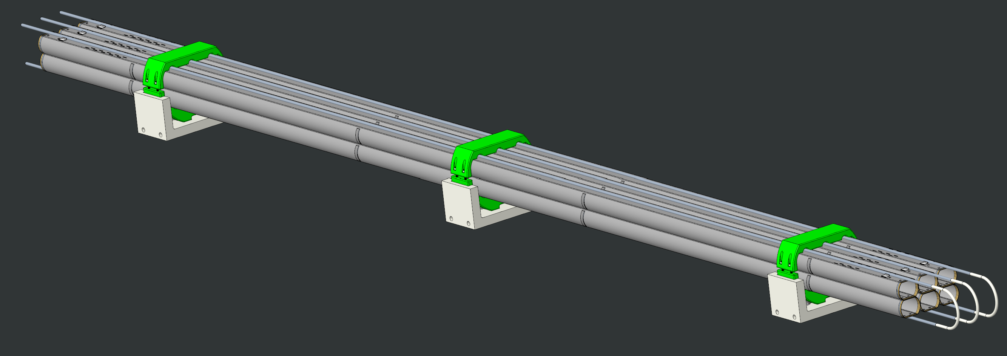
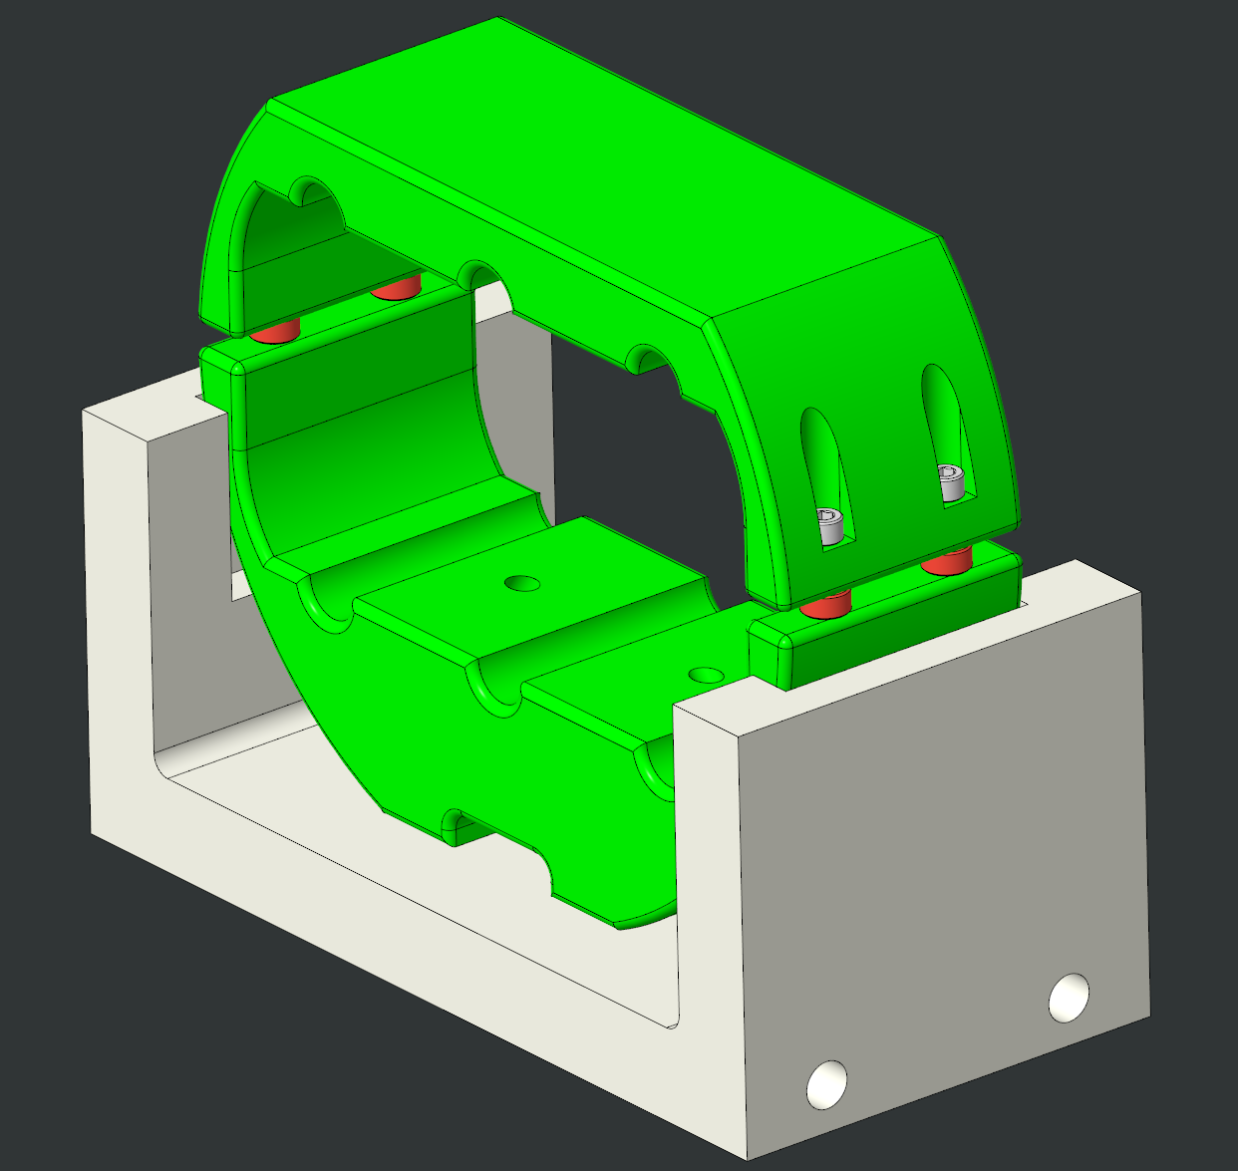
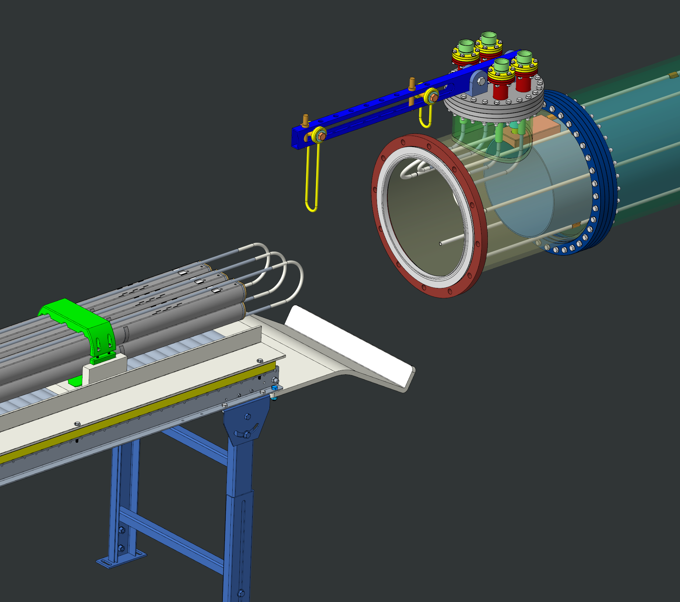
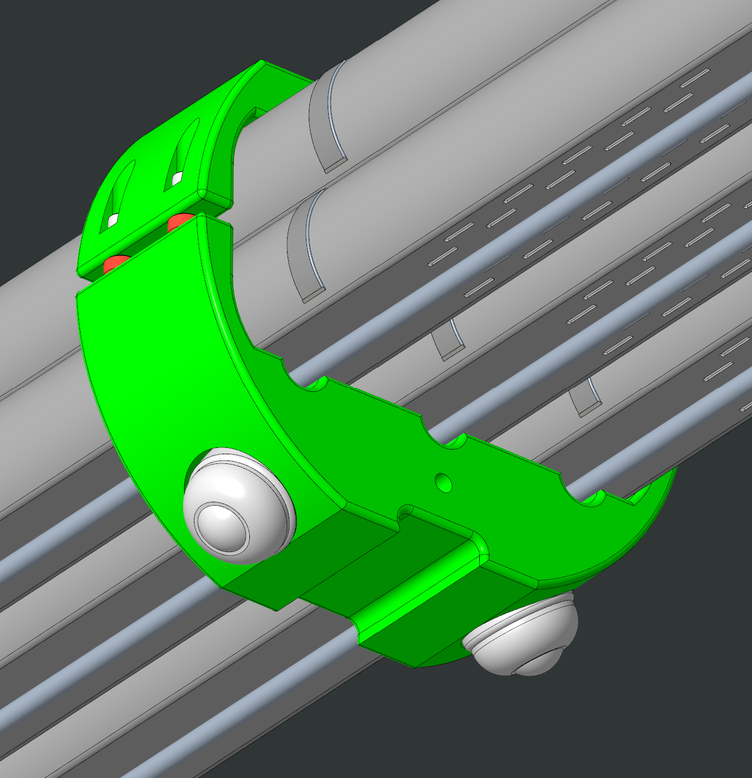
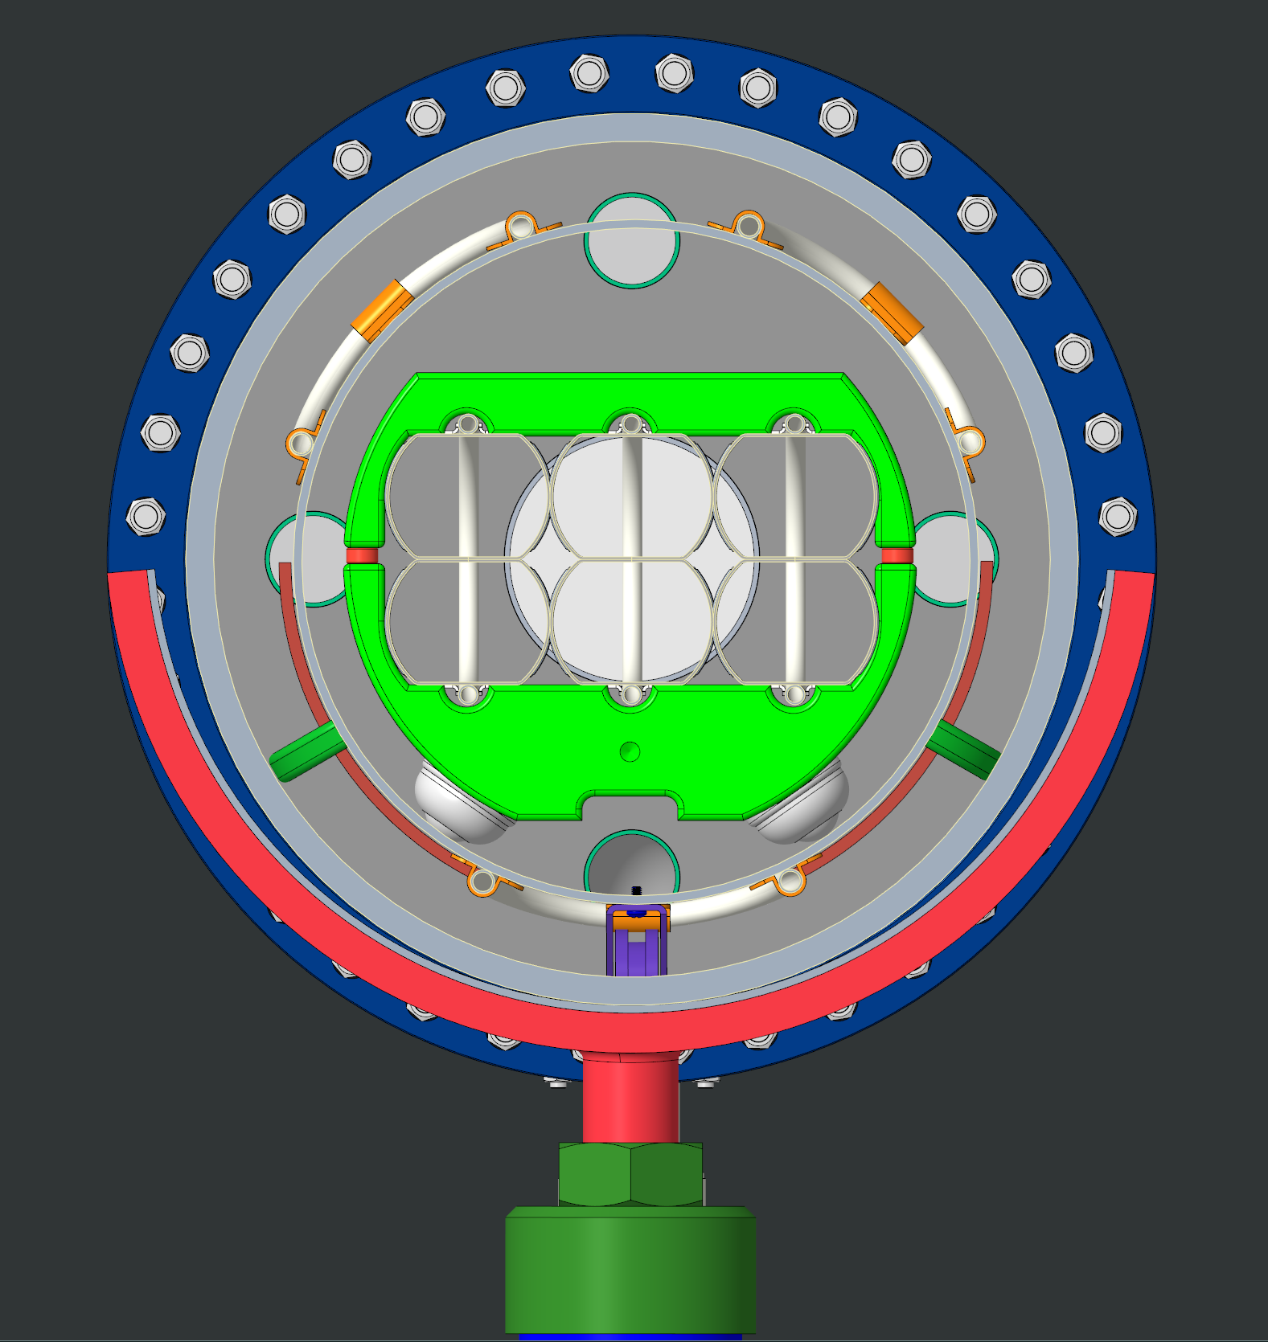
Pack of 6 Beam Screens for Cold-Leak Test with Helium

Slide 7
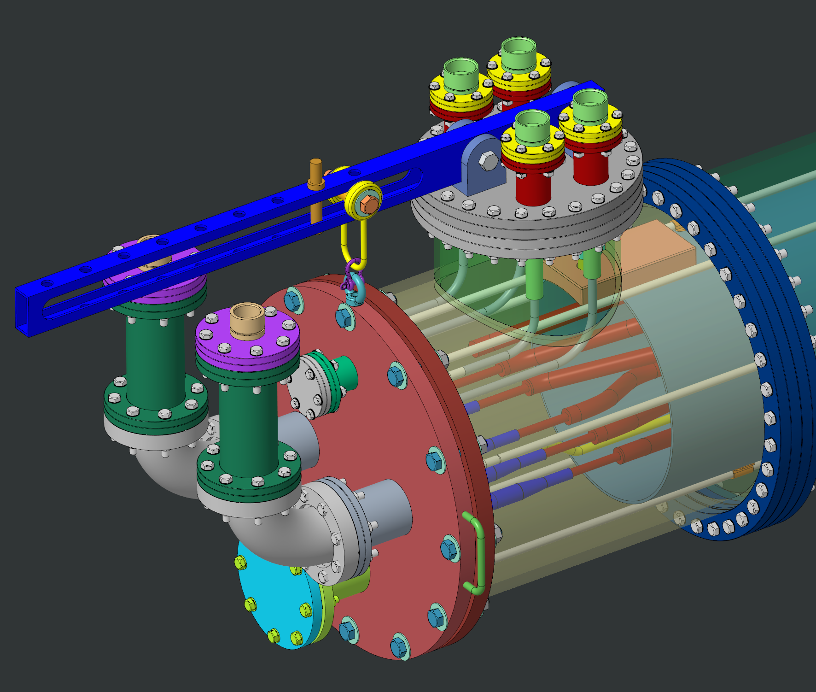
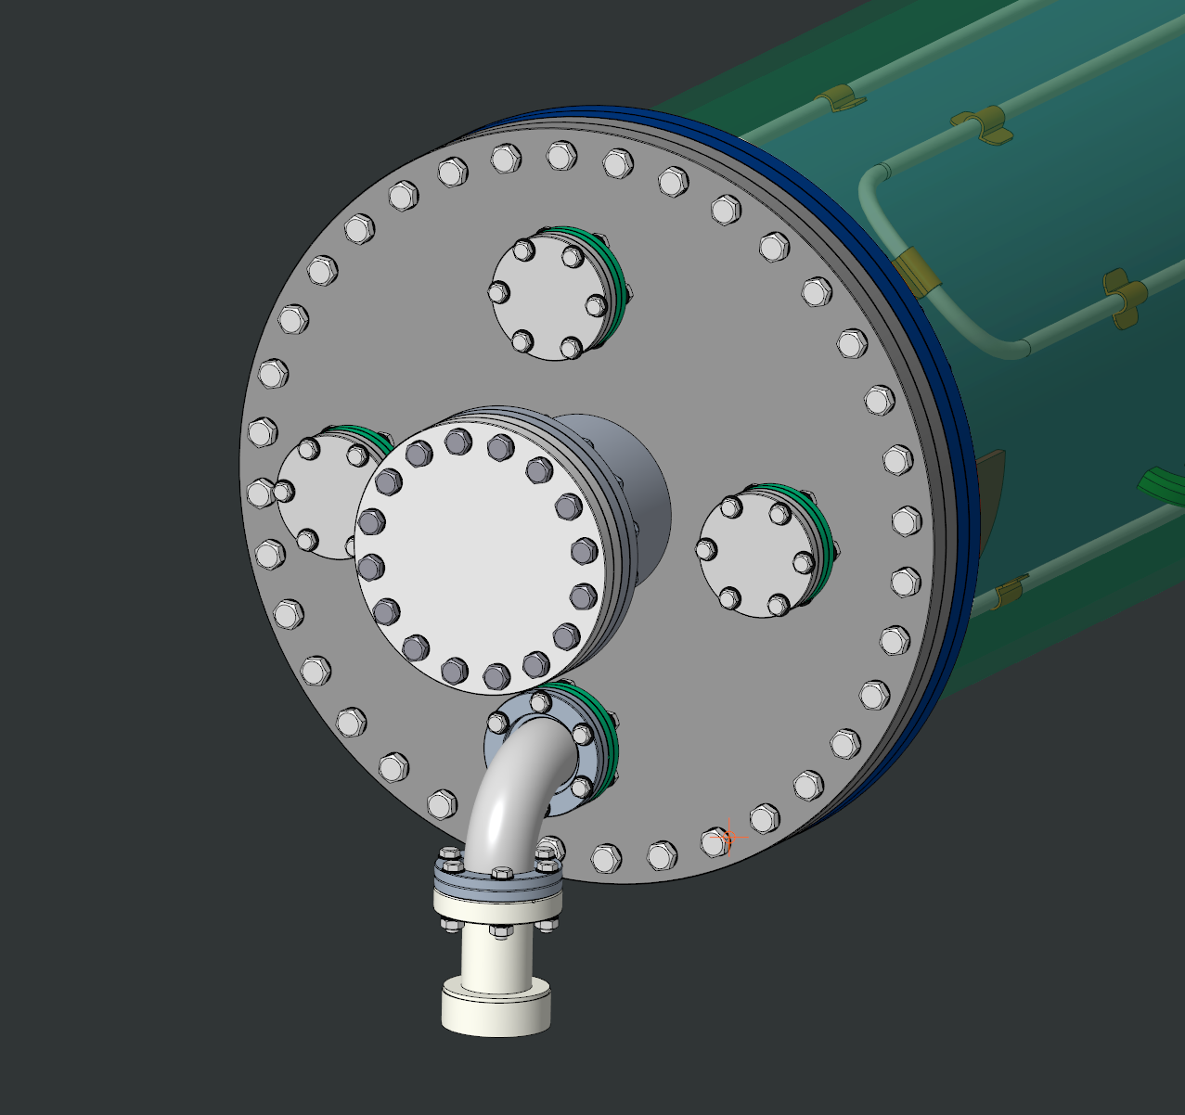
All Flanges are Off-the-Shelf Flanges
Front: ISO O ring flange
All Other Flanges: ConFlat Type
LN2 Lines
Helium Lines
FRONT
BACK
Pressure relief:
Breakable disk

Slide 8
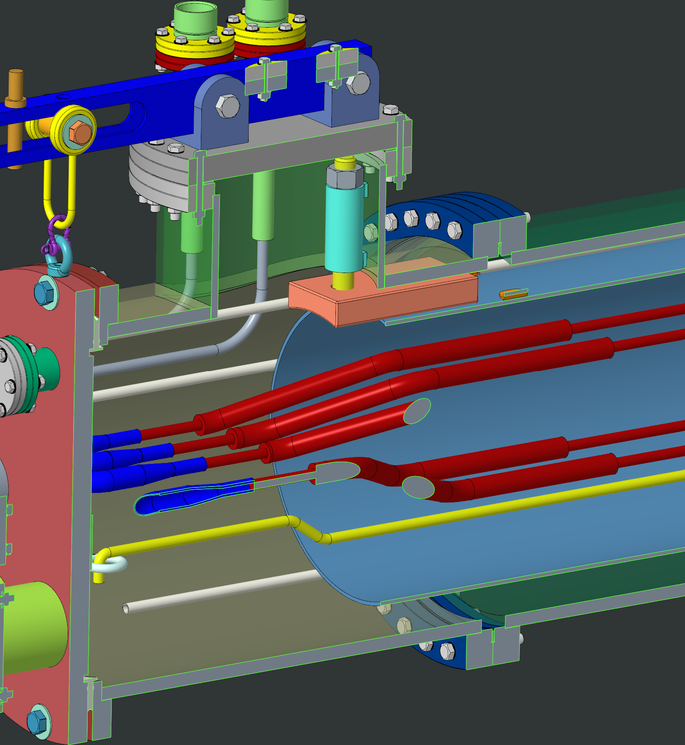
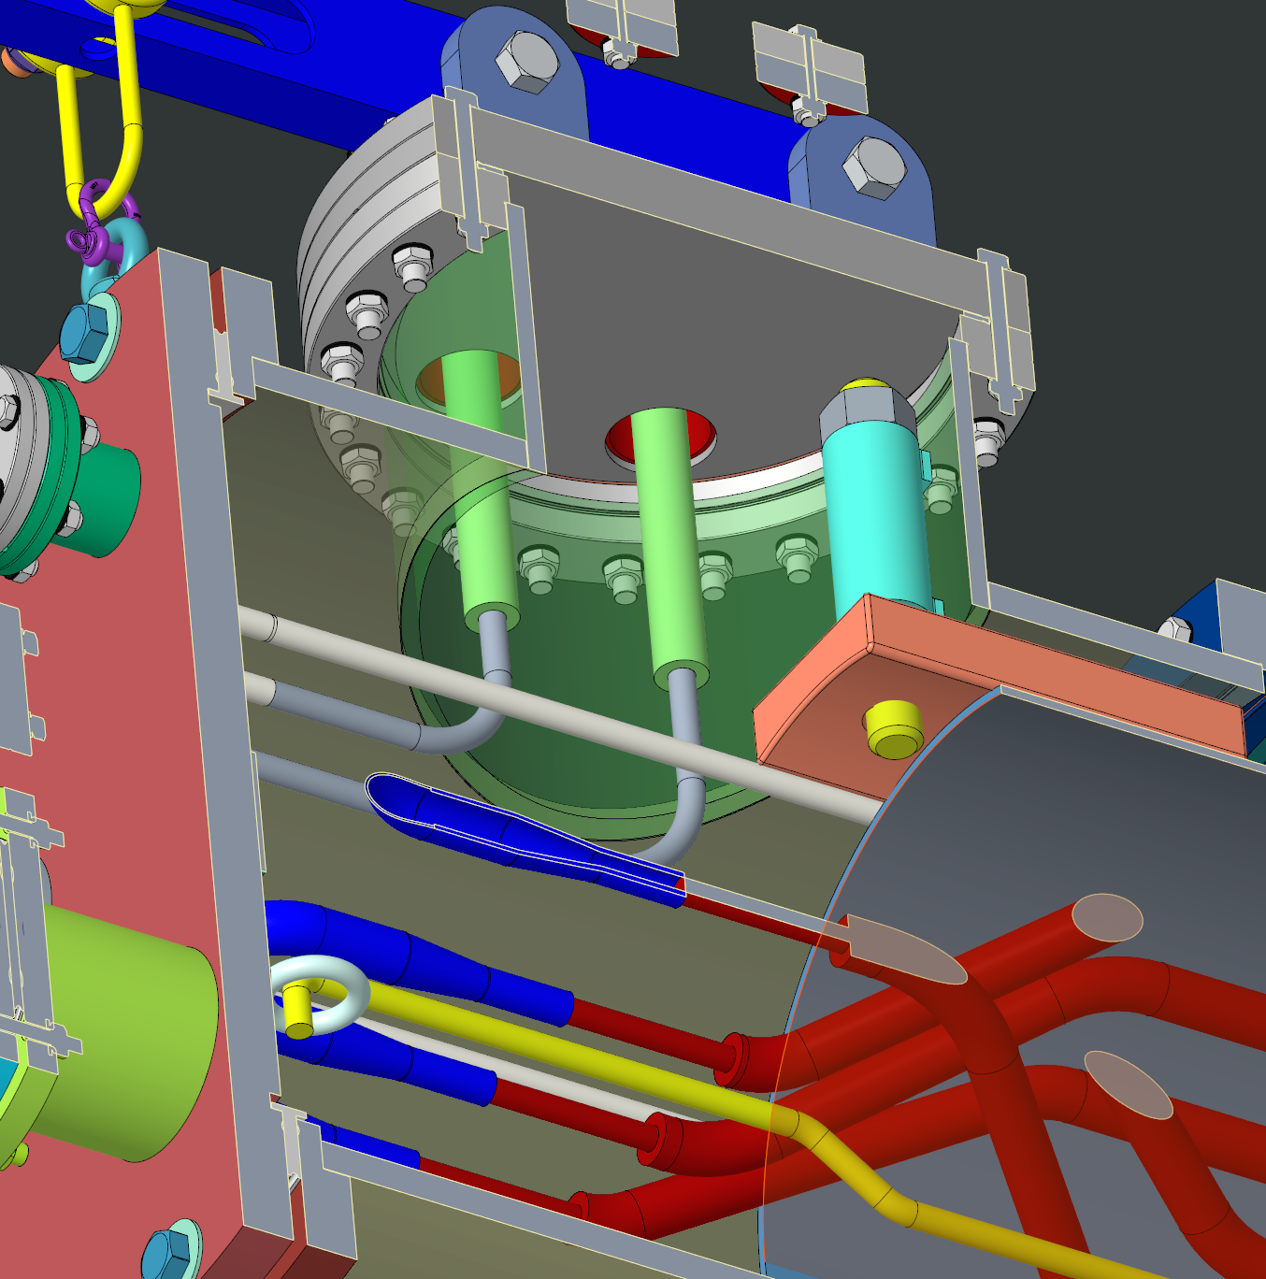
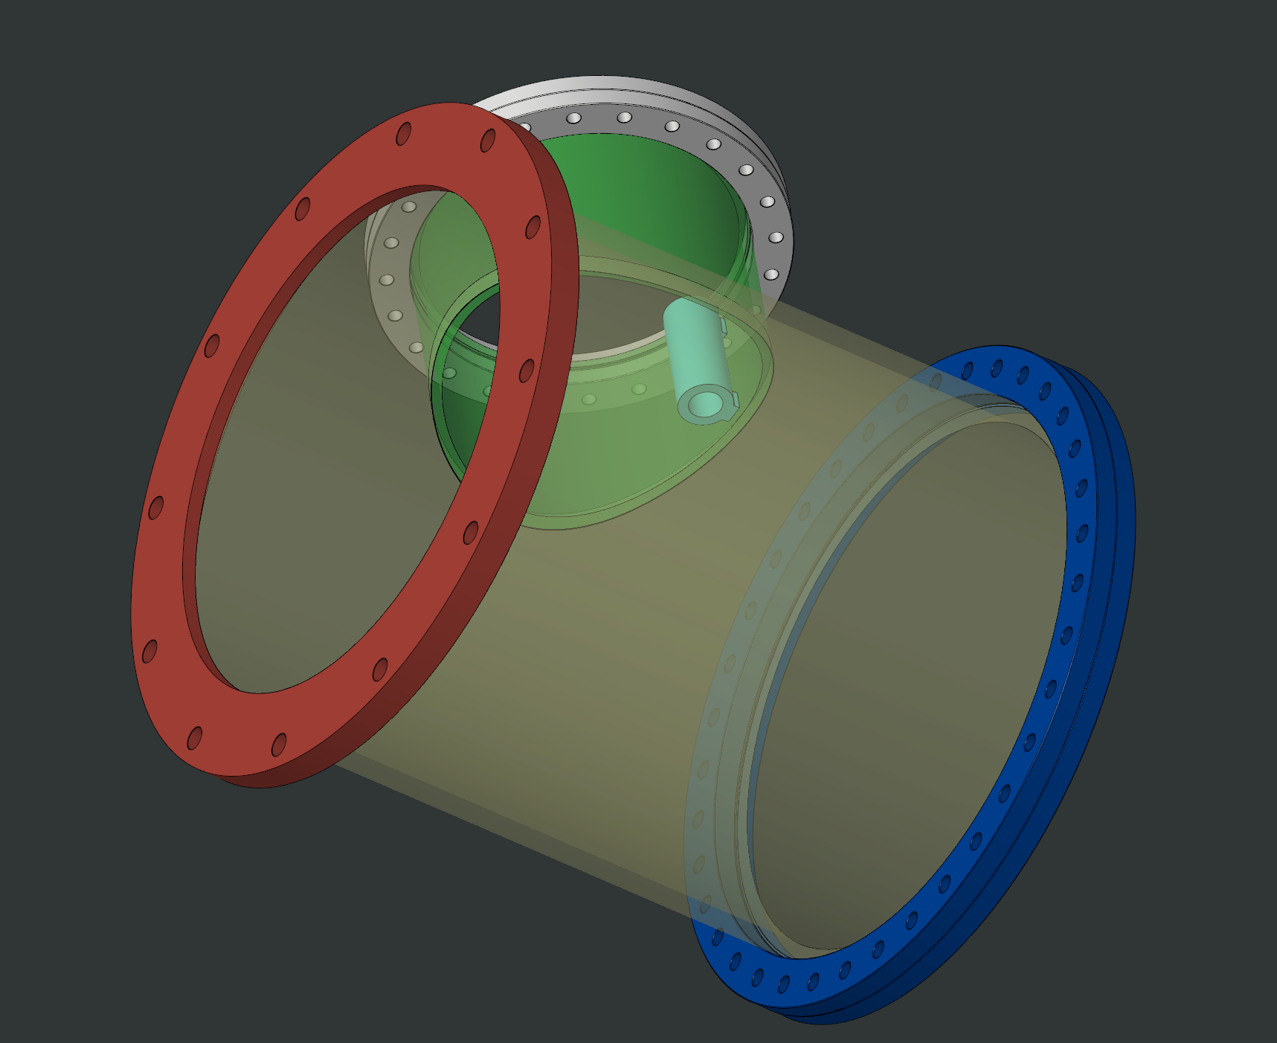
Thermal Expansion Anchor

Slide 9
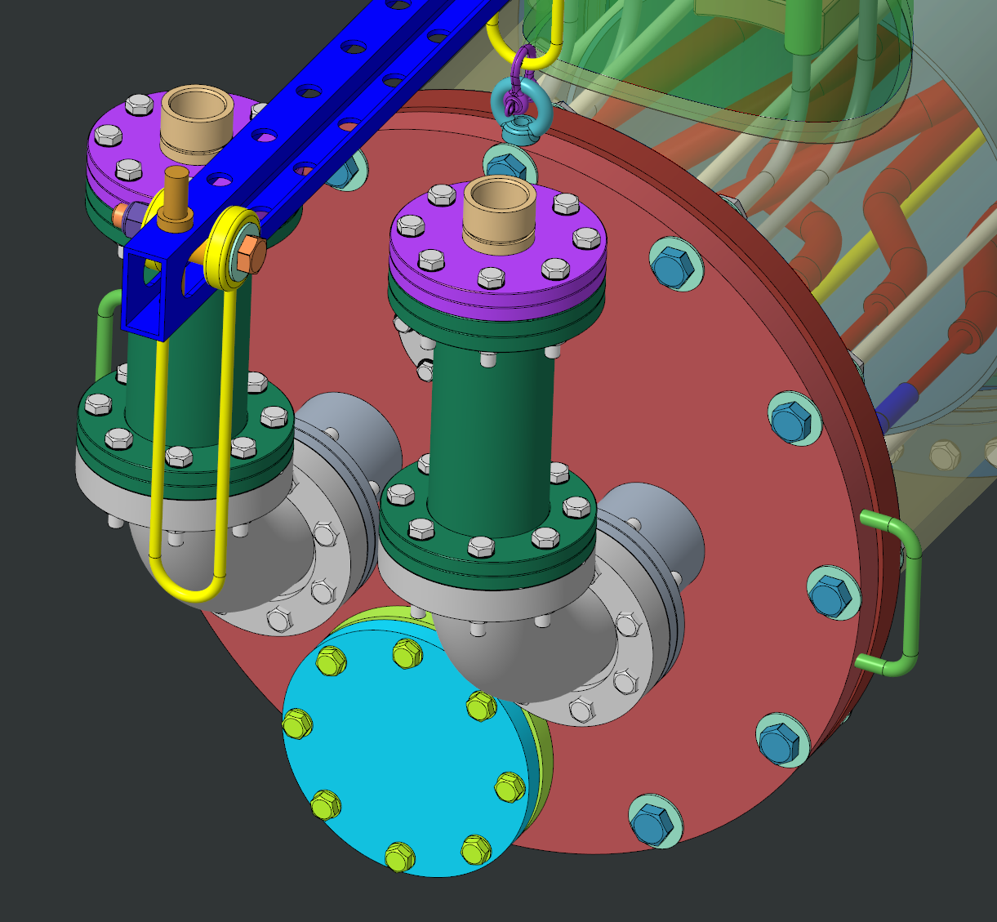
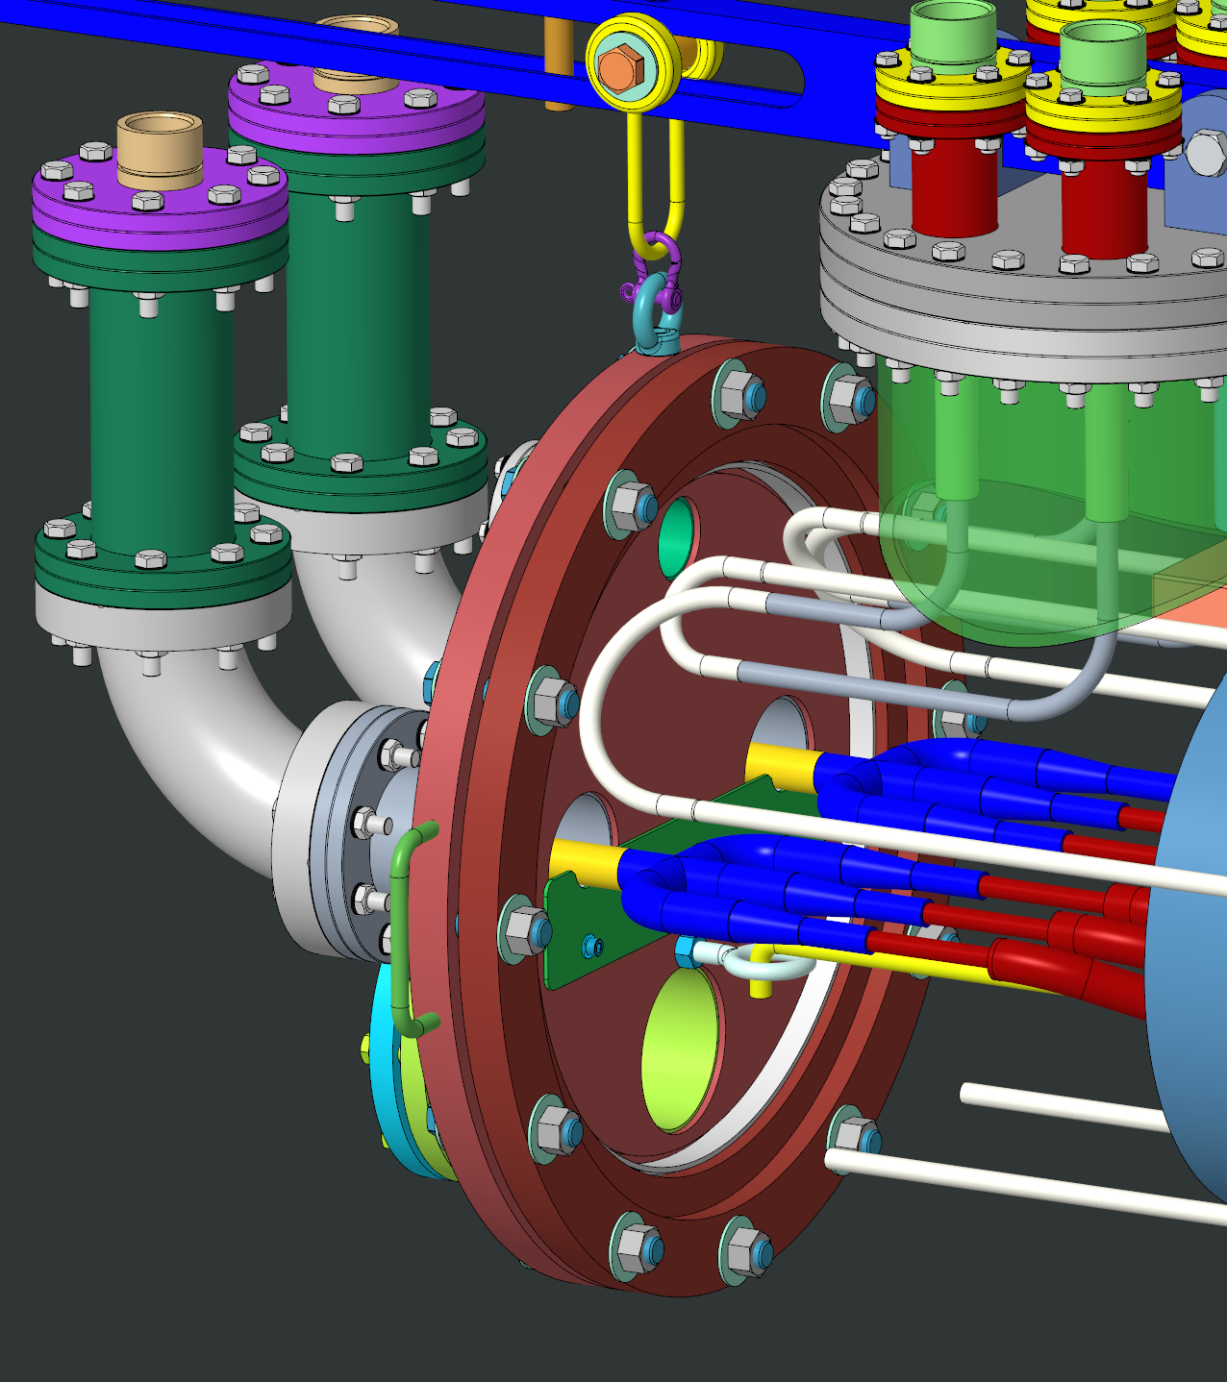
Front: Helium Supply/Return with Bayonet Connections
- Ready to Connect 6 Helium lines

Slide 10
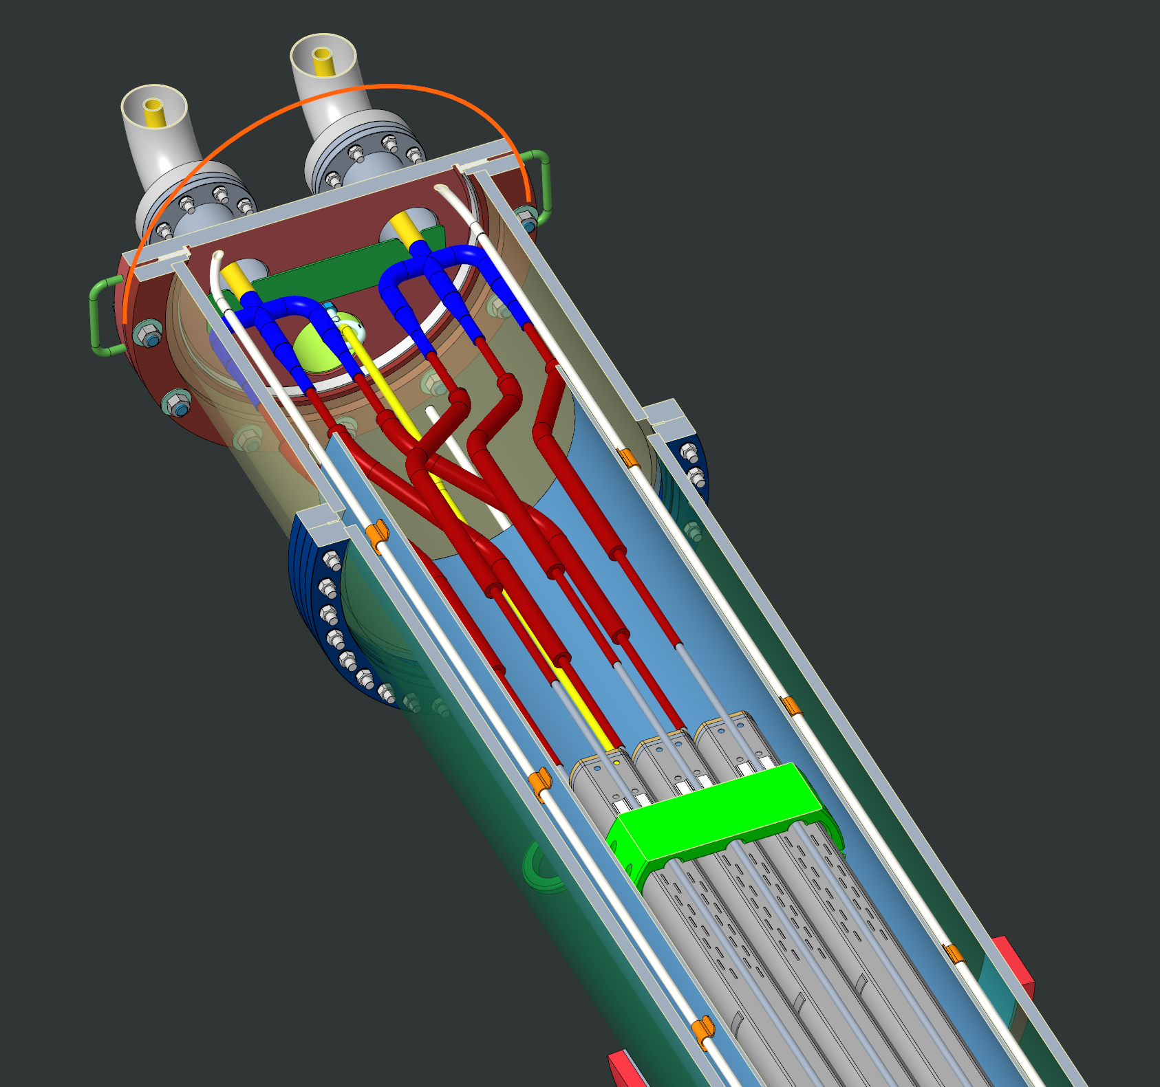
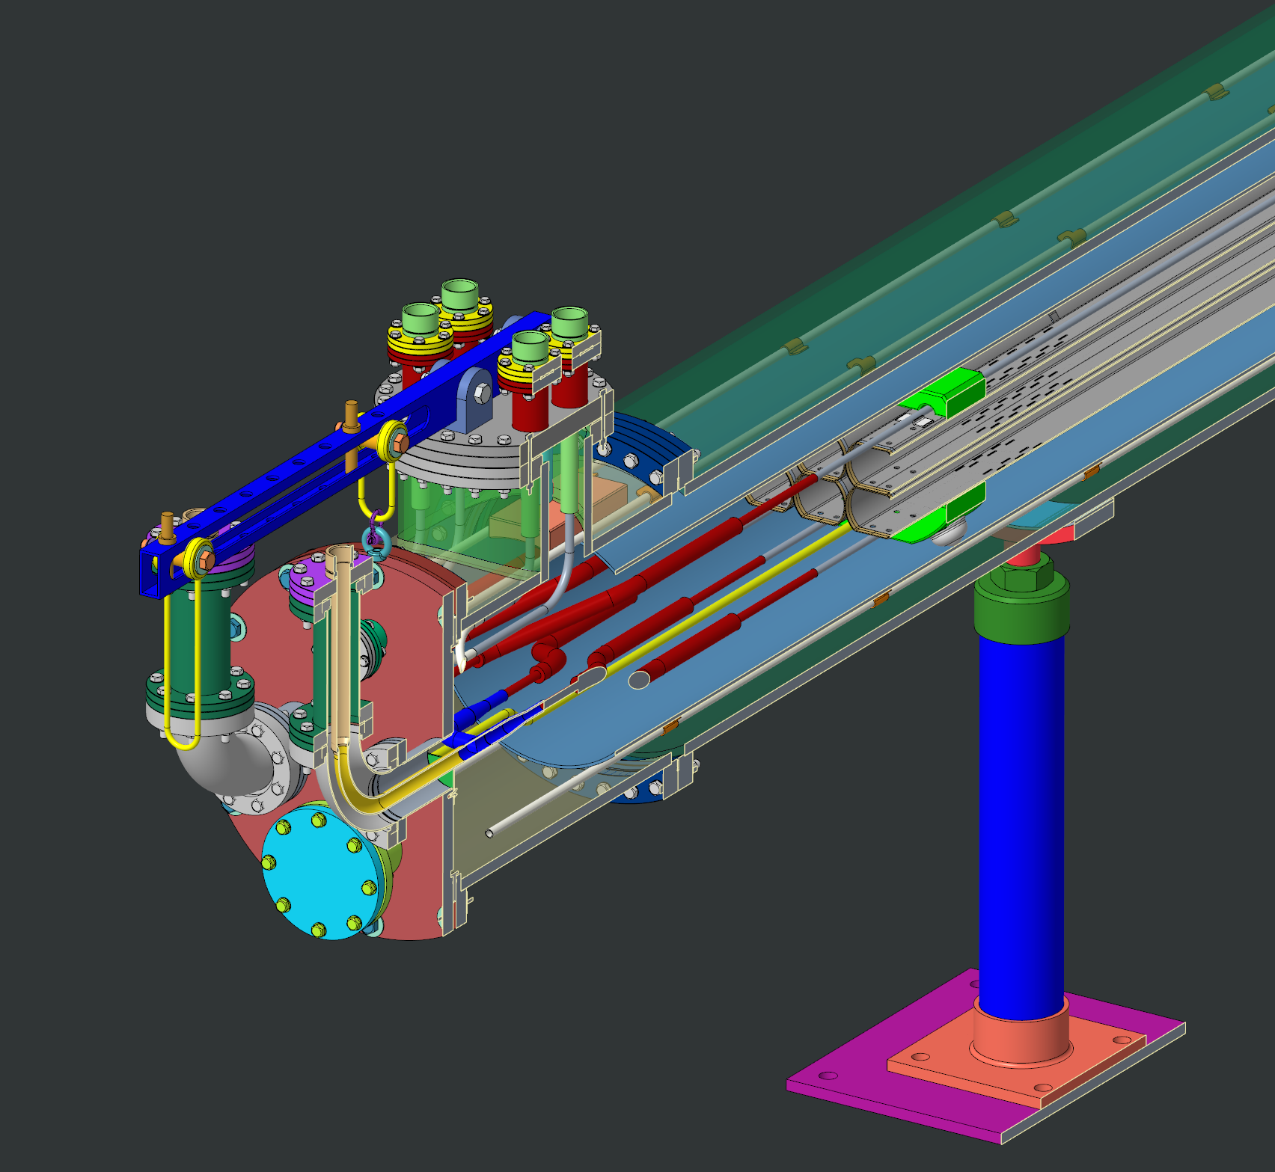
Front Details with Top & Side Section View

Slide 11
Thermal Analysis with ANSYS

Slide 12
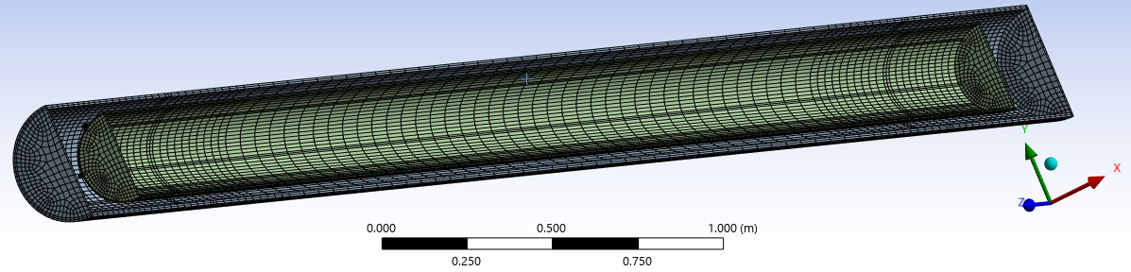
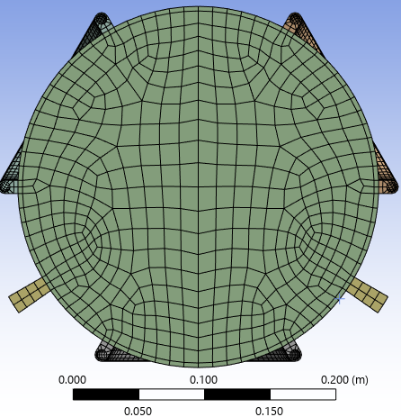
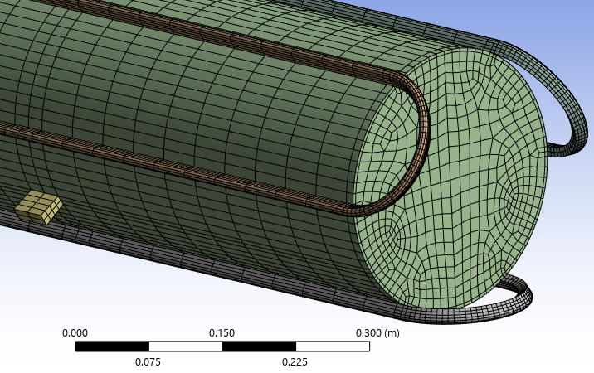
ANSYS Model for Radiation Analysis (L=6m)
Design: Cryo=~6150mm,Thermal Shield L=~5,740mm & D_Pedestals=~4570mm
Number of Nodes: ~60k

Slide 13
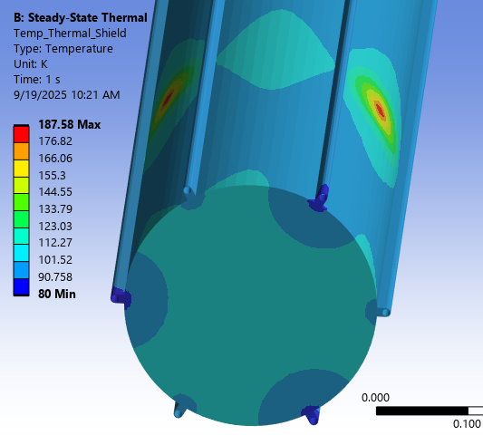
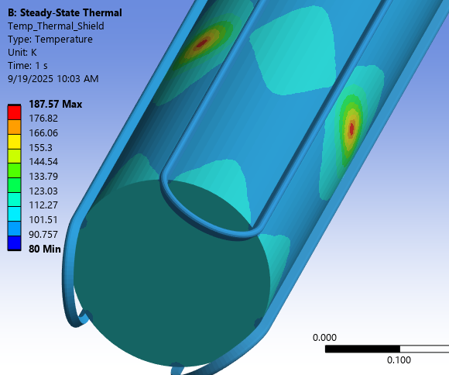
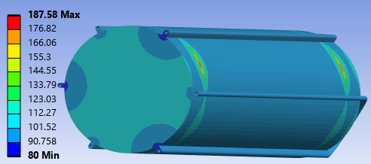
Steady-State on Thermal Shield: LN2 Inlet=80K & Exit=100K
~110 K
~110 K
~100 K
~100 K
Conductivity:SS304: 10W/m/K
Soldering M: 100~400W/m/K

Slide 14
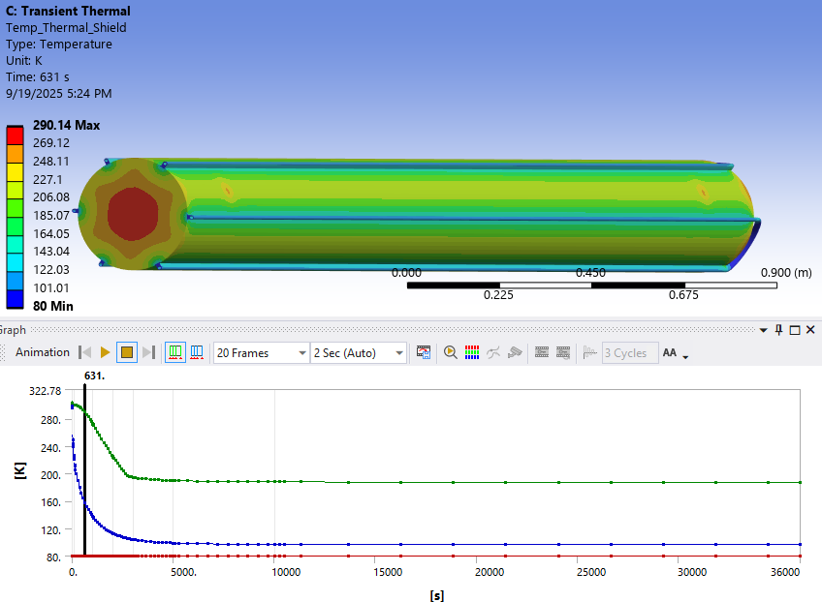
Transient Thermal Results [K] on Thermal Shield
After 10 minutes
Maximum T along Time
Average T along Time

Slide 15
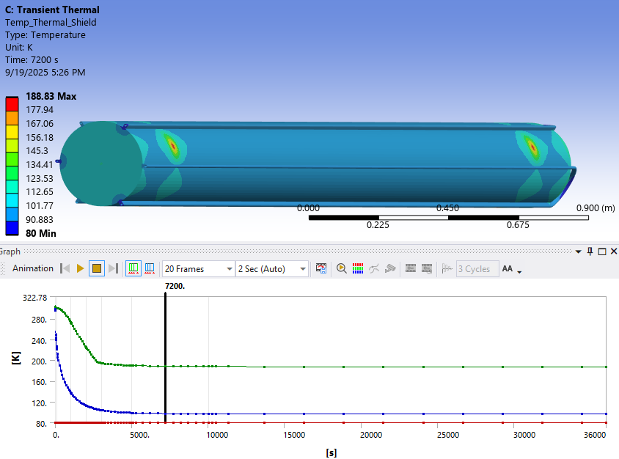
Transient Thermal Results [K] on Thermal Shield
~100 K
After 2 hrs:
187.58 K / 188.83 K =
~99% of Steady State

Slide 16
LN2 Exit Temperature Assumption
With varying exit temperature as a real situation, the cooling time to reach
The steady-state may take around 2 times longer than the simulation results.
300K
200K
Real Exit Temp (Not calculated): Cooling time (99%) < 4 hours
100K
Applied Ideal Exit Temp: Calculated Cooling time (99%) = 2 hours
Time

