Slide 1
Cradle, Barrel HCAL & Moving Mechanism
EIC Experimental Equipment Mechanical Engineering Round Table 10/6/25
Nathaniel Speece-Moyer (BNL)

Slide 2
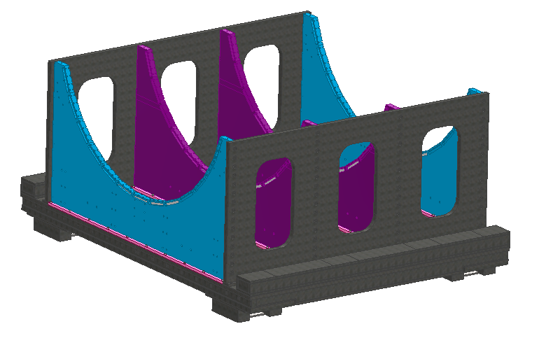
Cradle and Moving Mechanism Updates
Updates
Continuing to work on updating the CAD model with simplified fasteners for FEA analysis, split surfaces near welds and fasteners to make it easier to refine meshes in critical areas.
Added in cutout to access roller bolts.
Need to re-examine the lifting heights of pistons, layout of rollers, air bearing heights, and contact surfaces based on survey data and new requirements.
Cradle had been designed assuming 170 in from the floor to beam center.
Top of rails to beam center is 169.52 in (minimum) to 169.8 in (max). based on survey data as of 9/30/25.
The height from the rail to beam center to use for the cradle design will be 169.75 in per Rahul on 9/30/25.
Additional specs per Rahul on 9/30/25:
The pistons must lift the assembly a nominal 1 in.
Pistons must lift the cradle by 1.5 in then lower down.
Need to look at the above and verify that it all fits within current constraints or can easily be accommodated.
Current cradle design, based off sPHENIX cradle.

Slide 3
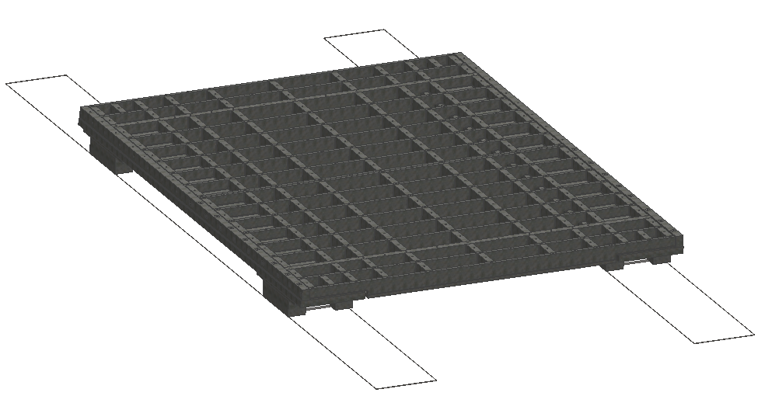
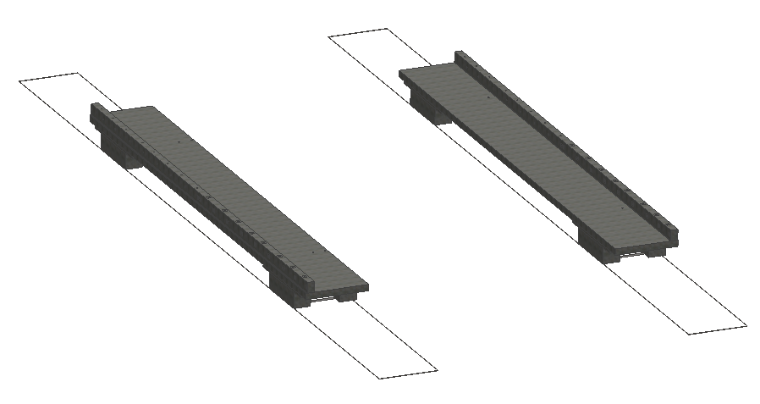
Cradle and Moving Mechanism Updates
Roller support beams set down first on rails.
Welded lower platform sections (2x) placed on roller support beams and bolted in place.

Slide 4
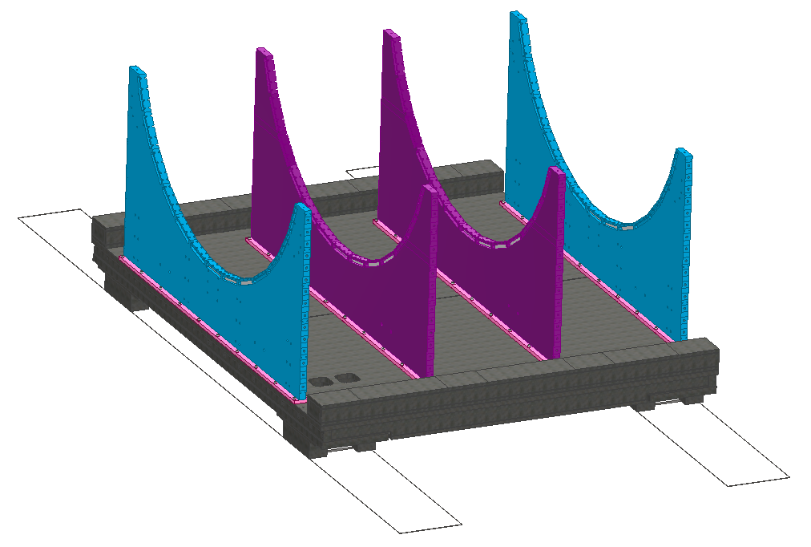
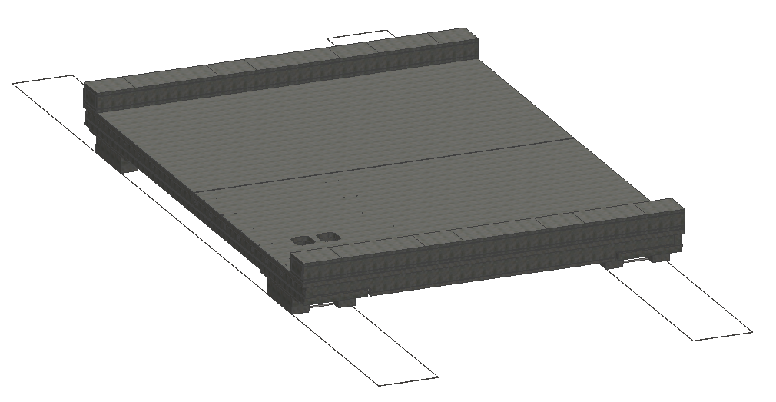
Cradle and Moving Mechanism Updates
Top plates attached, bolted.
HCAL pedestal sections attached and bolted in place.
Some braces from sPHENIX can be re-used to help with assembly but are not shown in the model.

Slide 5
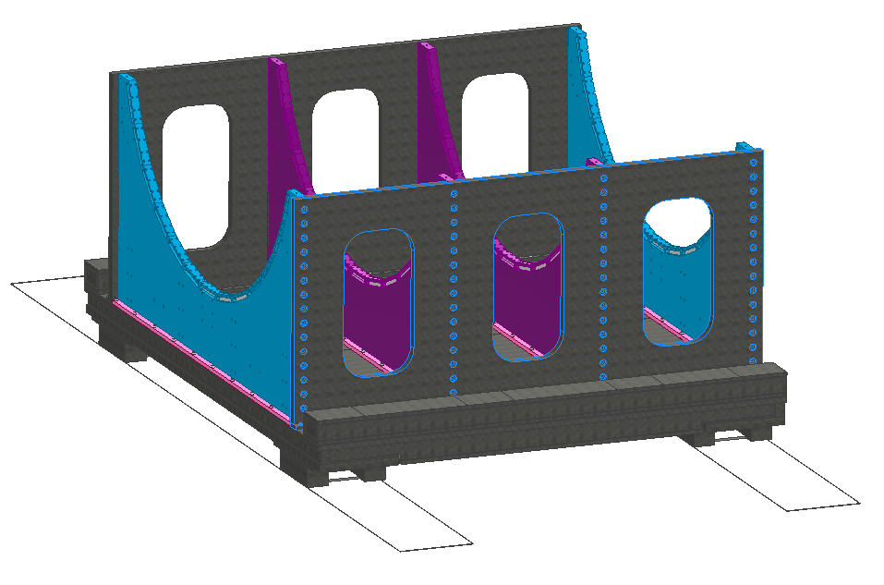
Cradle and Moving Mechanism Updates
Vertical braces attached, bolted.
HCAL can be assembled on the pedestals.

Slide 6
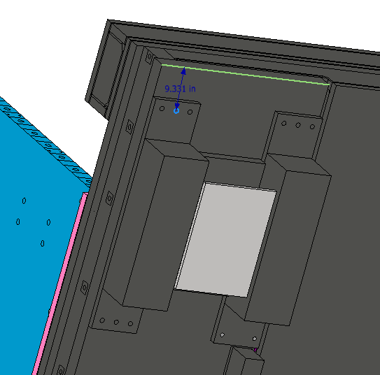
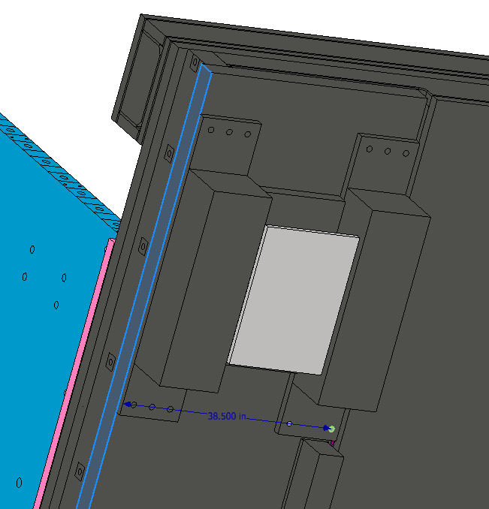
Access to roller bolts
The outer roller plate bolts can be easily accessed from underneath.
The inner set will likely need access from the top due to low clearance of cradle, being 38.5 in from outside.

Slide 7
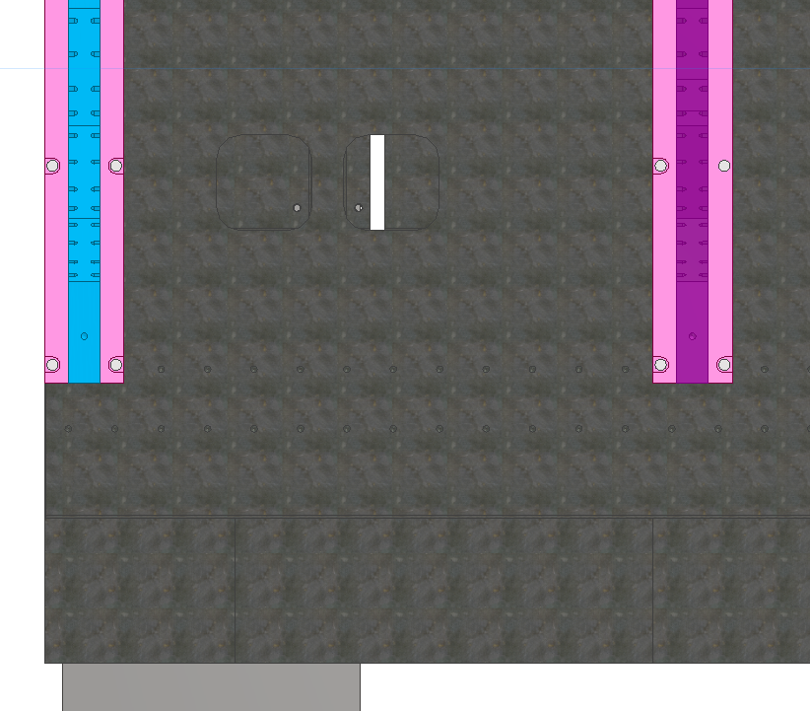
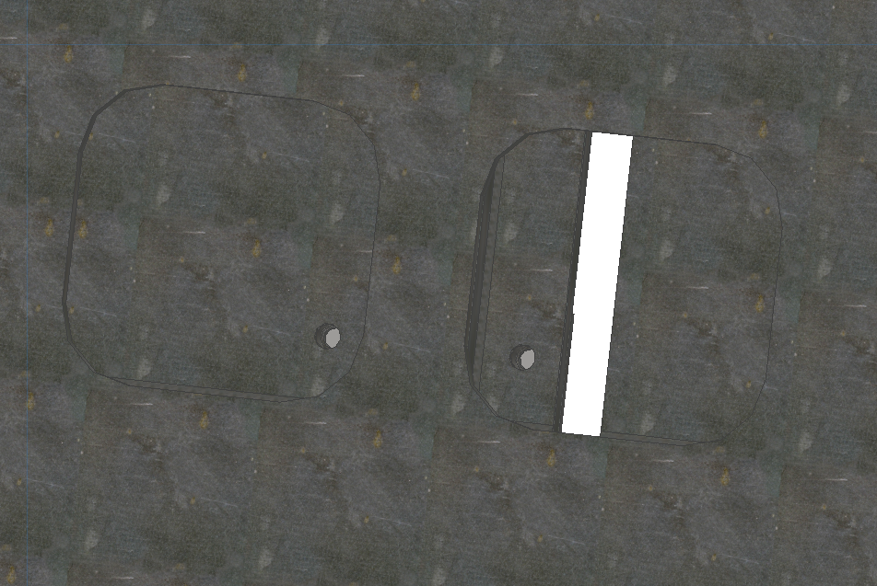
Access to roller bolts
Concept for access holes for bolts used to attach roller mounting plates.
More work is needed: Bolt head clearance, number of bolts, etc.

Slide 8
Summary and Next Steps
Per discussion on 9/30, need to complete FEA analysis on overall cradle, followed by designs of the following:
Seismic anchors
Design spec is they must withstand ¼ g
Fixed stops
Linkages to platforms
Additional work:
Detector platform (need to get input from magnet group on magnet force requirements, which will affect steel)
Interfaces between north and south platforms, detector platform.

Slide 9
Questions & Comments

