Slide 1

Physics Analysis Coordination Meeting
Exclusive/Diffractive/Tagging Updates
Stephen and Kong
21st October 2025

Slide 2

Working Group Updates
Several channels that need to finalise plots/outputs in next few weeks
  DVCS with π⁰ background
  eA 𝜙
  ³He tagging
  𝛶 1,2,3s separation → More on this in a second
  𝜇 Channels (TCS, J/𝜓→𝜇𝜇)
  Machine background impact on these
Requested that all analysers identify (and quantify) the dominant source of systematic uncertainty for their measurement
𝛶 1,2,3s separation → Previous analyser has graduated and transitioned to an industry role
  Need a new analyser for this channel!
A lot to get over the line, shifted to a more intense WG schedule

Slide 3
New Meeting Schedule
Shifting to a weekly working group meeting schedule until Christmas
  Expect a contribution from each analyser on a weekly basis
    Even if it’s just a single slide update uploaded to the indico
Analyzers | Oct 27 | Nov 3 | Nov 10 | Nov 17 | Nov 24 | Dec 1 | Dec 8 | Dec 15
Oliver & Jihee | Update | Post slides | Update | Post slides | Update | Post slides | Update | Summary
Maci | Update | Post slides | Update | Post slides | Update | Post slides | Update | Summary
Win | Update | Post slides | Update | Post slides | Update | Post slides | Update | Summary
Garry, A. Smith | Update | Post slides | Update | Post slides | Update | Post slides | Update | Summary
 |  |  |  |  |  |  |  | Summary
Olaiya | Post slides | Update | Post slides | Update | Post slides | Update | Post slides | Summary
Jan, Alex Jentsch | Post slides | Update | Post slides | Update | Post slides | Update | Post slides | Summary
Hadi | Post slides | Update | Post slides | Update | Post slides | Update | Post slides | Summary
Stephen Kay | Post slides | Update | Post slides | Update | Post slides | Update | Post slides | Summary
 |  |  |  |  |  |  |  | Kong & Stephen
Stephen will take lead on preTDR, Kong on WG Early Science Paper

Slide 4
RP Reconstruction Updates
Alex Jentsch discussed improvements to the RP transfer matrices (and therefore reconstruction) were discussed in EDT meeting yesterday
  https://indico.bnl.gov/event/26543/
  See meeting notes too
Improvements for any channels that needs p’ etc in RP
  I.e. lots of channels in EDT group
Improvements in a PR that will (hopefully) be merged v.soon and included in latest simulation run for EDT channels
Plots for PreTDR will include these improvements
Expect EDT priority 1 files to run by end of week with these changes/improvements

Slide 5
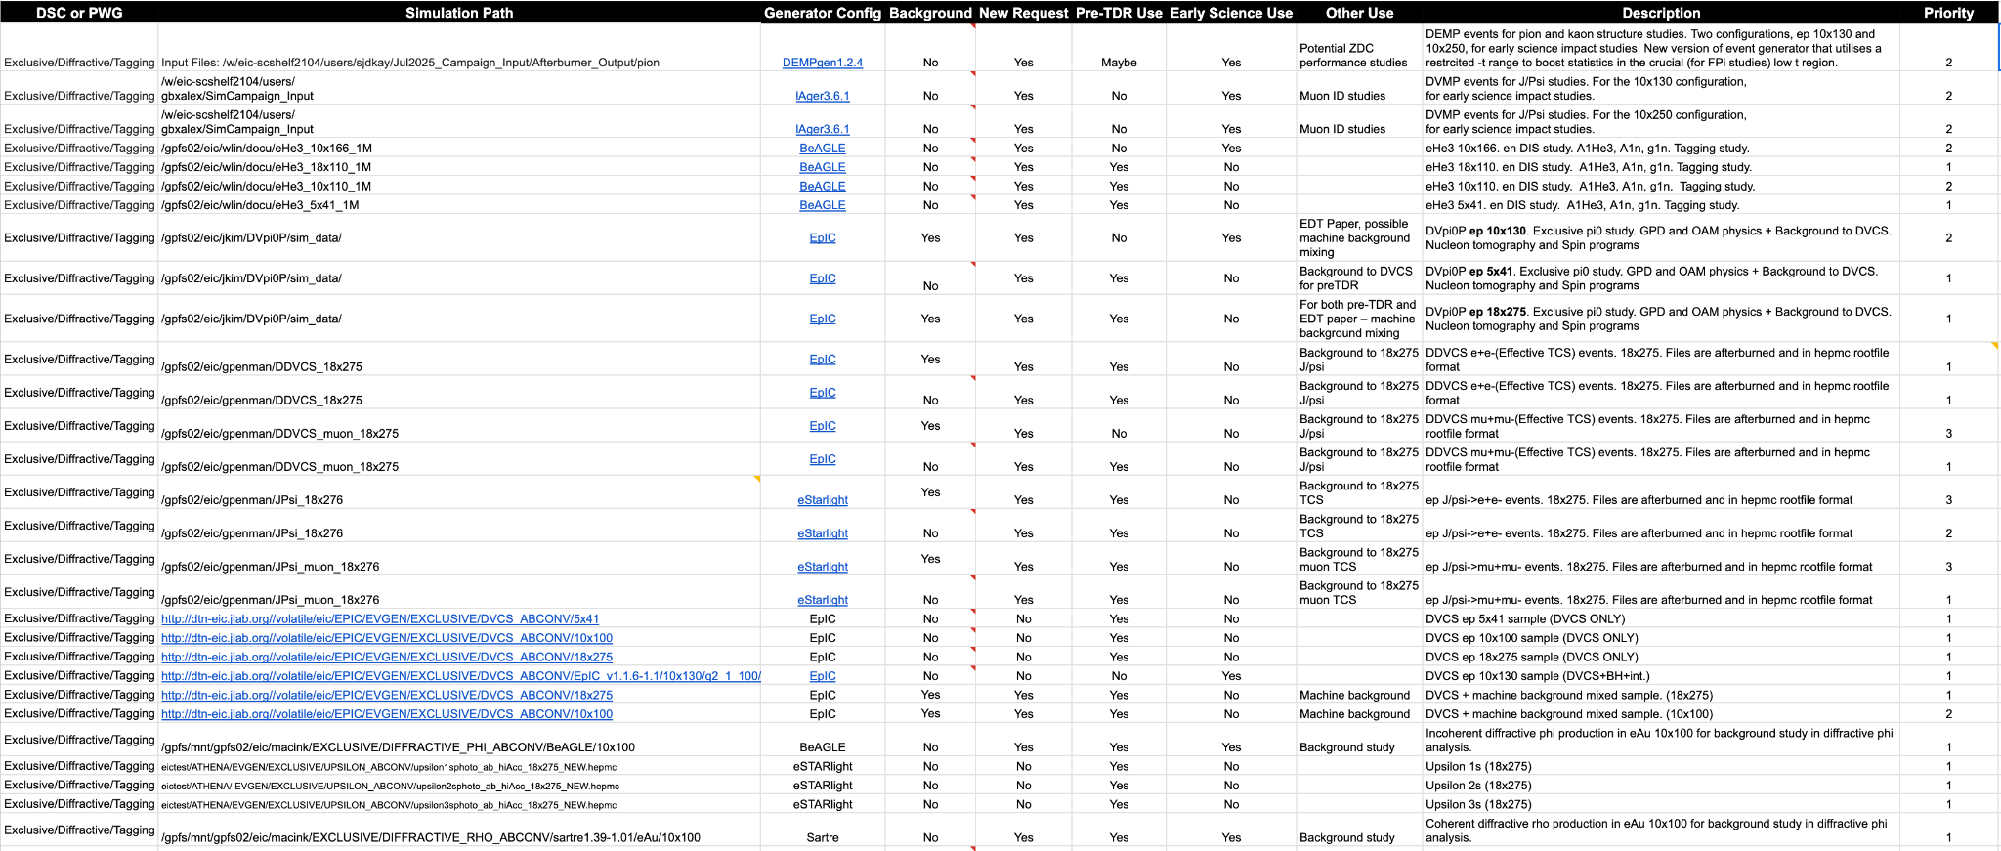
Campaign Files
Lots of channels in group, lots of request - latest table below (and here)

Slide 6
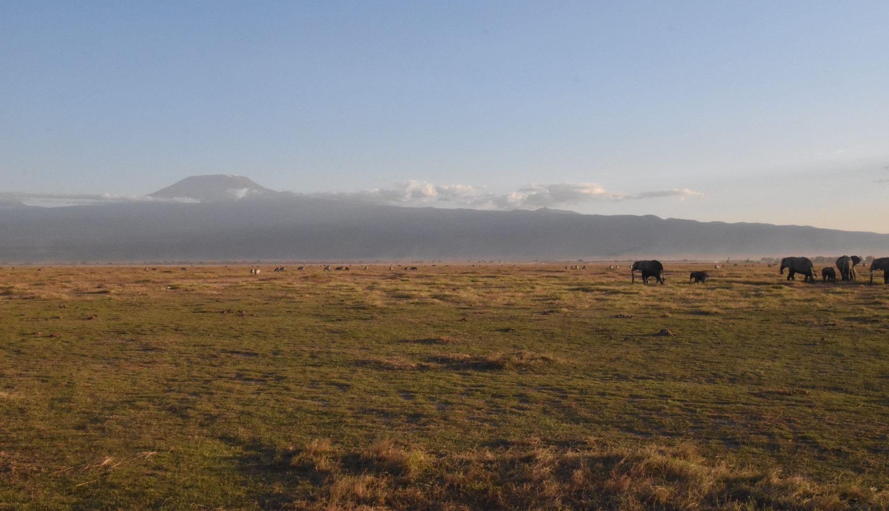
Thanks!
Any questions?

