Slide 1
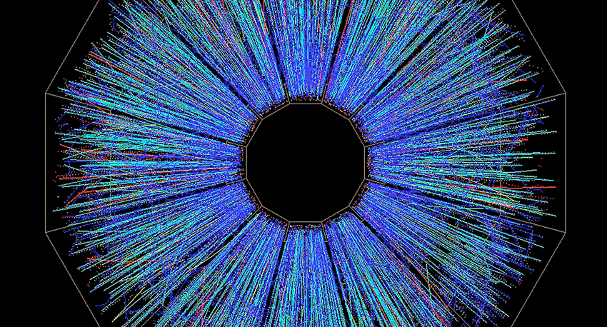
STAR Twenty-Five Year Celebration

Slide 2
The STAR Whitepaper
4381 Citations
It is the 136th most cited paper of all time on Inspire.
It is 41st in the list of papers in the past 20 years.
It is the second most highly cited nucl-ex paper (behind SNO neutrino oscillations).

