Slide 1
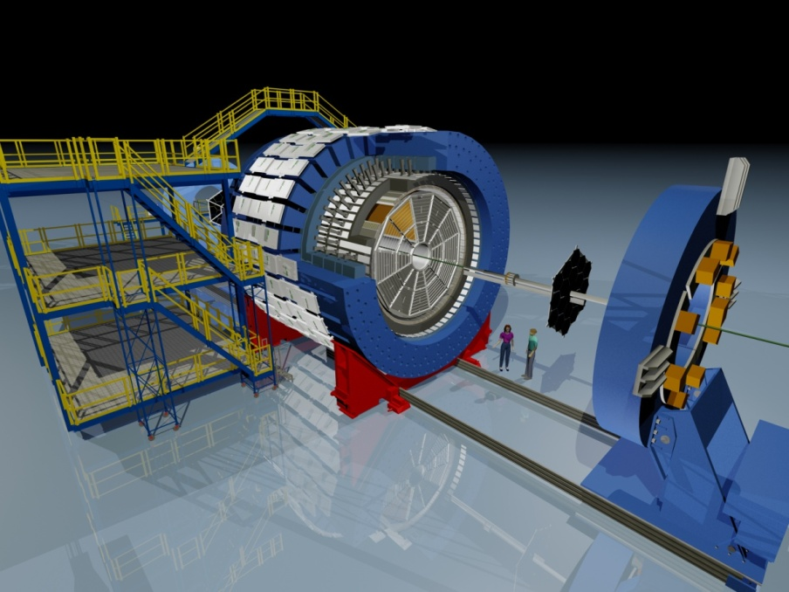
The Importance of Detector Experts (people) and being present in the Control Room
Bill Christie
STAR Celebration of 25 years of Operations
December 17, 2025

Slide 2
Outline
A brief and incomplete overview of the 25+ year history of STAR Ops
An inadequate attempt to mention the names of the myriad of Detector experts and others that supported STAR through the decades.
Some personal views on the 30+ years of my life associated with STAR

Slide 3
From my vantage point efforts on what would become STAR got started in 1990
Workshops on RHIC Physics ideas had been taking place for a few years leading up to 1990. Topics discussed included:
- What would the environment be like? How many particles would be generated in the collisions?
- How does one run in the collider environment?
- Basic discussions of the relative importance of detector acceptance vs detector precision?
- What detector technologies were appropriate for assembling a RHIC detector?
- The ideas covered a wide phase space, the discussions were lively, and in my view the meetings were very interesting.
In 1990 I graduated and took a Post Doc position in the RNC group at LBNL, working for John Harris.
In my years of running experiments at the BEVALAC (HISS Facility), and then working in this Post Doc position I knew and or met essentially all of the early proponents on the Letter of Intent, and then the fleshed out STAR proposal. Many fond memories!

Slide 4
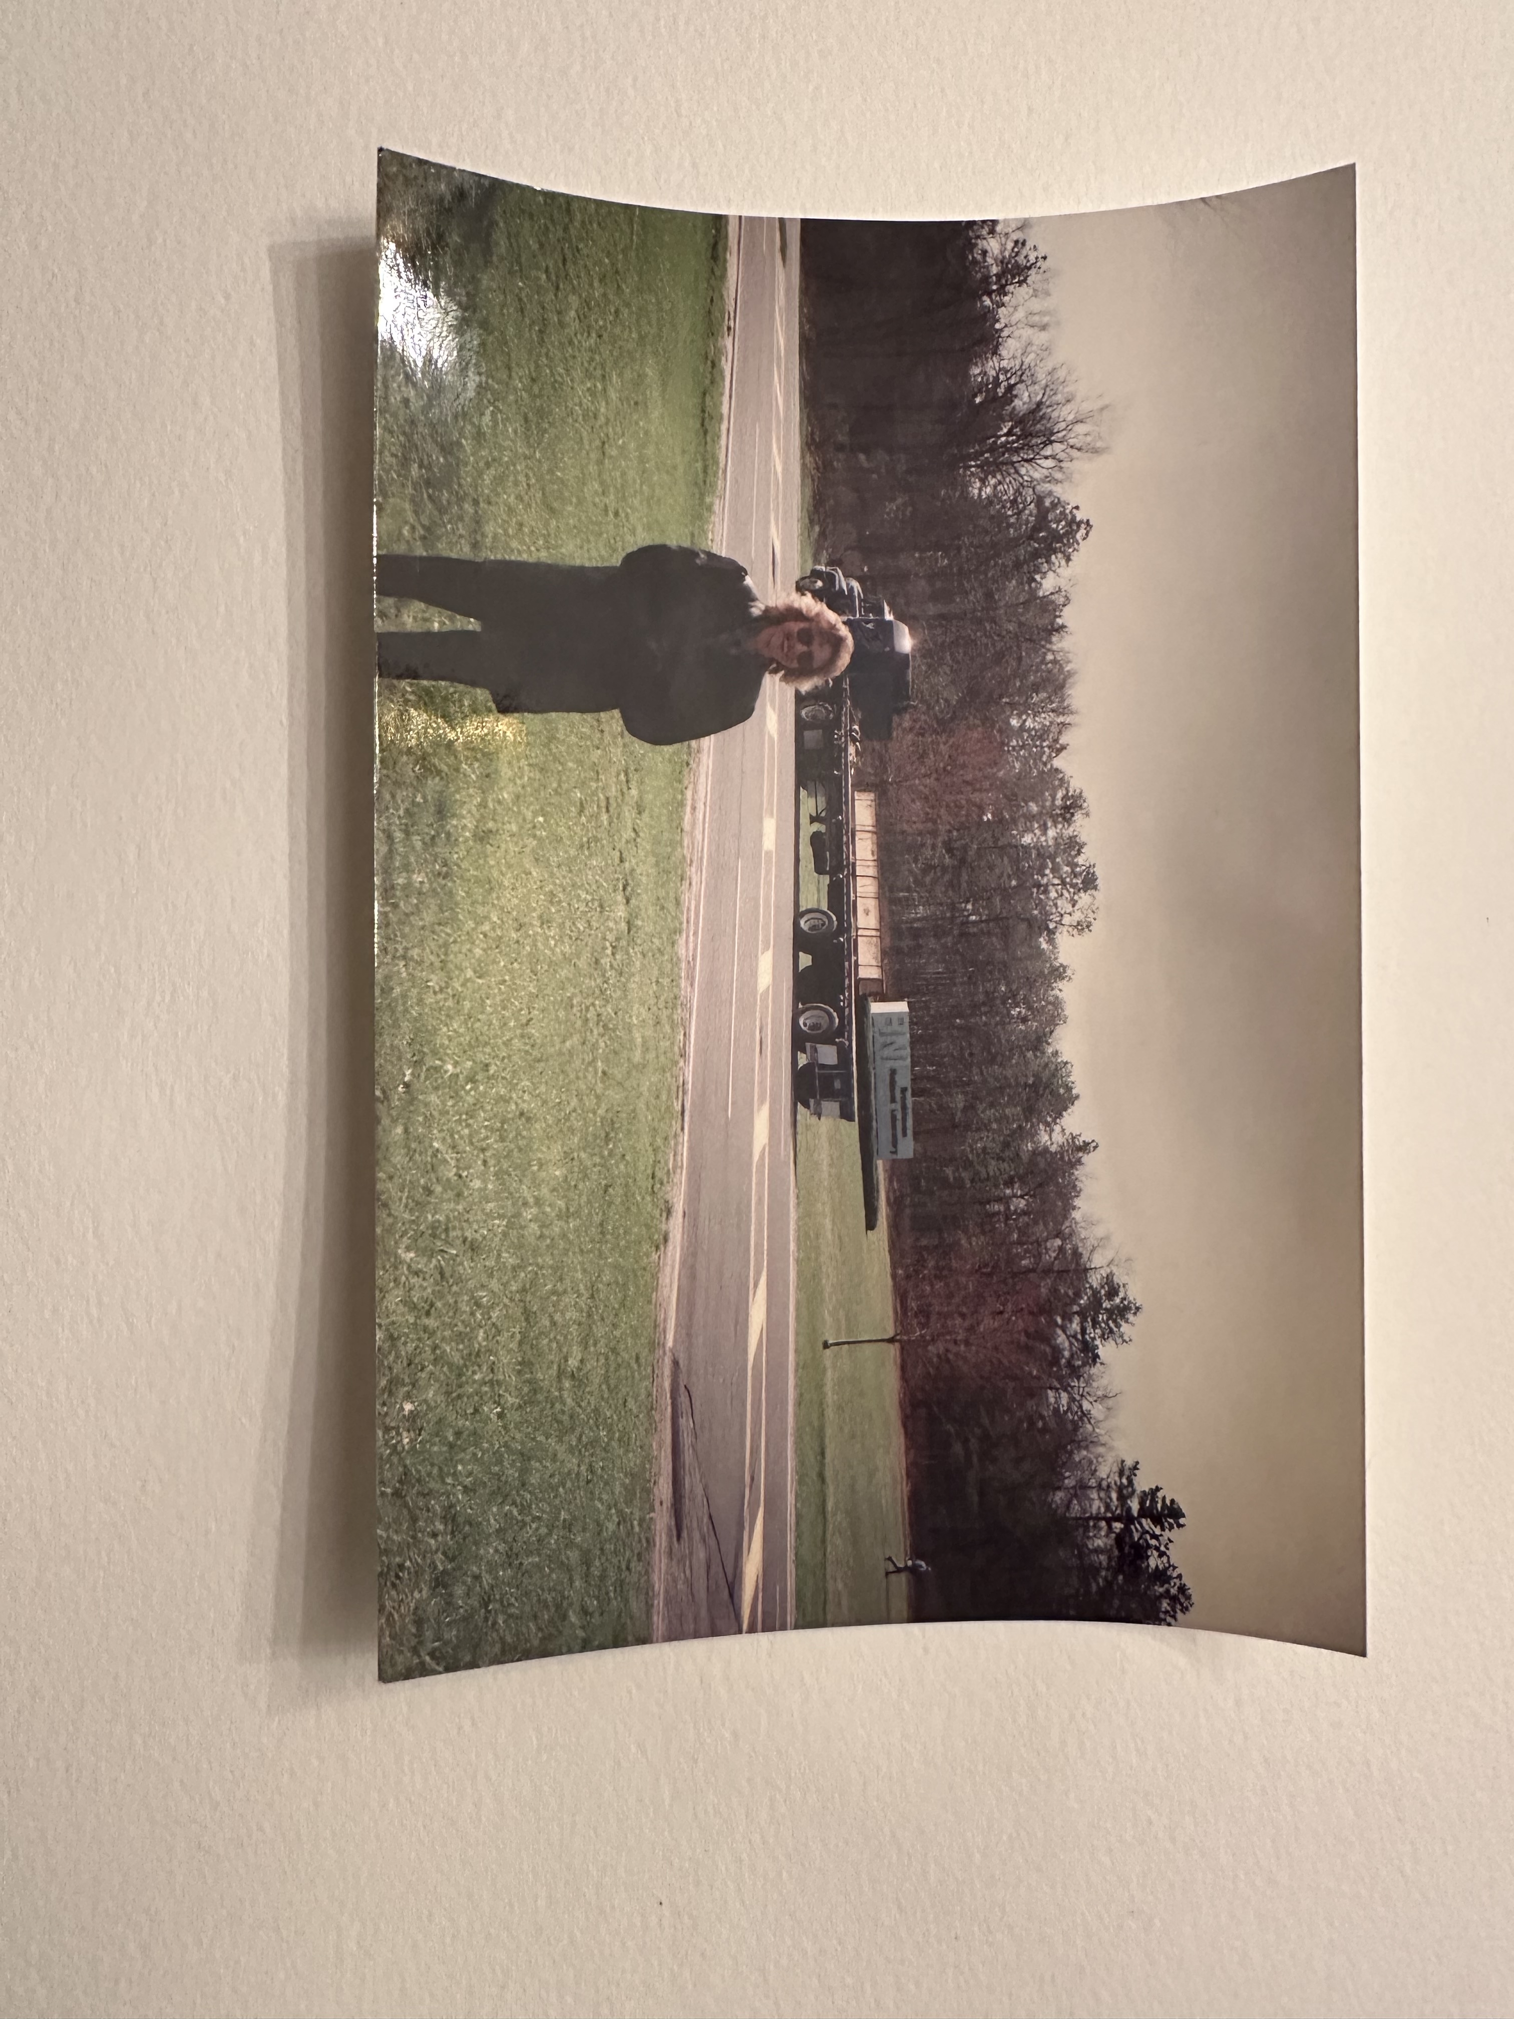
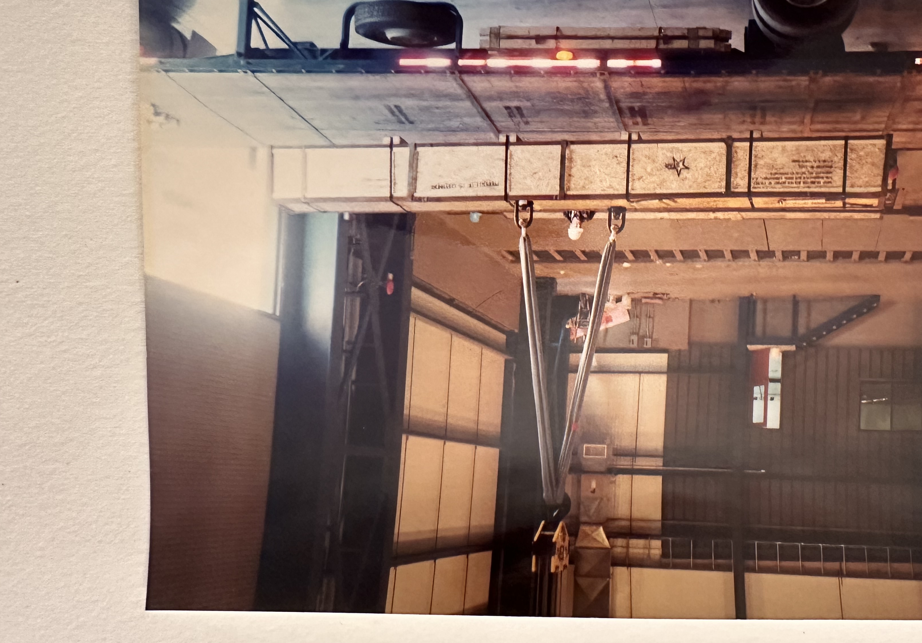
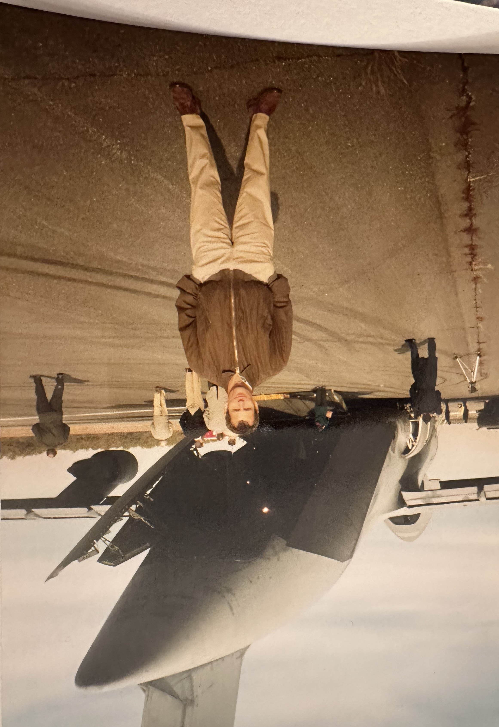
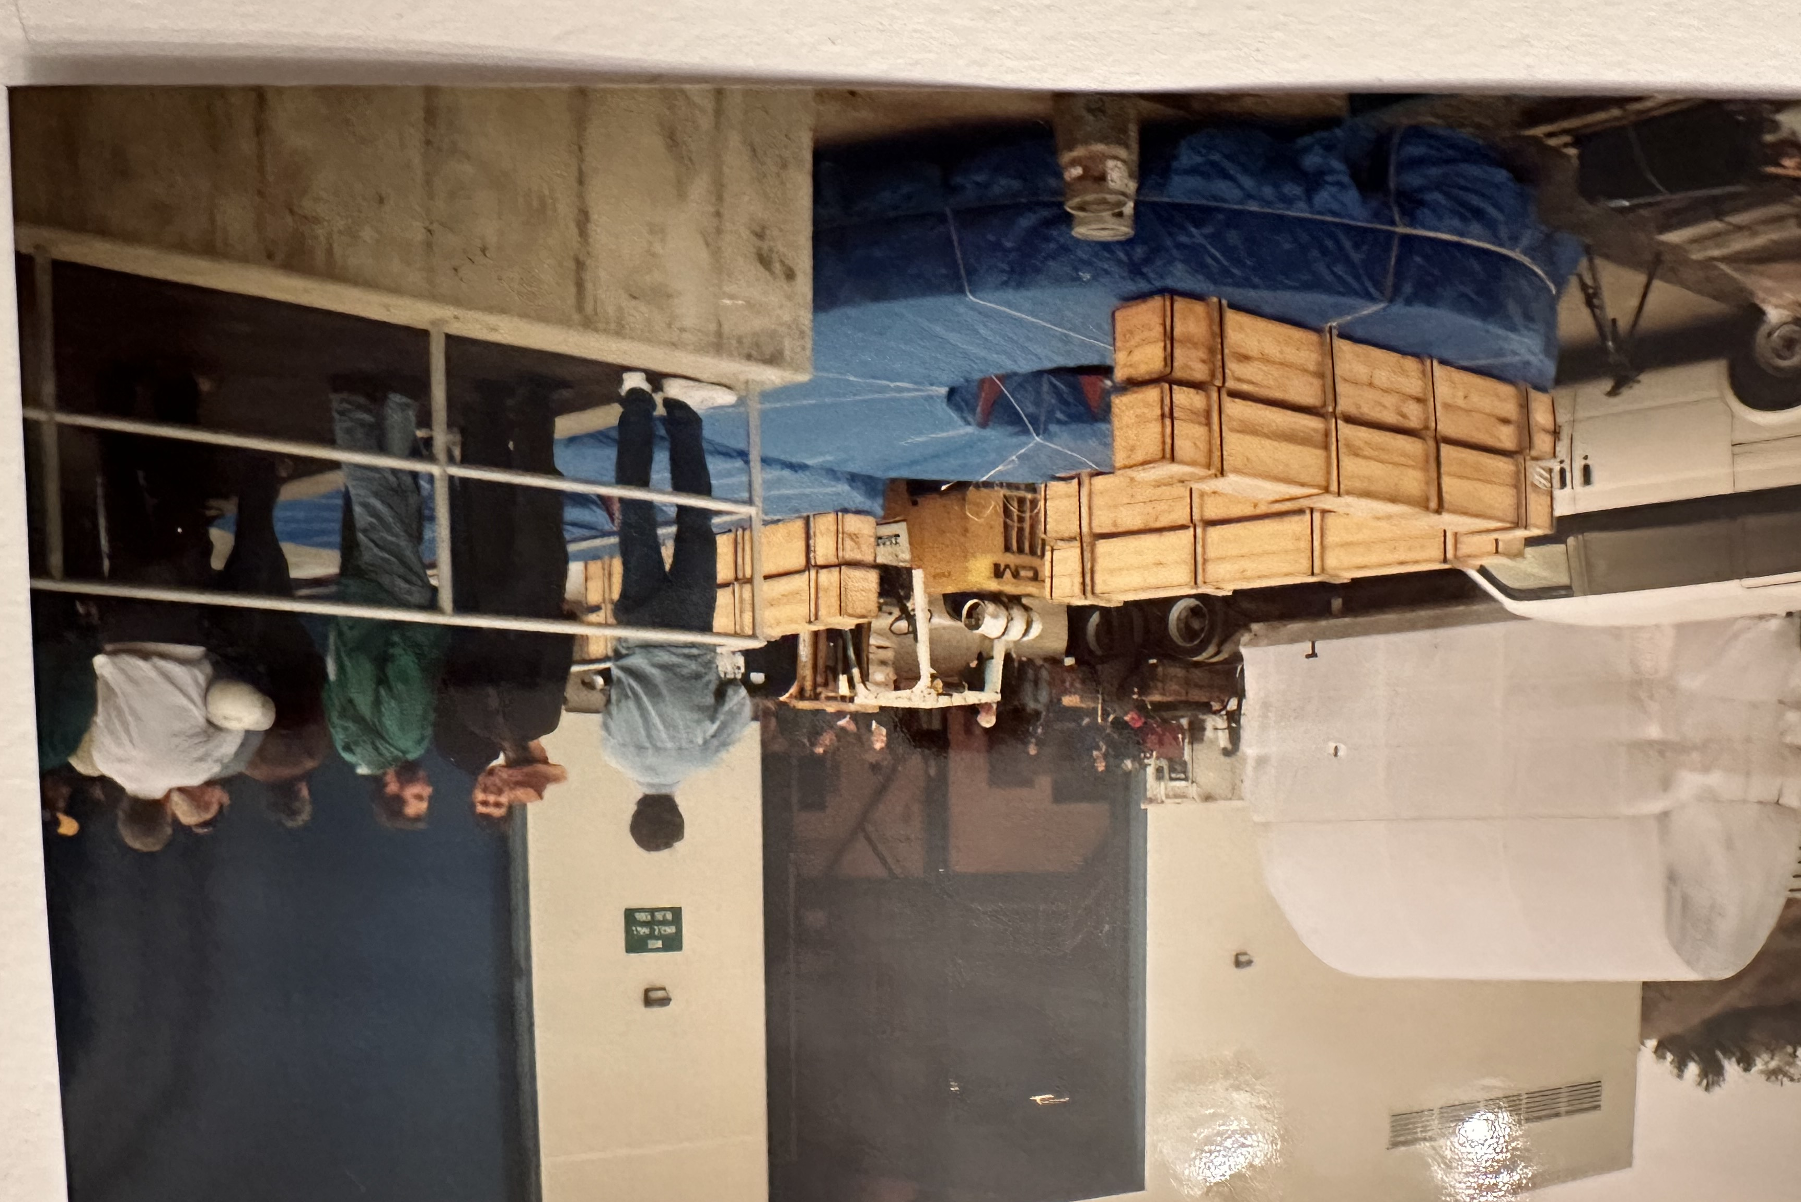
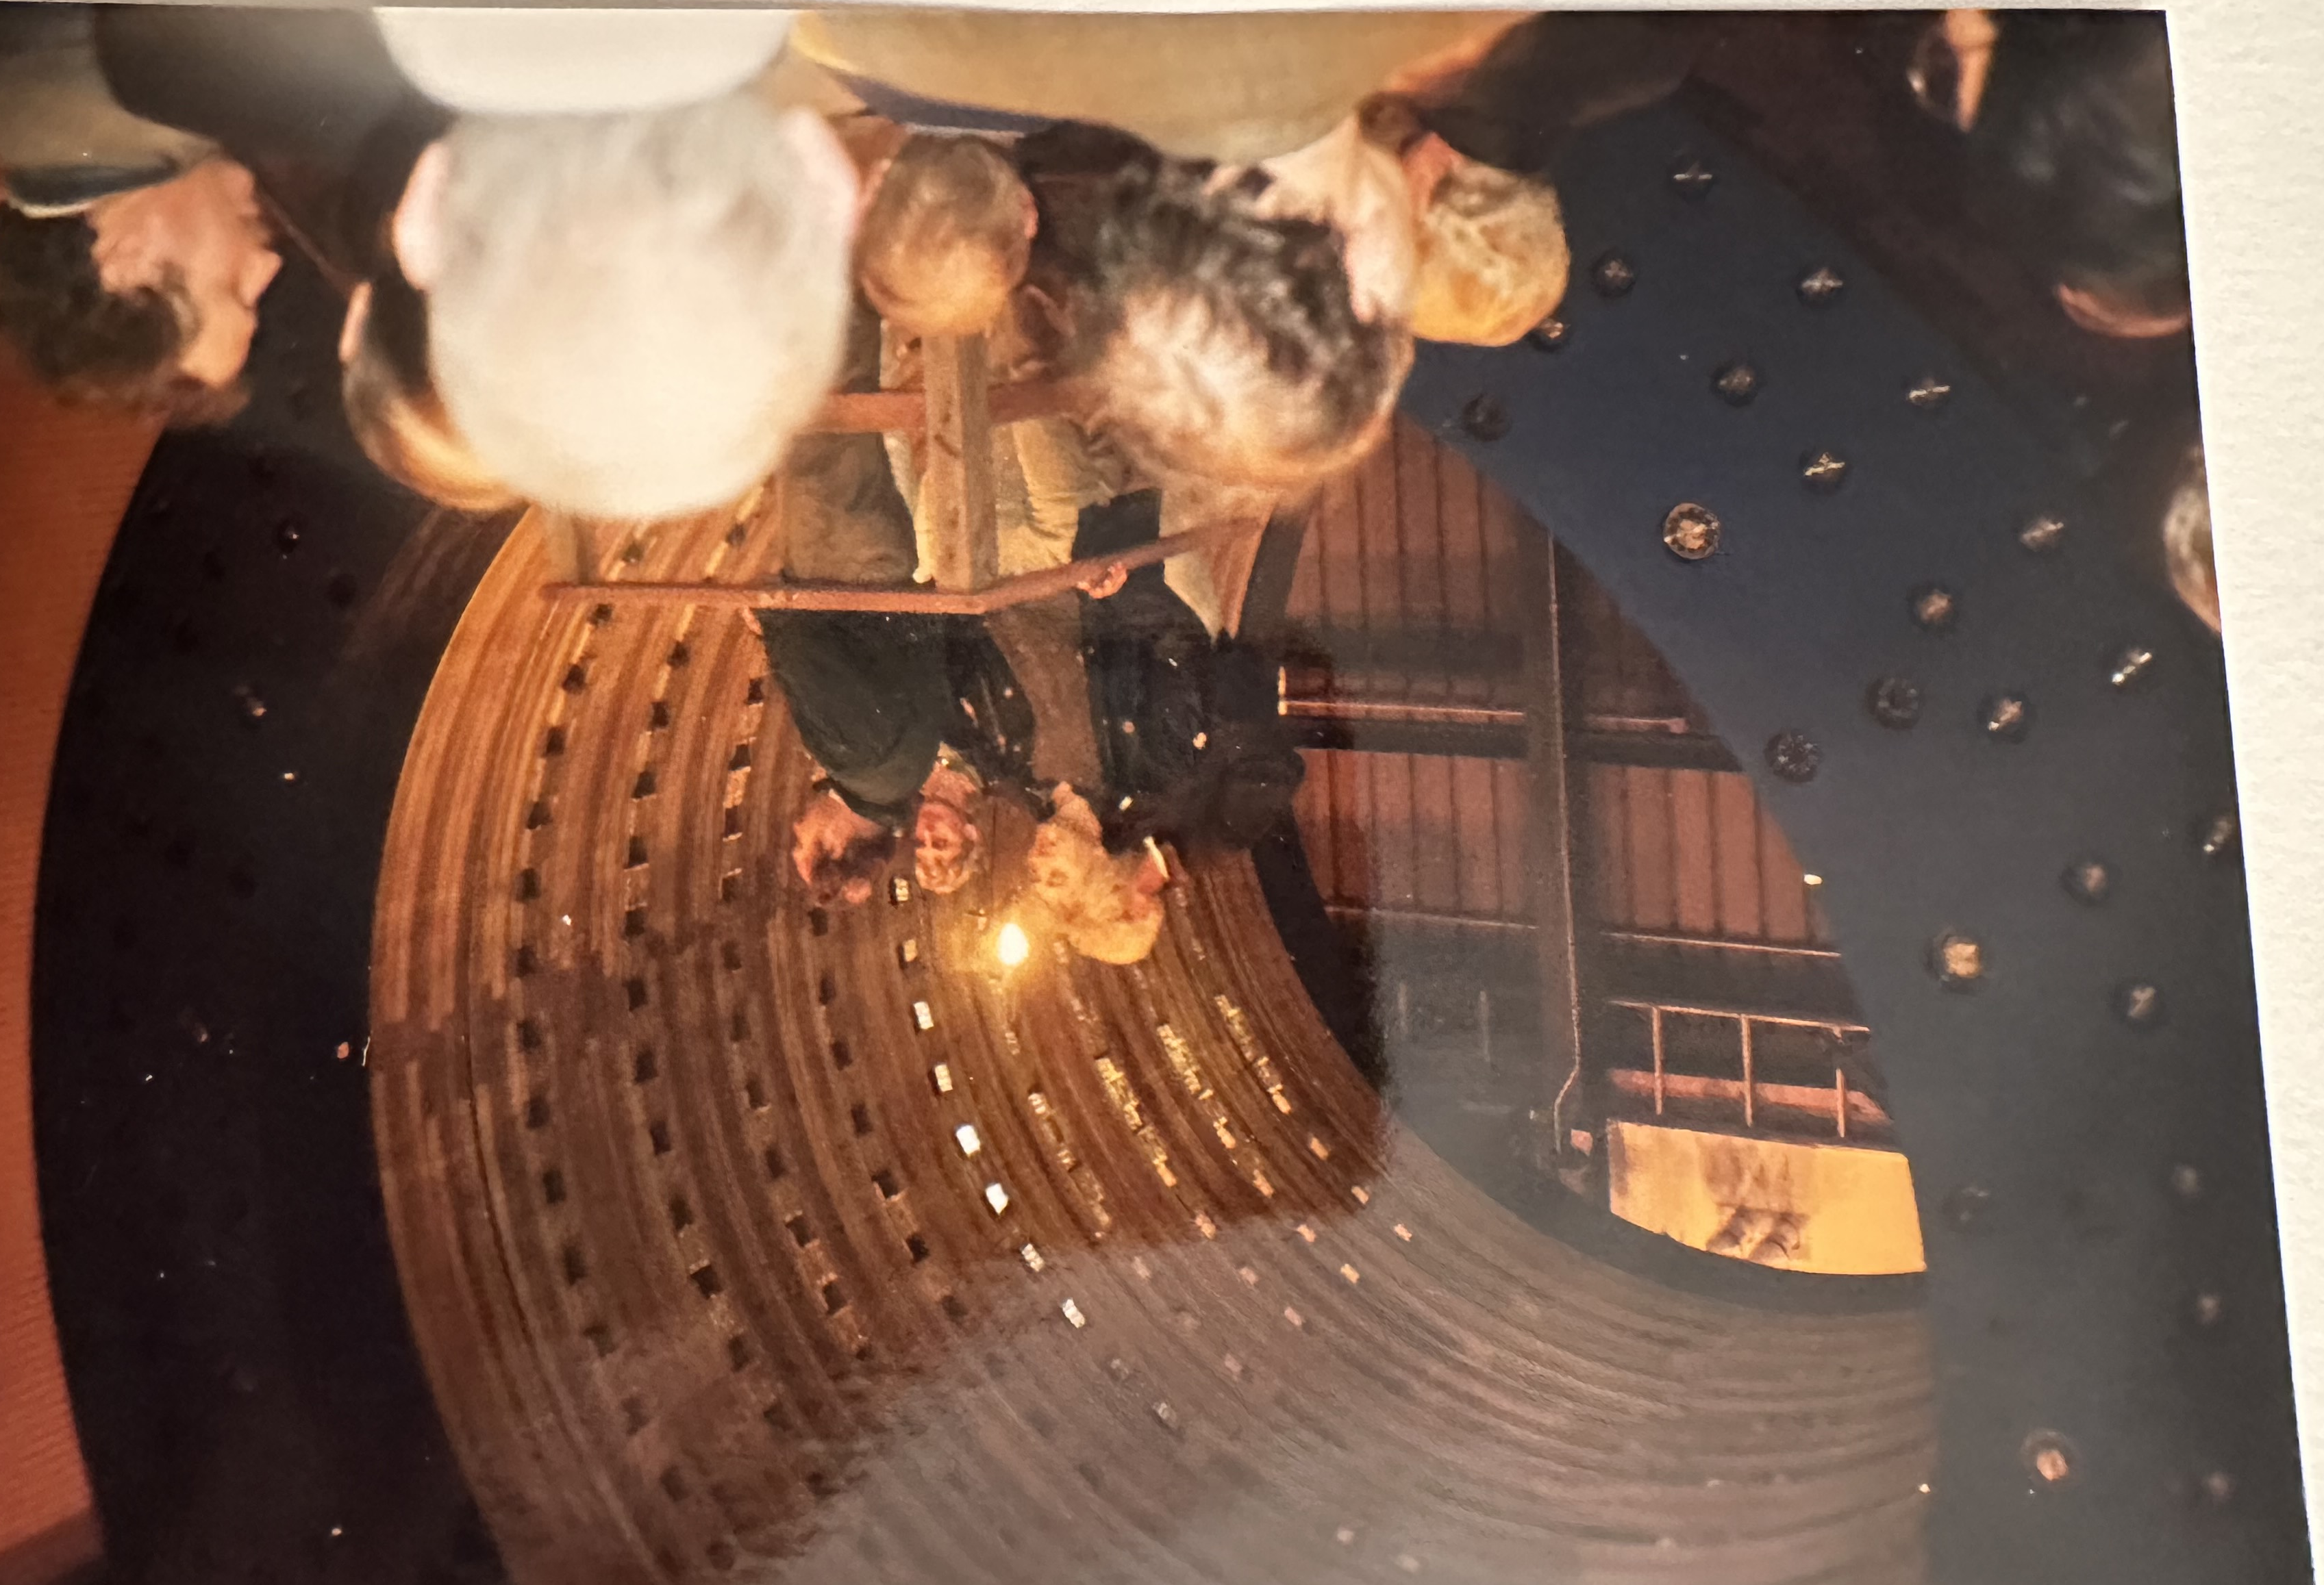
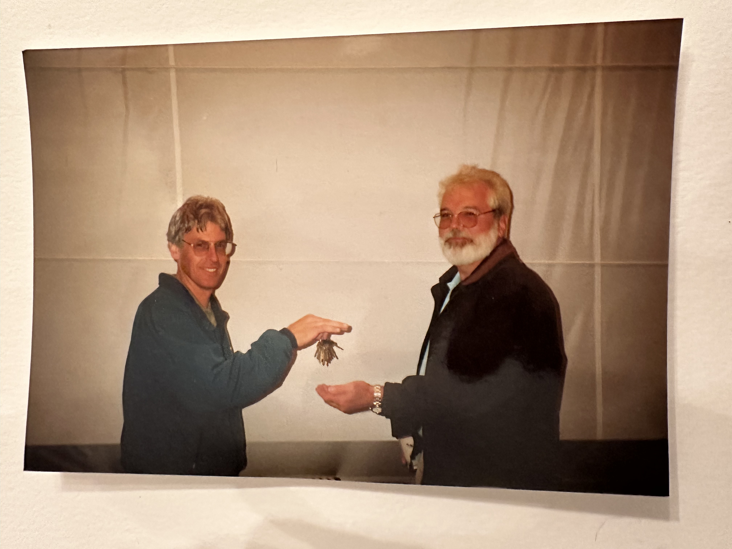
From ~1992 through 1999 STAR is Designed, prototyped (as needed), fabricated, and Assembled
Arrival of 1st Magnet backleg & Liz
Arrival of 1st Magnet backleg at STAR
Arrival of TPC via C130 & Bill Edwards
Arrival of TPC at STAR
A Ceremony for the TPC arrival
Russ handing over the TPC keys to Ralph

Slide 5
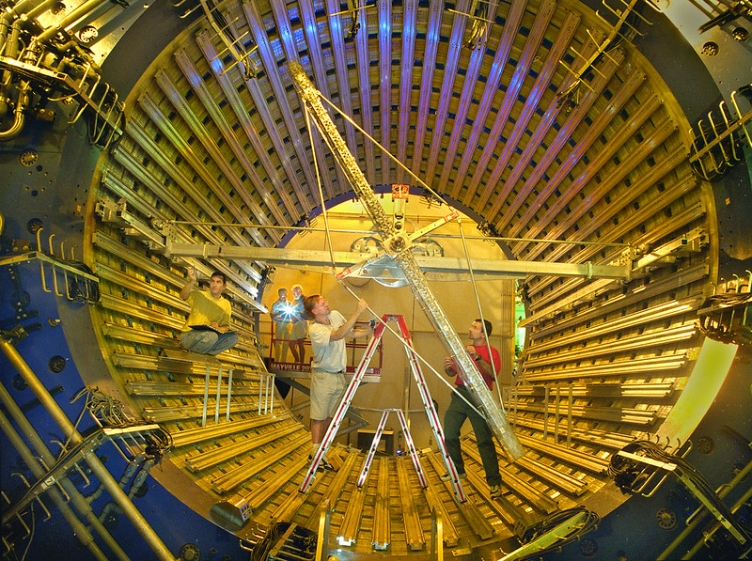
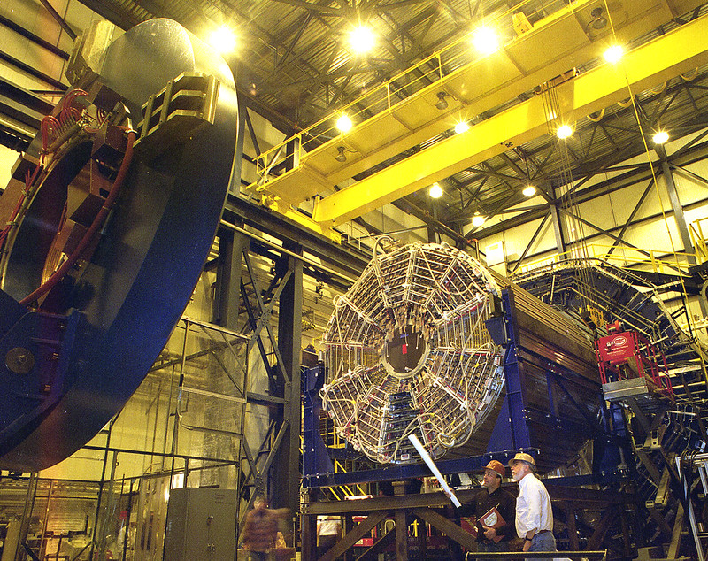
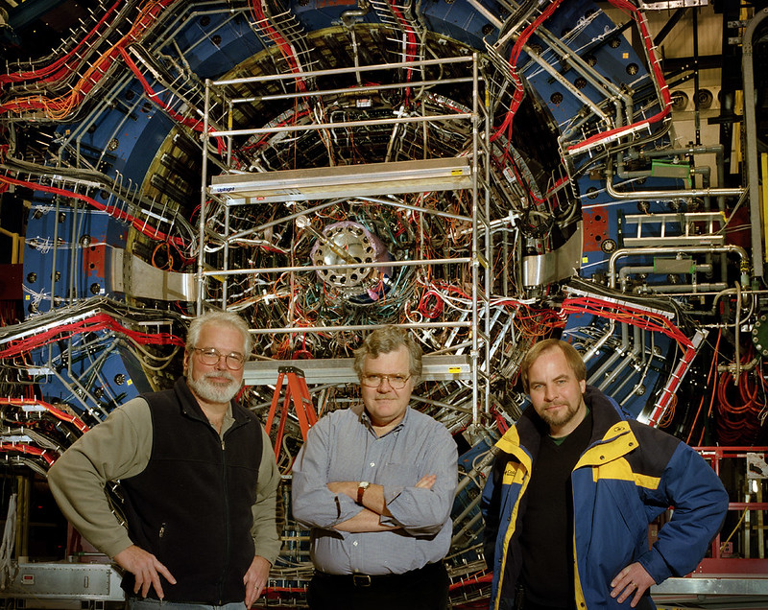
A few more Tasks are accomplished
Build and Map Magnet
Install the TPC
I wanted a pic of Ralph and Tim

Slide 6
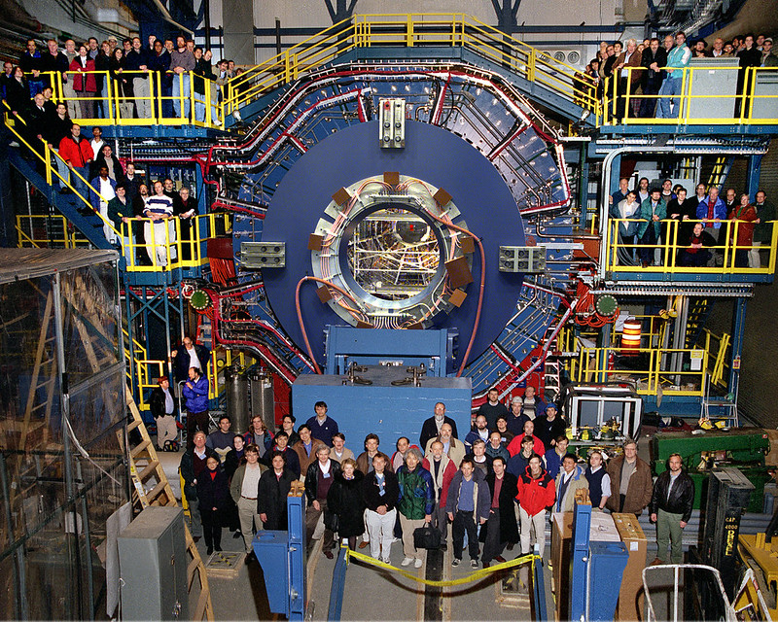
A few years later, Viola, the Collaboration and STAR Pose for a photo
And the STAR Operations Era begins

Slide 7
STAR was continually evolving and updating through its Operational Life
A list of updates and new systems (so many I may miss some):
- Silicon Vertex Tracker (SVT)
- Barrel Electromagnetic Calorimeter (BEMC)
- Barrel Time of Flight (BTOF, replaced Central Trigger Barrel)
- DAQ 100 Upgrade (takes STAR from 10 Hz to 100 Hz)
- Endcap Electromagnetic Calorimeter (EEMC)
- Photon Multiplicity Detector (PMD)
- Beam Beam Counters (BBC)
- Vertex Position Detectors (VPD)
- Forward Pion Detector prototype (pFPD)
- TPC electronics upgrade and DAQ 1000
- Fixed target installation into beam pipe (FXT)
- Muon Telescope detector (MTD)
- Silicon Strip Detector (SSD, twice)
- Heavy Flavor Tracker (HFT/Pxl)
- Forward Calorimeter (Using Strangelet Experiment modules)
- Forward Pion Detector (FPD,Using PHENIX Shalslick EMC modules)
- Pre and post shower detectors for FPD
- Inner TPC upgrade and new TPC electronics (iTPC)
- Endcap Time of Flight detector (eTOF)
- Forward Silicon Strip Detector (IST) - Forward GEM Tracker (FGT)
- Small strip chambers (sTGC) - pp2pp
- Forward Calorimeter System (FCS) - RHICf

Slide 8
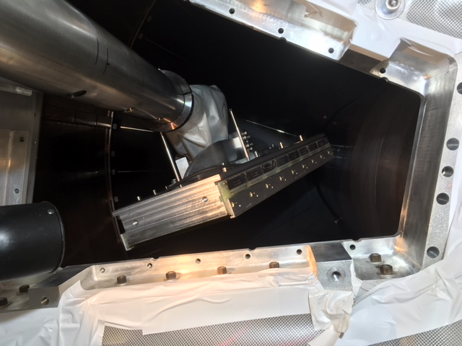
Now on to the Operations Support people and the Detector Experts
In this discussion I’m not going to discuss the critical importance of all of the people, with their vital expertise and skills, that went into designing, fabricating, and delivering all of various subsystems that made STAR’s long operational life so fruitful and successful.
What I will try to do is point out the people who played crucial roles in supporting STAR Operations. I apologize upfront for those that I forget to mention.
The main categories are:
- Administrative support
- Technical Support (STAR Technical
support group, aka STSG)
- Computing support
- Detector Experts
- Technical support provided by the
Collider Accelerator Department (CAD)
Align sector to fit through opening in wheel

Slide 9
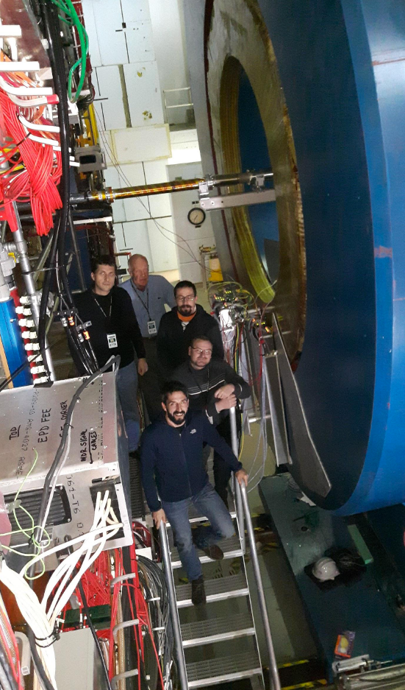
People who supported STAR Operations (1)
Administrative staff:
- Liz Mogavero. Longest serving member of this group. Liz worked at BNL prior to RHIC in the Multiple Particle Spectrometer (MPS) group. She transitioned to working on STAR when the MPS RHIC LOI was merged with the LBNL LOI, which became STAR.
- Cora Feliciano. Served for many years supporting the local BNL STAR group as well as travel and shift support for STAR Operations.
- Rachel Neves. Joined the local STAR group and carried on the efforts that Cora handled after Cora’s retirement.
- Penka Novakova. STSG support.
eTOF Crew

Slide 10
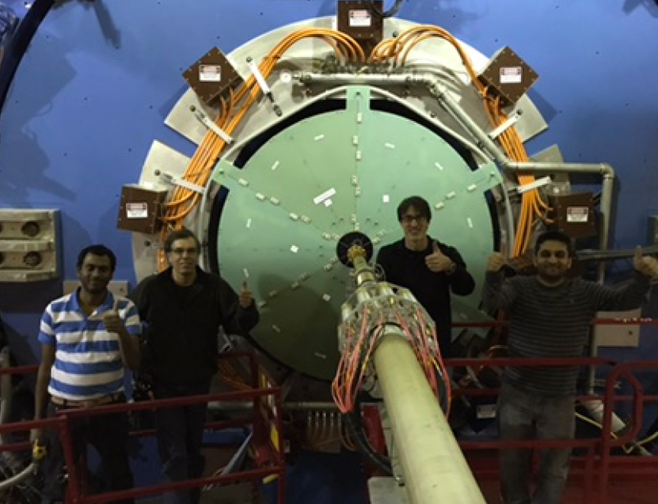
People who supported STAR Operations (2)
STAR Technical Support Group(STSG):
Mechanical Engineers
- Ralph Brown
- Bruce Miller (Safety)
- Rahul Sharma
Electrical Engineers
- Bob Sheets
- Dan Padrazo
- Cero D’Augustino
- Steve Valentino
Mechanical Techs
- Dave Dayton
- Tony Krupien
- Bob Soja
- Ken Sexton
- Greg Landon
Electrical Techs (some evolved to Engineers)
- Phil Kuczewski
- Ken Asselta
- Tim Camardi
- John Hammond
- Mike Capitola (Sp?)
All “Thumbs Up” after successful Installation
Ops Leaders/Coordinators
- Howard Wieman (Commis.)
- Bill Christie
- J.H. Lee
- Prasanth Shanmuganathan
- Zhangbu Xu
- Lijuan Ruan
- Robert Pak (Liaison/Safety)

Slide 11
People who supported STAR Operations (3)
Subsystem Leaders and Experts:
Global Interlocks
- Bill Christie
- Bob Soja
- Ralph Brown
- Alexei Lebedev
- Jim Thomas
- Prasanth Shanmuganathan
- Jeff Landgraf
- Robert Pak
Magnet
- Ken Foley
- Ron Longacre
- Bill Christie
- Robert Pak
- Prasanth Shanmuganathan
DAQ and Run Time Systems
- Mike Levine
- Tonko Ljubicic
- Jeff Landgraf
TPC/iTPC & TPC Gas
- Howard Wieman
- Blair Stringfellow
- Alexei Lebedev
- Jim Thomas
- Leonid Kotchenda
- Peter Kratchov
- Wayne Betts
- Dana Beavis
- Prasanth Shanmuganathan
Trigger
- Hank Crawford
- Jack Engelage
- John Nelson
- Eleanor Judd
- Zoran Milosevich
- Chris Perkins
- Mort Kaplan
- Gerard Visser
- John Mitchell
- One more from Carnegie Mellon (?)

Slide 12
People who supported STAR Operations (4)
BBC
- Les Bland
- Akio Ogawa
- Andrew Gordon
ZDC
- Bill Christie
- Zhangbu Xu
- Aihong Tang
- Yuhui Zhu
- Miroslav Simko
- Akio Ogawa
- Jacob Ceska
Slow Controls
- Mike Cherney
- Father McShane
- Dennis Reichhold
- Bill Waggoner
- Yuri Gorunov
- James Ross
- Jaroslav Adam
- Chanaka De Silva
- David Thlusty
BEMC
- Tom Cormier
- Stephen Trentalange
- Oleg Tsai
- Oleg Grachov
SVT
- Dave Lynn
- Jun Takahashi
- Ivan Kotov
EEMC
- Steve Vigdor
- Will Jacobs
- Scott Wissink
- Jim Sowinski
- Jan Belewski
- Rene Fatima
Databases
- Mike DePhillips
- Dmitry Arkhipkin

Slide 13
People who supported STAR Operations (5)
GMT
- Dick Majka
- Nicolas Smirnov
FTPC
- Volcker Eckardt
- Peter Seyboth
- Frank Simon
- Alexei Lebedev
L3 Event Display
- Thomas Deitel
- Thorsten Kellegger
- Seems like 1 or 2 more (?)
Online Plots (aka Panitkin plots)
- Sergei Panitkin
- Claude Pruneau
- Frank Laue
- Paul Sorenson
- David Kettler
- Matt Lamont
- Jeff Landgraf
TOF
- B. Llope
- G. Eppley
- Jo Schambach
- Jing Liu
- Shuai Yang
- Joey Butterworth
- Alexei Lebedev
Forward GEM Tracker (FGT)
- Bernd Surrow
- Gerrit van Nieuwenhuizen
- Gerard Visser
- Paul Nord
- Donald Koetze
Computing & Hardware Support
- Bill Love
- Al Sauly
- Torre Wenaus
- Jerome Lauret
- Wayne Betts
- Levente Hajdu
- Matthew Ahrenstein
- Mike Poats
- Gene Van Buren

Slide 14
People who supported STAR Operations (6)
FPD & FMS
- Les Bland
- Akio Ogawa
- Mriganka Moudal
- Stephen Trentalange
- Yu XiPan
- Chris Dilks
- Andrew Gordon
- Greg Rakness
- Joanna Kiryluk
- Steve Heppelmann
- Sam Heppelman
Pp2pp
- Wlodek Gyuryn
- Romiro Debbe
- Kin Yip
SSD(1)
- Vi Nahm Tran
- Jonathan Bouchet
SSD(2)
- Jim Thomas
- Thorsten Stezelberger
- Jonathan Boucet
- Long Zhou
HFT/PXL
- Giacomo Contin
- Jo Schambach
- Xingming Sun
- Xin Dong
- Xiongming Sun
- Leo Greiner
IST
- Gerrit van Nieuwenhuizen
- Bahok Abi
- Yaping Wang
FMS preshower
- Akio Ogawa
- Oleg Eyser

Slide 15
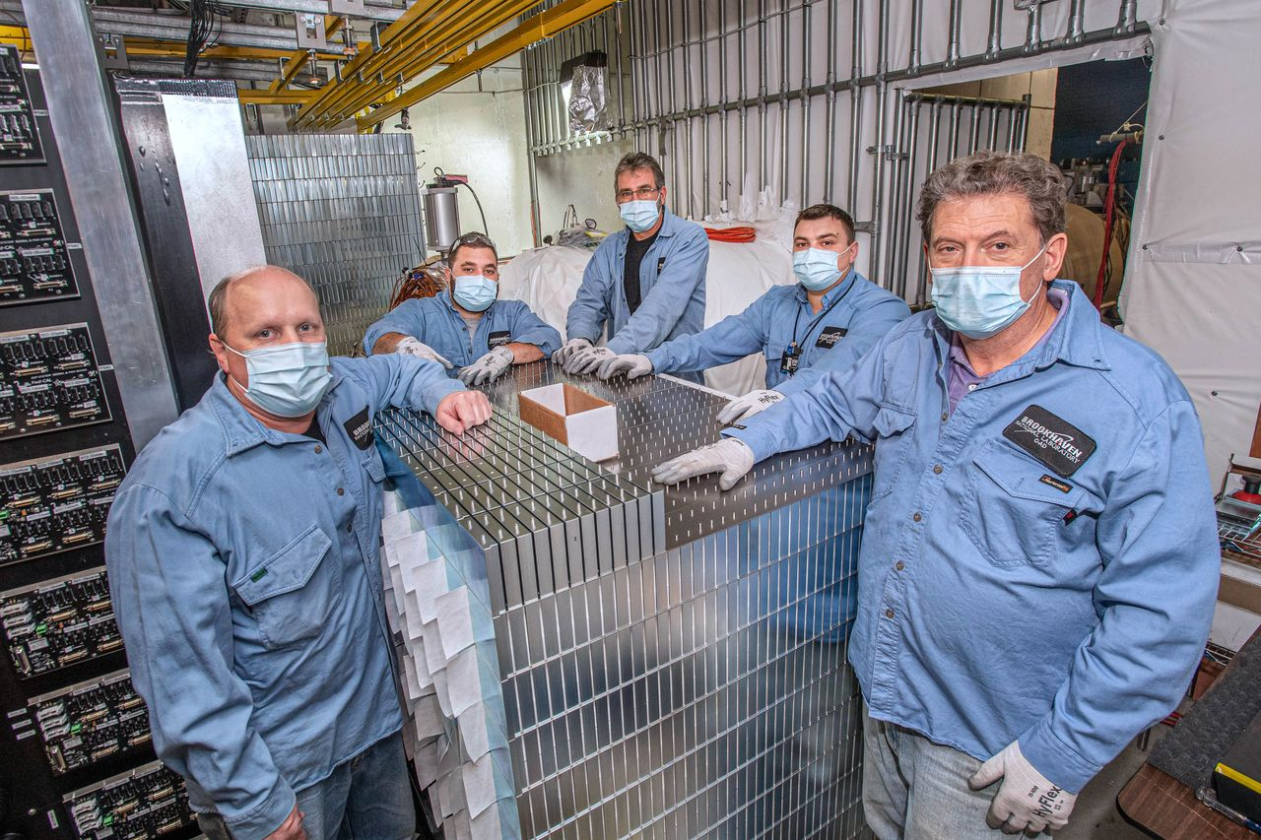
People who supported STAR Operations (7)
MTD
- Daniel Torres Valladares
- Geary Eppley
- Lijuan Ruan
EPD
- Tristan Protzman
- Maria Stefaniak
- Mike Lisa
FCS
- Akio Ogawa
- Oleg Tsai
eTOF
- Daniel Tores Valladares
- Norbert Herman
- David Tlusty
- Geary Eppley
PMD
- Need to fill in
HLT
- Diyu Sheen
FST
- Pritwish Tribedy
- Souvik Paul
- Gaven Wilks
sTGC
- Prasanth Shanmuganathan
- David Tlusty
- Tonko Ljubicic
CAD Techs stacking the HCAL

Slide 16
People who supported STAR Operations (8)
A few names that I’m fairly certain were Detector Experts, but I couldn’t remember which system they belonged to:
- Christophe Suire
- Alex Suaide
- Dylan Thein
I tried to capture all of the subsystems, and associated Detector Experts that served as on call experts in the preceding 6 pages. I’d be shocked if I got it either complete or completely correct. If anyone sees omissions or mistakes, and they’d like to see the slides corrected, please feel free to send me the info. and I’ll update the slides and repost the talk.
The people that supported STAR Operations, including all those who served shifts, are the key ingredient leading to STAR’s incredible success over 25 years of operation.

Slide 17
Importance of people being present in the Control room, on site, or readily reachable via phone on any day of the week and any hour of the day
I believe essentially all of you listening or reading these slides has served on shift at STAR. You know that when something goes down, doesn’t respond to the procedures that you have at hand to resolve issues, and especially if the fault prevents you from running STAR to accumulate any useful Physics quality data that there is great relief when an Expert answers your call for help and guidance.
The efforts of all of the local support staff, the detector experts, and the CAD Technical support (key Engineers and Tech staff) were of vital importance to the success of the STAR Operations effort!

Slide 18
Some personal thoughts on my experiences with STAR Operations
Operating a large Collider detector is a big Challenge.
The moment you close one up and start running pieces of the detector start experiencing failures. One has to manage these failures.
I experienced some very dark and troubling hours sitting in the Control room at times trying to get STAR running. This mostly happened early in STAR’s Operational life, usually early in the morning, and when expert help was unavailable. I absolutely learned/understood the importance of having help available when ever needed, 24/7.
The dark hours were vastly outnumbered by the many more times I experienced in the Control room, or in the cave, the feelings of exhaltation and satisfaction of resolving some obscure problem, or overcoming some obstacle, with the help of our colleagues, and getting STAR back online or pushing it forward in some manner!
For me, it has been an incredible journey. I derive enormous satisfaction from the extremely successful results of all of our efforts.
What a ride!!

