Slide 1



STAR 25-Year Celebration, December 17-18, 2025, BNL
STAR Power of Jet Quenching
Xin-Nian Wang
Central China Normal University

Slide 2
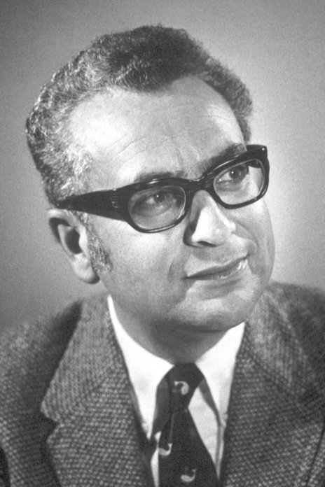
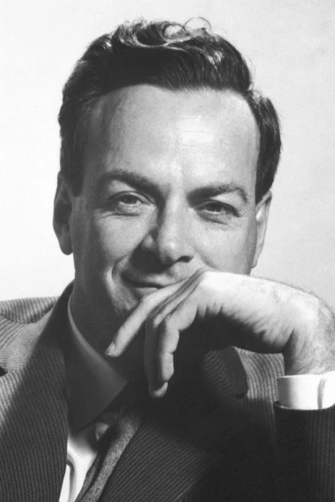
Pre-QCD era: quark model, parton model and “jet”
Discovery of a zoo of hadrons: mesons, baryons and excited states:
Leading to quark model (1968) by Gell-Mann and Zweig
    Observation of Bjorken scaling of cross sections of deeply inelastic scattering:
    Leading to the parton model (1969) of hadrons by Feynman
    Production of energetic hadrons in high-energy collisions:
      Uncorrelated jet model for hadron production: De Groot and Ruijgrok (1971)
Gell-Mann
Feynman
Notes:
From QCD to QGP: Strong interaction in extremis.
Hagedorn: Statistical Bootstrap
Though it became evident after the development of the quark model that there exists ever increasingly number of hadron states with a limiting temperature for strong interacting matter, it was the discovery of the asymptotic freedom of QCD in 1973 that leads to the realization of phase transition from hadron to quark-gluon matter at high temperature. QCD also provides the theoretical foundation for determining the phase transition temperature and using hard QCD processes as probes of the quark-gluon plasma. Experiments at the Relativistic Heavy-ion Collider (RHIC) and Large Hadron Collider (LHC) have shown a strongly coupled QGP created in the center of high-energy heavy-ion collisions. This talk will review the progress made in understanding the properties of this strongly coupled QGP in the last two decades through studies of collective phenomena in soft hadrons and hard probes using energetic jets. Interplay between soft and hard probes and spin dynamics in heavy-ion collisions will be highlighted and the perspective of future directions will be discussed.

Slide 3
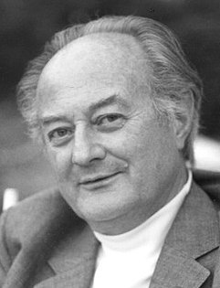
Hagedorn limiting temperature
Increasing number of hadron production (and decays) in high-energy collisions
Hagedorn statistic boost trap model (1968):
With the solution:
Partition function of the Hagedorn (hadron) resonance gas (HRG) model:
Notes:
\rho(m,V_0)=\delta(m-m_0) +\sum_N \frac{1}{N!}\left[\frac{V_0}{(2\pi)^3}\right]^N \int \prod_{i=1}^N\left[dm_i\rho(m_i)d^3p_i\right] \delta^4(\sum_i p_i -p)
\ln {\cal Z}(T,V)=\frac{VT}{2\pi^2}\int dm m^2 \rho(m) K_2(m/T)
\approx V\left[\frac{T}{2\pi}\right]^{3/2}\int dm m^{-3/2}e^{-m\left[\frac{1}{T}-\frac{1}{T_H}\right]}
\rightarrow \infty \;\;\;\; {\rm when}\;\; T>T_H

Slide 4
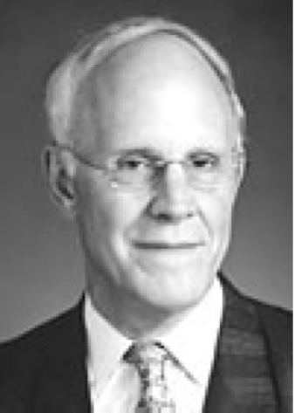
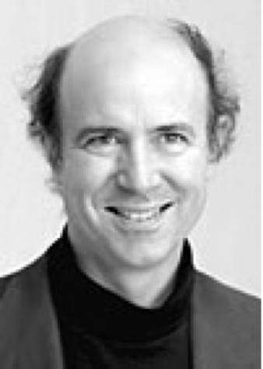
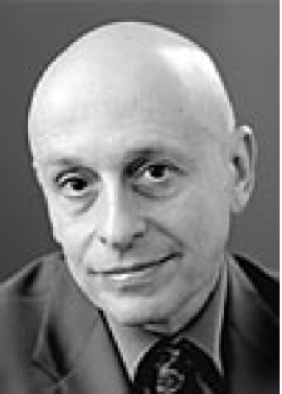
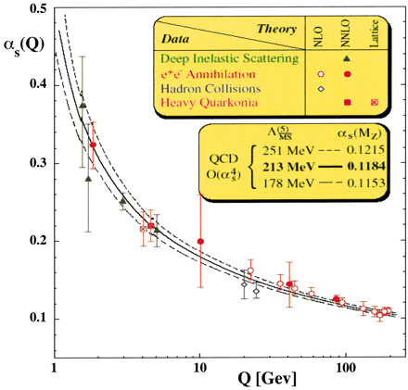
Asymptotic freedom & confinement in QCD
Gross & Wilczek; Politzer (1973)
← Confinement
screening
S Bethke J. Phys. G26 (2000) R27
anti-screening
Asymptotically free →
Notes:
The surface plot illustrates the reduction of the vacuum action density in a plane passing through the centers of the quark-antiquark pair. The vector field illustrates the gradient of this reduction. The tube joining the two quarks reveals the positions in space where the vacuum action is maximally expelled and corresponds to the famous "flux tube" of QCD. As the separation between the quarks changes the tube gets longer but the diameter remains approximately constant. As it costs energy to expel the vacuum field fluctuations, a linear confinement potential is felt between quarks.

Slide 5
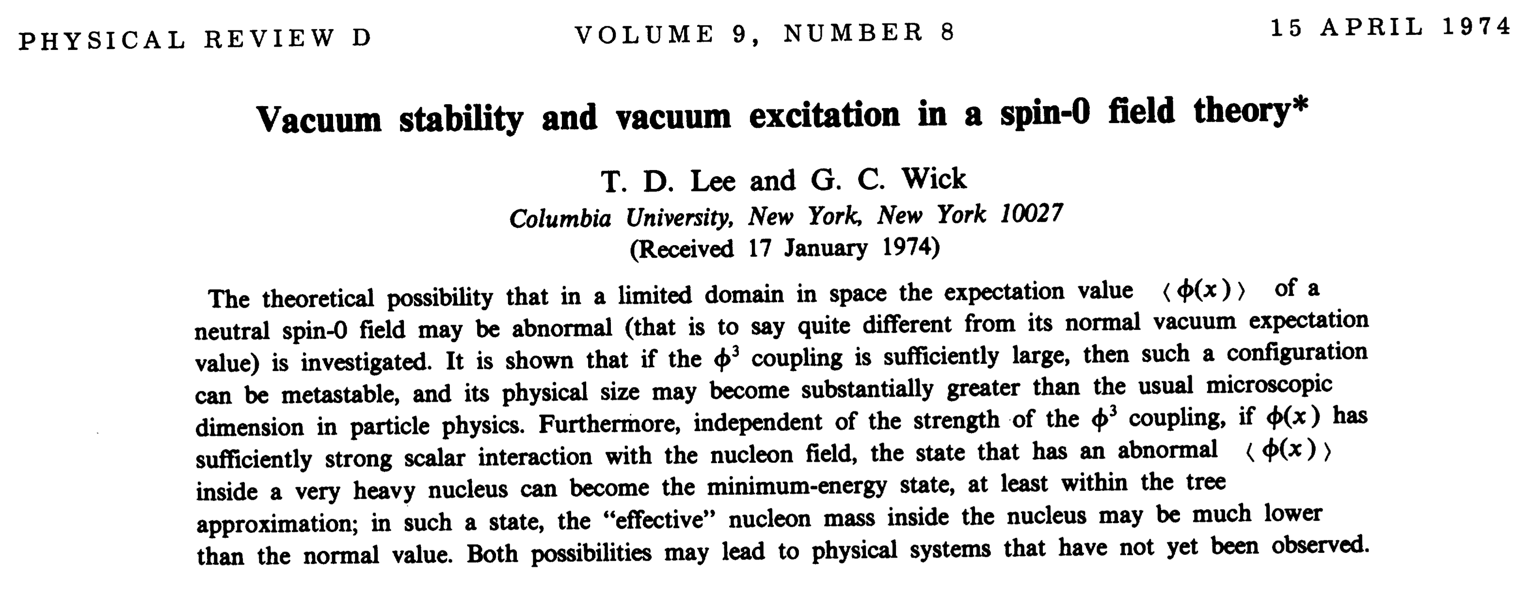
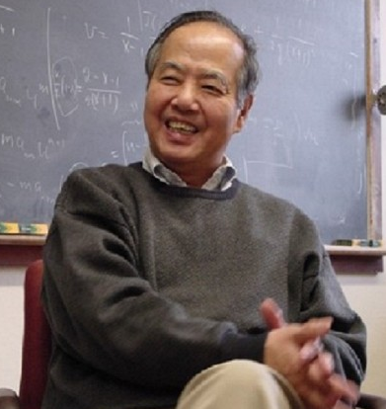
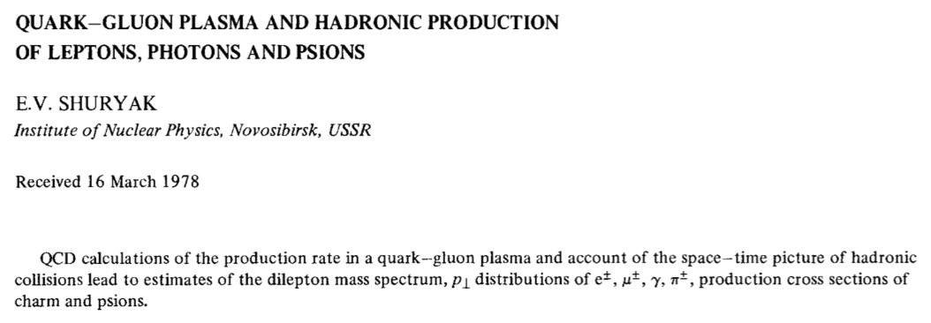
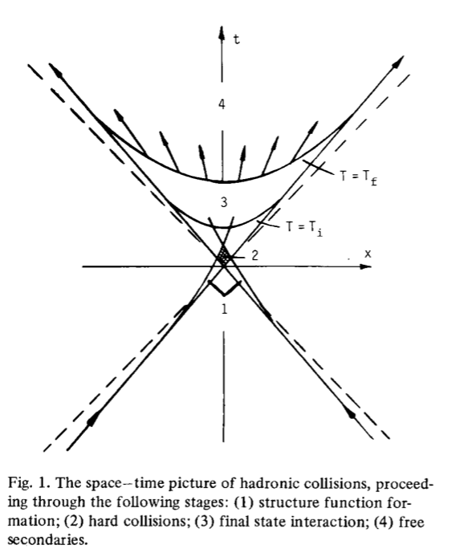
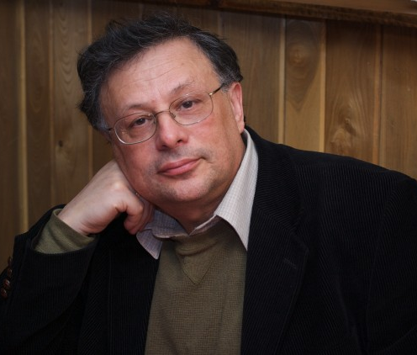
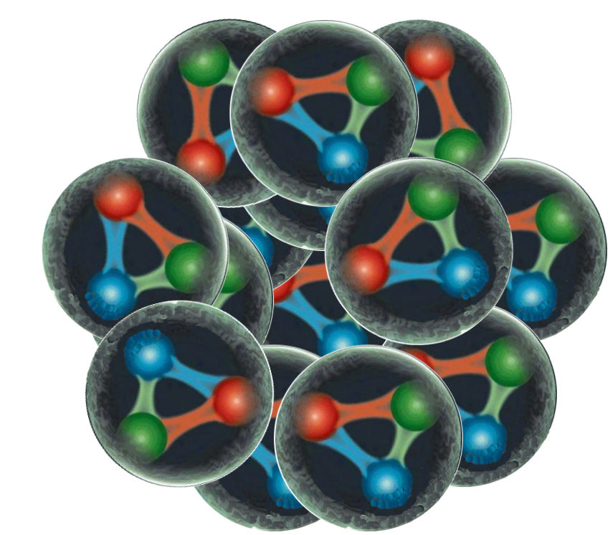
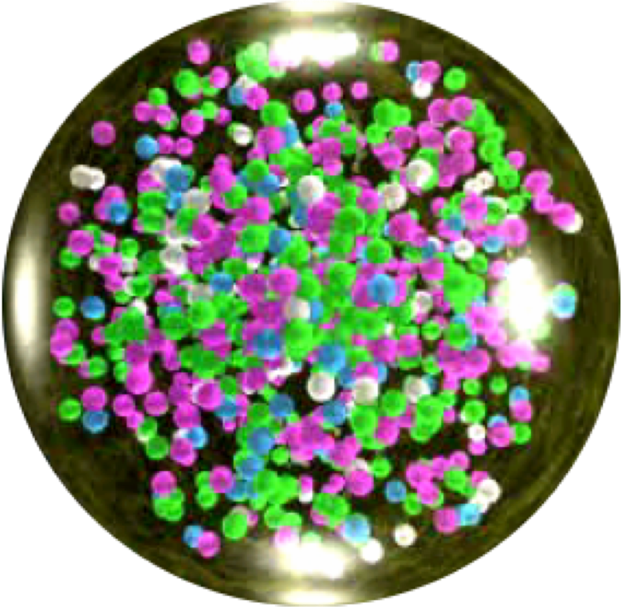
QGP - Quark-gluon plasma
T. D. Lee and G. Wick (1974)
N. Cabibbo and G. Parisi (1975), J. Collins and M. Perry (1975), G. Baym and S. Chin (1976)
Phys.Lett.B 78 (1978) 150,
Sov.J.Nucl.Phys. 28 (1978) 408,
Yad.Fiz. 28 (1978) 796-808
Normal nuclear matter
QGP
Notes:
\epsilon_{q,g}=6n_f\frac{7\pi^2}{120}T^4 + 16\frac{\pi^2}{30}T^4
P_\pi(T_c)=P_{q+g}(T_c)
4B=\langle \frac{\alpha_s}{12\pi} F^{\mu\nu}F_{\mu\nu}\rangle \approx (188 {\rm MeV})^4

Slide 6
Properties of QGP in A+A Collisions
Multi-messenger study of dynamics and properties of QGP
Soft probes: collective flow - bulk properties, EoS, transport properties, initial conditions
Hard probes: Jet quenching, heavy quarks– Jet transport coefficients, diffusion constant
EM Probes: EM emission – Temperature, EM response, medium modification of resonances
Notes:
One must rely mostly on phenomenological extraction of these transport coefficients from experimental data
Truly a multi-messenger problem
Involves multiple probes, ranging from long to short range properties according to the energy scale of the probes

Slide 7
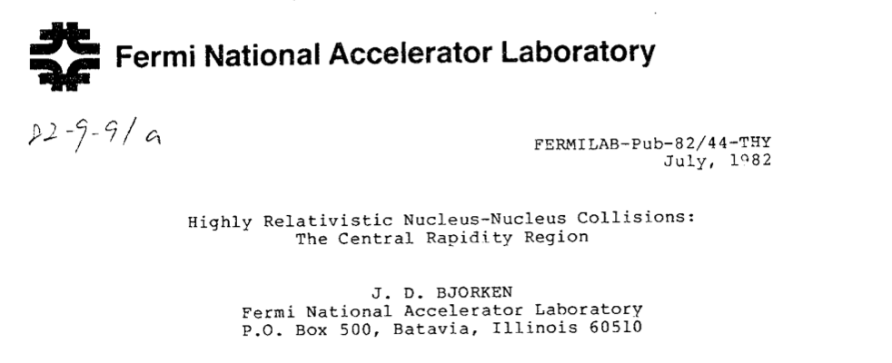

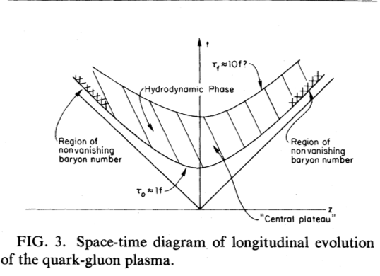
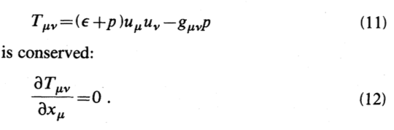

One of Bjorken’s two preprints in the summer of 1982
Phys.Rev.D 27 (1983) 140-151 (citations 3822)
Bjorken flow

Slide 8
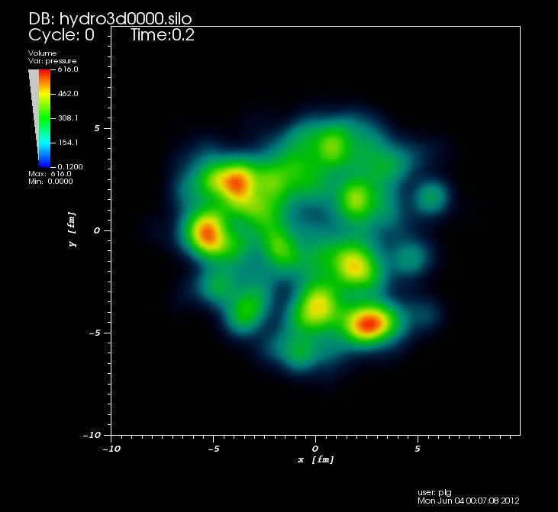
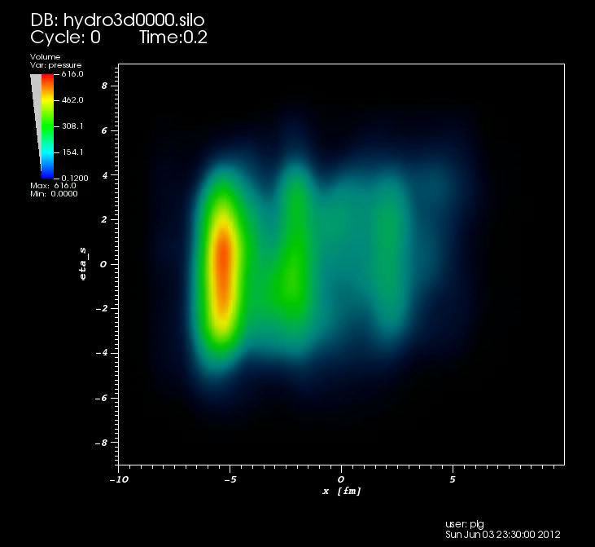
Collective flow of QGP
Pang, Petersen & XNW, Phys.Rev.C 97 (2018) 6, 064918
Hydrodynamics:
  a low-momentum effective theory
  Inputs from first principle QCD (lattice QCD)
  EoS p(ε), transport coefficients ξ(T), ζ(T) (??)
  Initial condition: parton prod. & thermalization
y
x
η
Initial thermalization: hydrodynamic attractors, hydrodynamization, anisotropic hydrodynamics, kinetic theory, etc
x
(3+1)D viscous hydro (CLVisc) with AMPT initial condition
Notes:
Even though there are still a lot or theoretical issues need to be addressed, …., it is still the most successful model to describe data
T^{\mu\nu}=(\epsilon + P)u^\mu u^\nu - P g^{\mu\nu} +\Delta T^{\mu\nu}
\Delta T^{\mu\nu}=\eta (\Delta^\mu u^\nu+\Delta^\nu u^\mu) + (\frac{2}{3}\eta-\zeta)H^{\mu\nu}\partial_\rho u^\rho
\partial_\mu T^{\mu\nu}=0

Slide 9
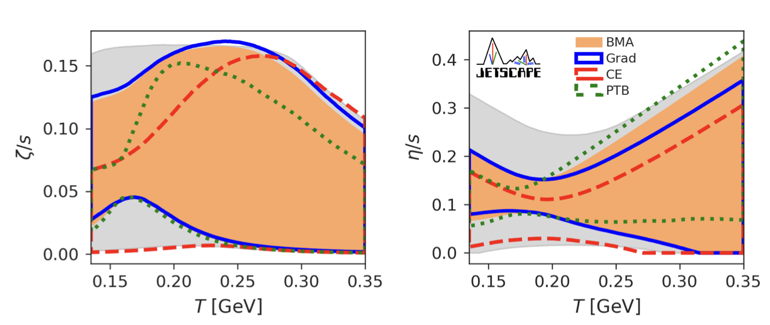
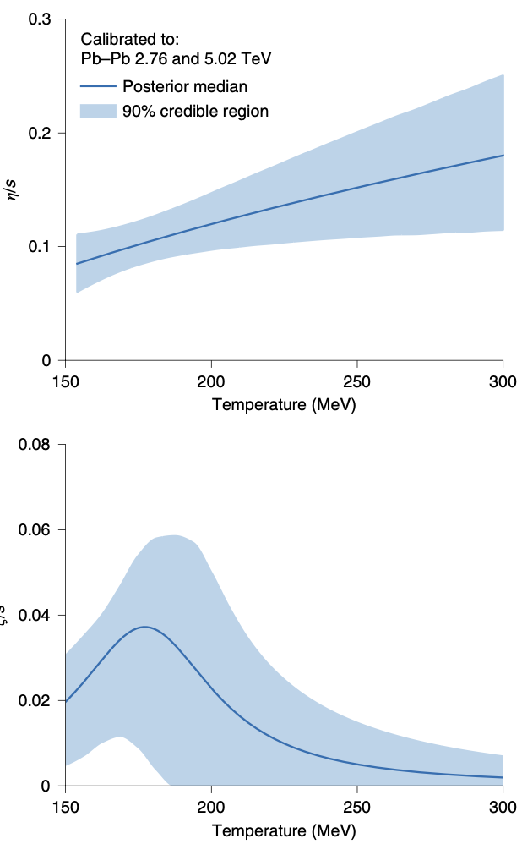
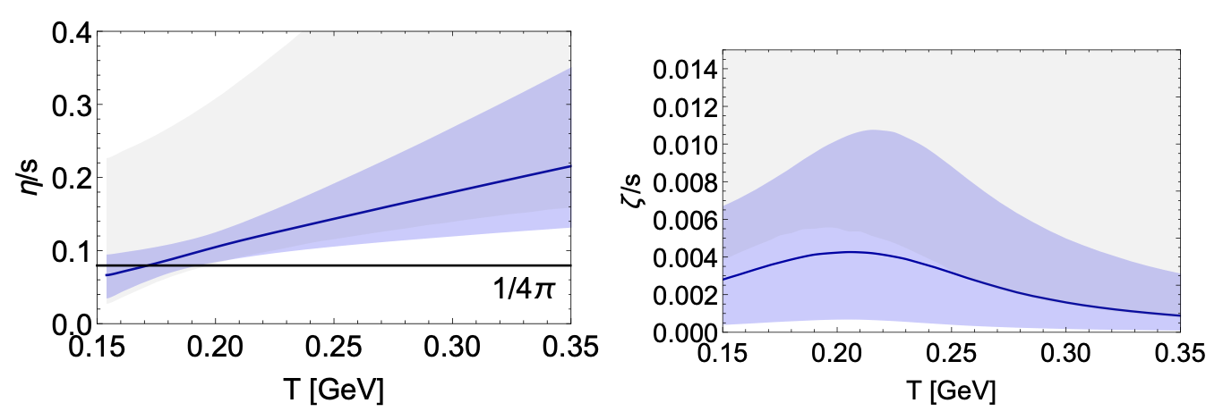
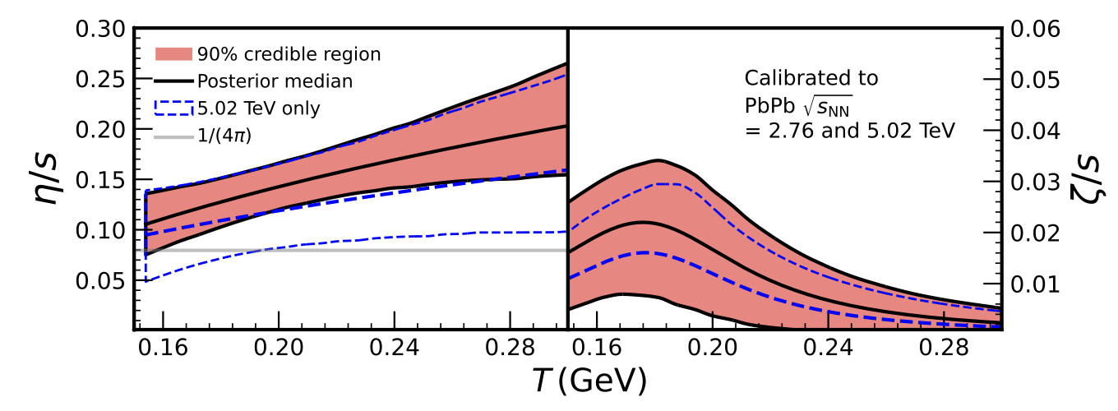
Bayesian inference of transport coefficients
Duke
e-Print: 2010.15130; 2010.15134
Nature Phys. 15 (2019) 11, 1113
trajectum
e-Print: 2010.03928
2011.01430
2+1D viscous hydro
Trento initial condition
Hadr transpt: SMASH, UrQMD
e-Print: 2111.08145
Uncertainties:
modeling of initial condition (short distance correlation, early non-equilibrium evolution), transition to hadron transport ( resonances) etc.
Parkkila, et al.
Notes:
In last decade, efforts in Bayesian inference have flourished, the method enables one to use data and constrain multiple model parameters.
These are collaborative efforts (like JETSCAPE and BAND) involving a spectrum of people in statistics, computer scientists experimentalists and theorists.
2+1d hydro + emulations
There are differences among these inferences due to modelling differences, or model uncertainty,
It describes how a prior belief of the distribution of certain physical parameters will be updated to the posterior distribution after comparing theory with new experimental data, as encoded in the likelihood fun
\mathcal{P}^{(i)}(\boldsymbol{x}|\mathbf{y}_{\exp}) = \frac{\mathcal{P}^{(i)}(\mathbf{y}_{\exp}|\boldsymbol{x}) \mathcal{P}(\boldsymbol{x}) }{\mathcal{P}^{(i)}(\mathbf{y}_{\exp})}
ction that quantifies the model’s descriptive power

Slide 10
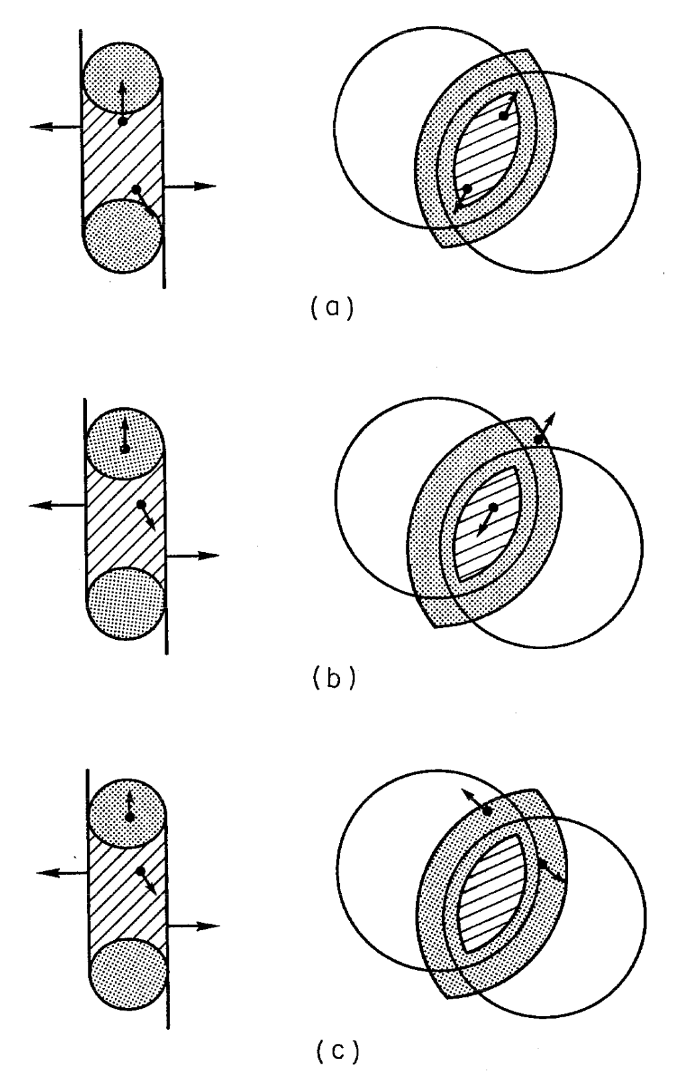
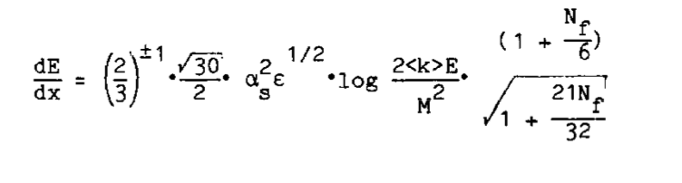
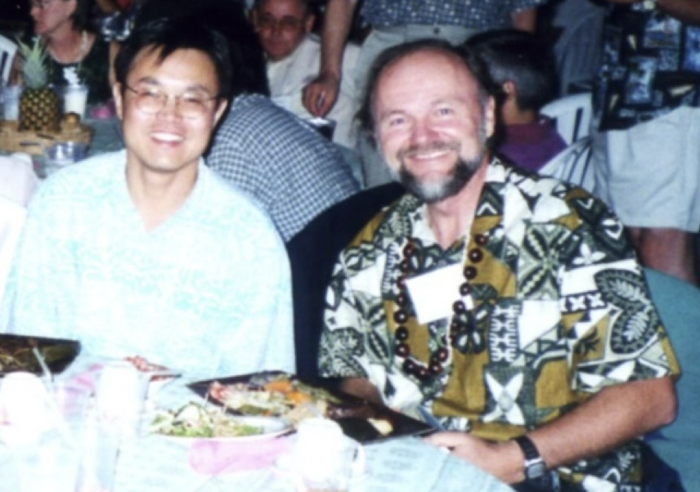
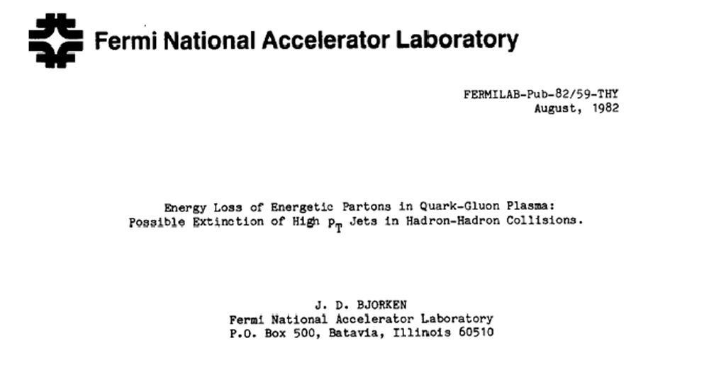
Bjorken’s second preprint in 1982
Elastic energy loss
Inelastic pQCD parton energy loss:
Gyulassy & XNW (1994),
BDMPS (1995), Zakharov (1996)

Slide 11
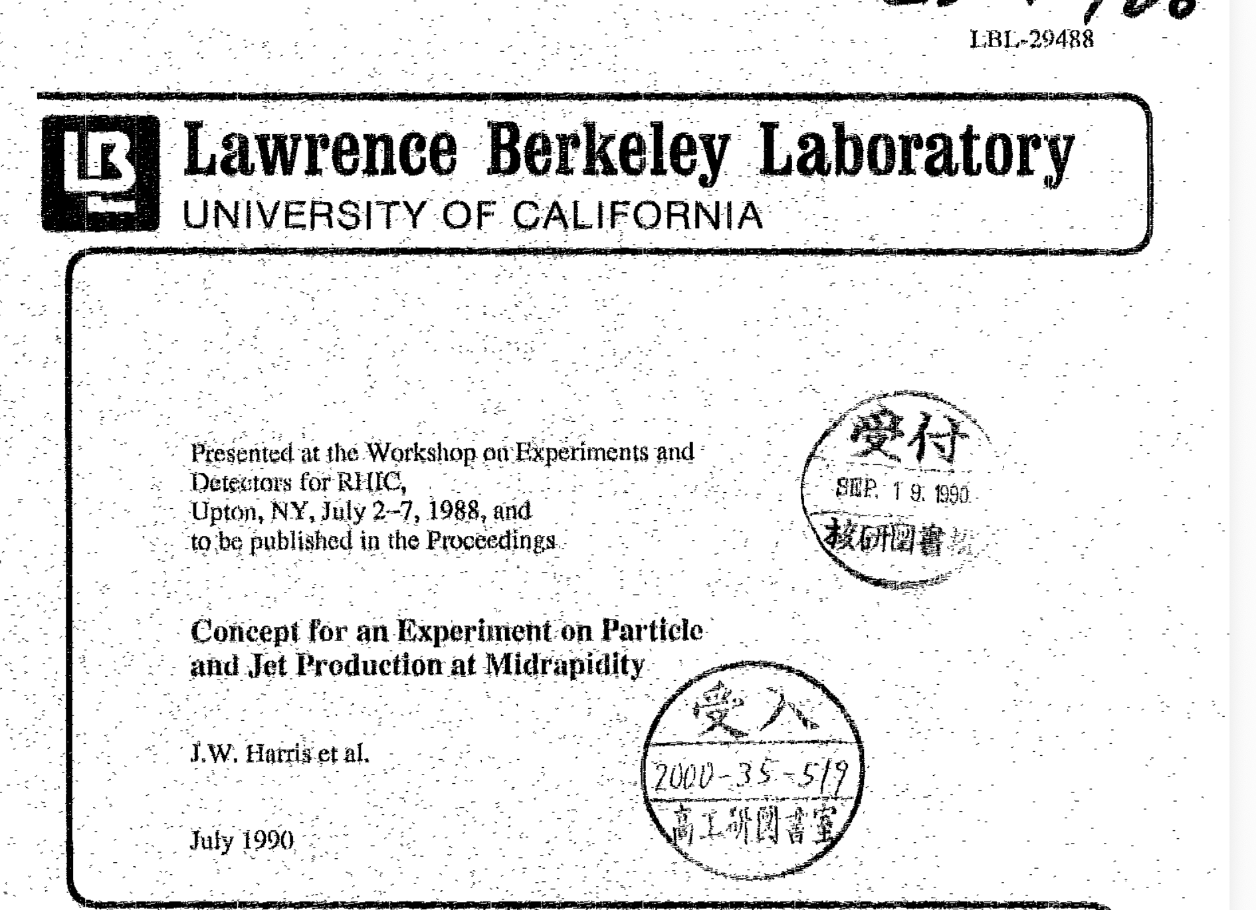
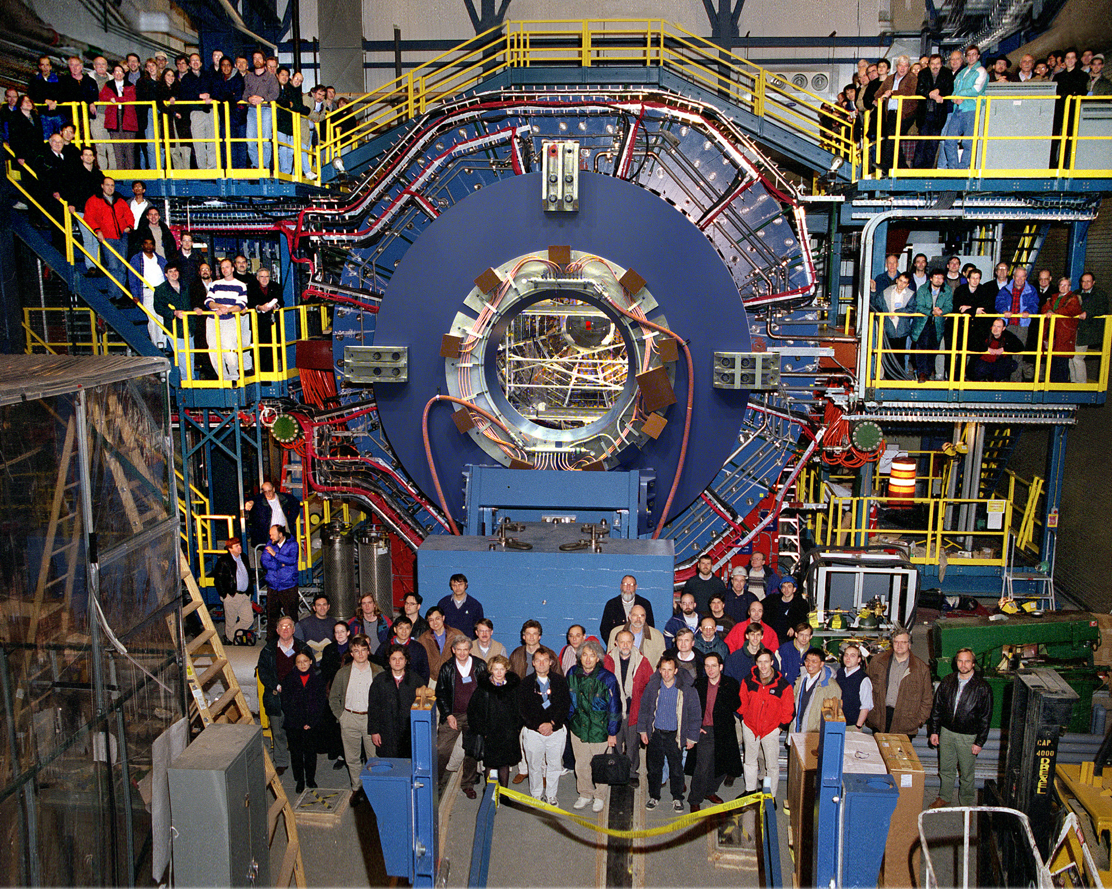
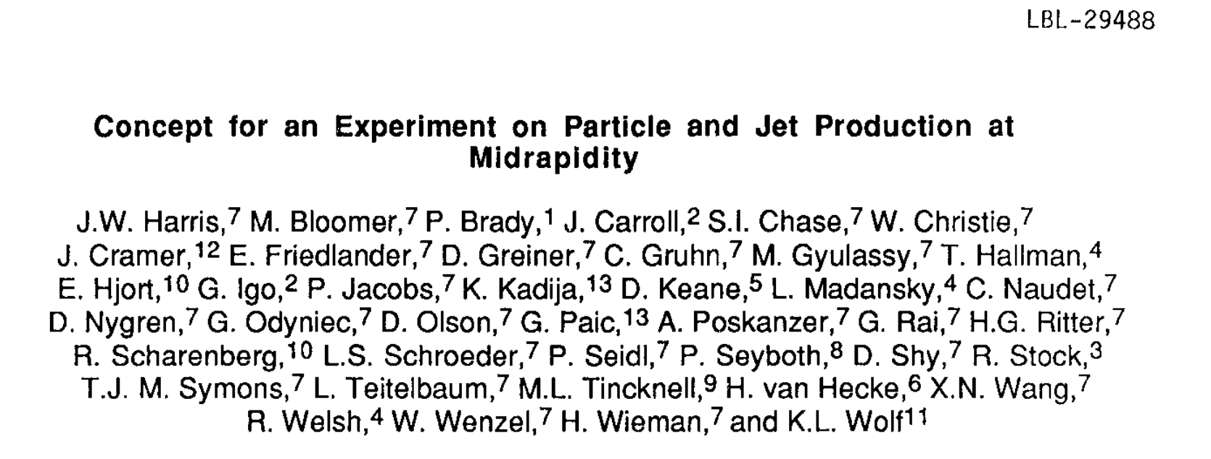
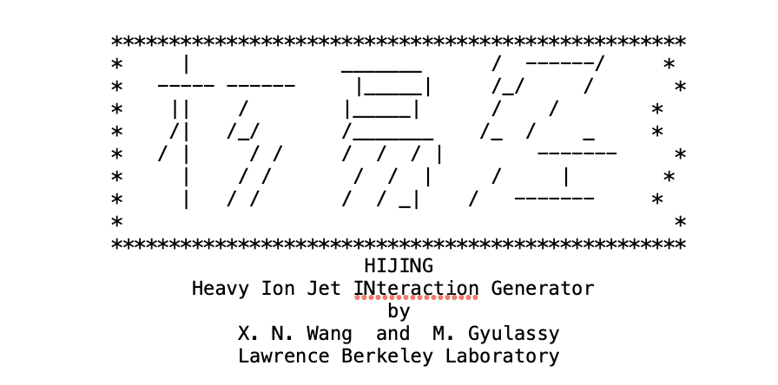
Jet Physics at the center of STAR conceptual design
XNW & Gyulassy, Phys. Rev. D 44, 3501-3516 (1991)

Slide 12

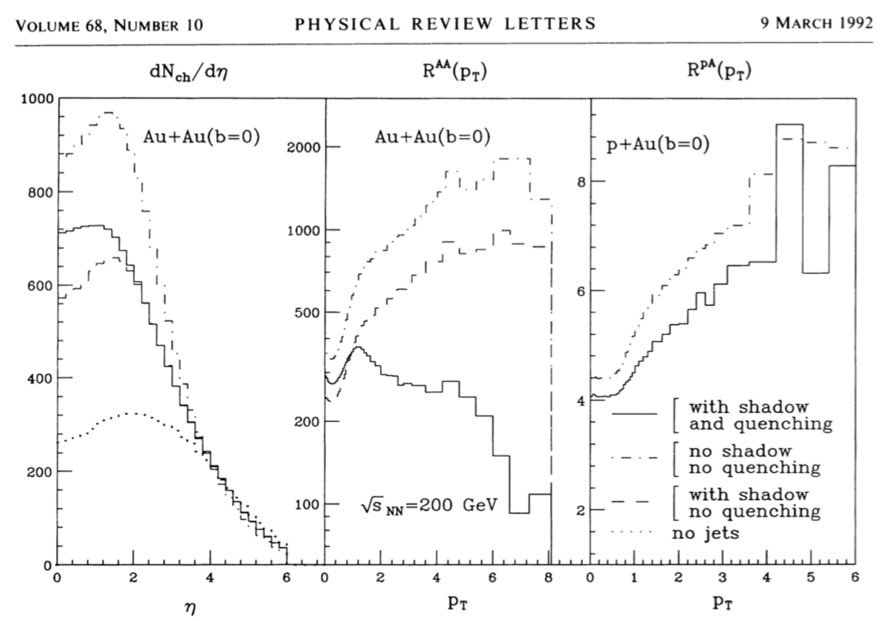
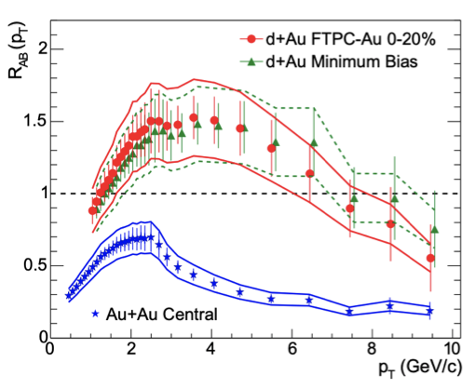
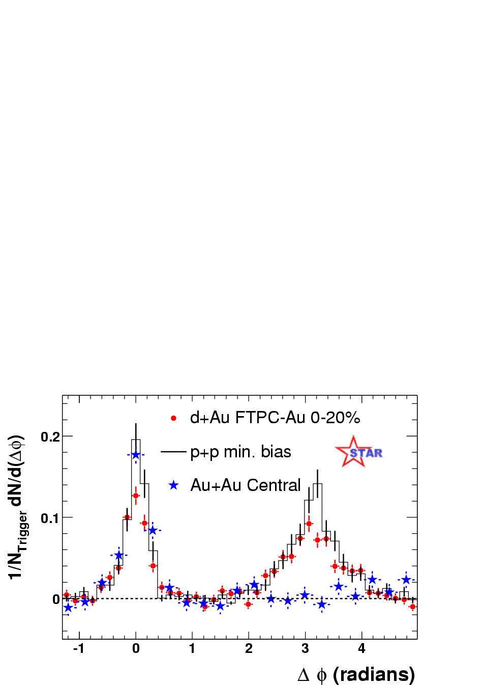
Discovery of jet quenching at RHIC
Gyulassy, XNW: Suppression of leading hadrons due to jet quenching
Phys. Rev. Lett. 68 (1992) 1480-1483
XNW, Phys. Rev. C 58 (1998) 2321
Pedestal&flow subtracted
STAR Collaboration, Phys. Rev. Lett. 91 (2003) 072304,

Slide 13
Parton energy loss and jet transport
Inelastic energy loss
Elastic energy loss
Jet transport coefficient:
pQCD (BDMPS’96)
AdS/CFT (Liu,Rajagopal &Wideman’06)
lattice QCD (Majumder’12)
Extract jet transport coefficient from parton energy loss
Notes:
\frac{dE_{el}}{dx}=\int\frac{d^3k}{(2\pi)^3}dq_\perp^2 f(k) \frac{q_\perp^2}{2k}\frac{d\sigma}{dq_\perp^2}\approx C\frac{3\pi}{2}\alpha_s^2T^2\ln\frac{s^*}{4\mu_D^2}
\frac{dE_{el}}{dx}=\int\frac{d^3k}{(2\pi)^3}dq_\perp^2 f(k) \frac{q_\perp^2}{2k}\frac{d\sigma}{dq_\perp^2}\approx \langle \frac{1}{2\omega}\rangle \hat q
\frac{dE_{rad}}{dx}\approx \frac{2C_A\alpha_s}{\pi} \hat q (x) \int dz \frac{d\ell_\perp^2}{\ell_\perp^4}zP(z)\sin^2\frac{\ell_\perp^2 (x-x_0)}{4z(1-z)E}
\widetilde P_{a\rightarrow ag}(z)
d\sigma_h=\sum_{a,b,c} f_a\otimes f_b\otimes d\sigma_{ab \rightarrow c+X}\otimes \widetilde D_{c/h}
\widetilde D_{c/h}(z_h)\approx
\widetilde P_{a\rightarrow ag}(z) \otimes D_{a/h}(z_h)

Slide 14
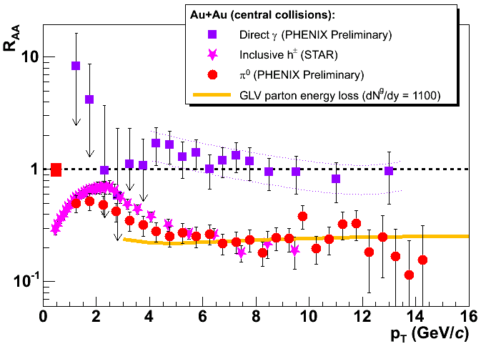
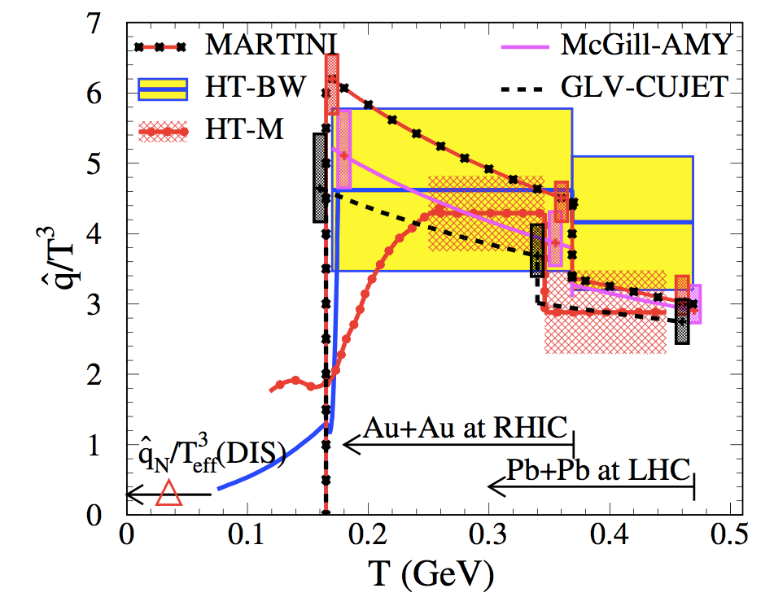
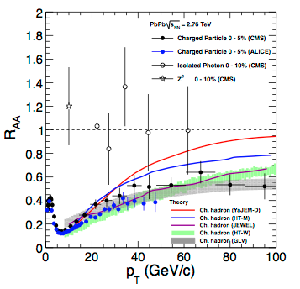
Jet transport coefficient at RHIC and LHC
JET Collaboration, Phys.Rev.C 90 (2014) 1, 014909
Pedestal&flow subtracted
Notes:
We are not done with hadron spectra and correlations, they can provide stringent constraints on qhat especially dihedron and gamma/Z-hadron correlations

Slide 15
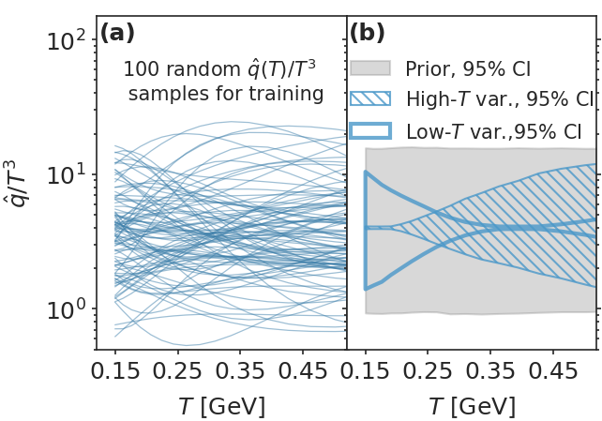
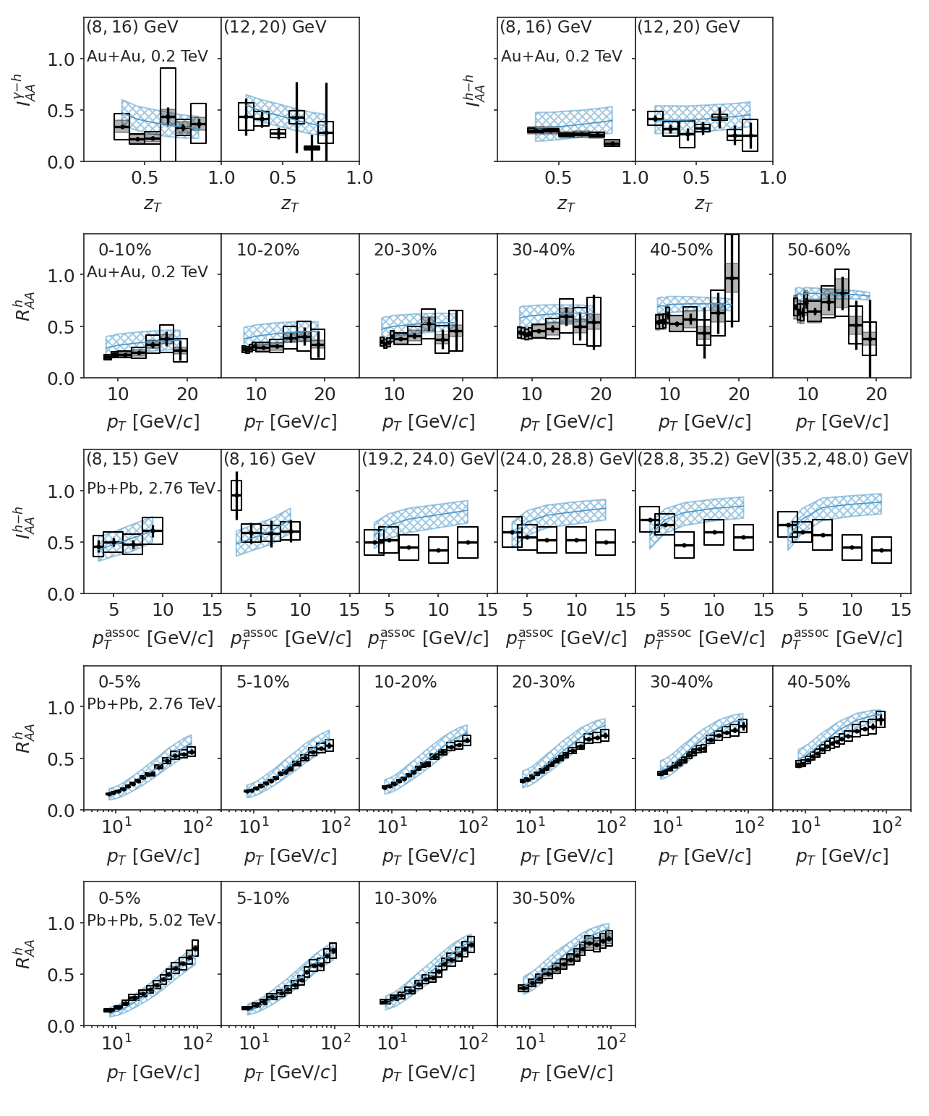
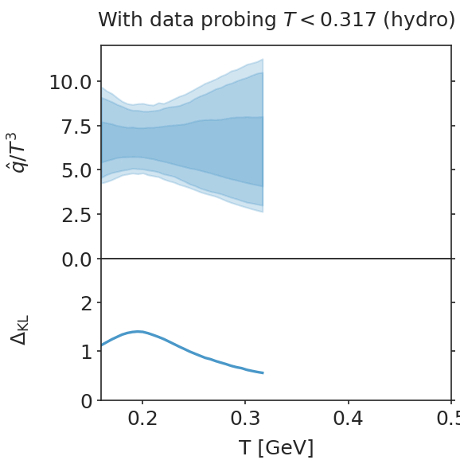
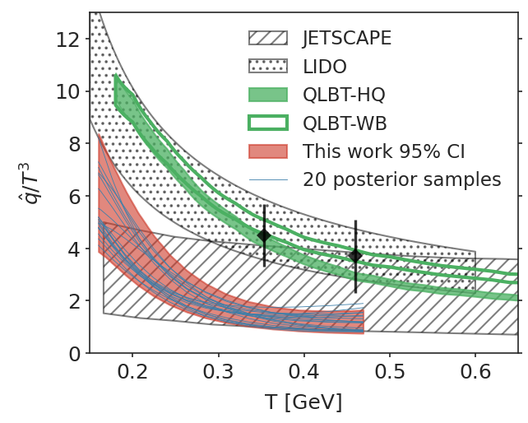
Bayesian inference of jet transport coefficient
Strong T-dependence
Weak E-dependence
Information-Field approach to priors is free of long-range correlation
e-Print: 2206.01340
e-Print: 2208.14419
Notes:
We are not done with hadron spectra and correlations, they can provide stringent constraints on qhat especially dihedron and gamma/Z-hadron correlations

Slide 16
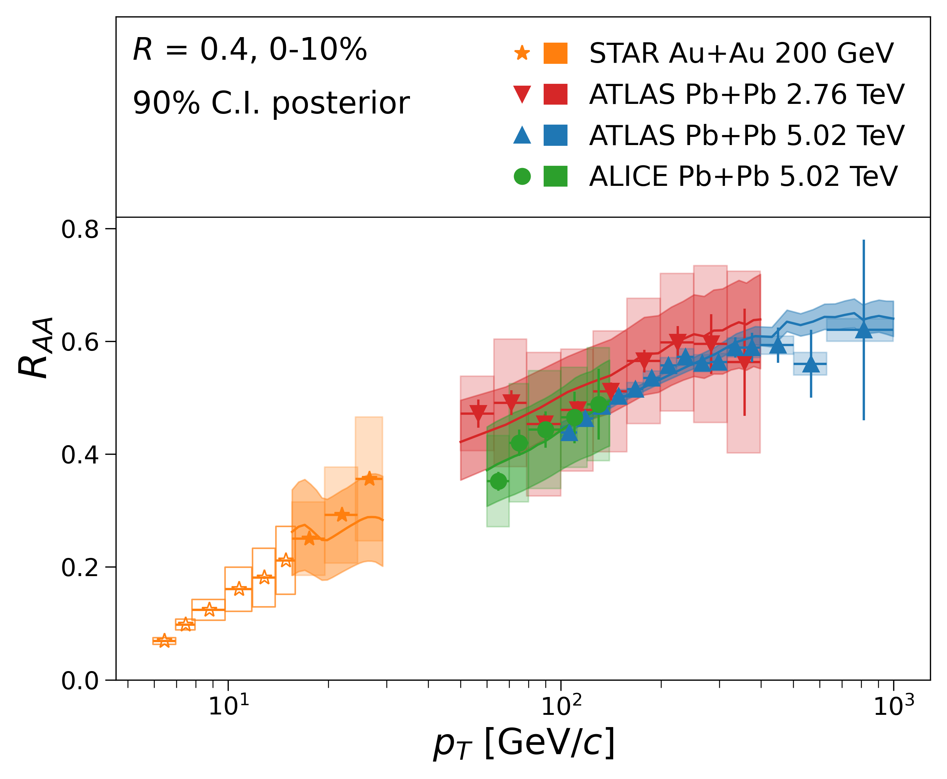
Jet suppression at RHIC and LHC
Wu, Ke, and XNW, Phys. Rev. C 108 (2023) no. 3, 034911
STAR’s charged jets
medium response, background and jet energy loss

Slide 17
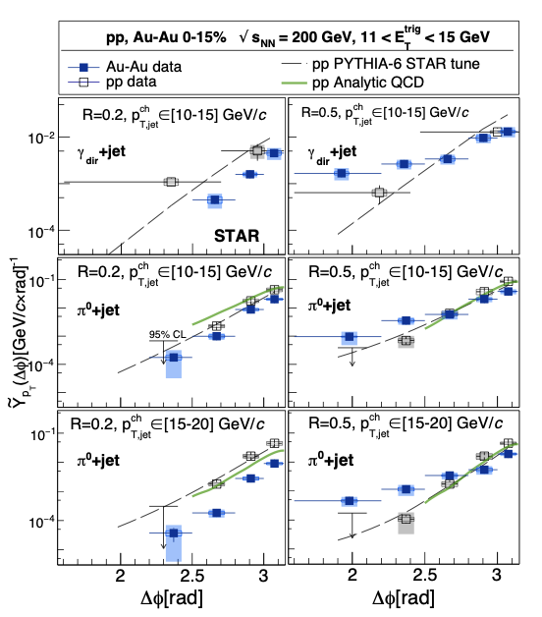
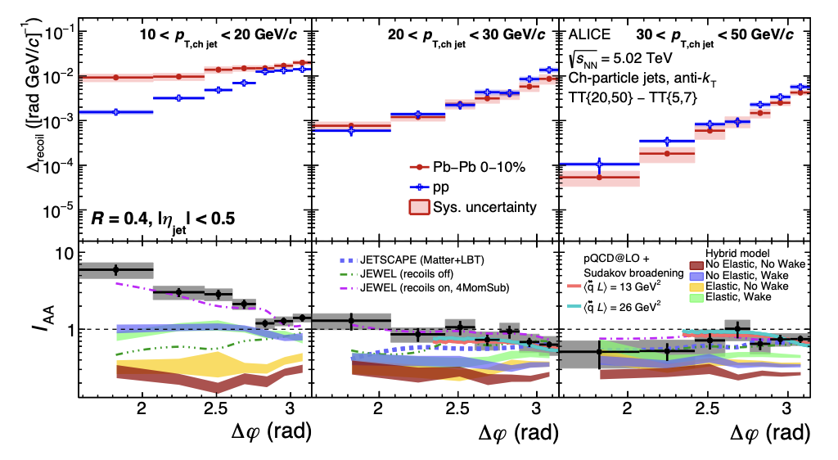
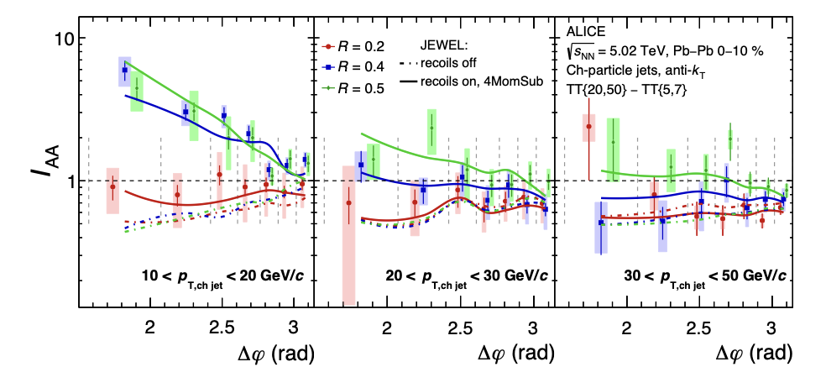
JET modification at RHIC and LHC
Enhancement of large R and low p_{T} jets with large acoplanarity
Enhancement:
Only for large R jets
Only for low p_T jets
At large angle away from π - large acoplanarity
not Molie’re scattering
STAR Collaboration, 2505.05789
ALICE Collaboration, Phys. Rev .Lett. 133 (2024) 2, 022301

Slide 18
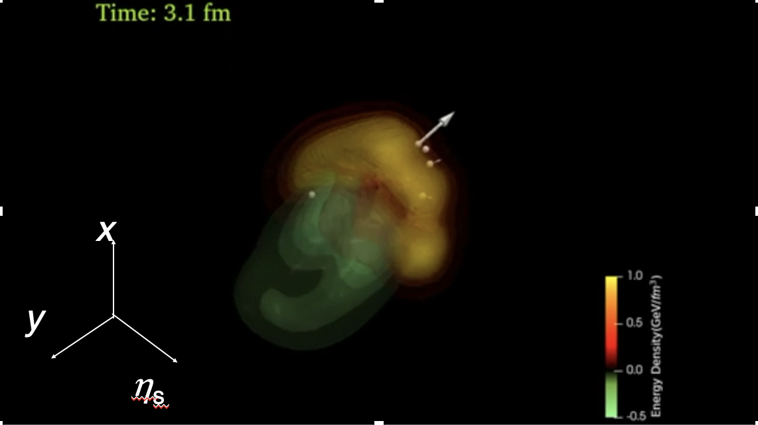
LBT: Jet-induced medium response
Energy transverse distribution of medium response in a static medium
3D energy density distribution of the medium response induced by a γ-jet in a 0-10% Pb+Pb event
Notes:
f_i(p_i)=\frac{1}{e^{p_i\cdot u/T}\pm 1} (i=2,4)
f_i(p)=(2\pi)^3\delta^3(\vec p_i-\vec p_0)\delta^3(\vec x-\vec x_0-t\vec v_i) [i=1,3]
\frac{dN_g}{dzd^2k_\perp dt}=\frac{2\alpha_s N_c}{\pi k_\perp^4} P(z)
(\hat p\cdot u) \hat q \sin^2(\frac{t-t_0}{2\tau_f})

Slide 19
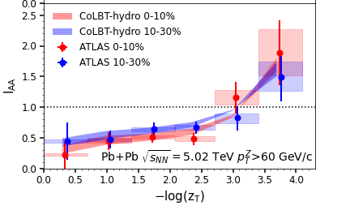
Modification of jets and medium response
r
CoLBT
e-Print: 2101.05422
Notes:
In order to Simultaneous description of hadron and jet RAA need to include jet-induced medium response

Slide 20
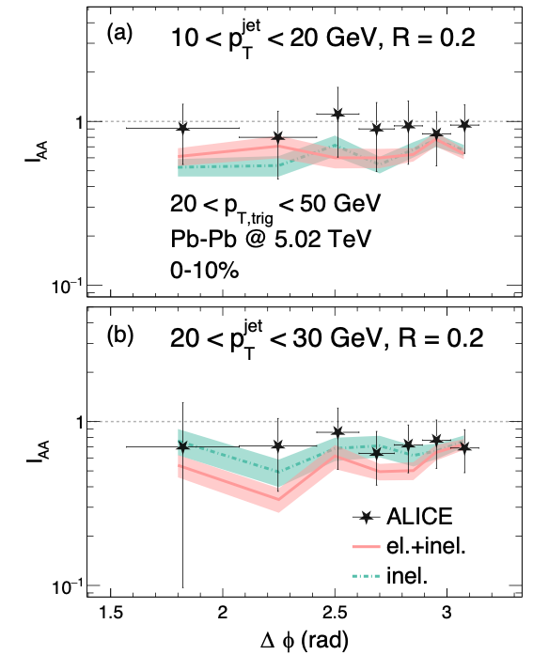
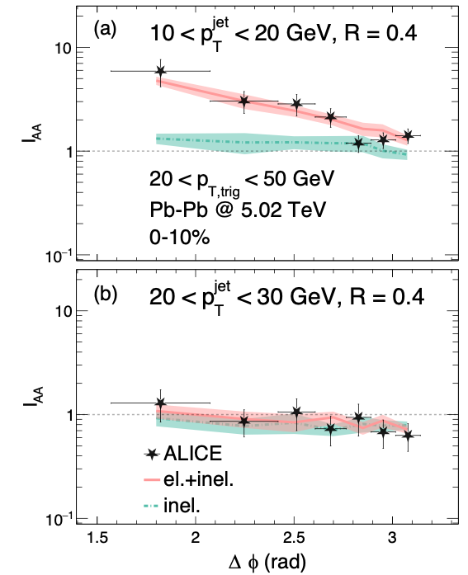
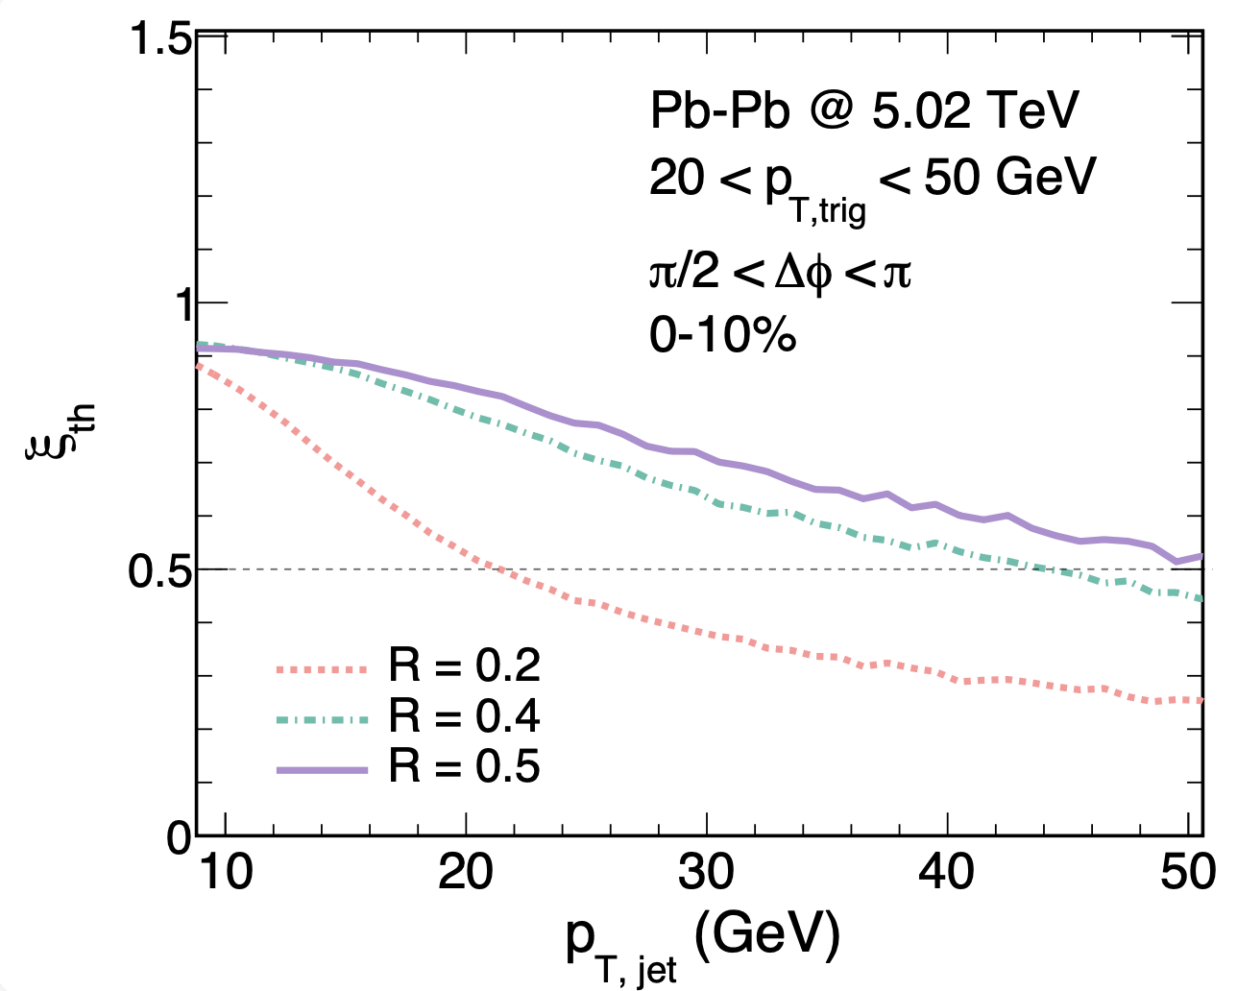
Emergence of thermal recoil jets

Slide 21


Substructure of thermal recoil jets
Much broadened Jet shape
Thermal-like pT hadron spectra inside jets

Slide 22




Search for jet-induced diffusion wake
γ-triggered-jet-hadron correlation
Diffusion (DF) wake leads to depletion of soft hadron yield in the back of jet direction
Yang, Tan, Chen,Pang & XNW, PRL, 130 (2023) , 052301
Jet
MPI
DF-wake
Notes:
Diffusion wake a universal phenomenon accompanying the projectile induced Mach wake

Slide 23



Rapidity asymmetry: background-free signal of diffusion wake
γ-hadron correlation in
γ-jet with/without rapidity gap
Yang & XNW, Phys.Rev.Lett. 135 (2025) 7, 072302;
e-Print: 2508.04194
γ
γ

Slide 24

Asymmetric jet shape
φ
Energetic hadrons at the core of jet deflected away from center
Soft hadrons from medium response at large angle flow into center
Xiao, He, Pang, Zhang & XNW, PRC 109 (2024) 5, 054906 (e-print: 2402.00264)

Slide 25

From QCD to QGP: Precision Frontier in the Future
Solid and quantifiable theories necessary to understand properties of QGP
Precision studies necessary even though difficult
Connection?
jet transport
viscosity
Perfect fluid？ strongly coupled？
Majumder, Muller & XNW, PRL 99, 192301 (2007)

Slide 26


Spin dynamics in heavy-ion collisions
Liang & Wang,
PRL94(2005)102301
Single scattering:
Vector meson spin alignment
y
In equilibrium:
x
z
STAR
Nature 614 (2023) 244
F. Becattini et al, Annsla Phys. 338, 32 (2013)
P_{Λ}=P_{s}
(quark model)
STAR
Nature 548 (2017) 62
ω ~ 10¹⁹ s⁻¹
The most vortical fluid!
Sheng, Oliva, Liang, Wang & XNW, PRL. 131 (2023) 4, 042304
Notes:
Because of the geometry of nucleus-nucleus collisions, non-central collisions have enormous amount of orbital angular momentum L,
This is one discovery during the last LRP period that has open a new window to many new properties of QGP, and many theoretical studies,
P_{q(\bar q)}^\mu \approx\frac{1}{4m_q}\epsilon^{\mu\nu\rho\sigma}\left[\omega_{\rho\sigma}\pm \frac{e_q}{(u\cdot p) T}F_{\rho\sigma}\right]p_\nu
P_q\approx -\pi\frac{\mu p}{m_q^2}\sim \frac{\omega}{T}
\rho_{00}\approx \frac{1}{3}+\frac{g_\phi^2}{m_\phi^2 T_{\rm eff}^2}(C_1B^2\phi +C_2 E^2_\phi)
{\cal R}=\langle\frac{\vec\omega\cdot(\hat t\times \vec v)}{|\hat t\times v|}\rangle

Slide 27


Hyperon spin correlations
strong-field induced hyperon spin correlation
Sheng, Wu, Rischke, XNW, to be published
Strong interaction
Notes:
\langle P_z^\Lambda(\phi_1) P_z^\Lambda(\phi_2)\rangle

Slide 28


Mapping out the phase and properties of nuclear matter
QGP: The most perfect, most vortical and most opaque fluid
May the STAR Continues to Shine!

Slide 31
Parton propagation in QCD medium
Elastic parton energy loss:
Inelastic parton energy loss:
Gyulassy & XNW (1994), BDMPS (1995), Zakharov (1996)
Bjorken (1982)
Thoma & Gyulassy (1990)
q⁻
E
l
Y Zhang & XNW
arXiv: 2104.04520
k
p
k
ω
Gluon formation time
Notes:
\dfrac{d N_g }{d l_{\perp}^2 dz}=
\int_{y^-}^\infty d y_1^- & \left[ \rho_A(y_1^-,\vec{y}_{\perp}) \dfrac{2\pi\alpha_s}{N_c} \pi \int \dfrac{d k^2_{\perp}}{(2\pi)^2} \frac{\phi_N(0,\vec{k}_{\perp})}{{k}_{\perp}^2} \right]\\
&\times \pi\dfrac{\alpha_s}{2\pi}P_{qg}(z)\frac{C_A}{l_{\perp}^2}\mathcal{N}_g(\vec{l}_{\perp},\vec{k}_{\perp})
\mathcal{N}_g^{\textsl{static+soft}}
=\int \frac{d\varphi}{2\pi} \frac{2\vec{k}_{\perp}\cdot\vec{l}_{\perp}}{(\vec{l}_{\perp}-\vec{k}_{\perp})^2} \left( 1-\cos[\frac{(\vec l_\perp -\vec k_\perp)^2}{2q^-z(1-z)}
y_1^-]\right)
\mathcal{N}_g^{\textsl{static+soft}}
=\int \frac{d\varphi}{2\pi} \frac{2\vec{k}_{\perp}\cdot\vec{l}_{\perp}}{(\vec{l}_{\perp}-\vec{k}_{\perp})^2} \left( 1-\cos[\frac{(\vec l_\perp -\vec k_\perp)^2}{2q^-z(1-z)}
y_1^-]\right)
\frac{dE_{el}^a}{dx}=\sum_b\int d\omega f_b(\omega/T) \int dk_\perp^2 \frac{d\sigma_{ab}}{dk_\perp^2} k_0
\approx C_a \frac{3\pi}{2}\alpha_s^2 T^2 \log \frac{2.6ET}{4\mu_D^2}

