Slide 1
Remembrances of STAR
Jim Sowinski

Slide 2
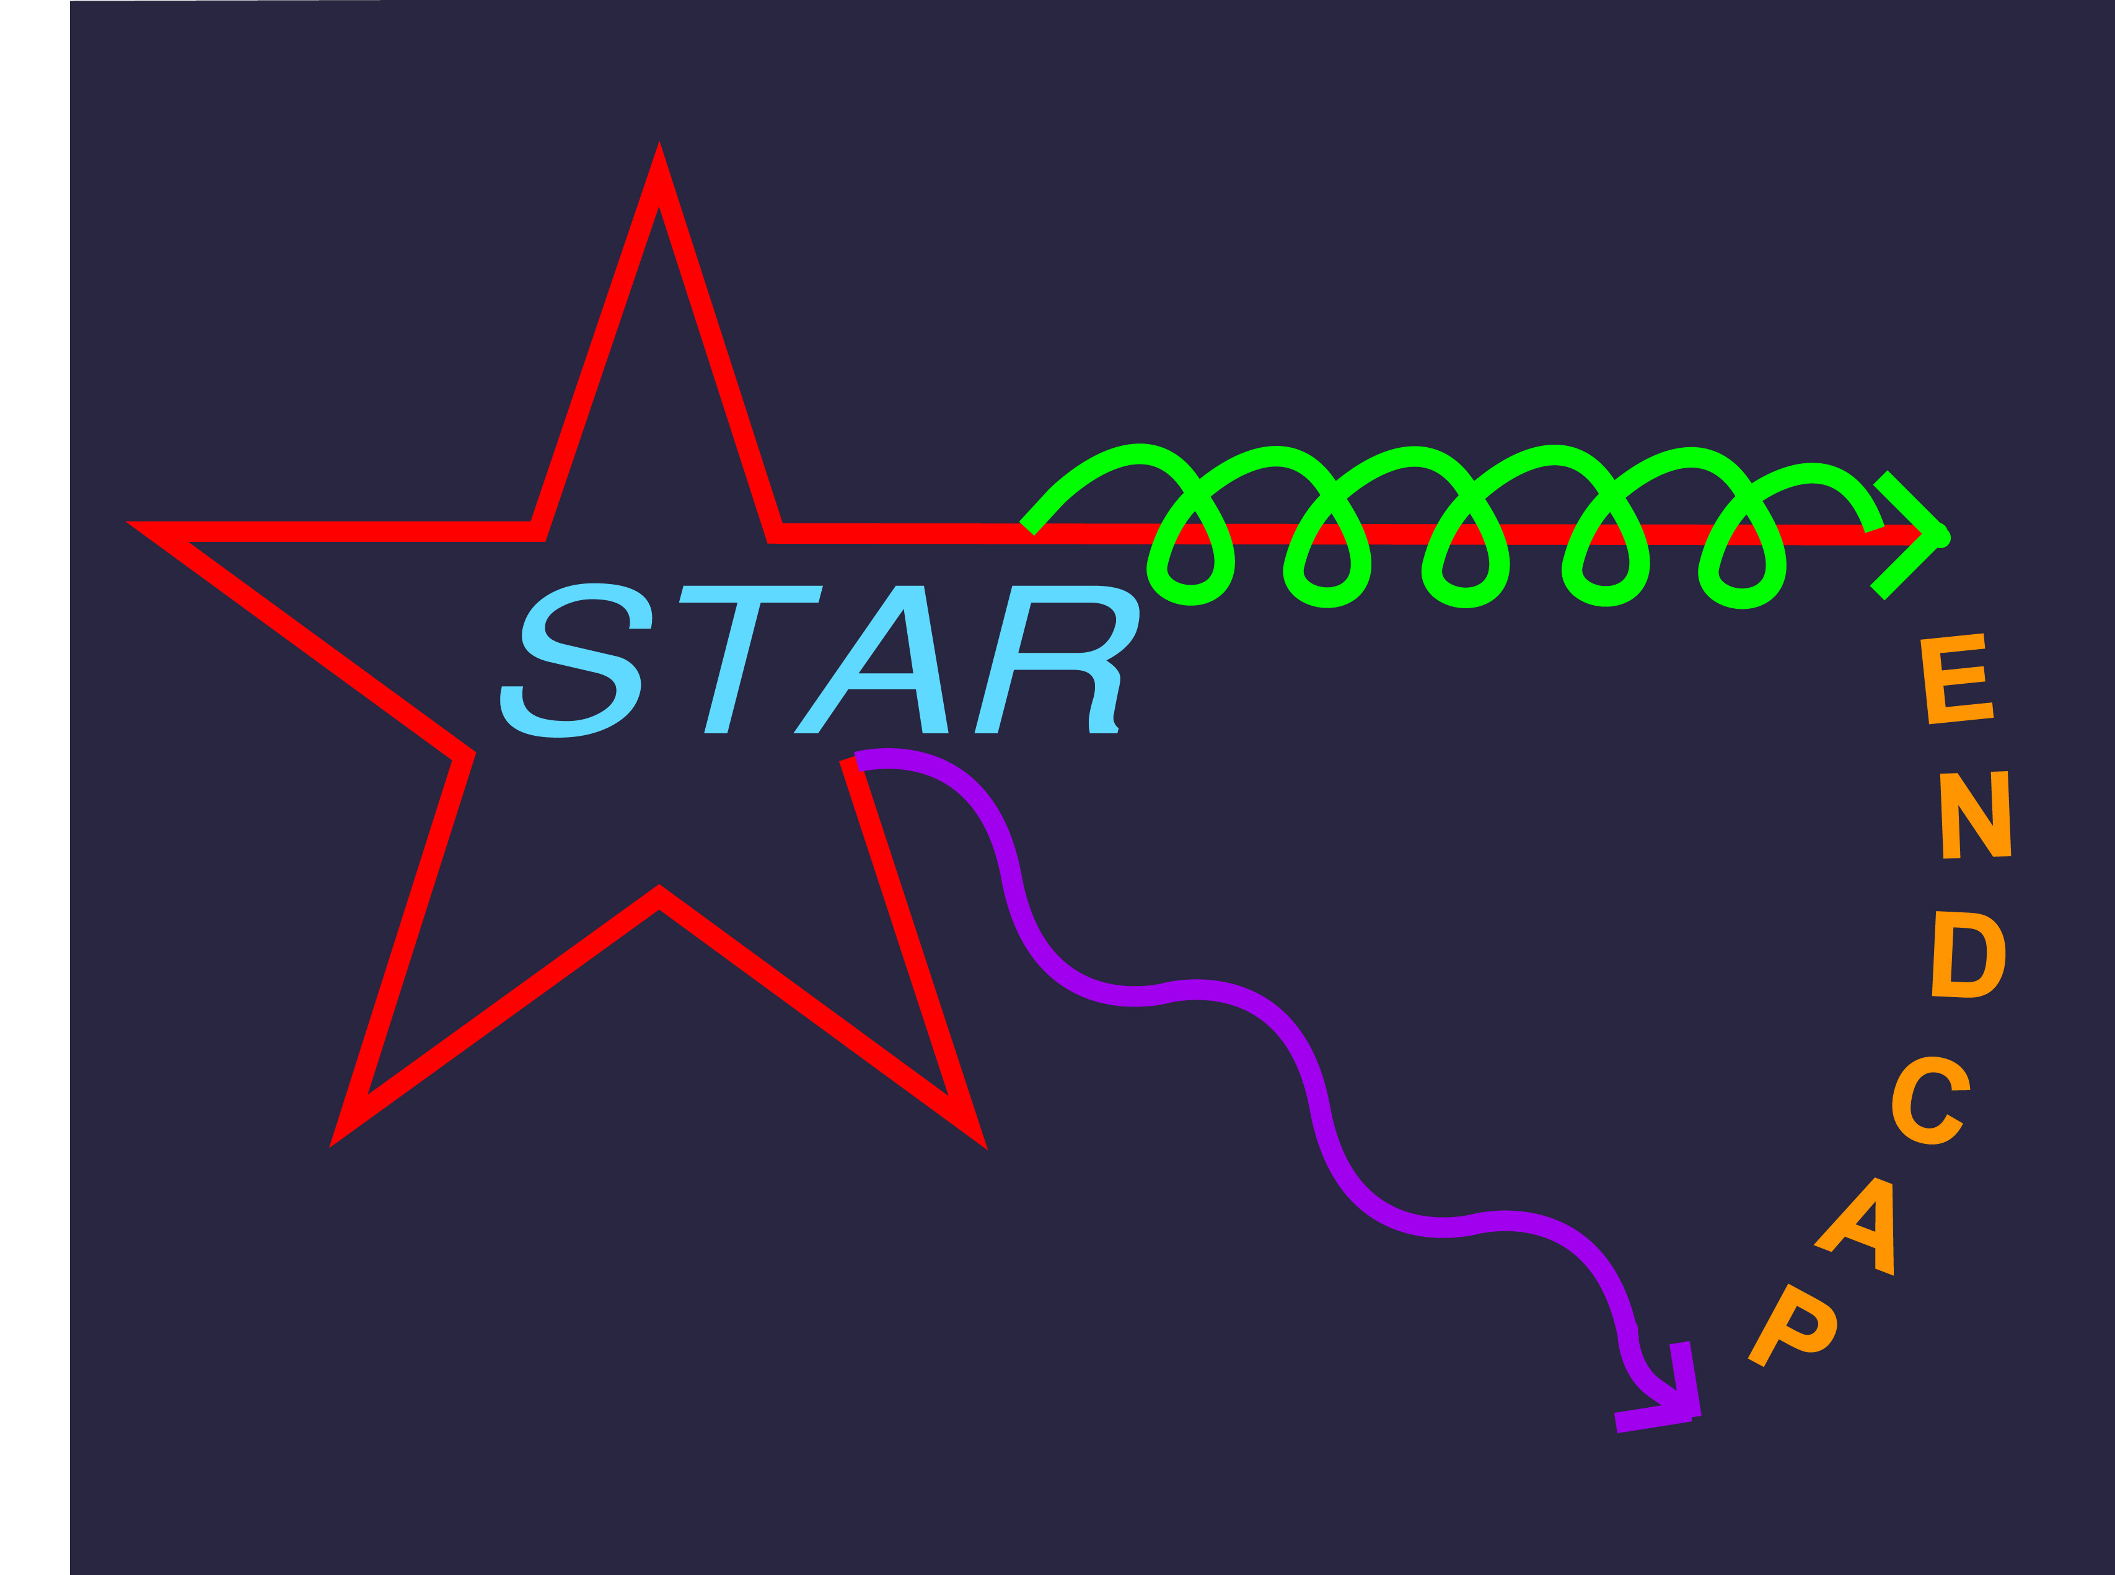
Indiana University Group
Joined around 2000 with interest in spin program and constructing the Endcap EM Calorimeter
Originally Les Bland, Will Jacobs, Me, Scott Wissink, Steve Vigdor

Slide 3
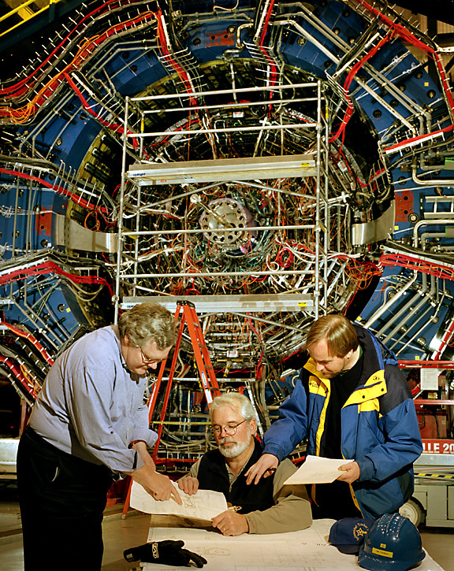
Tim, Ralph and Bill in the Wide Angle Hall

Slide 4
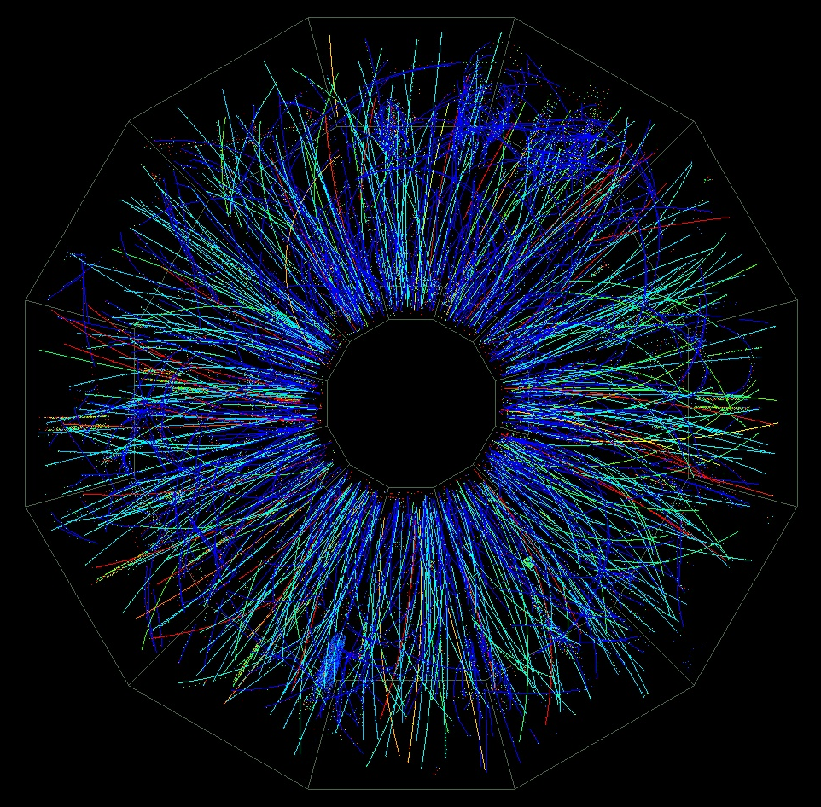
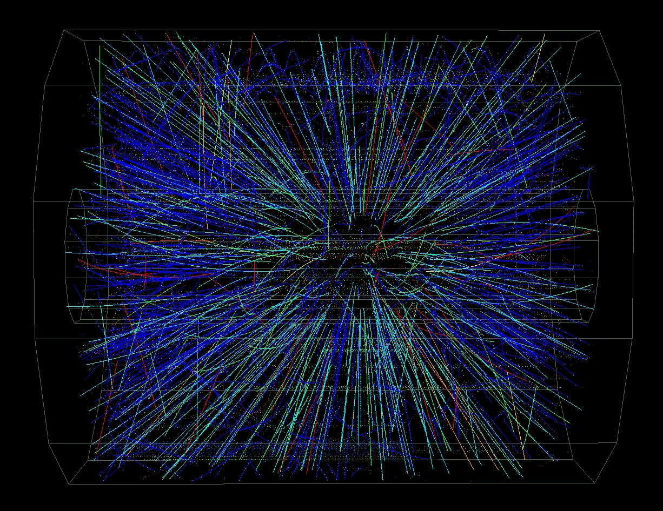
Au on Au Event at CM Energy ~ 130 GeV*A
Data taken June 25, 2000.
The first 12 events were captured on tape!
Real-time track reconstruction
Pictures from Level 3 online display. ( < 70 mSec )

Slide 5
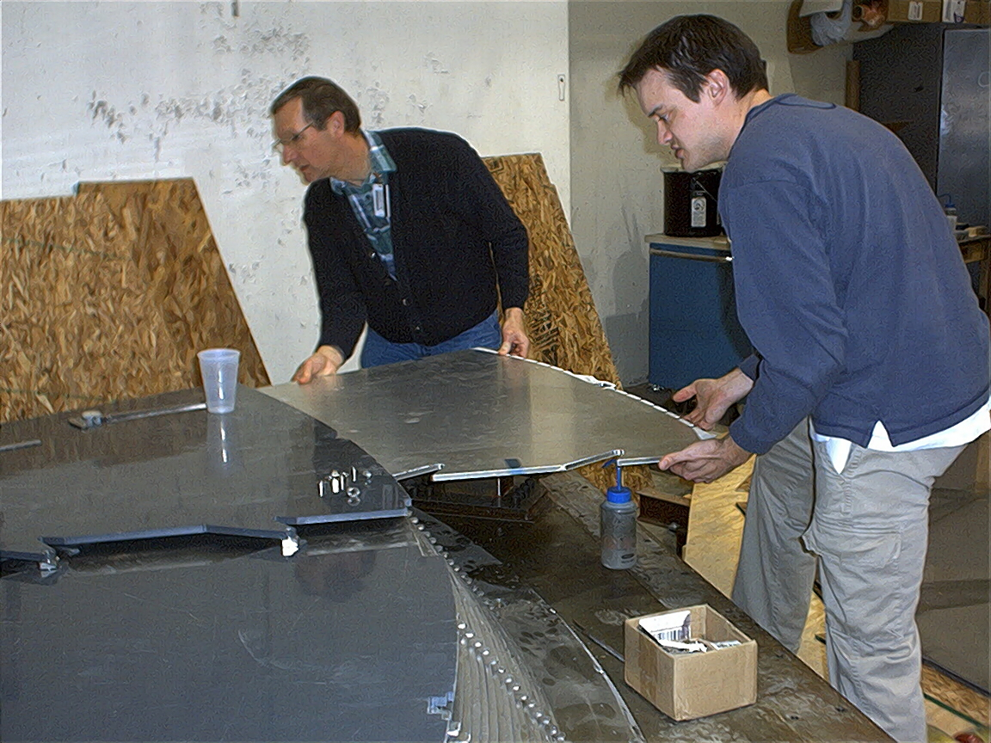
Test fitting SMD at IUCF
Hal Spinka
John Puskar Pasewicz lead EEMC Engineer

Slide 6
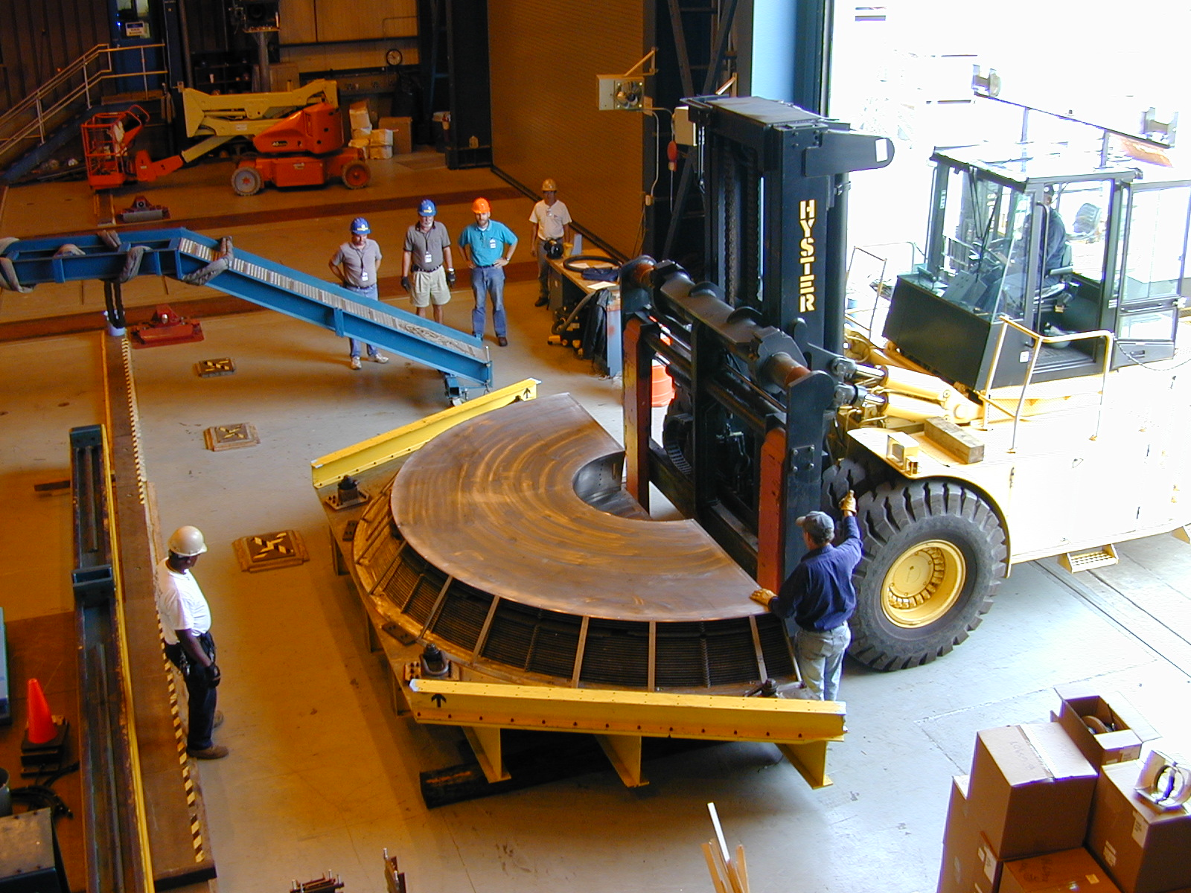
Delivery of the EEMC
Bill Ralph Me

Slide 7
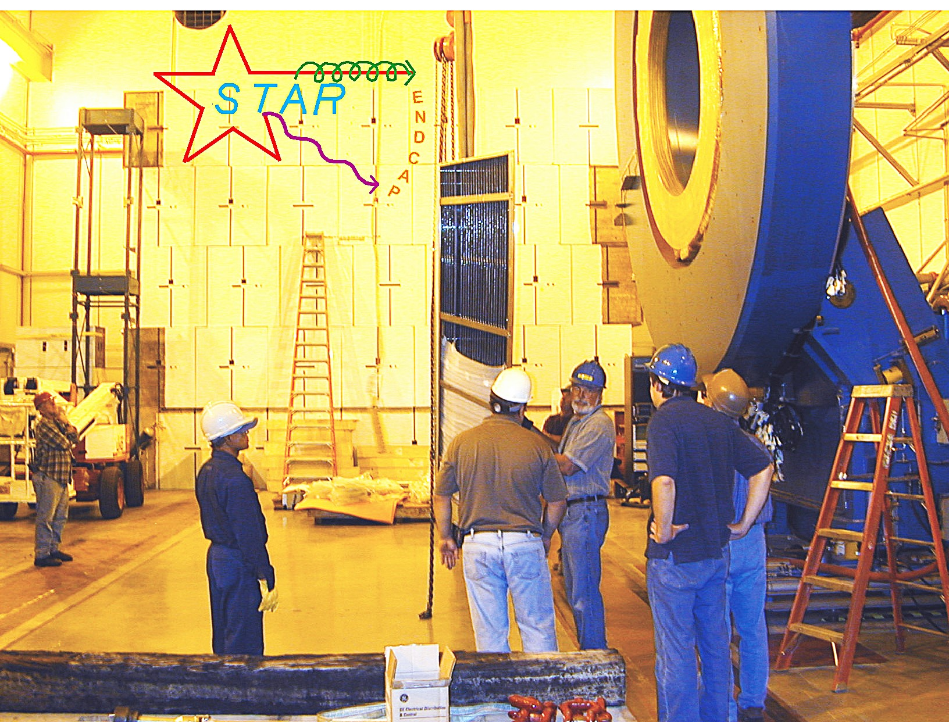
Mounting lower half of EEMC. Ralph says to John “You are off by 0.2 degrees from vertical”

Slide 8
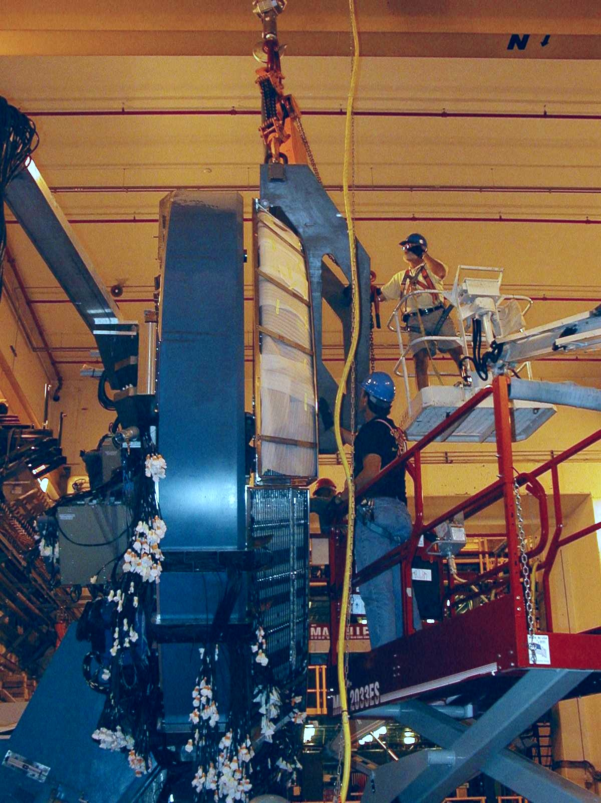
Installing the upper half of the EEMC.
Tony Krupien and Bob Soja

Slide 9
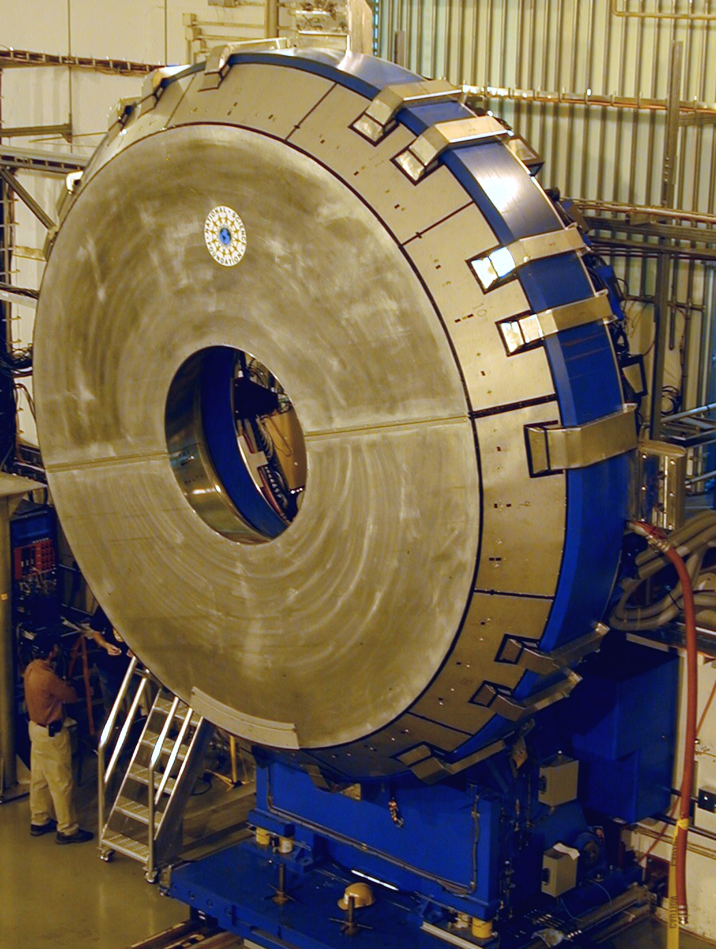
EEMC fully installed
Will Jacobs in the shadows

Slide 10
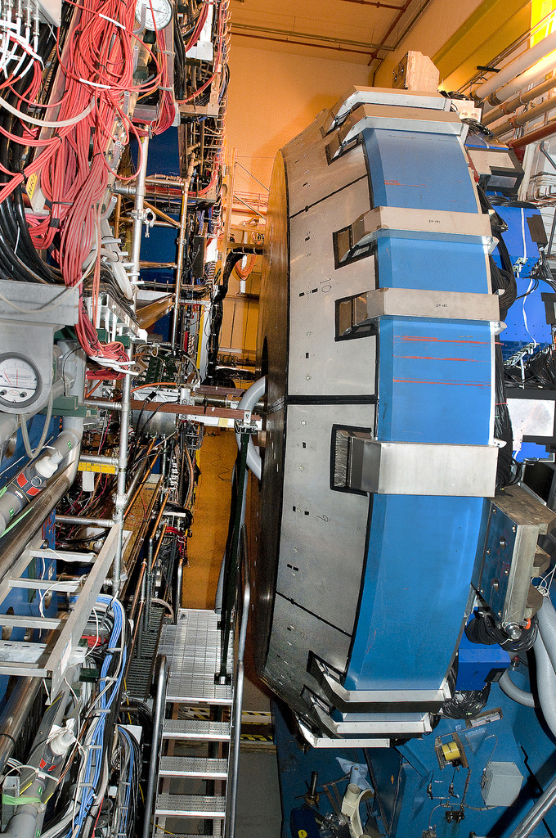
EEMC

Slide 11
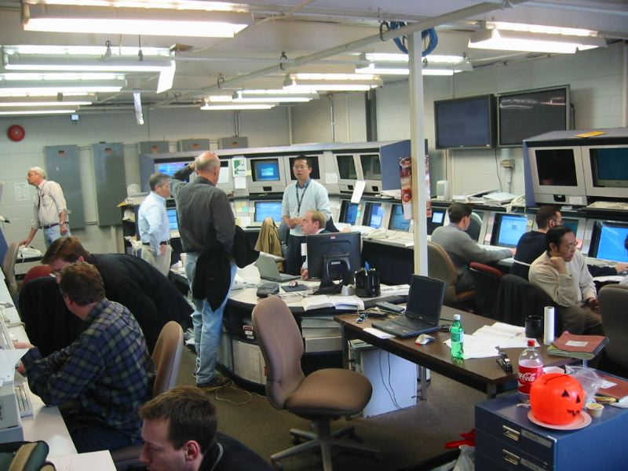
STAR Control Room Gary Epply Zhangbu Dick Majka Steve Trentalange

Slide 12
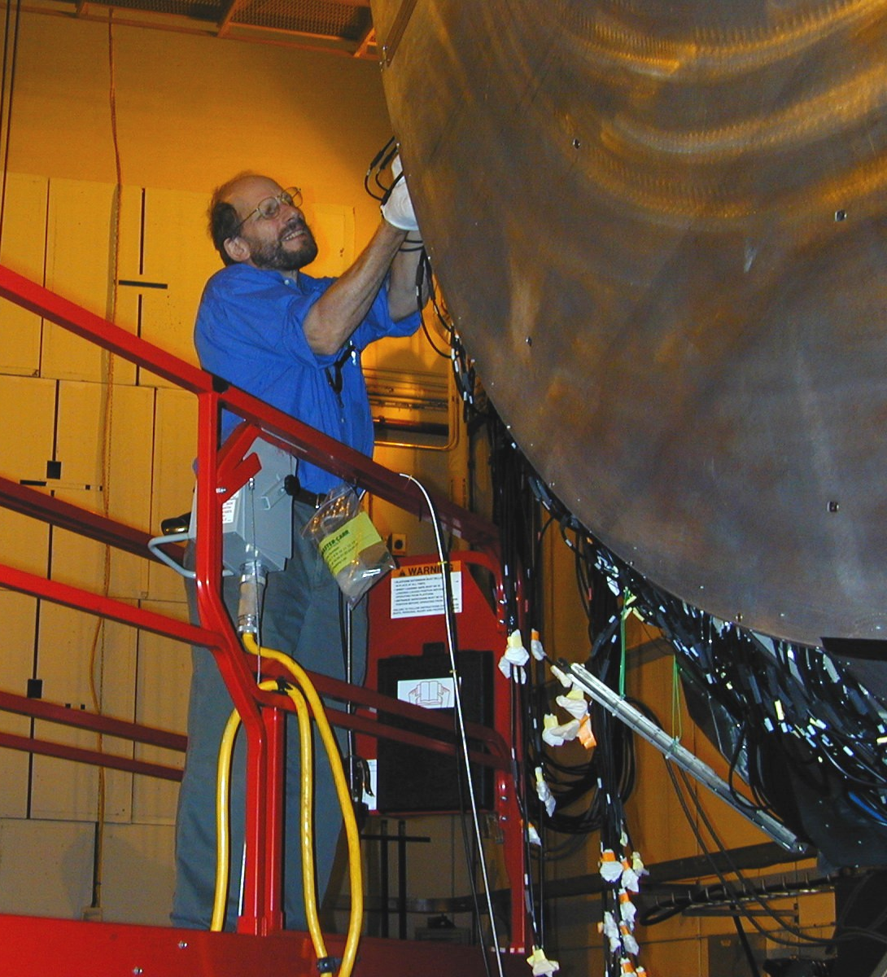
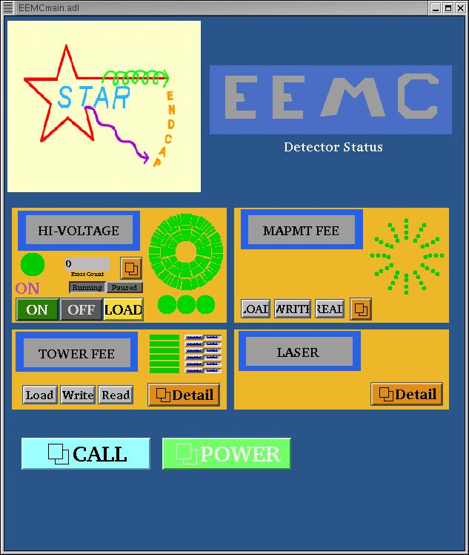
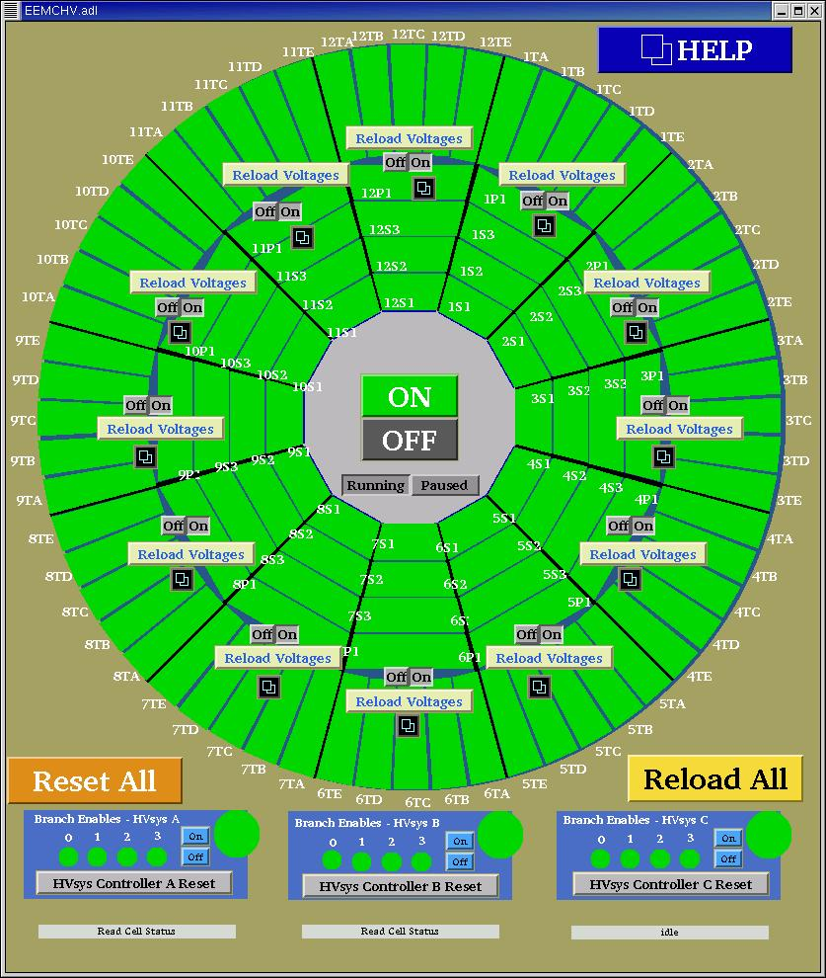
Will Beginning to End
Fibering EEMC On Will’s computer till the end

Slide 13
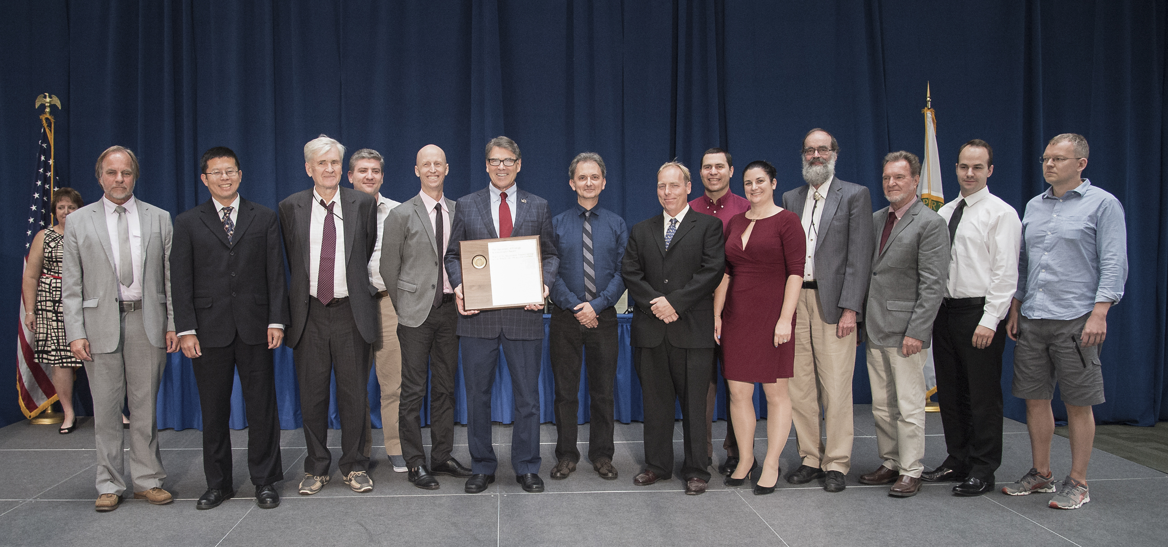
DOE Award to STAR for the Perfect Liquid

