Slide 1
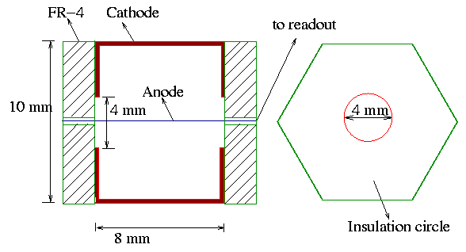
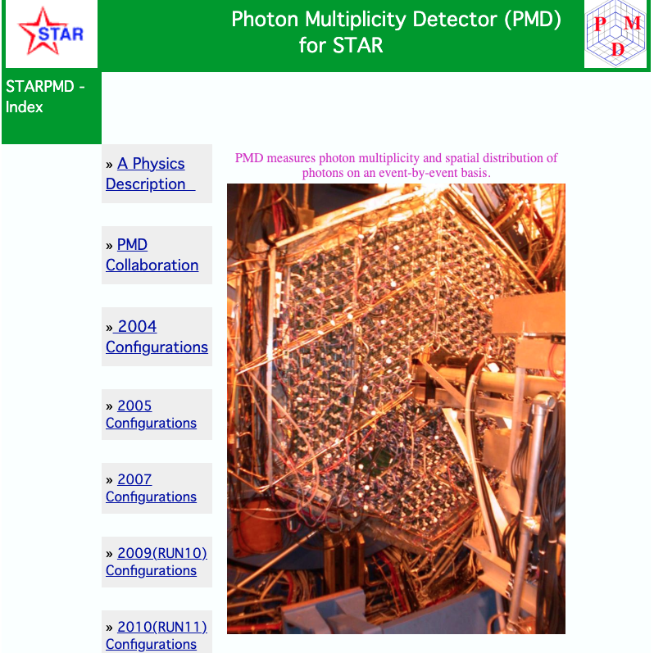
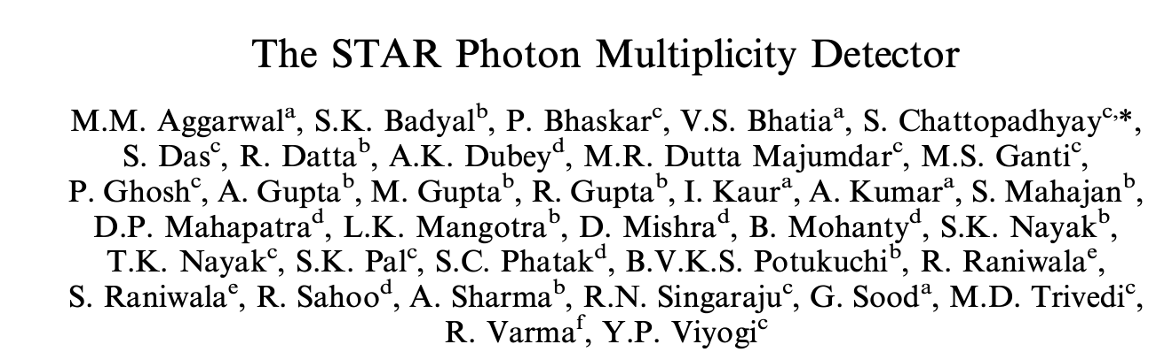
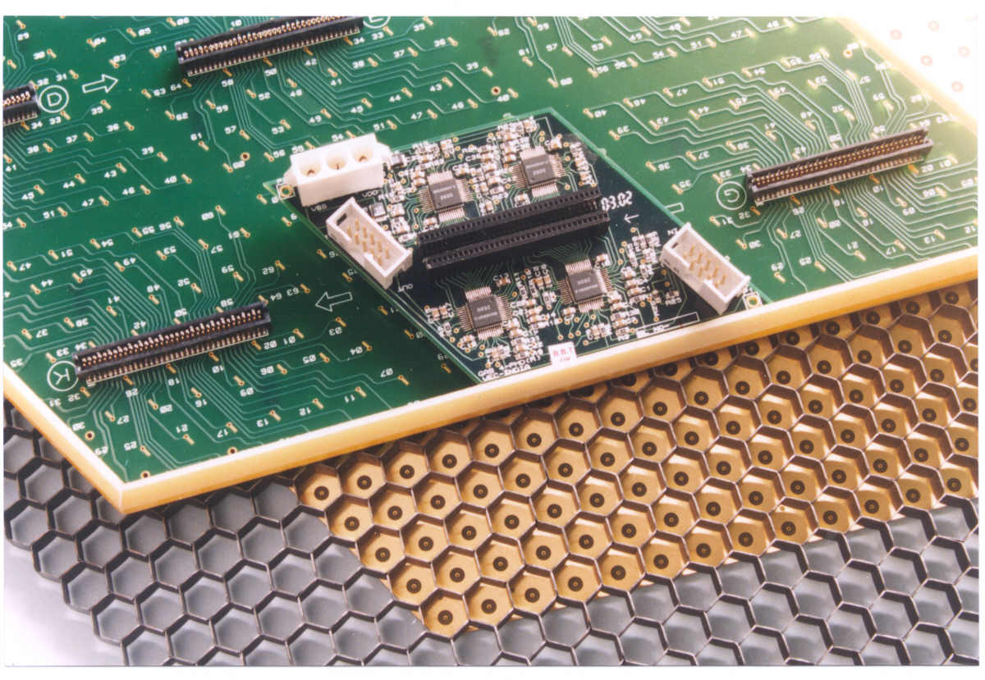
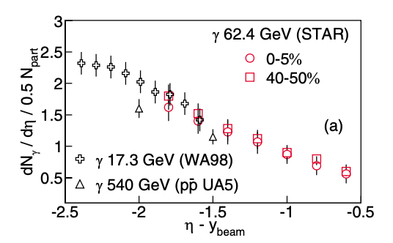
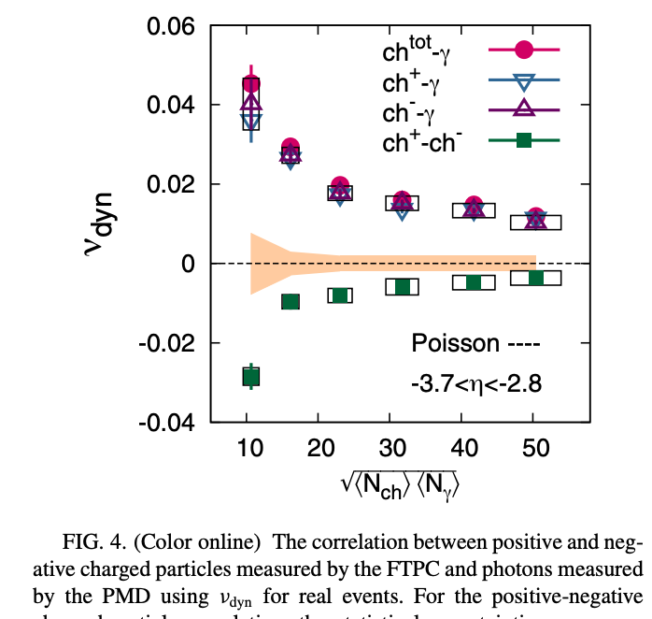
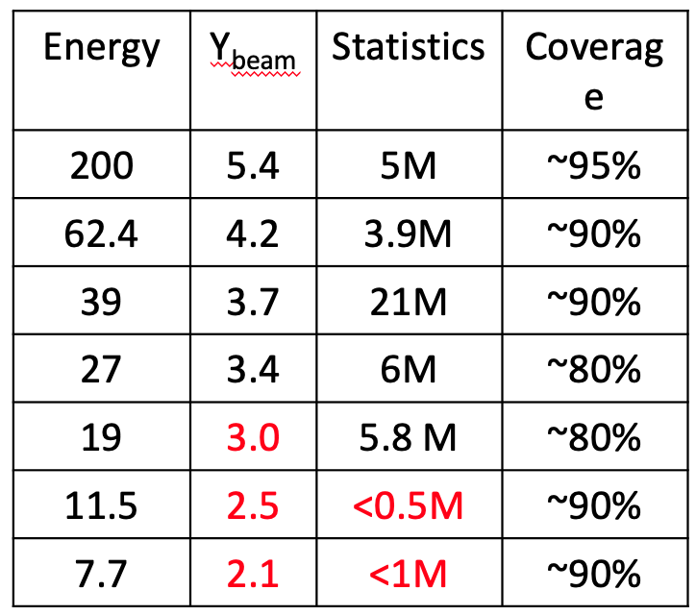
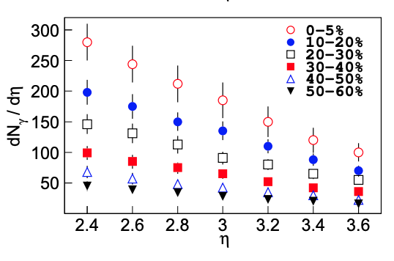
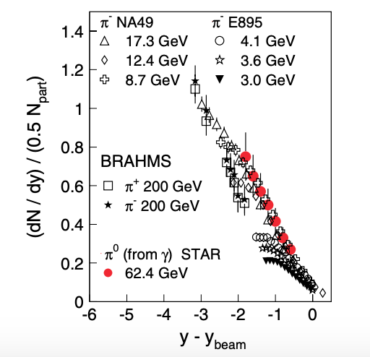
STAR Photon Multiplicity Detector (PMD)
Bikash Sinha
Y.P. Viyogi
Monika Sharma
Sunil Dogra
Nihar Sahoo
Niraj Gupta
Pawan Netrakanti
Lokesh Kumar
Renu Bala
Arghya Chatterjee
Dronika Solanki
Bhanu Sharma
Sabita Das
Amol Sarkar
Basanta Nandi
Zubayer Ahmad
Arnab
Debasish Das
Arindam
Nasim
Rehan
Prithwish Tribedy
.. and many more students and techs who did tests and operated the PMD.
Efforts from India
IOP, Bhubaneshwar
Panjab University
University of Rajasthan
University of Jammu
VECC, Kolkata
IIT-Bombay, Mumbai
NISER, Bhubaneshwar
Two sensitive planes -
Each -arrays of 41472 gas proportional counters
Charged-to-neutral correlation
Disoriented chiral condensates?

Slide 2
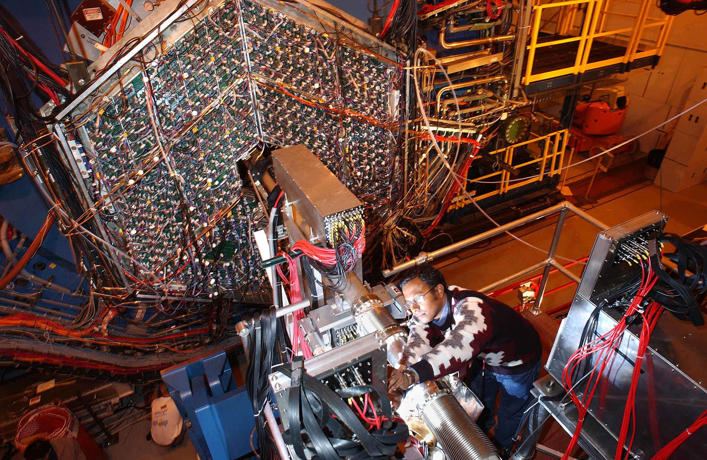
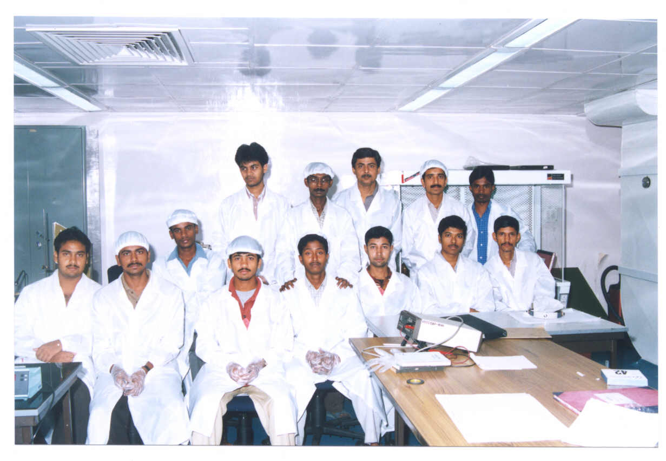
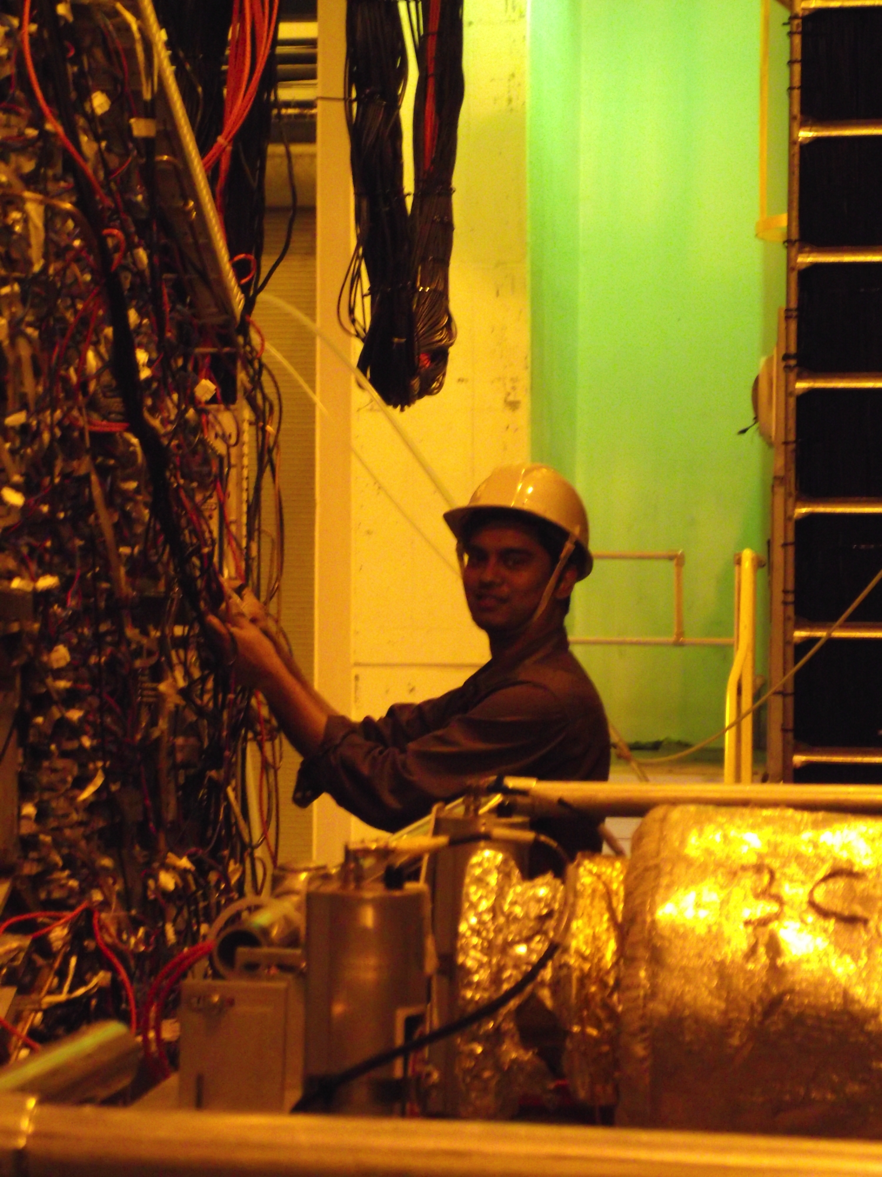
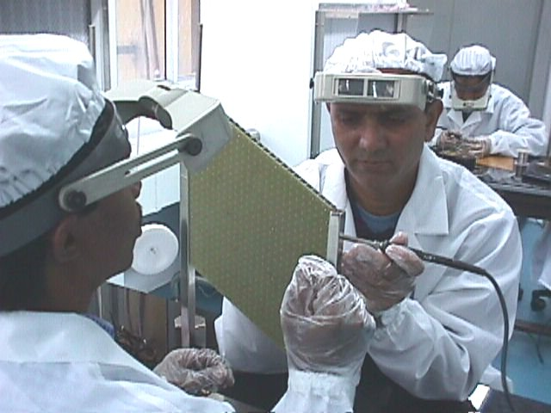
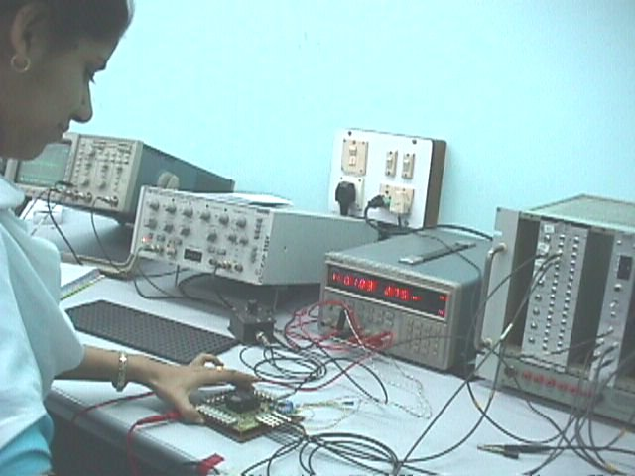
STAR PMD
PMD
PMD Dismantled d
uring the week of 21 sep, 2011

