Slide 1
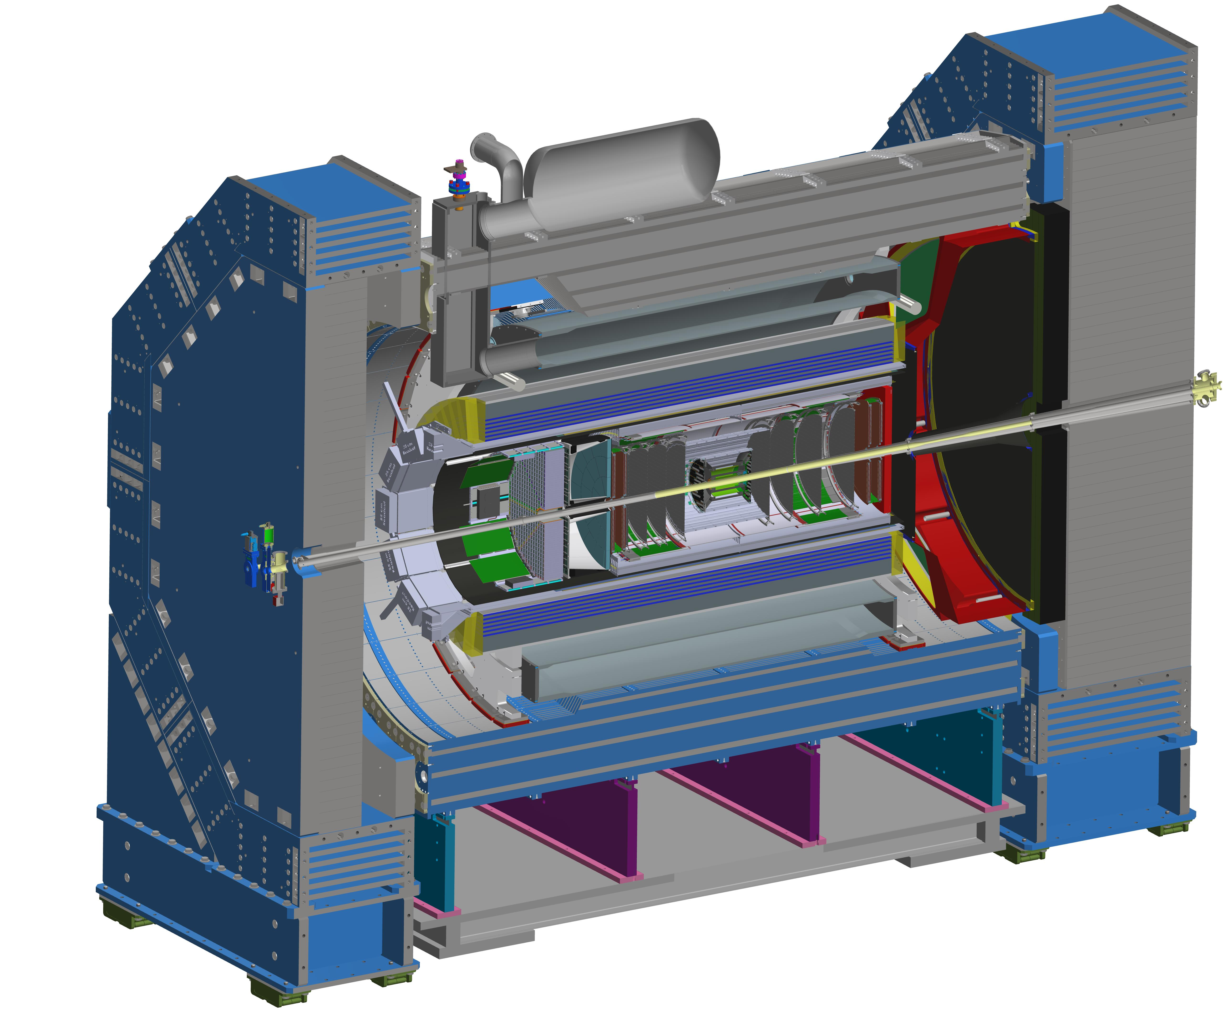



EIC and
Status Report
John Lajoie
Oak Ridge National Laboratory

Slide 2
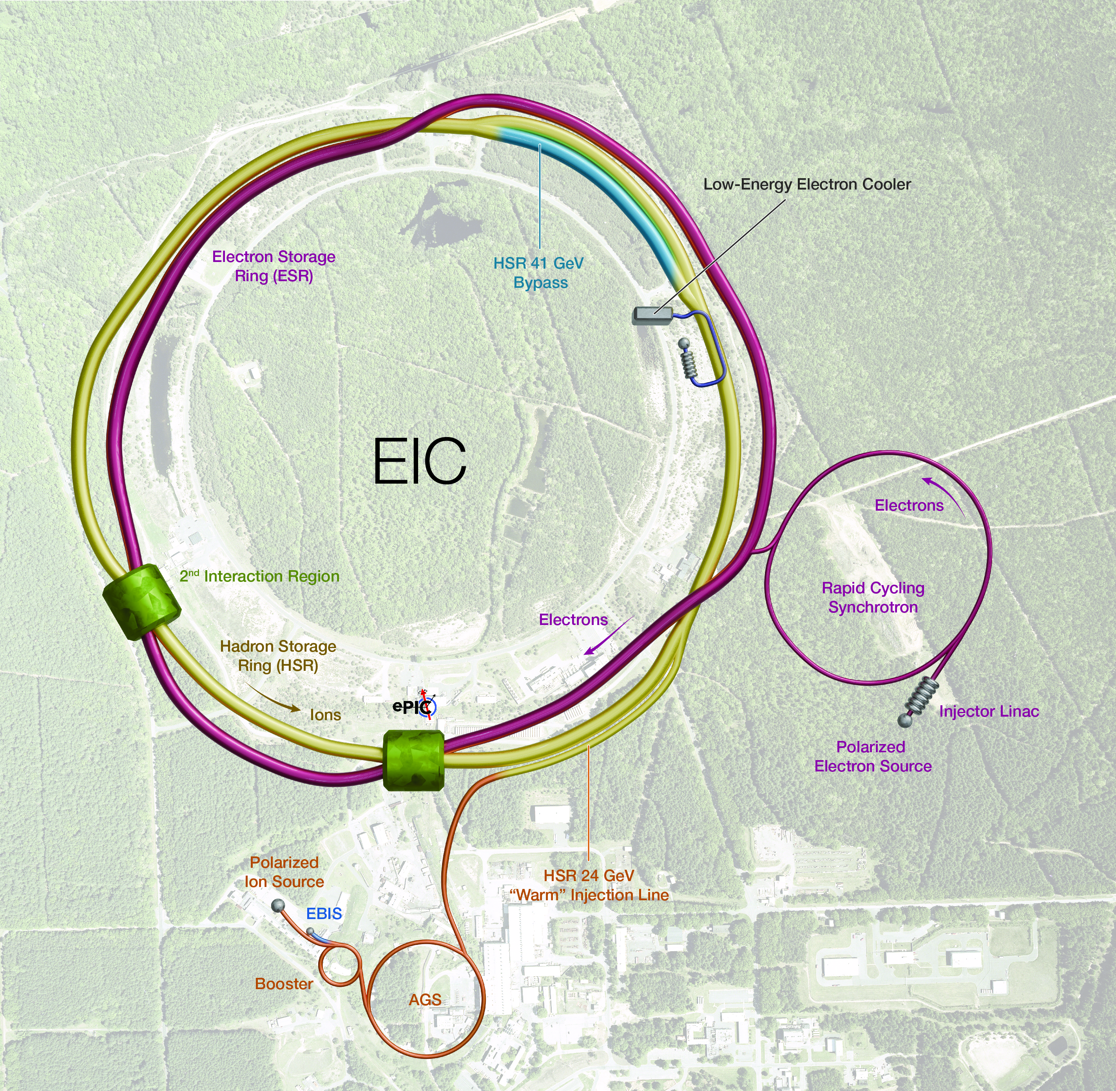


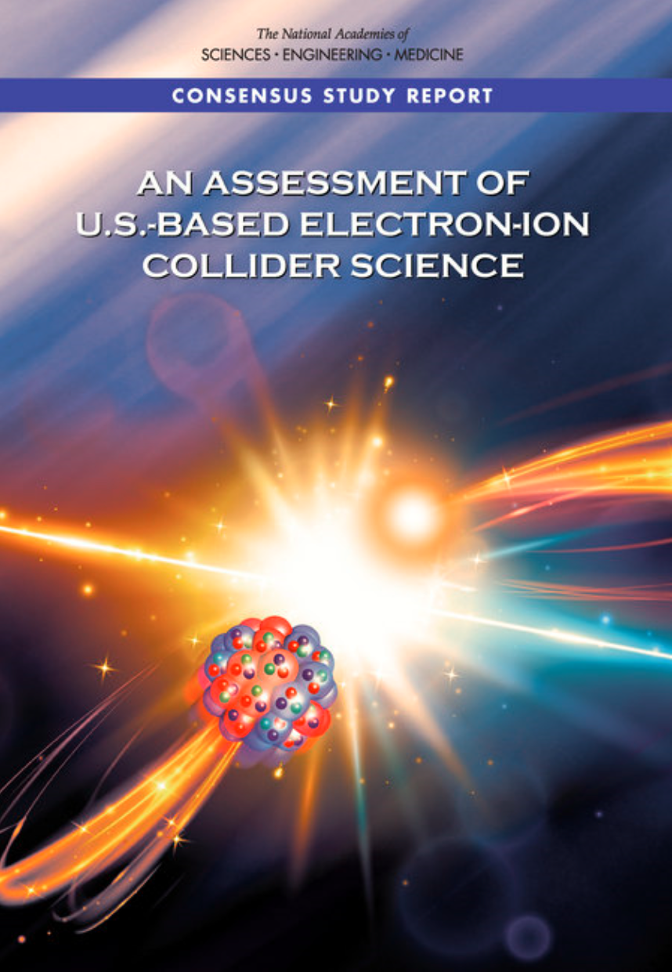
Status of the EIC Project
Joint responsibility of
BNL and Jefferson Lab
~$3B investment
  CD-0 (2019), CD-1 (2021)
  CD-3A (2024)
  CD-3B (2025) (expected)
Explore the structure of matter via QCD:
  Origin of Nucleon Mass & Spin
  Confinement
  Nucleon / Nuclear Femtography
  Dense Gluon States
  BSM

Slide 3
EIC Important Dates 2025
Milestone
DOE Independent Project Review (IPR) | Jan. 7-9, 2025
Start Developing Scope of Subprojects | January 10, 2025
IR SC Magnet Steering Group Meetings - Monthly | January 17, 2025
Project Advisory Committee Meeting | February 11, 2025
EIC Advisory Board Meeting | February 25, 2025
Electron Injector Design and Cost Review | April 8-10, 2025
Infrastructure Construction Advisory Committee | April 16-17, 2025
Project Advisory Committee "Red Team" Review | May 20-21, 2025
Resource Review Board Meeting (Prague) | June 5-6, 2025
Detector Advisory Committee Meeting | June 11-13, 2025
EIC Advisory Board Meeting | June 17, 2025
DOE CD-3B ESAAB Approval | Pending
DOE IPR Focused Status Review | August 5-7, 2025

Slide 4
Project Delivery Strategy
Deliver the full EIC facility scope using subprojects and the phased implementation of the EIC project scope. The strategy enables the start of the EIC construction when the first subproject is ready and the start of the EIC science program during collider commissioning, concurrent with the final subproject equipment installation. Line-Item Construction Project includes the full scope required to meet EIC facility performance requirements.
Integrated Project Office & Beam Commissioning (IPO) (L. Lari, Project Manager)
 | Long Lead Procurements & NYS Funded Scope (C. Folz)
First SP |  | Accelerator Storage Rings (ASR) – Infrastructure, HSR, ESR, Install (C. Folz, SPM)
 |  |  | Detector (DET) – Integration, Install (R. Ent and E. Aschenauer, POCs)
 |  |  |  | Interaction Region (IR) - Civil Construction, SC Magnets, Crab Cavities, Machine Protection, Installation (S. Nagaitsev, POC)
 |  |  |  | Electron Injector (EIN) – Infras., LINAC, RCS, Install (Q. Wu, POC)
Last SP |  |  |  |  |  |  | Energy and Luminosity Ramp-up (ELR) (K. Wilson, POC)
Early
Science
10/6/2025
ePIC Software and Computing Review
4

Slide 5
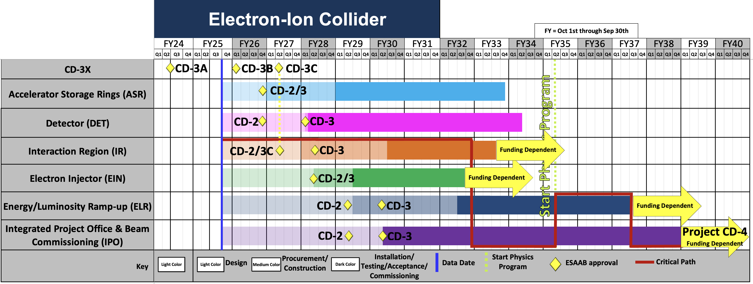
High Level Schedule
Effect of the $300M/y peak funding profile on the schedule
10/6/2025
ePIC Software and Computing Review
5

Slide 6
August 5-7 OPA EIC Focused Status Review
From the committee charge:
The purpose of this review is to assess (1) efforts to document the scope necessary to deliver an Electron-Collider facility (EIC) capable of achieving the mission need and (2) the details for the EIC subproject strategy.
1. Are the key performance parameters and scope for each subproject well documented, traceable, reasonable, and justifiable? Does the roll-up of subproject scope unambiguously and progressively elaborate a complete and responsive Electron-Ion Collider facility in an asset-oriented hierarchy? Are subproject interfaces understood and clearly delineated at this stage of design? Would attainment of the key performance parameters of all subprojects indicate delivery of the mission need?
2. Are opportunity and threat risks, both technical and safety, identified? Are plans for leveraging or mitigating the risks adequate for this phase of the design?
3. Will following the strategy for defining subprojects result in an execution of the EIC project that would maintain project momentum while mitigating schedule risks potential funding constraints could impose?

Slide 7
Takeway Messages Aug.5-7th IPR Status Review
This review was an important milestone – it is the first time the EIC project presented a complete plan based on subprojects and received comprehensive feedback from DOE.
The committee would like to have the EIC project re-evaluate the Key Performance Parameters (KPP’s)
  The combination of all subproject KPP’s should be consistent with the EIC meeting mission need
  Include beam commissioning to validate successful integration
  Report to DOE Before Dec. 31, 2025
  Next DOE review 2QFY26
Key Performance Parameter: a critical, measurable attribute of a system or contract that defines its essential performance characteristics.

Slide 8
DOE and EIC Planning Dates ‘25-’26
Milestone |  | Milestone
DOE Independent Project Review (IPR) | Jan. 7-9, 2025 | DOE RHIC R&R/Injector Operations Review | Sept. 8-10, 2025
Start Developing Scope of Subprojects | January 10, 2025 | Machine Advisory Committee Meeting | Sept. 16-18, 2025
IR SC Magnet Steering Group Meetings - Monthly | January 17, 2025 | Infrastructure Construction Advisory Committee | October 2025
Project Advisory Committee Meeting | February 11, 2025 | Resource Review Board Meeting (BNL) | Nov. 4-5, 2025
EIC Advisory Board Meeting | February 25, 2025 | Assessments of Baseline Readiness for SPs Detector Interaction Region Accelerator Storage Rings Global and Energy and Luminosity Ramp-Up Electron Injector (follow-up to Apr ‘25 Review) | Nov. 12-14, 2025 Nov. 18-20, 2025 Jan. 14-16, 2025 February 2026 April 2026
Electron Injector Design and Cost Review | April 8-10, 2025
Infrastructure Construction Advisory Committee | April 16-17, 2025
Project Advisory Committee "Red Team" Review | May 20-21, 2025
Resource Review Board Meeting (Prague) | June 5-6, 2025
Detector Advisory Committee Meeting | June 11-13, 2025 | RHIC Operations Conclude | ~End 2025
EIC Advisory Board Meeting | June 17, 2025 | RHIC Removal and Repurposing (R&R) Starts | ~Early 2026
DOE CD-3B ESAAB Approval | Pending | DOE IPR Comprehensive Review | Mar 9-13, 2026
DOE IPR Focused Status Review | August 5-7, 2025 | DOE CD-2 Detector Subproject Review | ~ June 2026
 |  | DOE CD-2/3 Accelerator Storage Rings | ~ June 2026

Slide 9
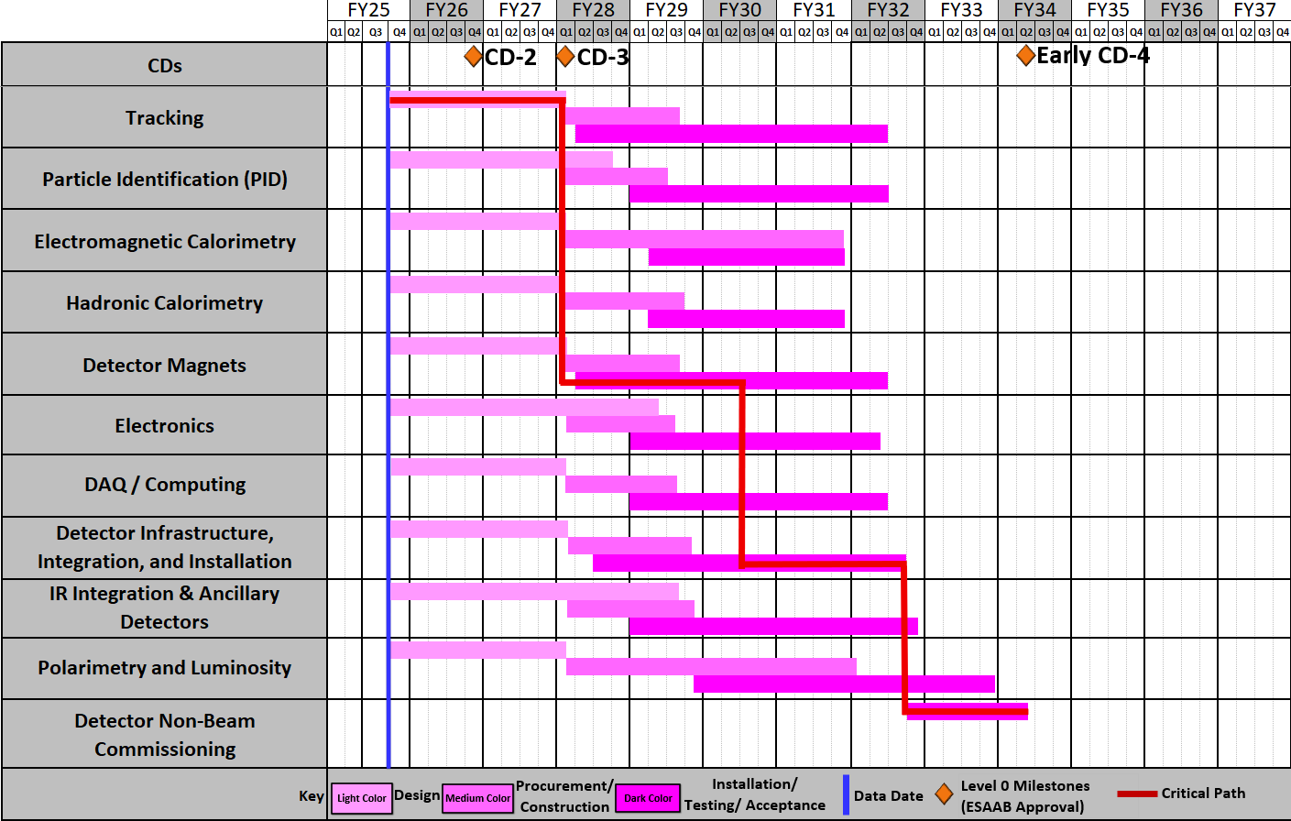
DET Subproject Schedule
Ready
for non-beam
commissioning
Ready
for
commissioning
with beam
Schedule Drivers:
  To hold the date for a CD-2 Independent Project
  Review (IPR) expected not before June 2026
  To keep the (inter)national user community engaged
  and limit the danger to lose groups
  all subdetectors need to be more or less ready at the same time to be assembled to ePIC
  Superconducting Solenoid → CD-3A item
  Silicon Sensors (MAPS, AC-LGAD & ASTROPIX)
  ASIC long time frames only one ASIC designed from scratch all others are modifications to existing ASICS
  Items with long production times, single vendor and complex assembly → CD-3A & CD-3B
  International agreements driving in-kind and MAPS design (agreement with CERN)
10/6/2025
ePIC Software and Computing Review
9

Slide 10

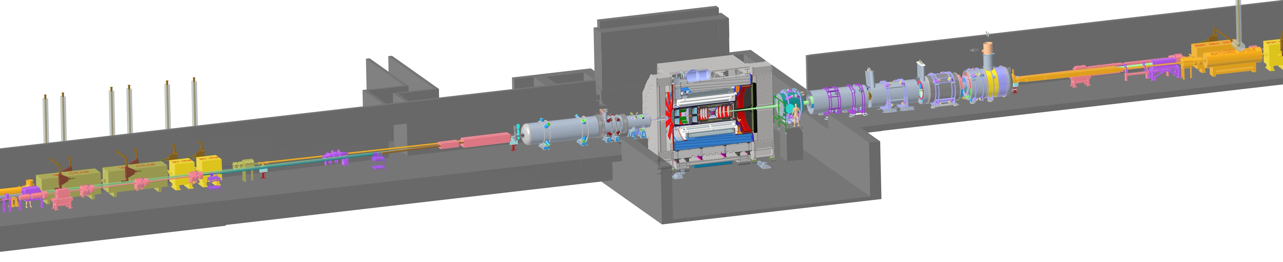
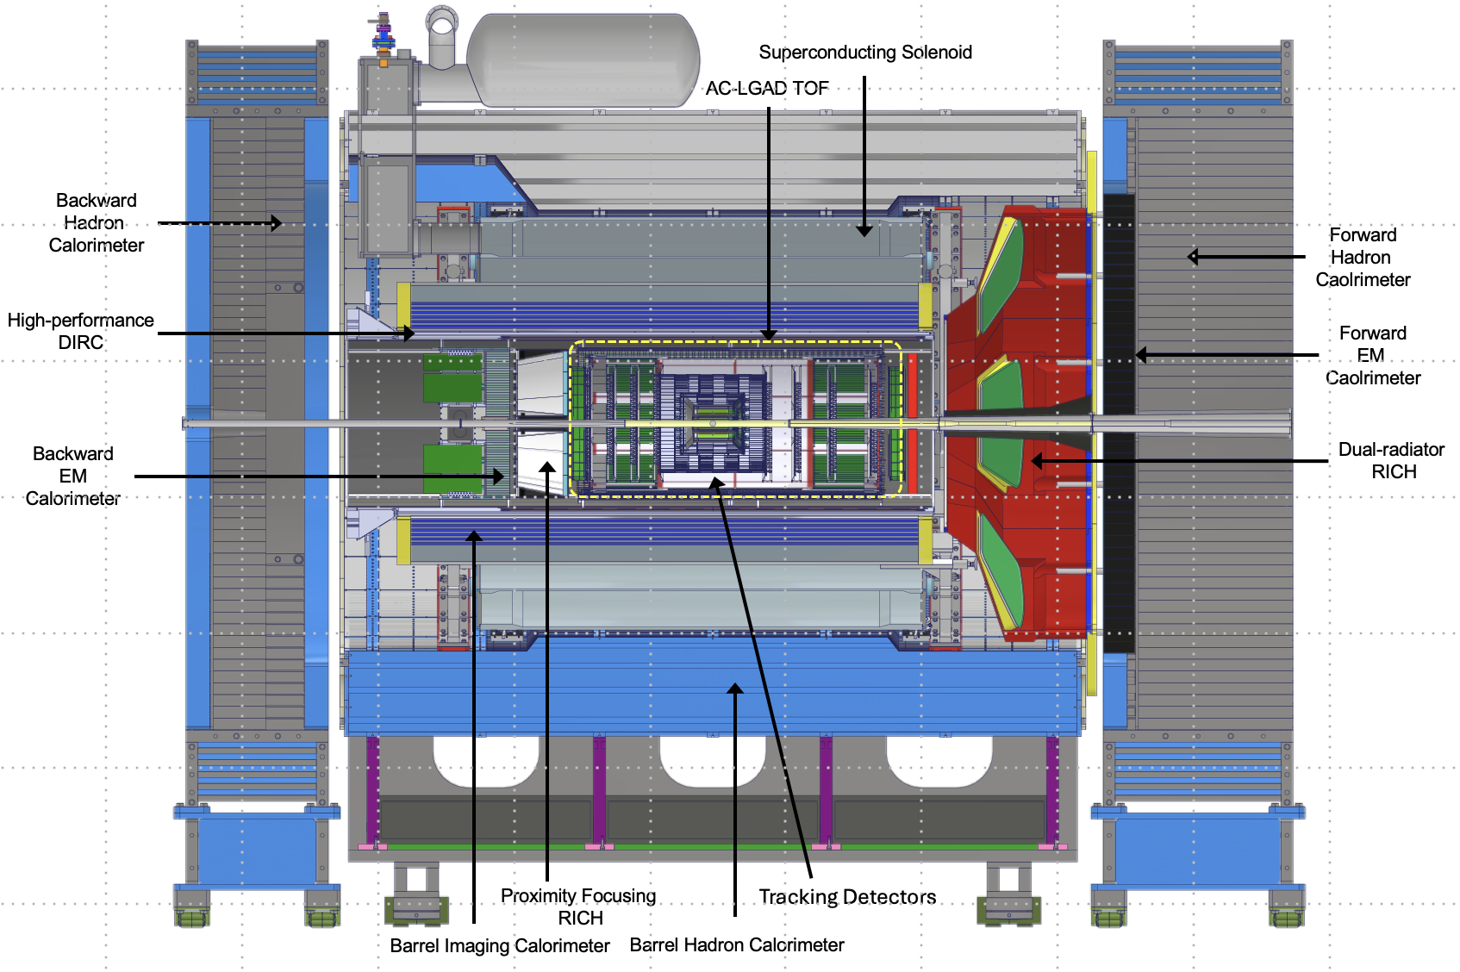
ePIC – The EIC State-of-the-Art General-Purpose Detector
electron beam
Zero Degree Calorimeter
p/A beam
Luminosity
System
Low-Q2 Taggers
B0 Magnet
Spectrometer
Roman Pots (RPs) and
Off-Momentum Detectors (OMDs)
26 subsystems over ± 40 m
to measure particle momenta, energy and particle type
3 electromagnetic calorimeters
3 hadronic calorimeters
Silicon and Multi-pattern gas detectors
3 RICH detector + time-of-flight
7 Auxiliary detectors (Si + HCal + ECals)
electron and hadron polarimetry
Integration, Installation and Infrastructure
Non-Beam Commissioning
Highest scientific flexibility
→ fully streaming readout electronics and data acquisition
→ integration AI/ML capabilities from the start
10

Slide 11
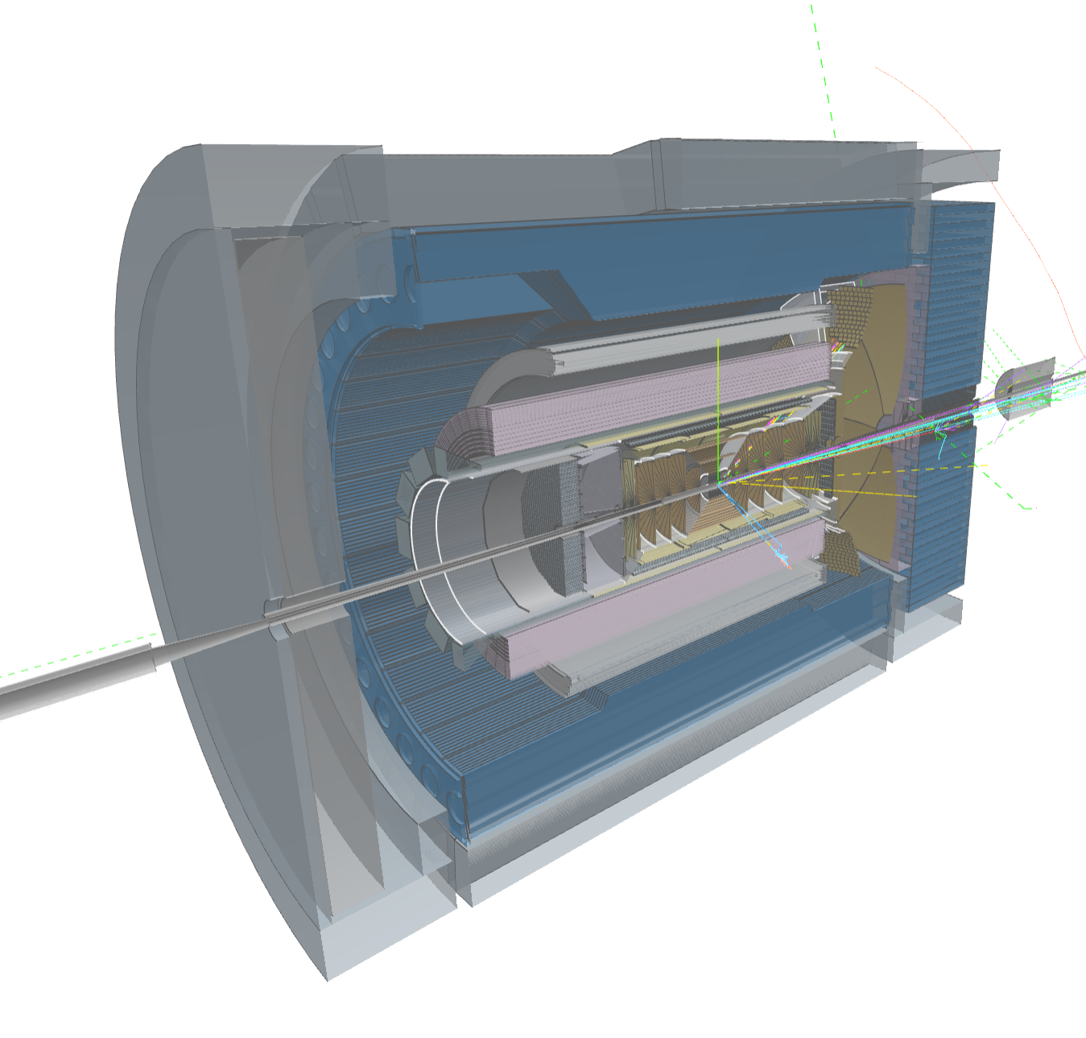
Compute-Detector Integration
Streaming Readout and DAQ:
High-speed data flow: The front-end electronics are designed to support a total bandwidth of up to 50 Tbps, with over 3,000 fiber streams feeding data from the detector to the computing system.
Zero dead time: By avoiding a traditional hardware trigger, the system eliminates dead time and allows for unbiased data collection.
AI and ML in the Data Pipeline:
Intelligent data filtering: AI/ML algorithms can select the most relevant collision events to study.
Real-time feedback: AI can enable rapid detector diagnostics and optimization, with systems capable of automatically calibrating detectors and validating data.
Streaming Computing Model:
Continuous calibration and alignment: Enables rapid delivery of scientific results.
Echelon Model: Organizes resources across the computing hierarchy and enables international contributions.
ePIC event display by Dmitry Romanov

Slide 12
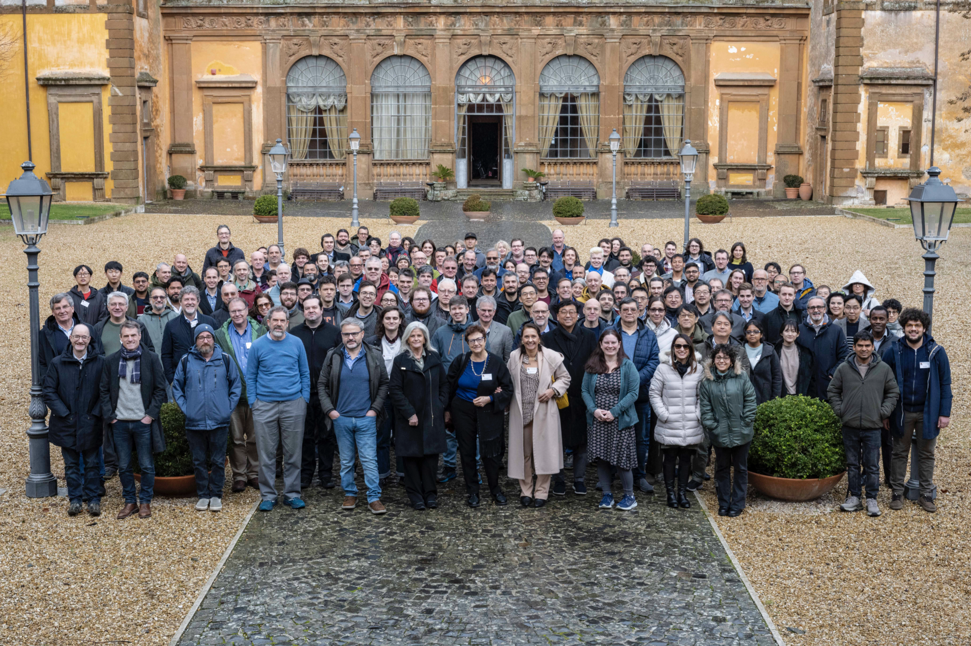
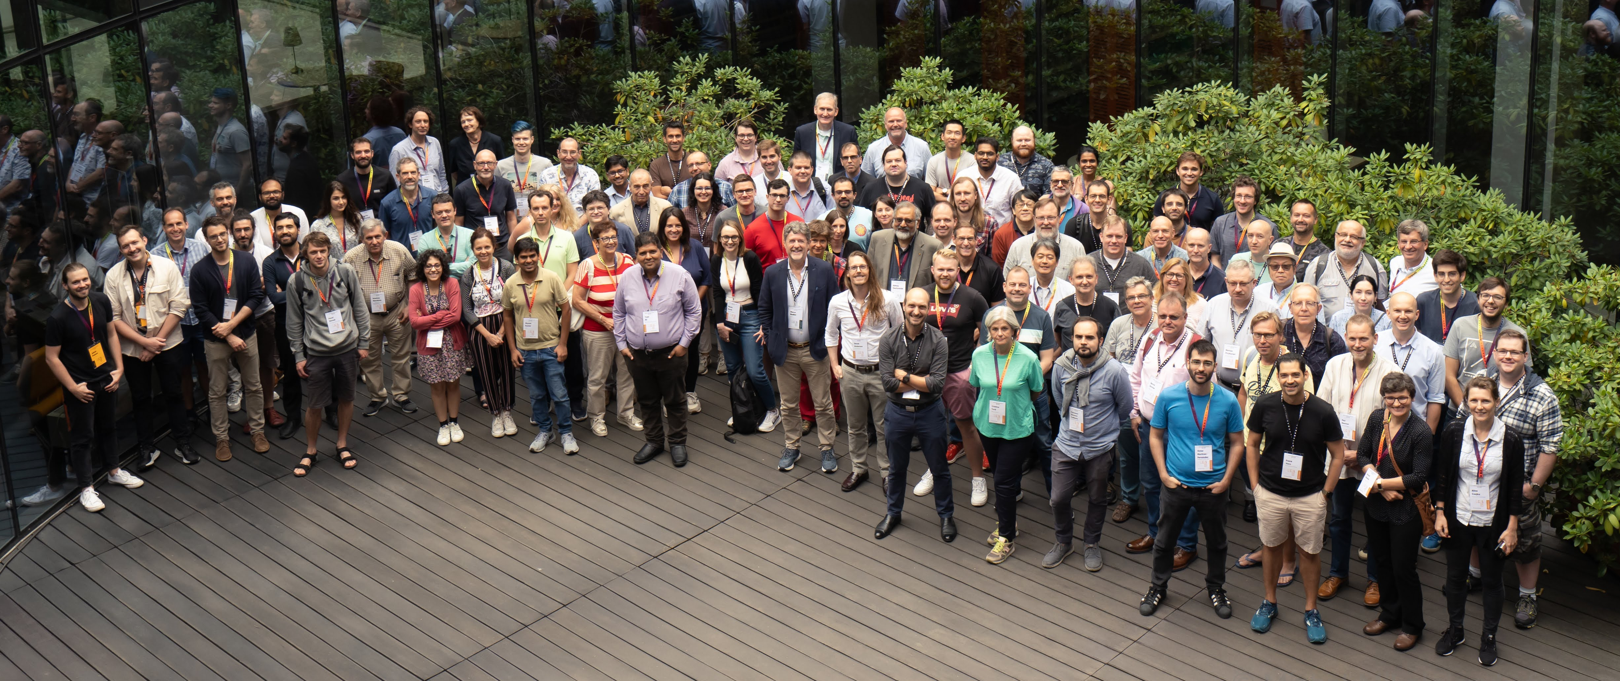
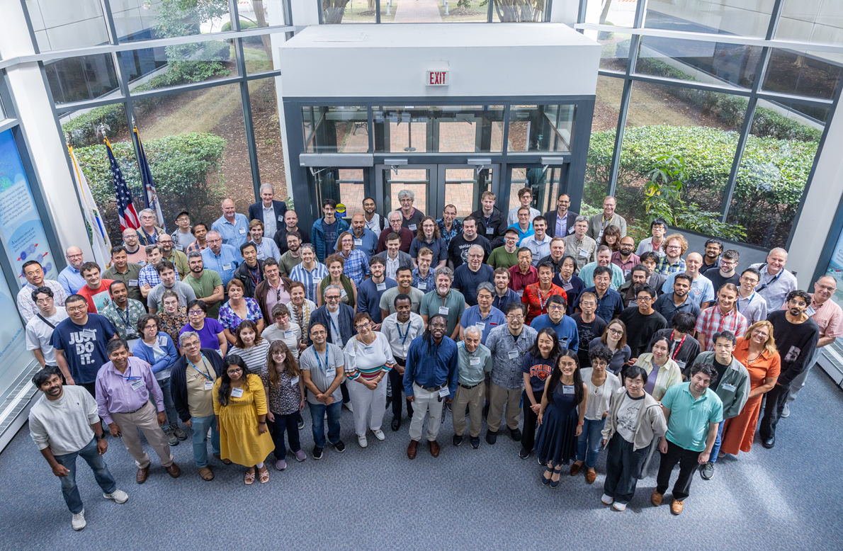
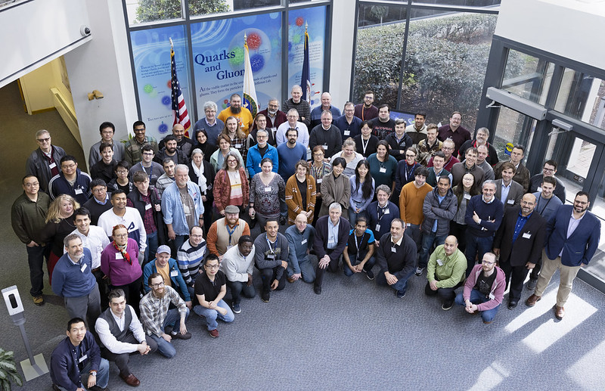
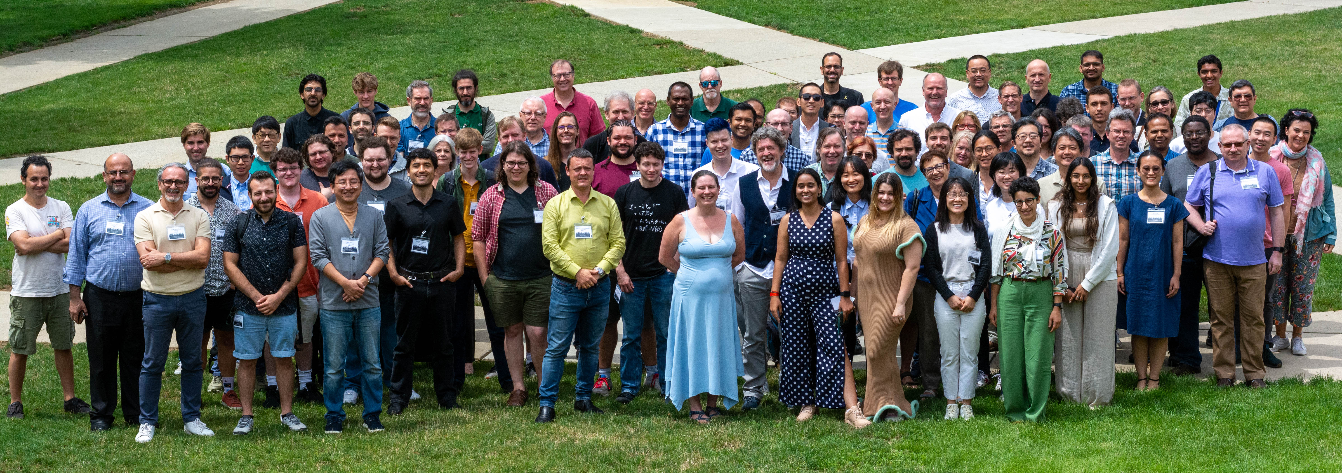
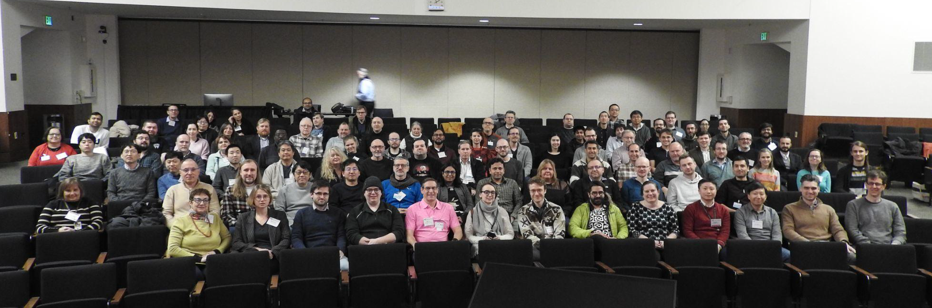
The Collaboration
JLab, Jan. 2023
Warsaw, July 2023
ePIC is a community of scientists dedicated to realizing the EIC science mission.
The ePIC Collaboration is as unique as the ePIC detector.
Frascati, January 2025
EICUG/ePIC Meeting – Lehigh, July 2024
Jefferson Lab, July 2025
ANL, Jan 2024

Slide 13
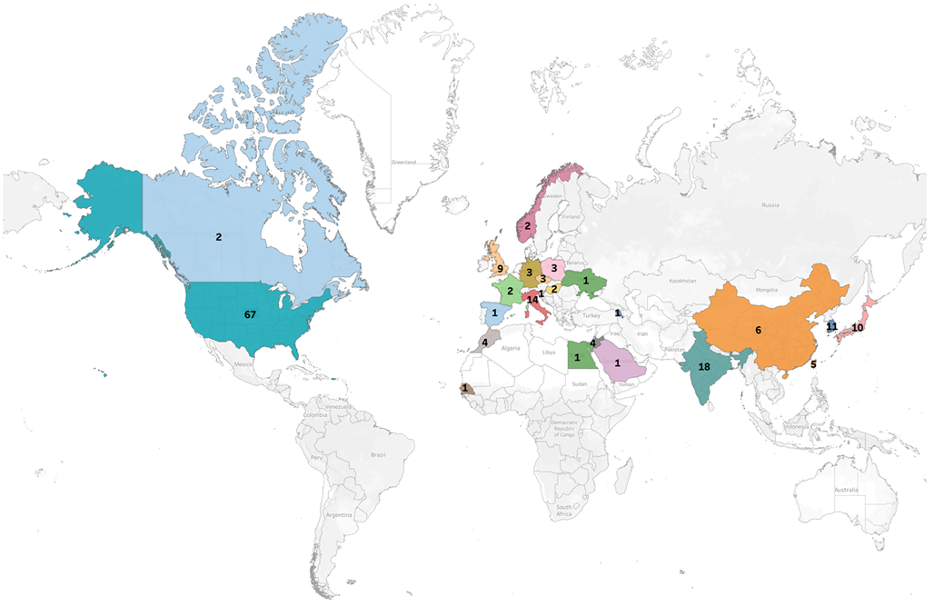
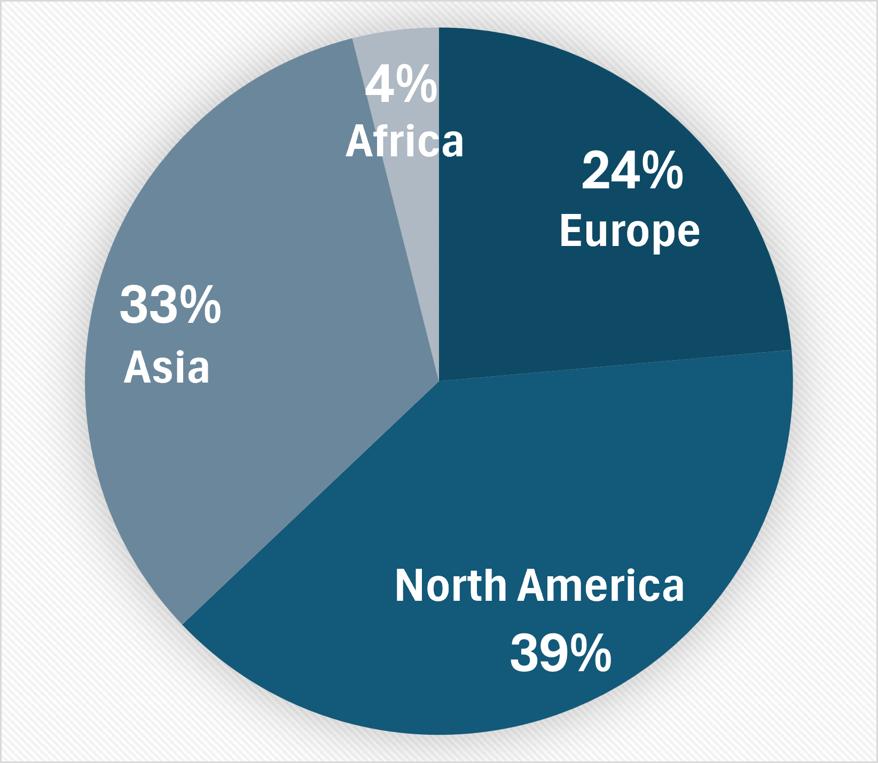
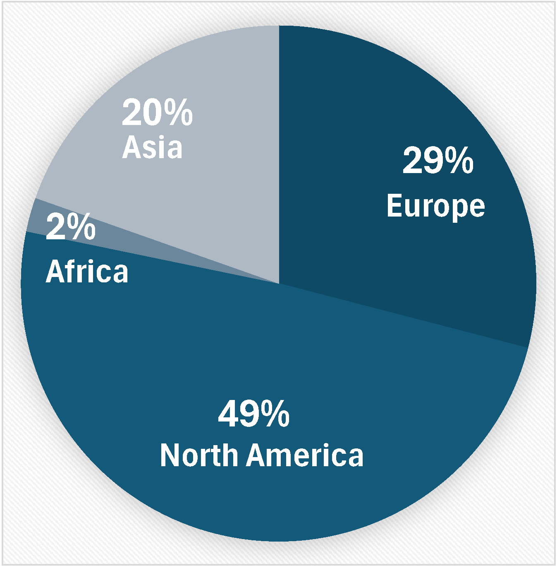
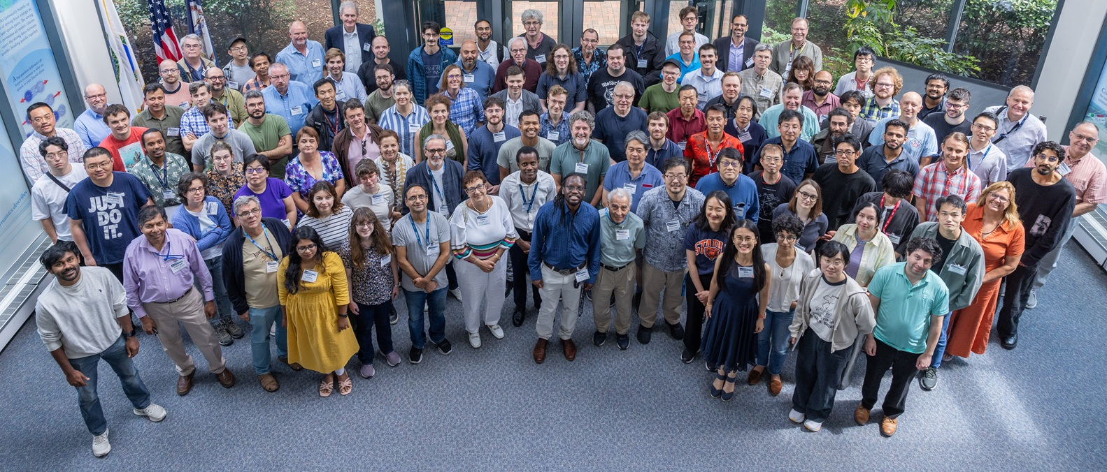
Institutions:
Collaborators:
>1000 collaborators
182 institutions, 26 countries
The ePIC Collaboration is strong, active and growing:
CERN Recognized Experiment
Adding new collaborating institutions
Ongoing subdetector design reviews
Current Collaboration Priorities:
Writing ePIC preTDR, v2.2 due Dec. 2025
Developing the EIC Early Science plan:
Supporting baselining for the ePIC detector in 2026
ePIC Collaboration - July 2025

Slide 14
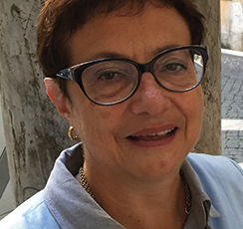

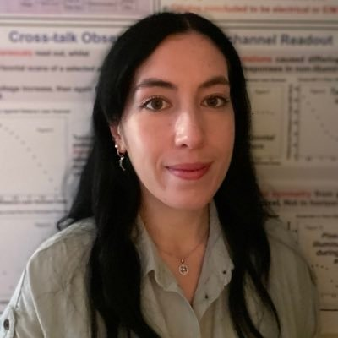
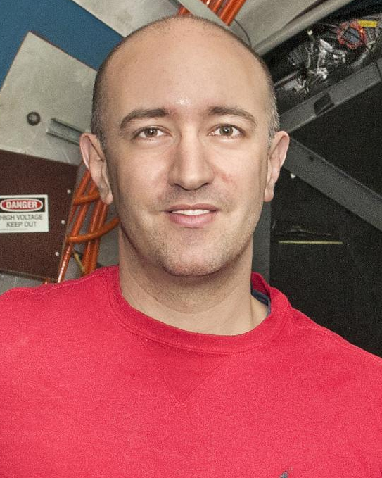



ePIC Collaboration Structure
Collaboration Council
Institutional Representatives
Spokesperson’s Office
Spokesperson (SP)
Deputies
EIC Project
Executive Board
Standing Committees
Professional Conduct
Conferences and Talks
Membership
Elections
Publications
Ad-Hoc Committees
Technical Coordination (TC)
Software and Computing Coordination (SCC)
Physics Analysis Coordination
(AC)
Technical Coordinator (Acting)
• Silvia Dalla Torre (INFN)
Deputy TC’s:
Prakhar Garg (Yale)
John Haggerty (BNL)
Oskar Hartbrich (ORNL)
Matt Posik (Temple)
SCC Coordinator
• Markus Diefenthaler (JLab)
Dmitry Kalinkin
(BNL, Deputy SCC for Development)
Torre Wenaus
(BNL, Deputy SCC for Infrastructure)
Wouter Deconinck
(U. Manitoba, Deputy SCC for Operations)
Physics Analysis Co-Coordinators
• Rachel Montgomery
(Glasgow)
• Salvatore Fazio
(Univ. Calabria)
Rosi Reed (Deputy, Lehigh)

Slide 15




2025 -2026
PDR: DAQ - Slow
Controls
Early 2026
PDR2: Polarimetry
Jan 2026
DOE OPA Status
5-7th August, 2025
PDR2: Si Tracking Detectors
~Jan 2026
ePIC pre-TDR
V2.2
(Dec 2025)
ePIC Early Physics Workshop
April 24-25, 2025
10th Detector Advisory Committee
June 11-13th 2025
ePIC Physics Readiness Workshop
Sept. 17-18th, 2025
PDR2: Cerenkov PID
April 1-2, 2025
FDR: BABAR DIRC Bar Refurbishment
PDR2: MPGD Detectors
~Nov 2025 – Jan 2026
PDR: HCals
October 2026
ePIC Software and
Computing Review
Oct 6-7, 2025
ePIC Software and
Computing Technical Interchange – May 12th
PDR: Magnet/Cryo Infrastructure
Nov. 2025
BIC In-Person Workshop
April 9-11,
2025
SVT Summer
Workfest
June 9-11,
2025
PDR3: IR Integ.
& Aux. Det
March 2026
DOE IPR and ICR, 9-13th March. 2026
PDR3: Elec./DAQ
Sept. 3-4th, 2025
Frascati
Jan 20-24,2025
PDR2: AC-LGAD Detectors
November 2025
Jefferson Lab. July 14-18
Vancouver
Jan. 12-16
Calorimetry
Workshop
June 5-9th, 2025
PDR3: Barrel EMCal
Sept. 17-18th
2025
6th EIC RRB Meeting
Nov. 4-5th 2025
EICO
2-4th April 2025
FDR: Backward & Forward EM Calorimetry, Barrel & Forward HCAL
July 2025
PDR: Integ. + Installation
(inside GST)
Dec. 15th, 2026
HSF-India/ePIC Workshop
May 13-17th, 2025
PDR: Integ. + Installation
(outside GST)
Oct. 30th, 2025
CD-2 Review
late 2026
Detector Subproject Baseline Readiness Director's Review
12-14 Nov. 2025
5th EIC RRB Meeting
June 5-6th 2025
Detector R&D Day (ePIC/Project)
16-17th April 2025

Slide 16
ePIC preTDR and Publication Plan
process design phase
writing
(TDR/notes)
Prepare
papers for
publication
structuring the
effort
preTDR v2.0
Review v2.0
(internal/external)
December 2025 pre-TDR v2.2+
NIM Special
Issue
mid-2026
Mid Jan.24
Mid Mar.24
preTDR v1.0
Dec. 24
July 2025
Formation of Editorial Board
Preparation of the pre-TDR a major focus for the collaboration
  Required for CD-2 baseline review
  Critical support for simulations, reconstruction, and data preservation from
  Software and Computing
Will open a NIM Special Issue in early 2026, open for ~6 mos
  Publish a super-set of the material prepared for the pre-TDR
  Early Science whitepaper
Streaming Computing Model publication in preparation

Slide 17
The EIC Early Science Program
Year - 1
Year - 2
Year - 3
Year - 4
Year - 5
New Capability:
Commission electron polarization in parallel
Run:
10 GeV electrons on 115 GeV/u heavy ion beams (Ru or Cu)
Physics:
Add your preferred science topic
+ electron polarization
New Capability:
Commission proton polarization in parallel
Run:
10 GeV polarized electrons on 130 GeV/u Deuterium
Physics:
Add your preferred science topic
Run:
Last weeks 10 GeV electrons and 130 GeV polarized protons
Physics:
Add your preferred science topic
+ electron polarization
+ proton polarization
New Capability:
Commission running with hadron spin rotators
Run:
10 GeV polarized electrons on 130 GeV transverse polarized protons
Physics:
Add your preferred science topic
Run:
Last weeks switch to longitudinal proton polarization
Physics:
Add your preferred science topic
+ electron polarization
+ proton polarization
+ operation of hadron spin rotators
New Capability:
Commission hadron accelerator to operate with not centered orbits
Run:
10 GeV polarized electrons on 100 GeV Au
Physics:
Add your preferred science topic
Run:
10 GeV electrons on 250 GeV transverse and longitudinal polarized protons
Physics:
Add your preferred science topic
+ electron polarization
+ proton polarization
+ operation of hadron spin rotators
+ operation of hadron beams with not centered orbits
Run:
10 GeV polarized electrons on 100 GeV Au
Physics:
Add your preferred science topic
Run:
10 GeV electrons on 166 GeV transverse and longitudinal polarized He-3
Physics:
Add your preferred science topic
Physics Readiness and Early Science Workshop:
Sept. 17 - 18th, 2025
https://indico.bnl.gov/event/29343/
Time to install additional ESR RF and HSR PS to
reach design current and max. energies

Slide 18
Engagement from (US) Universities
From the Sept. 2024 ECSAC Review:
Recommendation: Investigate how the US universities can contribute to the S&C needs of the experiment, and present a plan at the next ECSAC review.
Collaboration leadership is dedicated to increasing engagement across the collaboration.

Slide 19
ePIC Statements of Service 2025
From the ePIC Membership Policy:
Continued authorship in the ePIC Collaboration requires membership in a signing institution and
inclusion in an annual institutional “statement of service”.
The annual statement of service is intended to reflect institutional commitments for the coming
year, and document contributions to ePIC carried out during the previous year. It is expected
that the majority of institutions will maintain signing status, once obtained, while they are active
members of ePIC.
Completed in early 2025
67% of collaborators intend to qualify for authorship in 2025 (0.15 FTE average)
  176 FTE on detector,
  23 FTE on Physics Analysis
  12 FTE on Software and Computing

Slide 20
Projections from 2025 Survey
GUIDANCE FOR INFORMATION TO BE FILLED IN THE TABLE
Fill the table with total workforce that you plan to dedicate to ePIC - expressed in FTE - of the nine different personnel types. Do not include personnel paid by EIC/ePIC R&D, PED or construction funds. The information requested is for any effort on behalf of the ePIC Collaboration, not just construction of ePIC.
Also please identify the two main areas of efforts of your group contributing to ePIC for each year. We expect this will evolve year to year, and we also understand that most groups do not have firm plans past the next few years.
For the purposes of this survey, please assume a constant total level of effort for your group, across all activities (both ePIC and non-ePIC), for the time period of the projection. Assume that there are no increases in students, postdocs or faculty working on ePIC due to new positions, but only redirection of effort from other group activities that may be winding down. In this way the overall effort on ePIC may increase over time, as workforce is redirected from other projects.
For purposes of this survey assume that the first physics run of ePIC is in 2034.
In addition to commitments for 2025, also requested projections for how collaborations might see the evolution of their engagement in ePIC
~70% of institutions responded
  Same fraction US/international

Slide 21
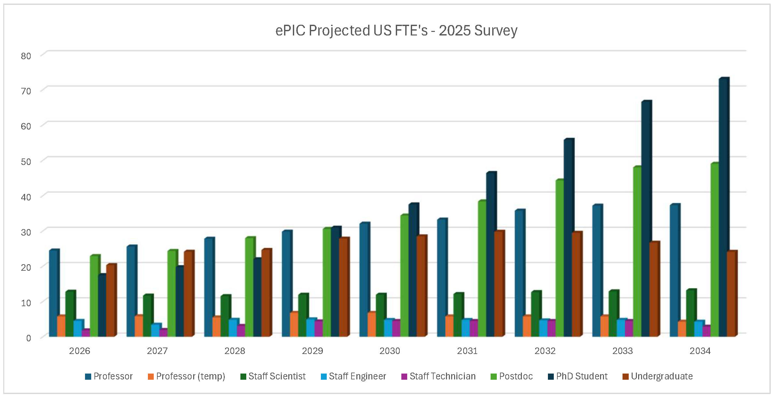
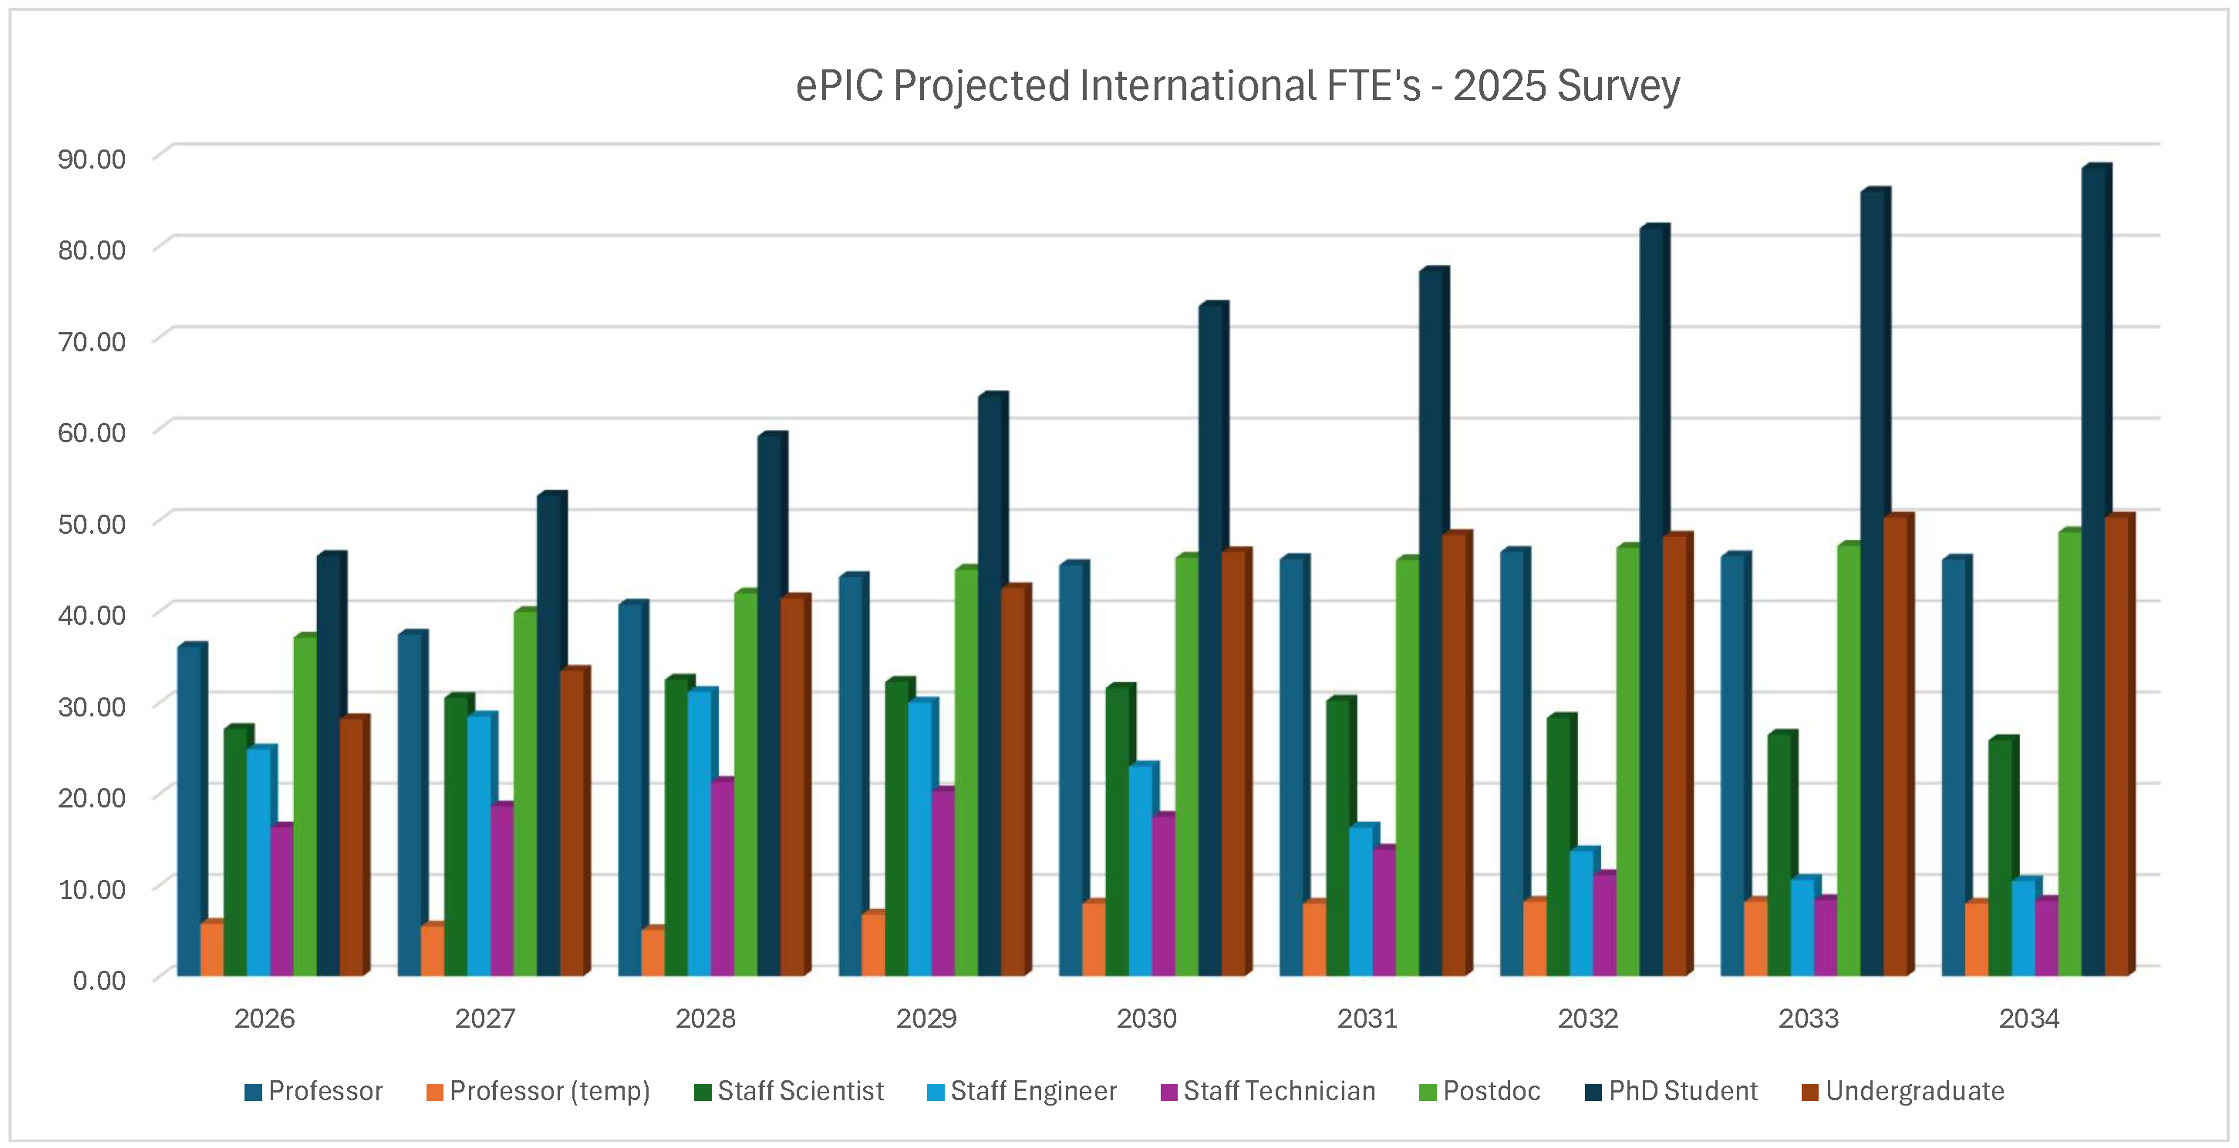
Projections Results from 2025 Survey
Collaboration engagement is projected to grow steadily as we move through ePIC construction.
Both US and international institutions project the effort will scale up as we move into construction, especially students and postdocs, although there are differences in details.

Slide 22
Challenges with ePIC Engagement
DOE NP budgets have been flat-flat, while the EIC timescale is 10+ years in the future.
  Research support for groups involved in EIC is spread across two NP programs.
  University groups and National Labs cannot grow their effort on the EIC. Any effort must come from existing workforce, which competes with existing commitments.
  The long EIC horizon makes it difficult to engage more than a fraction of a postdoc or student’s time.
The current geopolitical situation complicates international collaboration.
  International interest in EIC remains strong, but skepticism growing with international funding agencies
The EIC schedule has slipped over the past two years. This has made it difficult to communicate urgency.
  The new subproject plan and end of the RHIC run have helped by defining a more definite timeline
  On the positive side, this has given more time to cultivate international involvement

Slide 23
Priorities from Frascati Collaboration Meeting
At the Jan 2026 collaboration meeting in Frascati, the collaboration focused on setting priorities for the coming year. This resulted in a set of action items from the coordination offices.
ePIC S&C led the way by developing detailed charges for WG’s
  Adopted by other coordination offices
  Written charge improves communication and accountability
S&C Priorities Included:
  Improved onboarding for analysis efforts (with Physics Analysis Coordination)
  Defined a set of milestones for progress in simulations:
    Fidelity to engineering design (with EIC Project)
    Inclusion of backgrounds in simulated events
    Reconstruction and simulation tools
    Work towards reconstruction in timeframes
More details on the priorities in the talks that follow.

Slide 24
The Status of the Collaboration
The ePIC Collaboration is strong, active and growing!
  International participation is key to the success of ePIC
The collaboration is committed to advancing the technical design of the detector and supporting baselining (CD-2) for the DET subproject.
Physics Working groups are developing the EIC Early Science Program
ePIC Software and Computing has made great progress
  A small number of people are shouldering an outsized burden
The 2026 survey will further clarify commitments from ePIC institutions and the trajectory of ePIC engagement
  This is an opportunity for collaboration leadership to engage with institutions and improve engagement in all parts of the collaboration

Slide 25


Slide 26
ePIC Resources
Public Website - https://www.bnl.gov/eic/epic.php
Mailing Lists – https://lists.bnl.gov/mailman/listinfo
Indico Agenda - https://indico.bnl.gov/category/402/
  ePIC Software and Computing: https://indico.bnl.gov/category/435/
Wiki - https://wiki.bnl.gov/EPIC
ePIC Software Training:
  Landing Page: https://eic.github.io/documentation/landingpage.html
  Tutorials: https://eic.github.io/documentation/tutorials.html
Mattermost: https://chat.epic-eic.org
ePIC Zenodo Community: https://zenodo.org/communities/epic

Slide 27
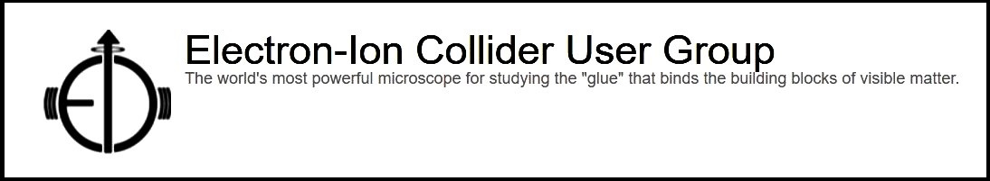

EICUG Membership
The EICUG is a vital organization to promote the interests of the EIC community!
  Without the EICUG we would never have gotten far enough to form ePIC!
Please register your institution!
Check with your EICUG IB representative to get registered as a member
https://www.eicug.org/content/join.html

Slide 28



ePIC Committees
Membership Committee:
Chair: Peter Steinberg (BNL)
Vice-Chair: Pietro Antonioli (INFN-Bologna)
Friederike Bock (ORNL), Helen Caines (Yale), Doug Higinbotham (JLab), Bedhanga Moharty (NISER), Silvia Niccolai (IJCLAB), Marzia Rosati (ISU)
Collaboration Council
Institutional Representatives
Professional Conduct Committee:
Chair: Megan Connors (GSU)
Vice-Chair: Christine Nattrass (UTK)
Francesco Bossù (CEA-Saclay), Wouter Deconinck (University of Manitoba), Narbe Kalantarians (Virginia Union University) , Iris Ponce Pinto (Yale University) , Maya Shimomura (Nara Women’s University) , Allison Zec (University of New Hampshire)
Standing Committees
Professional Conduct
Conferences and Talks
Membership
Elections
Publications
Ad-Hoc Committees
Conferences and Talks:
Chair: Maria Zurek (ANL)
Vice-Chair: Brian Page (BNL)
Barbara Jacak (Berkeley), Daniel Brandenburg (OSU), Dmitry Kalinkin (Kentucky), Nick Zachariou (York), Xuan Li (LANL), Nicola Rubini (Bologna), Wouter Deconinck (Manitoba)
Publications Committee:
Chair: Rene Bellwied (U. Houston)
Vice –Chair: Annalisa Mastroserio (INFN Bari)
Lokesh Kumar (Panjab U.), Michela Chiosso (Torino), Prithwish Tribedy (BNL), Markus Diefenthaler (JLab), Sevil Salur (Rutgers),
ex-officio w. Conferences and Talks Committee:
Daniel Brandenburg (OSU)
Elections Committee:
Chair: Helen Caines (Yale)
Vice-Chair: Ken Barish (UCR)
Past-Chair: John Arrington (LBNL)
Maria Stefaniak (OSU), Domenico Elia (INFN)

Slide 29
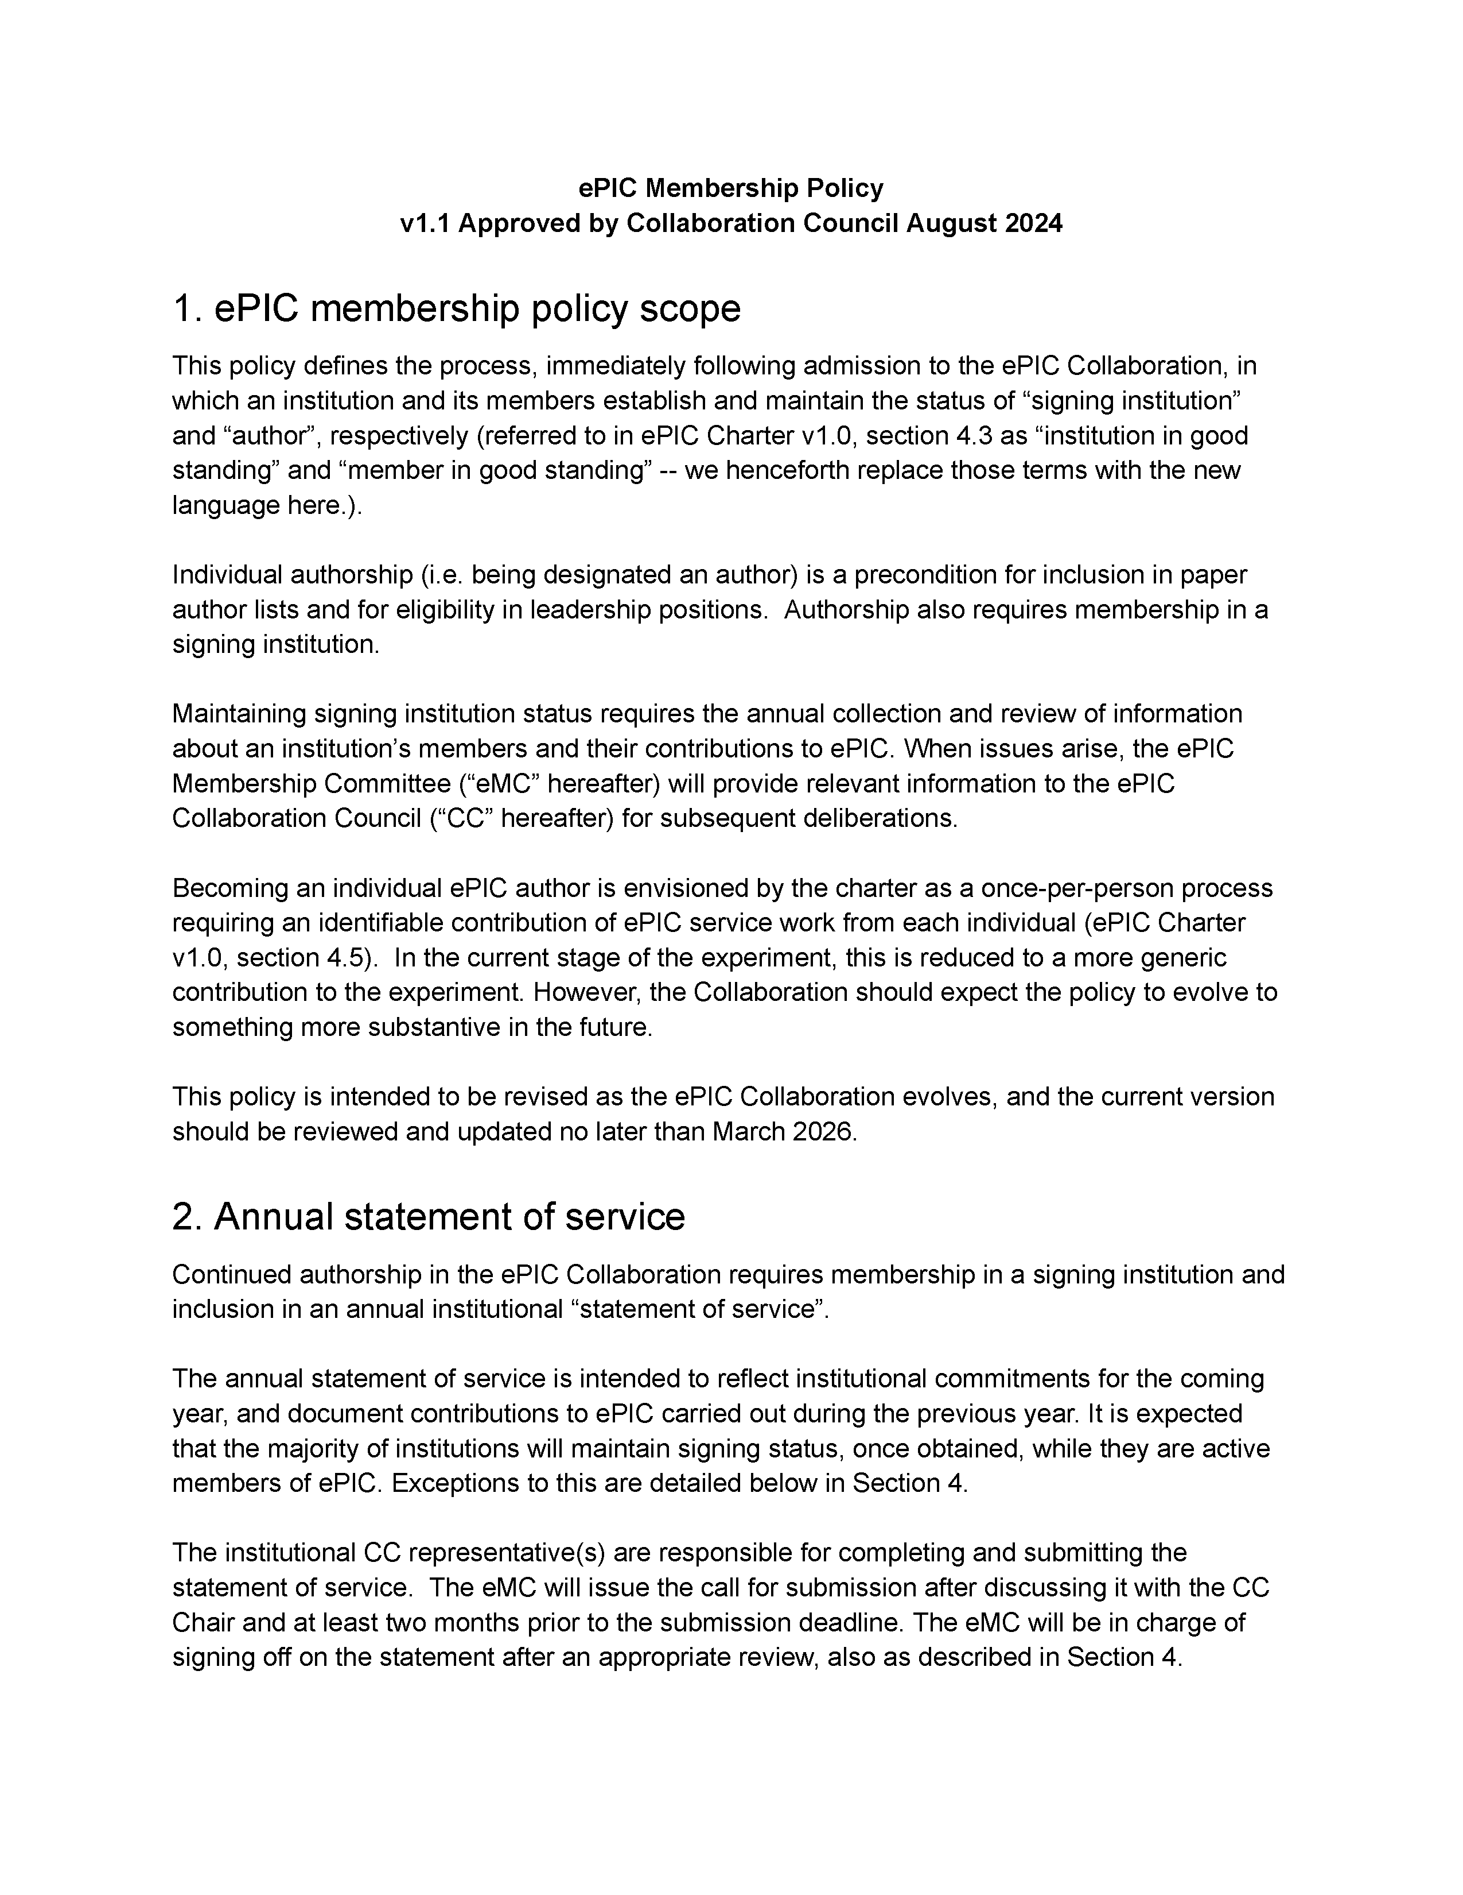
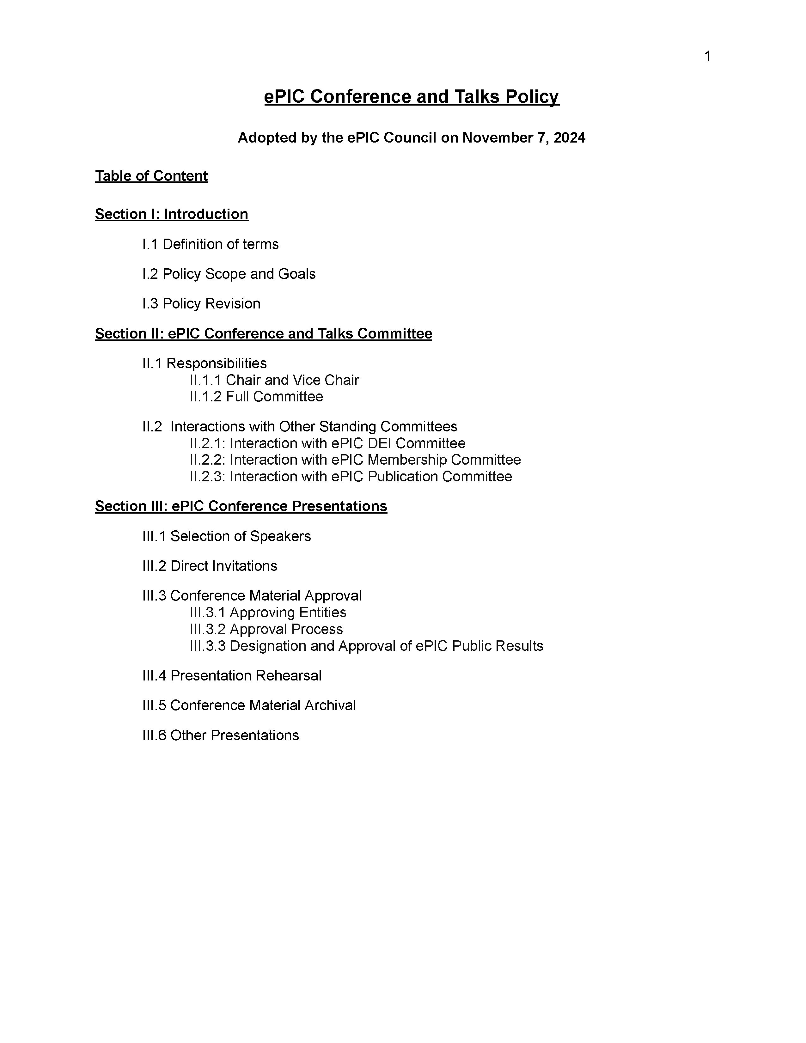
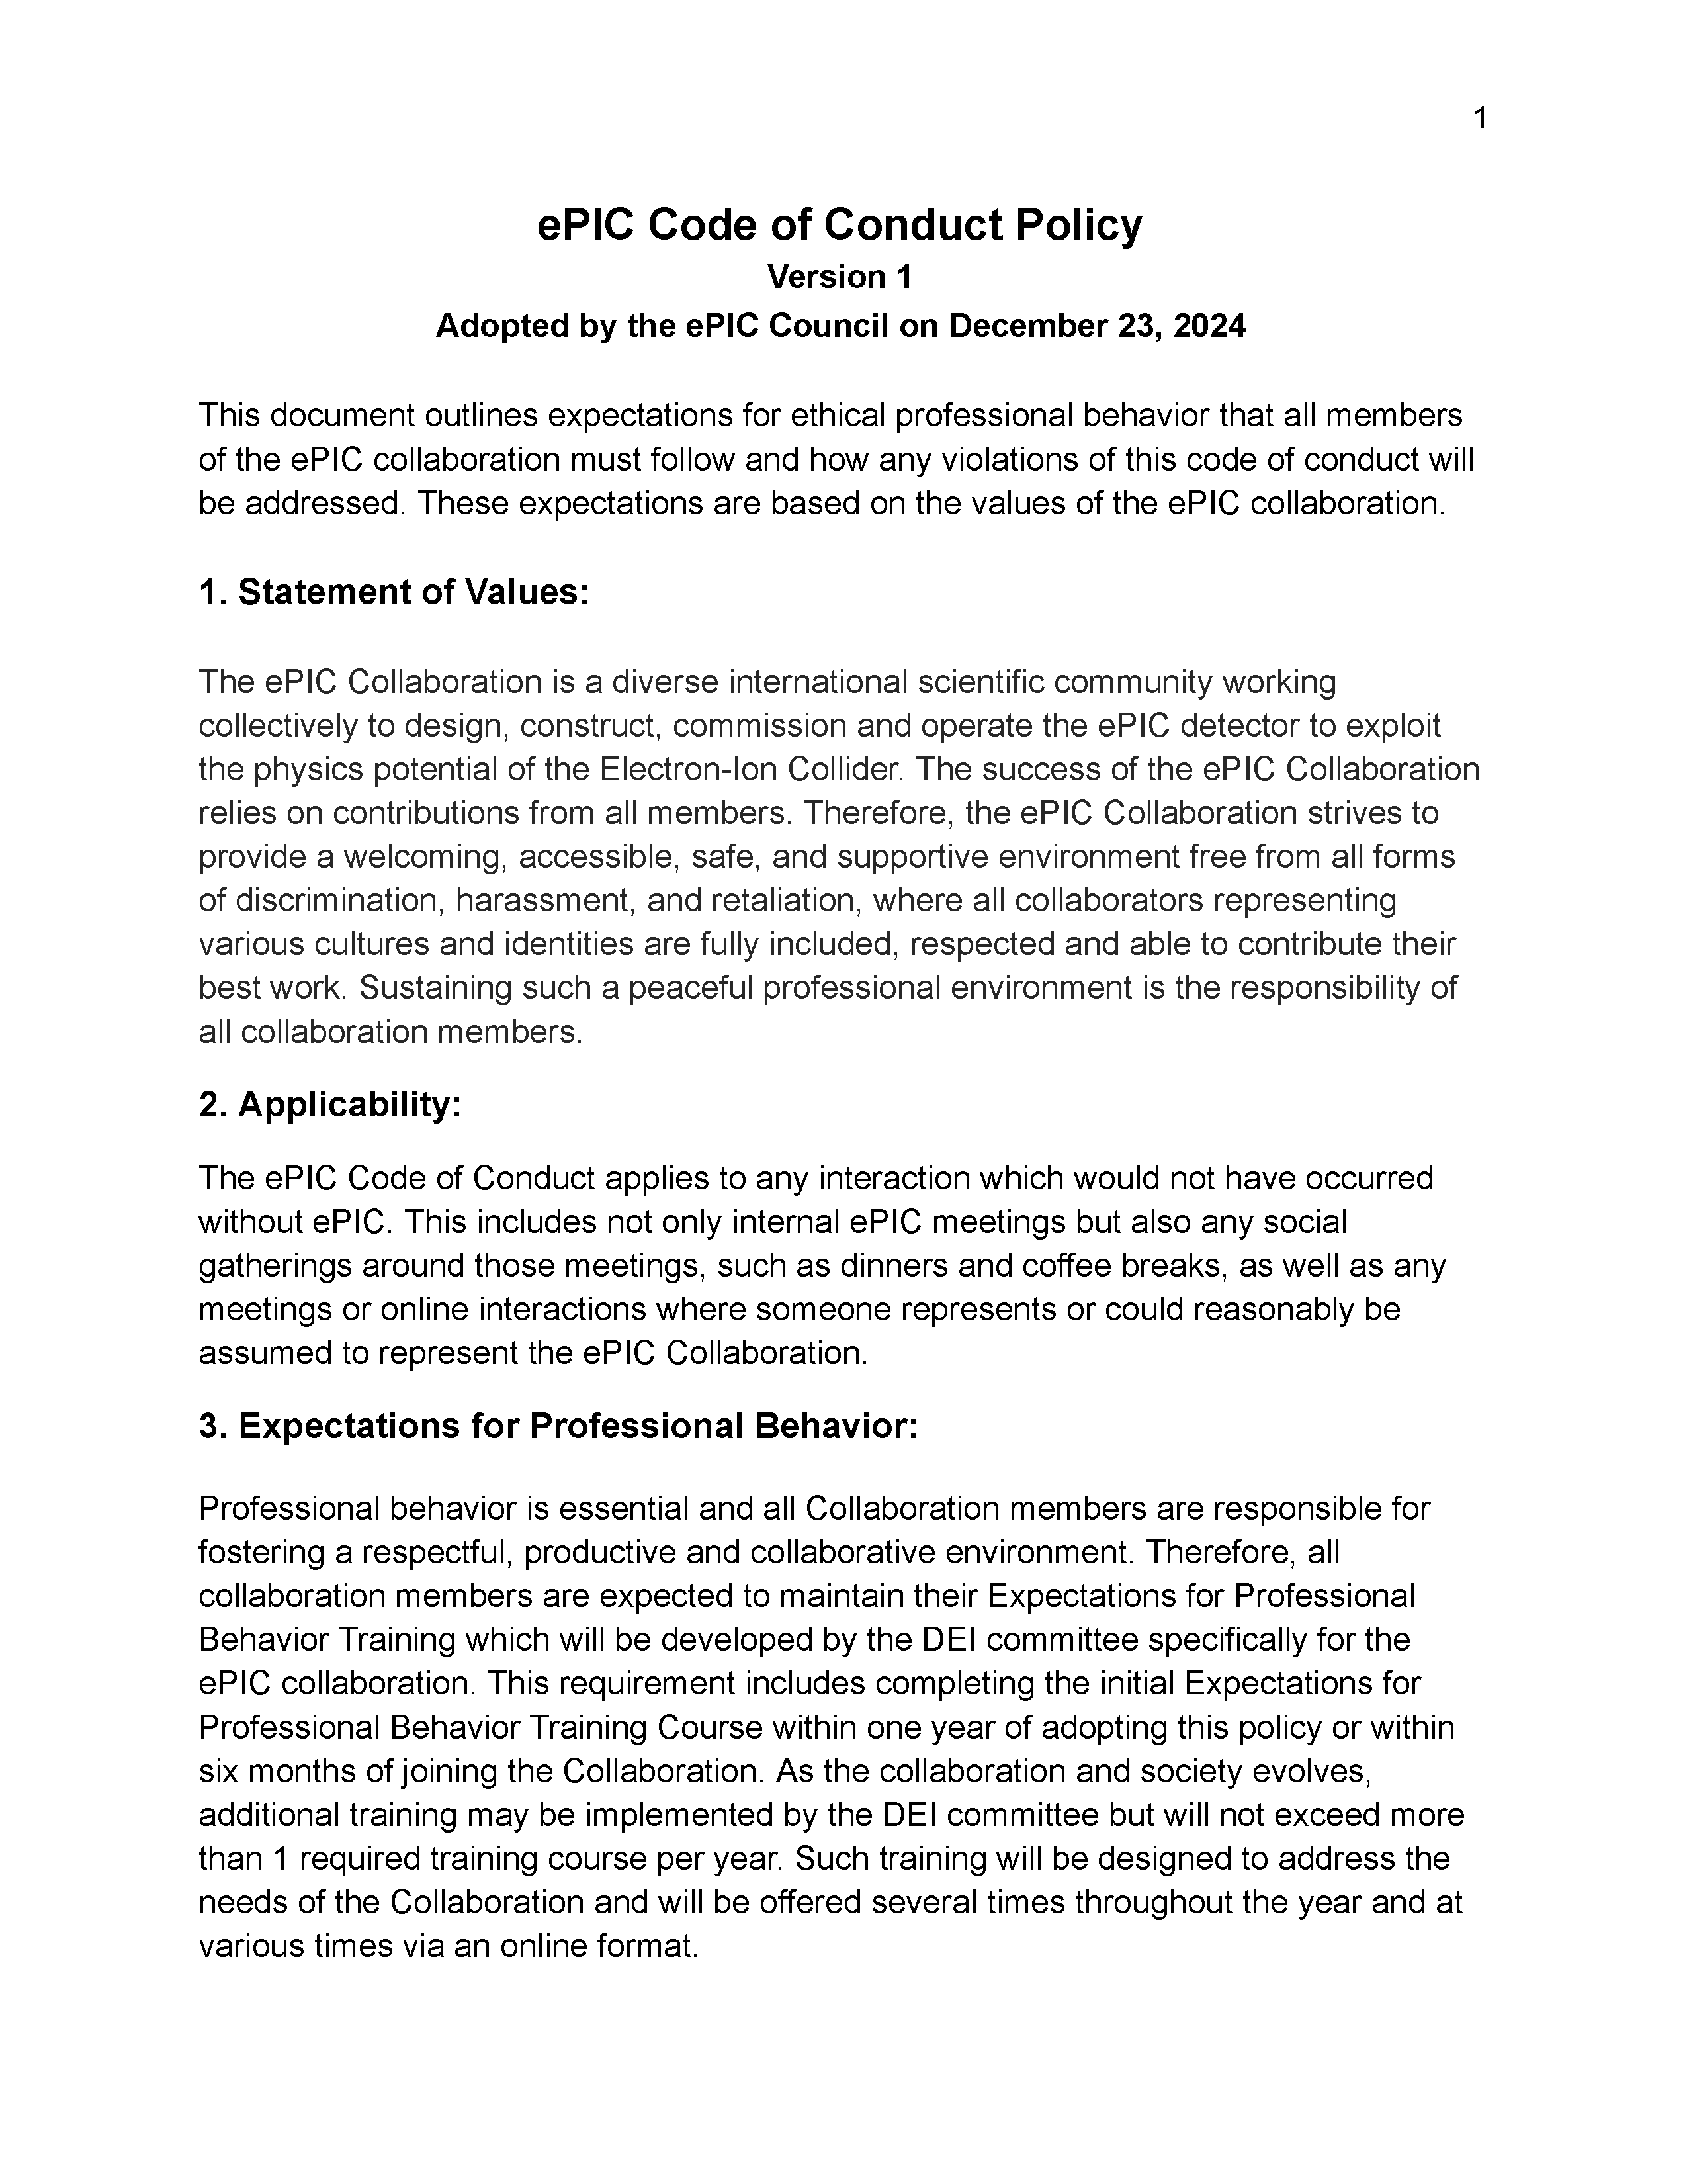
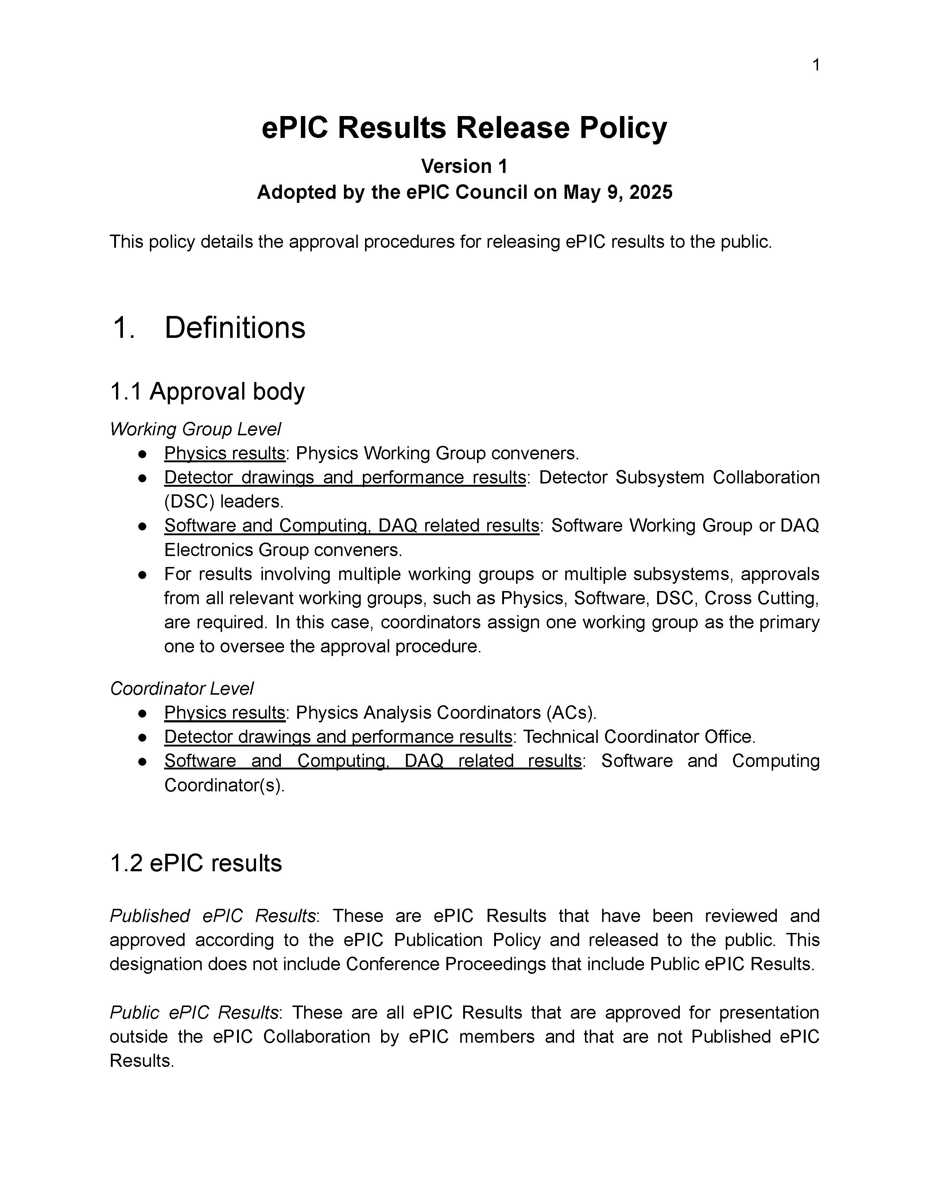
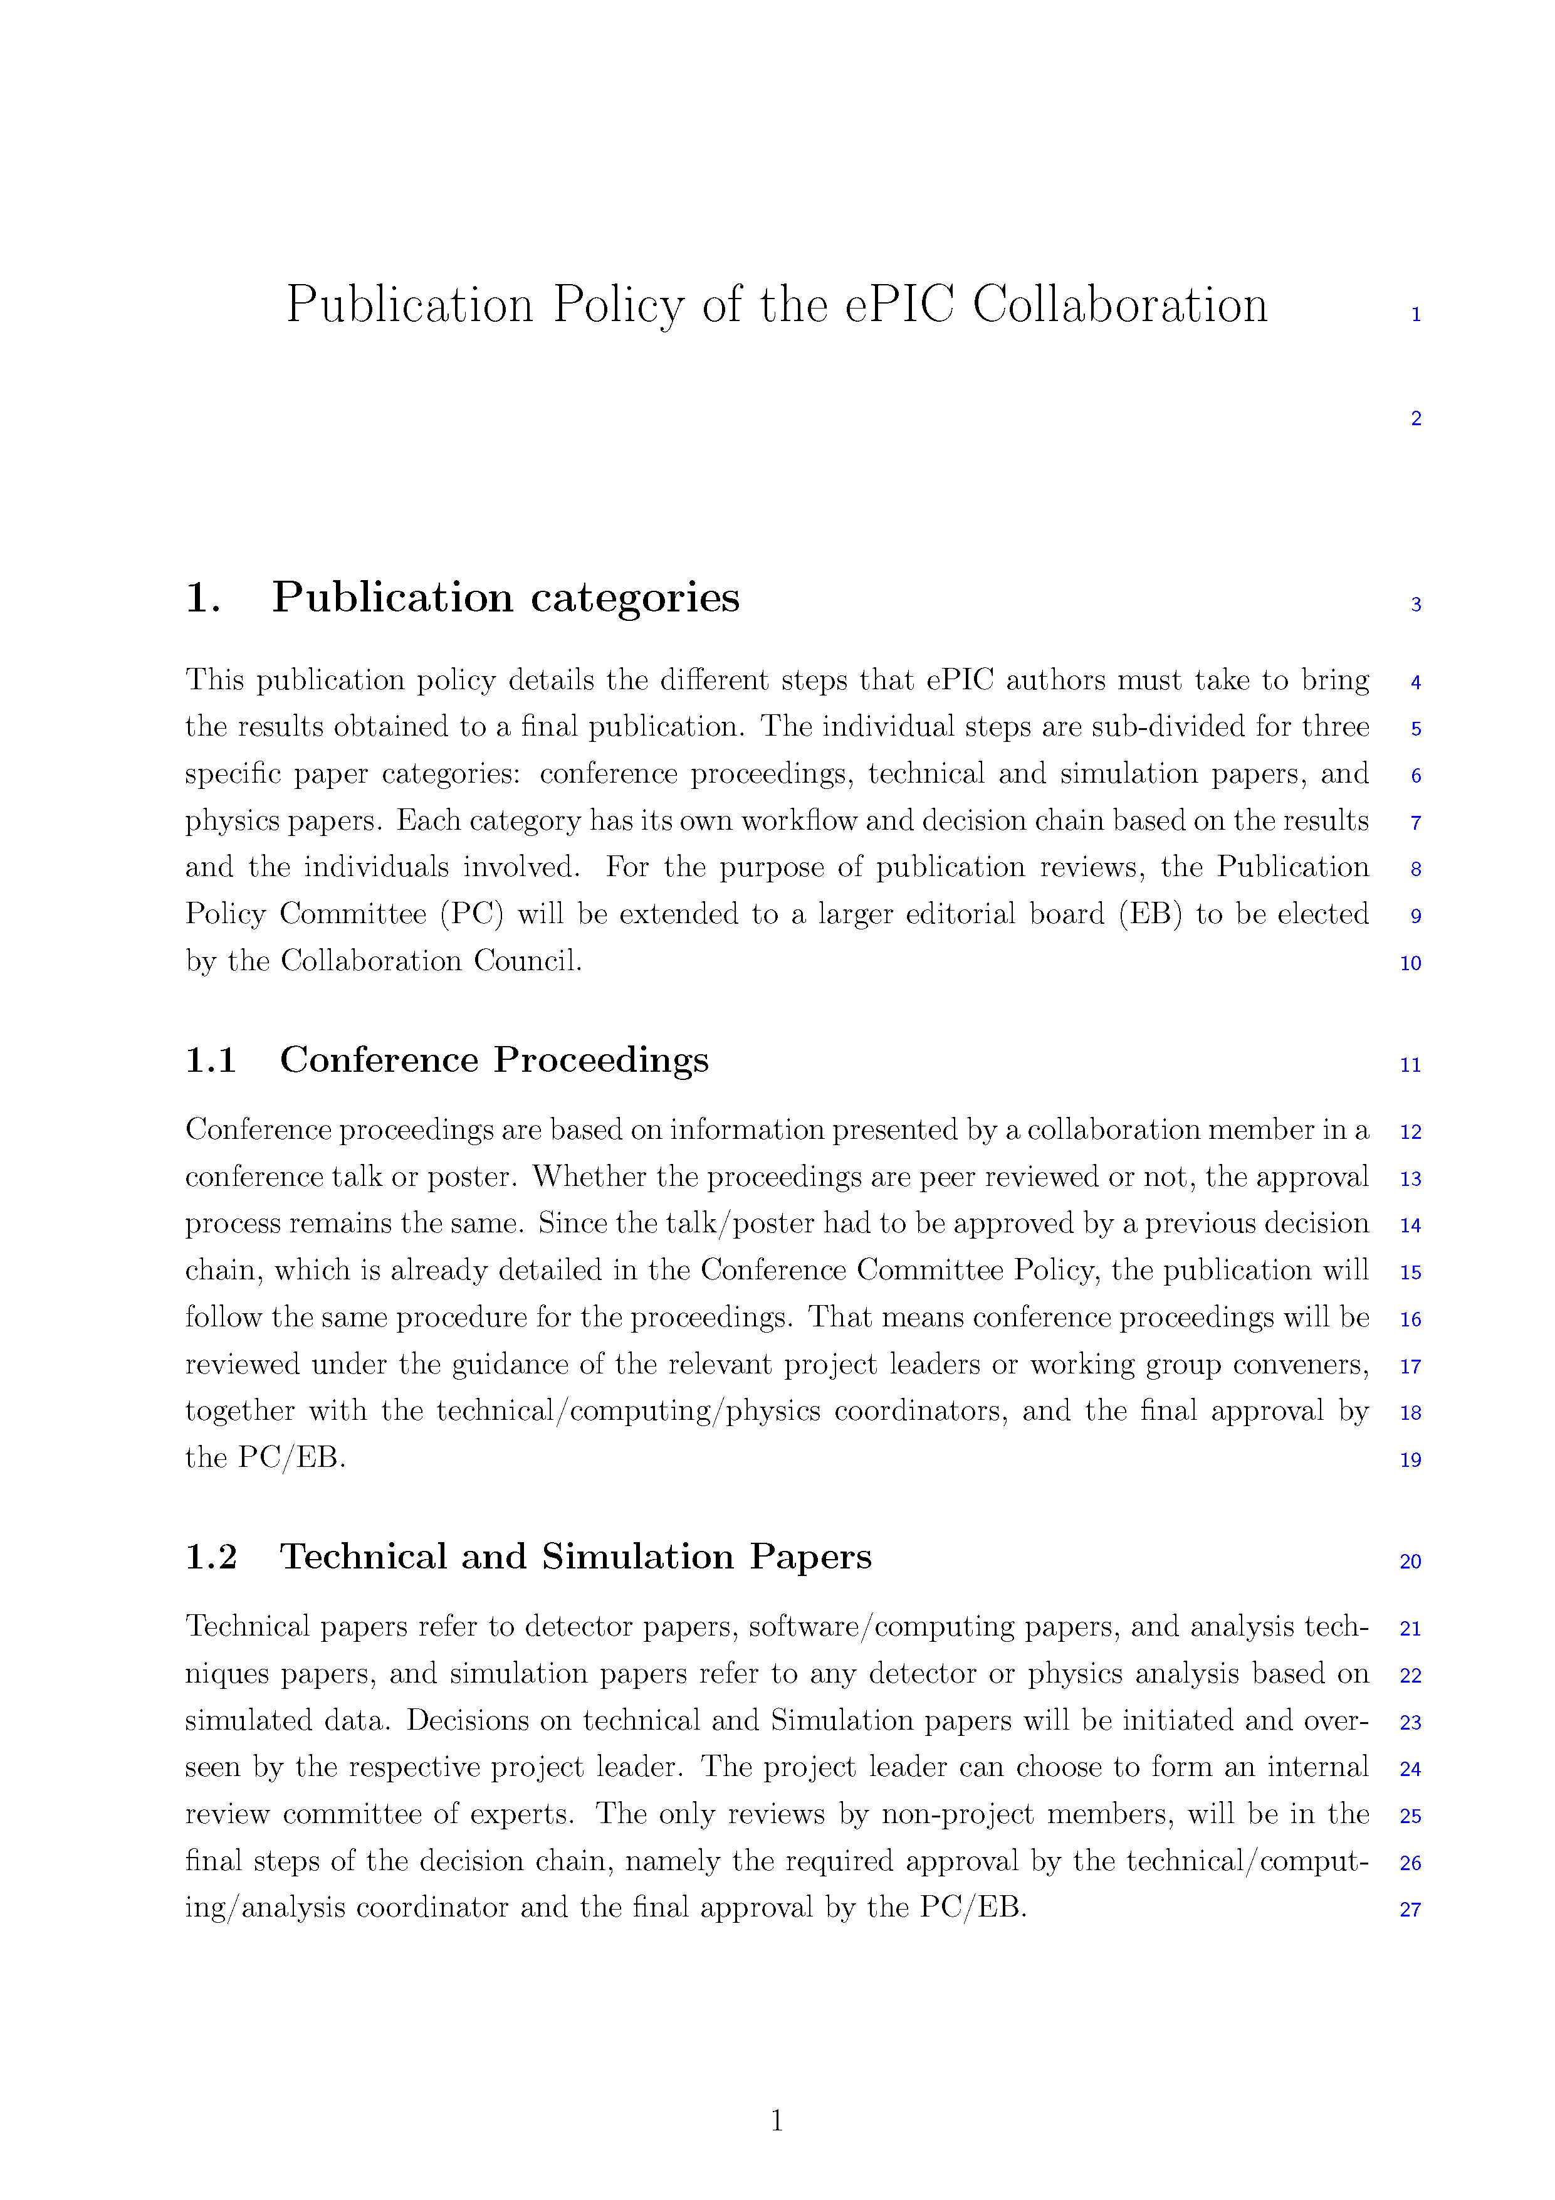
Formation of ePIC Policies
The Membership Policy was endorsed by the Collaboration Council August 2024.
The Conference and Talks Policy was endorsed by the Collaboration Council November 2024.
The Code of Conduct was endorsed by the Collaboration Council December 2024.
The Results Release Policy was endorsed by the Collaboration Council May 2025.
The Publication Policy is in an advanced draft, discussed in CC meetings in January and April 2025.

Slide 30
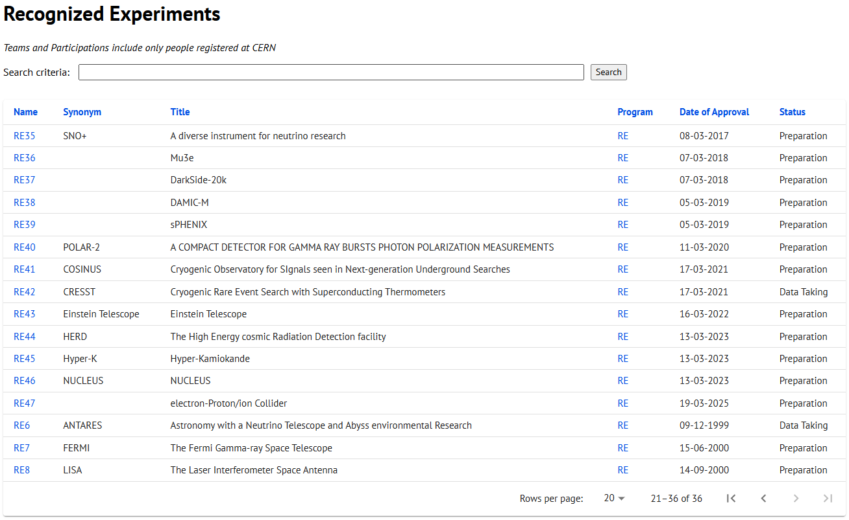
CERN Recognized Experiment Status: RE47
ePIC now appears in the CERN Grey Book database as RE47:
https://greybook.cern.ch/experiment/recognized
Two steps to get ePIC Collaborators registered at CERN:
CC Representative needs to register as team leader with
CERN Users Office:
  https://usersoffice.web.cern.ch/
  https://usersoffice.web.cern.ch/team-leaders-corner
  Users.Office@cern.ch
CC member can then certify registrations of team members
Several ePIC groups successfully registered

Slide 31

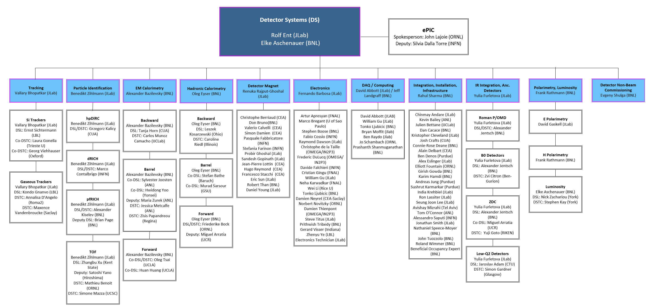




Integrating collaboration in Detector Subproject Organization
10/6/2025
ePIC Software and Computing Review
31

Slide 32
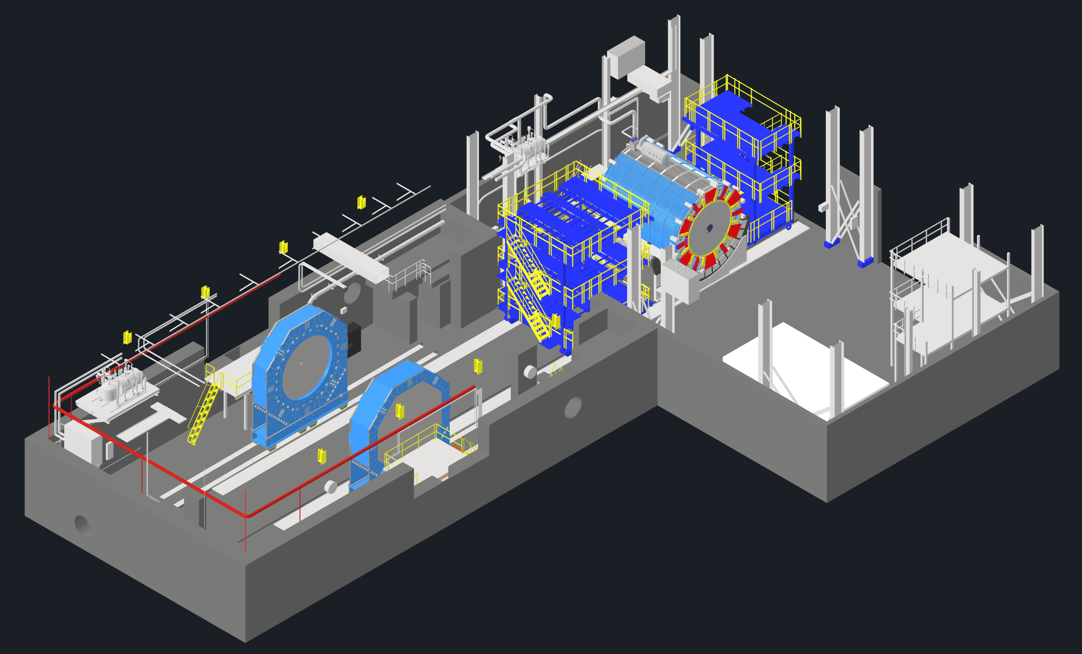
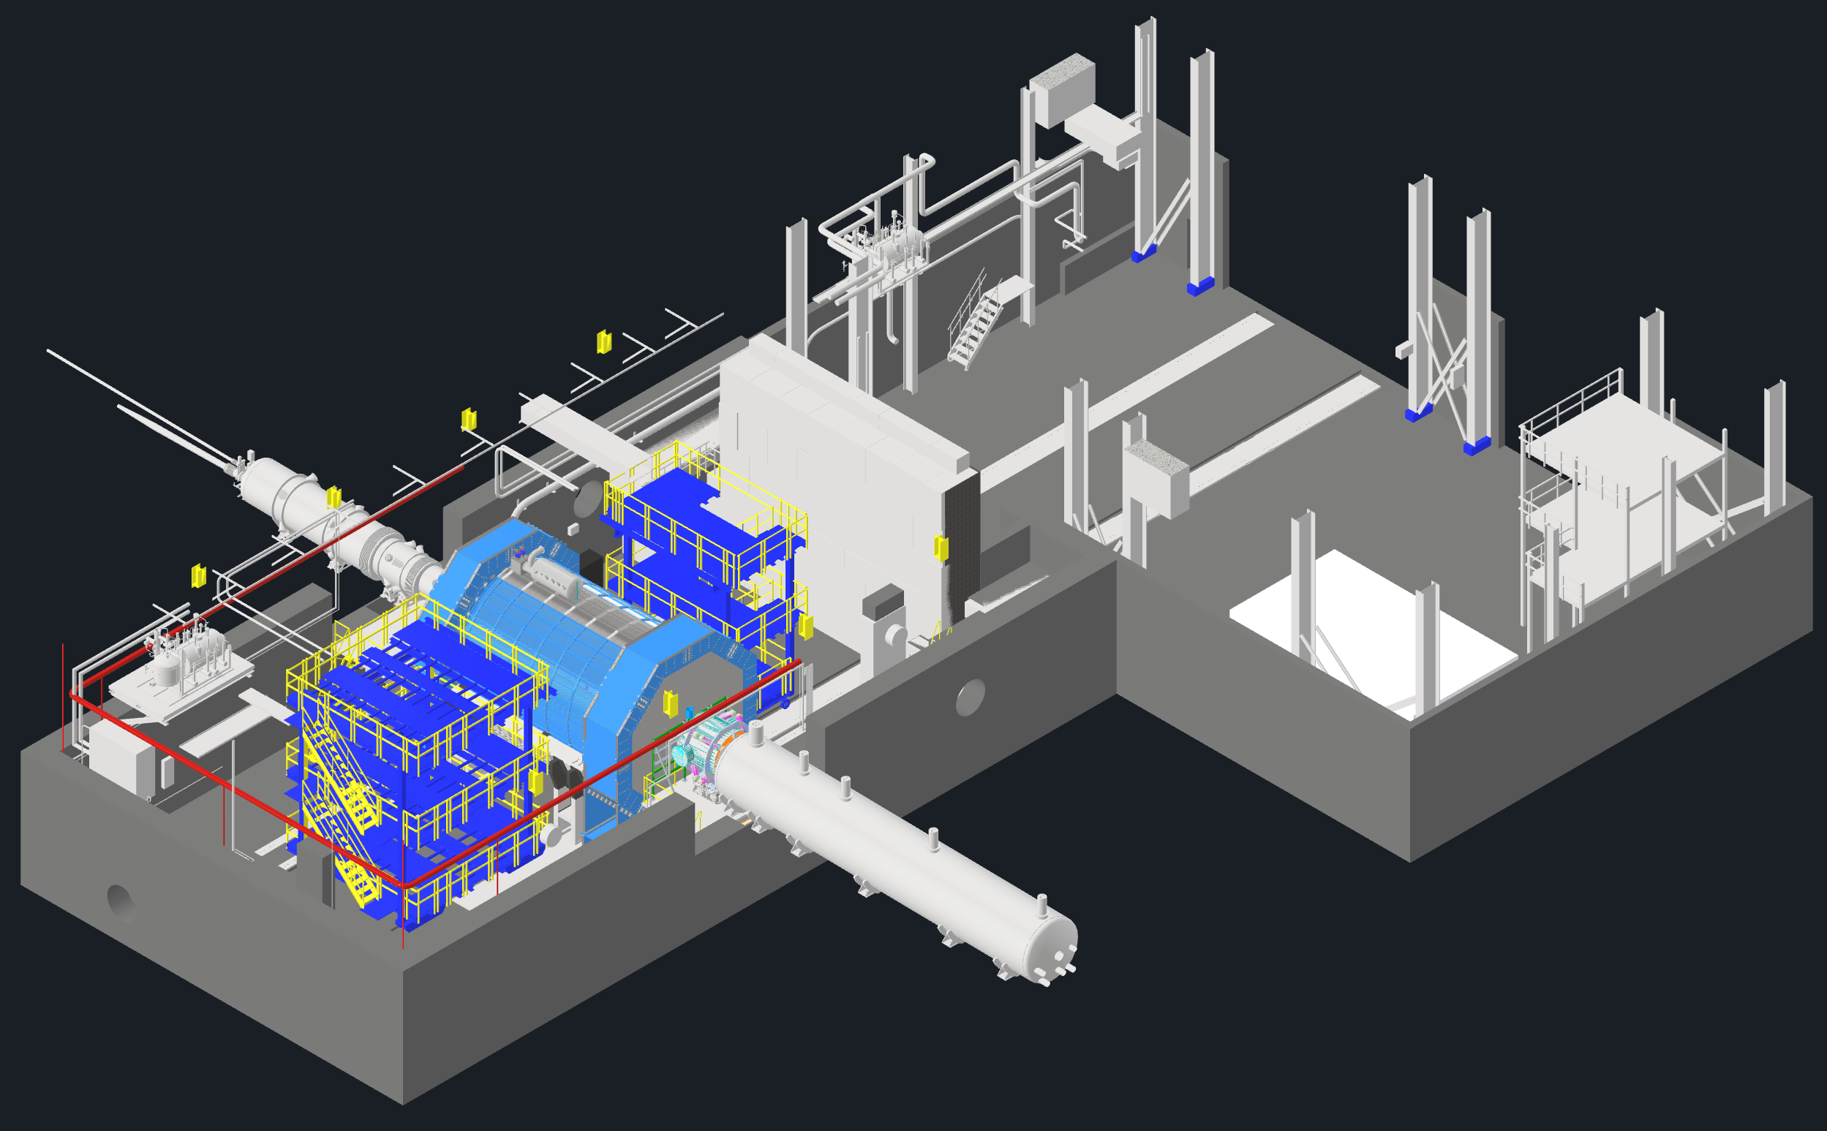
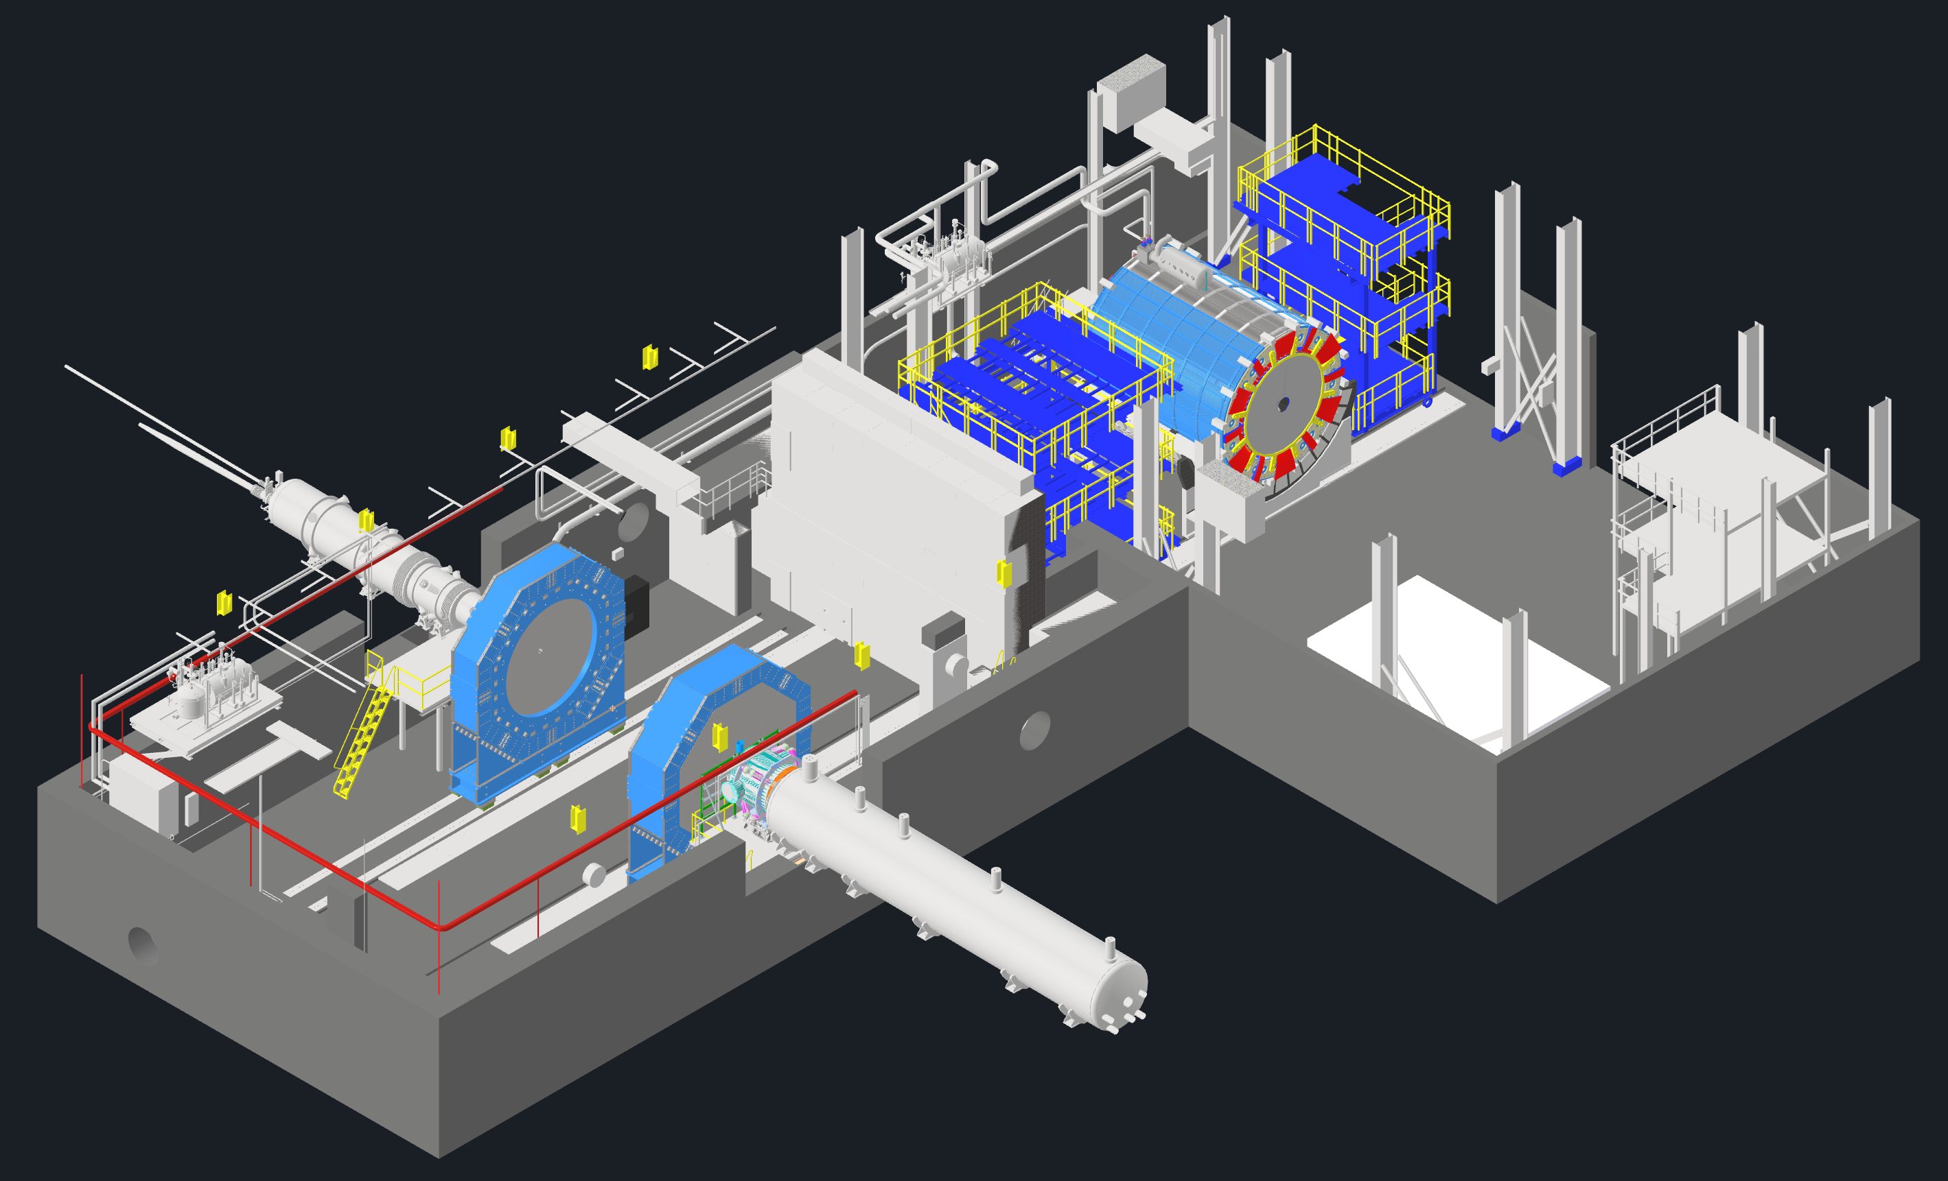
EIC - ePIC Commissioning
Q2/2033
~ CY 2034
exact dates under development
ePIC no-beam commissioning
ePIC commissioning with beam
ePIC fully assembled and Ready for Cosmic Data Taking
EIC first beam commissioning
central ePIC in assembly hall
endcap calorimeters
and beam pipe with instrumentation to have a first look on backgrounds
Luminosity detector and hadron & electron polarimeters fully installed
Move central
ePIC into wide-angle hall
Commission
ePIC with beam
All auxiliary detectors, but RPs and OMDs are installed
Start of Science
program
RPs and OMDs will be installed in year-2
10/6/2025
ePIC Software and Computing Review
32

Slide 33






New Institutions so far in 2025
RCNP/Osaka
  CC Member Shinsuke Osaka
Seoul National University
  CC Member Seonho Choi
Texas Southern University
  CC member Nissem Abdelrahman
Johannes Gutenberg University Mainz
  CC member Tyler Kutz
Mount Allison University
  CC member David Hornidge
University of Hawaii at Manoa
  CC member Jennifer Ott
18 new institutions added since the start of 2024!

Slide 34
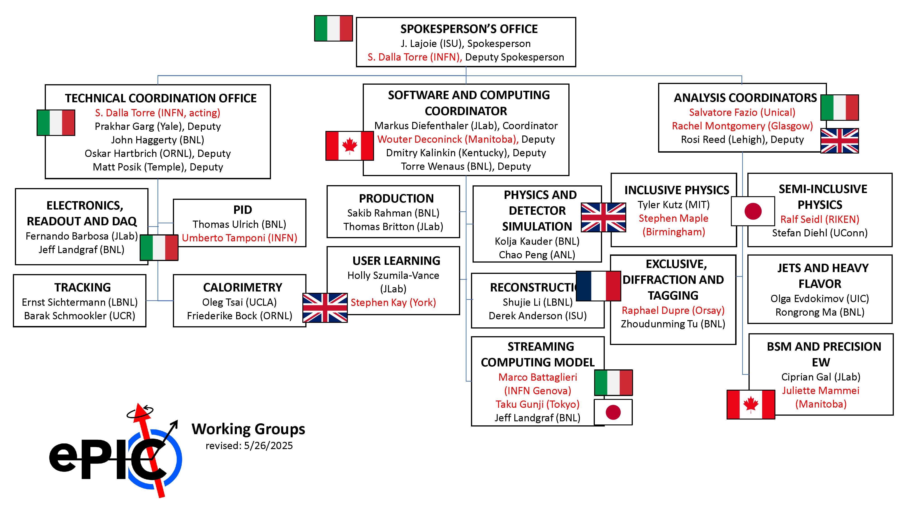
Reminder: ePIC Working Group Structure
*the Validation WG was deactivated and folded into Development

Slide 35
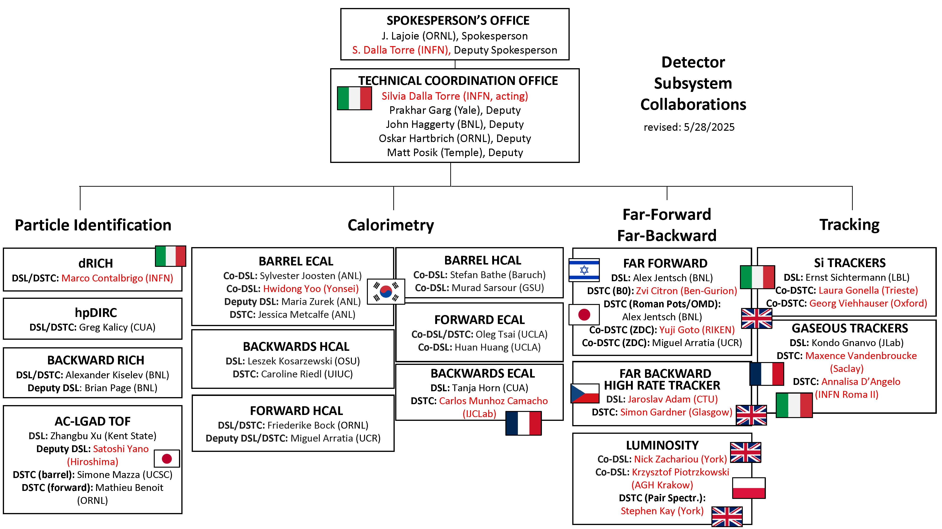
Reminder: ePIC DSC Structure
New personnel since last RRB

Slide 36
CD-3A Status and CD-3B Scope
CD | Scope | Status
CD-3A | Lead Tungstate Crystals for the Detector Backward Electro-Magnetic (EM) Calorimeter (1500 of 3000 crystals) | Contract awarded 3/5/2025 (CRYTUR) – 600 crystals delivered – quality tests completed on 470 crystals, all passed specifications
 | Scintillating Fibers for the Detector Barrel (1125 km of 4900 km) and Forward EM Calorimeters (750 km of 3000 km) | Barrel SciFi: Contract with Kuraray close to be awarded → for signature at Kuraray Forward SciFi: Contract awarded 3/12/2025 (Luxium) -> 2nd batch fulfills requirements → 38 km received to date
 | Silicon Photomultipliers for the Detector Forward Hadronic Calorimeter (321k of 540k) | Contract awarded 11/25/2024 (Hamamatsu) → first delivery of 100K arrived at BNL →QA at Yale starting
 | Steel towers for the Detector Forward Hadronic Calorimeter (650 towers of 1500) | All engineering test articles are finalized; Contract moving to DOE for bidding approval
 | Detector Solenoid Magnet Design and Fabrication and Conductor | Solenoid: becomes in-kind. Tender process starting in August led by Italy Conductor: contract fully signed🥂 🍾
CD-3B | Lead Tungstate Crystals for the Detector Backward Electro-Magnetic (EM) Calorimeter (1000 pieces cont. CD-3A) | Waiting for CD-3B approval Implemented as options in CD-3A contracts
 | Scintillating Fibers for the Detector Barrel (1264 km cont. CD-3A ) and Forward EM Calorimeters (1065 km cont. CD-3A )
 | Steel towers for the Detector Forward Hadronic Calorimeter (200 towers cont. CD-3A )
 | Detector Solenoid Magnet Power Supply | SOW is signed and approved; the specification document is approved. TPRR completed in August 2025
 | Flux Return Steel for the Electron and Hadron Endcap Structures (50% of needed steel → first phase hadron endcap) | procurement package nearly finalized, PRR planed for September 2025
 | VTRx+: Versatile Link Plus Transceivers (5500 pieces ) and lpGBT: Low Power GigaBit Transceivers (1500 pieces) | Procurement of components proceeding following the ER_2 MAPS sensor example --> assembly will happen after HI-LHC components are done.

