Slide 1

Updates on flat_OB
https://github.com/eic/epic/tree/flat_OB
https://github.com/eic/epic/pull/933
Joint track and vertex reconstruction and tracking wg meeting
02/10/2025
By Athavan Ramalingam

Slide 2
Following from Sam’s and Aditya’s update:
https://indico.bnl.gov/event/29542/
SVT_OB simulation -> flat_OB simulation
Current ePIC outer Barrel simulation geometries
Full CAD-file version: https://github.com/eic/epic/tree/SVTOB_UK
Realistic version of the staves
Used for hit maps and material thickness scans to aid design
Currently not working with eicrecon
Likely too complex and slow for routine simulations
Simplified flat component model (Aditya Yalavatti): https://github.com/eic/epic/tree/flat_OB
Simplified model with curved silicon surfaces (Sam Henry): https://github.com/eic/epic/tree/curved_OB
Used to not work with eicrecon, but it does now!
Designs updated to current stave models.
Fast routine simulations dues to being a simple model
Final goal: hybrid model with simplified curved surface for active silicon, and support structure from CAD files
2

Slide 3
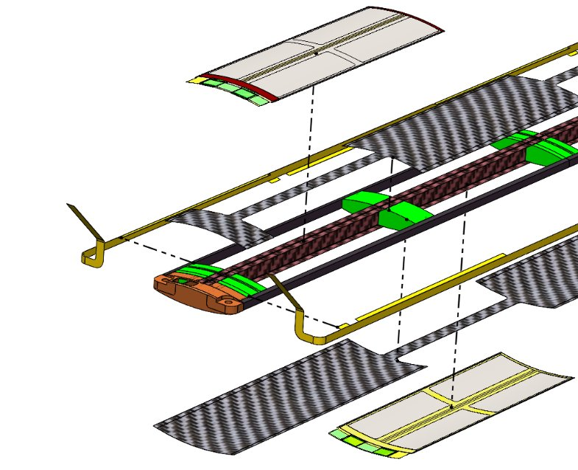
Previous CAD design:
Outer barrels
L3: 46 staves at 271mm radius
L4: 70 staves at 430mm radius
Staves – curved silicon on carbon fiber support

Slide 4
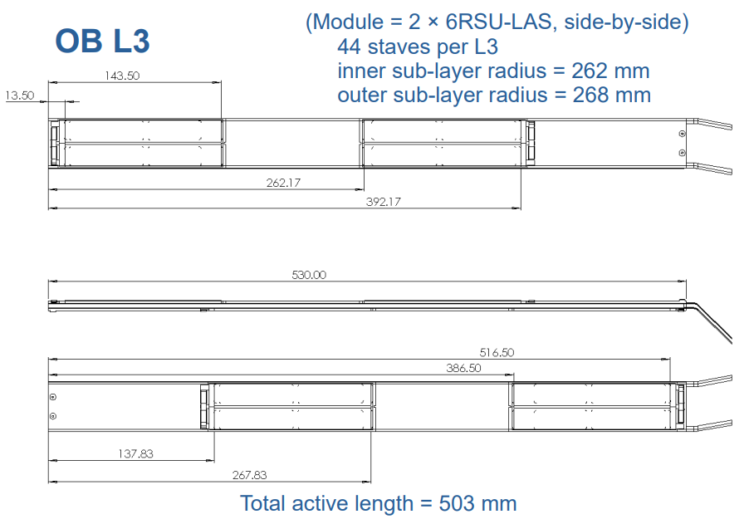
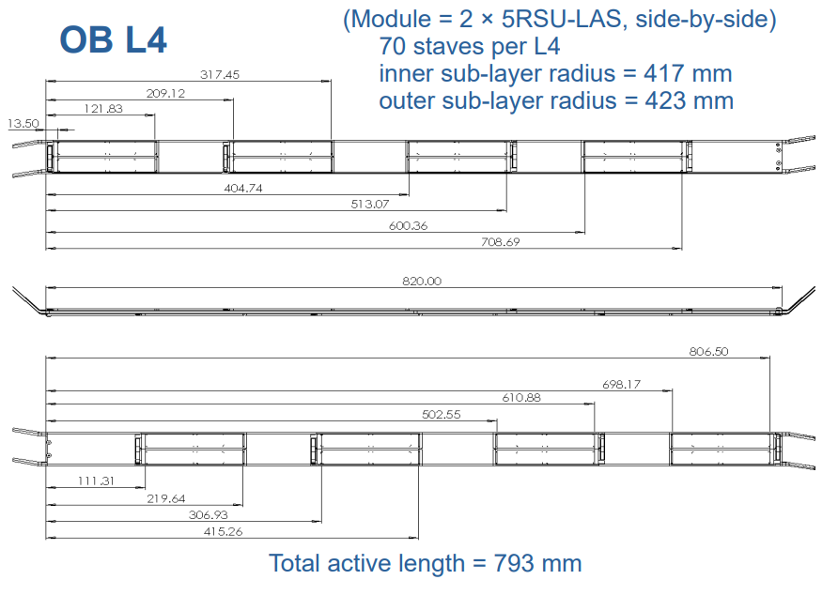
Current stave design:
From ePIC SVT WP4 & WP6 joint meeting:
https://indico.bnl.gov/event/29758/

Slide 5
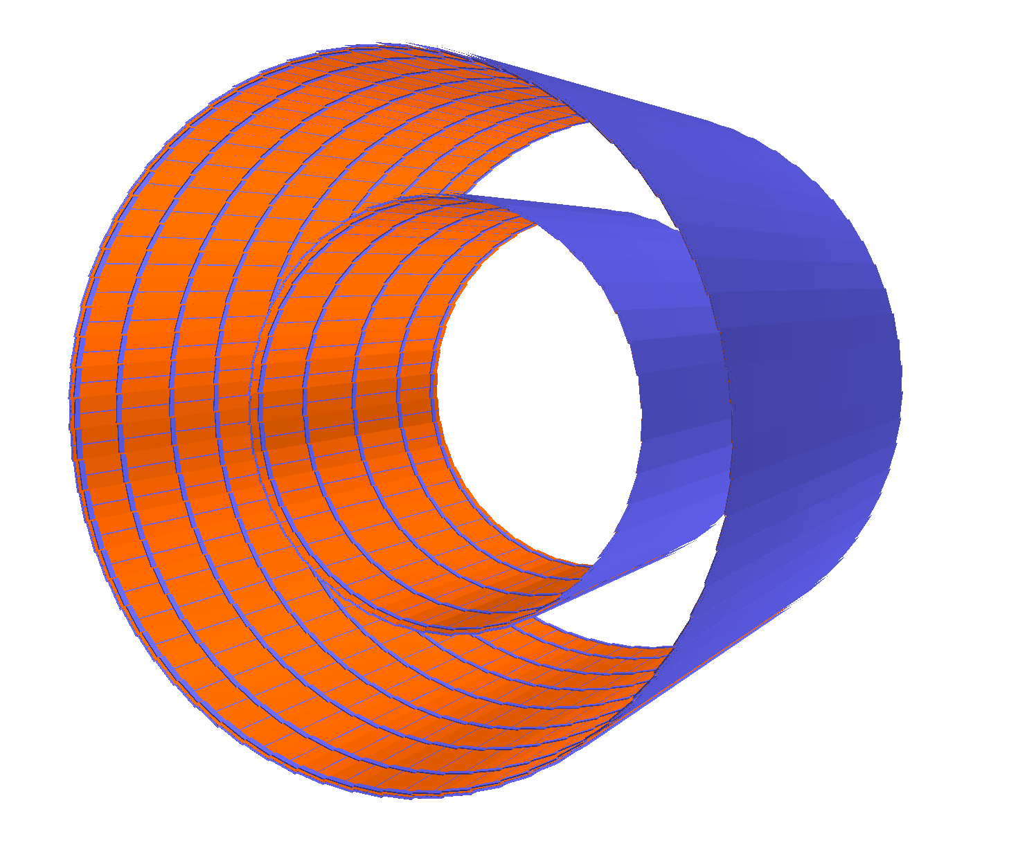
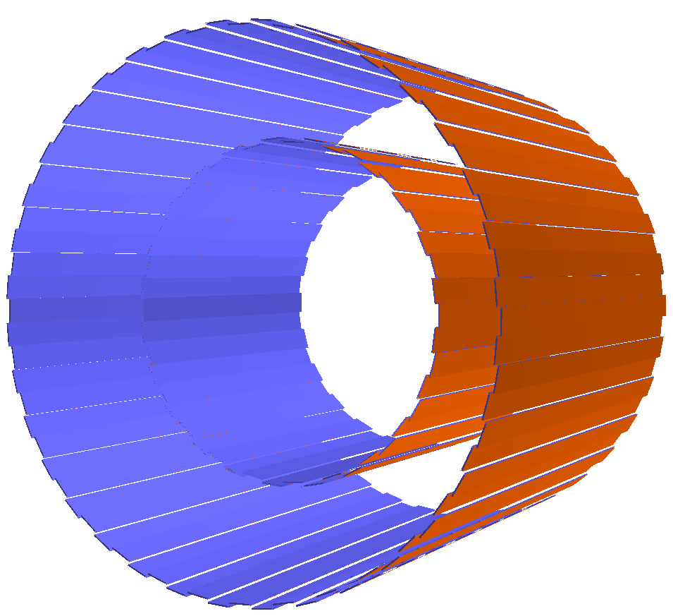
Comparison of flat_OB past to present
Silicon Barrel - castellated
Silicon Barrel

Slide 6
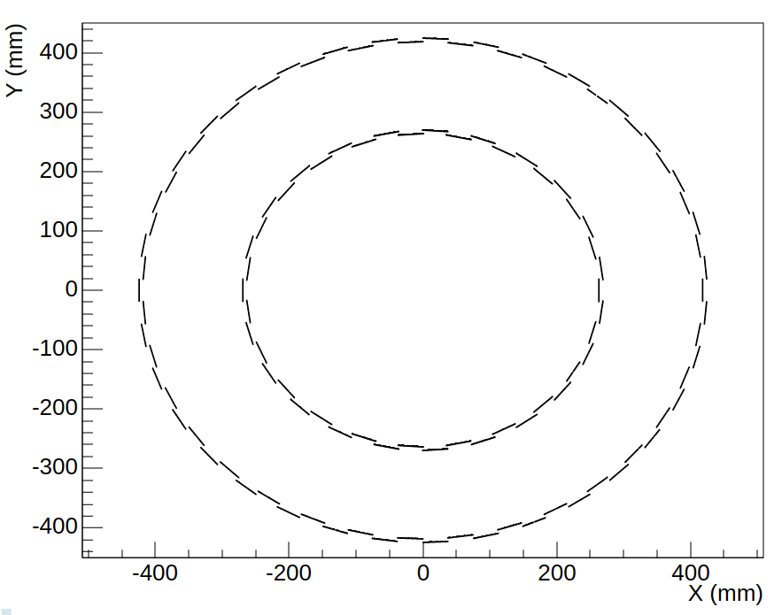
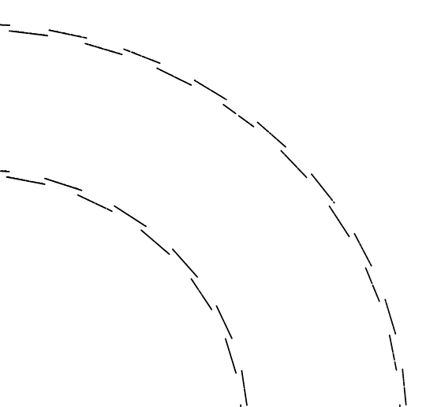
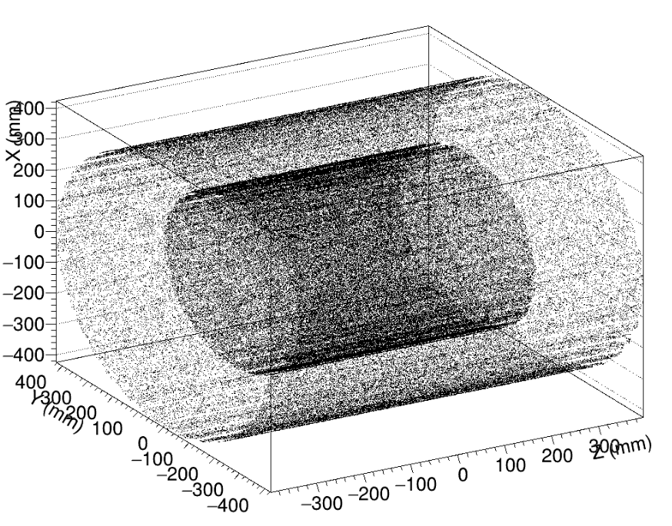
100k single particle simulations of $π^{−}$ (15GeV/c)
Will double check with more events
L4 radius ~420 mm
L3 radius ~265 mm
6

Slide 7
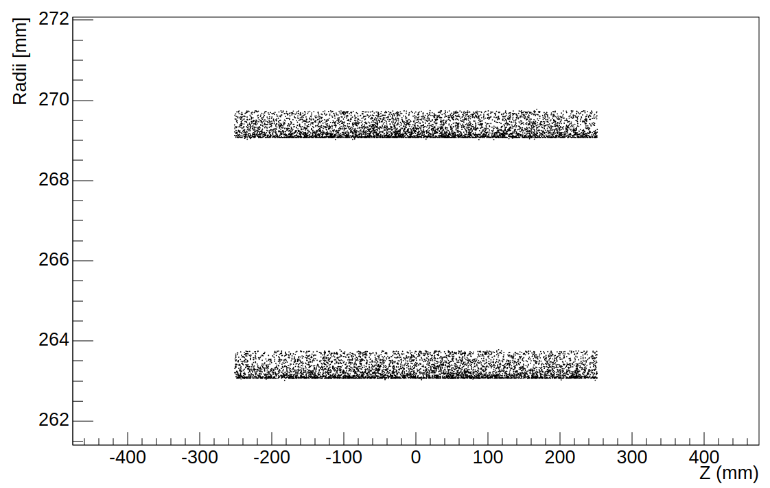
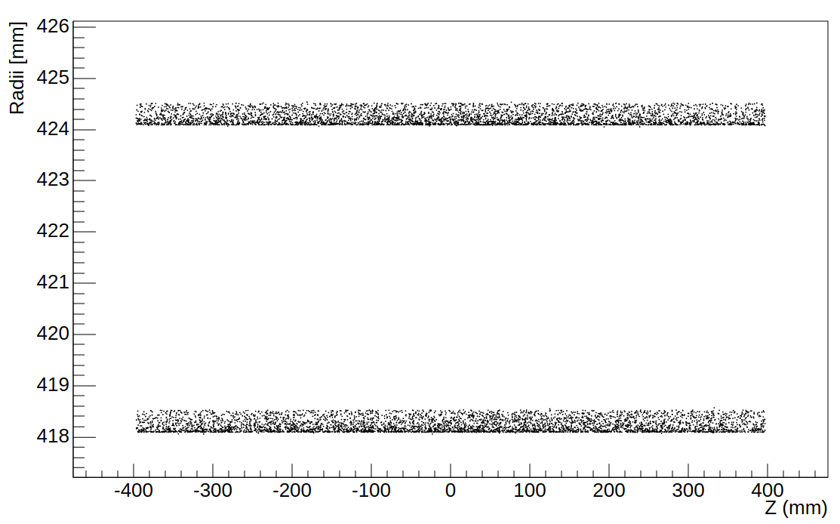
Flat OB – L3
Top radius: ~269.1 to ~269.7mm
Bottom Radius: ~263.1 to ~263.7 mm
Difference: ~6mm
Flat OB – L4
Top radius: ~424.1to ~424.5mm
Bottom Radius: ~418.1 to ~418.5 mm
Difference: ~6mm

Slide 8
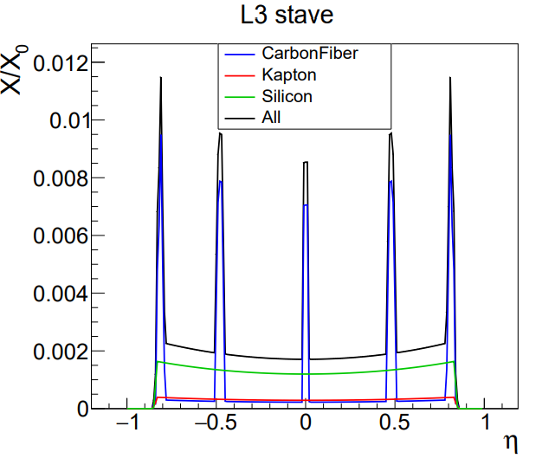
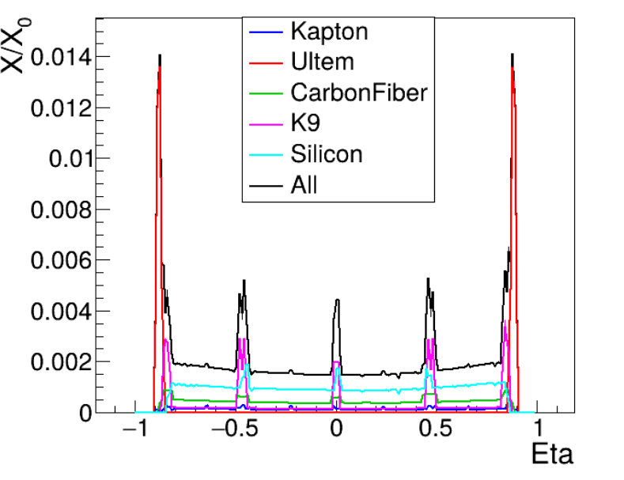
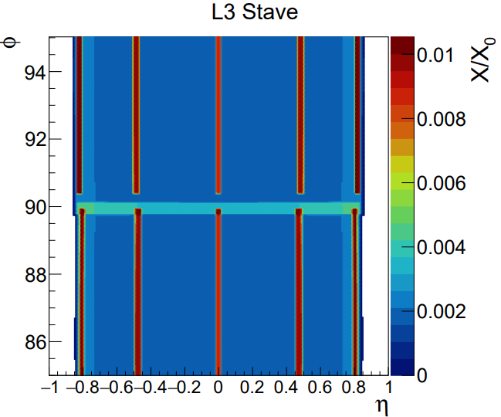
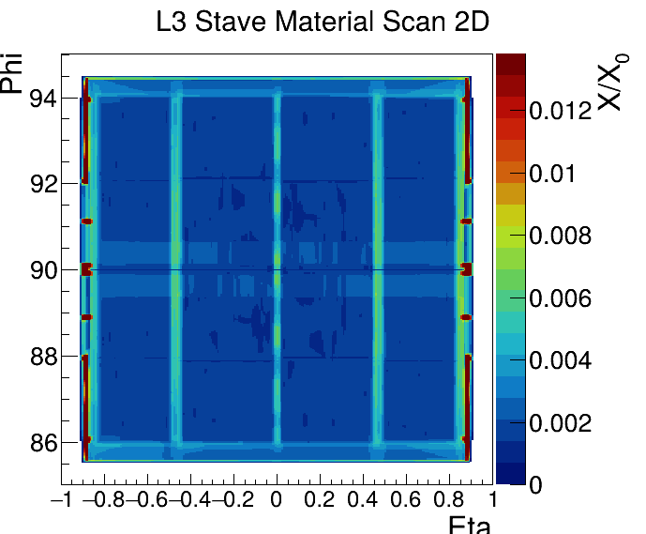
Flat_OB
L3 stave
SVT_OB
L3 stave
8

Slide 9
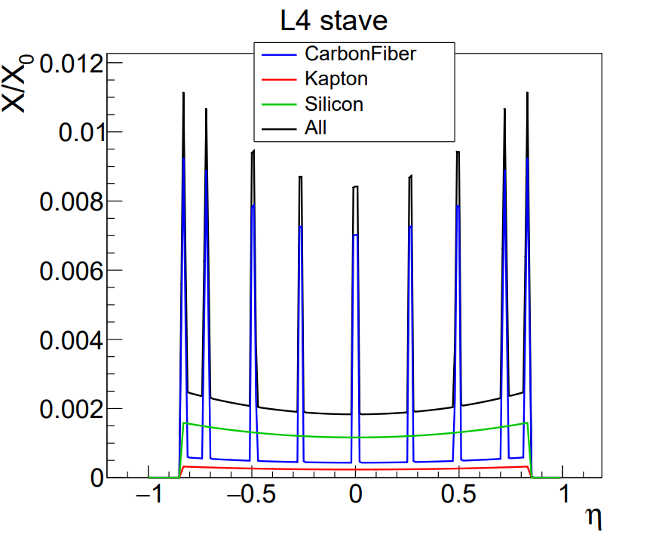
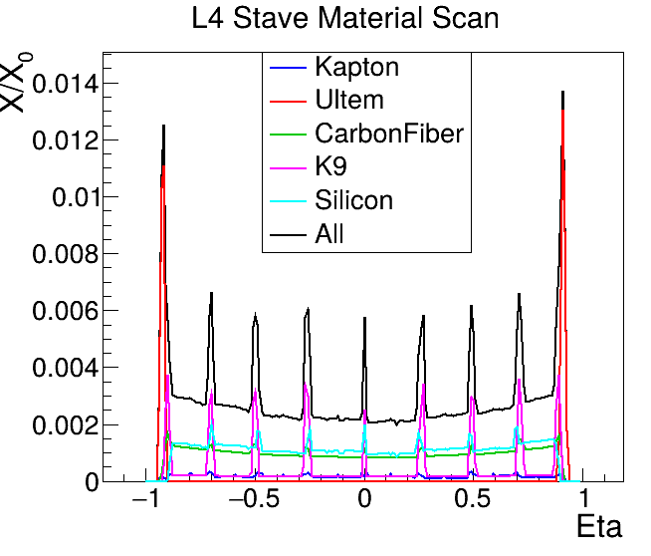
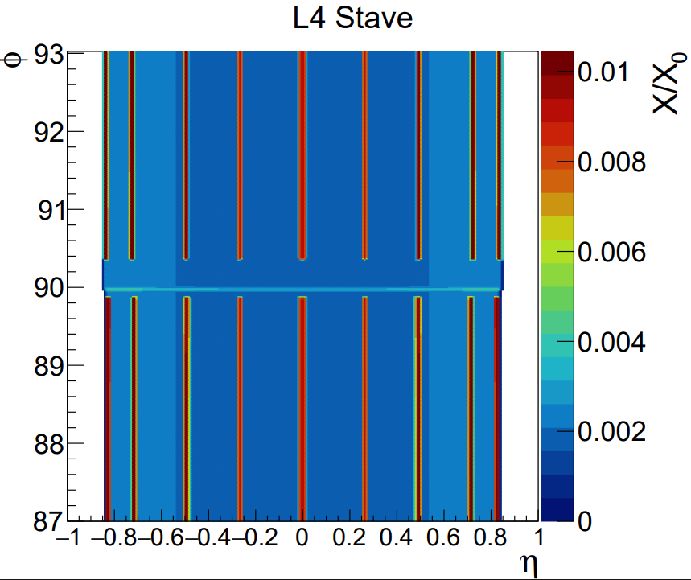
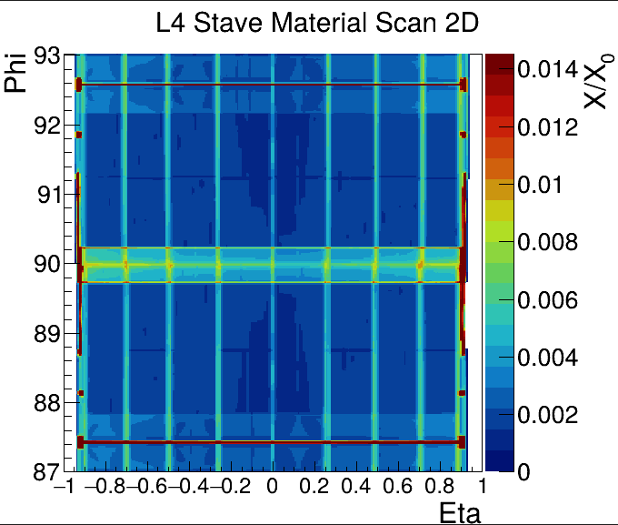
Flat_OB
L4 stave
SVT_OB
L4 stave
9

Slide 10
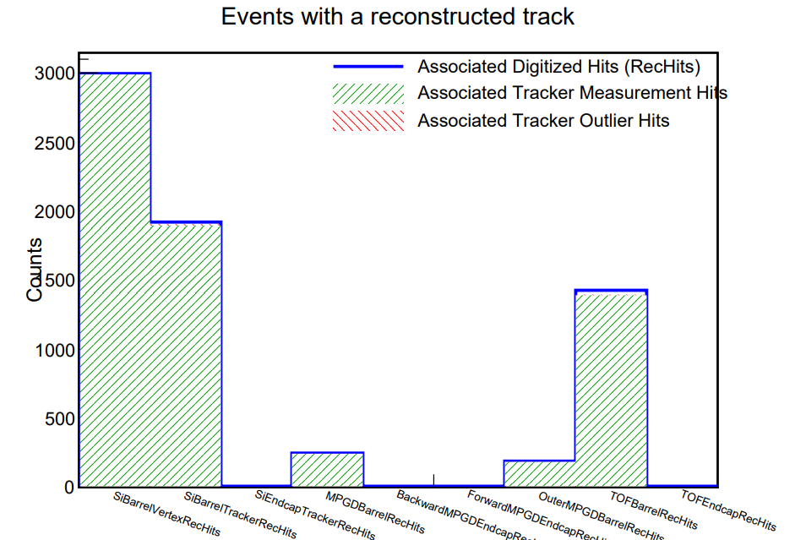
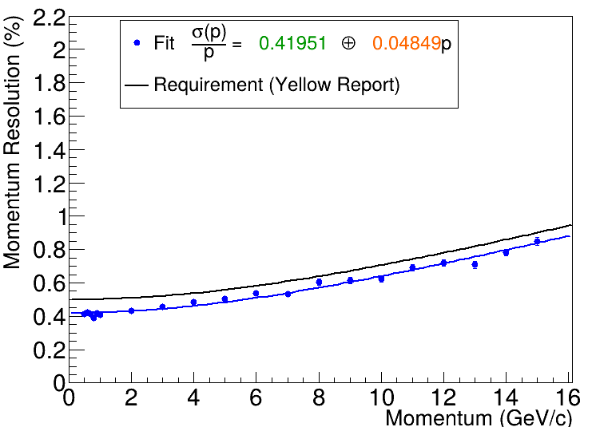


Flat_OB Momentum resolution
-$0.88≤η≤0.88$
Distribution: $η$

