Slide 1
Collider-Accelerator Department
Machine Advisory Committee
Wolfram Fischer
Deputy Associate Laboratory Director for Accelerators, NPP
Chair, C-AD
C-AD Machine Advisory Committee
17 December 2025
Notes:
15 min => 10 slides

Slide 2
Committee Members
Sasha Valishev, FNAL – Chair
Richard Scrivens, CERN
Andreas Lehrach, RWTH Aachen
Uli Wienands, ANL
Yoichi Sato, J-PARC/KEK
Ralph Assmann, GSI

Slide 3
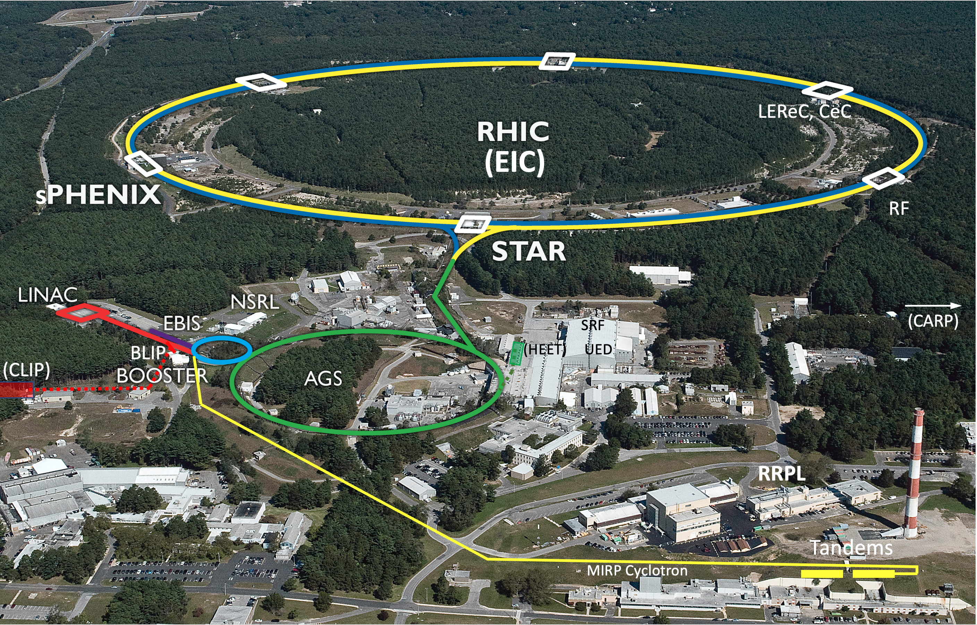
Collider-Accelerator Department facilities
Uniquely flexible and
only hadron collider in
US for exploration of
QCD phase diagram
and proton spin
Injectors also used for
application programs:
- Linac/BLIP for
isotope production
- Booster/NSRL for
space radiation studies
- Tandem for
industrial/academic users
R&D for future facilities
and application
sources, cooling, pol. beams, …

Slide 4
C-AD in transition – RHIC to EIC
RHIC beam operations to end no later than 28 Jan 2025
  Last Au+Au collision at 100 GeV/nucleon on 8 Dec 2025, 08:45:20
  Presently colliding polarized p+p (sPHENIX only)
  Possibly other modes (days)
    Au FXT at injection energy – STAR only
    APEX and CeC
Followed by several tests (PS, RF, LEReC)
Then transition to a new mode

Slide 5
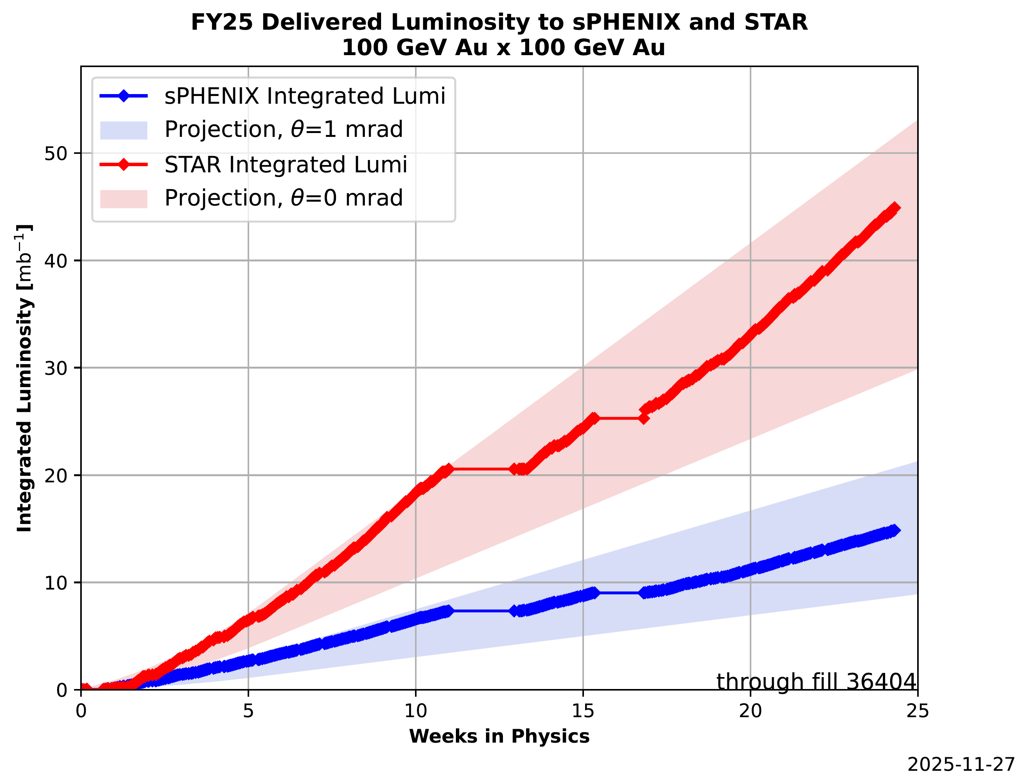
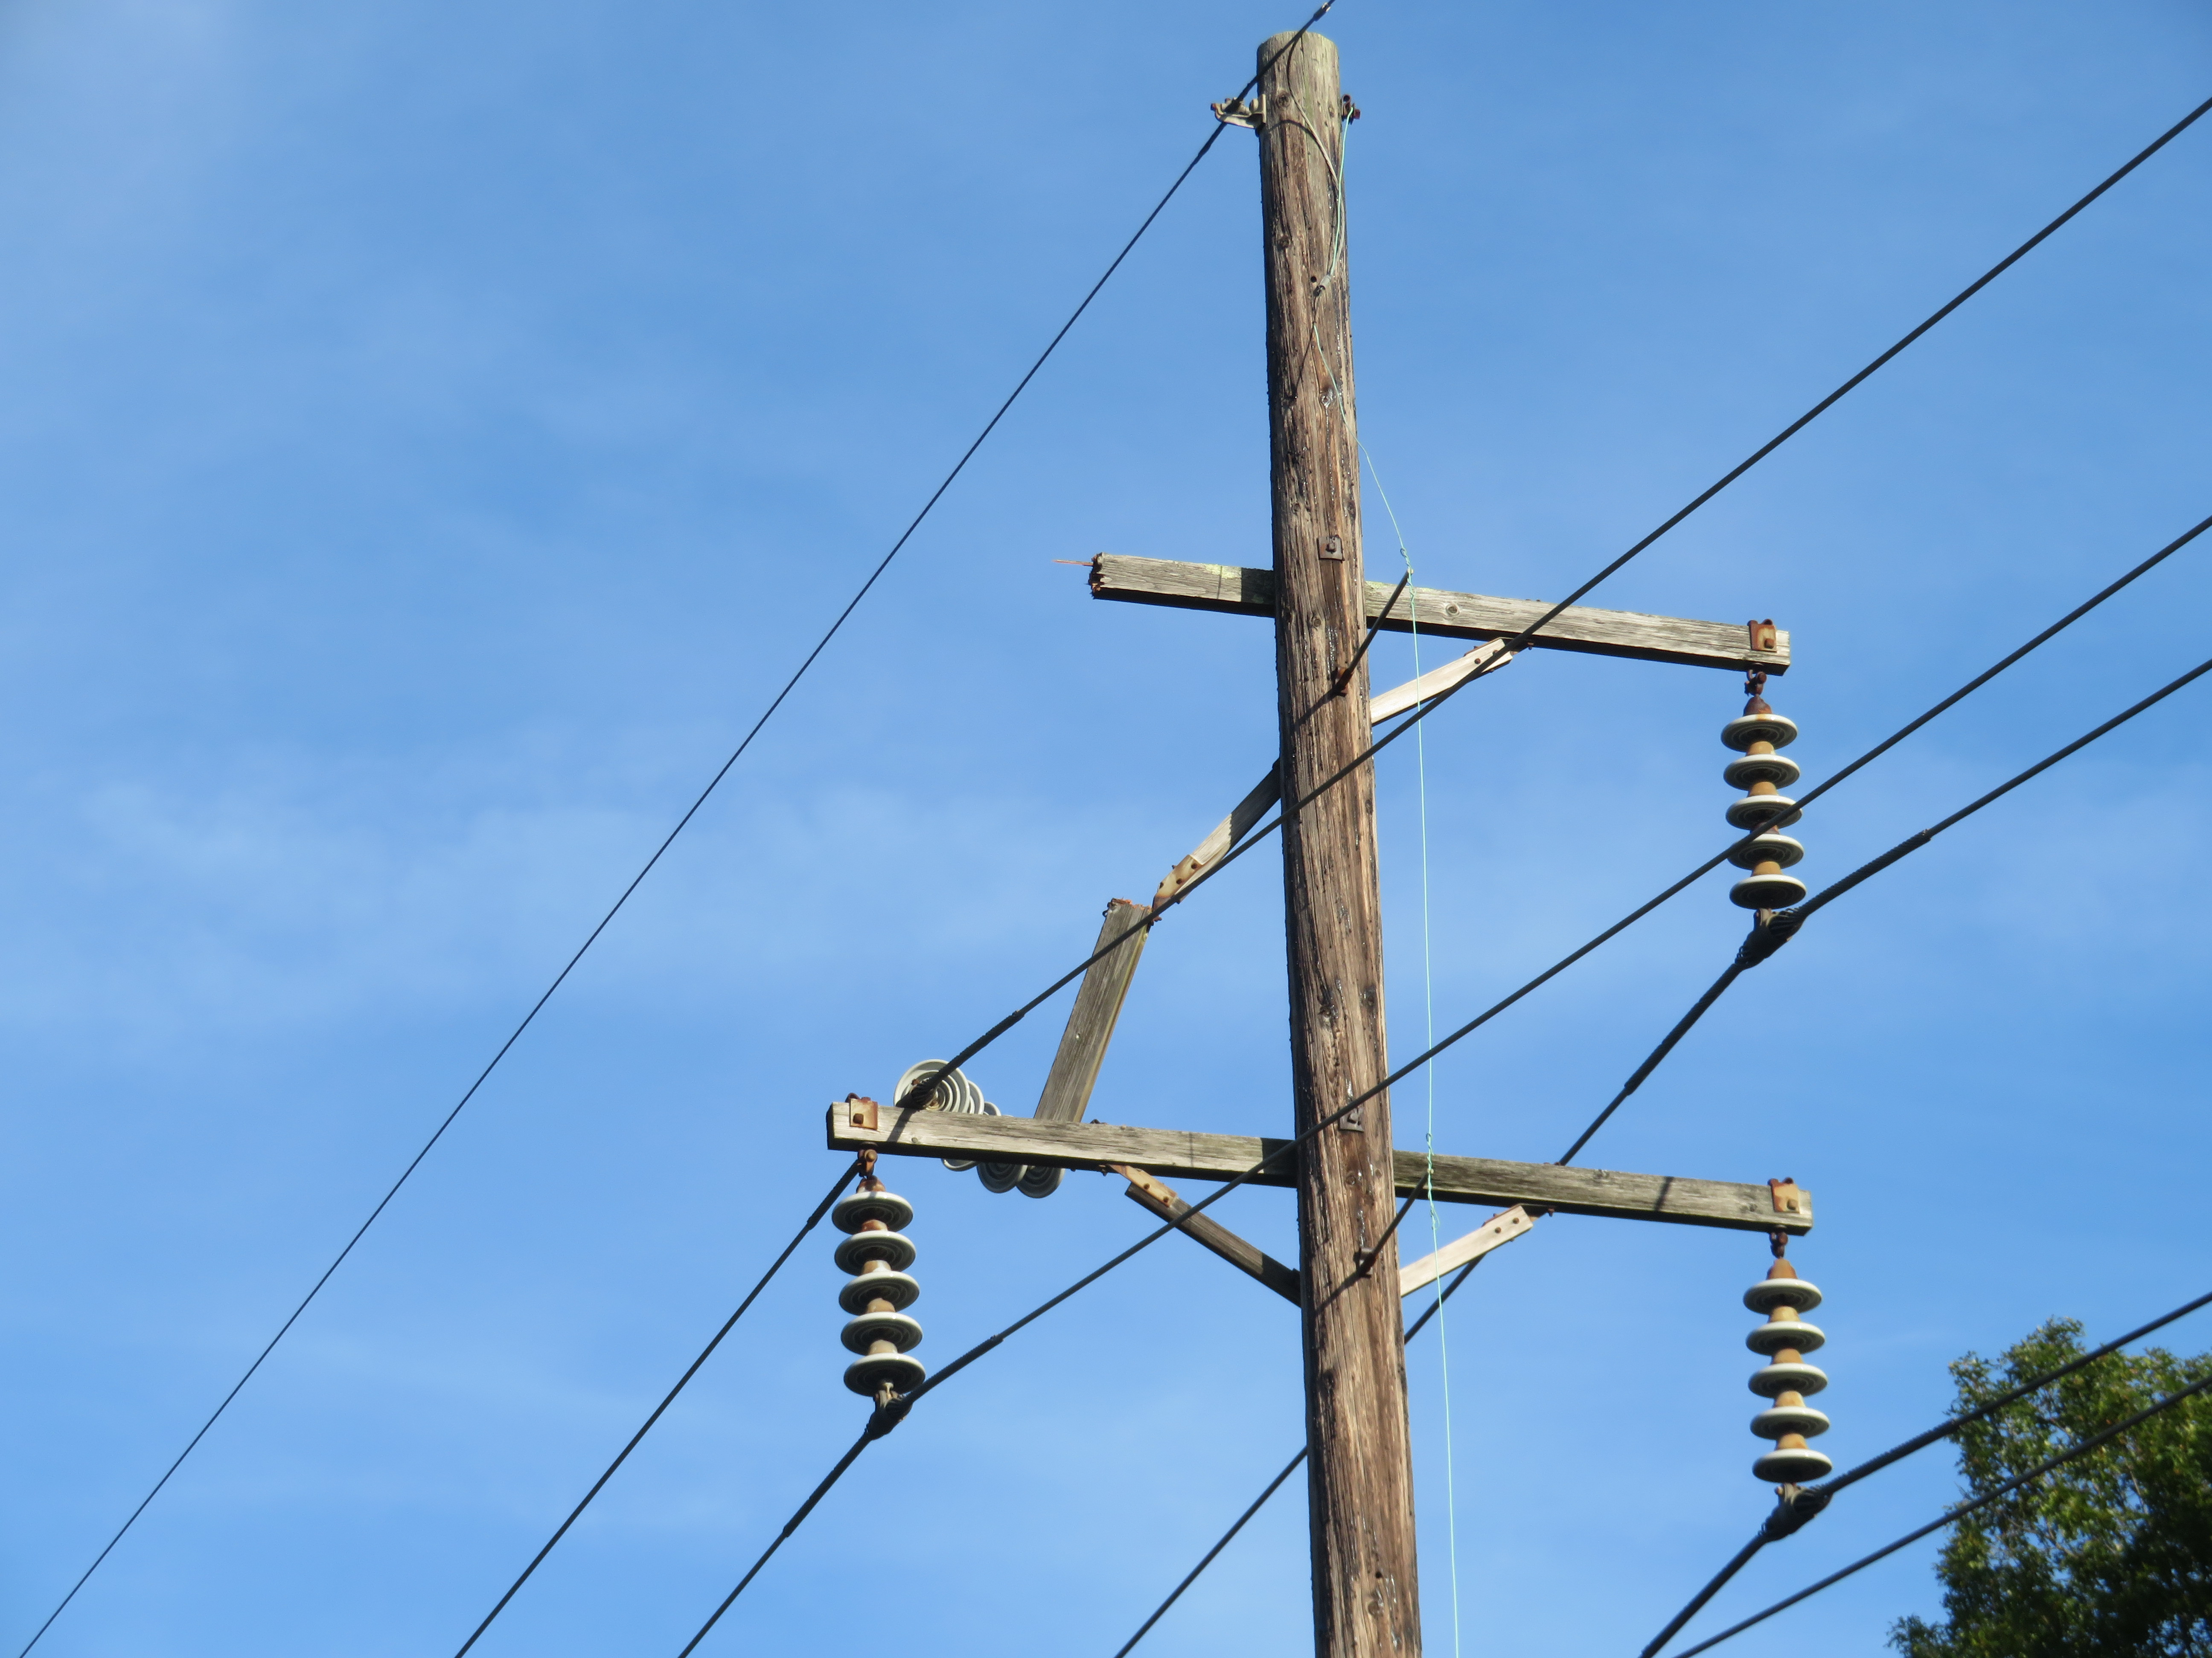
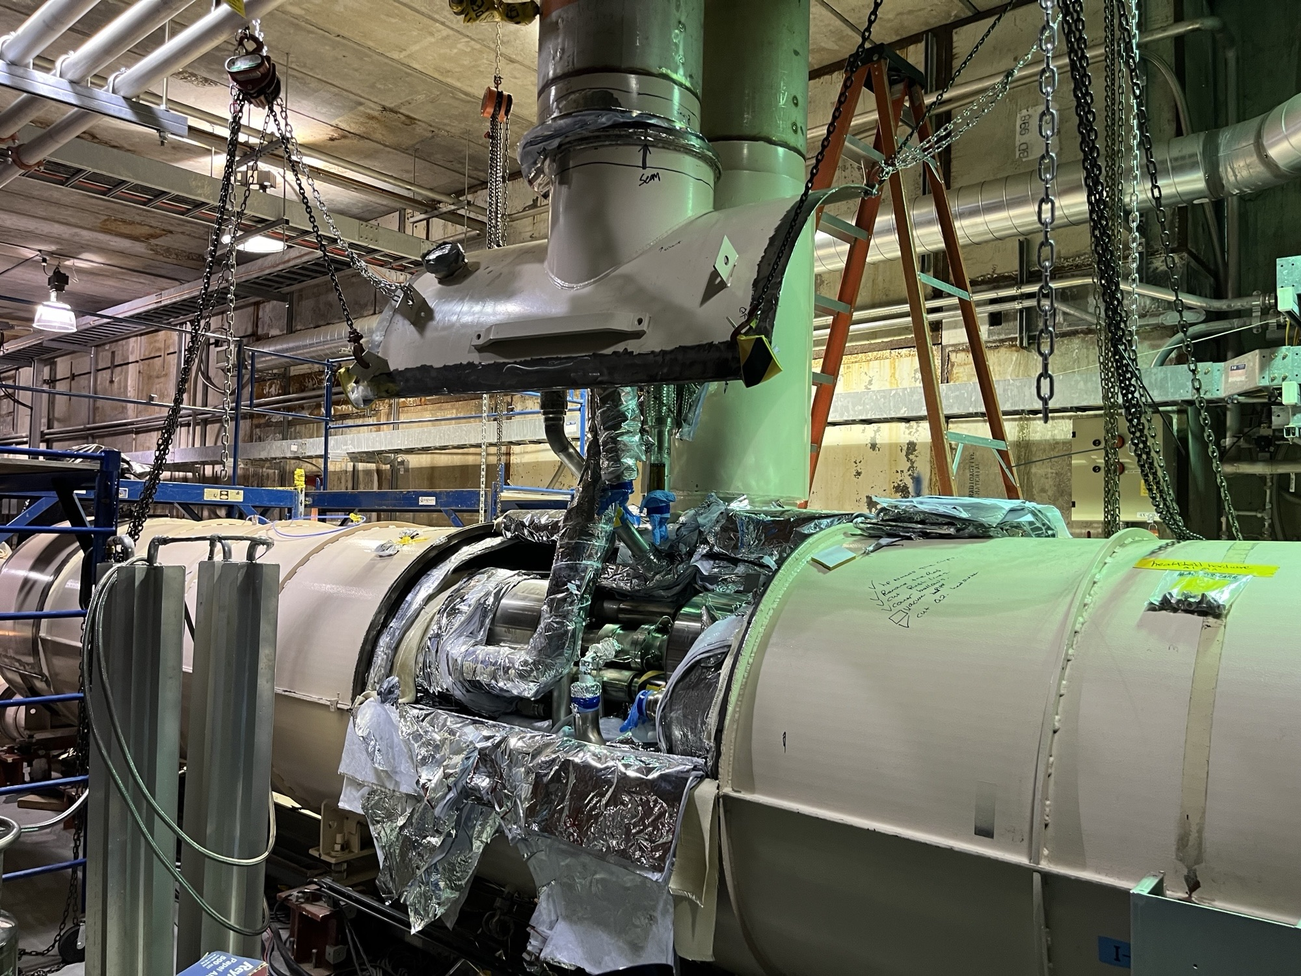
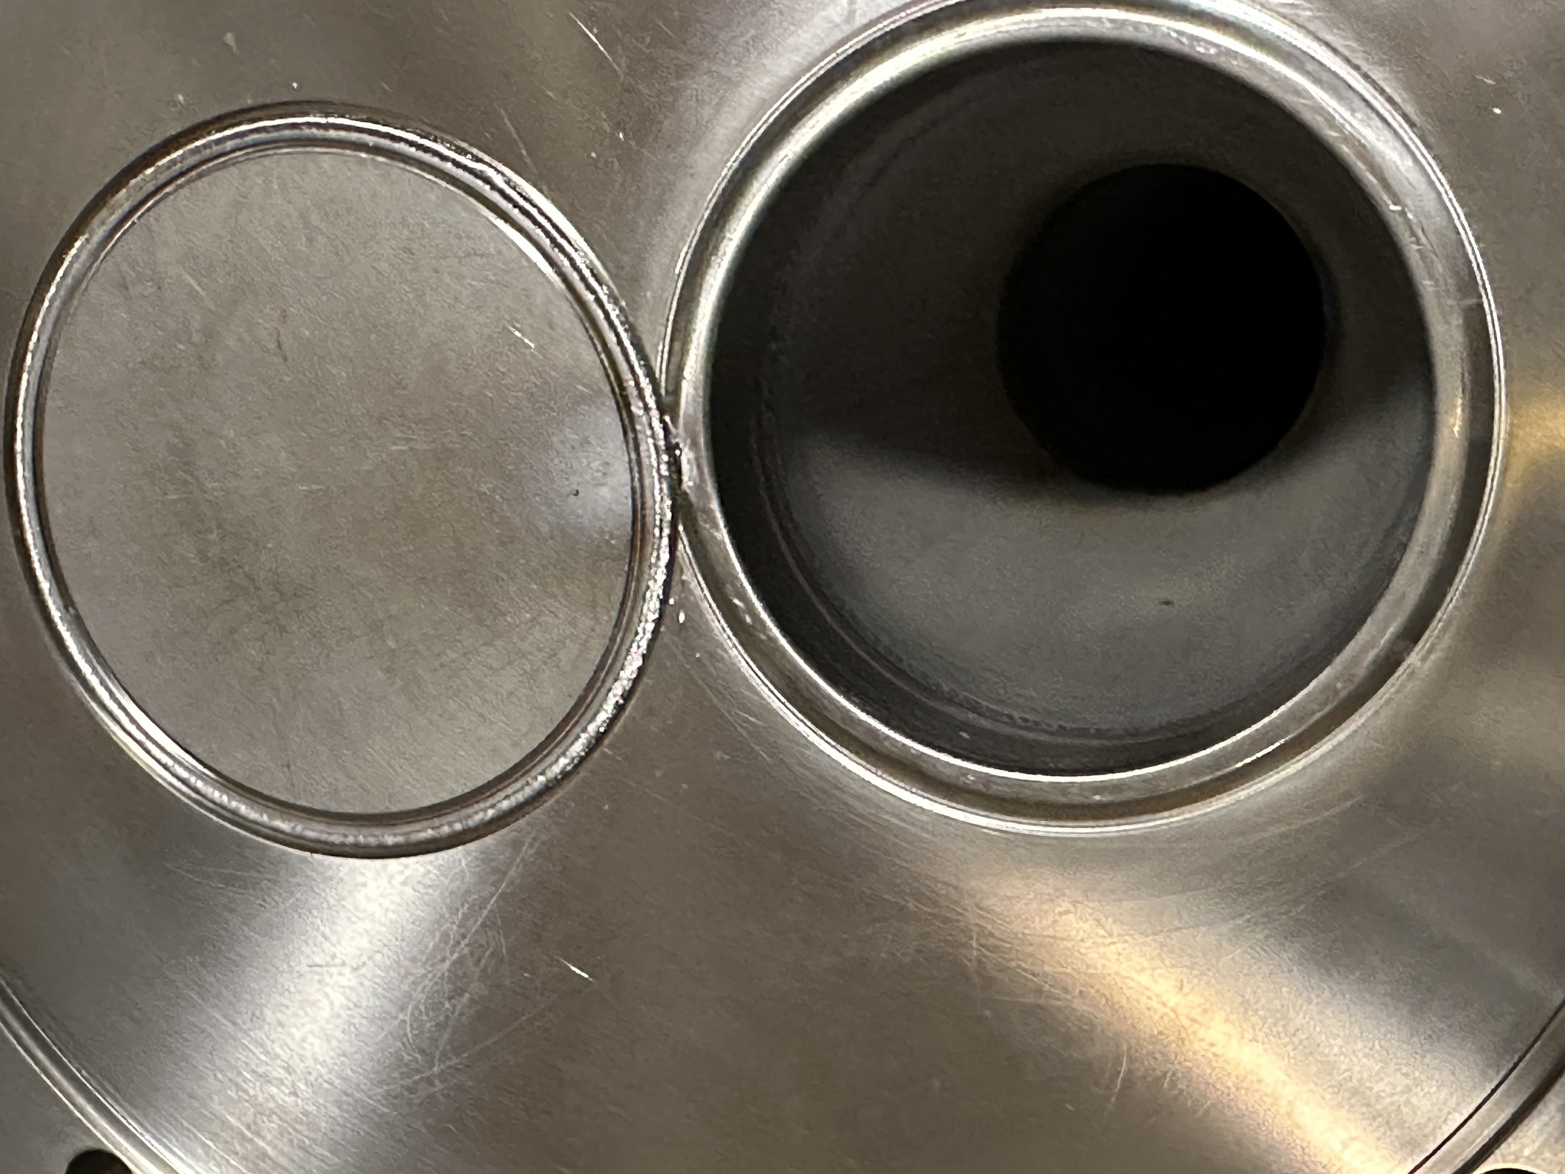
Final
Run-25
Au+Au
damaged 69 kV power line
repair shut off Central Cryo Plant
required managing helium inventory
15 days
Run Coordinator:
Travis Shrey
[μb⁻¹]
short in superconducting bus
repair required partial warm-up
opened several cryostats
65 days
unsynchronized beam abort
Yellow abort vacuum repair
14 days

Slide 6
C-AD in transition – RHIC to EIC
DOE Review for Injector Operations and RHIC Removals and Repurposing (R&R)
8-10 Sep 2025, remote reviewers
DOE NP funded activities from end of RHIC program to start
of EIC operations
8 Recommendations (3 submitted, 2 by 31 Dec, 3 by 31 Jan 2026)

Slide 7
BNL NP operations scope – after RHIC conclusion
Part of the EIC Portfolio – but not EIC Project
BNL NP Operations
  Recurring effort from end of RHIC operation to beginning of EIC operation
  Hadron Injectors and Technical Infrastructure
  Experimental Support
  Regular upgrades
  ESH, ARRs
  Research and Development
RHIC Removal and Repurposing Project (R&R)
  Project with scope, cost, schedule (not under O 413.3B)
Large Upgrades Projects needed for EIC
  Project with scope, cost, schedule (not under O 413.3B)
<= MAC-22
<= MAC-22
<= MAC-22
<= MAC-22

Slide 8
BNL NP Operations

Slide 9
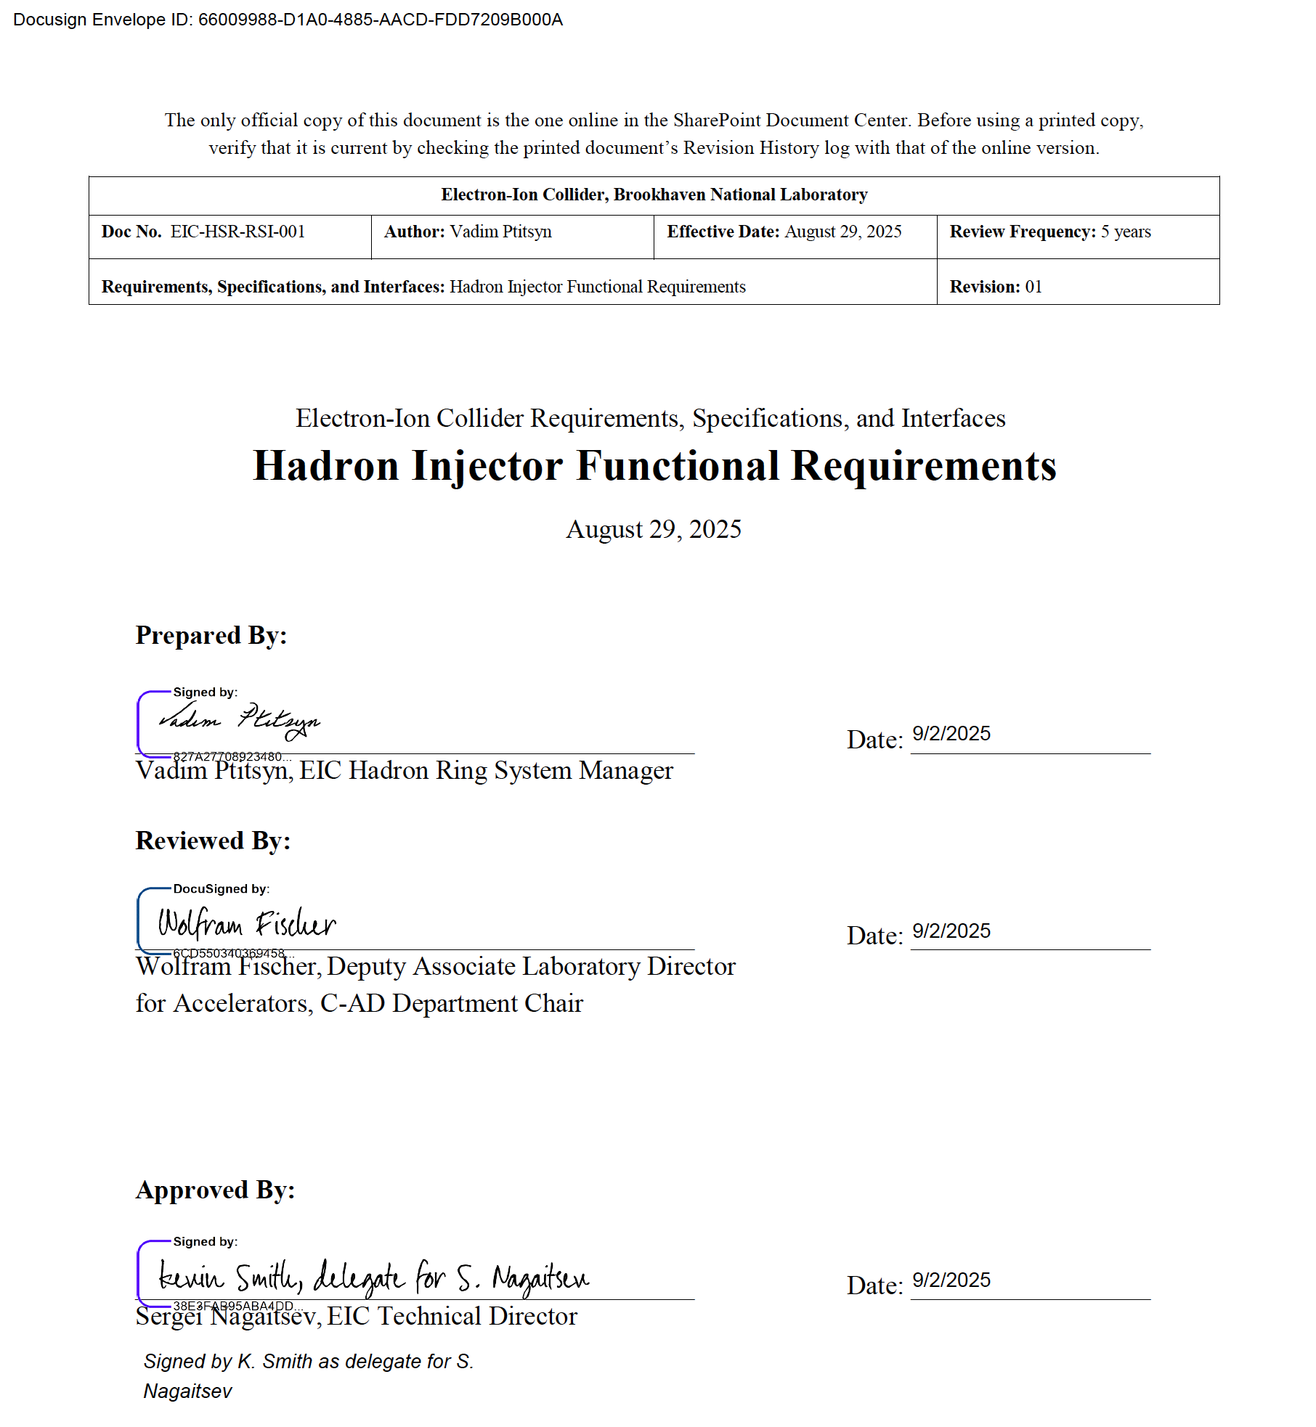
EIC Requirements for Hadron Injectors
Beam parameters (in table)
Support 85% EIC availability
(RHIC 85.0% 10-year average 2015-2024)
Beam ready when needed for EIC
Captured in formal document →
Parameter | p | d | h | Au
Charge number Z | 1 | 1 | 2 | 79
Mass number A | 1 | 2 | 3 | 197
Injection Energy [GeV] | 23.8 | 12.2 | 11.1 | 9.8
Bunch Intensity [10¹⁰] | 32 | 15 | 13 | 0.23
RMS norm. emittance, h/v [mm] | 2.5 | 2 | 2 | 2
RMS long. emittance [10⁻³ eV∙s] | 42 | 42 | 35 | 42
Polarization [%] | 72 | - | 72 | -

Slide 10
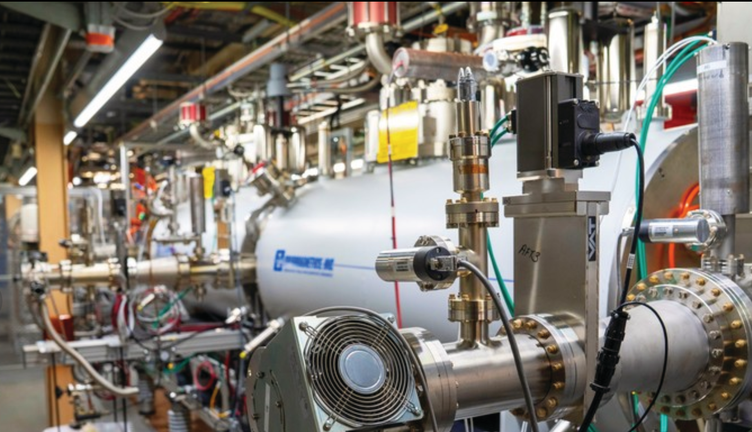
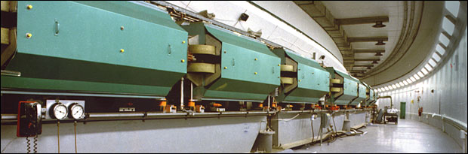
Hadron Injectors
EBIS
High-intensity high-brightness pulsed ion sources
(Laser Ion Source, polarized proton and He-3 source,
high-intensity H– source)
Electron Beam Ion Source (EBIS)
H– Linac (200 MeV, 120 m long)
AGS Booster (1.5 GeV p / 100 MeV/n ions, C = 200 m)
Alternating Gradient Synchrotron (AGS)
(25 GeV p / 10 GeV/n ions, C = 800 m)
Transfer lines between these machines and to HSR (YD26)
Mid-term R&D for
sources, polarized beams, beam cooling
[Tandems not included – self supporting]
Linac
AGS

Slide 11
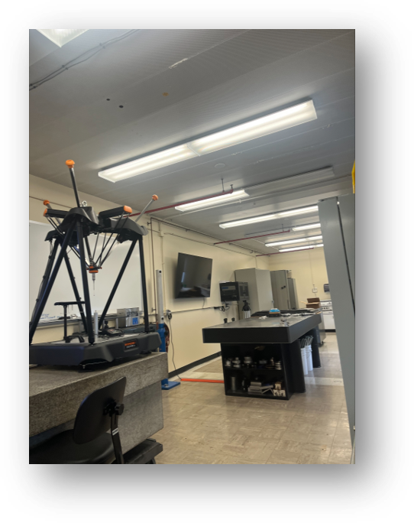
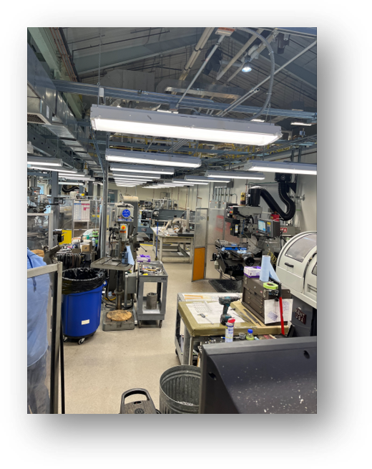
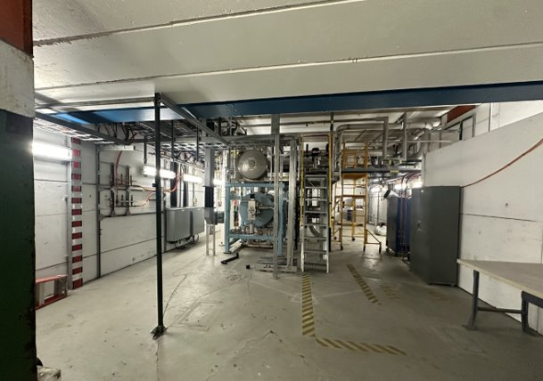
Technical Infrastructure
Shop areas (power supplies, vacuum,
instrumentation, RF, cryo, electronics
and experimental support)
Test areas (primarily experimental hall
bldg. 912)
Equipment buildings for hadron injectors,
experiments and RHIC/HSR (not office
buildings) – approximately 100 buildings

Slide 12
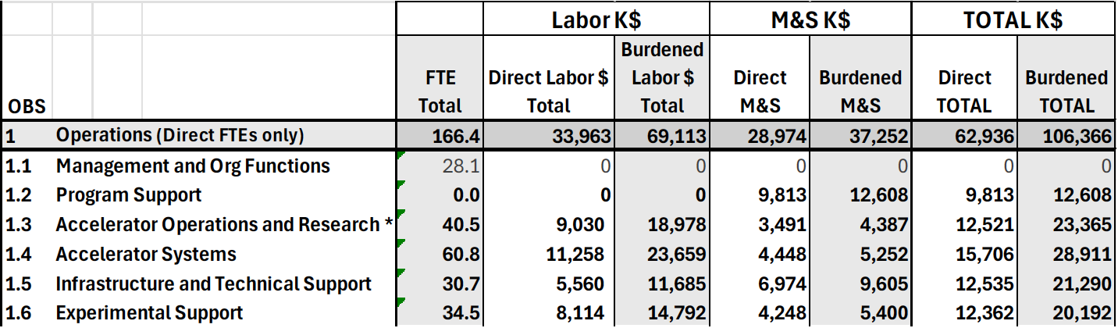
Cost Summary – BNL NP Operations
For annual effort to maintain Hadron Injectors and Technical Infrastructure,
perform regular Upgrades, and Experimental Support
After RHIC operation concludes, in FY26$
164.1

Slide 13
RHIC Removals and Repurposing (R&R)
Large Upgrade Projects Required for EIC
[time-limited efforts, not DOE 413.3B]

Slide 14
RHIC Removals and Repurposing (R&R)
RHIC R&R is a project with scope, cost, schedule
(not under DOE project order O 413.3B)
Preparation of the present RHIC tunnel for EIC construction:
  EIC uses only one of the RHIC hadron rings as the Hadron Storage Ring (HSR)
  EIC adds Electron Storage Ring (ESR) in tunnel
Removal of RHIC equipment not used by EIC from tunnel
and experimental halls
Delivery of some equipment to EIC for Repurposing
R&R has low technical risk, dominated by labor

Slide 15
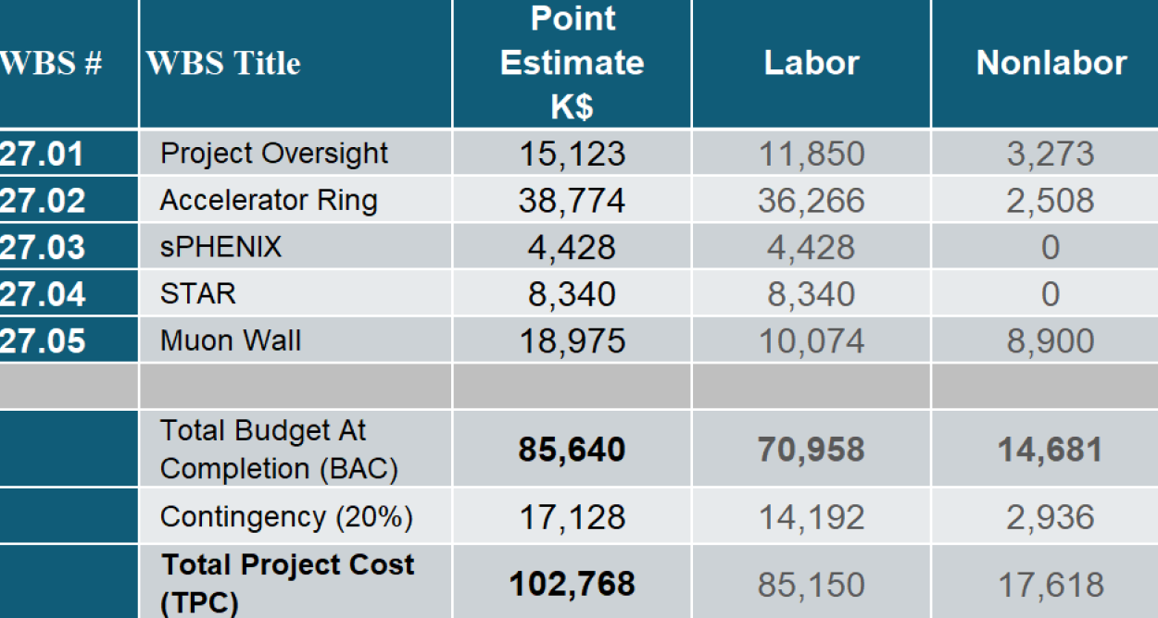
RHIC Removals and Repurposing (R&R)
Based on Project Definition, BOE, and DOE G 413.3-21A (Jun-2018) Cost Estimating Guide, appropriate range estimate is Class 2 (L: -5% H: +20%)
Project Contingency assigned
is 20% applied to the BAC
Predominantly Labor project, 85% Labor and 15% Nonlabor
Nonlabor is comprised of Muon Wall contractor and general material consumables across all WBS elements within Project Oversight
Technical driven schedule:
FY2026 to FY2029 w/o Muon Wall; to FY2031 w/ Muon Wall
Funding profile $30M / $30M / $43M

Slide 16
Large Upgrade Projects in Order of Priority
Upgrade projects with funding needs beyond the assumption in recurring BNL NP Operations budget ($3M/y for AIP+CE):
Central Cryo Plant Upgrade ($34.0M)
SRF Test Facility Upgrade ($17.7M)
LINAC RF Power Amplifier Upgrade Phase I ($12.7M)
(start of conversion from triode to solid state, Phase II ~$88M)
AGS Cooling Water System Upgrade ($9.1M)
Notes:
Should removal of legacy infrastructure

Slide 17
Additional uses of hadron injectors
Operation of Linac for DOE isotope production at BLIP
[BLIP = Brookhaven Linac Isotope Producer, incremental costs recovered]
Operation of LION/EBIS/Booster for space radiation studies
[LION = Laser Ion Source, EBIS = Electron Beam Ions Source,
NSRL = NASA Space Radiation Laboratory, incremental costs recovered]
NASA Space Radiation Lab (NSRL) at BNL is a unique national test facility for
  Space biology
  High-Energy (>100 MeV/nucleon) space electronics testing

Slide 18
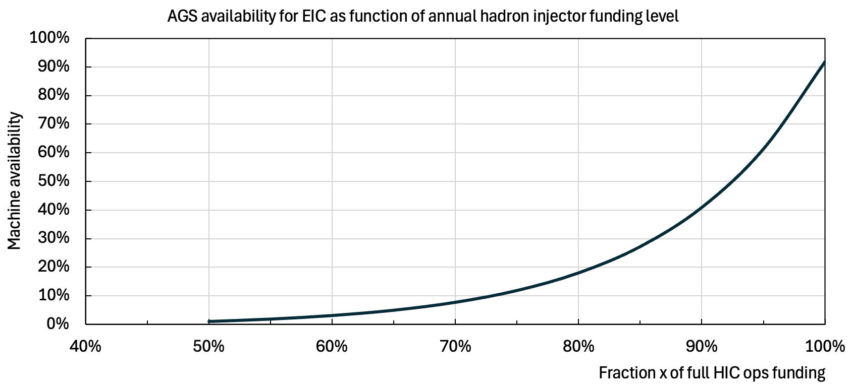
Model of EIC hadron injector availability vs HIC funding
Infinite
cost
Ops review estimate (Sep 2025)
(well estimated)
3-parameter model
Funding level for 90%
Funding level for 0%
Steepness
Is there a better model?
Steepness
(rough estimate)
0% availability
(rough estimate)
~20% reduction makes EIC commissioning and operation ineffective
idles EIC for long periods at ~$300M/y EIC ops budget
could take a decade to reach 85% DOE availability requirement (cf CEBAF)
[100% ~ $65M/y]

Slide 19
Recommendations from MAC-21

Slide 20
MAC-21 recommendation responses
RHIC Performance in Run-24 and planning for Run-25
R1: The nature of the instabilities encountered (during scrubbing run with p) should be described in more detail. => Michiko Minty
R2: Define a strategy for the 56 MHz cavity before the start of the run, that achieves an optimal trade-off between invested time and expected performance gain. => Michiko Minty
Experimental background in Run-24 and sPHENIX MVTX experimental background task force
R3: Calculate the overall aperture bottleneck for a betatron halo particle (at a setting of horizontal collimator, e.g. 8 sigma-beta-x) that at the same time has an energy offset at the momentum aperture (e.g. 4.5 sigma-E). Use the known local aperture, the horizontal beta function and the horizontal dispersion to see if such a particle can get lost at the second taper in front of sPHENIX or at another “high impact” location that can shine into the detector. Only if this is true, a global momentum collimation can safely protect the experiment. Otherwise, local origins of off-momentum ions might be responsible, to be counteracted by local protection measures.
=> Michiko Minty
R4: Check the dependence of background on bunch intensity and horizontal collimator settings.
=> Michiko Minty
R5: The addition of local shielding in sPHENIX seems like a good idea and should be done before Run-25 if at all possible.
=> Michiko Minty

Slide 21
MAC-21 recommendation responses
Injector upgrade plans over the next decade
R6: Continue optimizing the modernization plan and produce a prioritized list of tasks for next year’s review.
=> Rob Michnoff
CeC status and plans for Run-25
R7: Overcome the lack of reliability: both in terms of beam parameter jitter and poor repeatability of operation set-ups. => Alexei Fedotov
R8: Develop a Plan B to continue the CeC development after the RHIC shutdown. => Alexei Fedotov
Polarization increase with AGS skew quads in Run-24
R9: Consider installing a polarized gas target to get an absolute polarization measurement that would help to track the polarization in the accelerator chain. => Frank Rathmann
R10: In Run-25, prioritize addressing model inaccuracies at energies below transition. => Kiel Hock
Physics-informed ML for polarization increase in injectors (FOA)
R11: At the next MAC, present a summary of the usage of the optimization tools created for BNL accelerator operations. => Kevin Brown

Slide 22
MAC-21 recommendation responses
BNCT lithium beam driver (LDRD 24-046)
R12: For MAC-22, clarify the scope of responsibilities among collaborators and highlight the BNL part.
=> Masahiro Okamura
EBIS Status and Performance
R13: At the MAC-22 present the plans and schedule for the polarized 3He development. => John Ritter
FFA synchrotron for medical applications (LDRD 24-010)
R14: 3D field maps including fringe fields should be incorporated in beam simulation, and the necessary dynamic aperture demonstrated. Correction schemes should also be investigated. => Dejan Trbojevic
High Energy Cooling R&D
R15: Consider engaging external partners (e.g. university faculty, graduate students) to accelerate the work on HEC options. => Alexei Fedotov
R16: Begin work towards an integrated assessment of beam dynamics in EIC hadron cooling (i.e. start-to-end simulation) for the HEC options. => Alexei Fedotov

Slide 23
MAC-22 Charge

Slide 24
MAC-22 Charge
After 25 years of RHIC operation, the Collider-Accelerator Department (C-AD) is concluding the final RHIC Run with the new sPHENIX and the upgraded STAR detectors in January 2026. After completion of the RHIC physics programs, C-AD will assume responsibility for removal of equipment not needed for the EIC from the RHIC tunnel and experimental halls, will maintain the hadron accelerator complex in a ready state, operate the hadron injectors for isotope production at BLIP and space radiation studies at NSRL, and will continue R&D in accelerator science and technology.
During this year’s MAC we request the committee’s review and advice on (i) the plans for maintaining and upgrading the hadron injector complex over the next 3 years and beyond, and (ii) the strategy and efforts of the C-AD R&D efforts.
Please address the following charge questions:
a) Comment on possible models of availability as a function of funding, and
risks associated with single points of failure.
b) Are the C-AD plans aligned with the EIC goals over the next decade?
c) Are the present efforts well executed, and future work well planned?
Any other comments on the C-AD accelerator operation and R&D are welcome.
It is requested that a concise report responsive to this charge be forwarded to the C-AD Chair, Wolfram Fischer, by 5 January 2026.

Slide 25
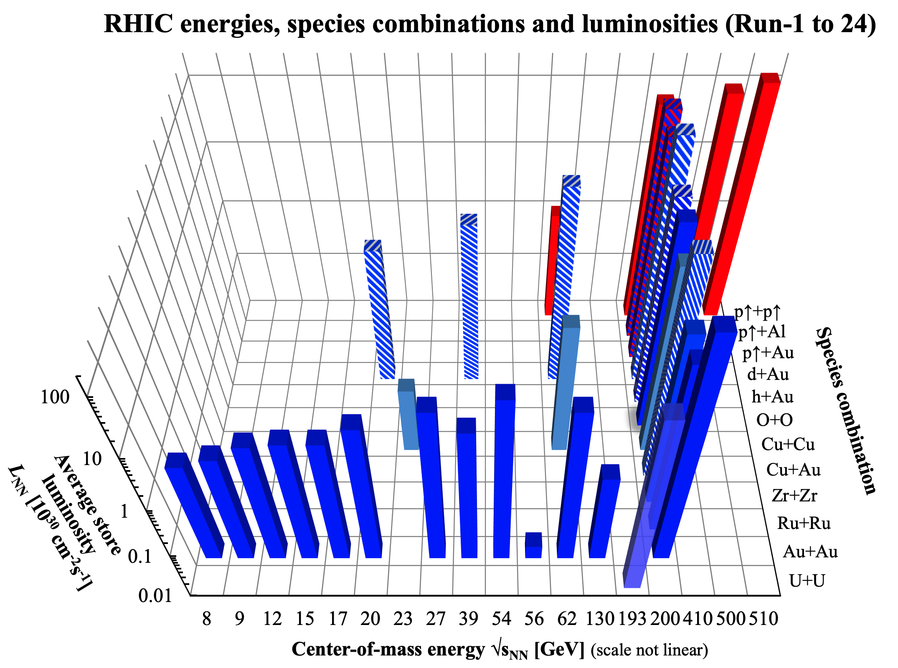
Used stochastic or
electron cooling in
1 or 2 beams
Approaching the conclusion of
25 spectacular years in Jan 2026
L design
L design
nominal injection

Slide 26
Thank you
MAC advice was essential
for advancing the RHIC program

