Slide 1
200 MeV H- Linac RF Amplifier Upgrade Plan
Freddy Severino
Head, RF Systems, Collider-Accelerator Department
C-AD Machine Advisory Committee
December 2025

Slide 2
Presentation Outline
Introduction
Upgrade Justification
Project Scope
Upgrade Options Considered - 40-Year Operations View
Basis of Proposed Upgrade Path (Cost, Risks, and Vendor Estimates)
Cost and Schedule for Demonstrator Unit
Summary

Slide 3
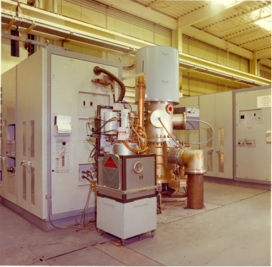
Introduction
The LINAC (200 MeV Linear Accelerator) has been in operation since November 1970, marking over five decades of continuous use in critical scientific research.
The LINAC RF system consists of 9 RF Tanks, each powered by a 5 MW pulsed RF power amplifier, with a 200 kW driver amplifier and 5 kW pre-driver.
  These systems operate at a resonant frequency of 201.25 MHz and support key operations including BLIP, NSRL, RHIC, and future EIC operations for polarized proton beams.
Over the years, critical upgrades have enhanced LINAC's reliability, but the system is still heavily reliant on legacy RF tube technology.
Urgency for Upgrade: The current RF amplifier system, which uses vacuum tubes, faces supply risks and decreasing reliability. As the system ages, there is an urgent need to convert to solid-state technology to ensure the continued safe, efficient, and reliable operation of the LINAC.
Complete RF System Driver, 5 MW PA, Modulator

Slide 4
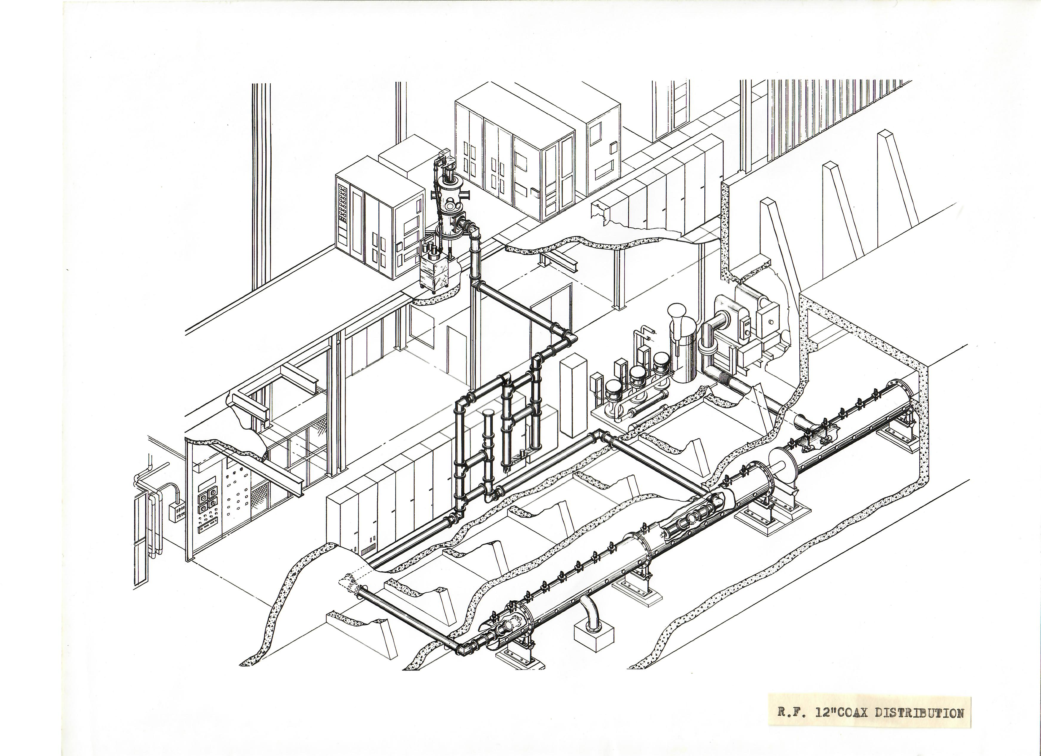
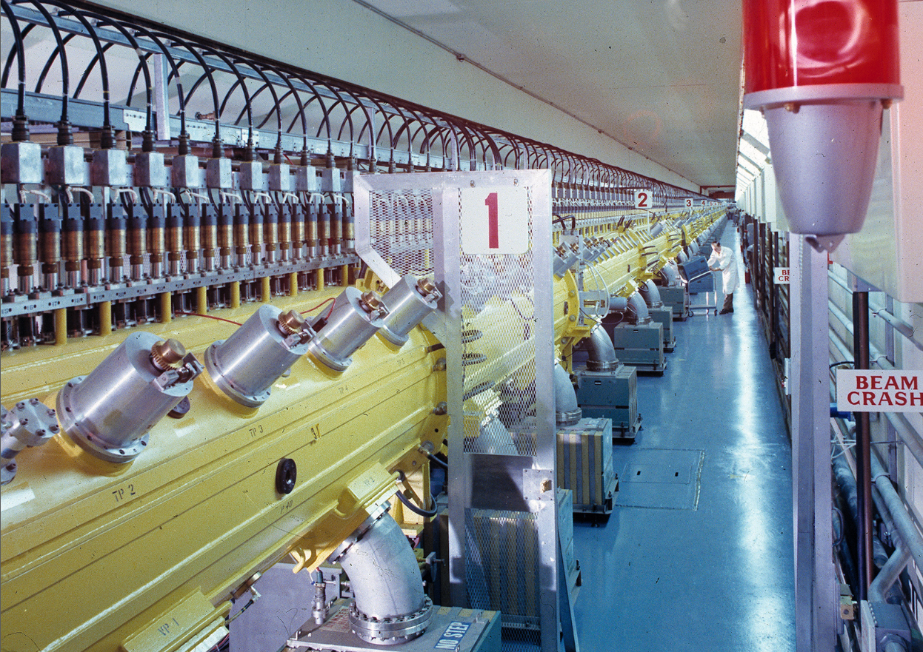
RF Systems View
The LINAC RF system consists of 9 RF Tanks, each powered by a 5 MW pulsed RF power amplifier.
Coax run from the PA through the phase shifter, 3 dB hybrid power divider, and feeding two loops in each tank (repeated for all 9 tanks)
Drift Tubes

Slide 5
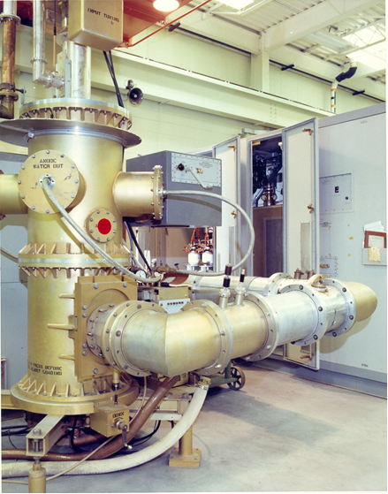
Upgrade Justification- RF Tube Supply Risk
Aging Technology & Growing Supply Risk
  LINAC relies on two high-power RF tubes (4616 & 7835) for beam acceleration
  Originally developed in the 1950s for now-defunct systems, these tubes are now sole-sourced with uncertain long-term availability
  Modulator tubes (LPT32 & 8618) are also sole-source, with rebuilds as the only supply option
Tube Supply Status & Risks
  Inventory: ~6 years (BLIP @ 60 mA) / ~10 years (EIC/NSRL @ 400 µA))
  Supply Risk: Vendors may exit the business in 3–4 years without large orders. Warranty issues if manufacturer exits the business.
  Quality concerns:
      Shorter lifespans & declining reliability (new/rebuilt tubes)
      Skilled labor loss affecting manufacturing consistency
Conclusion: Without intervention, LINAC operations face significant risk due to dwindling tube supply, unreliable rebuilds, and potential obsolescence of critical components.
RCA 7835 Power Triode, 7 MW Peak Power

Slide 6
Project Scope
Scope: This project will initiate the transition of the LINAC RF Power Amplifiers to solid-state technology by upgrading one of nine high-power amplifiers currently utilizing legacy vacuum tubes (types 4616 and 7835). The scope includes developing technical specifications and a Statement of Work (SOW), evaluating vendor proposals, and selecting a solid-state solution based on performance metrics and system compatibility. One amplifier unit will be procured, factory-tested, and installed in LINAC Tank 9 to replace the existing tube-based amplifier. This upgrade will serve as a proof-of-concept, informing the future replacement strategy for the remaining eight RF amplifiers.
Out of Scope:
Replacement of the remaining LINAC RF amplifier units.
(Future phases will convert 6 of 8 tanks; 2 low-power tanks remain tube-based.)
Assumptions:
Existing infrastructure can support solid-state amplifier integration with minor adjustments.
Technical experts are available for reviews and vendor evaluations.
The selected vendor will meet all contractual technical and delivery requirements.

Slide 7
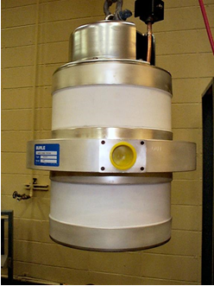
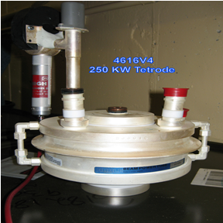
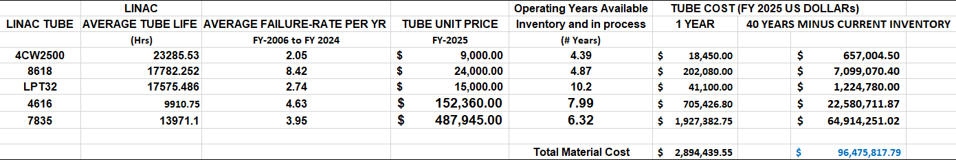
Upgrade Options - 40-years of Operations
Four options were evaluated for projected 40-years of operations for BLIP/NSRL & EIC:
Option 1: Keeping the same tube but stock for critical component for next 40 years.
Present stockpiling of RF and modulator tubes is not sustainable
Sole-source manufacturers of RF tubes is likely to exit the business
Large tube order for 40 years within the next 3 to 4 years
Critical material for tube manufacturing may not be available
Large tube storage facility needed at BNL
Large number of tubes to validate and test at BNL
Warranty issues when manufacturer exits the business
Estimated material cost 40 Years (9 Tanks): $96 M
(C/o: Vinnie LoDestro)
7835 Triode ($487,945.00 )
4616 Tetrode ($152,360.00)

Slide 8
Upgrade Options - 40-years of Operations
Four options evaluated for projected 40-years operations (BLIP/NSRL & EIC):
Option 2: Low power Diacrode tubes (Los Alamos) (Cost ~81 M + facility upgrades)
Description: This option involves combining two Diacrode tubes to achieve 4 MW of RF power
Required Modifications:
  Major Facility Modifications: The dual-amplifier design requires significant changes to the existing setup, including modifications to infrastructure and support systems.
  Installation Time: Expected to result in 18 months of interruption to LINAC operations, impacting critical research schedules.
Material Cost Estimate:
  Estimated 40-year cost for 9 Tanks: ~$81 M
  Additional facility upgrades cost.
Option 3: Replacing high power tubes with CPI Klystron (Fermi Lab) (Cost ~88 M + facility upgrades)
Description: This option involves replacing the current high-power RF tubes with CPI Klystron technology.
Required Modifications:
  Major Facility Modifications: (Larger size of the CPI Klystron amplifiers)
  Radiation Safety: The CPI Klystron system is a radiation-generating device, which adds complexity to safety measures and regulatory requirements.
  Operational Impact: (24 Months of Disruption)
Material Cost Estimate:
  Estimated 40-year cost for 9 Tanks: ~$88 M
  Additional facility upgrade costs required for the larger amplifiers and safety modifications

Slide 9
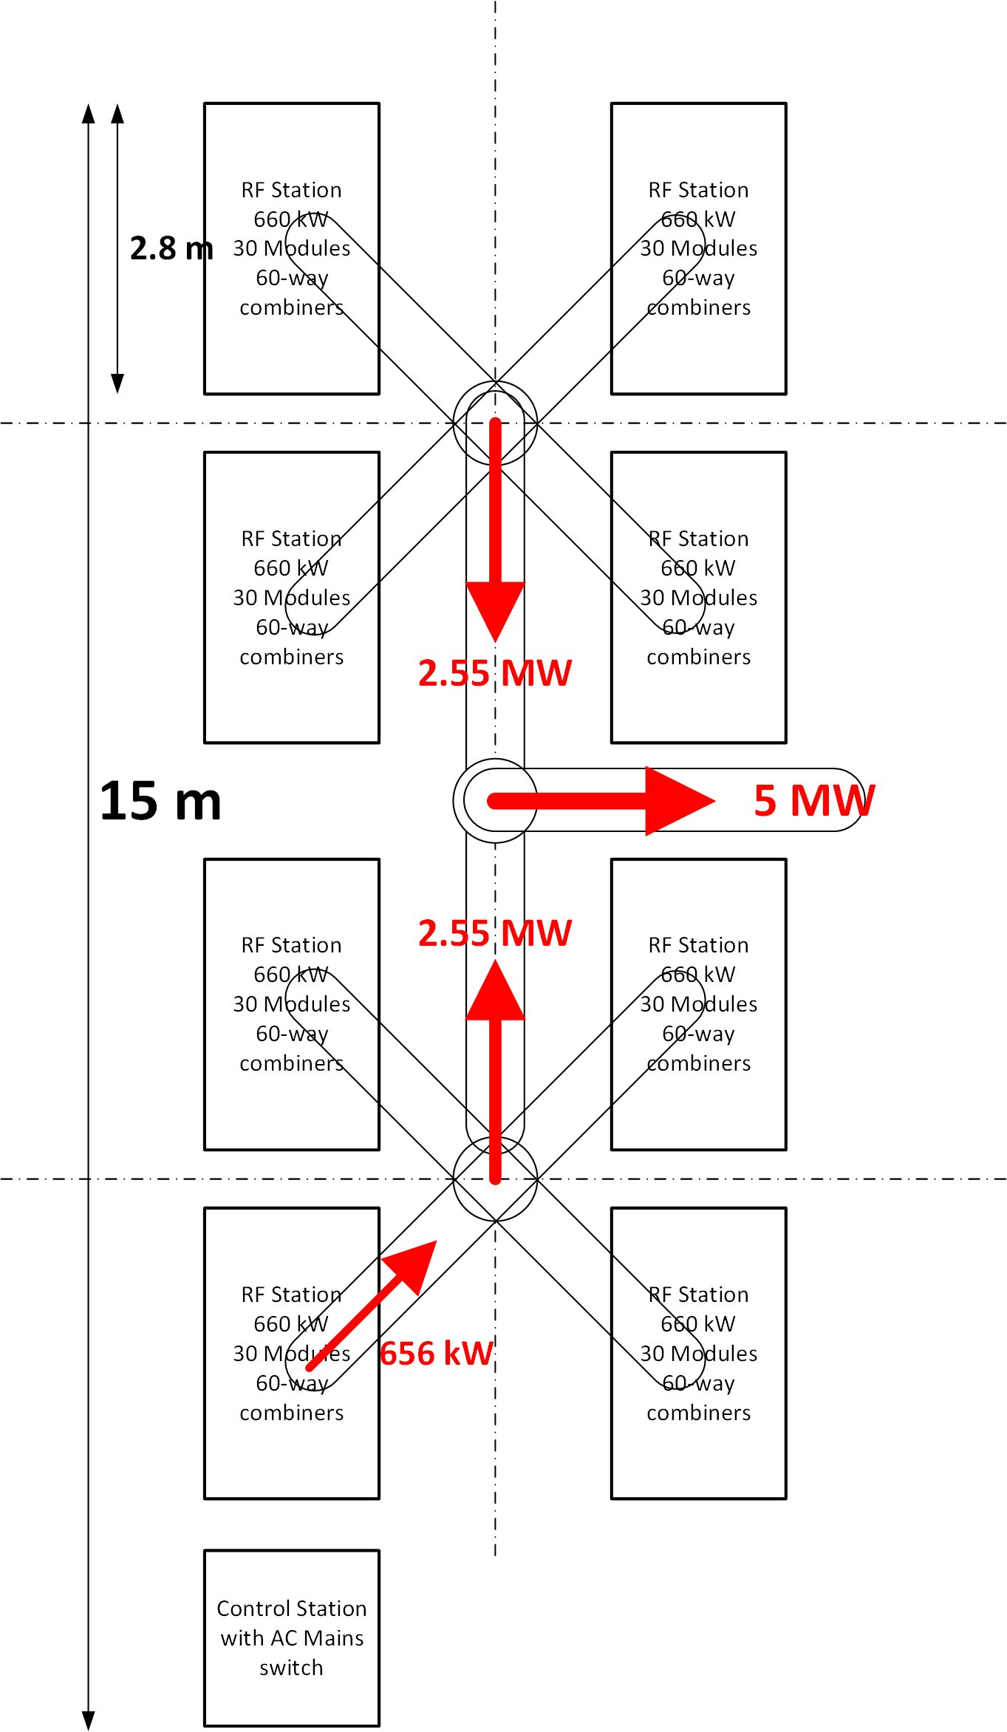
Upgrade Options - 40-years of Operations
Option 4: Phase conversion to Solid-State RF Amplifier
Key Advantages:
Eliminates single-source risk – transition from aging tubes
Proven, modern SSA technology
Major cost savings – power cut from 2.5–3 MW → ~800 kW
Enhanced safety – 50/100 V vs. 50 kV systems
No civil construction required
Non-disruptive rollout – install during shutdowns
Scalable & phased upgrade path
Improved performance – longer pulse length (1.2 ms)
Better diagnostics & remote control
Estimated Material Costs:
Estimated 40-year cost for 9 Tanks (Phase 1 & 2): ~$80 M
Fits into existing building, No modification needed
c/o Alex Zaltsman
5 MW Solid-State Amplifier to replace Complete RF System( Driver, RF PA, Modulator)

Slide 10
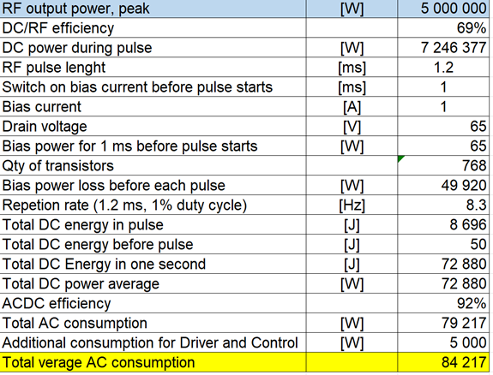
SSA CRE-3201A 201MHz, 5 MW, pulse, 1.2 ms, 1% duty cycle: 7.500.000 € per piece
(Alex Zaltsman)
FY2024 Budgetary Quote
5 MW RF PA Unit Cost ~$8.1 M
Wall-plug power consumption will be around 80-120 kW
Benchmarking
SSA pulsed systems: ~$1.62/Watt
CW systems (e.g., EIC CW PA): ~$7/Watt
This comparison demonstrates that the proposed SSA solution is highly cost-effective, delivering required performance at the fraction of $/W of continuous-wave systems.

Slide 11
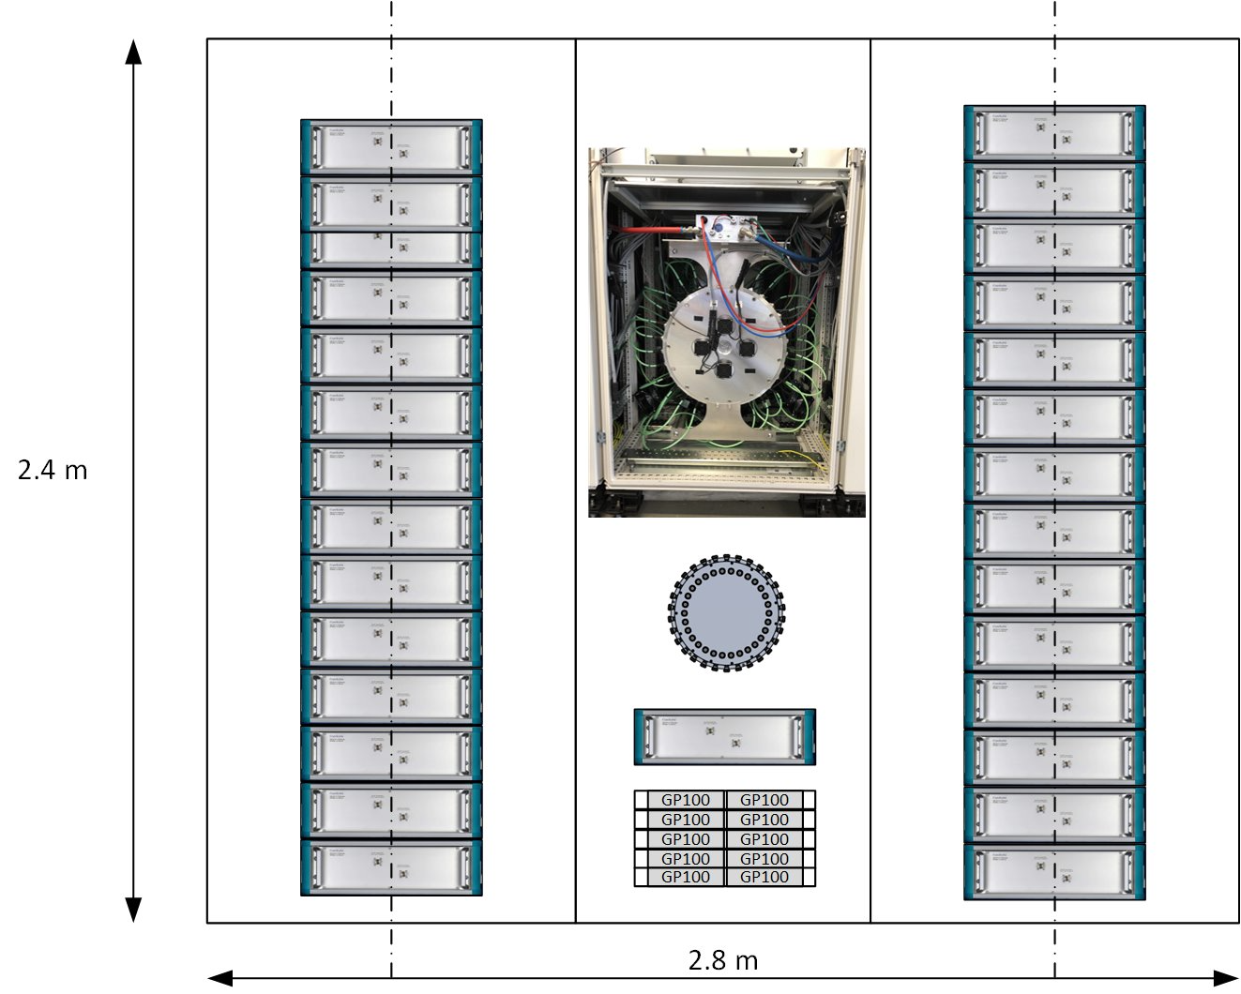
Layout of the system
Fits into existing building, No modification needed

Slide 12
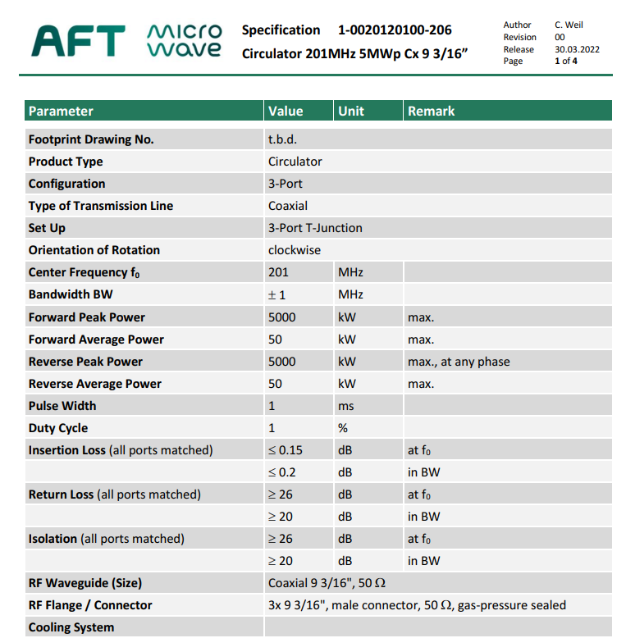
RF Circulator 201MHz, 5 MW, pulse, 1.2 ms, 1% duty cycle: $280,000.00 per piece
FY2024 Budgetary Quote
Single Unit

Slide 13
Cost Estimate : Equipment Cost
$8.8M Equipment Cost (Tank 9 Solid-State Conversion)
  Based on FY24 budgetary quotes for one unit
Material Cost | Estimated Cost
SOLID-STATE RF AMPLIFIER 201MHz, 5 MW, pulse, 1.2 ms, 1% duty cycle | $8,100,000
RF Circulator 201MHz, 5 MW, pulse, 1.2 ms, 1% duty cycle | $280,000
RF Load, 201 MHz, 5 MW, Pulse, 1% duty cycle | $100,000
RF Components (Directional Couplers, Cables, Adapter) | $20,000
Critical Spares (Estimated) | $300,000
Equipment Total Cost | $8,800,000

Slide 14
Key Technical Specifications
Parameter | Nominal | Units | Range
Frequency | 201.25 | MHz
Output Power | > 5 | MW | @ 1.0 dB compression
Bandwidth | > 2 | MHz | @ 1 dB
RF Pulse Width | 1.2 | ms
Duty Cycle | 1.0 | %
Pulse Rise/Fall Time | < 1 | us
Efficiency | > 60 | % | From AC to RF
Group Delay | < 250 | ns
DC Level | 50 - 100 | V

Slide 15
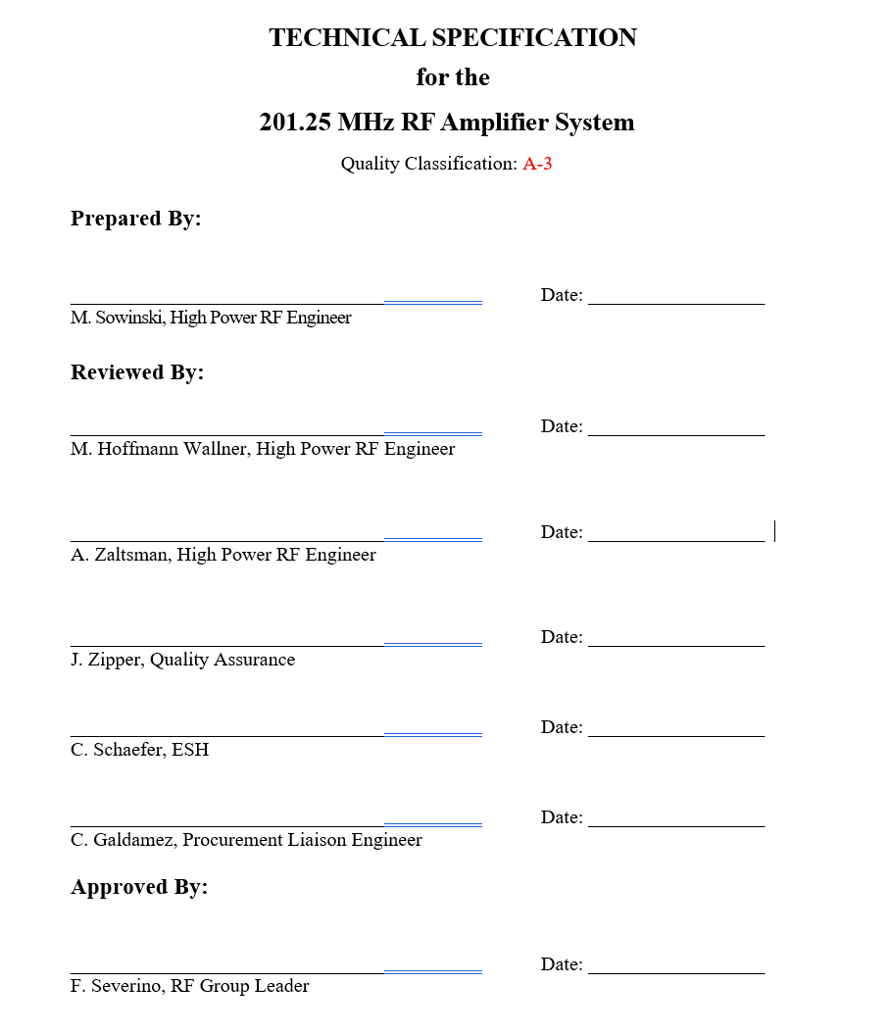
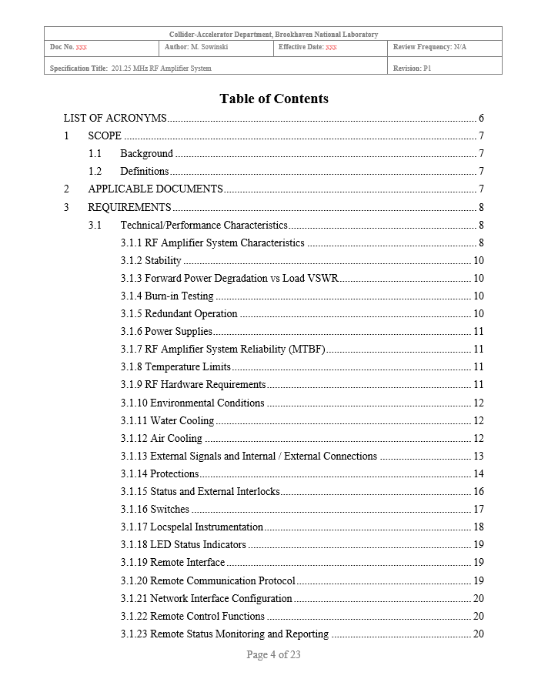
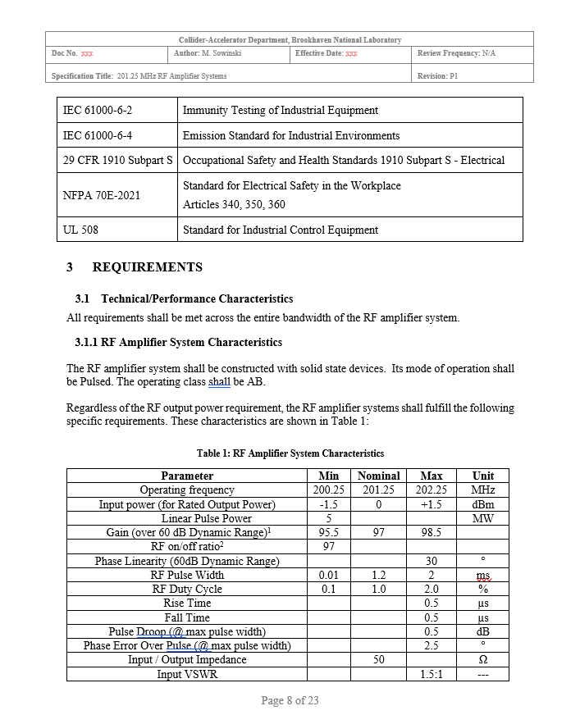
Technical Specifications & SOW
We have begun collecting the technical specifications and are consolidating all system requirements. To support the design effort, we will host a seminar with experts from the high-power RF community to review lessons learned, evaluate solid-state amplifier technology options, and obtain guidance on long-term reliability considerations.

Slide 16
Key Design Requirements
System Overview
  Replace existing amplifier chain (pre-driver → 200 kW driver → HP tube PA) with a 5 MW solid-state system.
  Focus on high efficiency and high operational reliability.
Modular Architecture
  ≥20% power overhead; full rated output with up to 20% modules offline.
  Fail-safe behavior: no cascading failures; continued operation until scheduled maintenance.
Protection & Fault Tolerance
  No damage under RF short, open, arc, or high-reflection conditions
  Defined VSWR tolerance; robust arc/reflection protection.
  Redundant critical power supplies—no single-point failure.
Maintainability
  Plug-in, field-replaceable RF modules.
  Clear fault indication (front-panel LED + control-system reporting).
Diagnostics & Integration
  Comprehensive temperature and health monitoring.
  Full monitoring interface to facility control system.

Slide 17
Proposed Project Schedule
Project Scope: Tank 9 Solid-State Conversion
Immediate Decision Needed → To enable order placement by May 2027
Preparation Phase (May 2026 – May 2027)
  Technical specifications and SOW development
  ~1 year procurement preparation effort
Procurement & Delivery:
  Complete order package/ place SSA order by May 2027
  Delivery expected Aug 2029 (24-month lead time)
Integration Timeline:
  Removal/Installation in Tank 9: June – December 2029
  System Level Test & Validation : January – June 2030
Future Scope: Phased Rollout for 6 of Remaining 8 Tanks
Maintain tube inventory through June 2030 (8–10 years coverage)
Order 6 SSA units by December 2030
Install during summer shutdowns: 2 tanks/year (2030–2034)
Use leftover tube inventory to support 40-year operation of Tanks 1 & 2 (low-power systems)

Slide 18
LINAC RF Amplifier Upgrade – Summary
Objective: Modernize the LINAC RF system using solid-state amplifiers to mitigate long-term supply risk associated with obsolete, sole-source RF vacuum tubes.
Mission & Urgency: The LINAC RF system is mission-critical for RHIC/EIC, BLIP, and NASA NSRL, but depends on 5 MW vacuum tubes with credible production loss in ~3–4 years and limited remaining inventory.
Technology Selection: Multiple upgrade paths were evaluated (including continued tube procurement and alternative tube technologies); solid-state RF was selected as the lowest-risk, most sustainable option based on reliability, safety, vendor diversity, and lifecycle cost.
Phase 1 – Tank 9 Only (Demonstration):
  Convert Tank 9 from tube-based RF to a 5 MW, 201 MHz solid-state system to validate performance, integration, reliability, and lifecycle cost.
  Duration: ~4 years (decision ~2026; install/validate 2029–2030)
  Cost Estimate: $12.9 M (fully burdened, includes contingency)
  Installed during scheduled shutdowns; no impact to operations
Phase 2 – Follow-On Upgrade (Post-Demonstration):
  Following successful Phase 1, begin a phased conversion of six additional LINAC RF systems, starting ~2030 and completing over ~4 years.
  Estimated additional cost: ~$80 M
MAC Input Requested:
  Review the technology selection and phased approach; assess technical, schedule, and supply-chain risk; and advise on Phase 1 initiation and funding, approval pathway, procurement strategy, and the proposed plan for a phased upgrade.

Slide 19
Thank You

