Slide 1
C-AD R&D Strategy and Plans
Alexei Fedotov
Deputy Division Head, Accelerator Operations and Research Division
C-AD Machine Advisory Committee Meeting
17-19 December 2025

Slide 2
C-AD Accelerator R&D and expertise
Collider-Accelerator Department (C-AD) has unique world’s expertise and leadership in several areas:
1. Ion beam sources:
  World records in high-current intense ion sources
  Highest intensity polarized ion source
2. Electron beam sources:
  High-charge polarized electron beam source
  High-intensity high-brightness electron sources
  State-of-the-art laser systems
3. Polarized ion beams:
  The only polarized hadron collider; polarization control through a chain of several accelerators
4. Beam Cooling:
  World’s first application of bunched beam stochastic cooling in a collider
  World’s first RF-based electron cooler using bunched electron beam
  World’s first electron cooler without use of electron beam magnetization
  World’s first application of electron cooling in a collider, to cool beams in collisions

Slide 3
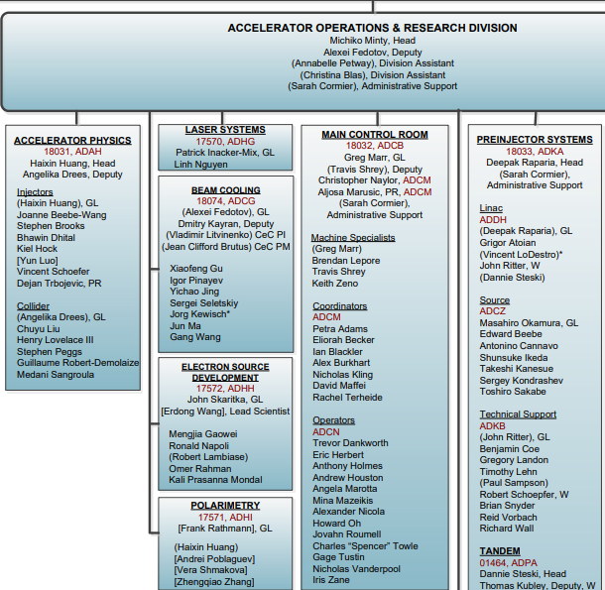
C-AD Accelerator R&D (present)
Ion beam sources (OBS 1.3.9):
  High-intensity H– source
  Polarized proton source (OPPIS)
  Laser Ion Source (LION)
  Electron Beam Ion Source (EBIS)
  Polarized He-3 production
Electron beam sources (OBS 1.3.3 and 1.3.5):
  Polarized electron beam source
  High intensity electron sources (LEReC DC guns, CeC SRF gun)
  Photocathodes and laser systems
Polarized ion beams (OBS 1.3.2 and 1.3.6):
  AGS spin resonance correction with skew quadrupoles
  Machine Learning for AGS polarization increase
  Polarimetry in AGS/RHIC/EIC (jets, pC), He-3
Beam Cooling (OBS 1.3.4):
  Coherent Electron Cooling (CeC)
  RF-based electron cooler LEReC
  Low-Energy Cooler for EIC, High-Energy Cooling
Advanced accelerator R&D (external funding):
  Machine Learning in accelerators (FOA funding)
  Extreme low-emittance ion sources (LDRD funding)
  Permanent magnets for Fixed Field Alternating Synchrotron (LDRD)
  Ion sources (LDRD, FOA funding)
  Electron sources (ECA funding)
Accelerator R&D is distributed across
several C-AD groups (OBS 1.3.2-1.3.6 and 1.3.9):
1.3.3
1.3.2
1.3.4
1.3.9
1.3.5
1.3.6

Slide 4
C-AD R&D Strategy
Strategy:
Maintain leadership and expertise in key areas and
align mid-term R&D with EIC needs and future EIC performance and capabilities.
Pursue advanced accelerator R&D (external funding using FOA and LDRDs)
Actively pursue AI/ML applications at various C-AD accelerators to optimize beam controls, automate machine tuning and data analysis, improving reliability and operations.
Our goal is to use mid-term R&D in a coherent strategy to maintain leadership in technology which we need for the EIC,
for future EIC capabilities and upgrades, and
possibly the next generation of NP facilities
with focus on:
1) Ions sources
2) Electron sources
3) Polarizations and Polarimetry
4) Beam cooling

Slide 5
Focused mid-term R&D efforts
Focused mid-term R&D efforts:
Ions sources:
- To fully establish EIC requirements, including polarized He-3 source development
- Develop future EIC capabilities
Electron sources:
- Development of polarized and high-current cathodes for the EIC
Development of high-current electron Gun suitable for the EIC
Polarization and polarimetry:
- Maximizing polarization through Injectors chain of accelerators
- Development of robust polarimetry at various stages of acceleration
High-Energy Cooling (HEC):
- Development of HEC system for the EIC to maximize luminosity and fully optimize the EIC potential

Slide 6
Mid-term R&D presentations
Ion sources:
Polarized He3 source development: J. Ritter
Next-Generation High-Current Ion Sources: Demonstration with Niobium: M. Okamura
Polarized deuteron ion source: D. Steski
Electron sources:
High-current Gun developments: LEReC and Stony Brook R&D guns: in this presentation
Cathodes R&D: M. Gaowei
Polarization and polarimetry:
Polarization development: K. Hock
Polarimetry : F. Rathmann
Beam Cooling:
Development of high-energy cooling systems: S. Seletskiy

Slide 7
Ion sources R&D

Slide 8
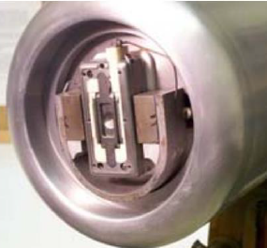
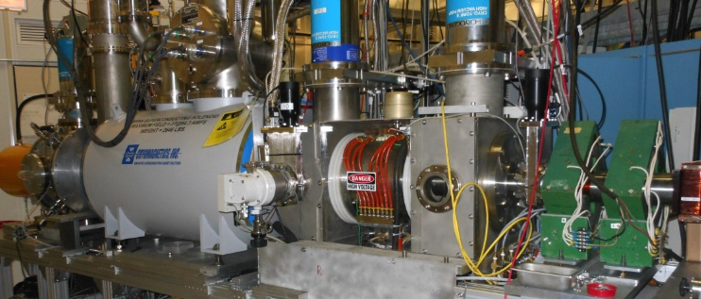
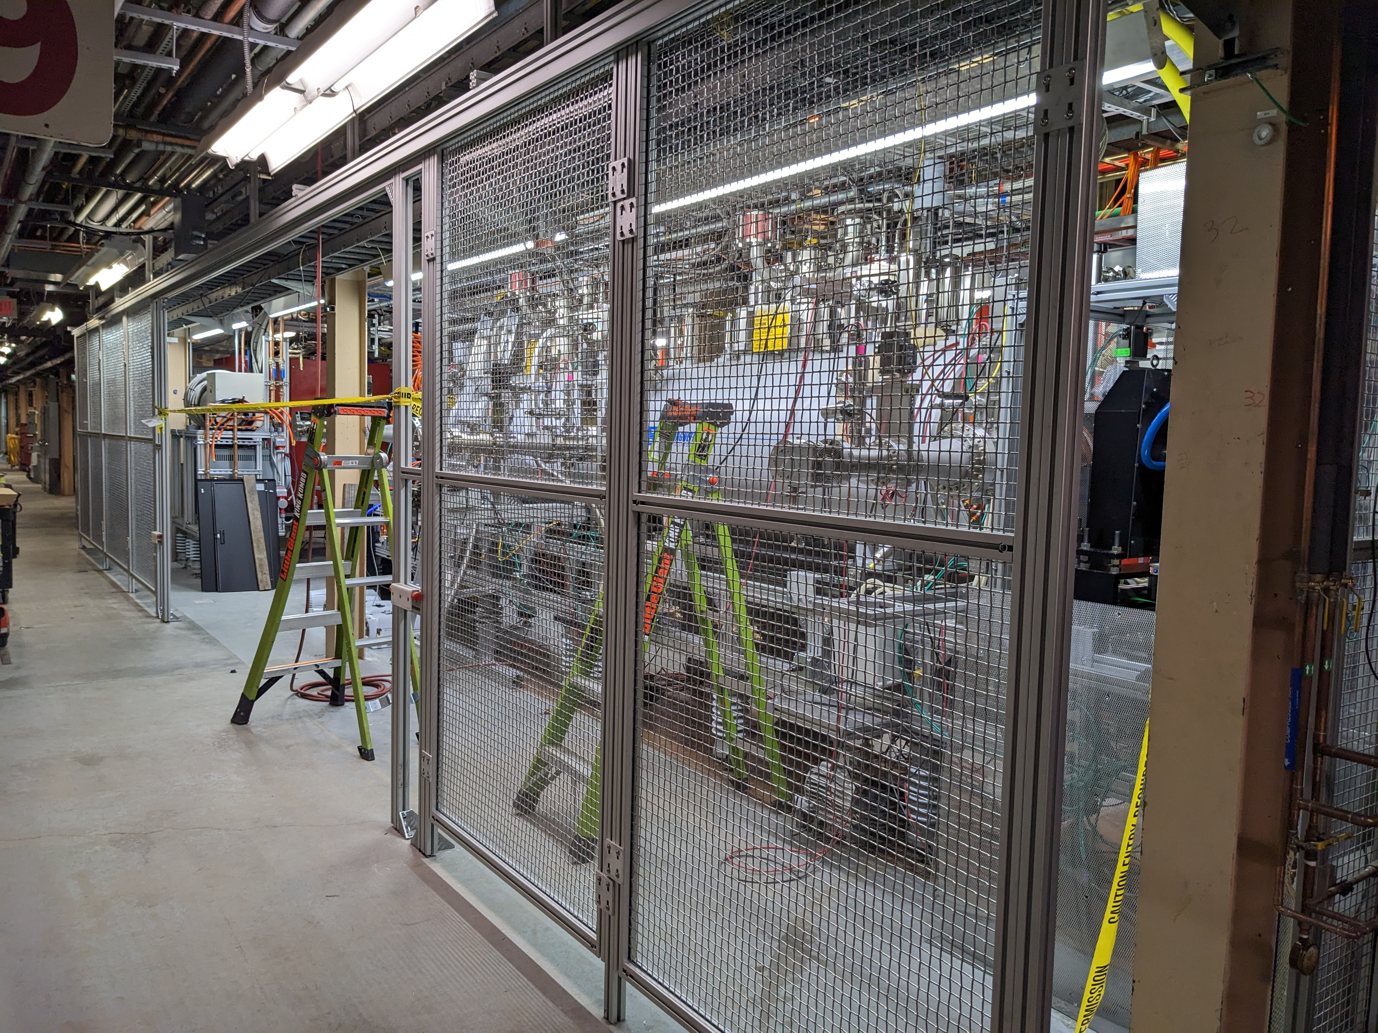
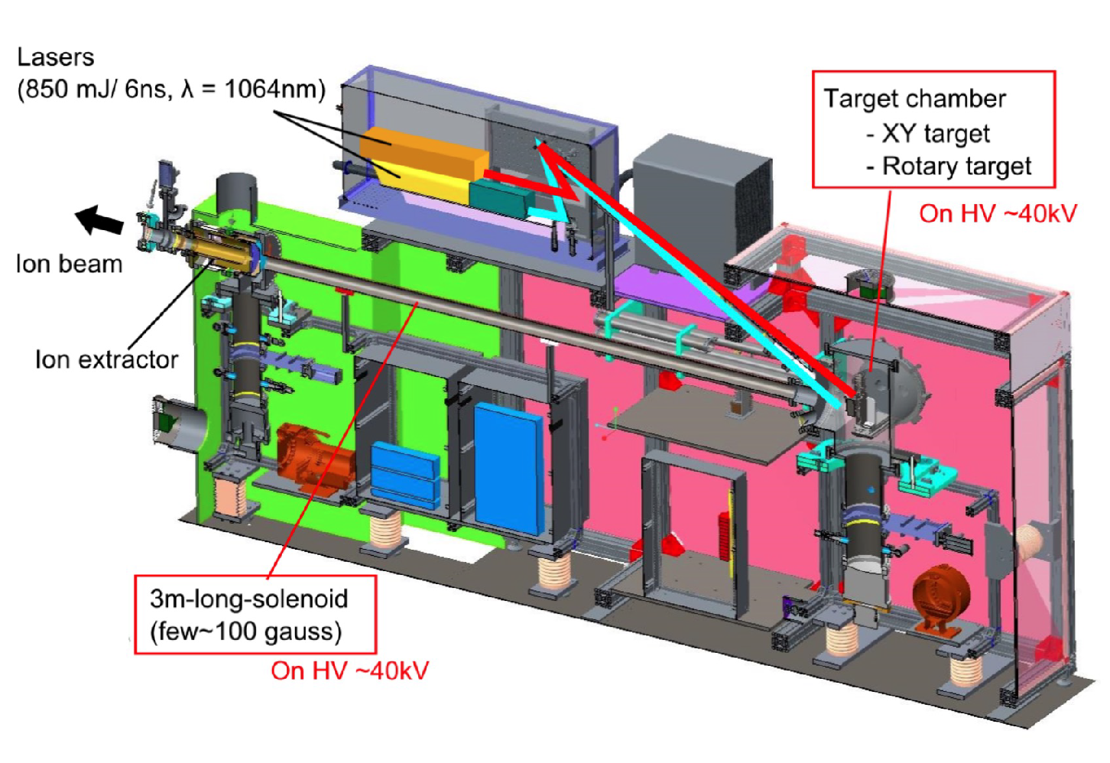
Ion sources - highlights
Magnetron
source
Magnetron H⁻ source
Hydrogen plasma interacts with Cs-Mo surface
Highest H⁻ peak current (135 mA)
Optically Pumped Polarized Ion Source (OPPIS)
Polarized electrons from optically pumped Rb
are used to generate polarized H⁻ ions
Highest intensity (1 mA) polarized (85%) H⁻ source
Electron Beam Ion Source (EBIS)
~10 A e-beam inside 5 T solenoid used to
stepwise ionize heavy ions, Au³²⁺ after about 40 ms
World’s highest intensity EBIS
Laser Ion Source (LION)
Development of high-current laser source for wide range of ions
OPPIS
Extended EBIS
LION

Slide 9
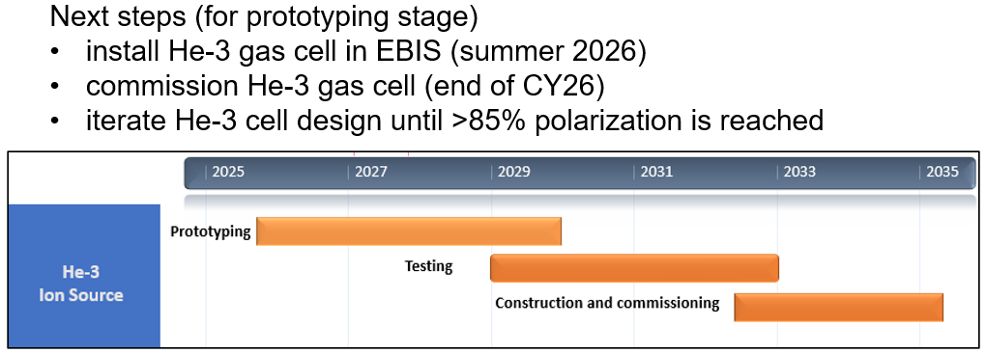
Ion sources – future mid-term R&D plans
  Polarized ³He ion source, J. Ritter presentation
  Polarized deuteron ion source (FOA), D. Steski presentation
  Development of high-current highly charged Laser Ion Source (FOA), M. Okamura presentation
He-3 source R&D plans (J. Ritter):
9

Slide 10
Electron Sources R&D
10

Slide 11
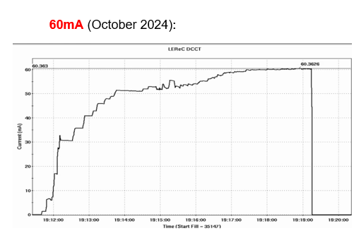
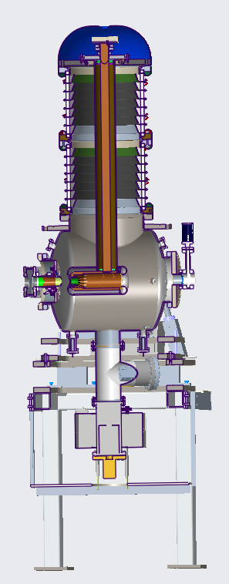
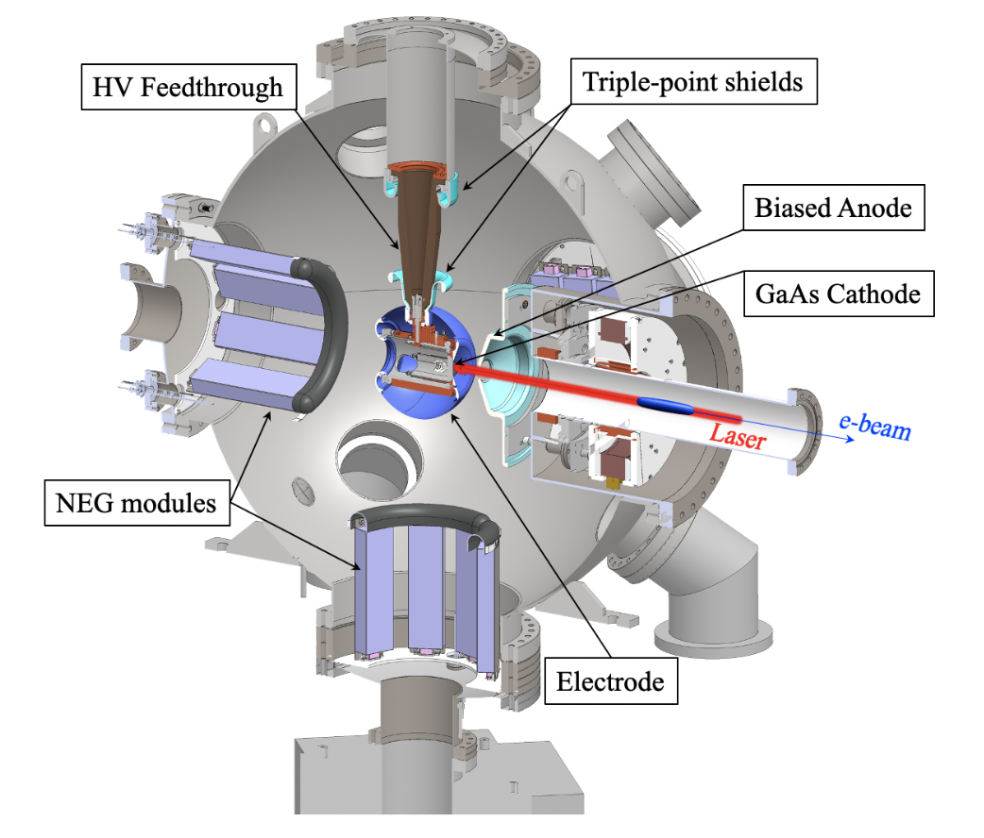
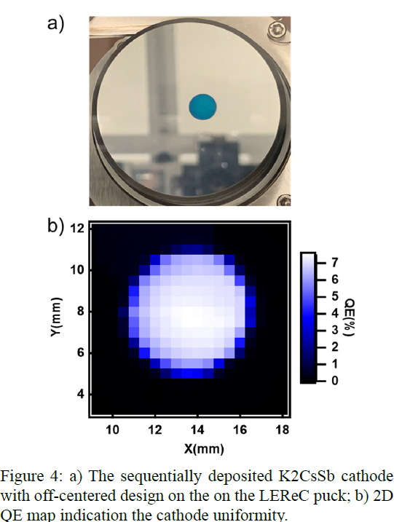
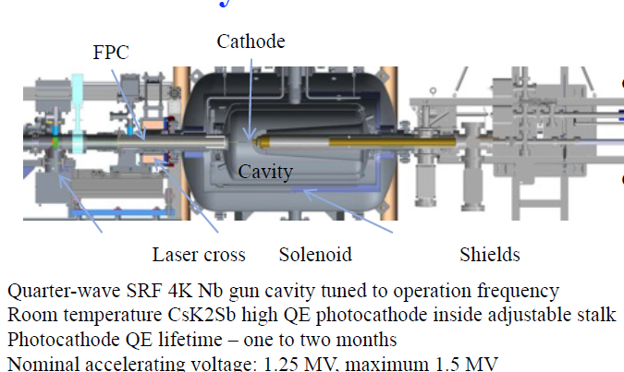
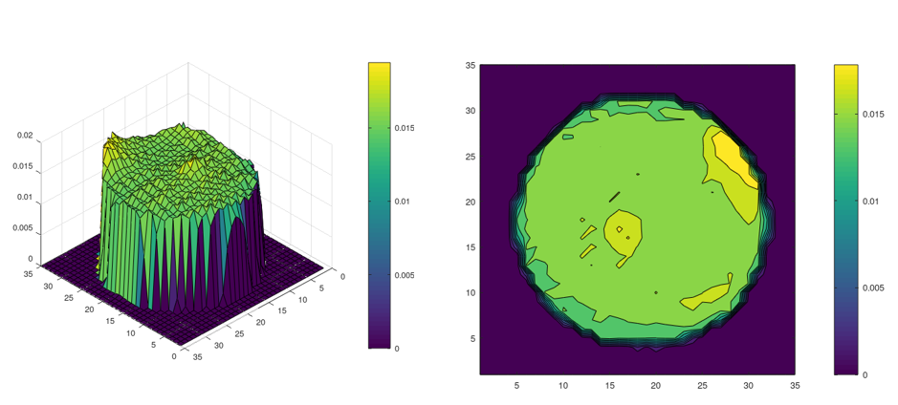
Electron sources - highlights
Active photocathode development
  Bi-alkali antimonide cathodes with high QE
  Polarized cathodes
DC photo-electron gun for LEReC
  350-400 kV operation
  Demonstrated 60mA (EIC requirement 75mA)
DC photo-electron inverted gun at Stony Brook (SB)
  R&D Gun under construction at Stony Brook University
SRF photo-electron gun for CeC
  High brightness: 0.3 um emittance for 0.5nC charge
  High bunch charges: up to 10 nC
Laser systems
  State of the art laser systems for LEReC, CeC and SB guns.

Slide 12
Electron sources – future R&D plans
Development and support of high-current e-gun systems for EIC, see next 3 slides
- LEReC Gun R&D
- Stony Brook University R&D gun
Plans:
2026-2027: High-current tests with LEReC and Stony Brook guns
2028: Determine which Gun and HVPS is best suited for the EIC hadron cooler.
2. Advanced cathodes R&D, see Mengjia Gaowei presentation
12

Slide 13
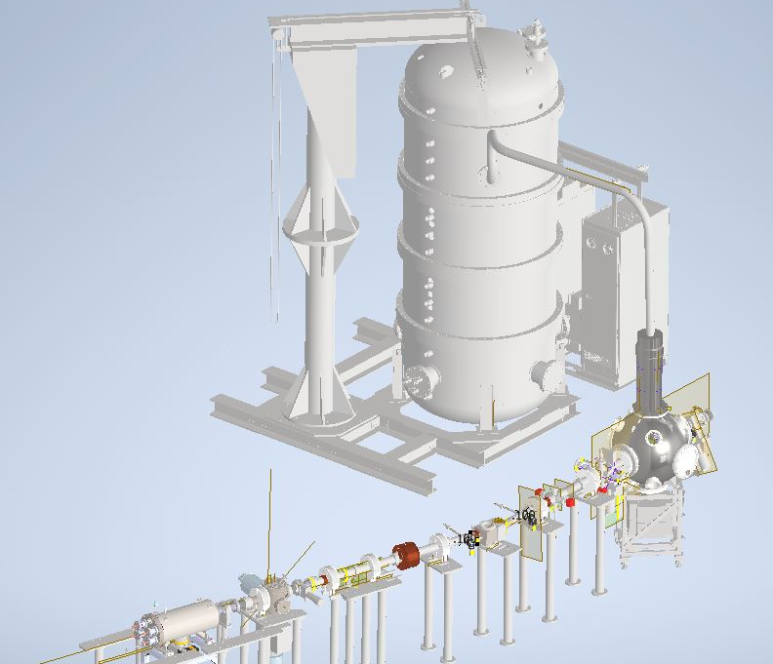
EIC Electron Cooler gun choices
EIC DOE Review, January 2025:
“The requirements for the DC electron gun for the LEC are beyond the current state-of-the-art
performance presently demonstrated by DC gun and high-QE (quantum efficiency)
semiconductor cathode technology. A significant R&D effort is necessary to demonstrate the
required performance. The project has at least two options to consider: pursuit of a new gun
being developed at Stony Brook University, and potential improvements to the existing LEReC
gun. The project is encouraged to consider investigating both options in parallel until the
required performance has been demonstrated.”
LEReC Gun:
Existing LEReC Gun (400kV) and HVPS (600kV).
Need to demonstrate stable operation at required current (75mA) for the EIC.
R&D Gun at Stony Brook (under development):
Gun (500kV) and HVPS (600kV): designed to operate at 100mA. Active cathode cooling. Tests with beam to start in late 2026.

Slide 14
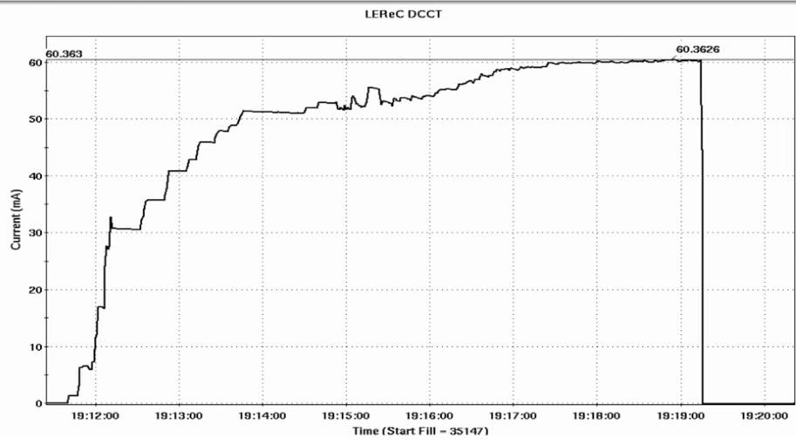
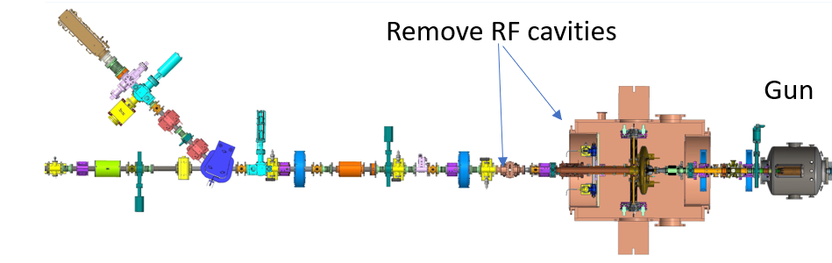
LEReC Gun high-current tests and plans
High current source is required for EIC LEC:
  The LEC requires stable operation at 75mA current @350-375kV.
High-current source R&D:
  Explore LEReC Gun operation with high-current up to 80mA.
  Explore Gun and HVPS long-term stability at high currents.
After 2025 RHIC run (2026-2027):
Gun (400kV) to low-power dump tests (P=32kW; V=400kV, I=80mA).
Remove two RF cavities in LEReC injection line (as part of RHIC R&R project). Install spool vacuum pipe with several devices in place.
Details on these tests plan are being developed in coordination with RHIC Removal project, Safety, Access Controls and other groups.
LEReC DC gun tests (to injection beam dump):
Stable operation at 50mA @320kV (April 2022)
60mA @300kV (October 2024):
14

Slide 15
Stony Brook R&D gun plans
 | Schedule | Current status
HVPS | Fall 2025 | Testing at the vendor
Gun | Fall 2025 | Machining and parts in assembly
Beamline upgrade | Mar. 2026 | Procurement
Laser | Nov. 2025 | Installation onsite, then move to SBU
Photocathode | Feb. 2026 | Installation onsite, then move to SBU
HV components (cable, resistor) | Aug. 2025 | Vendor fabrication
Beam dump | Mar. 2025 | Tested
Low Current test | Fall 2026
High Current tests | 2027

Slide 16
Polarization and Polarimetry R&D
16

Slide 17
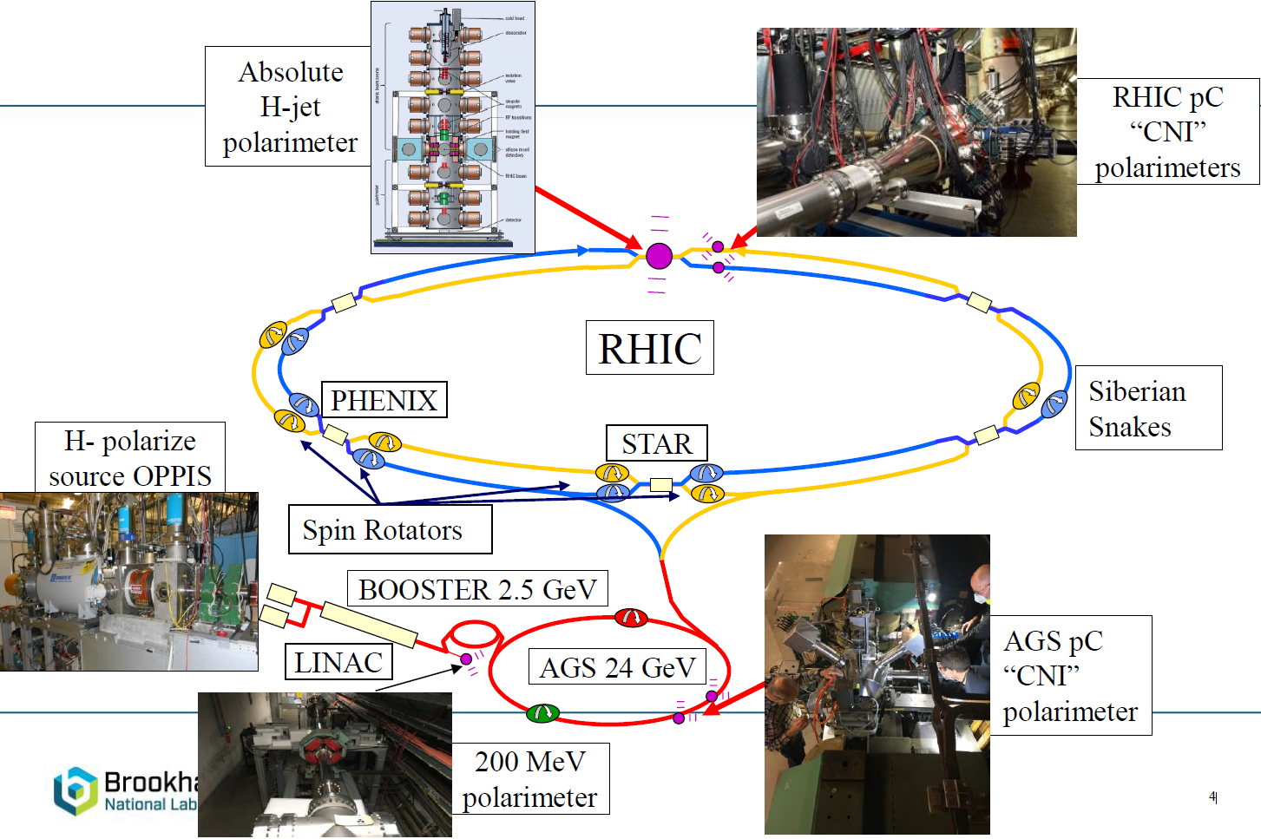
Polarization devices through accelerator chain
H- polarized
source OPPIS

Slide 18
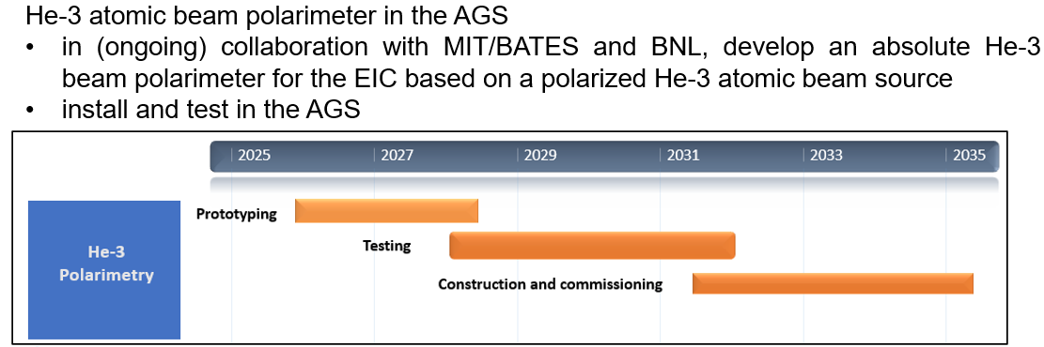
Polarization and Polarimetry – future R&D plans
Polarization development and improvements:
- Polarized protons: simulations and development in the injectors to overcome both intrinsic and imperfection resonances. (2026-2030, in backup slides)
- Polarized He-3 simulations and development in the injectors.
Plan (2027-2030): Develop He-3 polarization in injector complex
see K. Hock presentation for He-3 polarization development plans
Polarimetry:
- Development of simulation tools for polarized atomic beams
- RHIC H-jet refurbishment and upgrades for EIC needs
- Design of new AGS polarimeter for absolute polarization measurements
see F. Rathmann presentation for Polarimetry details and plans

Slide 19
Beam Cooling R&D

Slide 20
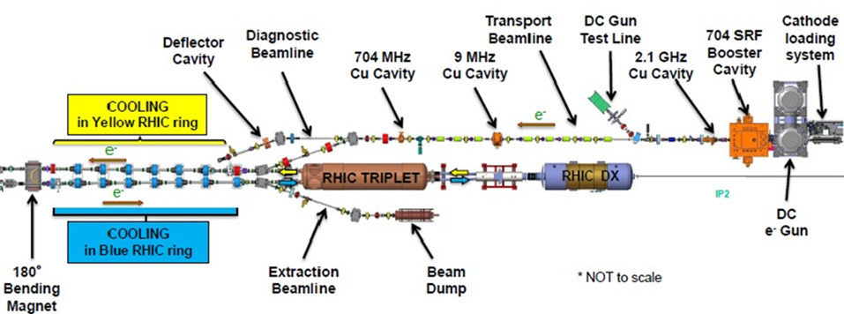
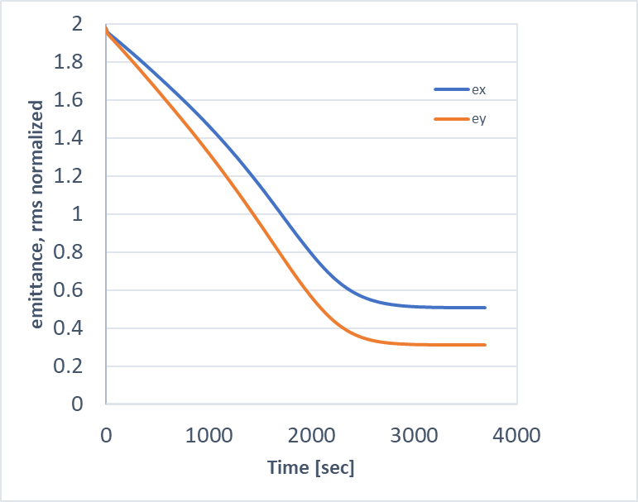
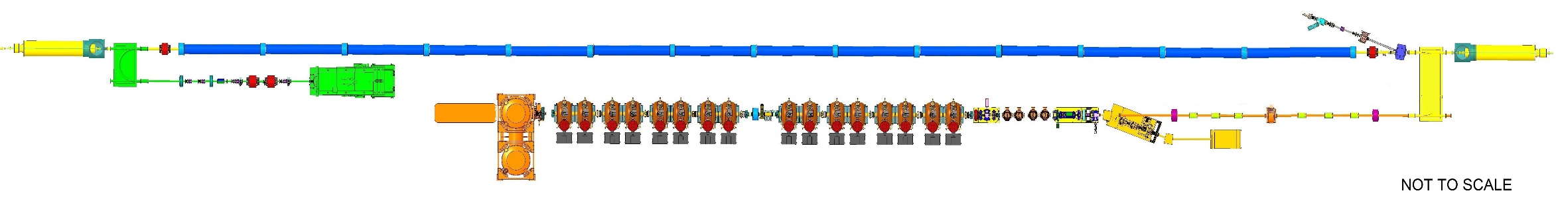
RF-based Electron cooling at RHIC and EIC
LEReC @RHIC is a fully-operational electron cooler which utilizes RF-accelerated electron bunches (2 MeV electron kinetic energy).
LEReC approach was chosen for the Low-Energy Cooler @EIC (12.5 MeV electron kinetic energy).
Operational 3D cooling of Au ions during RHIC Run 2021
180°Dipole
(U-turn)
Mu-metal shielding
RF diagnostics line with Deflecting cavity
180° Dipole
Spectrometer
Cooling Section
cooling
RF diagnostic
hadron
hadron
hadron
e⁻
HSR
e⁻
e⁻
HSR
extraction
Injector test
transport
Extraction line
injection
24MHz
RF cavity
900 kW Beam Dump
Cathode transport
16x 197 MHz
NCRF LINAC
4x 591 MHz
NCRF correction Cavities
Laser
197 MHz
DC Gun
Cooling simulations of protons at γ=25

Slide 21
High-energy Cooling for future EIC upgrades
Robust High-Energy Cooling (HEC) system capable of fully counteracting emittance growth at collision energies would greatly improve luminosity in the EIC.
Previously, the HEC system for the EIC was based on a novel method of micro-bunched Coherent Electron Cooling (CeC). While in recent years CeC R&D studies have made significant progress, there are crucial unresolved issues related with extremely tight tolerances on timing electron and hadron beams in the cooler and cooling diagnostic, for EIC parameters.
Several approaches using well-established technique of Electron Cooling (EC) are presently being explored at CAD for HEC application:
Design of storage Ring Electron Cooler where electron bunches which provide cooling of protons are being cooled themselves via synchrotron radiation in wiggler magnets.
Design of ERL-based Recirculator where electron bunches are supplied by high-brightness electron source.

Slide 22
Beam Cooling – future R&D plans
High-Energy Cooling (HEC) accelerator physics and accelerator design R&D, in order to develop a feasible and efficient scheme for the HEC (for future EIC upgrade):
  2026: Conceptual Design Report for Ring-based High-Energy Cooler
  2027-2028: Conceptual Design of ERL-based Recirculator Cooler, see S. Seletskiy presentation
  Evaluate risks and costs
  Hold review to choose a most reliable and cost-effective approach for the HEC.

Slide 23
Response to Recommendations: High Energy Cooling
Last December we presented High-Energy Cooling design based on the storage Ring Electron Cooler HEC.
High Energy Cooling R&D:
R15: Consider engaging external partners (e.g. university faculty, graduate students) to accelerate the work on HEC options.
We followed up on R15 with close collaboration with Cornell University (Jonathan Unger, graduate student).
Results: finalized Dynamic Aperture studies, performed detailed study of effects of nonlinearities and magnet errors. We are getting close to producing CDR for this approach (S. Seletskiy et al.: BNL-228463-2025-TECH, July 2025).
For the ERL-based HEC, collaboration with JLAB (see S. Seletskiy presentation).
R16: Begin work towards an integrated assessment of beam dynamics in EIC hadron cooling (i.e. start-to-end simulation) for the HEC options.
On R16, once proper design of the HEC is chosen the plan is to have such integrated beam dynamics studies.

Slide 24
Response to Recommendations: CeC
Coherent Electron Cooling (CeC):
R7: Overcome the lack of reliability: both in terms of beam parameter jitter and poor repeatability of operation set-ups.
In the past, CeC worked in the regime where it was difficult to establish required electron beam parameters with high peak current, which required constant tuning of accelerator. Also, last year setup strongly depended on laser configuration which required proper stacking of several laser pulses.
For 2025, CeC switched to a new lower energy setup where much smaller peak current of electron beam is required and it is easier to achieve required electron beam parameters. Requirements on laser were also simplified without the need of laser pulse stacking.
This year, CeC was able to achieve required electron beam parameters many times routinely with required stability.
CeC experiment started to use dedicated APEX time on December 3 and 17. Additional dedicated time (several days) at the end of Physics run in January is under consideration.
R8: Develop a Plan B to continue the CeC development after the RHIC shutdown.
There is no Plan B to continue CeC development.
After the end of RHIC operations, RHIC Cryo will be off. CeC accelerator which requires cryo will be taken apart.

Slide 25
Machine learning in Accelerator

Slide 26
AI/Machine Learning in accelerators
AI/Machine Learning (ML) is being actively applied for various accelerators at the C-AD to optimize beam controls, automate machine tuning and data analysis.
Developed AI/ML tools will be used for EIC operations and optimizations.
Examples:
Electron Beam Ion Source (EBIS) intensity improvement
Polarization improvement in the injector chain of accelerators
Beam Cooling optimization
see K. Brown presentation for details
Notes:
35 min, max 25 slides

Slide 27
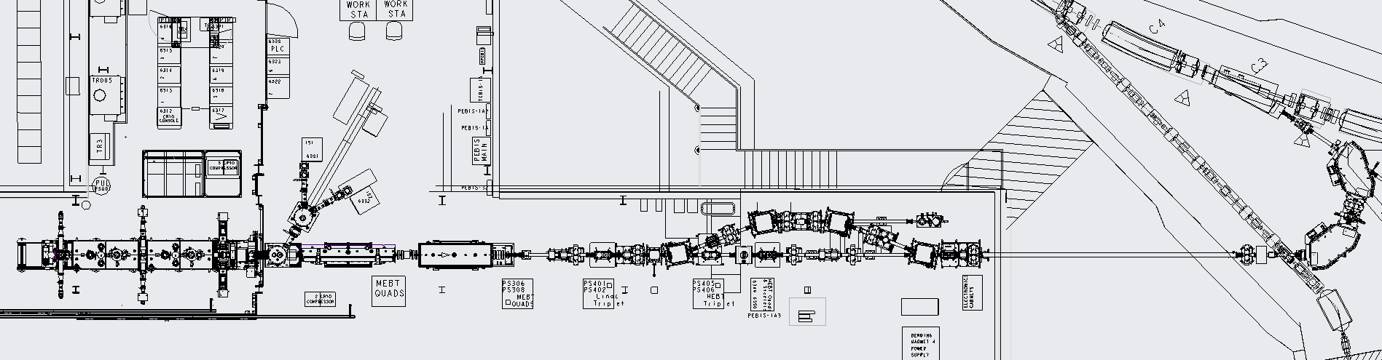
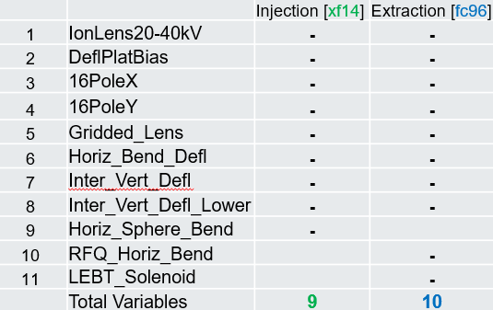
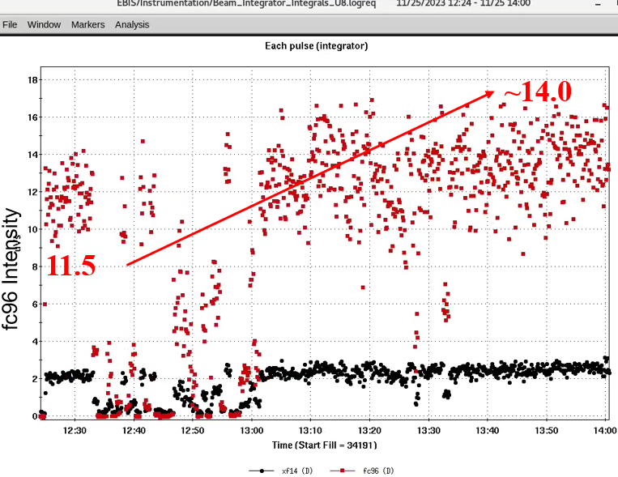
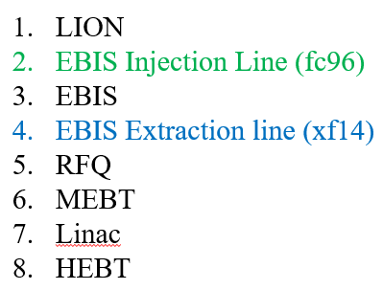
ML: EBIS Intensity Optimization using GPTune (FOA funding)
LION
fc96
1
2
RFQ
LINAC
3
4
5
6
7
8
EBIS
Buncher1
xf14
Buncher2
Buncher3
22% improvement
(from not optimum state)

Slide 28
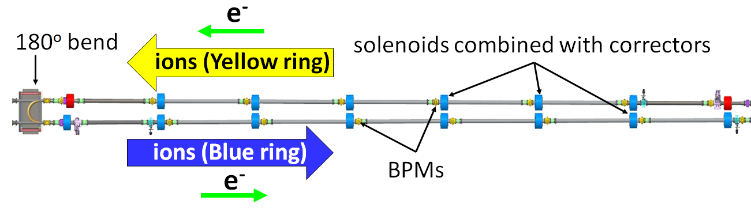
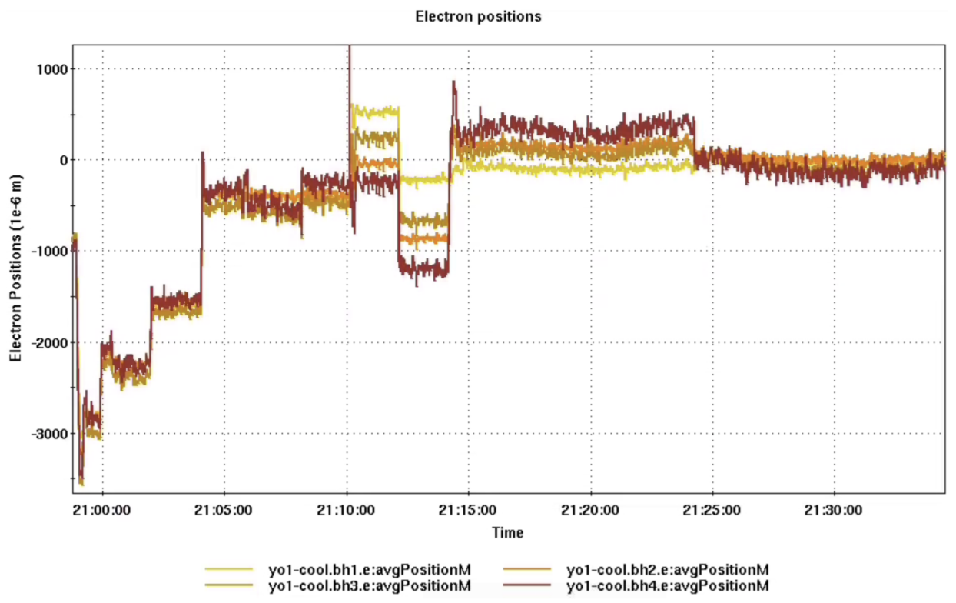
ML: Beam Cooling applications at LEReC
LEReC was used as a testing ground for machine learning (ML) algorithms, which in the future may become useful for optimizing performance of the coolers.
The objective of the test was to optimize the cooling rate by improving the e-beam trajectory (as measured by BPMs in the cooling section).
Results:
The algorithm based on Bayesian Optimization method worked successfully and returned optimum for cooling e-beam trajectory.
Y. Gao, W. Lin, et al., “Bayesian optimization experiment for trajectory alignment at the low energy RHIC electron cooling system”, PRAB 25, 014601 (2022).

Slide 29
Advance Accelerator R&D

Slide 30
Advanced Accelerator R&D
In addition to focused mid-term R&D efforts, we actively pursue advanced accelerator R&D (external funding using FOA, ECA and BNL LDRDs):
  Extreme low-emittance ion sources (LDRD), S. Brooks presentation
  Permanent magnets for Fixed Field Alternating Synchrotron (LDRD), D. Trbojevic presentation
  Lithium-Beam driver for Boron Neutron Capture Therapy (LDRD), M. Okamura presentation
  Production and acceleration of molecular ion beams (LDRD), S. Ikeda presentation
  Monoenergetic neutron beam (LDRD), X. Jiang presentation
  Advanced cathodes R&D (ECA), M. Gaowei presentation
  Laser-driven Nb source (LDRD), A. Cannavo
  Development of CW Laser Ion Source (LDRD), S. Kondrashev
  High-Voltage R&D for pEDM (LDRD), H. Huang

Slide 31
Summary
C-AD has unique world’s expertise and leadership in several areas which are essential for future EIC needs and broader NP community:
Ion beam sources
Electron beam sources
Polarized ion beams
Beam Cooling
Mid-term R&D is focused on these key areas to maintain leadership in technology which we need for the EIC, for future EIC capabilities and upgrades, and possibly the next generation of NP facilities.
In addition to focused mid-term R&D efforts, we actively pursue advanced accelerator R&D (external funding using FOA and LDRDs):
AI/Machine Learning (ML) is being actively applied for various accelerators at the C-AD to optimize beam controls, automate machine tuning and data analysis. Developed AI/ML tools will be used for EIC operations and optimizations.
Notes:
35 min, max 25 slides

Slide 32
Backup slides

Slide 33
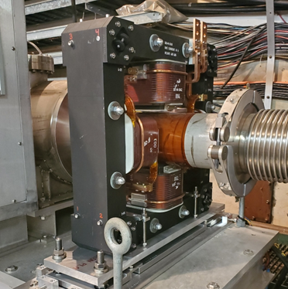
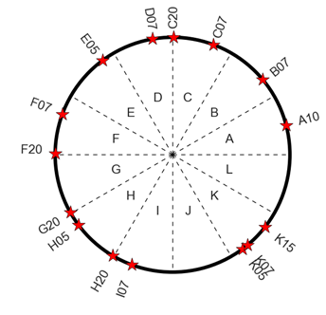
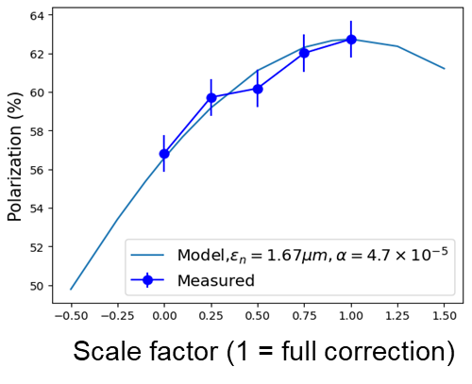
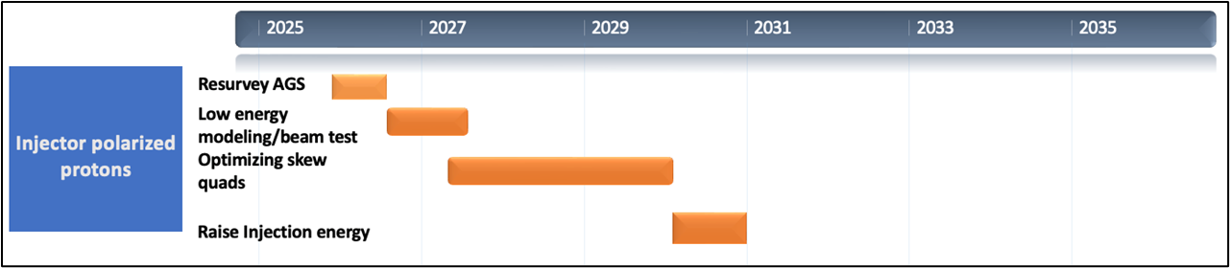

Polarized Beam Developments – protons
SQ locations ( )
re-survey and align AGS magnets (summer 2026)
improve modeling of AGS lattice at lower energies; beam test with skew quads (Dec 2026)
upgrade AGS Booster and AGS BPMs (by Feb 2028)
optimize operations with skew quads over entire AGS energy range (Dec 2028)
optimize skew quads settings for polarization (Dec 2029)
test raising AGS injection energy from Gγ=4.5 to Gγ=5.5 (Dec 2030)
AGS skew quad
polarization (%)
correction with ~½ of the SQs

Slide 34
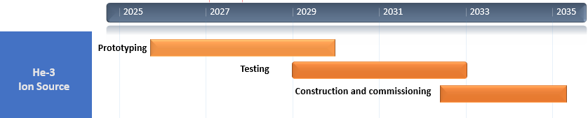
Polarized He-3 Ion Source Developments*
*Developments in collaboration with MIT/BATES
EIC He-3 requirement: 13e10/bunch with 72% polarization
polarization (%)
Test Lab
Achievements to date
~ 90% polarization in test lab
~ 60% in electron beam ion source (EBIS) mockup
Next steps (for prototyping stage)
install He-3 gas cell in EBIS (summer 2026)
commission He-3 gas cell (end of CY26)
iterate He-3 cell design until >85% polarization is reached
EBIS mockup
He-3 gas cell

Slide 35
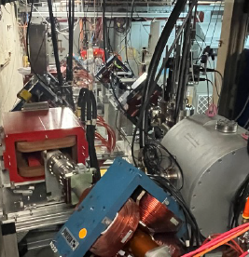
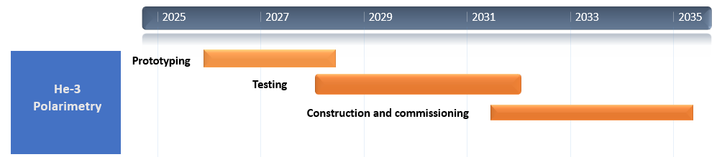
He-3 Polarimetry Developments
Source polarimeter (6 MeV absolute measurements)
commission (by end of CY26)
optimize He-3 beam parameters (pulse length, pulse peak current and polarization) to optimize for <1% statistical error
commission spin flipper chicane
spin flipper chicane
spin flipper chicane
Source
He-3 atomic beam polarimeter in the AGS
in (ongoing) collaboration with MIT/BATES and BNL, develop an absolute He-3 beam polarimeter for the EIC based on a polarized He-3 atomic beam source
install and test in the AGS

Slide 36
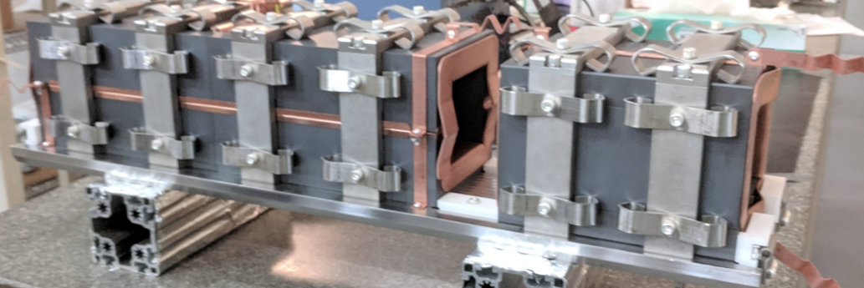
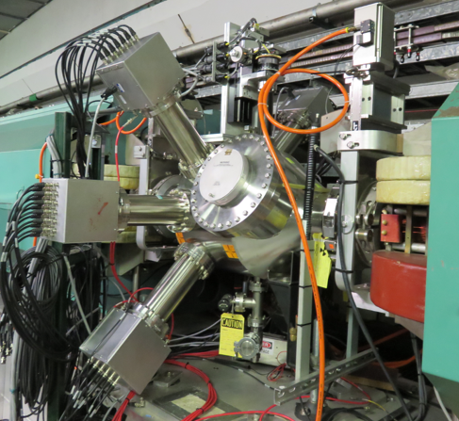
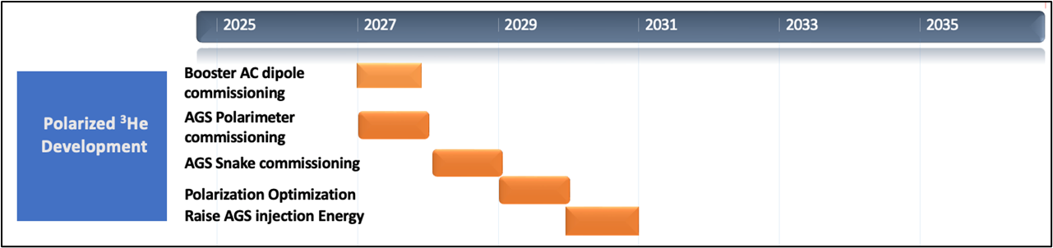
Polarized Beam Developments – He-3
commission Booster AC dipole to overcome intrinsic resonances
commission AGS CNI polarimeter (Dec 2027)
commission AGS partial snakes (Dec 2028)
optimize polarization transmission efficiency via betatron tunes (Dec 2029)
test raising AGS injection energy (Dec 2030)
Booster AC dipole
CNI polarimeter

Slide 37
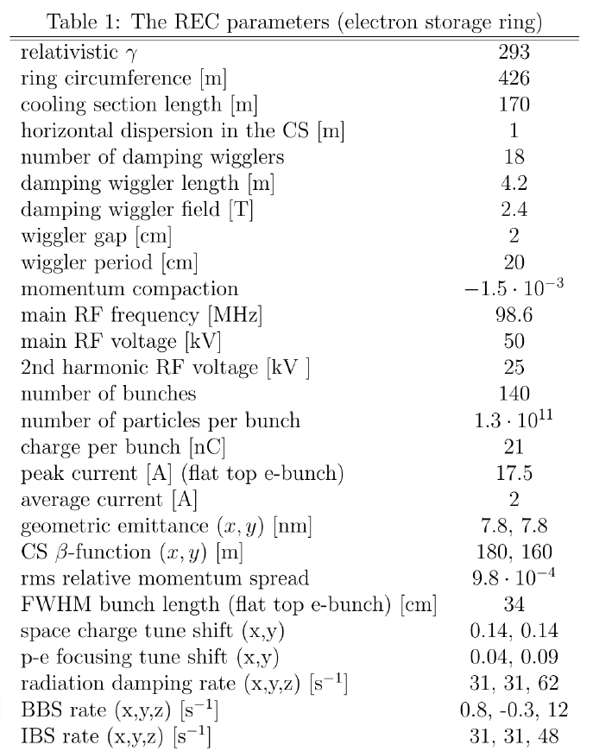
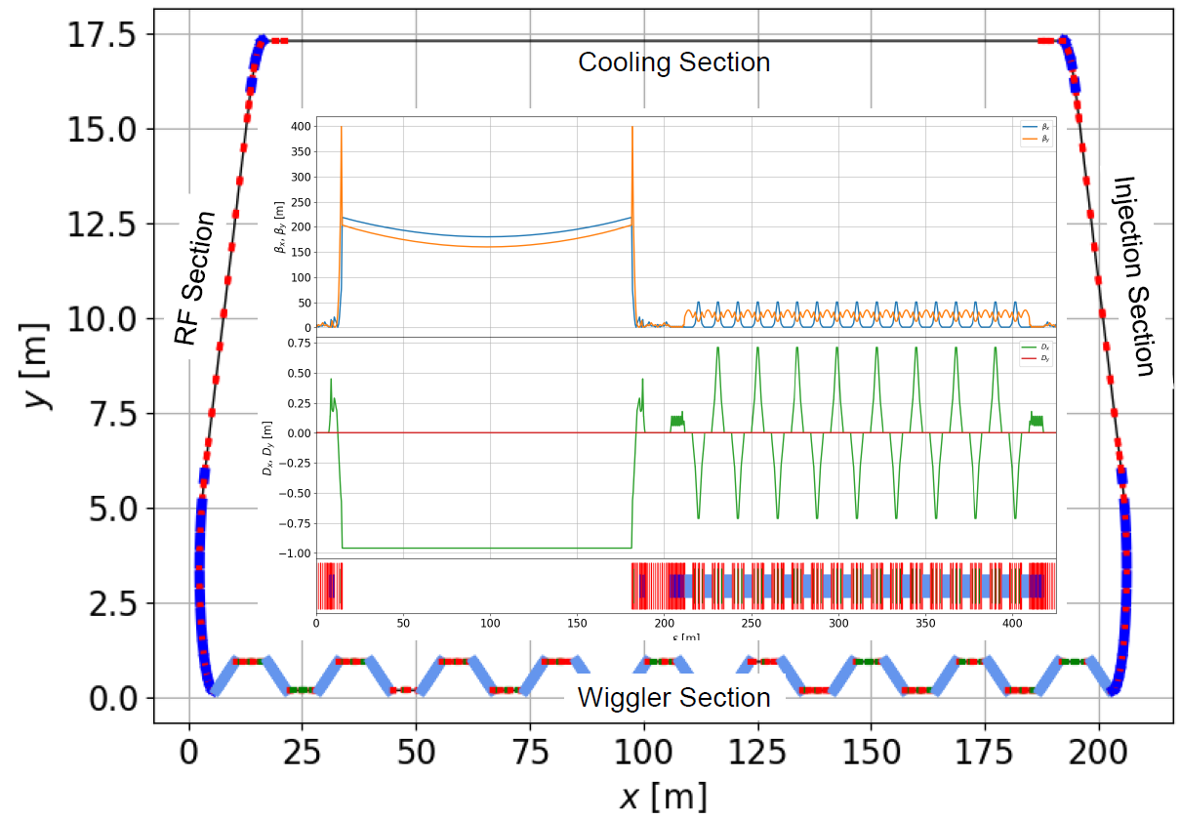
High-energy Ring Electron Cooler
The Ring Electron Cooler (REC) is a non-magnetized, bunched electron cooler based on an electron storage ring, which utilizes damping wigglers to provide radiation damping for the electrons.

Slide 38
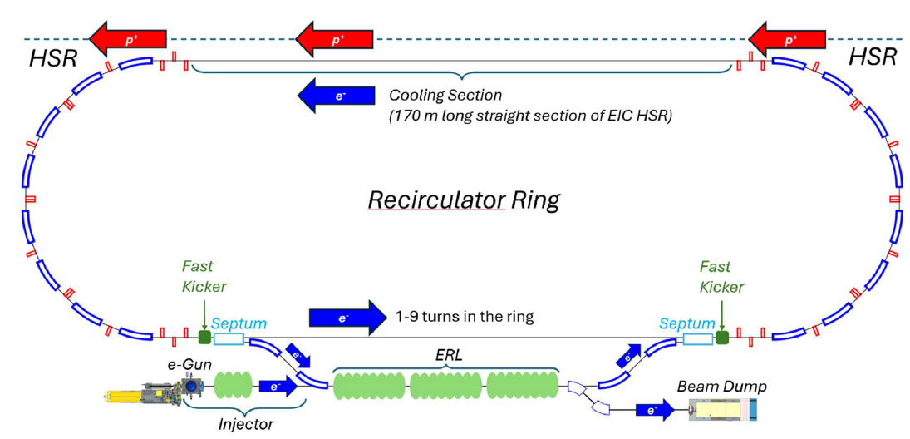
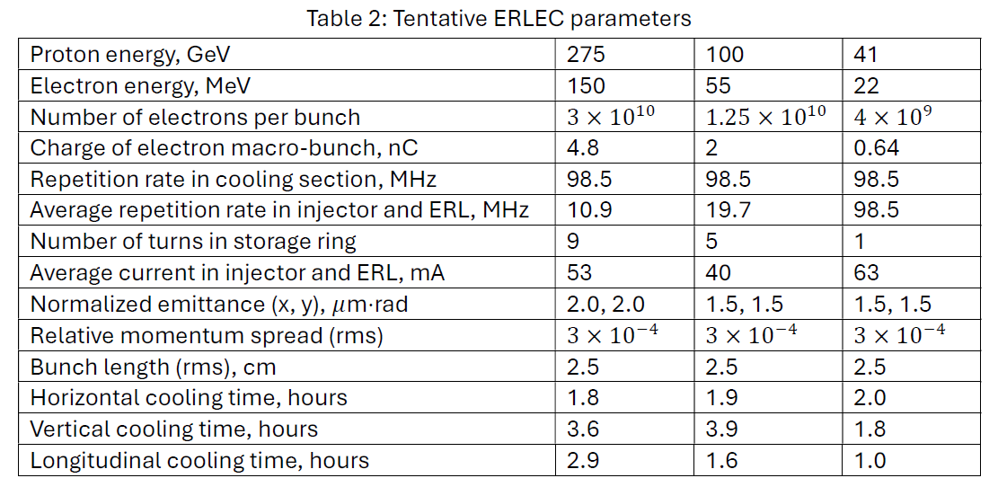
High-energy Recirculator Cooler
- Electron bunches are accelerated in the ERL
- Recirculated in the ring for just a few turns (1-9)
to reduce current required from injector
- Decelerated and sent to a beam dump
- Non-magnetized electron beam is used

Slide 39
ML: Tools for beam polarization increase (FOA funding)
Collaborators: Georg Hoffstaetter (Cornell) + Kevin Brown (BNL), BNL, Cornell, JLAB, SLAC, RPI
Goal: higher and more stable proton polarization from AGS.
Strategy: (1) Emittance reduction, (2) More accurate timing of tune jumps, (3) Reduction of resonance driving terms
Methods: Gaussian Process (GP), Bayesian Optimization (BO), physics informed learning, and digital twins.
Example:
Bayesian optimization of the Booster injection process.
Top plot: power supply currents of two correctors and two quadrupoles in the Linac-to-Booster line.
Middle plot: beam intensity after Booster injection and acceleration.
Bottom plot: Beam size measurements in the Booster-to-AGS line
during Bayesian optimization.
Results: This Bayesian Optimization is
now available as a control system application to operators.
The goal is to use ML for automatically optimizing and maintaining beam emittances in Booster and AGS which should help with polarization preservation in injectors.

